Slide 1
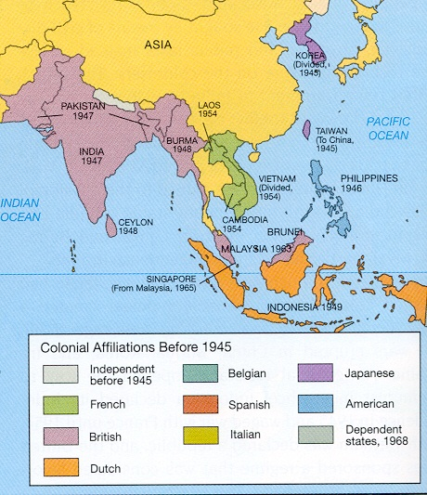

Slide 2
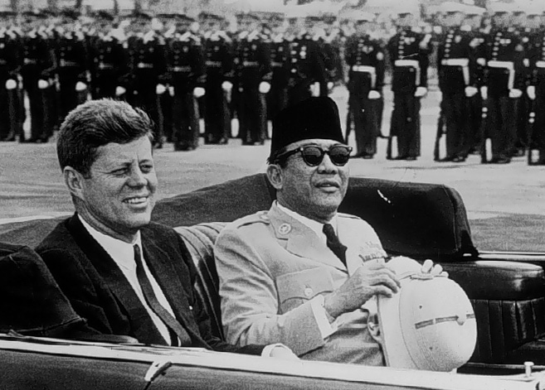

Slide 3
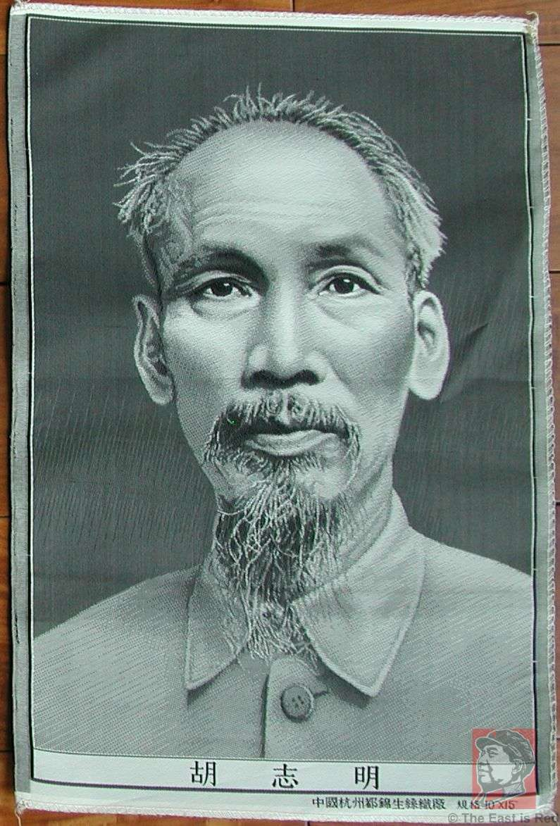

Slide 4
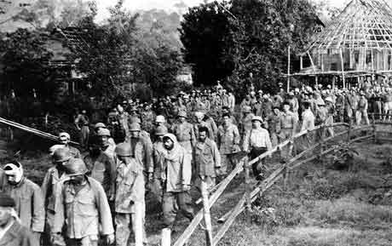

Slide 5


Slide 6
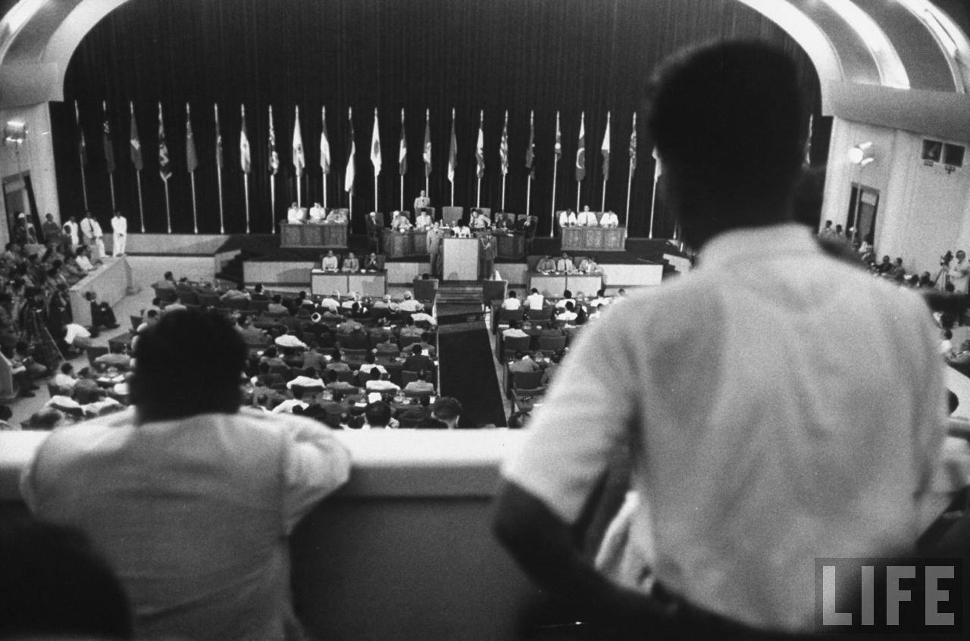

Slide 7
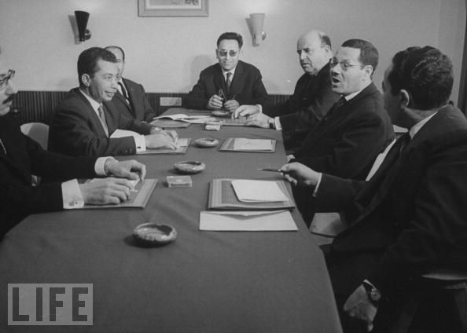
Notes:
Fln leadership

Slide 8
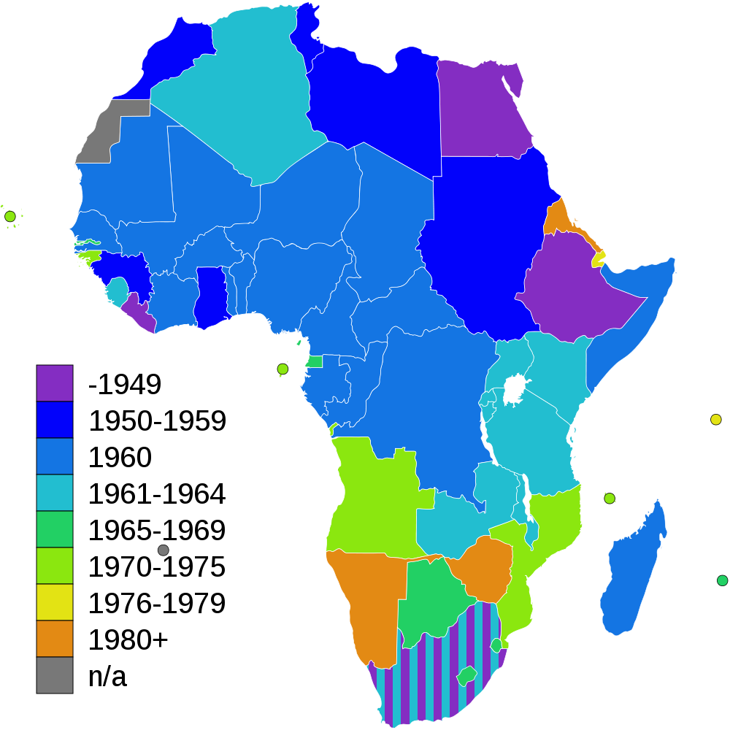

Slide 9
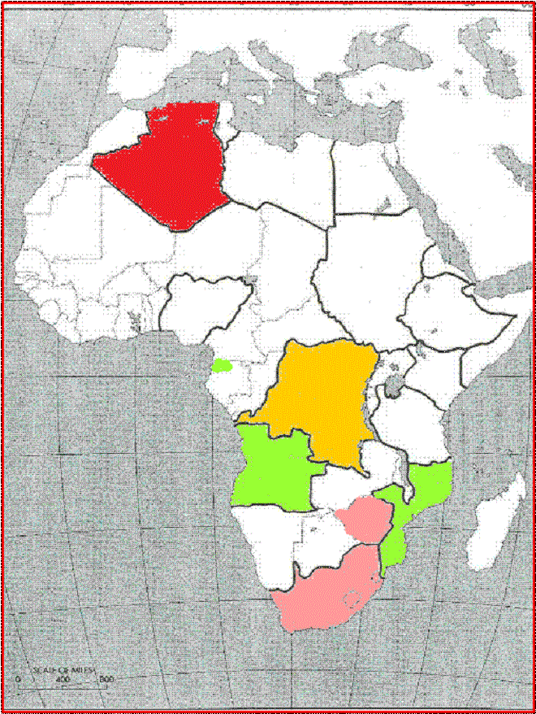

Slide 10
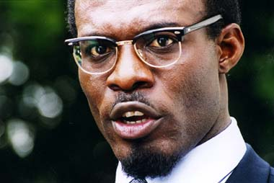
Notes:
lumumba

Slide 11
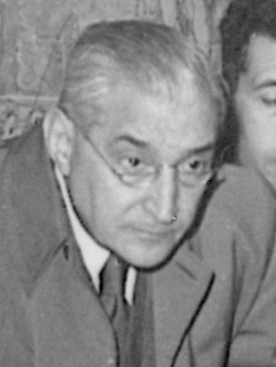
Notes:
Antonio salazar

Slide 12
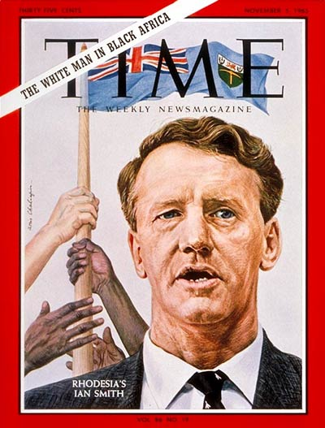

Slide 13
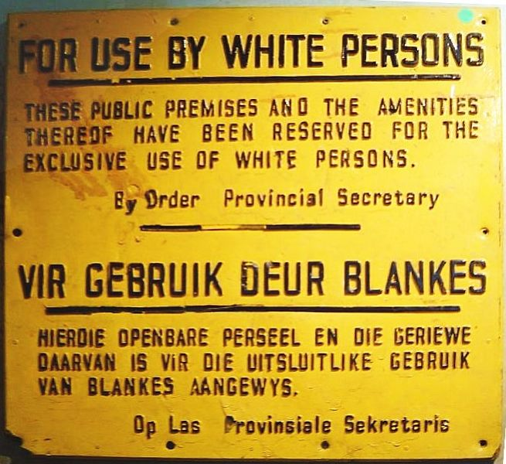

Slide 14
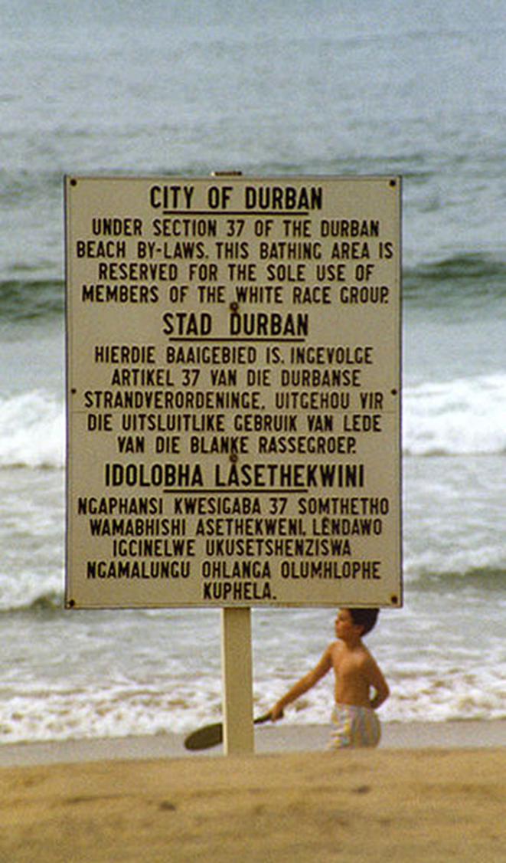
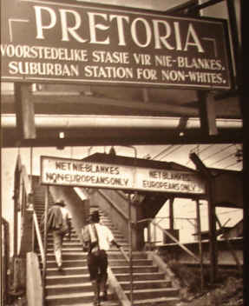

Slide 15
Pre-Brown key civil rights cases
Smith v. Allwright (1944): abolition of “all-white” primaries
Shelley v. Kramer (1948): courts can’t enforce “racial covenants” in house sales
Sweatt v. Painter (1950): separate law schools for blacks and whites unconstitutional
McLaurin v. Oklahoma (1950): separate graduate programs for blacks and whites unconstitutional

Slide 16
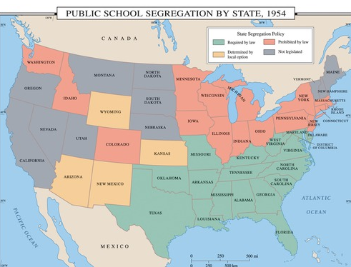

Slide 17
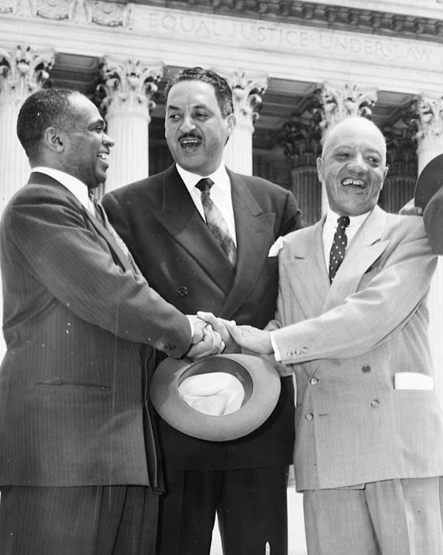

Slide 18
Brown v. Board of Education (1954, unanimous decision)
Does segregation of children in public schools solely on the basis of race, even though the physical facilities and other “tangible” factors may be equal, deprive the children of the minority group of equal educational opportunities? We believe that it does... Segregation of white and colored children in public schools has a detrimental effect upon the colored children. The impact is greater when it has the sanction of the law, for the policy of separating the races is usually interpreted as denoting the inferiority of the negro group...
We conclude that, in the field of public education, the doctrine of “separate but equal” has no place. Separate educational facilities are inherently unequal. Therefore, we hold that the plaintiffs and others similarly situated for whom the actions have been brought are, by reason of the segregation complained of, deprived of the equal protection of the laws guaranteed by the Fourteenth Amendment.

Slide 19


Slide 20


Slide 21
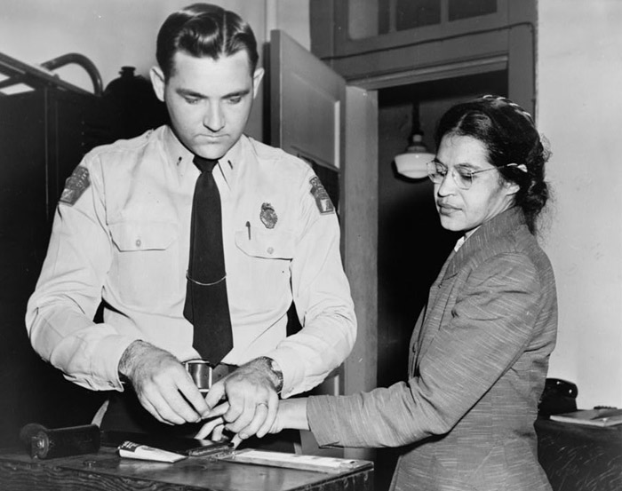

Slide 22
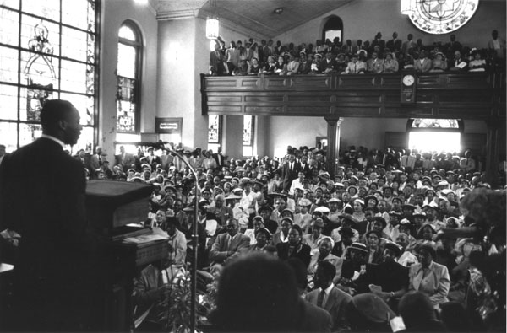

Slide 23


Slide 24
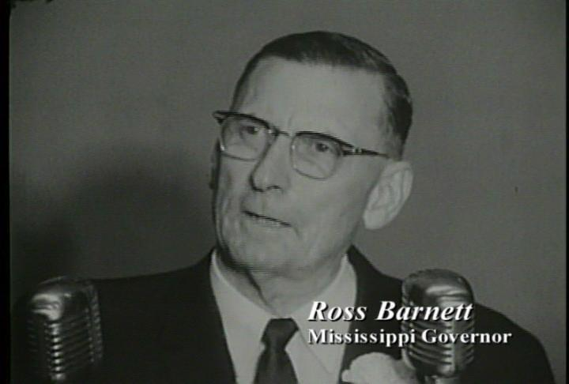

Slide 25

President Kennedy: We can’t consider moving [James] Meredith as long as, you know, there’s a riot outside, because he wouldn’t be safe.
Ross Barnett: Sir?
President Kennedy: We couldn’t consider moving Meredith if we haven’t been able to restore order outside. That’s the problem, Governor.
Barnett: Well, I’ll tell you what I’ll do, Mr. President--
President Kennedy: Yeah.
Barnett: I’ll go up there myself—
President Kennedy: Well, now, how long will it take you to get there?
Barnett: [ignoring Kennedy] And I’ll get a microphone and tell ‘em that you have agreed to re--, to, for him [Meredith] to be removed—
President Kennedy: [sharply] No. No. Now, wait a minute. How long—
Barnett: [Unclear interjection.]
President Kennedy: Wait a minute, Governor. Now, how long is it going to take you to get up there?
Barnett: About an hour.
President Kennedy: Now, I’ll tell you what, if you want to go up there and then you call me from up there. Then we’ll decide what we’re going to do, before you make any speeches about it.
Barnett: Well, all right.
President Kennedy: No sense in—
Barnett: Whatever you want—if you’d offer—
President Kennedy: You see, we’ve got an hour to go, and that’s not—we may not have an hour…
Barnett: Mr. President, please, why don’t you, can’t you give an order up there to remove Meredith?
President Kennedy: How can I remove him, Governor, when there’s a riot in the streets? He may step out of that building and something would happen to him. I can’t remove him under those conditions.

Slide 26
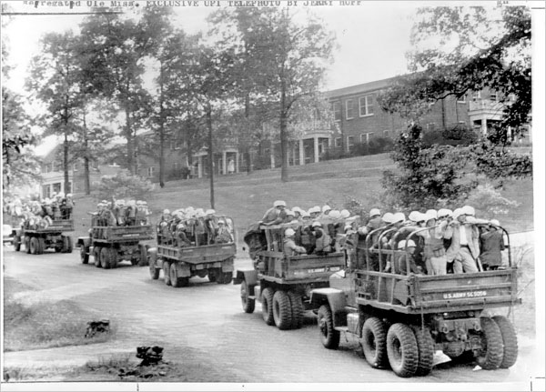

Slide 27


Slide 28
Major Features: Civil Rights Act (1964)
Title I
Barred unequal application of voter registration requirements, but did not abolish literacy tests sometimes used to disqualify African Americans and poor white voters.
Title II
Outlawed discrimination in hotels, motels, restaurants, theaters, and all other public accommodations engaged in interstate commerce; exempted private clubs without defining "private," thereby allowing a loophole.
Title III
Encouraged the desegregation of public schools and authorized the U. S. Attorney General to file suits to force desegregation, but did not authorize busing as a means to overcome segregation based on residence.
Title IV
Authorized but did not require withdrawal of federal funds from programs which practiced discrimination.
Title V
Outlawed discrimination in employment in any business exceeding twenty five people and creates an Equal Employment Opportunities Commission to review complaints, although it lacked meaningful enforcement powers.

Slide 29
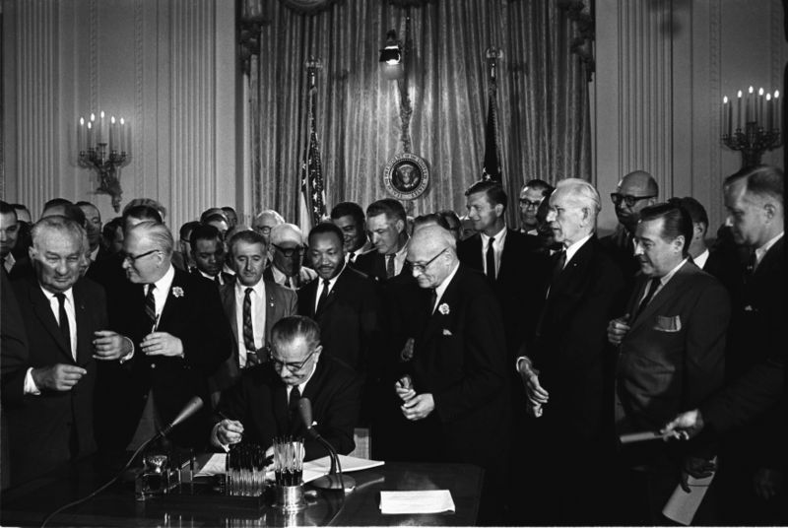

Slide 30


Slide 32
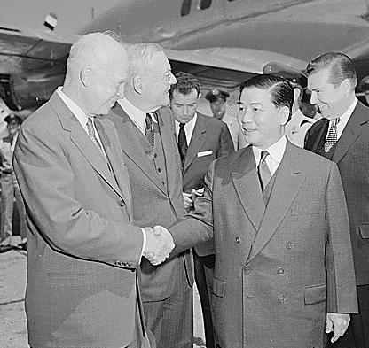

Slide 33
Time Period | U.S. Troops in Vietnam | U.S. Personnel Killed
End of 1961 | 2,067 | 16
End of 1962 | 11,500 | 52
End of 1963 | 19,000+ | 118

Slide 34


Slide 35


Slide 36
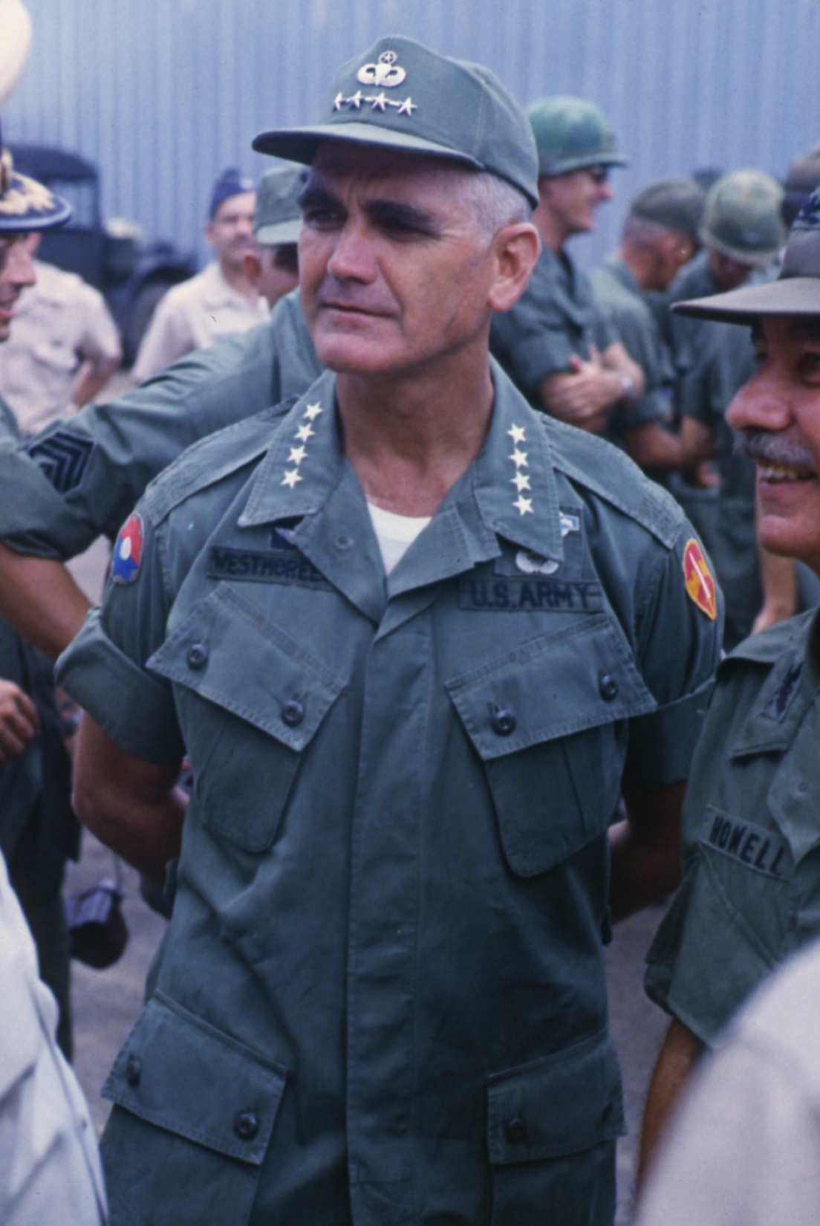

Slide 37


Slide 38
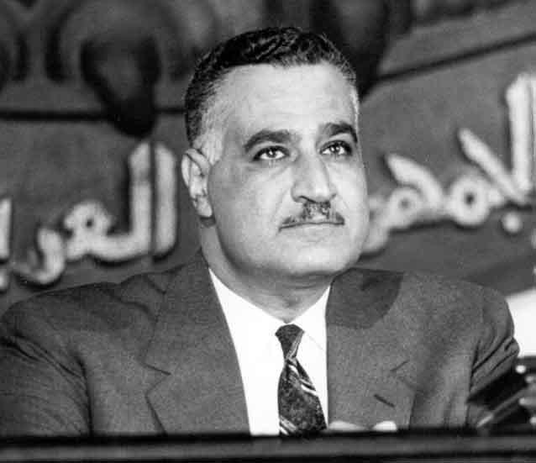

Slide 39
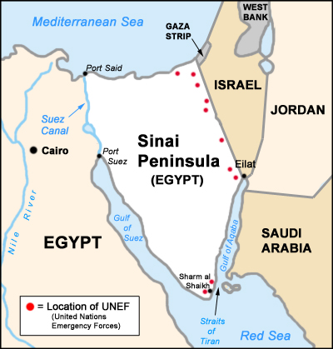

Slide 40
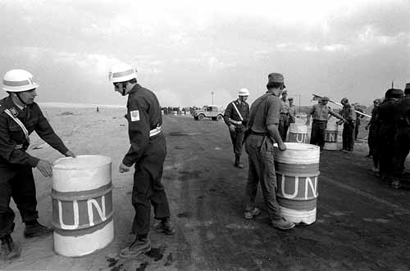

Slide 41
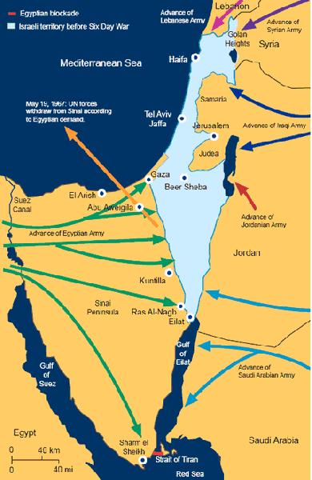

Slide 42
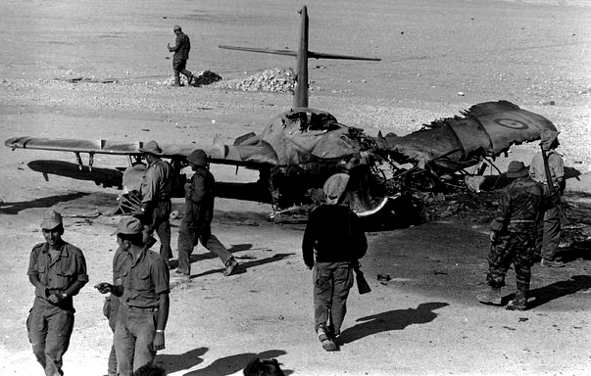

Slide 43
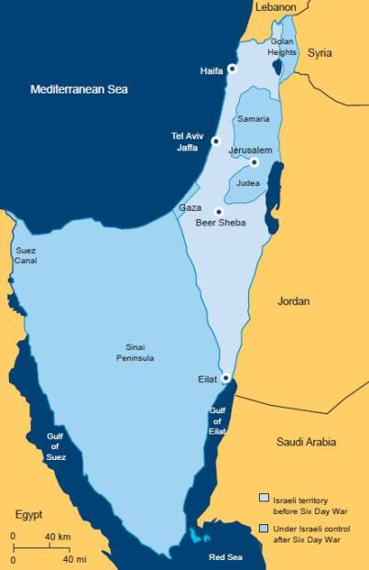

Slide 44
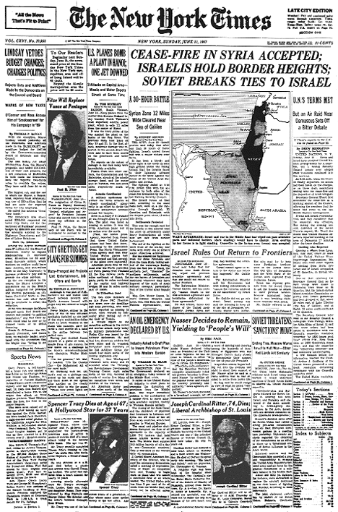

Slide 45
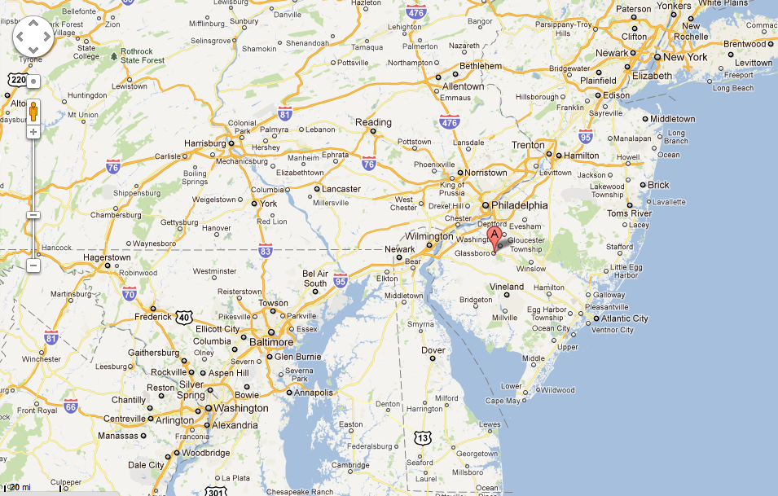

Slide 46
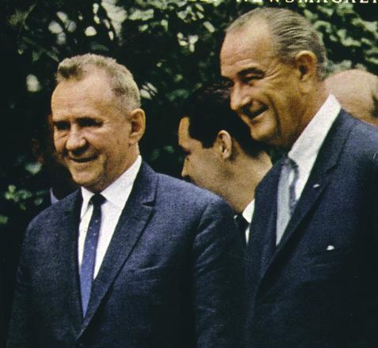

Slide 47
President Johnson: And I would say that, in fairness, as a teacher, I would grade him [Alexsey Kosygin] about a B+ on discussions on arms—that is, offensive, defensive missiles, the ABM. He made one or two passes I don’t want to discuss with anyone but you.
But he said, “I want you to know that if you do not deliver Israel here on this [UN] resolution—withdrawal—and you cannot pull these fighters back like you do two boxing men in the ring, separate the combatants, and you pull them back to where they were before this war started, then I want you to know there’s going to be a big war, and there’s going to be a great war, and it’s coming soon.”
And I said, “Well, now, Mr. Chairman, I hope that there’s not going to—
And he said, “They’ll fight with their fists and they’ll fight with arms.”
And I said, “Now, if you’re saying that the Israels [sic] and the Arabs are going to have some further difficulties, I hope they don’t. I’m going to do everything I can to keep ‘em from fighting, and I hope you do everything you can to keep ‘em from fighting. But if you’re saying that it goes beyond that area, and others will be fighting, then you’re speaking very serious business, and it’s something that concerns me greatly. And I think it should concern you.”
And he backed away from it, and said, “Well, I said that they would be fighting out there.” And I said, “Well, I’ll do all I can to keep ‘em from fighting; hope you do, too.”
Dwight Eisenhower: Mm. Mr. President—
President Johnson: He made another pass this afternoon along the same line, and I met him the same way, and he backed off from it again.

