Slide 1
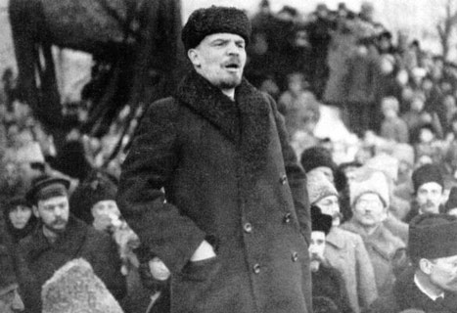

Slide 2
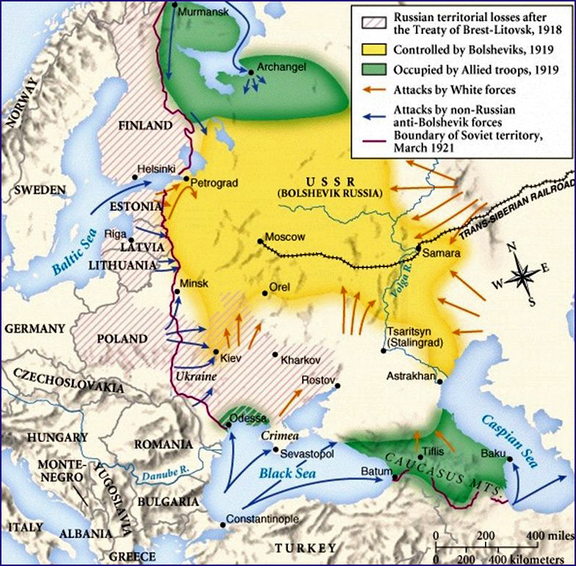

Slide 3
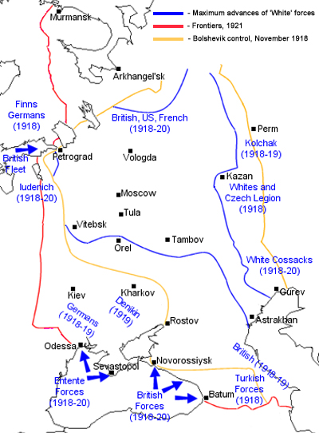

Slide 4


Slide 5
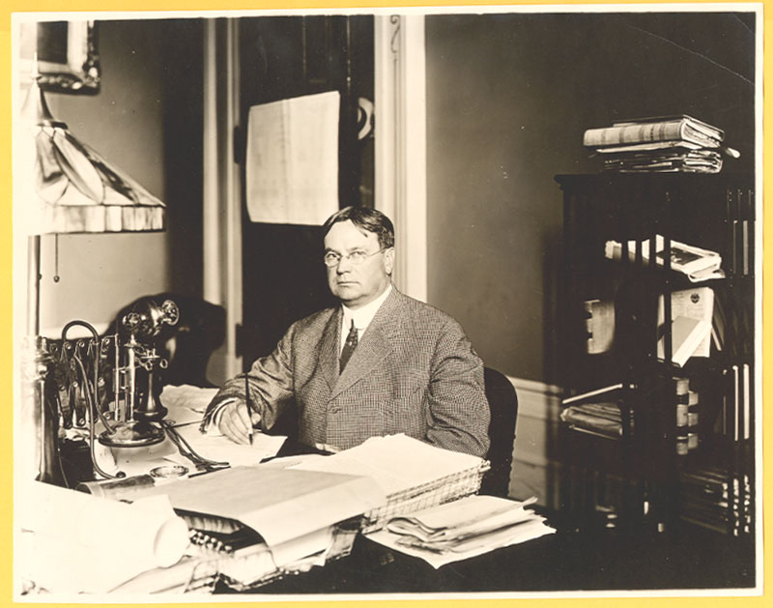

Slide 6


Slide 7
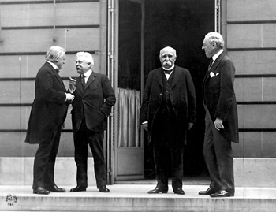

Slide 8
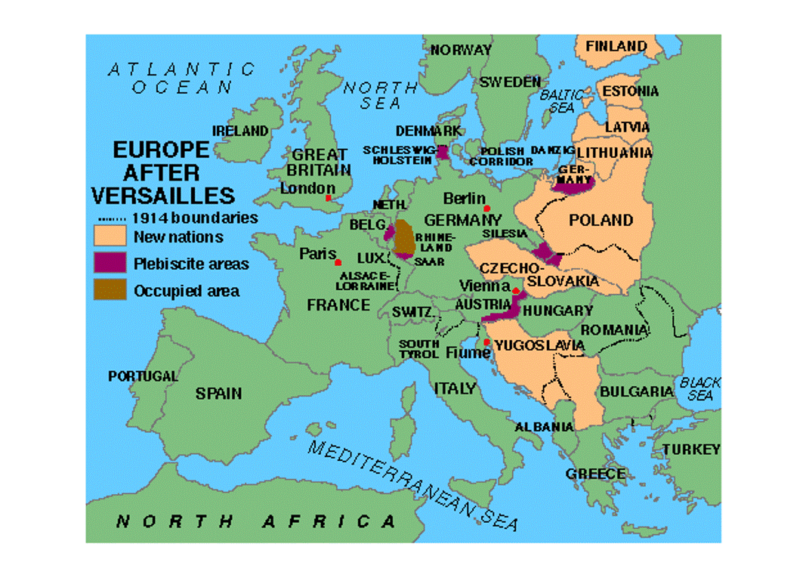

Slide 9
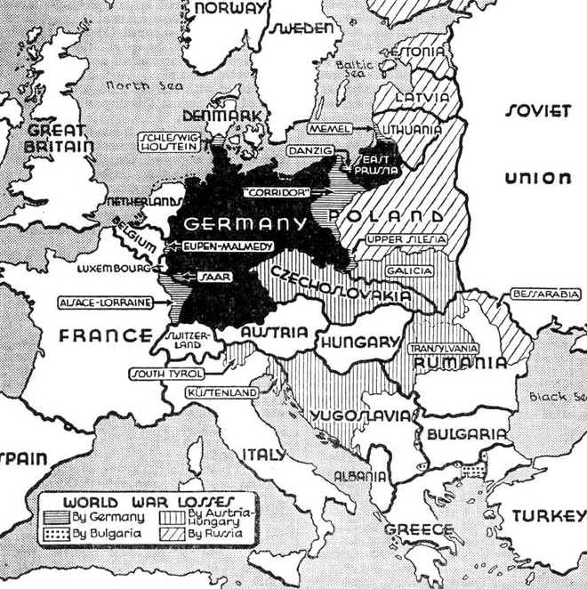

Slide 10
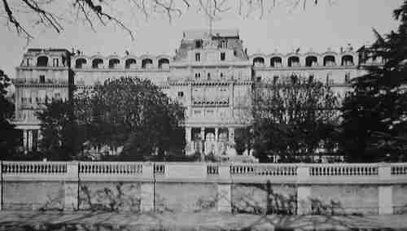

Slide 11
Article X
The Members of the League undertake to respect and preserve as against external aggression the territorial integrity and existing political independence of all Members of the League.
In the case of any such aggression or in case of any threat or danger of such aggression the Council shall advise upon the means by which this obligation shall be fulfilled.

Slide 12
ARTICLE 11
Any war or threat of war, whether immediately affecting any of the Members of the League or not, is hereby declared a matter of concern to the whole League, and the League shall take any action that may be deemed wise and effectual to safeguard the peace of nations. In case any such emergency should arise the Secretary General shall on the request of any Member of the League forthwith summon a meeting of the Council.
It is also declared to be the friendly right of each Member of the League to bring to the attention of the Assembly or of the Council any circumstance whatever affecting international relations which threatens to disturb international peace or the good understanding between nations upon which peace depends.

Slide 13
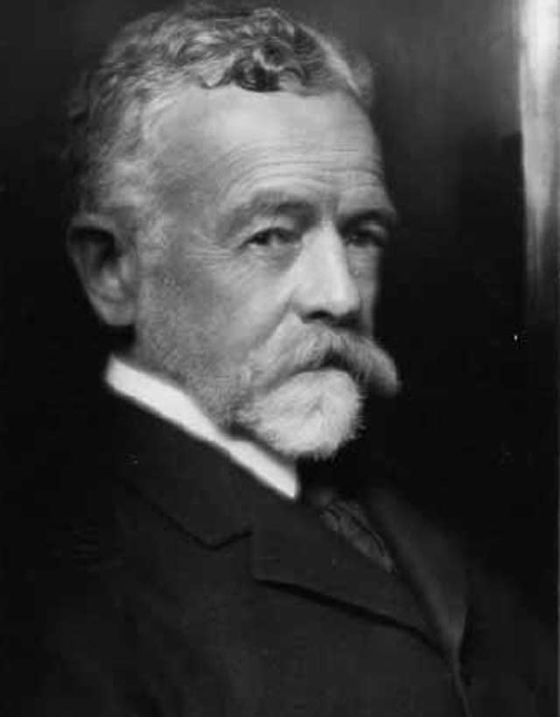

Slide 14
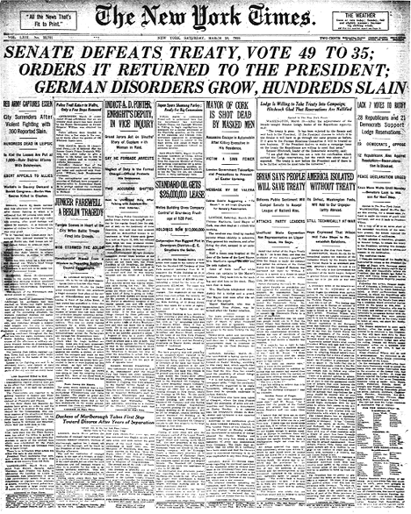

Slide 15
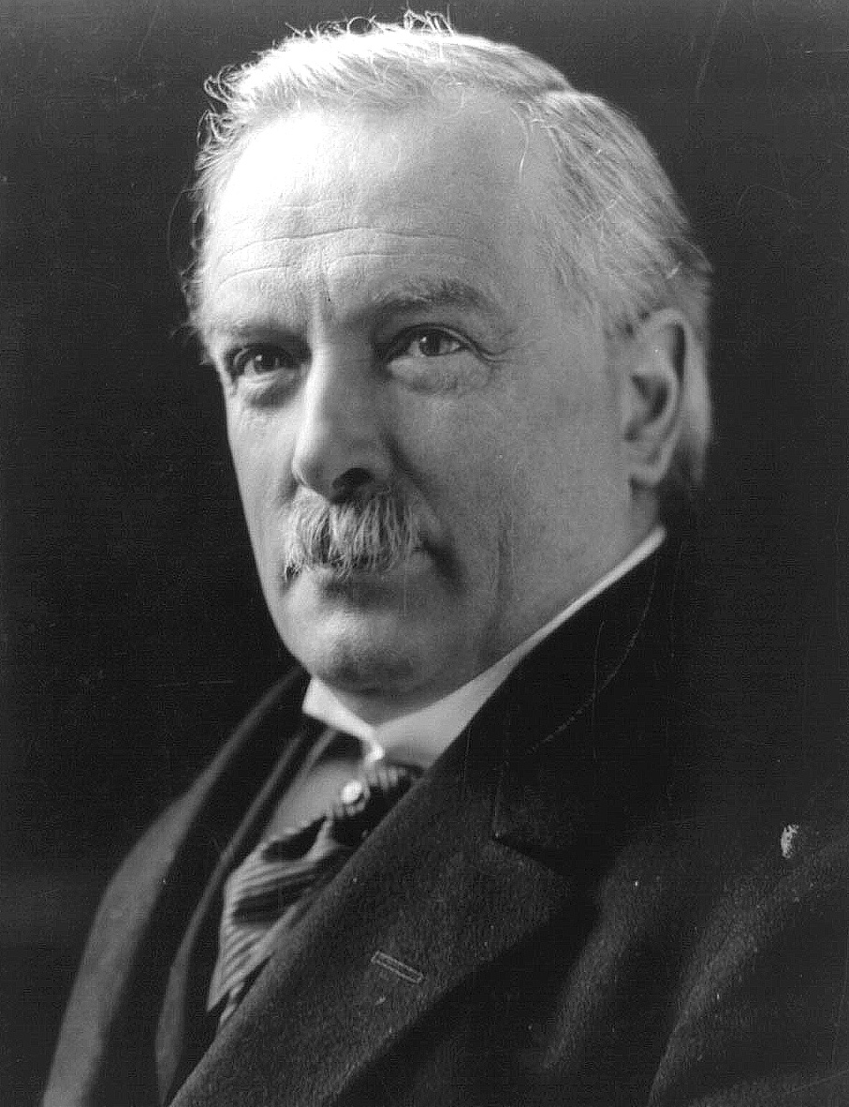

Slide 16
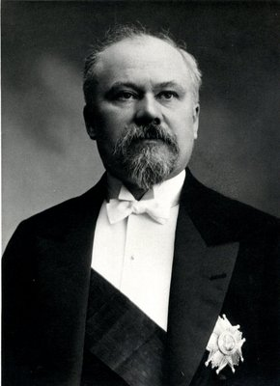

Slide 17
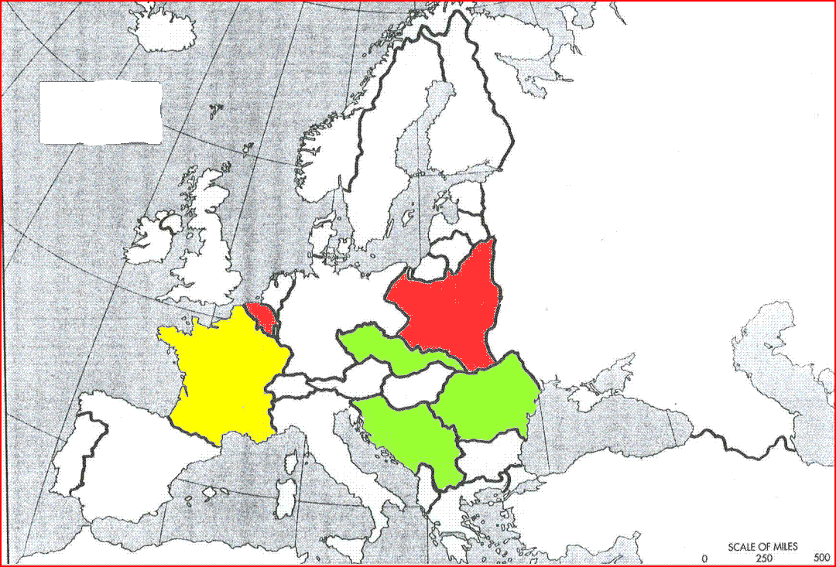

Slide 18
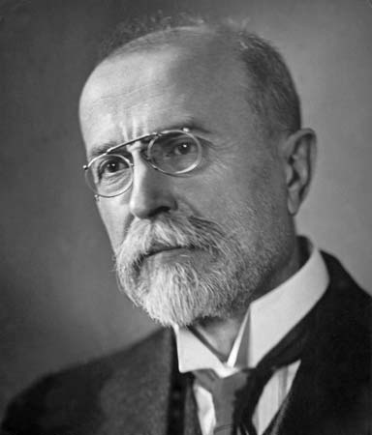
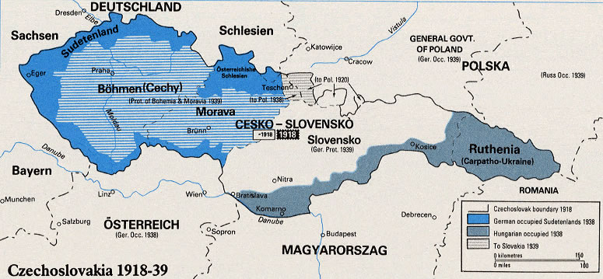

Slide 19


Slide 20
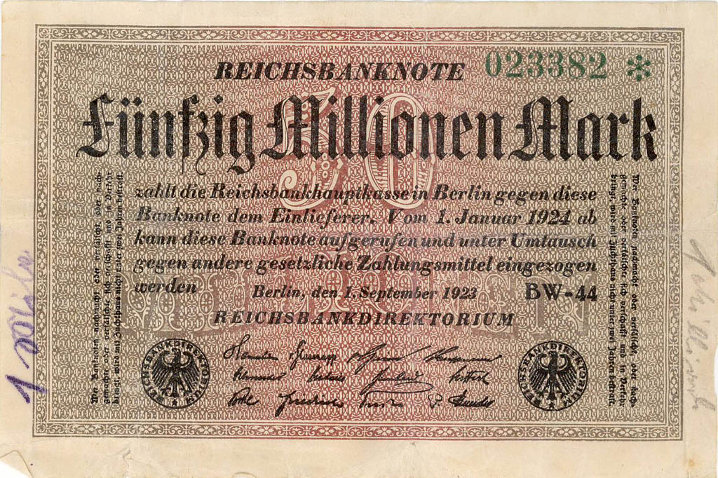

Slide 21
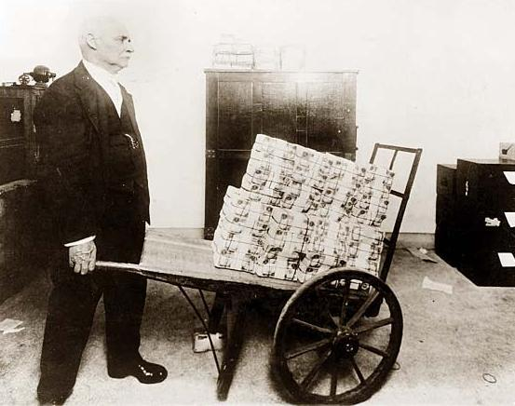

Slide 22
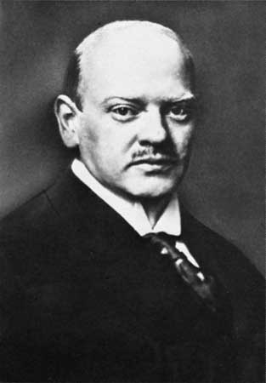

Slide 23
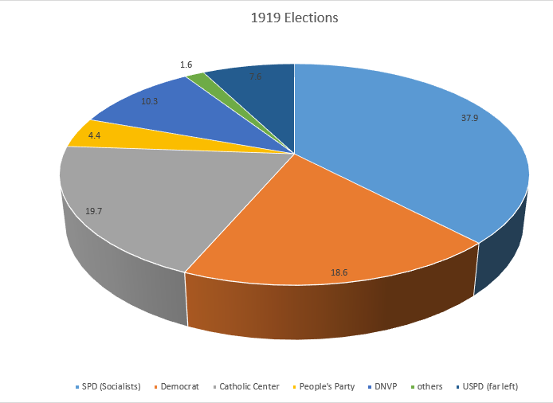

Slide 24
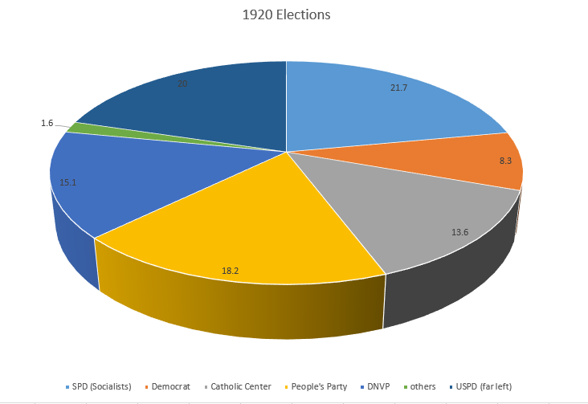

Slide 25
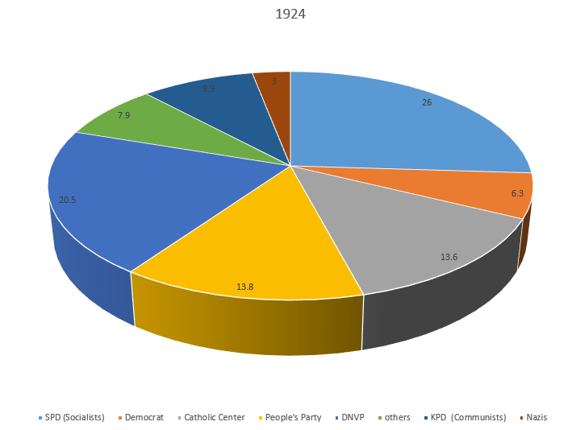

Slide 26
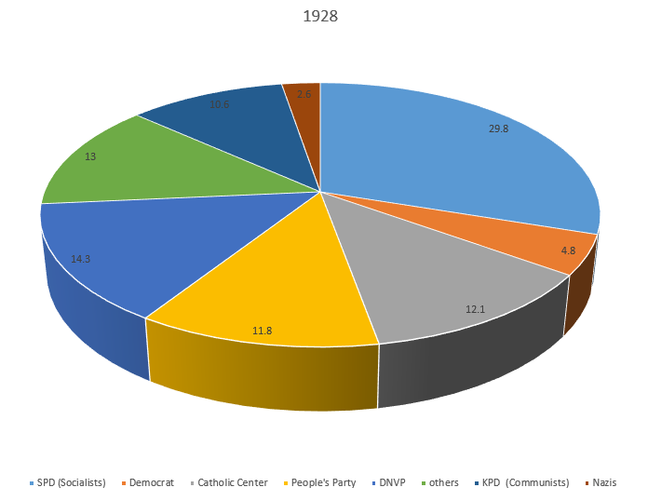

Slide 27


Slide 28
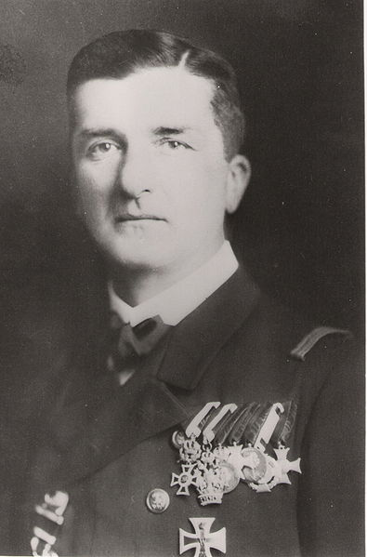

Slide 29
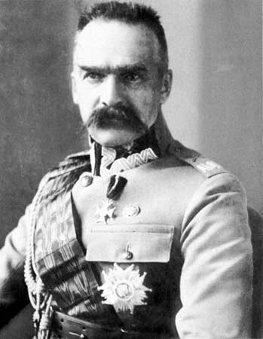

Slide 30
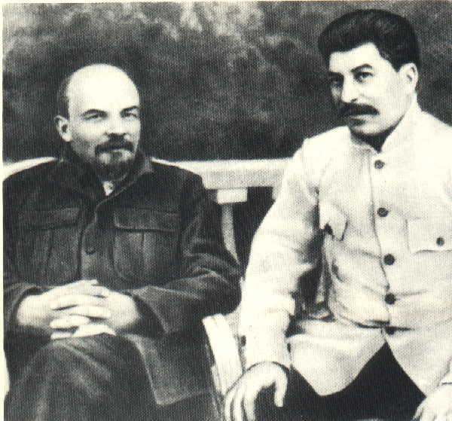

Slide 31
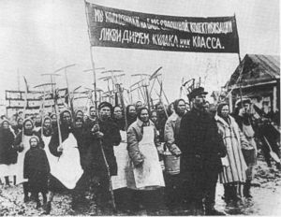

Slide 32
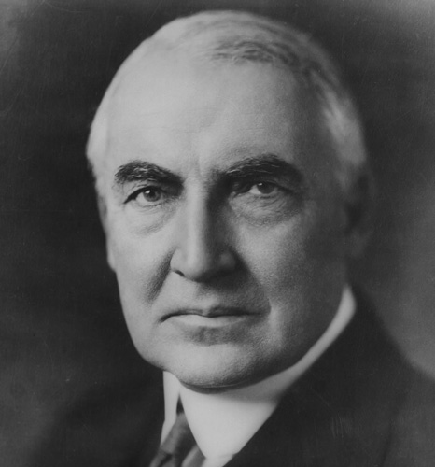

Slide 33
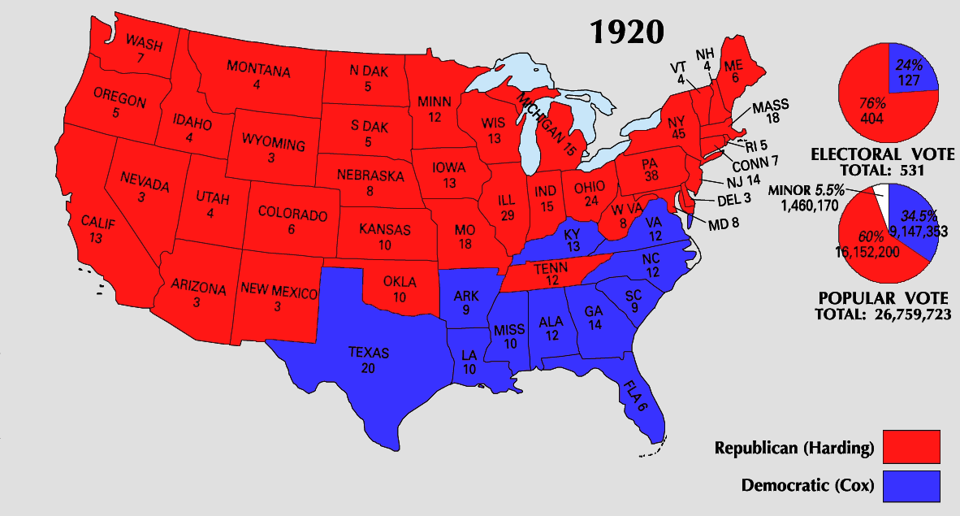

Slide 34
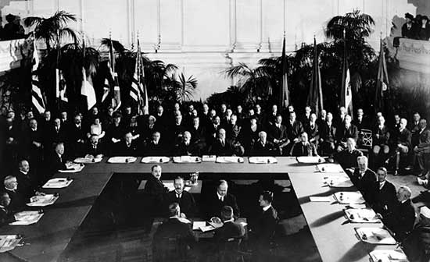

Slide 35
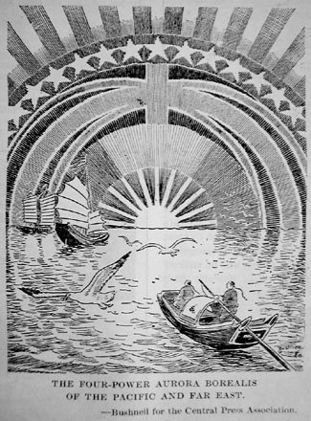

Slide 36
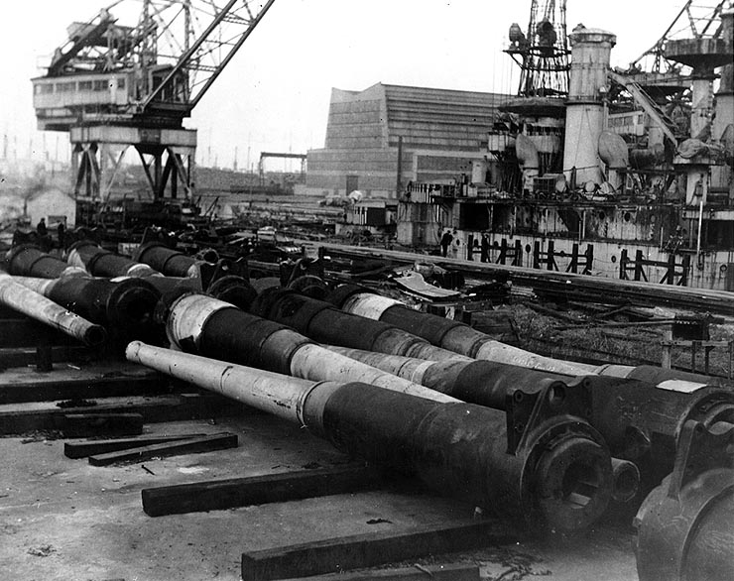

Slide 38
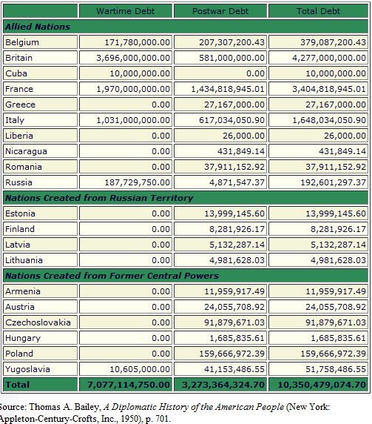

Slide 39
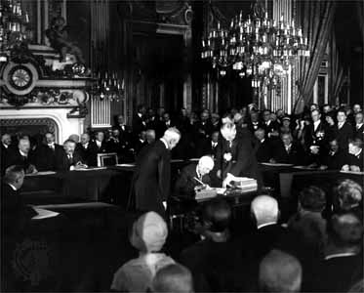
Notes:
K-b

Slide 40
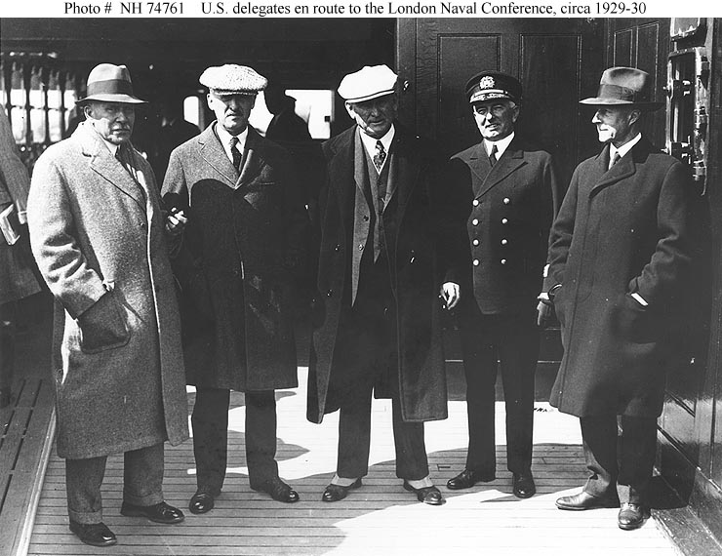
Notes:
lnconf

Slide 41


Slide 42
Article 27. Ownership of the lands and waters within the boundaries of the national territory is vested originally in the Nation, which has had, and has, the right to transmit title thereof to private persons, thereby constituting private property . . .
In the Nation is vested the direct ownership of all natural resources of the continental shelf and the submarine shelf of the islands; of all minerals or substances, which in veins, ledges, masses or ore pockets, form deposits of a nature distinct from the components of the earth itself, such as the minerals from which industrial metals and metalloids are extracted; deposits of precious stones, rock-salt and the deposits of salt formed by sea water; products derived from the decomposition of rocks, when subterranean works are required for their extraction; mineral or organic deposits of materials susceptible of utilization as fertilizers; solid mineral fuels; petroleum and all solid, liquid, and gaseous hydrocarbons; and the space above the national territory to the extent and within the terms fixed by international law . . .

Slide 43
Only Mexicans by birth or naturalization and Mexican companies have the right to acquire ownership of lands, waters, and their appurtenances, or to obtain concessions for the exploitation of mines or of waters. The State may grant the same right to foreigners, provided they agree before the Ministry of Foreign Relations to consider themselves as nationals in respect to such property, and bind themselves not to invoke the protection of their governments in matters relating thereto; under penalty, in case of noncompliance with this agreement, of forfeiture of the property acquired to the Nation . . .
All contracts and concessions made by former Governments since the year 1876, which have resulted in the monopolization of lands, waters, and natural resources of the Nation, by a single person or company, are declared subject to revision, and the Executive of the Union is empowered to declare them void whenever they involve serious prejudice to the public interest.

Slide 44
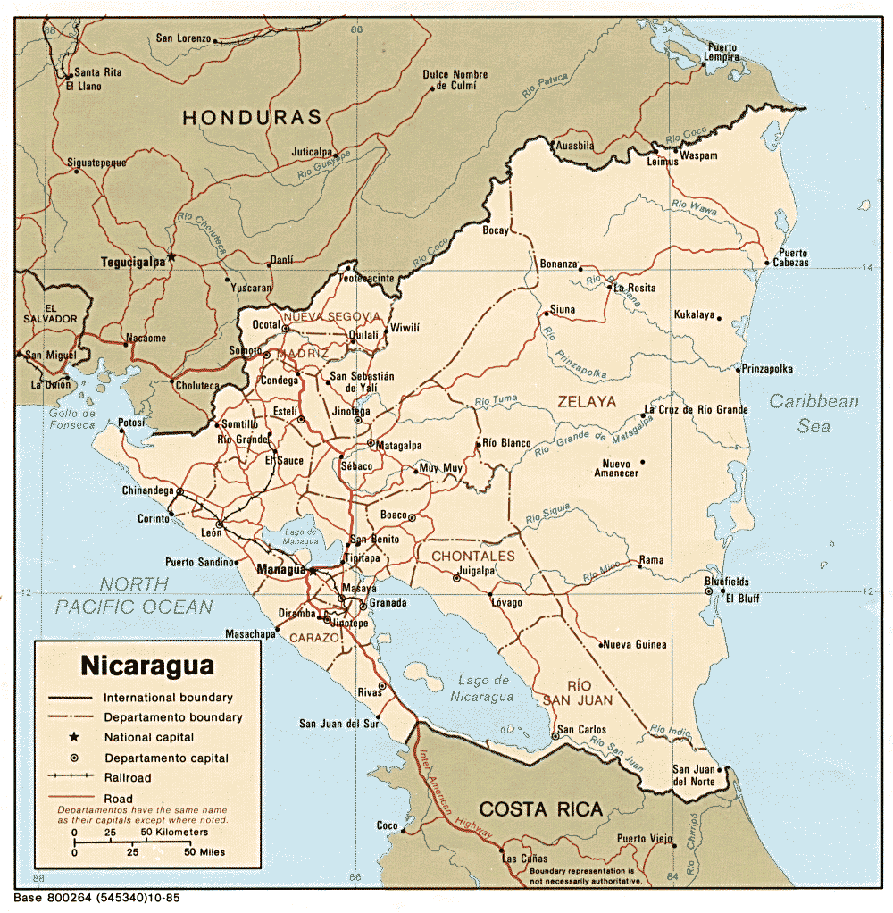

Slide 45
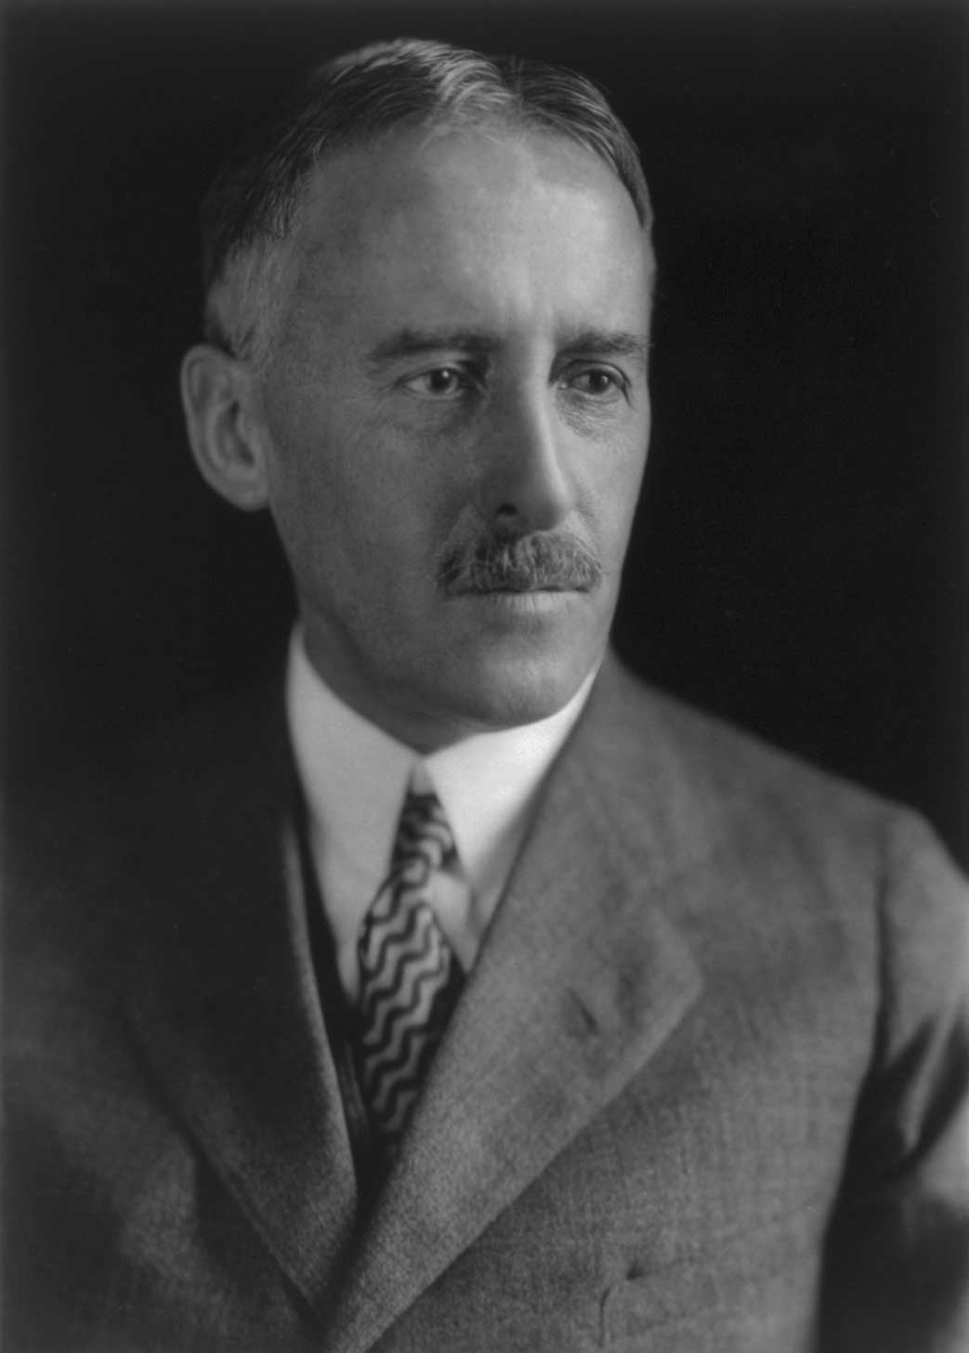
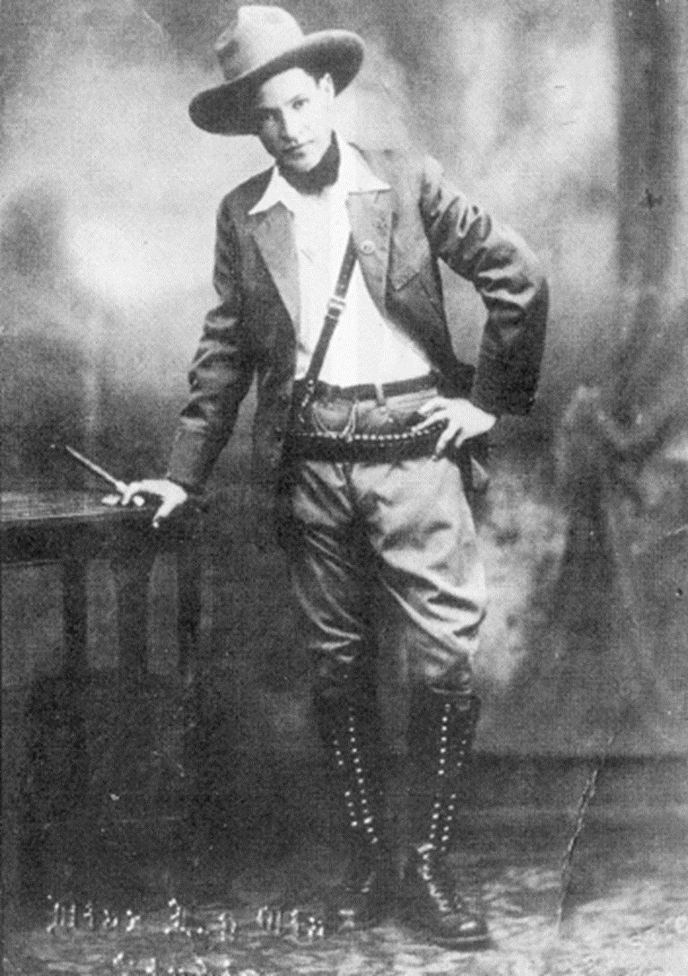
Notes:
stimson

Slide 46
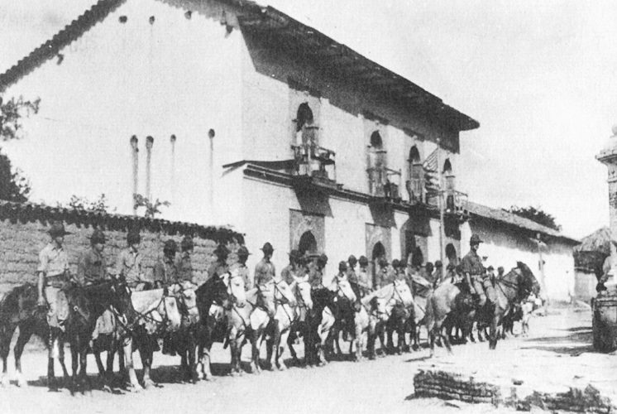

Slide 47
