Slide 1
New Deal (1935, 1939)
--medical care as part of Social Security?
--Wagner proposal (1939)—block grants to states to administer
Wagner-Murray-Dingell (1943)
--health care as a right
--protection from “economic fears” of sickness
Truman plan (1945, 1949)
--single plan run by federal government
--citizens pay monthly fee
--government subsidizes costs of poor
--58% initial public support

Slide 2
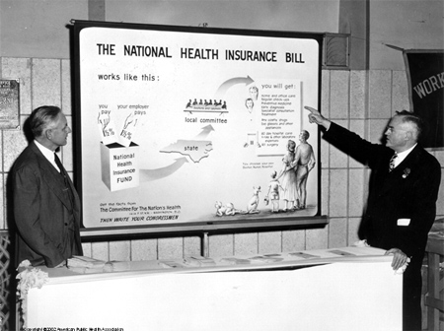

Slide 3

$1.5M lobbying effort
“Would socialized medicine lead to socialization of other phases of American life?” “Lenin thought so.”
He declared ”Socialized medicine is the keystone to the arch of the Socialist State.”
--late 1949, down to 36% approval
--national health insurance as “socialized medicine”

Slide 4
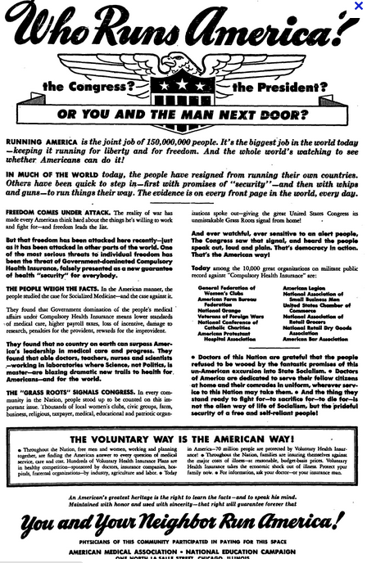

Slide 5
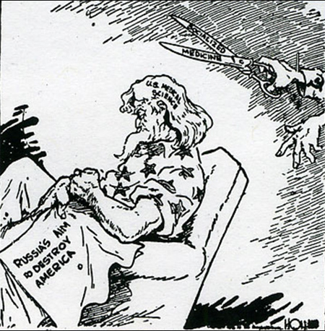

Slide 6
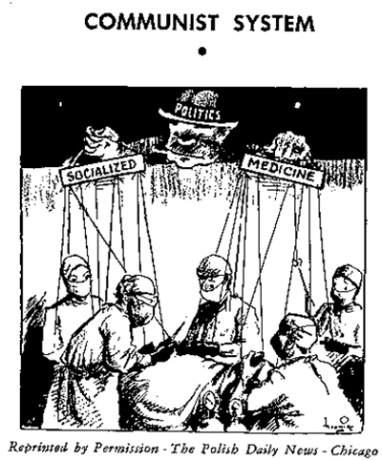

Slide 7
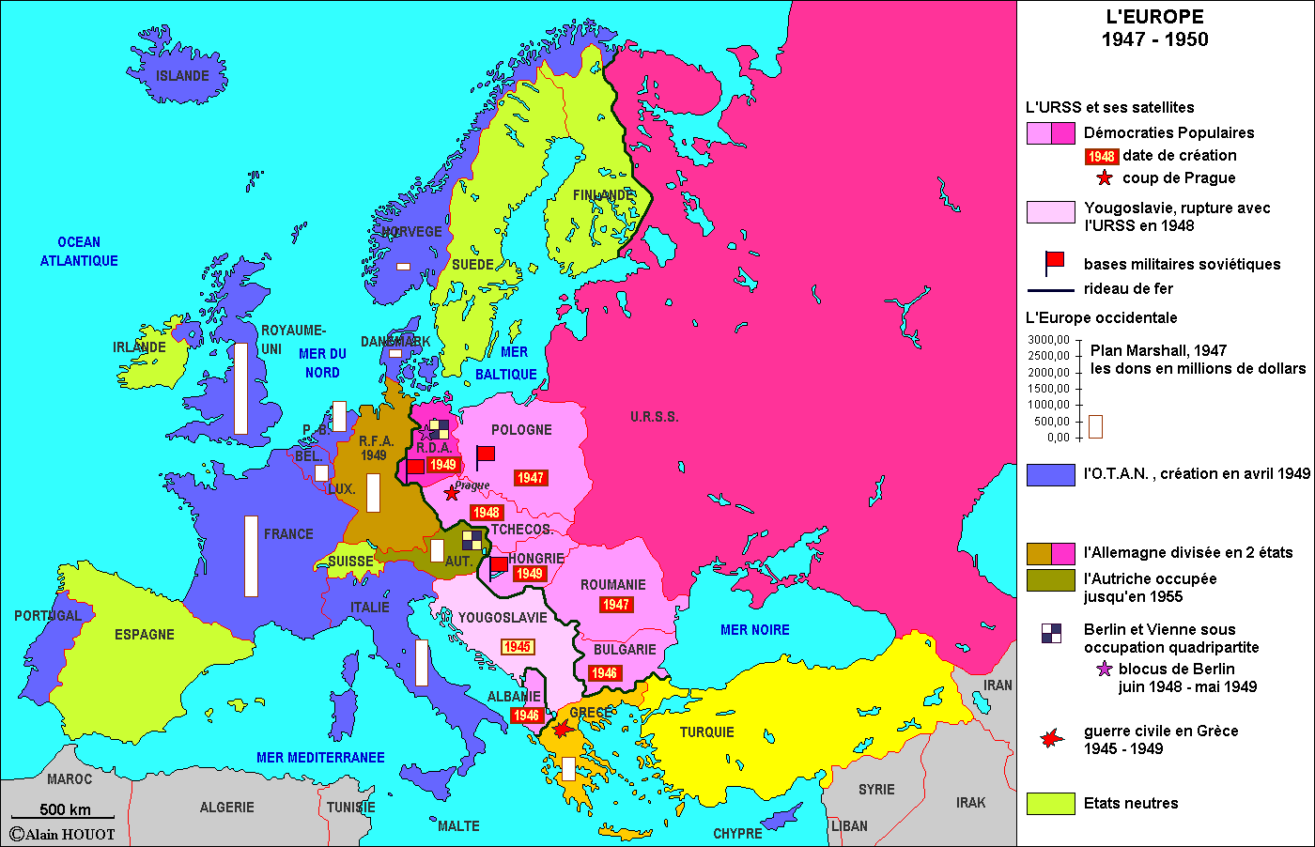

Slide 8

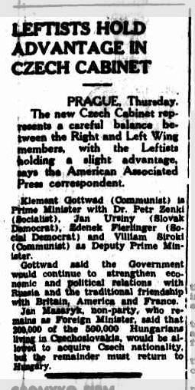

Slide 9
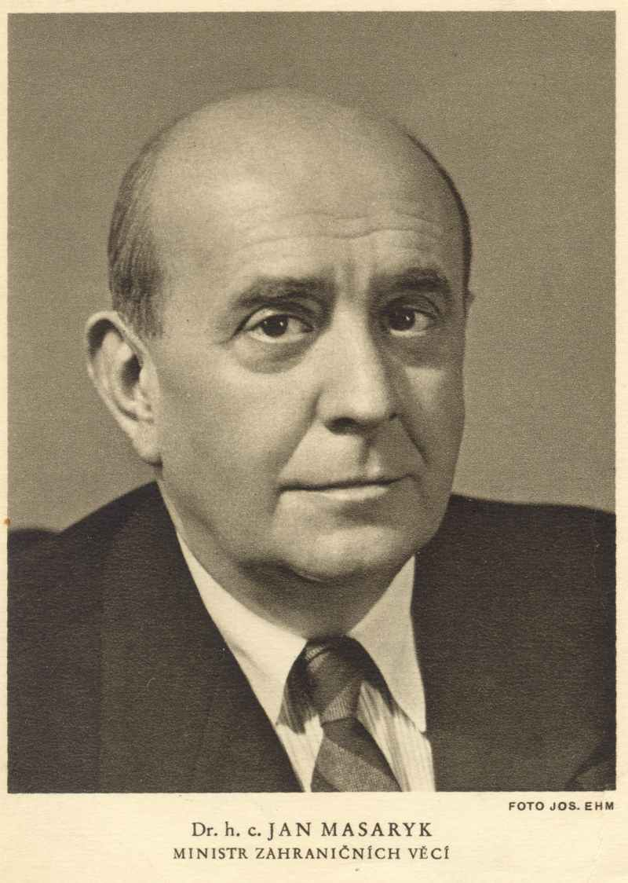

Slide 10


Slide 11
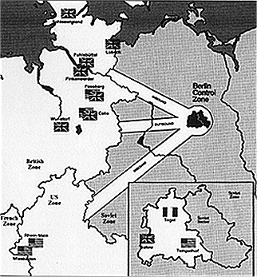

Slide 12
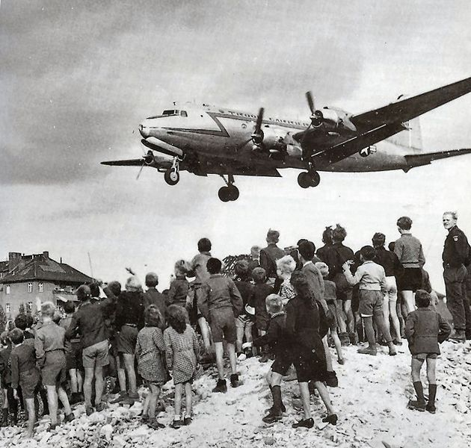

Slide 13
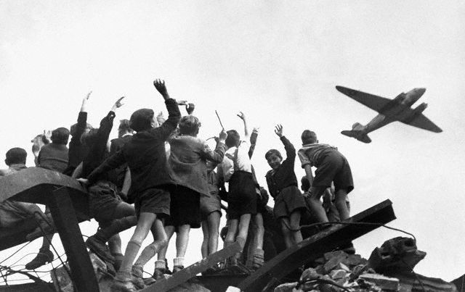

Slide 14
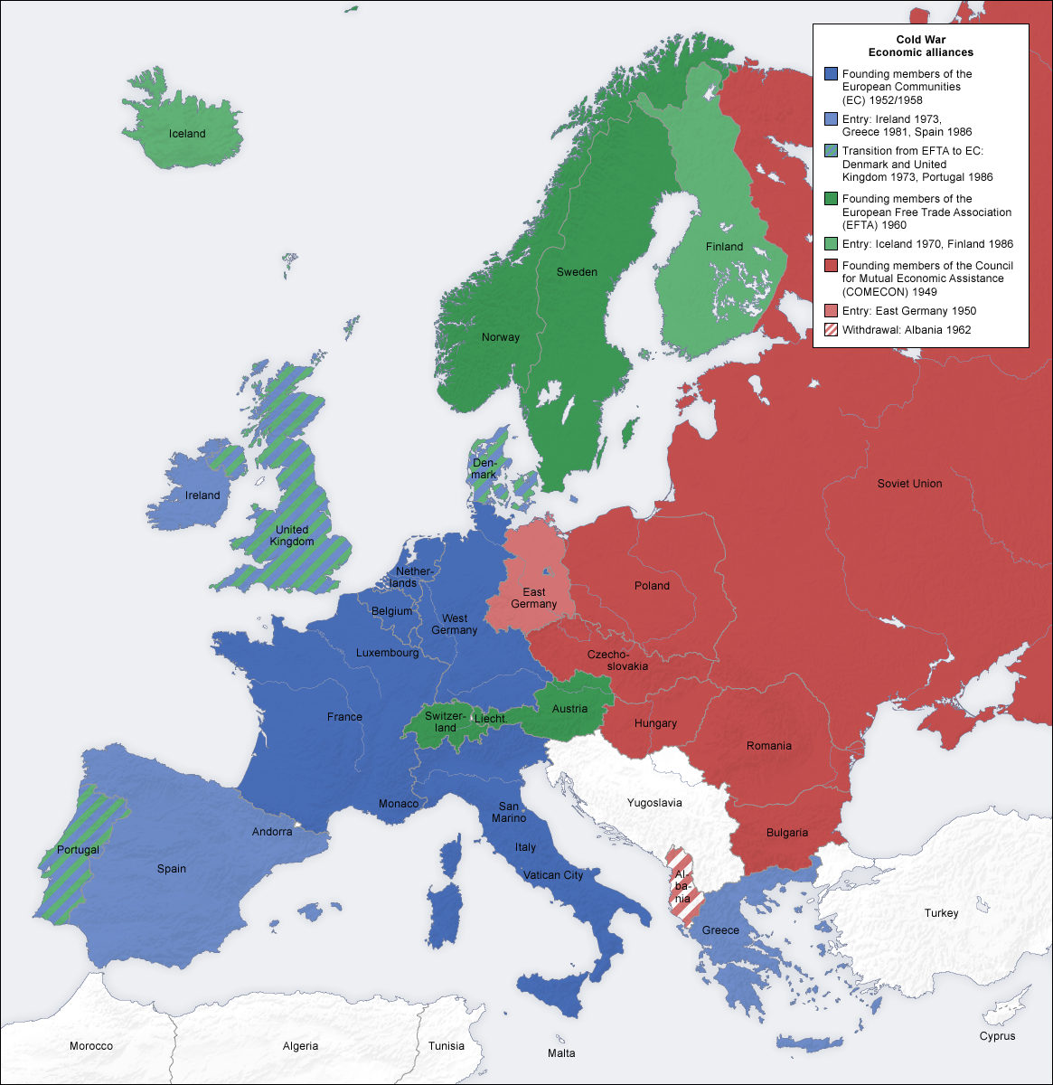

Slide 15
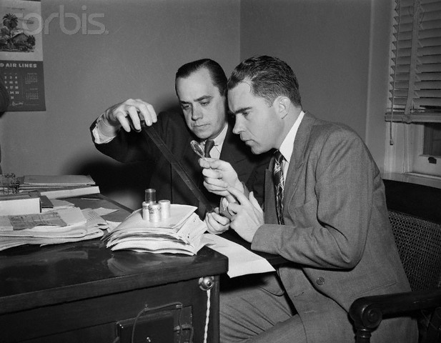

Slide 16
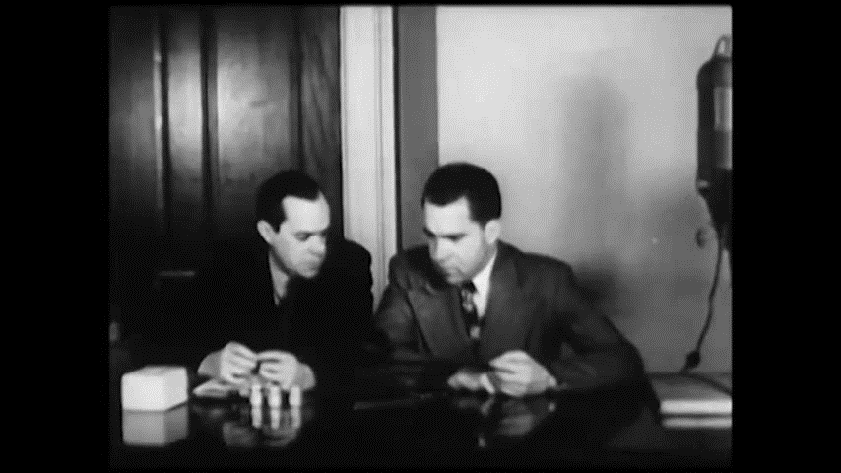

Slide 17
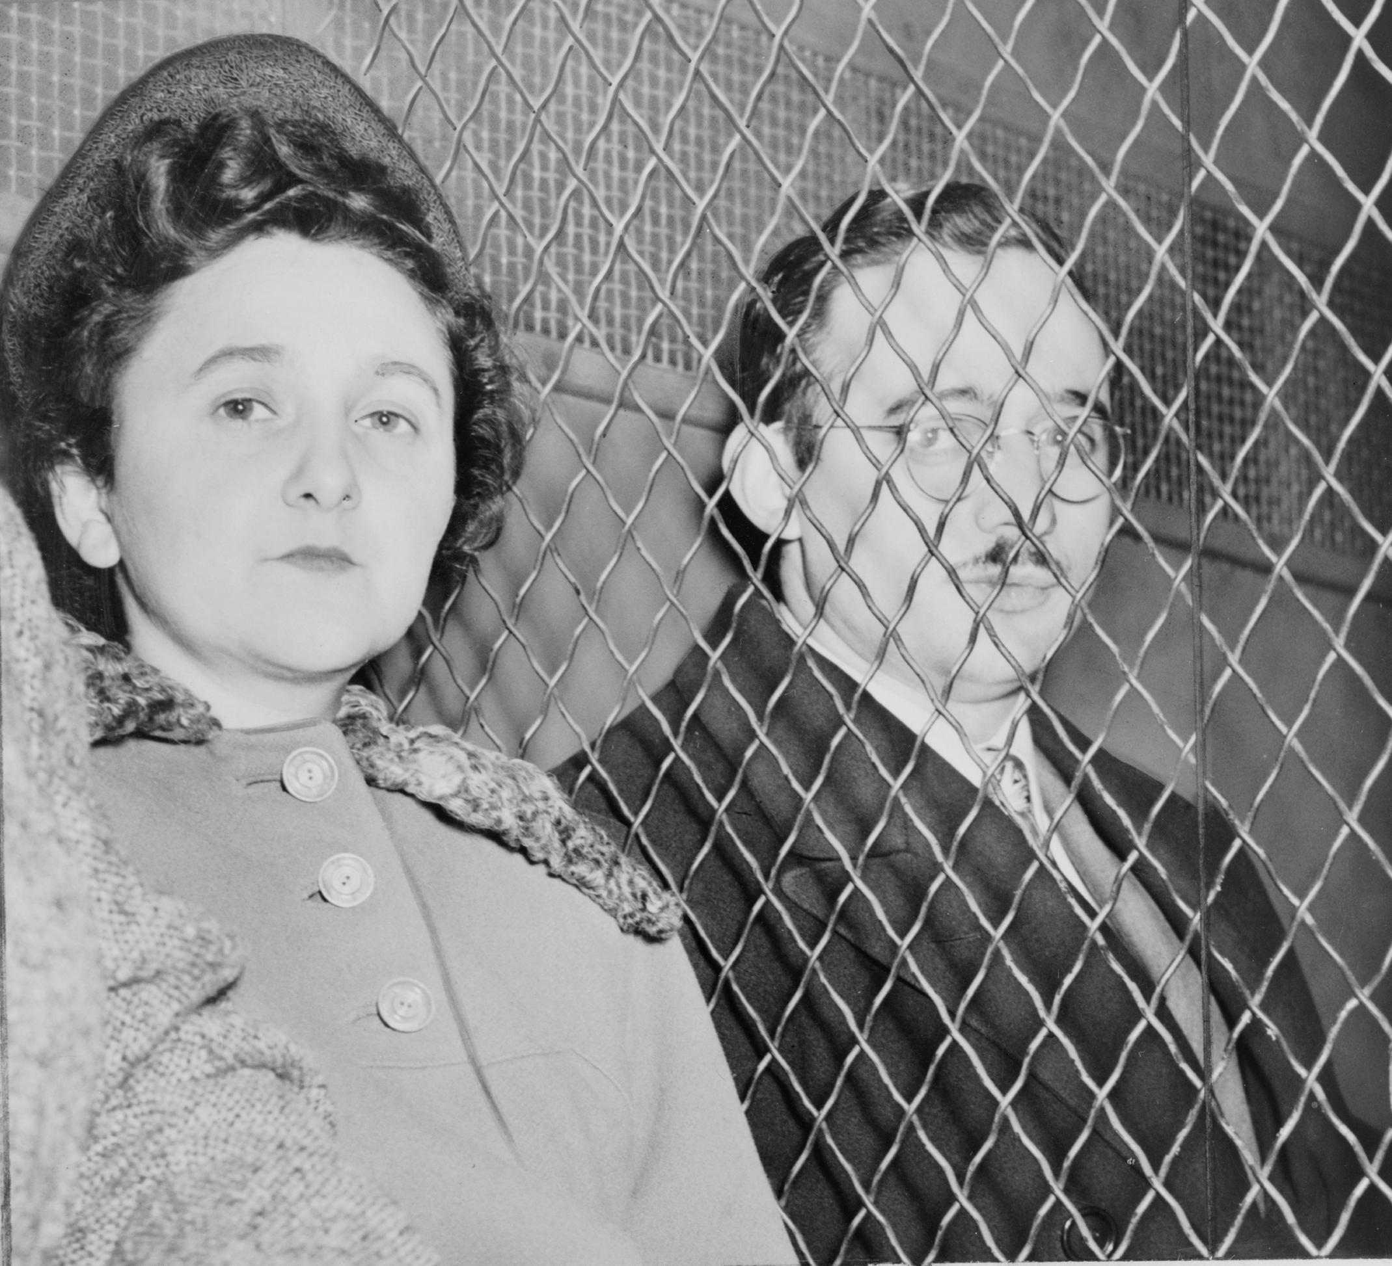

Slide 18
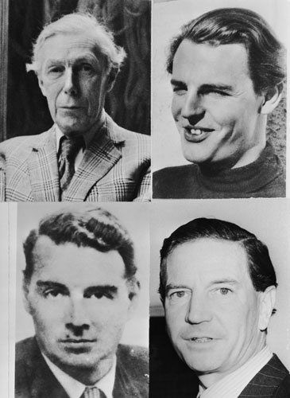

Slide 19
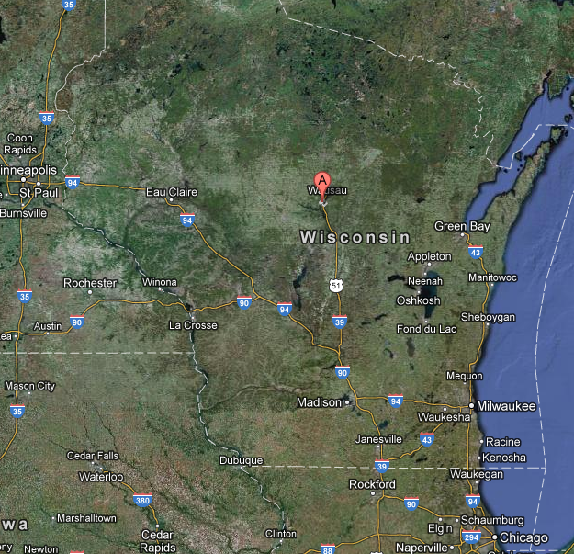
Notes:
mosinee

Slide 20
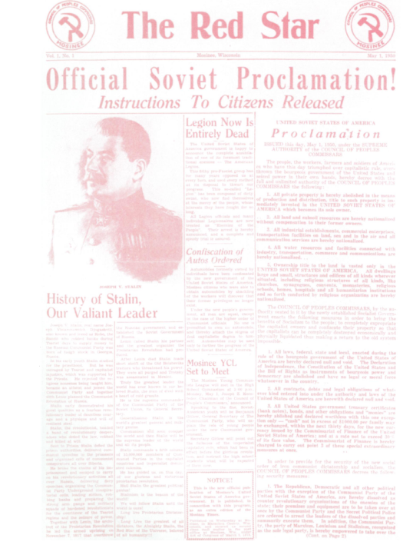
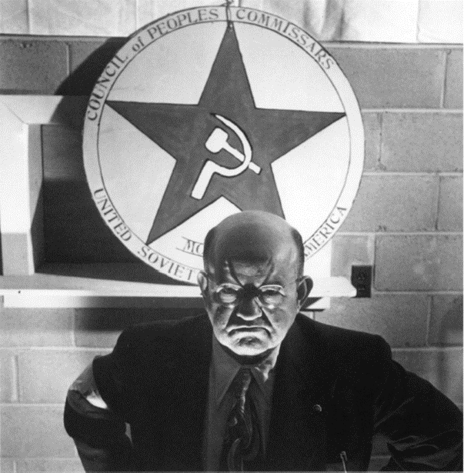

Slide 21
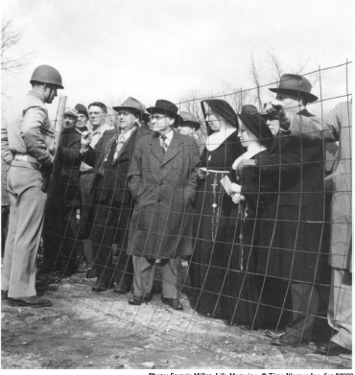
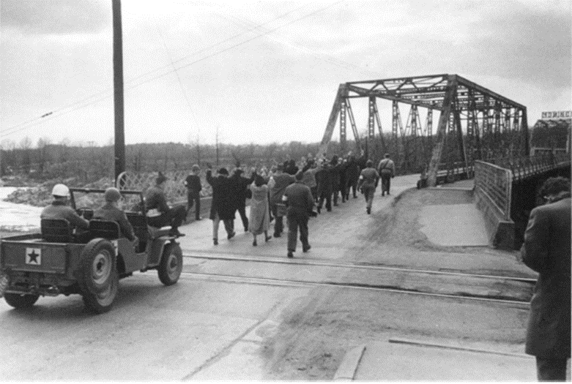

Slide 22
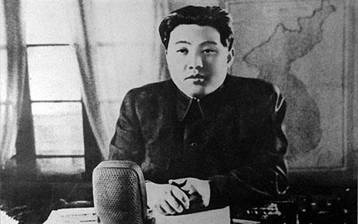
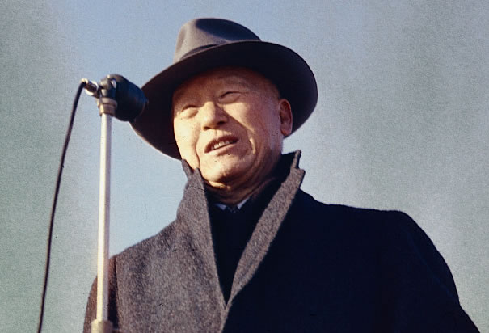

Slide 23
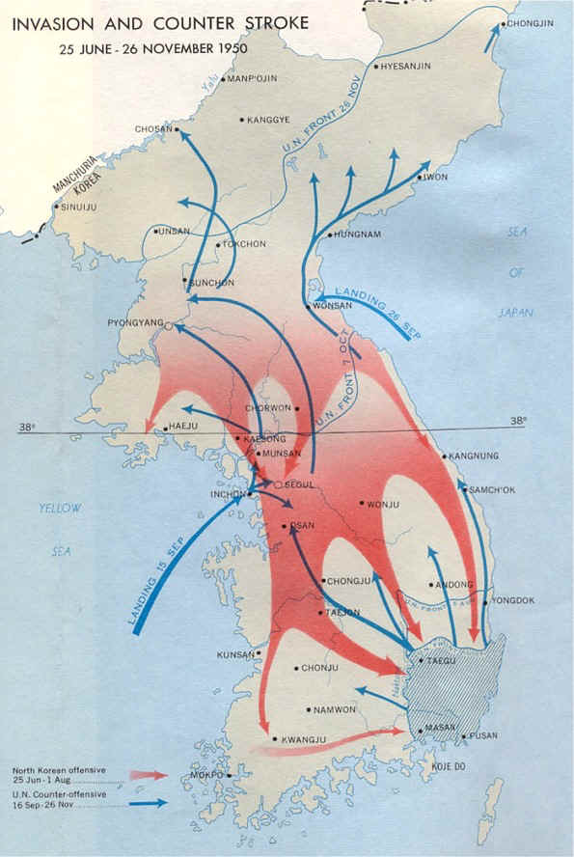

Slide 24

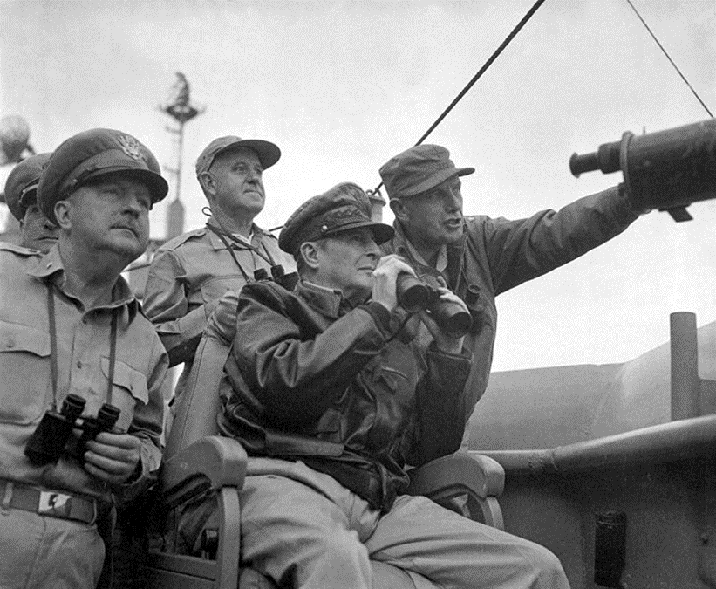

Slide 25
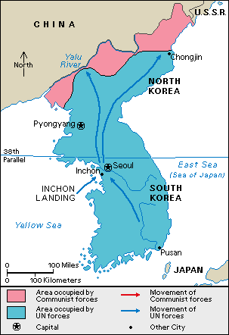

Slide 26
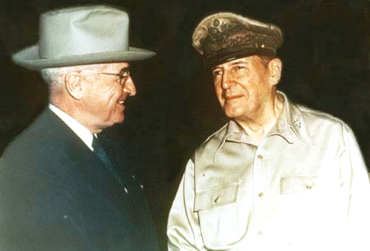
Notes:
wake

Slide 27
 | 1950 | 1951 | 1952
Defense budget | $13.3 B | $60.4B | $44 B
Army | 591,000 | 1.55 million | 1.595 million
Navy | 451,000 | 1.01 million | 1.05 million
Air Force | 411,000 | 1.06 million | 973,000

Slide 28


Slide 29
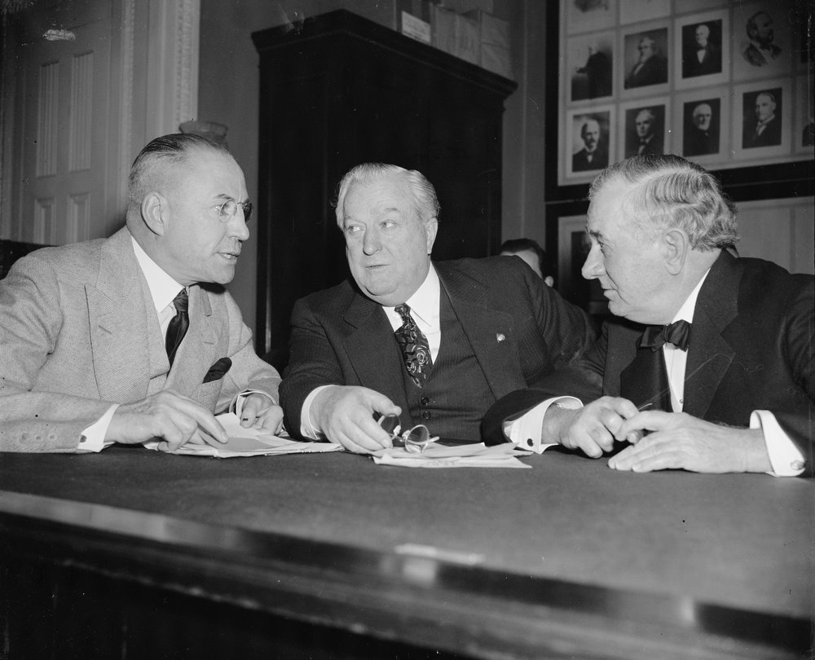

Slide 30
McCarran Internal Security Act (1950)
--Subversive Activities Control Board
--creation of Internal Security Subcommittee
--members CPUSA must register with federal government
--Communist-front organizations must provide membership to gov’t.
--restrictions on citizenship rights for those deemed threat to gov’t.
--authorize the President to “apprehend” and “detain” those for whom a “reasonable ground to believe” that he or she “probably will engage in, or probably will conspire with others to engage in, acts of espionage or of sabotage.”

Slide 31
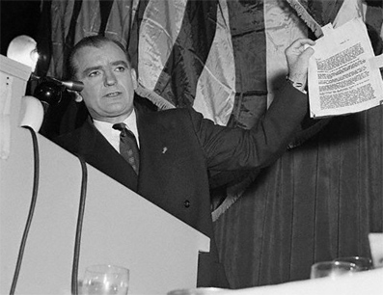

Slide 32
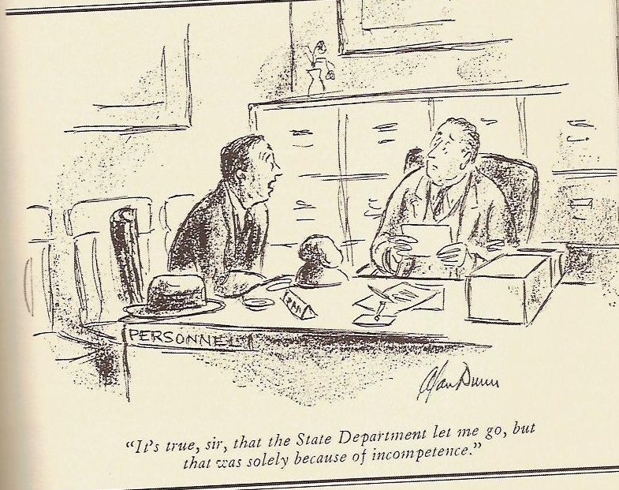

Slide 33
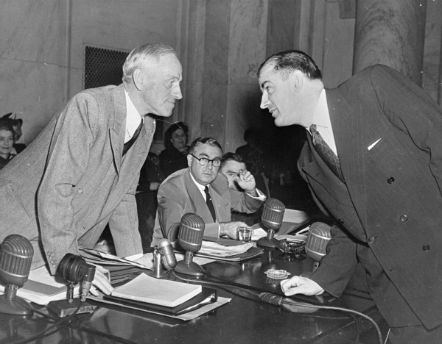
Notes:
tydings

Slide 34
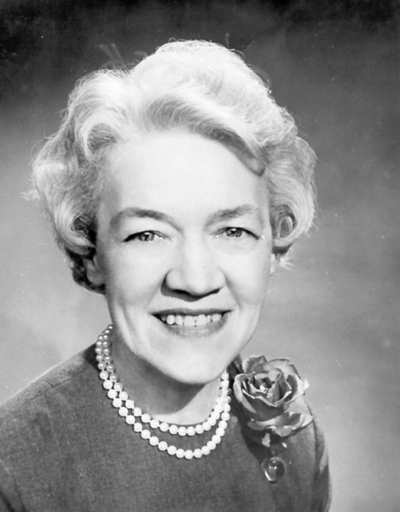

Slide 35
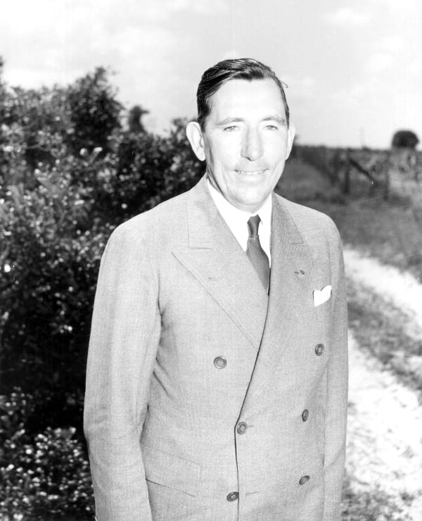

Slide 36
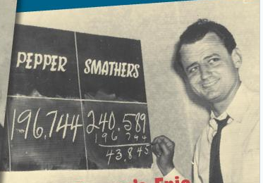

Slide 37
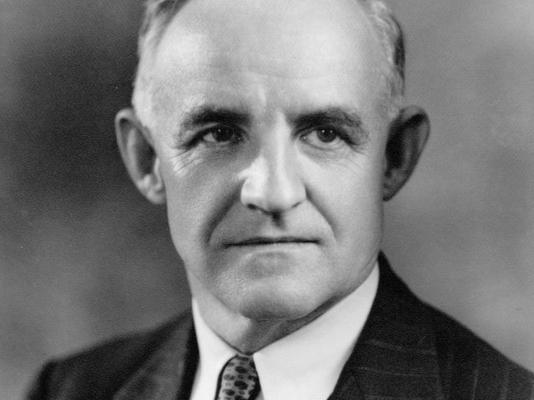

Slide 38
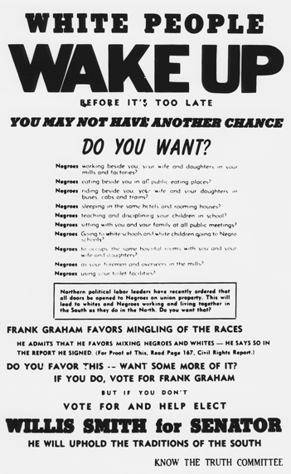

Slide 39
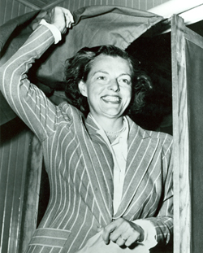

Slide 40
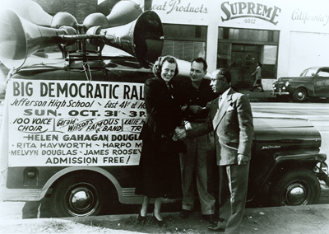

Slide 41
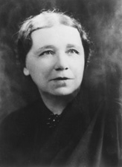
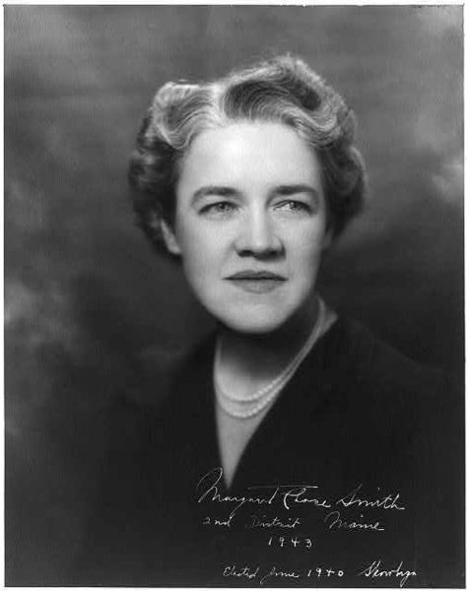

Slide 42
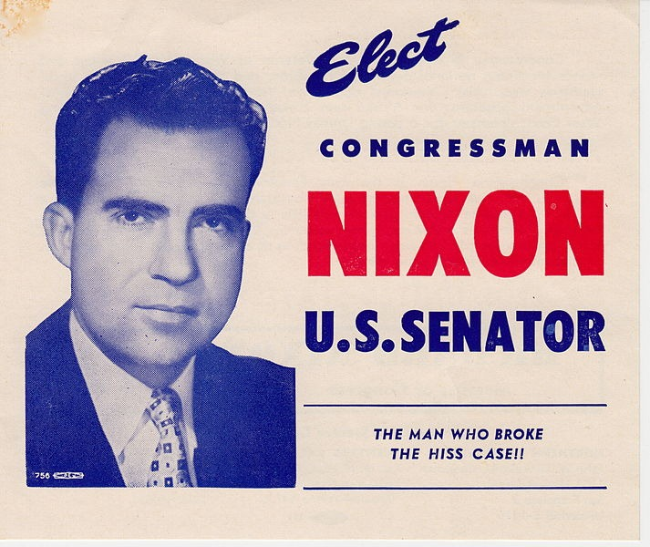

Slide 43
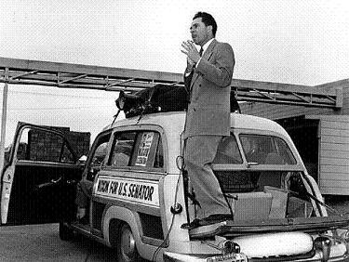

Slide 44
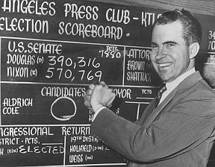

Slide 45
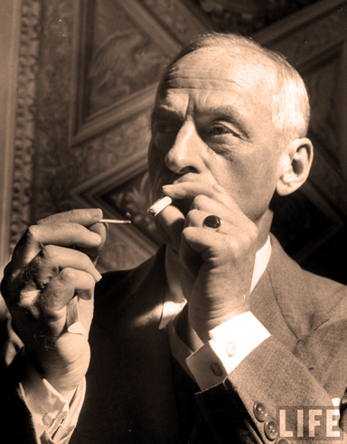

Slide 46
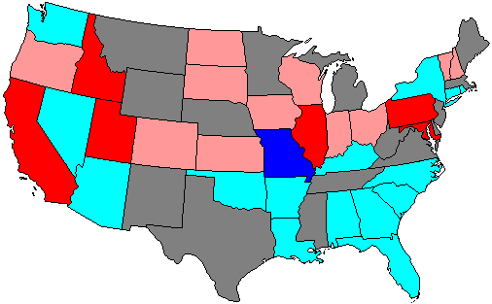
1950 Senate Elections

Slide 47
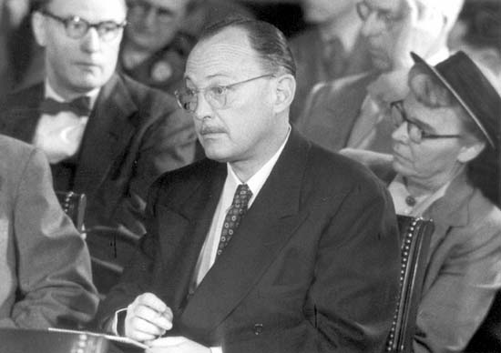
Notes:
lattimore

Slide 48
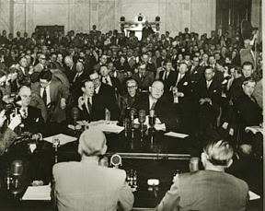
Notes:
lattimore

Slide 49


