Slide 1


Slide 2
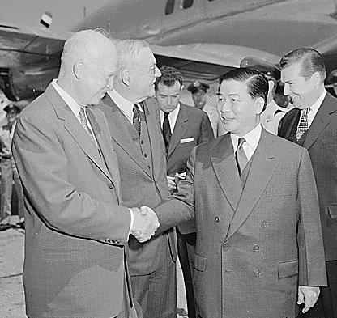

Slide 3
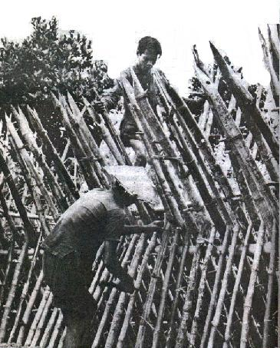
Notes:
Str hamlet

Slide 4
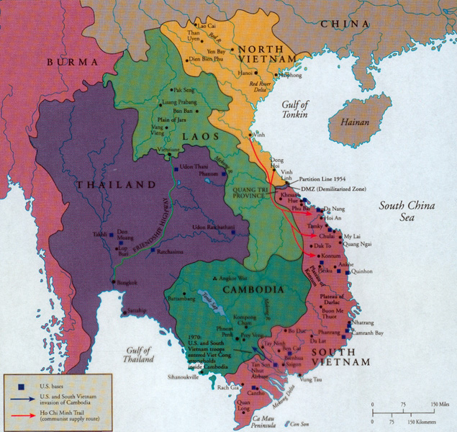

Slide 5
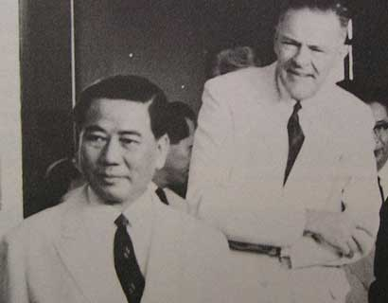

Slide 6
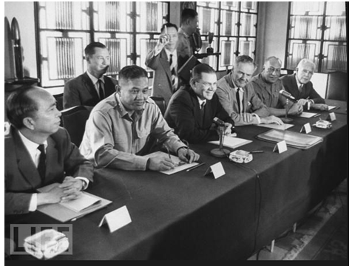

Slide 7
Time Period | U.S. Troops in Vietnam | U.S. Personnel Killed
End of 1961 | 2,067 | 16
End of 1962 | 11,500 | 52
End of 1963 | 19,000+ | 118

Slide 8


Slide 9


Slide 10

President Johnson: Do you think it’s a mistake to explain what I’m saying now about Vietnam, and what we’re faced with?
Robert McNamara: Well, I do think, Mr. President, that it would be wise for you to say as little as possible.
The frank answer is we don’t know what’s going on out there. The signs I see coming through the cables are disturbing signs—poor morale in Vietnamese forces, poor morale in the armed forces, disunity, a tremendous amount of coup planning against [South Vietnamese leader Nguyen] Khanh. About what you’d expect in a situation that’s had three governments in four months—
President Johnson: Well, then why don’t we take some pretty offensive steps pretty quickly, then? Why don’t we commend Khanh on his operation and try to prop him up? Why don’t we raise the salary of their soldiers to improve that morale, instead of waiting a long time? Why don’t we do some of these things that are inclined to bolster ‘em?
McNamara: Well, I’m not sure that they here . . .
President Johnson: I sure as hell don’t want to get in the position of Lodge recommending to me—the one thing he recommended is “please give us a little more pay for our soldiers,” and we turned him down.
McNamara: Oh, no, we’ve done that, sir.
President Johnson: We haven’t acted. We said we’re going to wait till you go out there [to Vietnam].
McNamara: Well, no. He knows there’s money for that. There’s no problem on that issue.
President Johnson: Well, then, why don’t we clear it up, so that we get him answered?
Now, I think that politically—I’m not a military strategist—but I think that as long as we’ve got him [Lodge] there, and he makes recommendations, and we act on ‘em, particularly if we act favorably, we’re not in too bad a condition politically.
But I think when he wires us and says, “The only damn thing I want you to do is to give ‘em an increase in pay because morale’s terrible,” and we say, “Well, wait,” then if something happens in between, I think we are caught with our britches down.

Slide 11


Slide 12

Notes:
Lbj signing tgr

Slide 13
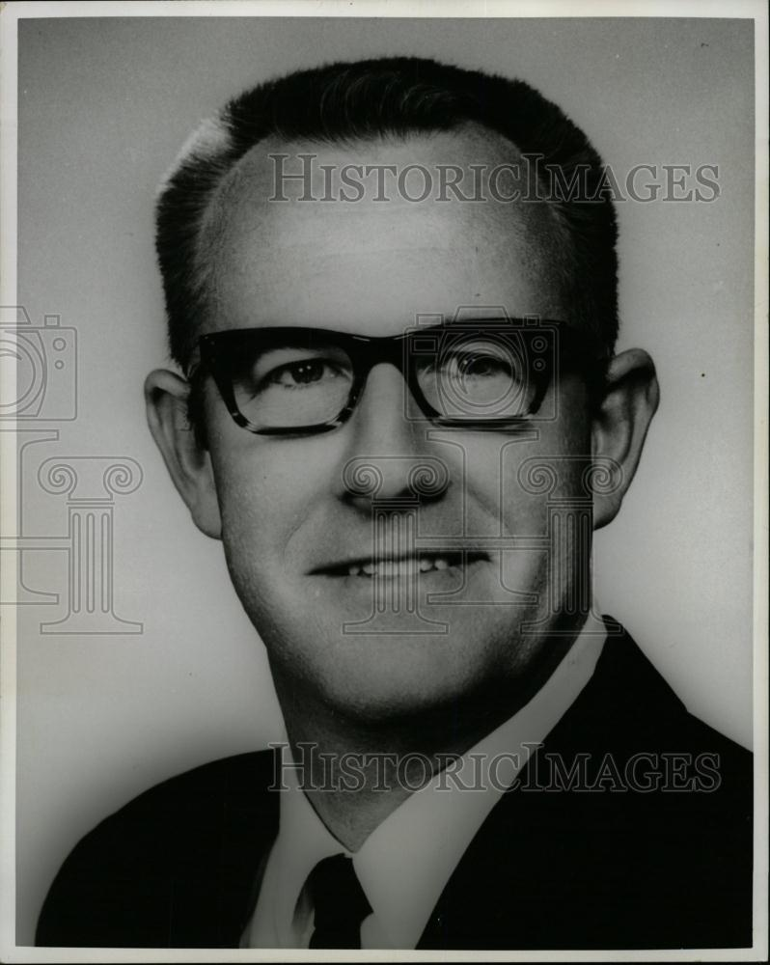

Slide 14


Slide 15


Slide 16
President Johnson: That was a good vote you had today.
Speaker McCormack: Yes, it was very good. 414 to nothing; one present. What’d the Senate do?
President Johnson: 88 to 2. Morse and Gruening.
McCormack: I don’t understand Gruening.
President Johnson: Oh, he’s no good. He’s worse than Morse. He’s just no good. I’ve spent millions on him up in Alaska [in reconstruction funds after the March 1964 Alaska earthquake]. He’s just no good.
And Morse is just as undependable and erratic as he can be.
McCormack: I know that. But I can’t understand the other fellow.
President Johnson: Say, I wanted to point out this little shitass [Ed] Foreman today got up and said that we [Johnson] acted impulsively by announcing that we had an answer on the way [to the Tonkin Gulf incidents] before the planes dropped their bombs.
[Break.]
President Johnson: It’s just a pure lie, and smokescreen.
McCormack: But he was booed two or three times. Tremendous booing on the Democratic side. He was—everybody knew he was just cheap and mean and contemptible. Well, you know what he is.
President Johnson: Yeah. Yeah, he’s no good.

Slide 17
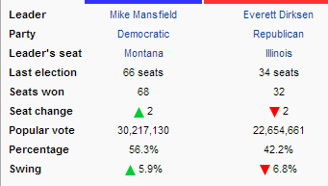
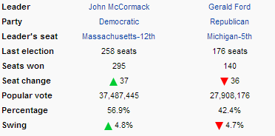

Slide 18
Voting Rights Act (1965)
Section 2 of the Voting Rights Act of 1965 prohibits voting practices or procedures that discriminate on the basis of race, color, or membership in one of the language minority groups identified in Section 4(f)(2) of the Act.
Section 5 freezes election practices or procedures in certain states until the new procedures have been subjected to review, either after an administrative review by the United States Attorney General, or after a lawsuit before the United States District Court for the District of Columbia. This means that voting changes in covered jurisdictions may not be used until that review has been obtained.
--DOJ description

Slide 19


Slide 20
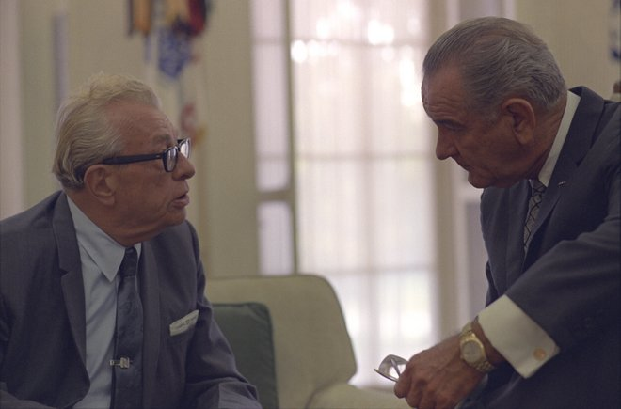

Slide 21
Dirksen: Hi.
President Johnson: How are you, my friend? Glad to hear you!
Dirksen: I’m all right; how are you?
President Johnson: You and [Senate majority leader] Mike [Mansfield] up there fraternizing together?
Dirksen: Yes, sir.
President Johnson: That’s wonderful, that’s good. How you feeling, Everett?
Dirksen: I’d have felt better if you’d have hustled me a half a dozen votes [on the conference committee report].
President Johnson: Well, you didn’t want me to. You told me you didn’t want me to do anything but sit there. All I’d have done is just stirred up 10 more against you. You—
Dirksen: Well, I wanted you to interfere on the right side—that’s what I was saying. [Both laugh.]
President Johnson: Well, you did a—
Dirksen: We got the Voting Rights bill out.
President Johnson: You ought to be proud of that, my friend.
Dirksen: We are proud of it. And I—
President Johnson: You had a lot to do with that, and—
Dirksen: Give [House Judiciary chairman Manny] Celler a compliment. That House really abused him over there, when they had that—
President Johnson: All right.
Dirksen: [continuing] They cracked him for turning cold shoulder, not supporting the House position on the poll tax.
President Johnson: All right, I will.
Dirksen: They gave Manny a rough time.
[Break.]
President Johnson: You must have made a helluva speech there today. The ticker’s made me wish I was there listening to you.
Dirksen: Well, why weren’t you here?
President Johnson: Well, because—you know I can’t have any fun anymore. [Dirksen chuckles.] They just lock me up. I can’t even drink Sanka. I just have to drink this damned old root beer.
They won’t let me get out. If I could get you and come and visit you, I’d do it nearly every night.
Dirksen: Well, why don’t you come right up here now, and I’ll pour you a drink? A good stiff bourbon.
President Johnson: Well, if you and Mike will stay there about 10 or 15 minutes, I might do it. I’m a little lonesome and I’d like to see you.
Dirksen: Are you kidding?
President Johnson: No, I’m not kidding.
Dirksen: All right, we’ll stay.
President Johnson: All right. OK.
Dirksen: All right. My office.
President Johnson: All right.

Slide 22
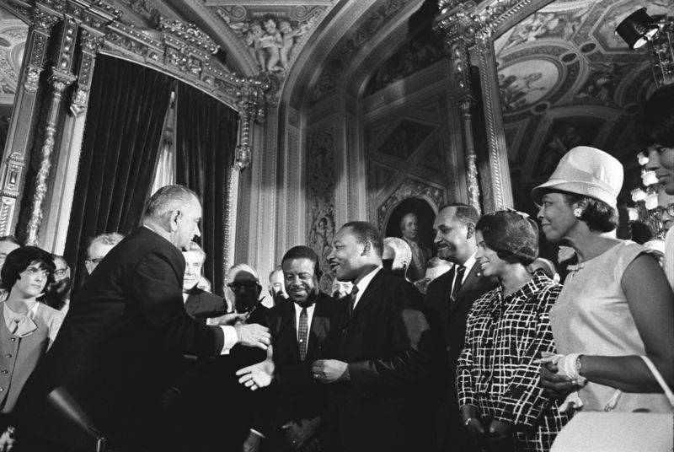

Slide 23
President Johnson: Now, what does it [the Medicare bill] do for you, the patient, on doctors? It says that you can have doctors’ bills paid up to what extent, or how much, or any limit?
Wilbur Cohen: The individual patient has to pay the first $50—
President Johnson: All right—
Cohen: [continuing] Deductible—
President Johnson: All right—
Cohen: [continuing] Then he’s got to pay 20 percent—
President Johnson: Of everything after that?
Cohen: Of everything after that. So if you went to the doctor and you had a $1000 bill, you’d pay the first $50 and then for the other 950, you’d have to pay 20 percent of that.
President Johnson: All right. But that keeps your hypochondriacs out.
Cohen: That keeps the hypochondriacs out. And at the same time, for most of the people, it would provide an overwhelming proportion of their physicians’ costs.
President Johnson: Yes, sir. And it’s something that nearly everyone could endure—they could borrow that much, or their folks could get ‘em that much, to pay their part.
[Break.]
President Johnson: What did the insurance companies [say]? Are they still raising hell, and mad?
Cohen: Well . . . Yes, I think they’re going to go over to the Senate, and raise hell on the thing, because quite frankly, there’s no longer any room for the private insurance companies to sell insurance for people over 65, when you take the combination of hospital care and the physicians’ services.
President Johnson: Yeah. OK. Now, I think that’s wonderful.
Now, remember this: nine out of ten things I get in trouble on is because they lay around. And tell the [House] Speaker and [Ways and Means Committee chairman] Wilbur [Mills] to just please get a rule just the moment they can—
Cohen: They want to bring it up next week, Mr. President.
President Johnson: Yeah, but you just tell them not to let it lay around. Do that! They want to, but they might not. Then that gets the doctors organized. Then they get the others organized. And that damn near killed my education bill, letting it lay around.
Cohen: Yeah.
President Johnson: It stinks. It’s just like a dead cat on the door. When a committee reports it, you’d better either bury that cat or get it some life.

Slide 24
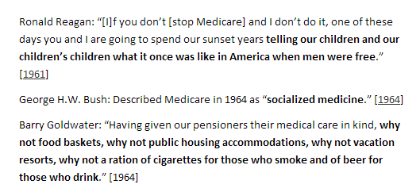

Slide 25
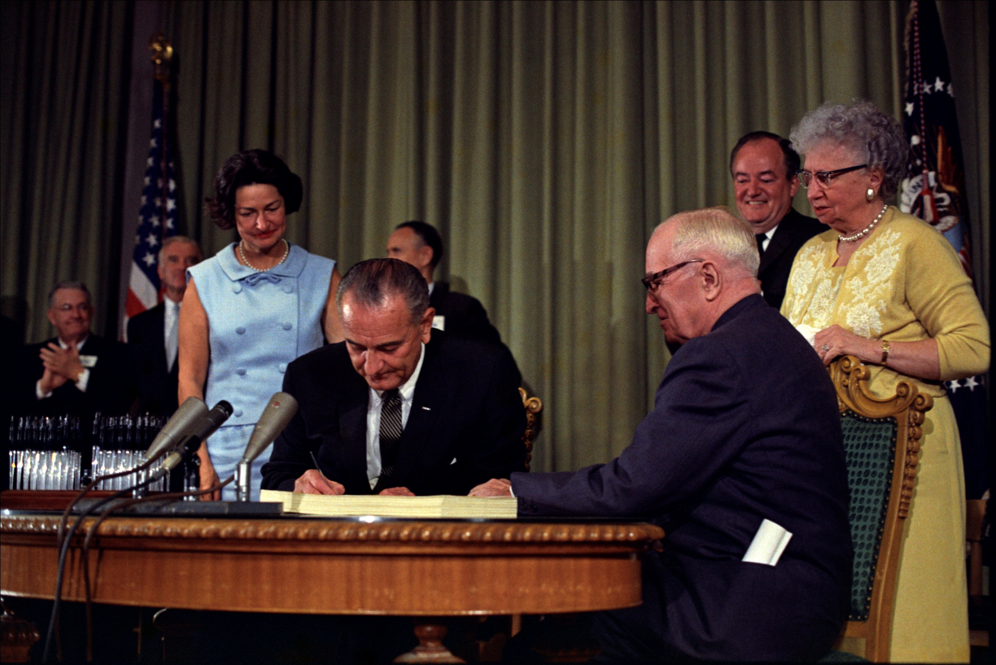

Slide 26
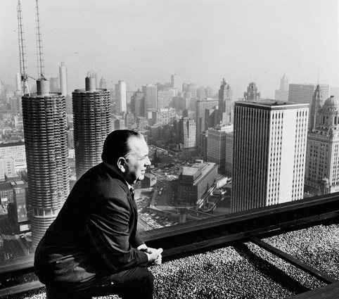

Slide 27
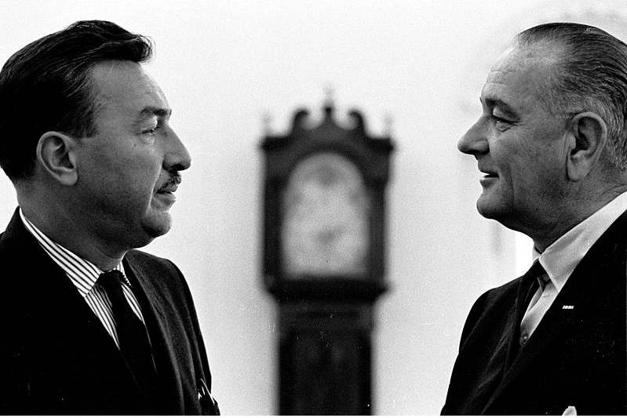

Slide 28
President Johnson: Hello?
Congressman Adam Clayton Powell: How’s my friend?
President Johnson: [stonily] Fine, Adam.
What the hell’s been happening to your [Education and Labor] Committee? I thought you told me two months ago that you were going to pass a [education] bill for me.
Powell: That’s right. Well, what happened: all hell’s broken loose, because—
President Johnson: Well, now, what the hell are you blackmailing me on a—
Powell: That’s not—
President Johnson: —four hundred . . . Well, hell, you didn’t—[because] you want a $400,000 appropriation for you, we couldn’t pass a billion, two hundred million [dollar funding bill] for the schoolkids.
Now, you know I’m for you, and you know that I’m going to help you any way I can. I’ve got nothing to do with what you’re doing in the House investigation [of Powell’s personal finances]. But you damn near defeated the best education bill I’ve got. And I hope you’re going to be proud of it.
Powell: No. Now, you know your Appalachia bill, that there is—
President Johnson: Well, now, Appalachia ain’t got a damn thing to do with you. If you handle your committee and let us handle the other one!
Powell: Yeah, but there’s a clause in there, Mr. President—
President Johnson: There’s a clause that’s been in there for a long time.
And if you’re going to let [Ohio congressman William] Ayres [the committee’s ranking Republican] and [Oregon congresswoman] Edith Green [a conservative Democrat] lead you off the reservation, well, then I ran for nothing last year—
Powell: No—
President Johnson: [continuing] With 15 million votes. If you’re going to tie up this Congress, and screw it up—which you’ve done for three weeks, by running off [to Bimini, in the Bahamas] till you got a 400,000 [dollar] appropriation—why, we never can get anywhere.
And you defeat this [bill], and you hold it up, and you delay it, and you get us in this kind of shape, why, we can’t pass anything.
And that’s all right. But I think you’ll beat a hell of a bunch of your liberal Democrats [in the 1966 midterm elections]. I’m going to be here—it’s not going to bother me. But I just sure thought I had better leadership on that committee than what I’ve got without even talking.
Powell: Well—
President Johnson: And I’m awfully disappointed. Just very disappointed.
Powell: Now, Mr. President, don’t you think I have an entitlement to—
President Johnson: [forcefully] No, I don’t think you’re entitled to a damn thing that you did.
I think you told me, and looked me straight in the eye—
Powell: Mm-hmm.
President Johnson: [continuing] And said, “I’ll report this bill, and I’ll get it on the floor.” And you didn’t do it.
Powell: [By] March 1st.
President Johnson: And you did not do it.
Powell: It was [by] March 1st, because—
President Johnson: Well, Adam—
Powell: It was March—
President Johnson: [voice rising] No. Oh, hell no, you didn’t say till March 1st. You told me you were going to do it. And then you ran off for three weeks and they couldn’t even locate you . . . And your people [African-Americans] are being damn well taken care of in it [the bill].

Slide 29
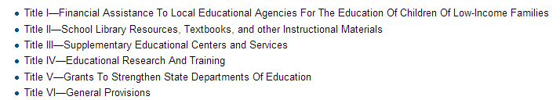

Slide 30
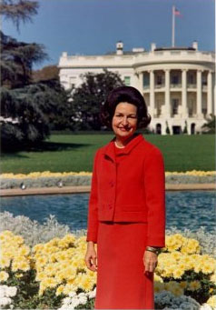

Slide 31
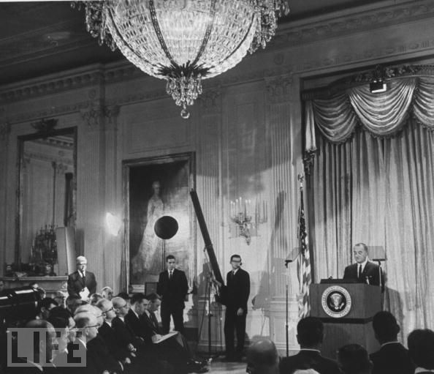

Slide 32
Lady Bird Johnson: You want to listen for about one minute to—
President Johnson: Yes, ma’am.
Lady Bird Johnson: —my critique, or would you rather wait till tonight?
President Johnson: Yes, ma’am. I’m willing now.
Lady Bird Johnson: I thought that you looked strong, firm, and like a reliable guy. Your looks were splendid. The close-ups were much better than the distance ones.
President Johnson: Well, you can’t get ‘em [the TV producers] to do it . . . the distance ones.
Lady Bird Johnson: Well, I would say this: there were more close-ups than there were distance ones.
During the statement, you were a little breathless and there was too much looking down and I think it was a little too fast. Not enough change of pace, a drop in voice at the end of sentence.
There was a considerable pick-up in drama and interest when the questioning began. Your voice was noticeably better, and your facial expressions noticeably better.
[Break.]
Lady Bird Johnson: When you’re going to have a prepared text, you need to have the opportunity to study it a little bit more, and to read it with a little more conviction, and interest, and change of pace. Because—
President Johnson: Well, the trouble is that they [the White House media] criticize you for taking so much time. They want to use it all for questions. Then their questions don’t produce any news, and if you don’t give ‘em news, you catch hell.
So my problem was trying to get through before 10 minutes, and I still ran 10 minutes today.
[Break.]
Lady Bird Johnson: I believe if I’d had that choice, I would have said use 13 minutes, or 14, for the statement.
In general, I’d say it was a good B+. How do you feel about it?
President Johnson: [quickly] I thought it was much better than last week.
Lady Bird Johnson: [unconvinced] Well, I heard last week, [you] see, and didn’t see it. And didn’t hear all of it.

Slide 33
