Slide 1
Great Society
Civil rights laws: Civil Rights Act (1964), Voting Rights Act (1965)
Anti-poverty laws: War on Poverty (1964), food stamps (1964)
Health care: Medicare (1965), Medicaid (1965)
Other liberal aims: model cities, education, arts, environmentalism (1965)

Slide 2
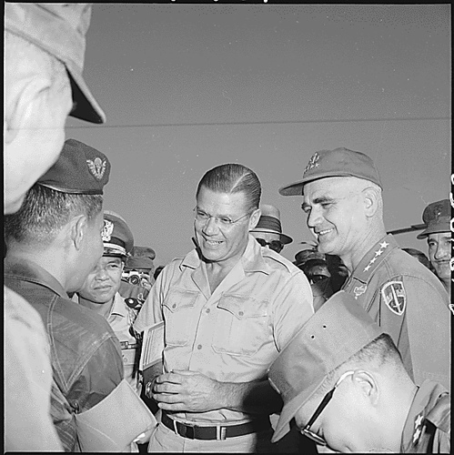

Slide 3
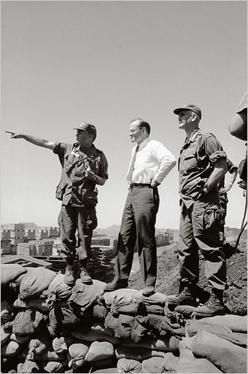
Notes:
Bundy and westnmireland after pleiku

Slide 4
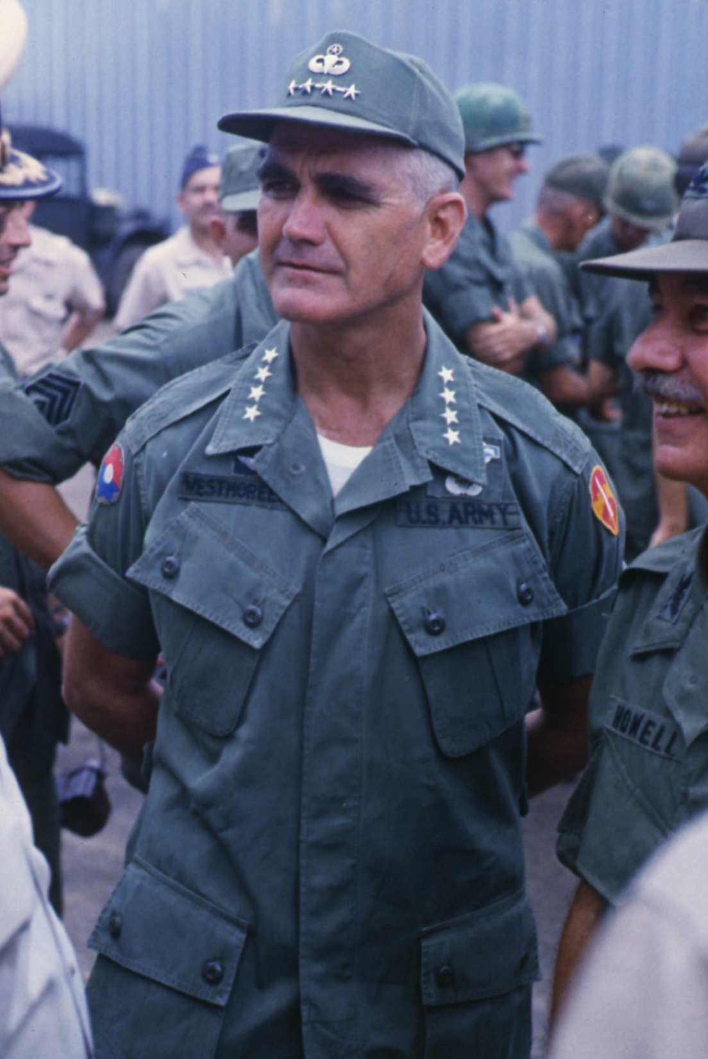

Slide 5


Slide 6
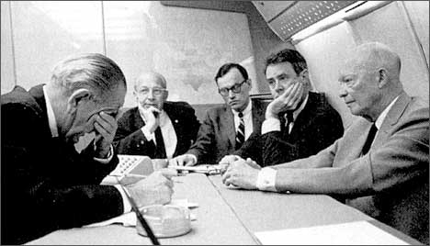
Notes:
Lbj rostow

Slide 7
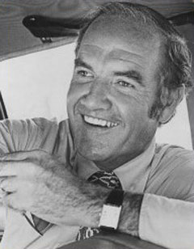

Slide 8
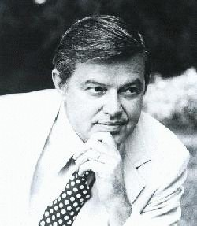

Slide 9


Slide 10
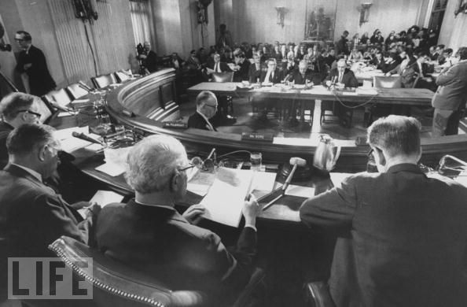

Slide 11

President Johnson: What they [adherents to the Bull Fulbright line on Vietnam] really think is that we oughtn’t to be there, and we ought to get out.
Well, I know we oughtn’t to be there, but I can’t get out. I just can’t be the architect of surrender. And don’t see—I’m trying every way in the world I can to find a way to . . . thing.
But they [the North Vietnamese] don’t have the pressure to bring them to the table as of yet. We don’t know whether they ever will.
I’m willing to do damn near anything. If I told you what I was willing to do, I wouldn’t have any program. [Senate Minority Leader Everett] Dirksen wouldn’t give me a dollar to operate the war. I just can’t operate in a glass bowl with all these things. But I’m willing to do nearly anything a human can do, if I can do it with any honor at all. But . . .
They started with me on Diem, you remember?
Eugene McCarthy: Yeah.
President Johnson: That he was corrupt and he ought to be killed. So we killed him. We all got together and got a goddamned bunch of thugs and we went in and assassinated him. Now, we’ve really had no political stability since then.
McCarthy: Yeah.

Slide 12
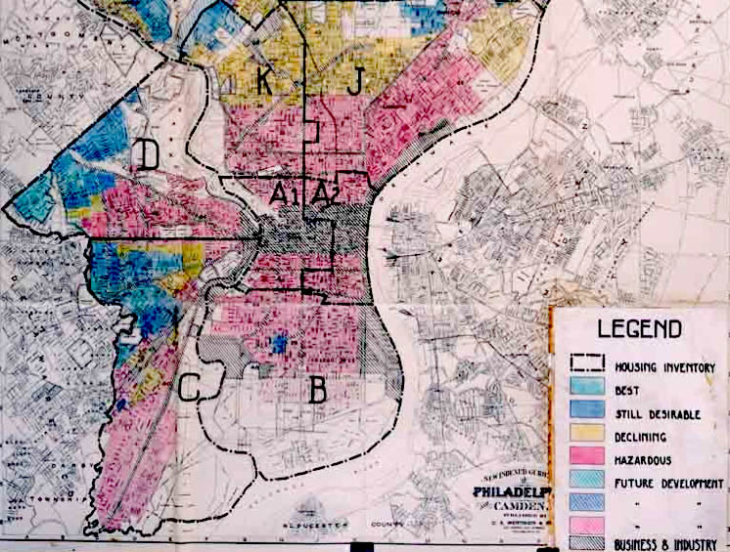

Slide 13


Slide 14
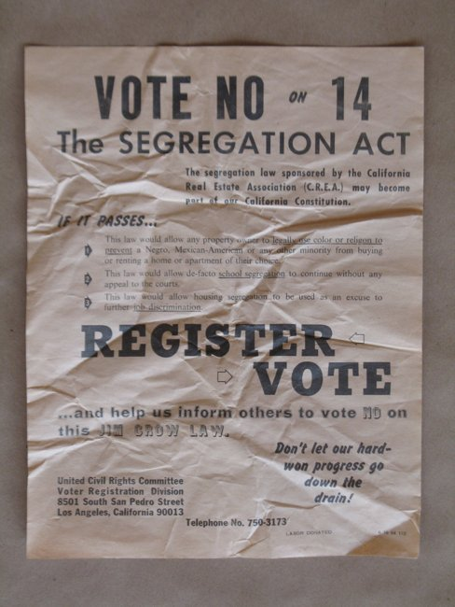

Slide 15


Slide 16
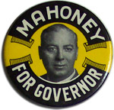

Slide 17
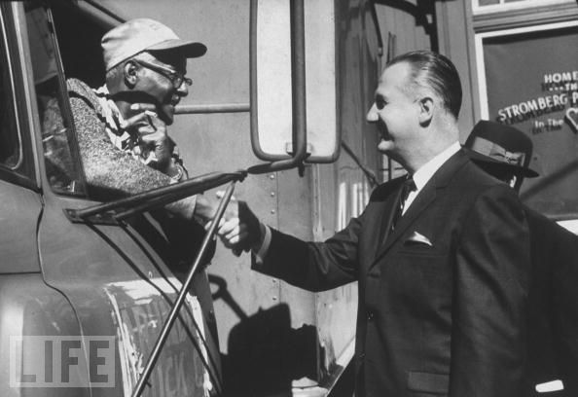

Slide 18
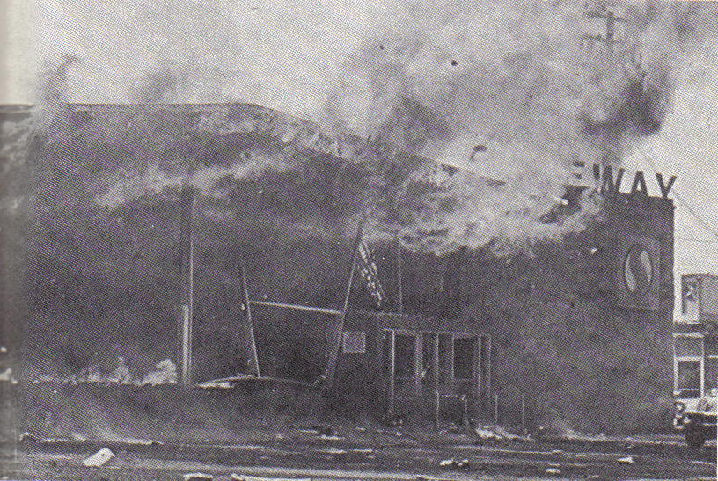

Slide 19
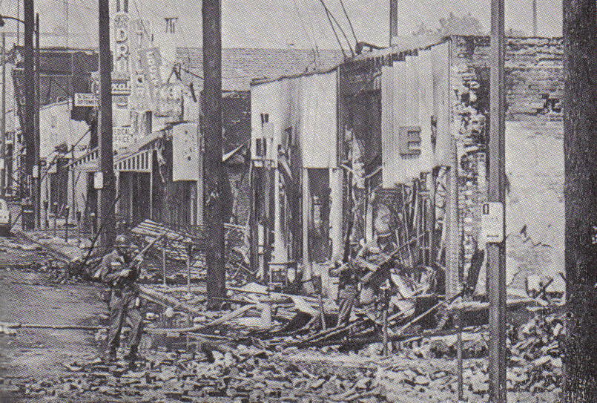

Slide 20
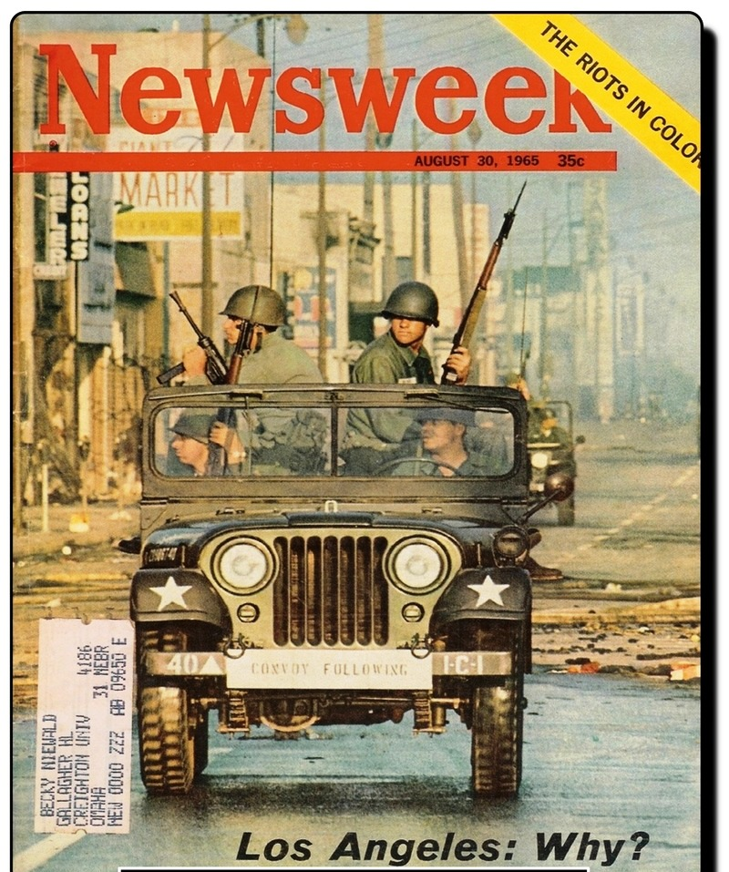

Slide 21
President Johnson: We are on powder kegs in a dozen places.
John McCone: Is that right?
President Johnson: What we’re ultimately going to have to do . . . You just have no idea of the depth of the feeling of these people [African-Americans]. You see . . . I see some of the boys [that have] worked for me that have had 2000 years of persecution [Jews] and how they suffer from it.
But these groups, they got really absolutely nothing to live for. Forty percent of ‘em are unemployed. These youngsters—they live with rats, and they’ve got no place to sleep. They start—they are all from broken homes, and illegitimate families, and all the . . . Narcotics are circulating around ‘em. And we’ve [whites] isolated them, and they are all in one area, and when they move in, why, we move out.
[Break.]
President Johnson: We’ve just got to find a way to wipe out these ghettoes.
McCone: Yeah.
President Johnson: And find someplace [for] housing, and put ‘em to work. We trained 12,000 last month, and found jobs for ‘em.

Slide 22
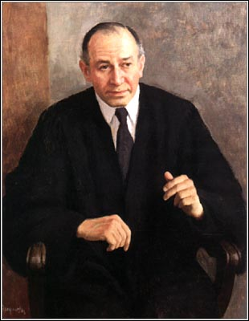

Slide 23
President Johnson: Yes, Mike?
Mike Mansfield: Mr. President, I talked to Jim [Eastland] in Mississippi. He said he was ready to go—
President Johnson: Sure.
Mansfield: -- on the 5th, but he said he got a call from [Att’y General] Ramsay Clark—
President Johnson: That’s right. But Ramsay’s cleaned it up now. It’s a mistake, and our flub, and our mistake. And he’s [Fortas] not going to be away, and he is going to be here, and we oughtn’t to give them all this extra time.
Because the Republican [Study] Committee has met—they’ve got ‘em in the House. And they’ve got [Iowa congressman H.R.] Gross kicked off, and they’ve got this old Hall—[Missouri congressman] Durward Hall—he’s kicked off, and they’re going to start a campaign on it.
Jim set it [the hearing] for the 5th, and [Arkansas senator John McClellan] and them all agreed on the 5th. Then Ramsay, very foolishly, called up and said they’d like to have it the 12th, because Abe [Fortas] would like to spend some days with his wife [a well-known tax attorney, Carol Agger]. He didn’t want to [accept the nomination], and she didn’t want him to go on the Court.
She said her life’s been ruined. I don’t know with these women—their lives get ruined mighty easy. Mrs. Fred Vinson—I sat up with her all night when Fred [Vinson] got appointed to the Court [by Harry Truman, in 1946]. [Speaker Sam] Rayburn and I had to go out there—she was going to divorce him.
[Break.]
Mansfield: OK, I’ll call him back right away.
President Johnson: That’s wonderful. Tell him that Ramsay’s got his trait now. We just flubbed. Put the blame on me or Ramsay. Ramsay flubbed it. And he flubbed it because of the other situation. Don’t talk about the wife—
Mansfield: No—
President Johnson: I just tell you that in . . . God bless you.
Mansfield: OK.
President Johnson: Bye.

Slide 24
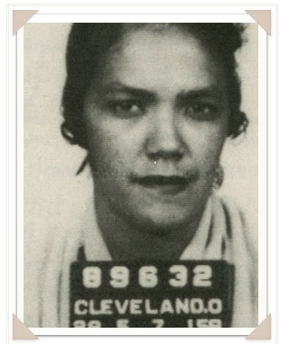
Notes:
Dollree mapp

Slide 25
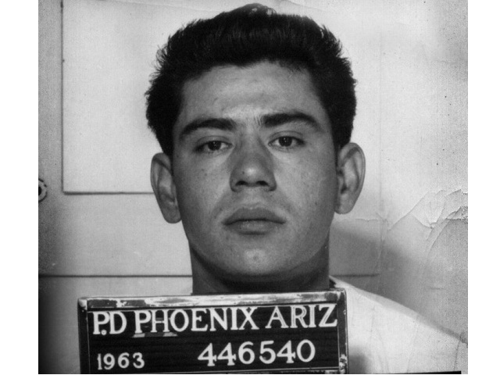

Slide 26
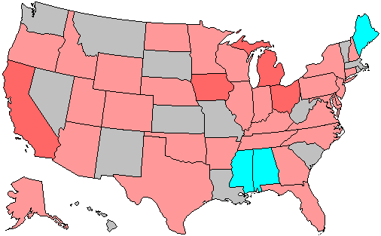
1966 House Elections
Red—Republican gains
Blue—Democrat gains

Slide 27
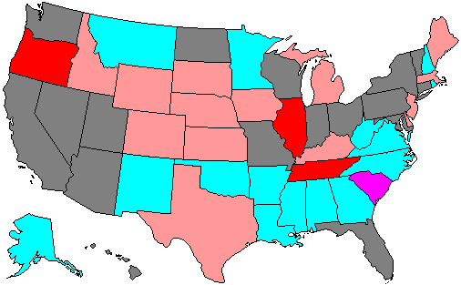
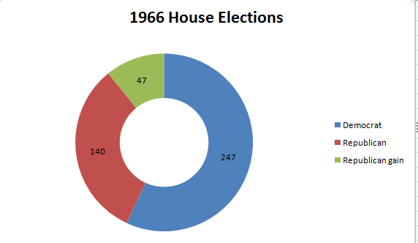

Slide 28
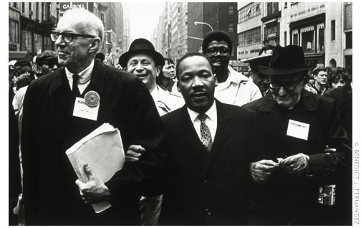

Slide 29
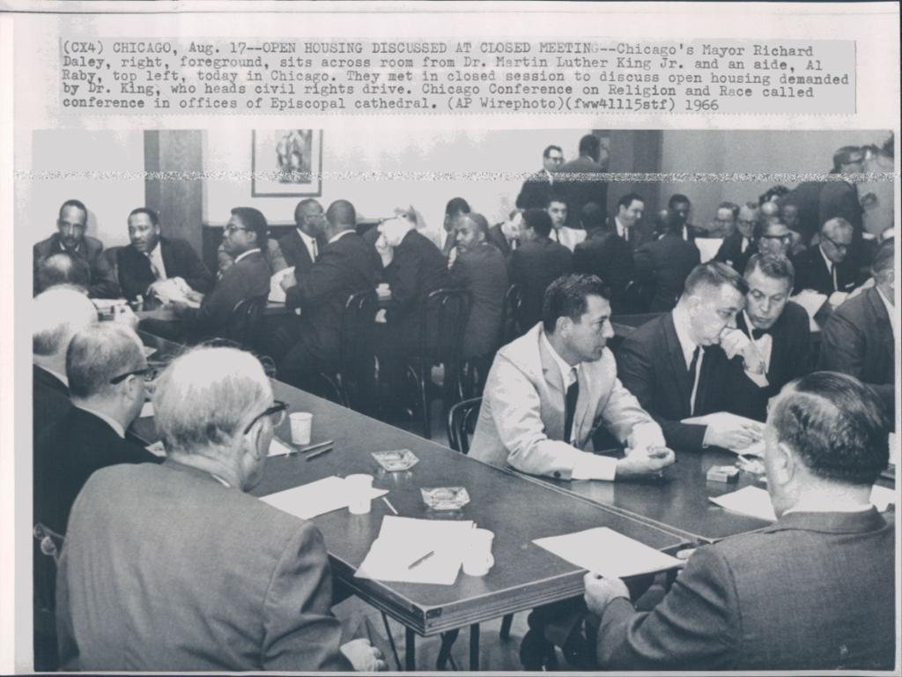

Slide 30
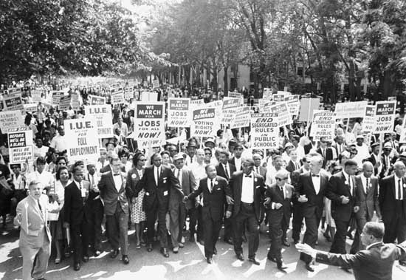

Slide 31
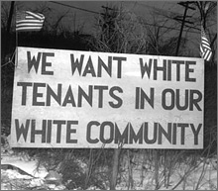

Slide 32
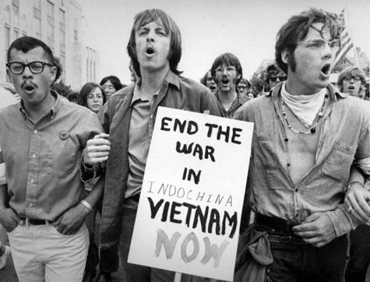

Slide 33
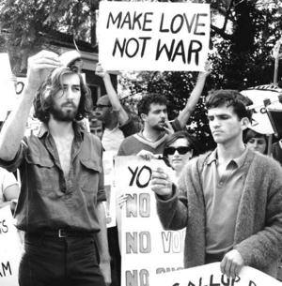

Slide 34
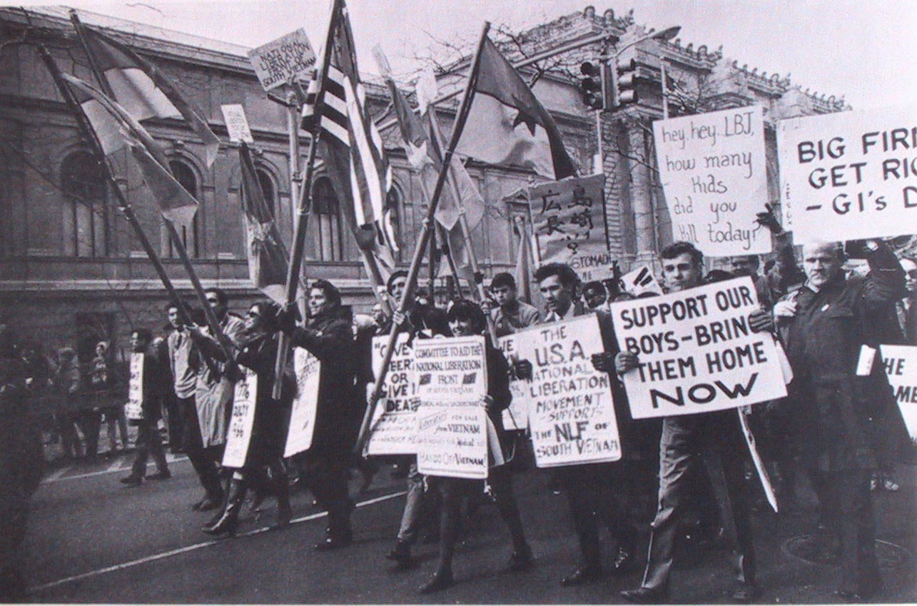

Slide 35
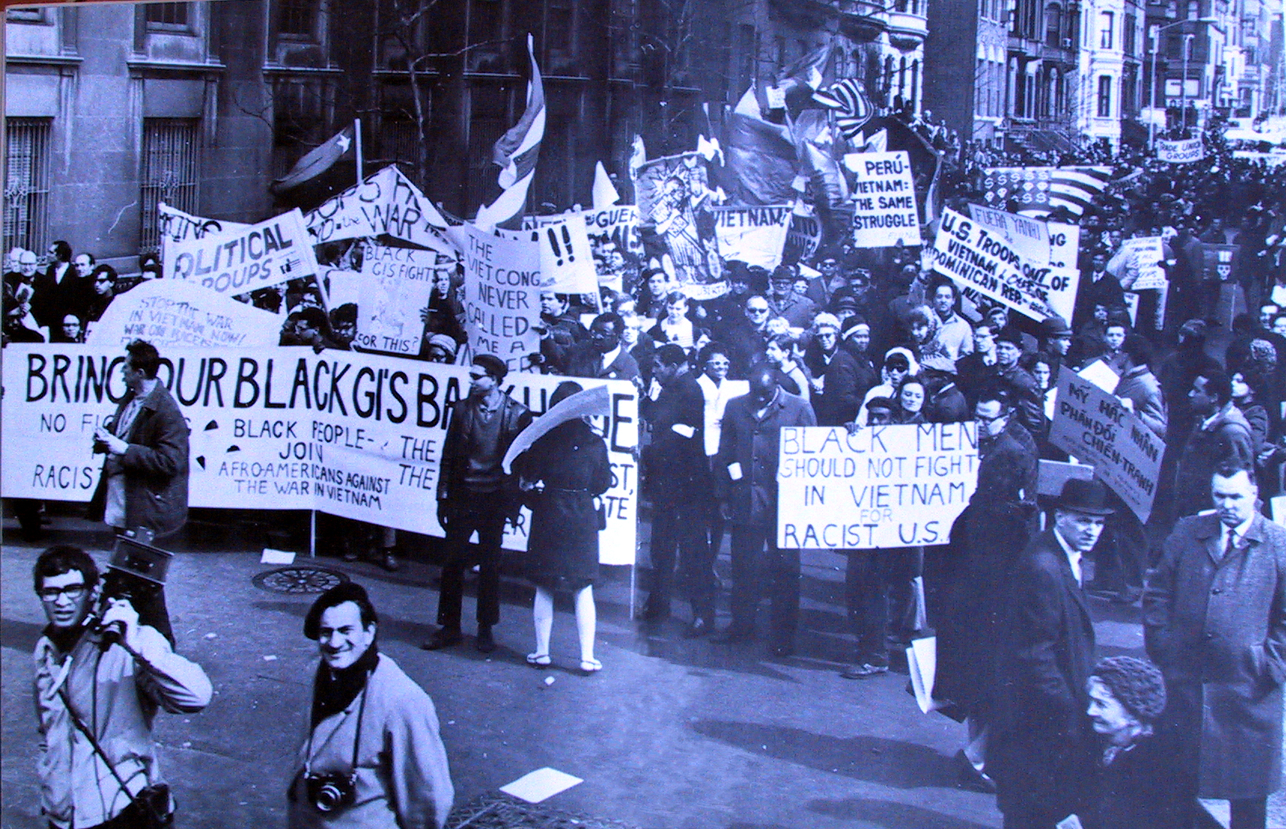

Slide 36
President Johnson: [Anti-war protesters] said give the money to poverty, and not Vietnam. And I think that’s hurting poverty more than anything in the world, is that these Commies are parading . . . and these kids with long-hairs . . . saying, you know, that they want poverty instead of Vietnam. And the Negroes. And I think that’s what people regard as the Great Society.
[Break.]
President Johnson: But in my judgment, the bigger request I make for poverty, the more danger it is being killed.
I don’t think they’re [Congress] just going to cut it; I think the same thing about [foreign] aid. I think if I ask for 2 billion or 3 billion for poverty, when I got 3 billion for jobs, and 24 billion [dollars] in other fields, I think they’d say, “Good God, it goes up: every time you get somebody a job, it costs you more.”
I think if we increase it a reasonable amount, that we have a much better chance of fighting and holding it [the administration request]. But I think that those boys over there [Shriver’s aides], who don’t know anything about legislative procedure, and these kids that give out these interviews—[Budget Director Charles] Schultze tells me that Shriver knows ‘em, but he doesn’t believe Shriver can control ‘em [his aides].
[Special Counsel] Harry [McPherson] tells me that he believes that other people in CAP [the Community Action Program] do this, and they override Shriver.

Slide 37


Slide 38
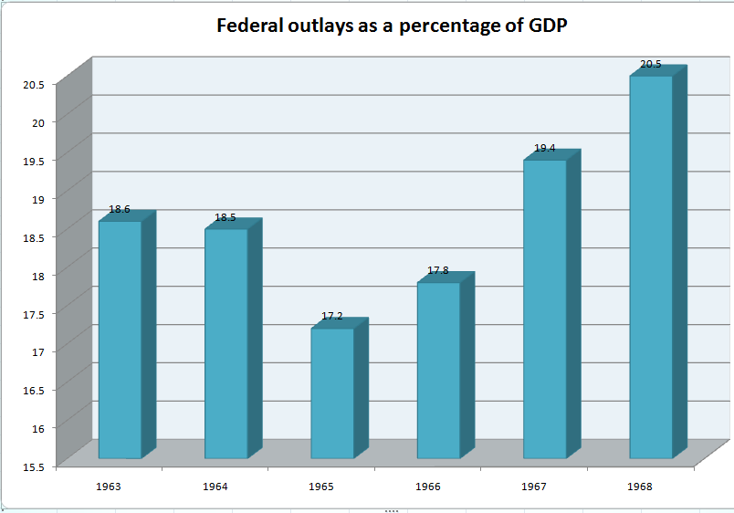

Slide 39
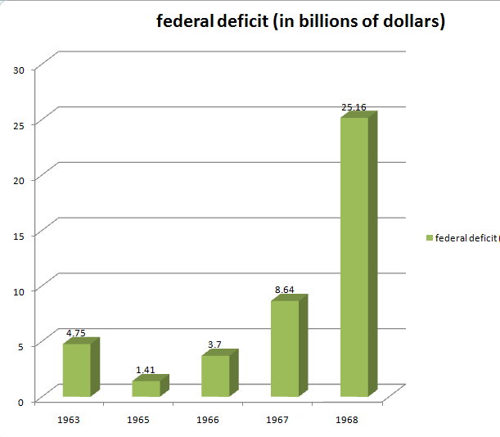

Slide 40
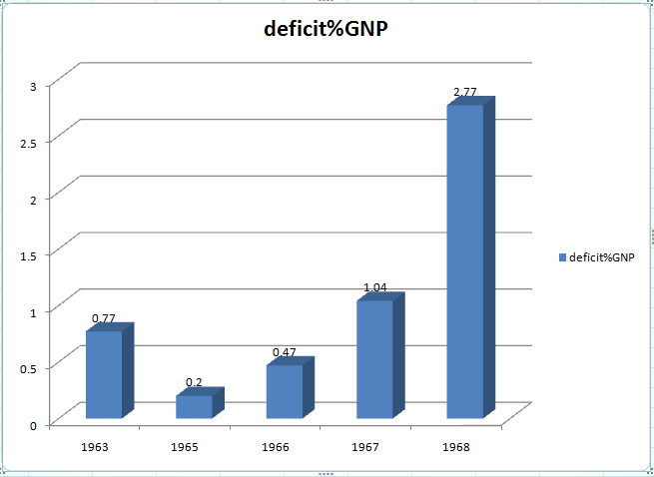

Slide 41
