Slide 1
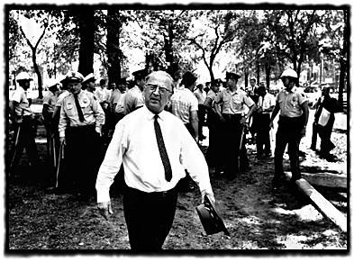

Slide 2


Slide 3


Slide 4
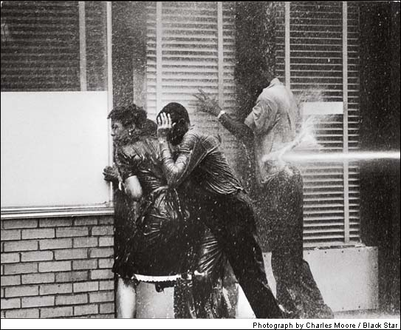

Slide 5
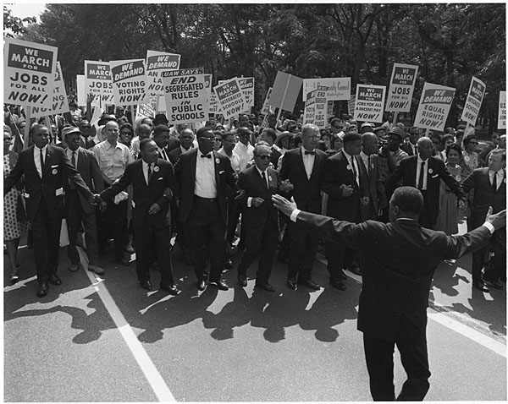

Slide 6


Slide 7
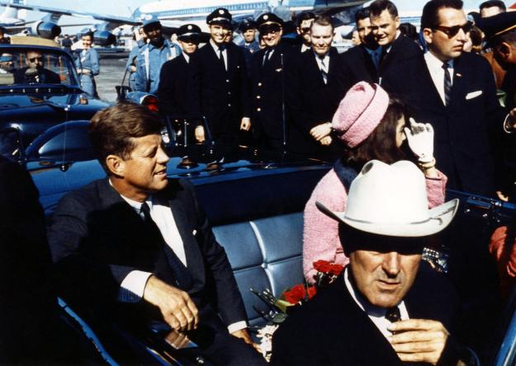

Slide 8
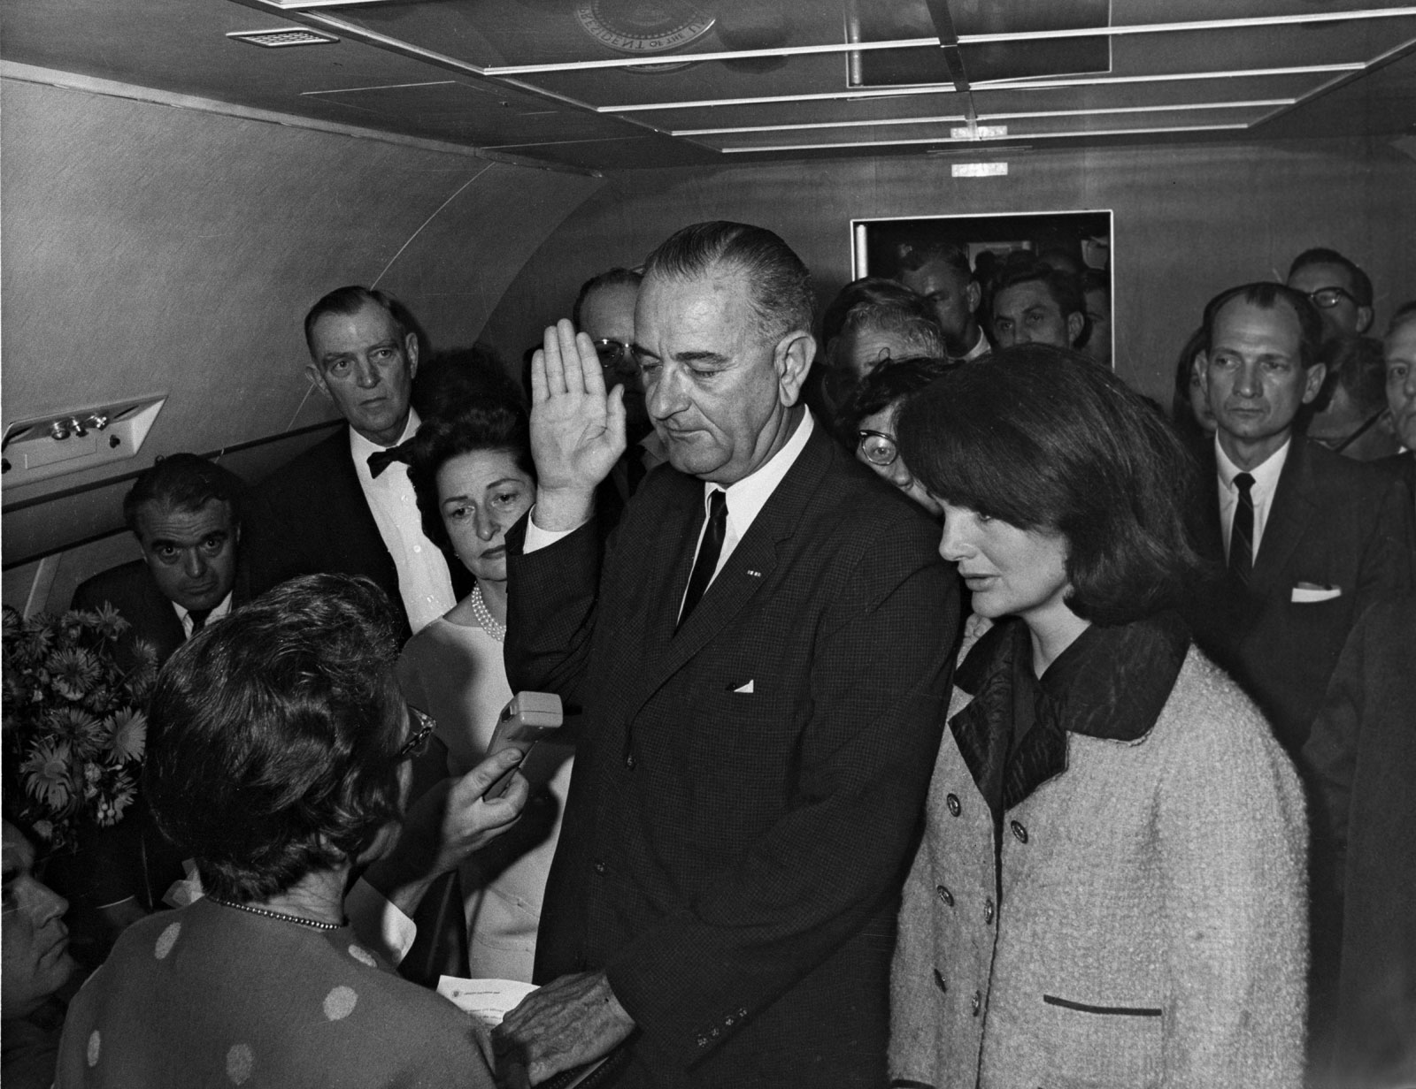

Slide 9


Slide 10
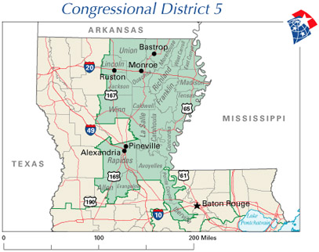

Slide 11
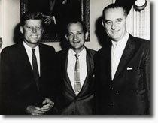

Slide 12

President Johnson: You want to know honestly how I feel?
Jack Brooks: Yeah.
President Johnson: I’m really humiliated that I’m President, and I’ve got a friendly Speaker, and I’ve got a friendly Majority Leader, and I’ve got a friendly [Texas Rep.] Albert Thomas, I’ve got a friendly Jack Brooks, and Otto Passman is king. I think that’s disgraceful in this country.
Because I want to tell you when I see you the next time—confidentially—
Brooks: Mm-hmm.
President Johnson: —what we’re looking at in the world. And it’s a hell of a lot worse than it was last year. And you’re giving us 3 billion [dollars] to deal with, and you gave Kennedy 3.9 [billion dollars].
And I don’t think that’s fair, and I don’t think it’s right. I think it’s awful that a goddamned Cajun from the hills of Louisiana has got more power—
Brooks: He’s no Frenchman, though!
President Johnson: —has got more power than all of us. I just think that’s awful.
Brooks: Yes.
President Johnson: But that’s what you’ve got to do. And some day we’ll get our way, and if I ever walk up in the cold of night and a rattlesnake’s out there and about ready to get him, I ain’t going to pull him off—I’ll tell you that.
Brooks: No, I understand.
President Johnson: Now, you remember that.
Brooks: I want you to remember it. We’ve got some people from—
President Johnson: I remember it. Now, you just go and tell all these Texans that want to hit Russia that I want to put those sons of bitches in uniform.
Brooks: They ought to be.
President Johnson: Let ‘em go fight the Communists for a while. They like to talk a big game—
Brooks: Yeah.
President Johnson: —but they don’t want to do a damn thing about it.
Brooks: I’m with you.
President Johnson: OK.
Brooks: Good night. Bless your heart.

Slide 13
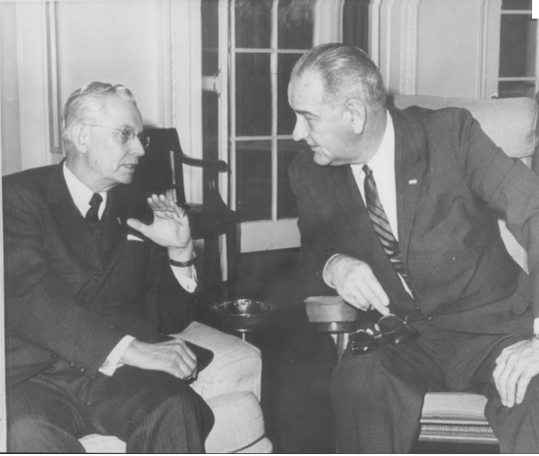
Notes:
Lbj and robert anderson

Slide 14
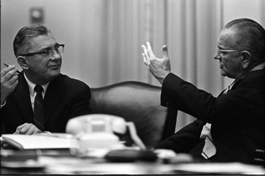

Slide 15
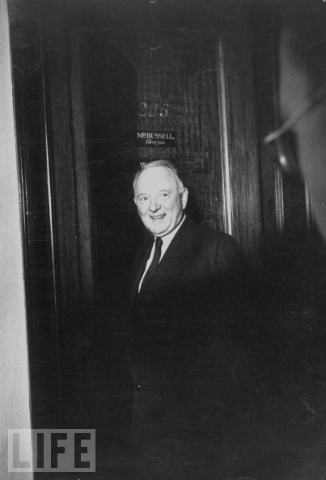
Notes:
Harry byrd

Slide 16
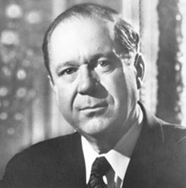

Slide 17
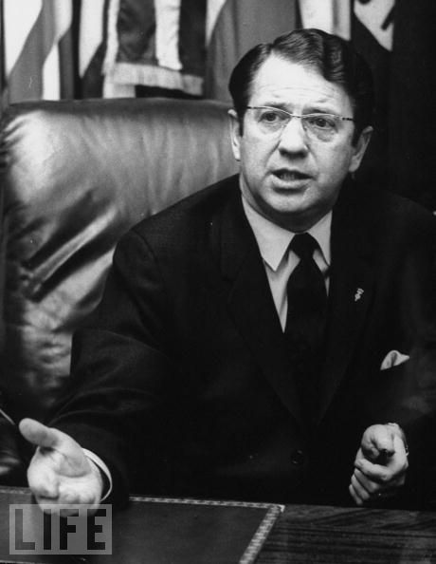

Slide 18
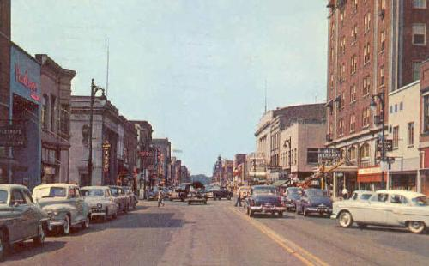
Notes:
Elkhart—once had 60 instruments manufacturers

Slide 19
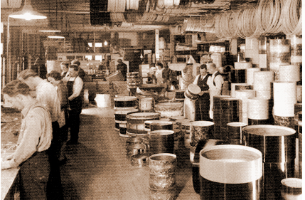
Notes:
Conn selmer

Slide 20
President Johnson: Vance?
Vance Hartke: Yes, sir.
President Johnson: Can’t you help me on this excise tax thing? You’re going to wreck this damn bill. We’re not going to have any. They’re going to get together this afternoon and try to make a motion to keep all excise taxes in there, and we need your help.
Hartke: [searching for words] Well, I mean, I suppose that way started out—
President Johnson: I know it. And [New Mexico senator] Clint Anderson, though, they all got mad yesterday because you-all screwed up that oil vote.
And they’re after the oil companies, and [Delaware senator John] Williams and everything else. Those big oil companies oughtn’t to be raising hell [for] 40 million. They got off with 400 million [in tax breaks], and they ought to let you-all off the hook.
But now we’ve got it in a big screwed-up mess, and we—all of us are going down in defeat if we can’t operate any better than that. There’s no leadership in the committee.
President Johnson: So for God’s sake, get in there. Clint Anderson says he’ll change, and you change, and get two or three more and let’s . . .
Hartke: The one big thing in there, the one thing I wanted, was [to cut the tax on] musical instruments.
President Johnson: Oh, well—
Hartke: This is—
President Johnson: What’s important is the big credit to the Democratic Party, and let’s go on.
The goddamned band and musical instruments—they won’t be talking about it next November.
Hartke: They will in Elkhart—
President Johnson: What they’re going to be judging us by is: they’re going to be judging us whether we passed the tax bill or not and whether we’ve got prosperity.

Slide 21
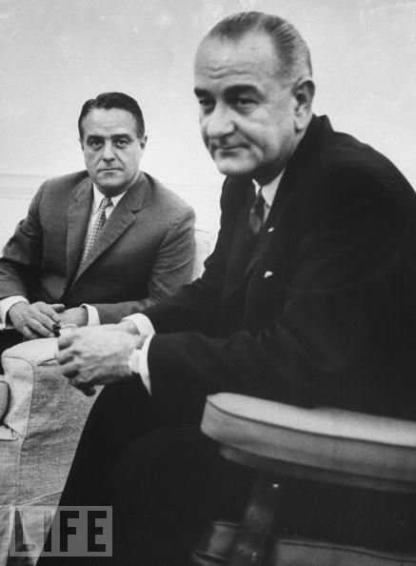

Slide 22
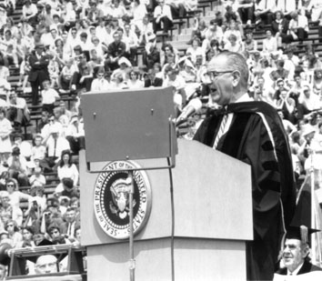

Slide 23
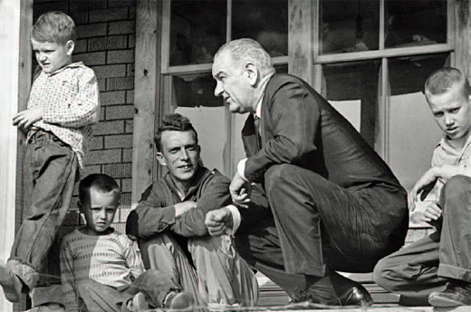
Notes:
Ap64—no electricity running water

Slide 24
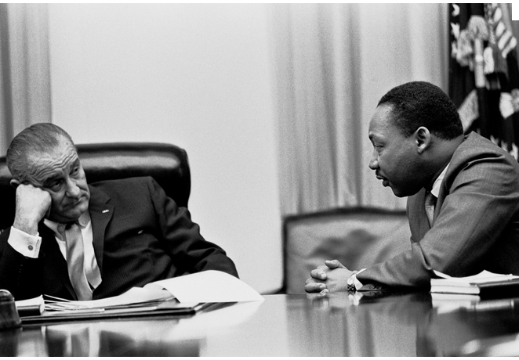

Slide 25
Economic Opportunity Act (1964)
VISTA (Volunteers In Service To America)
Job Corps
Head Start
Legal Services
Various local anti-poverty programs & targeted medical programs
Community Action Programs
“provides services, assistance, and other activities of sufficient scope and size to give promise of progress toward elimination of poverty or a cause or causes of poverty through developing employment opportunities, improving human performance, motivation, and productivity, or bettering the conditions under which people live, learn, and work.

Slide 26
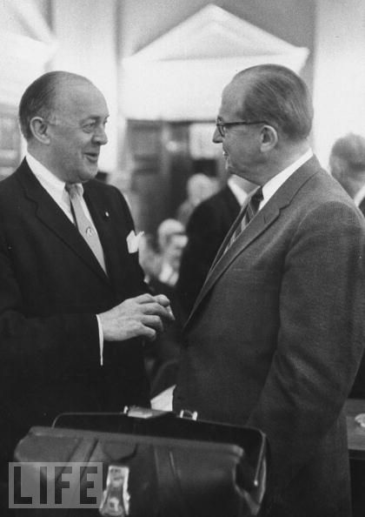

Slide 27
President Johnson: And I think that we’ve just got to sit down with our Northerners and tell them, “Now, goddamnit, you’re going to have poverty [legislation], and you’ve had accelerated public works, and you’ve had slum clearance, and you’ve had urban renewal, and you’ve had these things that we helped you on, and we’ve have passed all the labor things you want—manpower retraining.” [For] the Negroes—we’ve spent a lot of time on civil rights, for your area/districts.
Now, for God’s sakes, let us get some votes in the South and Midwest, so we can have the control.
Larry O’Brien: Yeah.
President Johnson: Just let us control this Congress by getting some votes in the South and Midwest. Now, we don’t want to keep on electing Republican-Democrats from Florida, from Texas, and these other states, and we don’t want to elect all-Republican delegations from the Midwest.
Larry O’Brien: Yeah.

Slide 28
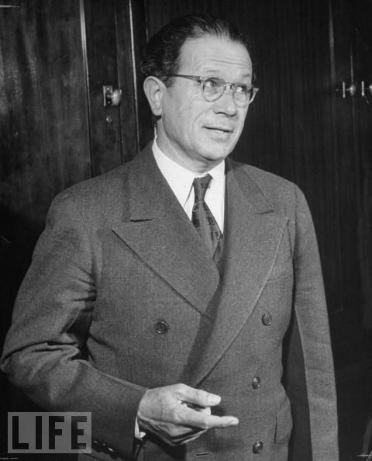

Slide 29
President Johnson: Now, you go on and get me some kind of a farm bill. I don’t want to know the detail—
Allen Ellender: I’m going to get you—
President Johnson: But you and [Agriculture Secretary] Orville Freeman get together; if you and Freeman can’t . . .
You see, this is an election year, and Democrats are up. If we don’t have a farm bill, they’re going to catch hell. Now, don’t—
Ellender: I’m going to get—
President Johnson: You and Freeman get—you and Freeman get together, and you-all agree on something, because he thinks you’re a good man—
Ellender: All right.
President Johnson: And you think he’s a good man—
Ellender: All right.
President Johnson: And damn it, you can agree. Both of you give a little bit—
Ellender: All right.
President Johnson: —and go on and get something!

Slide 30
Title II—Public Accommodations
Outlawed discrimination in hotels, motels, restaurants, theaters, and all other public accommodations engaged in interstate commerce; exempted private clubs without defining "private," thereby allowing a loophole.
Title VI—Nondiscrimination in Federally Assisted Programs
Authorized but did not require withdrawal of federal funds from programs which practiced discrimination.
Title VII—Equal Employment Opportunity
Outlawed discrimination [on basis of gender as well as race] in employment in any business exceeding twenty five people and creates an Equal Employment Opportunities Commission to review complaints, although it lacked meaningful enforcement powers.

Slide 31
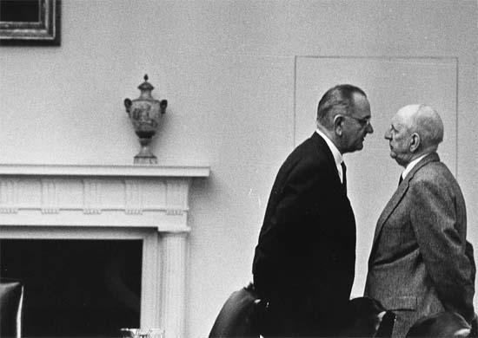

Slide 32
President Johnson: You oughtn’t to hold up my poverty bill. That’s a good bill and there’s no reason why you ought to keep the majority from [considering] it. If you can beat it, go on and beat it. But you oughtn’t to hold it up. You ought to give me a fait shake and give me a chance to vote on it. I’ve got it in my budget. I’ve cut my budget a billion under last year—
Halleck: Wait a minute; let me talk to you just a minute. You want the civil rights bill through; you wanted the tax bill through. And I helped you do it. And god damn it, did I help you on civil rights?
President Johnson: Yeah, you sure did. You helped [President] Kennedy, you agreed with—
Halleck: Oh, for Christ’s sake, I helped Kennedy and I’ve helped you.
President Johnson: That’s right.
Halleck: Now wait just a minute, my friend . . .
President Johnson: And you helped yourself. Because y’all want civil rights as much as we do. I believe it’s a non-partisan bill. I don’t think it’s a Johnson bill.
Halleck: No, no, no. You’re going to get all the political advantage—
President Johnson: No, no—
Halleck: We aren’t going to get a goddamned thing—
President Johnson: No, no.
Halleck: Wait just a minute. Now, we got a lot of things in that bill, that I don’t know what the hell the Senate put in there. Maybe we ought to kind of take a little look at it.
President Johnson: Maybe you ought to, I’m not saying that you—
Halleck: Now, wait a minute, Mr. President. I’m just looking at it hard-boiled. And once in a while, I can get hard-boiled.
President Johnson: Well, you wouldn’t want to go to your convention without a civil rights bill, would you?
Halleck: You know as a matter of fact if you scratch me very deep, Mr. President . . .
President Johnson: I wouldn’t scratch you at all, because I want to pat you.
Halleck: Now, wait a minute. Wait just a minute. [Johnson chuckles.] If I had my way, I’d let you be fussing with that goddamned thing before your convention instead of ours. But I’m perfectly willing to give you the right to sign that thing on July 4.
Now, I think you’re taking advantage of an Independence Day thing that ain’t right, but that’s not for me to say.
President Johnson: I don’t know what you’re talking about.

Slide 33
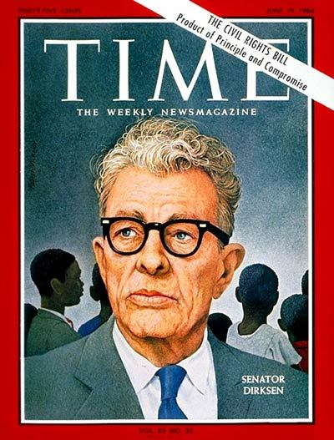

Slide 34
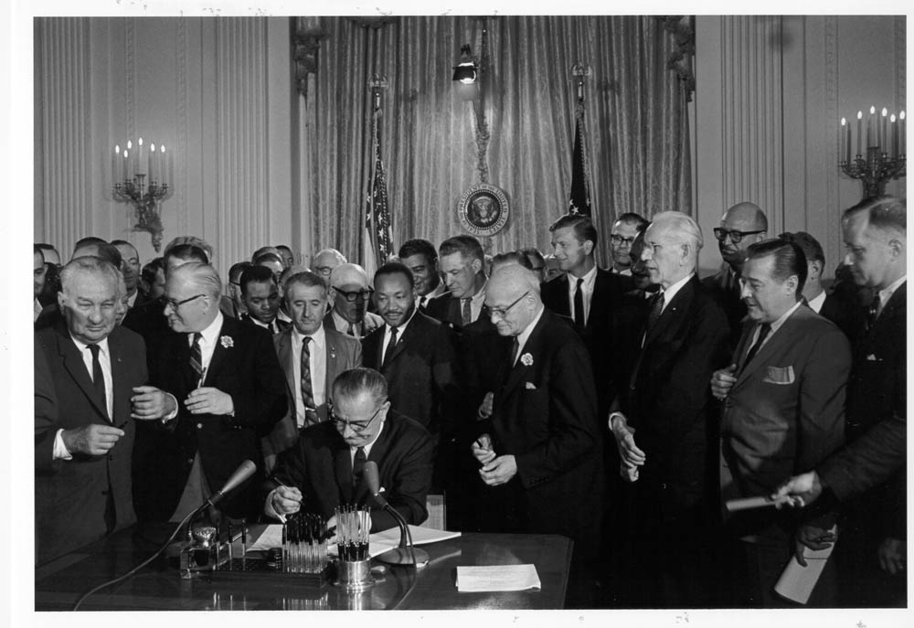

Slide 35
