Slide 1
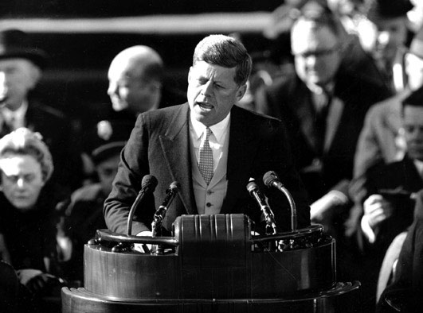
23199505891

Slide 2
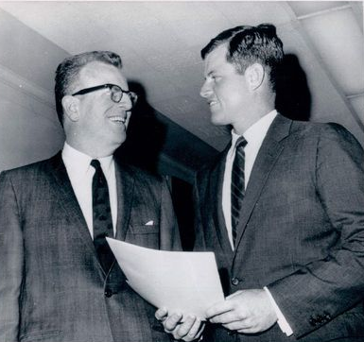

Slide 3
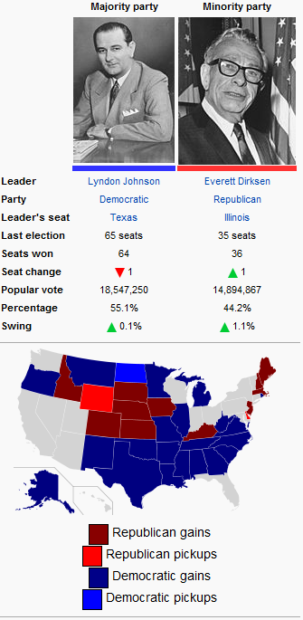
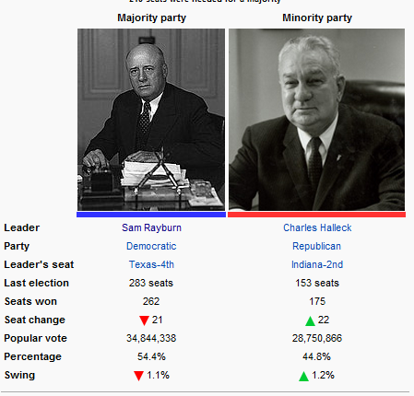

Slide 4
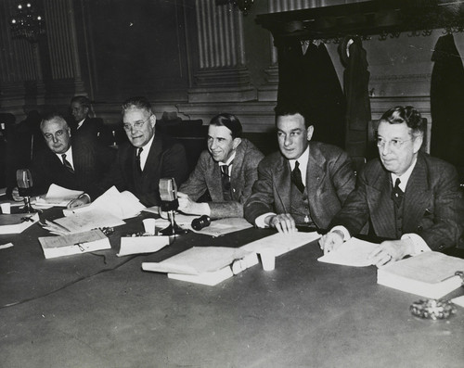

Slide 5
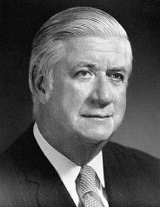
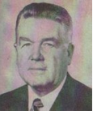

Slide 6
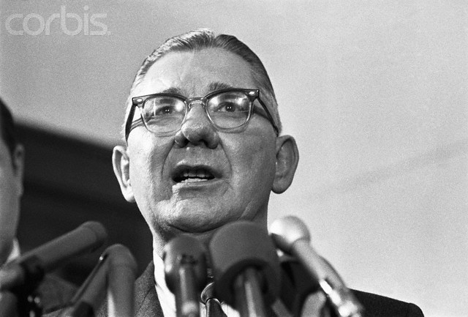

Slide 7
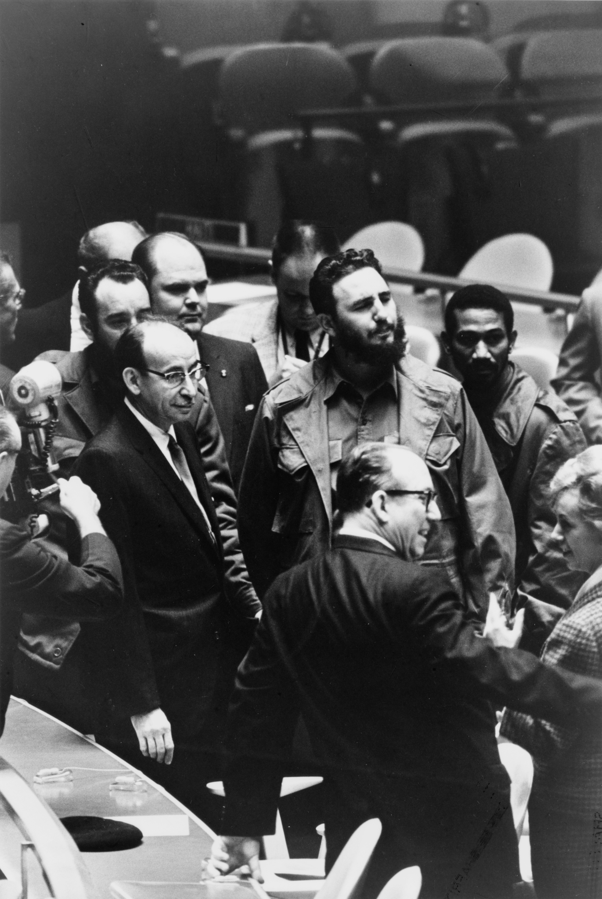

Slide 8
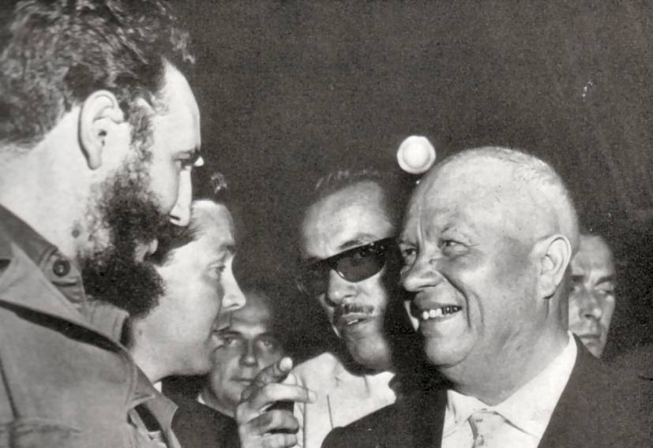

Slide 9


Slide 10


Slide 11
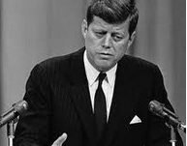

Slide 12
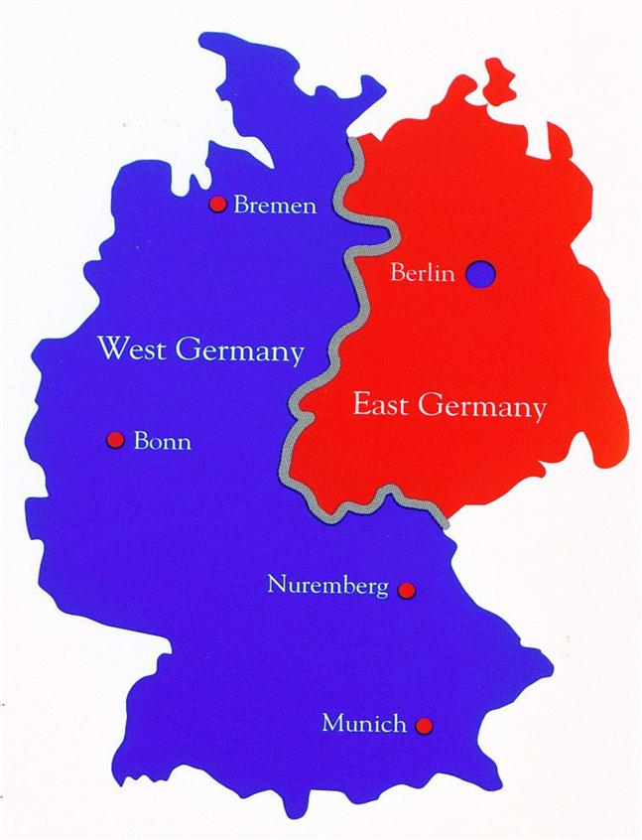

Slide 13
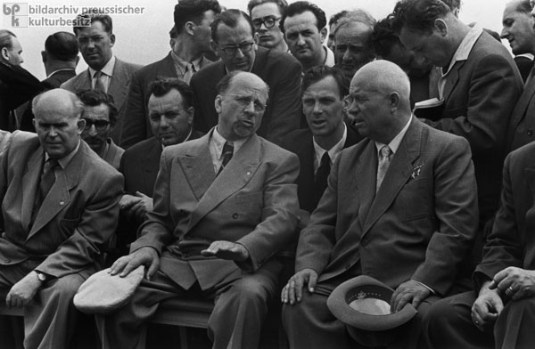

Slide 14
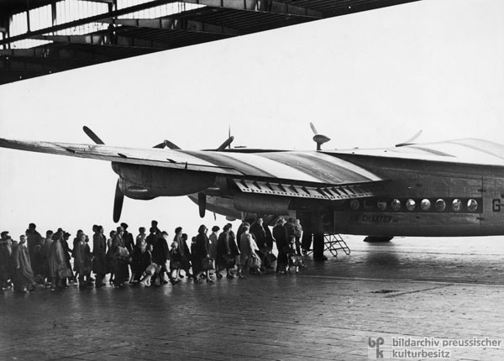

Slide 15
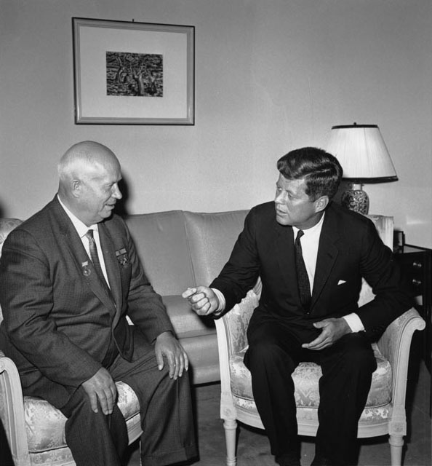

Slide 16
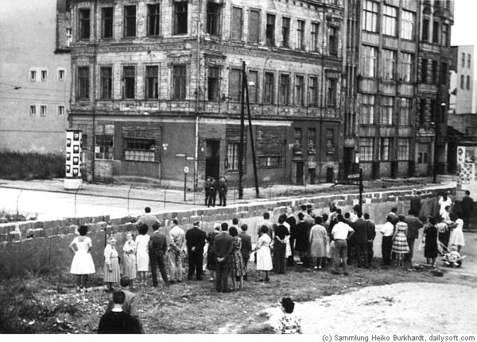

Slide 17


Slide 18
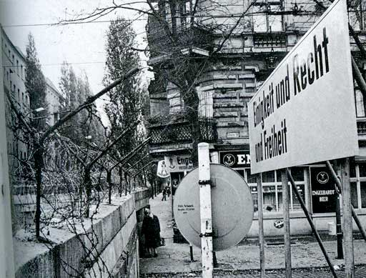

Slide 19
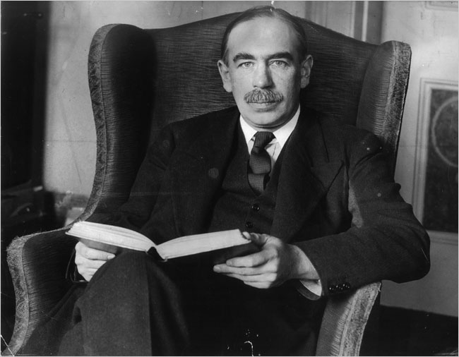

Slide 20
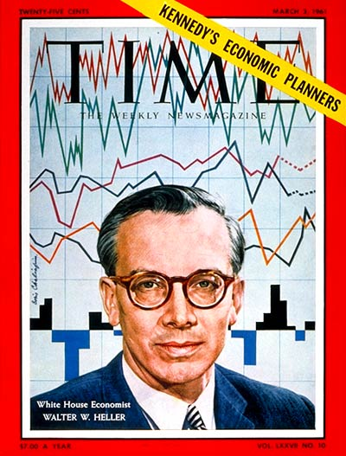

Slide 21
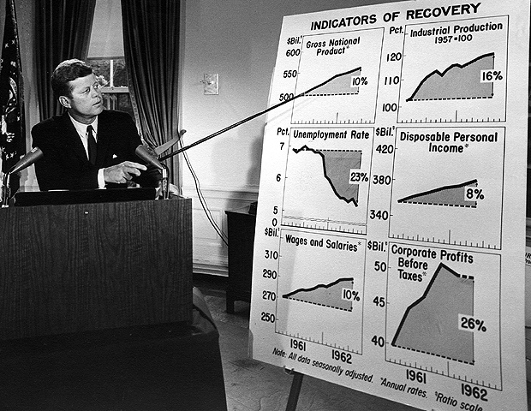

Slide 22
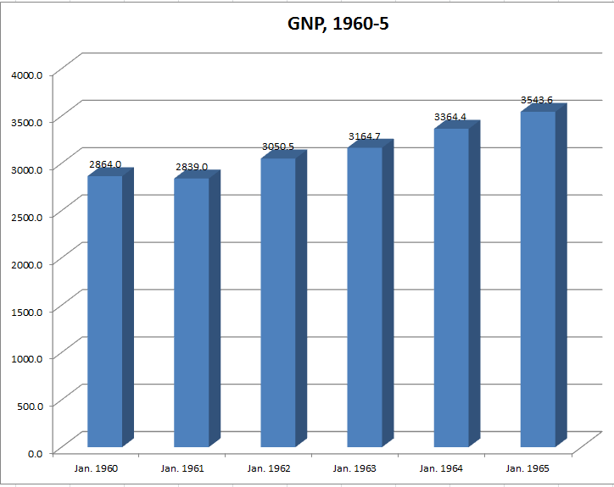

Slide 23
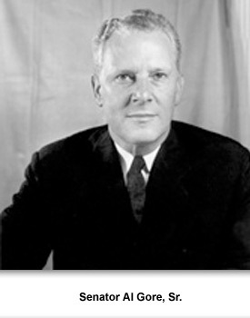

Slide 24
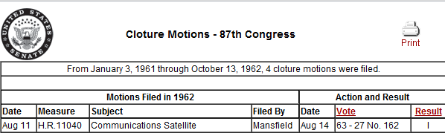

Slide 25
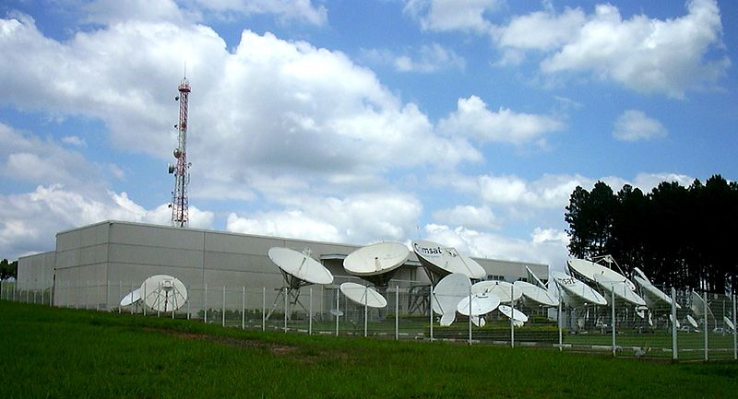

Slide 26

President Kennedy: Do you put this program [the lunar space program]—do you think this program is the top priority program of the agency?
NASA administrator James Webb: No, sir, I do not. I think it one of the top priority programs, but I think it’s very important to recognize here, that as you have found what you could do with a rocket, as you find how you could get out beyond the earth’s atmosphere and into space and make measurements, several scientific disciplines that are very powerful have beg[u]n to converge on this area.
President Kennedy: Jim, I think it is the top priority. I think we ought to have that very clear. If you—some of these other programs can slip six months or nine months and nothing particularly is going to happen that’s going to make… But this is important for political reasons, international political reasons, and for . . . This is, whether we like it or not, in a sense a race. If we get second up to the moon, it’s nice but it’s like being second anytime, so that I—and it we’re second by six months, because we didn’t give it the kind of priority, then of course that would be very serious.
So I think we have to take the view this is the top priority of it. It certainly is mine.
Webb: But the environment of space is where you’re going to operate the Apollo and where you’re going to do the landing.
President Kennedy: No, but I know all these other things, and the satellite—the communications and weather and all—they’re desirable, but they can wait.

Slide 27


Slide 28


Slide 29


Slide 30
Curtis LeMay: There’s one other factor that I didn’t mention that’s not quite in our field. But you invited us to comment on this at one time. And that is that we have had a talk about Cuba and the SAM [surface-to-air-missile] sites down there. And you have made some pretty strong statements about their being defensive, and that we would take action against offensive weapons.
I think that a blockade and political talk would be considered by a lot of our friends and neutrals as being a pretty weak response to this. And I’m sure a lot of our own citizens would feel that way, too.
In other words: you’re in a pretty bad fix at the present time.
President Kennedy: What did you say?
LeMay: You’re in a pretty bad fix.
President Kennedy: You’re in there with me. [Slight laughter.] Personally.

Slide 31
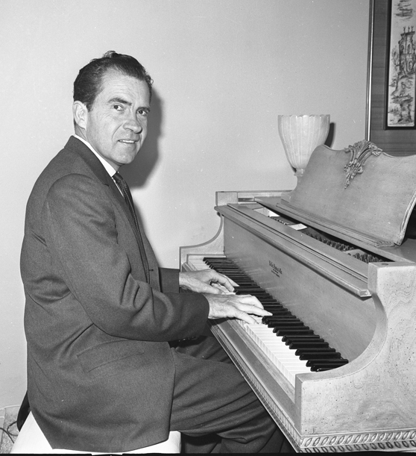

Slide 32
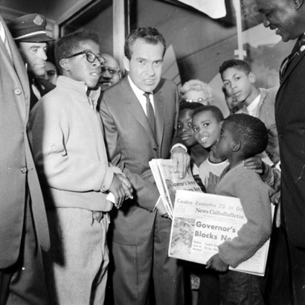

Slide 33
President Kennedy: . . . do it in 1960. Hell, I’d gotten them all in shape, so that . . . [Needle skips.] Huh?
Governor Pat Brown: Well, let me just tell you this—
President Kennedy: I’ll tell you this—you just reduced him to the nut house.
Brown: Listen: you gave me instructions and I follow your orders! [Unclear.]
President Kennedy: [chuckling] I understand. But God, that last farewell speech of his . . .
Brown: Wasn’t that terrible?
President Kennedy: Well, no, but it shows . . . [Needle skips.] What’s going to happen out there?
Brown: I don’t see how he can ever recover. [He lost] the leaders.
President Kennedy: Yeah.
Brown: [Former senator] Goodwin Knight walked out on him; [California conservative leader] Joe Shell told me he walked out on him.
This is a peculiar fellow. I really think he’s psychotic. He’s an able man, but he’s nuts.
President Kennedy: Yeah.
Brown: Like a lot of these paranoics. But . . .

Slide 34
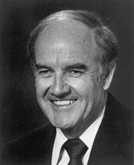
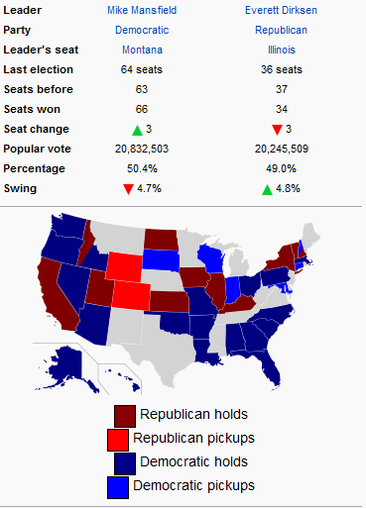
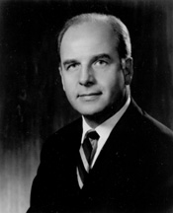
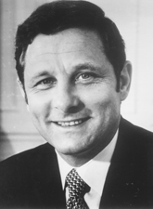

Slide 35
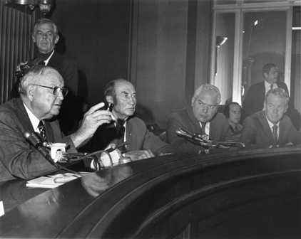

Slide 36
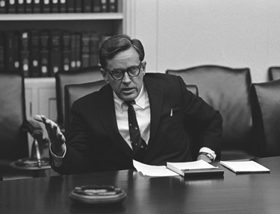
Notes:
Burke marshall

Slide 37
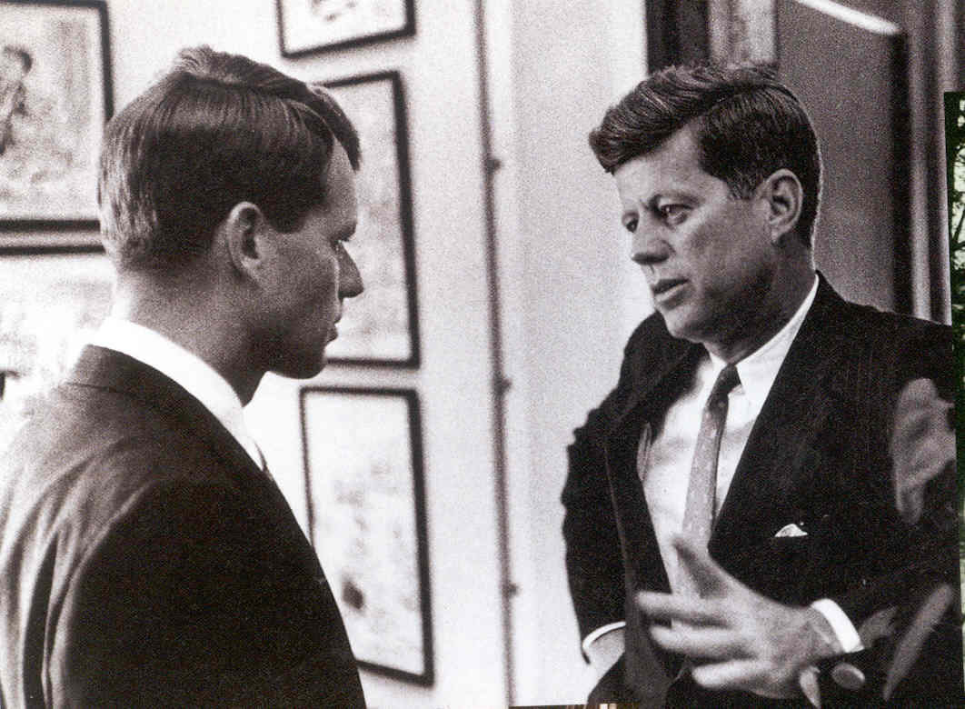

Slide 38
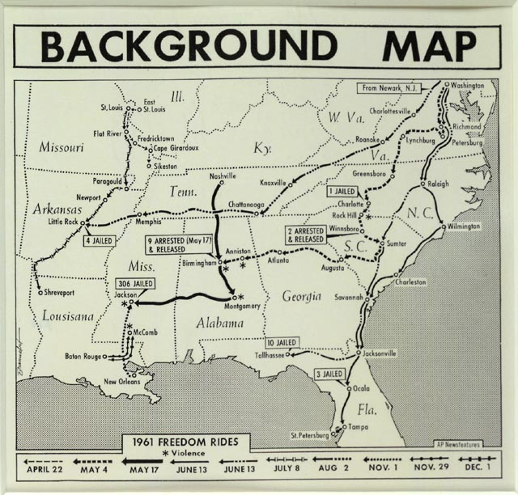

Slide 39
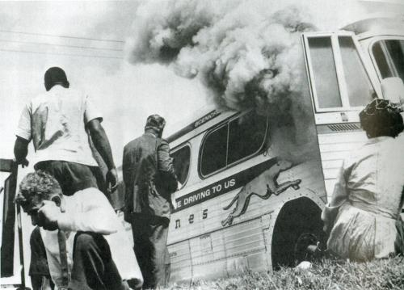

Slide 40


Slide 41


Slide 42


Slide 43


Slide 44
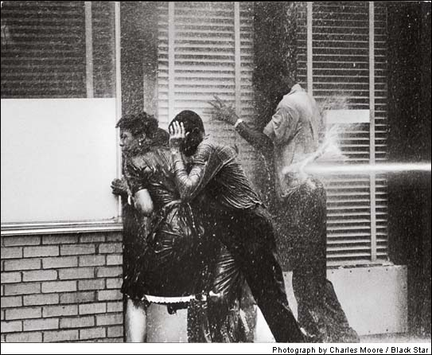

Slide 45


