Slide 1
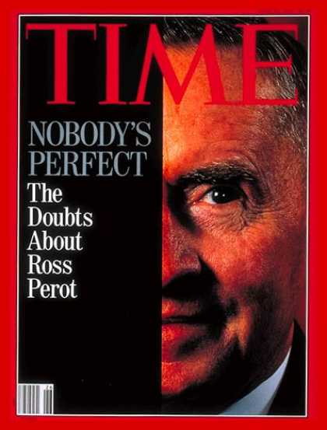

Slide 2
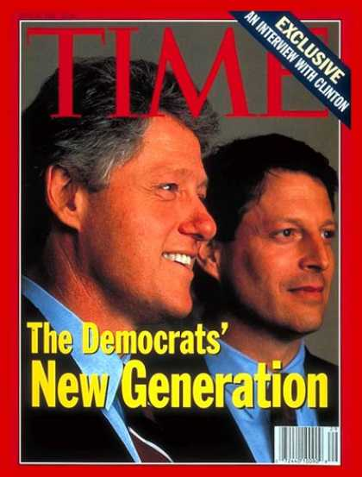

Slide 3
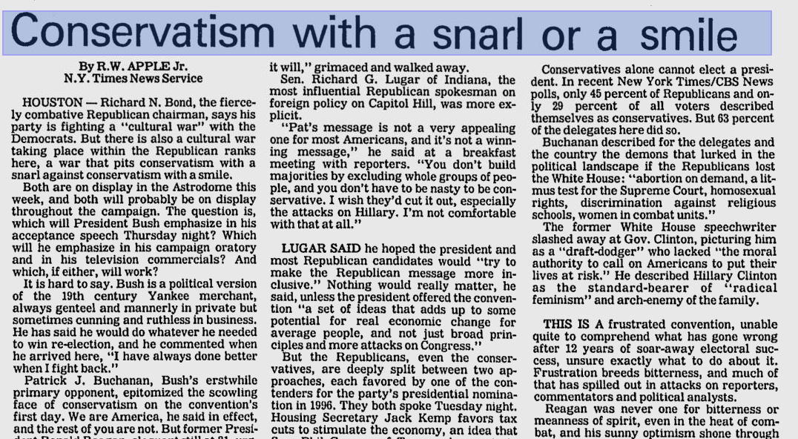

Slide 4
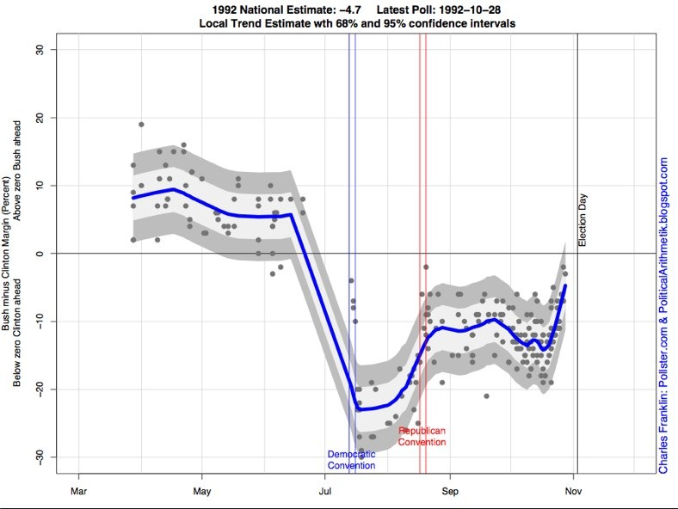

Slide 5
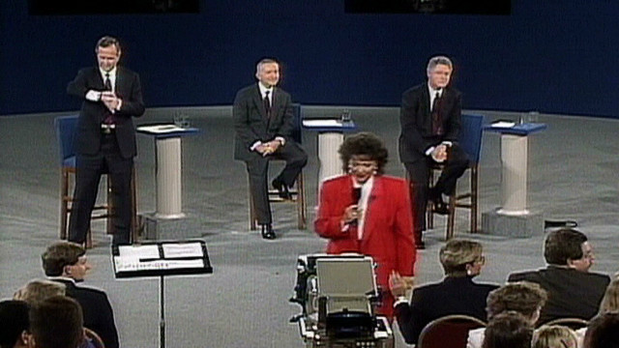

Slide 6


Slide 7
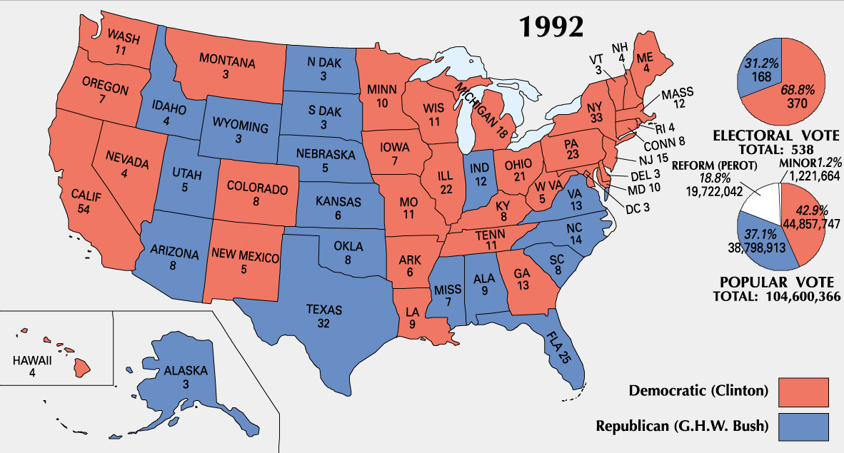

Slide 8
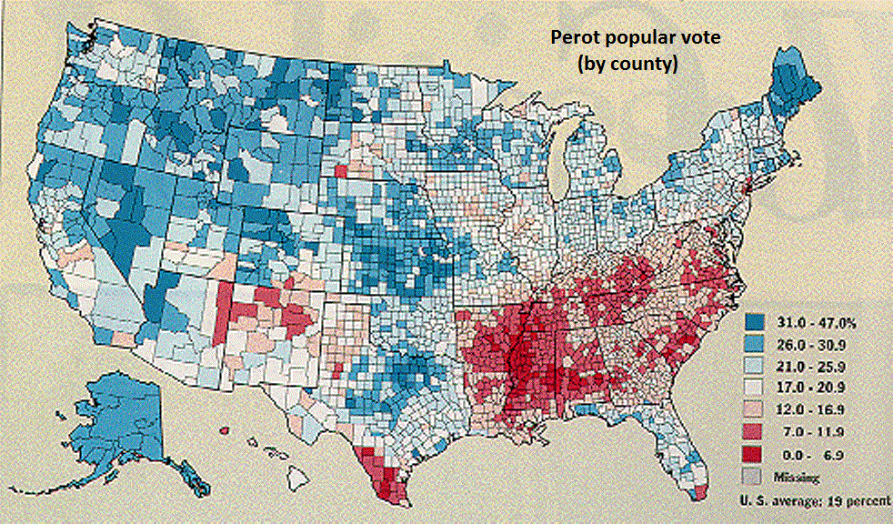

Slide 9
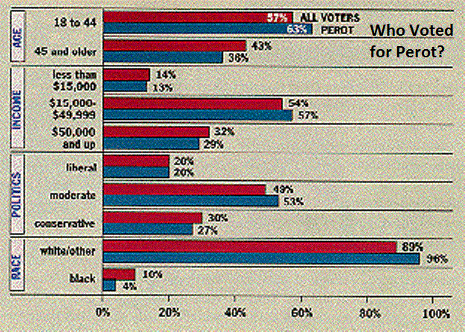

Slide 10


Slide 11
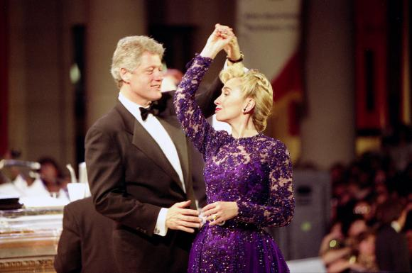

Slide 12
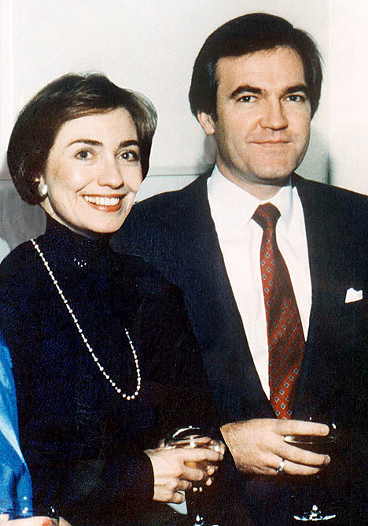

Slide 13
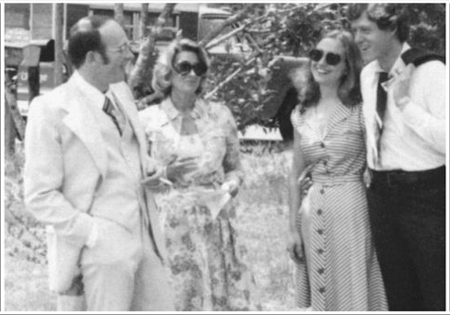

Slide 14
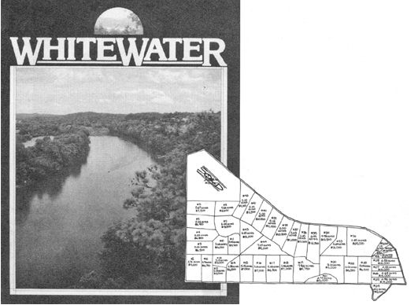

Slide 15
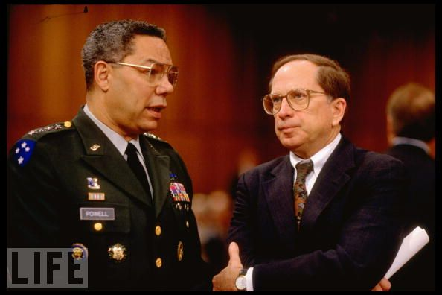

Slide 16


Slide 17
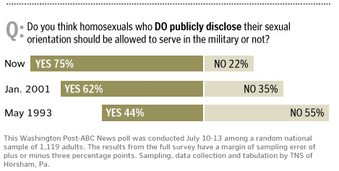
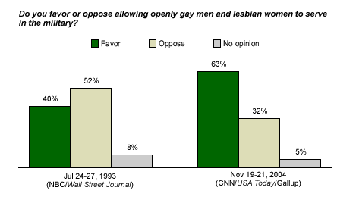

Slide 18
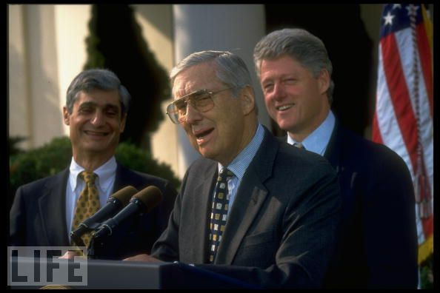

Slide 19
1993 Clinton budget
--raised rates on wealthiest (1.2% of population) to 36% and 39.6%
--raised gas tax by 4.3 cents/gallon
--expanded Earned Income Tax Credit (income tax reduction for working poor)
--raised tax rate for corporations
--expanded tax allowances for wealthier Social Security & Medicare recipients
Passes House 218-216
Passes Senate 50-50 (VP Gore casts tie-breaking vote)

Slide 20


Slide 21
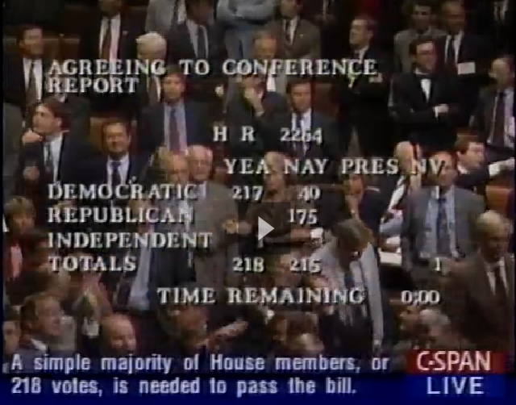

Slide 22


Slide 23
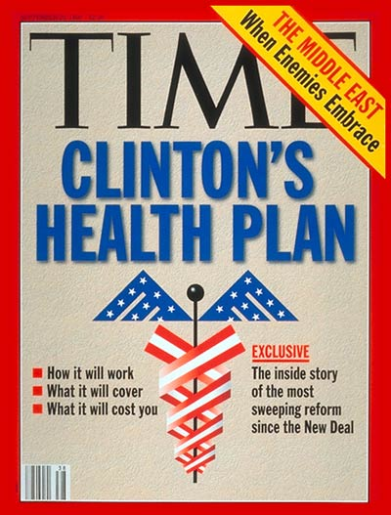

Slide 24


Slide 25
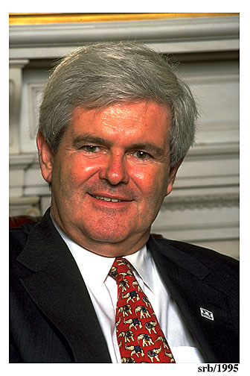

Slide 26


Slide 27
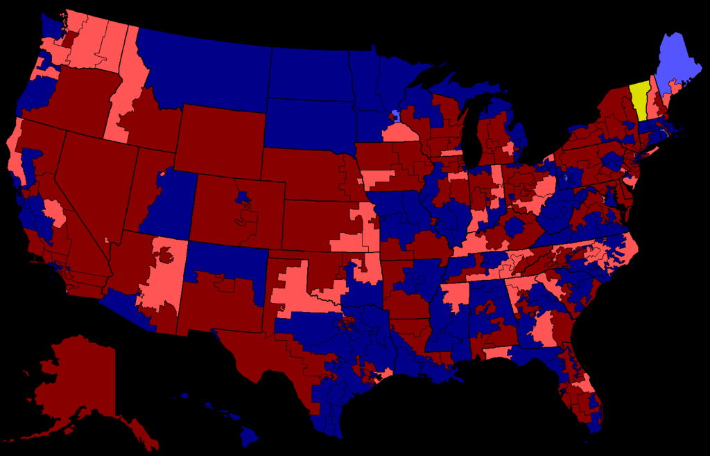
1994 House Elections

Slide 28
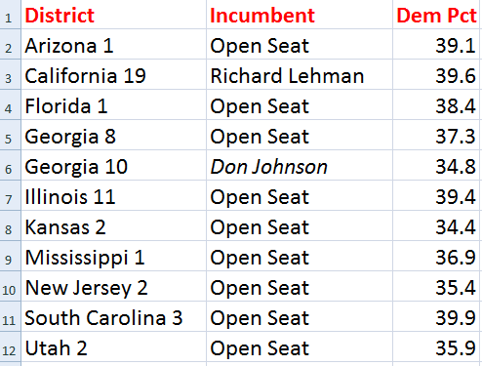
Democratic Losses, 1994, <40%

Slide 29
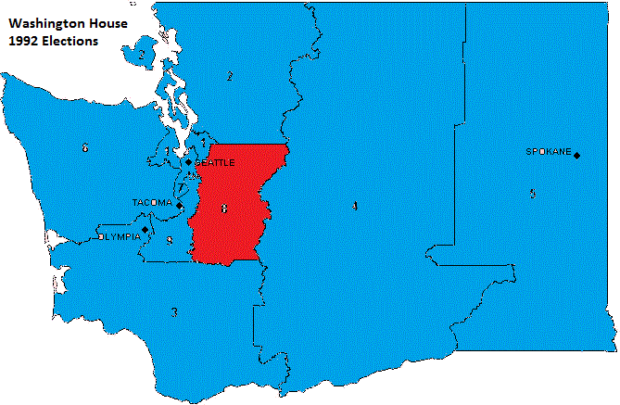

Slide 30
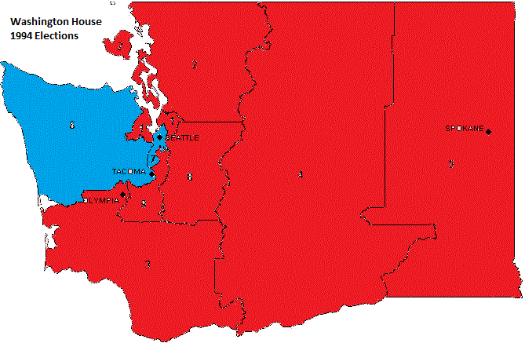

Slide 31
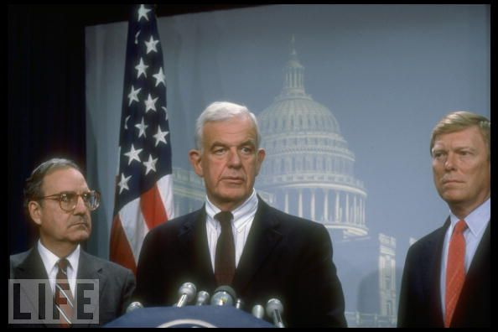

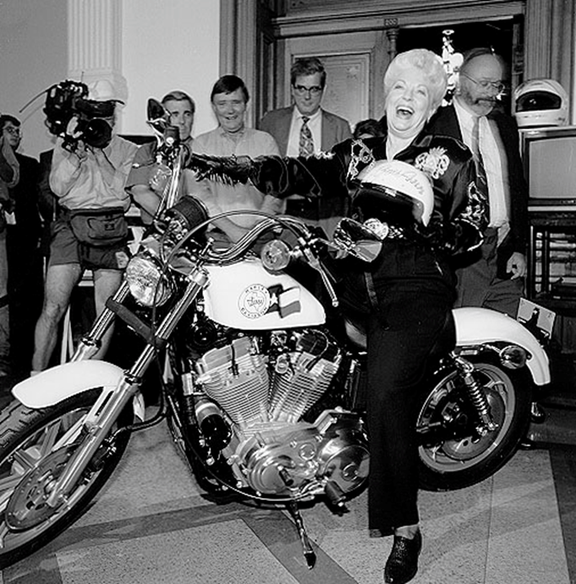

Slide 32
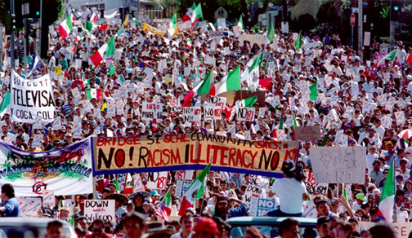

Slide 33


Slide 34
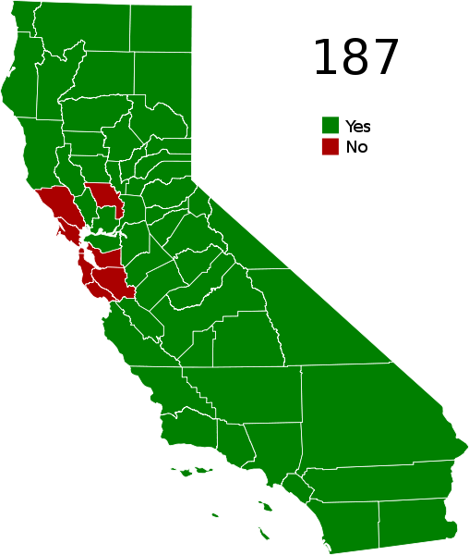

Slide 35
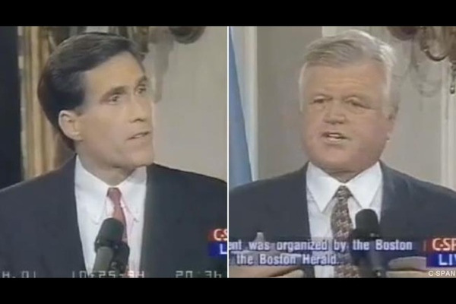

Slide 36
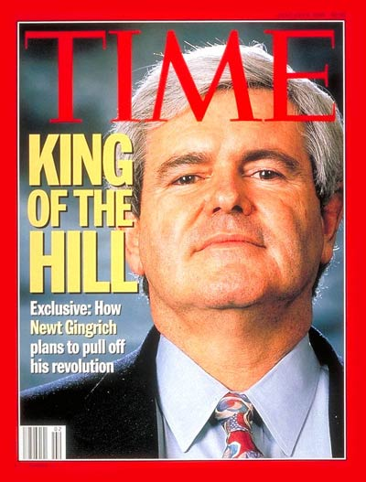

Slide 37
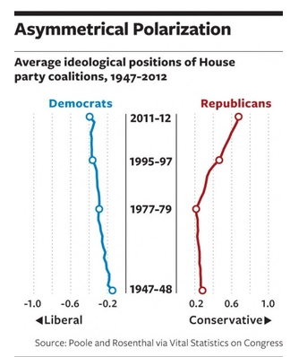

Slide 38


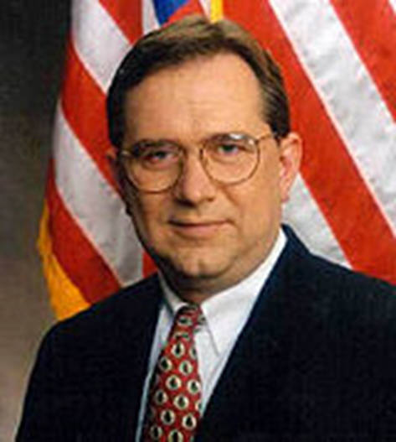

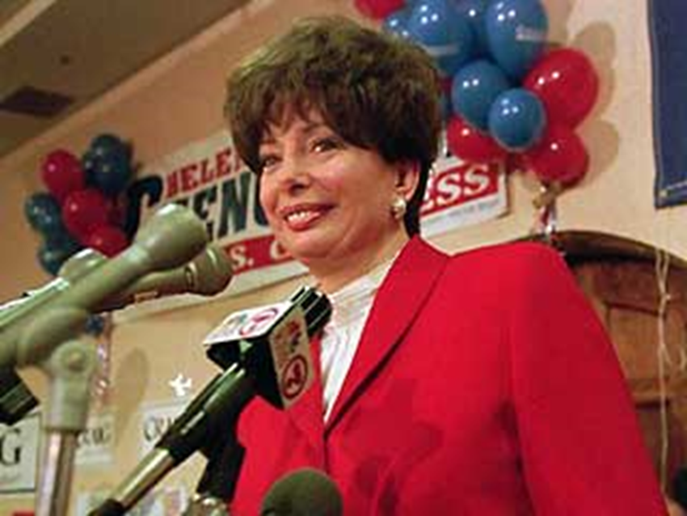

Slide 39

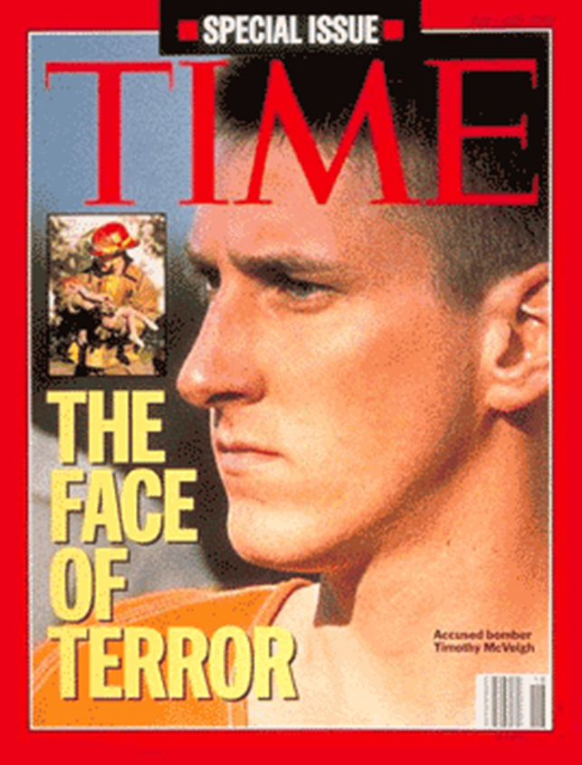

Slide 40


Slide 41
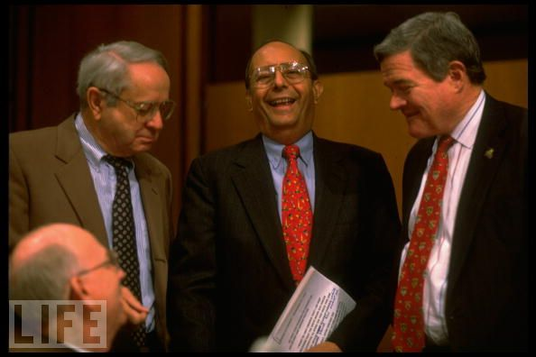

Slide 42
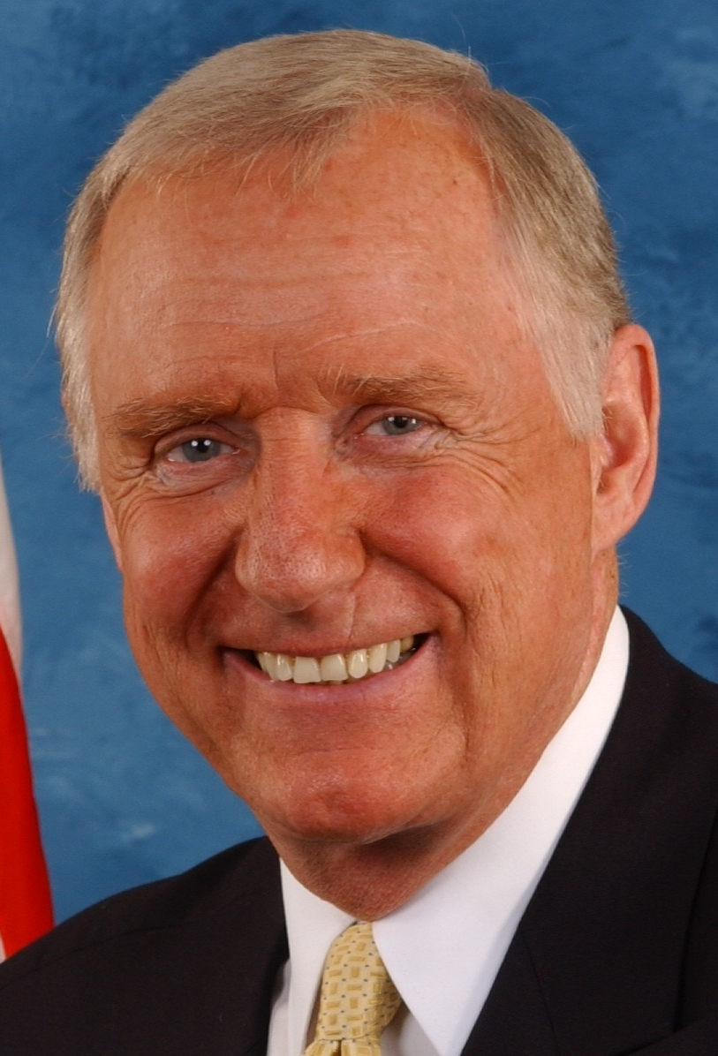

Slide 43
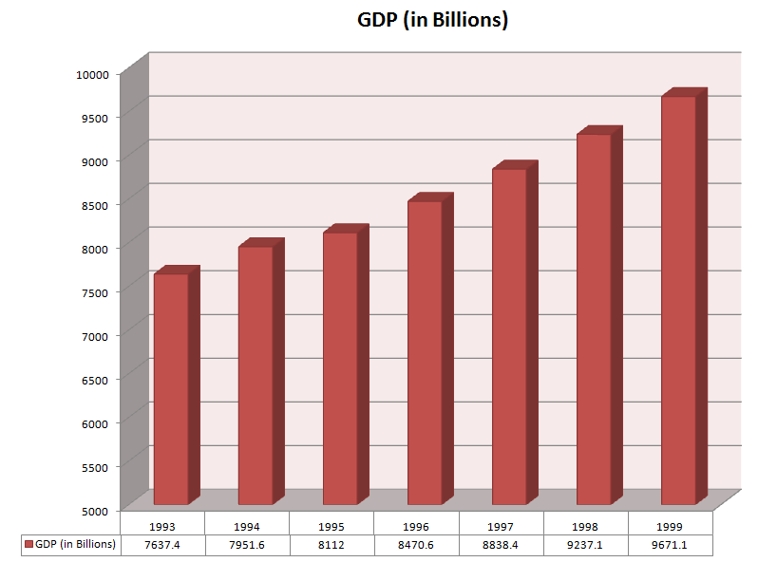

Slide 44
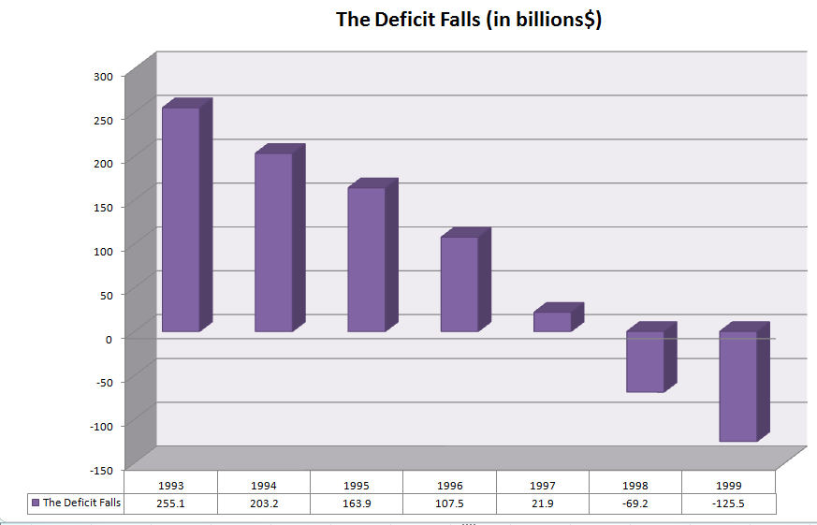

Slide 45
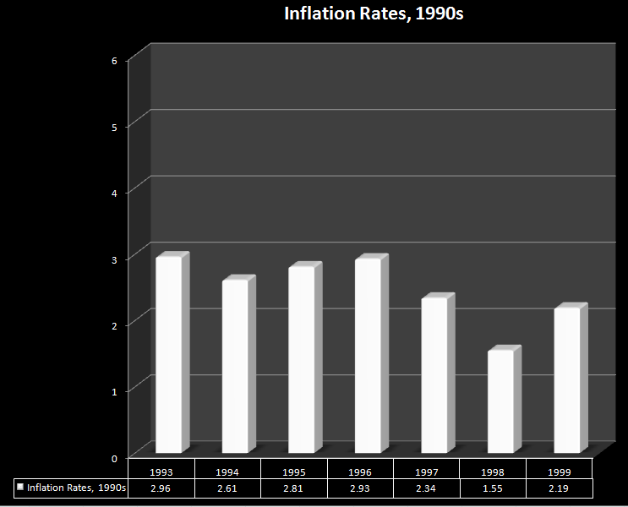

Slide 46
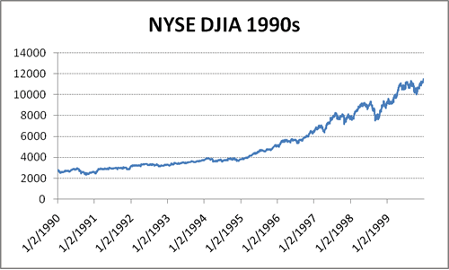

Slide 47


Slide 48
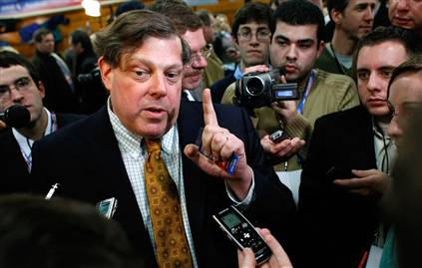

Slide 49

Defense of Marriage Act (1996)
Section 3. Definition of marriage
In determining the meaning of any Act of Congress, or of any ruling, regulation, or interpretation of the various administrative bureaus and agencies of the United States, the word 'marriage' means only a legal union between one man and one woman as husband and wife, and the word 'spouse' refers only to a person of the opposite sex who is a husband or a wife.

Slide 50
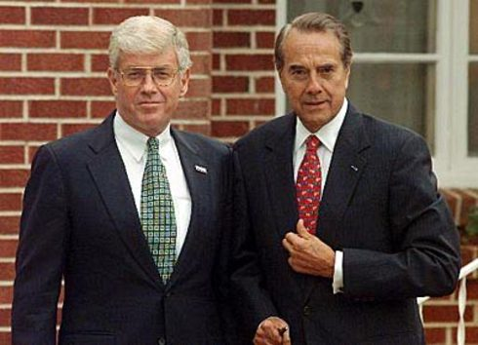

Slide 51
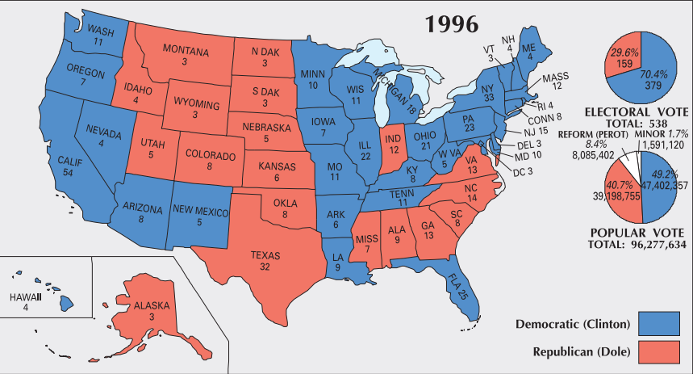

Slide 52
