Slide 1


Slide 2
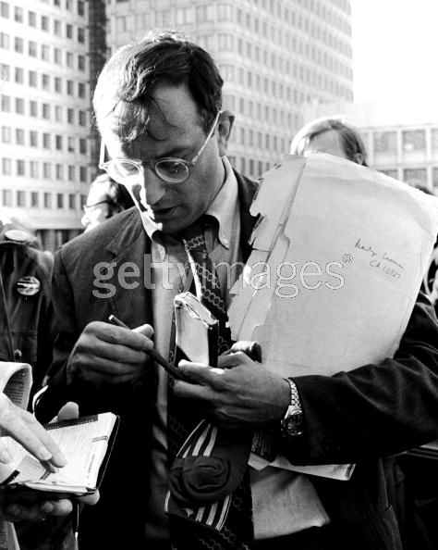

Slide 3
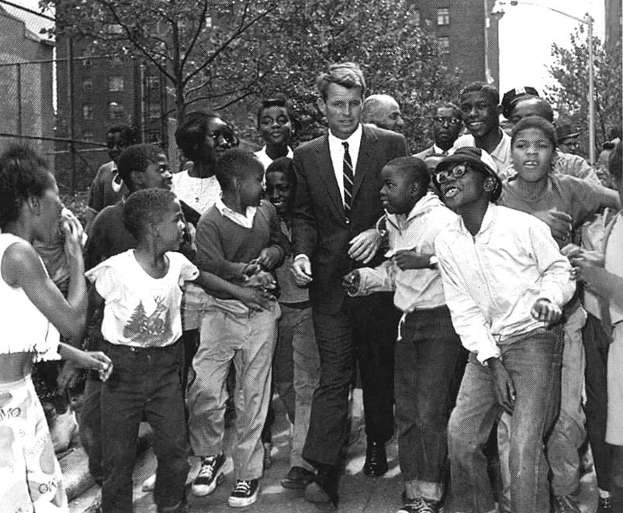

Slide 4
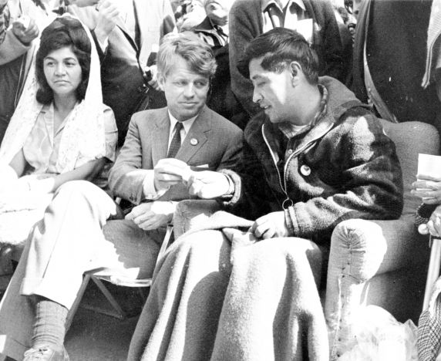

Slide 5
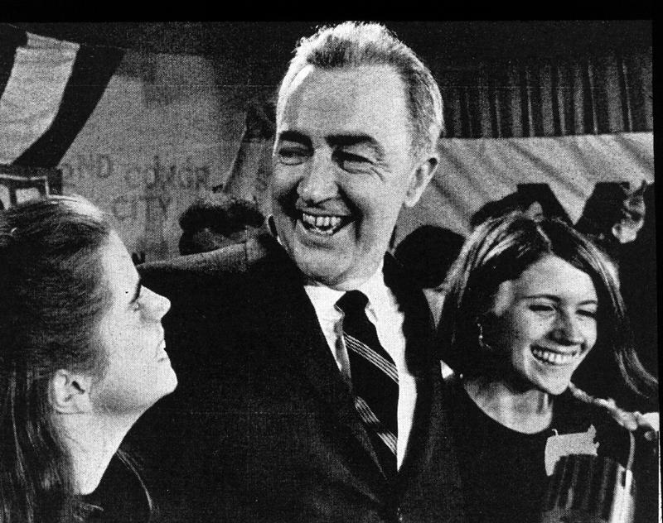

Slide 6
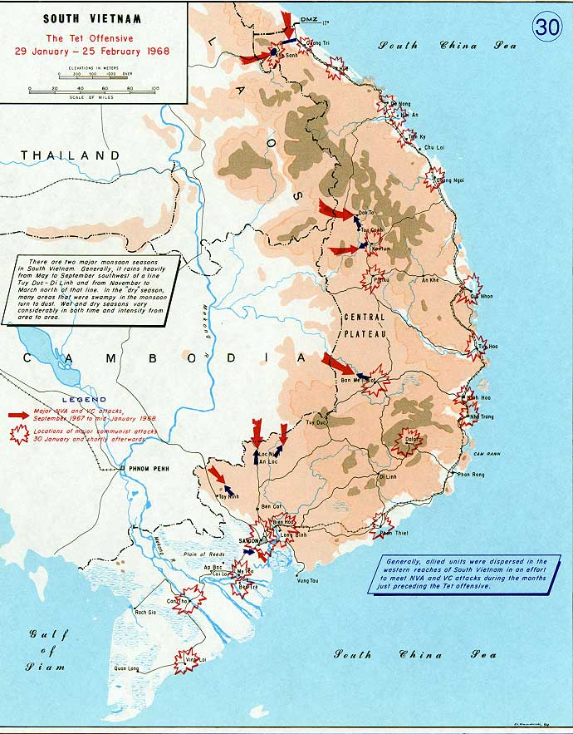

Slide 7
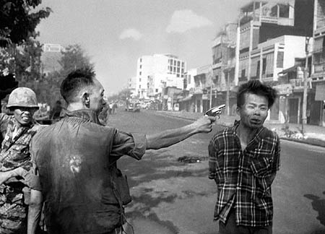

Slide 8
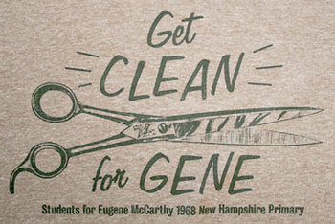

Slide 9
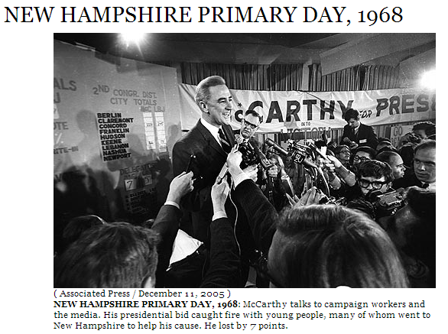

Slide 10
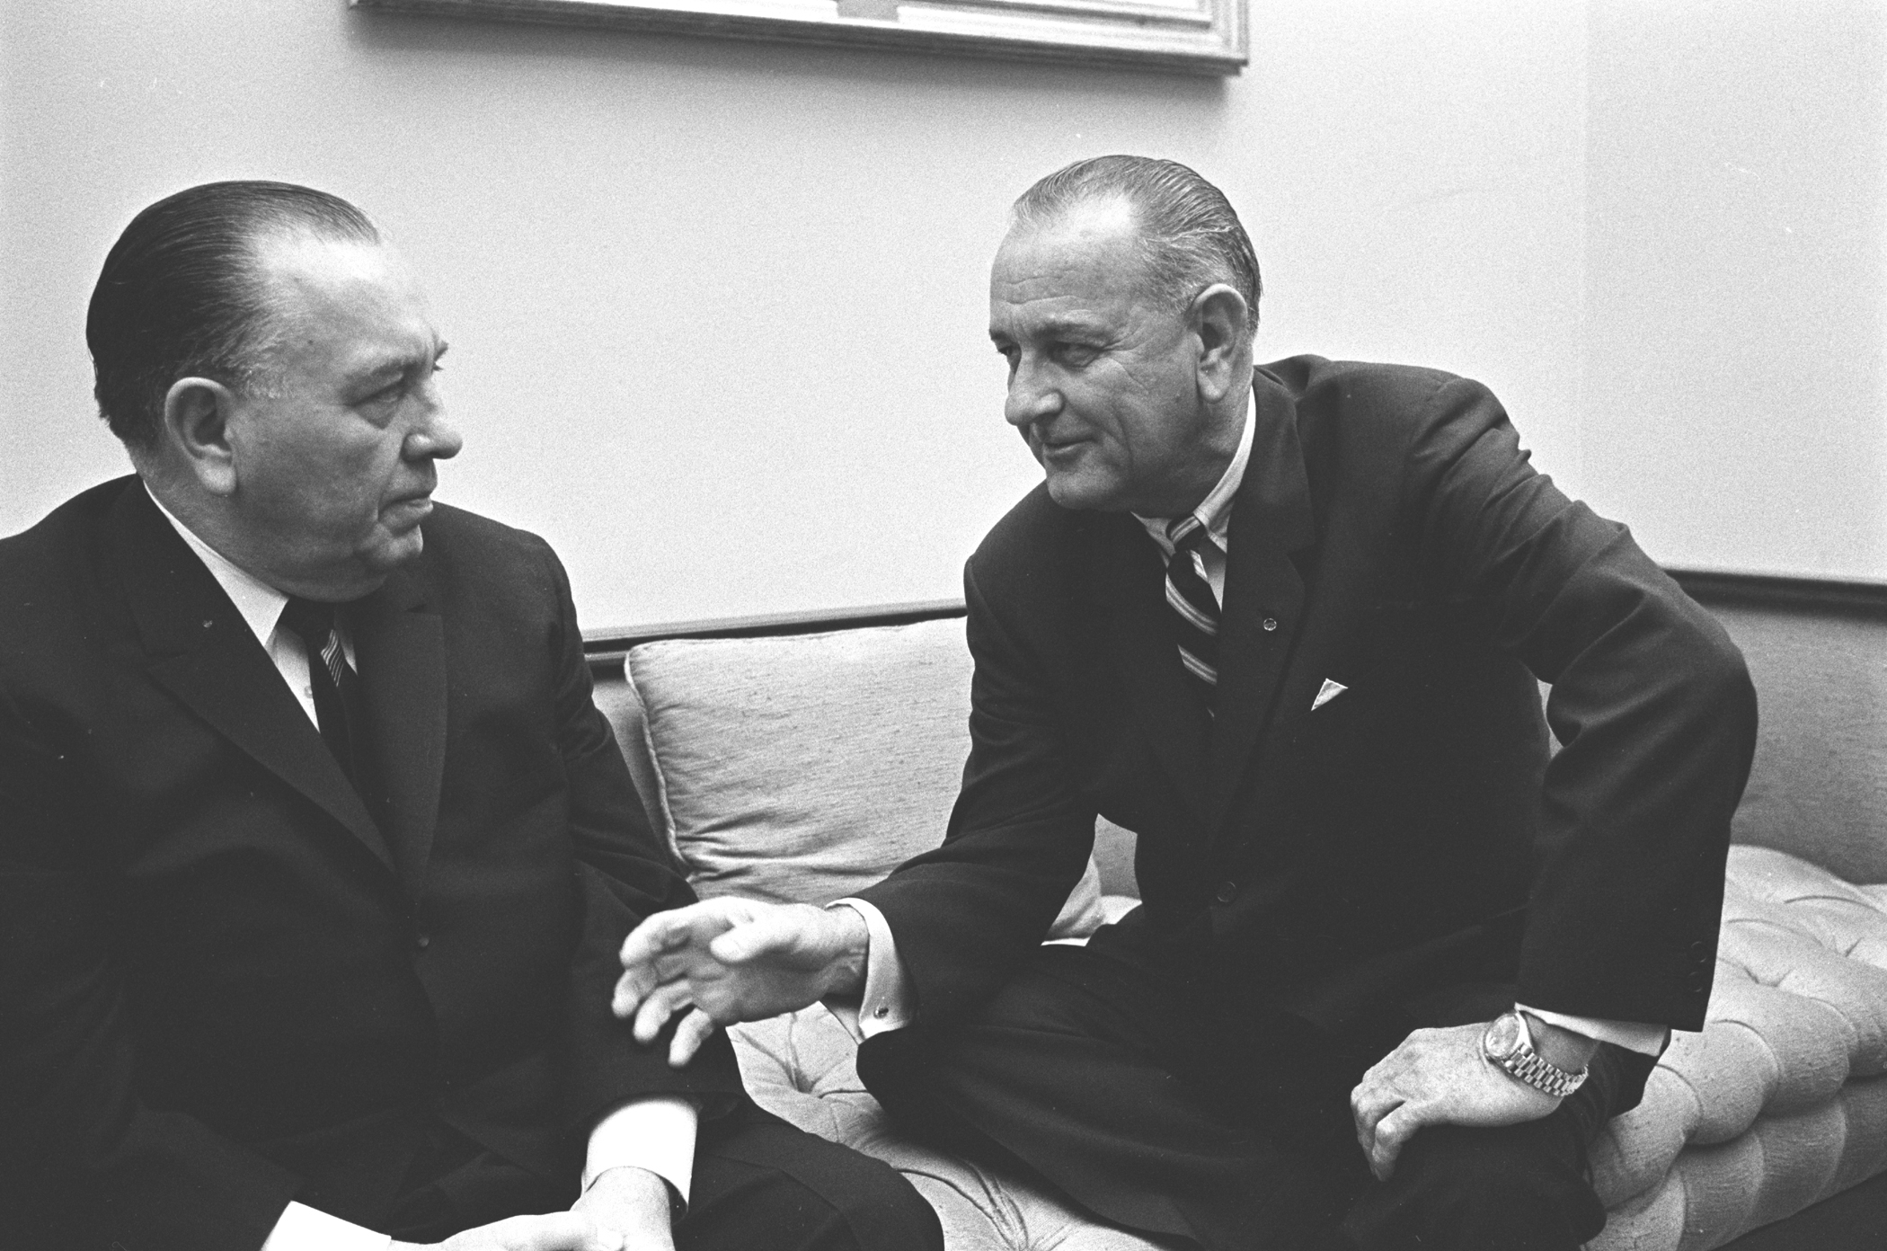

Slide 11

President Johnson: This Charleston, West Virginia paper [the Daily Mail] took a poll of all the delegates [to the Democratic National Convention], and it ran about 1400 for me and Humphrey, and about 49 for McCarthy, and about 39 for Bobby.
The 39 stragglers—all of you damn fellows [delegation chairs] will put on a son of a bitch, and when you’ve got 50 states and you only got 39 sons of bitches, that’s a pretty good average. We’ve got more than one bastard on our delegation, from Texas. [Daley chuckles.] But . . . I thought the poll came out pretty good.
But he [Kennedy] has got a few peaceniks up here in New York, and he’s got [historian Arthur] Schlesinger up at Harvard, and he has decided that it’s up to him to reclaim the Democratic Party.
Now, I’ll just tell you what will happen now: it just—beginning with me, and Hubert Humphrey, and [Texas governor] John Connally, and the rest of ‘em—if you ever thought that they had a goddamn revolution in the party, you never would see . . . These just have been little kindergarten, play Indians until this one came along.
Richard Daley: The only thing—you know, you never make any suggestions to the President. You never—
President Johnson: Hm.
Daley: The only thing I would say to you, as a friend: don’t let them get you too excited on this—
President Johnson: They wouldn’t—they wouldn’t at all! But I just thought—
Daley: I said to this fellow [RFK] in a telephone conversation, I says, “Robert, as an older man, and with great respect for the former President, don’t you do anything rash until I get a chance to talk to you.”
He said, “Well, what do you mean by that?”
I said, “Exactly what I said. Don’t be a goddamn fool. Because,” I said, “there’s a lot of people around you that just want you to stick your neck out, and want to push you out, because of their feelings against someone else.”
President Johnson: That’s right. How long ago was this?
Daley: This was last week.

Slide 12
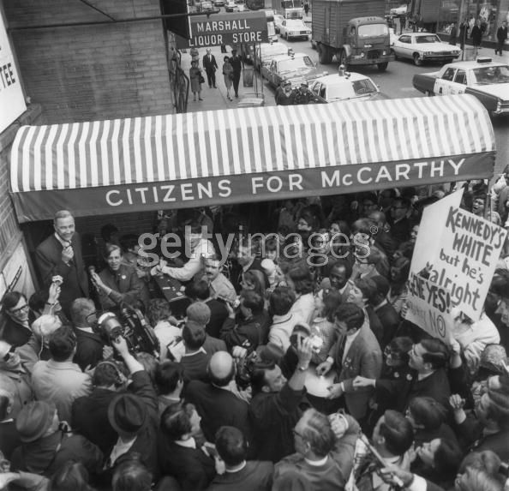

Slide 13
President Johnson: The cold hard facts are we do not have control [in Vietnam], and [Eugene] McCarthy doesn’t, and Bobby doesn’t, and no one else does at this stage, unless and until they [the North Vietnamese] see that this second wave of theirs—we have their documents; we know what their plans are—is not successful.
Now, I can’t get out and promise that they’re not going to . . . There is no question but that their attitude is harder. They just do not want to talk. And I guess it’s like you [the UAW] are when you are negotiating, and you’ve got the upper hand, and they’ve got to come to you—they can’t pee a drop without you. I think that’s the position they’re [the North Vietnamese] in.
They’re being well-supported. They’re not hurting. We’re not destroying anything they’ve got. We’re not invading ‘em. We’re not trying to capture them, we’re not taking their cities, we’re not killing their civilians. When we hit a target in North Vietnam—we’re hitting damn few. Last year, we had 6½ months that we had a complete pause at both Hanoi and Haiphong.
I can’t stress those things. Because when I do, I get every hawk in the country who thinks I’m not doing enough. And they want me to take out Haiphong immediately—and when I do, I take out a Russian ship, and I got a lot more problems.
Now, when you look at these plans, there’s not much [that] anybody’s got to do. They [McCarthy and Kennedy] say they don’t want withdrawal; they say they don’t want surrender. McCarthy said he wants negotiation. Well, goddamnit, we do, too!
Walter Reuther: Surely.
President Johnson: But we have the responsibility.
Now, you’ve got to be responsible, too. And I know your [union] board will give you hell; and I get hell from all of my people all the time. But this is a period and a time—these boys can’t get this nomination. They’re not going to get it. We’re going to take these states, and they’re not going to come close to it. They’ll win some primaries, because I don’t have much time to make calls like this.

Slide 14
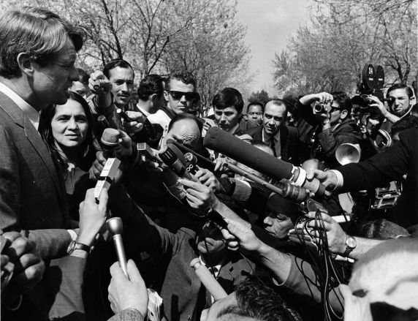

Slide 15
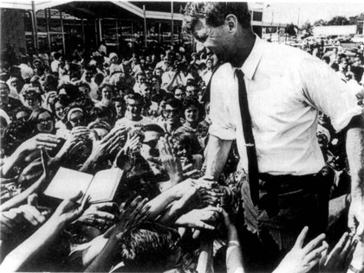

Slide 16
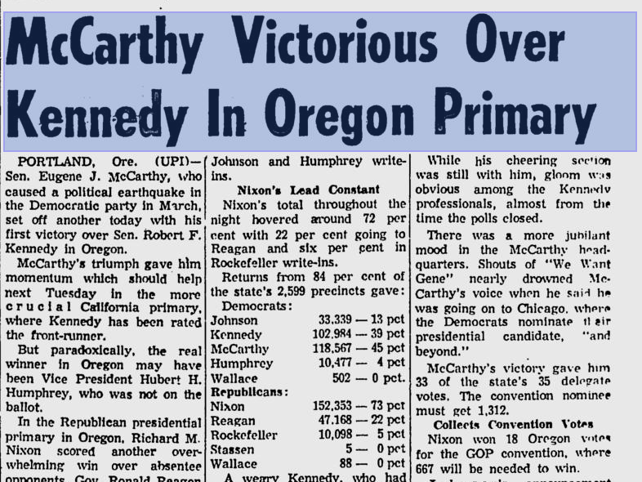

Slide 17
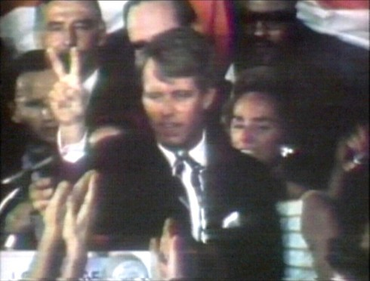

Slide 18
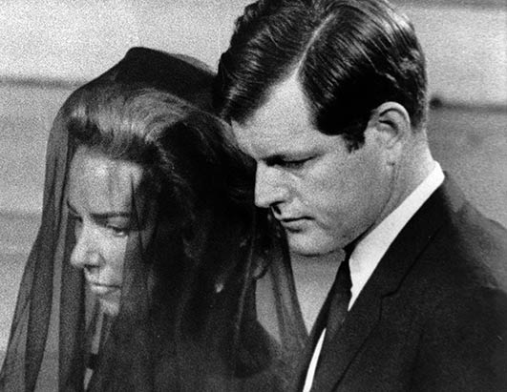

Slide 19
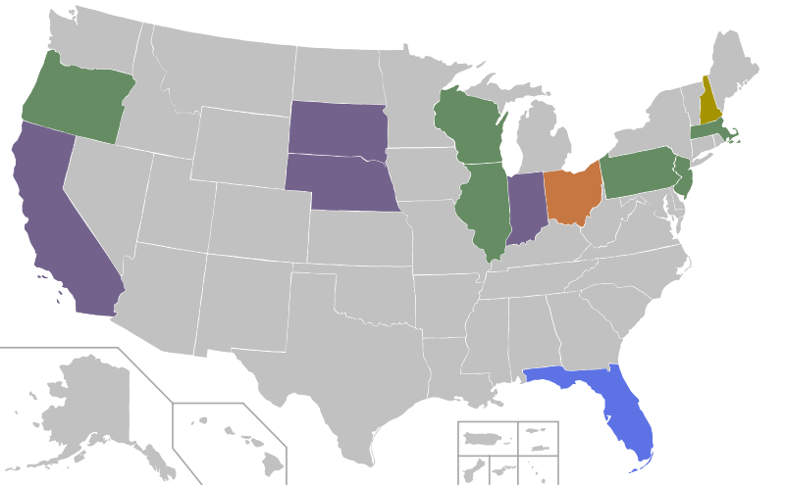
1968 Democratic Presidential Primaries

Slide 20
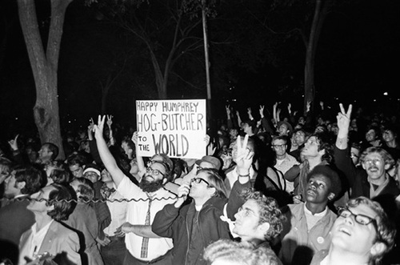

Slide 21
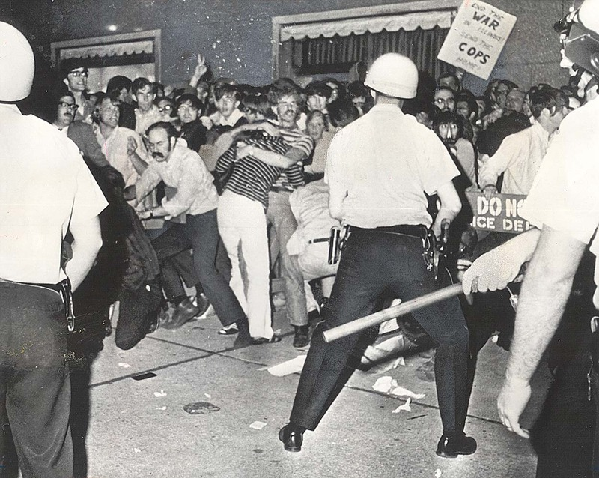

Slide 22
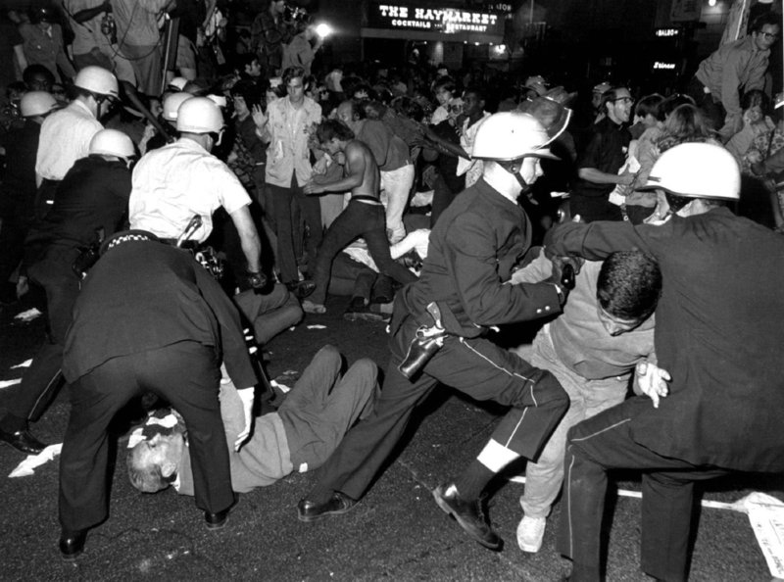

Slide 23
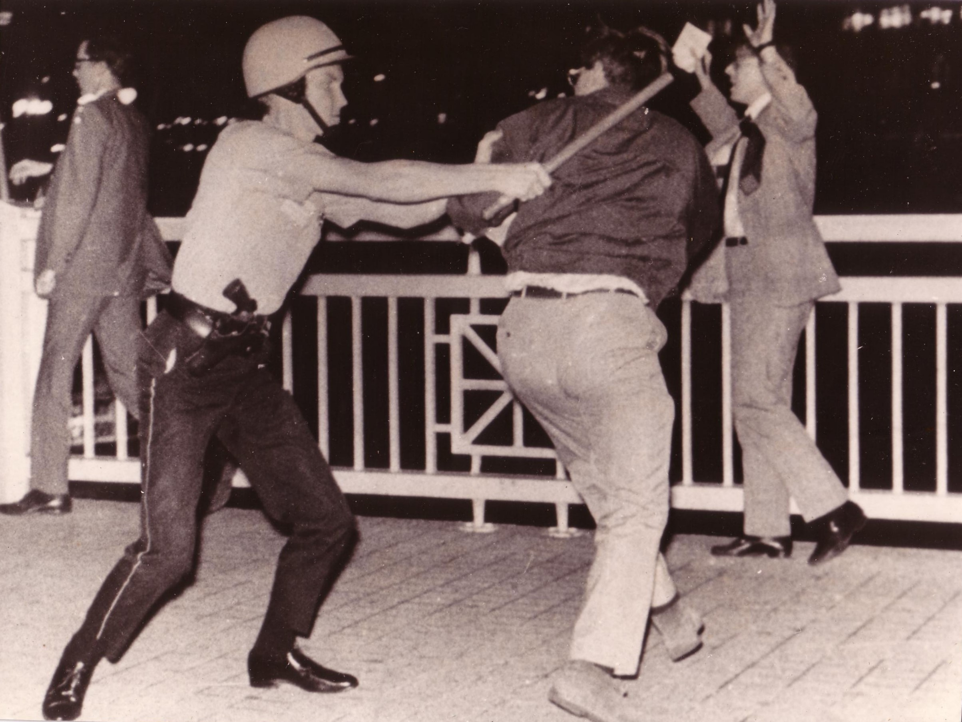

Slide 24
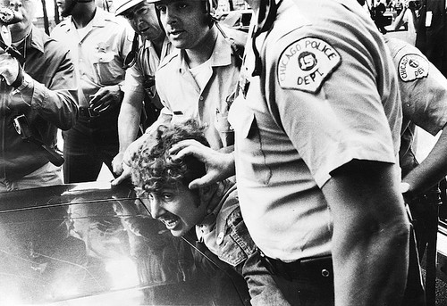

Slide 25
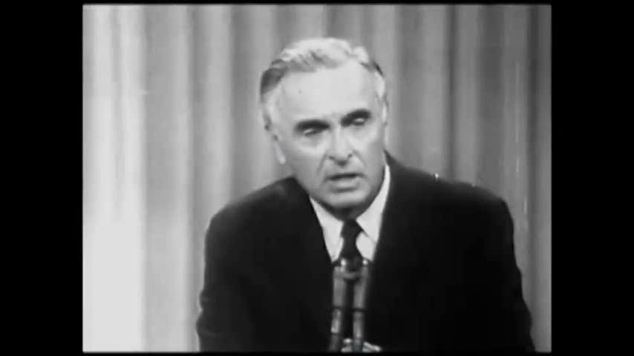

Slide 26
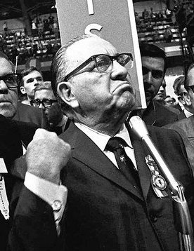

Slide 27
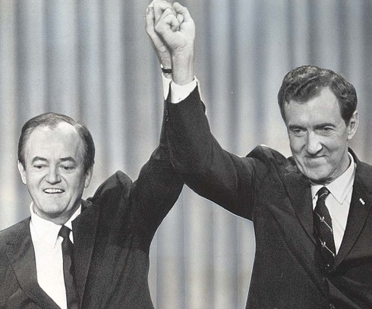

Slide 28
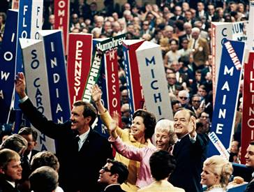

Slide 29
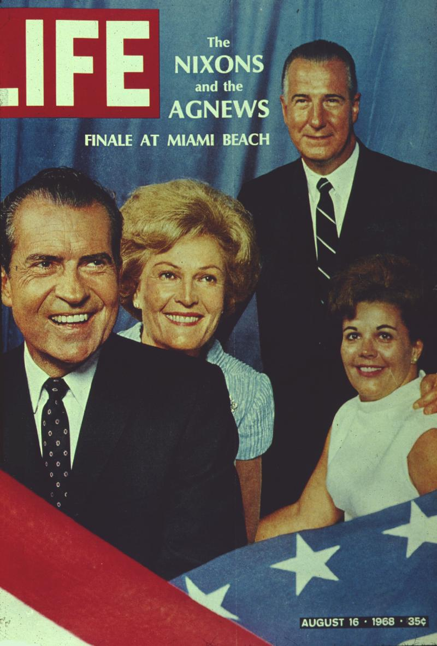

Slide 30
Nixon: As a matter of fact, let me say this, that on this—that I don’t give a goddamn what the politics is, and I hope, I’m sure Hubert [Humphrey] will feel the same way. But . . . And I know how you feel about the whole peace issue. But we’ve got to stand very firm. And I won’t say a damn word that’s going to embarrass you. You can be sure of that . . .
Let me ask you this: can you keep—just talking very candidly—can you keep your Vice President and others to keep them firm in this thing? Because, you know, to hell with the goddamn election, we must all stand firm on this.
President Johnson: That’s right.
Nixon: You know, I don’t think we’re going to go to war, but we’ve got to stand firm.
President Johnson: Very frankly, I don’t know. That’s the honest answer. I just plain don’t know.
Nixon: OK.
President Johnson: I have—
Nixon: Well, I stand firm.
President Johnson: I have done it up to now. I think it would be the best thing for the country, and I have said to them [the Humphrey campaign] that. And I have furthermore said that, in my judgment, if they didn’t do it, that you would murder them with it. That you would say—
Nixon: I think that’s true.
President Johnson: That you would say, “There’s a time—here in a time of crisis, you goddamn fellows tried to suck up to these folks.” And when you look at the polls this morning, it’s 61 to 24—
Nixon: I—
President Johnson: —against stopping the bombing. And I look at my two son-in-laws out there [serving in the military in Vietnam], and I tell ‘em to lay down your plane, keep it grounded, we won’t let you use it, and they say, “OK, what are you going to take away from them [the North Vietnamese]?” And I said, “Nothing; we haven’t talked about that.”
Well, they’ll say, “Screw ya’.”
Nixon: That’s right.
President Johnson: And these boys are coming home someday.
I got 32 applauses in 41 minutes last night [in his Detroit speech]. And I had a standing ovation when we went in; I had a standing ovation about halfway through my speech. I had a standing ovation at the end. I had 31 applauses.
And, by God, there wasn’t a paper in the United States that mentioned it.
Nixon: Well, the bastards, you know, like the goddamn New York Times—they don’t print the truth. That’s all.
President Johnson: That’s right. That’s right.
Nixon: They don’t print the truth.

Slide 31
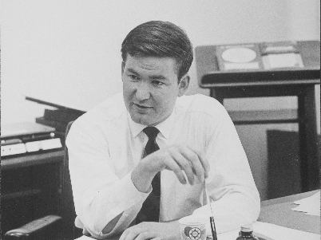

Slide 32
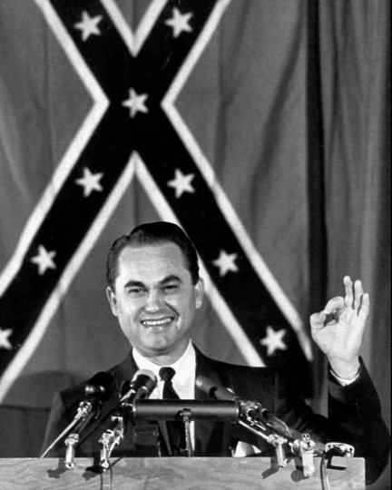

Slide 33
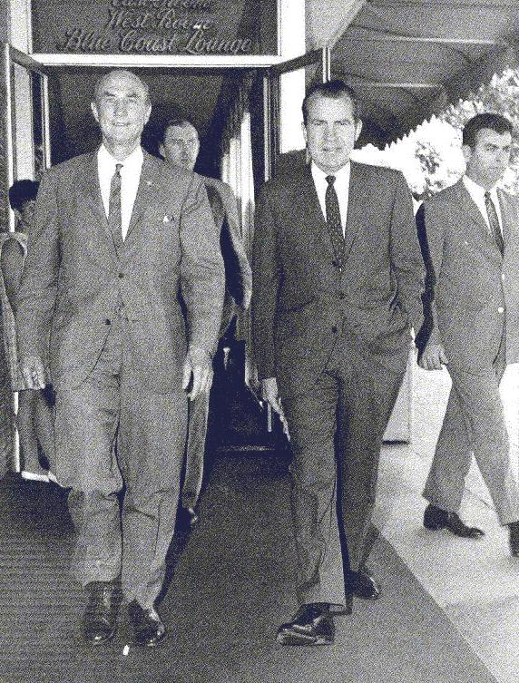

Slide 34
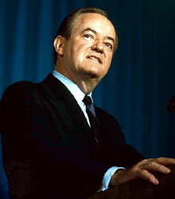

Slide 35
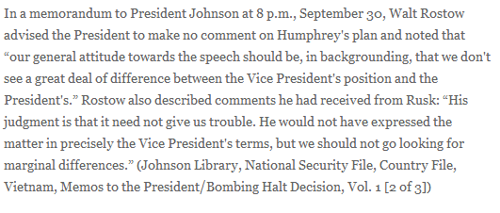

Slide 36
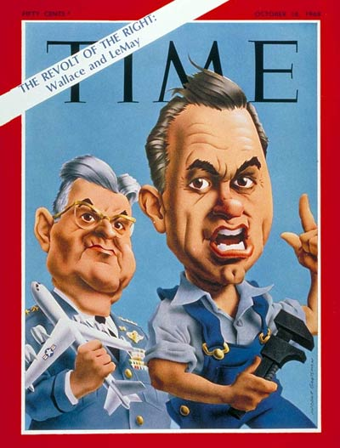

Slide 37
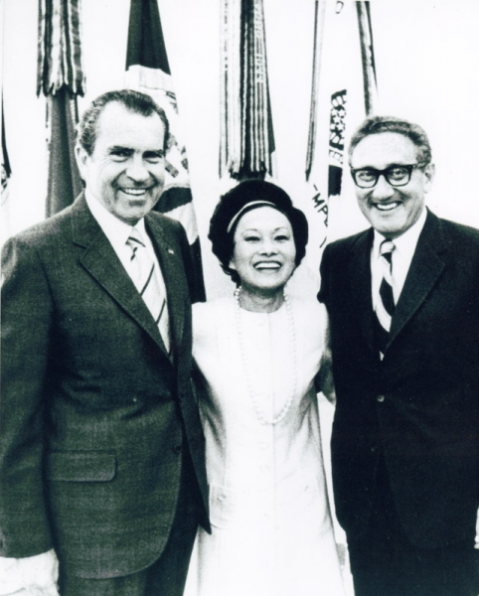

Slide 38
President Johnson: Now, I’m reading their hand, Everett. I don’t want to get this in the campaign.
Everett Dirksen: That’s right.
President Johnson And they oughtn’t to be doing this. This is treason.
Dirksen: I know.
[Break.]
President Johnson: [with Dirksen assenting] Now, I can identify ‘em, because I know who’s doing this. I don’t want to identify it. I think it would shock America if a principal candidate was playing with a source like this on a matter this important.
I don’t want to do that. But if they’re going to put this kind of stuff out, they ought to know that we know what they’re doing. I know who they’re talking to, and I know what they’re saying.
Well, now, what do you think we ought to do about it?
Dirksen: I better get in touch with him, I think, and tell him about it.
President Johnson: I think you better tell him that his people are saying to these folks that they oughtn’t to go through with this meeting [in Paris]. Now, if they don’t go through with the meeting, it’s not going to be me that’s hurt. I think it’s going to be whoever’s elected.
Dirksen: That’s right.
President Johnson: It may be—my guess—him.
Dirksen: Yeah.
President Johnson: And I think they’re making a very serious mistake. And I don’t want to say this.
Dirksen: Yeah.
President Johnson: And you’re the only one I’m going to say it to.
Dirksen: Yeah.
[Break.]
President Johnson: Well, I don’t know who it is that’s with Nixon. It may be [Wisconsin congressman Mel] Laird. It may be [aide Bryce] Harlow. It may be [campaign manager John] Mitchell. I don’t know who it is.
I know this: that they’re contacting a foreign power in the middle of a war.
Dirksen: That’s a mistake!
President Johnson: And it’s a damn bad mistake.
Dirksen: Oh, it is.
President Johnson: [with Dirksen assenting] And I don’t want to say you, and you’re the only man that I have enough confidence in to tell ‘em. But you better tell ‘em they better quit playing with it. You just tell ‘em that their people are messing around in this thing, and if they don’t want it on the front pages, they better quit it!

Slide 39
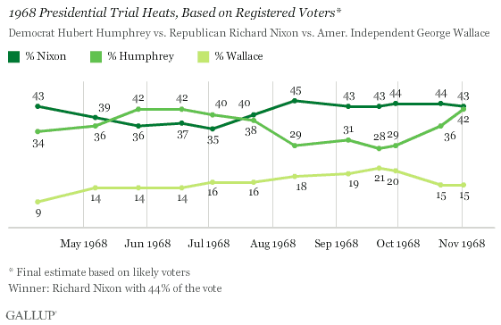

Slide 40
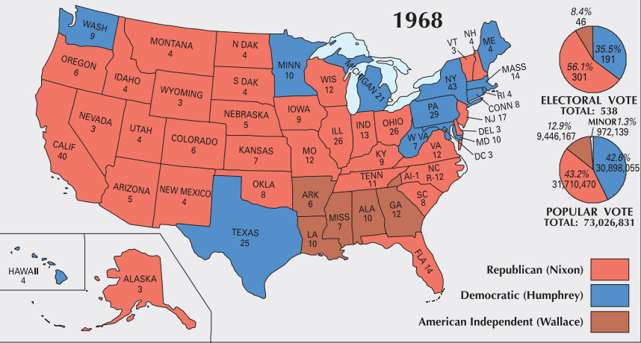

Slide 41
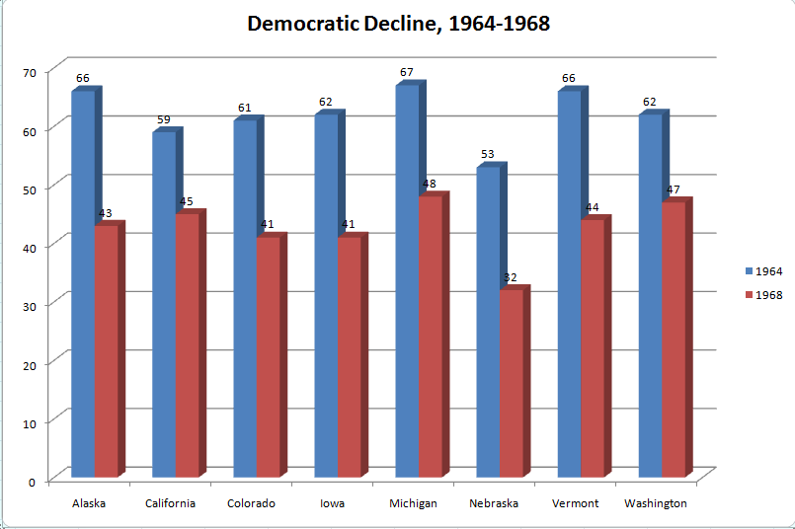

Slide 42
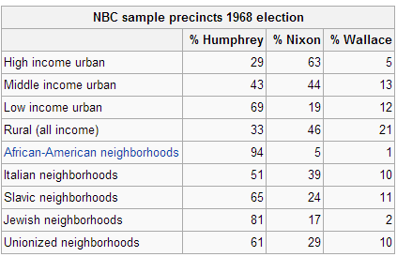

Slide 43
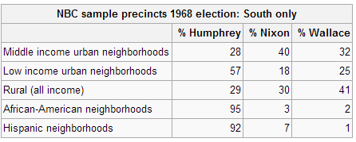

Slide 44
