Slide 1
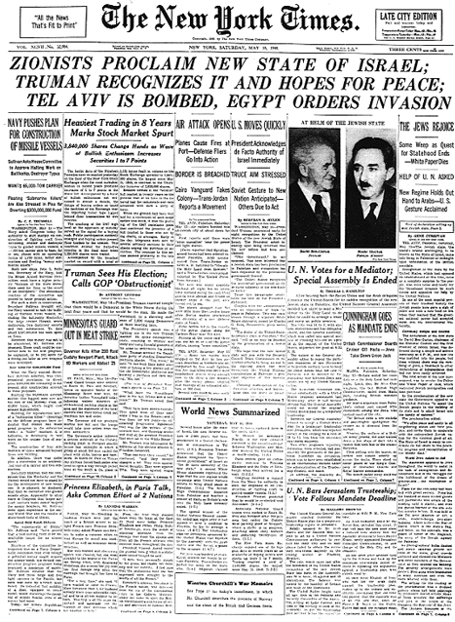

Slide 2
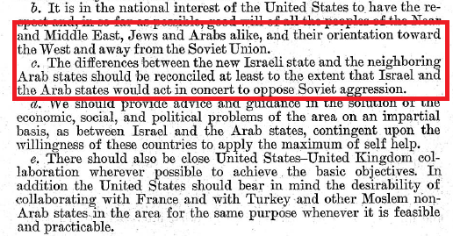
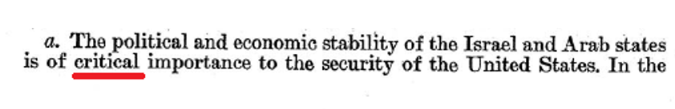
NSC 47/2 17 Oct. 1949

Slide 3
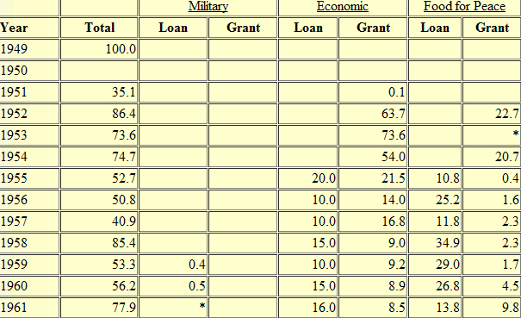
US Aid to Israel, FY 1949-1961 (millions of $$)

Slide 4
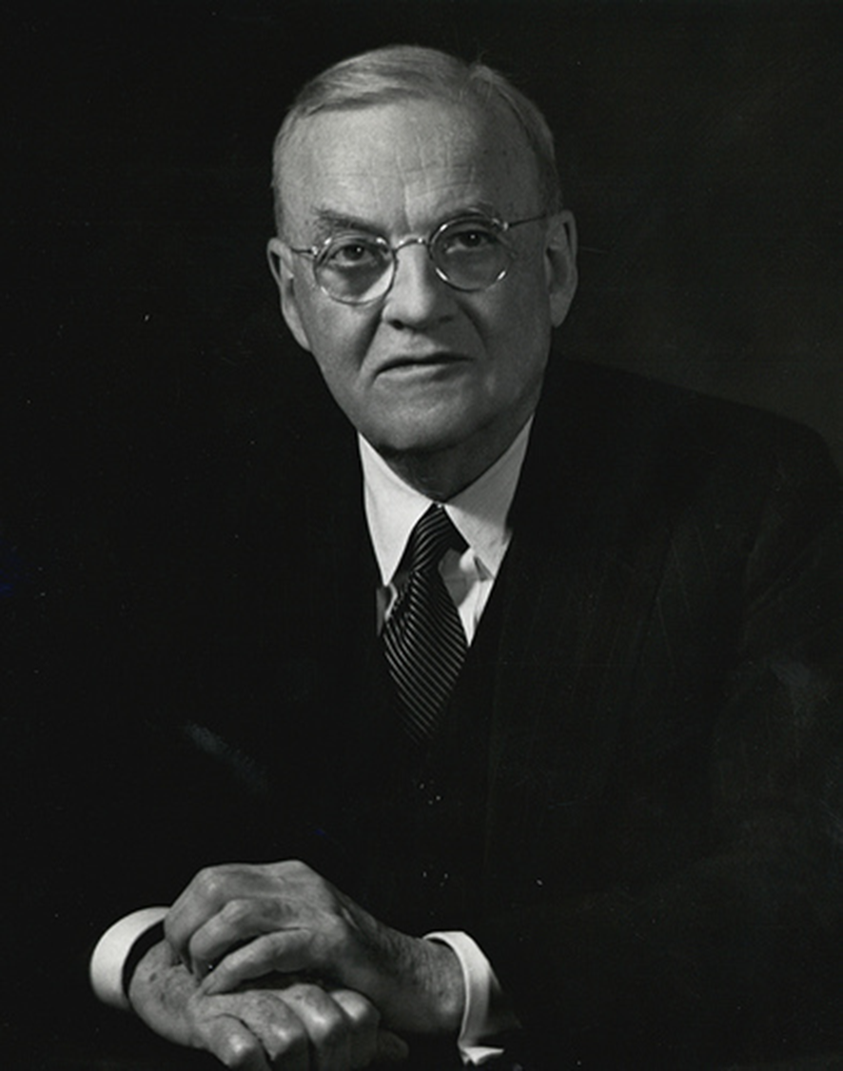
Dulles, Council on Foreign Relations
26 July 1955
What are the principal remaining problems? There are three that stand out above the others.
The first is the tragic plight of the 900,000 refugees who formerly lived in the territory that is now occupied by Israel.
The second is the pall of fear that hangs over the Arab and Israel people alike. The Arab countries fear that Israel will seek by violent means to expand at their expense. The Israelis fear that the Arabs will gradually marshal superior forces to be used to drive them into the sea and resent the measures of economic blockade which are now enforced against them.
The third is the lack of fixed permanent boundaries between Israel and its Arab neighbors.

Slide 5
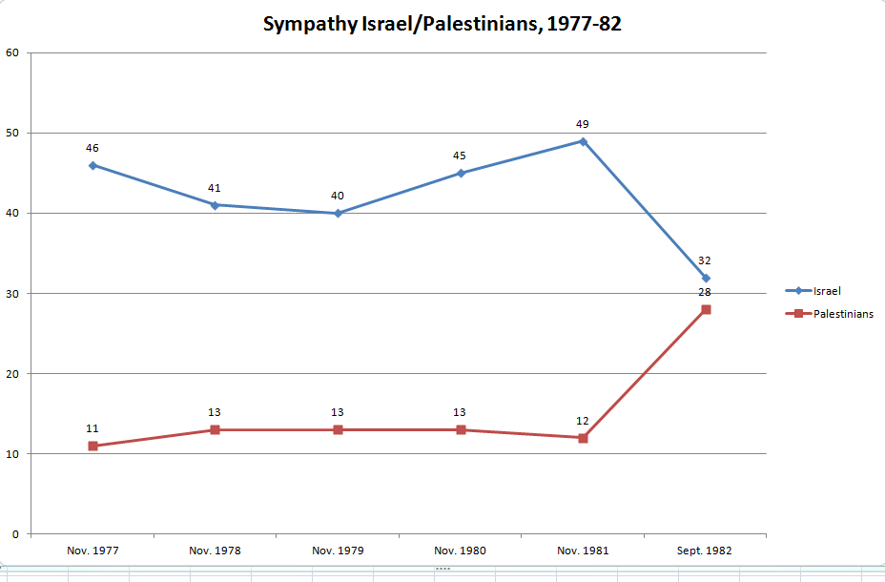

Slide 6
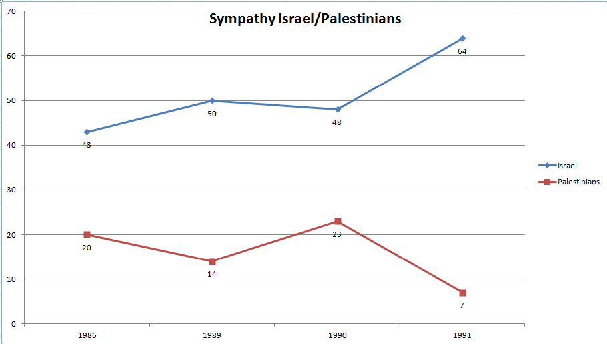

Slide 7

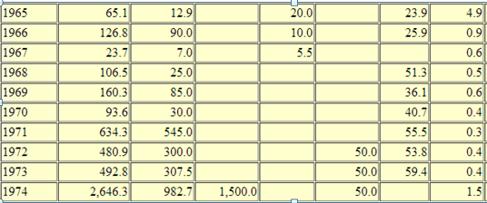
US Aid to Israel, FY 1965-1974 (millions of $$)

Slide 8
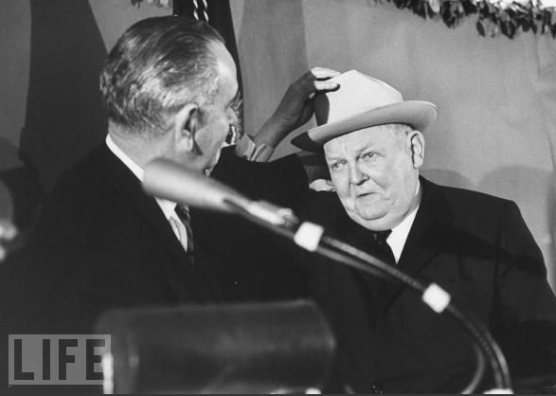

Slide 9
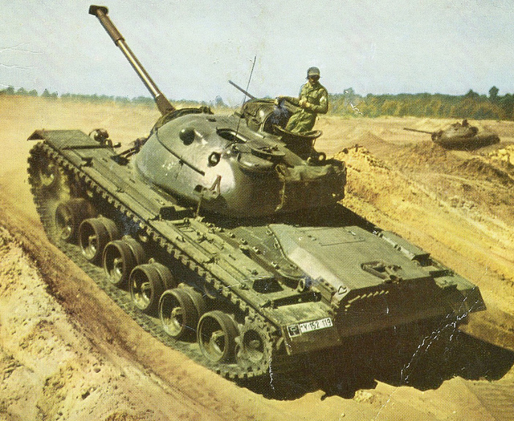
Notes:
150 German Bundeswehr M48 tank—option for 83 more

Slide 10
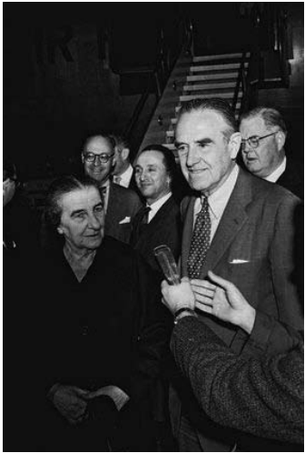

Slide 11

Dean Rusk: [reading from proposed telegram for Averell Harriman to present to Prime Minister Eshkol]
“ . . . Our deep concern about unification of Arab world behind Nasser with close working relationships with [the] Soviet bloc is [the] greatest threat to Israel we can imagine. The fact that it would be deeply injurious to U.S. interests in [the] Near East, including the security of Israel, seems to us to require that we and Israel would together to head it off. We agree to a private visit to Washington of [Shimon] Peres and [Yitzhak] Rabin. Must emphasize absence of publicity for such visit, as was accomplished on earlier occasions.” . . .
President Johnson: I had this feeling—I don’t know if it’s any good, but, God, I hate to transfer all those Jews into Washington, though, because I’m afraid that they’ll all move in at the slightest provocation. I wouldn’t be surprised if Golda’s [Meir] not on her way if we don’t watch.
But maybe not.
Do you think that we could say to Averell to strike out the [word] “sympathetically” [from the proposed agreement] and say, “We pledge to give you x tanks, and give ‘em the x tanks, and . . . ” It seems that the basis of his [Eshkol’s] objection is that [the U.S. saying] “we view sympathetically” doesn’t commit us.
Rusk: Uh-huh.
President Johnson: And that he wants a commitment.
It seems that we might, without great danger, raise the ante a little bit to what the Germans are giving them, and say if the Germans don’t complete it, we’ll complete it, plus 20 or something.

Slide 12
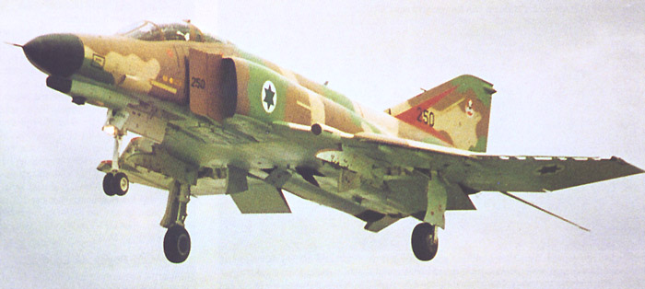

Slide 13
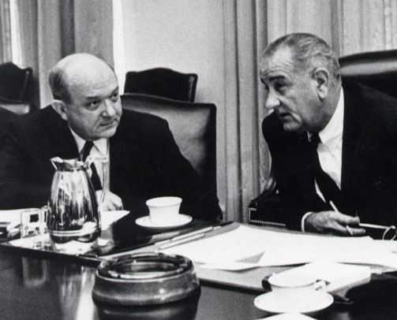

Slide 14
President Johnson: I don’t want to make any conditions, because I’ve been gone on the Phantoms, but I’m willing to help you put whatever pressure you can.
But I made the decision on the Phantoms, Dean, last January [1967], when I called Bob McNamara in here and told him to be ready to deliver ‘em this January [1968].
Dean Rusk: Yeah.
President Johnson: I just didn’t want to face up to it all during that period, as you well know.
Rusk: Well, I think Israel—
President Johnson: I wouldn’t say—now, I’m willing to threaten, and do everything I can, just as long as you know, I come clean with you: the Phantoms—they’re already shipped.
Rusk: [unenthusiastically] Mm-hmm.
President Johnson: Now, you can tell ‘em that we’ve got to have this, and we’ve got to have that. And I’ll tell ‘em the same thing, and shove, and fight. They can’t use ‘em [for a] nuclear [attack], and they can’t do this, and they’ve got to sign a non-proliferation treaty: I don’t care what all we say.
Rusk: Right.
President Johnson: I’m not going to tell them. But that decision’s already wrapped up.
Rusk: Well, they’ve already got out of there what they want, short of the delivery of the planes themselves.
President Johnson: Yes. Yes, that’s right.
Well, I think they would like to have the thing signed, and have the purchase order written, because they’ve had that with France, you know, and it’s been kicked out. And I want to be damn sure that I do it, and that I don’t wait till after the election, and Nixon and Humphrey do it.

Slide 15
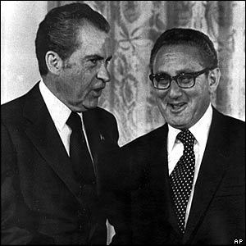

Slide 16
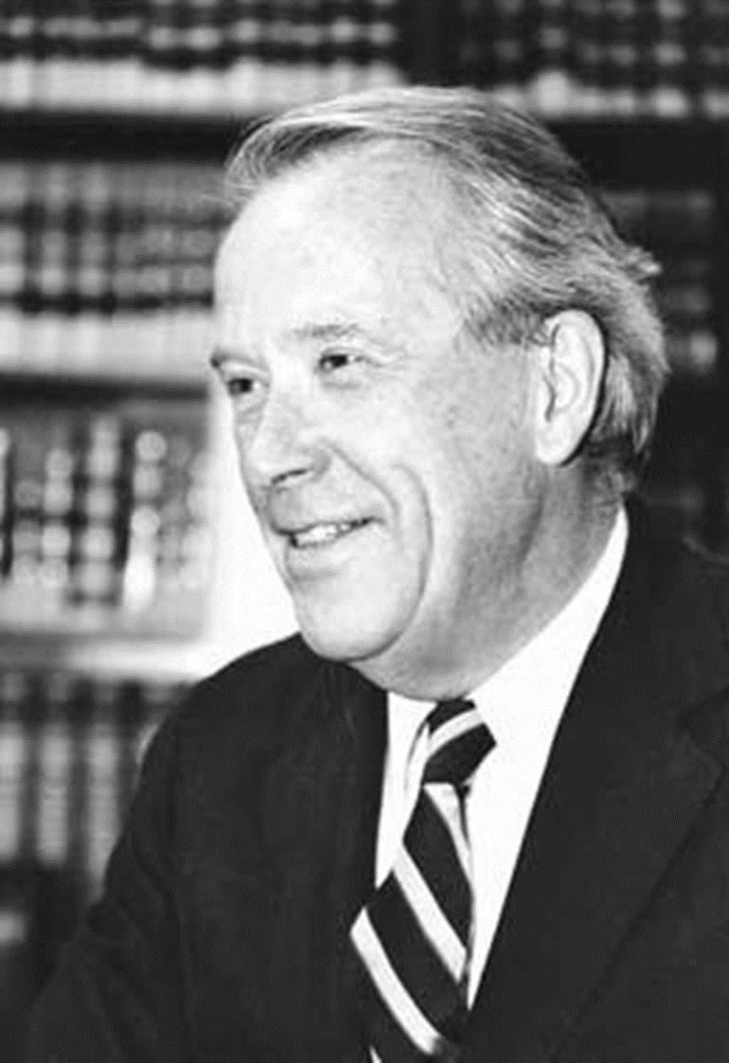
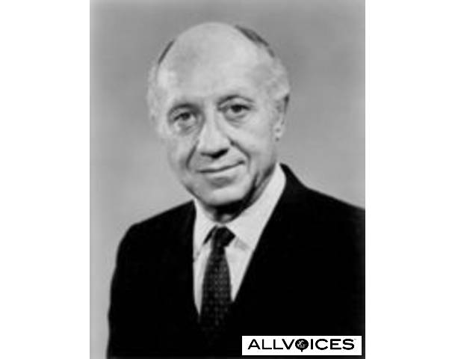

Slide 17
President Nixon: But it’s important to get across to them, Henry, and I hope you’ll talk to [New York senator Jacob] Javits and the rest of ‘em on this, and even [Washington senator Henry] Jackson: by God, if the Jewish community in this country makes Israel exit permits the condition for the Russian initiative, listen, they’re going to be hurting. That cannot work.
Henry Kissinger: [forcefully] Let’s face it: The emigration of Jews from the Soviet Union is not an objective of American foreign policy. And if they put Jews into gas chambers in the Soviet Union, it is not an American concern. It may be a humanitarian concern.
President Nixon: I know.
Kissinger: And . . .
President Nixon: Well, we can’t blow up the world because of it.
Kissinger: It’d be an outrage, but we cannot make out where gas chambers would go as far as I’m concerned.
President Nixon : I know.
Kissinger: There is no unrestricted right to emigration. If the Indians don’t let Farsis out, it would never occur to us to attach a rider to a foreign policy decision. And I think that the Jewish community in this country, on that issue, is behaving unconscionably. It’s behaving traitorously. I find—
President Nixon: Why can’t we get Jackson to get off the damn thing? He feels it, though. He is. He’s close to the Jewish community; he’s close to the Israelis.
Kissinger: Although, I suppose—
President Nixon: Well, of course, he’s taken a lot of money from them, too.
Kissinger: Exactly. They’re financing his [presidential] campaign in ’76. But Javits . . . I’m going to have a talk with Javits, and I’m going to tell him that it is unconscionable for the Jewish community to . . .
President Nixon: You see, what they [the pro-Jewish emigration forces in Congress] will do is to work that way with the radical, the nuthead, basically the anti-semitic nutheads, say. Anti-communists in the Senate and the House—a lot of them are anti-semitic—who want to screw the Russians for other reasons. And between them . . . You know, we’ve got to get most-favored-nation [status for the USSR, in trade relations], don’t we?
Kissinger: [forcefully] Mr. President, let’s face it: we have screwed Brezhnev.
I mean, you have outmaneuvered Brezhnev in a way that is almost pathetic.

Slide 18
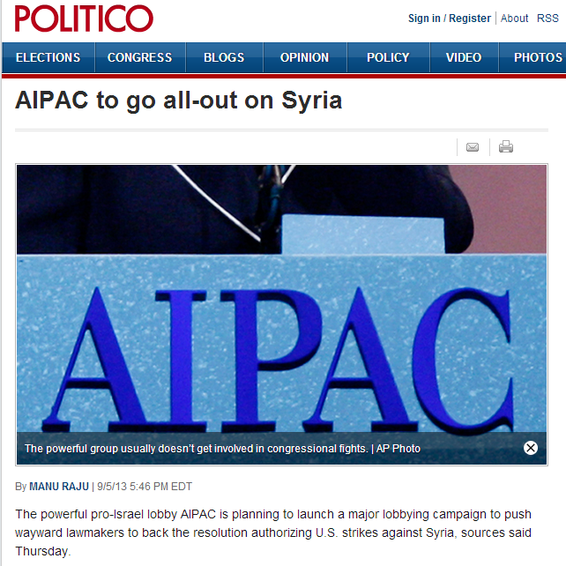

Slide 19
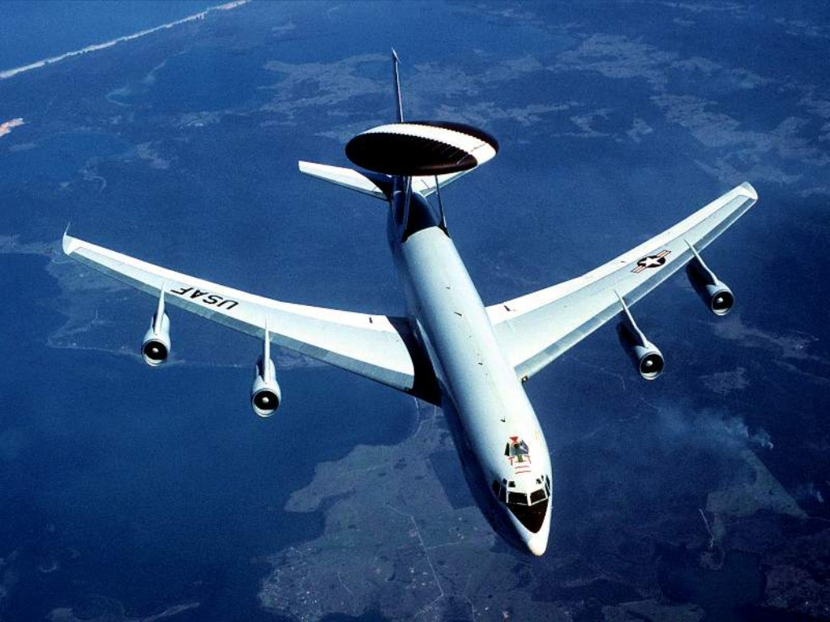

Slide 20

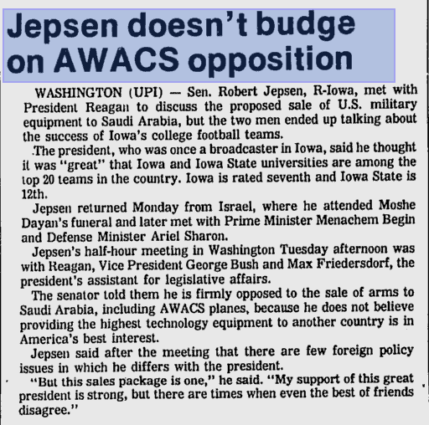
“This sale to an unstable country jeopardizes the security of our most advanced technology . . . This sale undermines the security of Israel . . . I pledge my efforts and my vote to block this sale.”

Slide 21
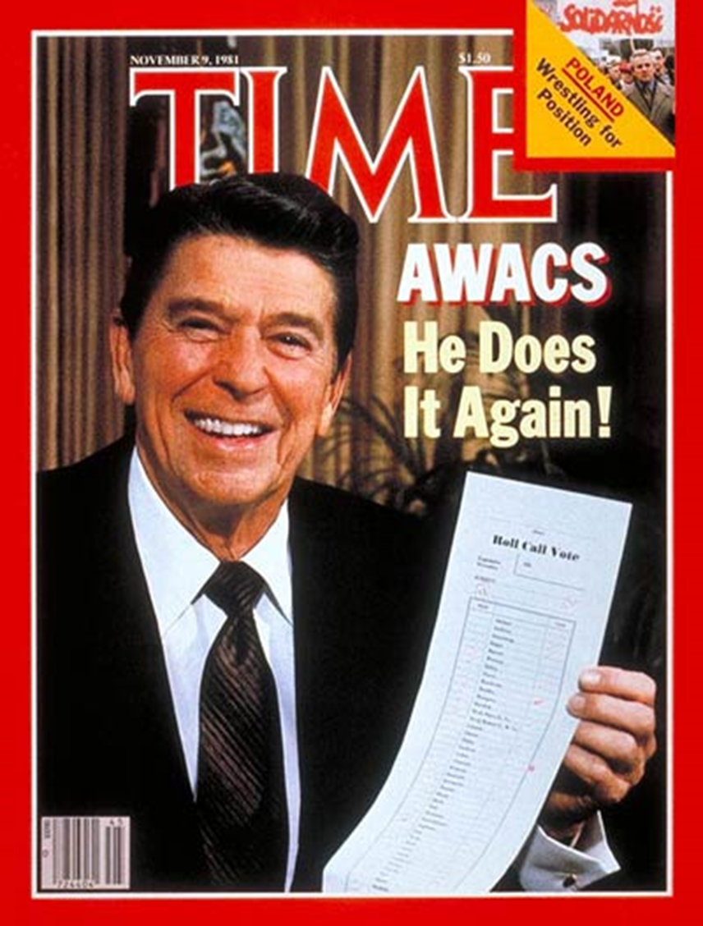
White House aide Ed Rollins:
“We just beat his brains out. We stood him up in front of an open grave and told him he could jump in if he wanted to.”

Slide 22
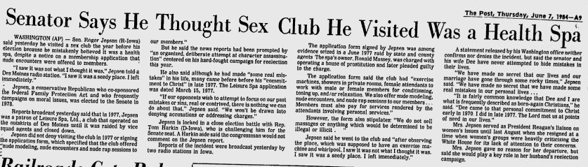

Slide 23
