Slide 1
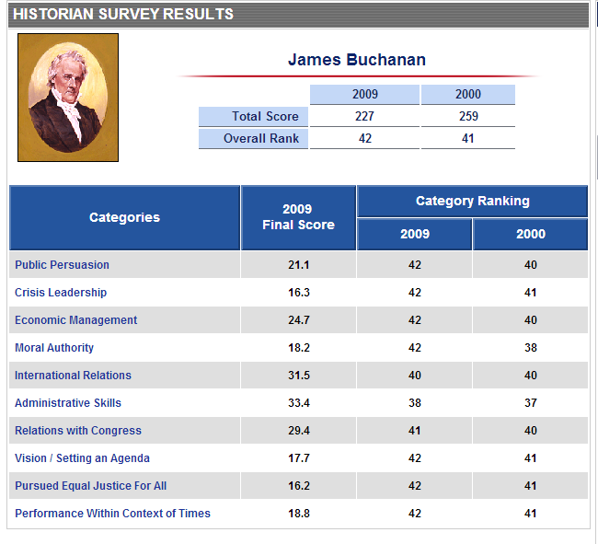

Slide 2
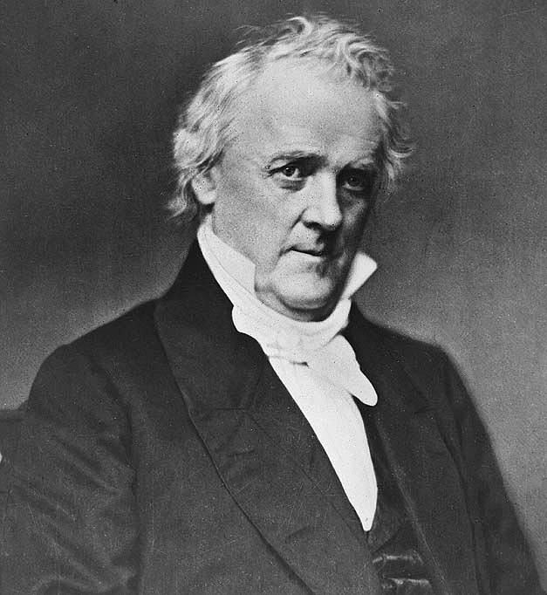
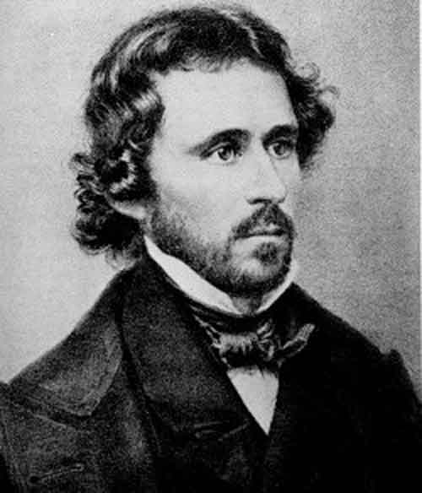

Slide 3
Democratic Platform: 1856
That the Federal Government is one of limited power, derived solely from the Constitution; and the grants of power made therein ought to be strictly construed by all the departments and agents of the government; and that it is inexpedient and dangerous to exercise doubtful constitutional powers…
That Congress has no power under the Constitution, to interfere with or control the domestic institutions of the several States, and that such States are the sole and proper judges of everything appertaining to their own affairs, not prohibited by the Constitution; …[The party backs] NON-INTERFERENCE BY CONGRESS WITH SLAVERY IN STATE AND TERRITORY, OR IN THE DISTRICT OF COLUMBIA….
We recognize the right of the people of all the Territories, including Kansas and Nebraska, acting through the legally and fairly expressed will of a majority of actual residents, and whenever the number of their inhabitants justifies it, to form a Constitution, with or without domestic slavery, and be admitted into the Union upon terms of perfect equality with the other States

Slide 4
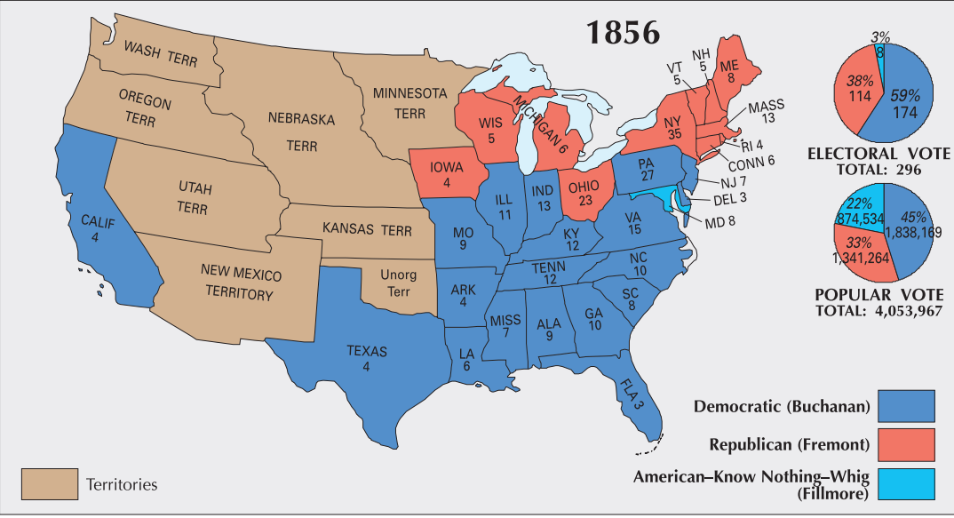

Slide 5
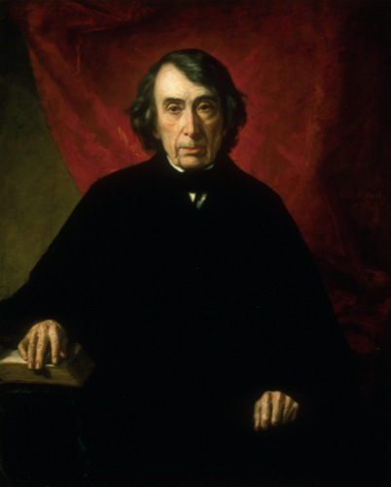
Notes:
taney

Slide 6
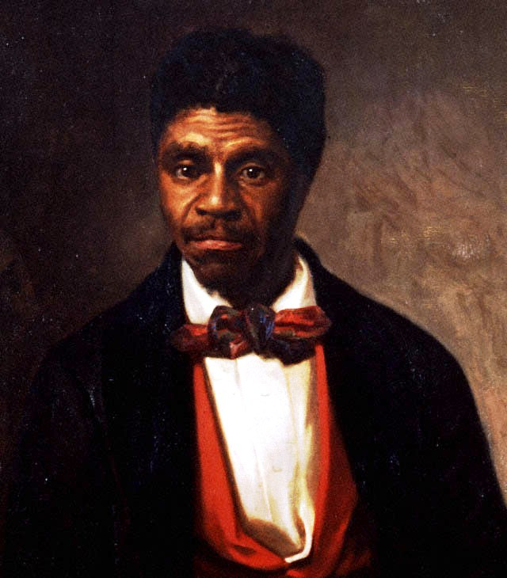

Slide 7
Dred Scott v. Sandford (1857)
Does the Constitution of the United States act upon [a slave] whenever he shall be made free under the laws of a State, and raised there to the rank of a citizen, and immediately clothe him with all the privileges of a citizen in every other State, and in its own courts?
The court think the affirmative of these propositions cannot be maintained. And if it cannot, the plaintiff in error could not be a citizen of the State of Missouri within the meaning of the Constitution of the United States, and, consequently, was not entitled to sue in its courts…
. . . The right of property in a slave is distinctly and expressly affirmed in the Constitution. The right to traffic in it, like an ordinary article of merchandise and property, was guarantied to the citizens of the United States in every State that might desire it for twenty years. And the Government in express terms is pledged to protect it in all future time if the slave escapes from his owner.
This is done in plain words — too plain to be misunderstood. And no word can be found in the Constitution which gives Congress a greater power over slave property or which entitles property of that kind to less protection that property of any other description.

Slide 8
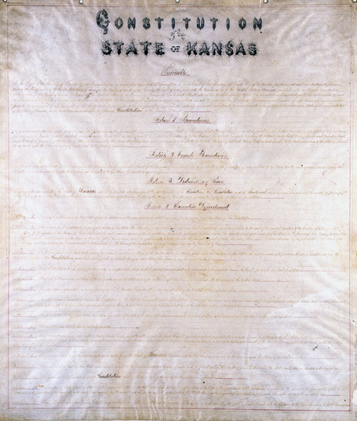
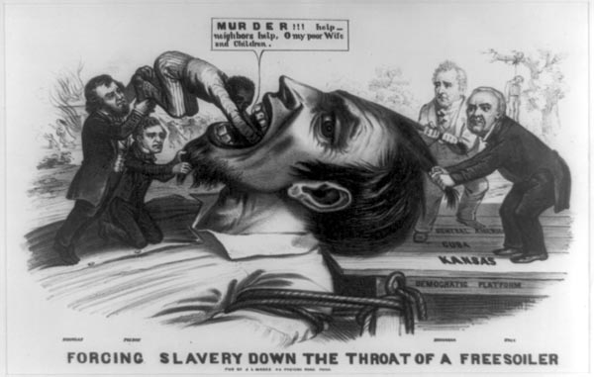

Slide 9
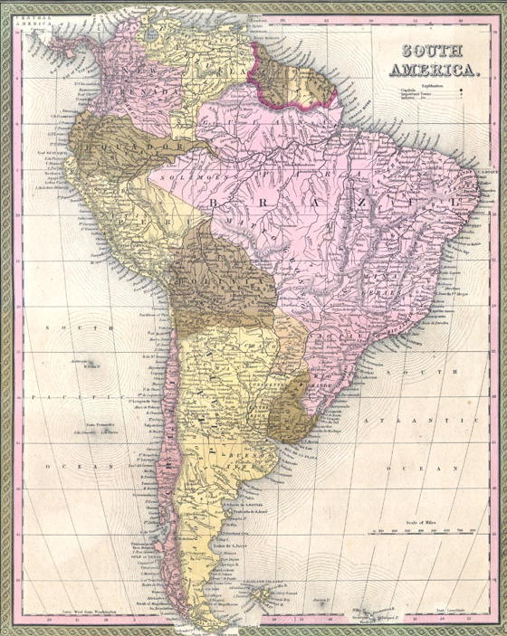

Slide 10
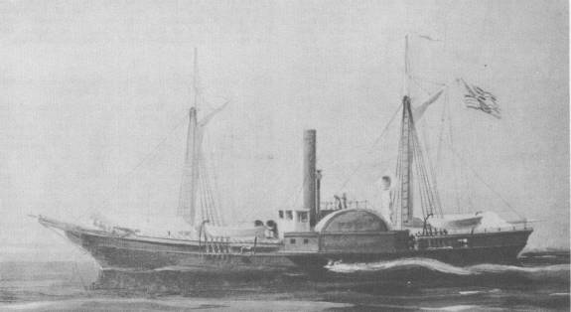
Notes:
Water witch

Slide 11

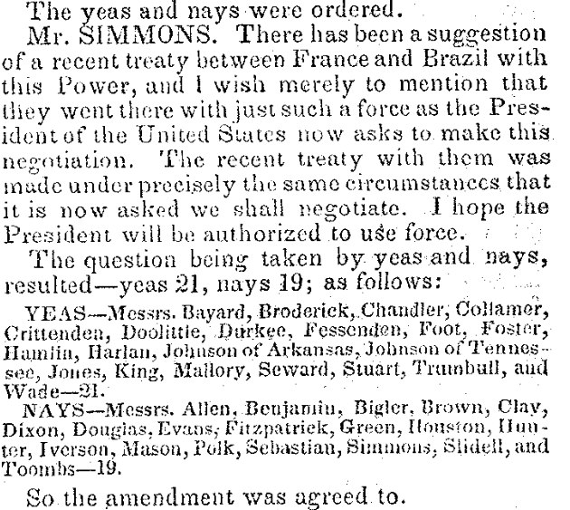

Slide 12
Buchanan message to Congress (Feb. 1859)
The republics south of the United States on this continent have unfortunately been frequently in a state of revolution and civil war ever since they achieved their independence . . . The Executive Governments of Great Britain, France, and other countries, possessing the war-making power, can promptly employ the necessary means to enforce immediate redress for similar outrages upon their subjects. Not so the Executive Government of the United States.
I therefore earnestly recommend to Congress, on whom the responsibility exclusively rests, to pass a law . . . conferring on the President the power to protect the lives and property of American citizens . . . The knowledge that such a law exists would of itself go far to prevent the outrages which it is intended to redress, and to render the employment of force unnecessary.
Such a grant of authority, thus limited in its extent, could in no just cause be regarded as a transfer of war-making power to the Executive, but only as an appropriate exercise of that power by the body to whom it exclusively belongs.

Slide 13
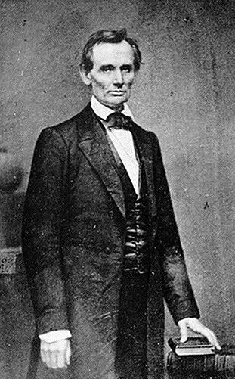

Slide 14
Lincoln “House Divided” speech (1858)
We are now far into the fifth year, since a policy was initiated, with the avowed object, and confident promise, of putting an end to slavery agitation.
Under the operation of that policy, that agitation has not only, not ceased, but has constantly augmented.
In my opinion, it will not cease, until a crisis shall have been reached, and passed.
"A house divided against itself cannot stand.“
I believe this government cannot endure, permanently half slave and half free.
I do not expect the Union to be dissolved -- I do not expect the house to fall -- but I do expect it will cease to be divided.
It will become all one thing or all the other.
Either the opponents of slavery, will arrest the further spread of it, and place it where the public mind shall rest in the belief that it is in the course of ultimate extinction; or its advocates will push it forward, till it shall become alike lawful in all the States, old as well as new -- North as well as South.

Slide 15
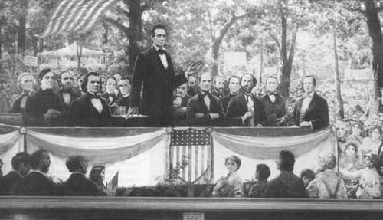

Slide 16
Senator Stephen Douglas (Lincoln-Douglas debates)
I ask you, are you in favor of conferring upon the negro the rights and privileges of citizenship? Do you desire to strike out of our State Constitution that clause which keeps slaves and free negroes out of the State, and allow the free negroes to flow in, and cover your prairies with black settlements? . . . I am opposed to negro citizenship in any and every form. I believe this Government was made on the white basis. I believe it was made by white men for the benefit of white men and their posterity forever, and I am in favor of confining citizenship to white men, men of European birth and descent, instead of conferring it upon negroes, Indians, and other inferior races.
Mr. Lincoln, following the example and lead of all the little Abolition orators, who go around and lecture in the basements of schools and churches, reads from the Declaration of Independence, that all men were created equal, and then asks, how can you deprive a negro of that equality which God and the Declaration of Independence awards to him? ... Now, I hold that Illinois had a right to abolish and prohibit slavery as she did, and I hold that Kentucky has the same right to continue and protect slavery that Illinois had to abolish it. I hold that New York had as much right to abolish slavery as Virginia has to continue it, and that each and every State of this Union is a sovereign power, with the right to do as it pleases upon this question of slavery, and upon all its domestic institutions. ...

Slide 17
Abraham Lincoln (Lincoln-Douglas debates)
I agree with Judge Douglas [the Negro] is not my equal in many respects—certainly not in color, perhaps not in moral or intellectual endowment. But in the right to eat the bread, without the leave of anybody else, which his own hand earns, he is my equal and the equal of Judge Douglas, and the equal of every living man . . .
This declared indifference, but, as I must think, covert real zeal for the spread of slavery, I cannot but hate. I hate it because of the monstrous injustice of slavery itself. I hate it because it deprives our republican example of its just influence in the world…
It is the eternal struggle between these two principles — right and wrong — throughout the world. They are the two principles that have stood face to face from the beginning of time; and will ever continue to struggle. The one is the common right of humanity, and the other the divine right of kings. It is the same principle in whatever shape it develops itself. It is the same spirit that says, "You toil and work and earn bread, and I'll eat it.“

Slide 18
1858 Midterm Elections (House of Representatives)
Republicans 114 seats +22
Democrats 101 seats -30
“Opposition” (pro-GOP) 17 seats +17
American 6 seats -8
1858 Midterm Elections (Senate, 22 seats up for election)
Democrats 38 seats -3
Republicans 26 seats +6
American 2 seats -3

Slide 19
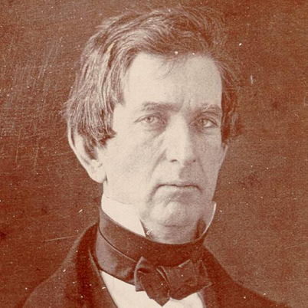
There is a higher law than the Constitution, which regulates our authority over the domain, and devotes it to the same noble purposes. The territory is a part, no inconsiderable part, of the common heritage of mankind, bestowed upon them by the Creator if the universe. We are his stewards, and must so discharge our trust as to secure in the highest attainable degree their happiness. How momentous that trust is…

Slide 20


Slide 21

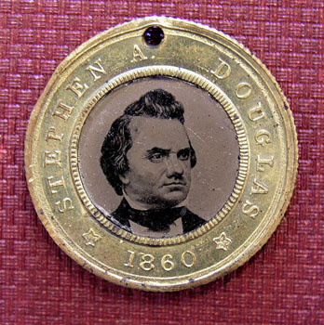
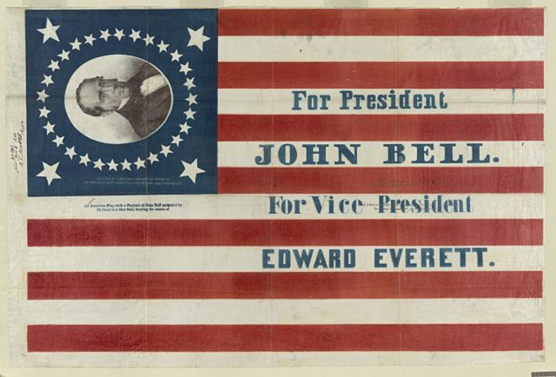
Notes:
breckenridge

Slide 22
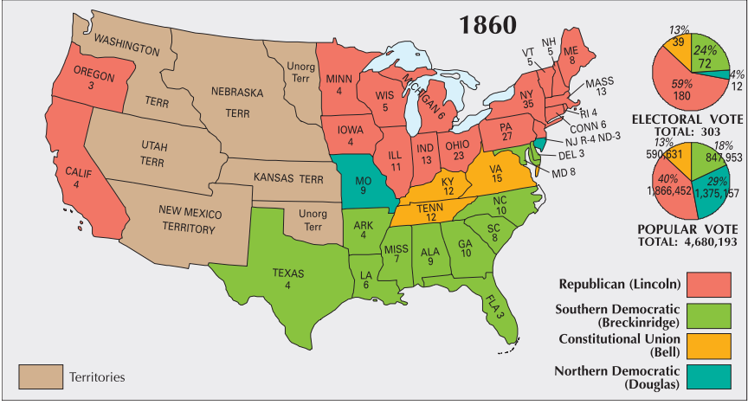

Slide 23


Slide 24
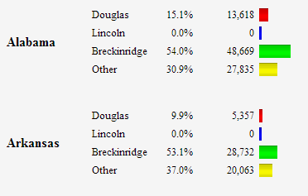
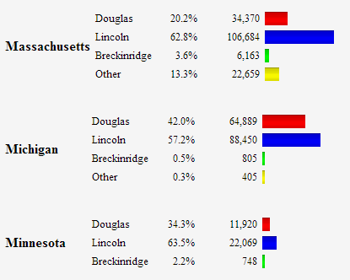
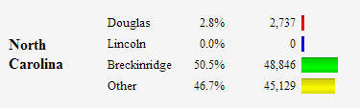

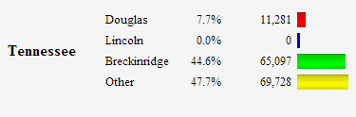
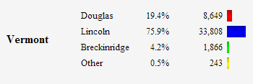
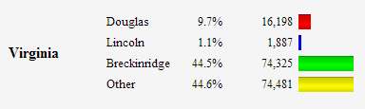

Slide 25
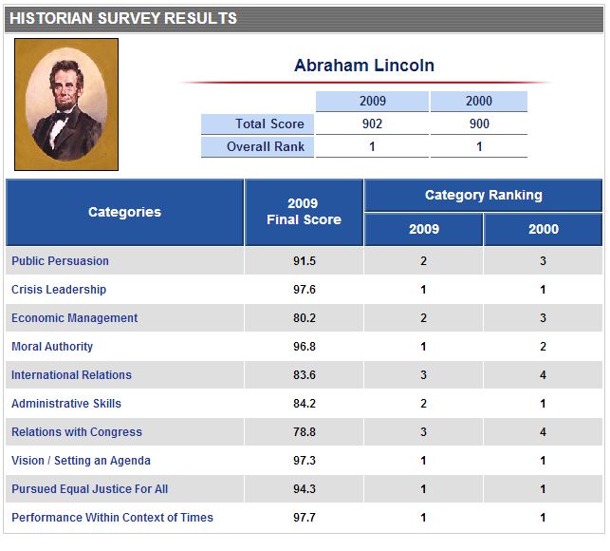

Slide 26
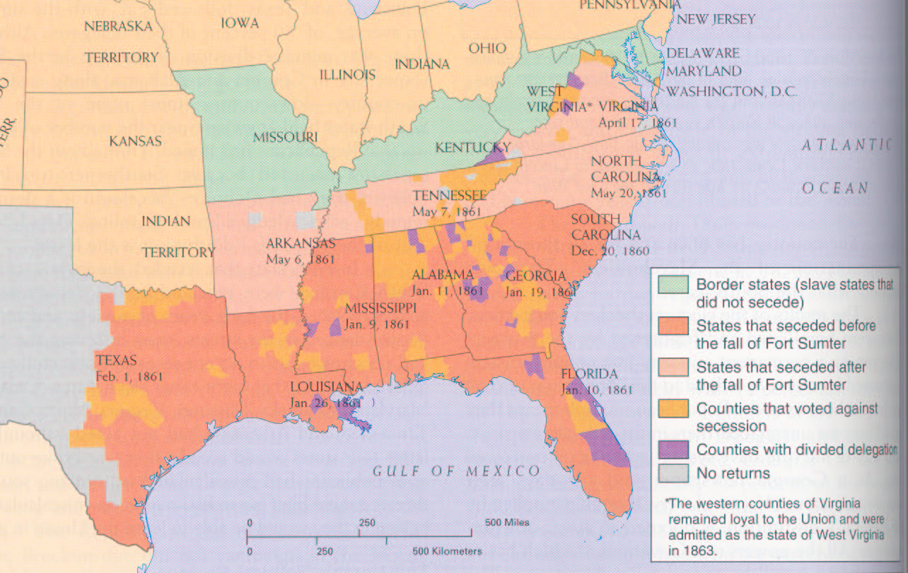

Slide 27


Slide 28
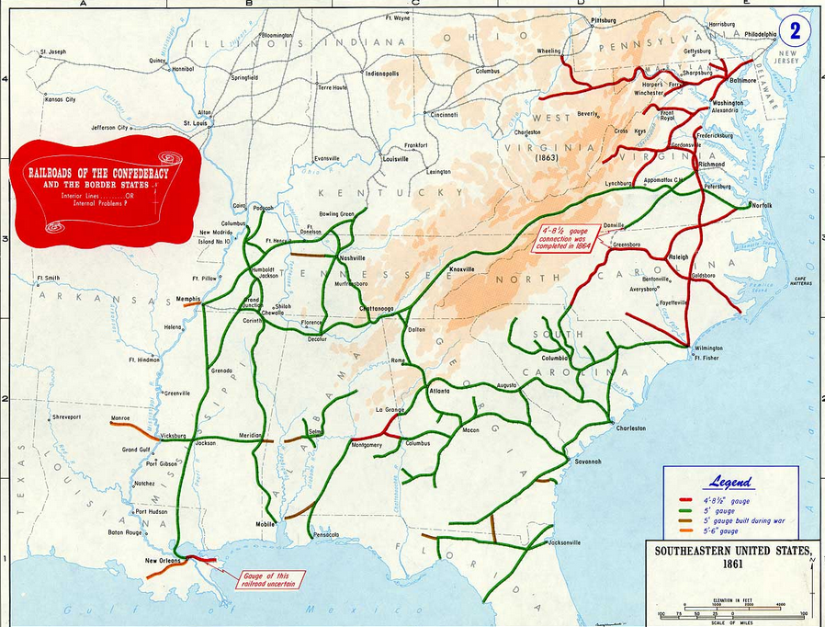

Slide 29
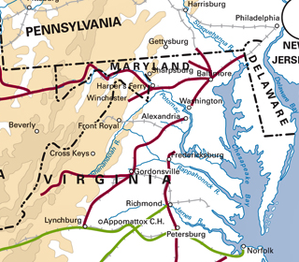

Slide 30
To the Commanding General,
Army of the United States
You are engaged in suppressing an insurrection against the laws of the United States. If at any point on or in the vicinity of any military line which is now or which shall be used between the city of Philadelphia and the city of Washington you find resistance which renders it necessary to suspend the writ of habeas corpus for the public safety, you personally, or through the officer in command at the point at which resistance occurs, are authorized to suspend that writ.
Abraham Lincoln.
Washington, April 27, 1861

Slide 31
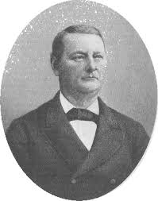
Notes:
John merryman

Slide 32
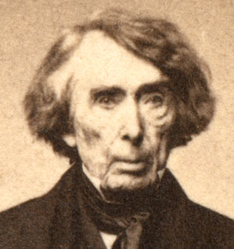

Slide 33
Ex Parte Merryman (1861)
The case, then, is simply this: A military officer residing in Pennsylvania issues an order to arrest a citizen of Maryland, upon vague and indefinite charges, without any proof, so far as appears . . .
With such provisions in the Constitution, expressed in language too clear to be misunderstood by any one, I can see no ground whatever for supposing that the President, in any emergency or in any state of things, can authorize the suspension of the privilege of the writ of habeas corpus, or arrest a citizen, except in aid of the judicial power. He certainly does not faithfully execute the laws if he takes upon himself legislative power by suspending the writ of habeas corpus and the judicial power, also, by arresting and imprisoning a person without due process of law. . .
The Government of the United States is one of delegated and limited powers. It derives it existence and authority altogether from the Constitution, and neither of its branches--executive, legislative or judicial--can exercise any of the powers of government beyond those specified and granted.

Slide 34
Lincoln, 4 July 1861 special session message
To state the question more directly, Are all the laws but one to go unexecuted, and the Government itself go to pieces lest that one be violated? Even in such a case, would not the official oath be broken if the Government should be overthrown when it was believed that disregarding the single law would tend to preserve it? …
This issue embraces more than the fate of these United States. It presents to the whole family of man the question whether a constitutional republic, or democracy--a government of the people by the same people--can or can not maintain its territorial integrity against its own domestic foes. It presents the question whether discontented individuals, too few in numbers to control administration according to organic law in any case, can always, upon the pretenses made in this case, or on any other pretenses, or arbitrarily without any pretense, break up their government, and thus practically put an end to free government upon the earth. It forces us to ask, Is there in all republics this inherent and fatal weakness? Must a government of necessity be too strong for the liberties of its own people, or too weak to maintain its own existence?

Slide 35
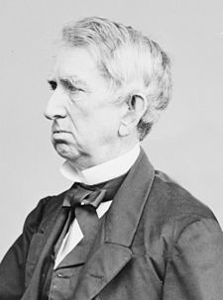

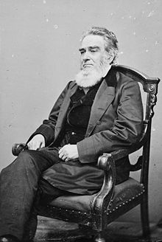
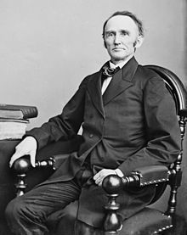
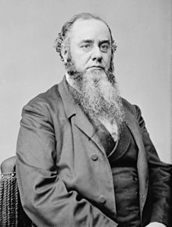
Notes:
3rd—Edward bates, ag, 4—Montgomery blair, postmaster; 5--stanton

Slide 36
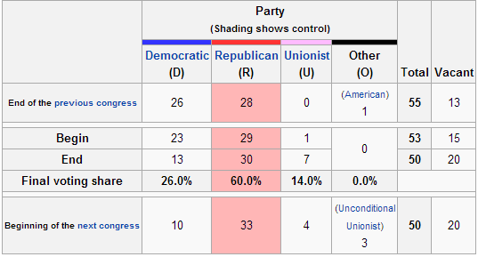
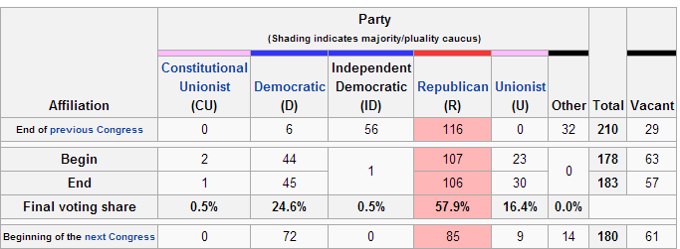

Slide 37
Homestead Act (1862)
Any person who is the head of a family, or who has arrived at the age of twenty-one years, and is a citizen of the United States, or who shall have filed his declaration of intention to become such, as required by the naturalization laws of the United States, and who has never borne arms against the United States Government or given aid and comfort to its enemies, shall, from and after the first January, eighteen hundred and sixty-three, be entitled to enter one quarter section or a less quantity of unappropriated public lands, upon which said person may have filed a preemption claim, or which may, at the time the application is made, be subject to preemption at one dollar and twenty-five cents, or less, per acre; or eighty acres or less of such unappropriated lands, at two dollars and fifty cents per acre, to be located in a body, in conformity to the legal subdivisions of the public lands, and after the same shall have been surveyed.
Passes House, 107-16; Senate 33-7.

Slide 38
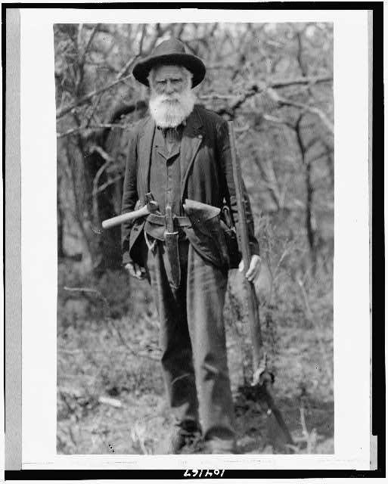
Notes:
Daniel Freeman, Nebraska, first homesteader, 1863

Slide 39
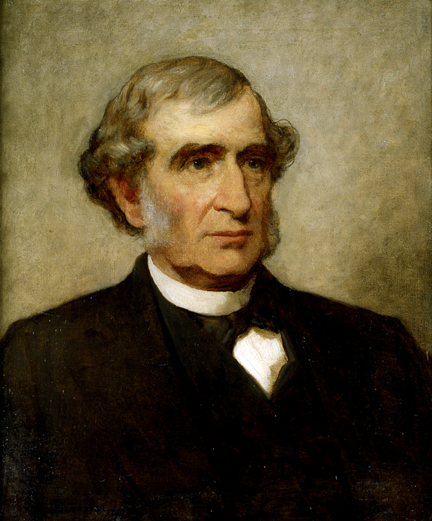
Morrill Act (1862)
Sale of federal public land for the “maintenance of at least one college where the leading object shall be, without excluding other scientific and classical studies and including military tactics, to teach such branches of learning as are related to agriculture and the mechanic arts, in such manner as the legislatures of the States may respectively prescribe, in order to promote the liberal and practical education of the industrial classes in the several pursuits and professions in life.”

Slide 40
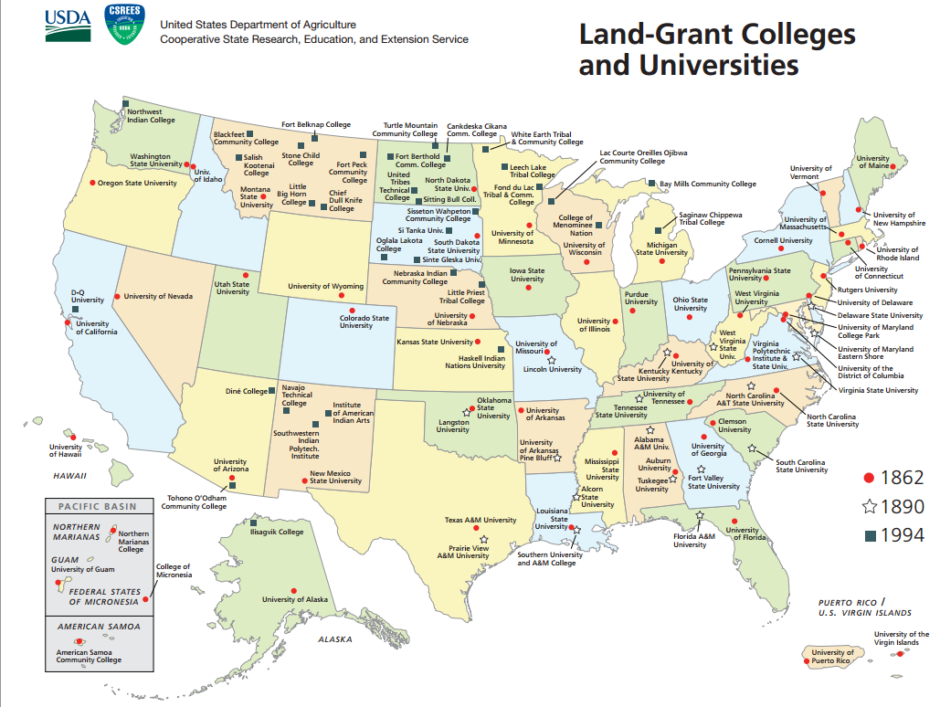

Slide 41
Pacific Railroad Act (1862)
The right of way through the public lands be, and the same is hereby, granted to said company for the construction of said railroad and telegraph line; and the right, power, and authority is hereby given to said company to take from the public lands adjacent to the line of said road, earth, stone, timber, and other materials for the construction thereof; said right of way is granted to said railroad to the extent of two hundred feet in width on each side of said railroad where it may pass over the public lands, including all necessary grounds for stations, buildings, workshops, and depots, machine shops, switches, side tracks, turntables, and, water stations. The United States shall extinguish as rapidly as may be the Indian titles to all lands falling under the operation of this act and required for the said right of way and; grants hereinafter made.

Slide 42
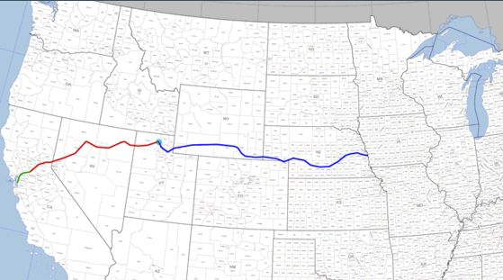

Slide 43
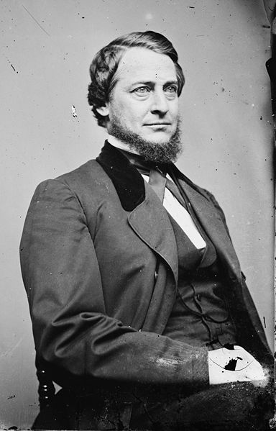
Notes:
vallandingham

Slide 44
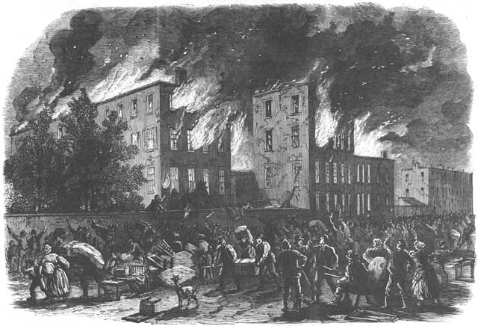
Notes:
Nyc draft riots

Slide 45
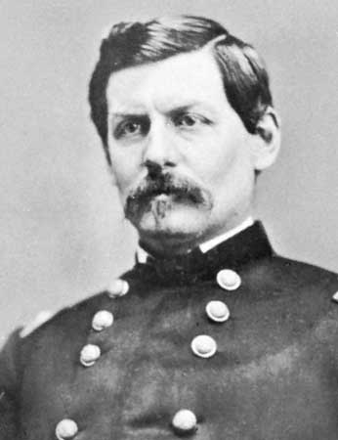
Notes:
mcclellan

Slide 46
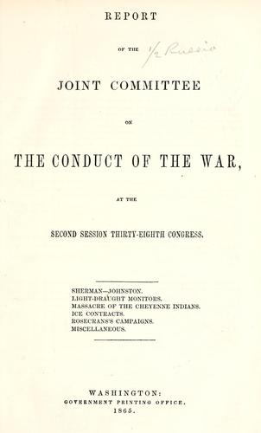

Slide 47
Emancipation Proclamation
That on the 1st day of January, A.D. 1863, all persons held as slaves within any State or designated part of a State the people whereof shall then be in rebellion against the United States shall be then, thenceforward, and forever free; and the executive government of the United States, including the military and naval authority thereof, will recognize and maintain the freedom of such persons and will do no act or acts to repress such persons, or any of them, in any efforts they may make for their actual freedom…
Now, therefore, I, Abraham Lincoln, President of the United States, by virtue of the power in me vested as Commander-In-Chief of the Army and Navy of the United States in time of actual armed rebellion against the authority and government of the United States, and as a fit and necessary war measure for supressing said rebellion…
And by virtue of the power and for the purpose aforesaid, I do order and declare that all persons held as slaves within said designated States and parts of States are, and henceforward shall be, free; and that the Executive Government of the United States, including the military and naval authorities thereof, will recognize and maintain the freedom of said persons.

Slide 48
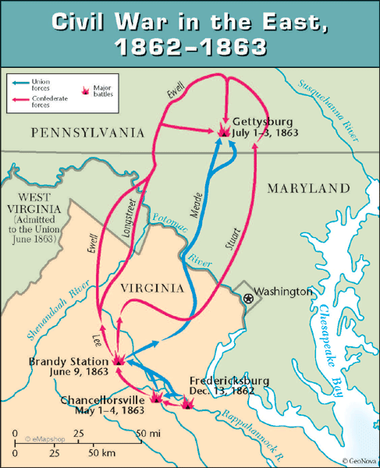

Slide 49
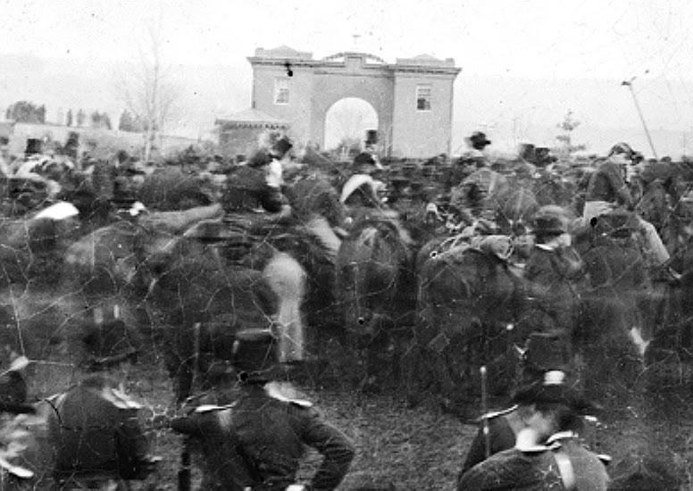

Slide 50
Four score and seven years ago our fathers brought forth on this continent, a new nation, conceived in Liberty, and dedicated to the proposition that all men are created equal.
Now we are engaged in a great civil war, testing whether that nation, or any nation so conceived and so dedicated, can long endure. We are met on a great battle-field of that war. We have come to dedicate a portion of that field, as a final resting place for those who here gave their lives that that nation might live. It is altogether fitting and proper that we should do this.
But, in a larger sense, we can not dedicate -- we can not consecrate -- we can not hallow -- this ground. The brave men, living and dead, who struggled here, have consecrated it, far above our poor power to add or detract. The world will little note, nor long remember what we say here, but it can never forget what they did here. It is for us the living, rather, to be dedicated here to the unfinished work which they who fought here have thus far so nobly advanced. It is rather for us to be here dedicated to the great task remaining before us -- that from these honored dead we take increased devotion to that cause for which they gave the last full measure of devotion -- that we here highly resolve that these dead shall not have died in vain -- that this nation, under God, shall have a new birth of freedom -- and that government of the people, by the people, for the people, shall not perish from the earth.

Slide 51
Contemporary Reaction (Democratic newspapers)
“The cheek of every American must tingle with shame as he reads the silly, flat and dishwatery utterances of the man who has to be pointed out to intelligent foreigners as the President of the United States.”
--Chicago Times
Pray “that the veil of oblivion shall be dropped over them and that they shall no more be repeated or thought of.”
-- Harrisburg Patriot and Union

Slide 52
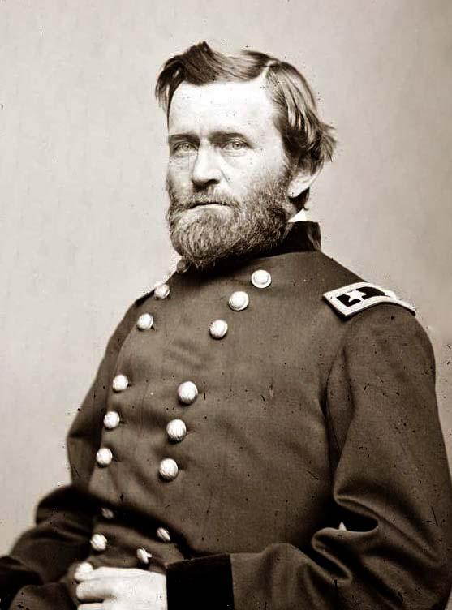

Slide 53
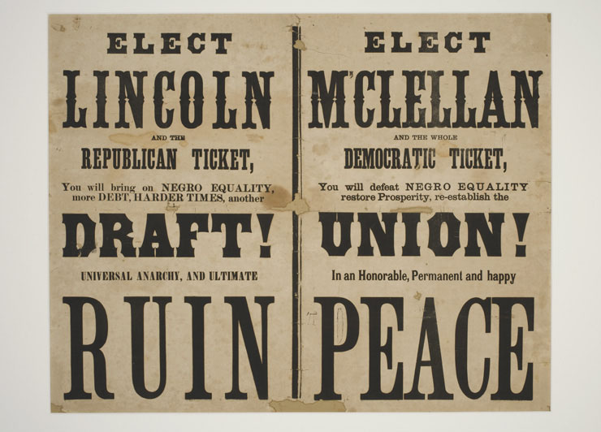

Slide 54
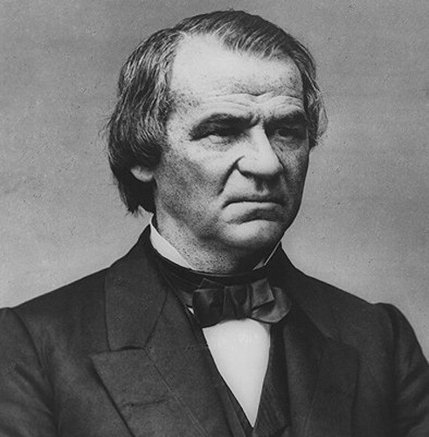

Slide 55
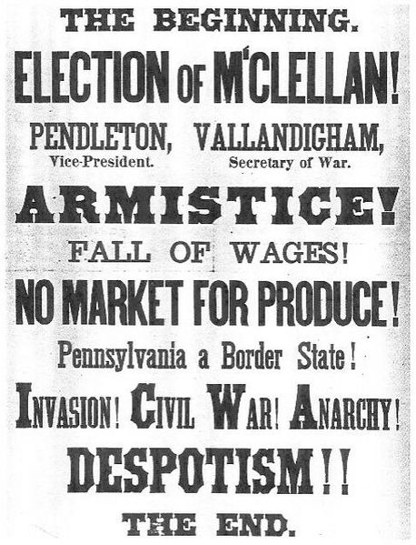

Slide 56
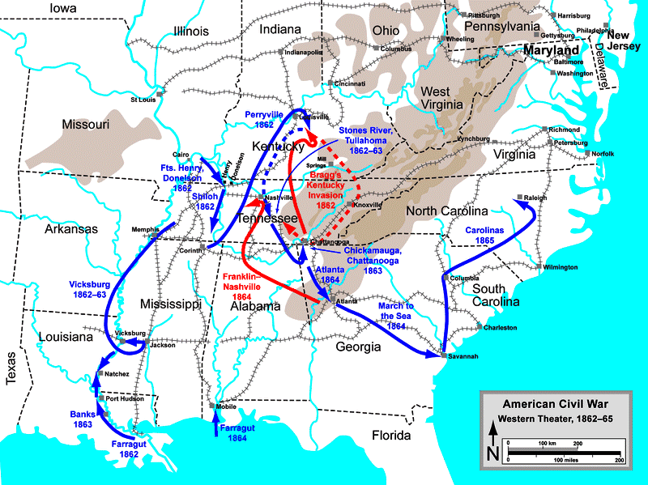

Slide 57


Slide 58


Slide 59


Slide 60


Slide 61


Slide 62
Reconstruction Plans
Lincoln
10% 1860 voters (white males) take oath of loyalty to Union
Wade-Davis bill
50% 1860 voters (white males) take oath of loyalty to Union
Confed. officeholders or those who “voluntarily” took up arms can’t vote/hold office
Confed. debt repudiated
New state constitutions that abolish slavery

Slide 63
13th Amendment
Section 1. Neither slavery nor involuntary servitude, except as a punishment for crime whereof the party shall have been duly convicted, shall exist within the United States, or any place subject to their jurisdiction.
Section 2. Congress shall have power to enforce this article by appropriate legislation.

Slide 64


Slide 65
1866 Civil Rights Act
That all persons born in the United States and not subject to any foreign power, excluding Indians not taxed, are hereby declared to be citizens of the United States; and . . . shall have the same right, in every State and Territory in the United States, to make and enforce contracts, to sue, be parties, and give evidence, to inherit, purchase, lease, sell, hold, and convey real and personal property, and to full and equal benefit of all laws and proceedings for the security of person and property, as is enjoyed by white citizens, and shall be subject to like punishment, pains, and penalties, and to none other, any law, statute, ordinance, regulation, or custom, to the contrary notwithstanding . . .
That the district courts of the United States, within their respective districts, shall have, exclusively of the courts of the several States, cognizance of all crimes and offences committed against the provisions of this act . . .

Slide 66
14th Amendment (1866-8)
Section 1.
All persons born or naturalized in the United States, and subject to the jurisdiction thereof, are citizens of the United States and of the state wherein they reside. No state shall make or enforce any law which shall abridge the privileges or immunities of citizens of the United States; nor shall any state deprive any person of life, liberty, or property, without due process of law; nor deny to any person within its jurisdiction the equal protection of the laws.
Section 2.
[States that deny right to vote lose representatives for voters disenfranchised.]
Section 3.
[No Confederate officeholder or military officer can serve in Congress.]
Section 4.
[Confederate debt repudiated.]

Slide 67

Notes:
Johnson/Grant swing around circle

Slide 68


Slide 69


Slide 70
Reconstruction Acts (1867)
Creation of five military districts in the seceded states not including Tennessee, which had ratified the Fourteenth Amendment to the United States Constitution and was readmitted to the Union;
Requiring congressional approval for new state constitutions (which were required for Confederate states to rejoin the Union);
Confederate states give voting rights to all men;
All former Confederate states must ratify the 14th Amendment.

Slide 71


Slide 72

Notes:
stanton

Slide 73
Tenure of Office Act (1867)
Be it enacted, That every person holding any civil office to which he has been appointed by and with the advice and consent of the Senate, and every person who shall hereafter be appointed to any such office, and shall become duly qualified to act therein, is, and shall be entitled to hold such office until a successor shall have been in like manner appointed and duly qualified, except as herein otherwise provided: Provided, That the Secretaries of State, of the Treasury, of War, of the Navy, and of the Interior, the Postmaster-General, and the Attorney general, shall hold their offices respectively for and during the term of the President by whom they may have been appointed and for one month thereafter, subject to removal by and with the advice and consent of the Senate.

Slide 74


Slide 75


Slide 76


Slide 77

Impeachment vote map
Yellow—both senators vote to convict
Orange—divided delegation
Red—both senators vote to acquit

Slide 78

Edmund Ross, a Kansas Republican, cast the deciding vote that ended the impeachment proceedings against President Andrew Johnson…As the trial went on it became clear that the Republicans had no intention of giving Johnson a fair trial; rather, their emphasis was on convincing enough Senators to find Johnson guilty. Ross was overheard saying that while he had no sympathy for Johnson, he would do his best to see that he was fairly tried. Because Ross had previously been such a partisan Republican, he became the principal target of abuse from the press, the public, and his fellow Republican legislators. Nonetheless, Ross voted against convicting Johnson, reasoning that if a president could be forced out of office by insufficient evidence that was based on partisan disagreement, the presidency would then be under the control of whatever congressional faction held sway. Eventually, Ross was vindicated by the Supreme Court, which declared the Tenure of Office Act to be unconstitutional, and praised by the press and the public for having saved the country from dictatorship.

