Slide 1
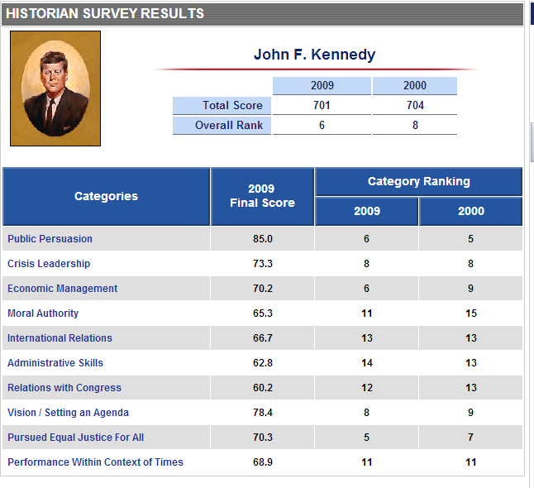

Slide 2
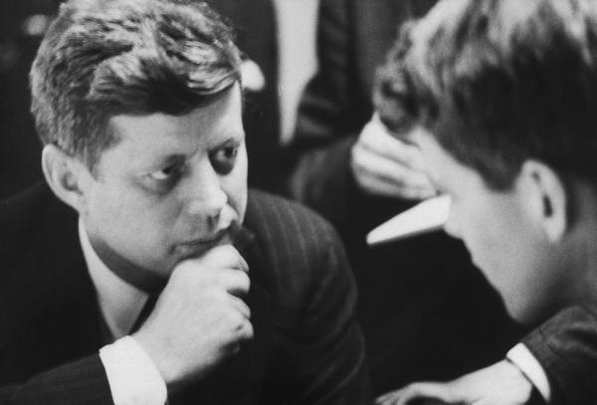
Notes:
Wi primary night

Slide 3
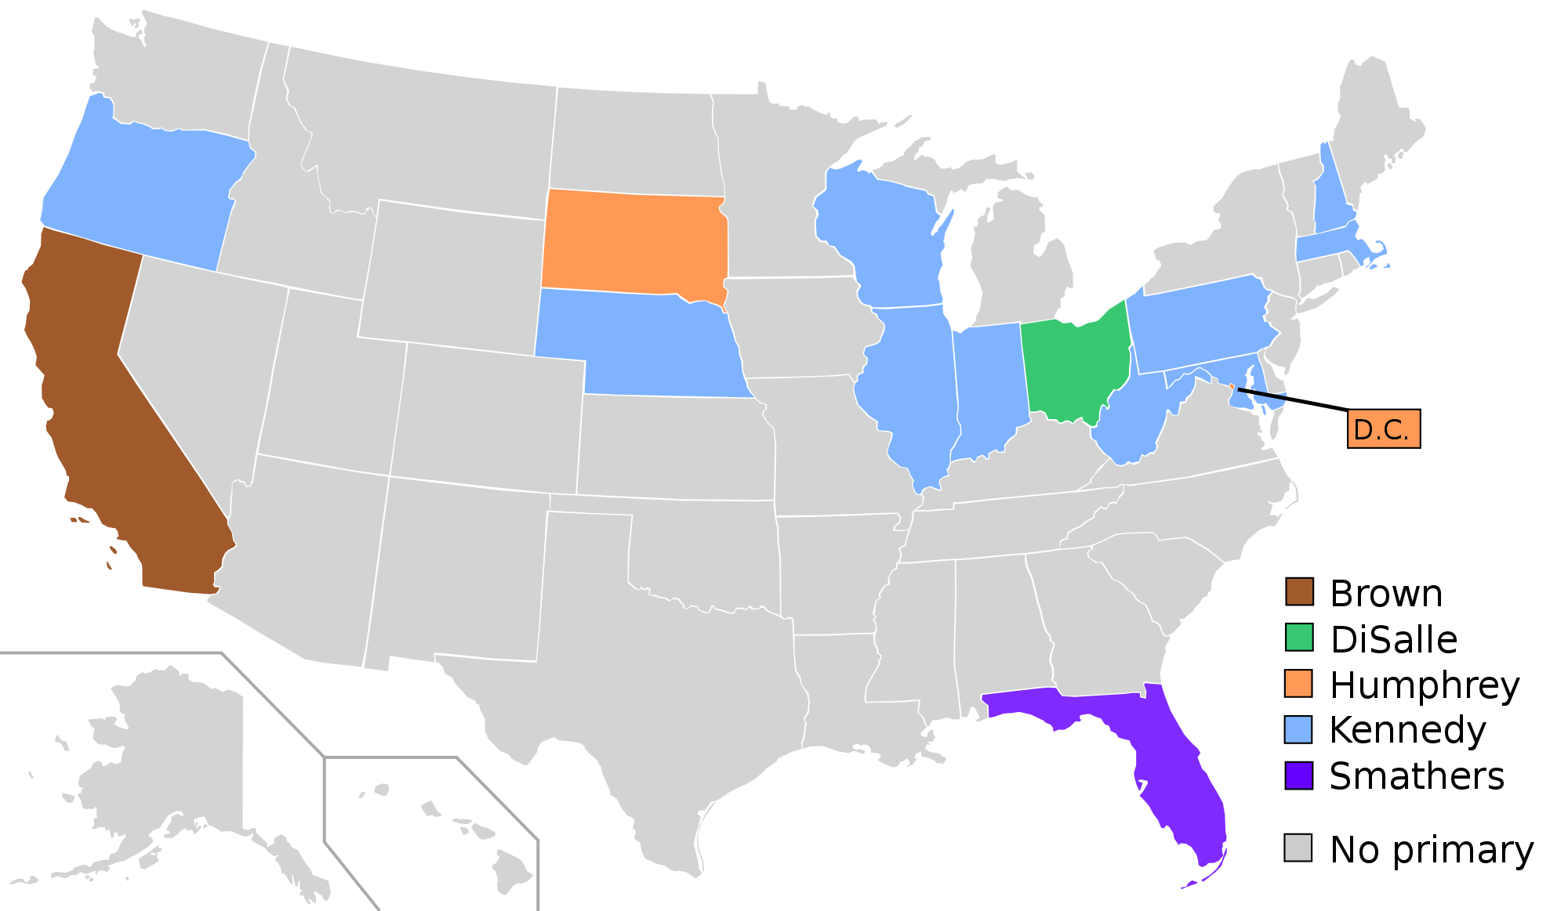

Slide 4
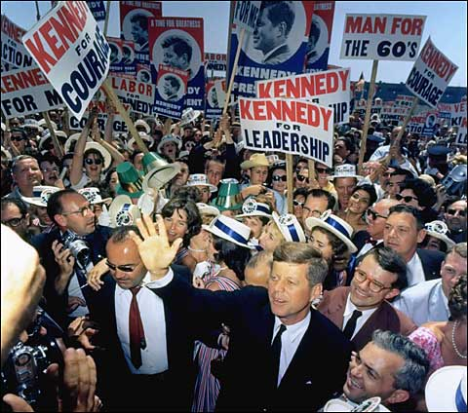

Slide 5
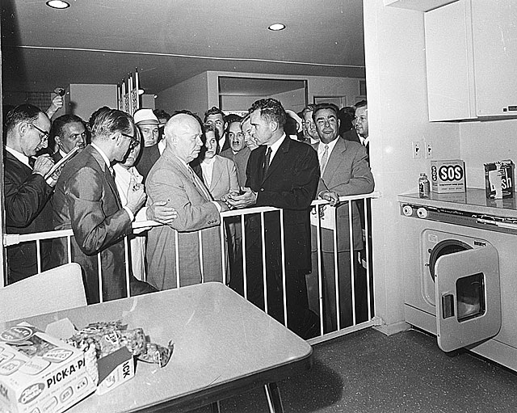

Slide 6
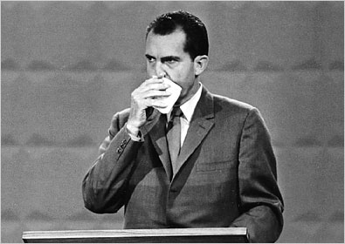

Slide 7
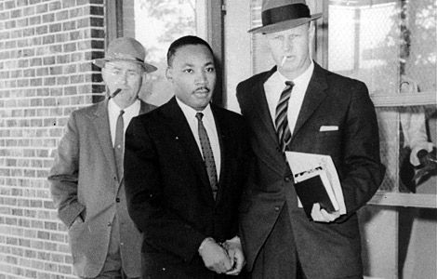

Slide 8
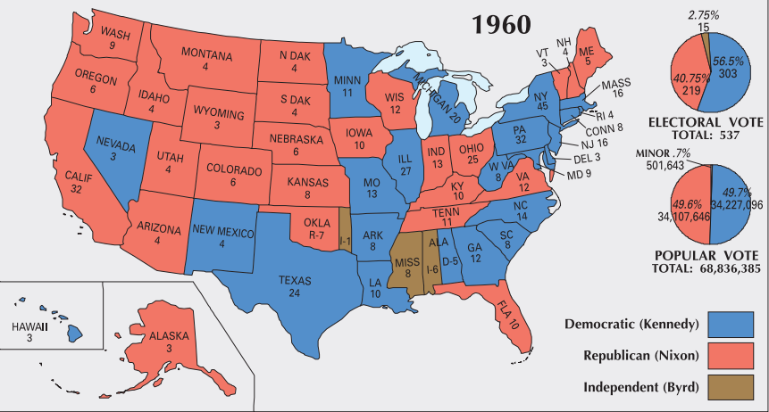

Slide 9
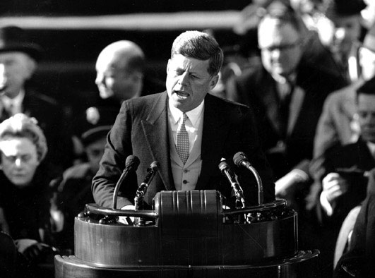
23199505891

Slide 10
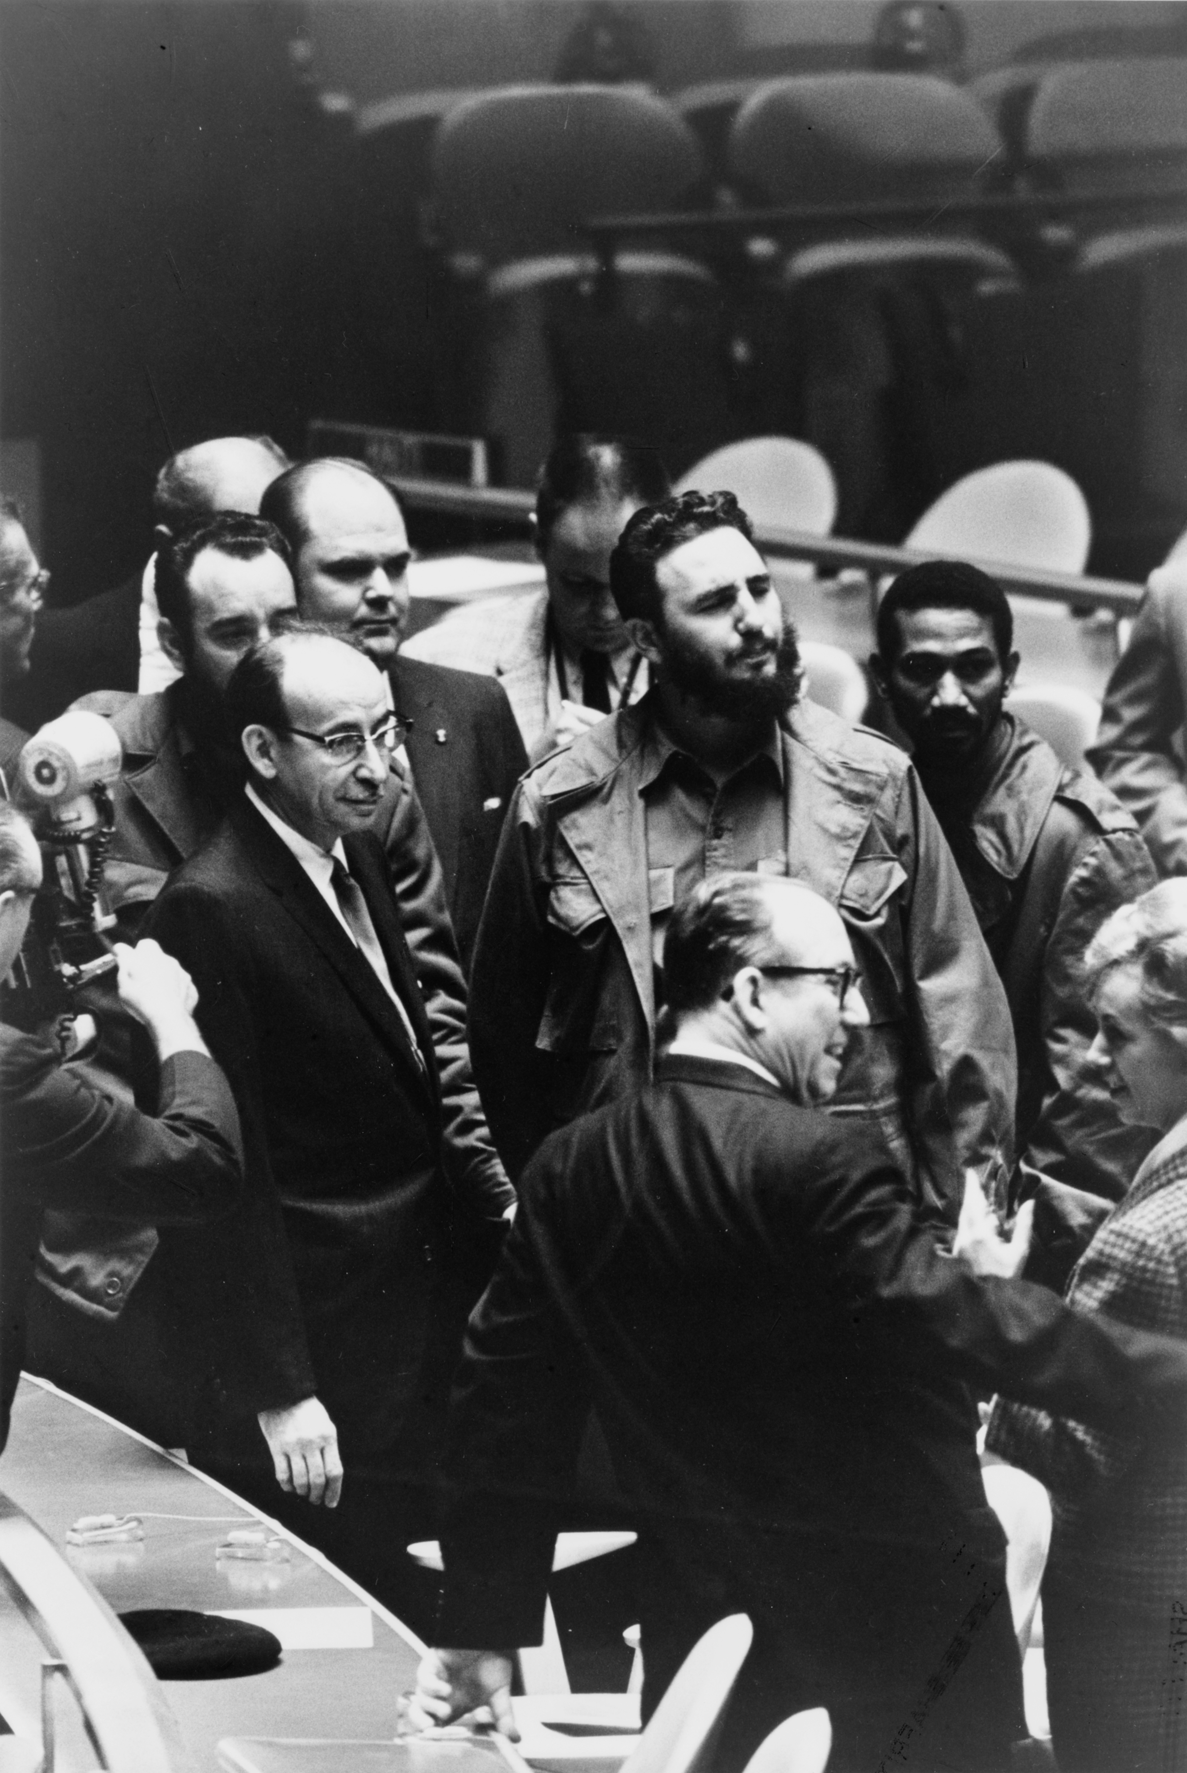

Slide 11



Slide 12
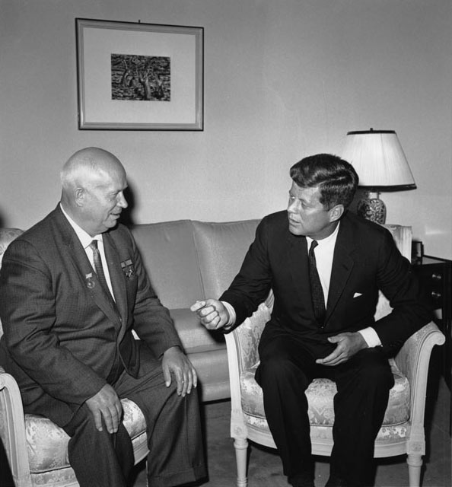

Slide 13


Slide 14
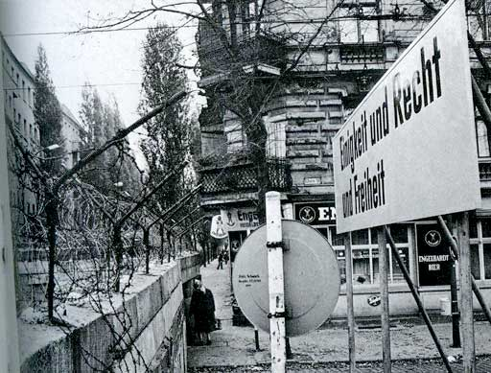

Slide 15


Slide 16


Slide 17


Slide 18


Slide 19
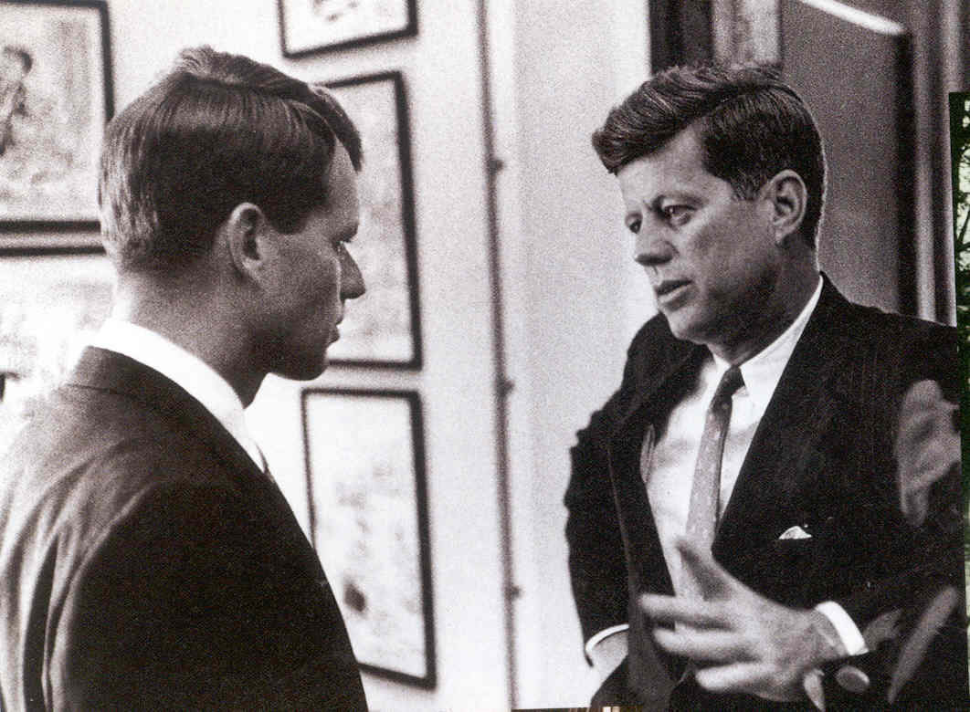

Slide 20
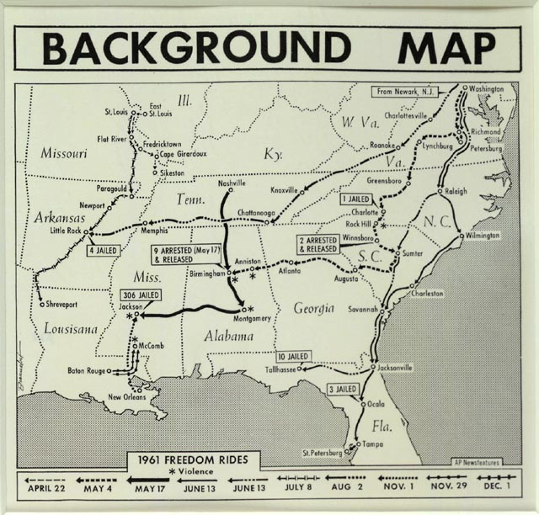

Slide 21
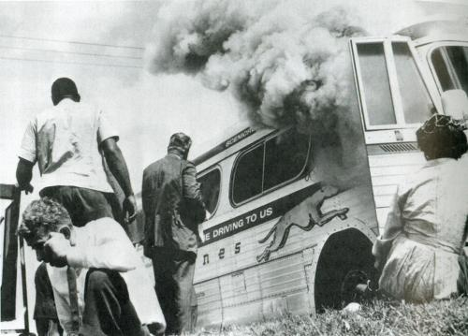

Slide 22


Slide 23


Slide 24


Slide 25
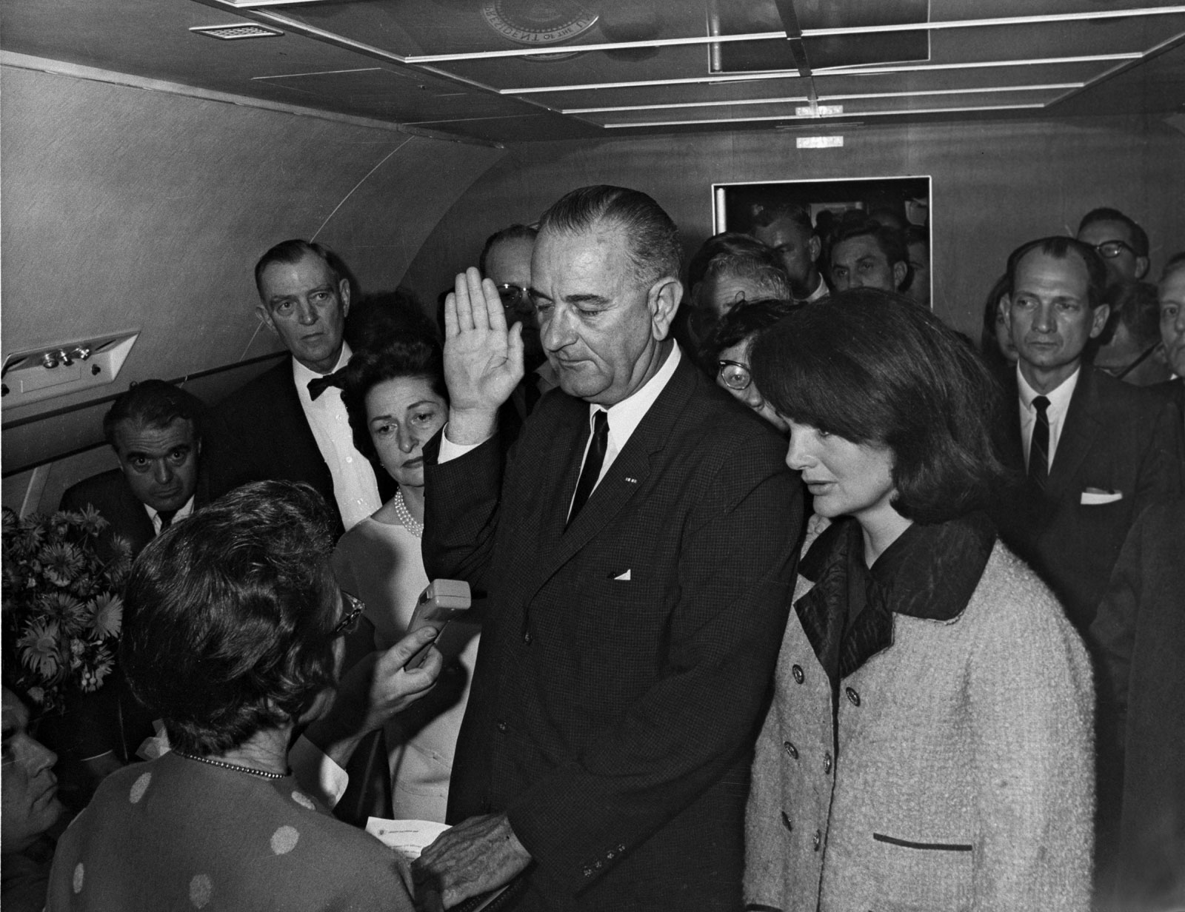

Slide 26
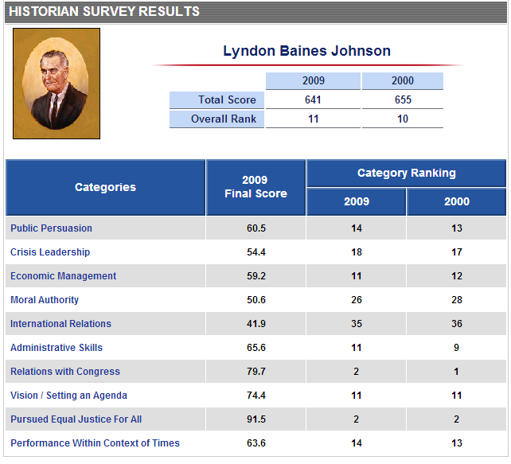

Slide 27

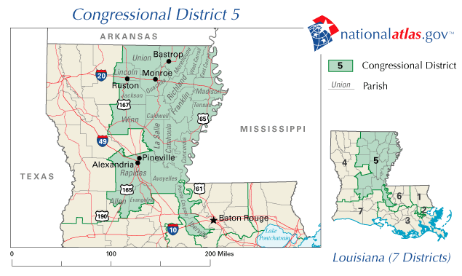

Slide 28
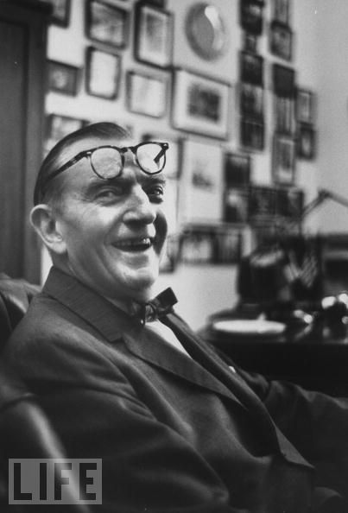
Notes:
thomas

Slide 29
President Johnson: I don’t want to debate it with you, my friend. I love you. But you know goddamn well when I ask ‘em not to make me notify ‘em publicly so it wouldn’t be in the papers . . .
Albert Thomas: Well . . .
President Johnson: You know that I know what I’m doing.
Thomas: Frankly, I—
President Johnson: You know, and we screwed it up. This damn fool [Minnesota senator Hubert] Humphrey put that paragraph on.
Thomas: That’s right—
President Johnson: I told [House Majority Leader Carl] Albert to get it off, cut it off.
Thomas: I think it’s your partners over on the Senate side. Now, old Otto [Passman] played ball. He told me he was going to do his damnedest to take it out.
Have you got the language in front of you?
President Johnson: Yes, sir, I’ve got it front of me. And it oughtn’t to be in there. It’s just a damn—
Thomas: [hurriedly reading] “Agency or national in connection with the purchase . . . [etc.].”
President Johnson: That’s right.
Thomas: “Or national except when the President determines that such guarantees would be in the national interest.”
President Johnson: That’s all right—period.
Thomas: “And reports each”—
President Johnson: No, no! No! Period, after “national interest.”
Thomas: I know, but read your language further. “And reports each determination.”
President Johnson: [loudly] Why should I want to report to everybody that I screwed a girl? You screwed one last night, but you don’t want to report it.
Thomas: [slyly] I wish I did.
President Johnson: Well, you know what I’m talking about. That made it come home to you, didn’t it?
Thomas: Well, it ain’t going to—
President Johnson: Don’t you think I’m a damned idiot, now.
Thomas: Now, now—
President Johnson: Well—
Thomas: Now, now, now, now. Of course not. But I don’t think it’s going to hamstring you a bit on—
President Johnson: It doesn’t hamstring me. It just publicizes that I’m pro-Russian right when [Richard] Nixon’s running against me. That’s all it does.
Thomas: Well, he ain’t going to run, because he ain’t going to—
President Johnson: Well, listen, Albert—
Thomas: —he ain’t going to get two or three—
President Johnson: Listen, Albert. You and I are buddies now. You understand politics, and I do, too. I’m telling you that we’re working with the Republicans up there 100 percent.
Thomas: Well, I’m on your side.
President Johnson: Well, all right. You just don’t ever agree that that’s a good clause, because you know goddamn well it ain’t. Don’t try to shit me, because I know better.
Thomas: Here’s the Speaker. Well, I’ve worked with it in the space program—
President Johnson: Yeah, you’ve worked with it, but you’ve been working with it under Republican presidents, not under Democrats. When a Democratic President has to report that he makes a determination that it’s in his interest to go with Russia, it’s not good when you’re running for office. Now, you know that, don’t you?

Slide 30
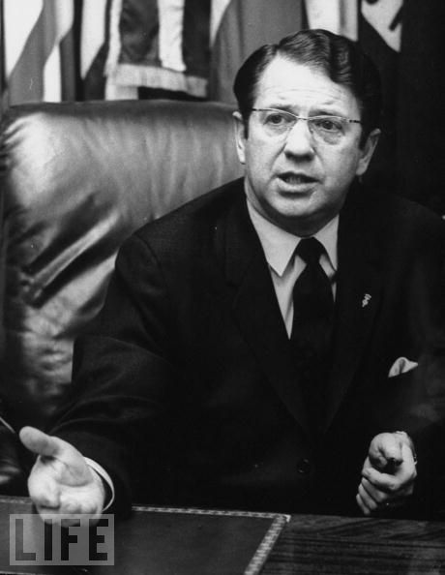

Slide 31
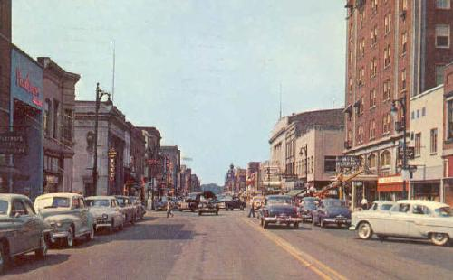
Notes:
Elkhart—once had 60 instruments manufacturers

Slide 32
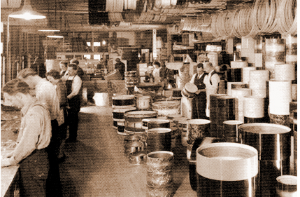
Notes:
Conn selmer

Slide 33
President Johnson: Vance?
Vance Hartke: Yes, sir.
President Johnson: Can’t you help me on this excise tax thing? You’re going to wreck this damn bill. We’re not going to have any. They’re going to get together this afternoon and try to make a motion to keep all excise taxes in there, and we need your help.
Hartke: [searching for words] Well, I mean, I suppose that way started out—
President Johnson: I know it. And [New Mexico senator] Clint Anderson, though, they all got mad yesterday because you-all screwed up that oil vote.
And they’re after the oil companies, and [Delaware senator John] Williams and everything else. Those big oil companies oughtn’t to be raising hell [for] 40 million. They got off with 400 million [in tax breaks], and they ought to let you-all off the hook.
But now we’ve got it in a big screwed-up mess, and we—all of us are going down in defeat if we can’t operate any better than that. There’s no leadership in the committee.
President Johnson: So for God’s sake, get in there. Clint Anderson says he’ll change, and you change, and get two or three more and let’s . . .
Hartke: The one big thing in there, the one thing I wanted, was [to cut the tax on] musical instruments.
President Johnson: Oh, well—
Hartke: This is—
President Johnson: What’s important is the big credit to the Democratic Party, and let’s go on.
The goddamned band and musical instruments—they won’t be talking about it next November.
Hartke: They will in Elkhart—
President Johnson: What they’re going to be judging us by is: they’re going to be judging us whether we passed the tax bill or not and whether we’ve got prosperity.

Slide 34
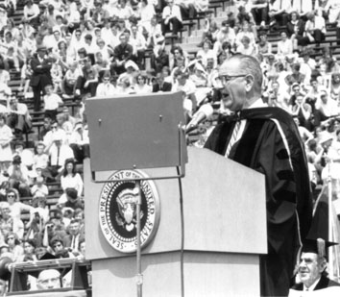

Slide 35
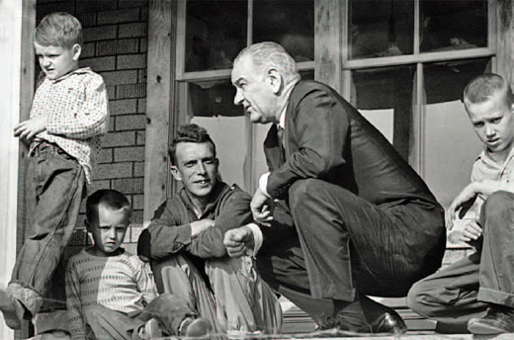
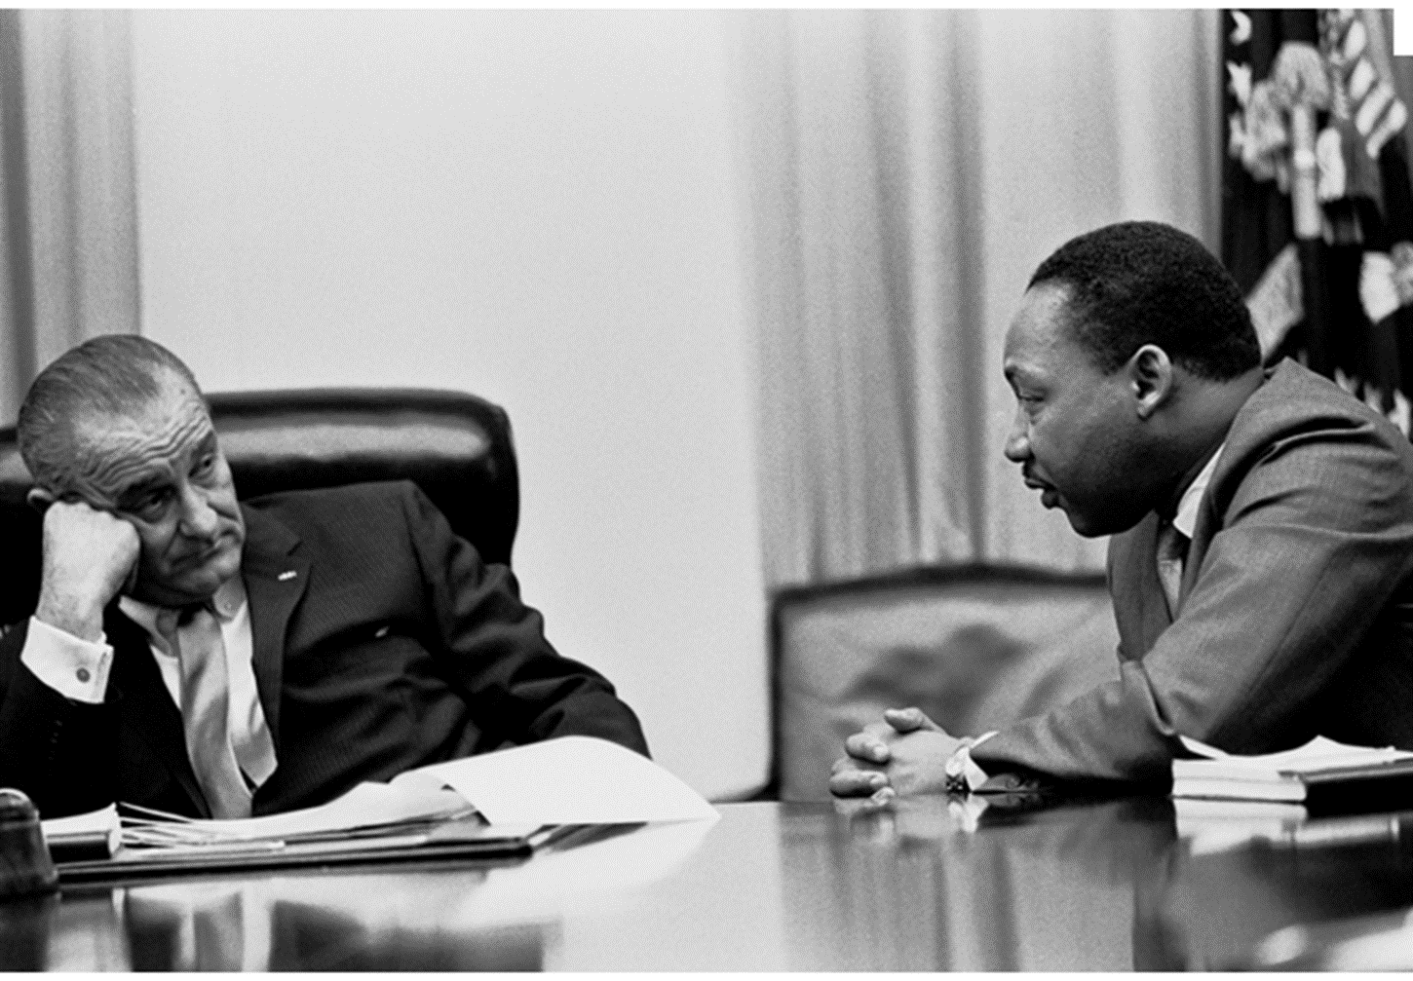
Notes:
Ap64—no electricity running water

Slide 36
Economic Opportunity Act (1964)
VISTA (Volunteers In Service To America)
Job Corps
Head Start
Legal Services
Various local anti-poverty programs & targeted medical programs
Community Action Programs
“provides services, assistance, and other activities of sufficient scope and size to give promise of progress toward elimination of poverty or a cause or causes of poverty through developing employment opportunities, improving human performance, motivation, and productivity, or bettering the conditions under which people live, learn, and work.

Slide 37
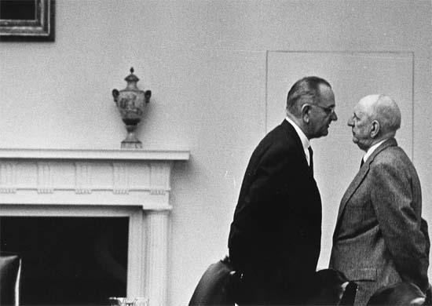

Slide 38
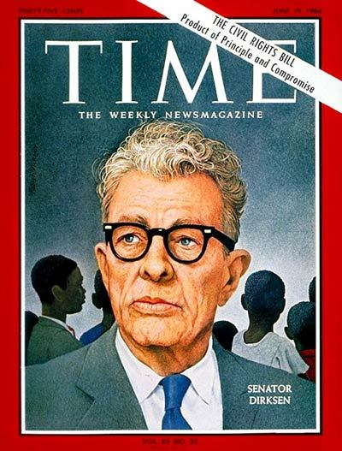

Slide 39
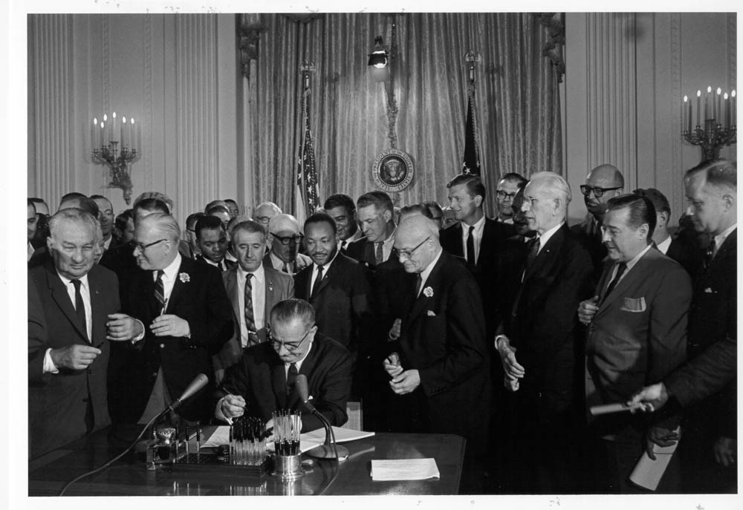

Slide 40
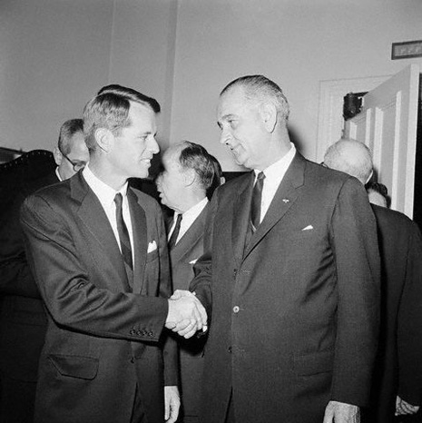

Slide 41
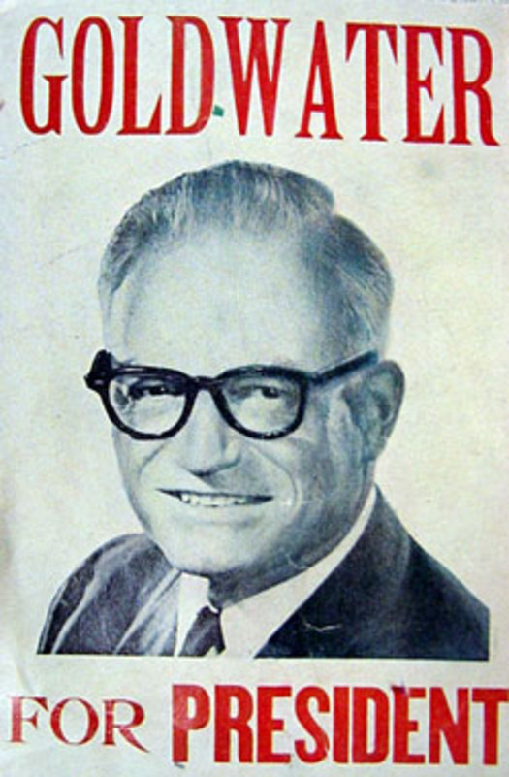

Slide 42
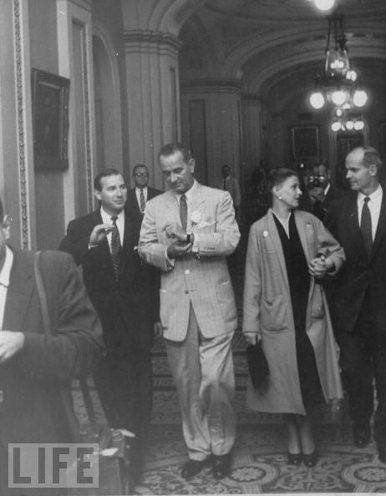

Slide 43


Slide 44
President Johnson: What’s happening is we’re doing four or five things. Number one: we’re coming in there and seating the state of Mississippi. Every damn one of them. Now, they oughtn’t to be, Carl. They oughtn’t to …
Carl Sanders: I don’t—
President Johnson: You and I just can’t survive our political modern life with these goddamned fellows down there [white Mississippi leaders] that are eating them for breakfast every morning. They’ve got to quit that. And they’ve got to let them [African-Americans] vote. And they’ve got to let them shave. And they’ve got to let them eat, and things like that. And they don’t do it.
However much we love [Democratic Senators] Jim Eastland and John Stennis, they get a governor like Ross Barnett, and he’s messing around there with [George] Wallace, and they won’t let one [black] man go in a precinct convention. We’ve got to put a stop to that, because that’s just like the old days, by God, when they wouldn’t let them go in and cast a vote of any kind.
You’ve put a stop to it in your state. But we’re going to ignore that. We’re going to say, “Hell, yes, you did it. You’re wrong. You violated the ’57 [civil rights] law, and you violated the ’60 [civil rights] law, and you violated the ’64 [civil rights] law, but we’re going to seat you—every damn one of you. [dripping with sarcasm] You lily white babies, we’re going to salute you.”

Slide 45
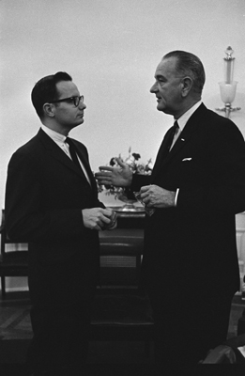

Slide 46
President Johnson: [The speech should stress that] we have a right to wish what we want to, think what we want to, worship where we want to, sleep where we want to.
Everything like . . . the basic fundamentals that—that Declaration of Independence, Bill of Rights, Constitution thing, wrapped up in one paragraph.
Do you remember the paragraph I’m talking about?
Bill Moyers: Yes, sir. I sure do.
President Johnson: But I want it elaborated on a little bit—“A mind to be trained, a child’s mind to be trained. A church to pray in. A home to sleep in. A job to work in.”
Moyers: All right.
President Johnson: Let’s get education, religion, free speech, free press—“read what he pleases”—that will round him out as a well-balanced, tolerant, understanding individual.
Moyers: All right.
President Johnson: Instead of one of these kooks.
Moyers: OK.
President Johnson: [chuckling] Do you follow me there, now?
Moyers: Gotcha.
President Johnson: I want that one paragraph so that I can have all the Johnson philosophy.
He [Reuther] said, “Now, you’ve got to speak some on poverty. You’ve got to speak some on education. You’ve got to speak some on Medicare.” Somebody’s told him it’s going to be a high level speech. And he wants it a party hack speech.
I said, “Well, I’m going to refer to all of them.” I want it in one paragraph—my philosophy. So that when you quote what I had in that Southwest Quarterly [article]—“I’m a free man, an American, and a senator, in that order, and so forth.” Do you remember?
Moyers: Right.
President Johnson: I want something that you can quote like this the rest of our lives. You can put it up in the preface of your book. “I see a . . . I have a vision . . . dash . . . a vision of a land where a child can [pauses for nine seconds] have a home to live in.”
[quickly] And then repeat what I just said to you.
Moyers: OK.
President Johnson: “Can read what he wants to, and can wishwhat he wants to, and can dream what he wants to.” Put in the words, “I have a vision.” Let’s get a little bit of this holy-rolly populist stuff. [voice rising] “I have a vision of a land where every child [pauses] can have training to fit his abilities, a home to protect him from the elements, a church to kneel in.”
Throw at least two biblical quotations in, that are very simple, that every one of them have heard—these working [men], these auto mechanics.
Moyers: All right.
President Johnson: It’s what you Baptists just pour to them all the time.
Moyers: [chuckling] All right.
President Johnson: Make it simple; don’t give me one of these long ones.
Moyers: Right.
President Johnson: Just go back and get me one of the commandments. These Baptists preachers—don’t get on that adultery one. Get some of these, “Thou shalt not [pauses] lie on thy brother.” [Chuckles.]
Moyers: All right. OK.
President Johnson: OK.

Slide 47
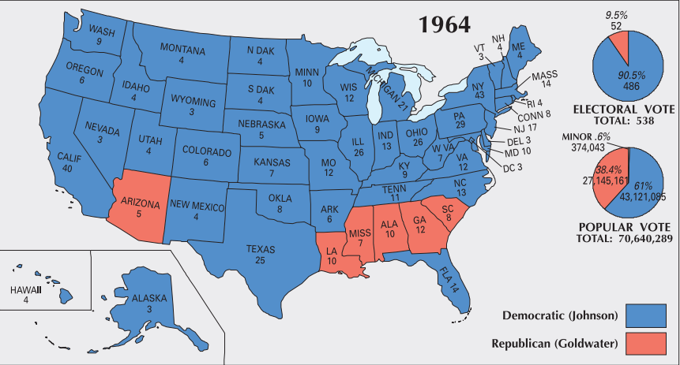

Slide 48
Voting Rights Act (1965)
Section 2 of the Voting Rights Act of 1965 prohibits voting practices or procedures that discriminate on the basis of race, color, or membership in one of the language minority groups identified in Section 4(f)(2) of the Act.
Section 5 freezes election practices or procedures in certain states until the new procedures have been subjected to review, either after an administrative review by the United States Attorney General, or after a lawsuit before the United States District Court for the District of Columbia. This means that voting changes in covered jurisdictions may not be used until that review has been obtained.
--DOJ description

Slide 49


Slide 50
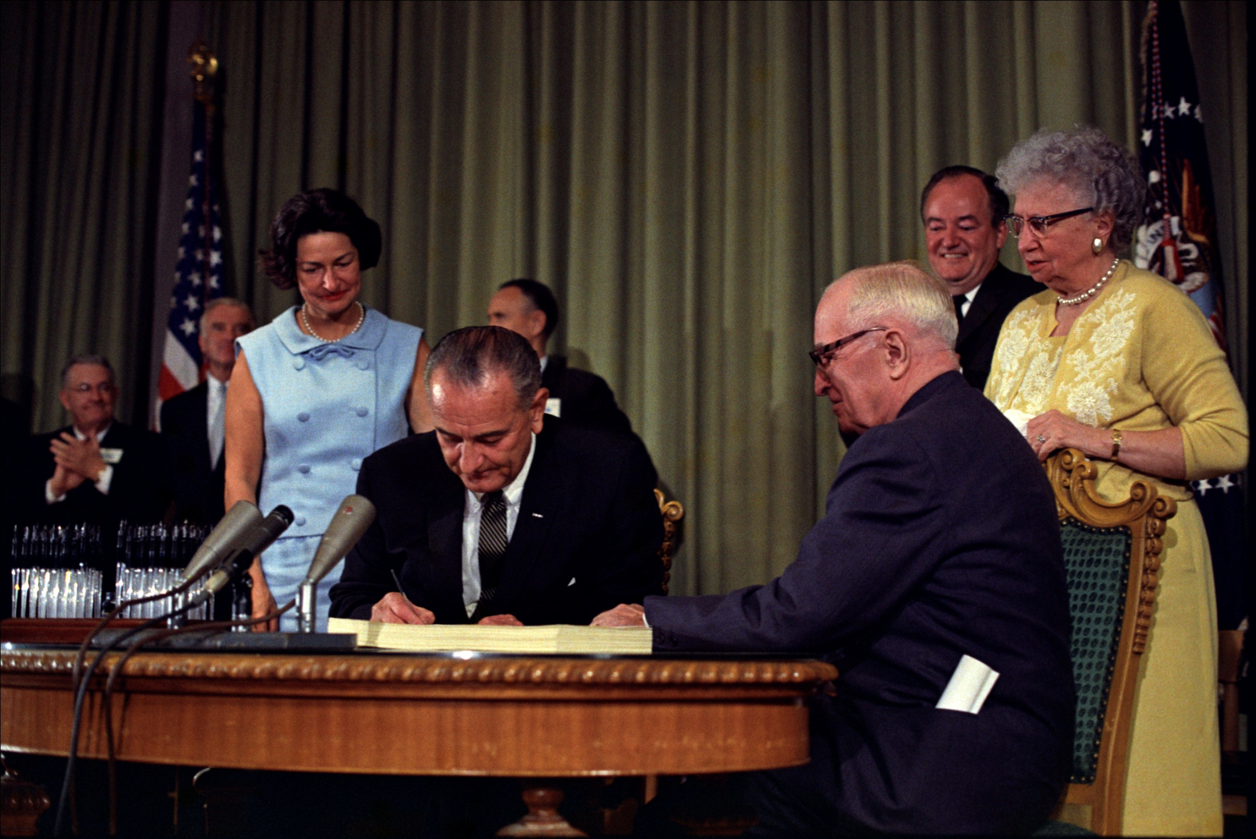

Slide 51
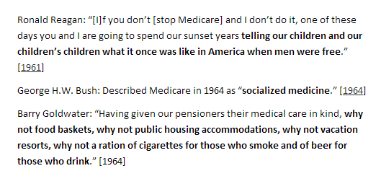

Slide 52


Slide 53


Slide 54
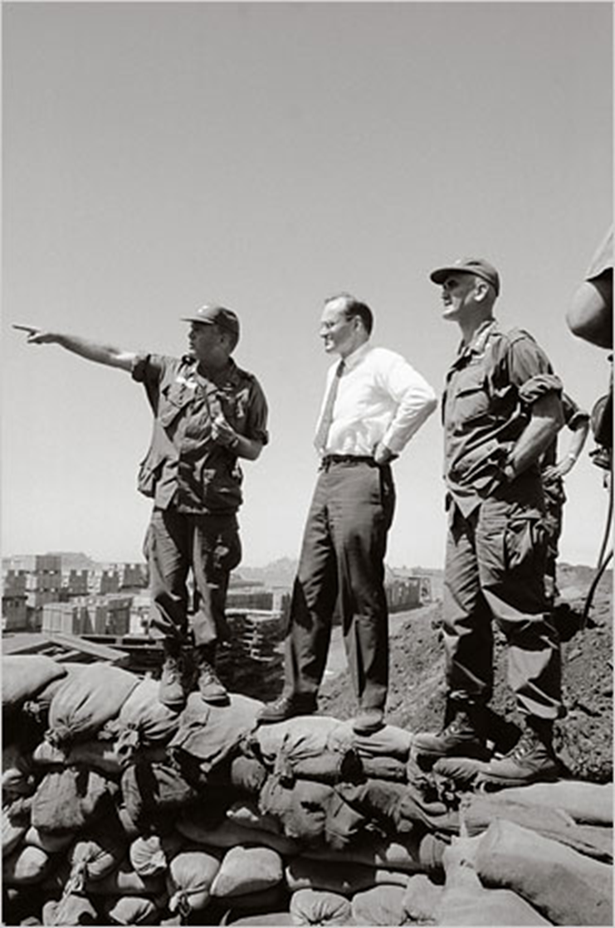
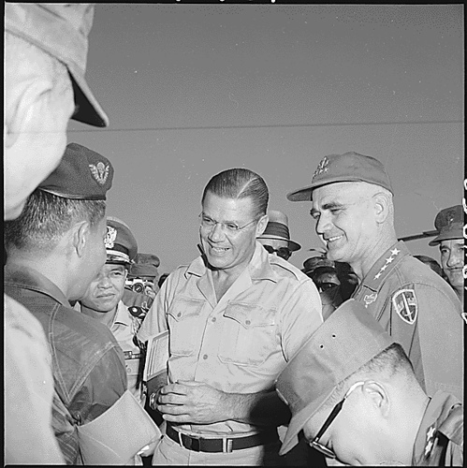

Slide 55


Slide 56
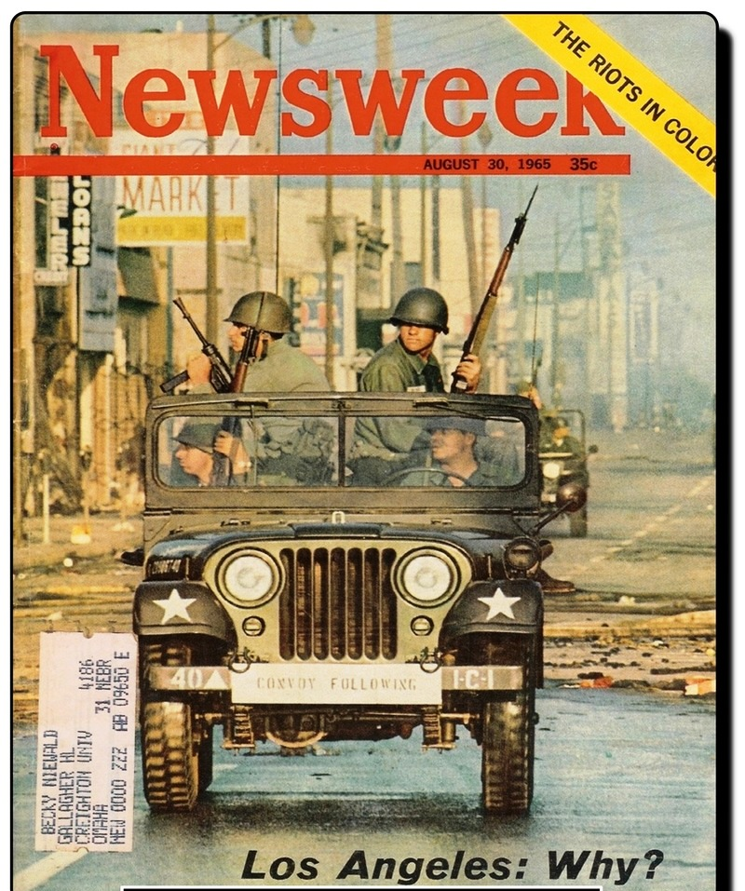

Slide 57
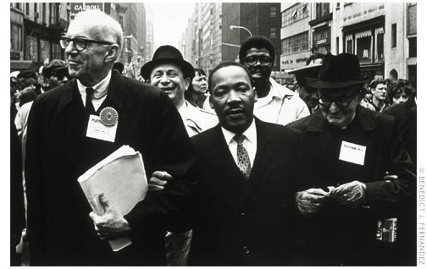

Slide 58
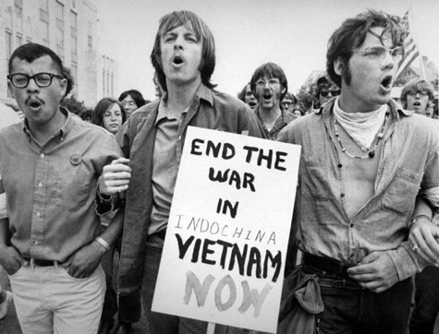

Slide 59


Slide 60
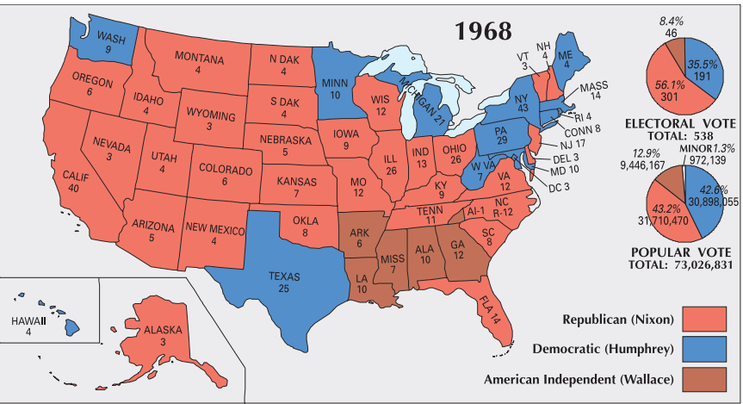

Slide 61
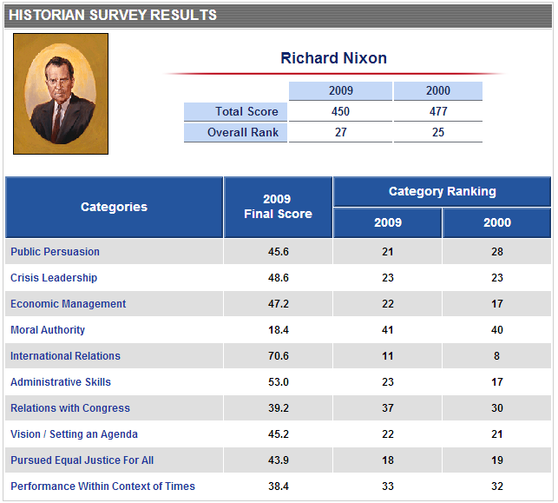

Slide 62
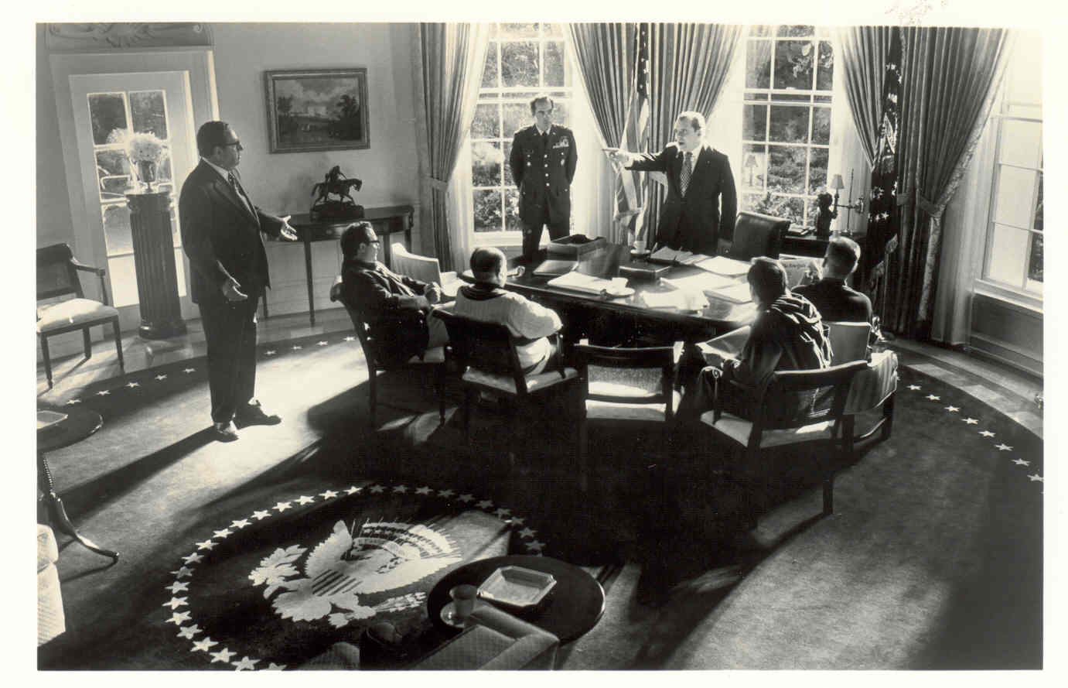

Slide 63
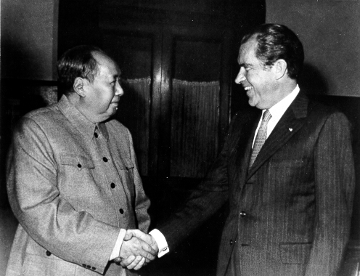

Slide 64
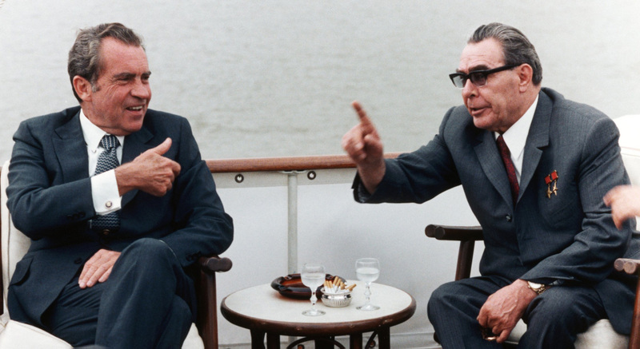

Slide 65
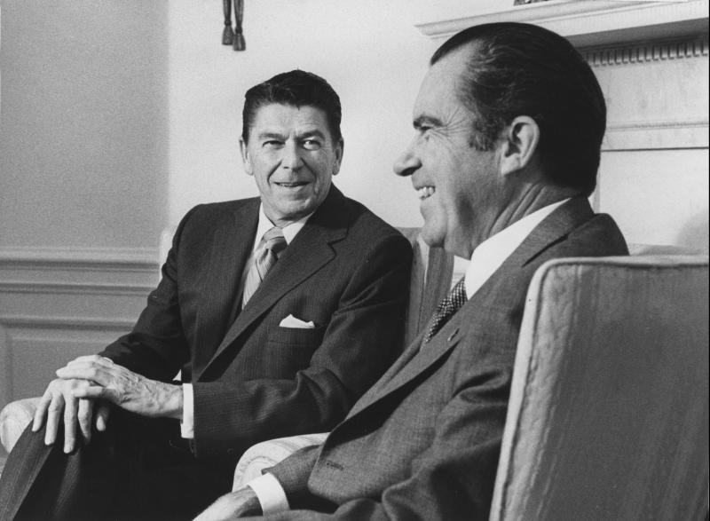

Slide 66
President Nixon:.. . we learned a lot from Mr. [Ronald] Reagan.
Henry Kissinger: Oh, yeah, yeah. Well, he started bleeding. He said that you have a real problem with the conservatives.
President Nixon: Oh, I know.
Kissinger: Which is no news to you. He says you’re going to wind up without any friends, because you can’t win the liberals anyway.
President Nixon: Jesus.
Kissinger: And the conservatives are just saying—
President Nixon: Henry, let me tell you part of his problem, of course, is that he’s in a very, very poor position in California, you know.
[Break.]
Kissinger: Well, I think he’s a—actually I think he’s a pretty decent guy.
President Nixon: Oh, decent, no question, but his brains?
Kissinger: Well, his brains, are negligible. I—
President Nixon: He’s really pretty shallow, Henry.
Kissinger: He’s shallow. He’s got no . . . He’s an actor. When he gets a line he does it very well. He said, “Hell, people are remembered not for what they do, but for what they say. Can’t you find a few good lines?” [Chuckles.] That’s really an actor’s approach to foreign policy—to substantive—
President Nixon: I’ve said a lot of good things, too, you know damn well.
Kissinger: Well, that too.
[Break.]
President Nixon: Can you think though, Henry, can you think, though, that Reagan with certain forces running in the direction could be sitting right here?
Kissinger: Inconceivable.
President Nixon: No, but it could have happened.
Kissinger: It could have happened.
President Nixon: It could have happened in ‘68. What would have happened—
Kissinger: If Rockefeller had stayed in—I mean if Rockefeller had gone in competently—
President Nixon: That’s right.
Kissinger: I don’t think he [Rockefeller] had a chance, but he might just have been able to [unclear].
President Nixon: [Unclear.] That right. Can you imagine? The fellow really is a decent guy, a decent guy. But there isn’t—there’s no, in other words, everything is . . .
[Break.]
President Nixon: Back to Reagan though. It shows you how a man of limited mental capacity simply doesn’t know what the Christ is going on in the foreign area.

Slide 67
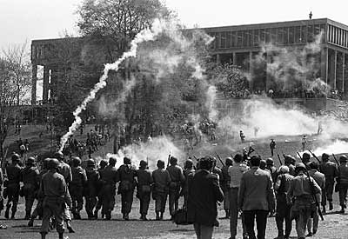

Slide 68
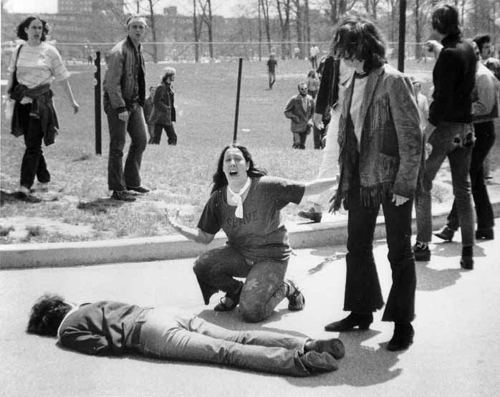

Slide 69
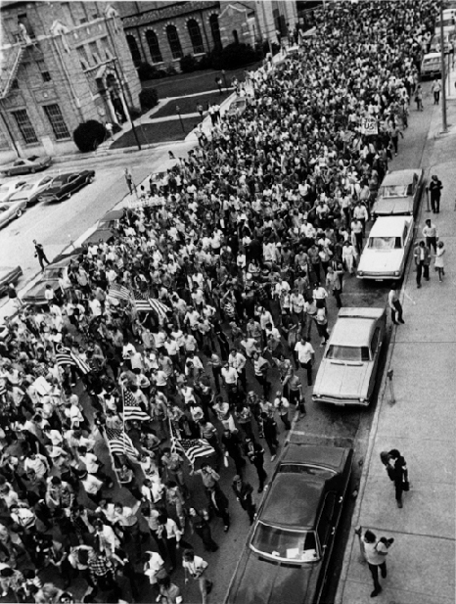

Slide 70
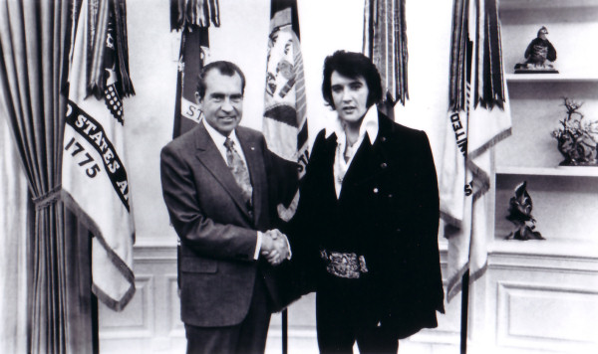

Slide 71


Slide 72


Slide 73


Slide 74


Slide 75


Slide 76


Slide 77


Slide 78
President Nixon: Henry, let me tell you about the Ivy League presidents. And Time, Newsweek, the New York Times, the Washington Post, and the [TV] network leaders.
They’re finished.
And, incidentally, that includes the business elite.
Henry Kissinger: Time has been a little better—
President Nixon: [unclear] yeah, but that’s—
Kissinger: [Editor Hugh] Sidey has been a disaster.
President Nixon: That’s right. He’s—
Kissinger: Life is a disaster.
President Nixon: That’s right. But my point that I’m making is this: they’re finished for this reason. That if, when it’s tough, they aren’t there, we don’t want them.
Now, we’ve got to build a new Establishment. We’re going to. And it isn’t going to come out of the Ivy League, you know. Let me say—I’ve already given instructions: you know, there’s never going to be another Harvard man hired in our staff? Not any new ones. We’ve got plenty already. No more.
It’s too bad—some good men will be missed. But why do we take people that have had their minds poisoned by the . . .?
Kissinger: We can’t.
President Nixon: Never, never, never.
Kissinger: We’ve got to put them to the sword, Mr. President.
President Nixon: I’m going to.
Kissinger: It’s just not—
President Nixon: I don’t mean that we’d get much better out of Ohio State. But, God, there’s a chance. At Harvard, there’s no chance.
Kissinger: You’ll get better out of—
President Nixon: [continuing] Yale! The same. Columbia—
Kissinger: Yale is worse than Harvard.
President Nixon: Much worse. Princeton. But, you see, the whole bunch of people have no courage, no guts.

Slide 79


Slide 80


Slide 81


Slide 82


Slide 83


Slide 84


Slide 85


Slide 86


