Slide 1
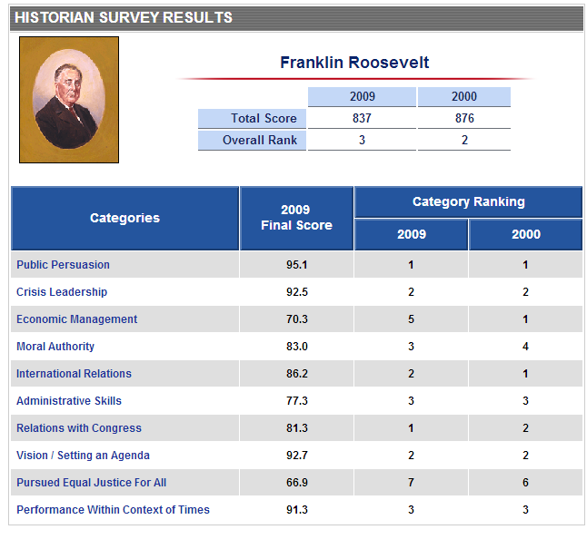

Slide 2
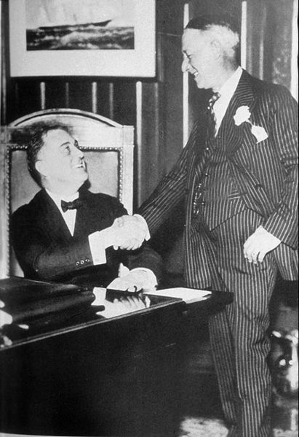

Slide 3


Slide 4
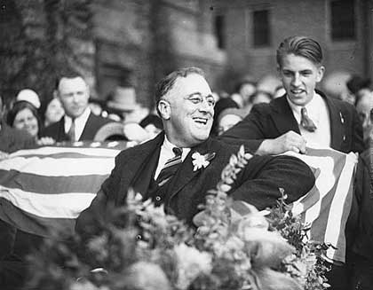

Slide 5
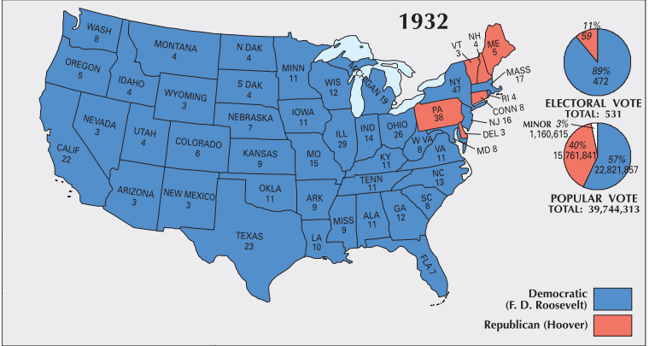

Slide 6
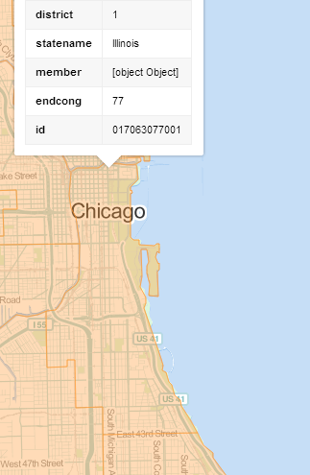
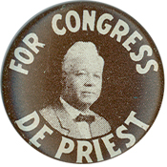
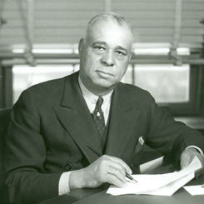
Notes:
Arthur mitchell

Slide 7


Slide 8
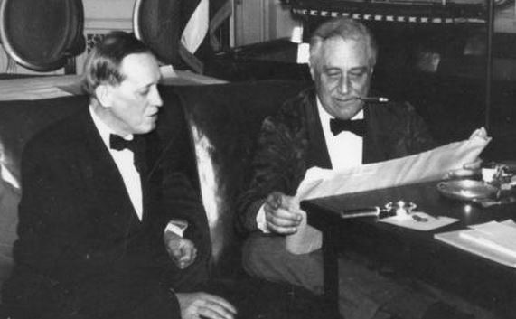
Notes:
Fdr harry hopkins

Slide 9
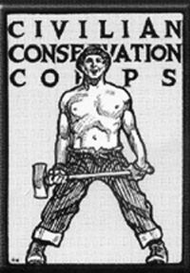

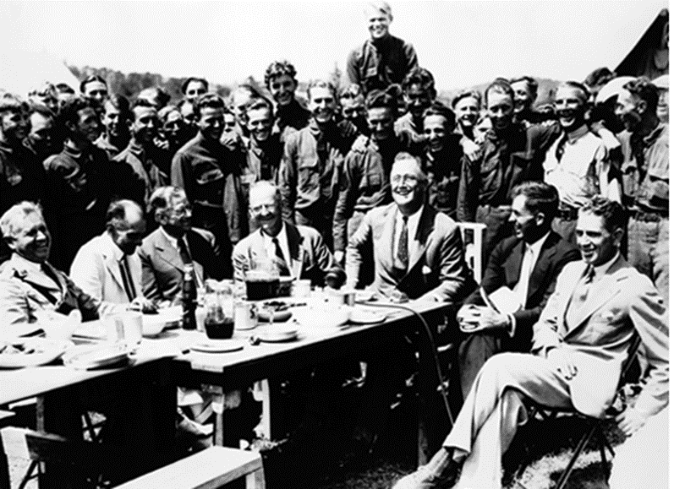

Slide 10
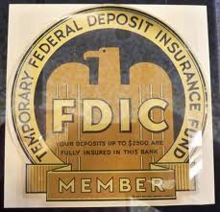

Slide 11
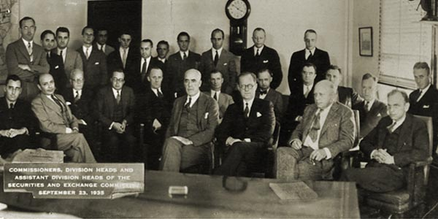

Slide 12
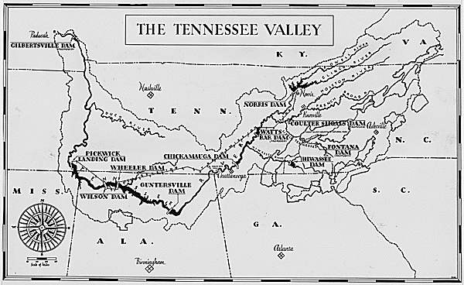

Slide 13
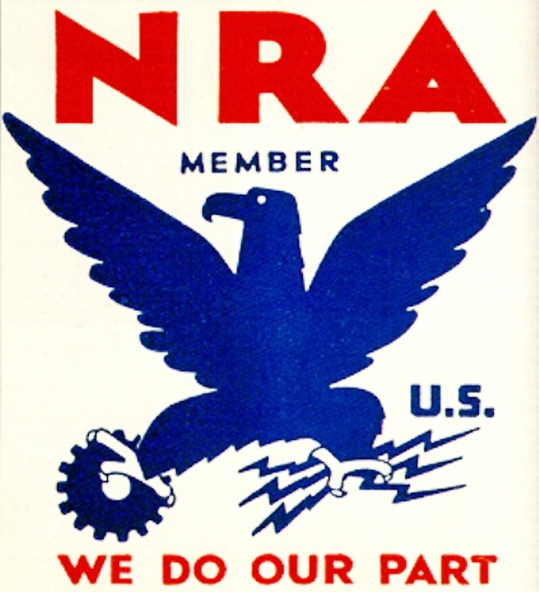

Slide 14
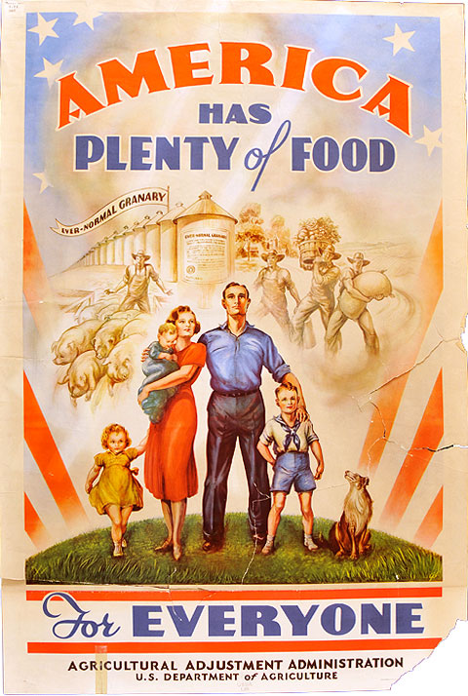

Slide 15

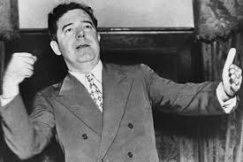

Slide 16
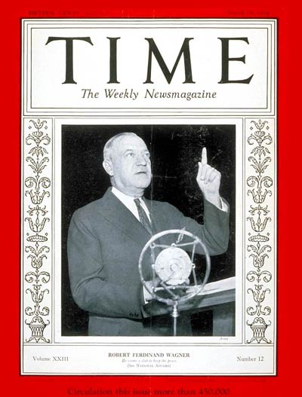

Slide 17
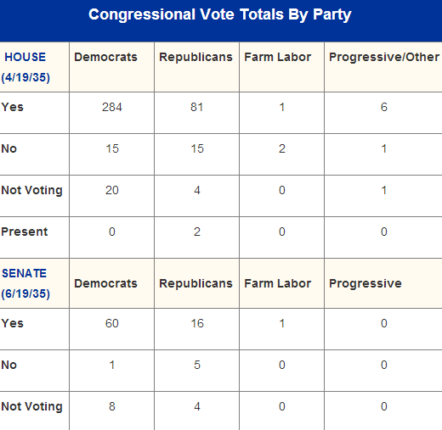
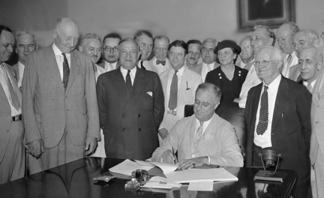

Slide 18
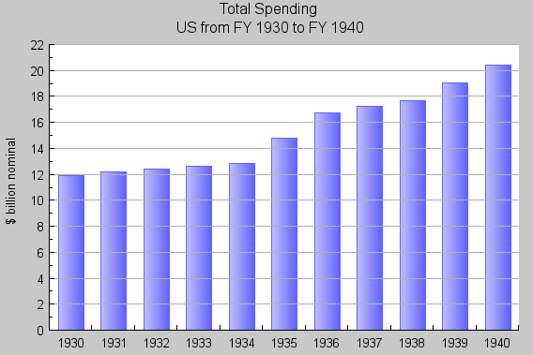

Slide 19


Slide 20
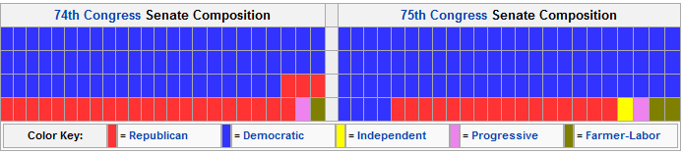
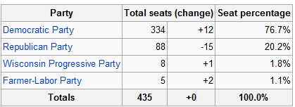
1936 Congressional Election Results

Slide 21
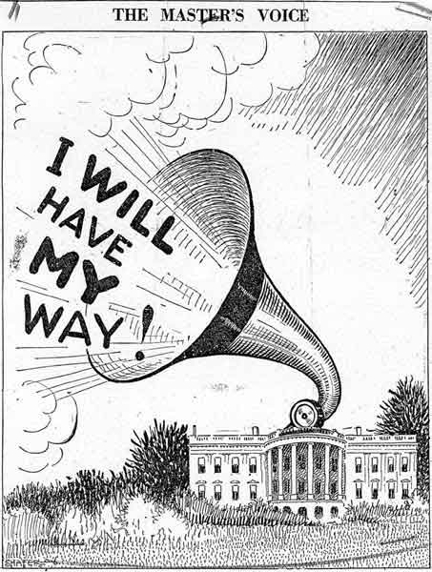

Slide 22
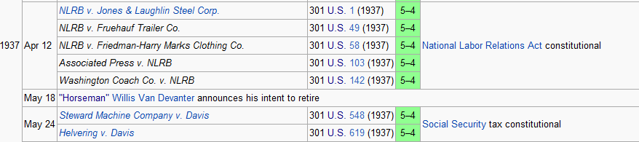

Slide 23
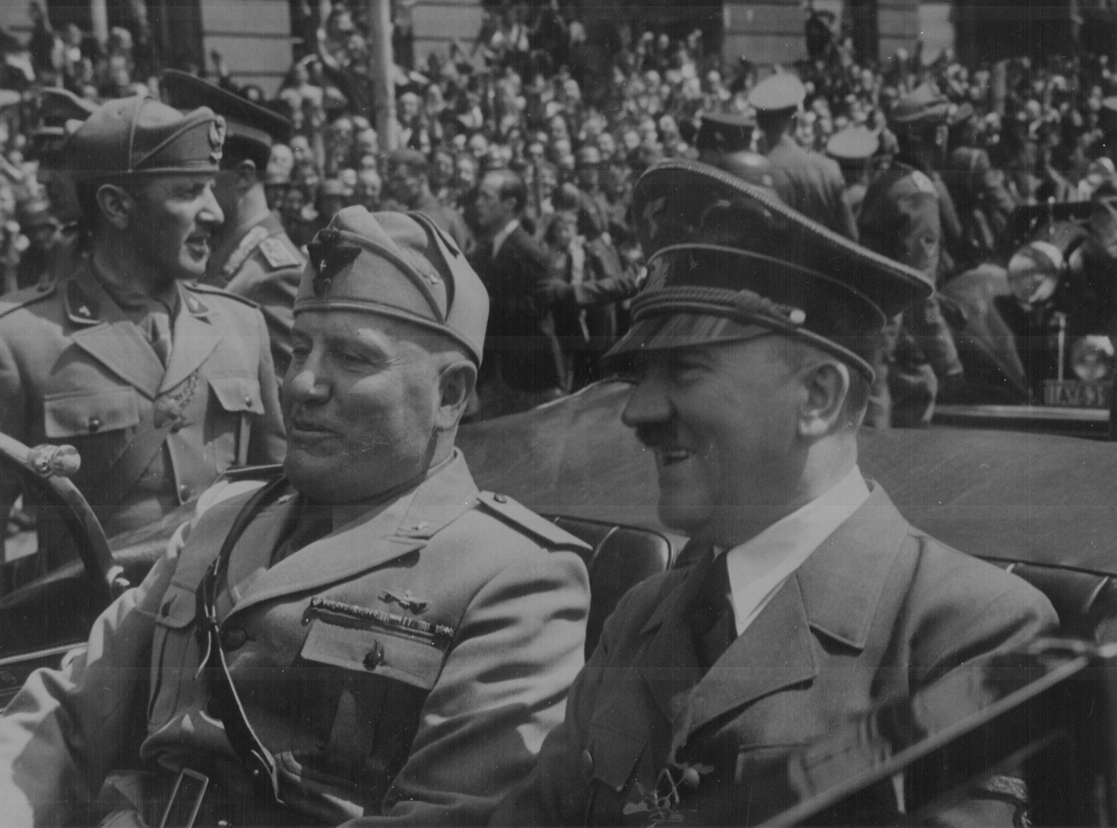

Slide 24
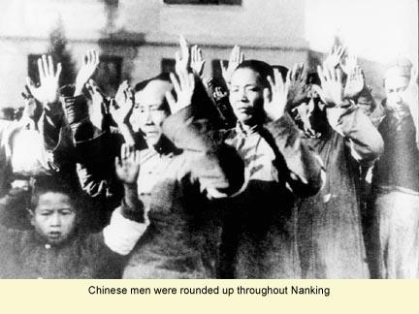

Slide 25
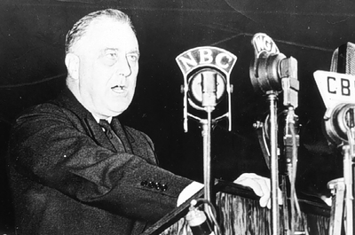
Notes:
Quaranine speech

Slide 26
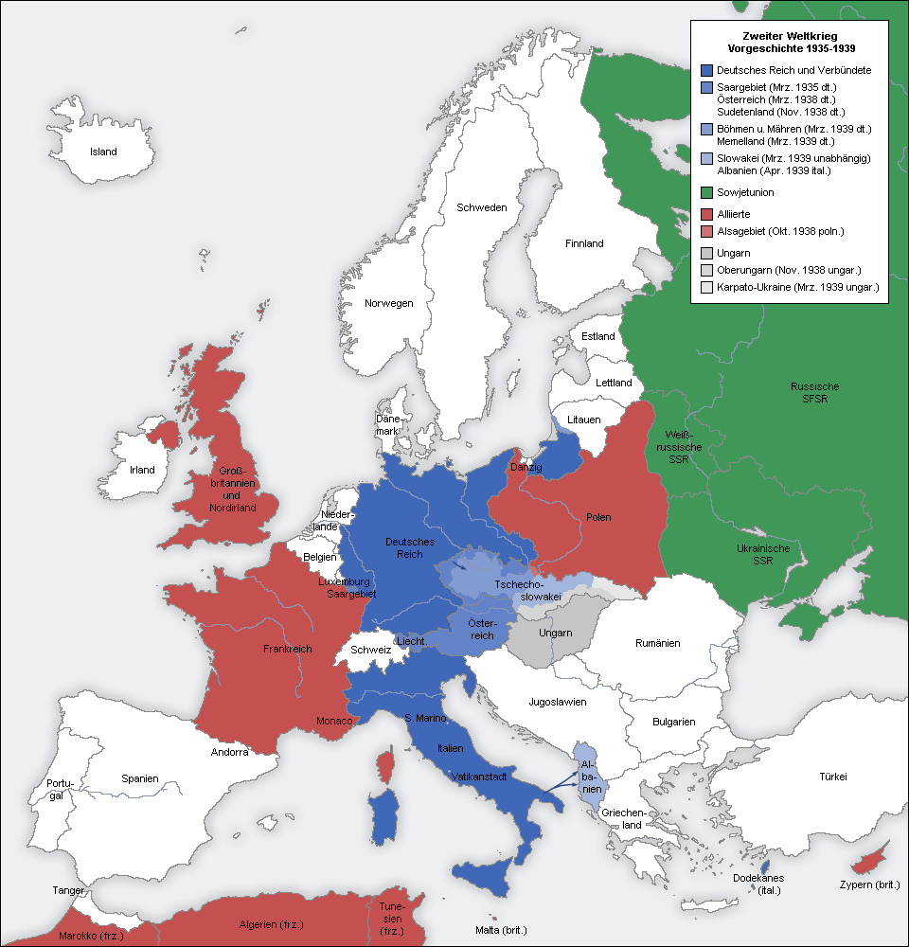

Slide 27
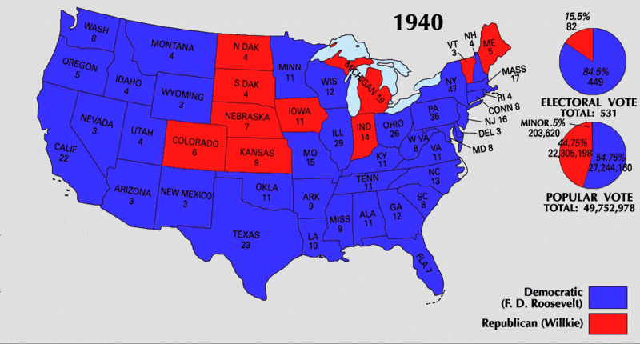

Slide 28
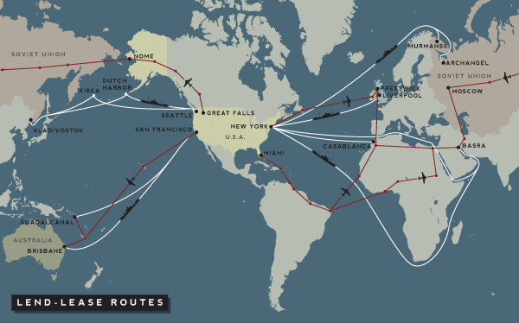

Slide 29
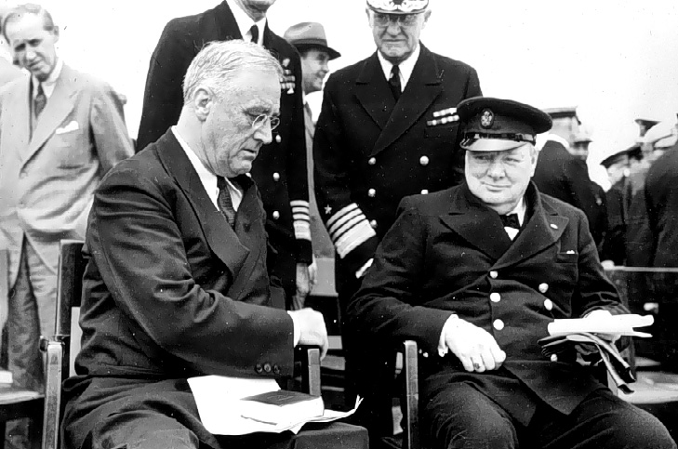

Slide 30
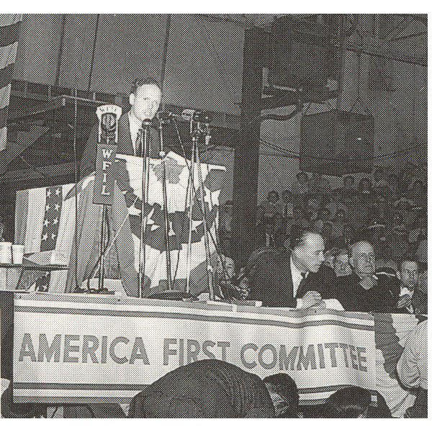

Slide 31
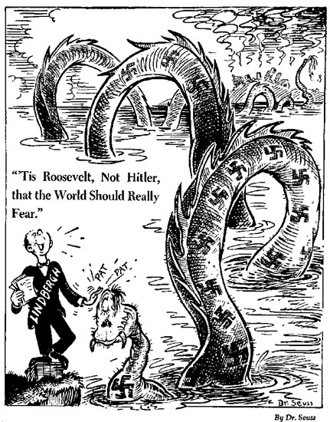

Slide 32
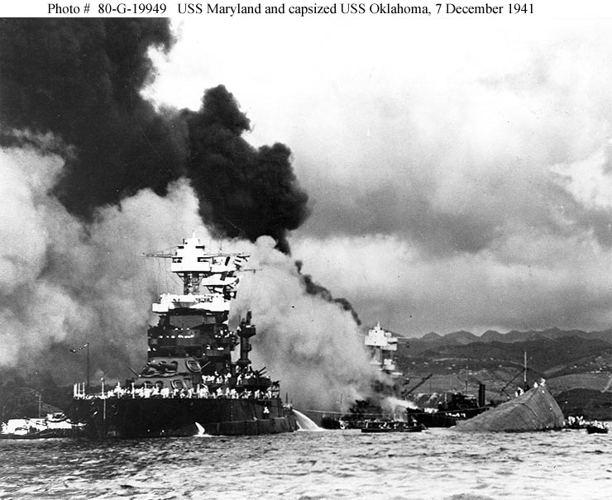

Slide 33
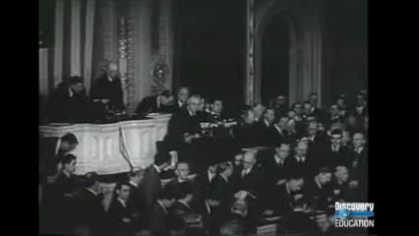

Slide 34
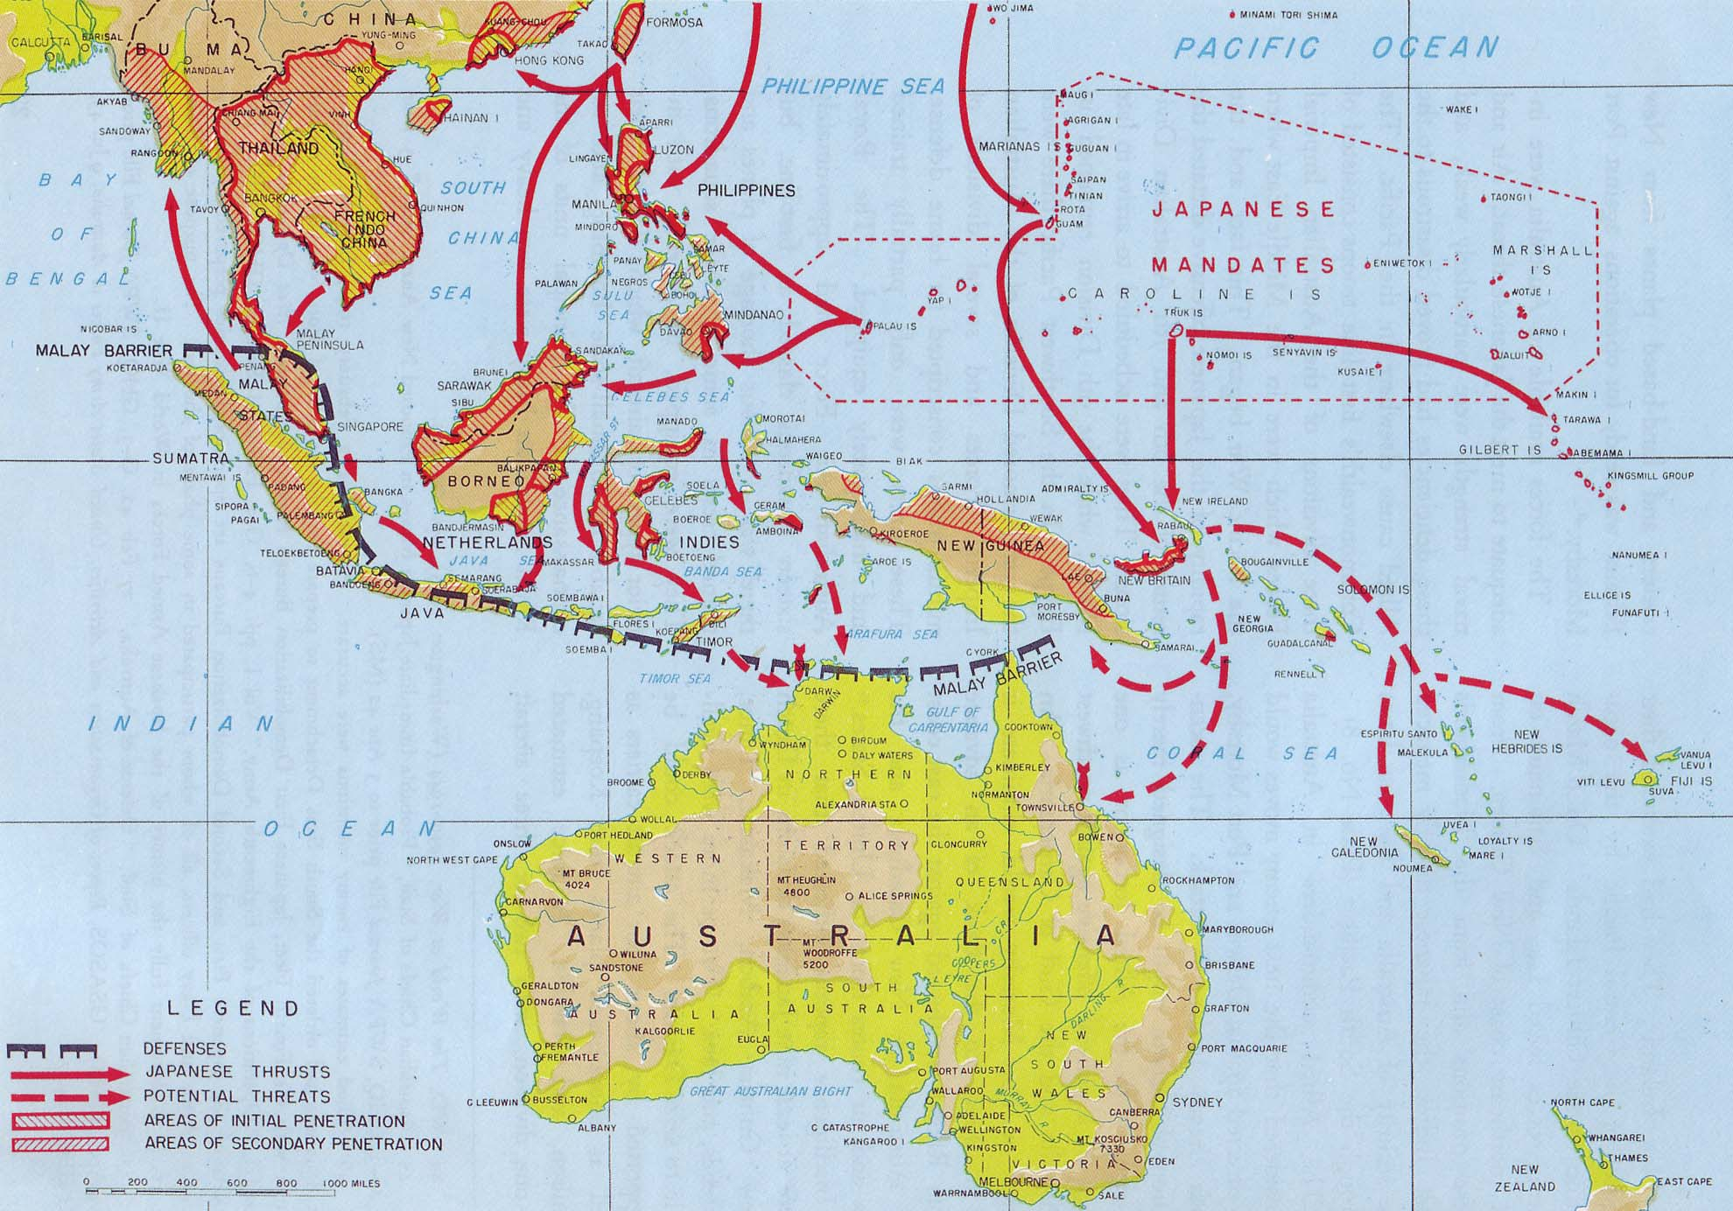

Slide 35
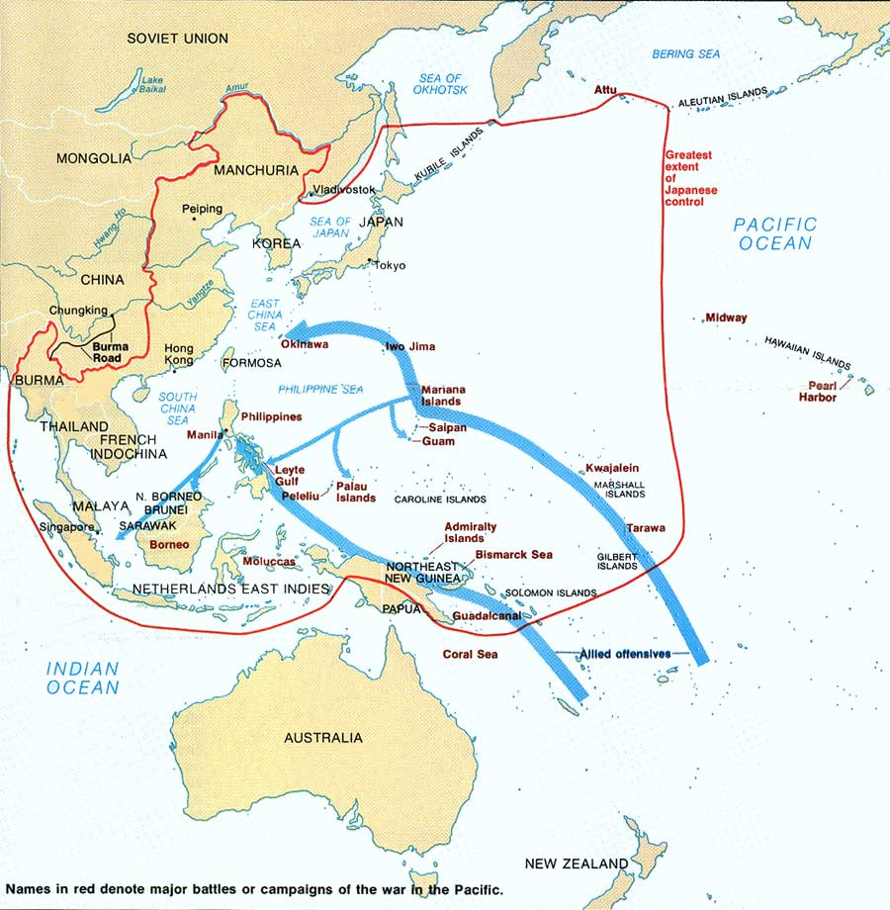

Slide 36
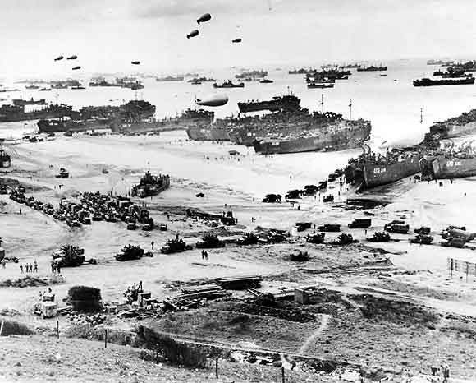

Slide 37
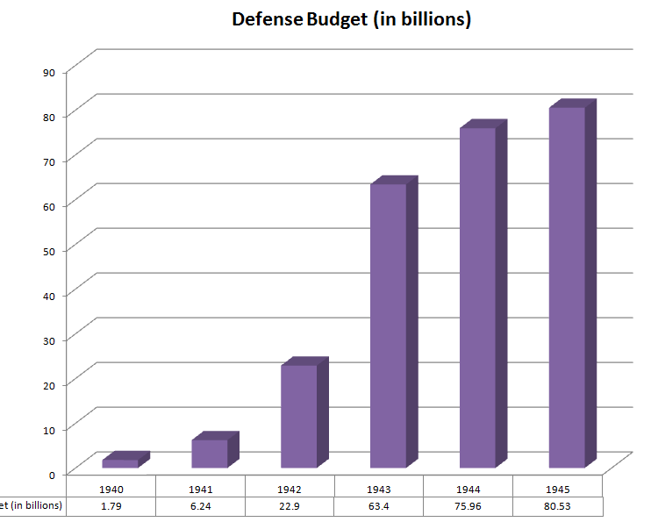

Slide 38
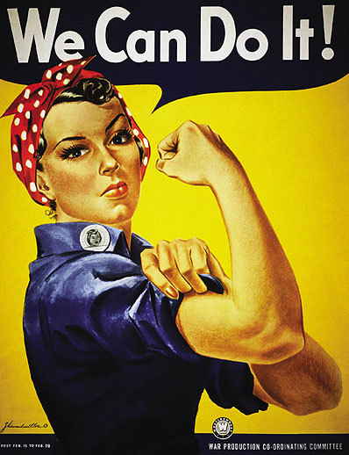
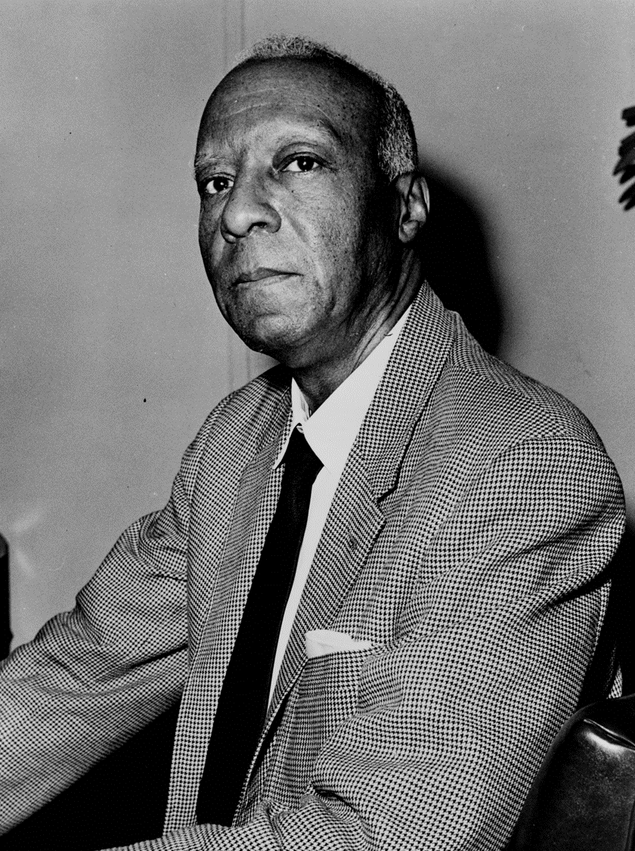

Slide 39


Slide 40
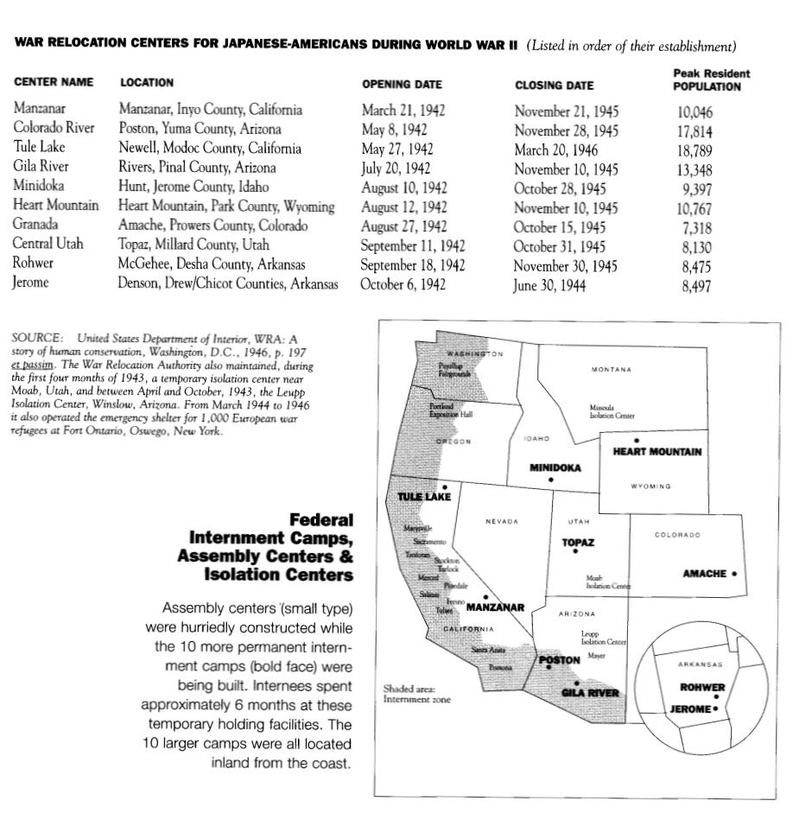

Slide 41
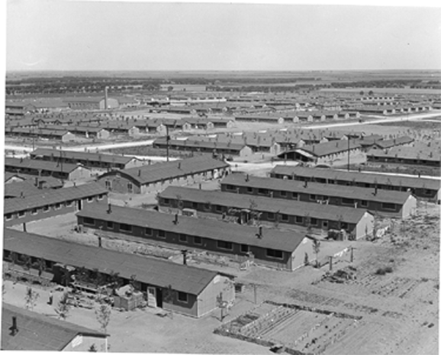
Notes:
Colorado internment camps

Slide 42
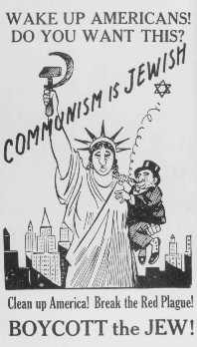

Slide 43
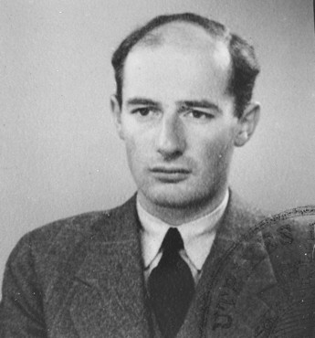

Slide 44
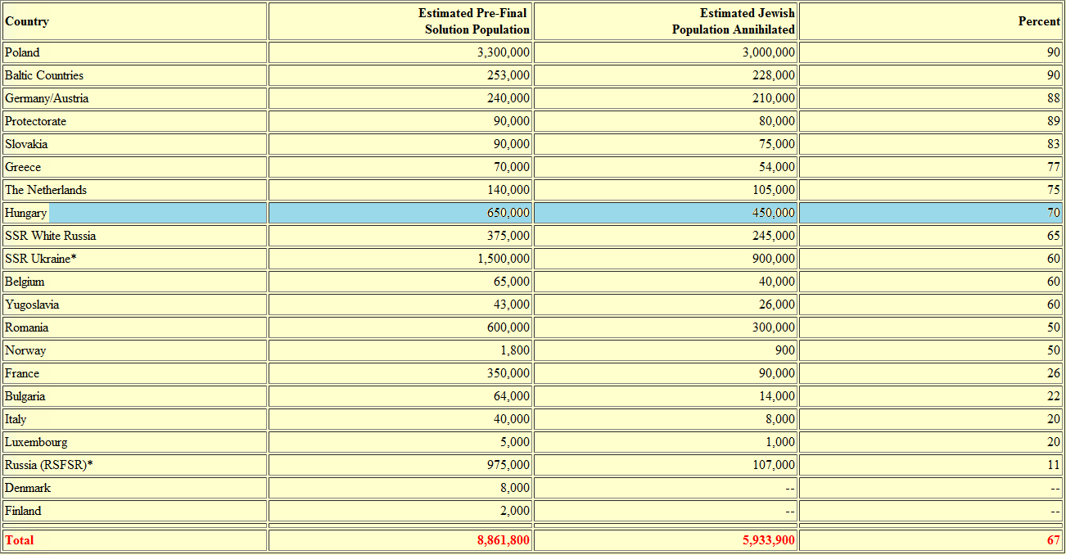

Slide 45
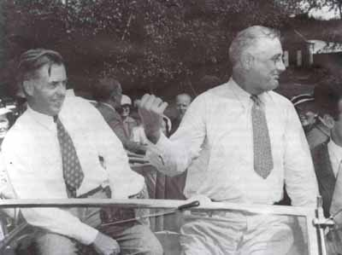

Slide 46
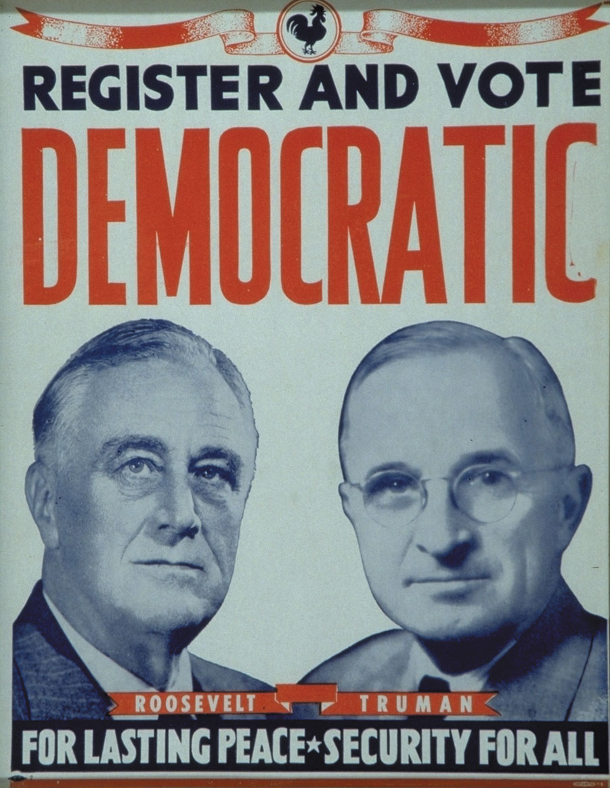

Slide 47
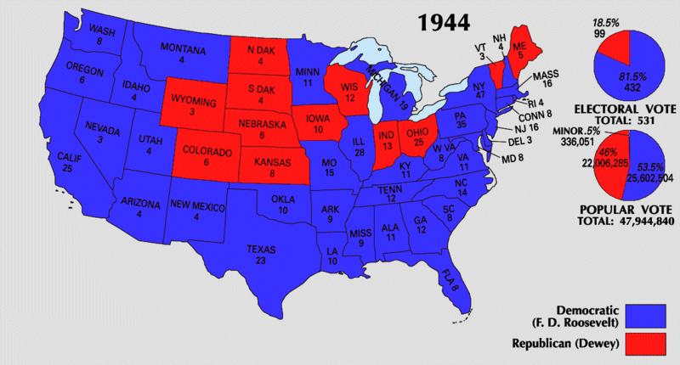

Slide 48
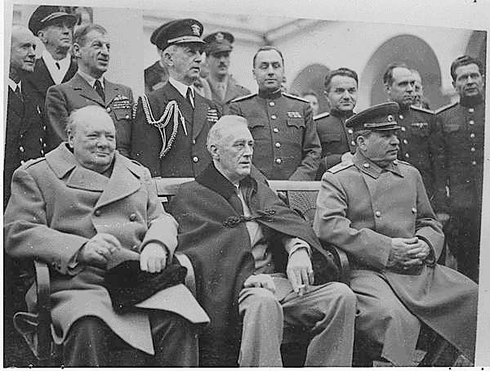

Slide 49


Slide 50

Notes:
Tru swearing in

Slide 51


Slide 52


Slide 53


Slide 54





Slide 55

Notes:
Rochester NY

Slide 56


Slide 57



Slide 58


Slide 59


Slide 60


Slide 61


Slide 62


Slide 63


Slide 64


Slide 65


Slide 66


Slide 67


Slide 68


Slide 69


Slide 70


Slide 71


Slide 72


Slide 73
New Deal (1935, 1939)
--medical care as part of Social Security?
--Wagner proposal (1939)—block grants to states to administer
Wagner-Murray-Dingell (1943)
--health care as a right
--protection from “economic fears” of sickness
Truman plan (1945, 1949)
--single plan run by federal government
--citizens pay monthly fee
--government subsidizes costs of poor
--58% initial public support

Slide 74


Slide 75

$1.5M lobbying effort
“Would socialized medicine lead to socialization of other phases of American life?” “Lenin thought so.”
He declared ”Socialized medicine is the keystone to the arch of the Socialist State.”
--late 1949, down to 36% approval
--national health insurance as “socialized medicine”

Slide 76


Slide 77


Slide 78


Slide 79


Slide 80


Slide 81


