Slide 1
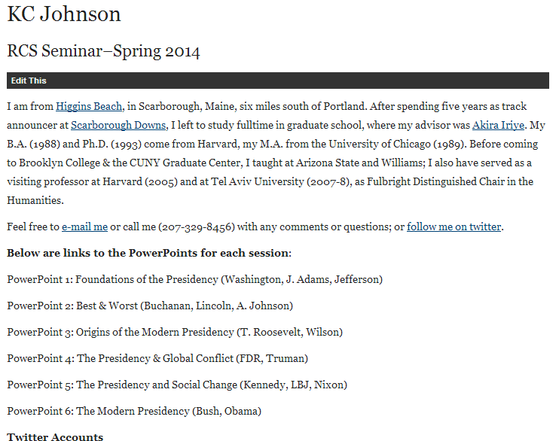

Slide 2


Slide 3
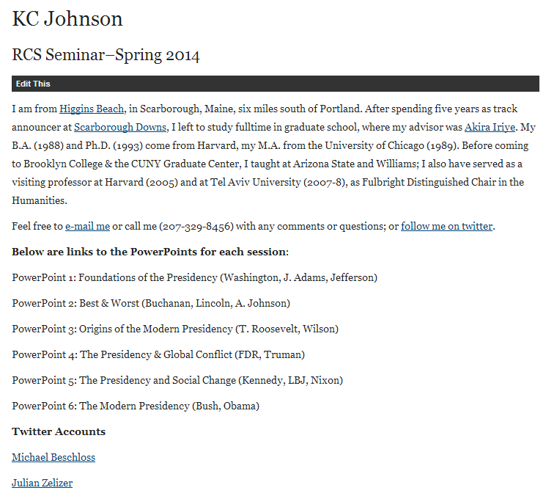

Slide 4
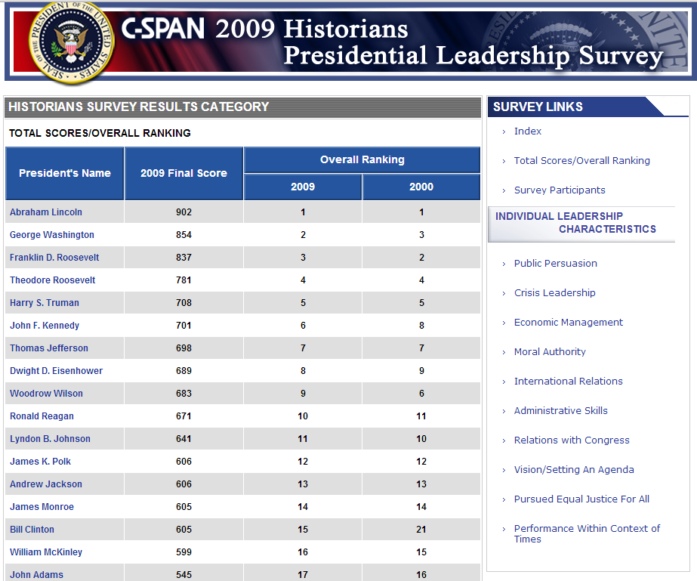

Slide 5
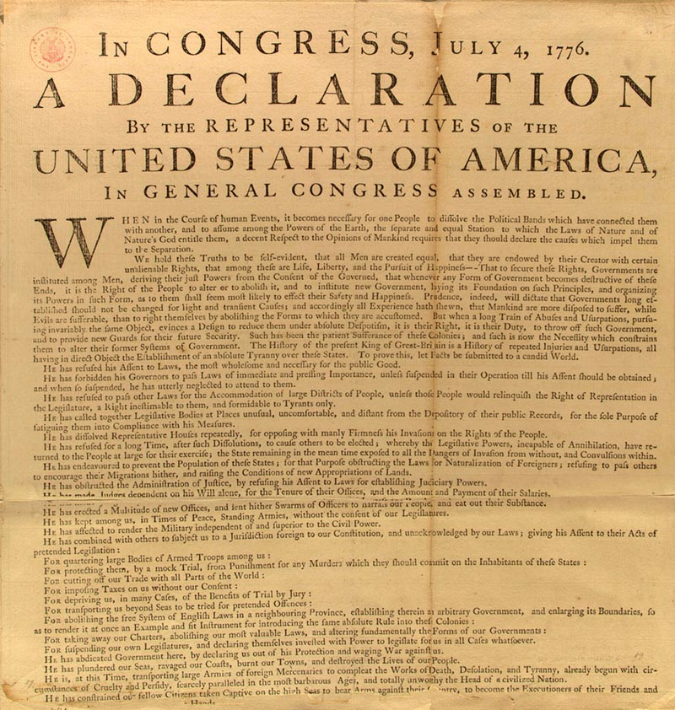

Slide 6
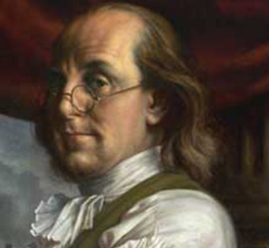

Slide 7
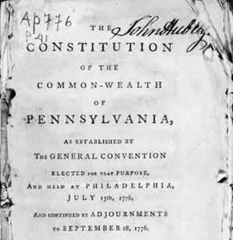

Slide 8
Pennsylvania (1776)—executive power
SECT. 20. The president, and in his absence the vice-president, with the council, five of whom shall be a quorum, shall have power to appoint and commissionate judges, naval officers, judge of the admiralty, attorney general and all other officers, civil and military . . .
They are to correspond with other states, and transact business with the officers of government, civil and military; and to prepare such business as may appear to them necessary to lay before the general assembly . . .
And shall have power to grant pardons and remit fines, in all cases whatsoever, except in cases of impeachment; and in cases of treason and murder, shall have power to grant reprieves, but not to pardon, until the end of the next sessions of assembly . . .
The president shall be commander in chief of the forces of the state, but shall not command in person, except advised thereto by the council, and then only so long as they shall approve thereof. The president and council shall have a secretary, and keep fair books of their proceedings, wherein any counsellor may enter his dissent, with his reasons in support of it.

Slide 9
NEW HAMPSHIRE (1776)
WE DO Resolve, that this Congress assume the name, power and authority of a house of Representatives or Assembly for the Colony of New-Hampshire And that said House then proceed to choose twelve persons, being. reputable freeholders and inhabitants within this colony . . . to be a distinct and separate branch of the Legislature by the name of a COUNCIL for this colony . . . That such Council appoint their President, and in his absence that the senior counsellor preside; that a Secretary be appointed by both branches, who may be a counsellor, or otherwise, as they shall choose:
That no act or resolve shall be valid and put into execution unless agreed to, and passed by both branches of the legislature;
That all public officers for the said colony, and each county, for the current year, be appointed by the Council and Assembly.

Slide 10
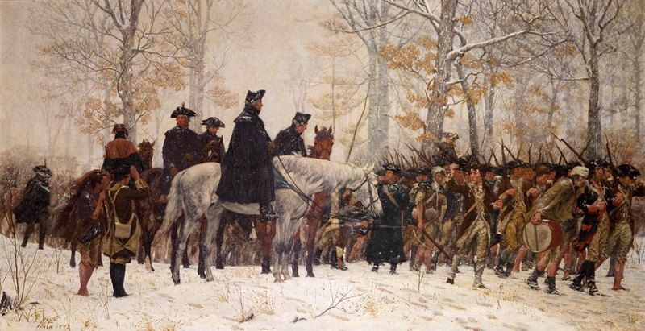

Slide 11


Slide 12
Massachusetts (1780)—executive power
Art. II. No bill or resolve of the senate or house of representatives shall become a law, and have force as such, until it shall have been laid before the governor for his revisal; and if he, upon such revision, approve thereof, he shall signify his approbation by signing the same.
----------------------
In cases of disagreement between the two houses, with regard to the necessity, expediency, or time of adjournment or prorogation, the governor, with advice of the council, shall have a right to adjourn or prorogue the general court, not exceeding ninety days, as he shall determine the public good shall require.

Slide 13
Massachusetts (1780)—Governor’s Council
Article IV. The governor shall have authority from time to time, at his discretion, to assemble and call together the councillors of this commonwealth for the time being; and the governor with the said councillors, or five of them at least, shall, and may, from time to time, hold and keep a council, for the ordering and directing the affairs of the commonwealth, agreeably to the constitution and the laws of the land…
All judicial officers, [the attorney-general,] the solicitor-general, [all sheriffs,] coroners, [and registers of probate,] shall be nominated and appointed by the governor, by and with the advice and consent of the council…

Slide 14
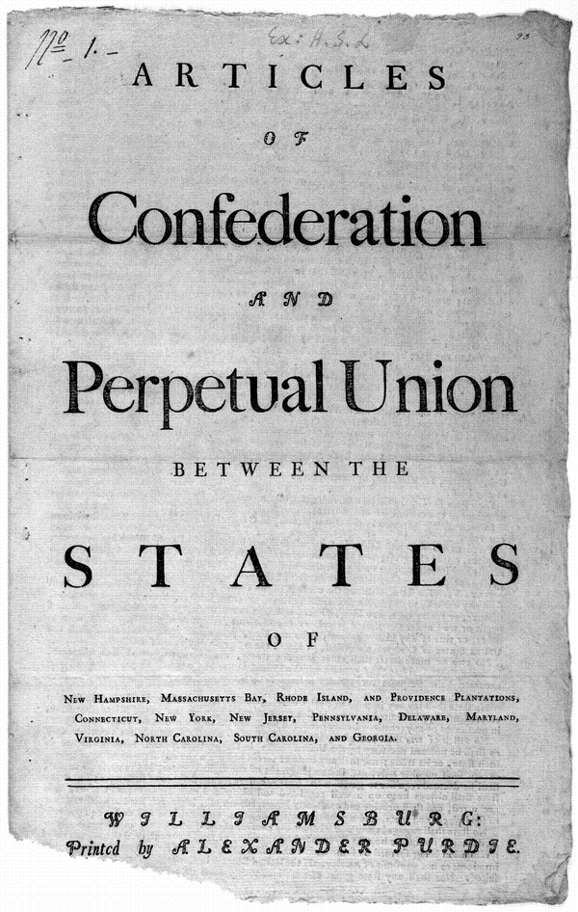

Slide 15
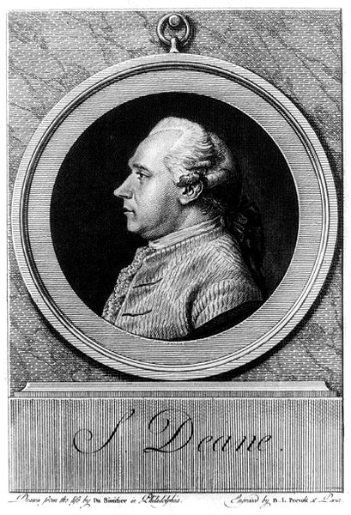
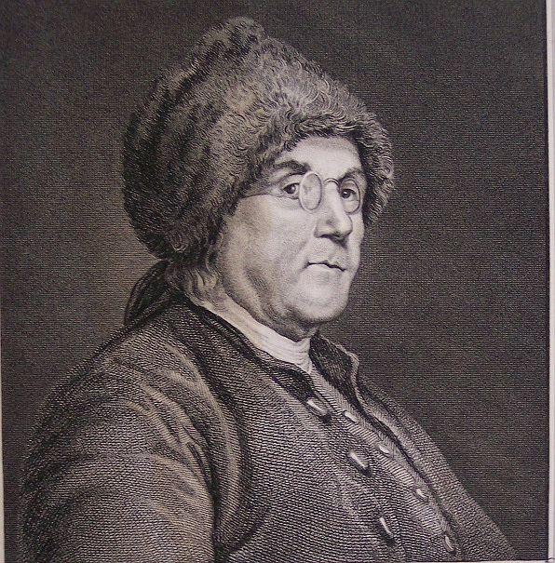
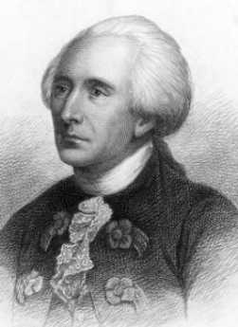

Slide 16
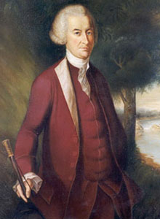
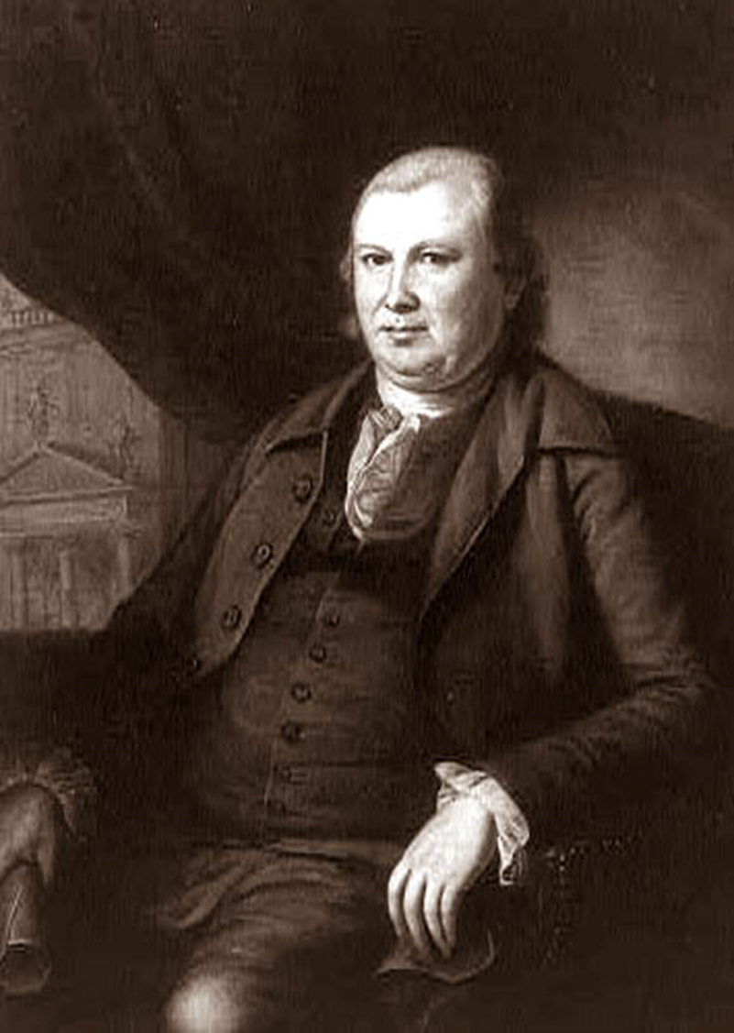

Slide 17
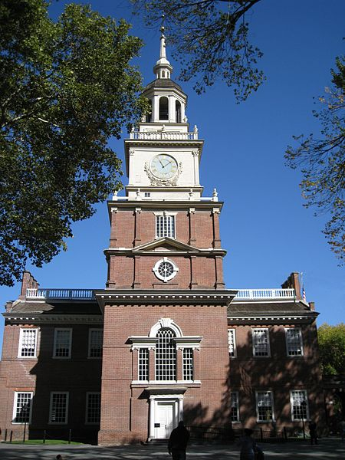
Notes:
Indpce hall

Slide 18

Notes:
Nassau hall princeton 1783

Slide 19
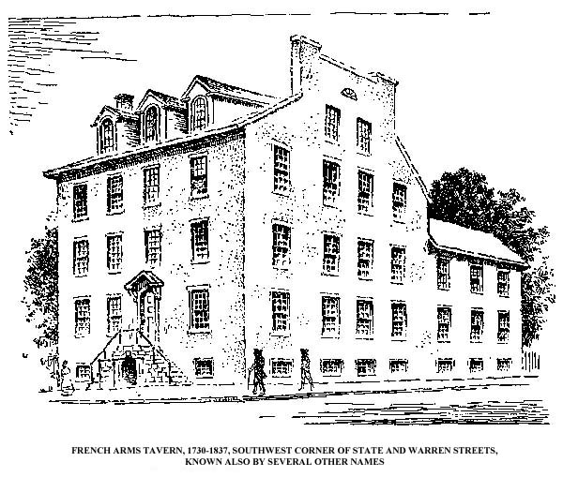
Notes:
French arms tavern 1785

Slide 20


Slide 21
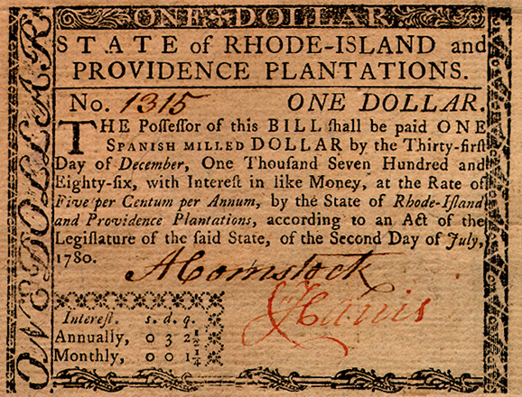

Slide 22


Slide 23

Notes:
Daniel shays

Slide 24
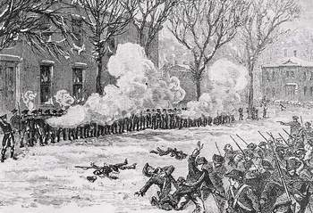
Notes:
shays

Slide 25
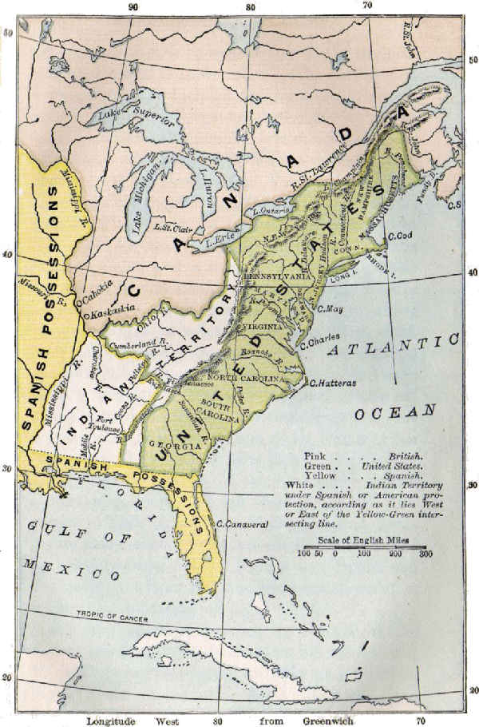
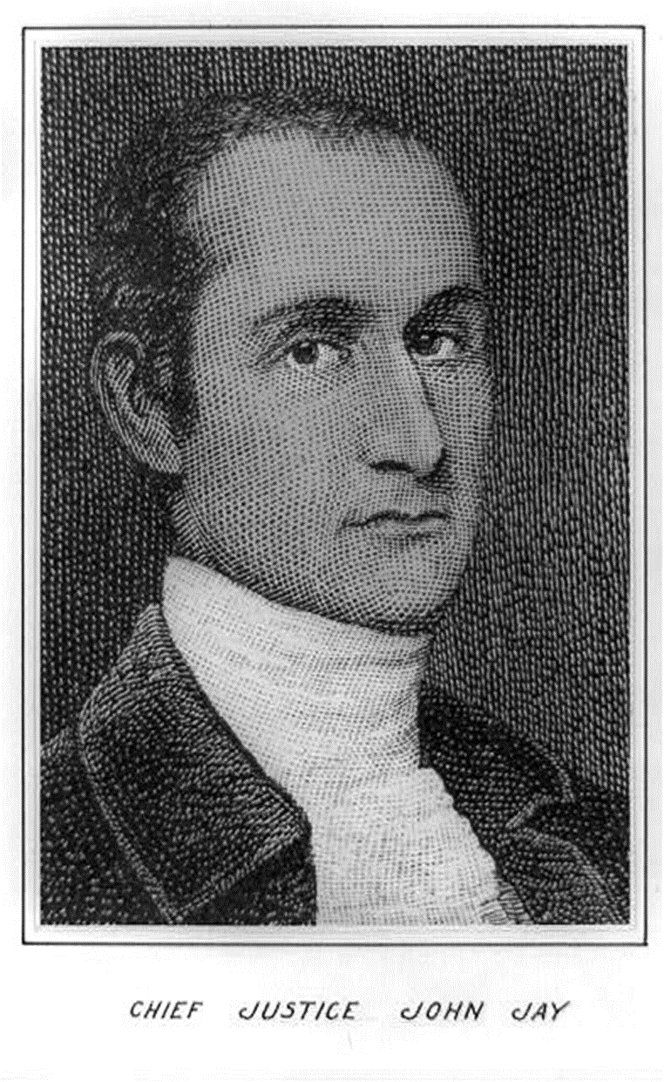

Slide 26
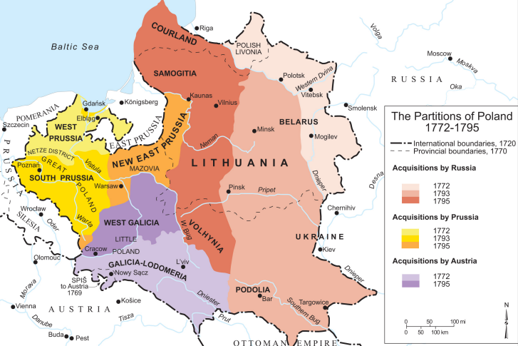

Slide 27


Slide 28
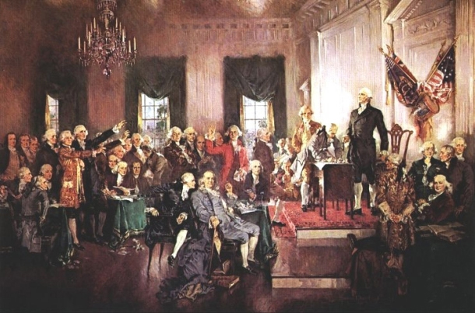

Slide 29


Slide 30
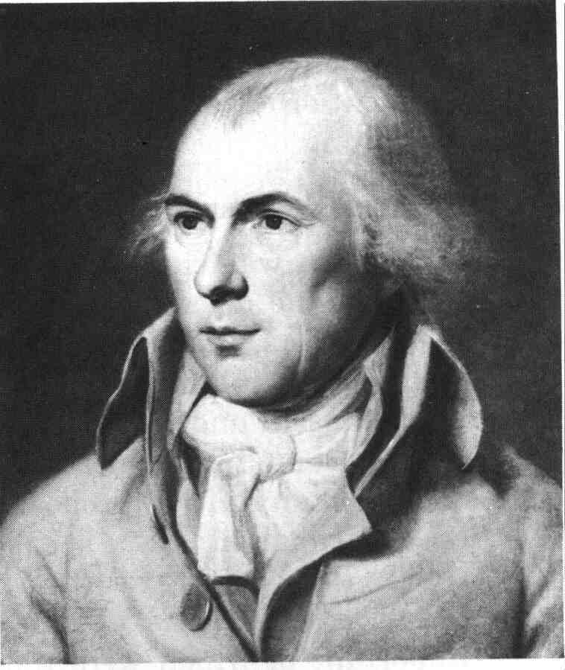

Slide 31
Virginia Plan (Phila.)
7. Res^{d} that a National Executive be instituted; to be chosen by the National Legislature for the term of years, to receive punctually at stated times, a fixed compensation for the services rendered, in which no increase or diminution shall be made so as to affect the Magistracy, existing at the time of increase or diminution, and to be ineligible a second time; and that besides a general authority to execute the National laws, it ought to enjoy the Executive rights vested in Congress by the Confederation.
8. Res^{d} that the Executive and a convenient number of the National Judiciary, ought to compose a Council of revision with authority to examine every act of the National Legislature before it shall operate, & every act of a particular Legislature before a Negative thereon shall be final; and that the dissent of the said Council shall amount to a rejection, unless the Act of the National Legislature be again passed, or that of a particular Legislature be again negatived by of the members of each branch.

Slide 32
New Jersey Plan (Phila.)
6. Resolved, that the united states in congress, shall be authorised to elect a federal executive, to consist of _____ person or persons, to continue in office for the term of _____ years, to receive punctually, at stated times, a fixed compensation for the services by him or them to be rendered, in which no increase or diminution shall be made, so as to affect the executive in office, at the time of such increase or diminution, to be paid out of the federal treasury; to be incapable of holding any other office or appointment during the time of service, and for _____ years after; to be ineligible a second time, and removable on impeachment and conviction for mar-practice, corrupt conduct, and neglect of duty.
7. Resolved, that the executive, besides a general authority to execute the federal acts, ought to appoint all federal officers, not otherwise provided for, and to direct all military operations; provided that the executive shall not on any occasion take command of any troops, so as personally to conduct any military enterprise as general, or in any other capacity.

Slide 33


Slide 34
Hamilton Plan: Executive Authority
IV. The supreme executive authority of the United States to be vested in a Governor, to be elected to serve during good behavior. His election to be made by electors chosen by electors chosen by the people, in the election districts aforesaid; or by electors chosen for that purpose by the respective Legislatures-provided that if an election be not made within a limited time, the President of the Senate shall be the Governor. The Governor to have a negative upon all laws about to be passed-and (to have) the execution of all laws passed-to be the Commander-in-Chief of the land and naval forces and of the militia of the United States- to have the entire direction of war when authorized or begun-to have, with the advice and approbation of the Senate, the power of making all treaties-to have the appointment of the heads or chief officers of the departments of finance, war, and foreign affairs-to have the nomination of all other officers (ambassadors to foreign nations included), subject to the approbation or rejection of the Senate to have the power of pardoning all offenses but treason, which he shall not pardon without the approbation of the Senate.

Slide 35


Slide 36
Article II, Section 2.
[The President] shall have power, by and with the advice and consent of the Senate, to make treaties, provided two thirds of the Senators present concur; and he shall nominate, and by and with the advice and consent of the Senate, shall appoint ambassadors, other public ministers and consuls, judges of the Supreme Court, and all other officers of the United States, whose appointments are not herein otherwise provided for, and which shall be established by law: but the Congress may by law vest the appointment of such inferior officers, as they think proper, in the President alone, in the courts of law, or in the heads of departments.

Slide 37
Article II
Section 1. The executive power shall be vested in a President of the United States of America. He shall hold his office during the term of four years, and, together with the Vice President, chosen for the same term, be elected, as follows:
Each state shall appoint, in such manner as the Legislature thereof may direct, a number of electors, equal to the whole number of Senators and Representatives to which the State may be entitled in the Congress: but no Senator or Representative, or person holding an office of trust or profit under the United States, shall be appointed an elector.

Slide 38
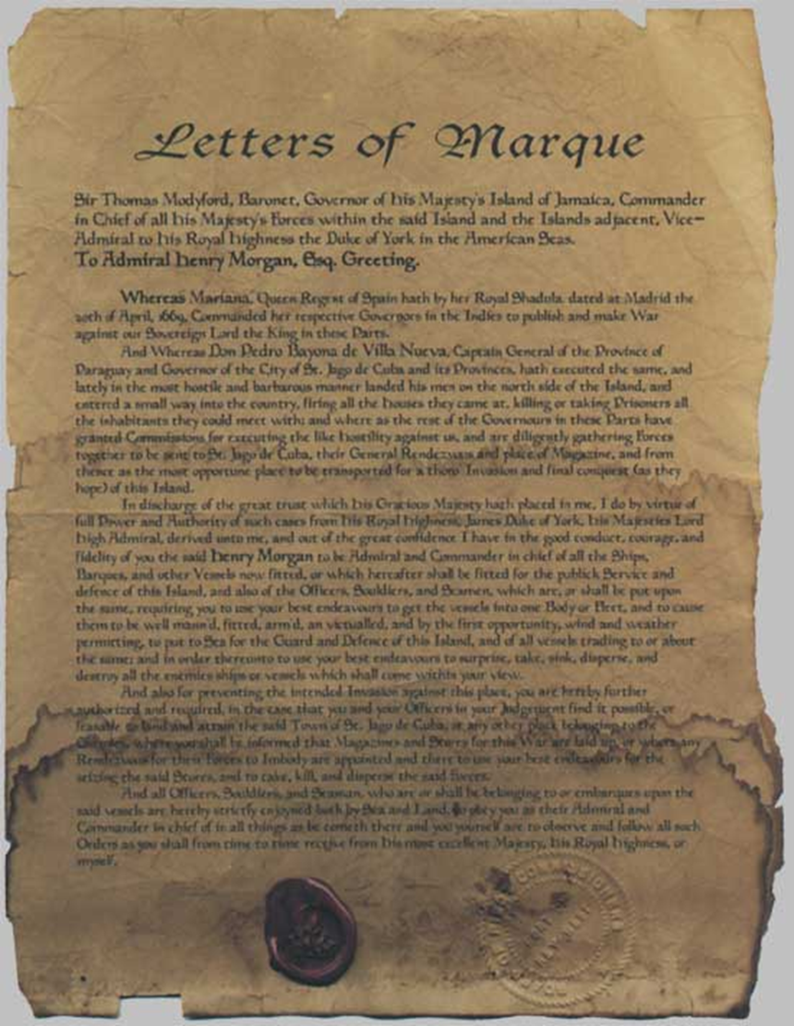
Article I, Section 8
Congress shall have power . . . to declare war, grant letters of marque and reprisal, and make rules concerning captures on land and water;
To raise and support armies, but no appropriation of money to that use shall be for a longer term than two years;
To provide and maintain a navy;
To make rules for the government and regulation of the land and naval forces;
To provide for calling forth the militia to execute the laws of the union, suppress insurrections and repel invasions.

Slide 39
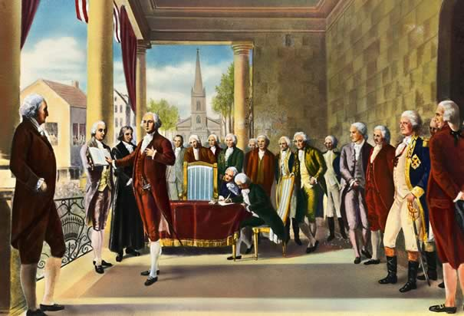

Slide 40
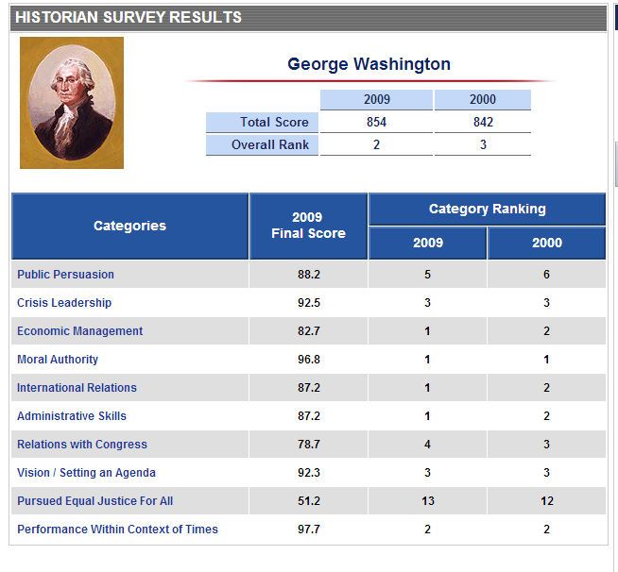

Slide 41
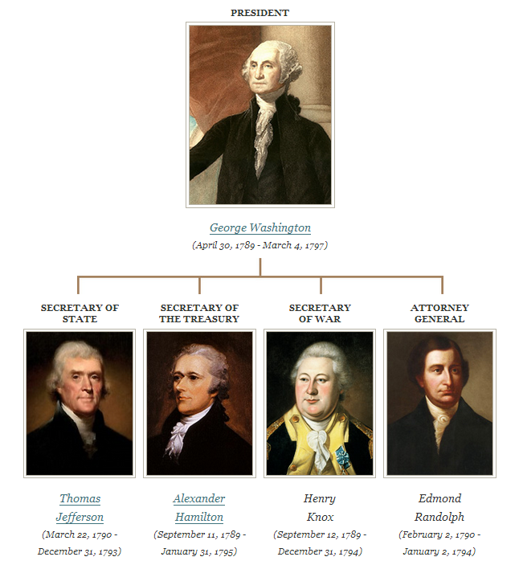

Slide 42


Slide 43
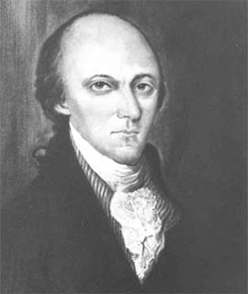
Faced with a motion to commit the report on negotiations with the southern Indians and questions that he and his Secretary of War had brought to the Senate, the President started up in a Violent fret. This defeats every purpose of my coming here, were the first words that he said. he then went on that he had brought his Secretary at War with him to give every necessary information, that the Secretary knew all about the Business--and yet he was delayed and could not go on with the Matter--… a pause for some time ensued. We Waited for him to withdraw, he did so with a discontented Air.
Wm. Maclay (PA)

Slide 44
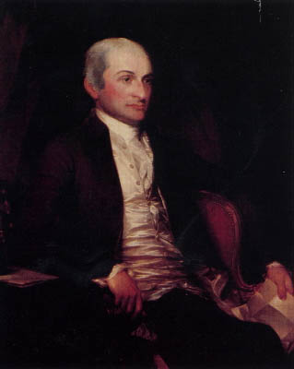
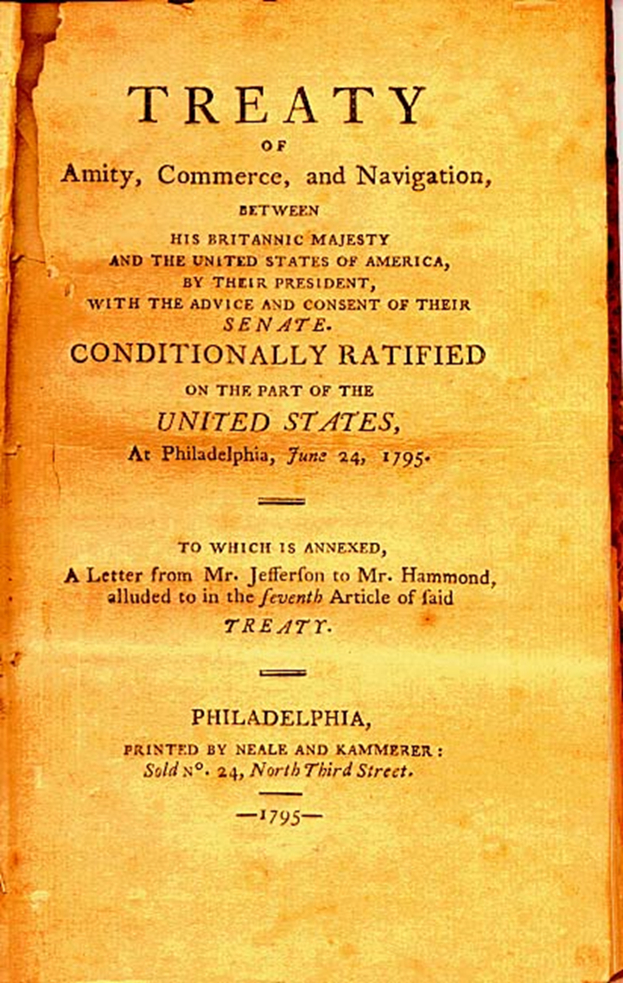

Slide 45
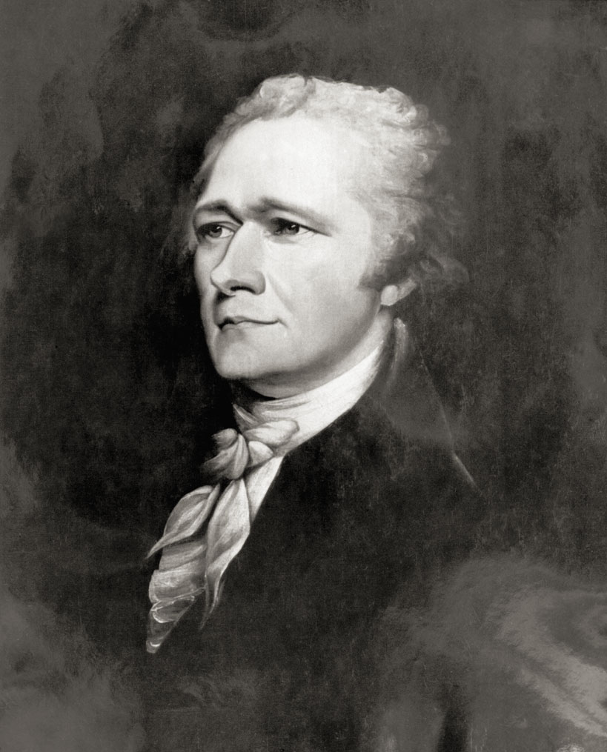

Slide 46
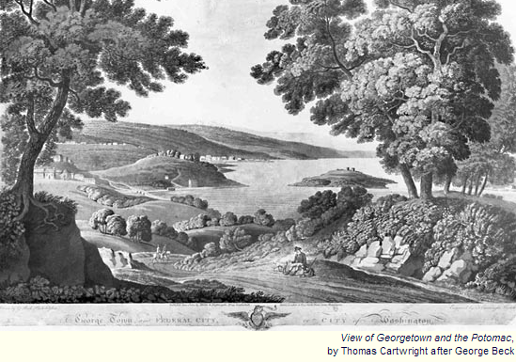

Slide 47
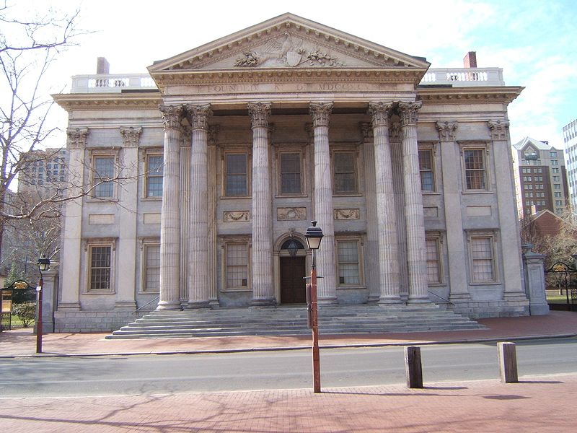
Notes:
Bank of us--philly

Slide 48
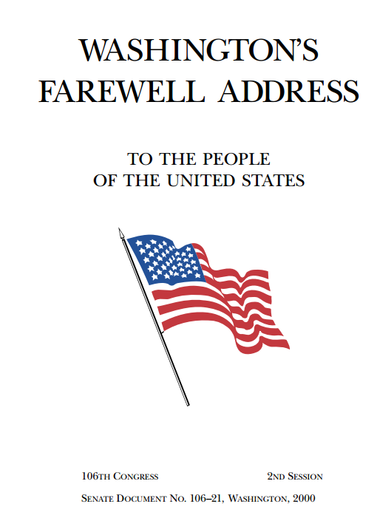

Slide 49
I have already intimated to you the danger of parties in the State, with particular reference to the founding of them on geographical discriminations. Let me now take a more comprehensive view, and warn you in the most solemn manner against the baneful effects of the spirit of party generally….
The alternate domination of one faction over another, sharpened by the spirit of revenge, natural to party dissension, which in different ages and countries has perpetrated the most horrid enormities, is itself a frightful despotism. But this leads at length to a more formal and permanent despotism. The disorders and miseries which result gradually incline the minds of men to seek security and repose in the absolute power of an individual; and sooner or later the chief of some prevailing faction, more able or more fortunate than his competitors, turns this disposition to the purposes of his own elevation, on the ruins of public liberty.
Without looking forward to an extremity of this kind (which nevertheless ought not to be entirely out of sight), the common and continual mischiefs of the spirit of party are sufficient to make it the interest and duty of a wise people to discourage and restrain it.
It serves always to distract the public councils and enfeeble the public administration. It agitates the community with ill-founded jealousies and false alarms, kindles the animosity of one part against another, foments occasionally riot and insurrection. It opens the door to foreign influence and corruption, which finds a facilitated access to the government itself through the channels of party passions. Thus the policy and the will of one country are subjected to the policy and will of another.
There is an opinion that parties in free countries are useful checks upon the administration of the government and serve to keep alive the spirit of liberty. This within certain limits is probably true; and in governments of a monarchical cast, patriotism may look with indulgence, if not with favor, upon the spirit of party. But in those of the popular character, in governments purely elective, it is a spirit not to be encouraged.

Slide 50
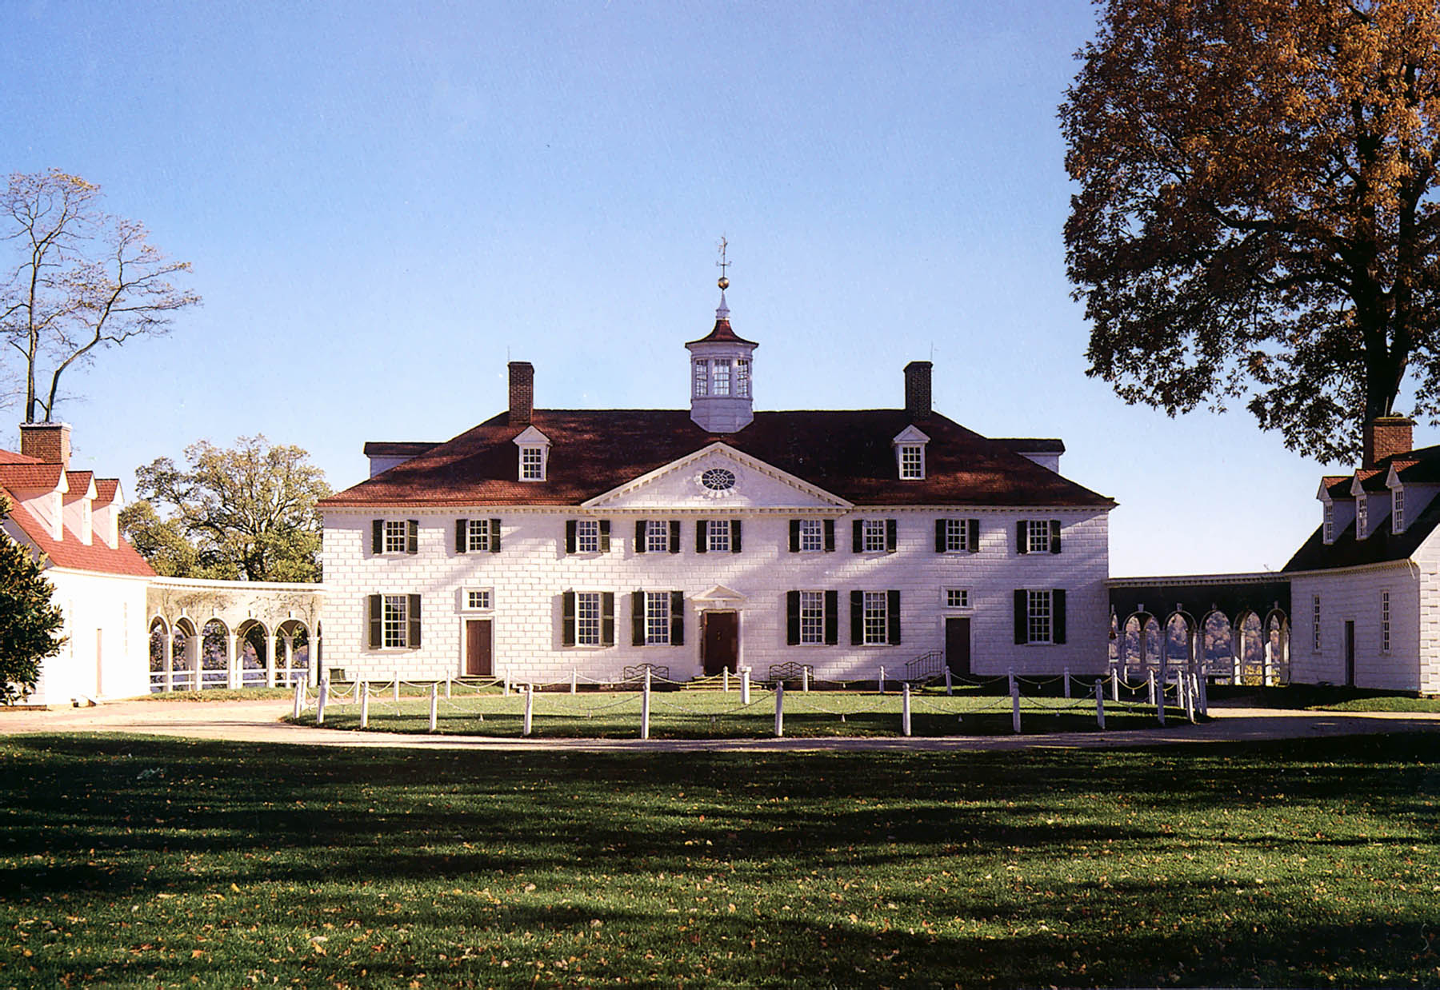

Slide 51
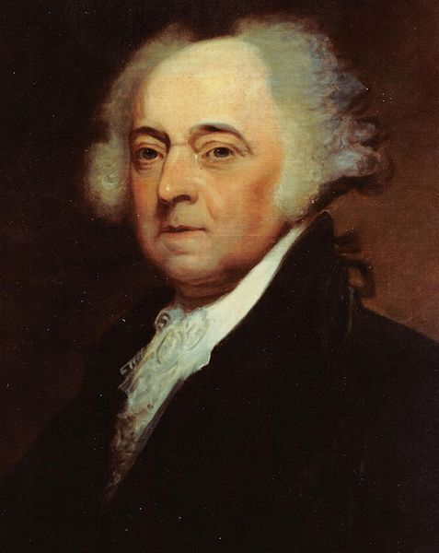
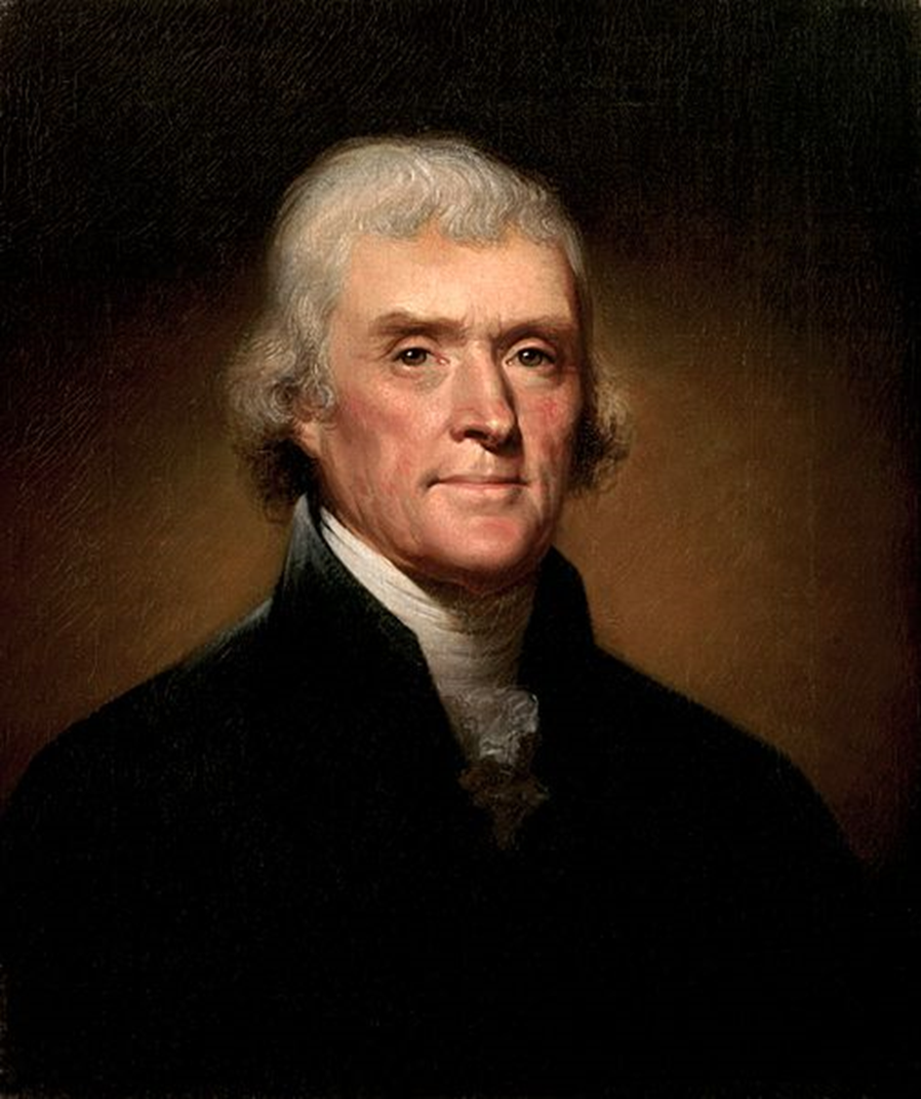

Slide 52
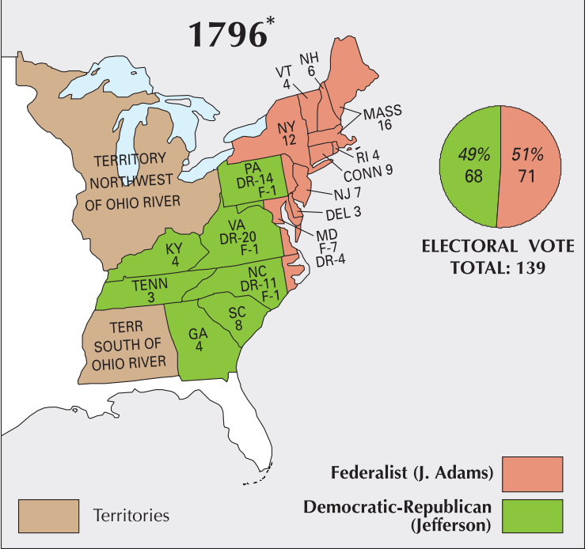

Slide 53
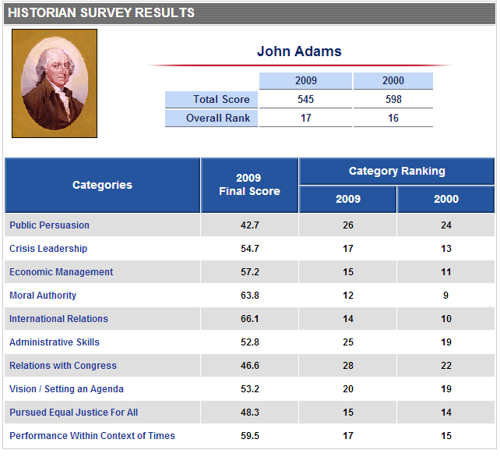

Slide 54
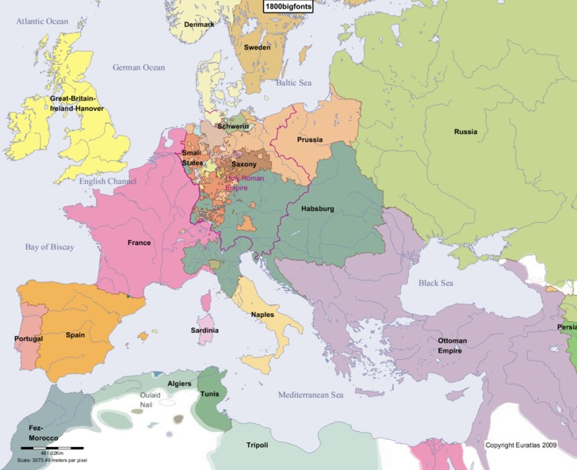

Slide 55
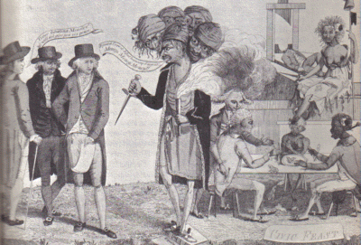

Slide 56
Sedition Act (1798)
If any person shall write, print, utter or publish, or shall cause or procure to be written, printed, uttered or published, or shall knowingly and willingly assist or aid in writing, printing, uttering or publishing any false, scandalous and malicious writing or writings against the government of the United States, or either house of the Congress of the United States, or the President of the United States, with intent to defame the said government, or either house of the said Congress, or the said President, or to bring them, or either of them, into contempt or disrepute; or to excite against them, or either or any of them, the hatred of the good people of the United States, or to stir up sedition within the United States, or to excite any unlawful combinations therein, for opposing or resisting any law of the United States, or any act of the President of the United States, done in pursuance of any such law, or of the powers in him vested by the constitution of the United States, or to resist, oppose, or defeat any such law or act, or to aid, encourage or abet any hostile designs of any foreign nation against United States, their people or government, then such person, being thereof convicted before any court of the United States having jurisdiction thereof, shall be punished by a fine not exceeding two thousand dollars, and by imprisonment not exceeding two years.

Slide 57
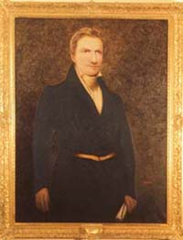
Notes:
Matthew lyon

Slide 58
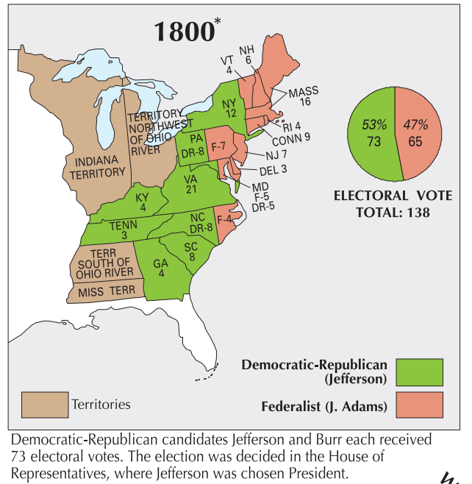

Slide 59
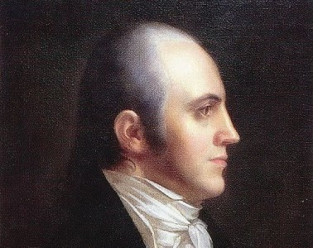

Slide 60
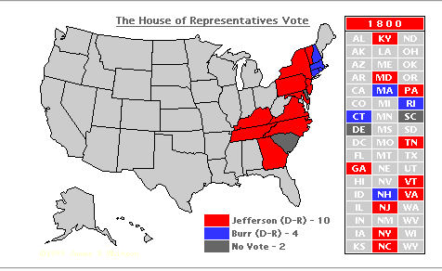

Slide 61
12th amendment
The Electors shall meet in their respective states, and vote by ballot for President and Vice-President, one of whom, at least, shall not be an inhabitant of the same state with themselves; they shall name in their ballots the person voted for as President, and in distinct ballots the person voted for as Vice-President, and they shall make distinct lists of all persons voted for as President, and of all persons voted for as Vice-President and of the number of votes for each, which lists they shall sign and certify, and transmit sealed to the seat of the government of the United States, directed to the President of the Senate;

Slide 62
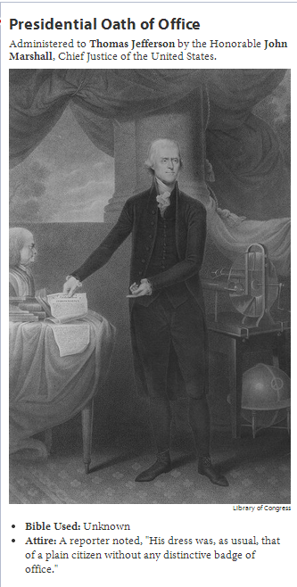

Slide 63
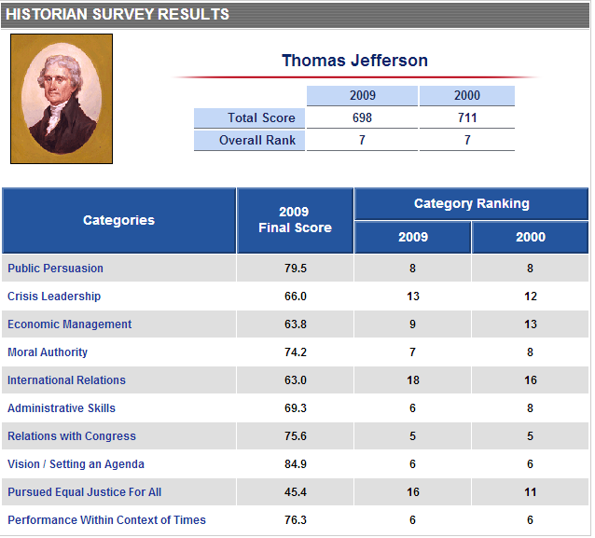

Slide 64
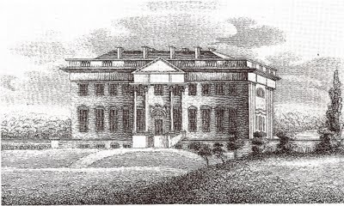
Notes:
Jefferson white house

Slide 65
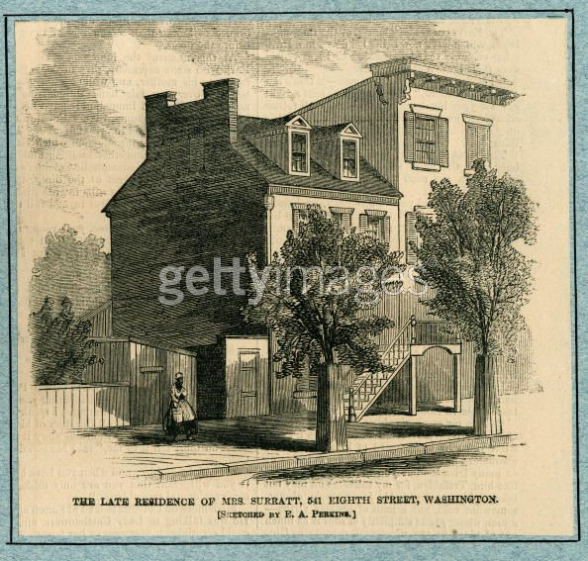
Notes:
boardinghouse

Slide 66
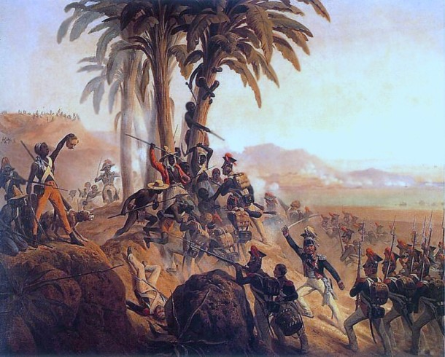

Slide 67
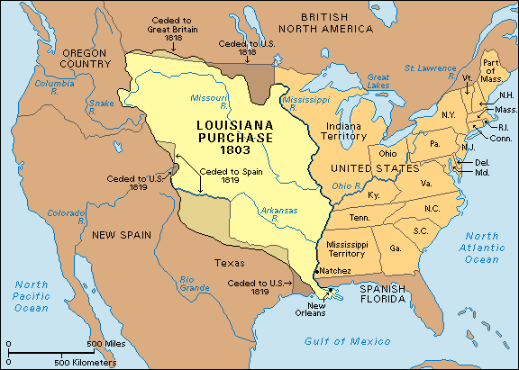

Slide 68


Slide 69


Slide 70





Slide 71


Slide 72


