Slide 1
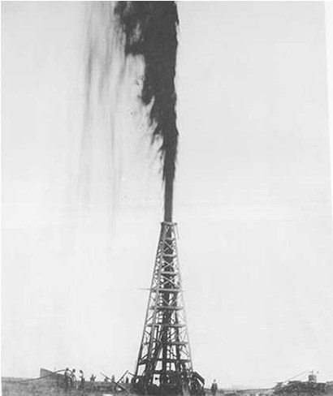
Notes:
Lucas gusher, Beaumont, 1st major TX gusher, 1900s

Slide 2
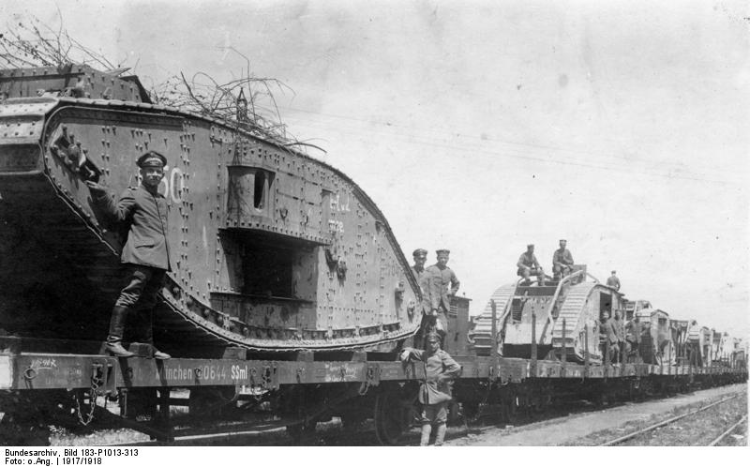

Slide 3
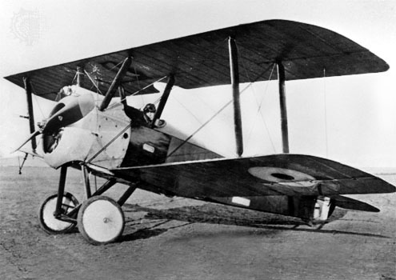

Slide 4
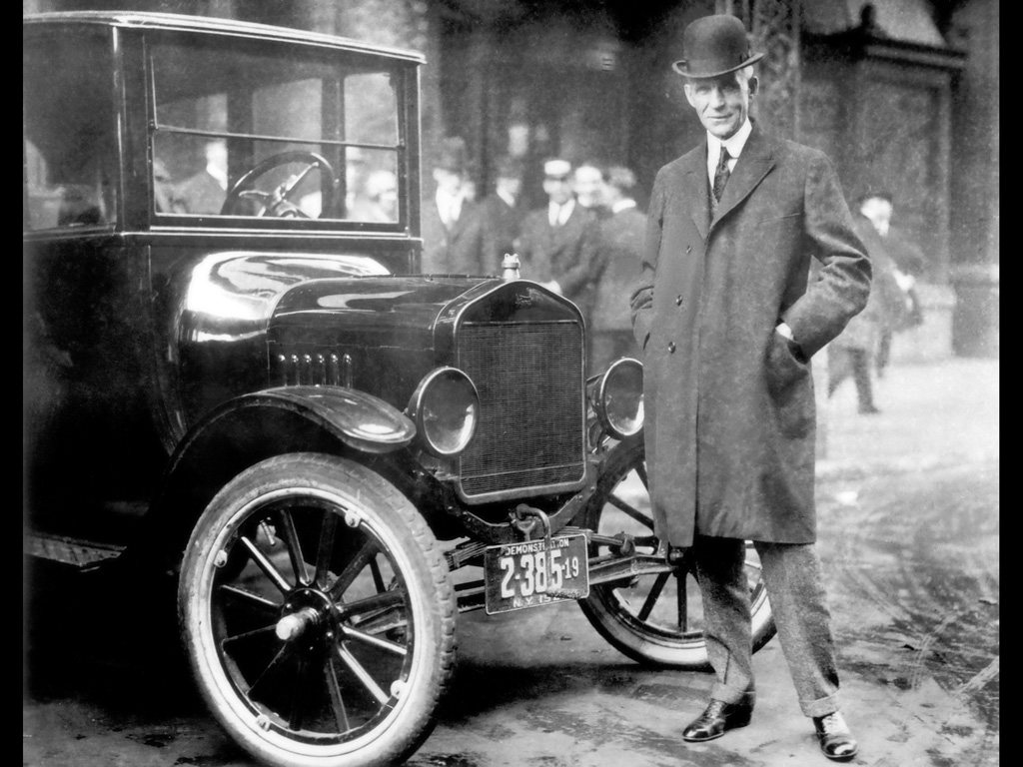
Notes:
Henry ford with model T

Slide 5
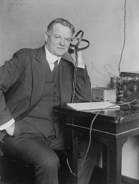

Slide 6
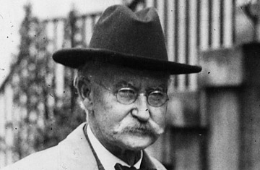
Notes:
Albert fall

Slide 7
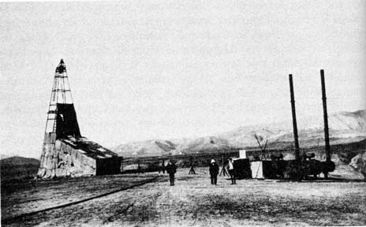
Notes:
1st oil well Iran 1908 (Masjid Sulaiman)

Slide 8
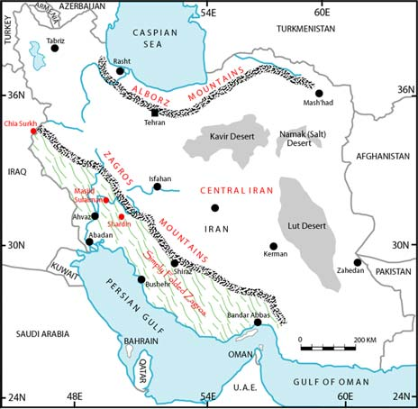
Notes:
Oil wells in shaded area

Slide 9
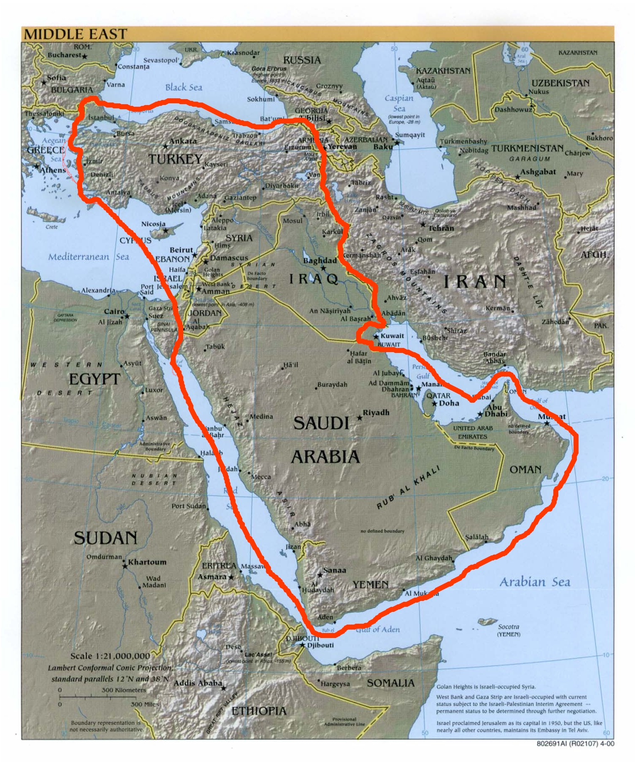

Slide 10
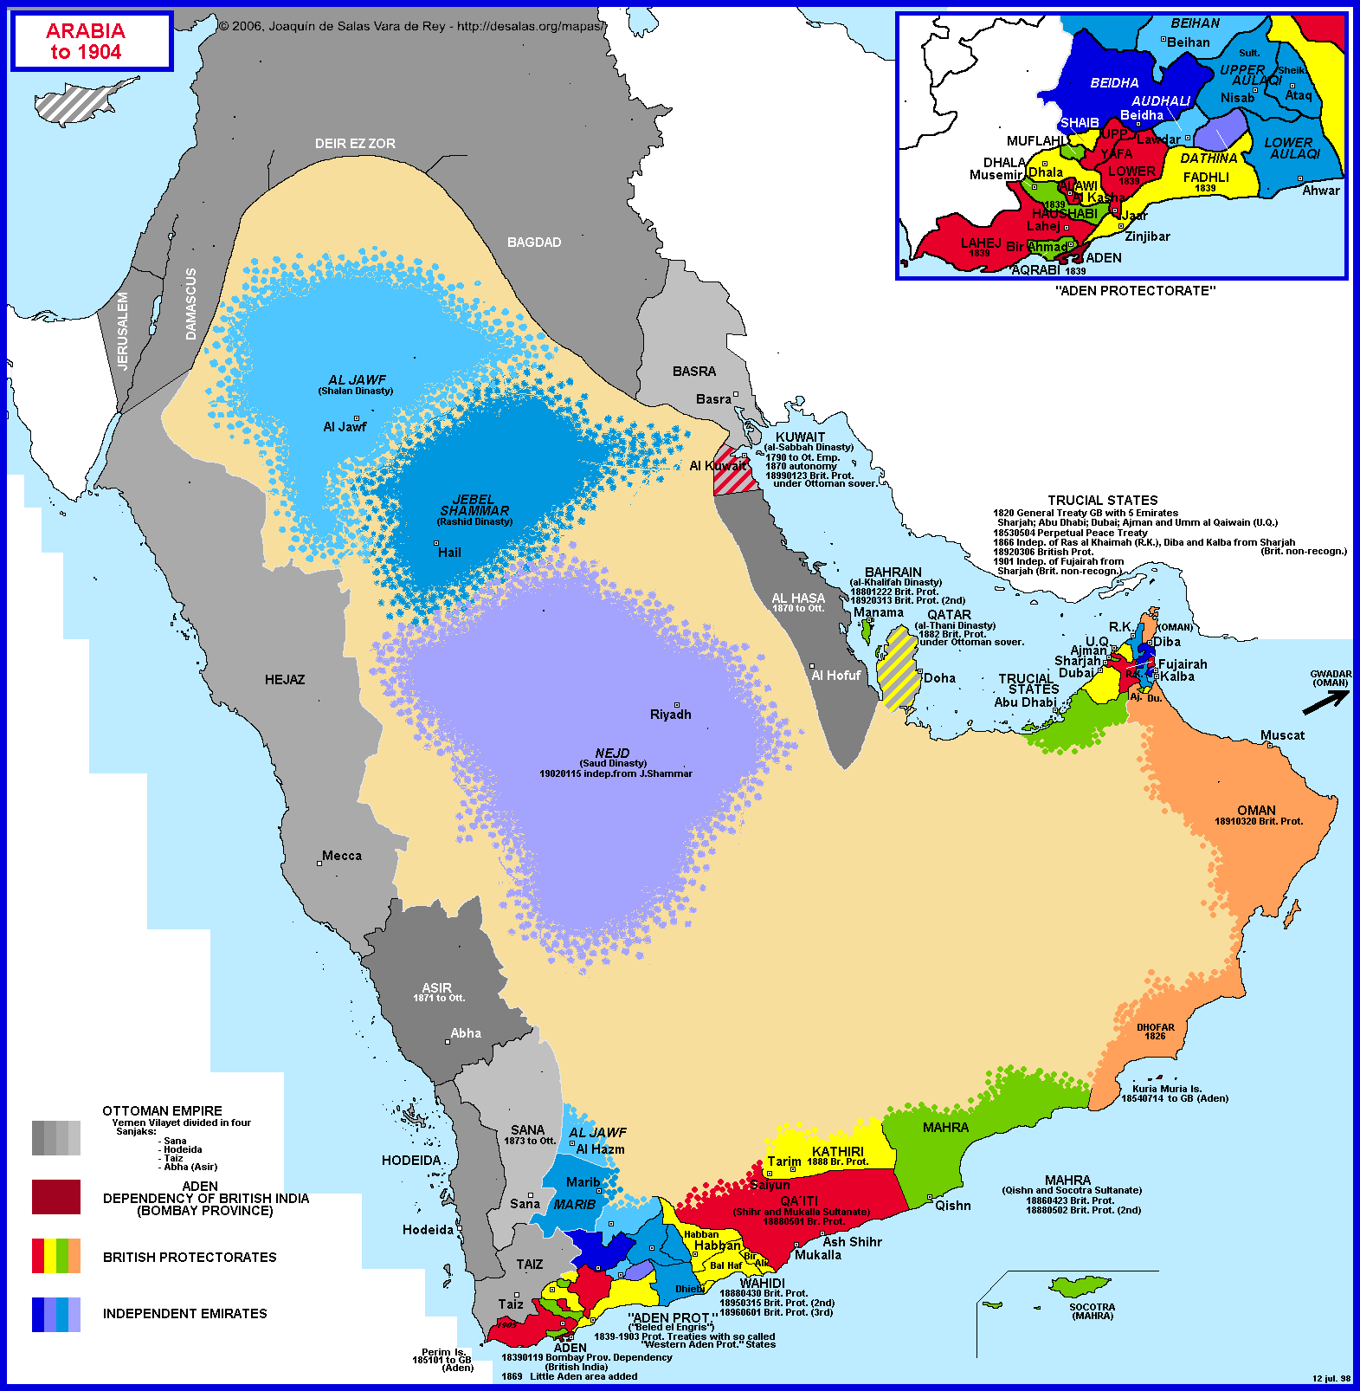

Slide 11
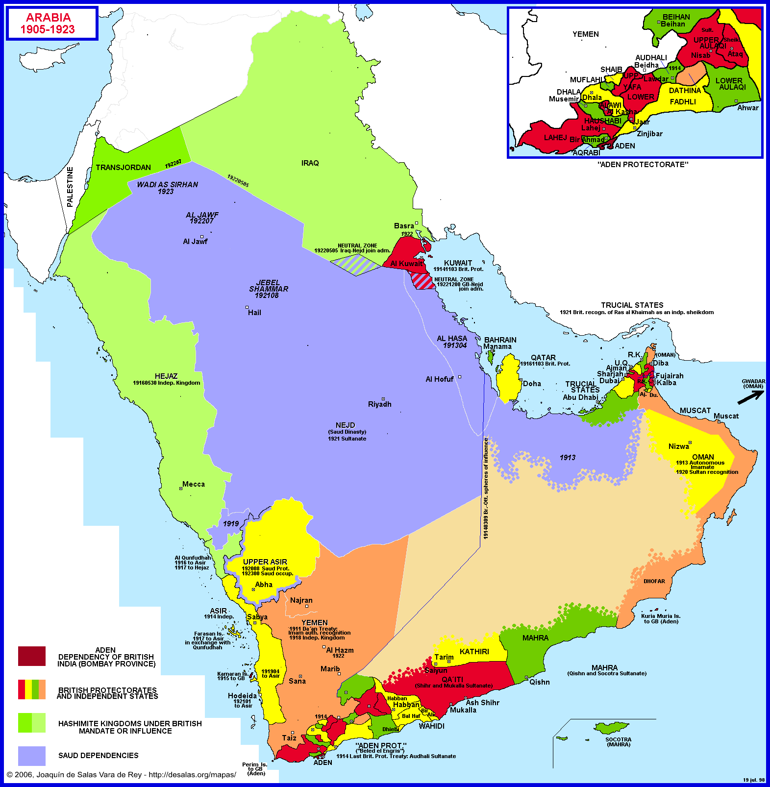

Slide 12
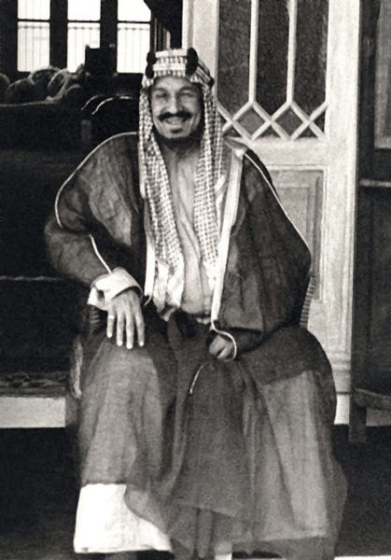
Notes:
Ibn saud

Slide 13
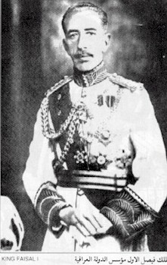
Notes:
King faisal

Slide 14
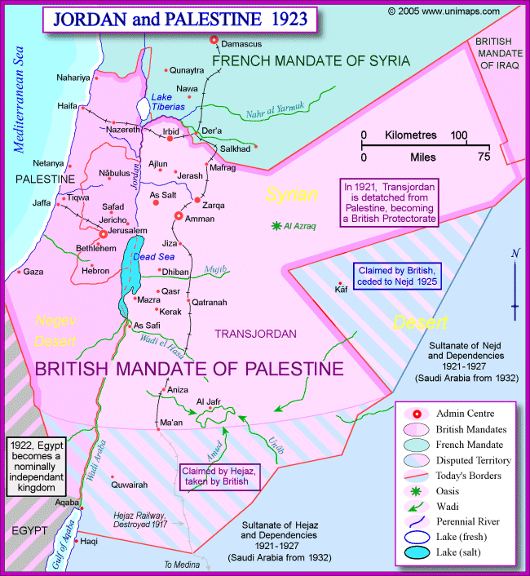

Slide 15


Slide 16
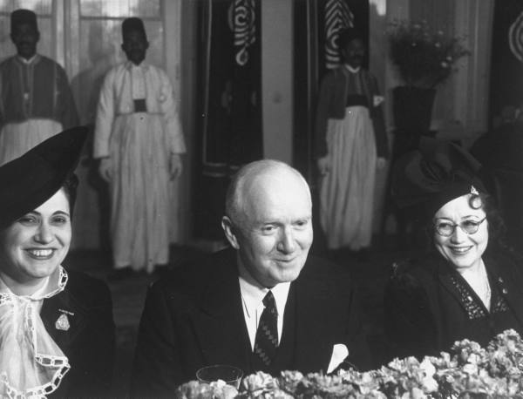
Notes:
Bert fish, 1st us ambassador to sarab

Slide 17
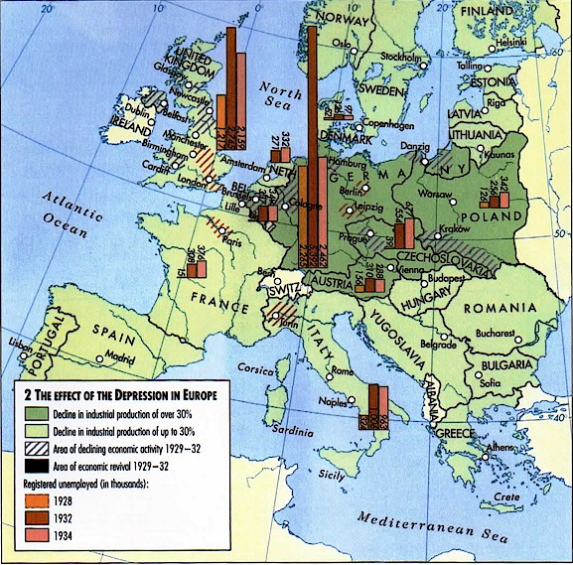

Slide 18
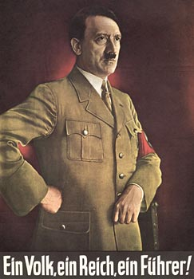

Slide 19
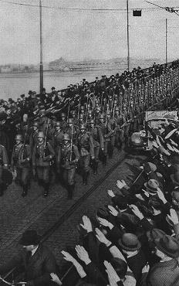

Slide 20
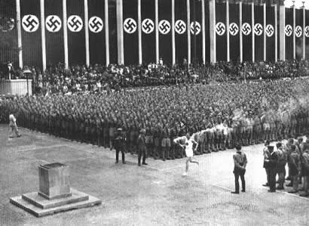

Slide 21
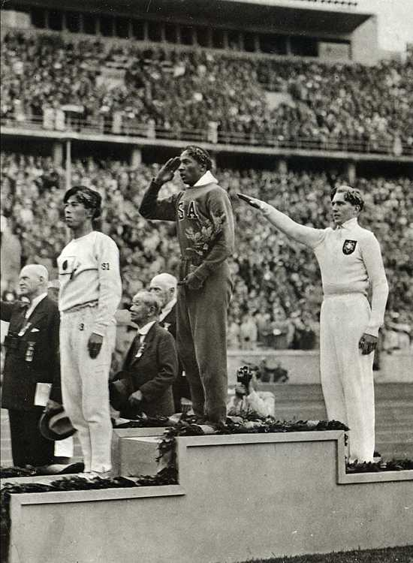

Slide 22
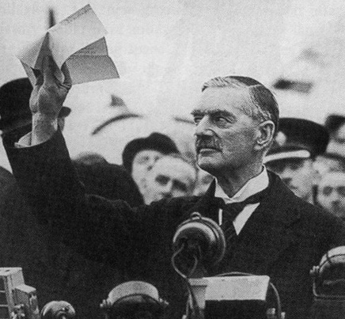

Slide 23
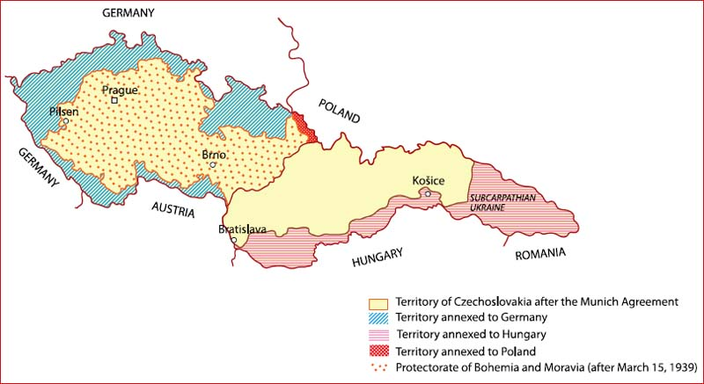

Slide 24
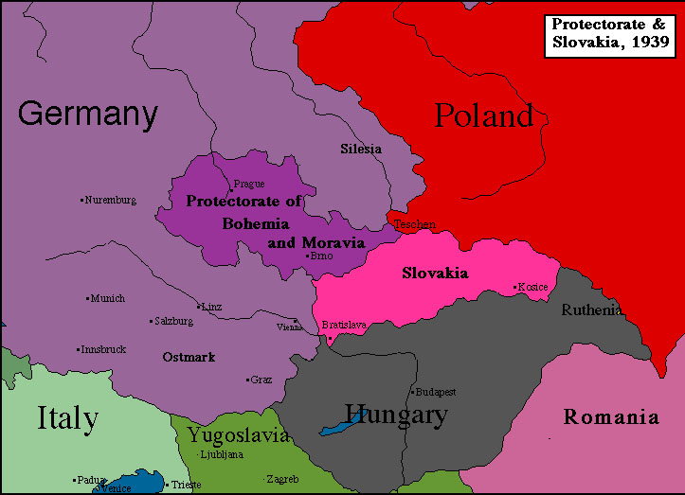

Slide 25
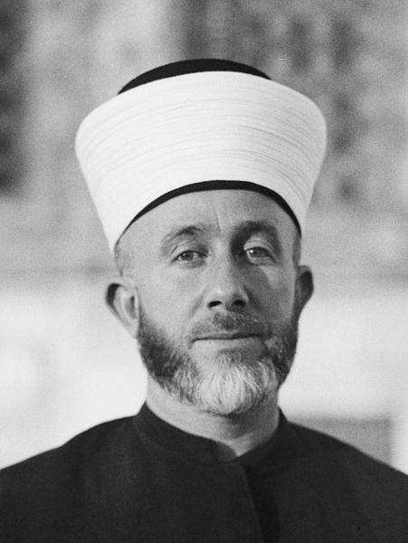
Notes:
Grand mufti

Slide 26
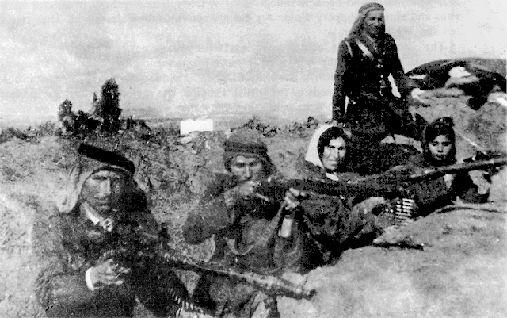

Slide 27
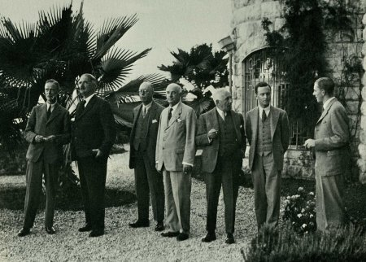

Slide 28
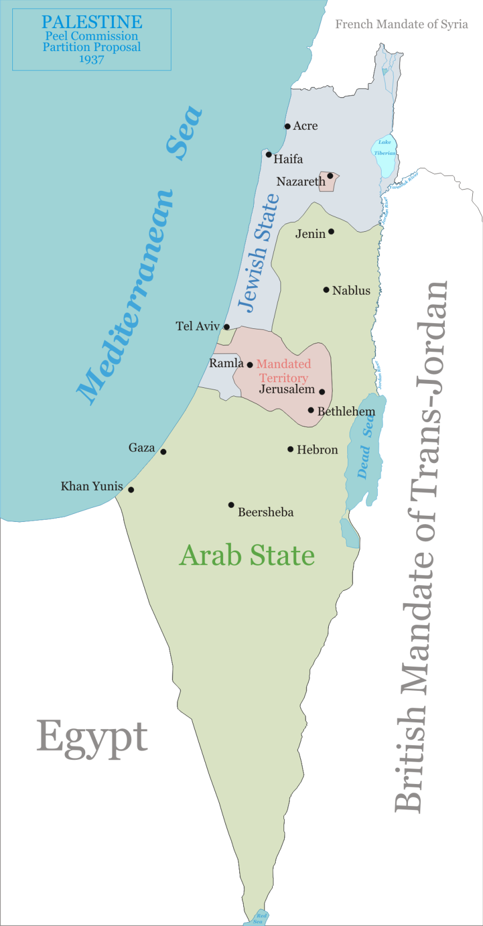

Slide 29
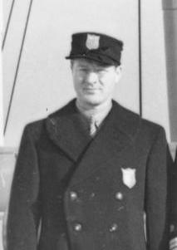
Notes:
Avery brundage

Slide 30

Notes:
ickes

Slide 31
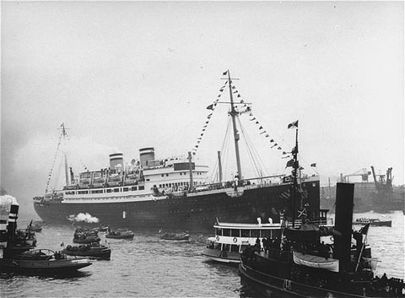
Notes:
St louis

Slide 32
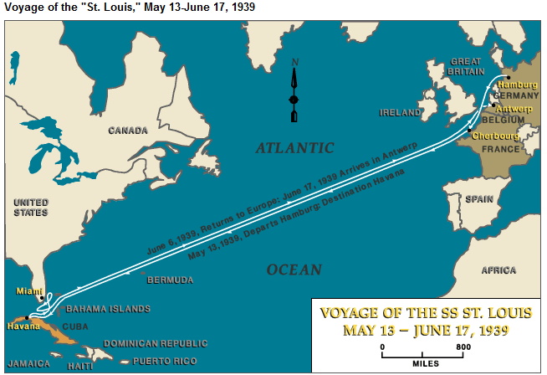

Slide 33
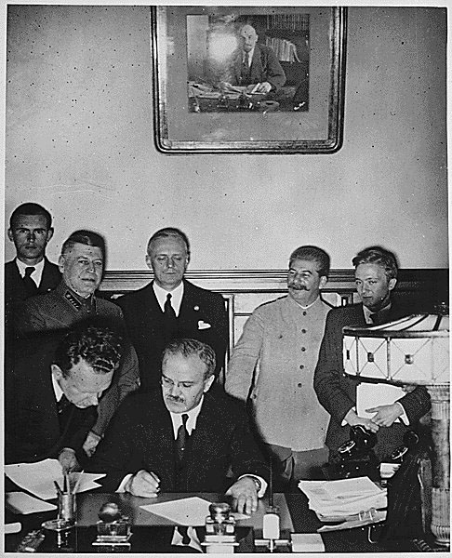

Slide 34
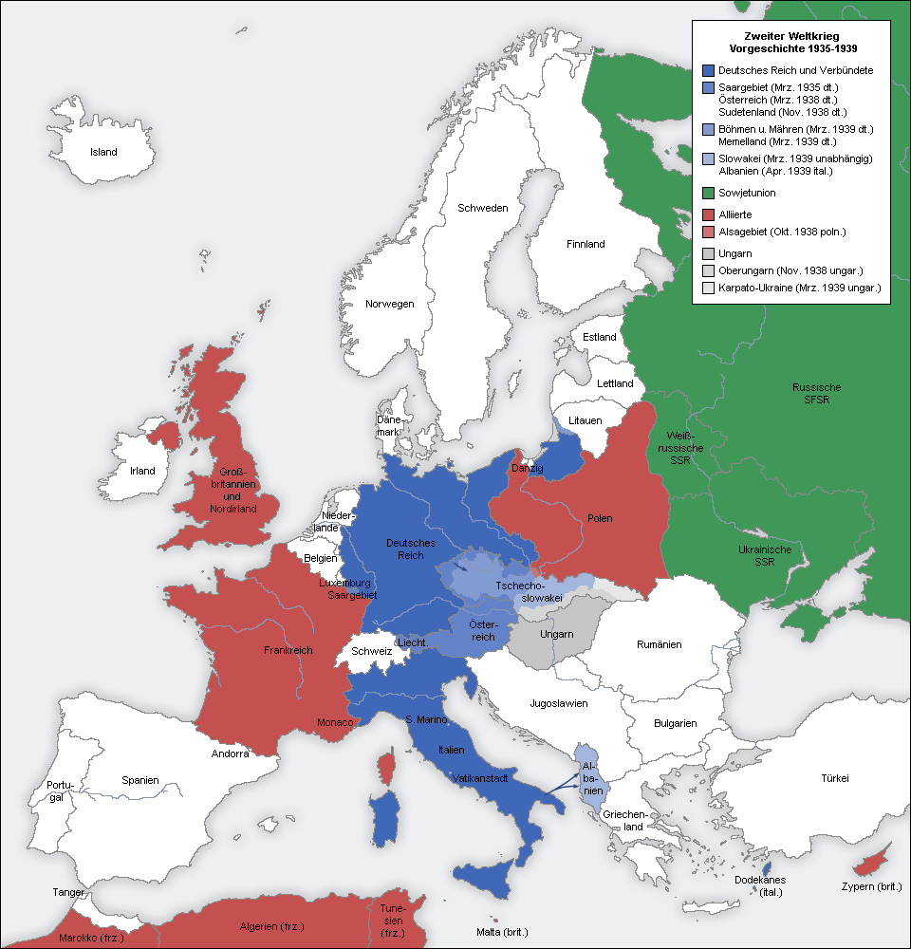

Slide 35
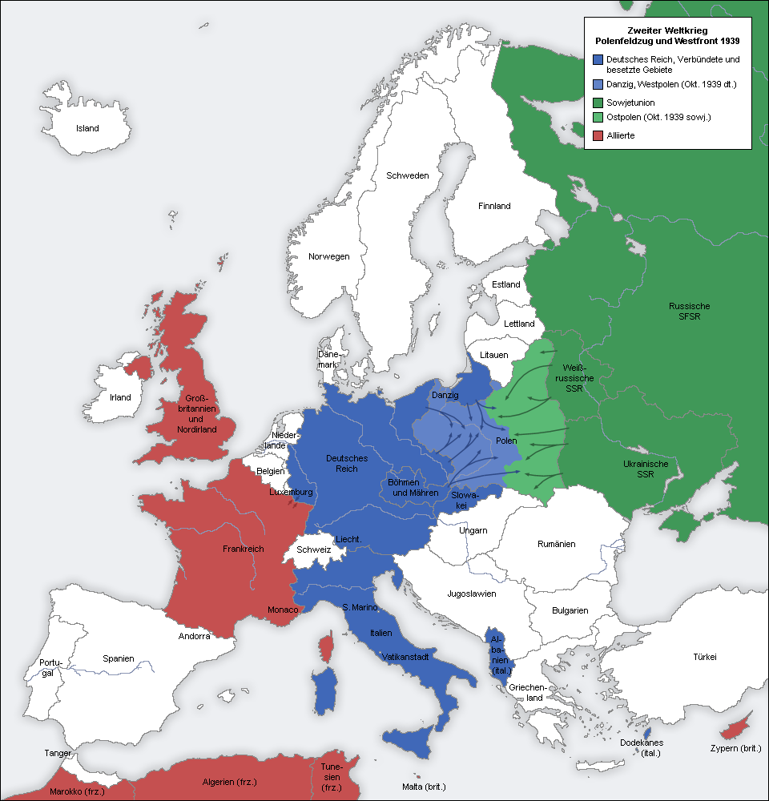

Slide 36
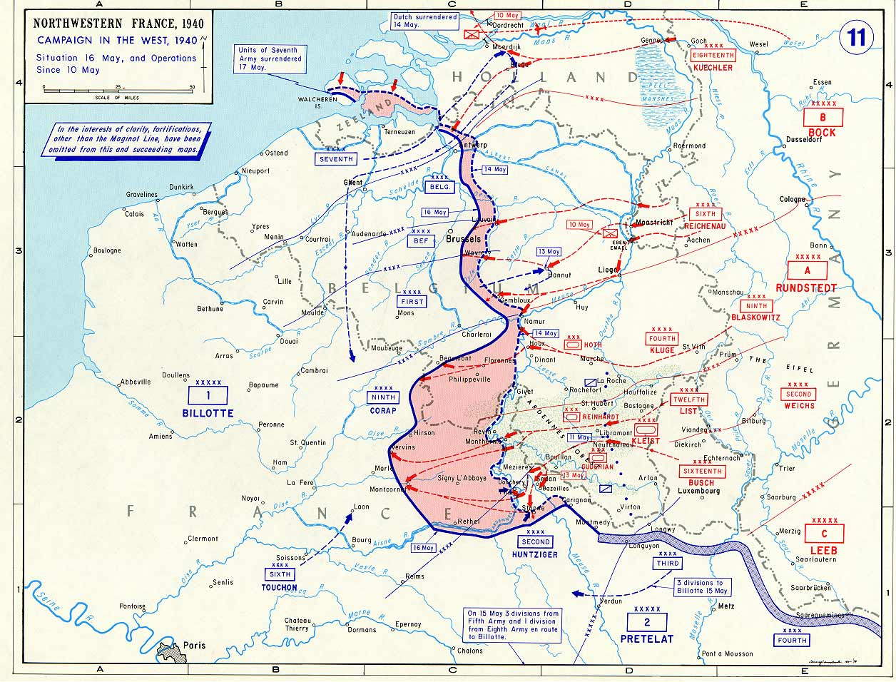

Slide 37
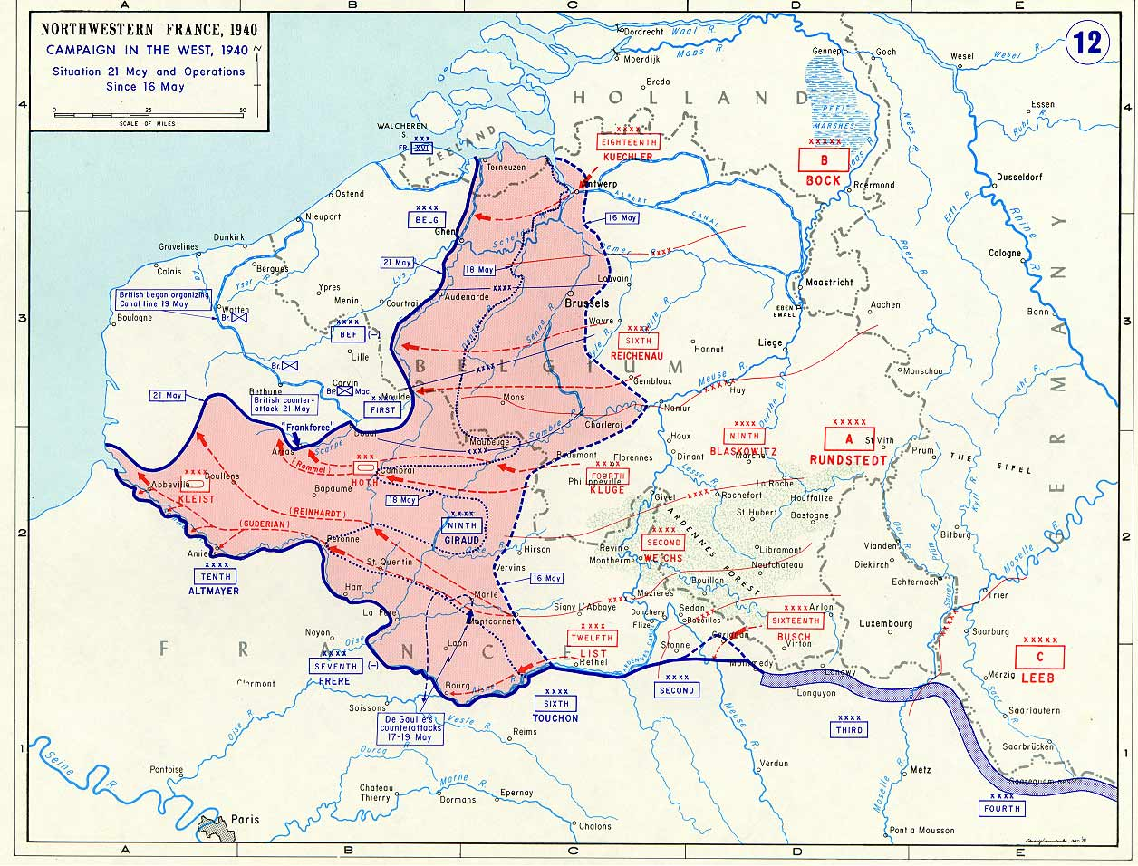

Slide 38
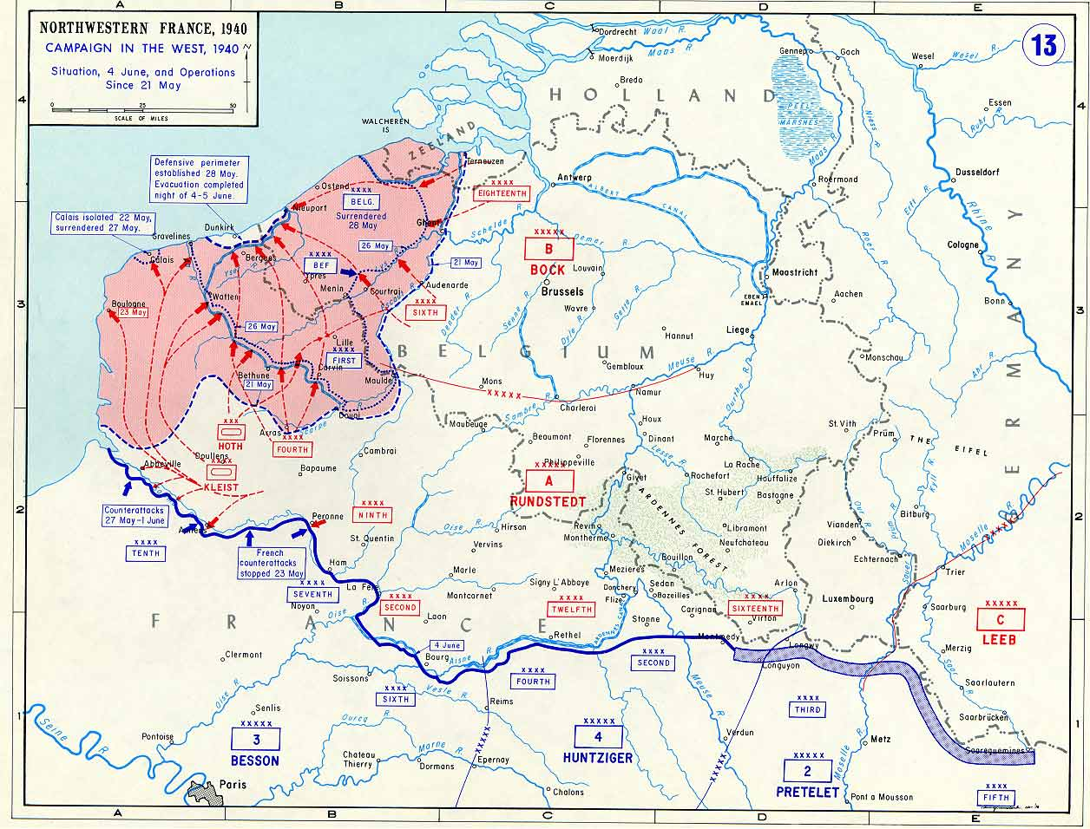

Slide 39
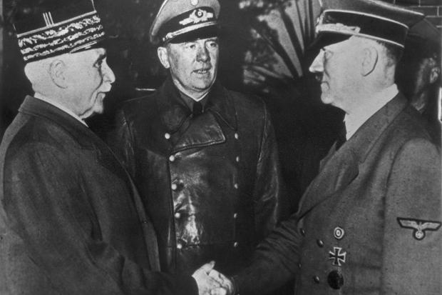

Slide 40


Slide 41
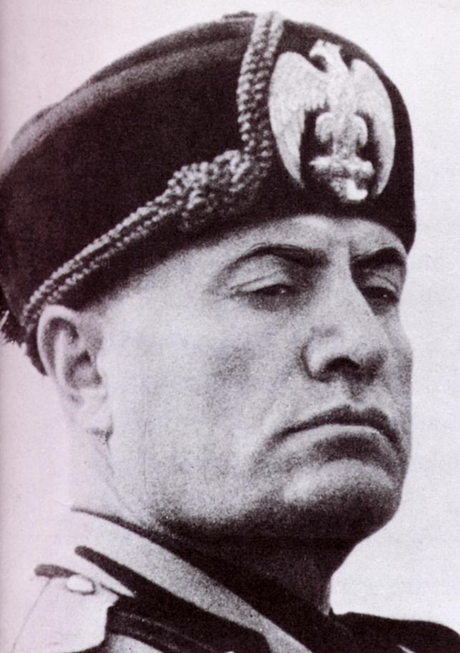

Slide 42
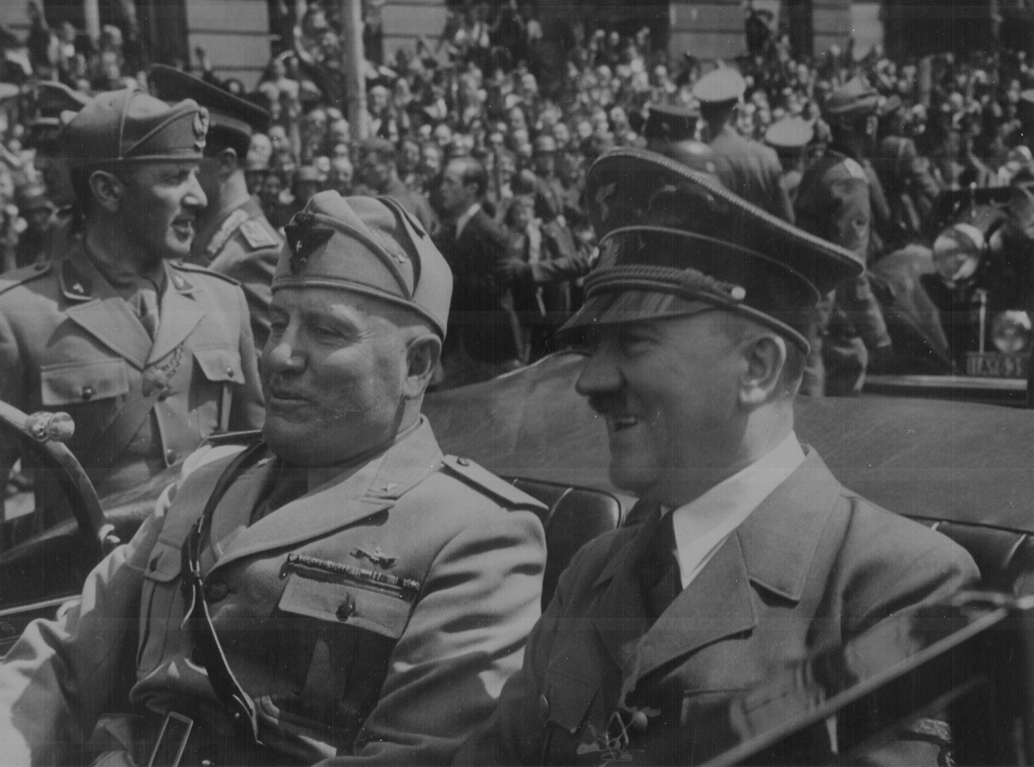

Slide 43
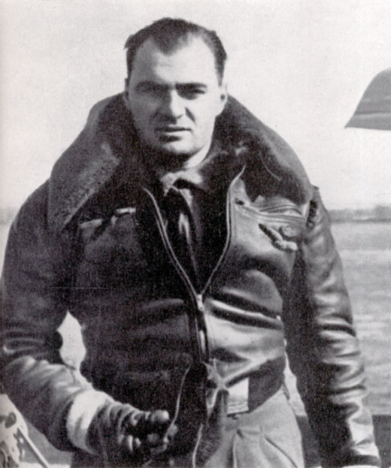
Notes:
Ettore muti—commander of italian attack squadron bahrain.dhahran

Slide 44
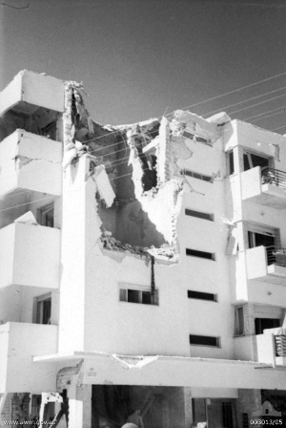
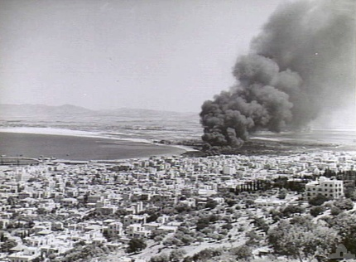

Slide 45
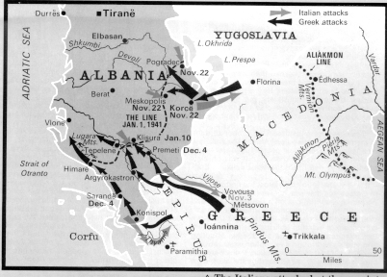

Slide 46
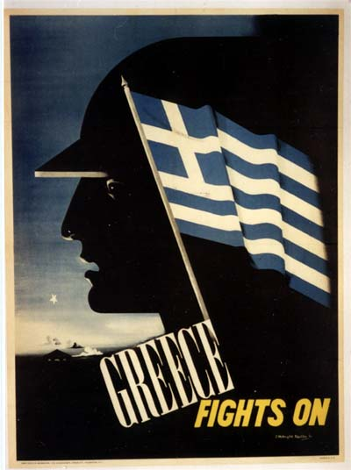
Notes:
Us prop poster

Slide 47
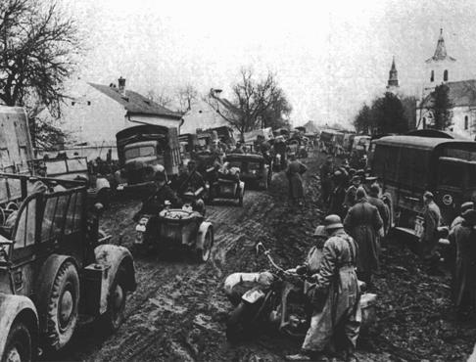

Slide 48
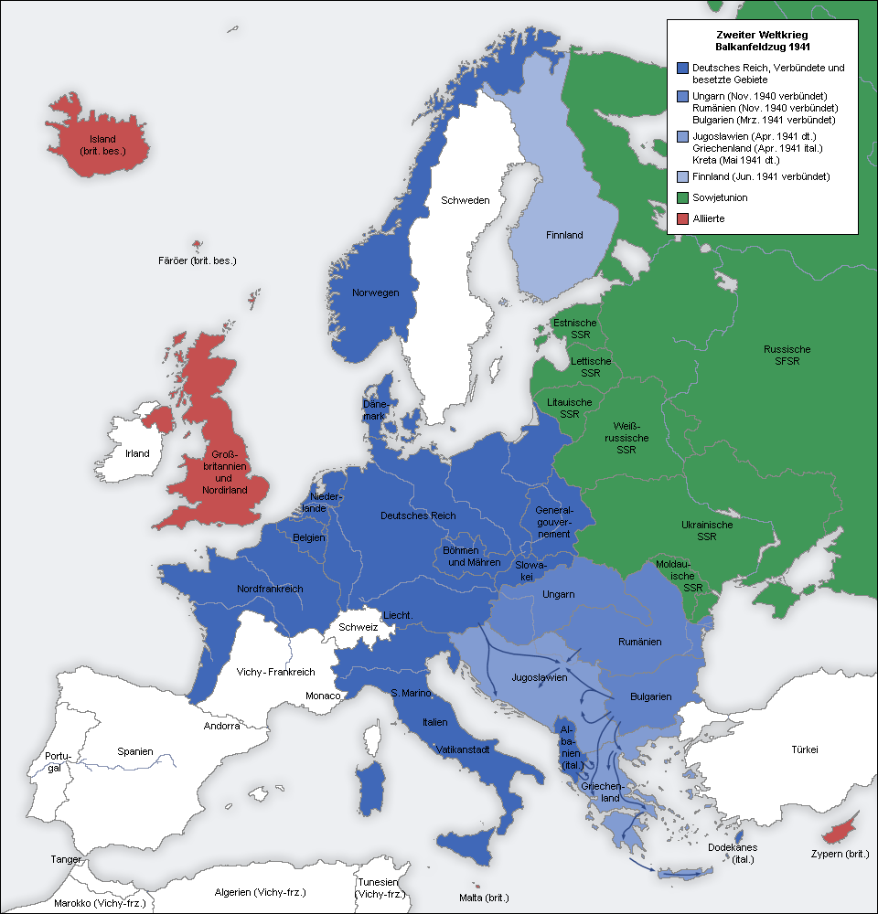

Slide 49
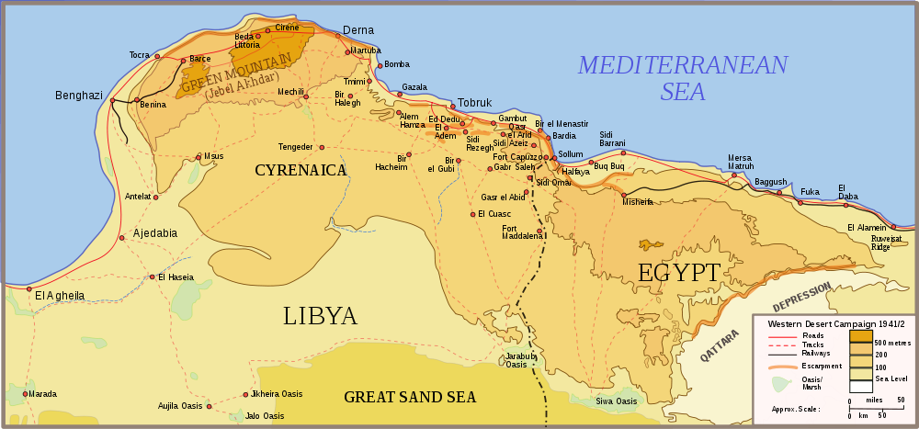

Slide 50
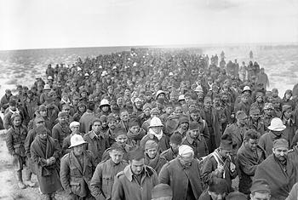
Notes:
Italian prisoners—op cmpass

Slide 51
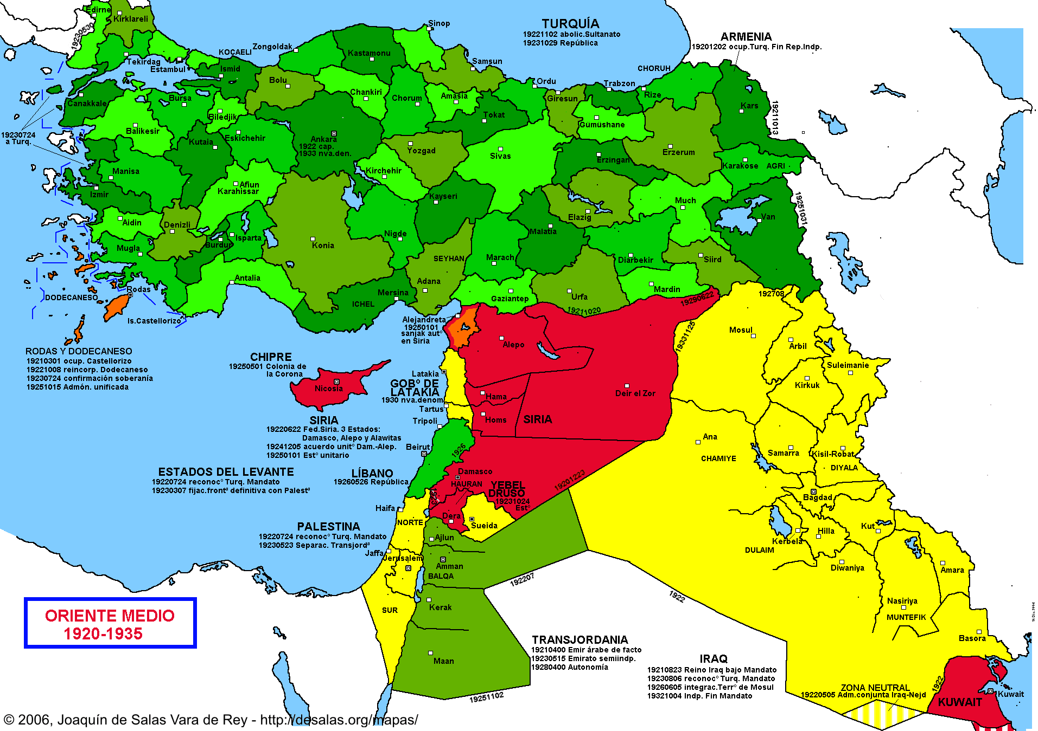

Slide 52
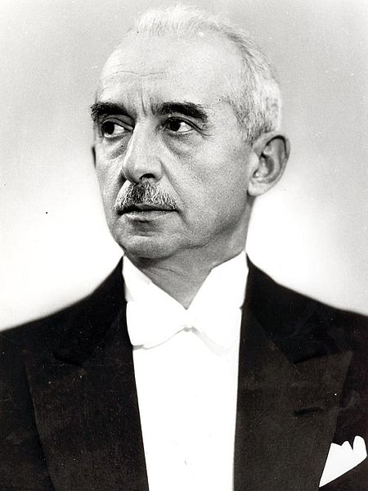
Notes:
inonu

Slide 53

Notes:
Von papen—amb to turkey

Slide 54


Slide 55

Notes:
Reza shah

Slide 56

Notes:
Signed photo of ah—in shah’s palace

Slide 57


Slide 58

Notes:
Persian corridor

Slide 59


Slide 60


Slide 61

Notes:
Rashid ali

Slide 62

Notes:
Mufti and ali at anniversary of coup in berlin

Slide 63


Slide 64

Notes:
darlan

Slide 65


Slide 66

Notes:
Aus troops in lebanon

Slide 67

Notes:
Uss california

Slide 68


Slide 69


Slide 70


Slide 71

Notes:
Dde with darlan

Slide 72

Notes:
rommel

Slide 73


Slide 74


Slide 75

Notes:
Churchill inonu 1943

Slide 76

Notes:
Struma—769 passengers, all but one died

Slide 77


Notes:
Behic ercin—amb to vichy; Selahattin Ulkumen

Slide 78


Slide 79


Slide 80

Notes:
Ante pavelic

Slide 81

Notes:
16th Bosnian muslim partisan bridgae

Slide 82


Slide 83

Notes:
teheran

Slide 84


Slide 85

Notes:
Dharhan air field (1950)

Slide 86

Notes:
Fdr and ibn saud

