Slide 1
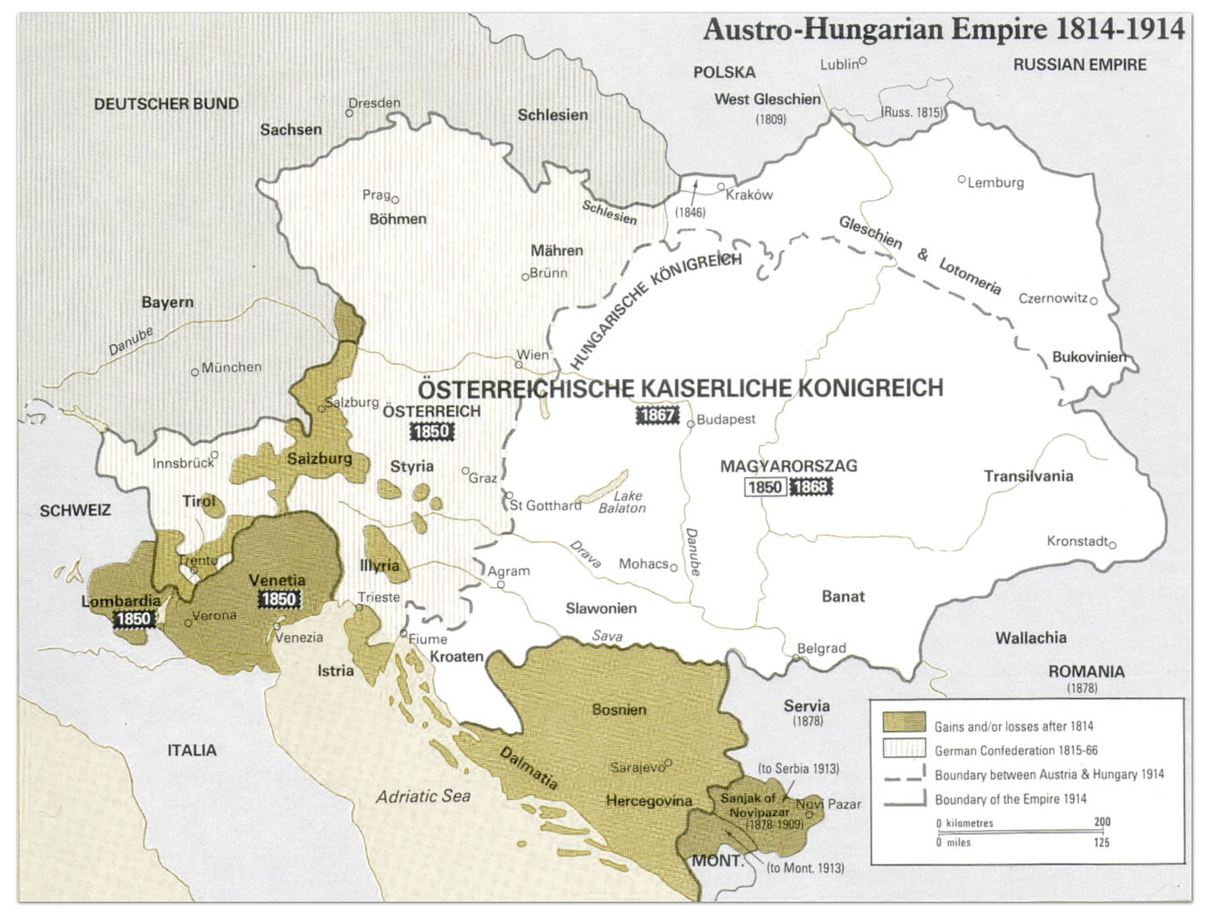

Slide 2
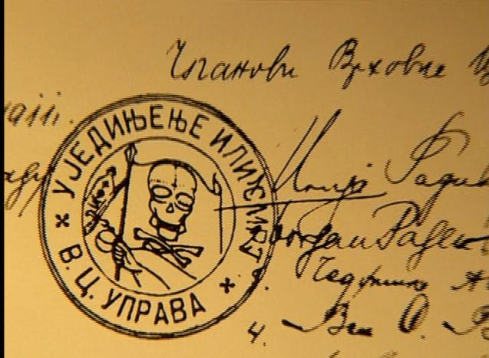
Notes:
Black hand symbol

Slide 3
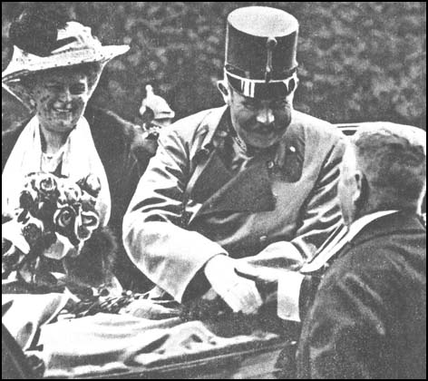

Slide 4
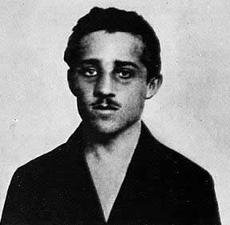
Notes:
Gavrilo princip

Slide 5
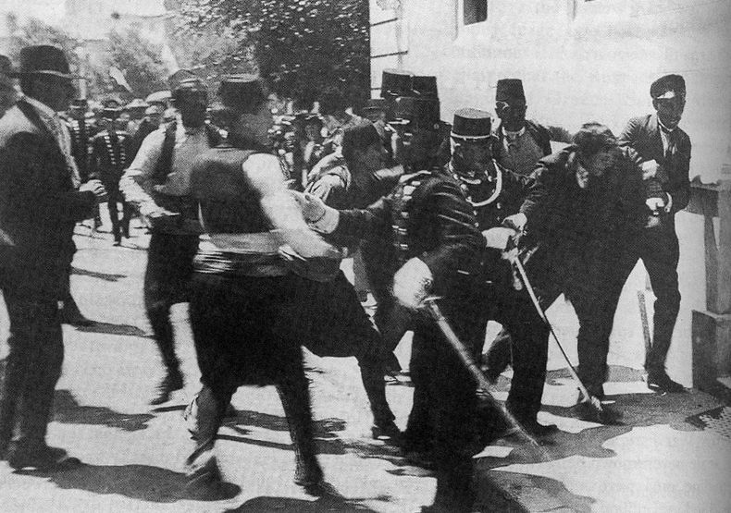

Slide 6


Slide 7
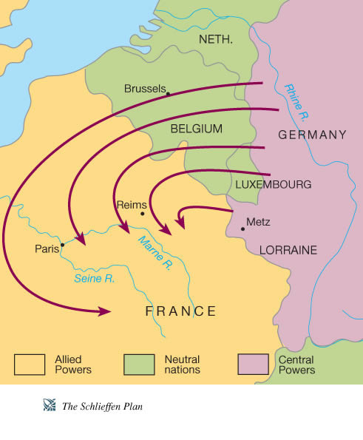

Slide 8
Treaty of Alliance Between Germany and Turkey, 2 August 1914
1. The two contracting parties agree to observe strict neutrality in regard to the present conflict between Austria-Hungary and Serbia.
2. In case Russia should intervene with active military measures, and should thus bring about a casus foederis for Germany with relation to Austria-Hungary, this casus foederis would also come into existence for Turkey.
3. In case of war, Germany will leave her military mission at the disposal of Turkey. The latter, for her part, assures the said military mission an effective influence on the general conduct of the army, in accordance with the understanding arrived at directly between His Excellency the Minister of War and His Excellency the Chief of the Military Mission.
4. Germany obligates herself, if necessary by force of arms, to protect Ottoman territory in case it should be threatened.
5. This agreement which has been concluded for the purpose of protecting both Empires from international complications which may result from the present conflict goes into force as soon as it is signed by the above-mentioned plenipotentiaries, and shall remain valid, together with any similar mutual agreements, until December 31, 1918.

Slide 9
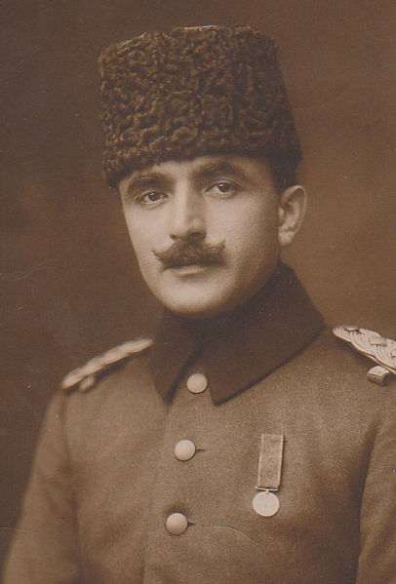
Notes:
Enver pasha

Slide 10
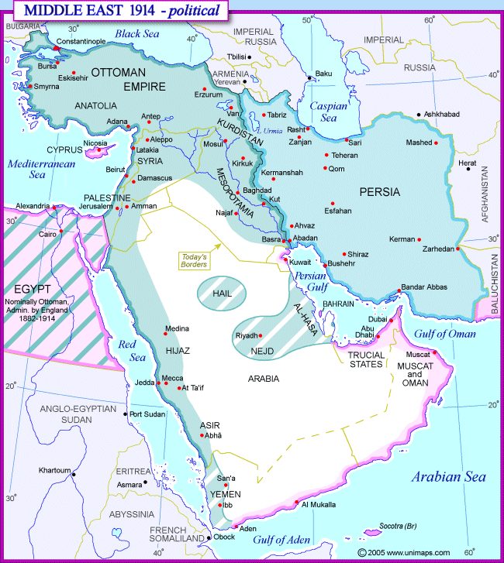

Slide 11
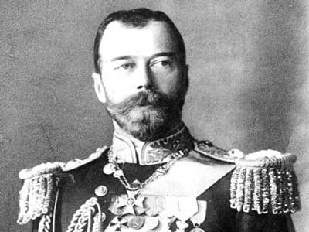

Slide 12
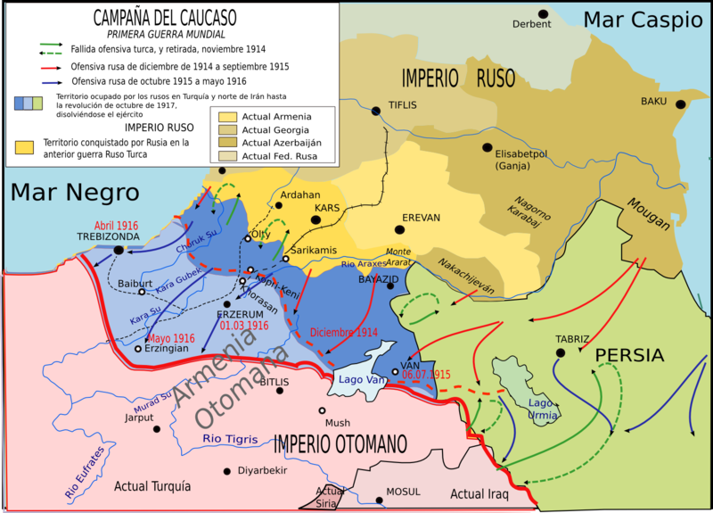

Slide 13
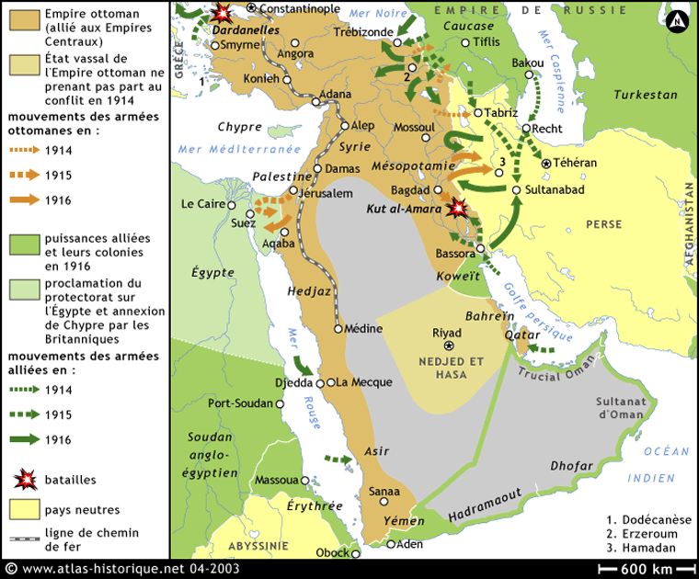

Slide 14
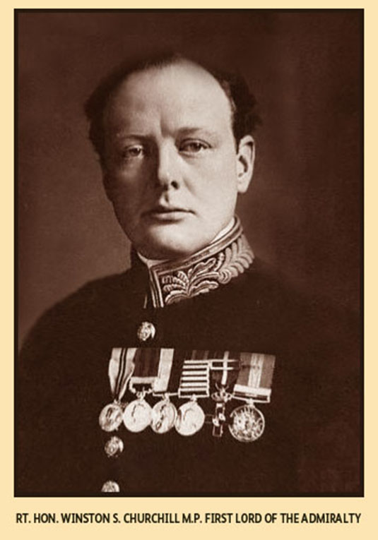

Slide 15
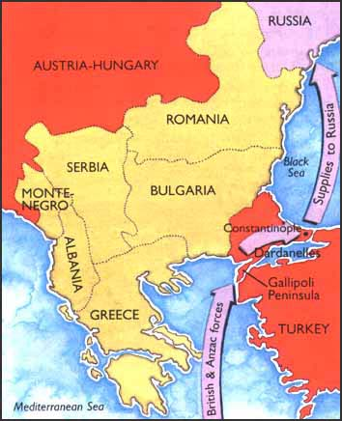

Slide 16
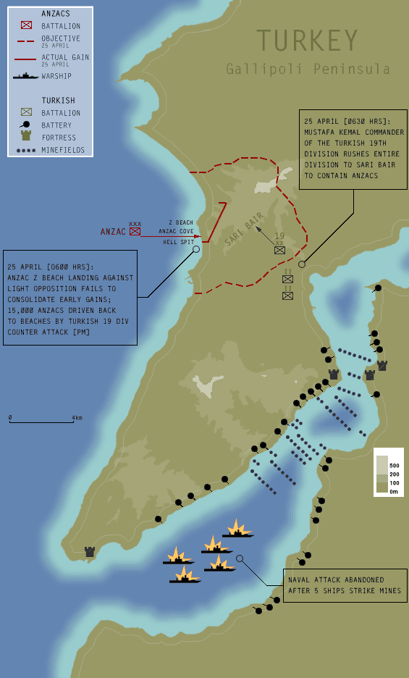

Slide 17
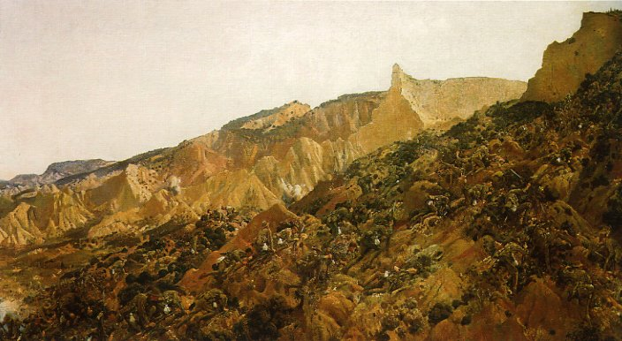

Slide 18
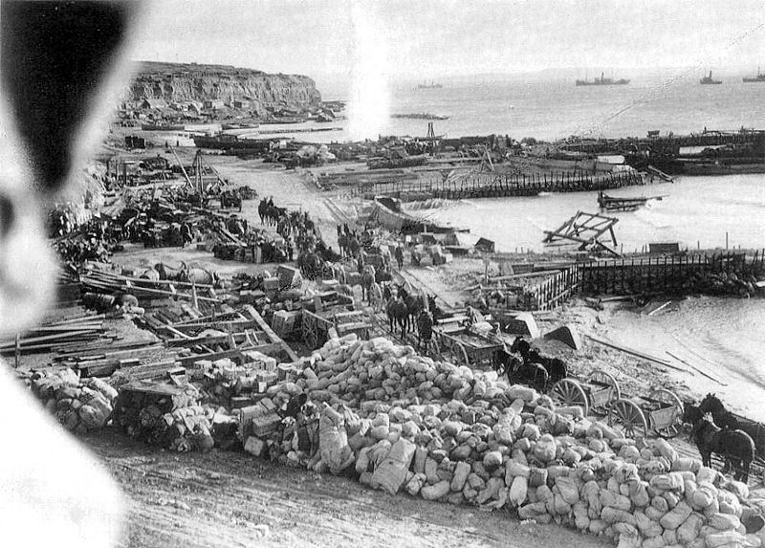

Slide 19
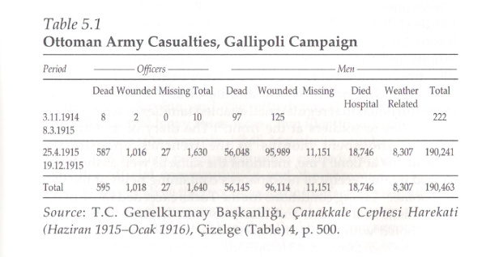

Slide 20
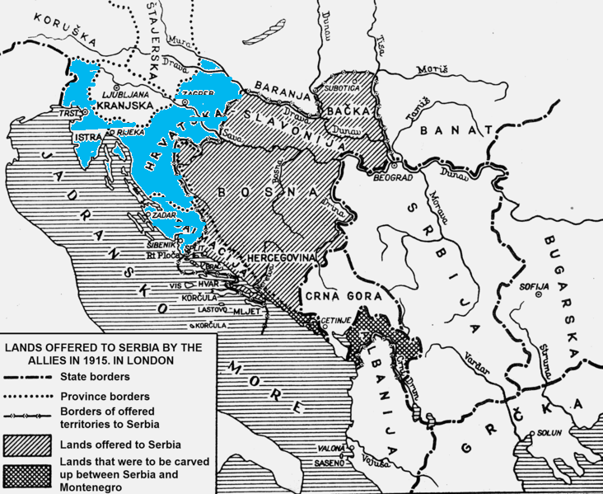

Slide 21
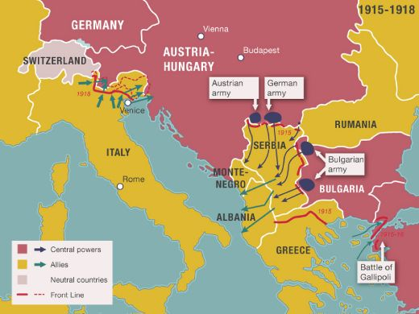

Slide 22
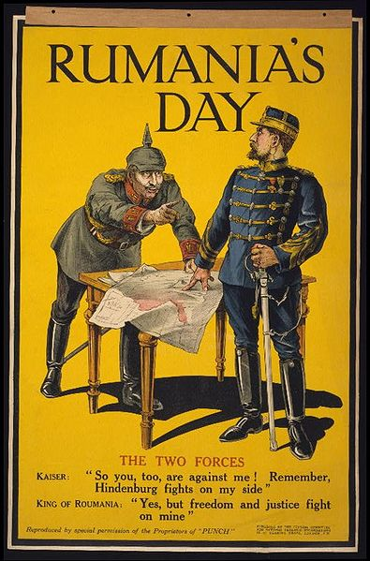

Slide 23
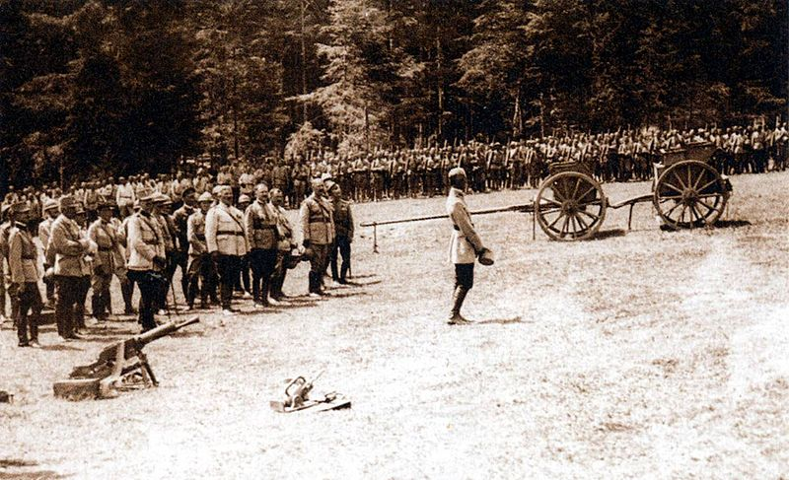

Slide 24
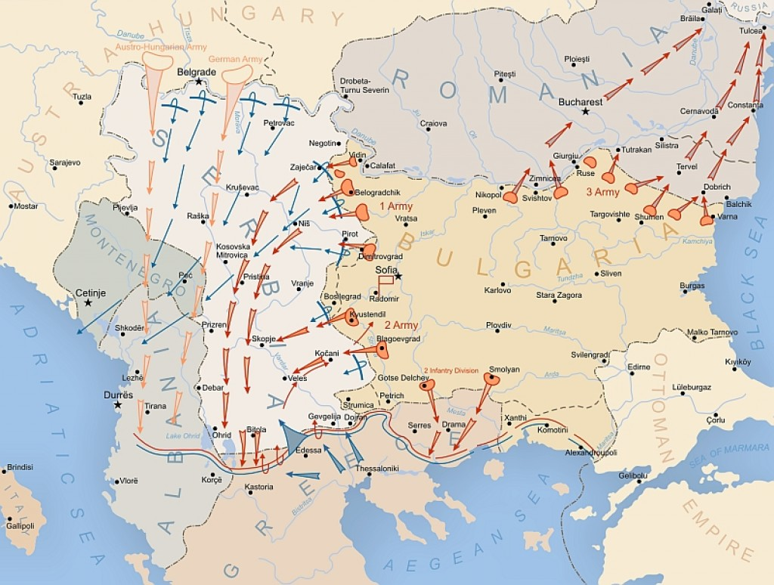

Slide 25
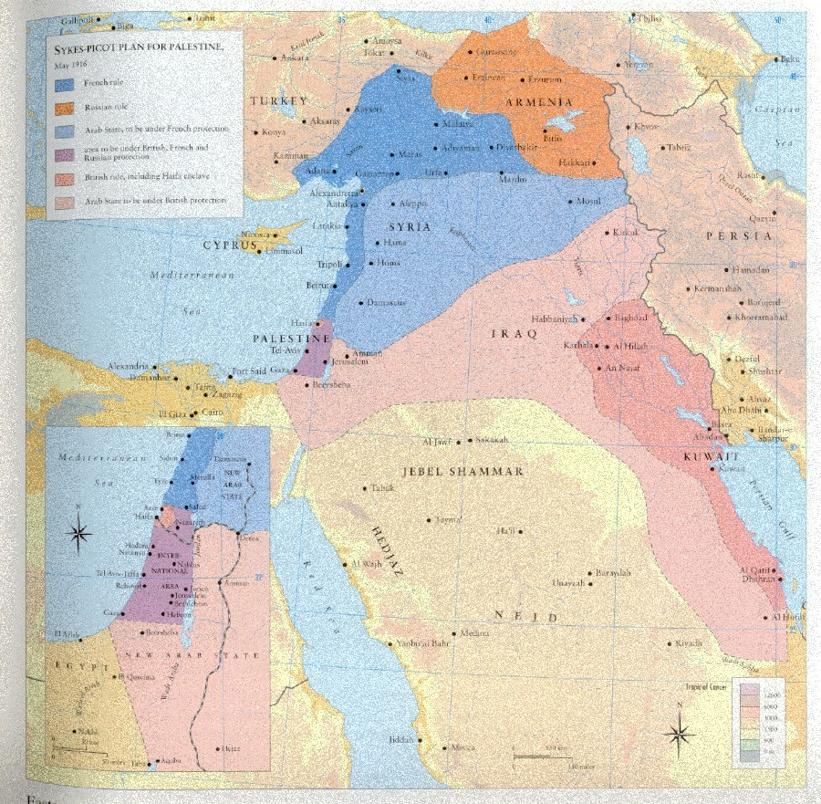

Slide 26
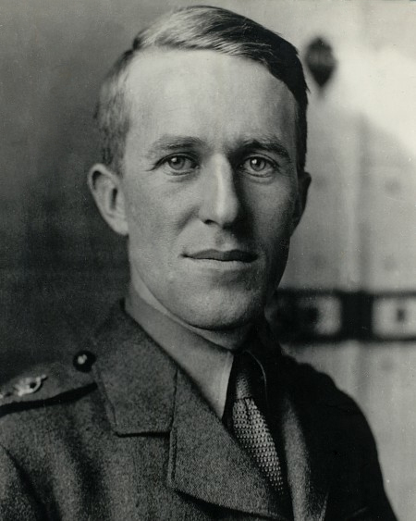
Notes:
Te lawrence

Slide 27
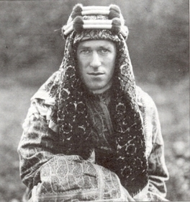

Slide 28
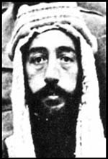

Slide 29
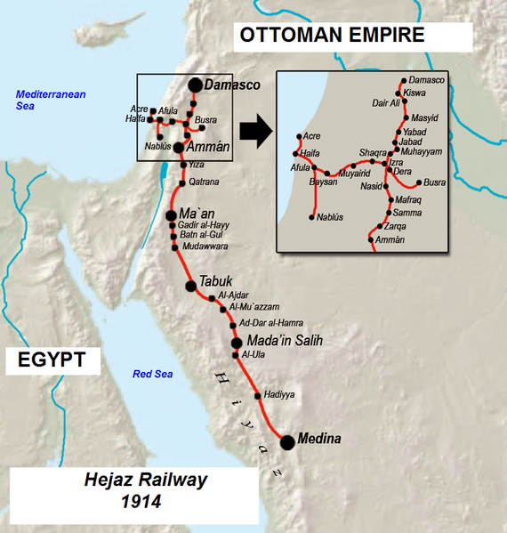

Slide 30
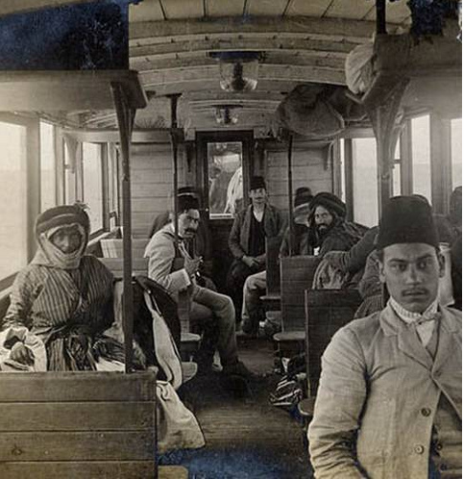
Notes:
Hejaz 1915

Slide 31
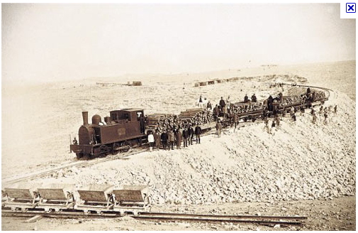
Notes:
Hejaz rr

Slide 32
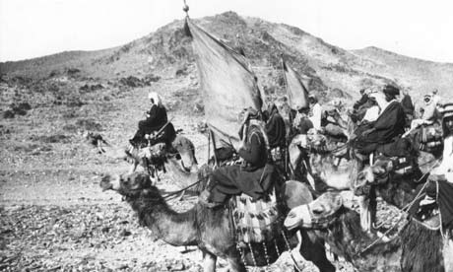

Slide 33
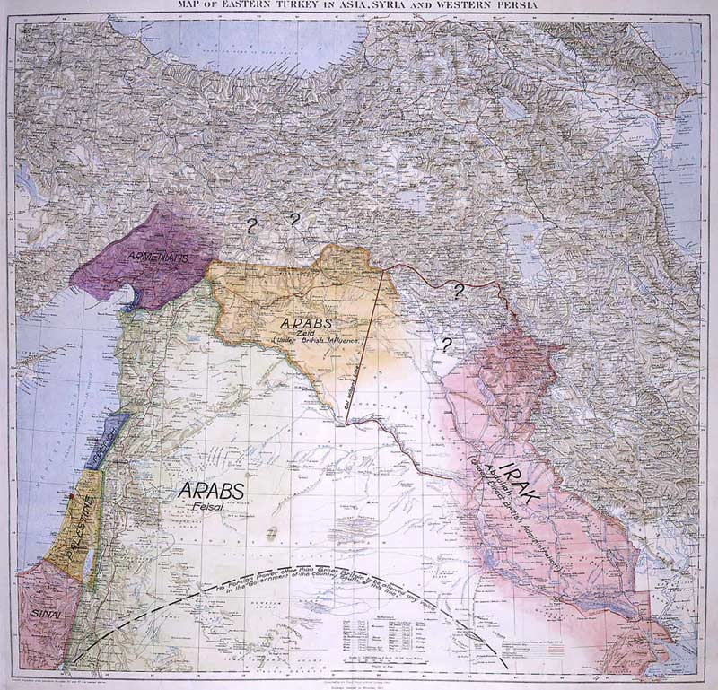
Notes:
Lawrence of arabia map

Slide 34


Slide 35
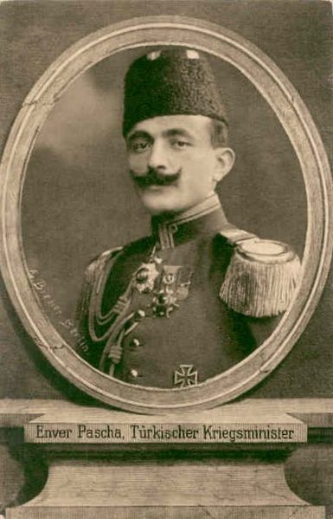

Slide 36
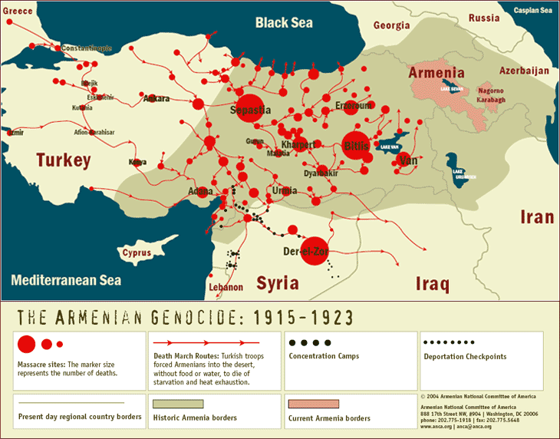

Slide 37
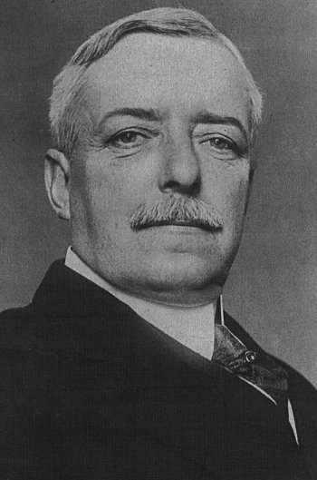
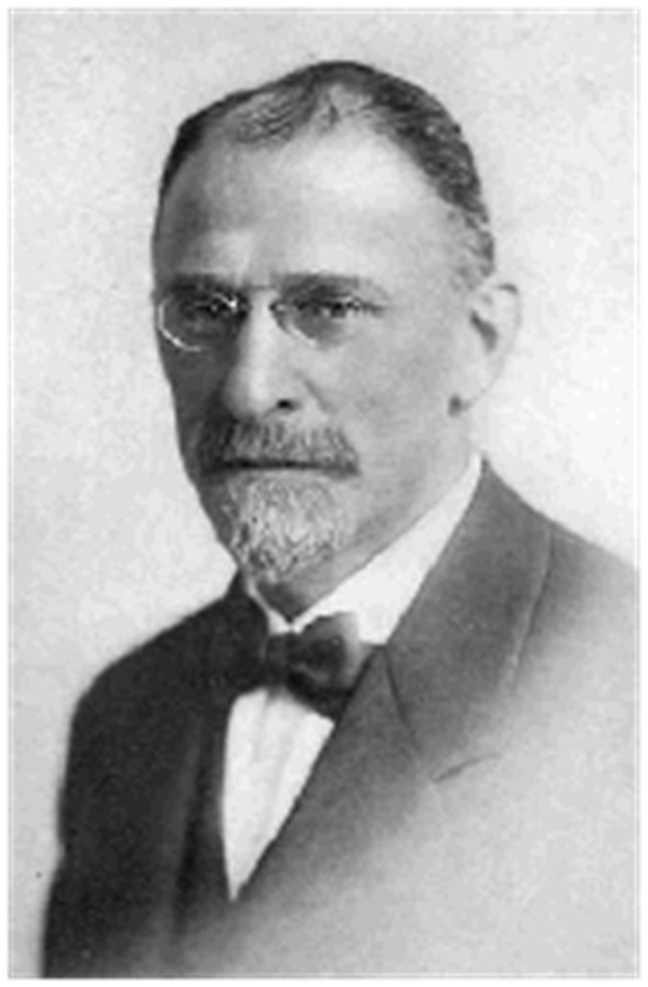

Slide 38
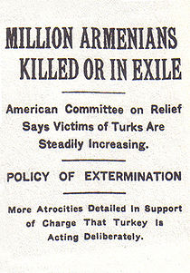
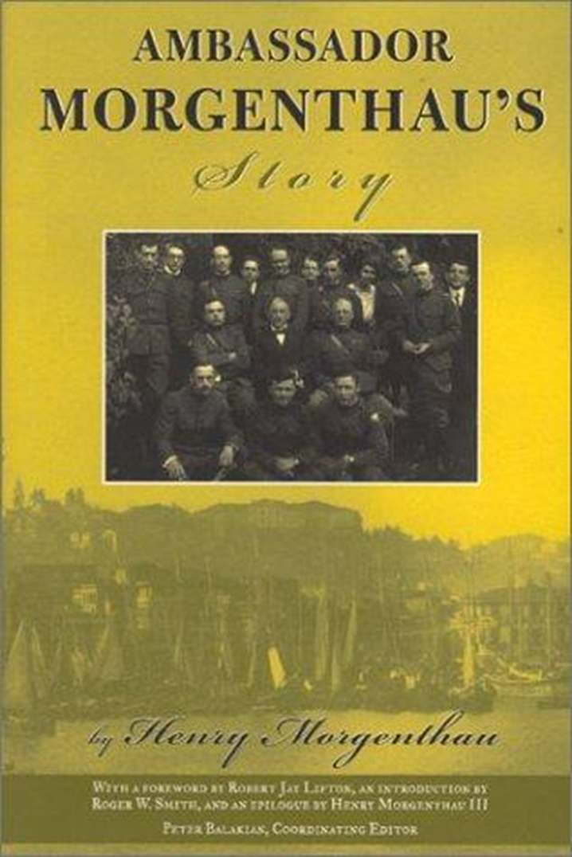

Slide 39
Wilson 14 Points address—8 Jan. 1918
The program of the world's peace, therefore, is our program; and that program, the only possible program, as we see it, is this: …
XI. Rumania, Serbia, and Montenegro should be evacuated; occupied territories restored; Serbia accorded free and secure access to the sea; and the relations of the several Balkan states to one another determined by friendly counsel along historically established lines of allegiance and nationality; and international guarantees of the political and economic independence and territorial integrity of the several Balkan states should be entered into.
XII. The Turkish portion of the present Ottoman Empire should be assured a secure sovereignty, but the other nationalities which are now under Turkish rule should be assured an undoubted security of life and an absolutely unmolested opportunity of autonomous development, and the Dardanelles should be permanently opened as a free passage to the ships and commerce of all nations under international guarantees.
In regard to these essential rectifications of wrong and assertions of right we feel ourselves to be intimate partners of all the governments and peoples associated together against the Imperialists.

Slide 40
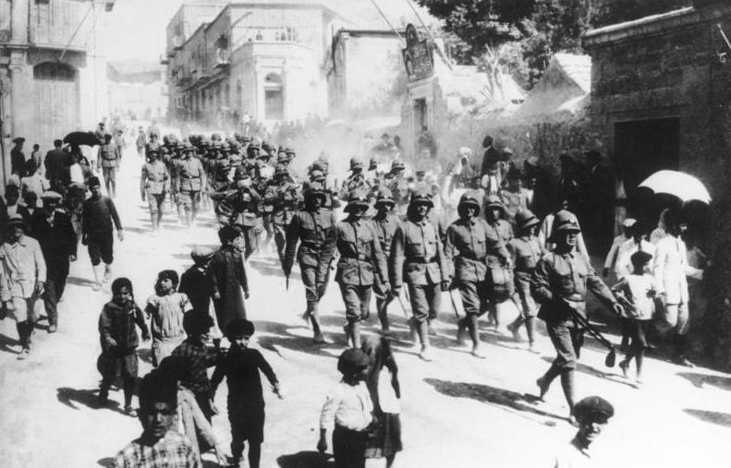
Notes:
German troops jerusalem 1916

Slide 41
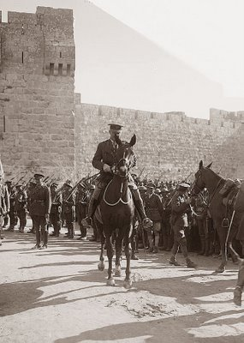
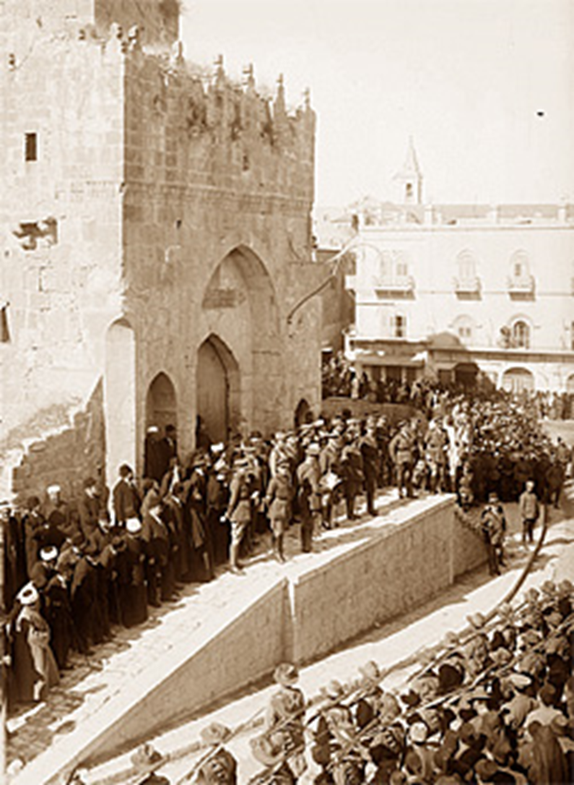
Notes:
allenby

Slide 42
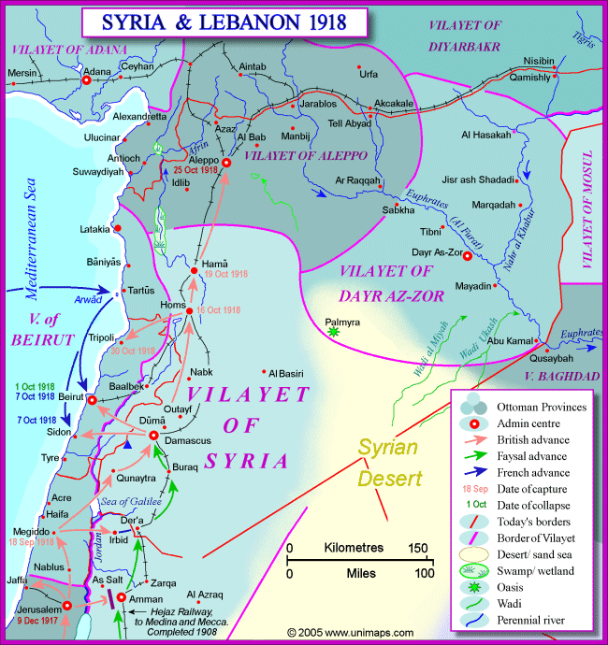

Slide 43
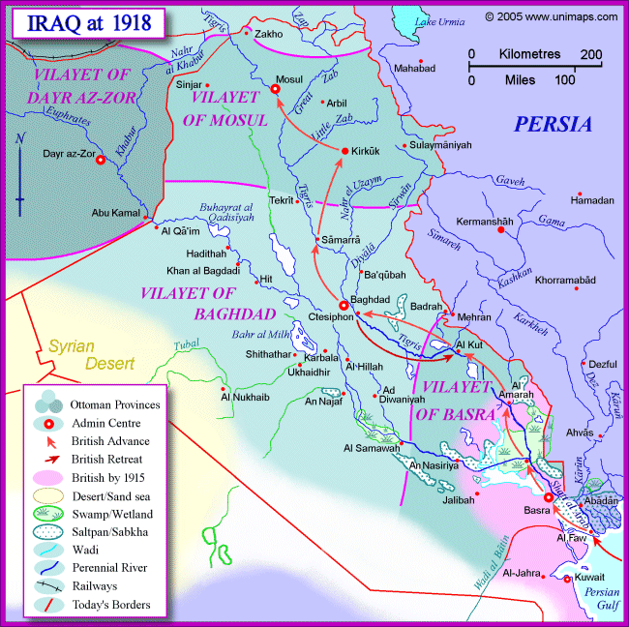

Slide 44
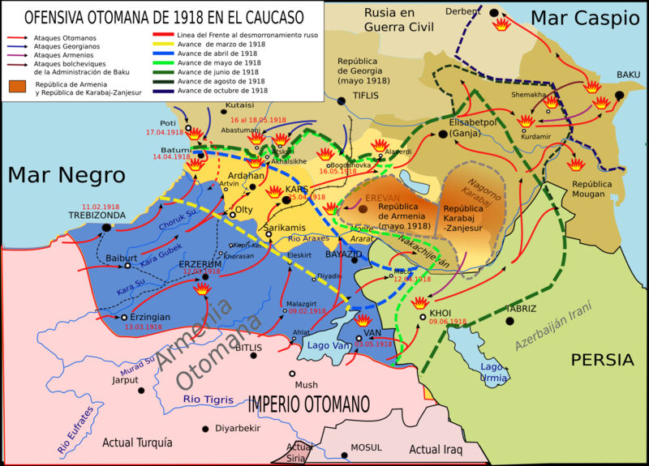

Slide 45
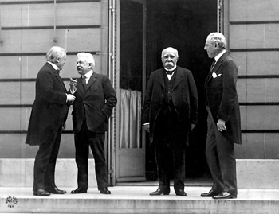

Slide 46
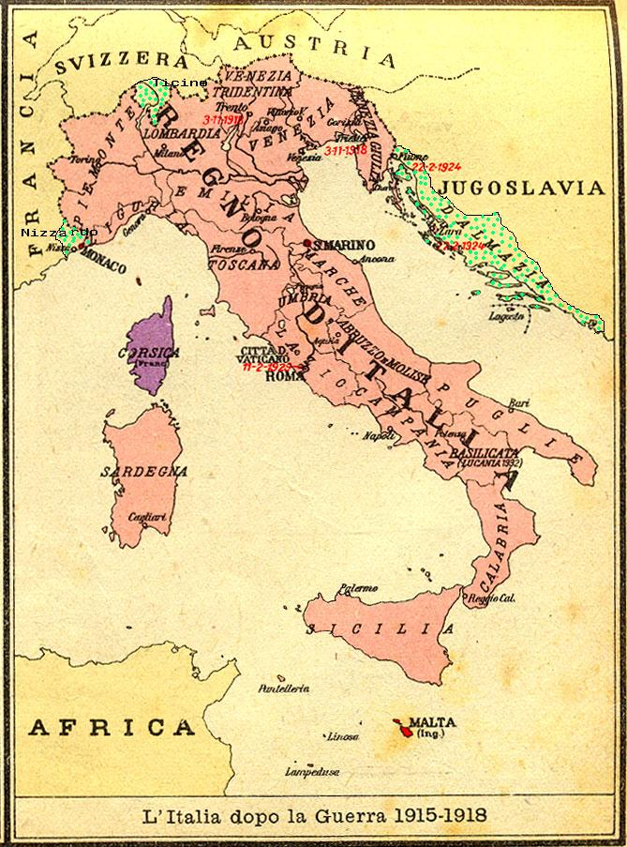

Slide 47
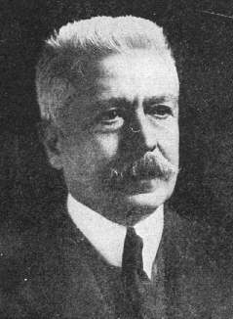

Slide 48
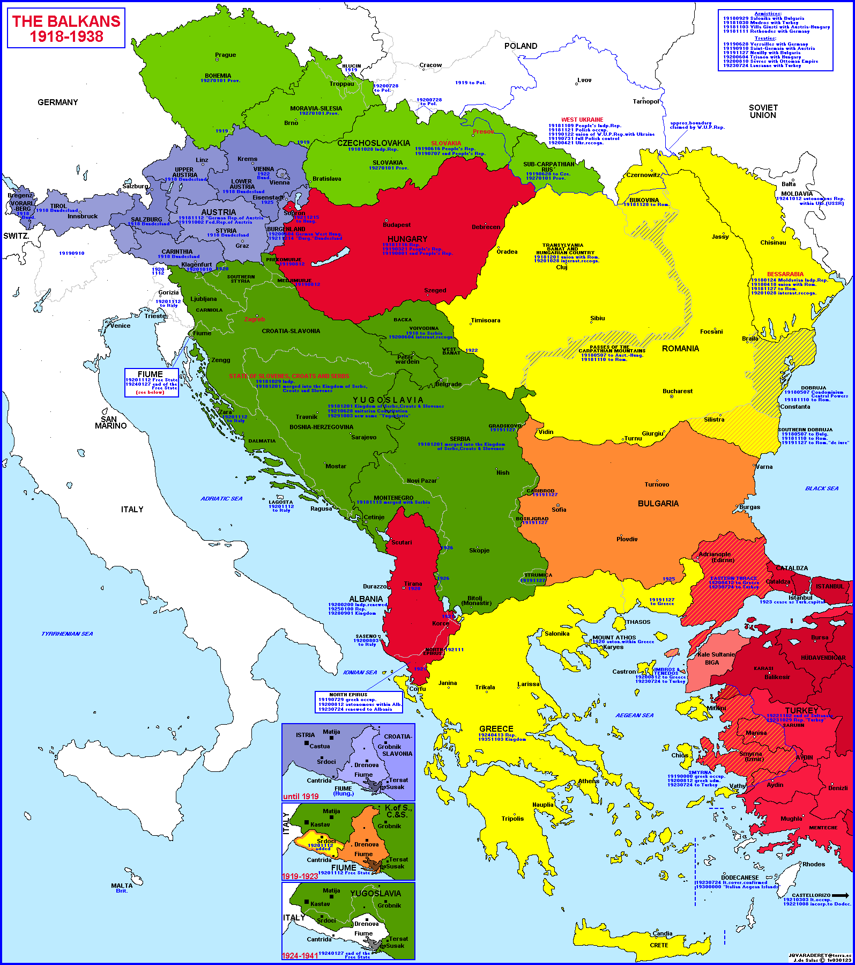

Slide 49
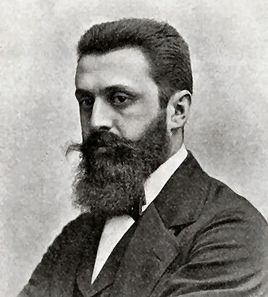
Notes:
herzl

Slide 50
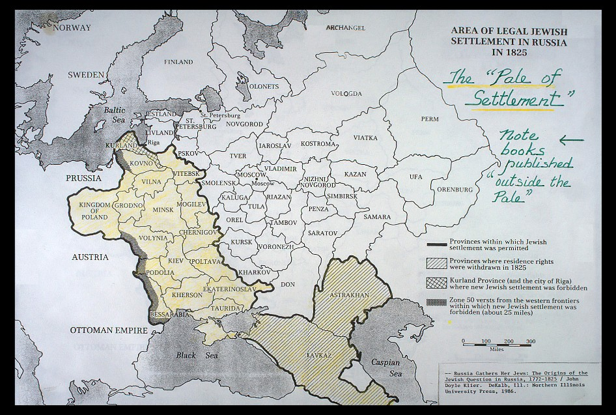

Slide 51
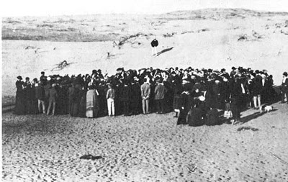
Notes:
1909 auction for land in tel aviv

Slide 52

Notes:
balfour

Slide 53
Foreign Office
November 2nd, 1917
Dear Lord Rothschild,
I have much pleasure in conveying to you, on behalf of His Majesty's Government, the following declaration of sympathy with Jewish Zionist aspirations which has been submitted to, and approved by, the Cabinet.
“His Majesty’s Government view with favour the establishment in Palestine of a national home for the Jewish people, and will use their best endeavours to facilitate the achievement of this object, it being clearly understood that nothing shall be done which may prejudice the civil and religious rights of existing non-Jewish communities in Palestine, or the rights and political status enjoyed by Jews in any other country.”
I should be grateful if you would bring this declaration to the knowledge of the Zionist Federation.
Yours sincerely,
Arthur James Balfour

Slide 54


Slide 55


Slide 56

Notes:
Transcaucasian republic

Slide 57


Slide 58


Slide 59


Slide 60


Slide 61


Slide 62


Slide 63


Slide 64


Slide 65



Slide 66
ARTICLE 22
To those colonies and territories which as a consequence of the late war have ceased to be under the sovereignty of the States which formerly governed them and which are inhabited by peoples not yet able to stand by themselves under the strenuous conditions of the modern world, there should be applied the principle that the well-being and development of such peoples form a sacred trust of civilisation and that securities for the performance of this trust should be embodied in this Covenant. The best method of giving practical effect to this principle is that the tutelage of such peoples should be entrusted to advanced nations who by reason of their resources, their experience or their geographical position can best undertake this responsibility, and who are willing to accept it, and that this tutelage should be exercised by them as Mandatories on behalf of the League. The character of the mandate must differ according to the stage of the development of the people, the geographical situation of the territory, its economic conditions, and other similar circumstances. Certain communities formerly belonging to the Turkish Empire have reached a stage of development where their existence as independent nations can be provisionally recognised subject to the rendering of administrative advice and assistance by a Mandatory until such time as they are able to stand alone. The wishes of these communities must be a principal consideration in the selection of the Mandatory.

Slide 67
ARTICLE 11
Any war or threat of war, whether immediately affecting any of the Members of the League or not, is hereby declared a matter of concern to the whole League, and the League shall take any action that may be deemed wise and effectual to safeguard the peace of nations. In case any such emergency should arise the Secretary General shall on the request of any Member of the League forthwith summon a meeting of the Council.
It is also declared to be the friendly right of each Member of the League to bring to the attention of the Assembly or of the Council any circumstance whatever affecting international relations which threatens to disturb international peace or the good understanding between nations upon which peace depends.

Slide 68

Notes:
Signing sevres

Slide 69


Slide 70


Slide 71


Slide 72


Slide 73

Notes:
Turkish general on offensive intro armenia

Slide 74


Slide 75

Notes:
Red army troops into yerevan

Slide 76


Slide 77


Notes:
Smyrna burning

Slide 78


Slide 79


