Slide 1

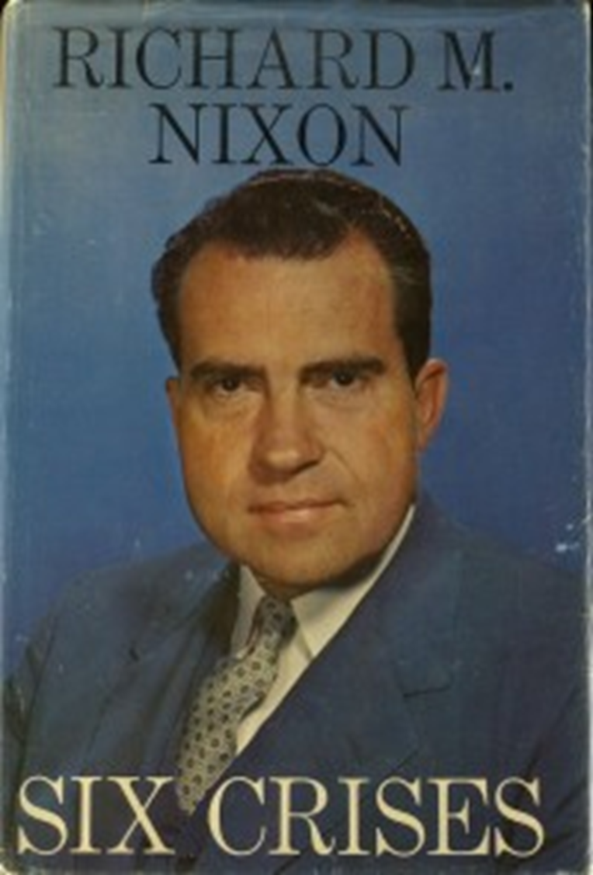

Slide 2
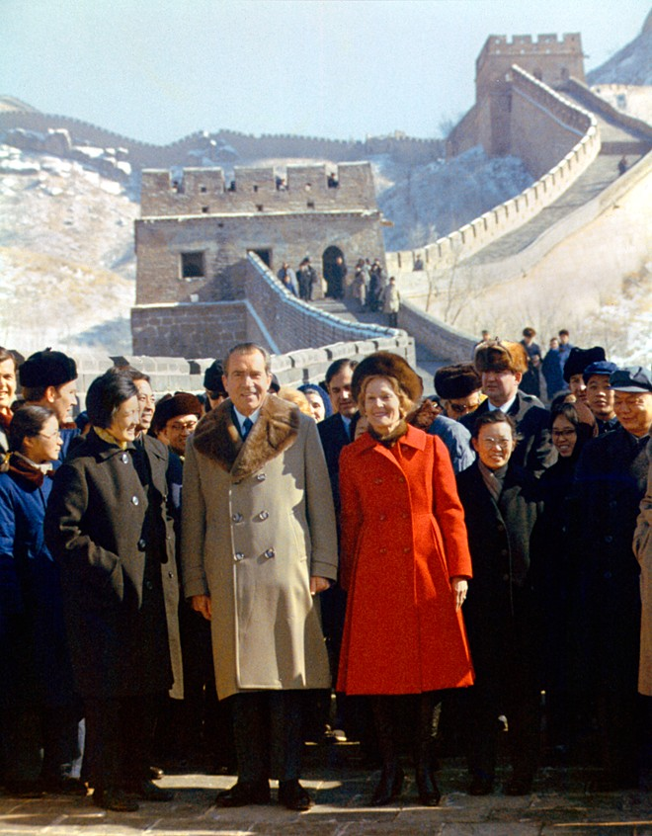

Slide 3
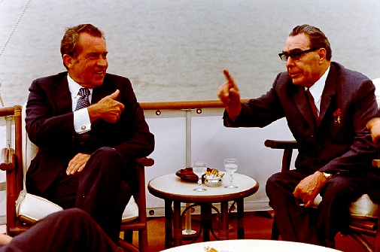

Slide 4
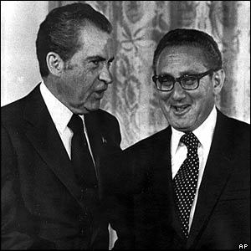

Slide 5
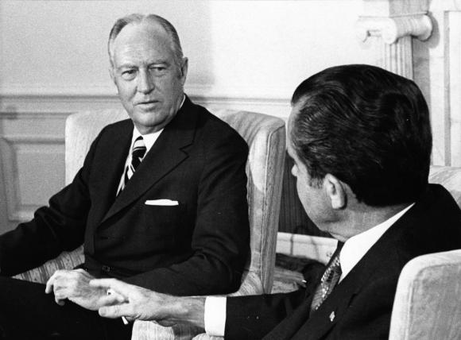

Slide 6

President Nixon: Even though the Mideast thing is tough for us—you know, we don’t know what’s going to happen—at least, it puts attention on that.
Rogers: That’s right. That’s right.
President Nixon: And frankly, Bill, nothing really can happen there. It just can’t happen, that’s all.
Rogers: No, and it isn’t going to happen right now, I don’t think.
President Nixon: No.
Rogers: And if it’s going to happen, it’s going to happen anyway. So I don’t believe that I’ll be blamed for it.
President Nixon: Right. Right.
Rogers: And I think I’ll get a pretty good reception—well, I know I’ll get a great reception in Israel, probably a pretty good reception in Egypt. Now, I may have some security problems in Jordan. I probably will go to Lebanon and maybe just a quick stop in Saudi Arabia. I will—that is no—
President Nixon: I’d do them. Personally, I think you should certainly do Saudi Arabia.
Rogers: Yeah.
President Nixon: If there’s any security problem, I don’t think you ought to go. Egypt, they’ll protect you.
Rogers: Yeah. The only security problem would be in Jordan, I think. But what the hell, that’s part of the job.
President Nixon: Where would you go in Jordan? Just—
Rogers: Just Amman.
President Nixon: Amman. I’ve never been there.
Rogers: Just to see the king.
President Nixon: Well, go and get the tank [a reference to the tanks supplied through U.S. military aid to Jordan].
Rogers: [Laughs.] Yeah.
President Nixon: He’s got the tank. Yeah.
Rogers: Well, I—
President Nixon: No, I see—I feel—you’ve got to decide. If you think it’s a good idea, you go.
Rogers: All right. I won’t make a decision until we check it out pretty carefully. But, I didn’t want to do it if you saw any disadvantage.
President Nixon: No. Not at all. No, I think it’s a very good thing to, sort of, put the spotlight of attention out there and if something can come out of it, it’d be great.
Rogers: Well, we may, you know, something may come out of it.
President Nixon: Right. Right.
Rogers: You can’t tell. And I’ll downplay the importance of it in my backgrounders and so forth.
President Nixon: Yeah. Say that it’s a trip for the purpose of touching base in these areas.
Rogers: Yeah.
President Nixon: And just talking with this matter over and so forth.
Rogers: In response to an invitation by all of them. See, it’s the first time that a president of Egypt has asked a—
President Nixon: Have you ever been to Israel?
Rogers: No.
President Nixon: Mm-hmm. The food’s lousy, but otherwise it’s all right. [Chuckles.]

Slide 7
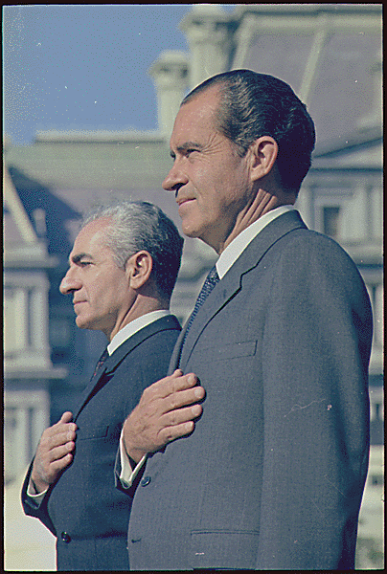
Notes:
Rn shah dc 1969

Slide 8
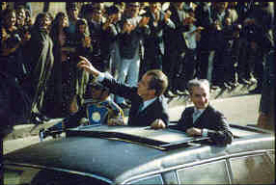
Notes:
1972—RN in Teheran

Slide 9
Douglas MacArthur, II: A strong Iran, sir, in terms of your conviction (which I share, 200 percent) that we must not see the basic balance between East and West altered radically . . . A strong Iran—
President Nixon: Yeah.
MacArthur: You know, the Soviets have been able, through their polarization of this Arab-Israel conflict—they have been able to gain increasing influence—
President Nixon: Oh!
MacArthur: —in these places, no question about it. A strong Iran helps to counterbalance that.
President Nixon: That’s right. It’s just one friend there. Face it, Iran is not of either world, really, in a sense. I guess. But the point it—if I felt, if we can go with that, we can have them strong. They’re at the center of it, and a friend of the United States. I couldn’t agree more, it’s something.
Because if you look around there, it just happens: Who else do we have, except for Europe? The Southern Mediterranean—it’s all gone.
[Morocco’s King] Hassan will be here—he’s a nice fellow, but Morocco, Christ, they can’t last [against the Soviets].
Morocco, Tunisia, Libya, Algeria. Sudan. Naturally, the UAR. All those little miserable countries around—Jordan, and Lebanon, and the rest . . . They’re like—they’d go down like ten-pins, just like that.
Some of them would like to be our friends. But central to every one of those countries (even as far off as Morocco) is the fact that the United States is aligned with Israel. And because we’re aligned with Israel [bangs the desk for emphasis], we are their enemy.
MacArthur: That’s right.
President Nixon: That’s what it is.
Now, this doesn’t mean that we let Israel go down the drain—because that would play into the Soviet hands, too. But it does mean that right now, we’re in a hell of a difficult spot. Because our Israeli tie makes us unpalatable to everybody in the Arab world, doesn’t it?
MacArthur: It does. To varying degrees.
President Nixon: Yes, some are like—but the Shah—the Shah—
MacArthur: Not wholly—
President Nixon: He’s awfully good with that stuff, you’d have to say.
MacArthur: He is.

Slide 10
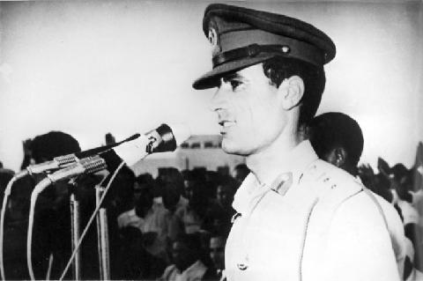

Slide 11
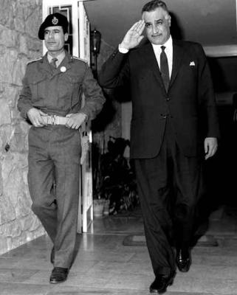

Slide 12
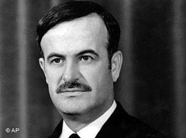
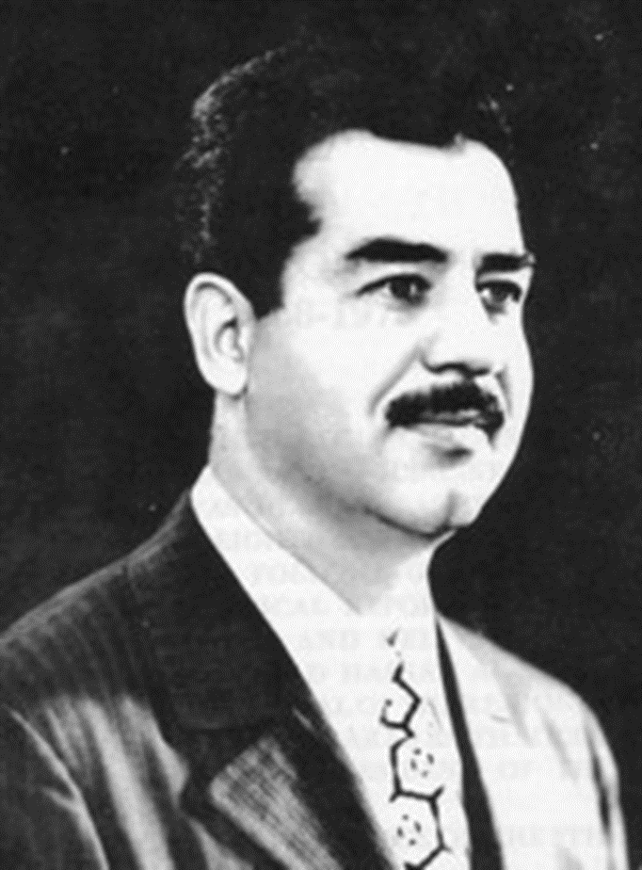

Slide 13
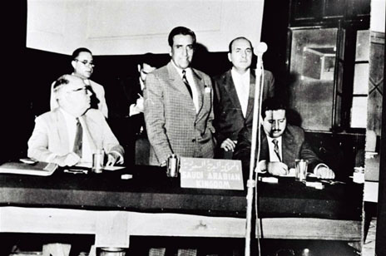
Notes:
Opec 1960—iran, iraq, kuwait, sa, ven

Slide 14
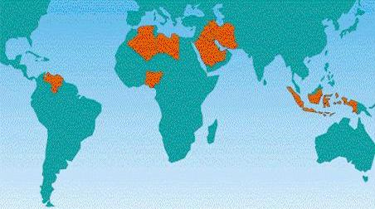

Slide 15
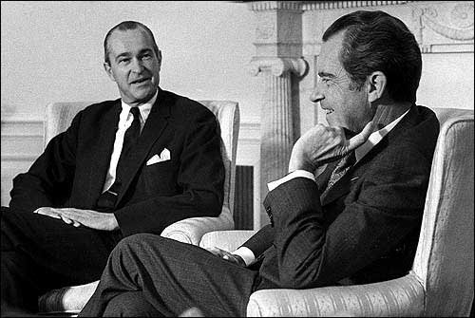
Notes:
Nixon helms

Slide 16
President Nixon: The Iranian oil thing, as you know, is in a, apparently one hell of a [mess?] . . .
[Break.]
President Nixon: What I have in mind: I’ve talked to—and everybody here thinks it’s a great idea (and I was talking to Henry [Kissinger] about something) . . . What I really have in mind is for you, basically, to be sort of the—without downgrading the other ambassadors—the ambassador in charge of that sort of area, you know what I mean?
Richard Helms: Yes, sir.
President Nixon: Particularly with [unclear] . . . So you could go down to those sheikdoms, and . . . and these other places, and pull this thing to—and then give us the recommendation, you know? And in charge of the area not only in terms of oil, and so forth, but in terms of the stability of the governments [excised for national security purposes].

Slide 17


Slide 18
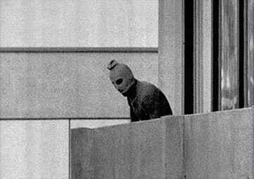

Slide 19
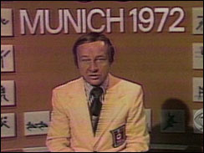

Slide 20
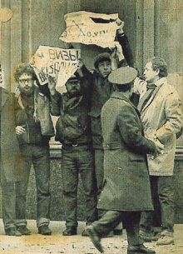

Slide 21
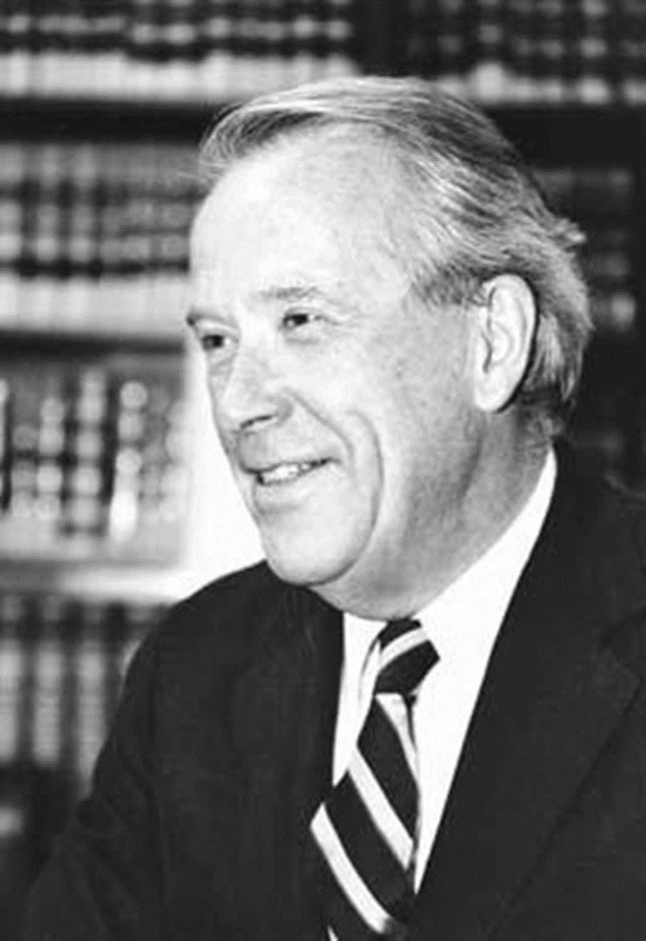
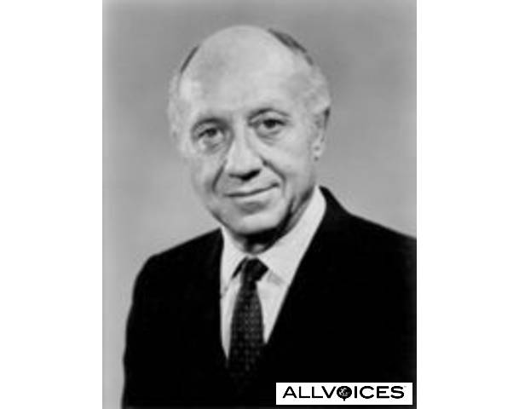

Slide 22
President Nixon: But it’s important to get across to them, Henry, and I hope you’ll talk to [New York senator Jacob] Javits and the rest of ‘em on this, even [Washington senator Henry] Jackson: by God, if the Jewish community in this country makes Israel exit permits the condition for the Russian initiative, listen, they’re going to be hurting. That will not work.
Henry Kissinger: [forcefully] Let’s face it: The emigration of Jews from the Soviet Union is not an objective of American foreign policy. And if they put Jews into gas chambers in the Soviet Union, it is not an American concern. It may be a humanitarian concern.
President Nixon: I know.
Henry Kissinger: And . . .
President Nixon: Well, we can’t blow up the world because of it.
Henry Kissinger: It’d be an outrage, but we cannot make out where gas chambers would go as far as I’m concerned.
President Nixon: I know.
Henry Kissinger: There is no unrestricted right to emigration. If the Indians don’t let Farsis out, it would never occur to us to attach a rider to a foreign policy decision. And I think that the Jewish community in this country, on that issue, is behaving unconscionably. It’s behaving traitorously. I find—
President Nixon: Why can’t we get Jackson to get off the damn thing? He feels it, though. He is. He’s close to the Jewish community; he’s close to the Israelis.
Henry Kissinger: Although, I suppose—
President Nixon: Well, of course, he’s taken a lot of money from them, too.
Henry Kissinger: Exactly. They’re financing his [presidential] campaign in ’76. But Javits . . . I’m going to have a talk with Javits, and I’m going to tell him that it is unconscionable for the Jewish community to . . .
President Nixon: You see, what they [the pro-Jewish emigration forces in Congress] will do is to work that way with the radical, the nuthead, basically the anti-semitic nutheads, say. Anti-communists in the Senate, the House—a lot of them are anti-semitic—who want to screw the Russians for other reasons. And between them . . . You know, we’ve got to get most-favored-nation [status for Russia, in trade relations], don’t we?
Henry Kissinger: [forcefully] Mr. President, let’s face it: we have screwed Brezhnev.
I mean, you have outmaneuvered Brezhnev in a way that is almost pathetic.

Slide 23
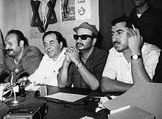

Slide 24
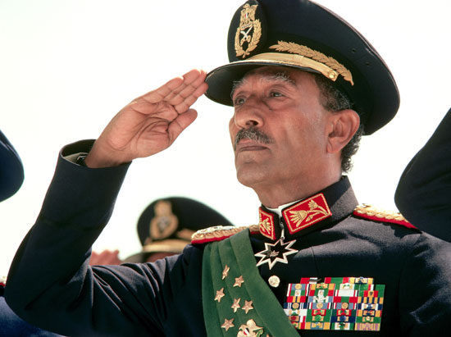

Slide 25
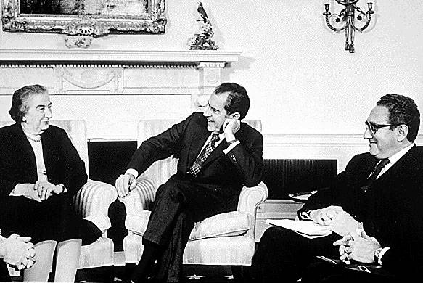

Slide 26
President Nixon: Let’s talk about the Russians, quite candidly. The Russians are panting to get some sort of a settlement. I think the reason they’re panting for it is that they want to get the Egyptian monkey off their back.
There may be other reasons, but we won’t try to judge Russian motives. Except that they want something done there for some time.
Now, you don’t want the Russians in your game—you’d rather have us in your game. You’d like to have the Russians, however—you know they’ve got to play a role. Because they’ve got to keep their clients from, you know, from breaking loose.
[Break.]
Now, however, what we’re really talking about here is a game, in which you would have to—in which I will tell you, give you the assurance, that Henry [Kissinger] will conduct this, under my direction, on an absolutely off-the-record basis.
Some of it will leak. And in any event, it doesn’t have to leak—you know what the Egyptians are doing all the time.
So, be that as it may, what we would like to do—what I would suggest—is that if he could discuss that, let us see whether there is something.
Now, what is the goal? Well, that’s good—you know that. You know there’s an impossible—the Egyptians on the one hand say they’d like an overall settlement before they talk about an interim settlement. And that’s the thing. . . And the other thing is the question you want security, they want sovereignty [in the Sinai]. And so those are insoluble [goals], right?
On the other hand, if we could get an interim settlement—I mean, let us face it: that’s in your interest—if it’s interim. And then we . . . the other one—now, we’re talking in the greatest of confidence—and the most, shall we say, fuzzy atmosphere. Because it has to be fuzzy for both sides. The more concrete it is, the less chance there is ever to get an agreement.
But Henry is the master at writing fuzzy language. Really. [All laugh heartily.]

Slide 27
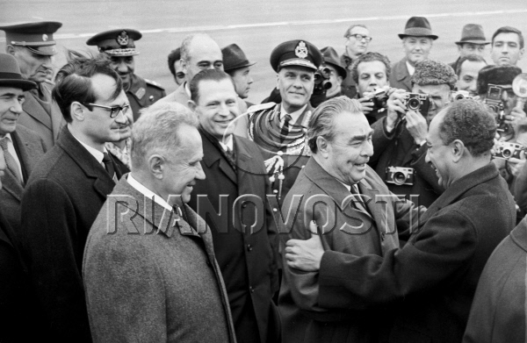

Slide 28
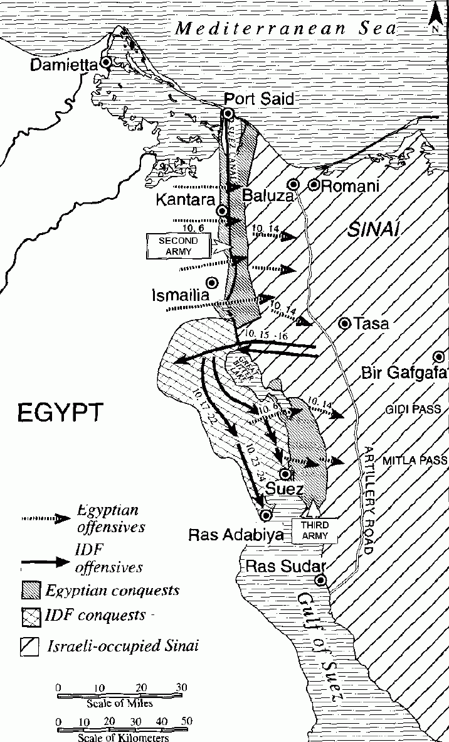

Slide 29
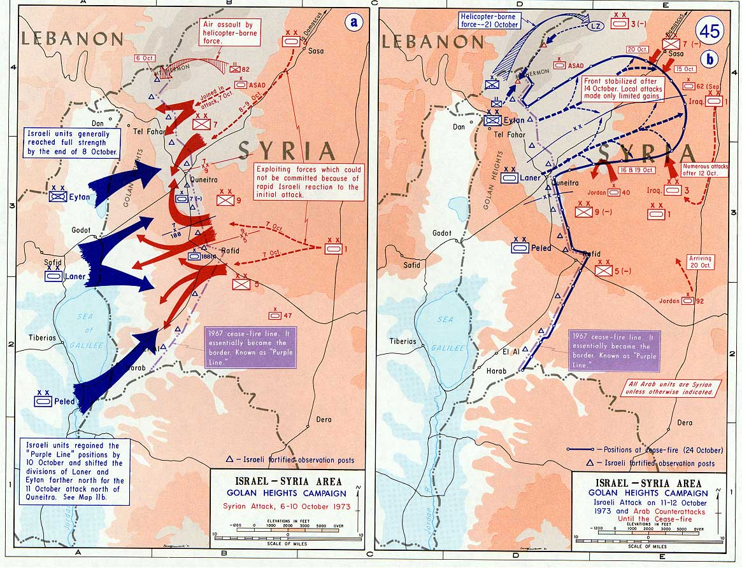

Slide 30
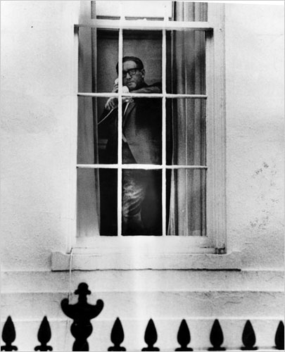

Slide 31
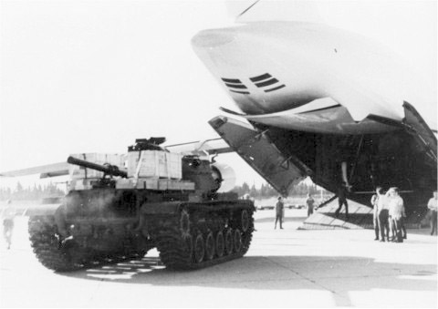
Notes:
M-60 tank supplied by US

Slide 32
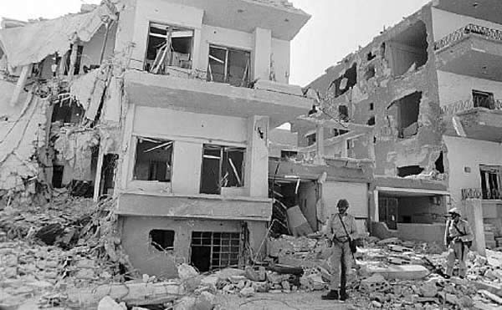
Notes:
Syr general staff hqs in damascus bombed

Slide 33
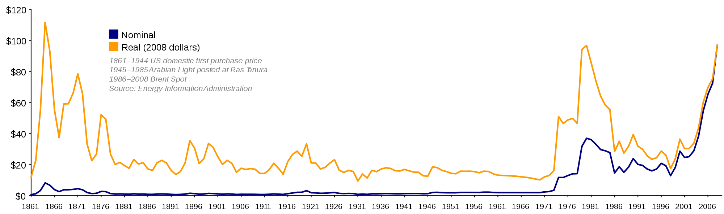

Slide 34
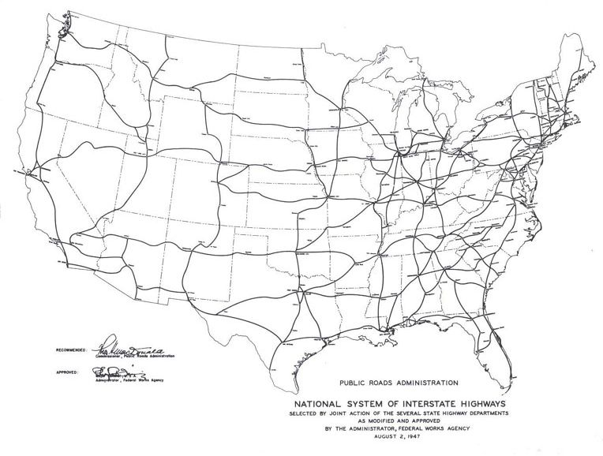

Slide 35
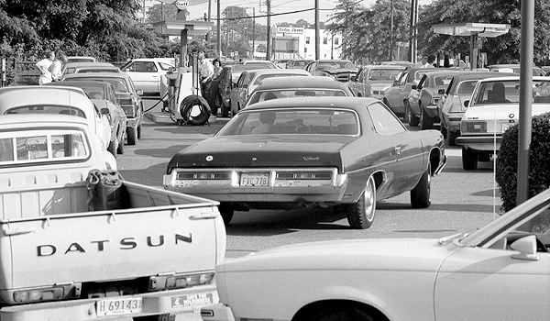

Slide 36
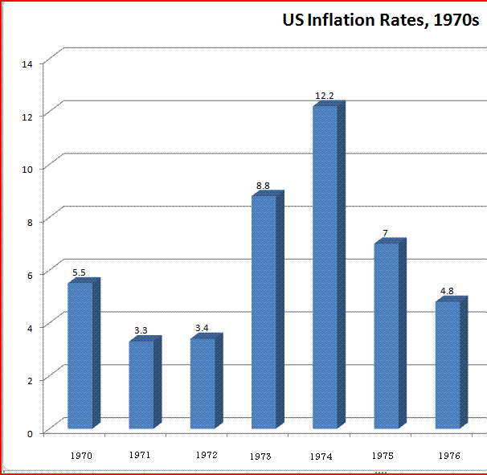

Slide 37
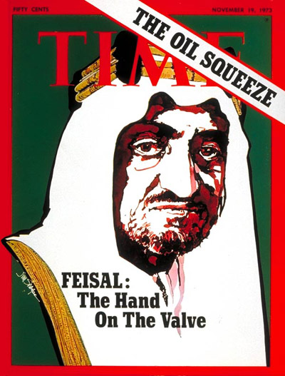

Slide 38
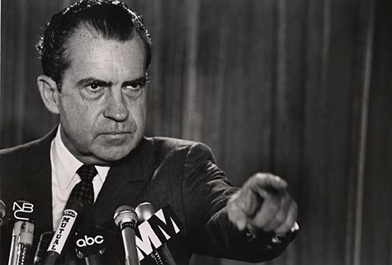

Slide 39
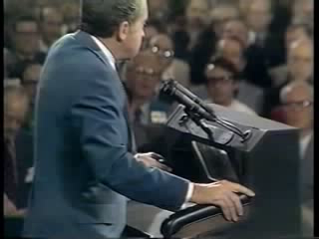

Slide 40


Slide 41
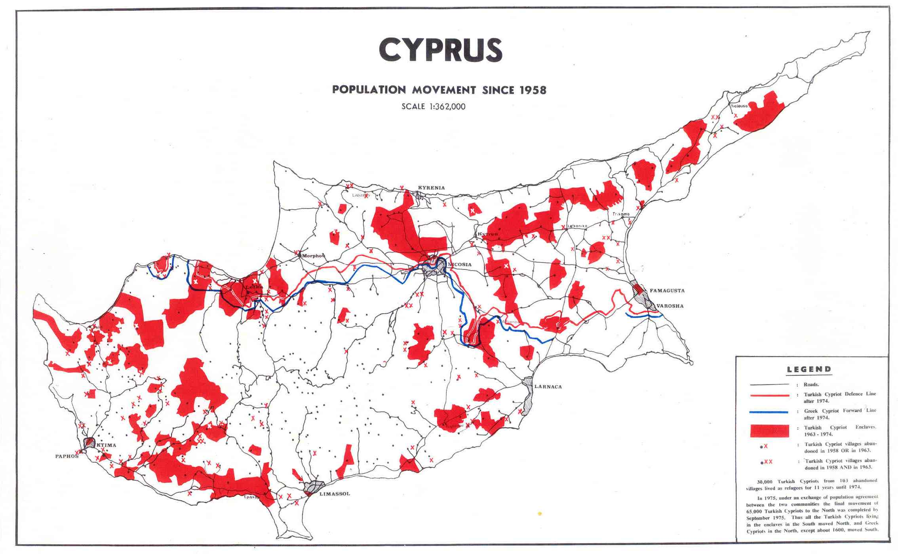

Slide 42
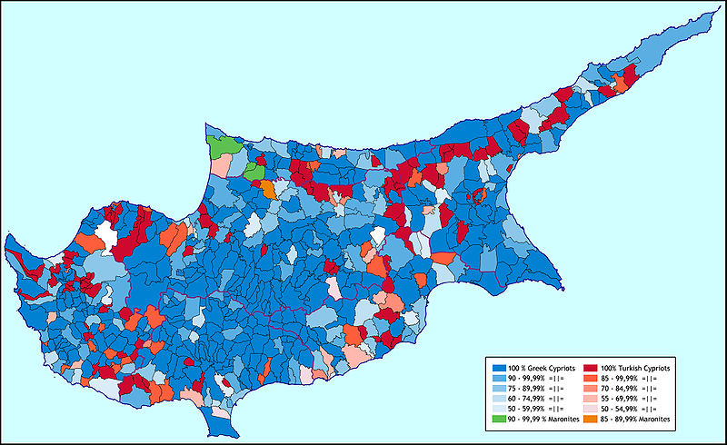

Slide 43
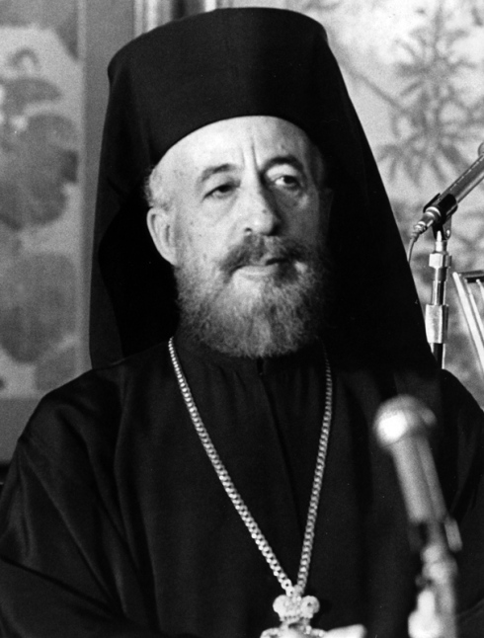

Slide 44
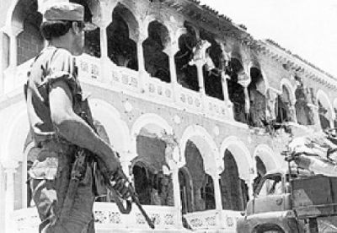
Notes:
Mkarios residence right after coup 15 jl74

Slide 45
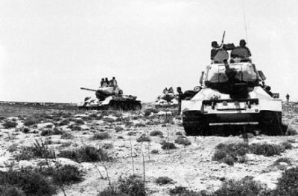

Slide 46
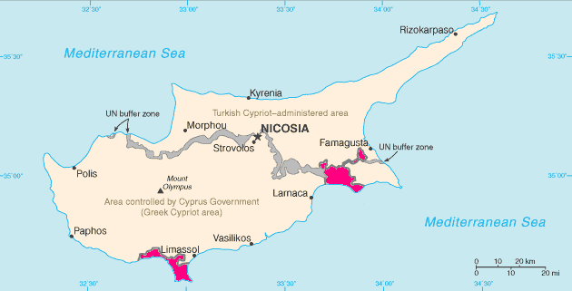

Slide 47
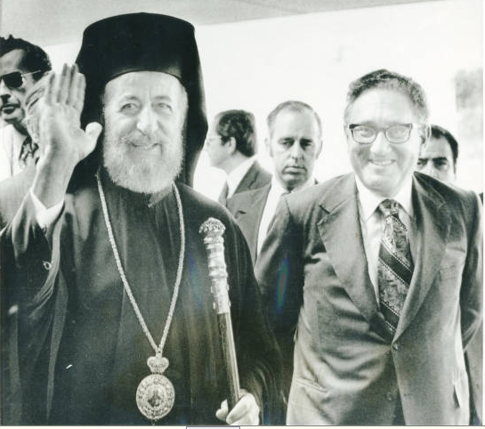

Slide 48
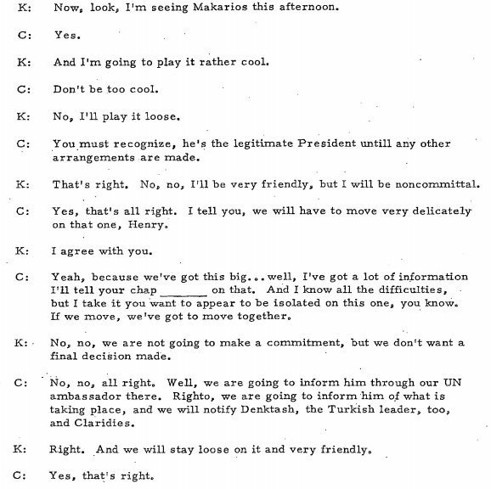
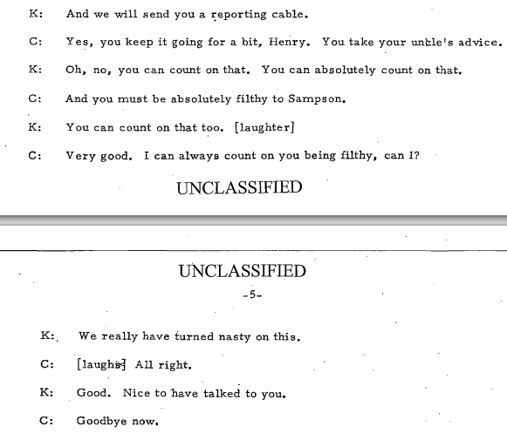

Slide 49
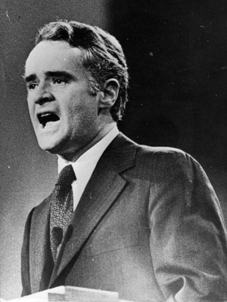

Slide 50
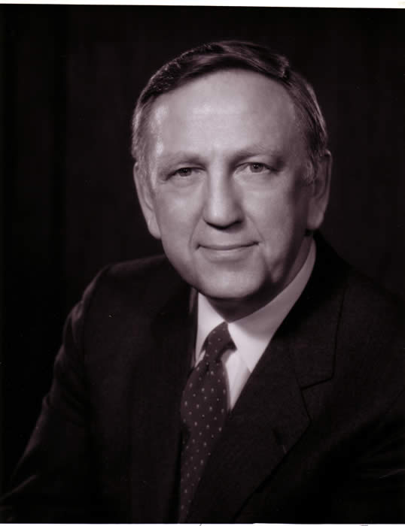
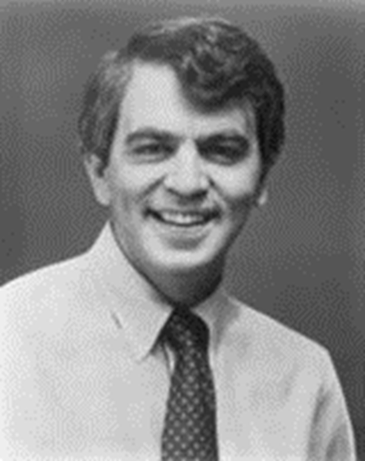
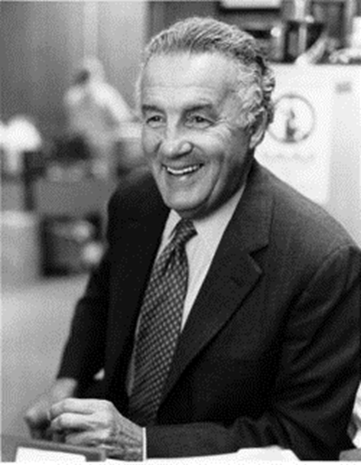
Notes:
brademas

Slide 51
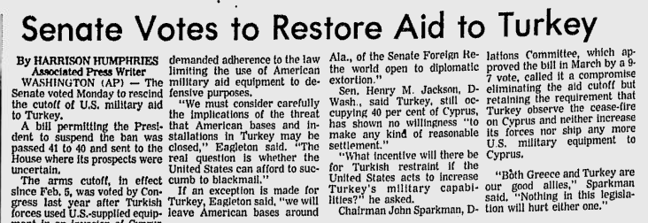

Slide 52
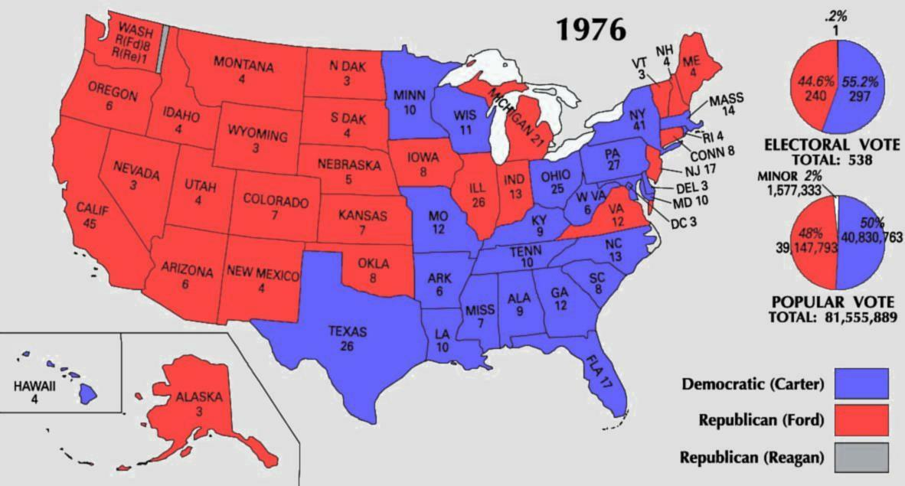

Slide 53




Slide 54


Slide 55


Slide 56


Slide 57


Slide 58



Slide 59


Slide 60


Slide 61


Slide 62


Slide 63


Slide 64


Slide 65


Slide 66


Slide 67


Slide 68


Slide 69


Slide 70


Slide 71

Notes:
yamit

Slide 72


Notes:
Evacuation yamit settlement--2500

Slide 73


Slide 74


Slide 75

Notes:
Carter late 77 teheran state visit—shah as oasis of stability

Slide 76

Notes:
State visit to US

Slide 77


