Slide 1
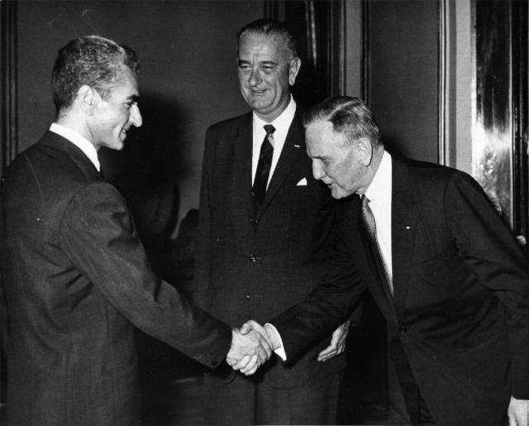
Notes:
1962 visit

Slide 2
From Time magazine:
Lyndon Johnson hit Teheran as though he were running for Shah—and if the warmth of his welcome was an indication, he might be able to get the job. With Wife Lady Bird and Daughter Lynda Bird, 18, the Vice President swept down Eisenhower Boulevard, so named after Ike's 1959 visit. Three times Johnson confused his smartly uniformed police escort by halting the motorcade and hopping out of his car to grasp all the outstretched hands within reach (one observer counted 300 in five minutes). The crowds responded with the highest praise they knew: "Javid Shah!" (Long live the King!).

Slide 3

President Johnson: Your majesty, how are ya’?
Shah of Iran: Mr. President, I am so glad to hear you.
President Johnson: Well, it’s wonderful to hear your voice. And we’re so happy to have you and the Empress back in our country again, even if it’s very brief.
Shah of Iran: Yes, unfortunately, we could not pay you, pay our—I mean, pay you our respects.
President Johnson: Oh, I would so much like to see you. I was oh-so-relieved, though, that you escaped the recent [assassination] attempt. You know from your own role at the time of President Kennedy’s [death] what a shock such an experience is.
Shah of Iran: Yes, it was rather true [chuckles a bit].
President Johnson: Yeah. [Abruptly changes topic.] Well, we were so pleased that you were so well-received in Brazil and Argentina.
[Break.]
President Johnson: Well, we certainly are grateful to you for your Dominican and Vietnamese position [in support of the United States], and . . . I’m very concerned that the Afro-Asian conference in Algiers next month will degenerate—I’m afraid it will be an anti-U.S. operation—unless some responsible delegation like Iran strands up against these steamrollers.
Shah of Iran: Yes—we shall do our duty. And we are grateful to you to have taken these attitudes, Mr. President.
President Johnson: Well, we have to take this when liberty’s at stake.
Shah of Iran: Oh, yes.
[Break.]
President Johnson: Everyone tells me you have just made phenomenal progress!
Shah of Iran: Yes, we have been very lucky.
President Johnson: Well, no, you’ve been very courageous—that’s what.

Slide 4


Slide 5
Article 22:
Zionism is a political movement organically associated with international imperialism and antagonistic to all action for liberation and to progressive movements in the world. It is racist and fanatic in its nature, aggressive, expansionist, and colonial in its aims, and fascist in its methods. Israel is the instrument of the Zionist movement, and geographical base for world imperialism placed strategically in the midst of the Arab homeland to combat the hopes of the Arab nation for liberation, unity, and progress. Israel is a constant source of threat vis-a-vis peace in the Middle East and the whole world. Since the liberation of Palestine will destroy the Zionist and imperialist presence and will contribute to the establishment of peace in the Middle East, the Palestinian people look for the support of all the progressive and peaceful forces and urge them all, irrespective of their affiliations and beliefs, to offer the Palestinian people all aid and support in their just struggle for the liberation of their homeland.
Article 19:
The partition of Palestine in 1947 and the establishment of the state of Israel are entirely illegal, regardless of the passage of time, because they were contrary to the will of the Palestinian people and to their natural right in their homeland, and inconsistent with the principles embodied in the Charter of the United Nations; particularly the right to self-determination.
Article 20:
The Balfour Declaration, the Mandate for Palestine, and everything that has been based upon them, are deemed null and void. Claims of historical or religious ties of Jews with Palestine are incompatible with the facts of history and the true conception of what constitutes statehood. Judaism, being a religion, is not an independent nationality. Nor do Jews constitute a single nation with an identity of its own; they are citizens of the states to which they belong.
Article 21:
The Arab Palestinian people, expressing themselves by the armed Palestinian revolution, reject all solutions which are substitutes for the total liberation of Palestine and reject all proposals aiming at the liquidation of the Palestinian problem, or its internationalization.

Slide 6
Article 2:
Palestine, with the boundaries it had during the British Mandate, is an indivisible territorial unit.
Article 6:
The Jews who had normally resided in Palestine until the beginning of the Zionist invasion will be considered Palestinians.
Article 22:
Zionism is a political movement organically associated with international imperialism and antagonistic to all action for liberation and to progressive movements in the world. It is racist and fanatic in its nature, aggressive, expansionist, and colonial in its aims, and fascist in its methods. Israel is the instrument of the Zionist movement, and geographical base for world imperialism placed strategically in the midst of the Arab homeland to combat the hopes of the Arab nation for liberation, unity, and progress. Israel is a constant source of threat vis-a-vis peace in the Middle East and the whole world. Since the liberation of Palestine will destroy the Zionist and imperialist presence and will contribute to the establishment of peace in the Middle East, the Palestinian people look for the support of all the progressive and peaceful forces and urge them all, irrespective of their affiliations and beliefs, to offer the Palestinian people all aid and support in their just struggle for the liberation of their homeland.

Slide 7
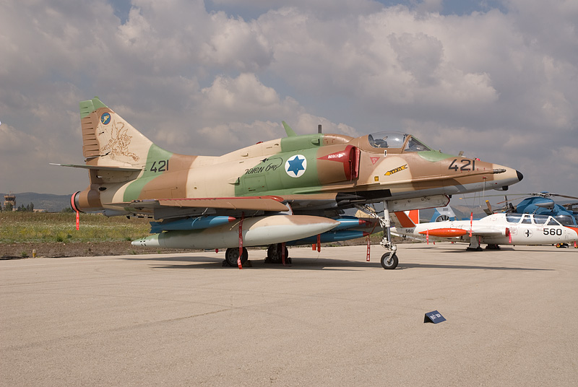
Notes:
skyhawk

Slide 8
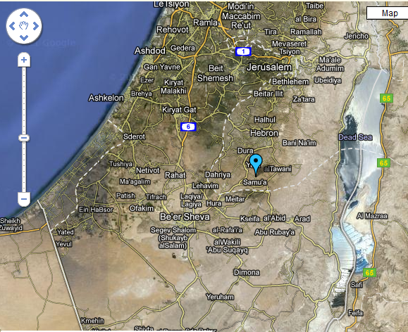

Slide 9
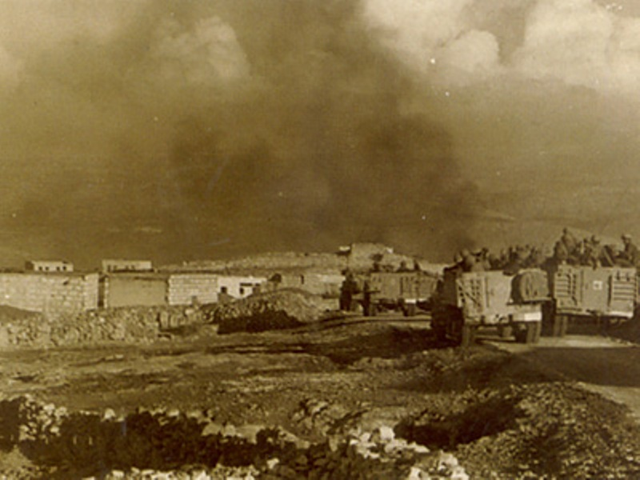
Notes:
samu

Slide 10
UN Resolution 228 (Nov. 1966)
The Security Council,
…Observing that this incident constituted a large-scale and carefully planned military action on the territory of Jordan by the armed forces of Israel,
…
Recalling the repeated resolutions of the Security Council asking for the cessation of violent incidents across the demarcation line, and not overlooking past incidents of this nature,
Reaffirming the necessity for strict adherence to the General Armistice Agreement,
1. Deplores the loss of life and heavy damage to property resulting from the action of the Government of Israel on 13 November 1966;
2. Censures Israel for this large-scale military action in violation of the United Nations Charter and of the General Armistice Agreement between Israel and Jordan;
3. Emphasizes to Israel that actions of military reprisal cannot be tolerated and that, if they are repeated, the Security Council will have to consider further and more effective steps as envisaged in the Charter to ensure against the repetition of such acts.

Slide 11
President Johnson: Have you got—have you got Jordan and Israel? I told them [the State Department] not to pee a drop on India, Pakistan, or Jordan and Israel without you. Have they checked all this stuff?
Arthur Goldberg: Nick [Katzenbach] gave you a memorandum of our conversation. And I’ve asked the Israel ambassador [to the United States], Abe Harman. He’ll come and see me Friday morning and I’ll get back to you.
President Johnson: What we’ll do is at the proper time—we won’t be chinchy with them, we’ll go back to [focusing on] Africa or something else. We can’t make a deal, but…
I just think they’re damn fools to let [King] Hussein get thrown out.
Goldberg: Yeah, I think they know that. And I’ll be glad to talk to them.
President Johnson: All right. OK.

Slide 12
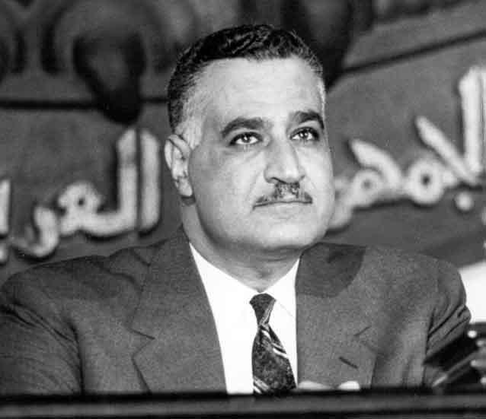

Slide 13
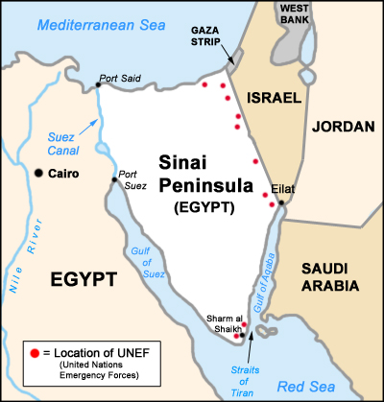

Slide 14
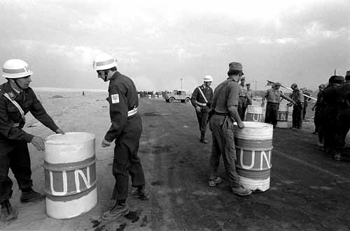

Slide 15
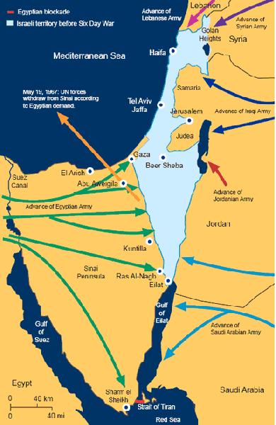

Slide 16
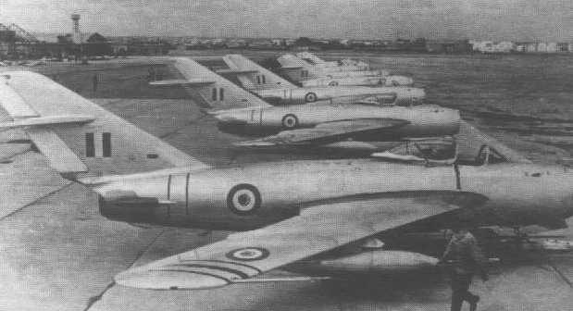
Notes:
Egy MIGs

Slide 17
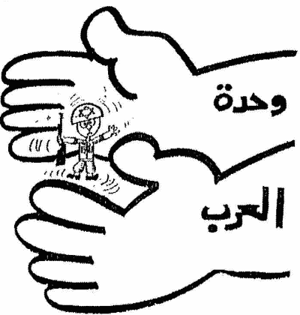

Slide 18
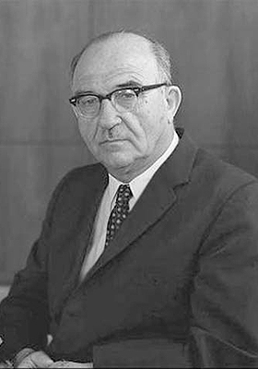

Slide 19
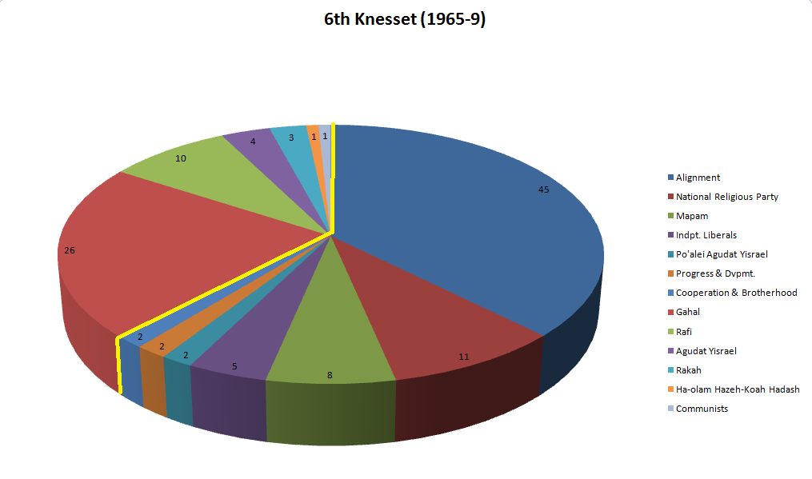

Slide 20
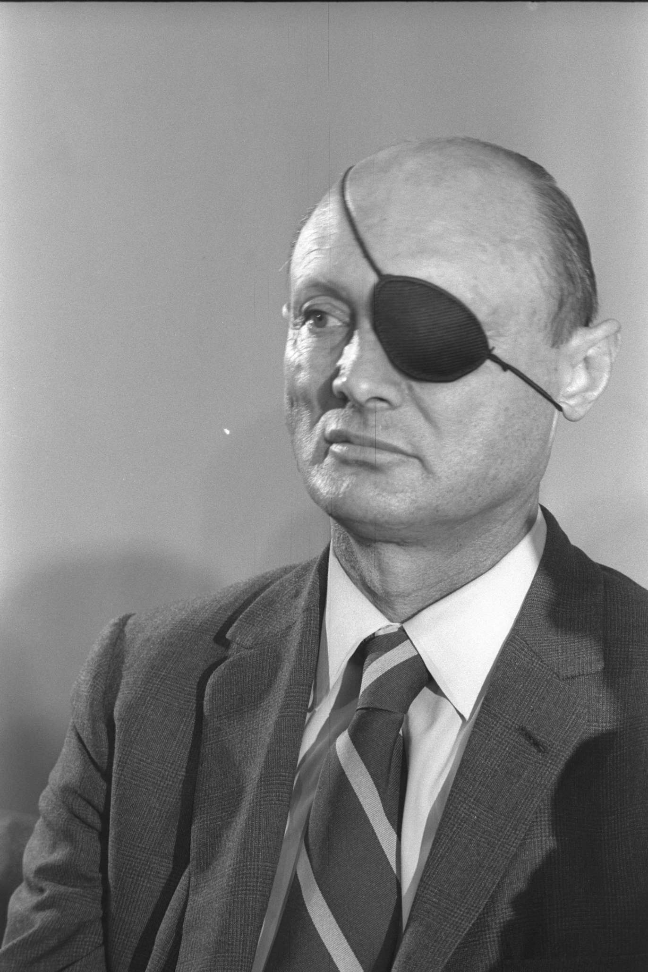

Slide 21
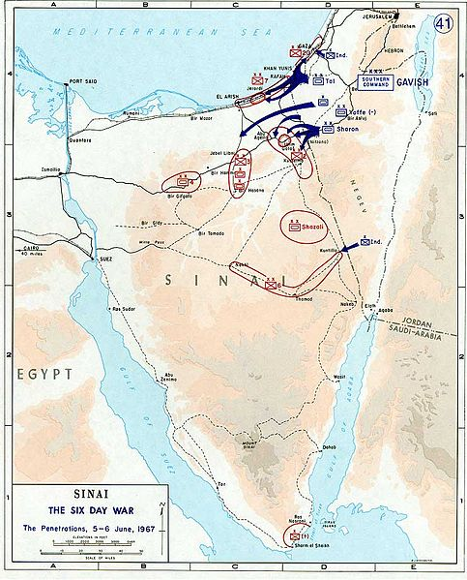

Slide 22
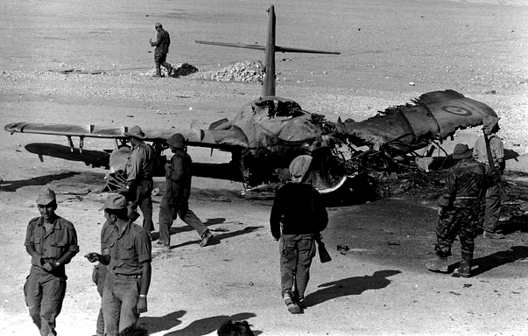

Slide 23
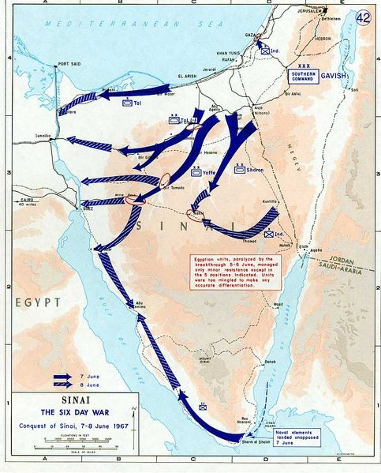

Slide 24
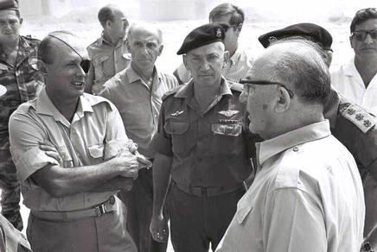

Slide 25
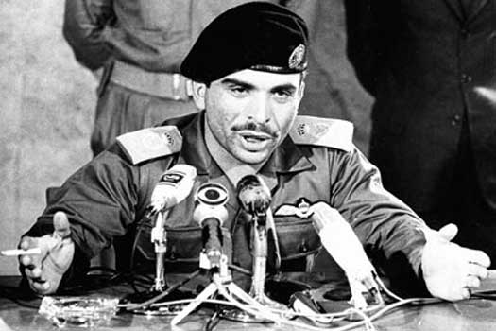

Slide 26
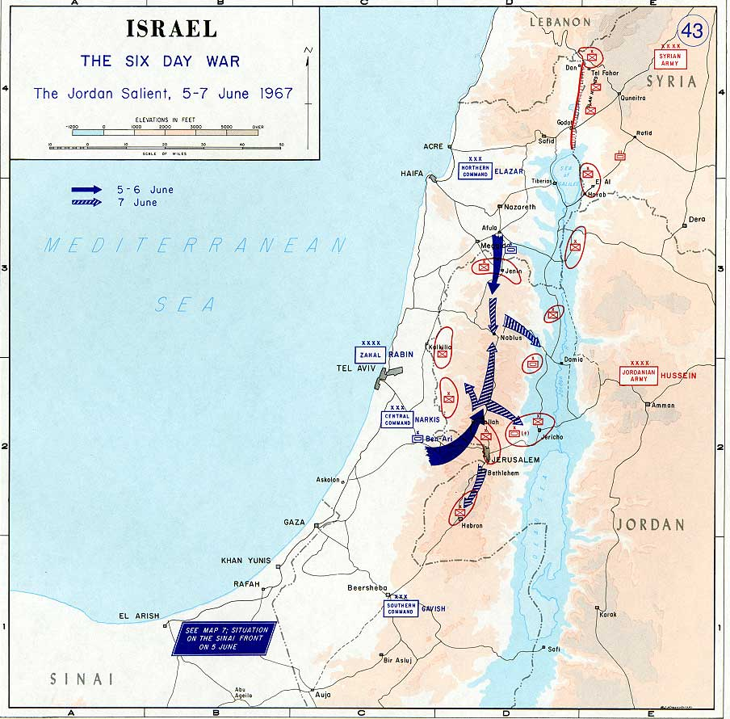

Slide 27
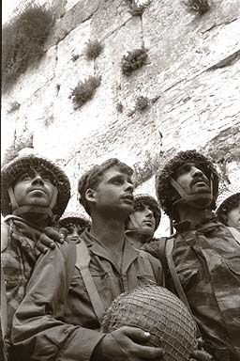
Notes:
Is paratroopers at wn wall

Slide 28
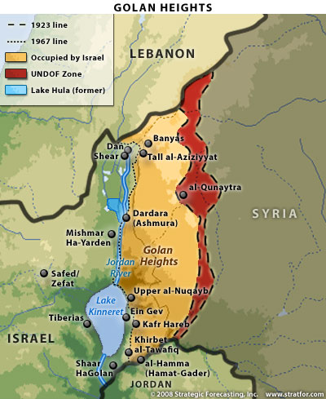

Slide 29
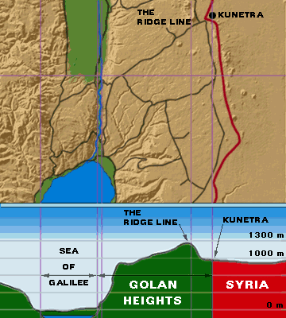

Slide 30
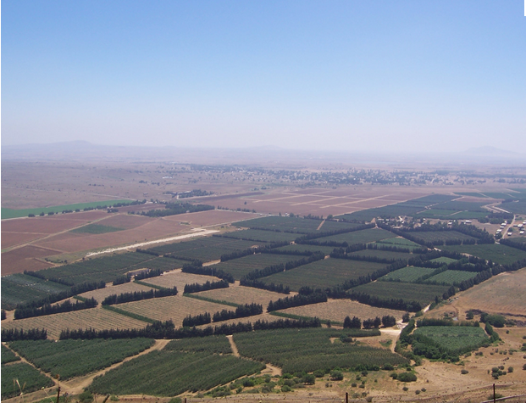

Slide 31
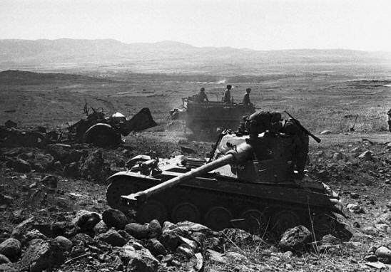

Slide 32
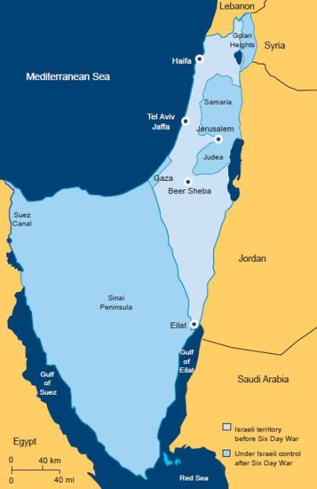

Slide 33
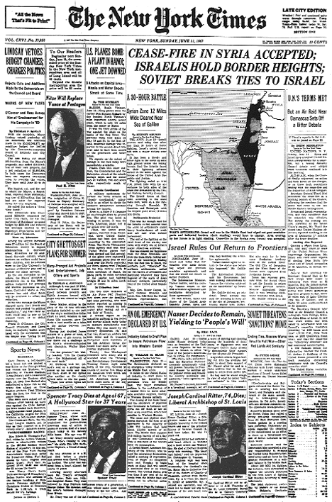

Slide 34
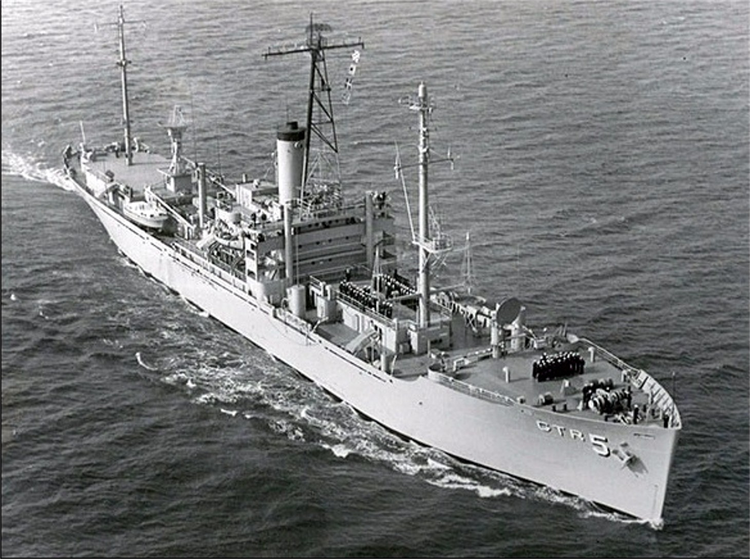

Slide 35
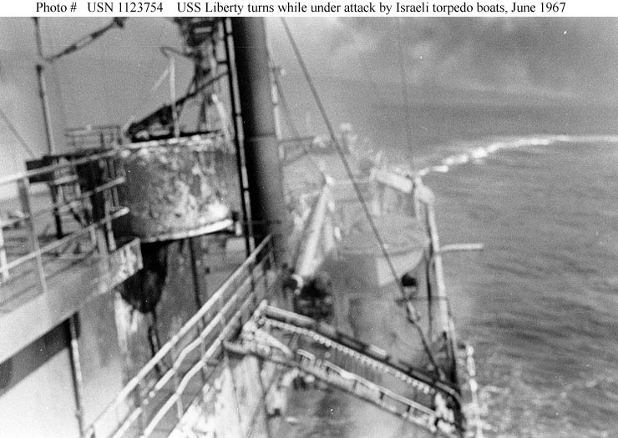

Slide 36
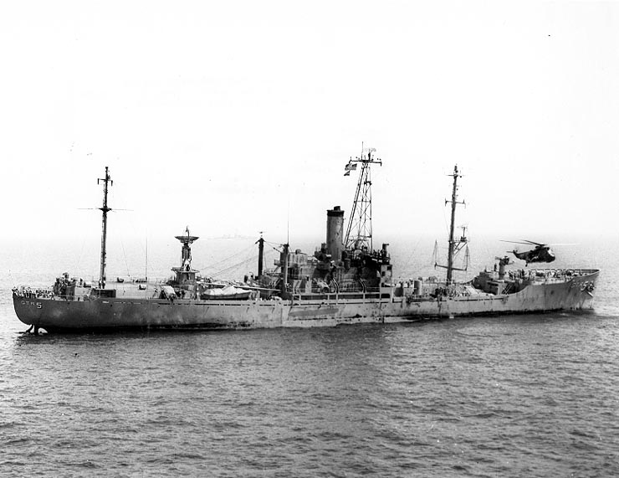
Notes:
Day after attack

Slide 37
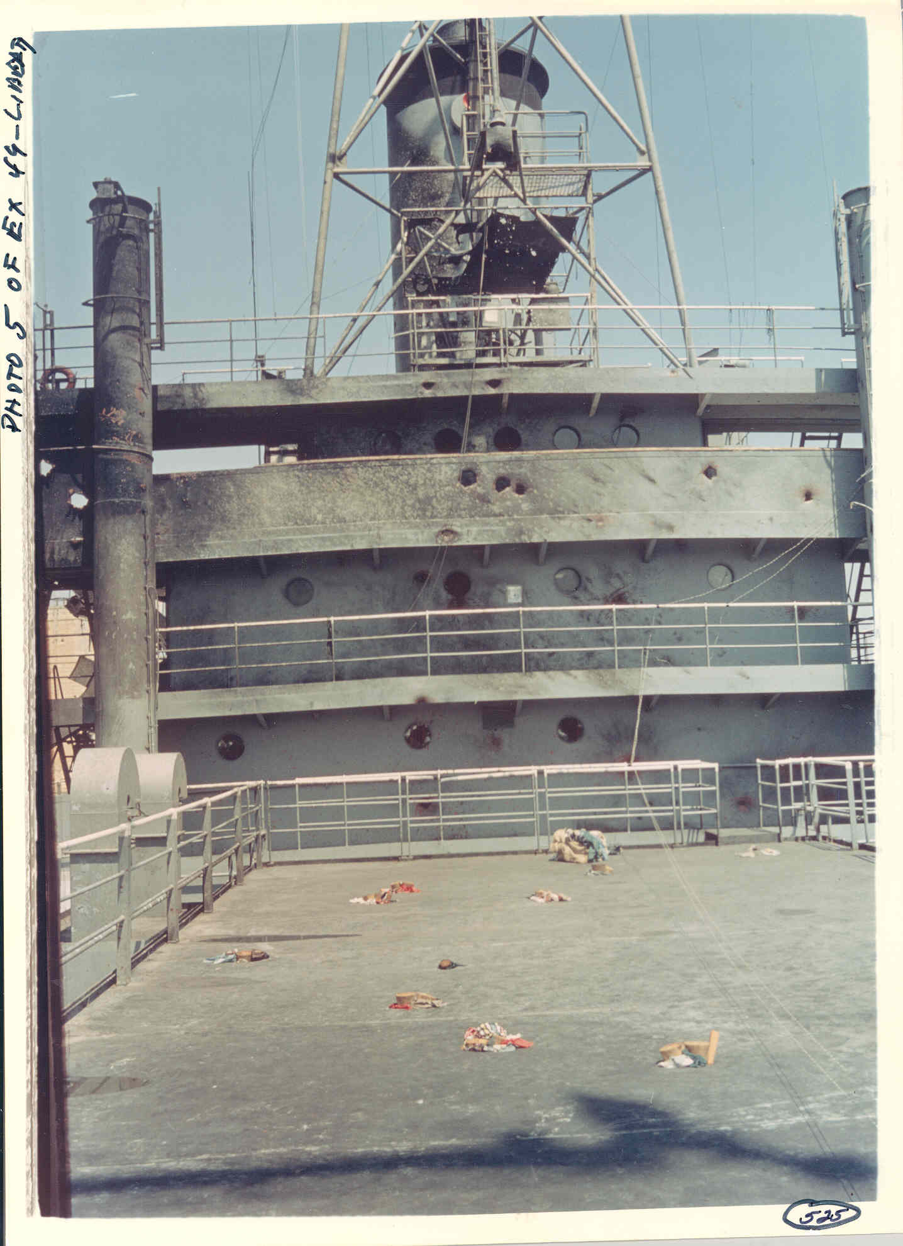

Slide 38
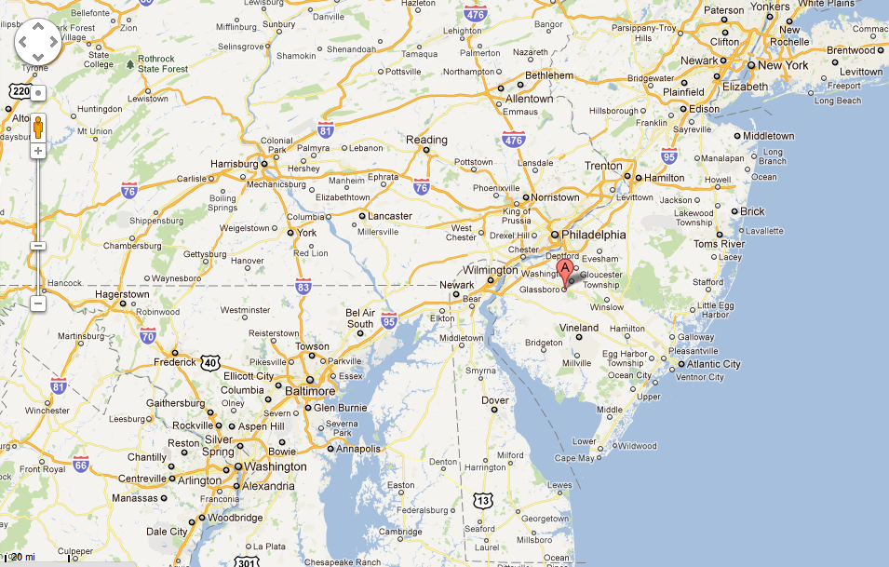

Slide 39
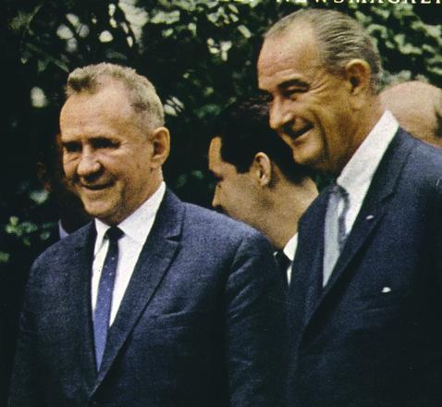

Slide 40
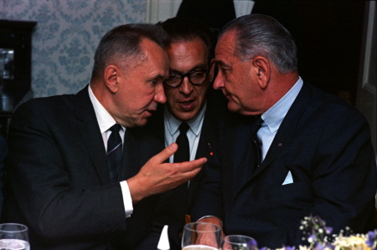

Slide 41
President Johnson: And I would say that, in fairness, as a teacher, I would grade him [Alexsey Kosygin] about a B+ on discussions on arms—that is, offensive, defensive missiles, the ABM. He made one or two passes I don’t want to discuss with anyone but you.
But he said, “I want you to know that if you do not deliver Israel here on this [UN] resolution—withdrawal—and you cannot pull these fighters back like you do two boxing men in the ring, separate the combatants, and you pull them back to where they were before this war started, then I want you to know there’s going to be a big war, and there’s going to be a great war, and it’s coming soon.”
And I said, “Well, now, Mr. Chairman, I hope that there’s not going to—
And he said, “They’ll fight with their fists and they’ll fight with arms.”
And I said, “Now, if you’re saying that the Israels [sic] and the Arabs are going to have some further difficulties, I hope they don’t. I’m going to do everything I can to keep ‘em from fighting, and I hope you do everything you can to keep ‘em from fighting. But if you’re saying that it goes beyond that area, and others will be fighting, then you’re speaking very serious business, and it’s something that concerns me greatly. And I think it should concern you.”
And he backed away from it, and said, “Well, I said that they would be fighting out there.” And I said, “Well, I’ll do all I can to keep ‘em from fighting; hope you do, too.”
Dwight Eisenhower: Mm. Mr. President—
President Johnson: He made another pass this afternoon along the same line, and I met him the same way, and he backed off from it again.

Slide 42
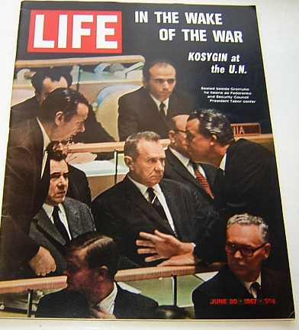

Slide 43
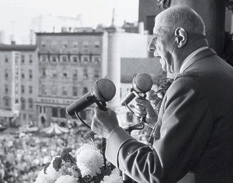

Slide 44
The establishment of a Zionist homeland in Palestine and then, after the Second World War, the establishment of the State of Israel raised at the time a certain amount of fears. The question could be asked, and was indeed asked even among many Jews, whether the settlement of this community on a land acquired under more or less justifiable conditions, in the midst of Arab populations who were basically hostile, would not lead to continued, incessant frictions and conflicts. Some people even feared that the Jews, until then scattered about, but who were still what they had always been, that is an elite people, sure of themselves and domineering, would, once assembled again on the land of their ancient greatness, turn into a burning and conquering ambition.
------------
In order to avoid hostilities, since May 24 France had been proposing to the three other great powers that she, jointly with the others, prohibit each of the two sides [Arabs and Israelis] from starting fighting.
We know that the voice of France went unheard, as Israel attacked and in six days of fighting, captured the objectives it had set itself.
Now, on the territories it has captured, it is organizing an occupation that cannot be carried out without oppression, repression, expulsions and resistance, which Israel, in its turn, calls terrorism.

Slide 45
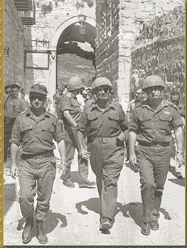

Slide 46
The General Assembly,
Deeply concerned at the situation prevailing in Jerusalem as a result of the measures taken by Israel to change the status of the City,
1. Considers that these measures are invalid;
2. Calls upon Israel to rescind all measures already taken and to desist forthwith from taking any action which would alter the status of Jerusalem;
3. Requests the Secretary-General to report to the General Assembly and the Security Council on the situation and on the implementation of the present resolution not later than one week from its adoption.

Slide 47
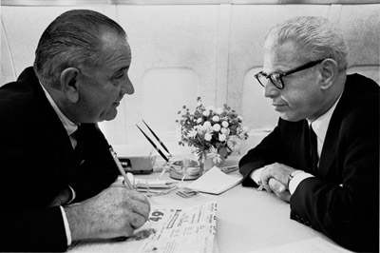

Slide 48
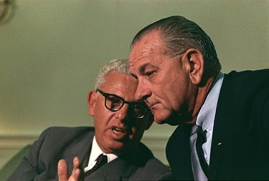

Slide 49
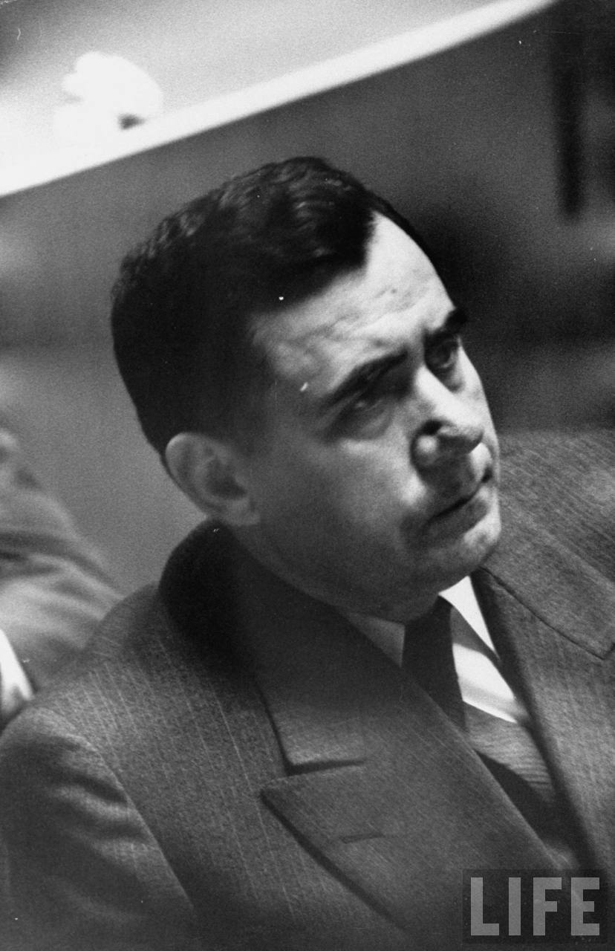

Slide 50
President Johnson: This damn [Soviet foreign minister Andrei] Gromyko’s the mean one, though. He is—
Arthur Goldberg: Mm-hmm. Well, he’s a record player.
President Johnson: He’s up here at Glassboro, and he just busts up everything.
Goldberg: Yeah. He’s still hanging around here?
President Johnson: Yes, that’s right. As long as he is, he’s going to have trouble.
Goldberg: Yeah. Well—
President Johnson: He’s just—
Goldberg: Dean [Rusk] has called me—
President Johnson: Every time this fellow would try to agree to something—every time Kosygin tried to agree—he wouldn’t let him.
Goldberg: He would hold him back?
President Johnson: Yes, sir.
Goldberg: Mm-hmm.
Dean had talked about coming back here. I said he’s welcome, but I would not dignify his presence. We ought to close this damn business and get him out of here.
President Johnson: I’d sure get him away as quick as I can.
Goldberg: Yeah.
President Johnson: Because he is no damn good. He’s poison.
Goldberg: He’s warmed up his plane about three or four times.
President Johnson: Why, you let him go. Quit holding him.
Goldberg: Yeah. But the only way we’ll get him out of here is to wind up [unclear].
President Johnson: Yeah. Well, I hope you can do it next week.
Goldberg: Yeah. Well, I’m hopeful—
President Johnson: What about the Security Council? What will they do on sanctions [against Israel]?
Goldberg: No, they won’t—well, there we are! We may be left alone again. But I wouldn’t think that would be possible I think we’d get some support against this. Although we’ve had some very weak reeds . . . You saw the British . . .
President Johnson: Looks like hell that the British quit us on this, and just 18 of us abstained.
Goldberg: Yeah. And it was—I told Rusk, it was kind of a motley company.
President Johnson: Who were the 18 with us?
Goldberg: Well, a couple of Africans, a few Latin Americans. That was about it.
President Johnson: Who were the Latins?
Goldberg: Uh, the Latins—
President Johnson: Nicaragua? [Chuckles.]
Goldberg: It’s published in the Washington Post; I don’t have the list in front of me.
President Johnson: Nicaragua, I guess. [Laughs heartily.]
Goldberg: Yeah, you can guess. It wasn’t a hell of an impressive showing. I felt a little lonesome over there.
President Johnson: Yeah, I did, too. I felt lonesome when I made it [the decision]. I knew it wouldn’t be anybody. But . . .
Goldberg: But it’s all right. It will go—our position was a pretty good position. We said that the whole kit and caboodle had to be settled. And I think that’s all right.

Slide 51
Un Resolution 2243, passed 99-0
Abstaining:
Australia,
Barbados,
Bolivia,
Central African Republic,
Colombia,
Democratic Republic of Congo,
Dahomey,
Gabon,
Iceland,
Italy,
Jamaica,
Kenya,
Liberia,
Malawi,
Malta,
Portugal,
Rwanda,
South Africa,
United States,
Uruguay.

Slide 52
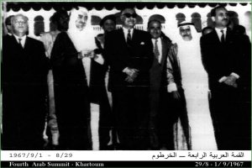

Slide 53
Khartoum Declaration
The Arab Heads of State have agreed to unite their political efforts at the international and diplomatic level to eliminate the effects of the aggression and to ensure the withdrawal of the aggressive Israeli forces from the Arab lands which have been occupied since the aggression of 5 June. This will be done within the framework of the main principles by which the Arab States abide, namely, no peace with Israel, no recognition of Israel, no negotiations with it, and insistence on the rights of the Palestinian people in their own country.

Slide 54
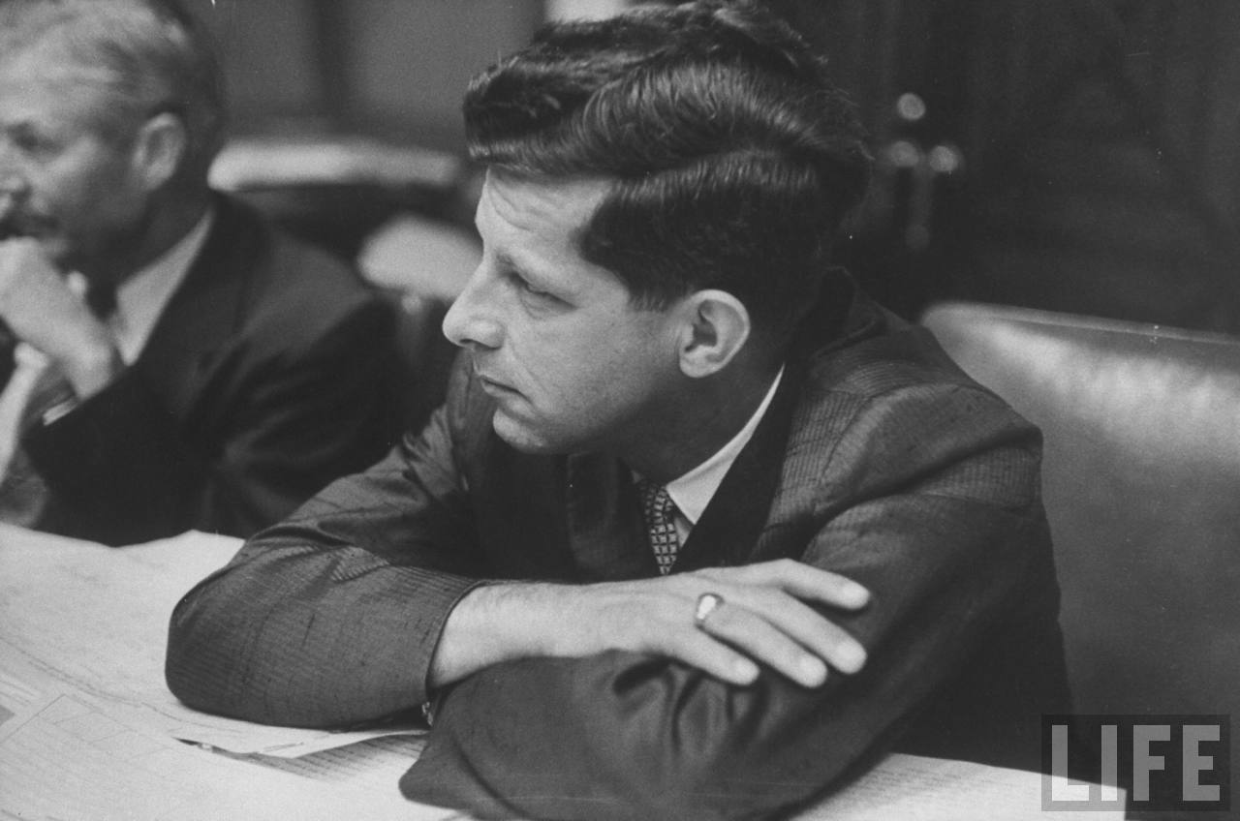

Slide 55
President Johnson: I’m thinking about what’s best for the country.
Gale McGee: Well, that would be—
President Johnson: And I don’t know of a human that I think is as knowledgeable in this general field, that is not New York-oriented, that is as articulate, that I think makes as good impression on TV. And I’ve watched them all.
I think you have a little of the mold of a Wilson and a Lincoln combination. I think you have a little of the George Marshall and Sam Houston. I think you look a little bit frontier, and pioneer, and a fellow that’s pulled himself up by his bootstraps. But I think you have enough sophistication and articulation that you’re effective as hell.
Now, that’s my type of man. I don’t want one of these Adlai Stevensons. I liked him, but he’s not—to me, I always kind of felt like he had to squat to pee.
Goldberg, on the other hand, is the best negotiator I have ever known.
McGee: Yes.
President Johnson: He does just absolutely have hydrophobia.
McGee: Yes.
President Johnson: And he talks a good deal when he ought to be listening.
McGee: Mm-hmm.
President Johnson: Now, you’ve got the great problems of the Middle East—and that’s the most dangerous thing. Vietnam is just chickenfeed compared to what the Russians are doing over there, and what may happen there. You’ve got this Cyprus thing that’s rough and tough.
[Break.]
President Johnson: Now, I wouldn’t agree, and I wouldn’t imply, and I’d think of several people if something happened to Rusk as secretary of state
McGee: Yes.
President Johnson: But I would say right in the beginning that one of the three names I would think of would be yours.
McGee: Oh, my.
President Johnson: And I know you never have thought in those terms—
McGee: No.
President Johnson: But that’s the way we think.
McGee: Yes.
President Johnson: I don’t want that to enter into it, and I don’t want it to be an implication, because I just very likely would appoint somebody else.
McGee: Yes.
President Johnson: But that’s what we think.

Slide 56
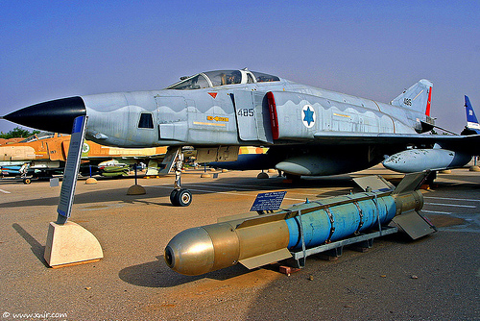

Slide 57
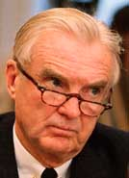

Slide 58
President Johnson: I’ve got to make a decision on those [Phantoms], and I want to make it as soon as—far enough ahead of time, before I go out [of office], not to be the last thing.
But I want the Russians to turn me down on disarmament. I’ve got a letter in his [Alexsey Kosygin’s] lap now.
And this idiot of a [Stuart] Symington has sent us word that if I don’t give Israel the Phantoms, that he’s going to kill our [foreign military] sale bill, where we can sell planes. If I don’t go ahead and give ‘em to ‘em [the Israelis].
And I can’t do it until Kosygin answers me. He’s not going to pee a drop with me: I know that. But I’ve got to have that behind me so I’ve got that as an excuse. [I can] say, “By God, I’ve tried everything. I tried a conference, I tried a proposal, I tried letters, I tried meetings, I pled with him. And finally he turned it down, and I just—there’s no other alternative. I have no course in the world except this.”
Abe Fortas: Yeah. That’s right.
President Johnson: And that’s what I’m trying to do.
Now, I never have told anybody I’m going to give ‘em to ‘em [the Israelis]. But I made up my mind a long time ago I was going to give ‘em to ‘em. But I’m not going to give ‘em to ‘em unless I can protect myself. I’m not going to be a goddamned arms merchant! I’m going to make them [the Soviets] to be the outlaws if I can.
Fortas: Sure. I think that’s very good.
President Johnson: Now, that’s what I’m trying to do.
And this little Effie [Ephraim Evron, minister in the Israeli embassy], is the only one I think in their organization that’s got sense enough to see it. He sees it all the time. He’s just as bright as that goddamned [unclear] dog of mine. He catches everything that comes along without telling him. So he helps.
But Symington is just the biggest muddlehead I ever saw. I thought you and Clark Clifford could advise somebody. [teasingly] Are all of your clients muddleheads like me and Symington? [Fortas laughs heartily.] I don’t understand it.
Fortas: Well, Stuart is absolutely one. I don’t know—he’s just got . . . Hell, I just don’t understand. Is this [issue] this fellow Solomon now?
President Johnson: No, no! Solomon’s a smart cookie. He’s bound to have plenty of sense.
No, no. I think he [Symington] just wants to be head of the Israel—get credit for ‘em.

Slide 59
Walt Rostow memo, Jan. 1968
1. More than just seeking a specific number of aircraft, Eshkol may be looking for a firmer commitment to Israel's security. He must understand that security guarantees and treaties are out, but he may seek a guaranteed source of arms. According to Dick's plausible report, the June war destroyed Eshkol's policy of putting out as many support lines as possible. His French and Russian policies are bankrupt, and he now seeks the closest possible tie with us.
…
If this report is true . . . it raises the problem of Eshkol trying to get too close to us. His possible offer to associate with us on Vietnam runs the risk of sharpening the image of Israel as our stooge and driving the wedge further between us and the Arabs. We want to consider whether Eshkol's quiet support wouldn't help you as much while avoiding damage abroad.

Slide 60
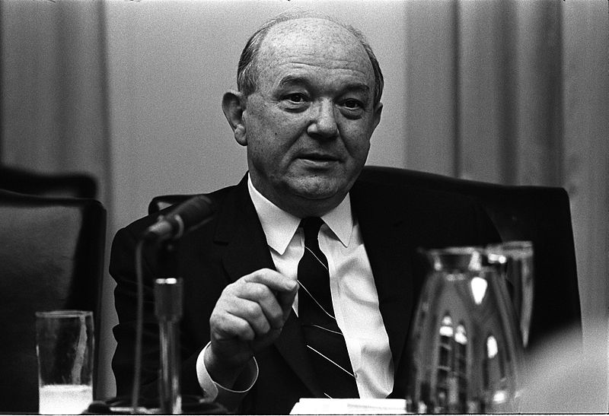

Slide 61
President Johnson: I don’t want to make any conditions, because I’ve been gone on the Phantoms, but I’m willing to help you put whatever pressure you can.
But I made the decision on the Phantoms, Dean, last January, when I called Bob McNamara in here and told him to be ready to deliver ‘em this January.
Rusk: Yeah.
President Johnson: I just didn’t want to face up to it all during that period, as you well know.
Rusk: Well, I think Israel—
President Johnson: I wouldn’t say—now, I’m willing to threaten, and do everything I can, just as long as you know, I come clean with you: the Phantoms—they’re already shipped.
Rusk: [unenthusiastically] Mm-hmm.
President Johnson: Now, you can tell ‘em that we’ve got to have this, and we’ve got to have that. And I’ll tell ‘em the same thing, and shove, and fight. They can’t use ‘em [for a] nuclear [attack], and they can’t do this, and they’ve got to sign a non-proliferation treaty: I don’t care what all we say.
Rusk: Right.
President Johnson: I’m not going to tell them. But that decision’s already wrapped up.
Rusk: Well, they’ve already got out of there what they want, short of the delivery of the planes themselves.
President Johnson: Yes. Yes, that’s right.
Well, I think they would like to have the thing signed, and have the purchase order written, because they’ve had that with France, you know, and it’s been kicked out. And I want to be damn sure that I do it, and that I don’t wait till after the election, and Nixon and Humphrey do it.

Slide 62
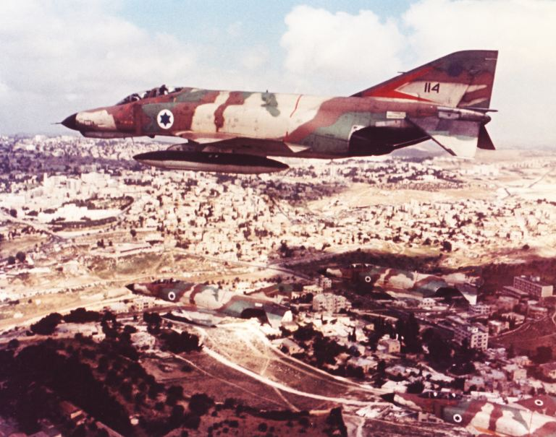

Slide 63
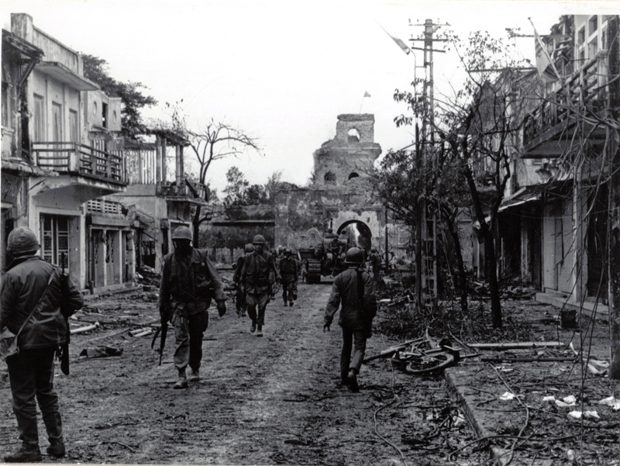
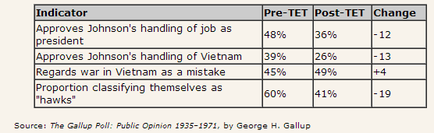

Slide 64
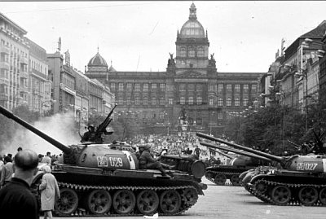
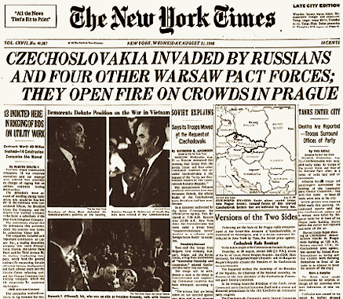

Slide 65
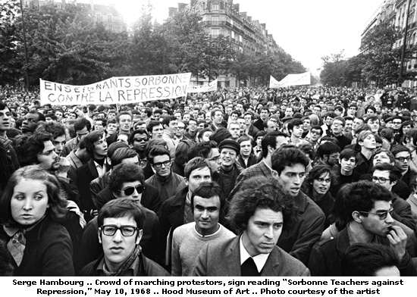


Slide 66


Slide 67


Slide 68


