Slide 1
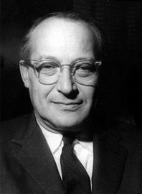
Notes:
rostow

Slide 2
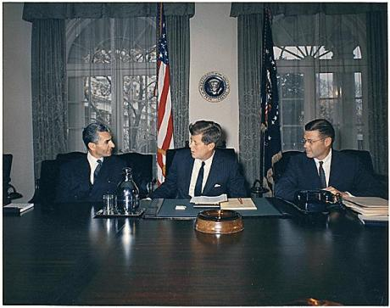

Slide 3
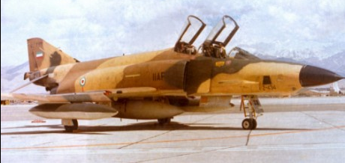
Notes:
RF-4

Slide 4
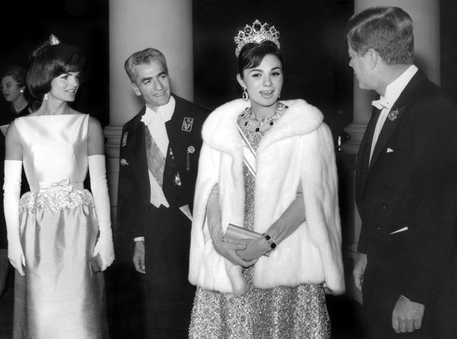

Slide 5
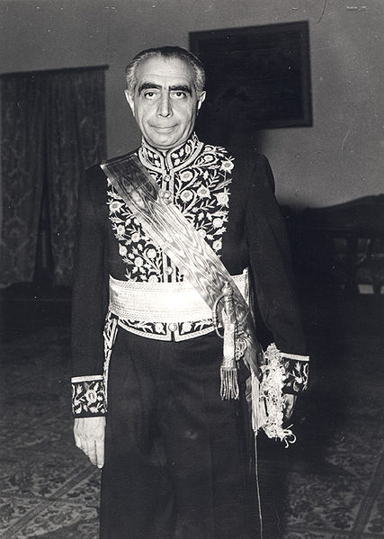
Notes:
Ali amini

Slide 6
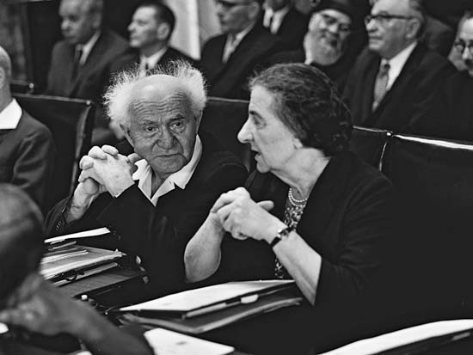

Slide 7
Wm. Bundy memo, 16 July 1962
The Joint Chiefs of Staff appraisal is inclosed. In summary, the Department of Defense views are:
Israel is vulnerable to UAR air attack and is becoming increasingly so with the arrival of additional Soviet TU-16's.
(b) The addition of the Hawk missile within Israel's air defense system would fill an important gap in their defense.
(c) Acquisition of the Hawk missile system by Israel would not alone act to shift the balance of military power between Israel and its neighbors.

Slide 8
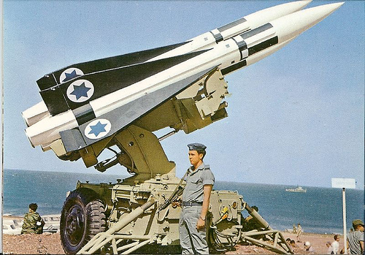
Notes:
Hawk missiles

Slide 9


Slide 10
US aid to Israel, Eisenhower & Kennedy administrations
 | Total | Military aid | Economic aid | Food for Peace
1954 | 74.7M | 0 | 54M | 20.7M
1955 | 52.7M | 0 | 41.5M | 11.2M
1956 | 50.8M | 0 | 24M | 26.8M
1957 | 40.9M | 0 | 26.8M | 14.1M
1958 | 61.2M | 0 | 24M | 37.2M
1959 | 50.3M | .4M | 19.2M | 30.7M
1960 | 55.7M | .5M | 23.9M | 31.3M
1961 | 45.1M | 0 | 24.5M | 23.6M
1962 | 83.9M | 13.2M | 45.4M | 25.3M
1963 | 76.7M | 13.3M | 45M | 18.4M

Slide 11

White House counselor Mike Feldman: As I said in my cable, the only time that I mentioned numbers was when they said, “We think they’ll [the Palestinian refugees] all take repatriation because of the pressures brought on them.” And I said, “This isn’t our own analysis. Our own analysis would indicate they don’t endanger your security.” And they said, “Well, what do you mean by that?”
I said, “Well, from the conversations that Dr. [Joseph] Johnson has had and from indications we’ve had from other people, it’s our best guess that not more than one in ten [refugees] would take repatriation,” and they accepted that. That’s all.
President Kennedy: What did they figure? It’s like a Negro wanting to go back to Mississippi, isn’t it? Or is that . . .
Feldman: It’s different because it’s as if the dominant doctrine were Black Muslim doctrine in a sense . . . [Laughs.]
President Kennedy: [Unclear.] Well, the whole question really is how much economic value they can get without [going back] . . . It’s quite a different thing to say that you want to go back as the only means of getting compensated . . . that you can get compensation without going back.
Of course, they both have a different view, don’t they? Nasser will think they [Palestinian refugees] all want to go back. He doesn’t think the Israelis will take them, so he thinks it’s going to collapse. The Israelis are . . .
Ass’t Secretary of State Robert Strong: They place a great deal of stress on the arguments that I made about—concerning the disincentives to going back.
President Kennedy: Yeah, but aren’t they . . . Isn’t one group going to be horribly disappointed, either the Israelis—
Strong: Yeah.
President Kennedy: —by a lot more than one out of ten coming back, or the Arabs when only one out of ten want to go back? Isn’t it going to blow up, then, the plan when this fact becomes a pattern?
Strong: I would think that’s a fair assumption.
Notes:
Ag 27 1962

Slide 12
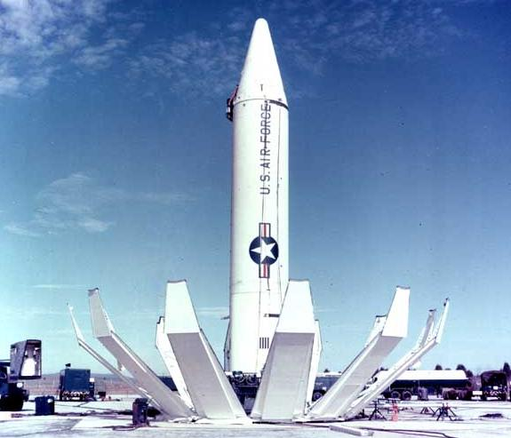
Notes:
jupiter

Slide 13
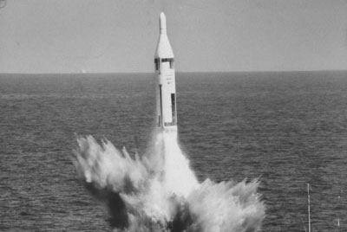
Notes:
polaris

Slide 14


Slide 15


Slide 16


Slide 17


Slide 18
President Kennedy: How much negotiations have we had with the Turks this week? Who’s done it?
Unidentified: No, we have not.
Secretary of State Dean Rusk: We haven’t talked with the Turks. The Turks have talked with us.
President Kennedy: Where have they talked with us?
Rusk: In NATO.
President Kennedy: Yeah, but have we gone to the Turkish government before this came out this week? I’ve talked about it now [in ExComm meetings] for a week. Have we had any conversations in Turkey, with the Turks?
Rusk: Well, we’ve asked [US ambassador to Italy Thomas] Finletter and [US ambassador to Turkey Douglas] Hare to give us their judgments on it. We’ve not actually talked with the Turks.
Undersec’y of State George Ball: We did it on a basis where, if we talked to the Turks, I mean, this would be an extremely unsettling business.
President Kennedy: Well, this is unsettling now, George, because he’s [Khrushchev’s] got us in a pretty good spot here. Because most people would regard this as not an unreasonable proposal, I’ll just tell you that. In fact, in many ways—
National Security Advisor McGeorge Bundy: But what “most people,” Mr. President?
President Kennedy: I think you’re going to have it very difficult to explain why we are going to take hostile military action in Cuba, against these sites, which is what we’re thinking about, when he’s [Khrushchev’s] saying, “If you’ll get yours out of Turkey, we’ll get ours out of Cuba.” I think you’ve got a very touchy point here . . .
Bundy: It isn’t as if we’d got the [Jupiter] missiles out, Mr. President. It would be different. Or if we had any understanding with the Turks that they ought to come out, it would be different. Neither of these is the case.

Slide 19
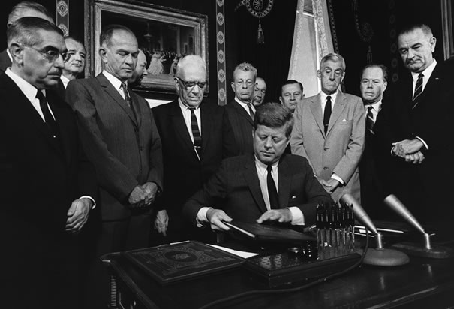
Notes:
Jfk signs test ban treaty

Slide 20
JFK press conference, 8 May 1963
QUESTION: Mr. President, do you consider the situation in the Middle East, the balance of power there, to have been changed as a result of recent developments, and what is the U.S. policy towards the security of Israel and Jordan in case they are threatened?
THE PRESIDENT: I don't think that the balance of military power has been changed in the Middle East in recent days. Obviously there are political changes in the Middle East which still do not show a precise pattern and on which we are unable to make any final judgments. The United States supports social and economic and political progress in the Middle East. We support the security of both Israel and her neighbors. We seek to limit the Near East arms race which obviously takes resources from an area already poor, and puts them into an increasing race which does not really bring any great security.

Slide 21
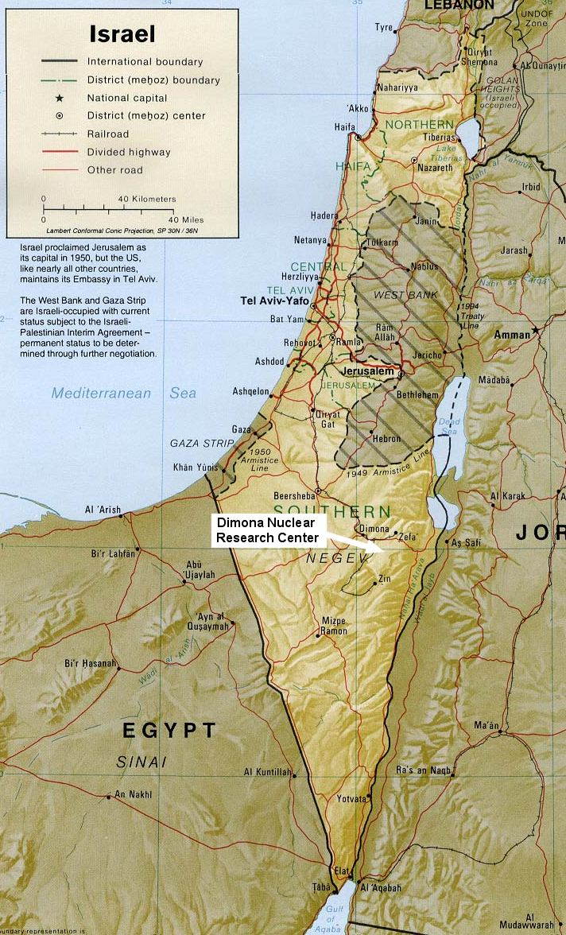

Slide 22
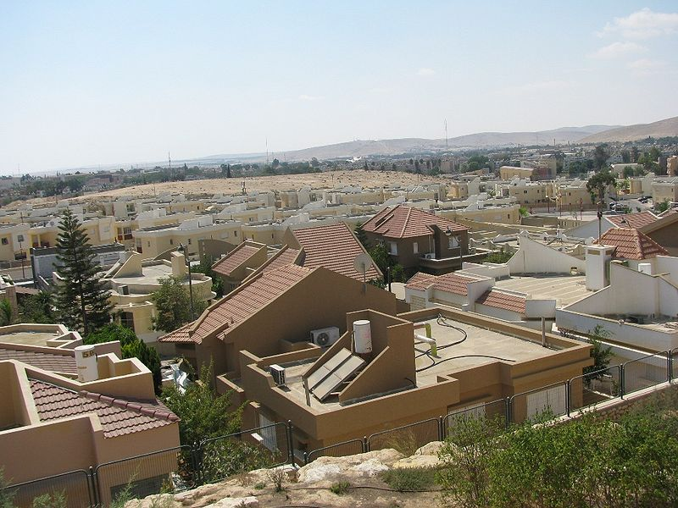
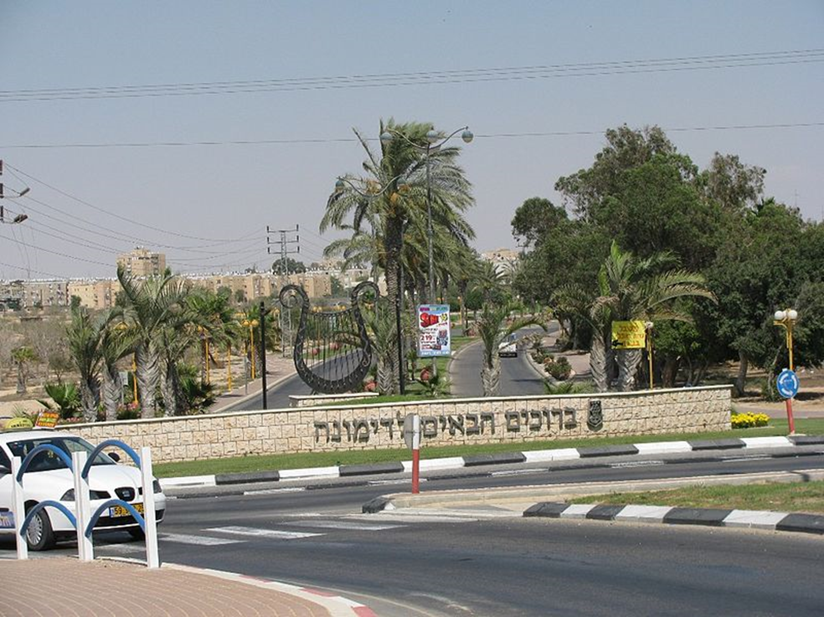

Slide 23
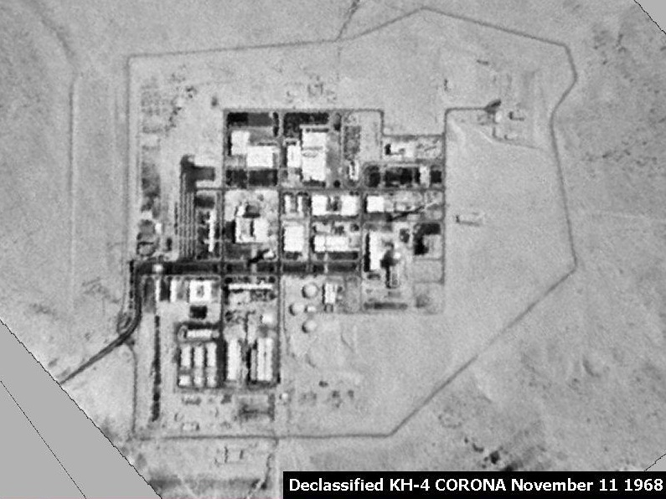

Slide 24
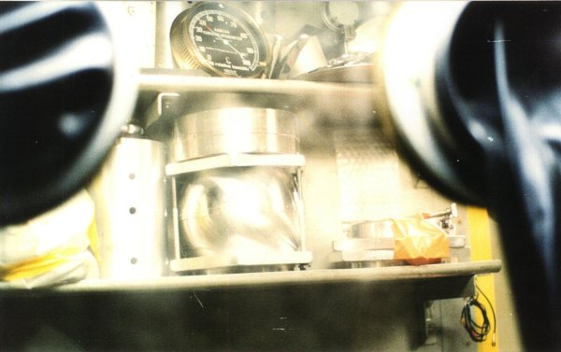
Notes:
Mordechai Vanunu bomb components

Slide 25
President Kennedy: My God, we wouldn’t continue our guarantee of [West] Germany if they started manufacturing nuclear weapons, which is really of vital importance to us compared to our position in Israel. Why should we guarantee Israel if they’re doing it? That’s . . .
Secretary of State Dean Rusk: A nuclear weapon explosion in Israel would drive the Arab world right into the Soviet arms. I can’t see that happening any other [way].
President Kennedy: It seems to me that if you’ve got this thing in there—a country, after all, who has received a good deal of assistance from us.
Is it fair to say the main source of foreign income is the United States?
Rusk: Without any question.
President Kennedy: Therefore, for them to do it—after all, they’re regarded as a very close associate of [ours], and a country which has been most recently the subject of a guarantee, of a commitment, by the President at a press conference—for there to be any question that this nation may be manufacturing nuclear weapons, and for this country, the United States, not to be able to determine that, places in my opinion, and the opinion of America, as well in the entire West—
Rusk: [Unclear] Middle East.
President Kennedy: If this should become public—we don’t want to sound threatening, but that’s the fact of the matter—it’s bound to have, I think, most adverse effects.
Rusk: [Unclear] lack of will.
President Kennedy: And I think if he [Prime Minister Ben Gurion] doesn’t do it [agree to U.S. inspections] then, we ought to leak it out to some paper that there’s a suspicion they won’t permit inspections, and all the rest.
Because I think, for them, the damage is just . . .
I mean, not only were they allowed to get the thing [nuclear weapon] themselves; it could encourage and stimulate them [the Arabs] to launch a military action before your [Israeli] program is completed.
So, therefore, it increases the dangers of war, and we’re quite obviously involved.
Notes:
17 May 63

Slide 26
Kennedy Letter to Ben Gurion, 18 May 1963
… The dangers in the proliferation of national nuclear weapons systems are so obvious that I am sure I need not repeat them here. It is because of our preoccupation with this problem that my Government has sought to arrange with you for periodic visits to Dimona . . .
We are concerned with the disturbing effects on world stability which would accompany the development of a nuclear weapons capability by Israel. I cannot imagine that the Arabs would refrain from turning to the Soviet Union for assistance if Israel were to develop a nuclear weapons capability--with all the consequences this would hold. But the problem is much larger than its impact on the Middle East. Development of a nuclear weapons capability by Israel would almost certainly lead other larger countries, that have so far refrained from such development, to feel that they must follow suit.
I can well appreciate your concern for developments in the UAR. But I see no present or imminent nuclear threat to Israel from there. I am assured that our intelligence on this question is good and that the Egyptians do not presently have any installation comparable to Dimona, nor any facilities potentially capable of nuclear weapons production . . .
I trust this message will convey the sense of urgency and the perspective in which I view your Government's early assent to the proposal first put to you by Ambassador Barbour on April 2.

Slide 27
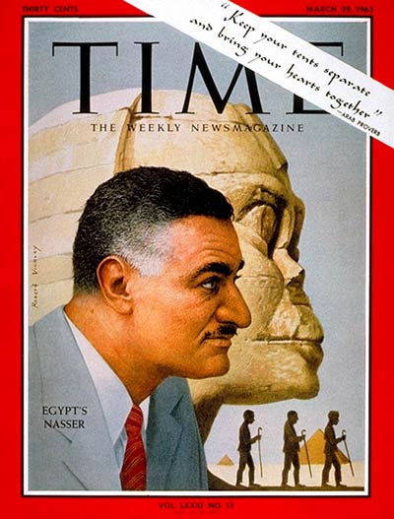

Slide 28
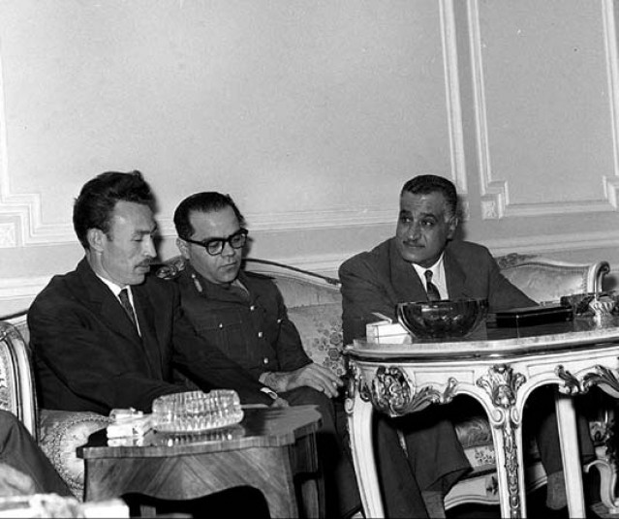
Notes:
w/ presidents of algeria, syria at cairo summit, 1963

Slide 29
President Kennedy: So let’s see what kind of a message we can get out to them, which carries some force to them, as if our concern is not totally the Israelis. It may be that we’ll want to come out with some sort of a guarantee next week, or reinforcement of the Tripartite [Agreement, between Britain, France, and the US]. But we want it to be understood in advance that it’s not just because of our concern about Israel.
Really our concern is mutual, because the peril is mutual—that the Israelis will move in a preemptive way at a time when they have the power; [and] that therefore, the fellow who’s really in more trouble is Nasser, not so much the Israelis. We would certainly want to get that point [across]—that that’s the way it looks to us, and that therefore any Tripartite guarantee would at least carry with it an appearance of, as I said, mutuality.
Now, the other thing is what we can do about the Jordanians—what we ought to try to do with the British. I think we ought to encourage the British to be more ready to move under some conditions. After all, this has been their traditional area: we’re not supposed to do everything.
So let’s get [British ambassador to the US] David Ormsby-Gore—
George Ball: I talked to David already this morning, and told him we’d [unclear], so I’ll get moving—
President Kennedy: Well, I think we can say that we could visualize a situation where we’d have to have somebody move in. it seems to me it ought to be the British.

Slide 30
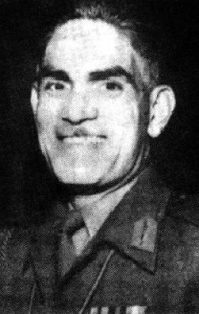

Slide 31
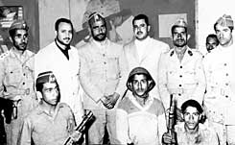
Notes:
Yemen oct 62 coup

Slide 32
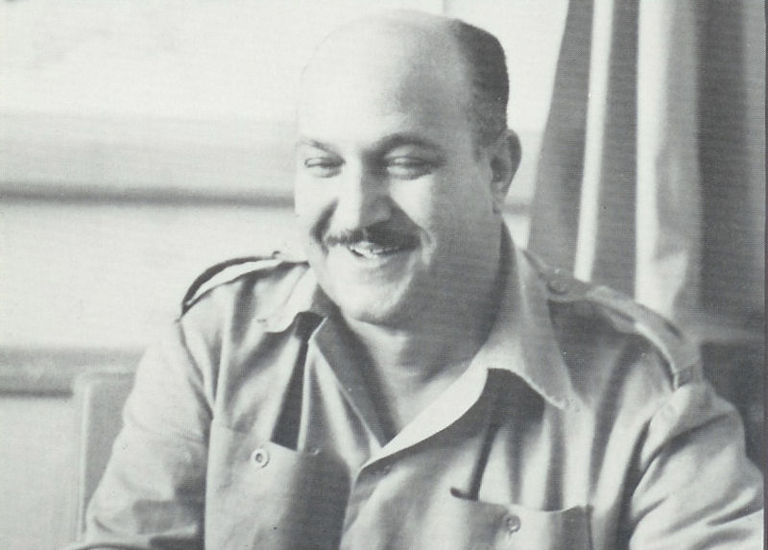
Notes:
Col hassan ali kamal—head of egy forces in yemen

Slide 33
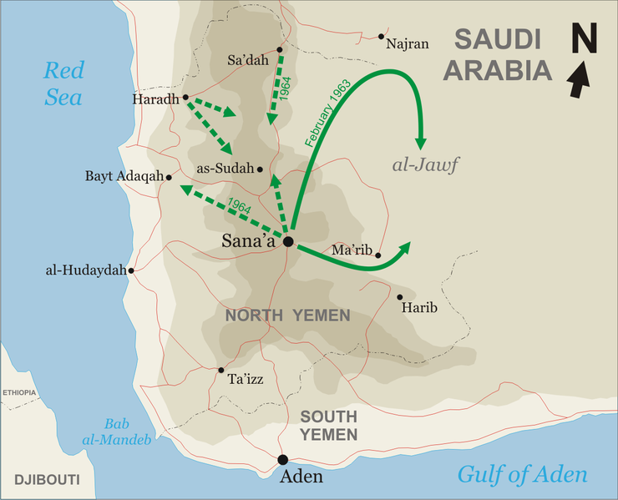

Slide 34
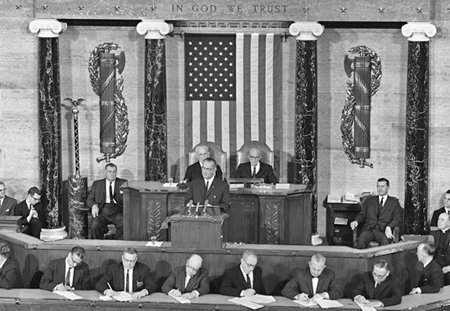

Slide 35

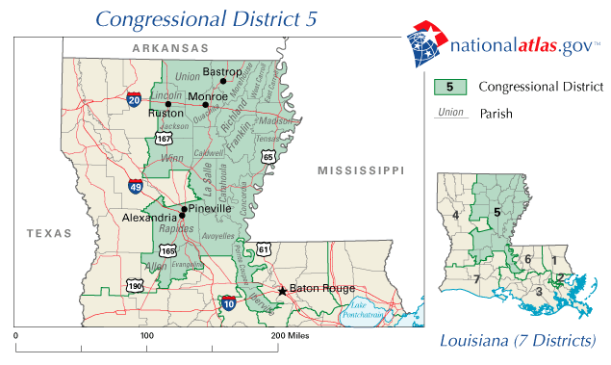

Slide 36
President Johnson: I don’t want to debate it with you, my friend. I love you. But you know goddamn well when I ask ‘em not to make me notify ‘em publicly so it wouldn’t be in the papers . . .
Albert Thomas: Well . . .
President Johnson: You know that I know what I’m doing.
Thomas: Frankly, I—
President Johnson: You know, and we screwed it up. This damn fool [Minnesota senator Hubert] Humphrey put that paragraph on.
Thomas: That’s right—
President Johnson: I told [House Majority Leader Carl] Albert to get it off, cut it off.
Thomas: I think it’s your partners over on the Senate side. Now, old Otto [Passman] played ball. He told me he was going to do his damnedest to take it out.
Have you got the language in front of you?
President Johnson: Yes, sir, I’ve got it front of me. And it oughtn’t to be in there. It’s just a damn—
Thomas: [hurriedly reading] “Agency or national in connection with the purchase . . . [etc.].”
President Johnson: That’s right.
Thomas: “Or national except when the President determines that such guarantees would be in the national interest.”
President Johnson: That’s all right—period.
Thomas: “And reports each”—
President Johnson: No, no! No! Period, after “national interest.”
Thomas: I know, but read your language further. “And reports each determination.”
President Johnson: [loudly] Why should I want to report to everybody that I screwed a girl? You screwed one last night, but you don’t want to report it.
Thomas: [slyly] I wish I did.
President Johnson: Well, you know what I’m talking about. That made it come home to you, didn’t it?
Thomas: Well, it ain’t going to—
President Johnson: Don’t you think I’m a damned idiot, now.
Thomas: Now, now—
President Johnson: Well—
Thomas: Now, now, now, now. Of course not. But I don’t think it’s going to hamstring you a bit on—
President Johnson: It doesn’t hamstring me. It just publicizes that I’m pro-Russian right when [Richard] Nixon’s running against me. That’s all it does.
Thomas: Well, he ain’t going to run, because he ain’t going to—
President Johnson: Well, listen, Albert—
Thomas: —he ain’t going to get two or three—
President Johnson: Listen, Albert. You and I are buddies now. You understand politics, and I do, too. I’m telling you that we’re working with the Republicans up there 100 percent.
Thomas: Well, I’m on your side.
President Johnson: Well, all right. You just don’t ever agree that that’s a good clause, because you know goddamn well it ain’t. Don’t try to shit me, because I know better.
Thomas: Here’s the Speaker. Well, I’ve worked with it in the space program—
President Johnson: Yeah, you’ve worked with it, but you’ve been working with it under Republican presidents, not under Democrats. When a Democratic President has to report that he makes a determination that it’s in his interest to go with Russia, it’s not good when you’re running for office. Now, you know that, don’t you?

Slide 37

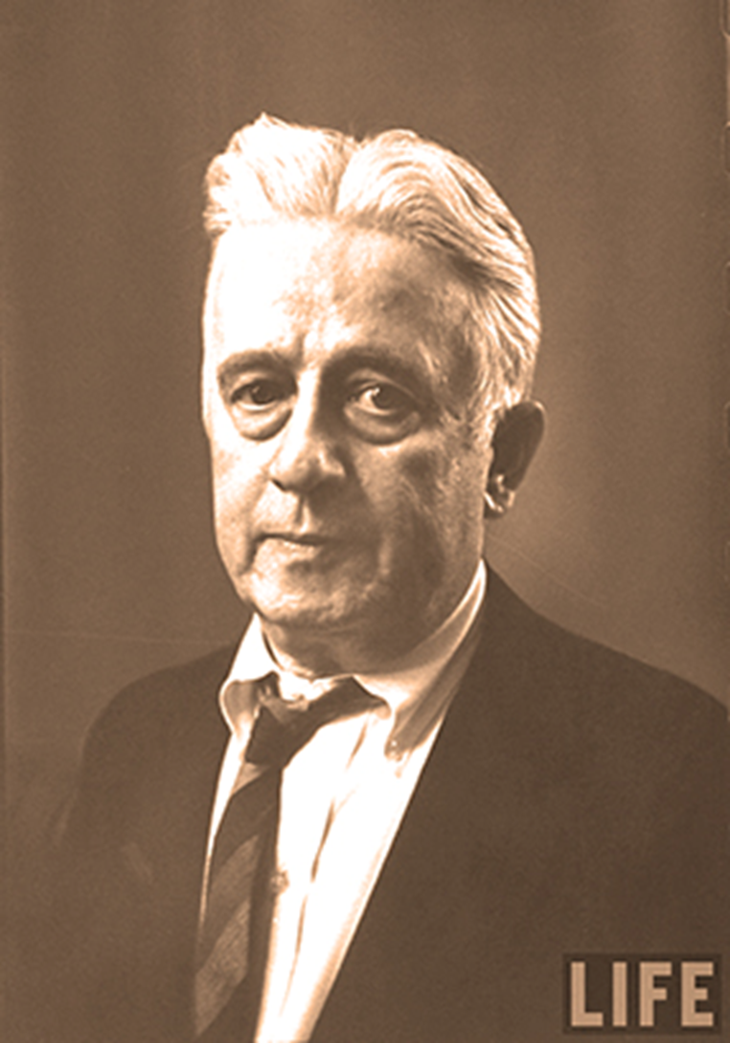

Slide 38
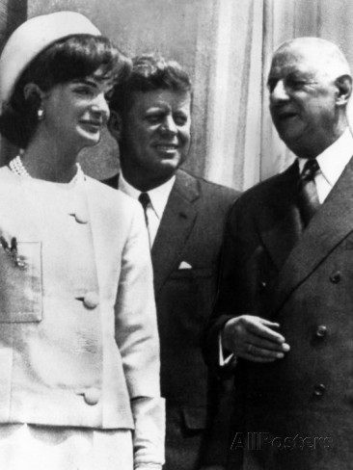

Slide 39
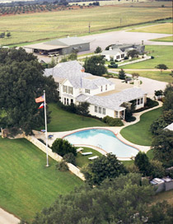

Slide 40
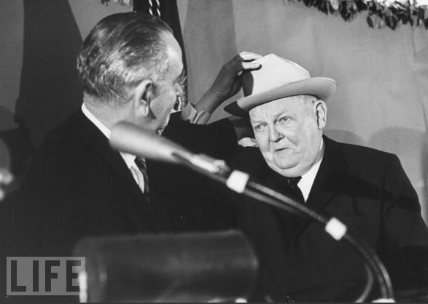

Slide 41
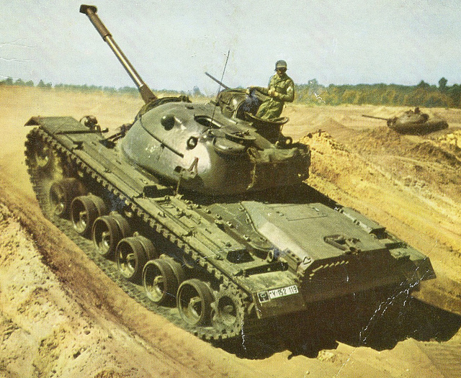
Notes:
150 German Bundeswehr M48 tank—option for 83 more

Slide 42
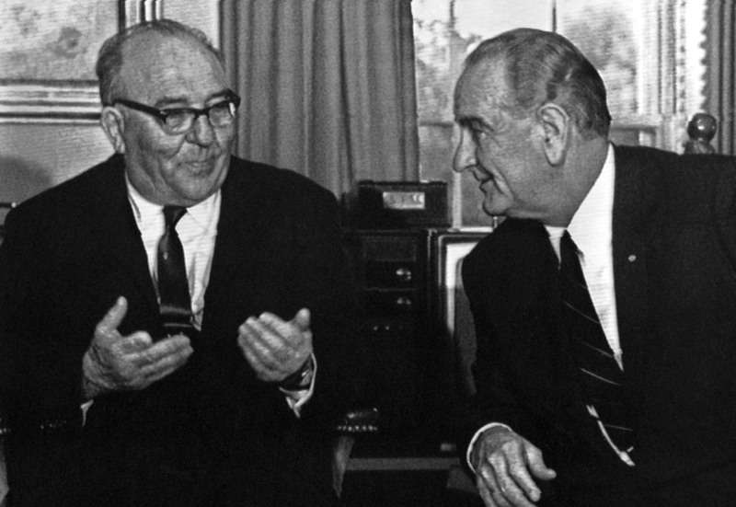
Notes:
Eshkol and lbj

Slide 43
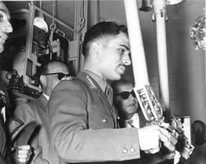

Slide 44
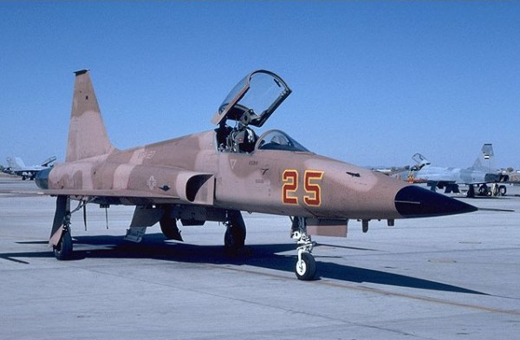
Notes:
F-5

Slide 45
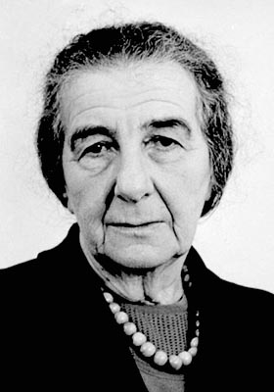

Slide 46
President Johnson: I like [Prime Minister Levi] Eshkol—I got along with him fine. I got along with [former prime minister David] Ben Gurion fine. I spent a lot of time with him, back when they were in real problems, and they were getting ready to [impose] sanctions [in 1963, over Dimona]. I just came down here and said, “Hell, no, that can’t be.”
Abe Feinberg: I remember that.
President Johnson: And I stopped it.
But they fight among themselves over there, and I’m not going to get in the middle of these clashes—have one of them leak it on me that I want to join up with the Arabs.
Feinberg: I gather that, for proper diplomatic reasons, you think that [Foreign Minister] Golda’s [Meir] visit here would be—
President Johnson: I just think—I think it would inflame the whole world. I think that the Germans would wonder if she’s coming to mess in that thing. I think that the Arabs would say, “Good God, what’s Johnson doing in here?” I think the Jews would all start sending telegrams . . .
I can’t imagine her getting off [the plane] with a suitcase without somebody saying, “Why?”
Feinberg: Yeah.
President Johnson: And then I don’t want to get another Arab/Ben Gurion/Eshkol/Erhard election in this thing if I can avoid it.
[Break.]
President Johnson: I’m friendly to these people, and I want to help them. But . . .
As our people see it, if they [the Israeli government] really, sincerely, genuinely feel that we oughtn’t to sell these planes to Jordan, and we oughtn’t to sell these tanks (we’re giving them as little as we can get by with; Nasser has got their feet to the fire)—well, we won’t do it. I’ll just say that, and I’m prepared to do it.
And I’m telling [special emissary Averell] Harriman to tell the prime minister that. Because I think it’s something that’s got to be settled with him . . .
Feinberg: With the prime minister of Israel?
President Johnson: Yeah. Yeah.
And now he’s [Harriman] going to say, “Now, you all decide this.” We have indications from our Jewish population in the United States that they think that’s the course we ought to follow.
Now, our judgment is we oughtn’t to do it. Our judgment is we oughtn’t to let this little king [King Hussein] go down the river. He’s got a million-and-a-half people, and he only controls a third of them—two-thirds [are] against him.
But he is the only voice that will stand up there. And if you want to turn him over and have a complete Soviet bloc, why, we’ll just have to—and we’ll get out of the arms business.

Slide 47
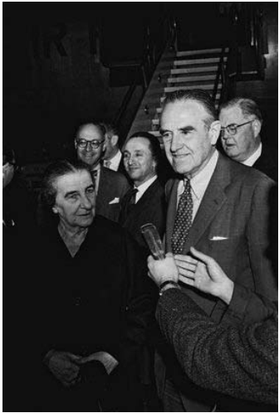

Slide 48
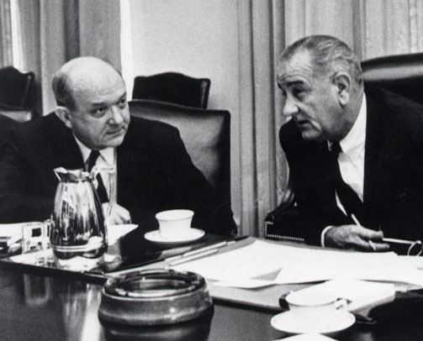

Slide 49
Dean Rusk: [reading from proposed telegram for Averell Harriman to present to Prime Minister Eshkol]
“ . . . Our deep concern about unification of Arab world behind Nasser with close working relationships with [the] Soviet bloc is [the] greatest threat to Israel we can imagine. The fact that it would be deeply injurious to U.S. interests in [the] Near East, including the security of Israel, seems to us to require that we and Israel would together to head it off. We agree to a private visit to Washington of [Shimon] Peres and [Yitzhak] Rabin. Must emphasize absence of publicity for such visit, as was accomplished on earlier occasions.” . . .
President Johnson: I had this feeling—I don’t know if it’s any good, but, God, I hate to transfer all those Jews into Washington, though, because I’m afraid that they’ll all move in at the slightest provocation. I wouldn’t be surprised if Golda’s [Meir] not on her way if we don’t watch.
But maybe not.
Do you think that we could say to Averell to strike out the [word] “sympathetically” [from the proposed agreement] and say, “We pledge to give you x tanks, and give ‘em the x tanks, plus the little beyond the tanks—without any planes? It seems that the basis of his [Eshkol’s] objection is that [the U.S. saying] “we view sympathetically” doesn’t commit us.
Rusk: Uh-huh.
President Johnson: And that he wants a commitment.
It seems that we might, without great danger, raise the ante a little bit to what the Germans are giving them, and say if the Germans don’t complete it, we’ll complete it, plus 20 or something.

Slide 50
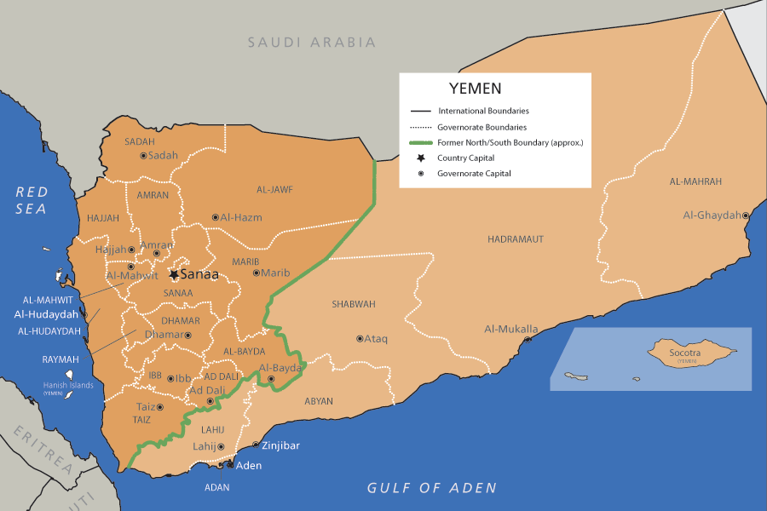

Slide 51
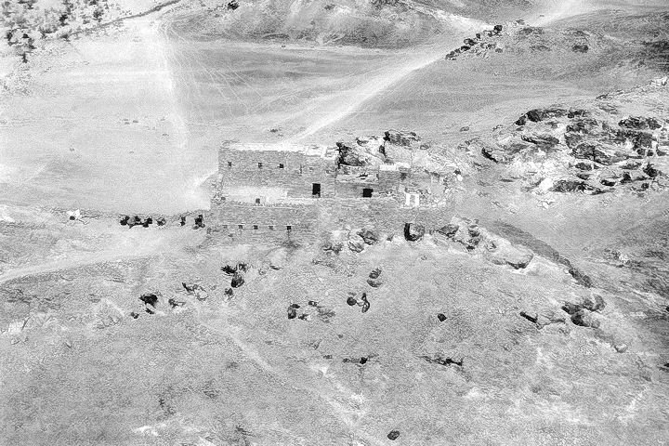
Notes:
British raid fort harib 28 March 1964

Slide 52
UN Resolution 188
The Security Council,
Having considered the complaint of the Yemen Arab Republic regarding the British air attack on Yemeni territory on 28 March 1964,
Deeply concerned a the serious situation prevailing in the area,
Recalling Article 2, paragraphs 3 and 4, of the Charter of the United Nations,
Having heard the statements made in the Security Council on this matter,
1. Condemns reprisals as incompatible with the purposes and principles of the United Nations;
2. Deplores the British military action at Harib on 28 March 1964
3. Deplores all attacks and incidents which have occurred in the area;
4. Calls upon the Yemen Arab Republic and the United Kingdom of Great Britain and Northern Ireland to exercise the maximum restraint in order to avoid further incidents and to restore peace in the area:
5. Requests the Secretary-General to use his good offices to try to settle outstanding issues, in agreement with the two parties.

Slide 53
Dean Rusk: In a lot of places here . . . He [Nasser] has not performed in Yemen, he is undermining us in the Wheelus Base [in Libya], and he is pitching this arms race into the Near East.
President Johnson: Well, this [vote on the pending UN resolution] is not going to help us with him, is it?
Rusk: But I think it's important for Nasser to know that we're not … that he mustn't take us for granted on these things … I think an abstention on this is something of a warning to Nasser that we're coming close to the end of the trail on this business.
President Johnson: Don't you think they'll pound us like hell all over the United Nations and all over the papers of the country?
Rusk: Oh, I think that there will be … there will be …
President Johnson: [UN ambassador Adlai] Stevenson will be running around raising hell like he was about the Venezuela delegation, won't he?
Rusk: Oh, I think he will be … he will be personally unhappy for two or three days, but I don't think there's going to be any major press campaign picking this up.
President Johnson: Have you already told him what to do?
Rusk: Yes. Well, I told him—we had an instruction for him several days ago not to have a resolution that condemned the British, and this does. It says it “deplores”—this thing the other day—but to express a general regret about violence along that frontier.
The resolution went beyond the point where we felt we could, in our total interests here, support it. But as it now stands, he is willing to—he is ready to do what we talked about this morning. But he just wanted to be sure that you knew that it’s a close, balanced decision, and that he had some concern about it.
President Johnson: Well, you just tell him that I do know, but I knew at the last minute. Didn’t know anything about it beforehand, I don’t know anything else.

Slide 54
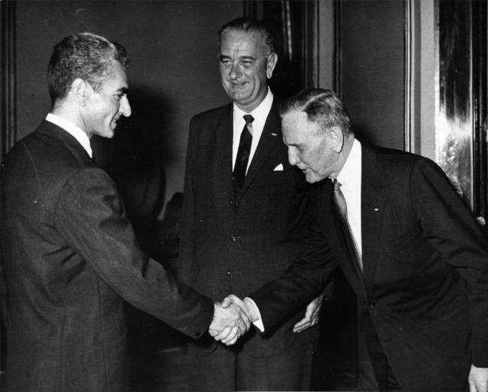
Notes:
1962 visit

Slide 55
From Time magazine:
Lyndon Johnson hit Teheran as though he were running for Shah—and if the warmth of his welcome was an indication, he might be able to get the job. With Wife Lady Bird and Daughter Lynda Bird, 18, the Vice President swept down Eisenhower Boulevard, so named after Ike's 1959 visit. Three times Johnson confused his smartly uniformed police escort by halting the motorcade and hopping out of his car to grasp all the outstretched hands within reach (one observer counted 300 in five minutes). The crowds responded with the highest praise they knew: "Javid Shah!" (Long live the King!).

Slide 56
President Johnson: Your majesty, how are ya’?
Shah of Iran: Mr. President, I am so glad to hear you.
President Johnson: Well, it’s wonderful to hear your voice. And we’re so happy to have you and the Empress back in our country again, even if it’s very brief.
Shah of Iran: Yes, unfortunately, we could not pay you, pay our—I mean, pay you our respects.
President Johnson: Oh, I would so much like to see you. I was oh-so-relieved, though, that you escaped the recent [assassination] attempt. You know from your own role at the time of President Kennedy’s [death] what a shock such an experience is.
Shah of Iran: Yes, it was rather true [chuckles a bit].
President Johnson: Yeah. [Abruptly changes topic.] Well, we were so pleased that you were so well-received in Brazil and Argentina.
[Break.]
President Johnson: Well, we certainly are grateful to you for your Dominican and Vietnamese position [in support of the United States], and . . . I’m very concerned that the Afro-Asian conference in Algiers next month will degenerate—I’m afraid it will be an anti-U.S. operation—unless some responsible delegation like Iran strands up against these steamrollers.
Shah of Iran: Yes—we shall do our duty. And we are grateful to you to have taken these attitudes, Mr. President.
President Johnson: Well, we have to take this when liberty’s at stake.
Shah of Iran: Oh, yes.
[Break.]
President Johnson: Everyone tells me you have just made phenomenal progress!
Shah of Iran: Yes, we have been very lucky.
President Johnson: Well, no, you’ve been very courageous—that’s what.

Slide 57


Slide 58
Article 22:
Zionism is a political movement organically associated with international imperialism and antagonistic to all action for liberation and to progressive movements in the world. It is racist and fanatic in its nature, aggressive, expansionist, and colonial in its aims, and fascist in its methods. Israel is the instrument of the Zionist movement, and geographical base for world imperialism placed strategically in the midst of the Arab homeland to combat the hopes of the Arab nation for liberation, unity, and progress. Israel is a constant source of threat vis-a-vis peace in the Middle East and the whole world. Since the liberation of Palestine will destroy the Zionist and imperialist presence and will contribute to the establishment of peace in the Middle East, the Palestinian people look for the support of all the progressive and peaceful forces and urge them all, irrespective of their affiliations and beliefs, to offer the Palestinian people all aid and support in their just struggle for the liberation of their homeland.
Article 19:
The partition of Palestine in 1947 and the establishment of the state of Israel are entirely illegal, regardless of the passage of time, because they were contrary to the will of the Palestinian people and to their natural right in their homeland, and inconsistent with the principles embodied in the Charter of the United Nations; particularly the right to self-determination.
Article 20:
The Balfour Declaration, the Mandate for Palestine, and everything that has been based upon them, are deemed null and void. Claims of historical or religious ties of Jews with Palestine are incompatible with the facts of history and the true conception of what constitutes statehood. Judaism, being a religion, is not an independent nationality. Nor do Jews constitute a single nation with an identity of its own; they are citizens of the states to which they belong.
Article 21:
The Arab Palestinian people, expressing themselves by the armed Palestinian revolution, reject all solutions which are substitutes for the total liberation of Palestine and reject all proposals aiming at the liquidation of the Palestinian problem, or its internationalization.

Slide 59
Article 2:
Palestine, with the boundaries it had during the British Mandate, is an indivisible territorial unit.
Article 6:
The Jews who had normally resided in Palestine until the beginning of the Zionist invasion will be considered Palestinians.
Article 22:
Zionism is a political movement organically associated with international imperialism and antagonistic to all action for liberation and to progressive movements in the world. It is racist and fanatic in its nature, aggressive, expansionist, and colonial in its aims, and fascist in its methods. Israel is the instrument of the Zionist movement, and geographical base for world imperialism placed strategically in the midst of the Arab homeland to combat the hopes of the Arab nation for liberation, unity, and progress. Israel is a constant source of threat vis-a-vis peace in the Middle East and the whole world. Since the liberation of Palestine will destroy the Zionist and imperialist presence and will contribute to the establishment of peace in the Middle East, the Palestinian people look for the support of all the progressive and peaceful forces and urge them all, irrespective of their affiliations and beliefs, to offer the Palestinian people all aid and support in their just struggle for the liberation of their homeland.

Slide 60
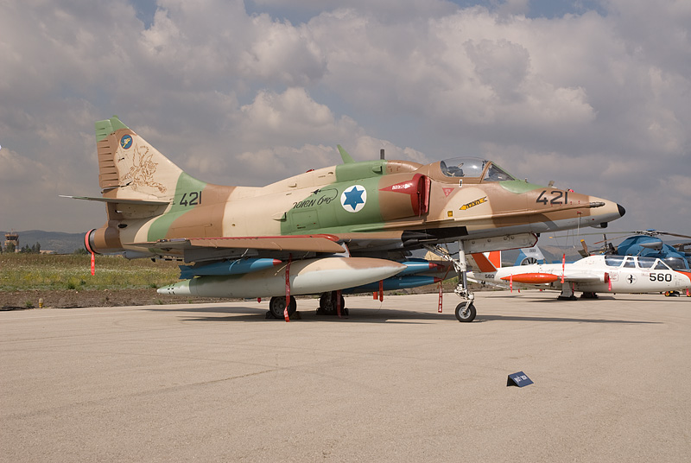
Notes:
skyhawk

Slide 61
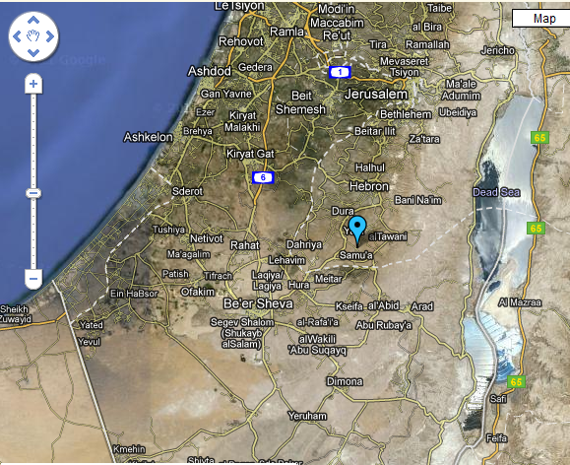

Slide 62
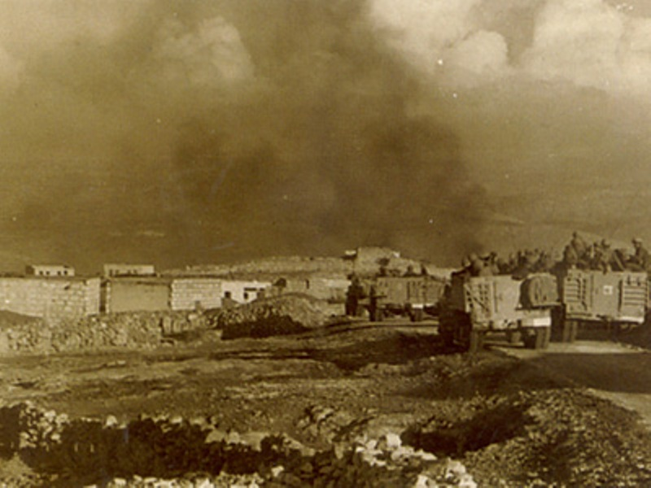
Notes:
samu

Slide 63
UN Resolution 228 (Nov. 1966)
The Security Council,
…Observing that this incident constituted a large-scale and carefully planned military action on the territory of Jordan by the armed forces of Israel,
…
Recalling the repeated resolutions of the Security Council asking for the cessation of violent incidents across the demarcation line, and not overlooking past incidents of this nature,
Reaffirming the necessity for strict adherence to the General Armistice Agreement,
1. Deplores the loss of life and heavy damage to property resulting from the action of the Government of Israel on 13 November 1966;
2. Censures Israel for this large-scale military action in violation of the United Nations Charter and of the General Armistice Agreement between Israel and Jordan;
3. Emphasizes to Israel that actions of military reprisal cannot be tolerated and that, if they are repeated, the Security Council will have to consider further and more effective steps as envisaged in the Charter to ensure against the repetition of such acts.

Slide 64
President Johnson: Have you got—have you got Jordan and Israel? I told them [the State Department] not to pee a drop on India, Pakistan, or Jordan and Israel without you. Have they checked all this stuff?
Arthur Goldberg: Nick [Katzenbach] gave you a memorandum of our conversation. And I’ve asked the Israel ambassador [to the United States], Abe Harman. He’ll come and see me Friday morning and I’ll get back to you.
President Johnson: What we’ll do is at the proper time—we won’t be chinchy with them, we’ll go back to [focusing on] Africa or something else. We can’t make a deal, but…
I just think they’re damn fools to let [King] Hussein get thrown out.
Goldberg: Yeah, I think they know that. And I’ll be glad to talk to them.
President Johnson: All right. OK.

Slide 65
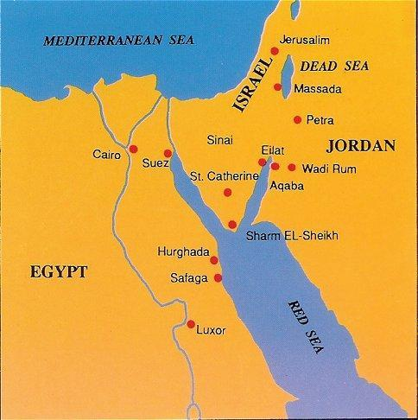

Slide 66
