Slide 1
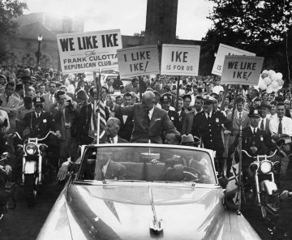

Slide 2


Slide 3


Slide 4
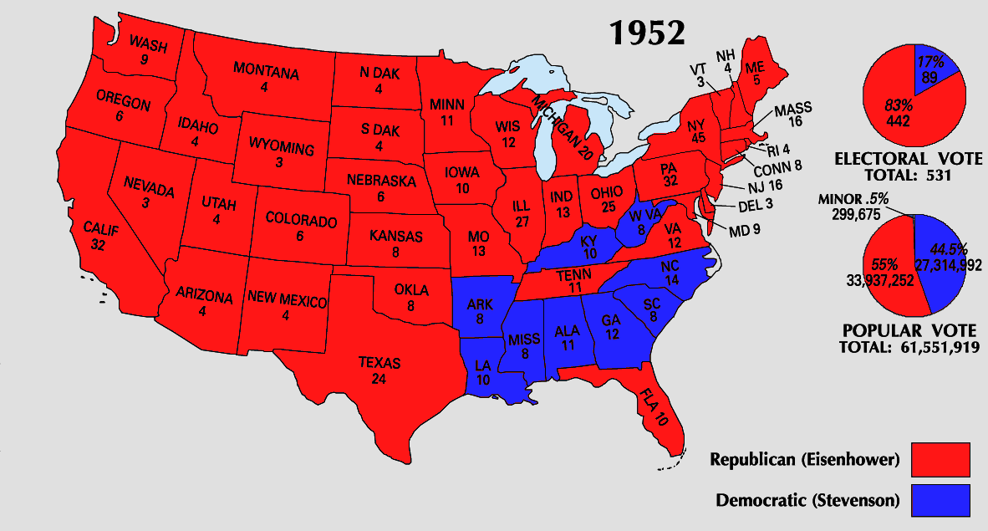

Slide 5


Slide 6
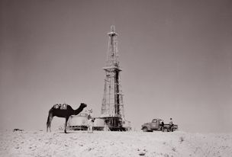
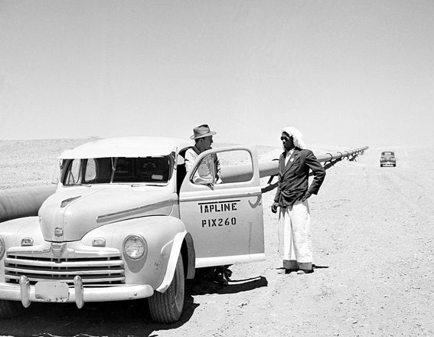
Notes:
Transarabian pipeline—to medit

Slide 7
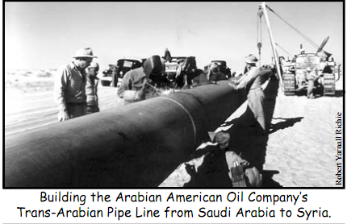

Slide 8
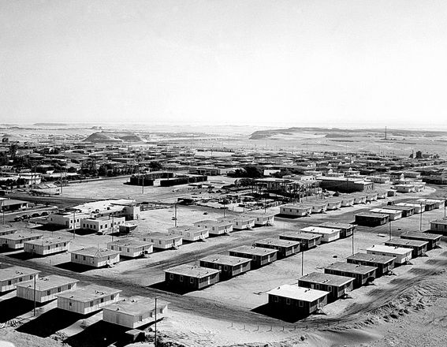
Notes:
Expn dharan

Slide 9
Saudi-ARAMCO revised agreement (1950)
Whereas, both the Government and Aramco recognize the necessity for resolving all matters in dispute so that Aramco may proceed with the development of oil resources in areas of Aramco's concession in full agreement with and having full cooperation from the Government;
Now, therefore, it is hereby agreed as follows:
1. Anything in article 21 in Aramco's concessionary agreement [of 29 May 1933] notwithstanding, Aramco submits to the income taxes provided in royal decrees, . . . it being understood that:
a. In no case shall the total of taxes, royalties, rentals and exactions of the Government for any year exceed fifty per cent (50%) of the gross income of Aramco, after such gross income has been reduced by Aramco's cost of operation, including losses and depreciation, and by income taxes, if any, payable to any foreign country but not reduced by any taxes, royalties, rentals, or other exactions of the Government for such year; and

Slide 10
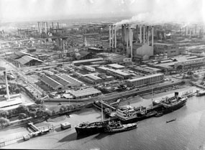
Notes:
Abadan refinery

Slide 11
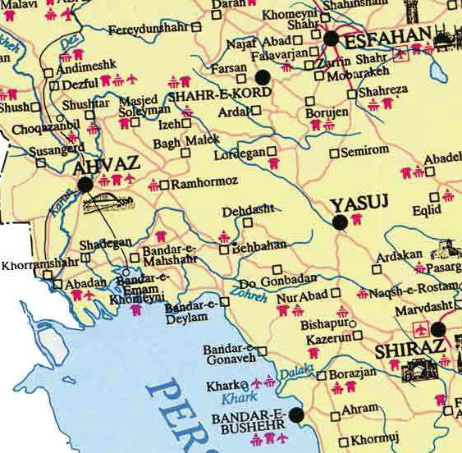

Slide 12
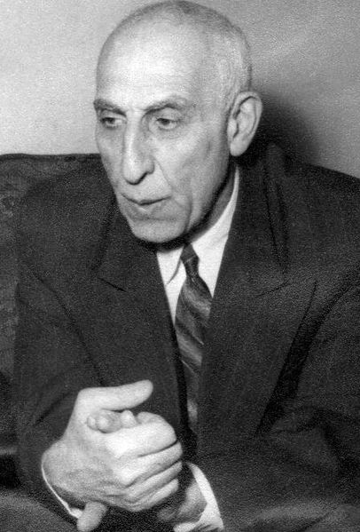
Notes:
mossadeq

Slide 13
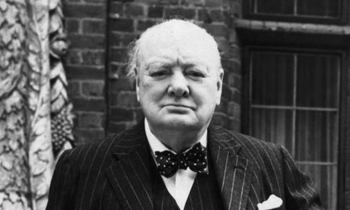

Slide 14
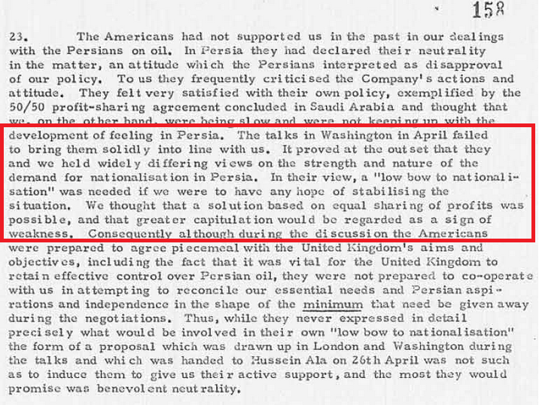
Notes:
Bri memo, 1951

Slide 15

Notes:
Allen dulles

Slide 16
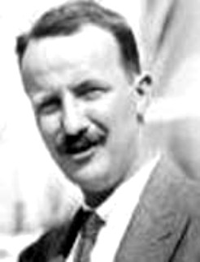
Notes:
Kermit roosevelt (grandson TR)

Slide 17
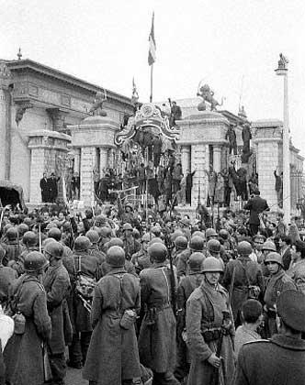
Notes:
Soldiers surrounding parliament

Slide 18
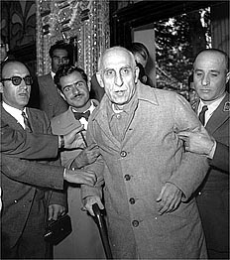

Slide 19
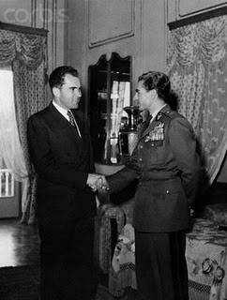

Slide 20
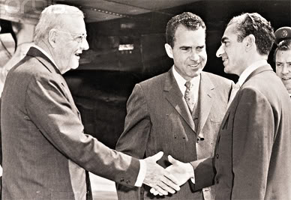

Slide 21
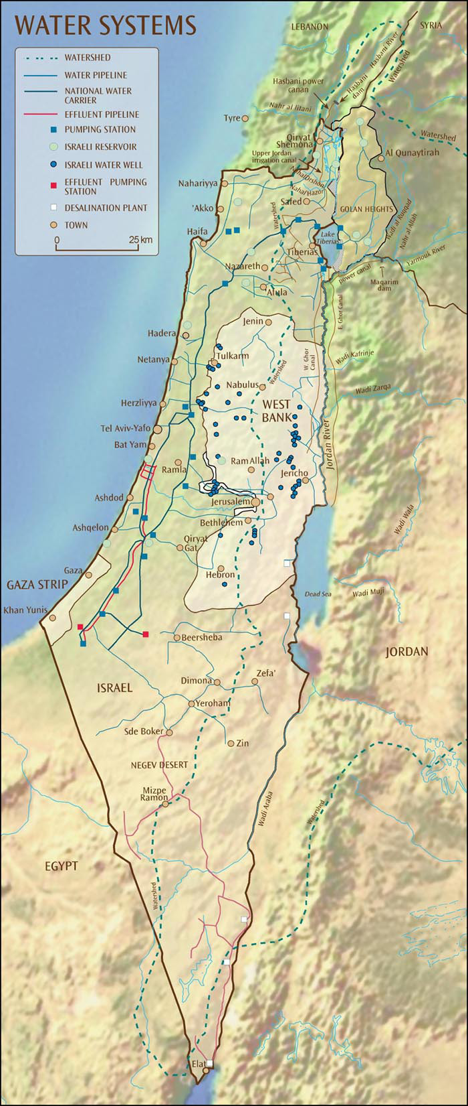

Slide 22
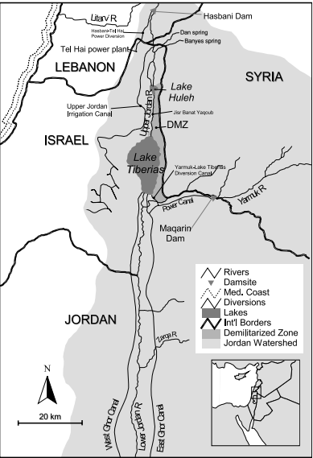

Slide 23
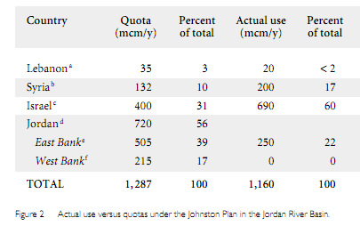

Slide 24
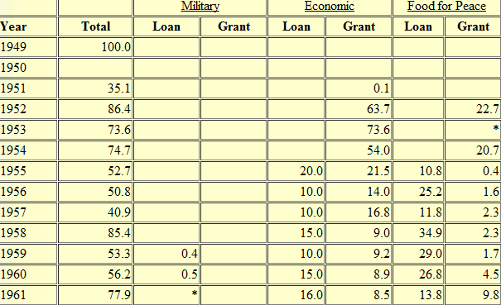
US Aid to Israel, FY 1949-1961 (millions of $$)

Slide 25
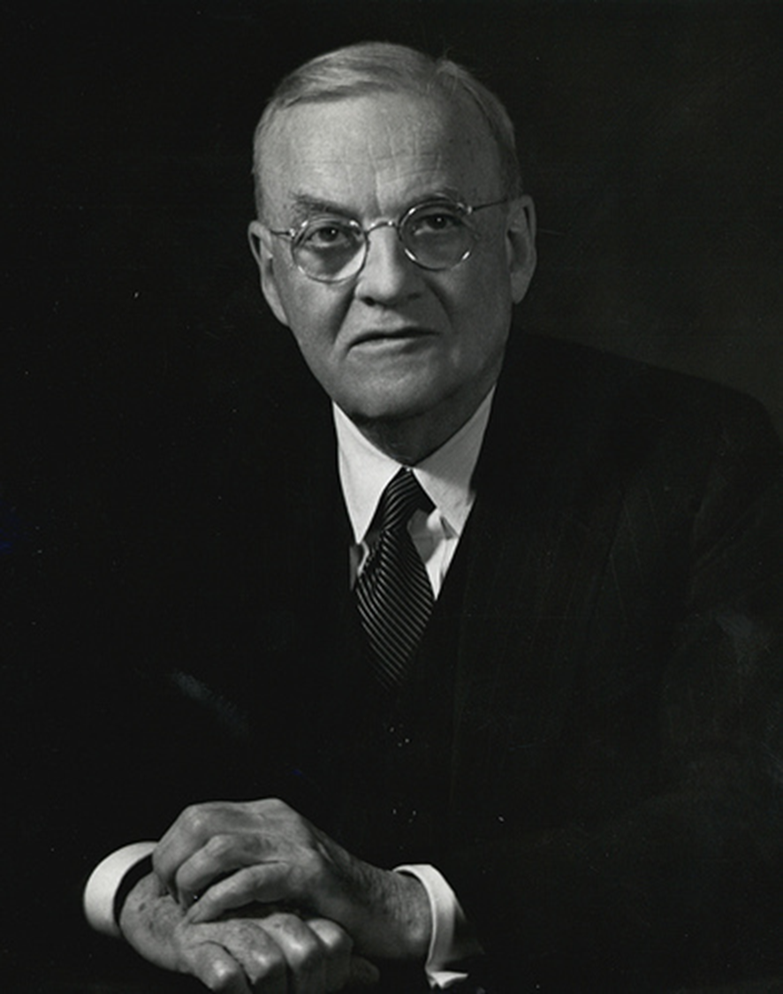
Dulles 1955 Council on Foreign Relations address
The tragic plight of 900,000 Arab refugees
The “pall of fear” of Israeli expansion and eventual Arab retaliation
The lack of fixed, permanent boundaries

Slide 26
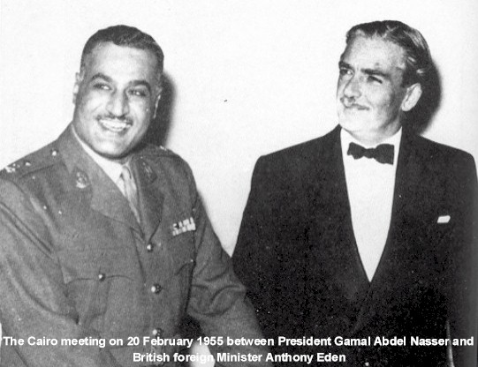

Slide 27
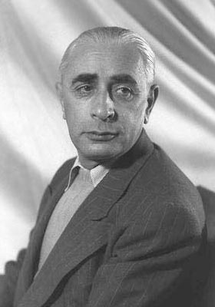
Notes:
Pinhas lavon

Slide 28
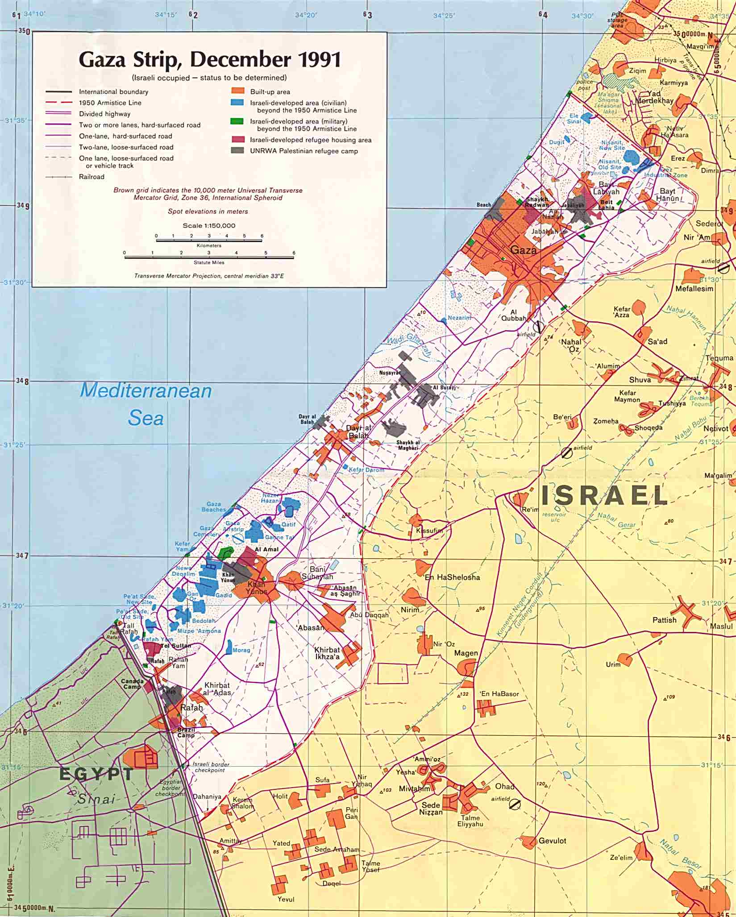

Slide 29
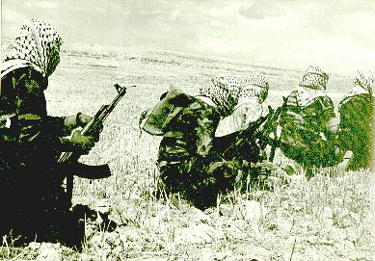
Notes:
fedayeen

Slide 30
United Nations Security Council Resolution 106
March 29, 1955
The Security Council,
Noting that the Egyptian-Israel Mixed Armistice Commission on 6 March 1955 determined that a "re-arranged and planned attack ordered by Israel authorities" was "committed by Israel regular army forces against the Egyptian regular army force" in the Gaza Strip on 28 February 1955,
Condemns this attack as a violation of the cease-fire provisions of Security Council resolution 54 (1948) and as inconsistent with the obligations of the parties under the General Armistice Agreement between Egypt and Israel and under the United Nations Charter;
2. Calls again upon Israel to take all necessary measures to prevent such actions;
3. Expresses its conviction that the maintenance of the General Armistice Agreement is threatened by any deliberate violation of that Agreement by one of the parties to it, and that no progress towards the return of permanent peace in Palestine can be made unless the parties comply strictly with their obligations under the General Armistice Agreement and the cease-fire provisions of its resolution 54 (1948).

Slide 31
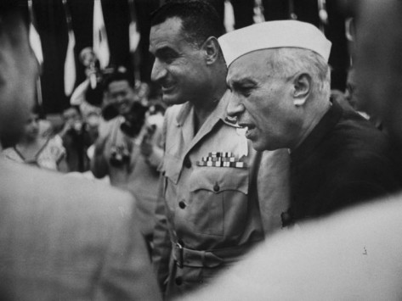
Notes:
Nasser & Nehru at Bandung

Slide 32

Notes:
Aswan dam

Slide 33
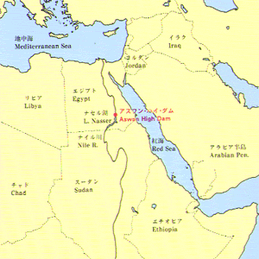

Slide 34
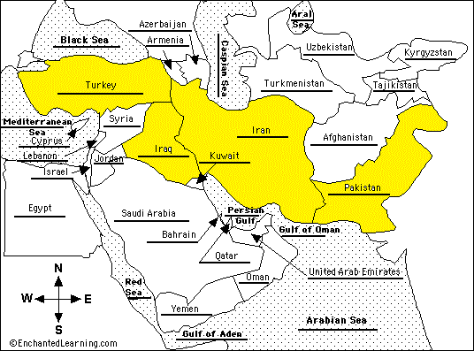

Slide 35
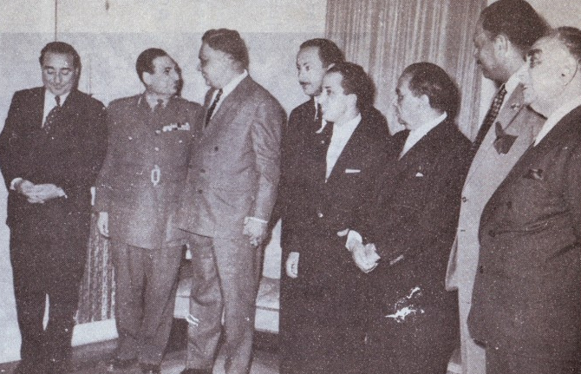
Notes:
Baghdad pact

Slide 36
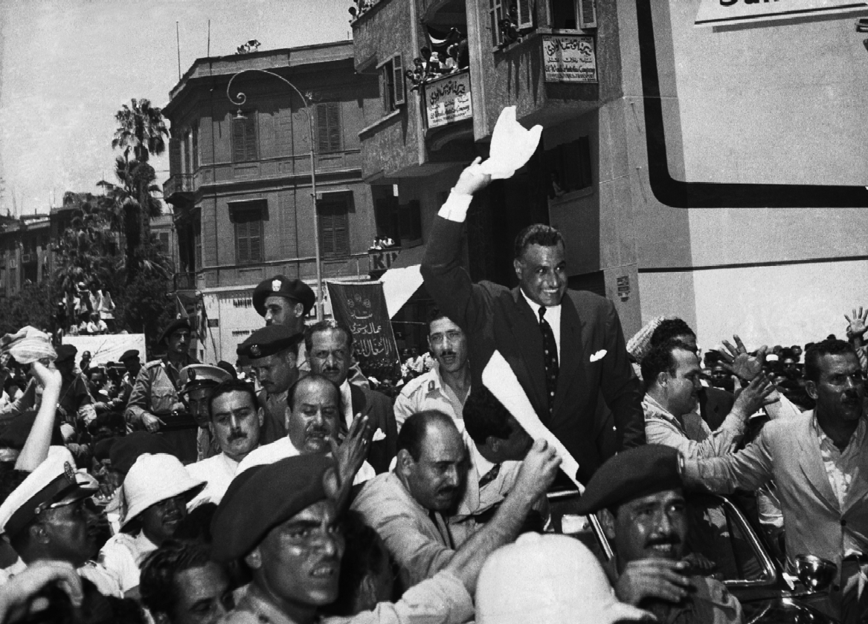
Notes:
Nasser following nationalization

Slide 37
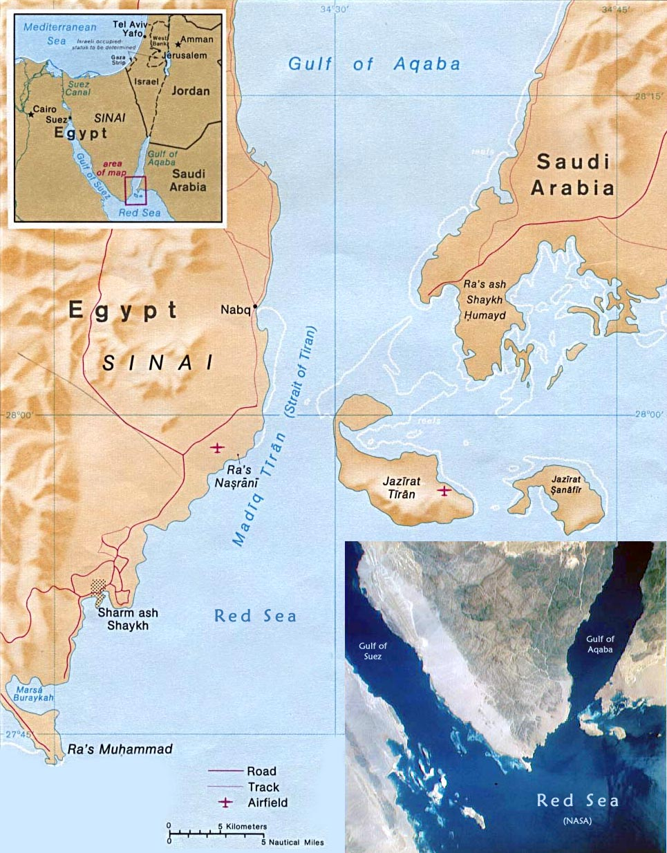

Slide 38


Slide 39
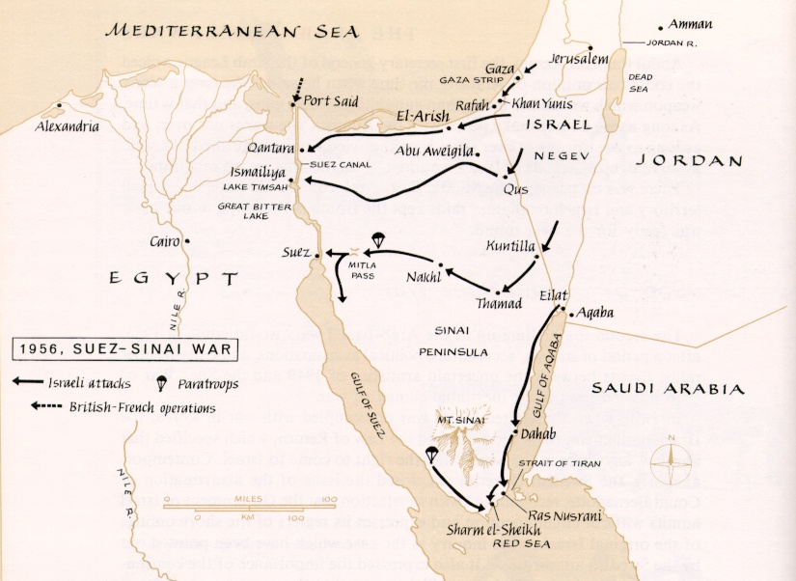

Slide 40
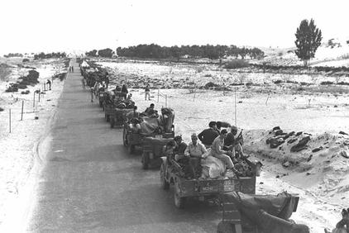

Slide 41
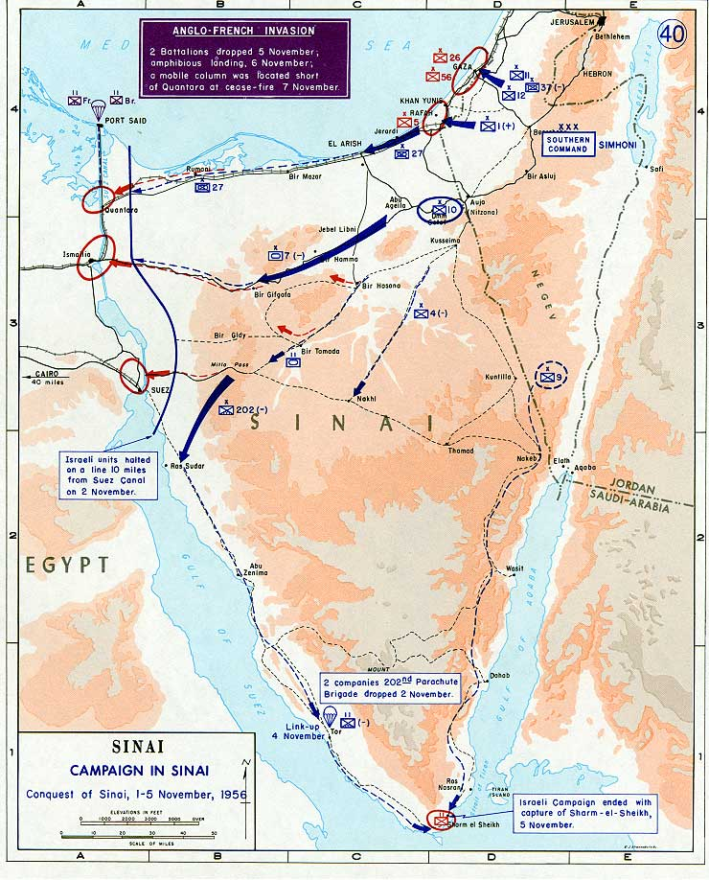

Slide 42
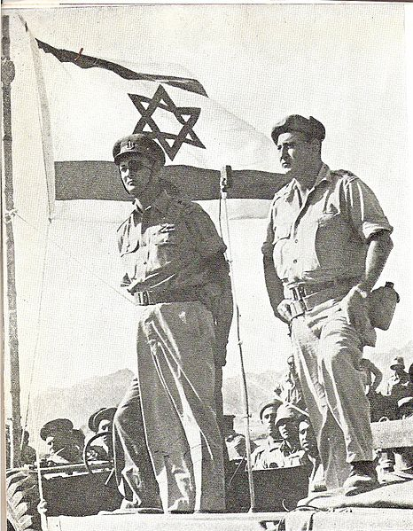
Notes:
Dayan at sharm el-shek

Slide 43


Slide 44


Slide 45
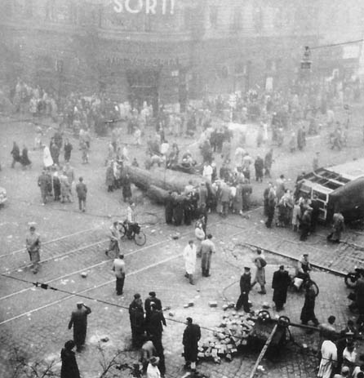

Slide 46


Slide 48
President Eisenhower to Prime Minister Ben-Gurion
November 7, 1956:
Dear Mr. Prime Minister:
… Statements attributed to your Government to the effect that Israel does not intend to withdraw from Egyptian territory, as requested by the United Nations, have been called to my attention. I must say frankly, Mr. Prime Minister, that the United States views these reports, if true, with deep concern. Any such decision by the Government of Israel would seriously undermine the urgent efforts being made by the United Nations to restore peace in the Middle East, and could not but bring about the condemnation of Israel as a violator of the principles as well as the directives of the United Nations.
It is our belief that as a matter of highest priority peace should be restored and foreign troops, except for United Nations forces, withdrawn from Egypt, after which new and energetic steps should be undertaken within the framework of the United Nations to solve the basic problems which have given rise to the present difficulty. The United States has tabled in the General Assembly two resolutions designed to accomplish the latter purposes, and hopes that they will be acted upon favorably as soon as the present emergency has been dealt with.
… It would be a matter of the greatest regret to all my countrymen if Israeli policy on a matter of such grave concern to the world should in any way impair the friendly cooperation between our two countries.

Slide 49
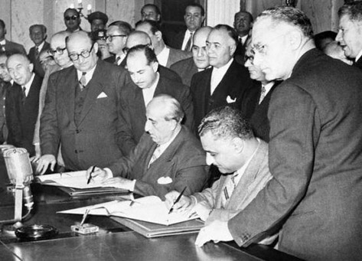
Notes:
Nasser and Syrian president Shukri Kuwatli signing uar agreement

Slide 50

Notes:
Uar flag

Slide 51
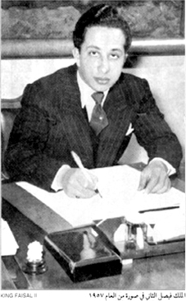
Notes:
King faisal

Slide 52
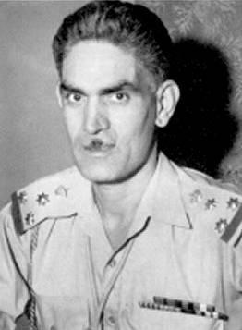
Notes:
Col. qasim

Slide 53
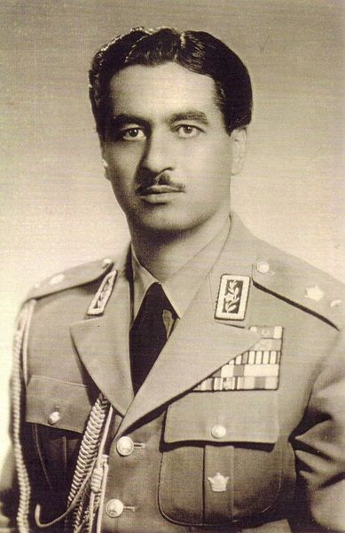
Notes:
Teymour bakhtiar—1st director SAVAK

Slide 54
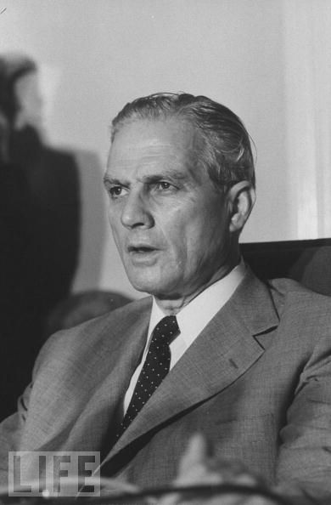
Notes:
chamoun

Slide 55
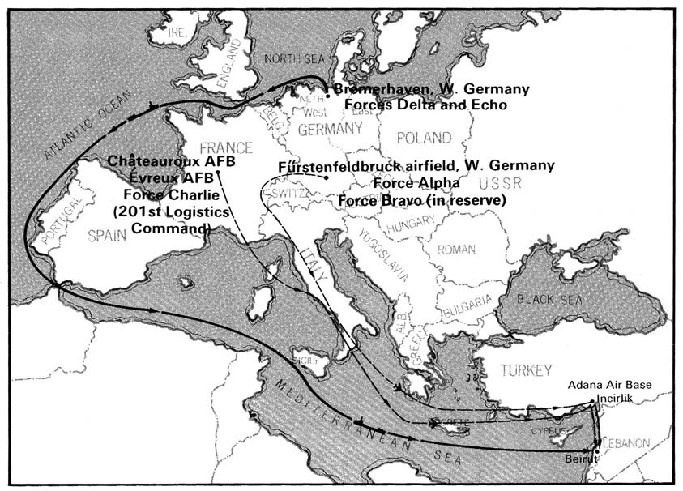

Slide 56
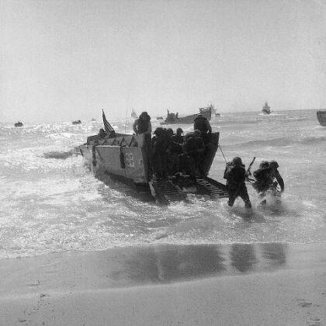

Slide 57
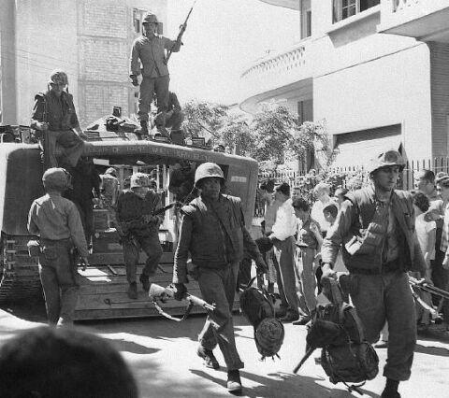

Slide 58
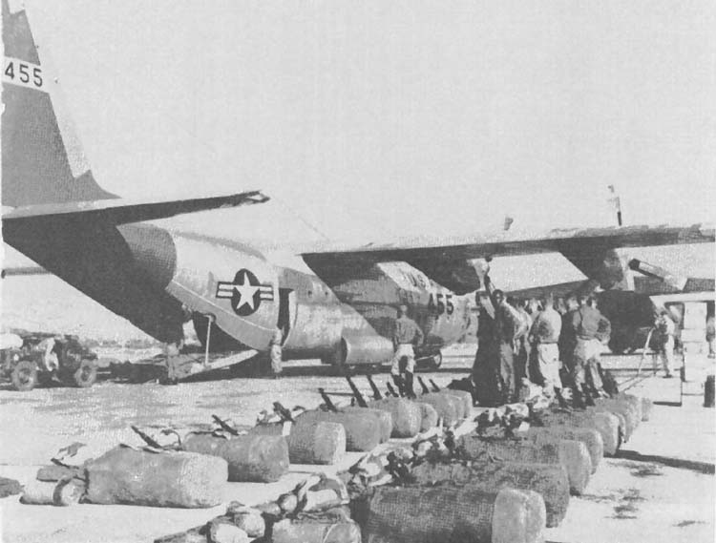
Notes:
Us transport plane

Slide 59
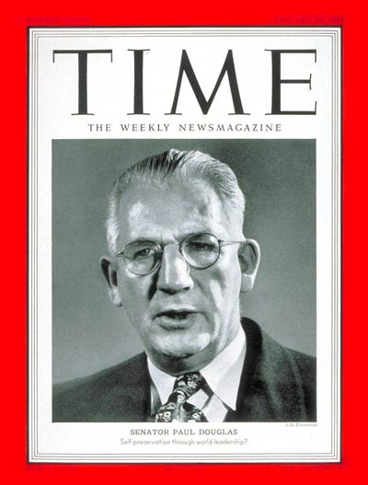
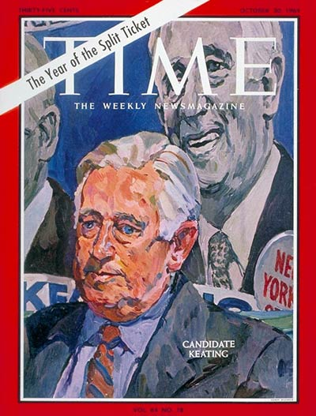

Slide 60
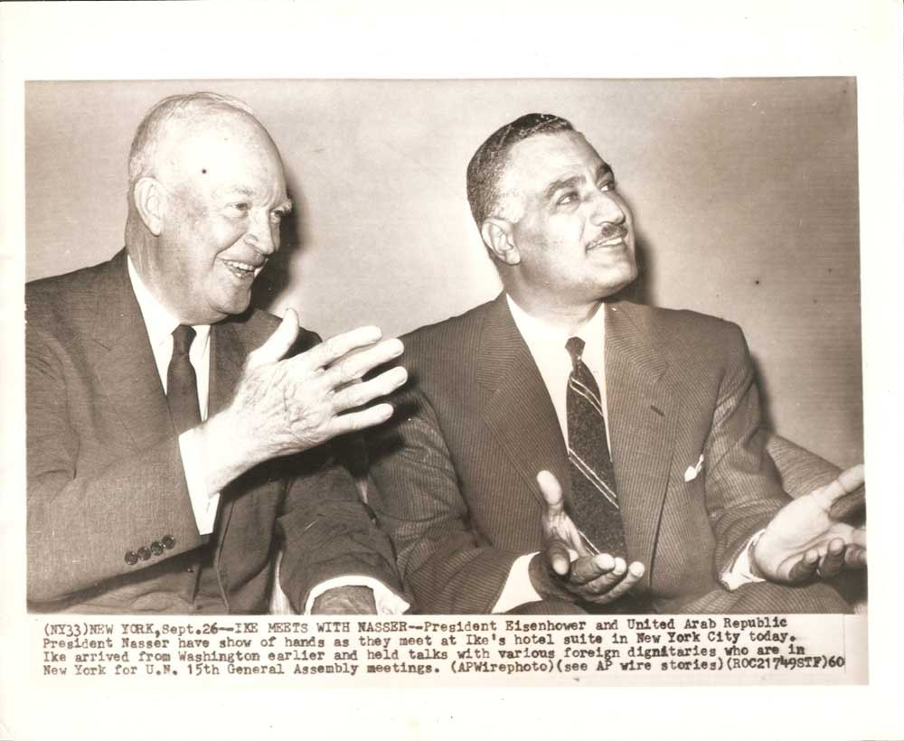
Notes:
Dde and nasser at UN

Slide 61
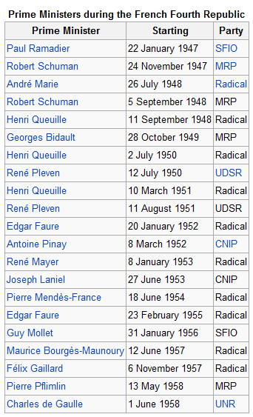

Slide 62
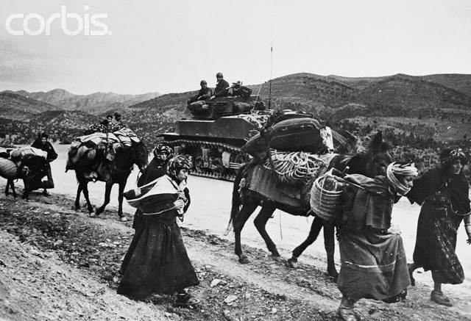

Slide 63

Notes:
French tanks searching for guerrillas 1954

Slide 64


Slide 65

Notes:
Ahmed ben bella 1956 arrest

Slide 66


Slide 67

Notes:
Morice line

Slide 68


Slide 69


Slide 70

Notes:
jupiter

Slide 71


Slide 72

Notes:
6 dec 1959—1st us pres to visit turkey

Slide 73


Slide 74


Slide 75


Slide 76


Slide 77


