Slide 1
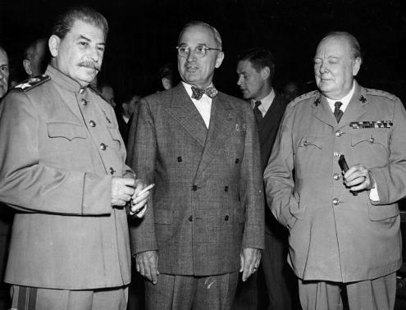

Slide 3
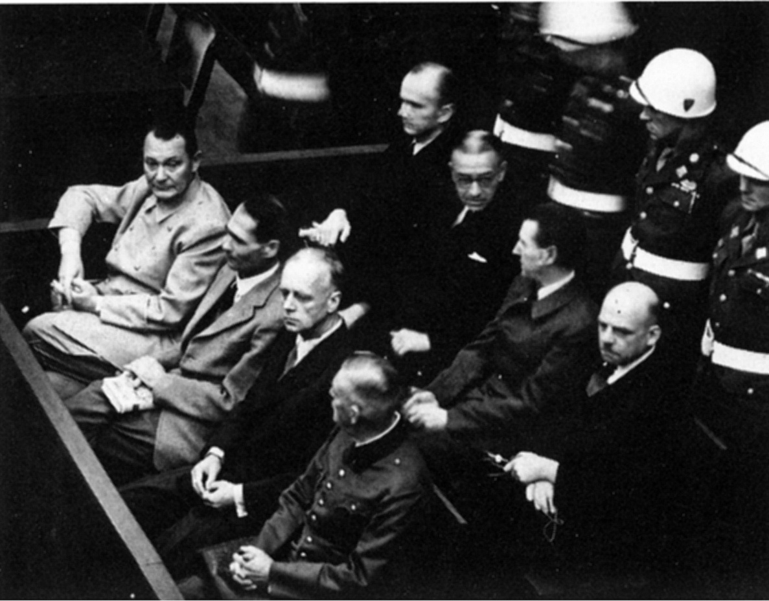

Slide 4
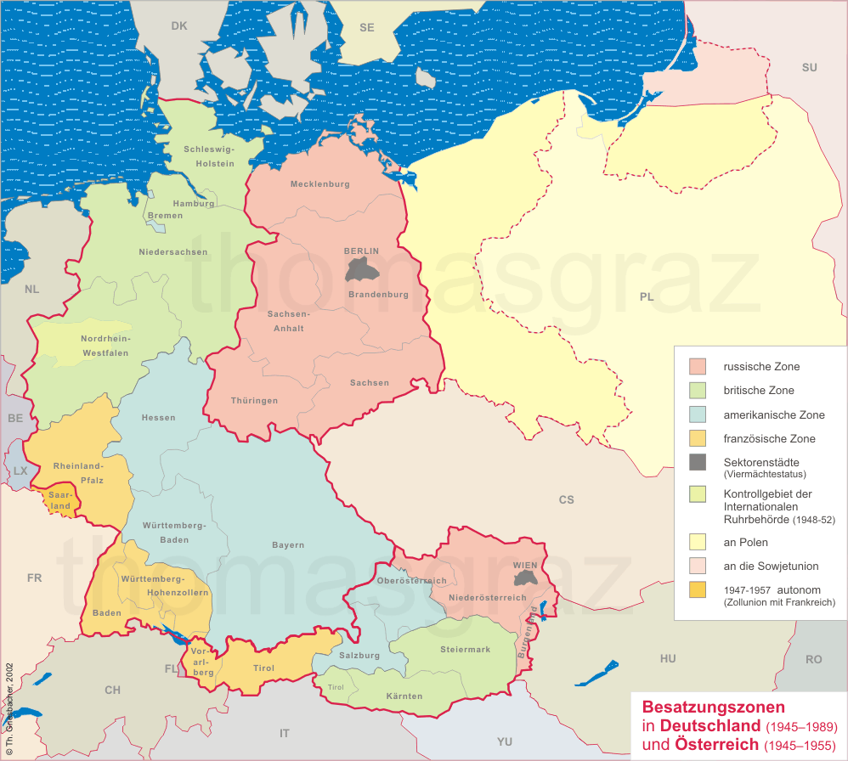

Slide 5
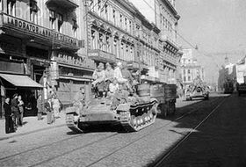
Notes:
Sov troops into bucharest, 1944

Slide 6


Slide 7
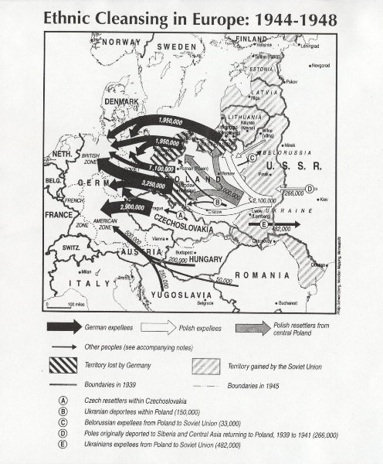

Slide 8
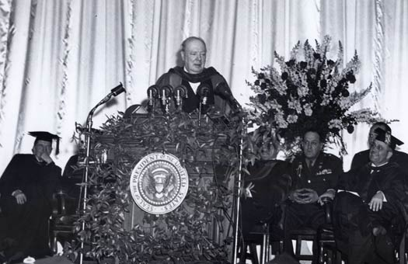

Slide 9
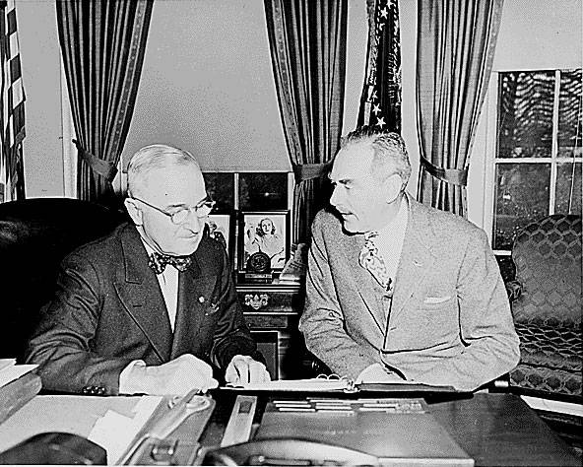

Slide 10
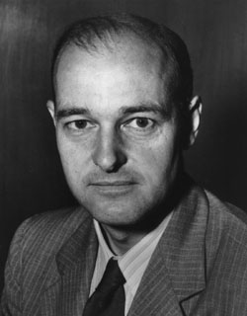

Slide 11
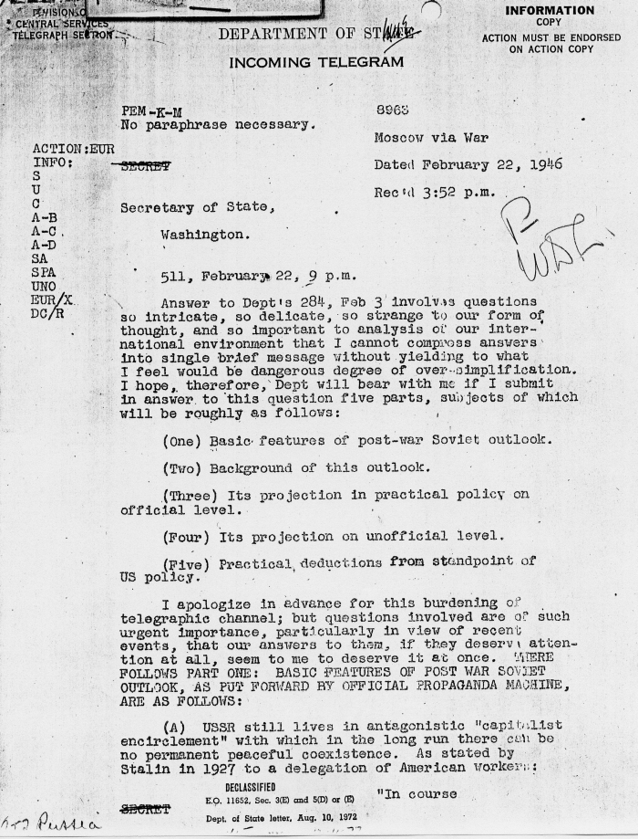

Slide 12
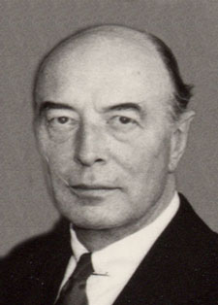
Notes:
lovett

Slide 13
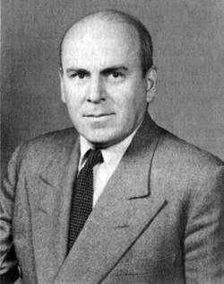
Notes:
mccloy

Slide 14
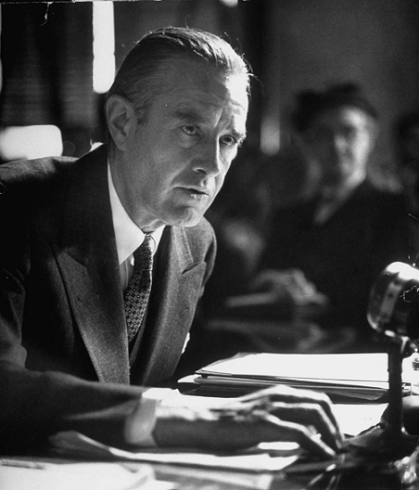
Notes:
harriman

Slide 15
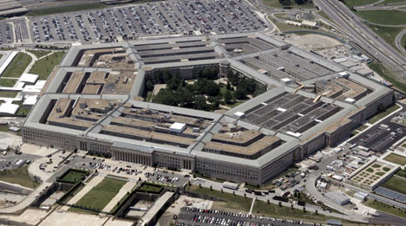

Slide 16
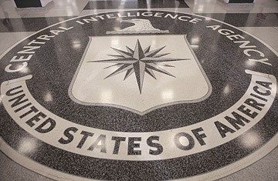

Slide 17
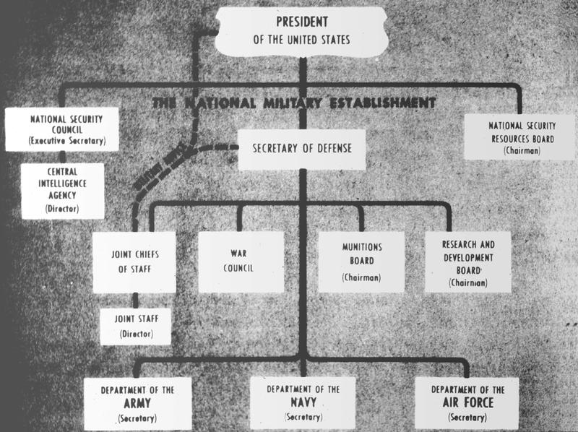

Slide 18
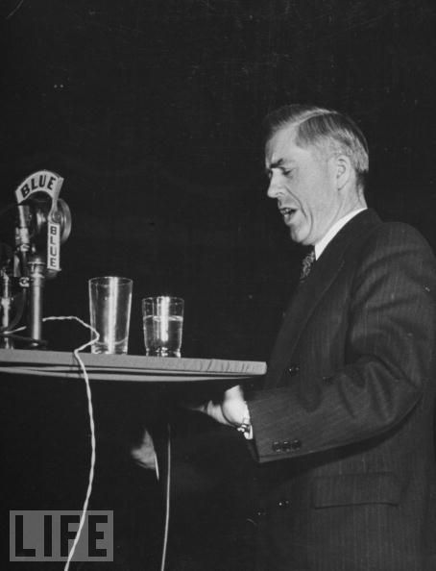

Slide 19
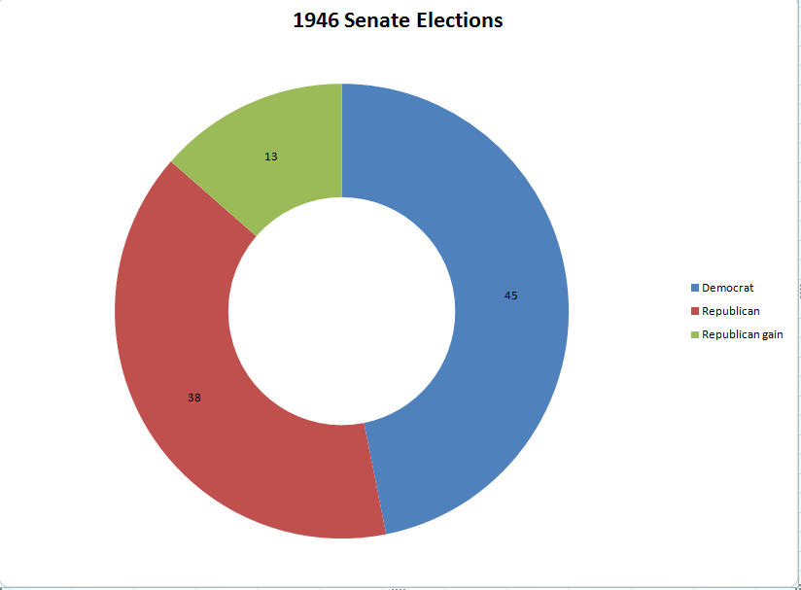

Slide 20
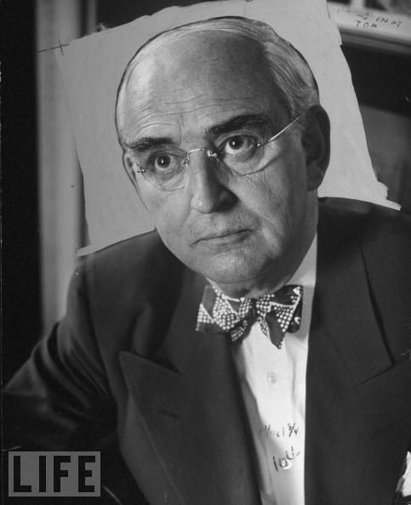
Notes:
vberg

Slide 21
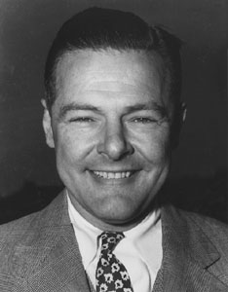

Slide 22
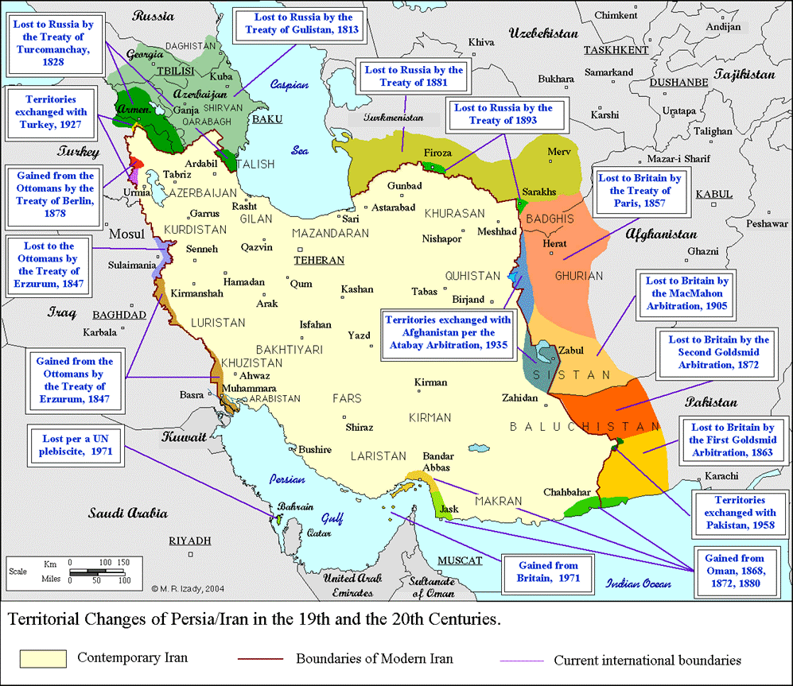

Slide 23
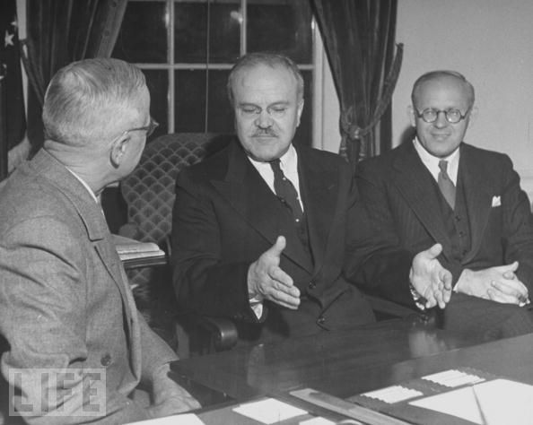
Notes:
Truman molotov

Slide 24
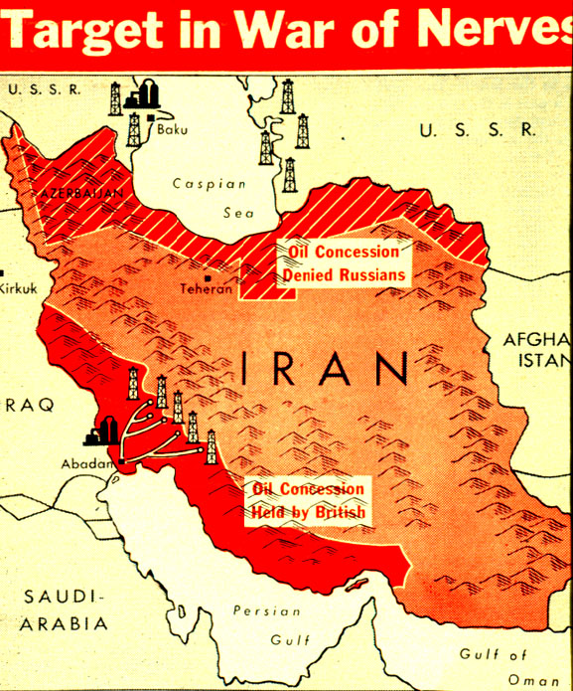

Slide 25
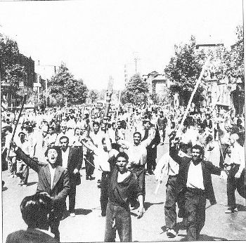
Notes:
Tudeh protesters

Slide 26


Slide 27
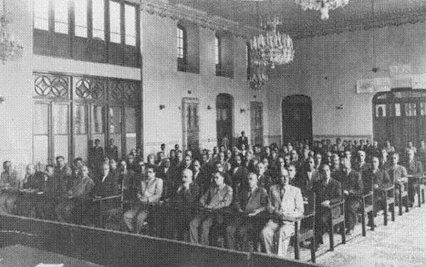
Notes:
Puppet azeri parl

Slide 28
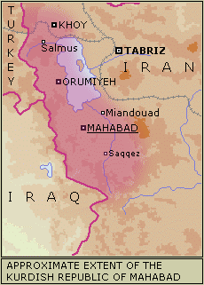

Slide 29
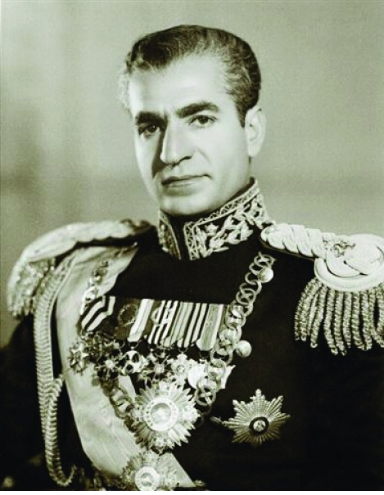

Slide 30
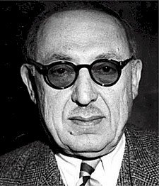
Notes:
Ahmad qavam

Slide 31
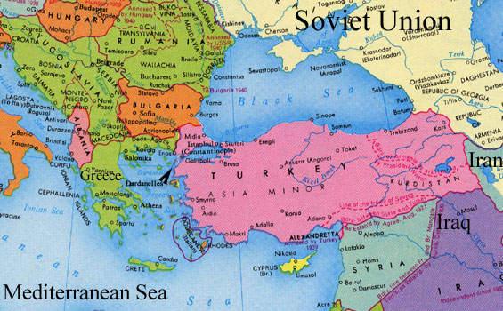

Slide 32
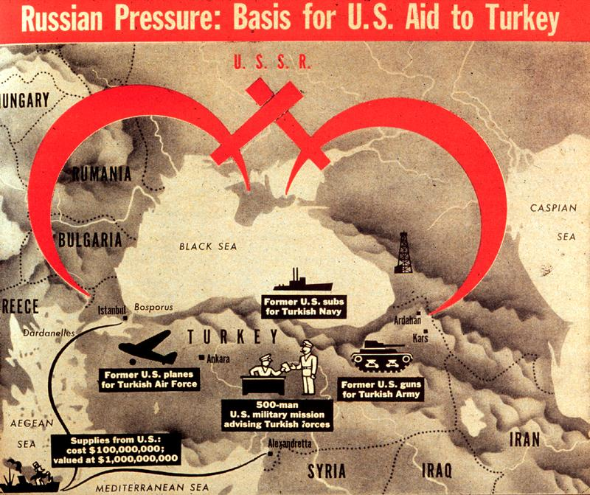

Slide 33
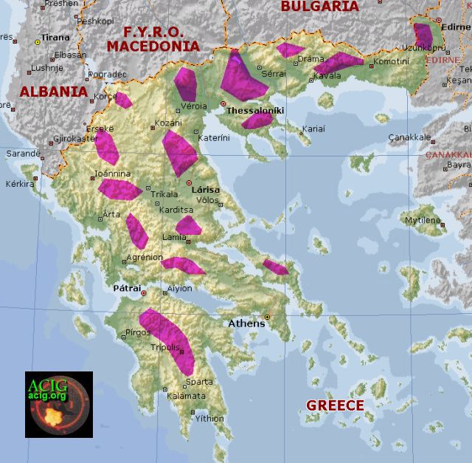

Slide 34
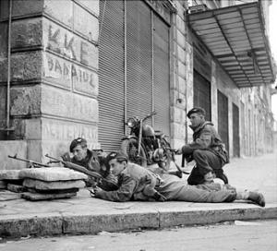
Notes:
Bri paratroopers in greece

Slide 35
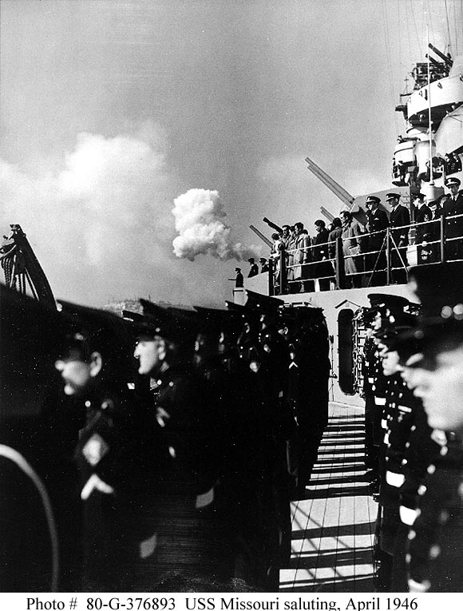

Slide 36


Slide 37
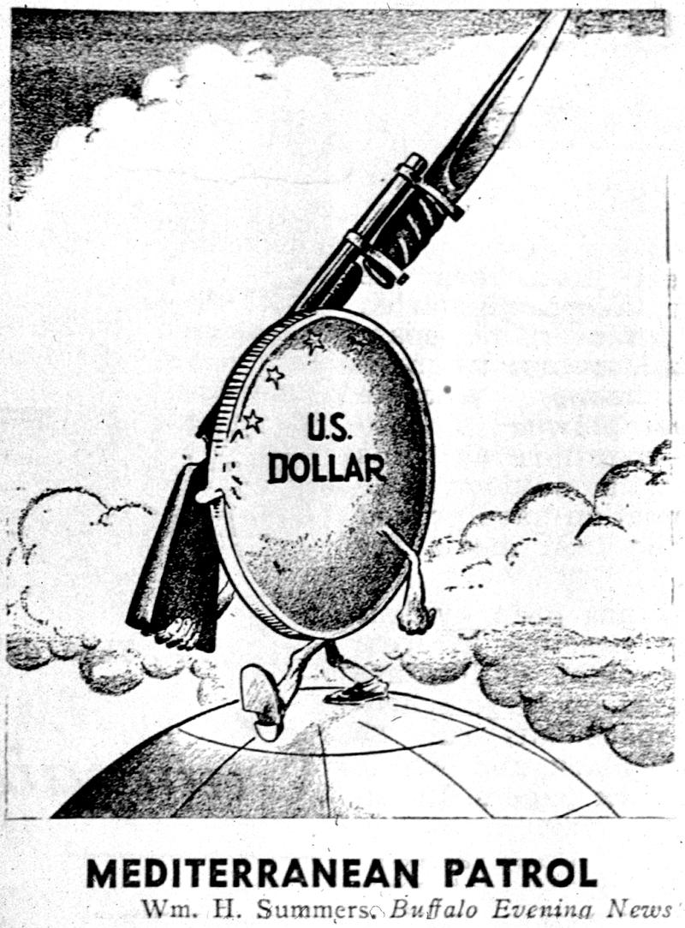

Slide 38
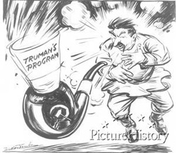

Slide 39
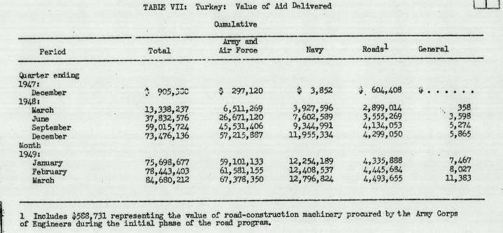

Slide 40


Slide 41
 | 1950 | 1951 | 1952
Defense budget | $13.3 B | $60.4B | $44 B
Army | 591,000 | 1.55 million | 1.595 million
Navy | 451,000 | 1.01 million | 1.05 million
Air Force | 411,000 | 1.06 million | 973,000

Slide 42
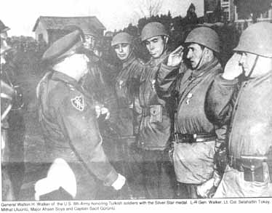
Notes:
Us general wm walker with turkish troops

Slide 43
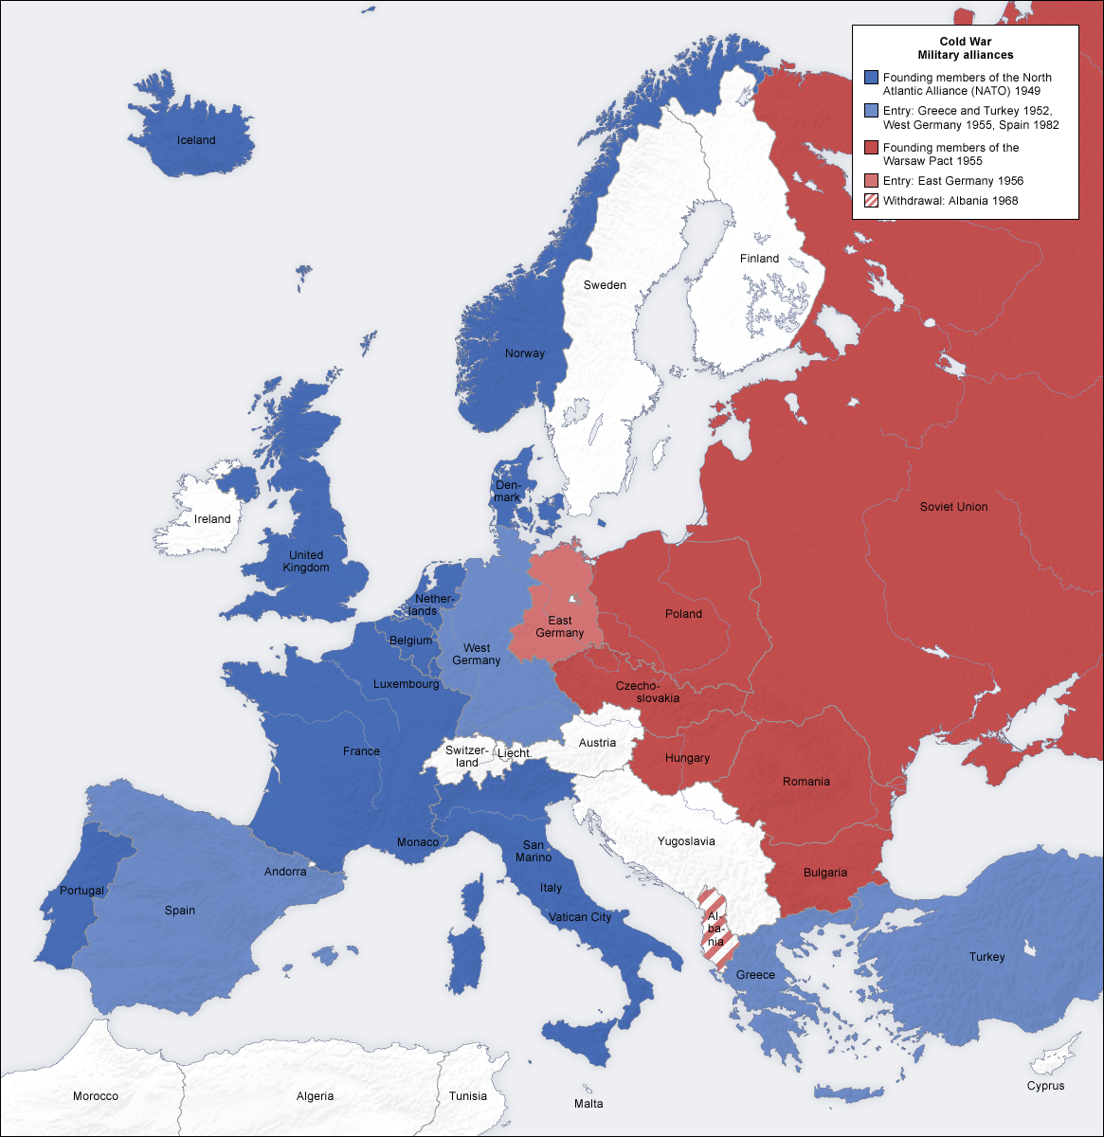

Slide 44
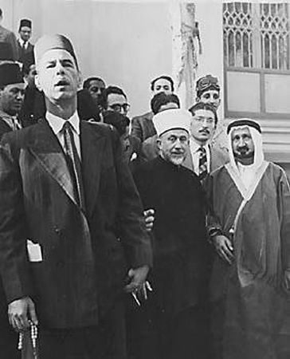
Notes:
Grand mufti in egypt

Slide 45
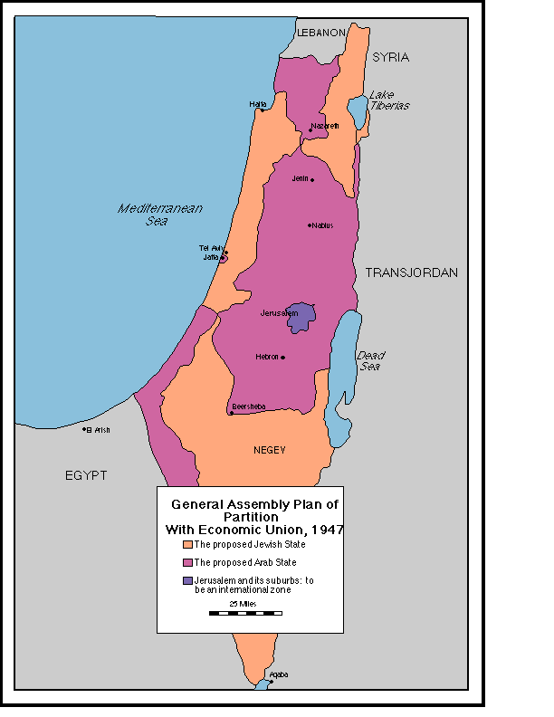

Slide 46
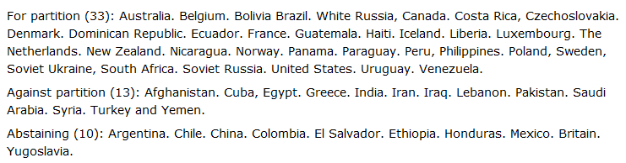

Slide 47
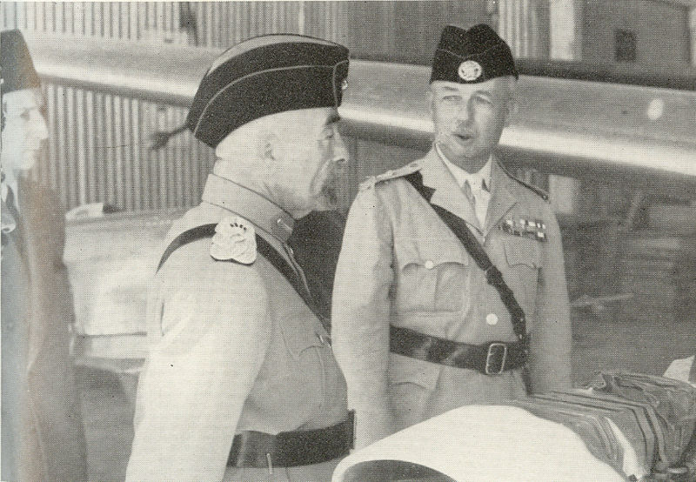
Notes:
King hussein

Slide 48
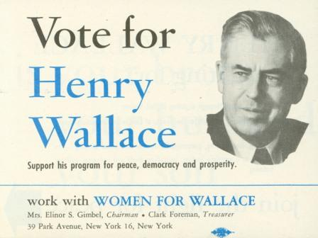

Slide 49
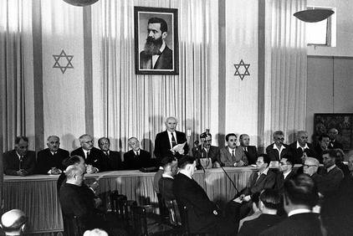
Notes:
Dec state of is, ben gurion

Slide 50
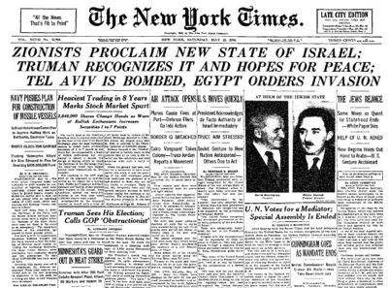

Slide 51
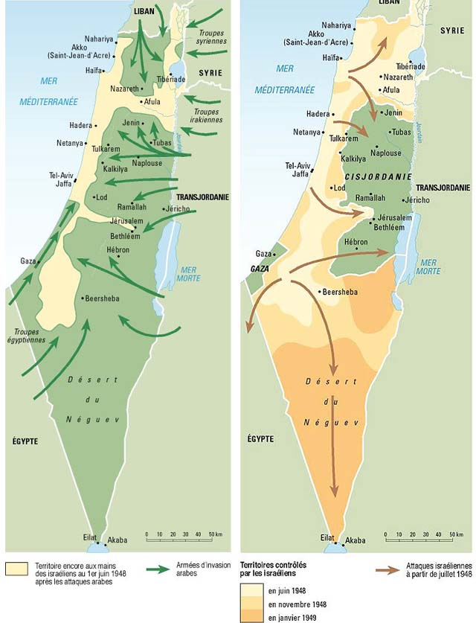

Slide 52
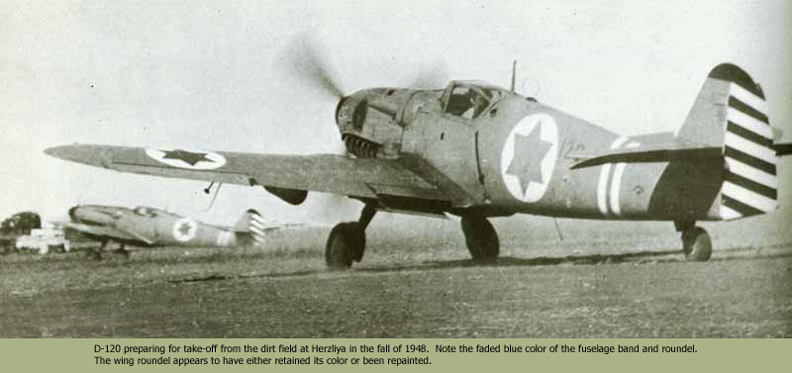
Notes:
From CZ

Slide 53
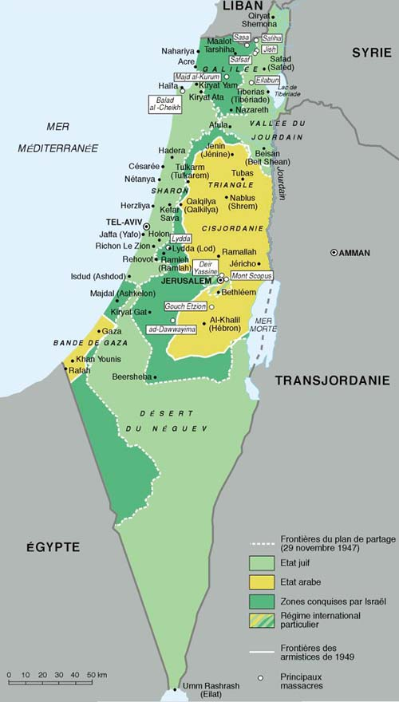

Slide 54
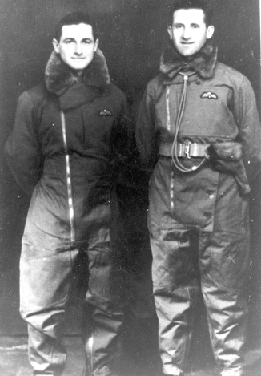
Notes:
Shaike Dan and Dan Lazar in parachutist uniform—parachute into Romania 1944

Slide 55
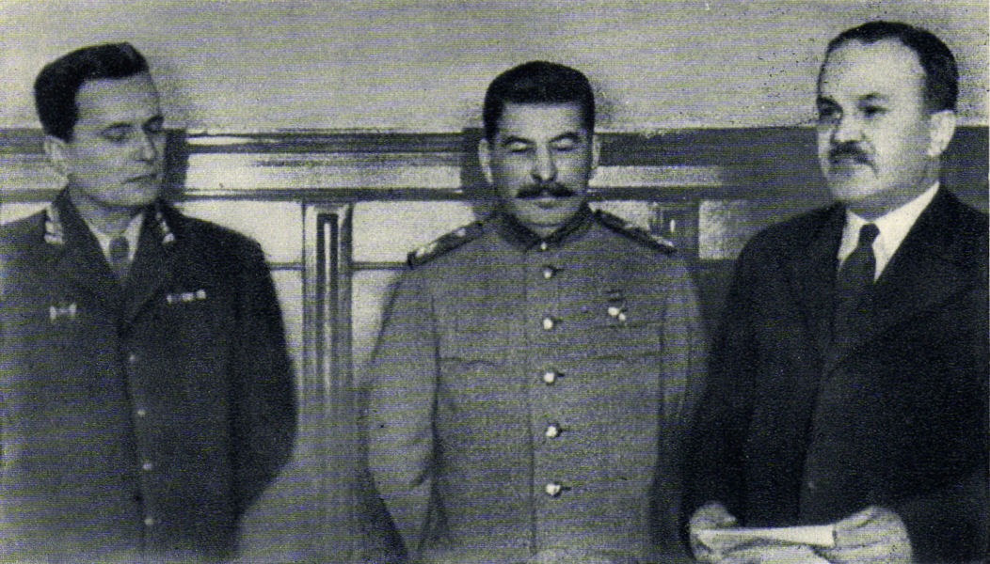
Notes:
Tito with stalin and molotov

Slide 56
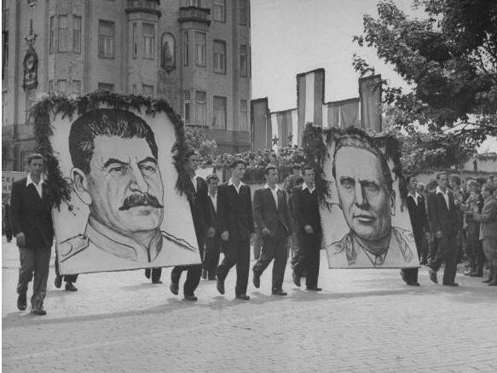

Slide 57


Slide 58


Slide 59


Slide 60


Slide 61


Slide 62

Notes:
Paul merker

Slide 63


Slide 64

Notes:
Gov’t of Emirate of Cyrenaica (1949)

Slide 65

Notes:
idris

Slide 66


Slide 67

Notes:
Wheelus air base

Slide 68


Slide 69


Slide 70


Slide 71


Slide 72


Slide 73


