Slide 1
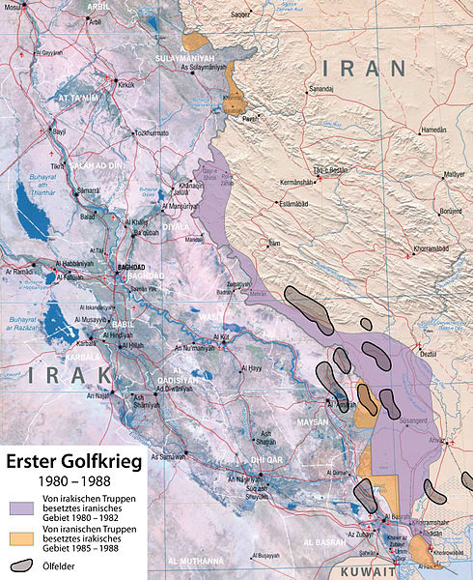

Slide 2
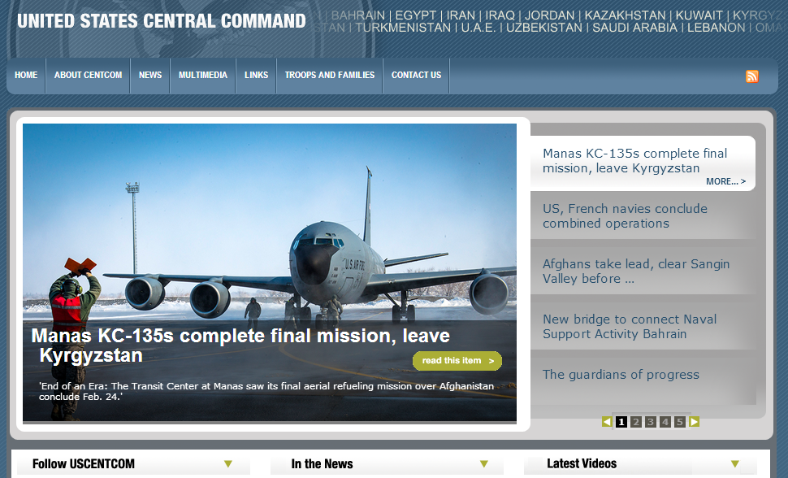

Slide 3
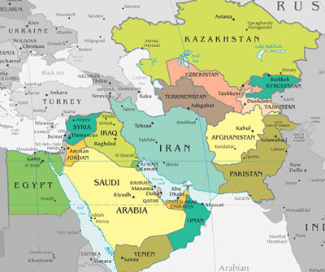
Notes:
Area responsibility

Slide 4
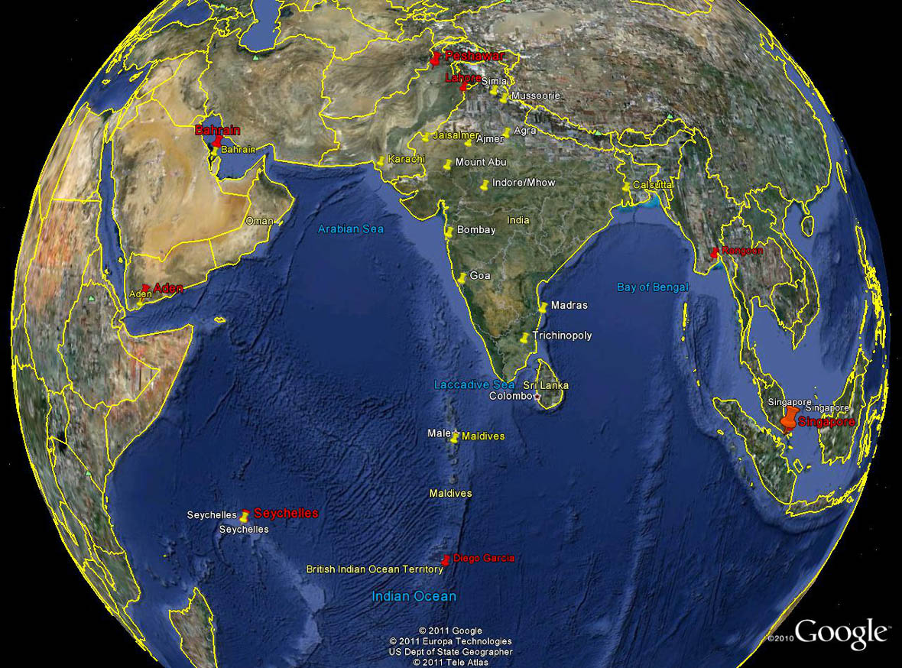

Slide 5
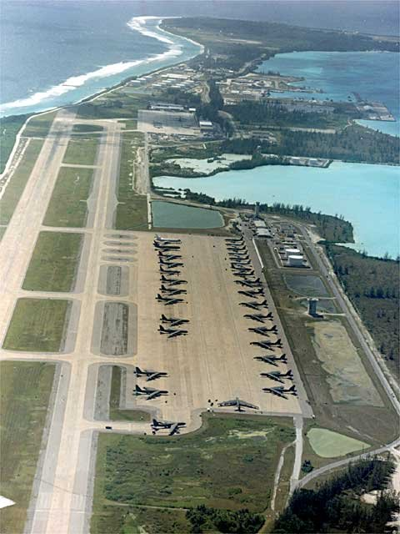

Slide 6
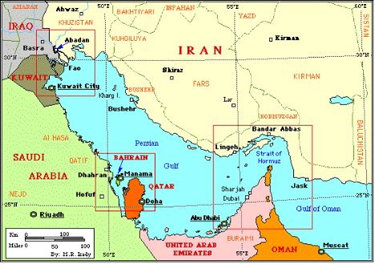

Slide 7
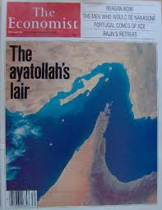

Slide 8
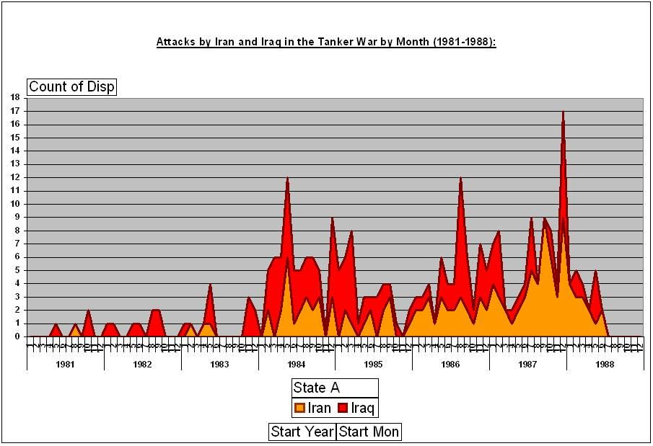

Slide 9
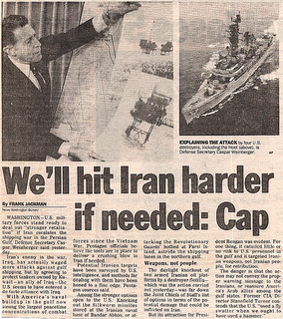

Slide 10
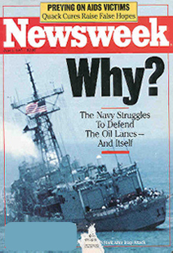

Slide 11
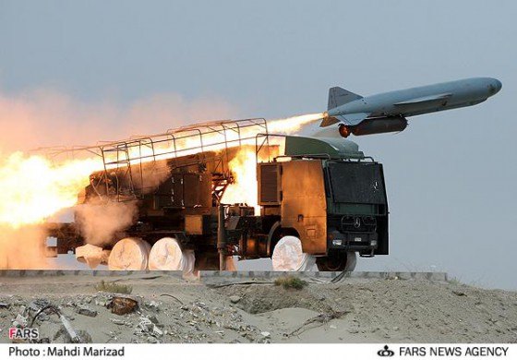
Notes:
Silkworm missile—prc missile

Slide 12
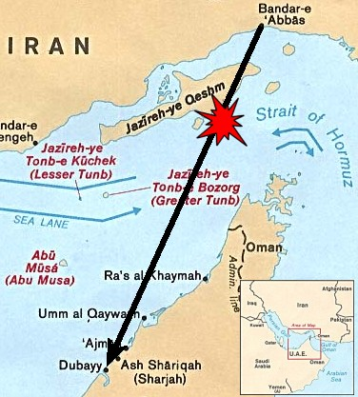
Notes:
Iran air flt 655 path—290 killed; ghwb: "I'll never apologize for the United States of America. Ever. I don't care what the facts are."

Slide 13
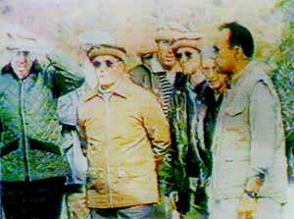

Slide 14
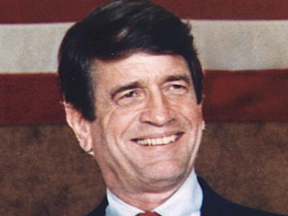

Slide 15
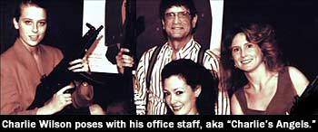

Slide 16
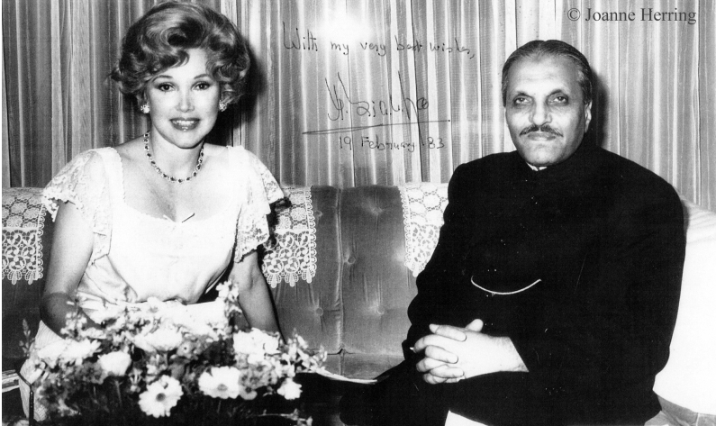
Notes:
Joanne herring

Slide 17
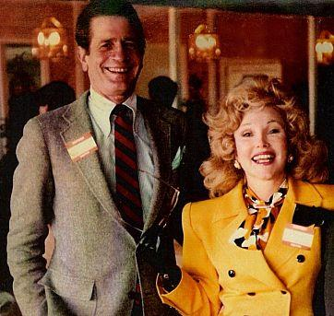

Slide 18

Notes:
ISI shield: Faith, Unity, Discipline

Slide 19
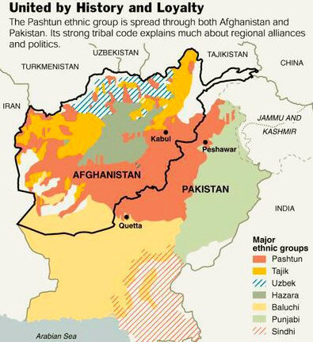

Slide 20
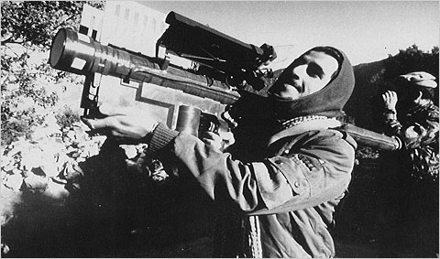

Slide 21
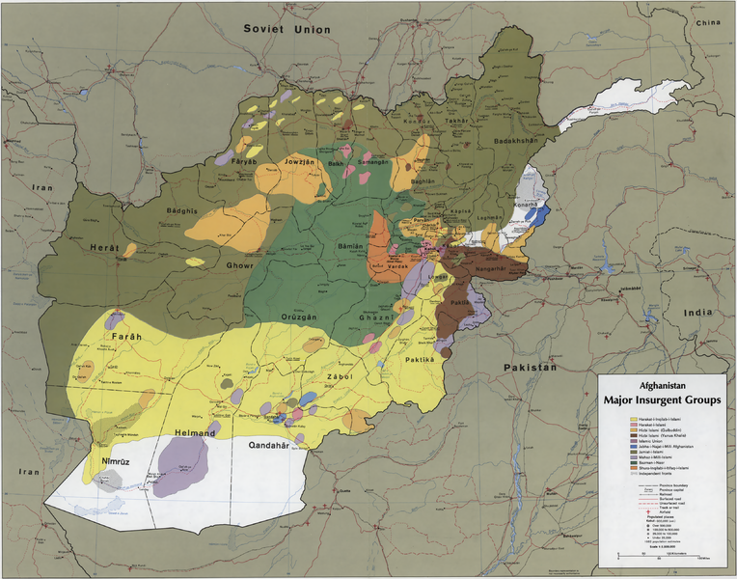

Slide 22
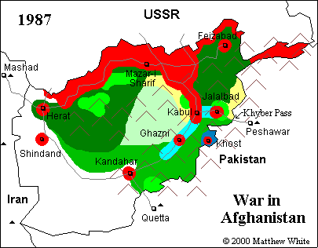

Slide 23
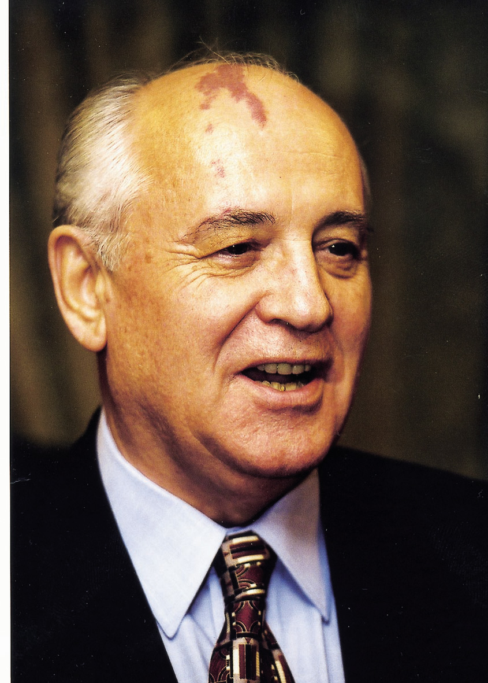

Slide 24
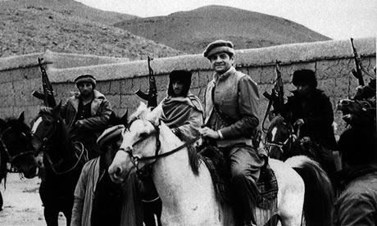

Slide 25
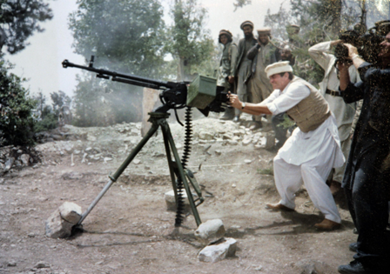

Slide 26
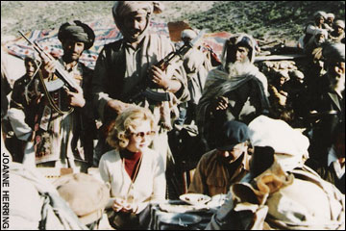
Notes:
Herring with mujahadeen

Slide 27
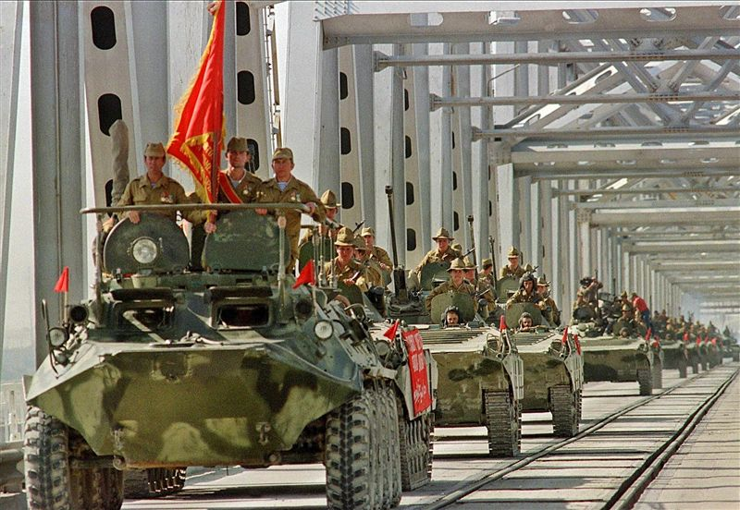

Slide 28
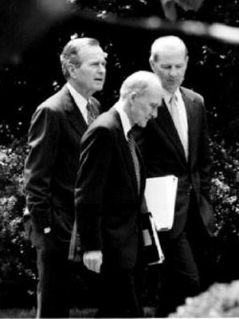
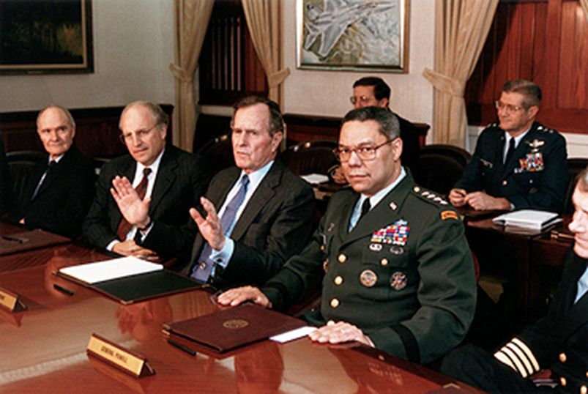

Slide 29
National Security Directive (NSD) 26
Access to Persian Gulf oil and the security of key friendly states in the area are vital to US national security. The United States remains committed to defend its vital interests in the region, if necessary and appropriate through the use of US military force, against the Soviet Union or any other regional power with interests inimical to our own. The United States also remains committed to support the individual and collective self-defense of friendly countries in the area to enable them to play a more active role in their own defense and thereby reduce the necessity for unilateral US military intervention.

Slide 30
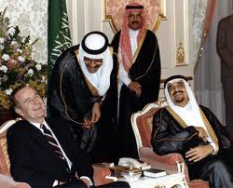

Slide 31
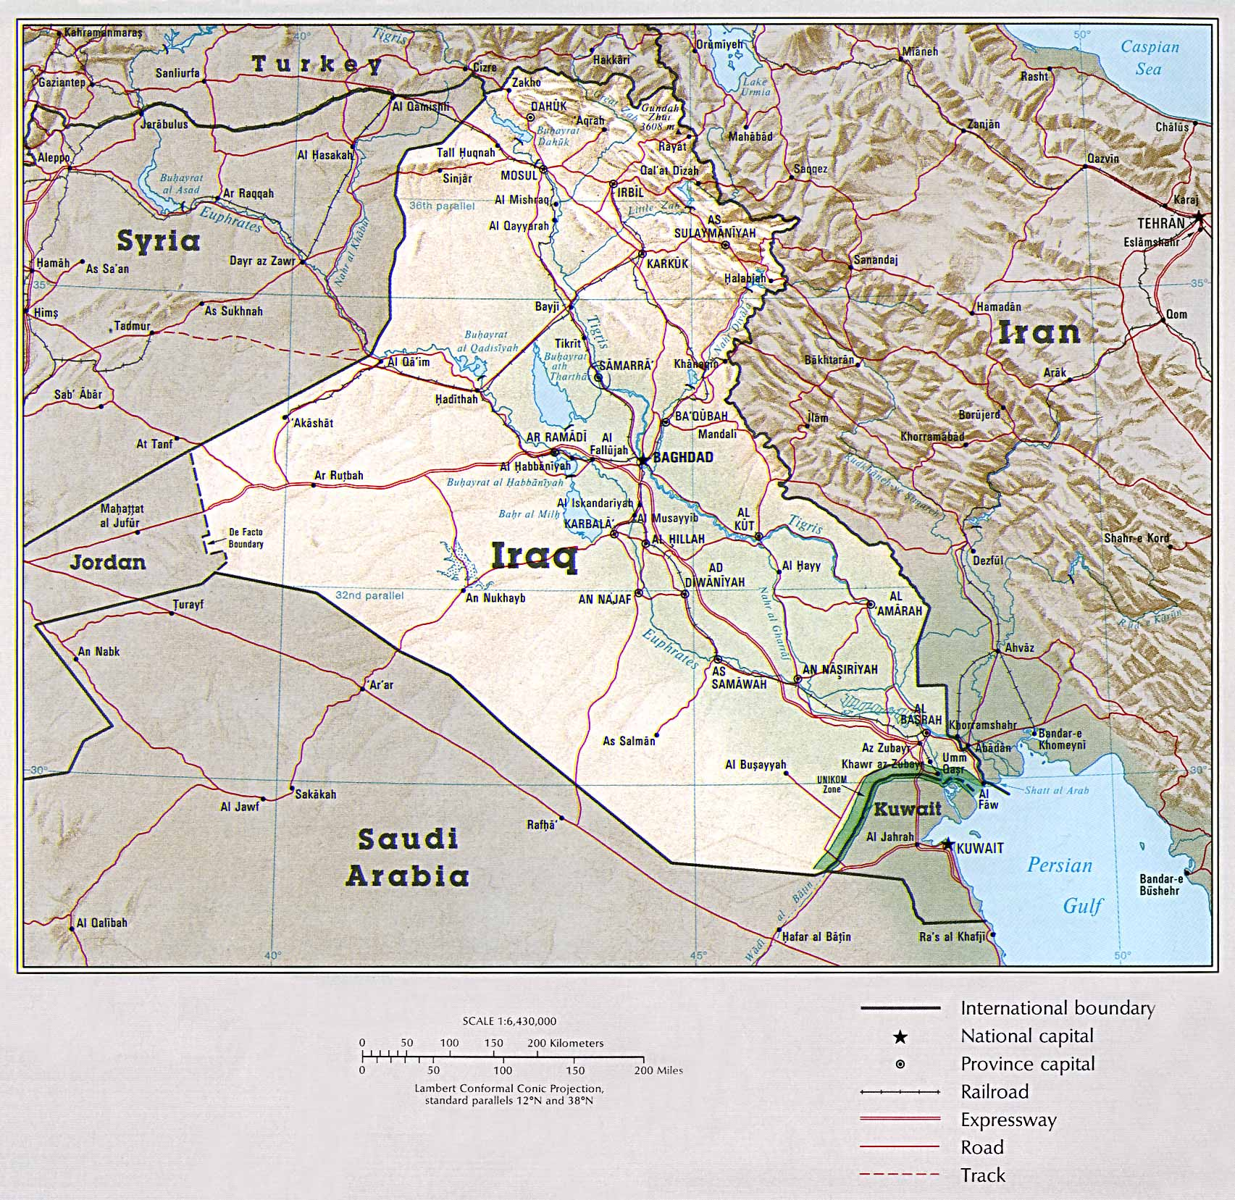

Slide 32
NSD 26—on Iraq
Normal relations between the US and Iraq would serve our longer-term interests and promote stability in both the Gulf and the Middle East. The United States government should propose economic and political incentives for Iraq to moderate its behavior and to increase our influence with Iraq.
But also:
Iraq would face economic and political sanctions if it continued to pursue biological and chemical weapons, and any breach by Iraq of IAEA safeguards in its nuclear program will result in a similar response.

Slide 33
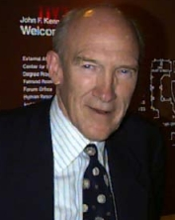
“Mr. President, I can see that what you have here isn’t really a policy problem; what you have is a public relations problem. You’ve got a problem with the haughty and pampered press. I know all about that, because I’ve got problems with the press back home. What you need is you need a good public relations person.”

Slide 34
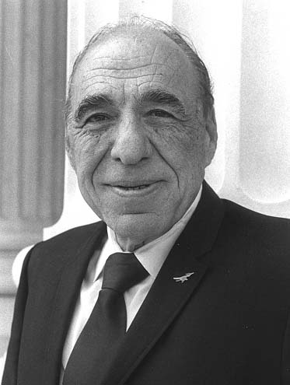

Slide 35
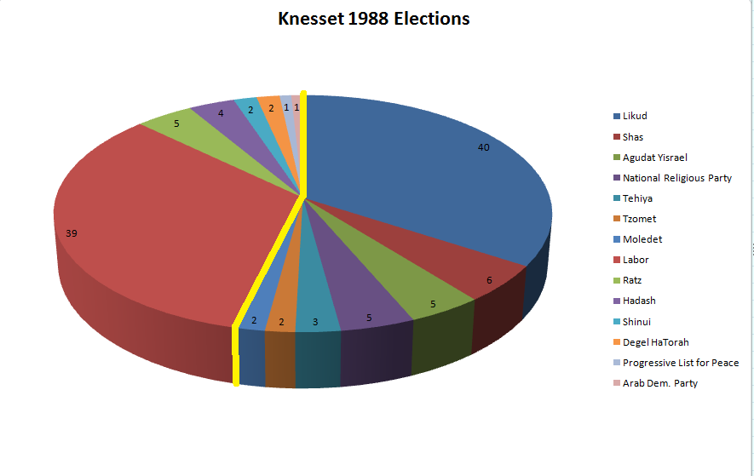

Slide 36
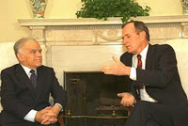

Slide 37
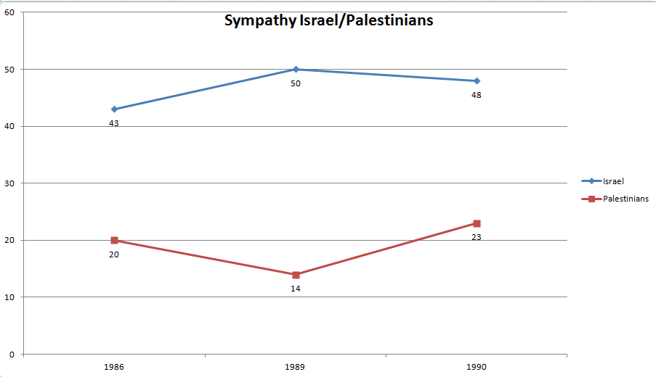

Slide 38
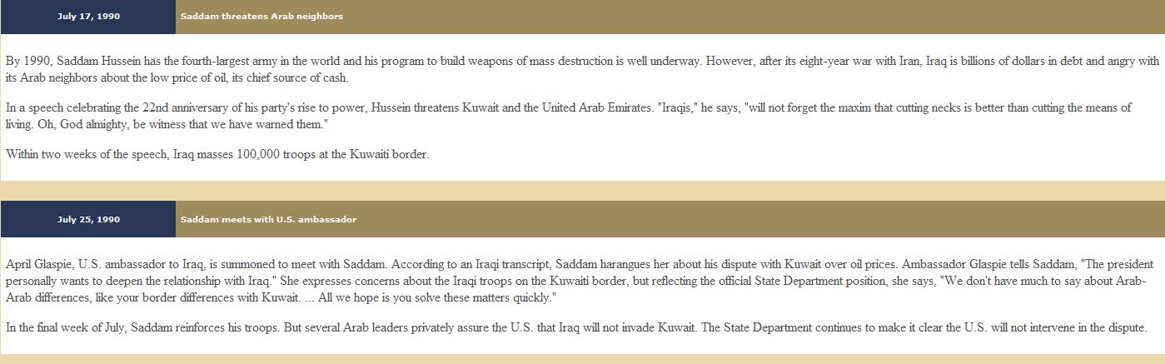

Slide 39
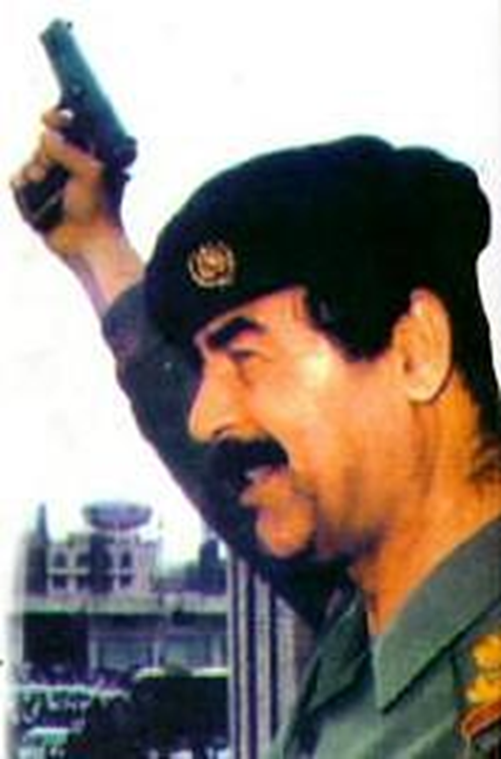
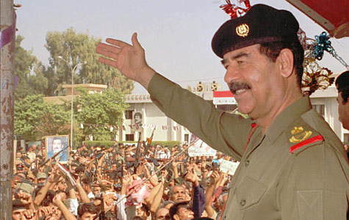

Slide 40
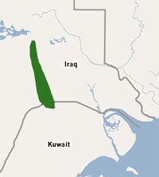
Notes:
Rumallah oil field

Slide 41
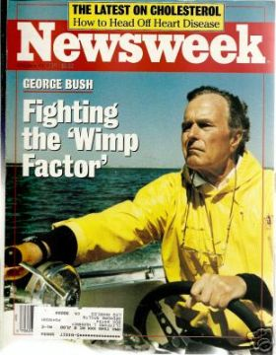

Slide 42
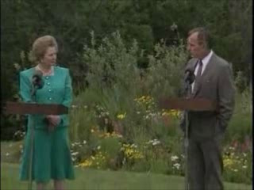

Slide 43
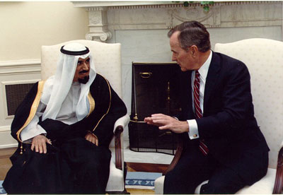
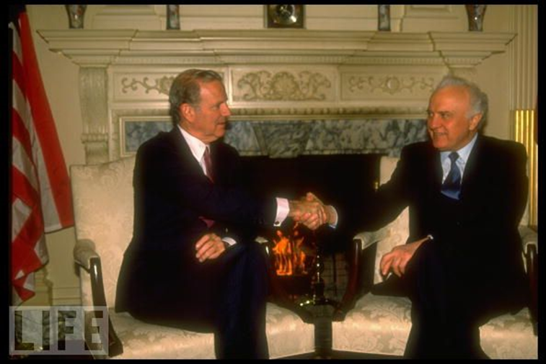
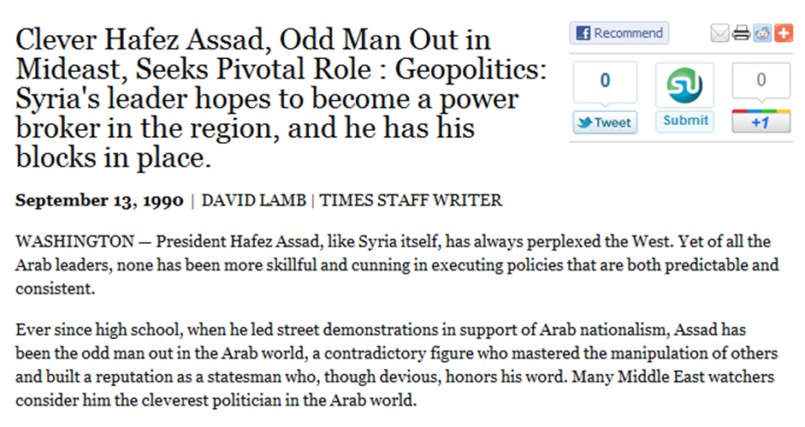
Notes:
Bush and emir of kuwait

Slide 44
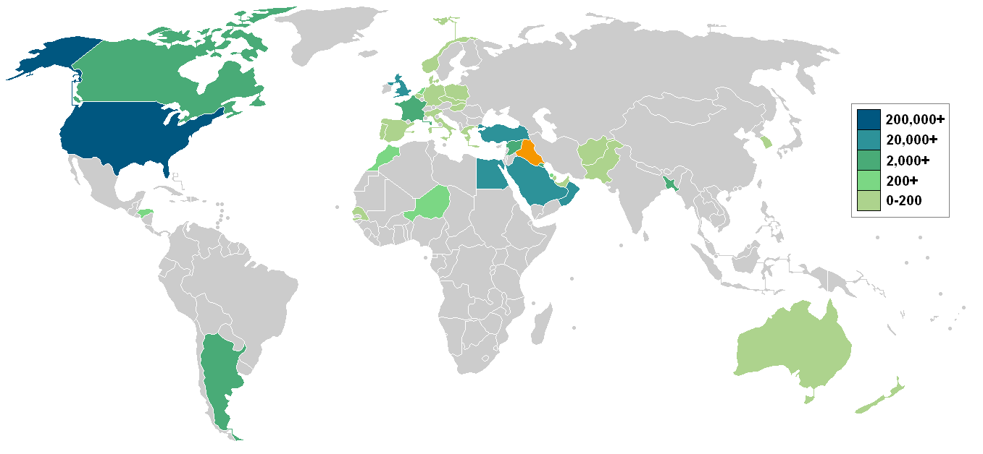

Slide 45
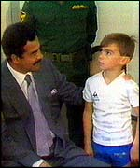

Slide 46
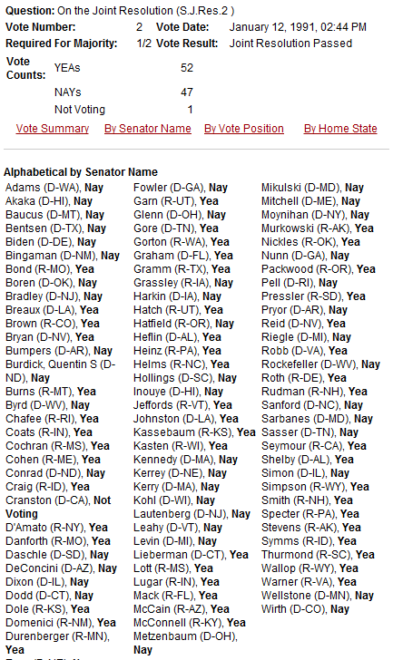

Slide 47
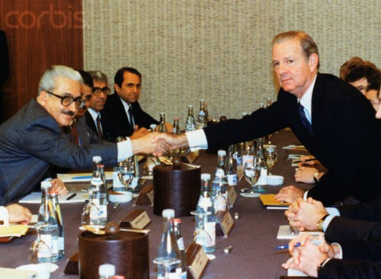

Slide 48
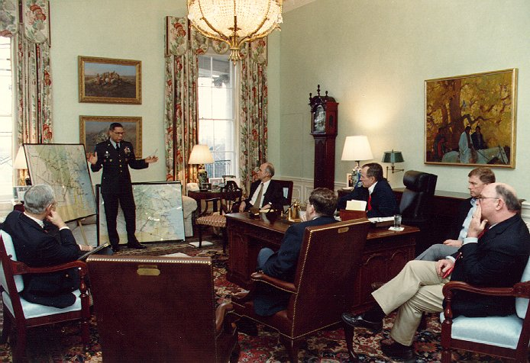

Slide 50
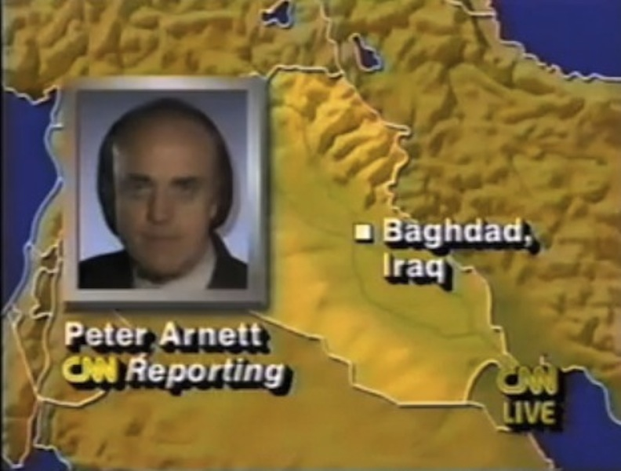

Slide 51


Slide 52


Notes:
scud

Slide 53


Slide 54


Slide 55


Slide 56


Slide 57


Slide 58


Slide 59


Slide 60


Slide 61


Slide 62

Notes:
Mohammed najibullah—3b sov aid 1990

Slide 63

Notes:
Pressler am.==no aid to countries that secry of state cant certify arent developing nuc bomb

Slide 64

Notes:
Nawaz sharif

Slide 65


Slide 66


Slide 67


Slide 68


Slide 69


Slide 70

Notes:
Syracuse memorial—35 students coming home after semester abroad

Slide 71

Notes:
Abdel Basset al-Megrahi

