Slide 1
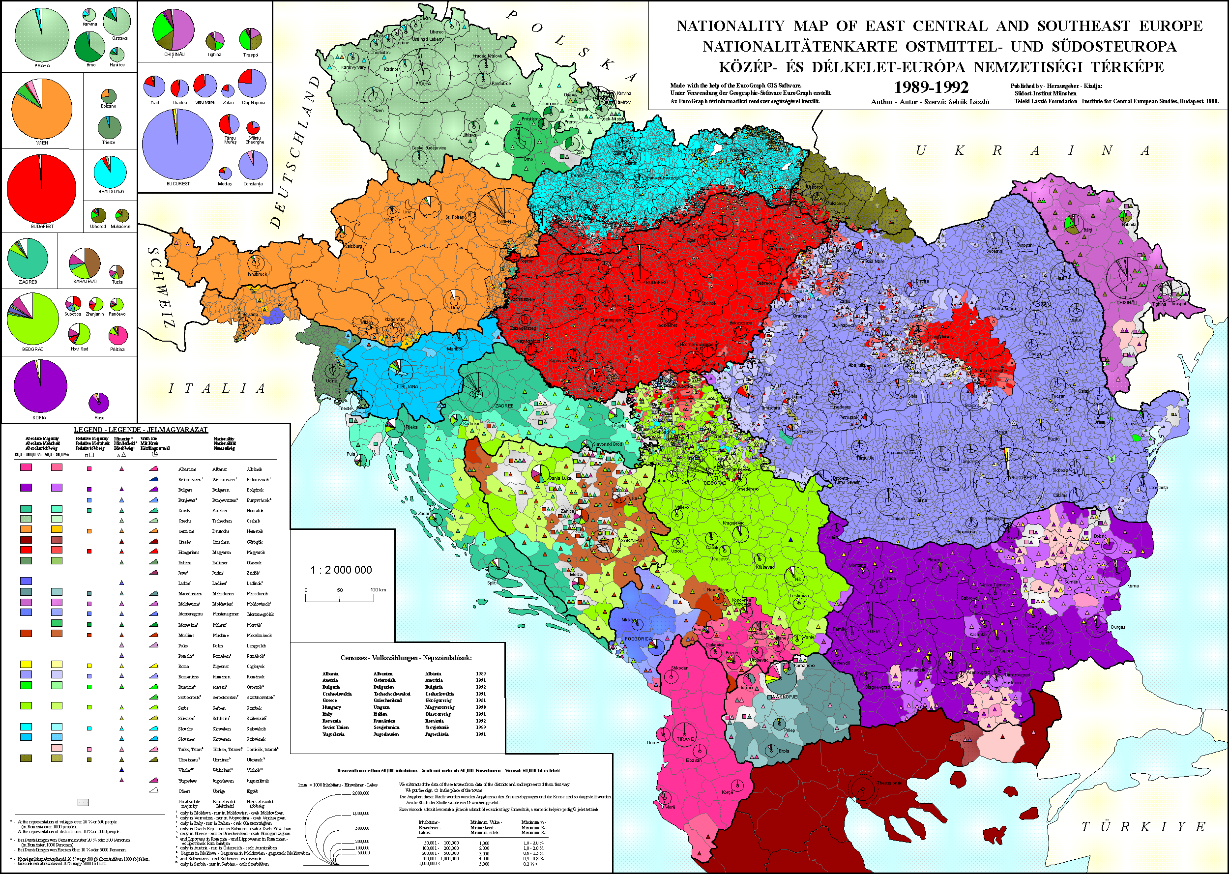

Slide 2
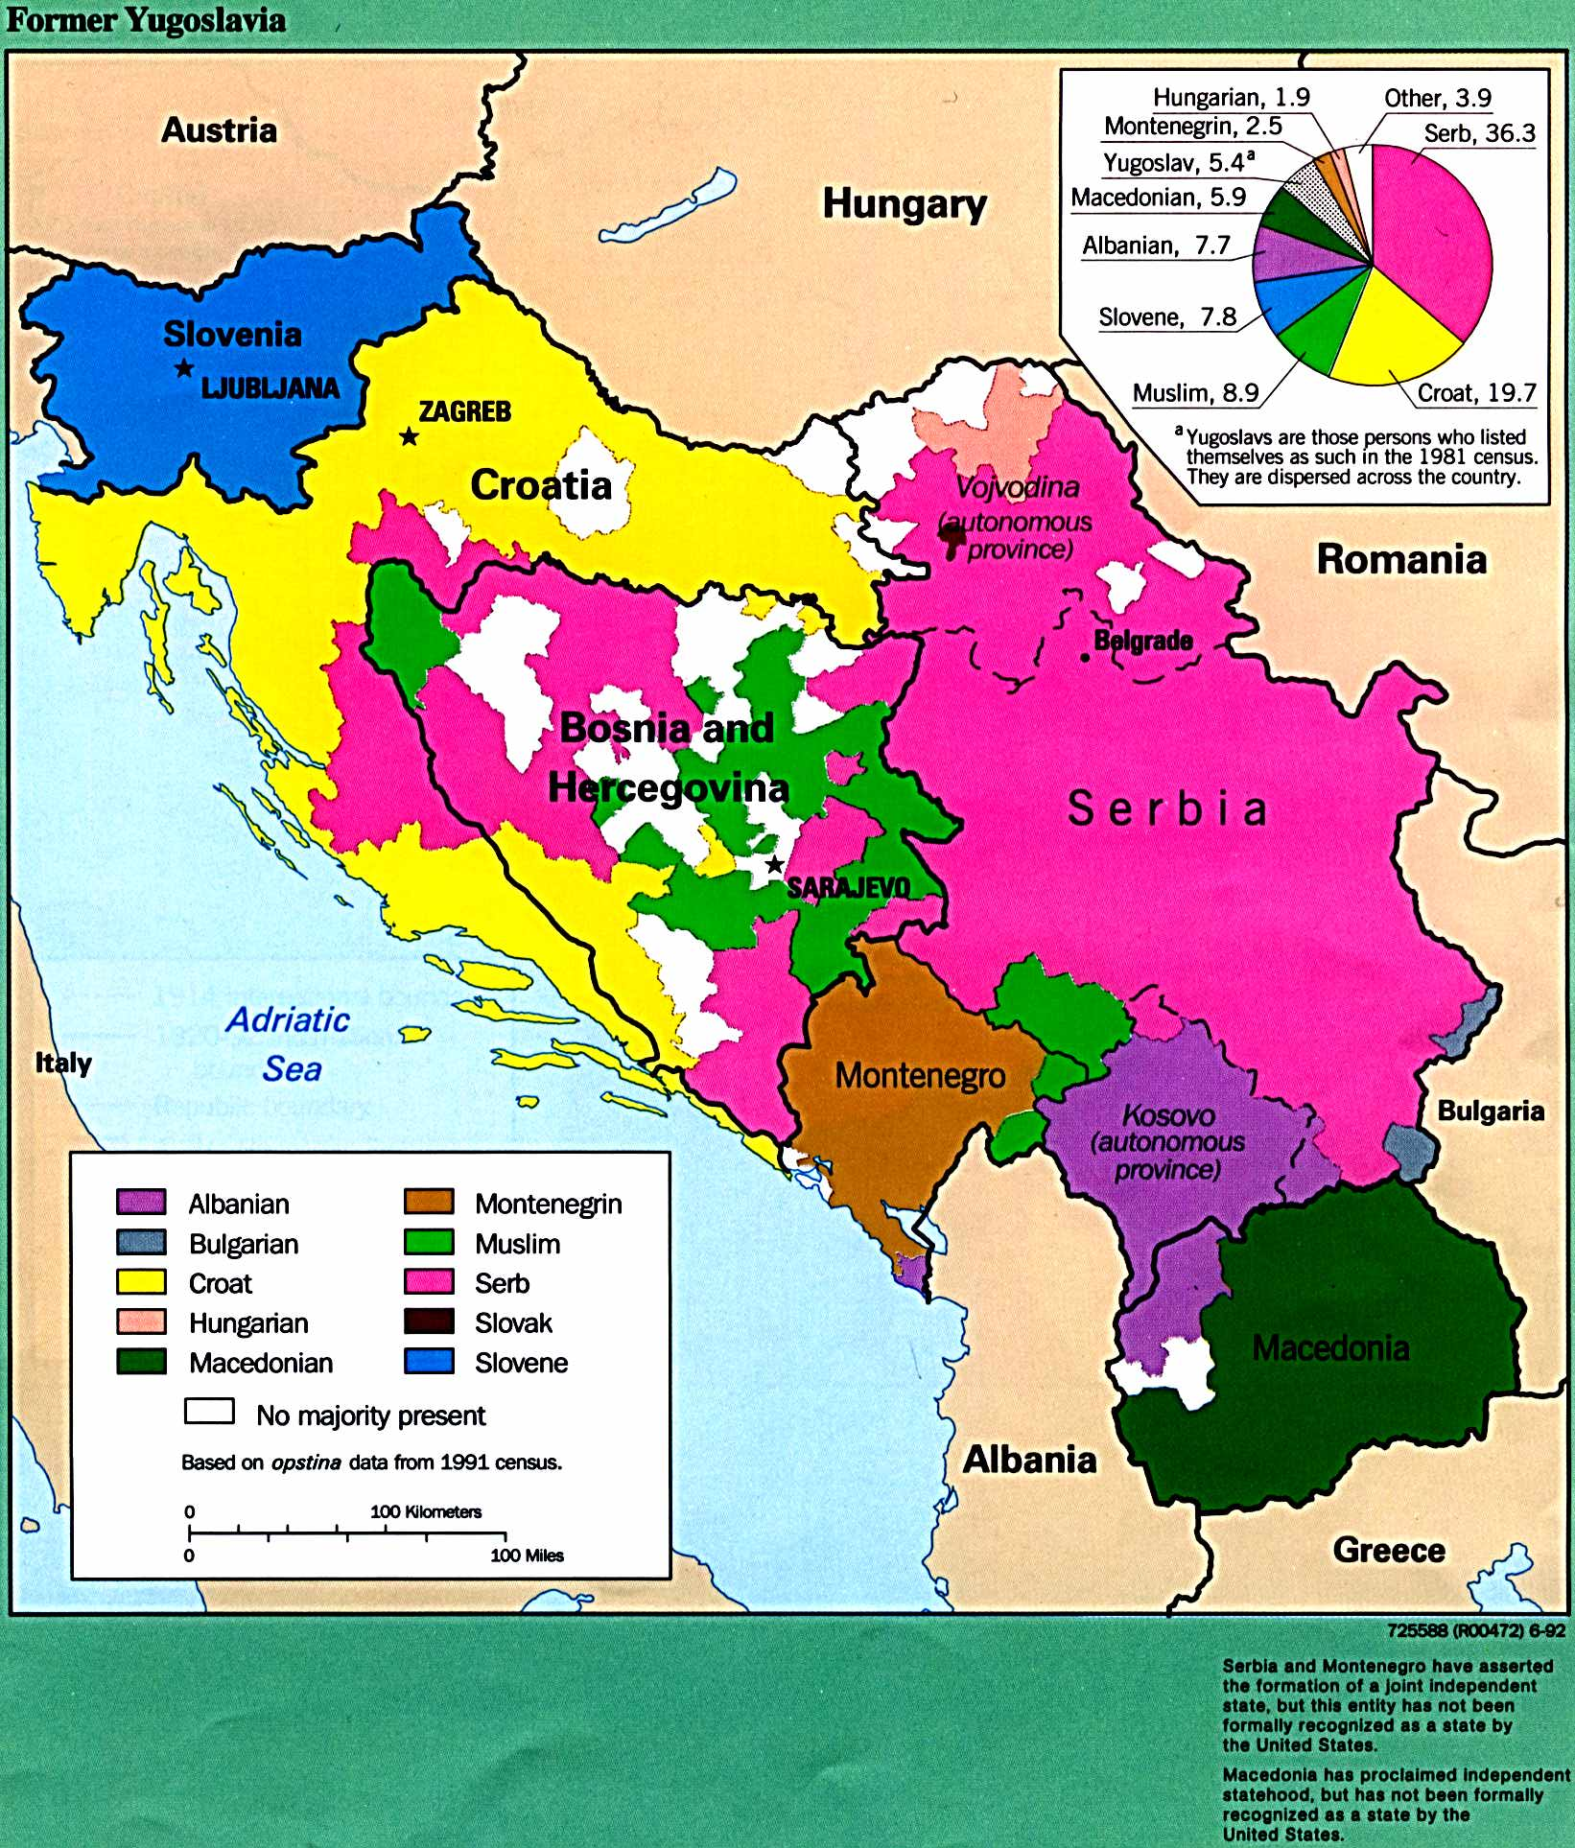

Slide 3
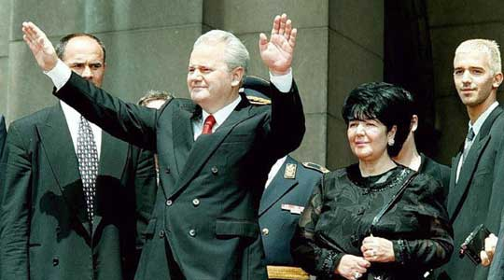

Slide 4
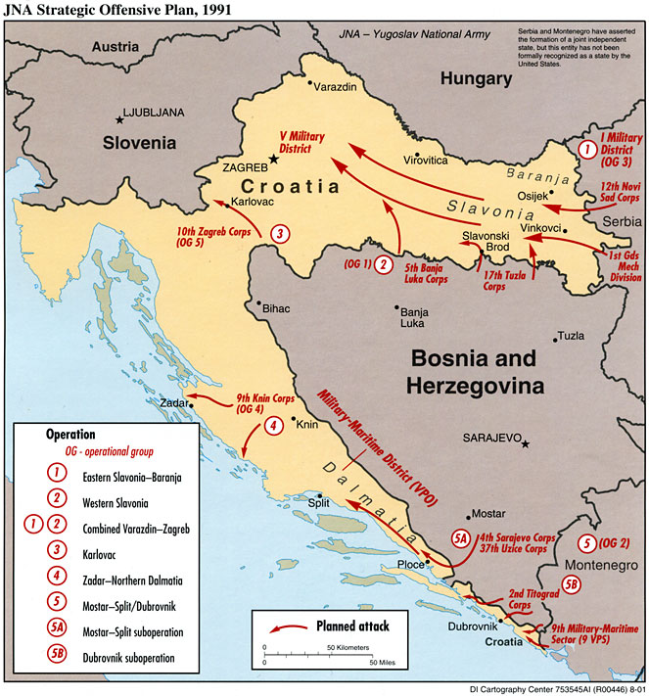

Slide 5
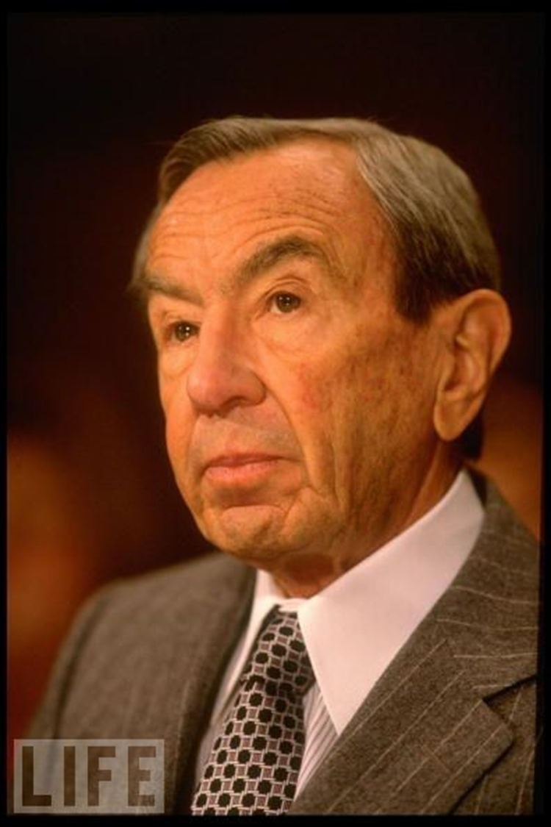
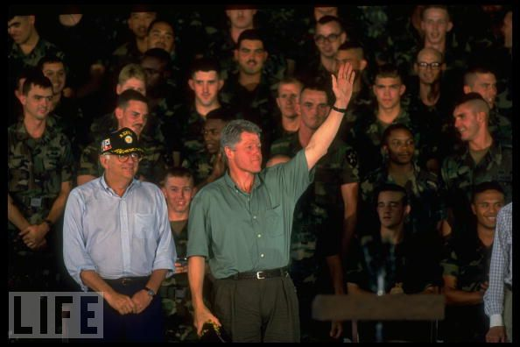
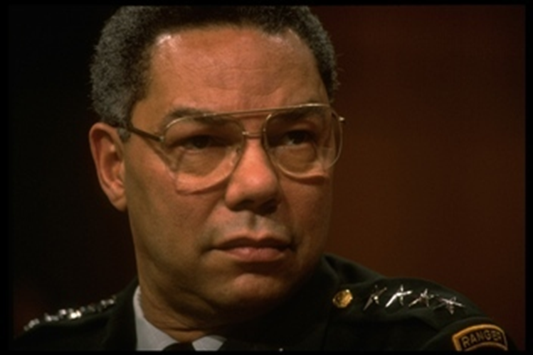

Slide 6
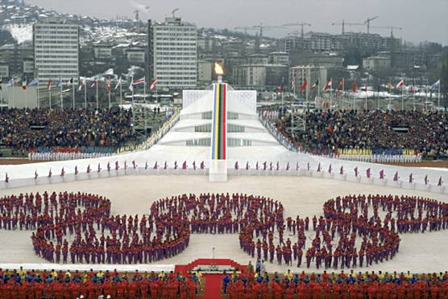

Slide 7
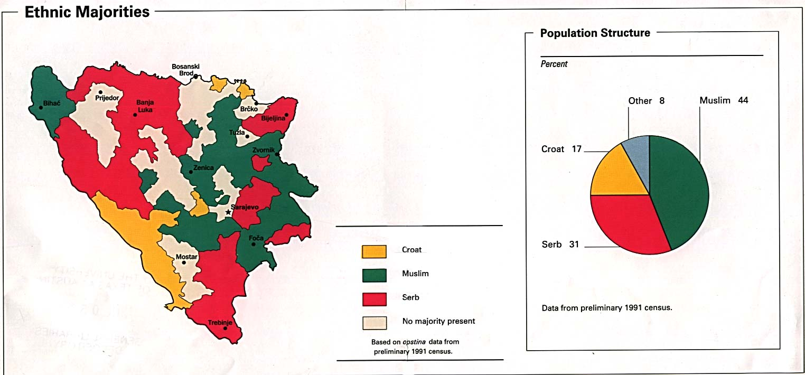

Slide 8
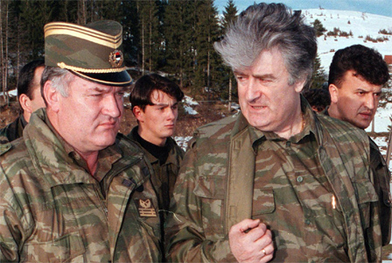

Slide 9
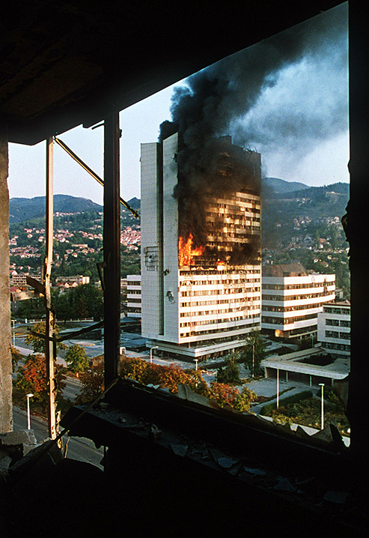

Slide 10
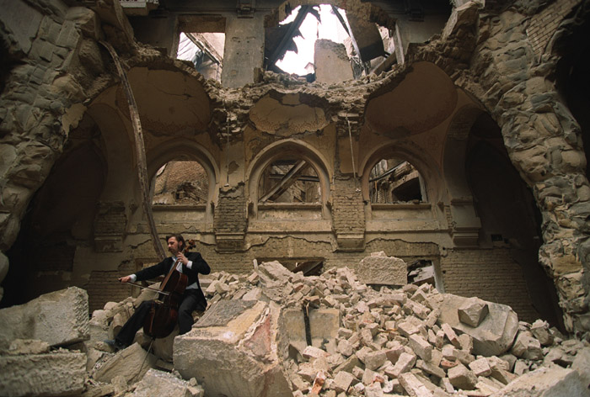

Slide 11
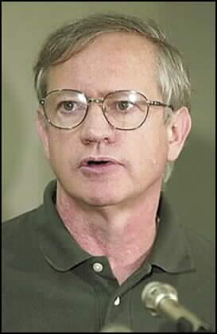

Slide 12
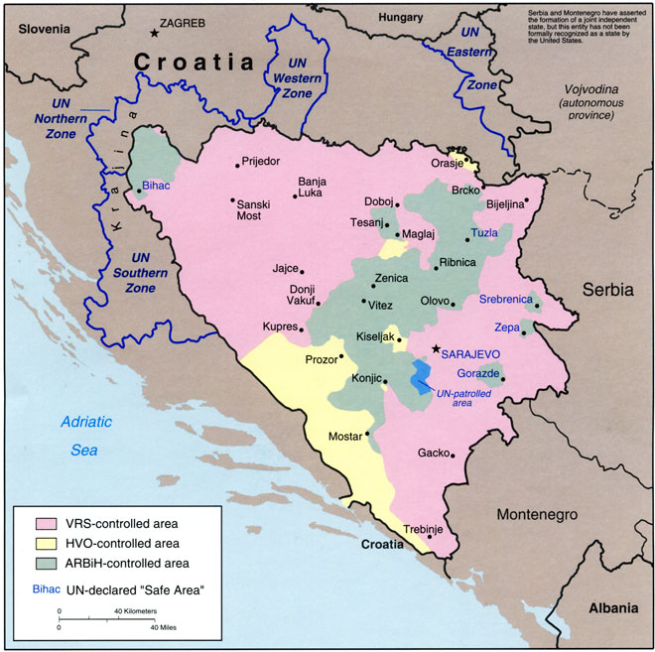

Slide 13
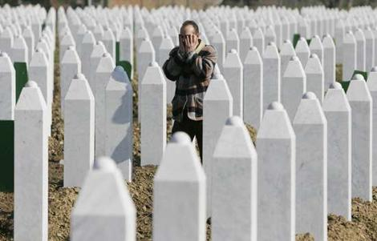

Slide 14
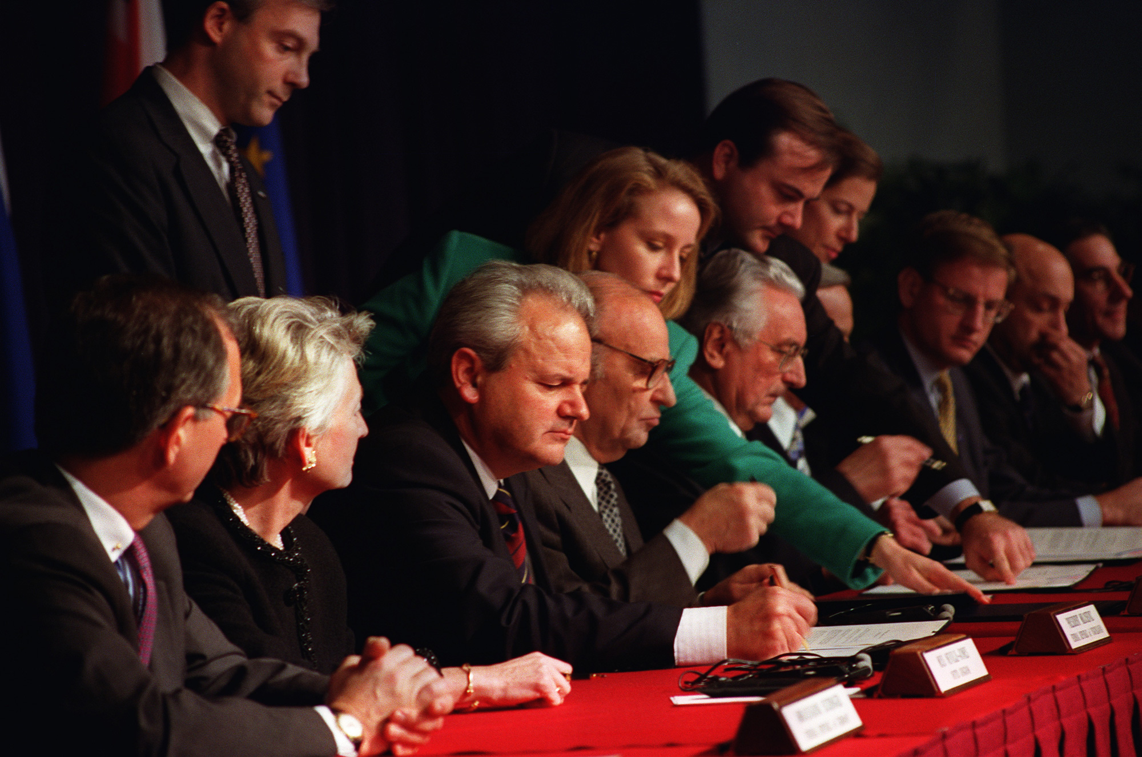

Slide 15
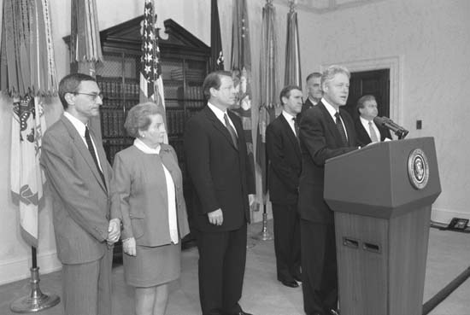

Slide 16
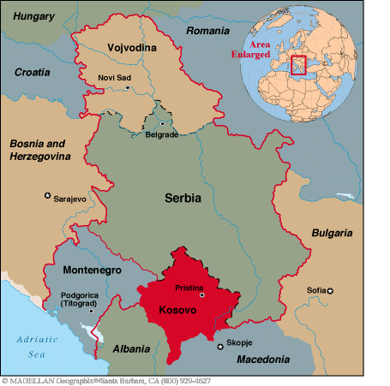

Slide 17
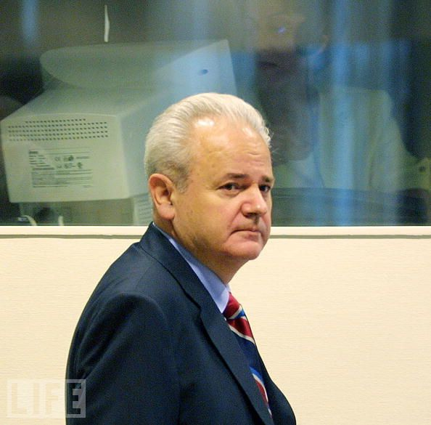

Slide 18
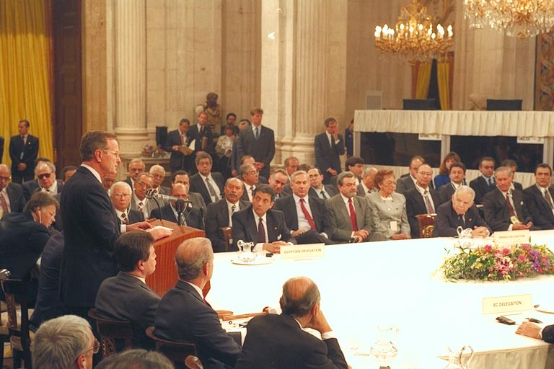
Notes:
Madrid conference opening

Slide 19
United Nations General Assembly Resolution 3379
(November 10, 1975)
THE GENERAL ASSEMBLY,
RECALLING its resolution 1904 (XVIII) of 20 November 1963, proclaiming the United Nations Declaration on the Elimination of All Forms of Racial Discrimination, and in particular its affirmation that "any doctrine of racial differentiation or superiority is scientifically false, morally condemnable, socially unjust and dangerous" and its expression of alarm at "the manifestations of racial discrimination still in evidence in some areas in the world, some of which are imposed by certain Governments by means of legislative, administrative or other measures",
…
TAKING NOTE ALSO of resolution 77 (XII) adopted by the Assembly of Heads of State and Government of the Organization of African Unity at its twelfth ordinary session, held at Kampala from 28 July to 1 August 1975, which considered "that the racist regime in occupied Palestine and the racist regime in Zimbabwe and South Africa have a common imperialist origin, forming a whole and having the same racist structure and being organically linked in their policy aimed at repression of the dignity and integrity of the human being",
…
DETERMINES that Zionism is a form of racism and racial discrimination.

Slide 20
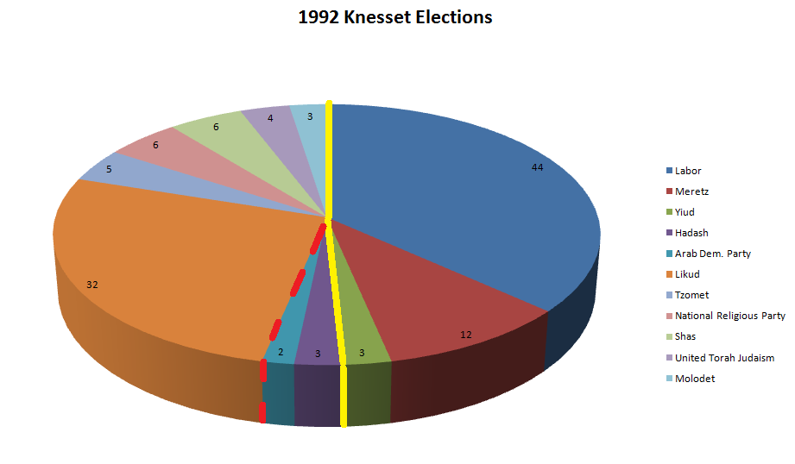

Slide 21
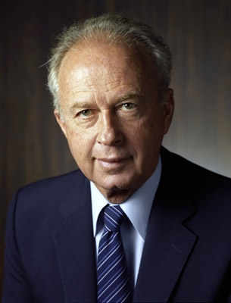

Slide 22
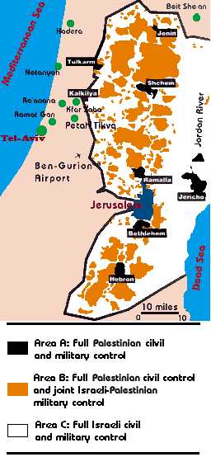

Slide 23
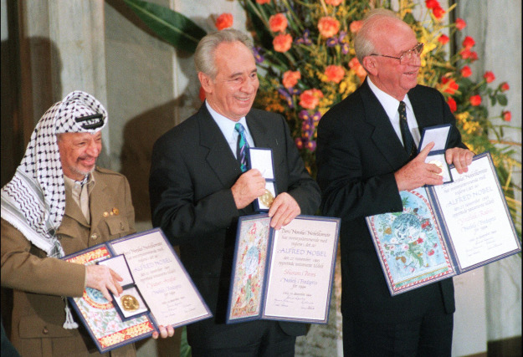

Slide 24
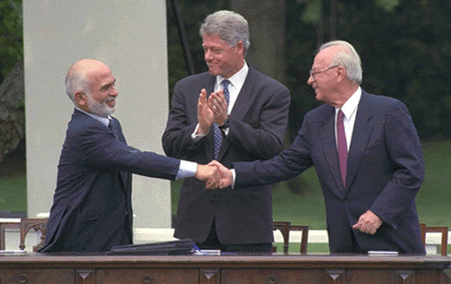

Slide 25
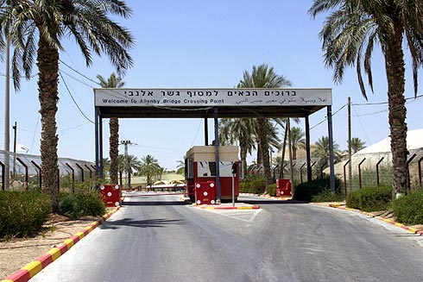

Slide 26
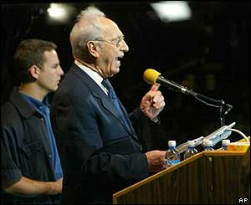

Slide 27
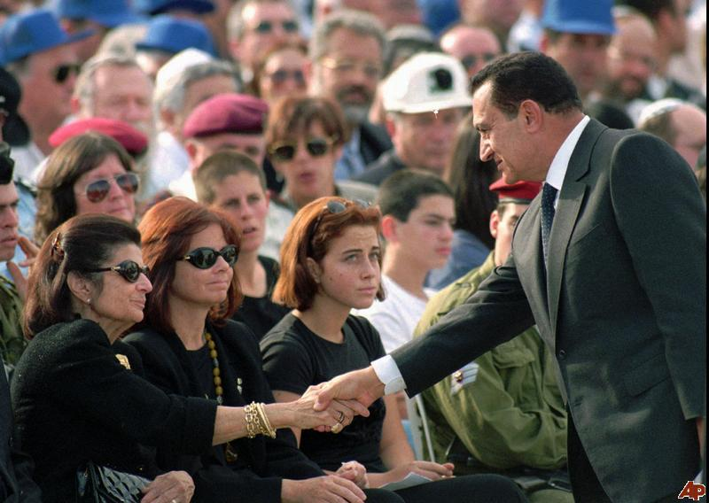
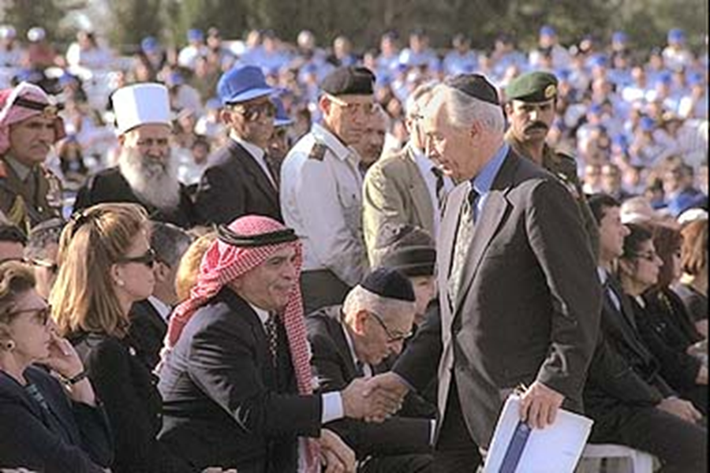

Slide 28
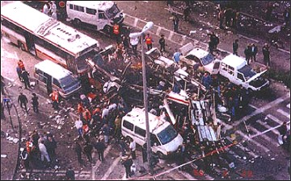
Notes:
Jerusalem 18 bus

Slide 29
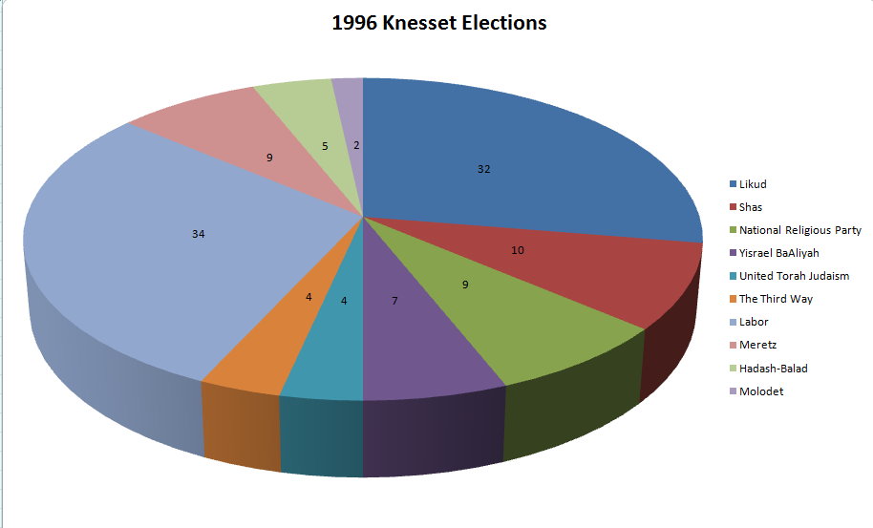

Slide 30
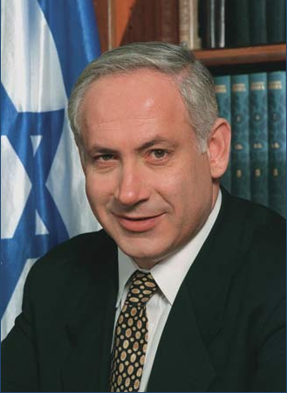
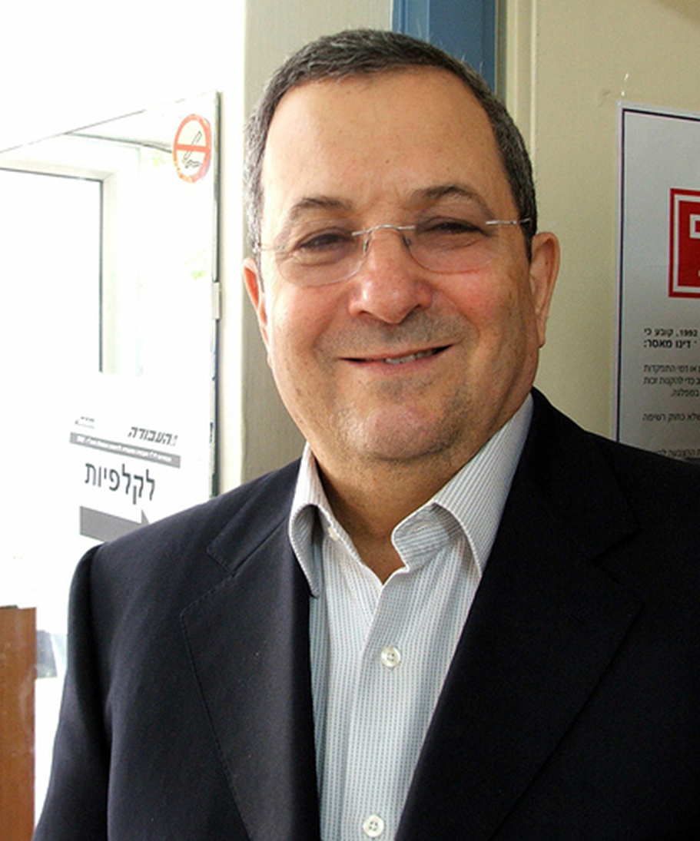

Slide 31
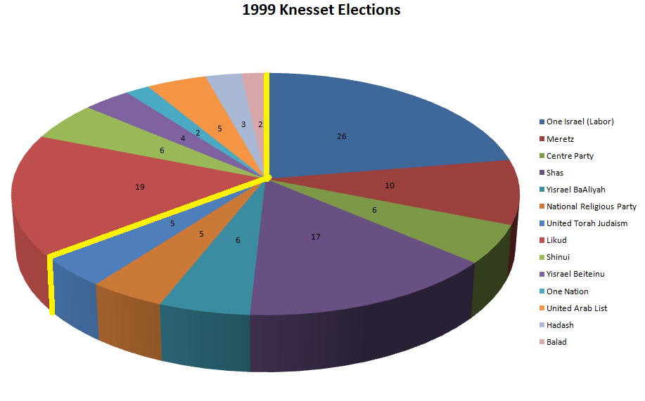

Slide 33
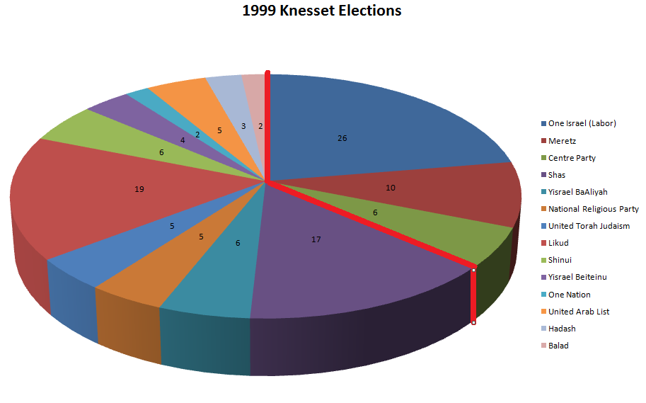

Slide 34
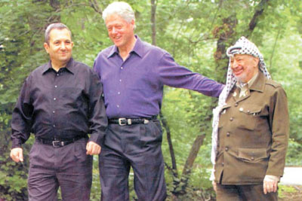

Slide 35
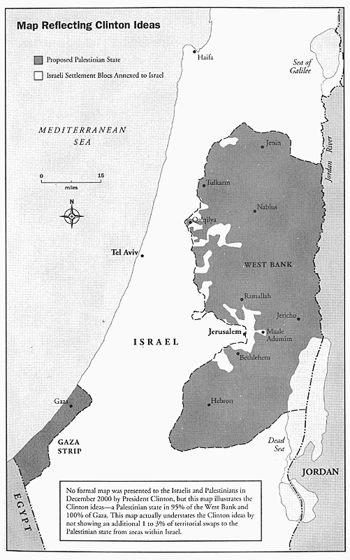

Slide 36
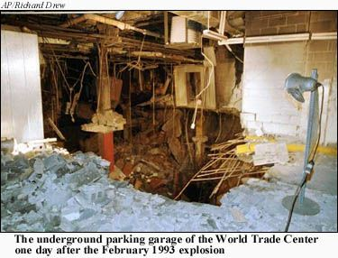

Slide 37
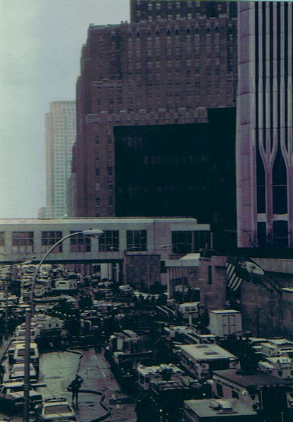

Slide 38
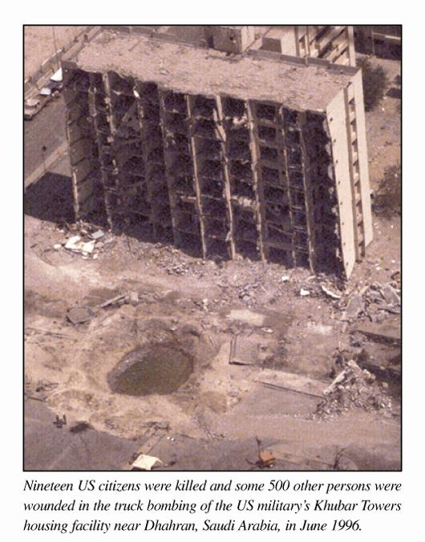

Slide 39
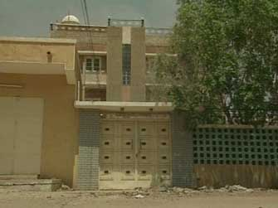
Notes:
Bin laden sudan house

Slide 40
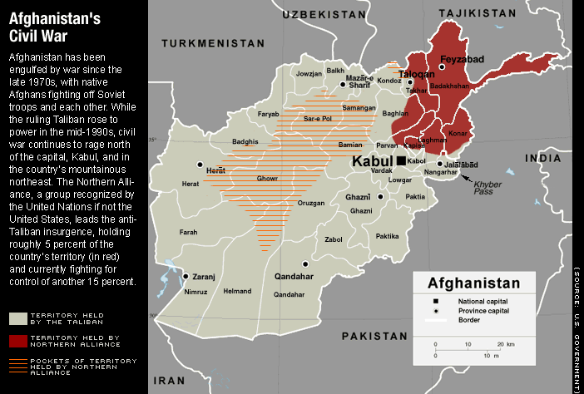

Slide 41
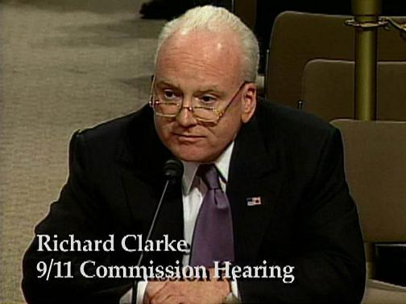
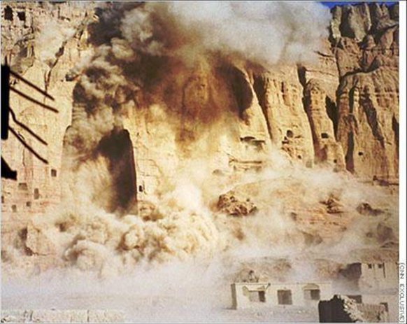
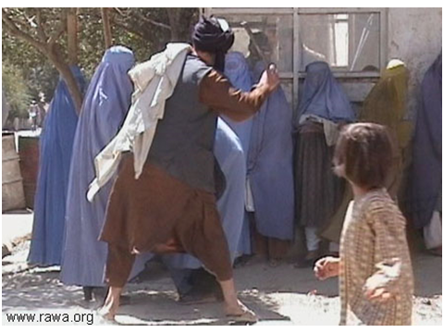
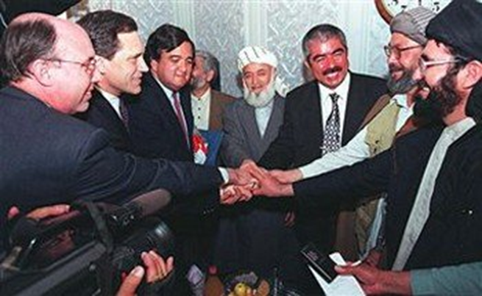

Slide 42
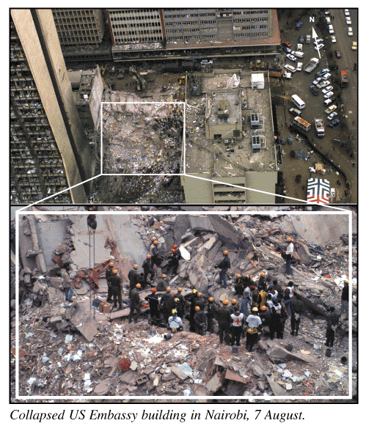

Slide 43
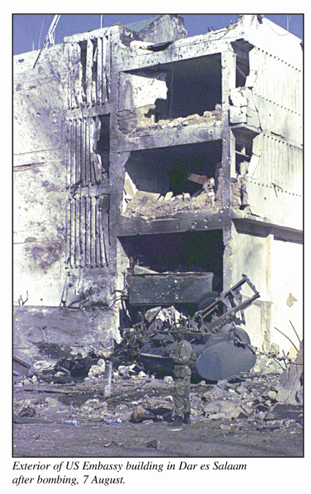

Slide 44
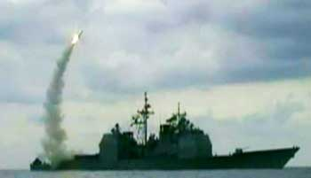
Notes:
Cruise missile strike—bin laden alerted isi

Slide 45
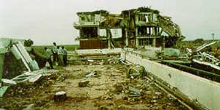
Notes:
Sudan strike

Slide 46


Slide 47


Slide 48

We need to deal with the problems of terrorism and these new weapons of mass destruction. Look, we’re gonna face some serious new challenges in the next four years.

Slide 49

What’s in the best interests of our people? When it comes to foreign policy that will be my guiding question. Is it in our nation's interests? Peace in the Middle East is in our nation's interests.

Slide 50


Slide 51


Slide 52


Slide 53


Slide 54


Slide 55


Slide 56


Slide 57

Notes:
Aid pakistan

Slide 58


Slide 59


Slide 60


Slide 61


Slide 62


Slide 63


Slide 65


Slide 66


Slide 67


Slide 68


Slide 69


Slide 70



Slide 71




Slide 72


Slide 73


Slide 74


Slide 75


Slide 76


Slide 77


Slide 78


Slide 79


Slide 80


