Slide 1
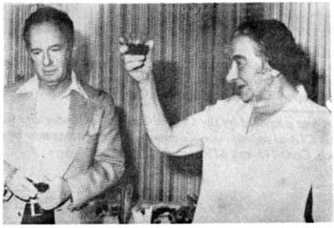

Slide 2
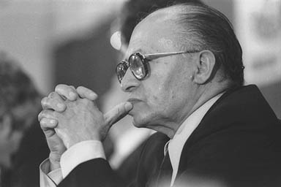

Slide 3
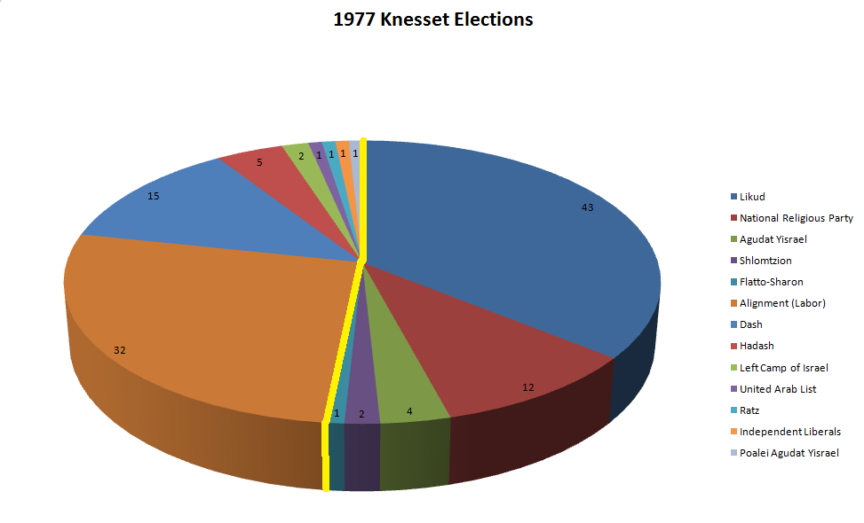

Slide 4
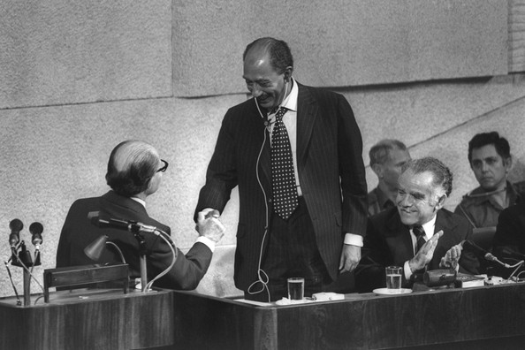

Slide 5
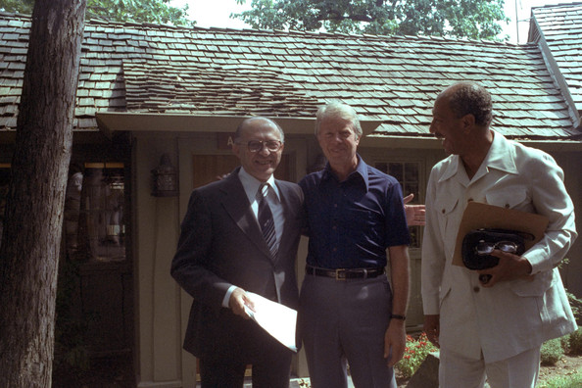

Slide 6
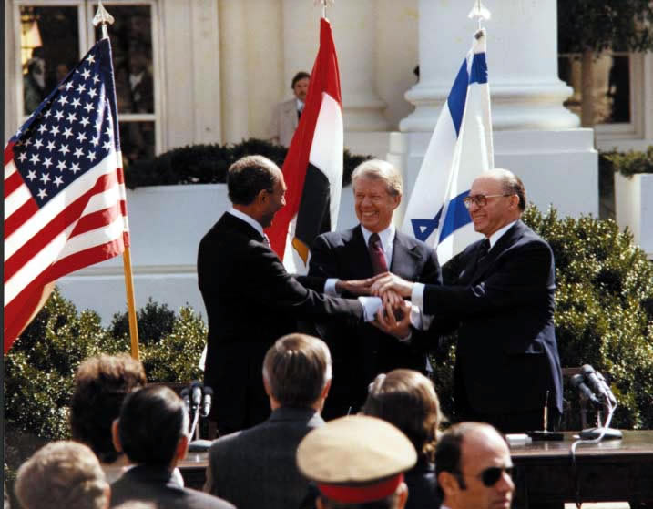

Slide 7
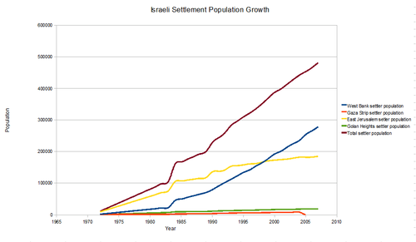

Slide 8
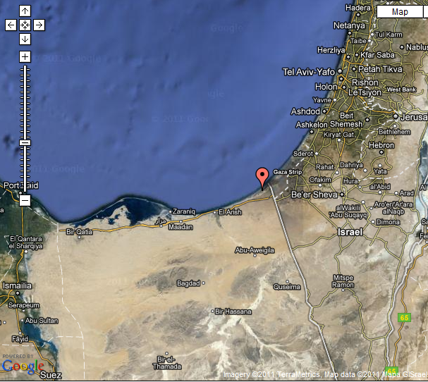
Notes:
yamit

Slide 9
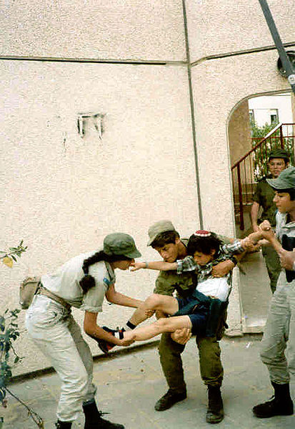
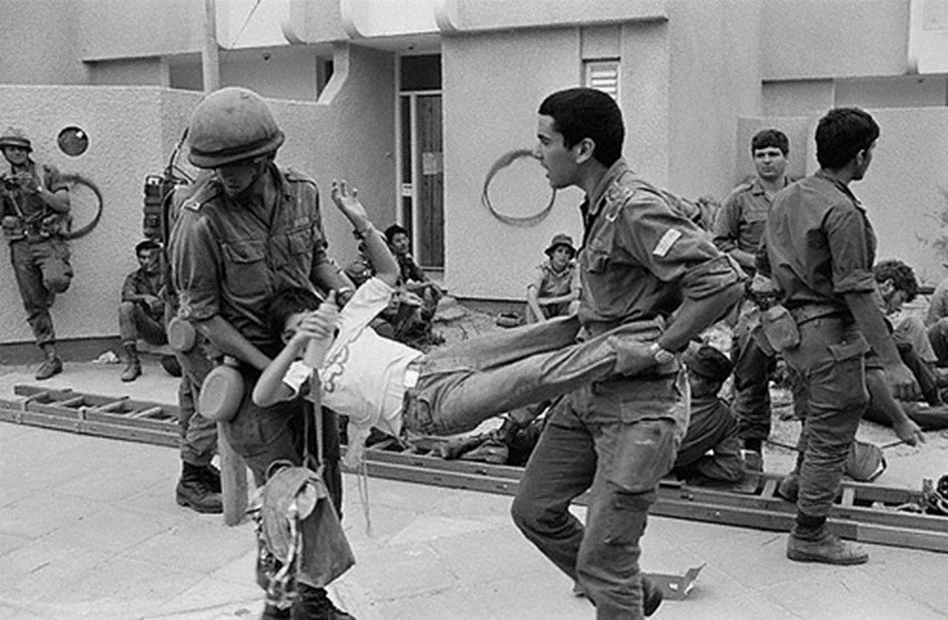
Notes:
Evacuation yamit settlement--2500

Slide 10


Slide 11


Slide 12

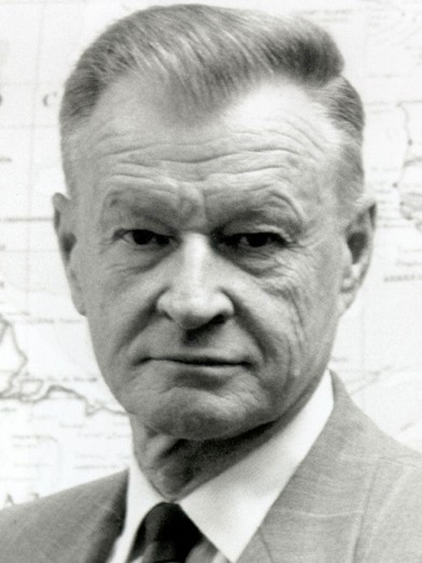


Slide 13
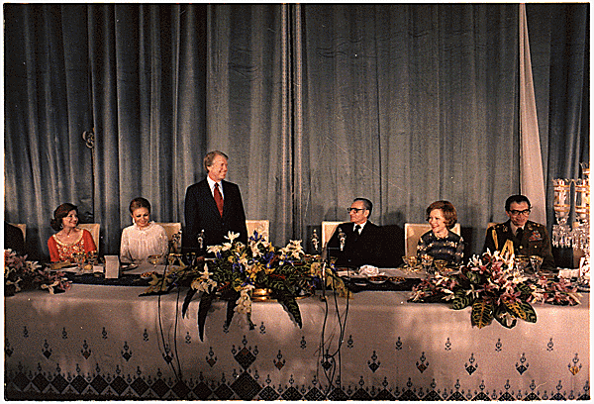
Notes:
Carter late 77 teheran state visit—shah as oasis of stability

Slide 14
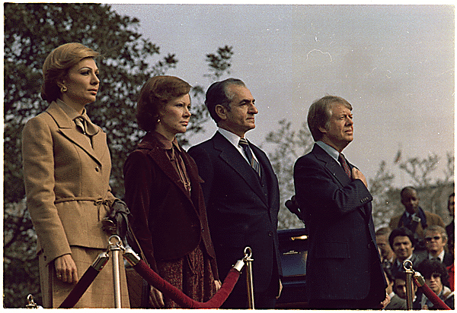
Notes:
State visit to US

Slide 15


Slide 16
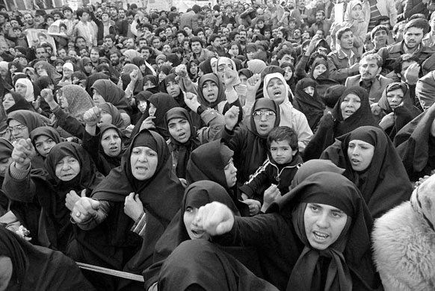

Slide 17
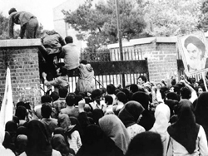

Slide 18
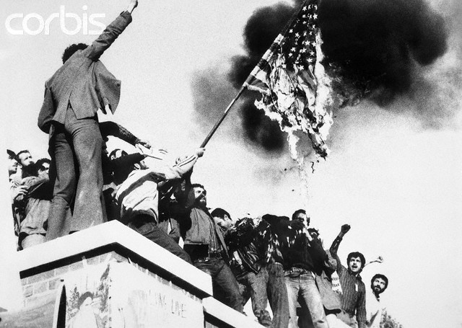
Notes:
seizure

Slide 19
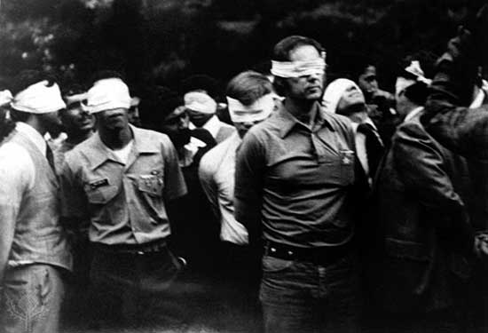

Slide 20
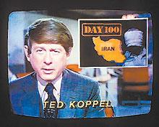

Slide 21

Notes:
Canadian caper

Slide 22
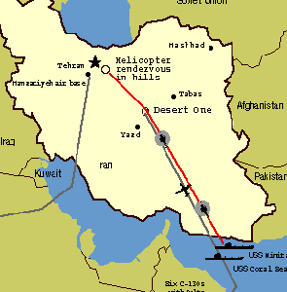

Slide 23
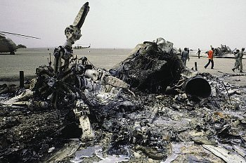

Slide 24
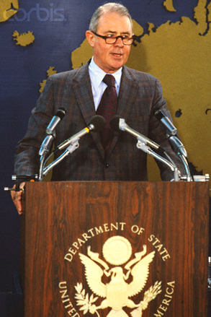

Slide 25
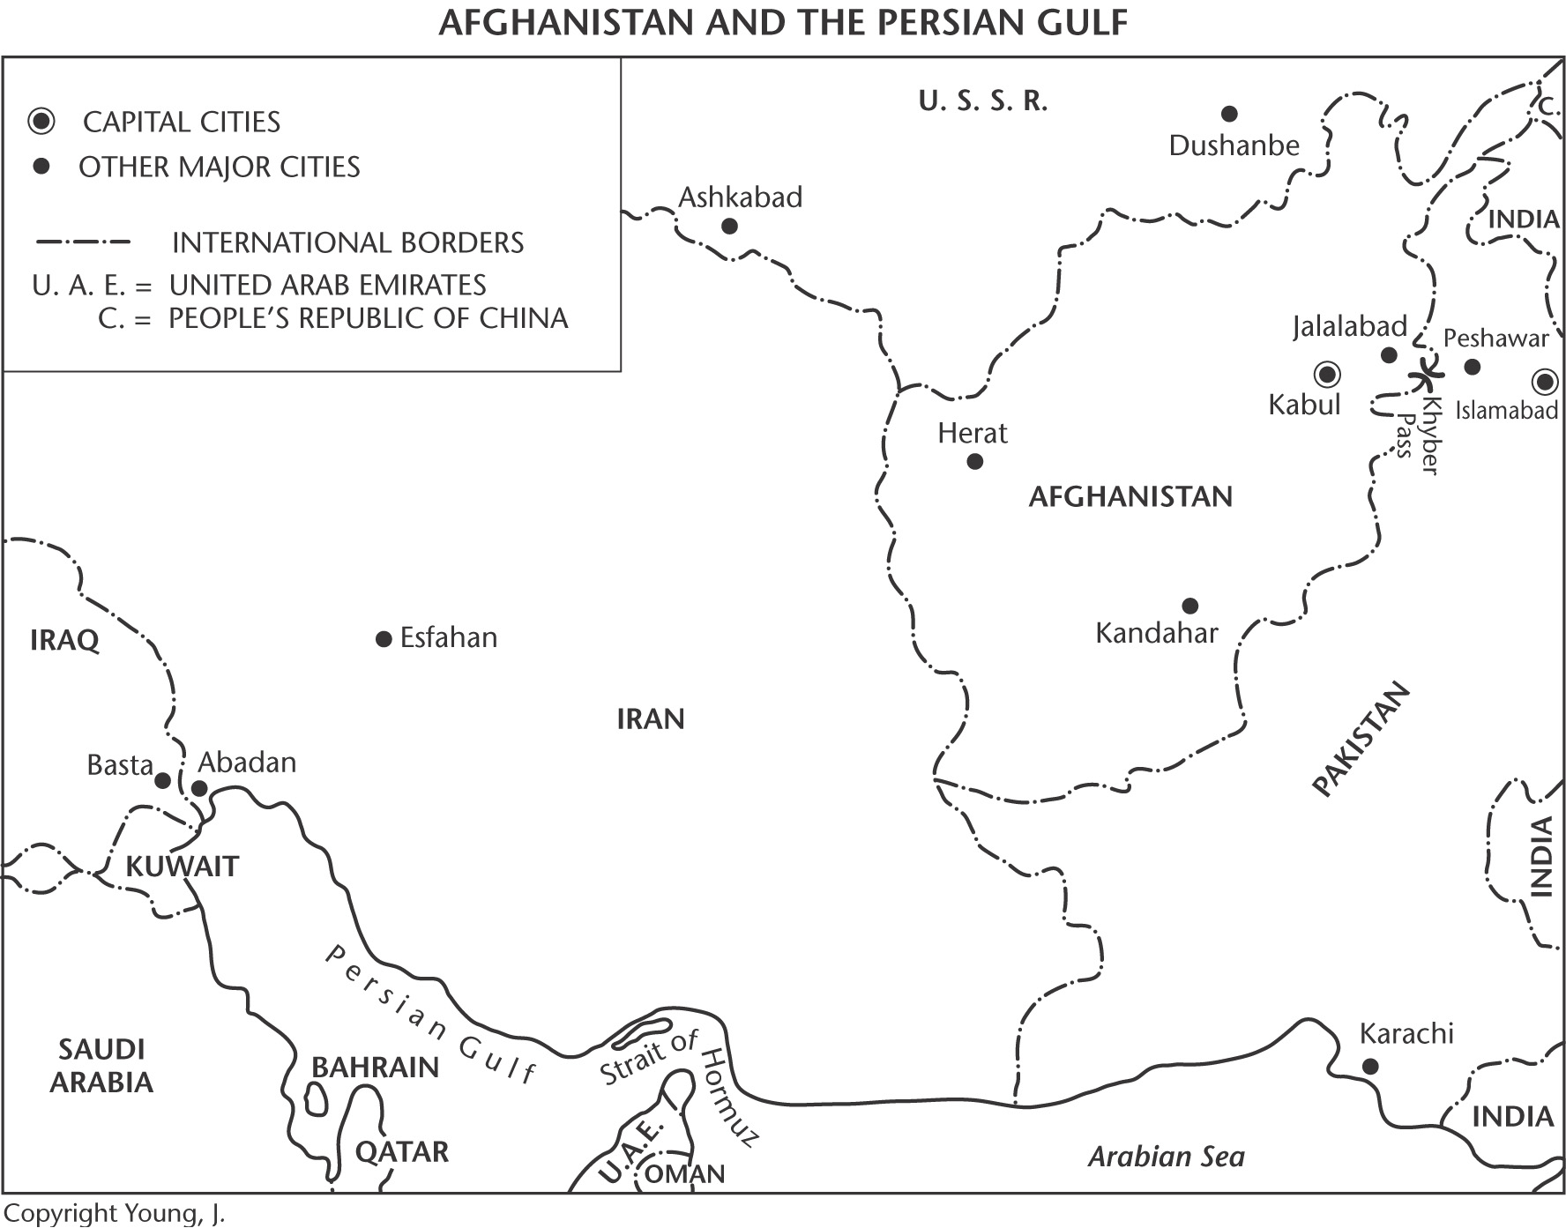

Slide 26
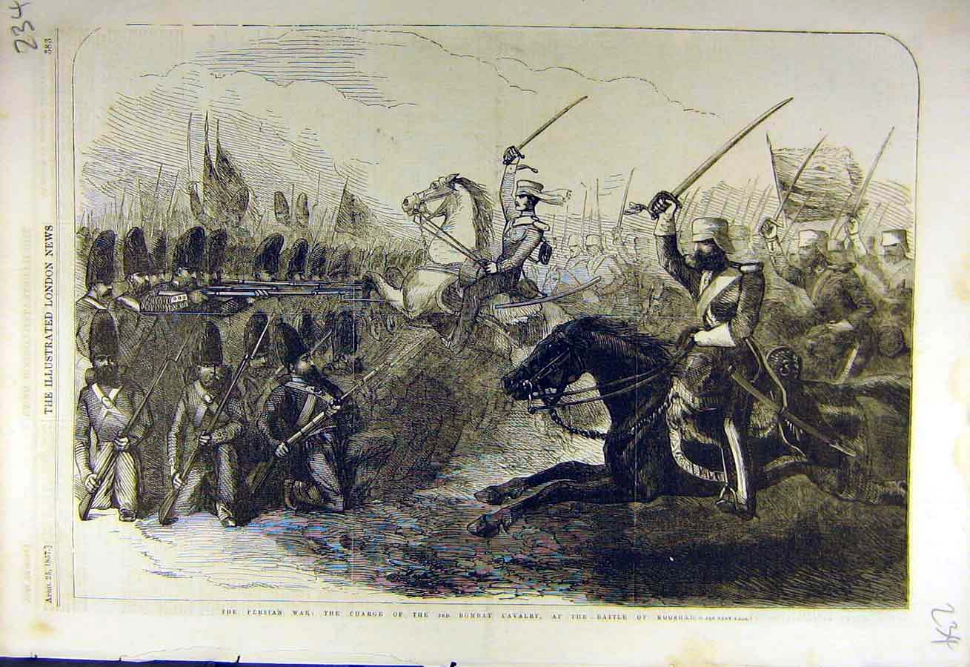
Notes:
Bombay cavalry

Slide 27
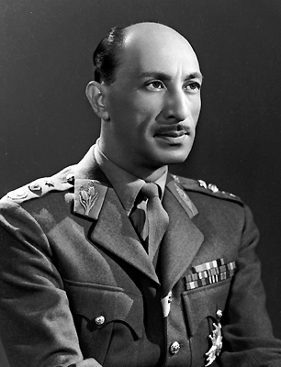

Slide 28
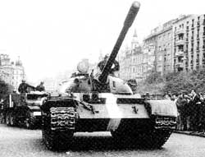

Slide 29
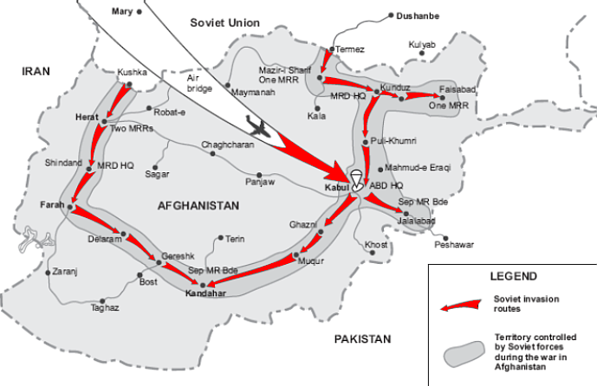

Slide 30



Slide 31
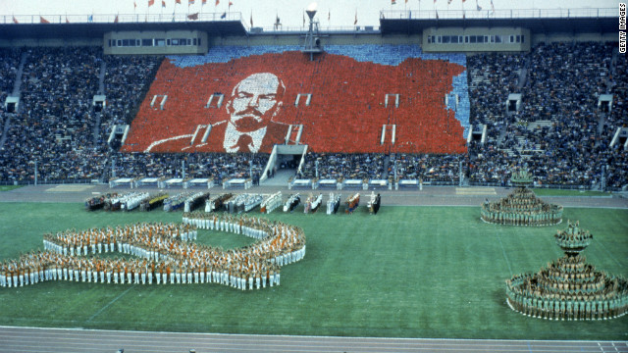

Slide 32


Slide 33


Slide 34
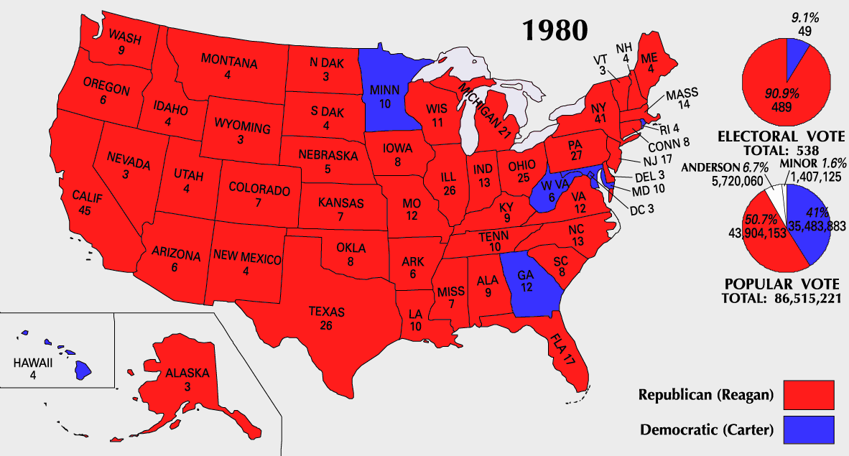

Slide 35
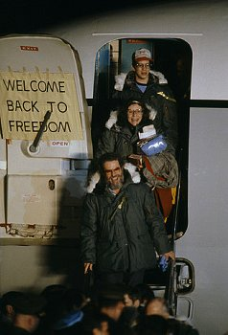

Slide 36

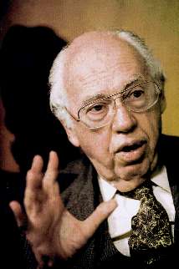



Slide 37


Slide 38


Slide 39
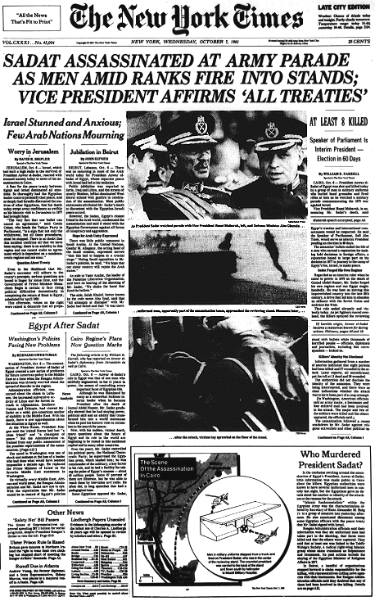

Slide 40
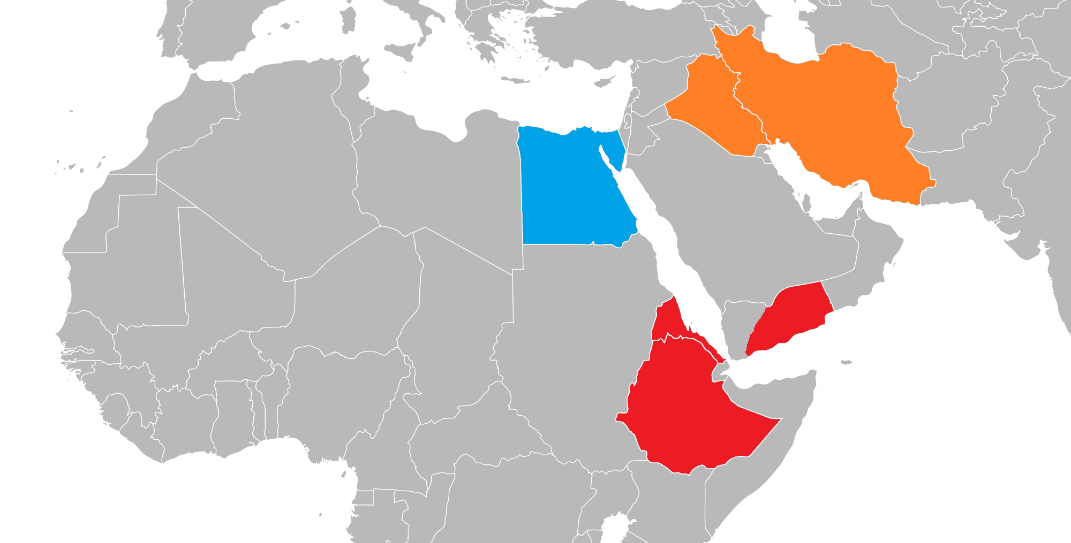

Slide 41


Slide 42

Ed Rollins: “We just beat his brains out. We stood him up in front of an open grave and told him he could jump in if he wanted to.”

Slide 43


Slide 44


Slide 45
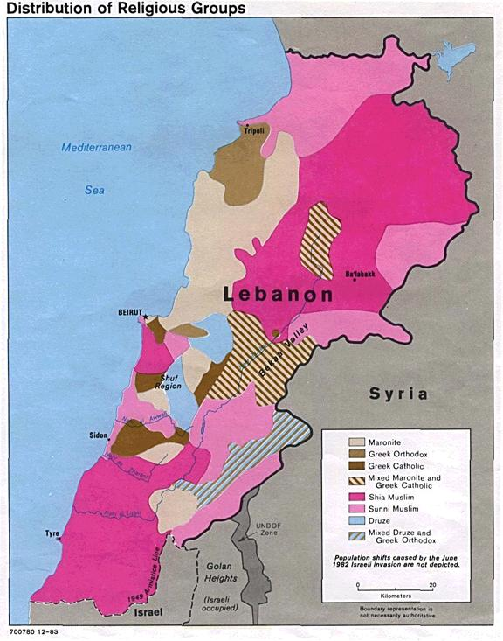

Slide 46


Slide 47
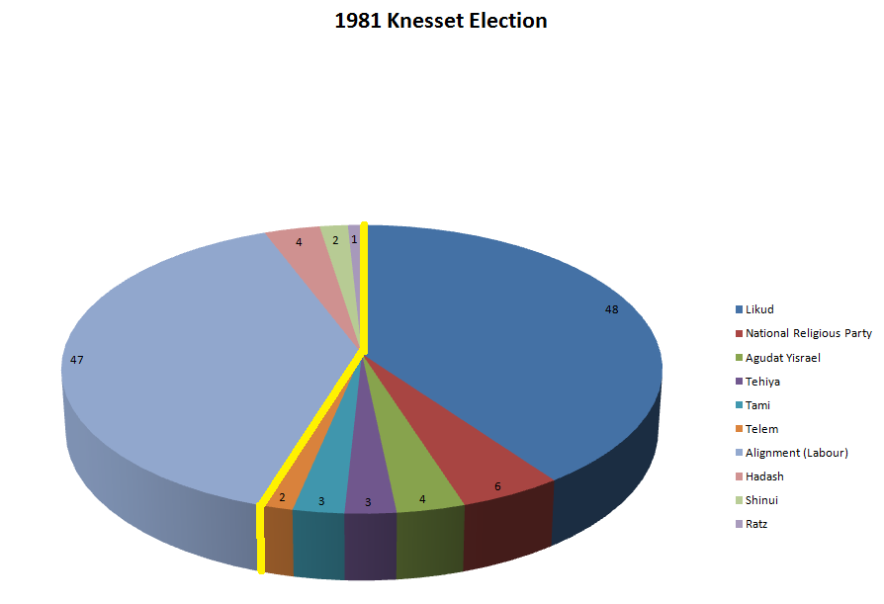

Slide 48
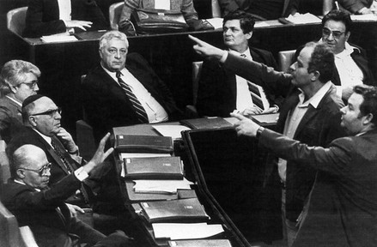

Slide 49
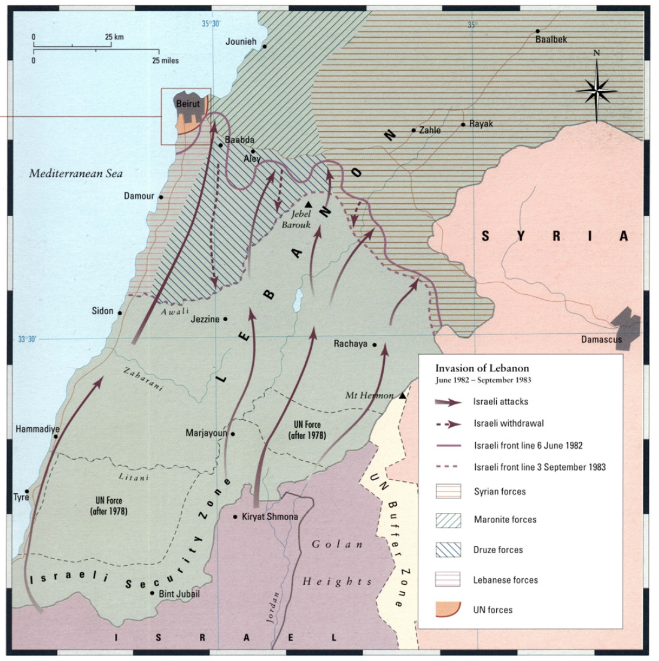

Slide 50

Notes:
gemayel

Slide 51


Slide 52
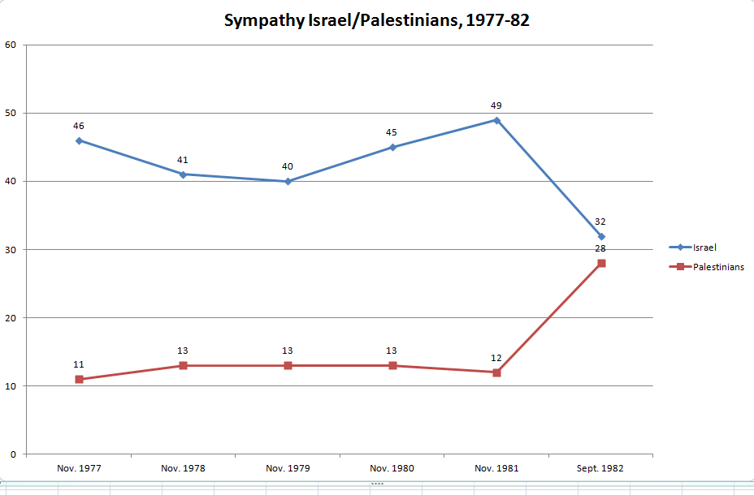

Slide 53
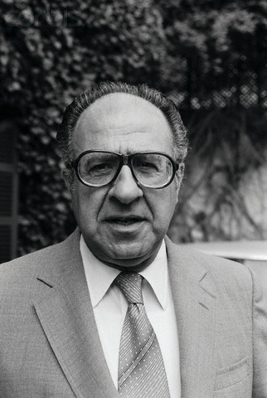
Notes:
habib

Slide 54
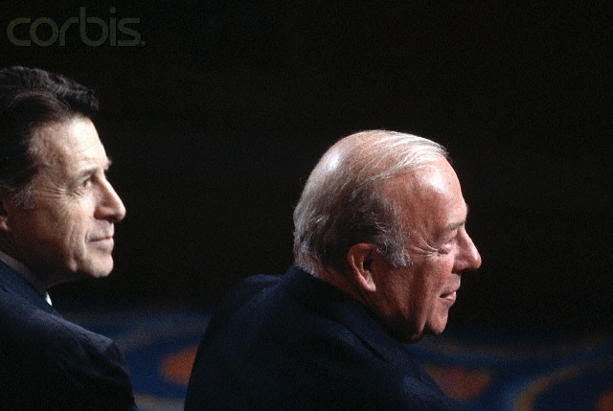

Slide 55


Slide 56
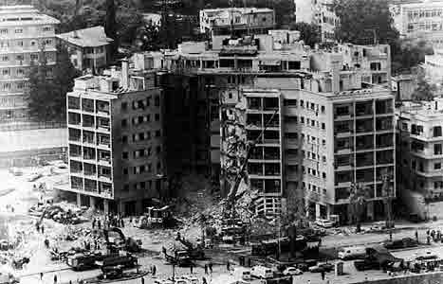

Slide 57


Slide 58





Slide 59



Slide 60


Slide 61

Notes:
Berlin disco

Slide 62
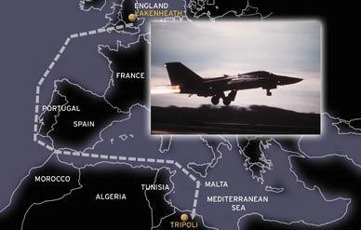

Slide 63


Slide 64

Notes:
Craxi

Slide 65
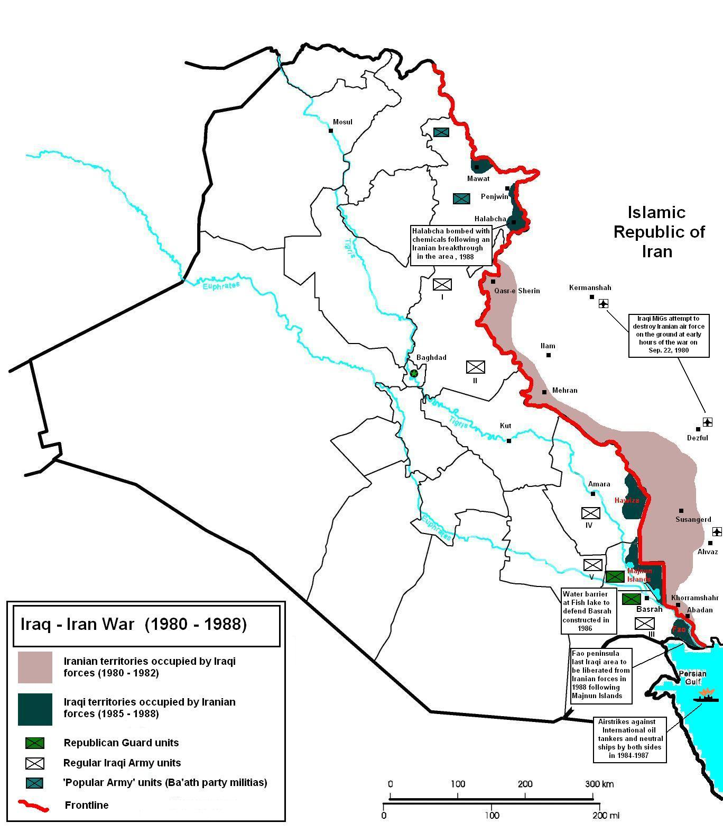

Slide 66

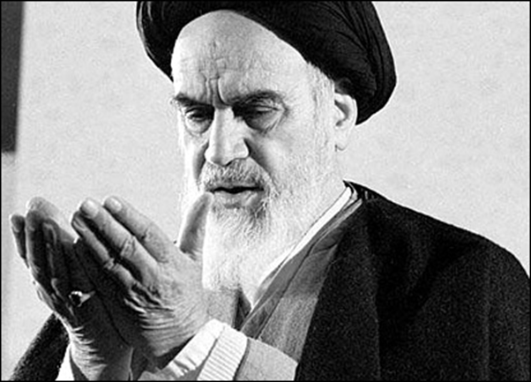

Slide 67
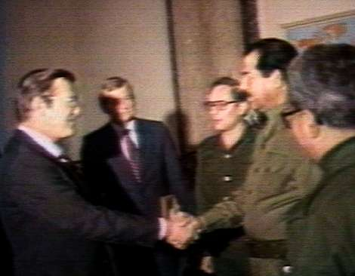

Slide 68


Slide 69
US shipment of weapons to Iran
1985
Aug. 20: Israel sends 96 TOW anti-tank missiles to Iran.
Sept. 14: Israel sends 408 more TOW missiles to Iran.
Nov. 24-25: The C.I.A. arranges for a shipment of 18 Hawk anti-aircraft missiles from Israel to Iran aboard a C.I.A. front company plane
1986
Feb. 17: The United States sends 500 TOW missiles to Israel, from American stocks, for shipment to Iran.
Feb. 27: Another shipment of 500 TOW missiles are sent to Israel, once again for shipment to Iran.
May 23-24: 508 TOW missiles and 240 spare parts for Hawk missiles are shipped to Israel.
Aug. 4: The United States sends Iran a shipment of spare parts for Hawk anti-aircraft missiles.
Oct. 28: 500 TOW missiles are sent from Israel to Iran.

Slide 70


