Slide 1
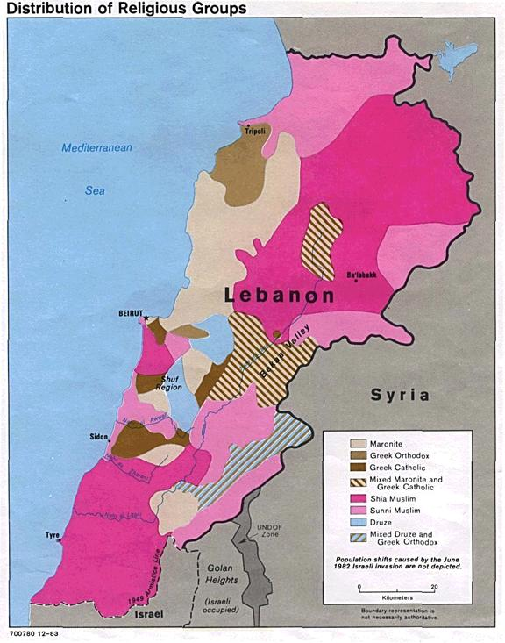

Slide 2
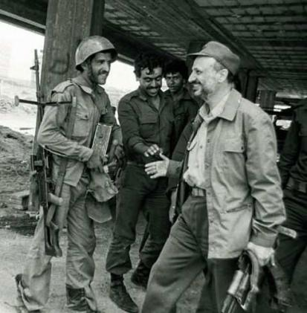

Slide 3
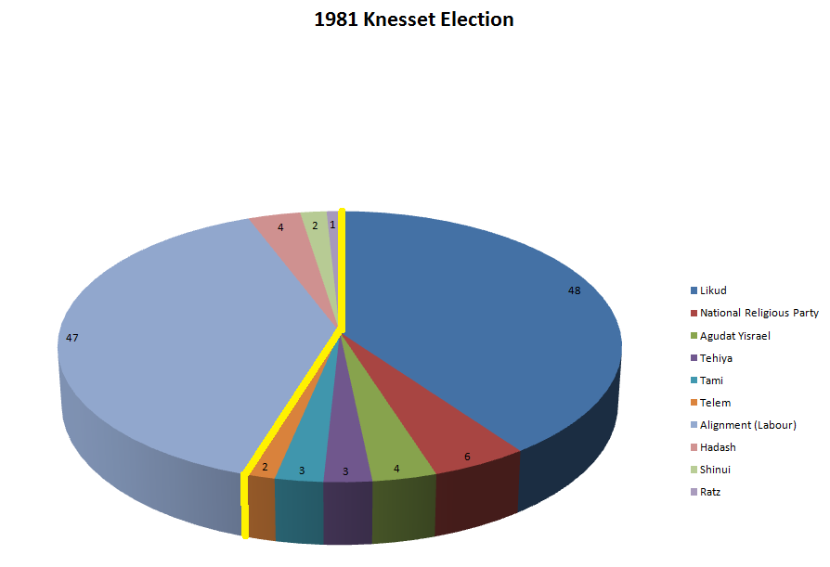

Slide 4
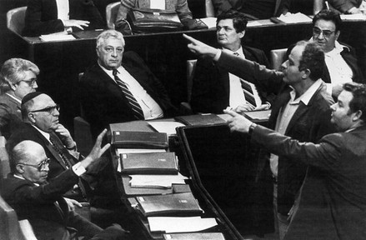

Slide 5
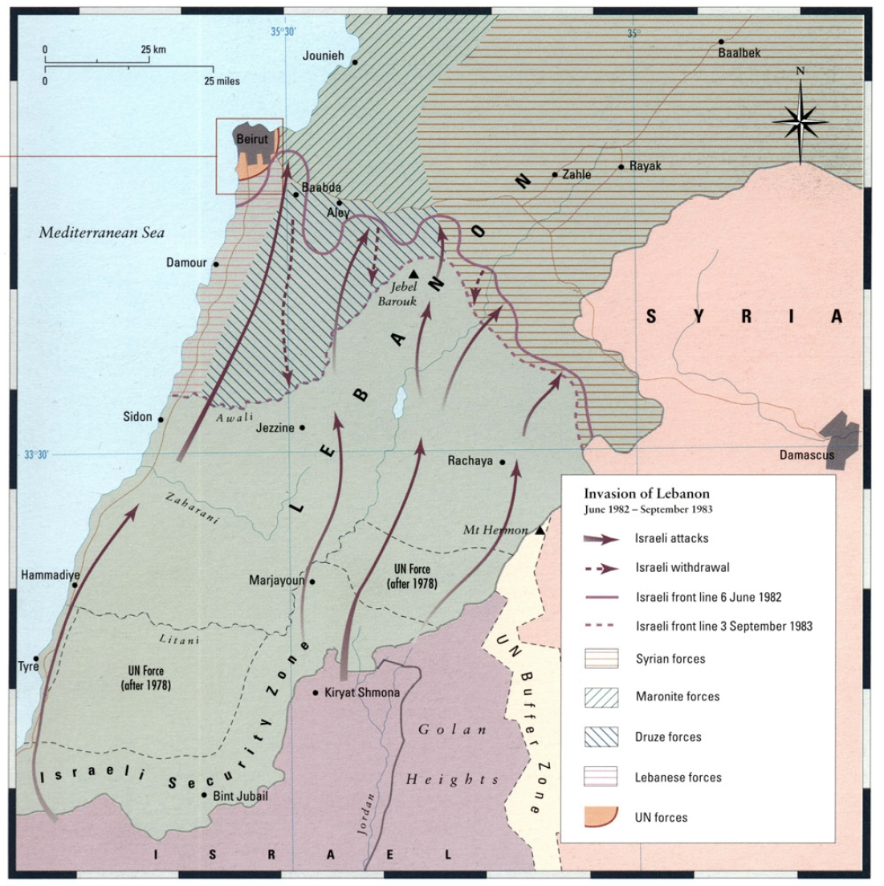

Slide 6
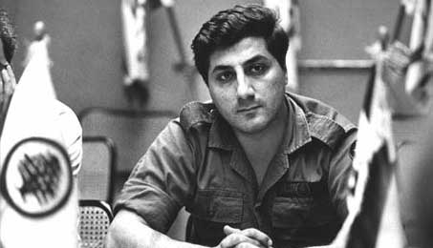
Notes:
gemayel

Slide 7


Slide 8
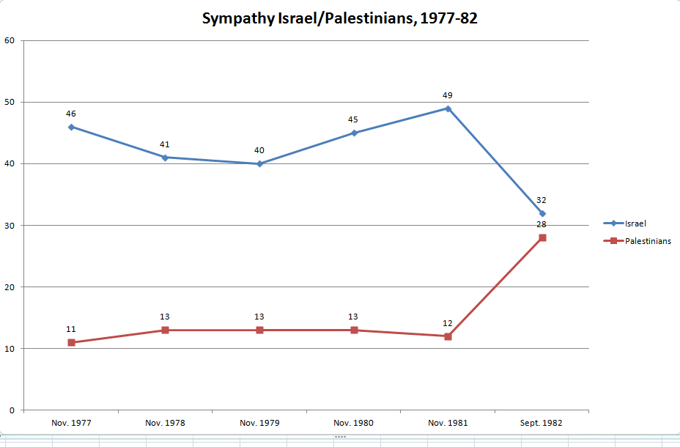

Slide 9
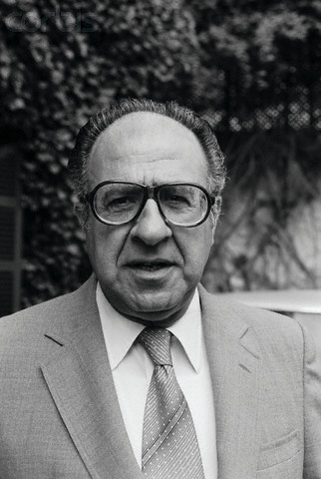
Notes:
habib

Slide 10


Slide 11
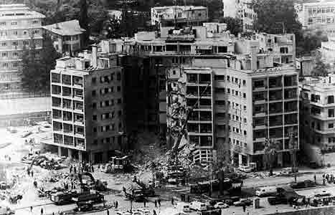

Slide 12
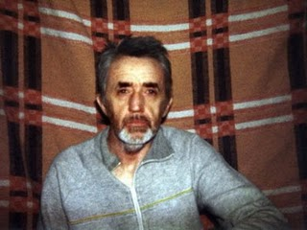
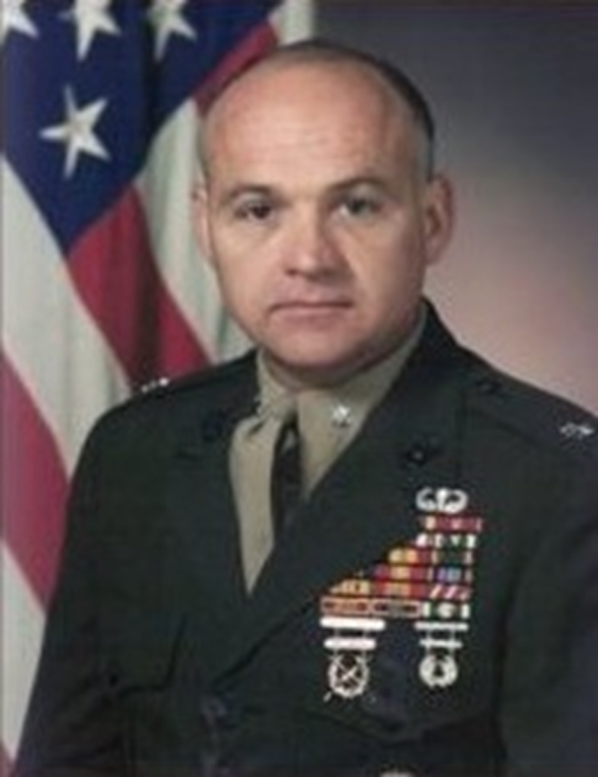

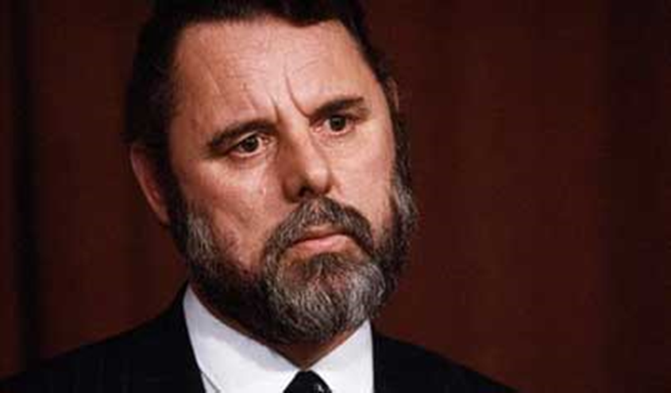

Slide 13
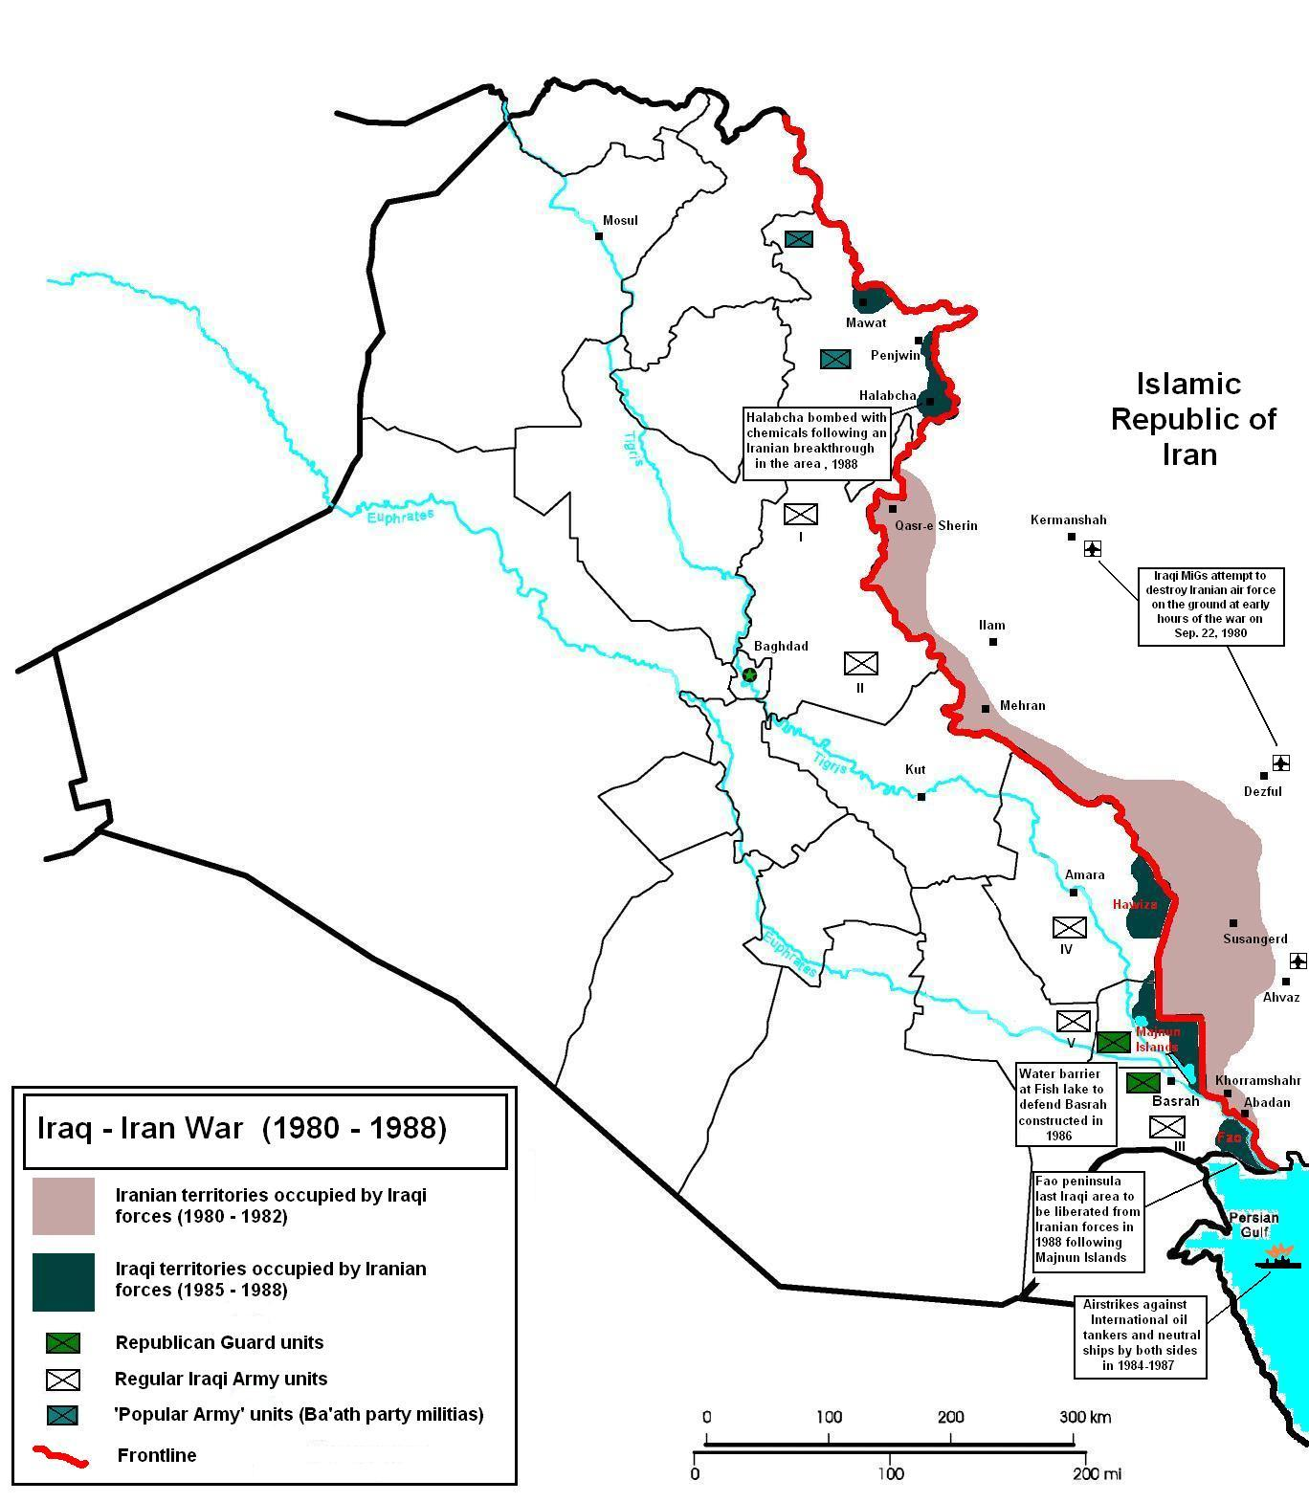

Slide 14
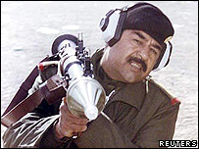
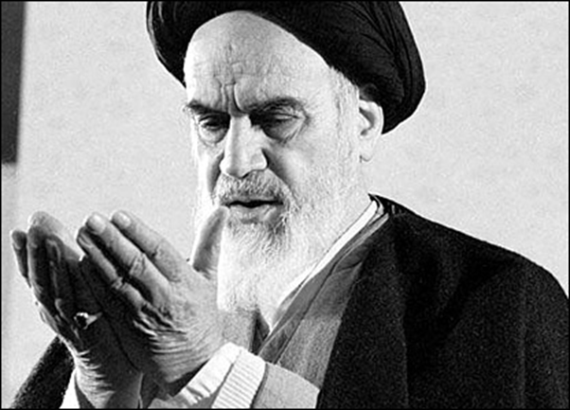

Slide 15
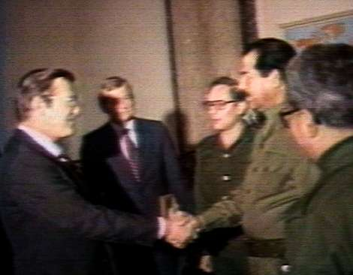

Slide 16
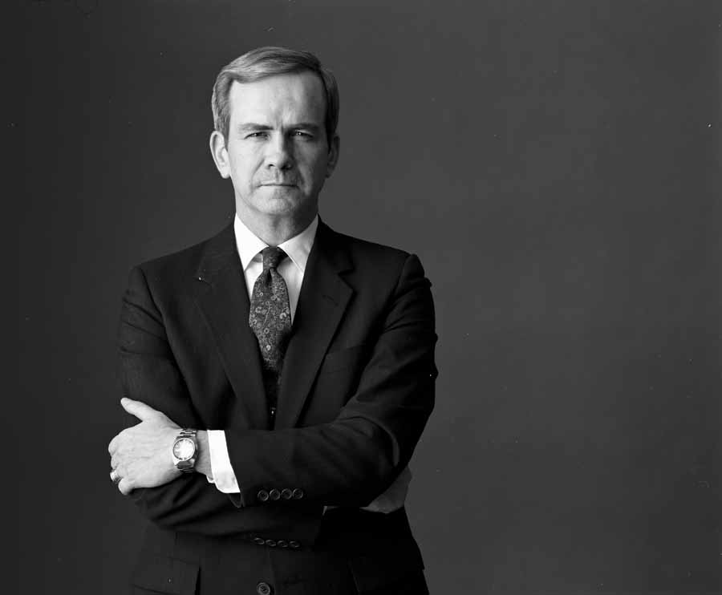

Slide 17
US shipment of weapons to Iran
1985
Aug. 20: Israel sends 96 TOW anti-tank missiles to Iran.
Sept. 14: Israel sends 408 more TOW missiles to Iran.
Nov. 24-25: The C.I.A. arranges for a shipment of 18 Hawk anti-aircraft missiles from Israel to Iran aboard a C.I.A. front company plane
1986
Feb. 17: The United States sends 500 TOW missiles to Israel, from American stocks, for shipment to Iran.
Feb. 27: Another shipment of 500 TOW missiles are sent to Israel, once again for shipment to Iran.
May 23-24: 508 TOW missiles and 240 spare parts for Hawk missiles are shipped to Israel.
Aug. 4: The United States sends Iran a shipment of spare parts for Hawk anti-aircraft missiles.
Oct. 28: 500 TOW missiles are sent from Israel to Iran.

Slide 18
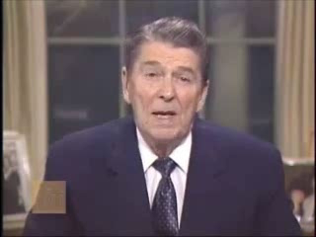

Slide 19
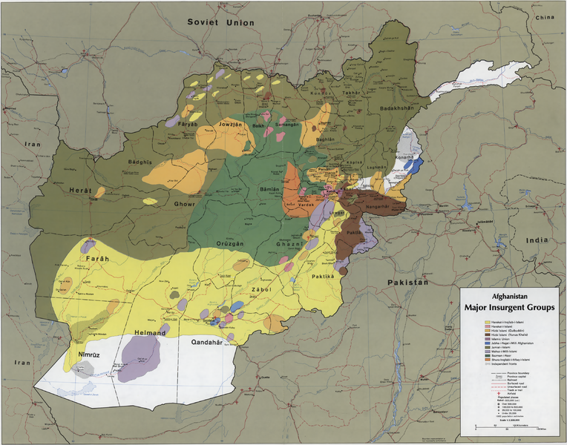

Slide 20
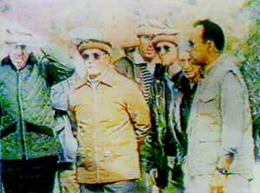

Slide 21


Slide 22


Slide 23
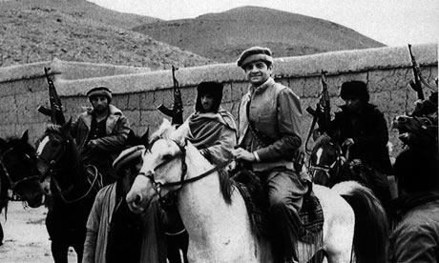
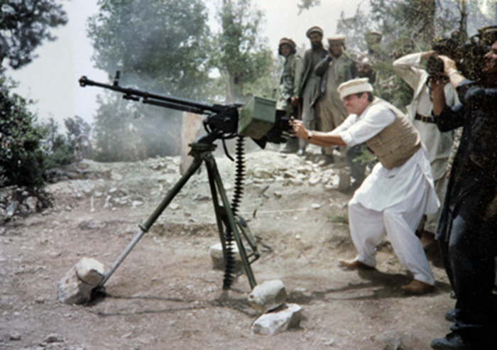

Slide 24
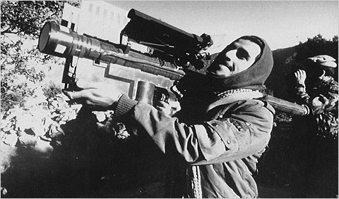

Slide 25
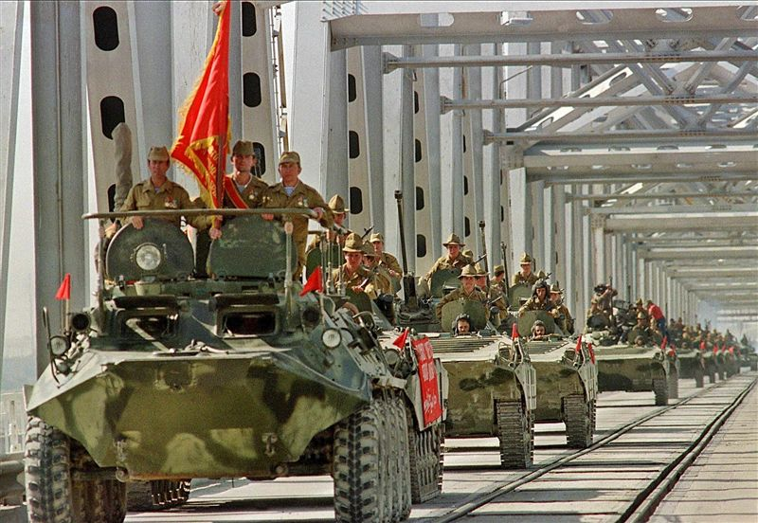

Slide 26
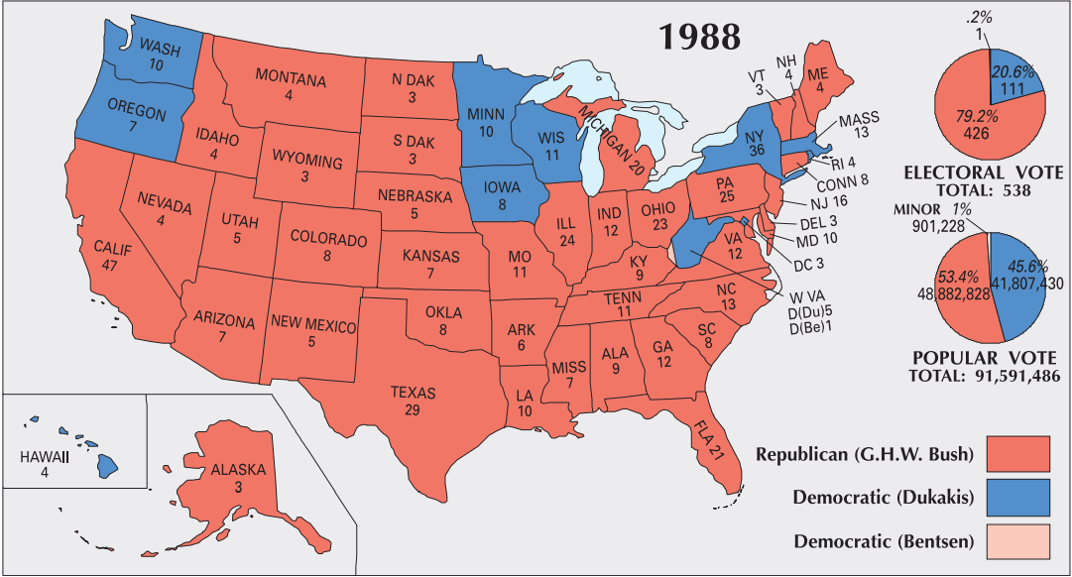

Slide 27
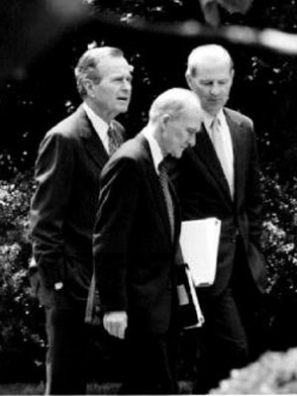
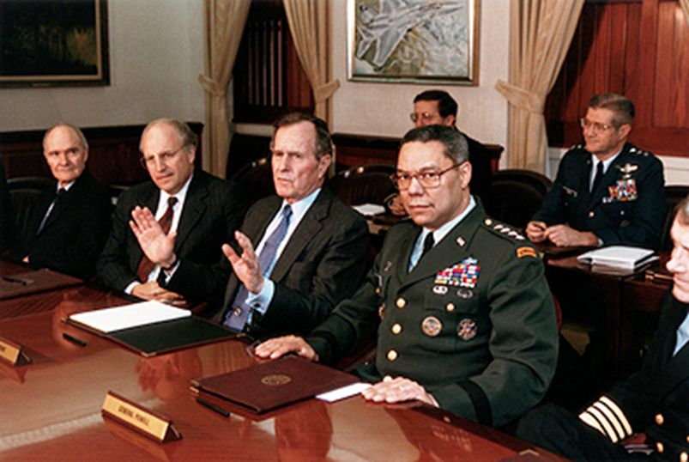

Slide 28



Slide 29
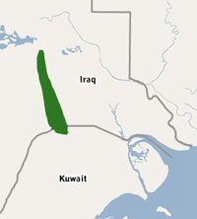
Notes:
Rumallah oil field

Slide 30


Slide 31
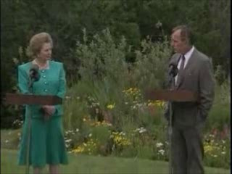

Slide 32
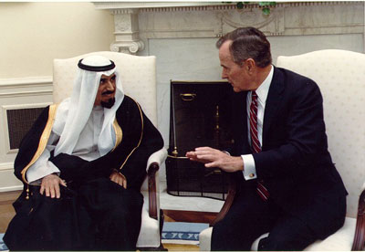
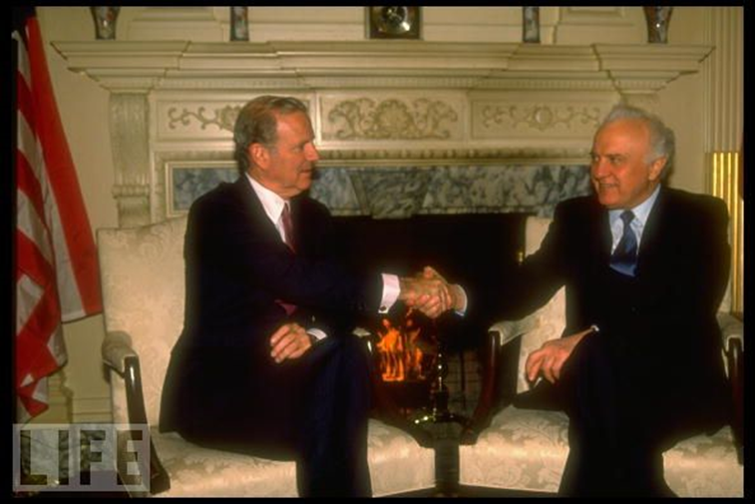
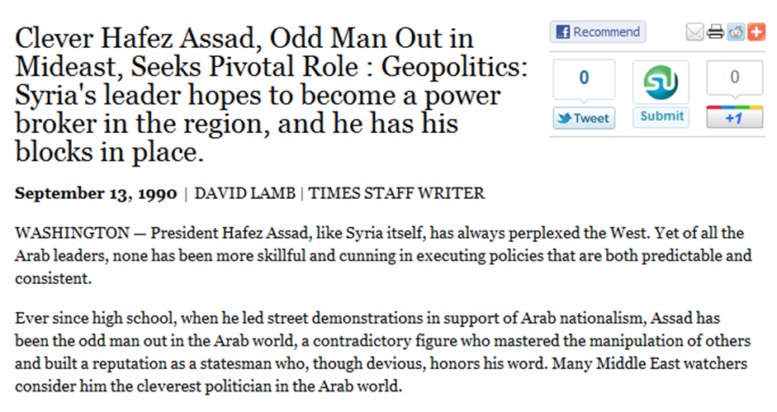
Notes:
Bush and emir of kuwait

Slide 33
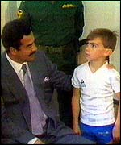

Slide 34
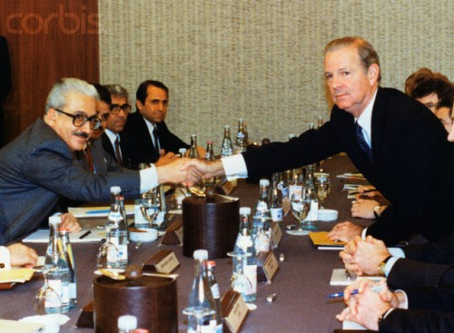

Slide 35
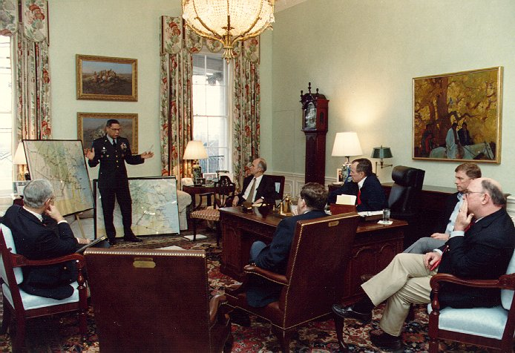

Slide 36
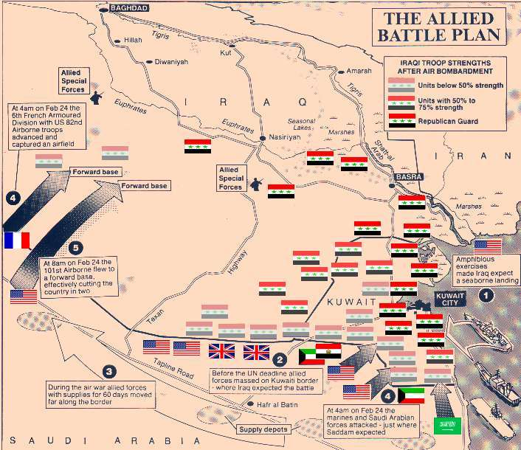

Slide 37
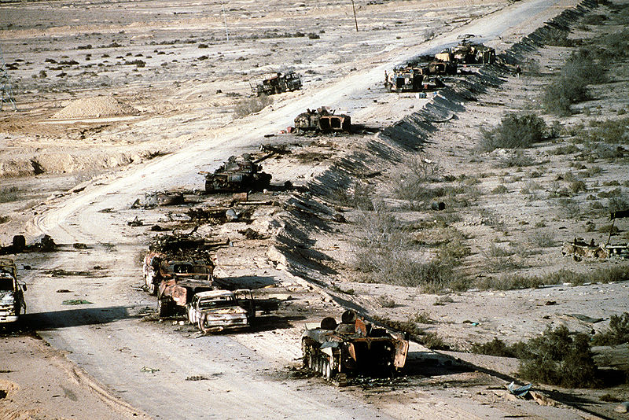

Slide 38
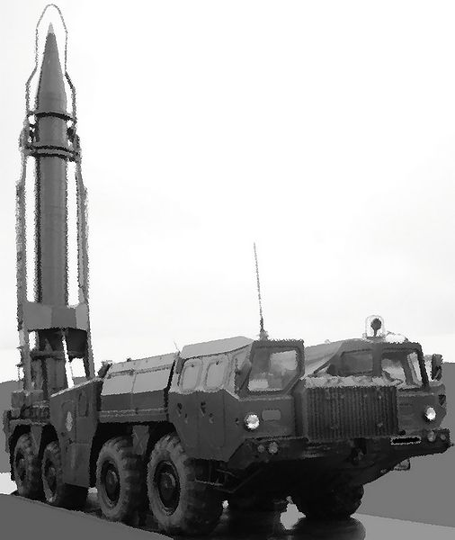
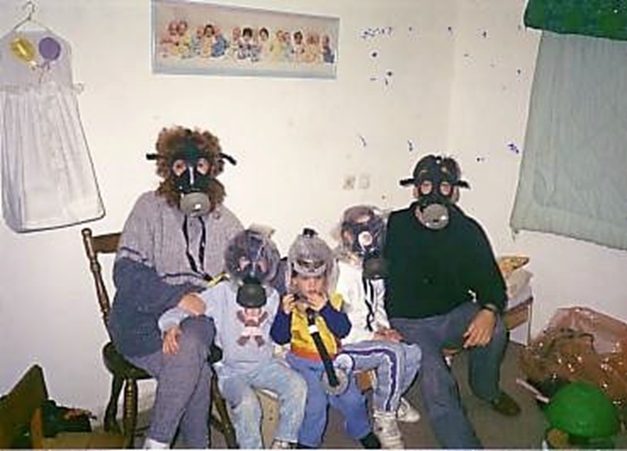
Notes:
scud

Slide 39
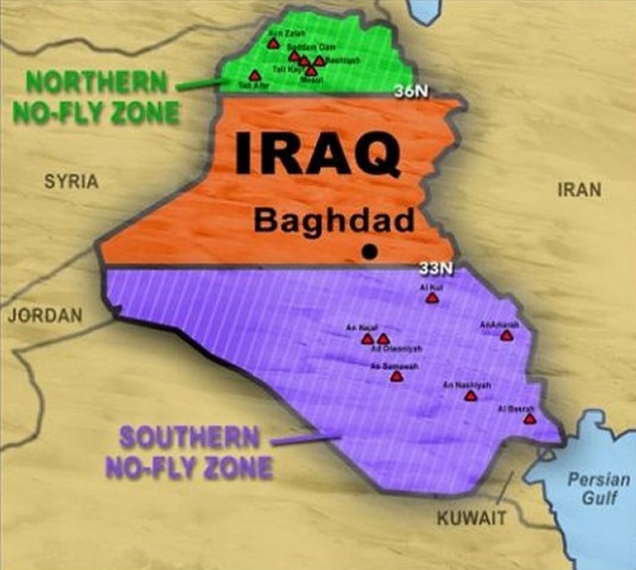

Slide 40
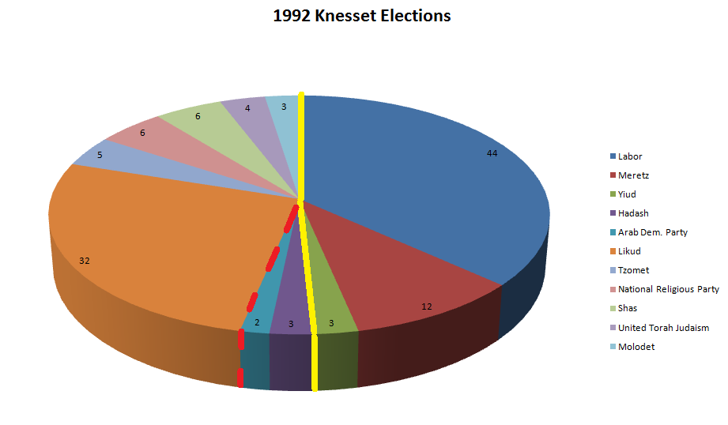

Slide 41


Slide 42
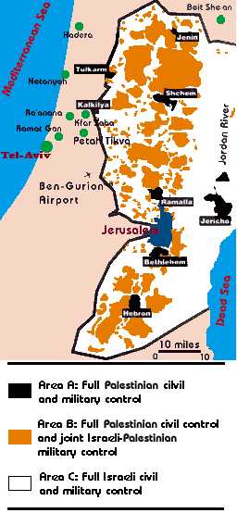

Slide 43
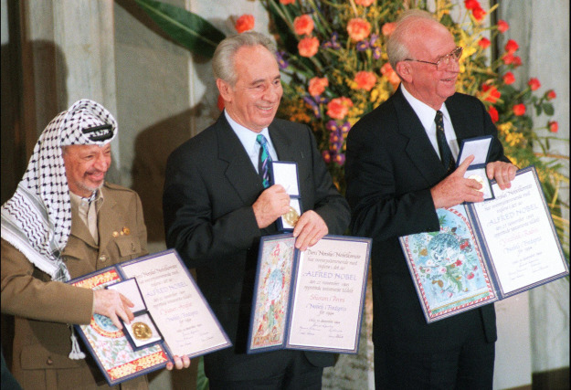

Slide 44
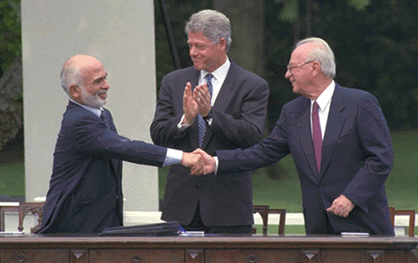

Slide 45
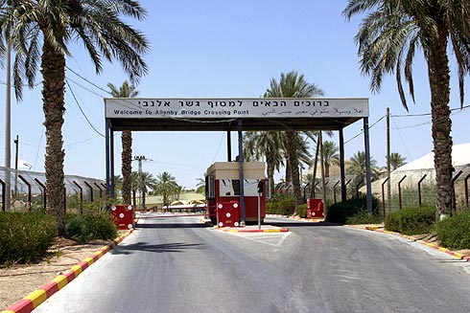

Slide 46
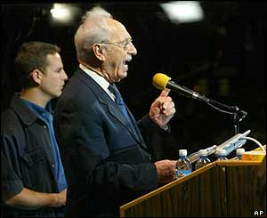

Slide 47
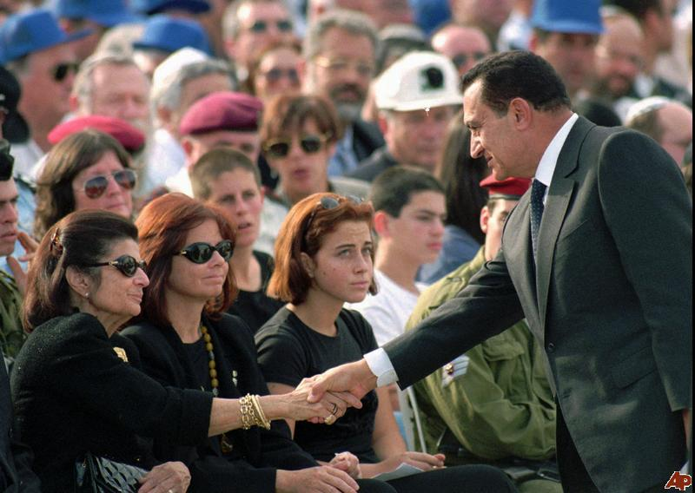
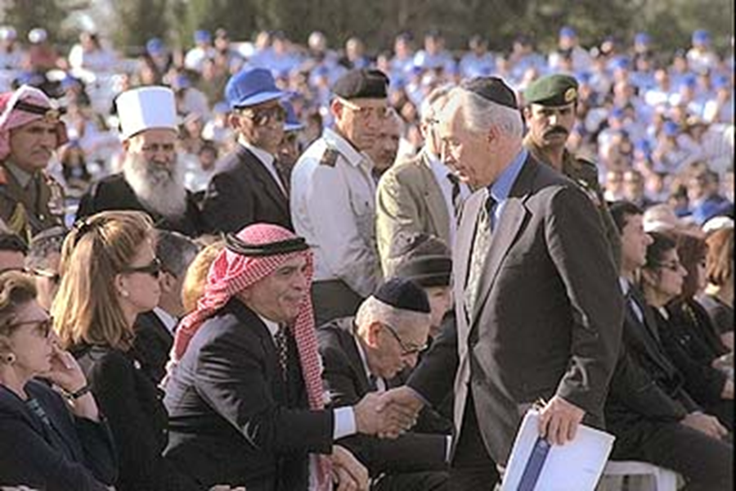

Slide 48
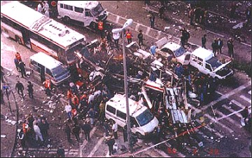
Notes:
Jerusalem 18 bus

Slide 49
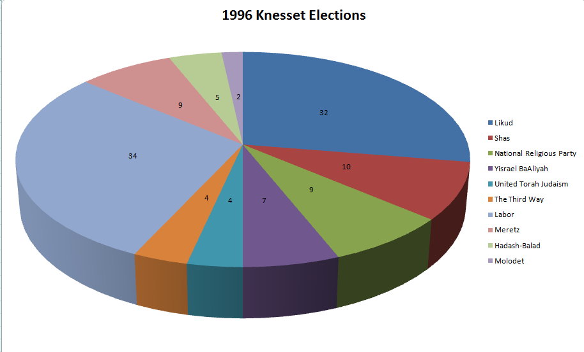

Slide 50



Slide 51


Slide 53


Slide 54


Slide 55


Slide 56


Slide 57


Slide 58


Slide 59

Notes:
Bin laden sudan house

Slide 60


Slide 61





Slide 62


Slide 63


Slide 64

Notes:
Cruise missile strike—bin laden alerted isi

Slide 65

Notes:
Sudan strike

Slide 66


Slide 67


Slide 68

We need to deal with the problems of terrorism and these new weapons of mass destruction. Look, we’re gonna face some serious new challenges in the next four years.

Slide 69

What’s in the best interests of our people? When it comes to foreign policy that will be my guiding question. Is it in our nation's interests? Peace in the Middle East is in our nation's interests.

