Slide 1


Slide 2
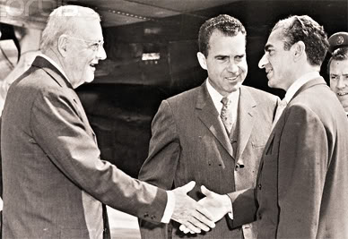
Notes:
1957

Slide 3

Douglas MacArthur, II: A strong Iran, sir, in terms of your conviction (which I share, 200 percent) that we must not see the basic balance between East and West altered radically . . . A strong Iran—
President Nixon: Yeah.
MacArthur: You know, the Soviets have been able, through their polarization of this Arab-Israel conflict—they have been able to gain increasing influence—
President Nixon: Oh!
MacArthur: —in these places, no question about it. A strong Iran helps to counterbalance that.
President Nixon: That’s right. It’s just one friend there. Face it, Iran is not of either world, really, in a sense. I guess. But the point it—if I felt, if we can go with that, we can have them strong. They’re at the center of it, and a friend of the United States. I couldn’t agree more, it’s something.
Because if you look around there, it just happens: Who else do we have, except for Europe? The Southern Mediterranean—it’s all gone.
[Morocco’s King] Hassan will be here—he’s a nice fellow, but Morocco, Christ, they can’t last [against the Soviets].
Morocco, Tunisia, Libya, Algeria. Sudan. Naturally, the UAR. All those little miserable countries around—Jordan, and Lebanon, and the rest . . . They’re like—they’d go down like ten-pins, just like that.
Some of them would like to be our friends. But central to every one of those countries (even as far off as Morocco) is the fact that the United States is aligned with Israel. And because we’re aligned with Israel [bangs the desk for emphasis], we are their enemy.
MacArthur: That’s right.
President Nixon: That’s what it is.
Now, this doesn’t mean that we let Israel go down the drain—because that would play into the Soviet hands, too. But it does mean that right now, we’re in a hell of a difficult spot. Because our Israeli tie makes us unpalatable to everybody in the Arab world, doesn’t it?
MacArthur: It does. To varying degrees.
President Nixon: Yes, some are like—but the Shah—the Shah—
MacArthur: Not wholly—
President Nixon: He’s awfully good with that stuff, you’d have to say.
MacArthur: He is.

Slide 4
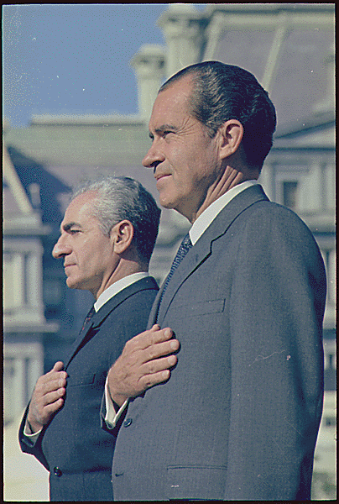
Notes:
Rn shah dc 1969

Slide 5
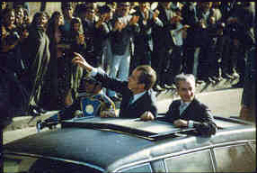
Notes:
1972—RN in Teheran

Slide 6
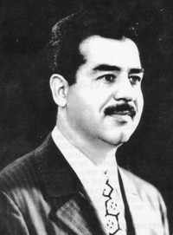

Slide 7
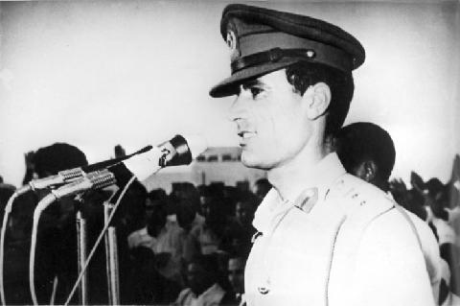

Slide 8
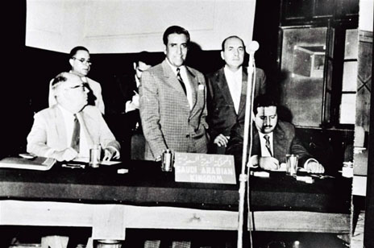
Notes:
Opec 1960—iran, iraq, kuwait, sa, ven

Slide 9
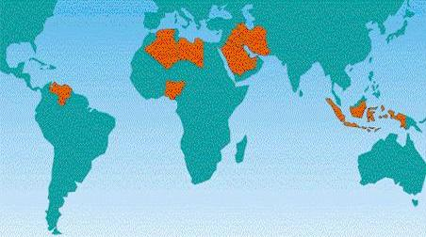

Slide 10
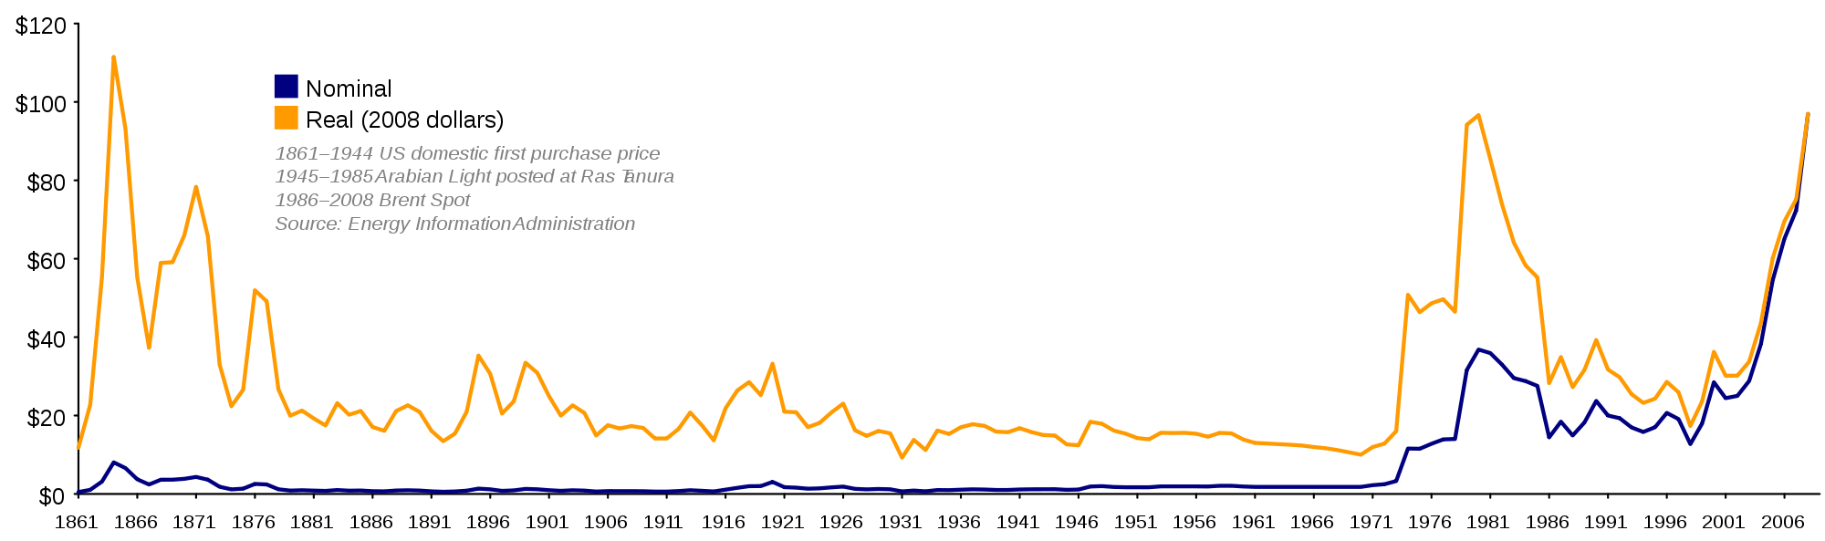

Slide 11
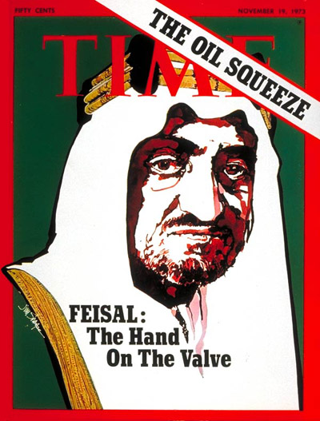

Slide 12
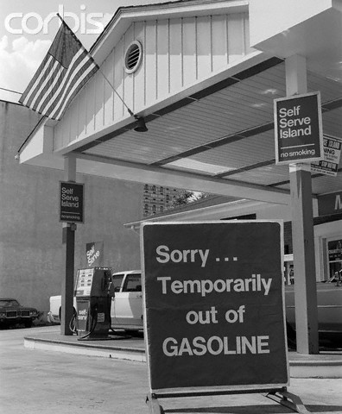

Slide 13
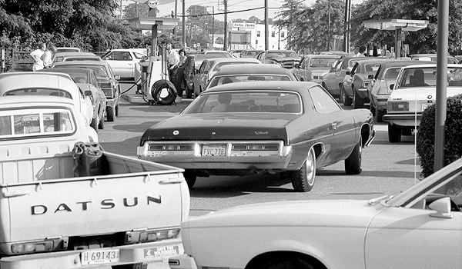

Slide 14
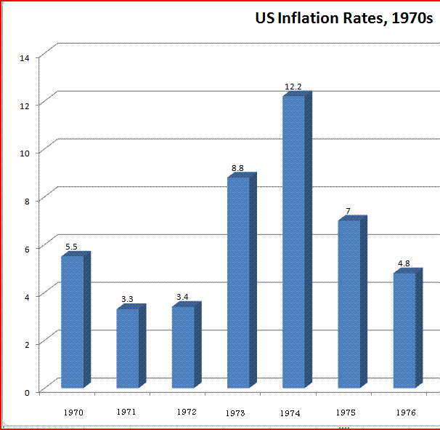

Slide 15
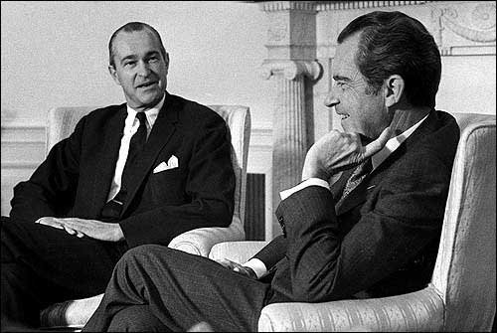
Notes:
Nixon helms

Slide 16
President Nixon: The Iranian oil thing, as you know, is in a, apparently one hell of a [mess?] . . .
[Break.]
President Nixon: What I have in mind: I’ve talked to—and everybody here thinks it’s a great idea (and I was talking to Henry [Kissinger] about something) . . . What I really have in mind is for you, basically, to be sort of the—without downgrading the other ambassadors—the ambassador in charge of that sort of area, you know what I mean?
Richard Helms: Yes, sir.
President Nixon: Particularly with [unclear] . . . So you could go down to those sheikdoms, and . . . and these other places, and pull this thing to—and then give us the recommendation, you know? And in charge of the area not only in terms of oil, and so forth, but in terms of the stability of the governments [excised for national security purposes].

Slide 17
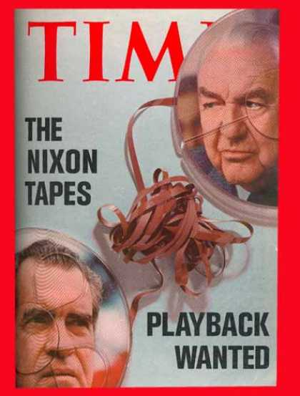

Slide 18


Slide 19
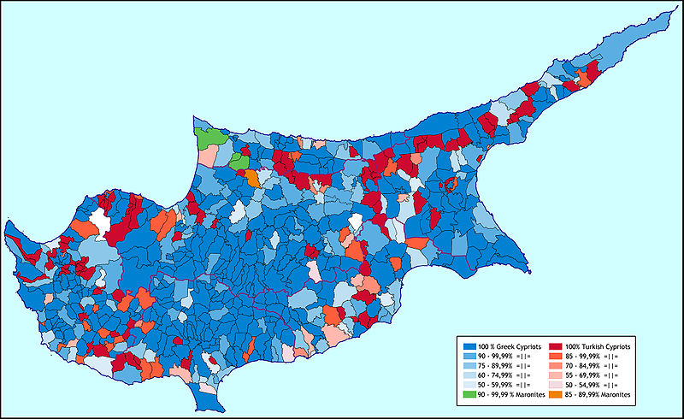

Slide 20
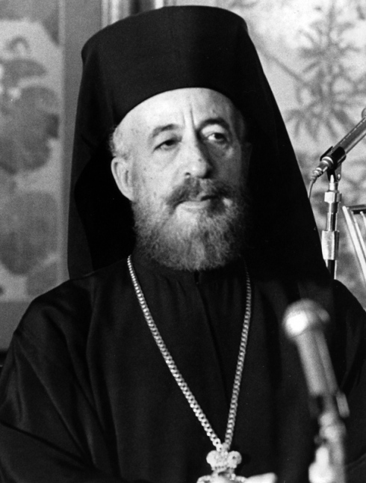

Slide 21
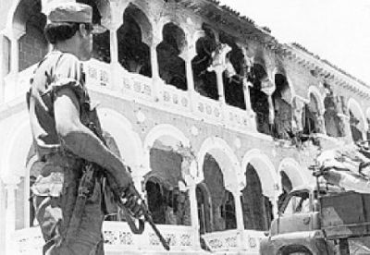
Notes:
Mkarios residence right after coup 15 jl74

Slide 22
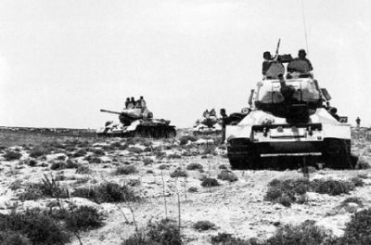

Slide 23
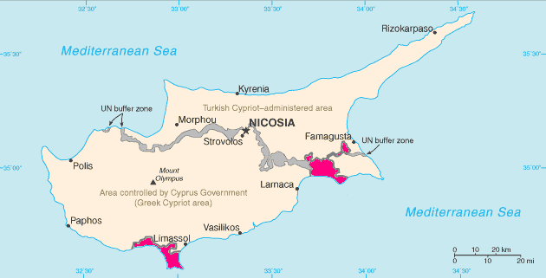

Slide 24
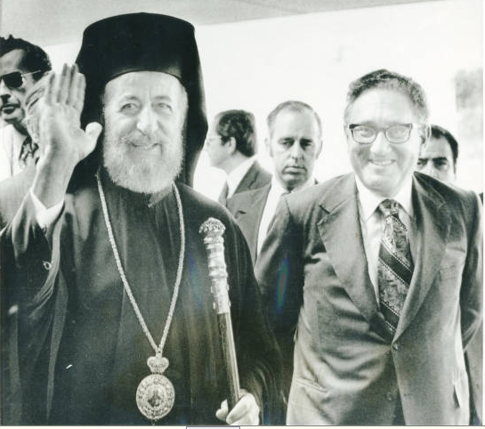

Slide 25
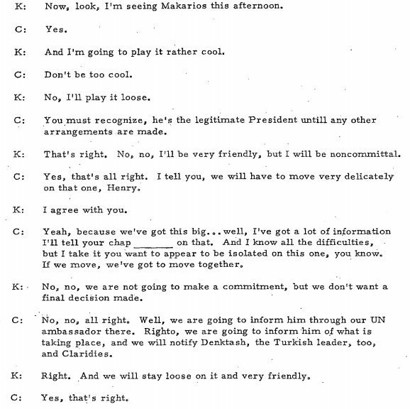
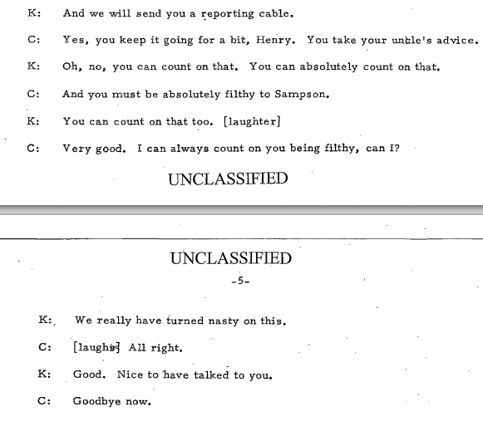

Slide 26
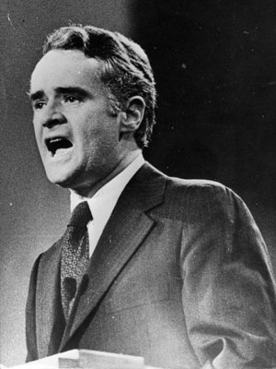

Slide 27
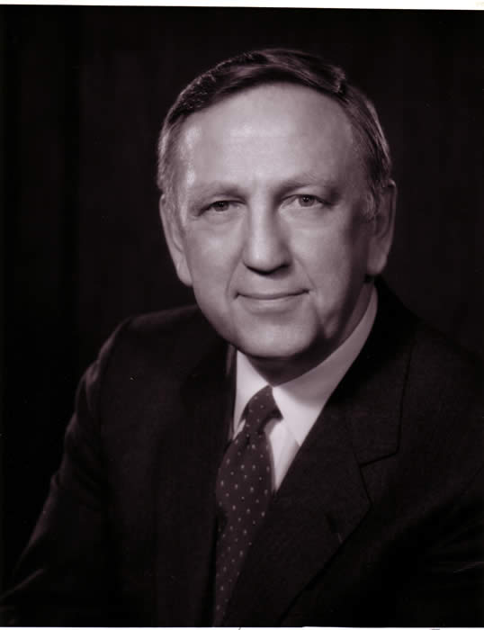
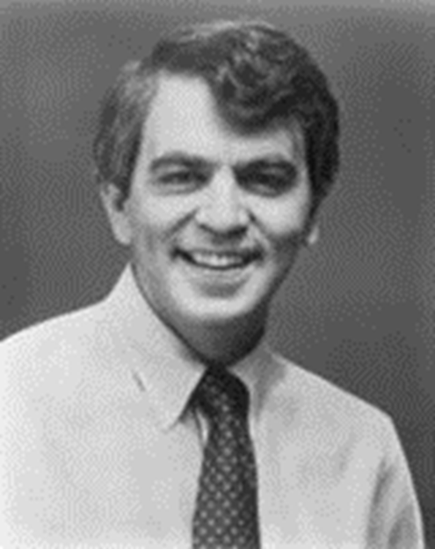
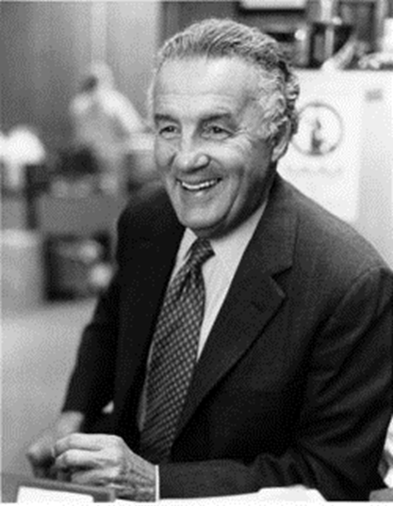
Notes:
brademas

Slide 28
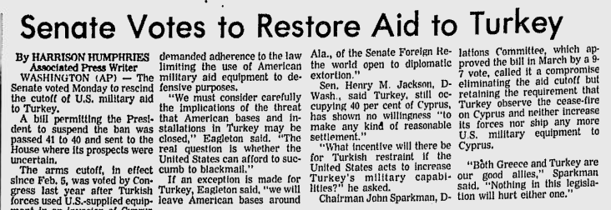

Slide 29
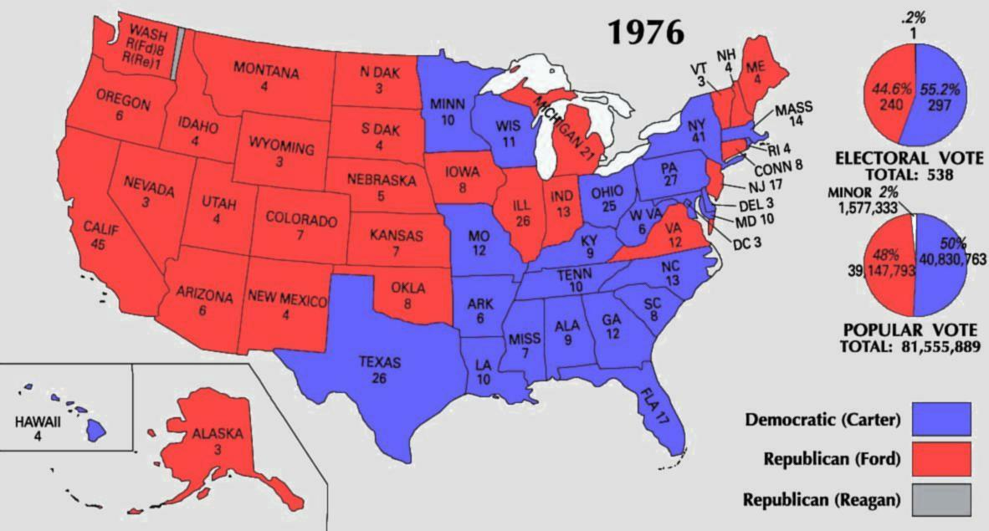

Slide 30
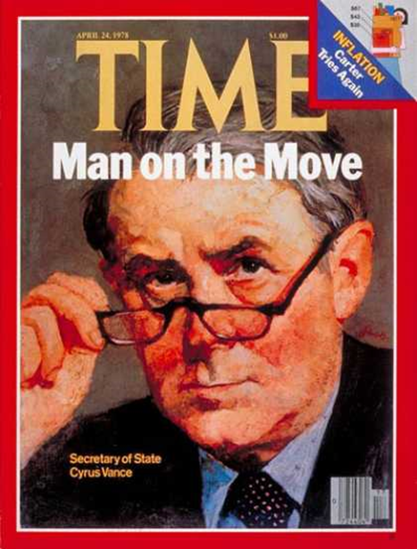
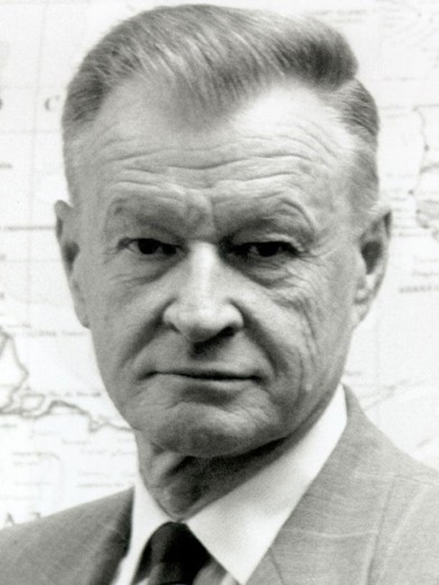
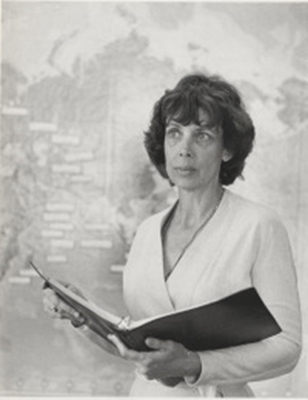

Slide 31
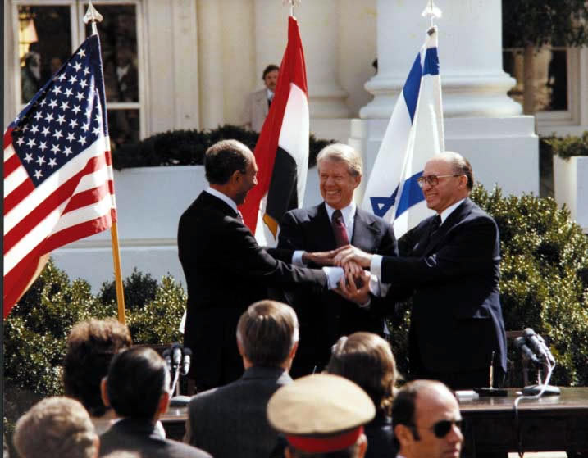

Slide 32
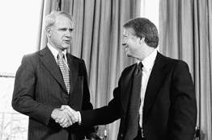

Slide 33
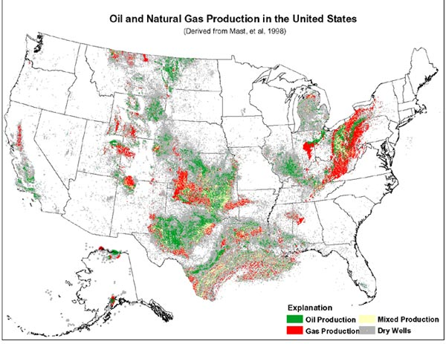

Slide 34
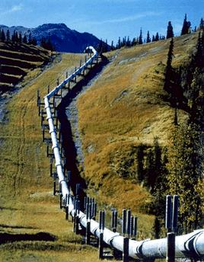

Slide 35
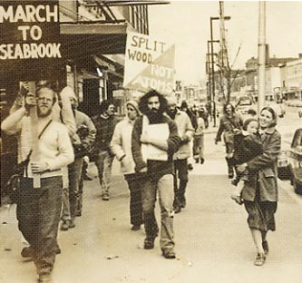

Slide 36
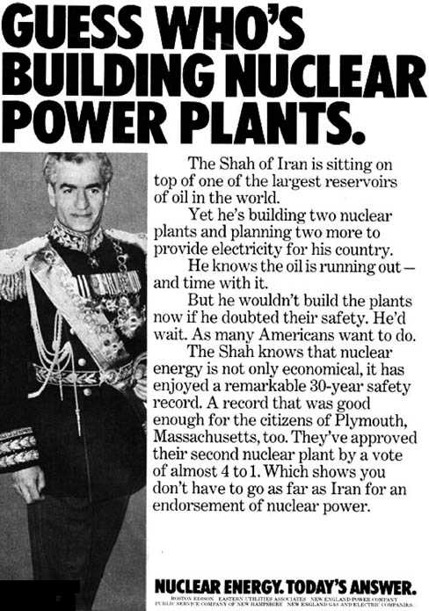

Slide 37
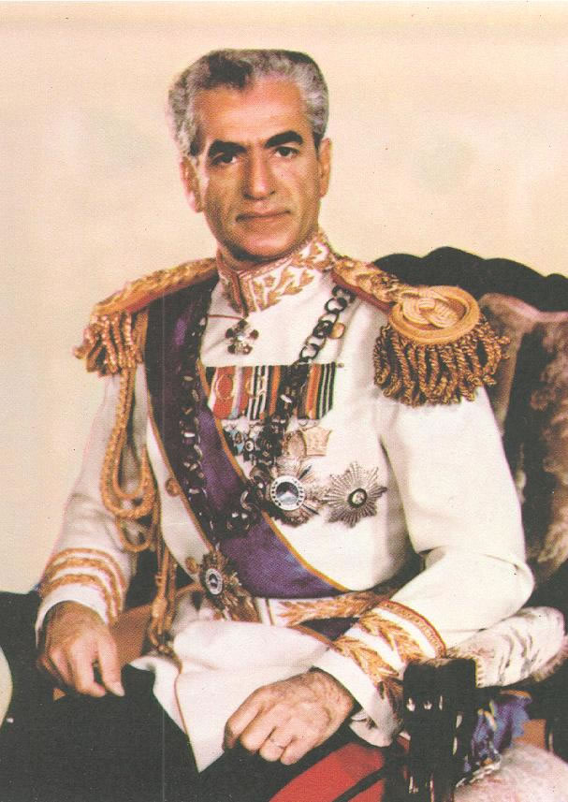

Slide 38
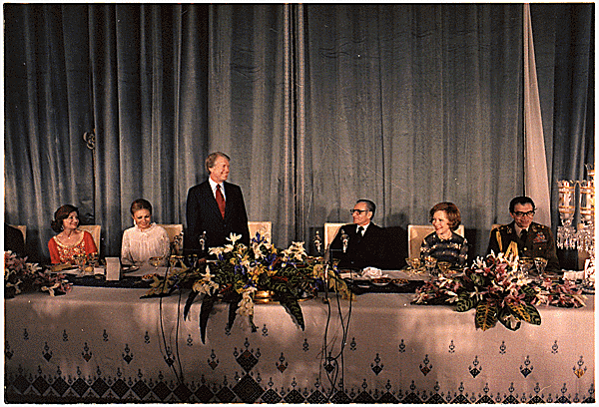
Notes:
Carter late 77 teheran state visit—shah as oasis of stability

Slide 39
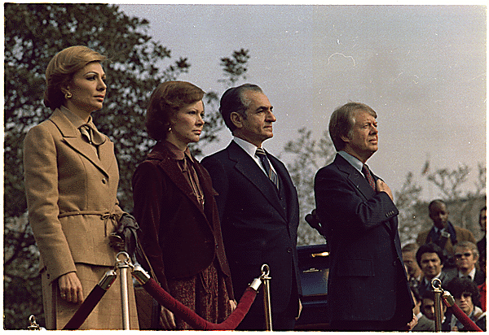
Notes:
State visit to US

Slide 40


Slide 41
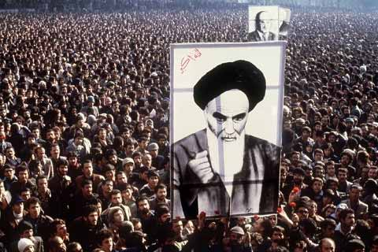

Slide 42
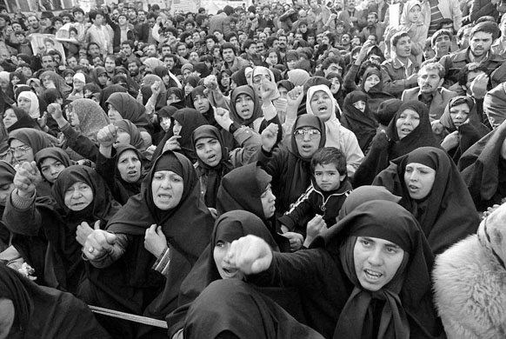

Slide 43
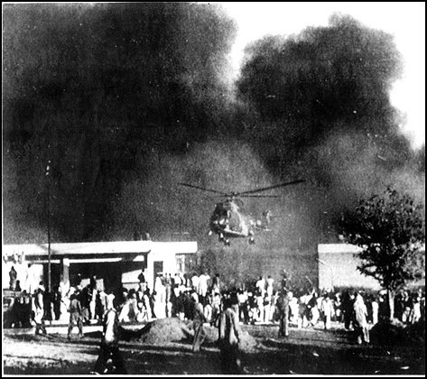
Notes:
Burning of embassy in Islamabad

Slide 44
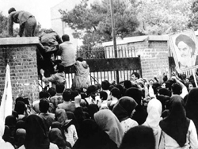

Slide 45
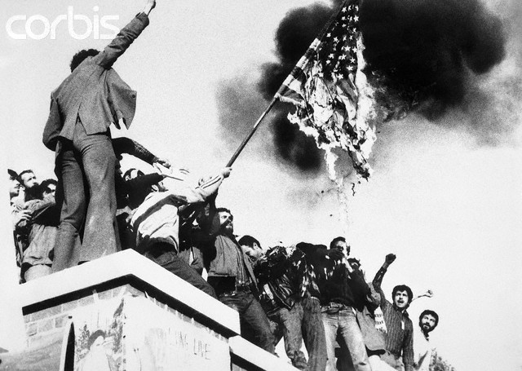
Notes:
seizure

Slide 46
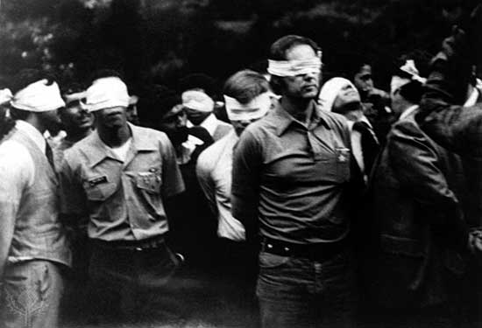

Slide 47
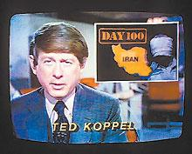

Slide 48
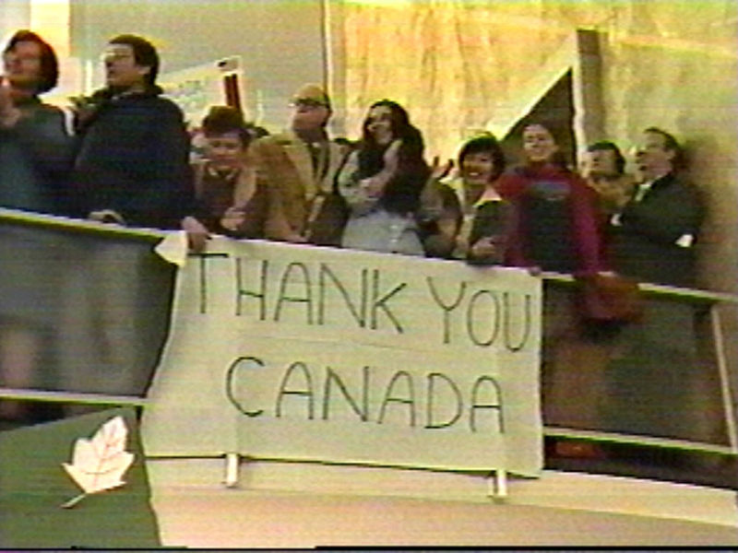
Notes:
Canadian caper

Slide 49
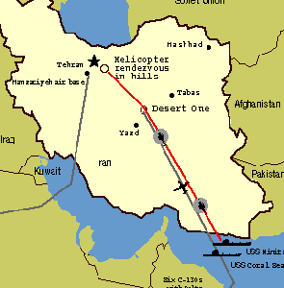

Slide 50
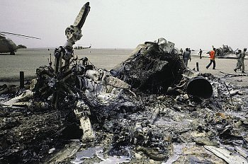

Slide 51


Slide 52


Slide 53

Notes:
Bombay cavalry

Slide 54


Slide 55


Slide 56


Slide 57


Slide 58


Slide 59


Slide 60


Slide 61


Slide 62


Slide 63


Slide 65

Ed Rollins: “We just beat his brains out. We stood him up in front of an open grave and told him he could jump in if he wanted to.”

Slide 66


Slide 67


