Slide 1
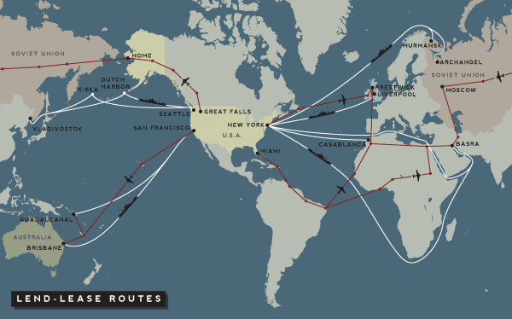

Slide 2
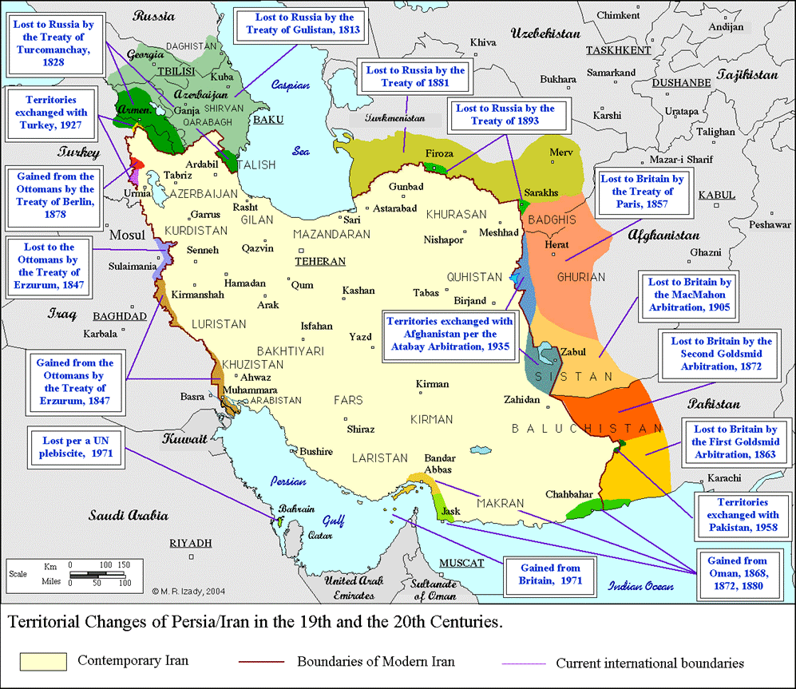

Slide 3
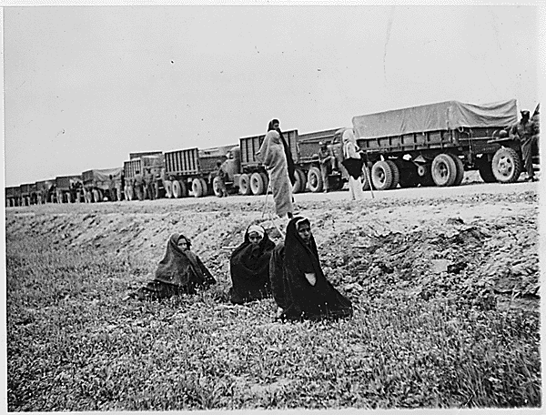
Notes:
Persian corridor

Slide 4
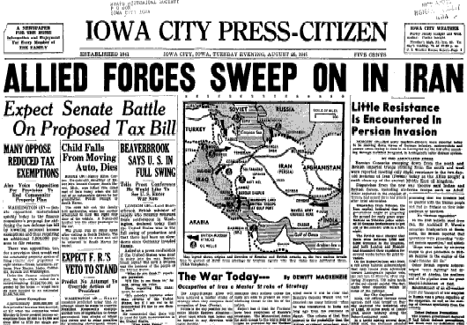

Slide 5
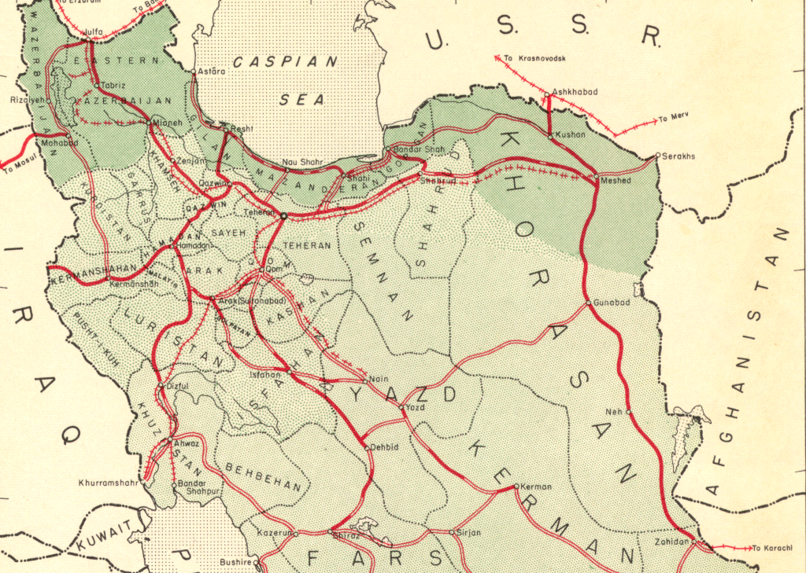

Slide 6
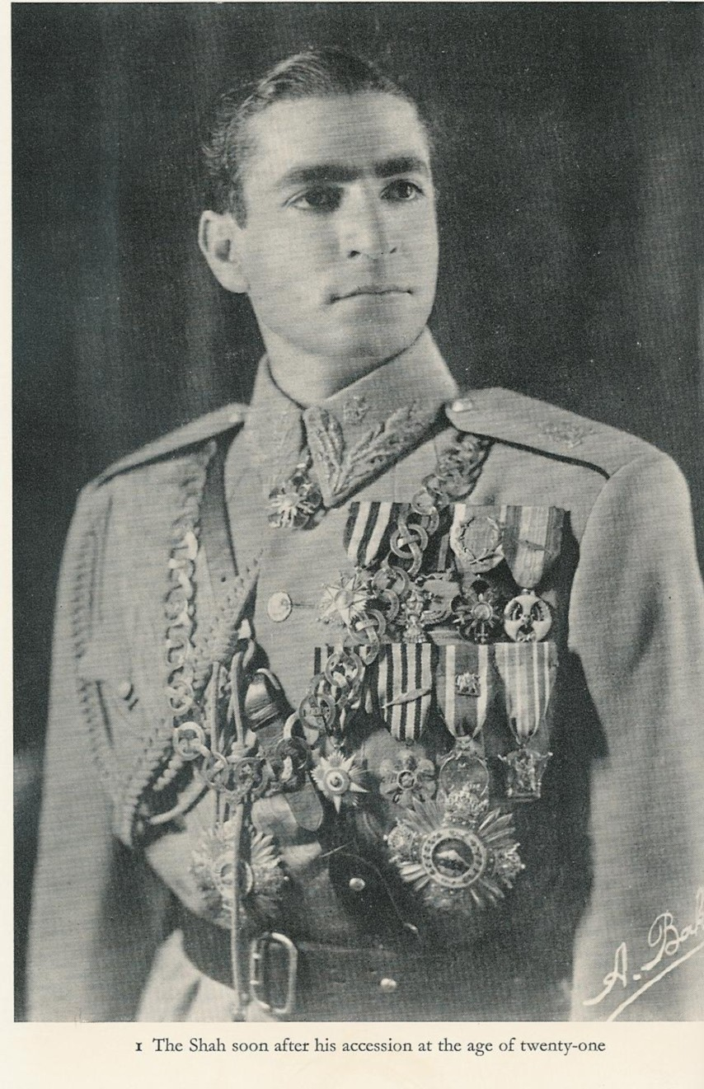

Slide 7
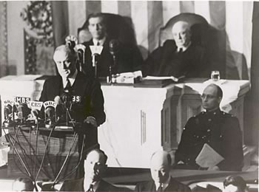

Slide 8
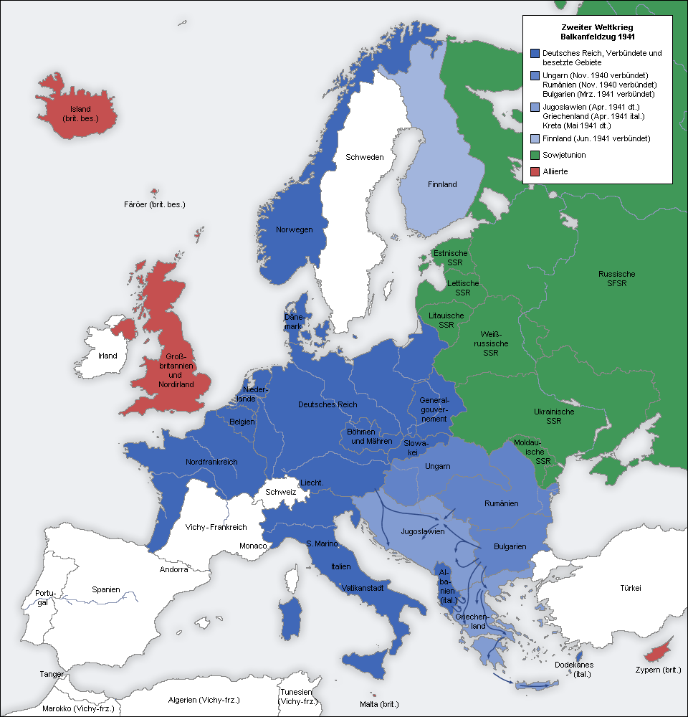

Slide 9
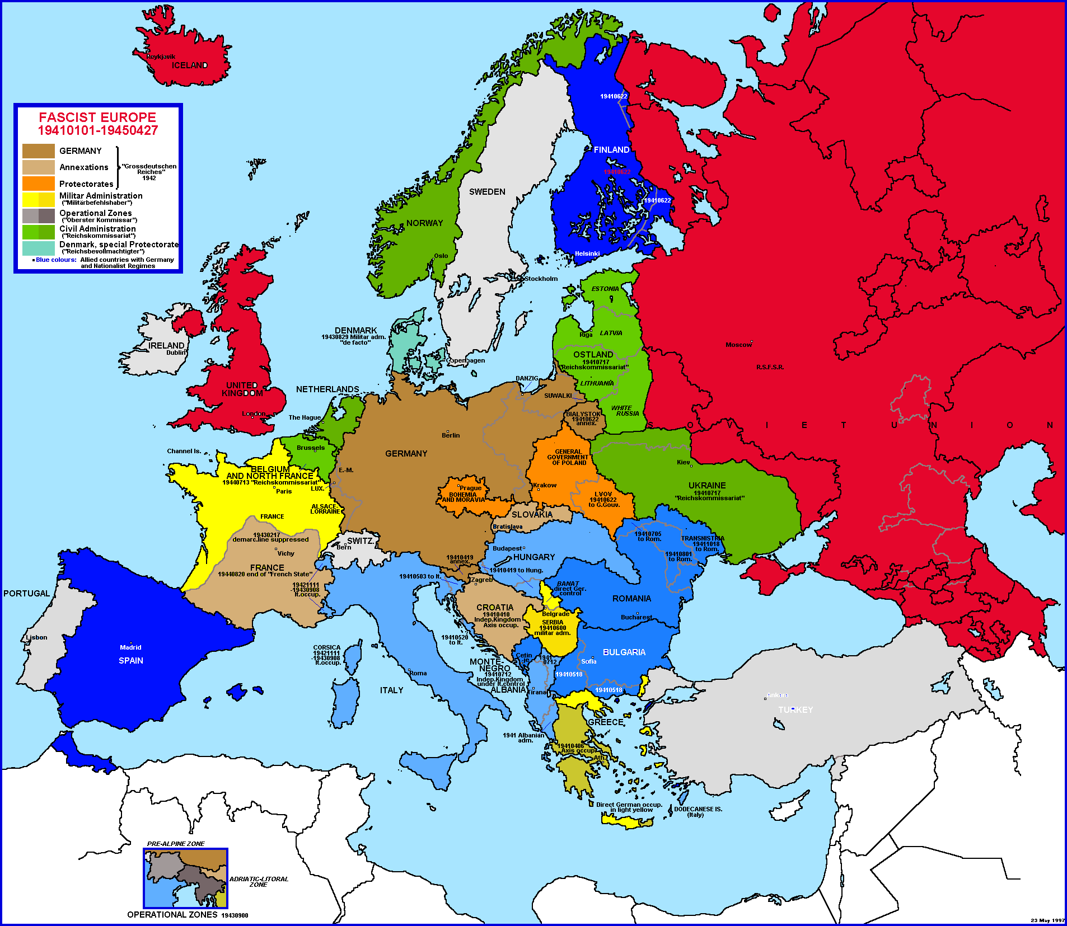

Slide 10


Slide 11
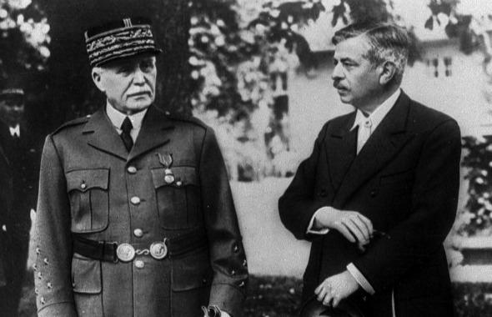
Notes:
petain

Slide 12
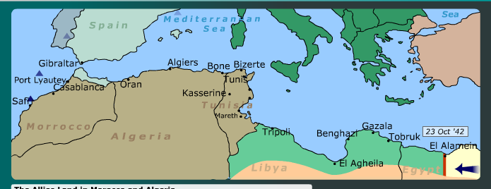

Slide 13
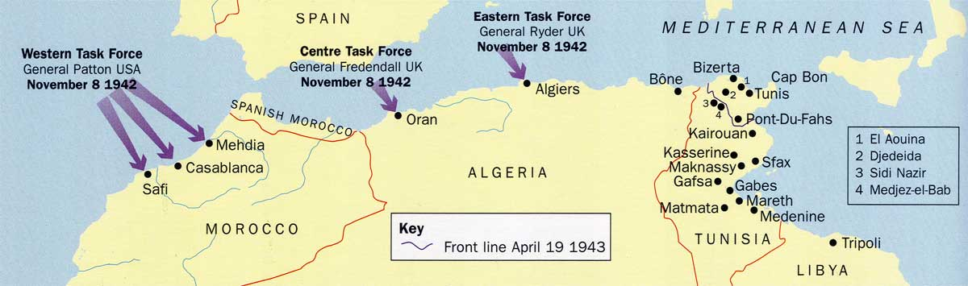

Slide 14
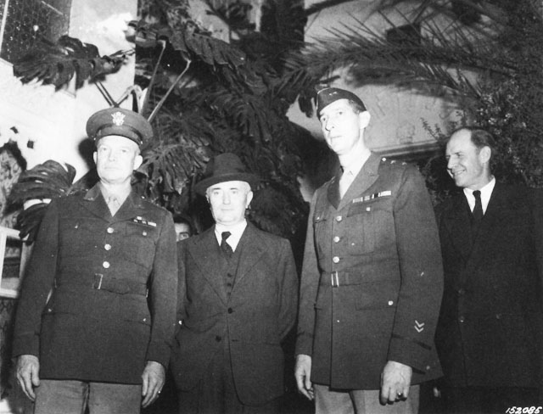
Notes:
Dde with darlan

Slide 15
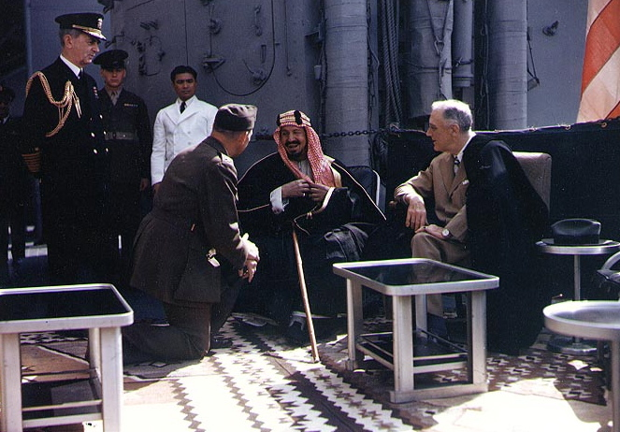
Notes:
Fdr and ibn saud

Slide 16
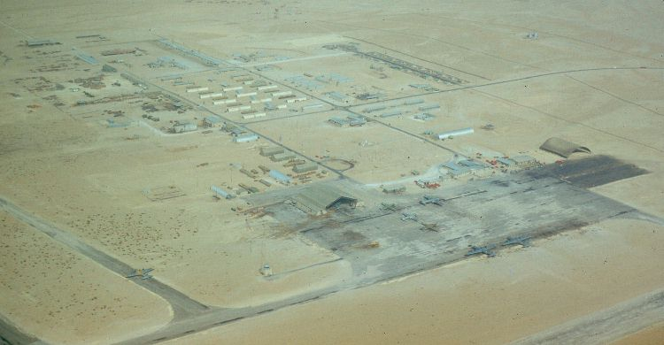
Notes:
Dharhan air field (1950)

Slide 17
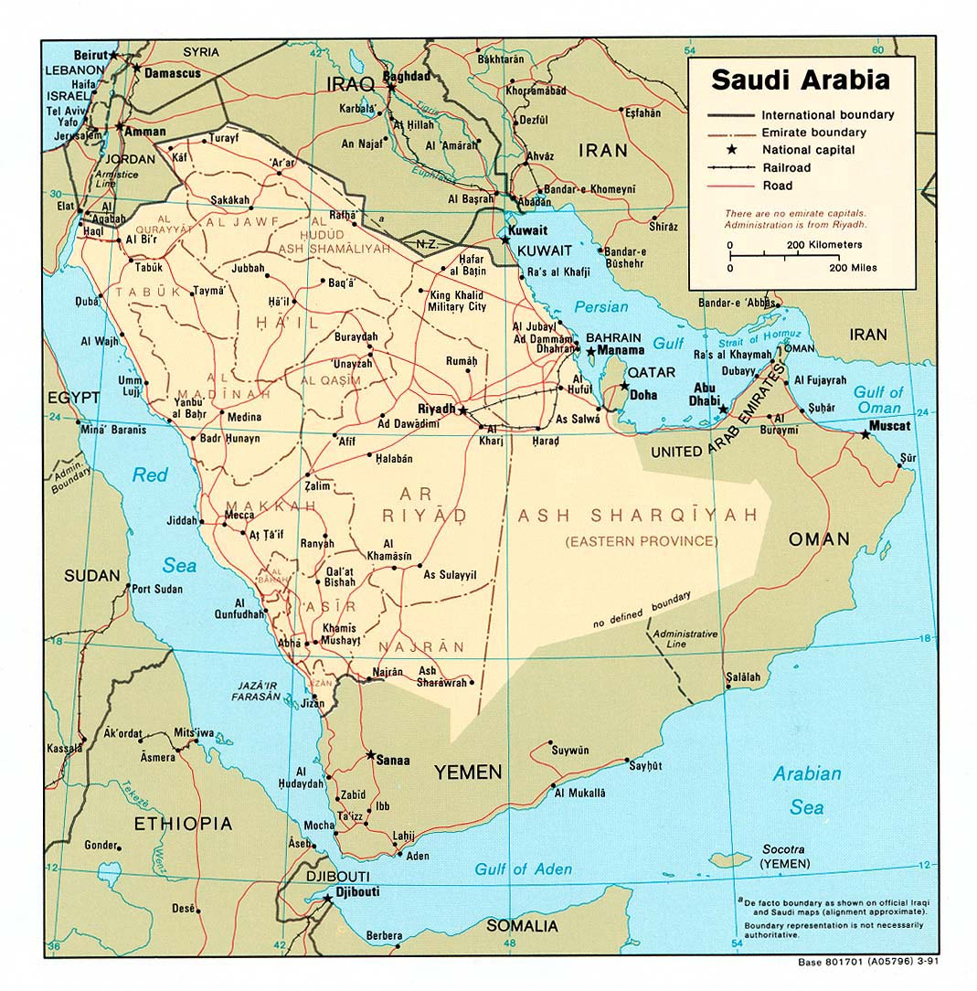

Slide 18
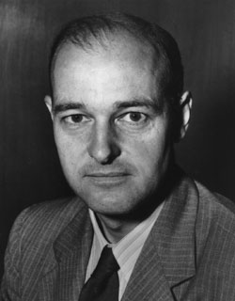

Slide 19
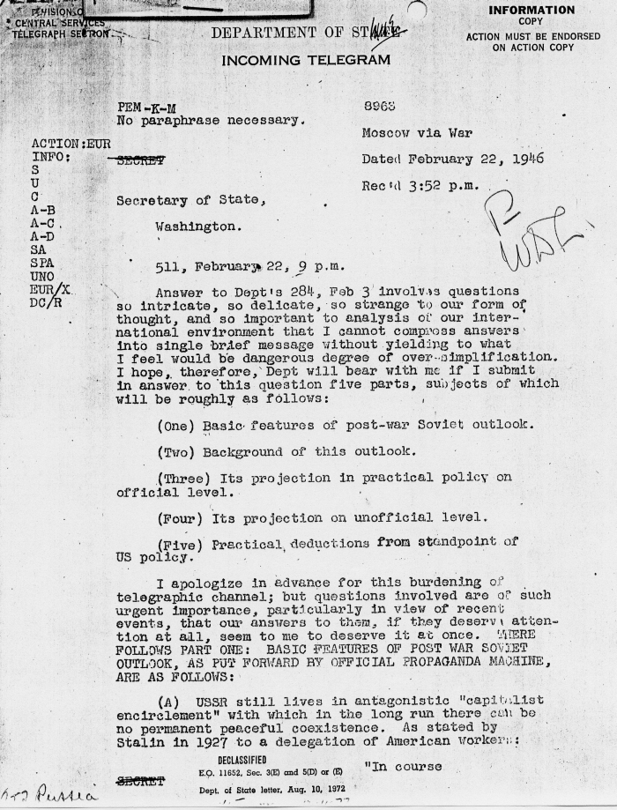

Slide 20
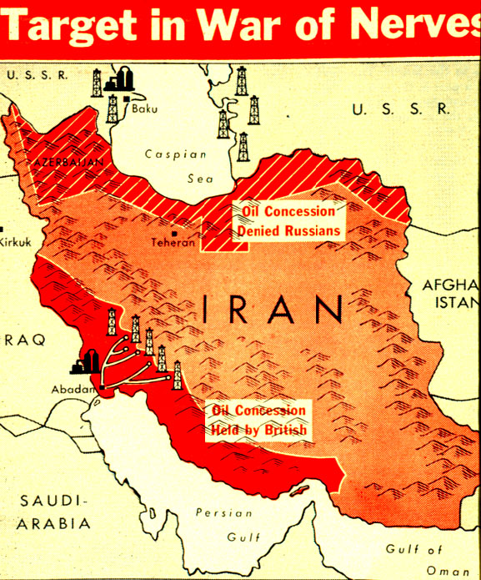

Slide 21
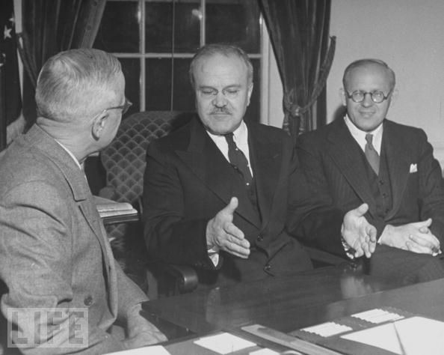
Notes:
Truman molotov

Slide 22
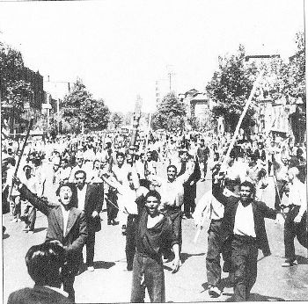
Notes:
Tudeh protesters

Slide 23


Slide 24
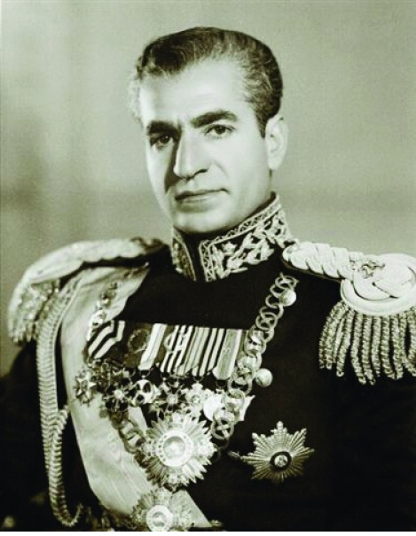

Slide 25
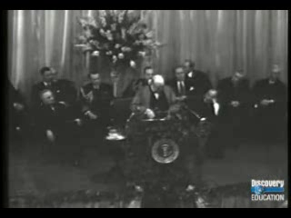

Slide 26
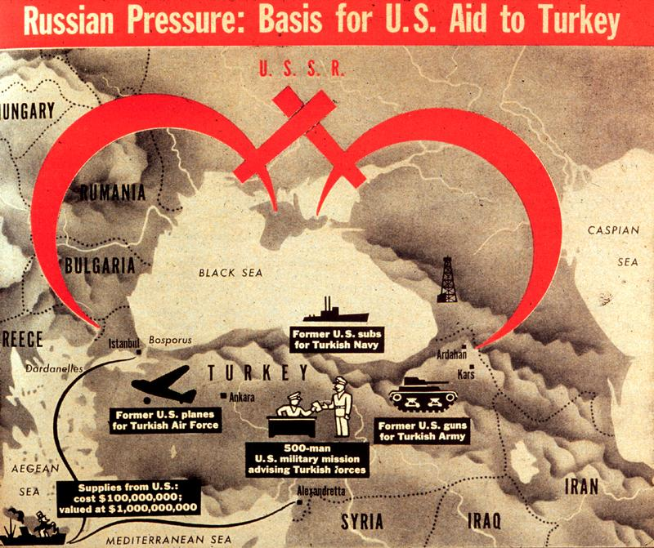

Slide 27


Slide 28
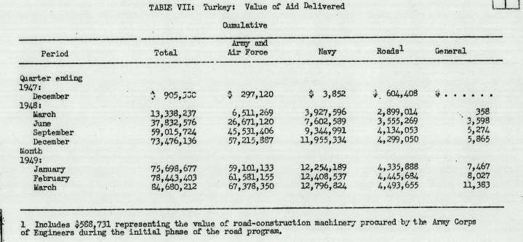

Slide 29
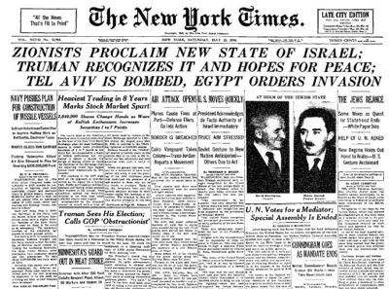

Slide 30
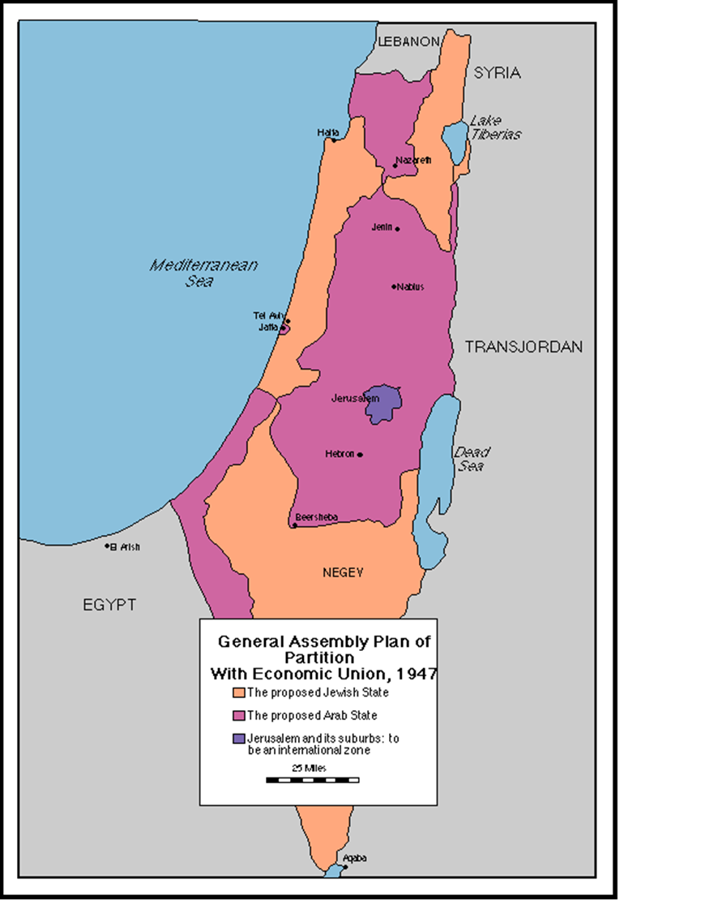
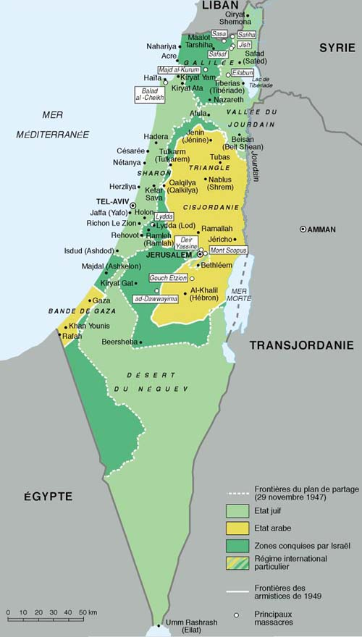

Slide 31
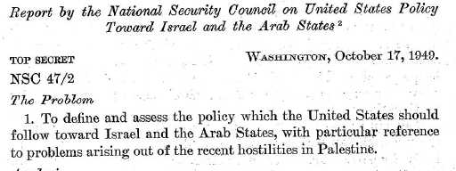

Slide 32
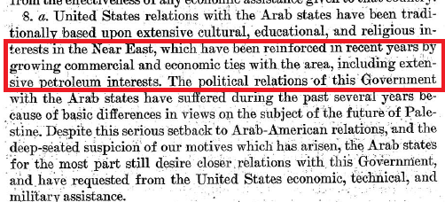

Slide 33
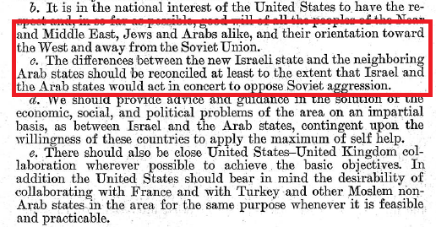

Slide 34
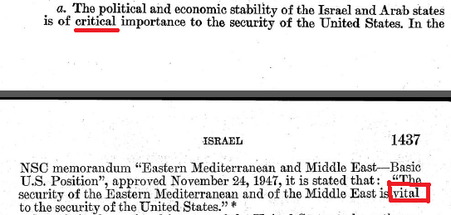

Slide 35
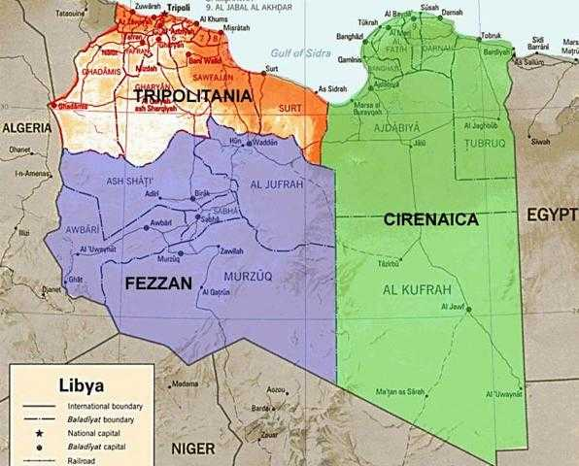

Slide 36
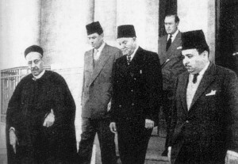
Notes:
Gov’t of Emirate of Cyrenaica (1949)

Slide 37
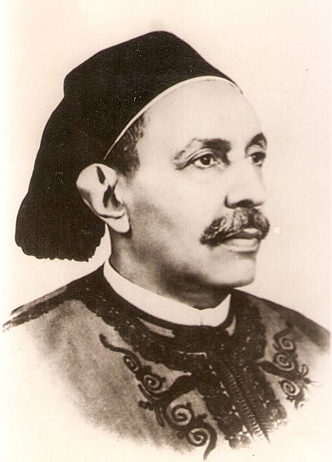
Notes:
idris

Slide 38
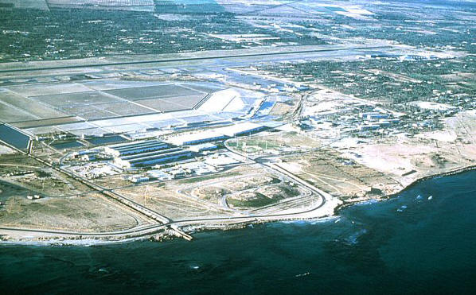
Notes:
Wheelus air base

Slide 39
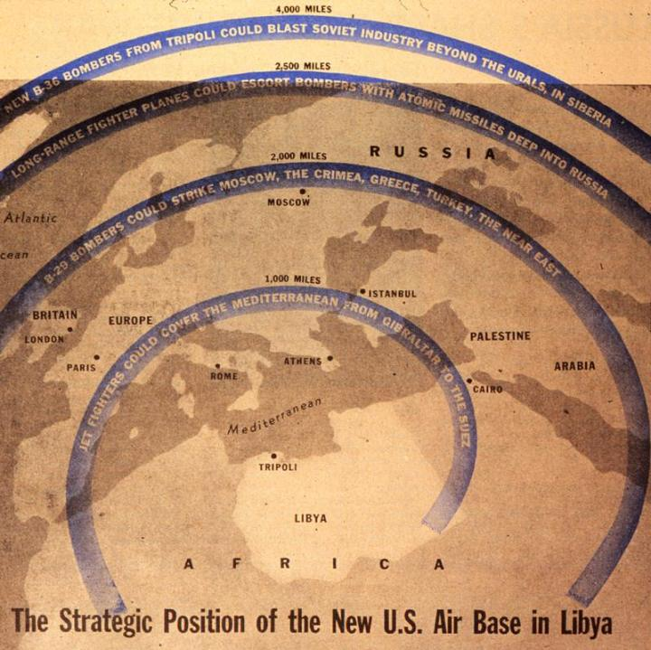

Slide 40
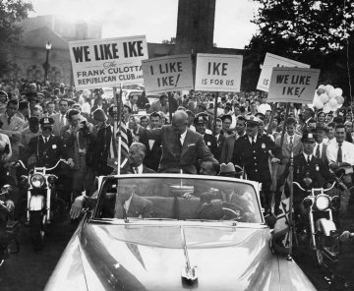

Slide 41


Slide 42
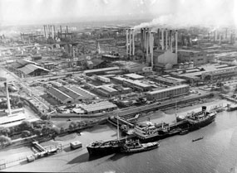
Notes:
Abadan refinery

Slide 43
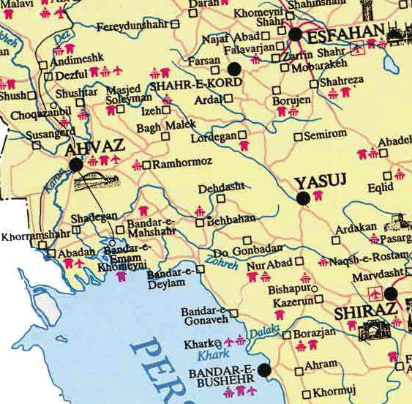

Slide 44
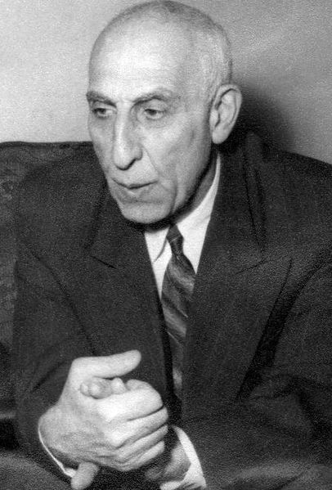
Notes:
mossadeq

Slide 45
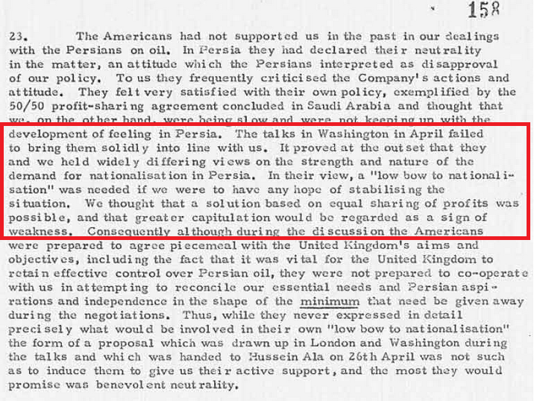
Notes:
Bri memo, 1951

Slide 46


Slide 47

Notes:
Allen dulles

Slide 48
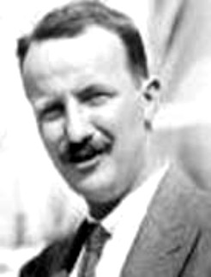
Notes:
Kermit roosevelt (grandson TR)

Slide 49
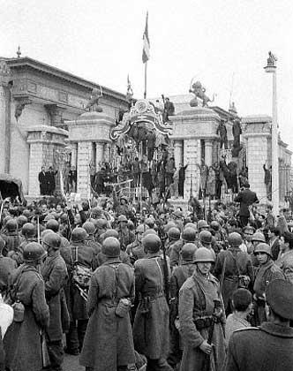
Notes:
Soldiers surrounding parliament

Slide 50
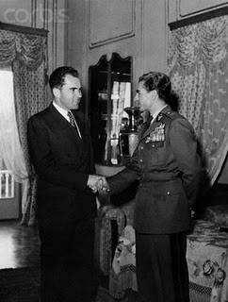

Slide 51
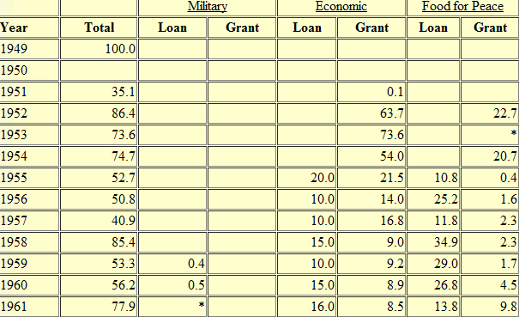
US Aid to Israel, FY 1949-1961 (millions of $$)

Slide 52
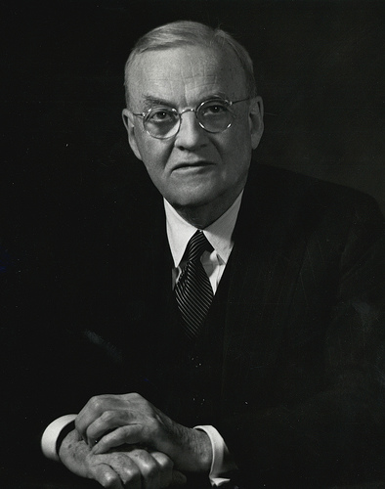

Slide 53
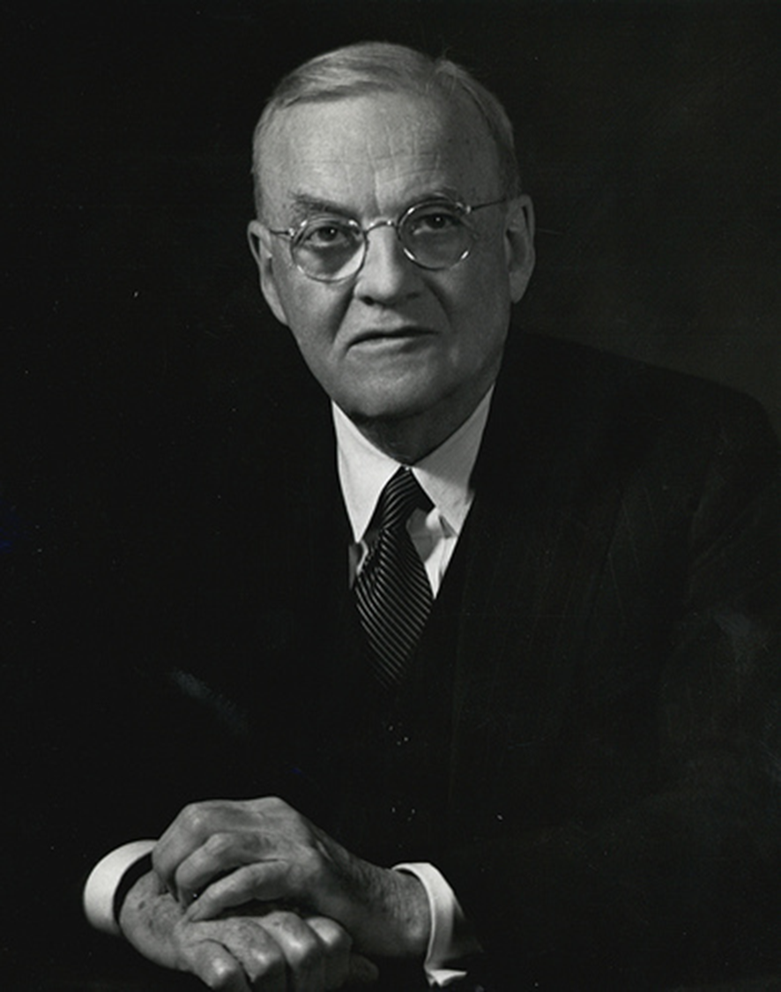
Dulles 1955 Council on Foreign Relations address
The tragic plight of 900,000 Arab refugees
The “pall of fear” of Israeli expansion and eventual Arab retaliation
The lack of fixed, permanent boundaries

Slide 54
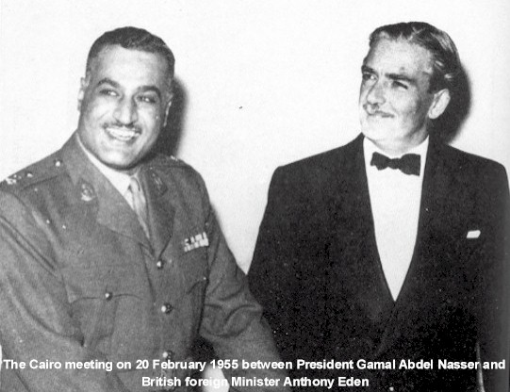

Slide 55

Notes:
Aswan dam

Slide 56
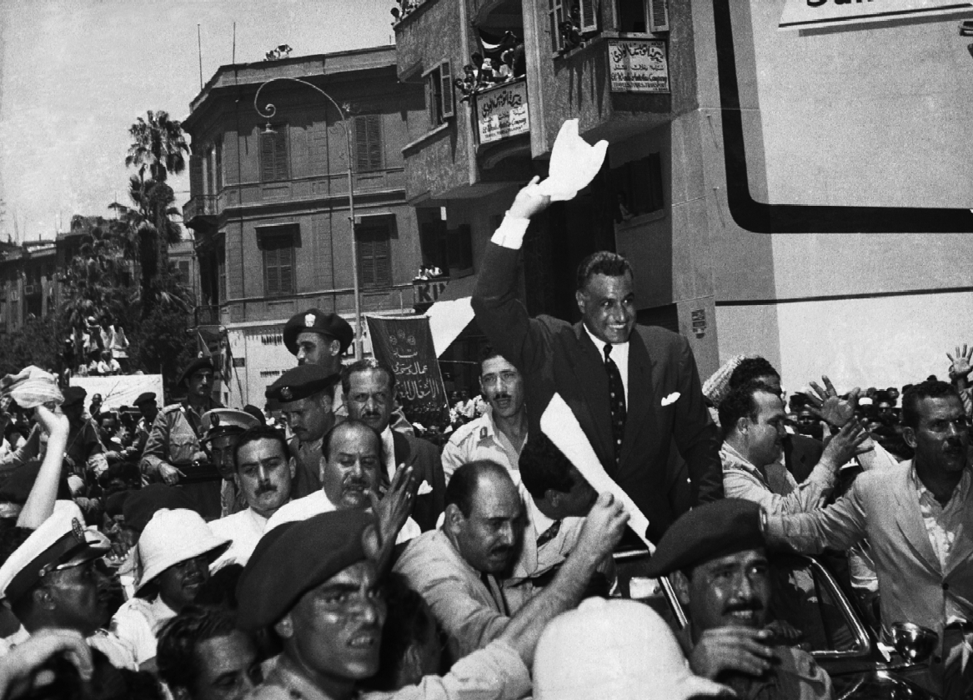
Notes:
Nasser following nationalization

Slide 57


Slide 58


Slide 59
President Eisenhower to Prime Minister Ben-Gurion
November 7, 1956:
Dear Mr. Prime Minister:
… Statements attributed to your Government to the effect that Israel does not intend to withdraw from Egyptian territory, as requested by the United Nations, have been called to my attention. I must say frankly, Mr. Prime Minister, that the United States views these reports, if true, with deep concern. Any such decision by the Government of Israel would seriously undermine the urgent efforts being made by the United Nations to restore peace in the Middle East, and could not but bring about the condemnation of Israel as a violator of the principles as well as the directives of the United Nations.
It is our belief that as a matter of highest priority peace should be restored and foreign troops, except for United Nations forces, withdrawn from Egypt, after which new and energetic steps should be undertaken within the framework of the United Nations to solve the basic problems which have given rise to the present difficulty. The United States has tabled in the General Assembly two resolutions designed to accomplish the latter purposes, and hopes that they will be acted upon favorably as soon as the present emergency has been dealt with.
… It would be a matter of the greatest regret to all my countrymen if Israeli policy on a matter of such grave concern to the world should in any way impair the friendly cooperation between our two countries.

