Slide 1
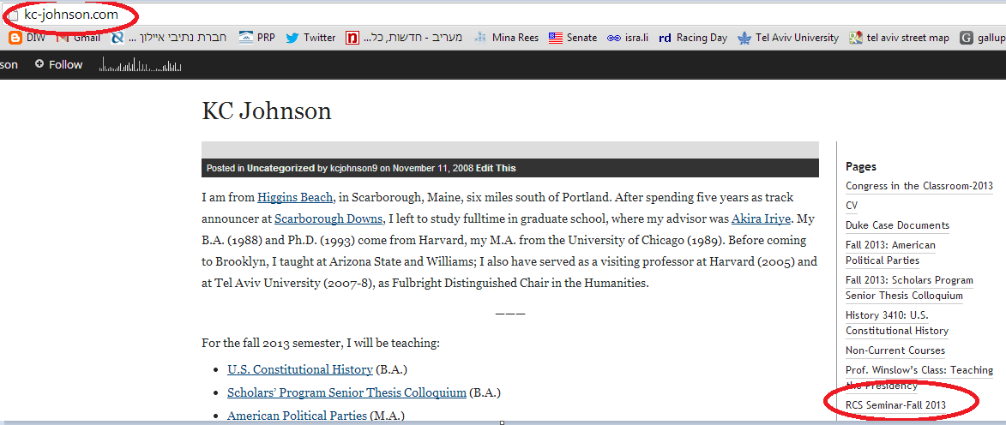

Slide 2
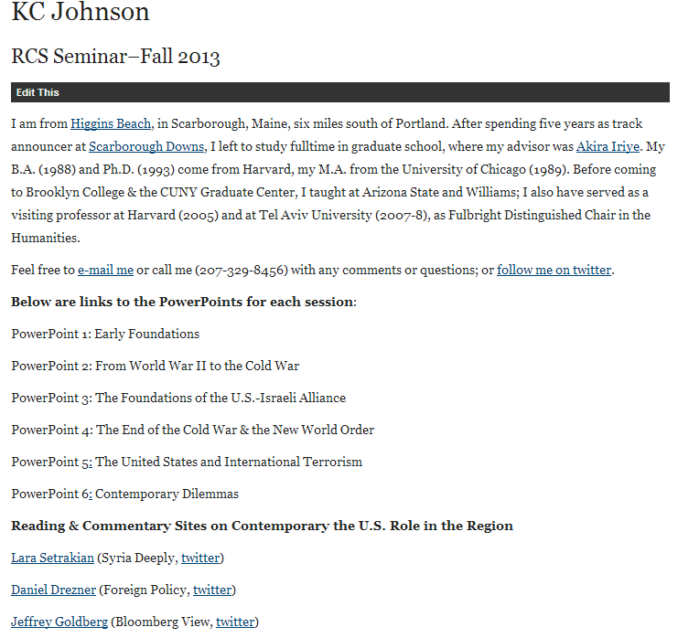

Slide 3
U.S.-Morocco Treaty of Friendship (1786)
Whereas the United States of America in Congress assembled by their Commission bearing date the twelvth day of May One thousand Seven hundred and Eighty four thought proper to constitute John Adams, Benjamin Franklin and Thomas Jefferson their Ministers Plenipotentiary, giving to them or a Majority of them full Powers to confer, treat & negotiate with the Ambassador, Minister or Commissioner of His Majesty the Emperor of Morocco concerning a Treaty of Amity and Commerce…
This is a Treaty of Peace and Friendship…
This Treaty shall continue in full Force, with the help of God for Fifty Years.

Slide 4
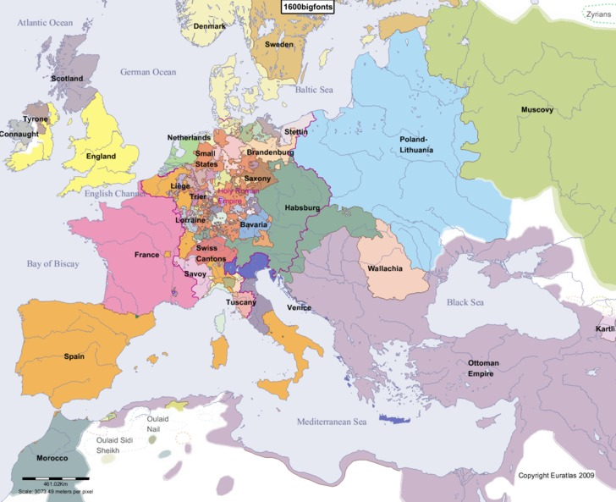

Slide 5
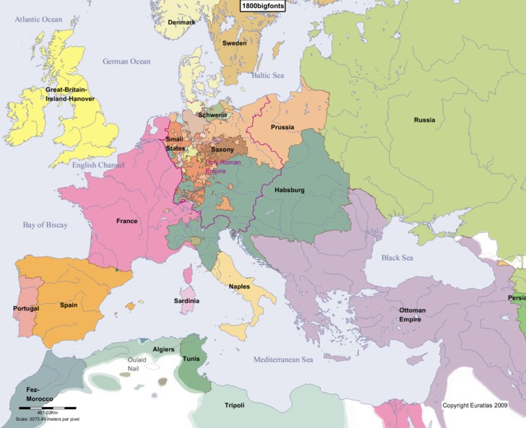

Slide 6


Slide 7
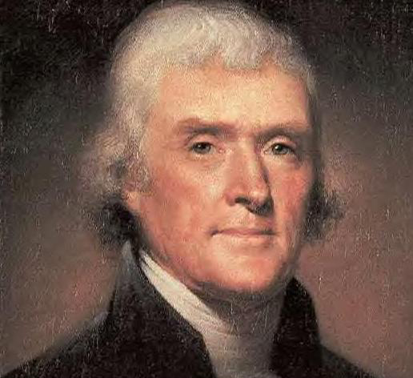
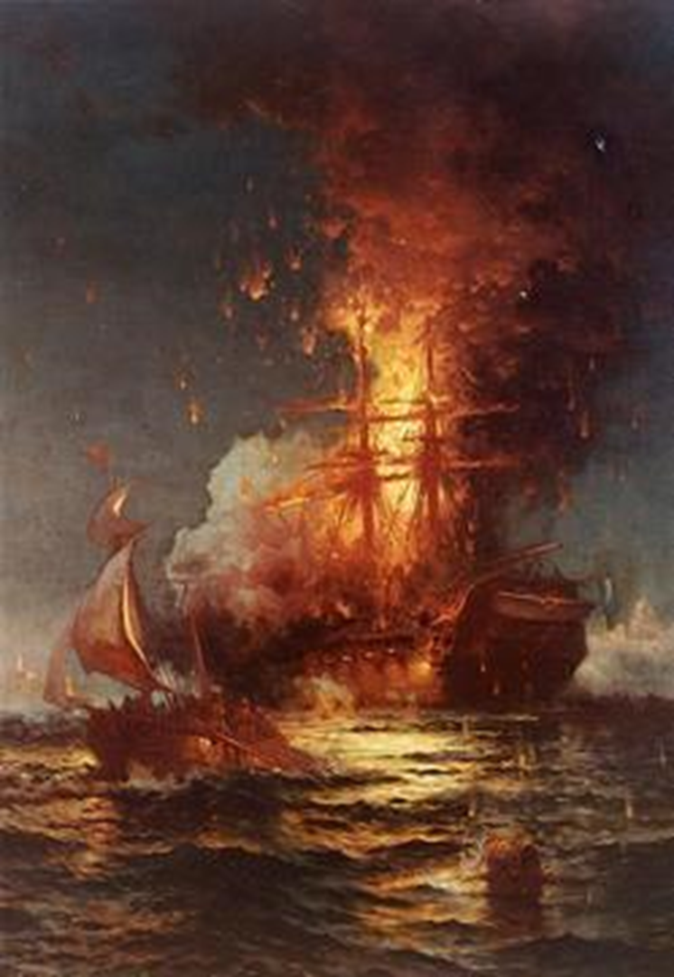

Slide 8
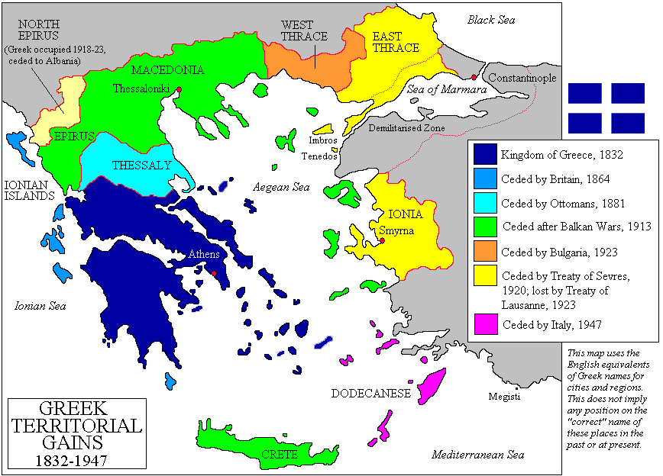

Slide 9
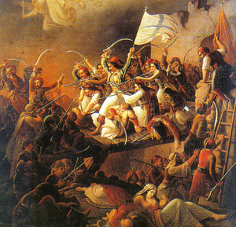

Slide 10


Slide 11
Monroe Doctrine (1823)
Of events in that quarter of the globe [Europe], with which we have so much intercourse and from which we derive our origin, we have always been anxious and interested spectators. The citizens of the United States cherish sentiments the most friendly in favor of the liberty and happiness of their fellow-men on that side of the Atlantic. In the wars of the European powers in matters relating to themselves we have never taken any part, nor does it comport with our policy to do so. It is only when our rights are invaded or seriously menaced that we resent injuries or make preparation for our defense. With the movements in this hemisphere we are of necessity more immediately connected, and by causes which must be obvious to all enlightened and impartial observers. The political system of the allied powers is essentially different in this respect from that of America. This difference proceeds from that which exists in their respective Governments; and to the defense of our own, which has been achieved by the loss of so much blood and treasure, and matured by the wisdom of their most enlightened citizens, and under which we have enjoyed unexampled felicity, this whole nation is devoted. We owe it, therefore, to candor and to the amicable relations existing between the United States and those powers to declare that we should consider any attempt on their part to extend their system to any portion of this hemisphere as dangerous to our peace and safety.

Slide 12
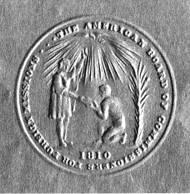
Notes:
ABCFM SEAL

Slide 13
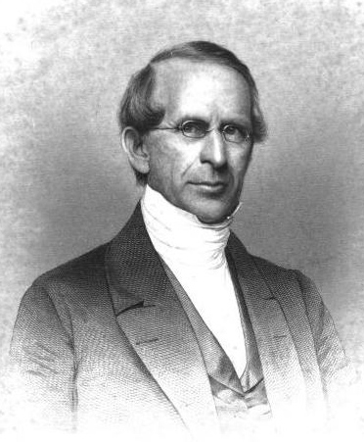
Notes:
Samuel worcester--abcfm

Slide 14
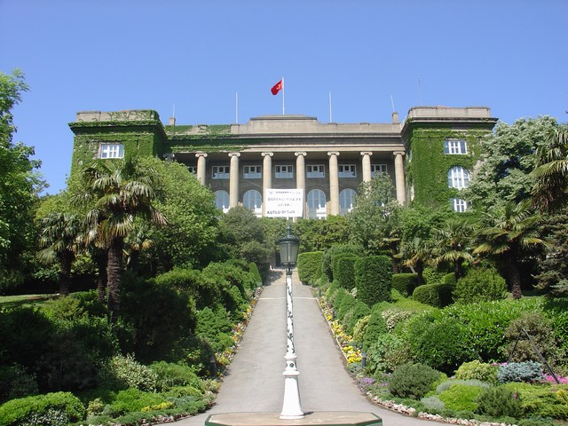
Notes:
Robert college, istanbul, oldest american school still in existence outside US

Slide 15
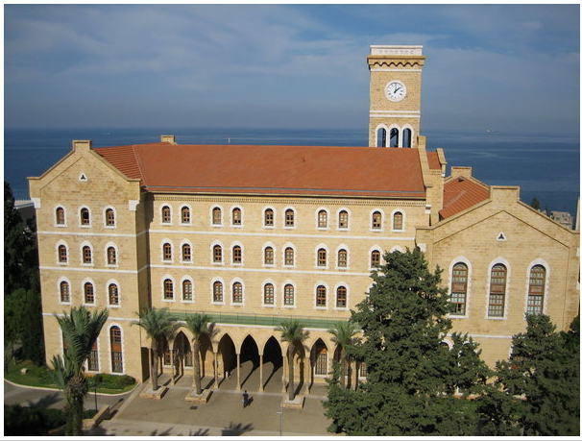
Notes:
Am univ beirut

Slide 16
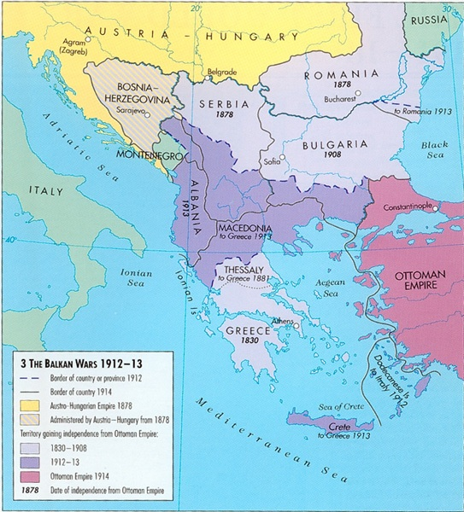

Slide 17
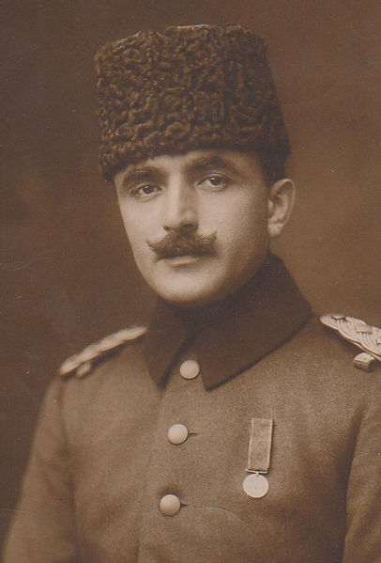
Notes:
Enver pasha

Slide 18
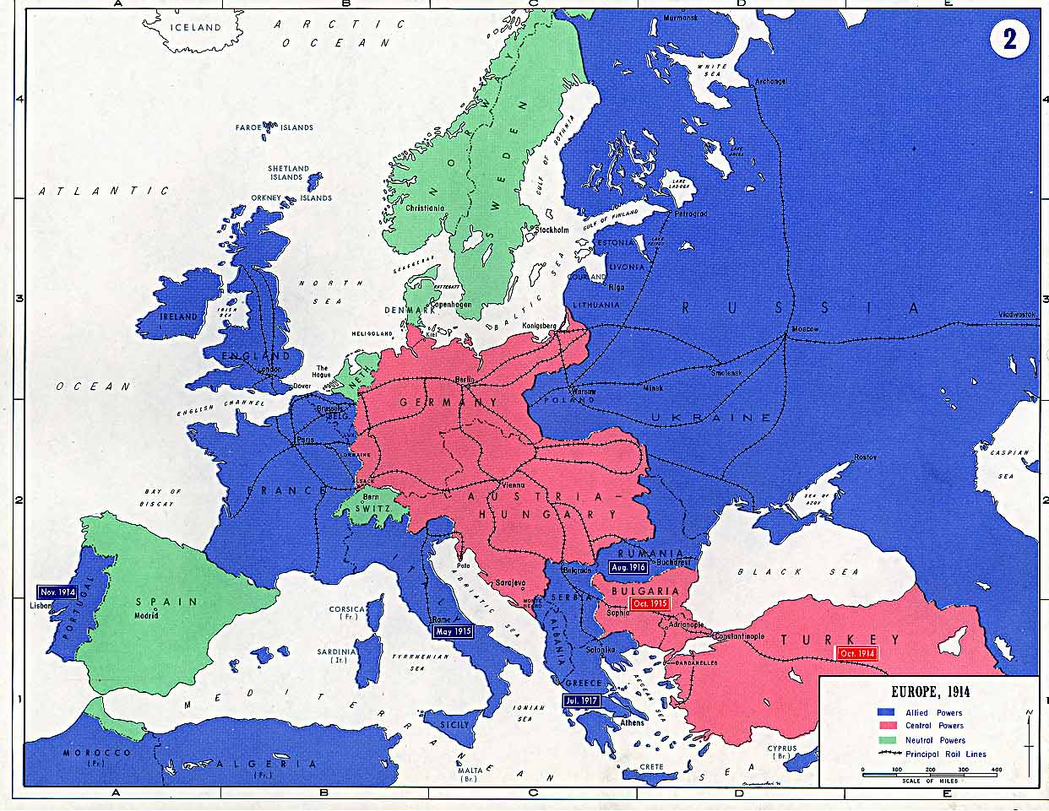

Slide 19
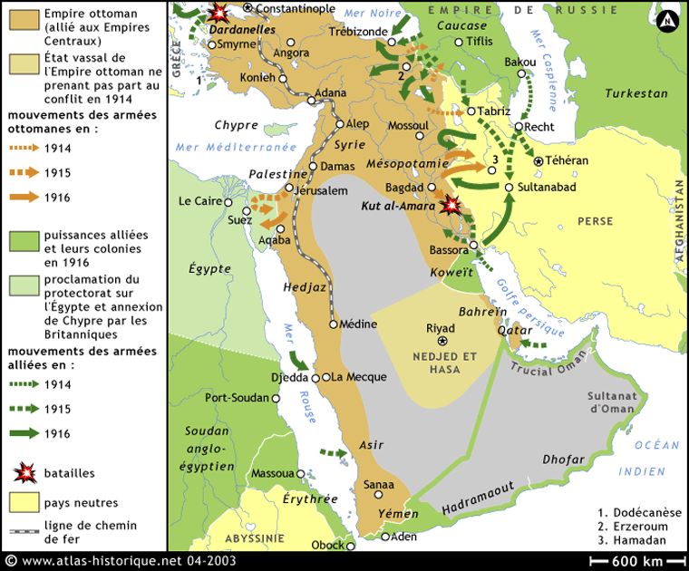

Slide 20
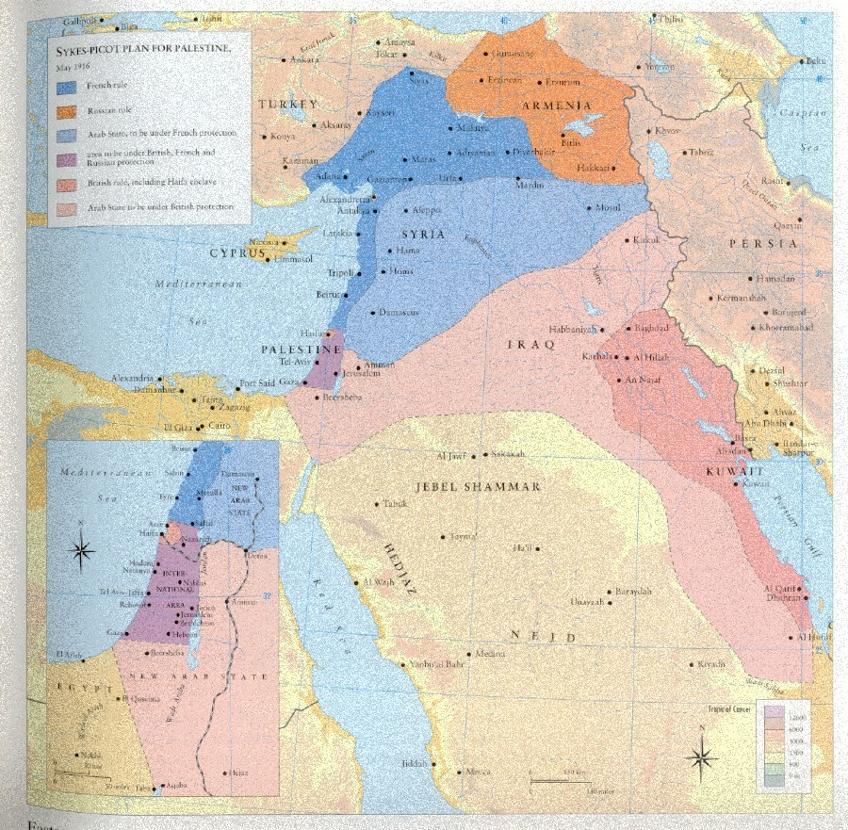

Slide 21


Slide 22
Wilson 14 Points address—8 Jan. 1918
The program of the world's peace, therefore, is our program; and that program, the only possible program, as we see it, is this: …
XI. Rumania, Serbia, and Montenegro should be evacuated; occupied territories restored; Serbia accorded free and secure access to the sea; and the relations of the several Balkan states to one another determined by friendly counsel along historically established lines of allegiance and nationality; and international guarantees of the political and economic independence and territorial integrity of the several Balkan states should be entered into.
XII. The Turkish portion of the present Ottoman Empire should be assured a secure sovereignty, but the other nationalities which are now under Turkish rule should be assured an undoubted security of life and an absolutely unmolested opportunity of autonomous development, and the Dardanelles should be permanently opened as a free passage to the ships and commerce of all nations under international guarantees.
In regard to these essential rectifications of wrong and assertions of right we feel ourselves to be intimate partners of all the governments and peoples associated together against the Imperialists.

Slide 23
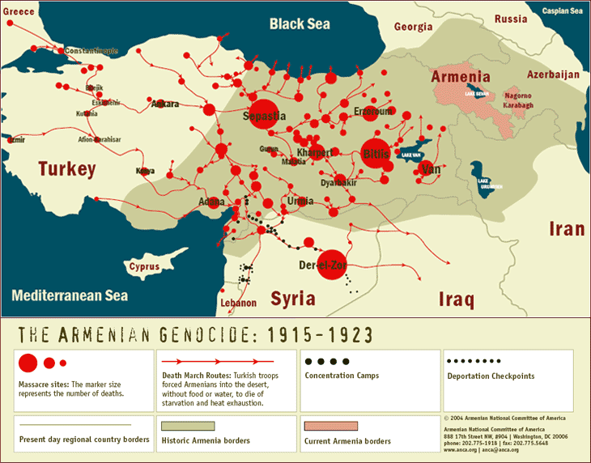

Slide 24
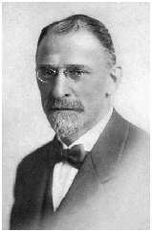
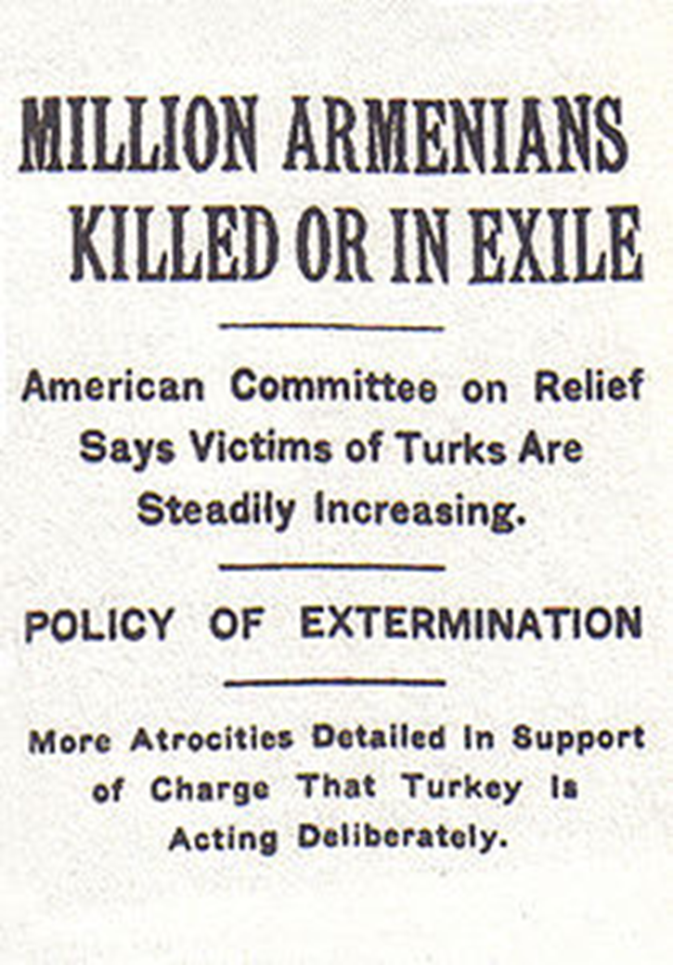
Notes:
Amb morgenthau

Slide 25
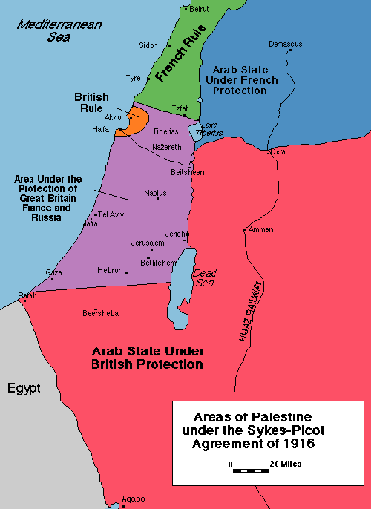

Slide 26
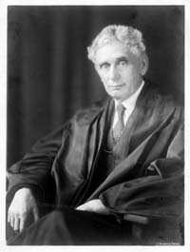

Slide 27
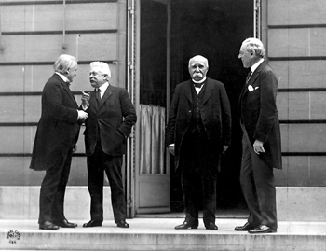

Slide 28
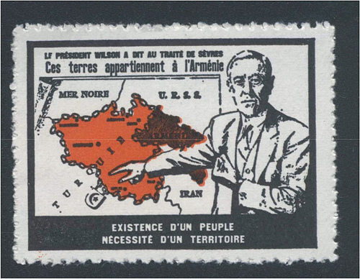

Slide 29
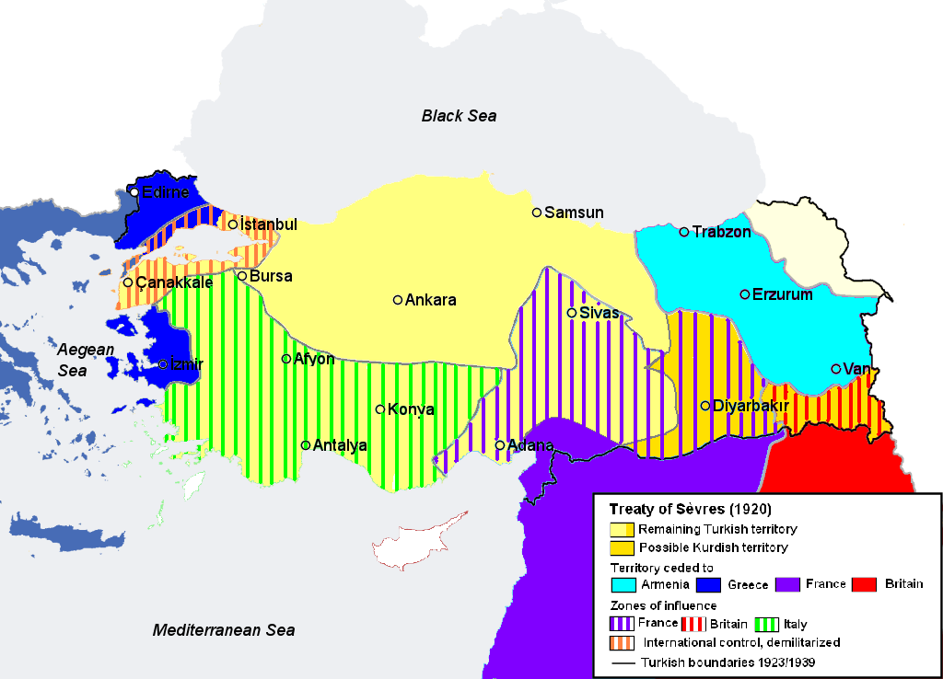

Slide 30
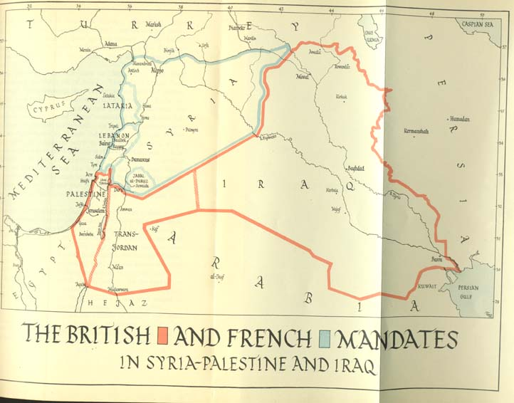

Slide 31
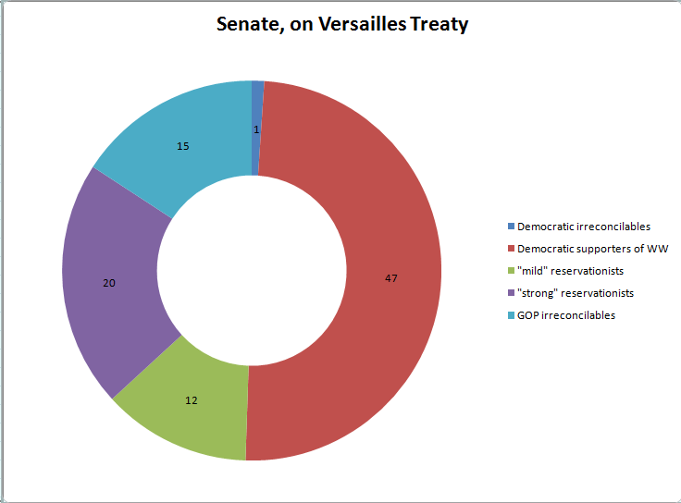

Slide 32
ARTICLE 22
To those colonies and territories which as a consequence of the late war have ceased to be under the sovereignty of the States which formerly governed them and which are inhabited by peoples not yet able to stand by themselves under the strenuous conditions of the modern world, there should be applied the principle that the well-being and development of such peoples form a sacred trust of civilisation and that securities for the performance of this trust should be embodied in this Covenant. The best method of giving practical effect to this principle is that the tutelage of such peoples should be entrusted to advanced nations who by reason of their resources, their experience or their geographical position can best undertake this responsibility, and who are willing to accept it, and that this tutelage should be exercised by them as Mandatories on behalf of the League. The character of the mandate must differ according to the stage of the development of the people, the geographical situation of the territory, its economic conditions, and other similar circumstances. Certain communities formerly belonging to the Turkish Empire have reached a stage of development where their existence as independent nations can be provisionally recognised subject to the rendering of administrative advice and assistance by a Mandatory until such time as they are able to stand alone. The wishes of these communities must be a principal consideration in the selection of the Mandatory.

Slide 33
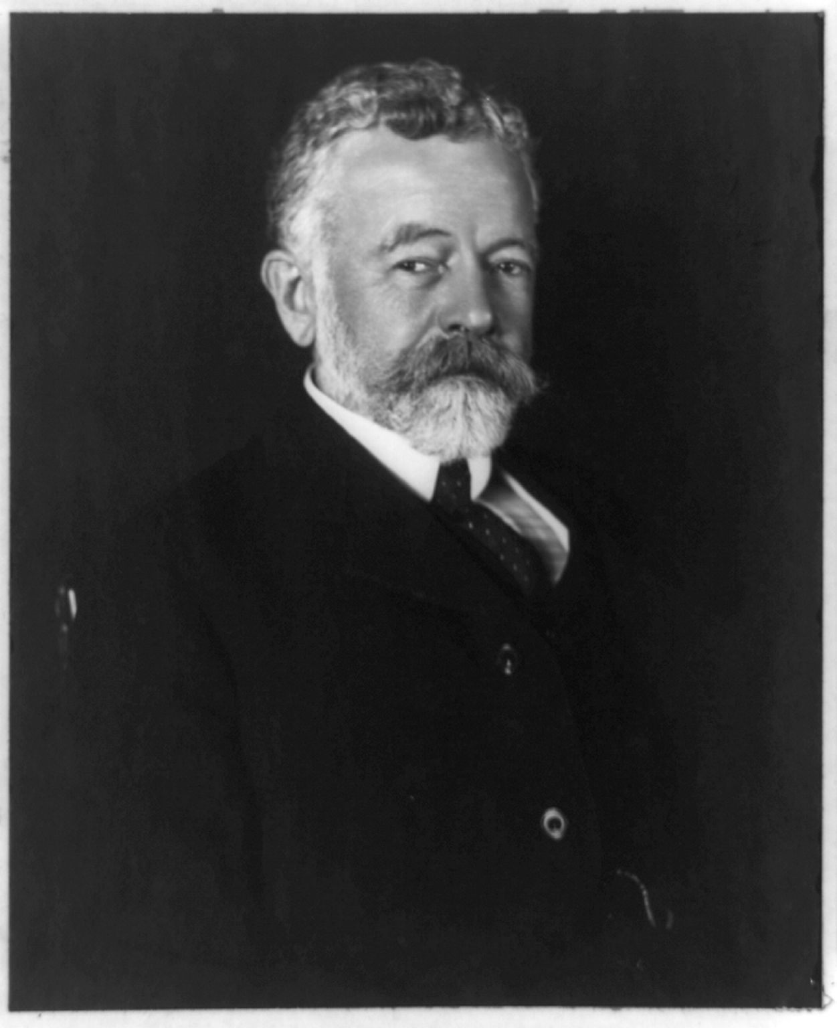

Slide 34
ARTICLE 11
Any war or threat of war, whether immediately affecting any of the Members of the League or not, is hereby declared a matter of concern to the whole League, and the League shall take any action that may be deemed wise and effectual to safeguard the peace of nations. In case any such emergency should arise the Secretary General shall on the request of any Member of the League forthwith summon a meeting of the Council.
It is also declared to be the friendly right of each Member of the League to bring to the attention of the Assembly or of the Council any circumstance whatever affecting international relations which threatens to disturb international peace or the good understanding between nations upon which peace depends.

Slide 35
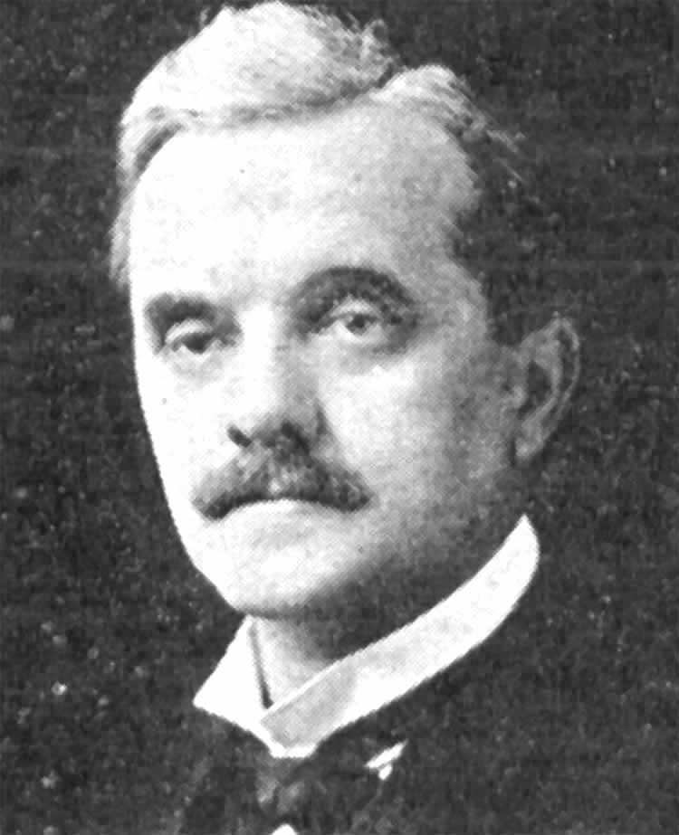

Slide 36
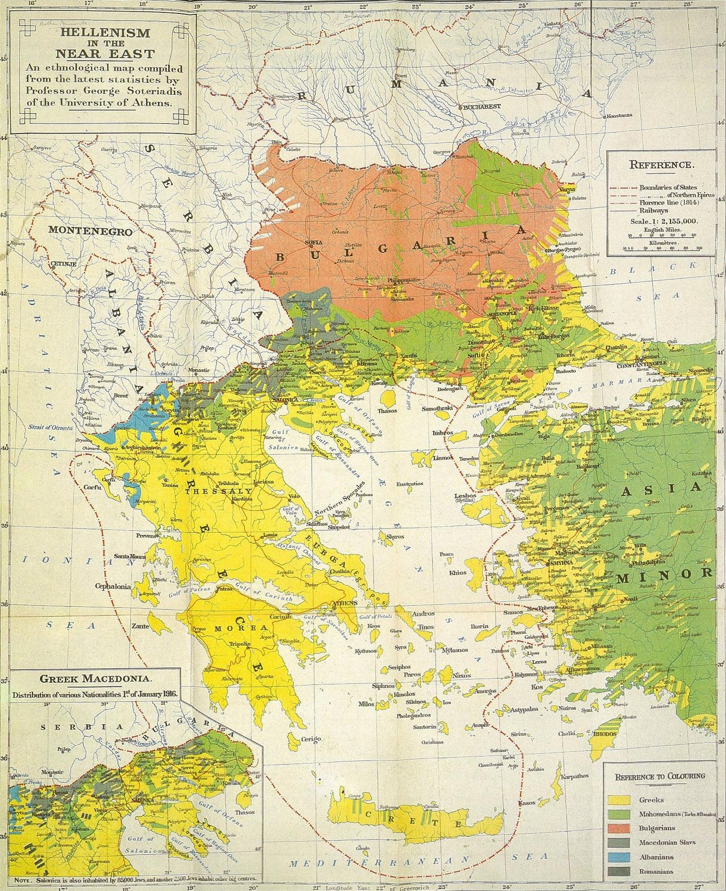

Slide 37
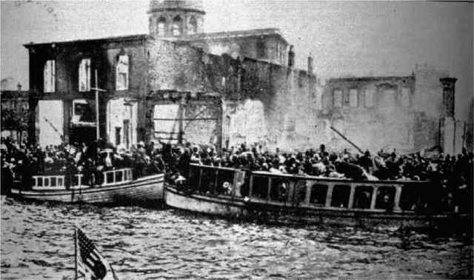
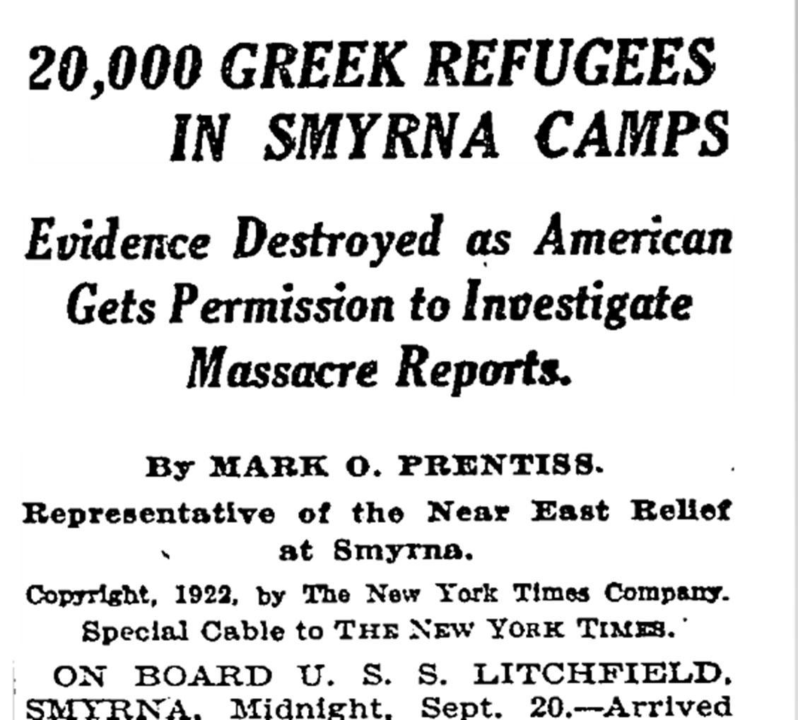
Notes:
Refugees fleeing smyrna—us sends ships

Slide 38
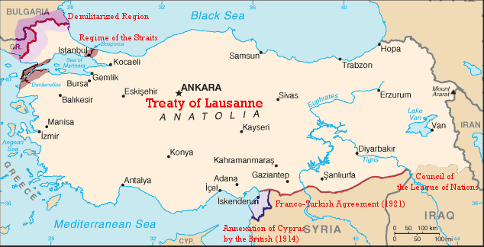

Slide 39
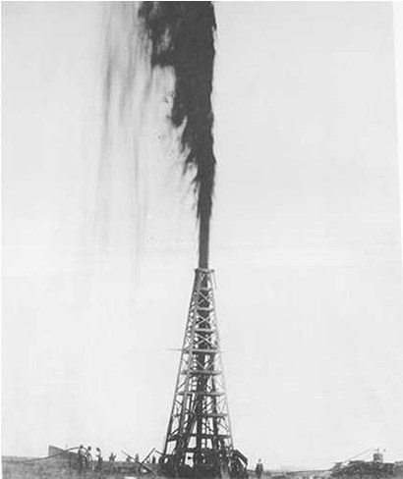
Notes:
Lucas gusher, Beaumont, 1st major TX gusher, 1900s

Slide 40
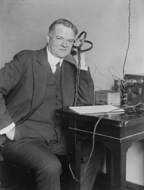

Slide 41
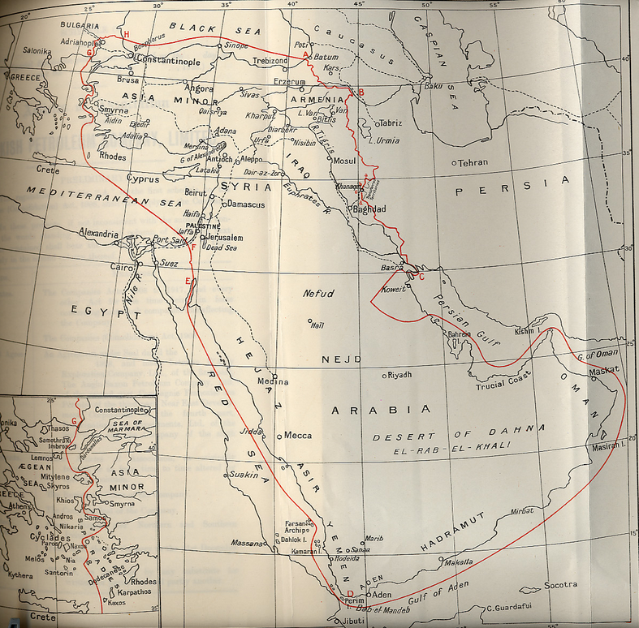

Slide 42
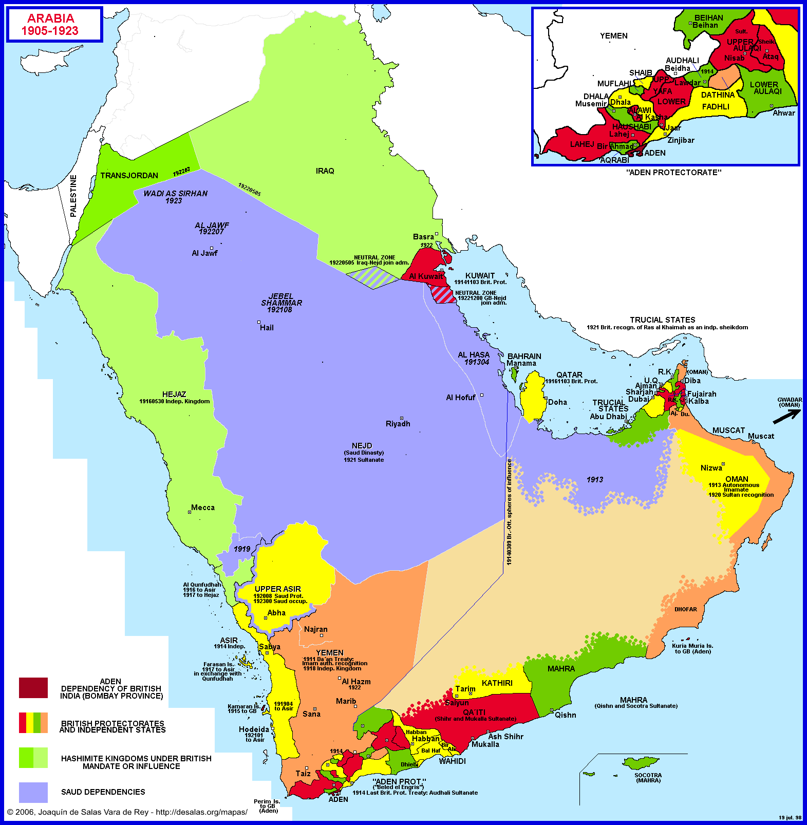

Slide 43


Slide 44
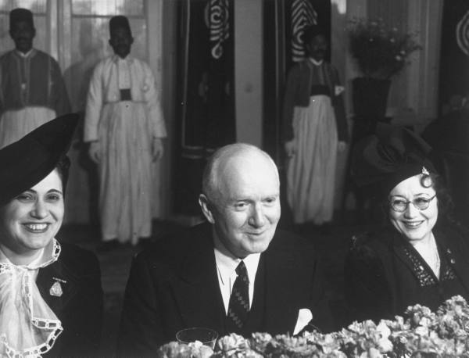
Notes:
Bert fish, 1st us ambassador to sarab

Slide 45
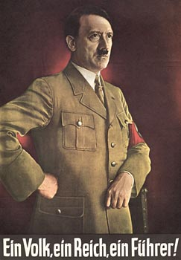

Slide 46
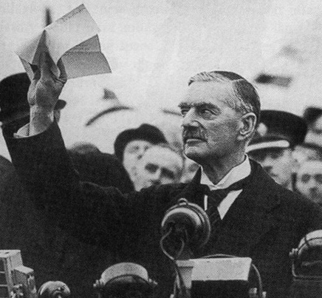

Slide 47
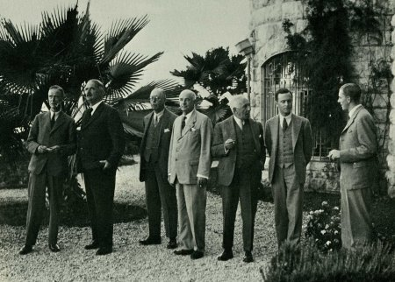

Slide 48
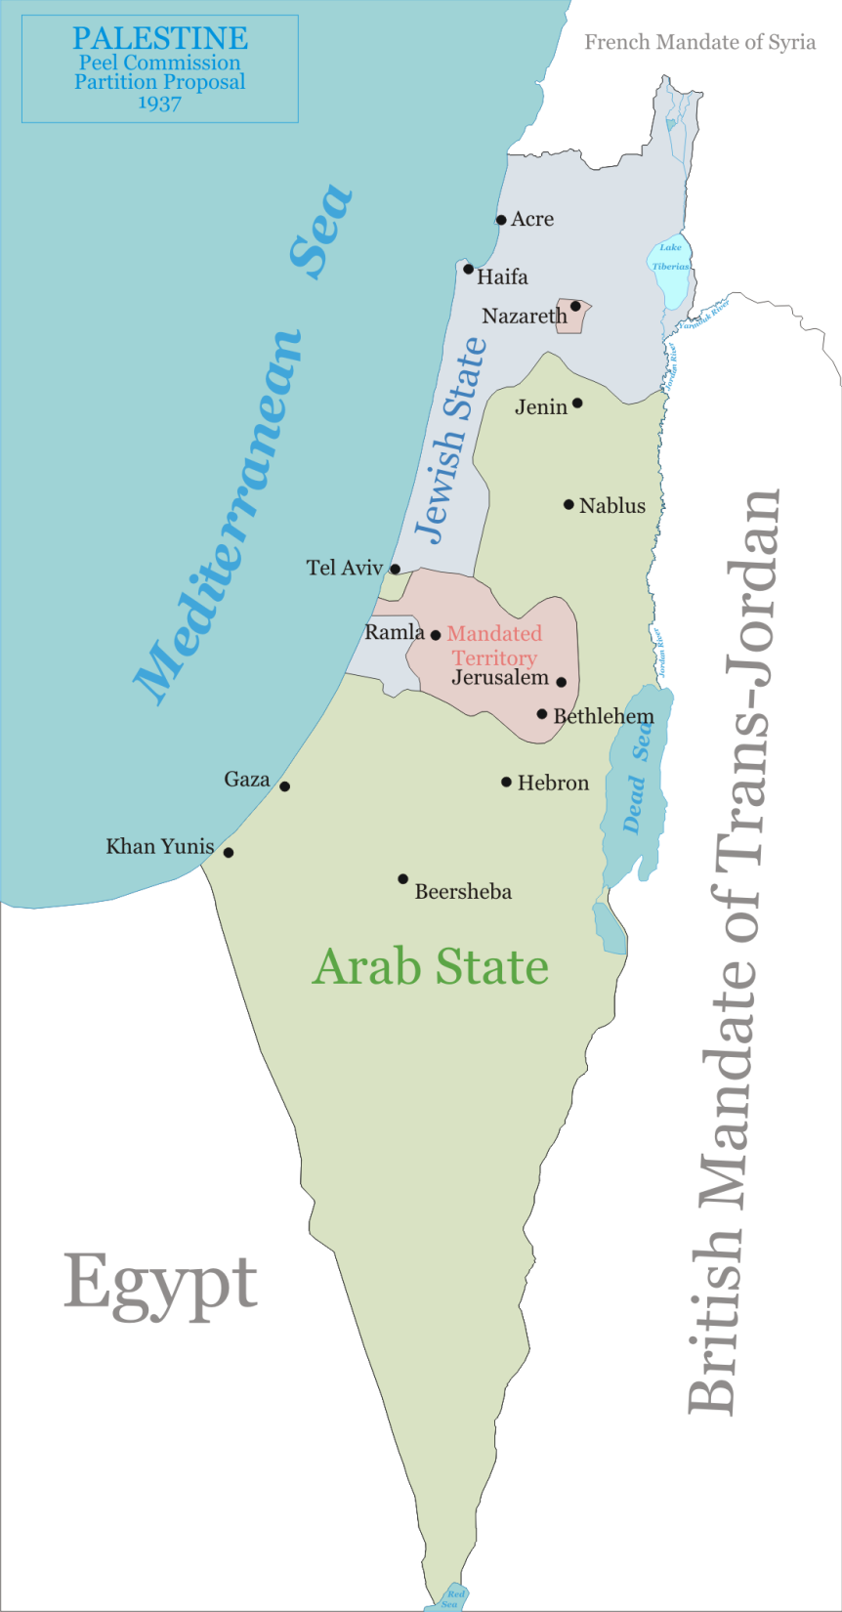

Slide 49
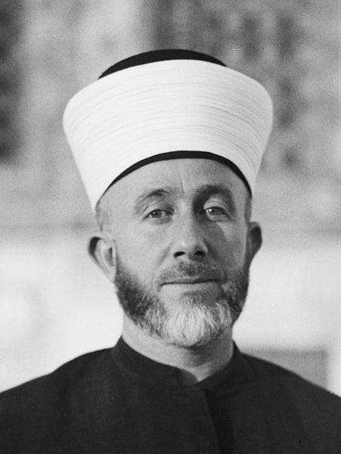
Notes:
Grand mufti

Slide 50
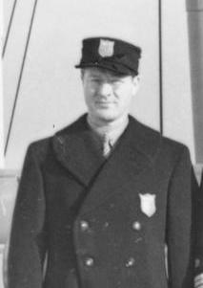

Notes:
Avery brundage

Slide 51
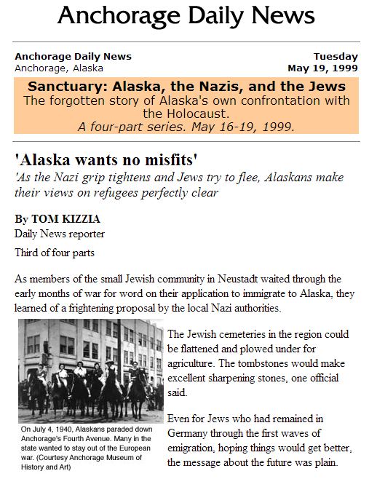

Notes:
ickes

Slide 52
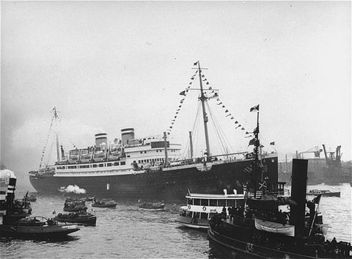
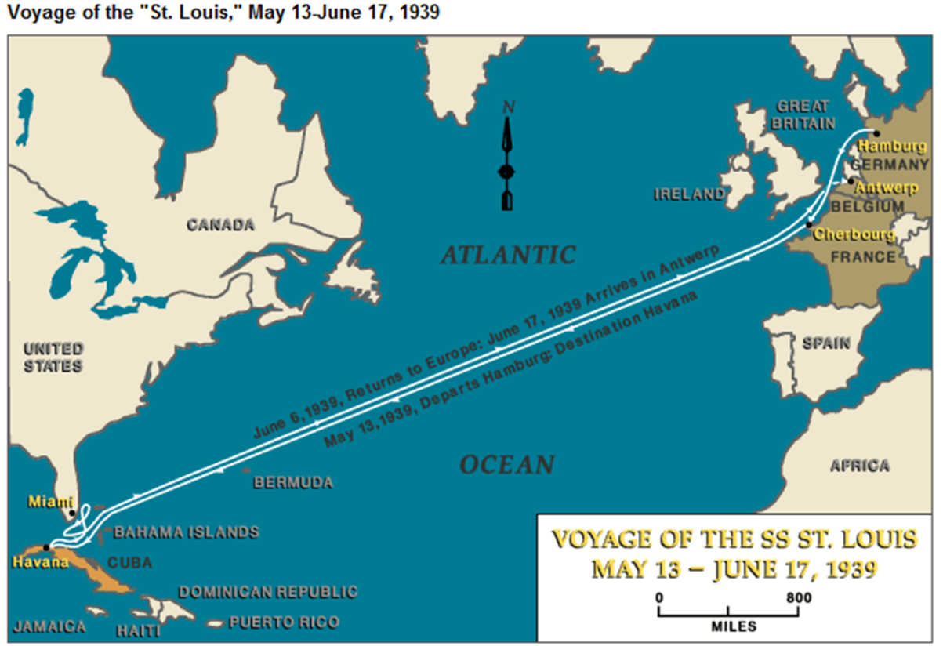
Notes:
St louis

Slide 53


