Slide 1
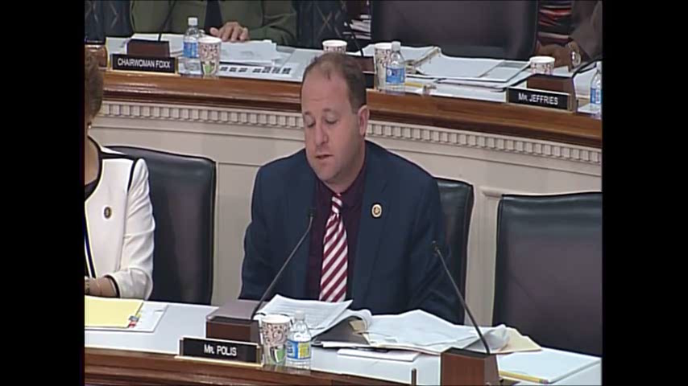

Slide 2
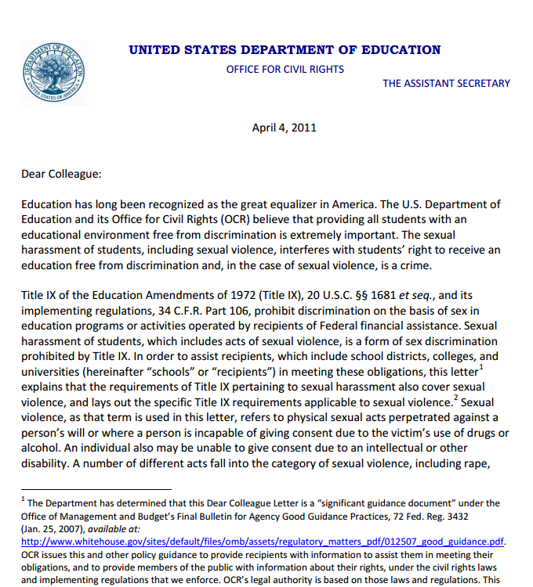
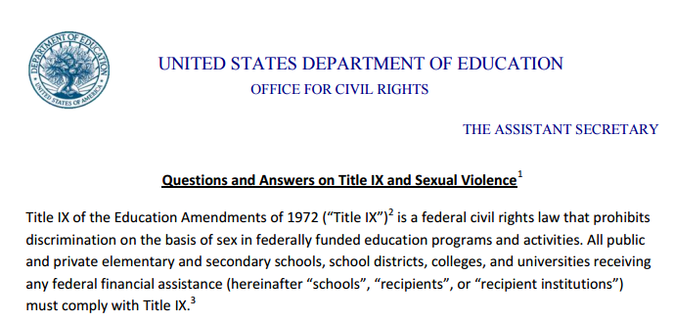
Required changes:
--lower burden of proof to preponderance-of-evidence (50.01 percent) standard
--allow accusers to appeal not-guilty findings
--accelerate investigations and adjudications (60 day deadline as recommended limit)
--training of all sexual assault panelists
--“steps to accord any due process rights do not restrict or unnecessarily delay the protections provided by Title IX to the complainant”
“Strongly” discourage:
--direct cross-examination of accuser

Slide 3
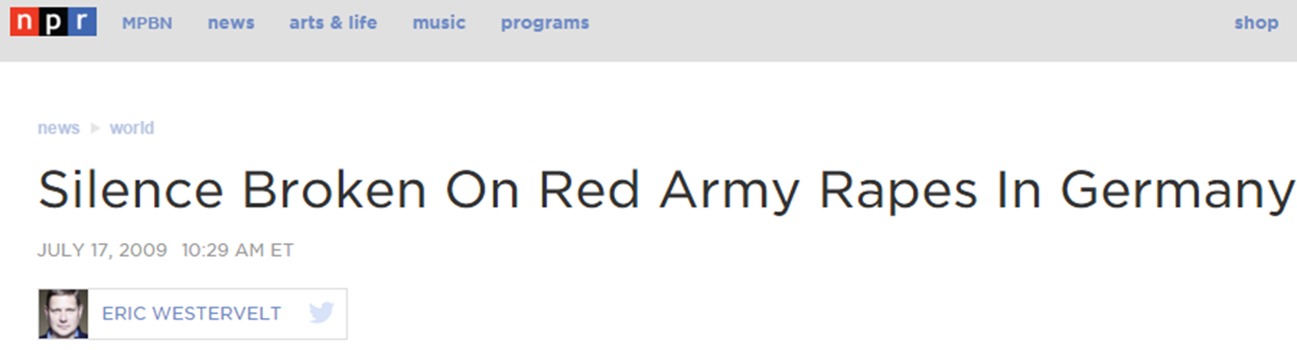
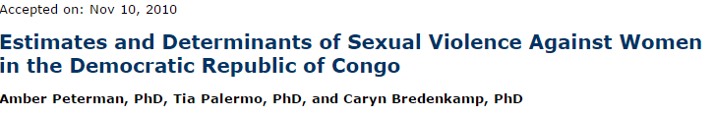
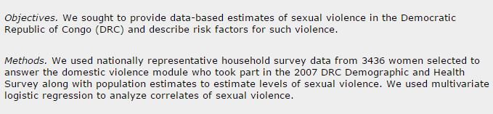

Slide 4
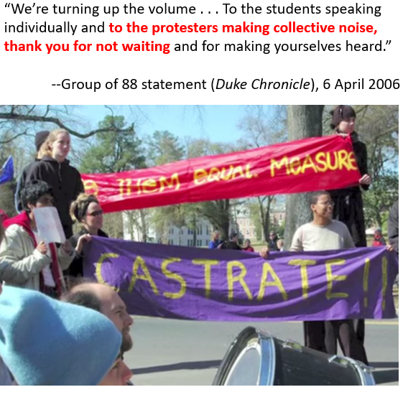

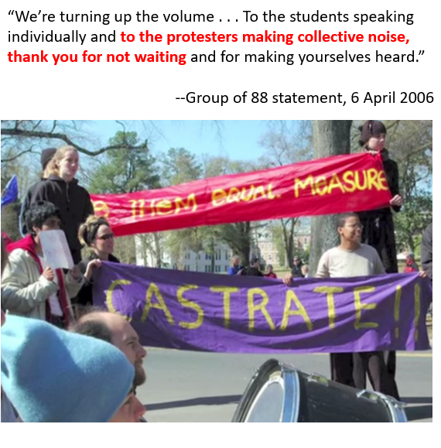
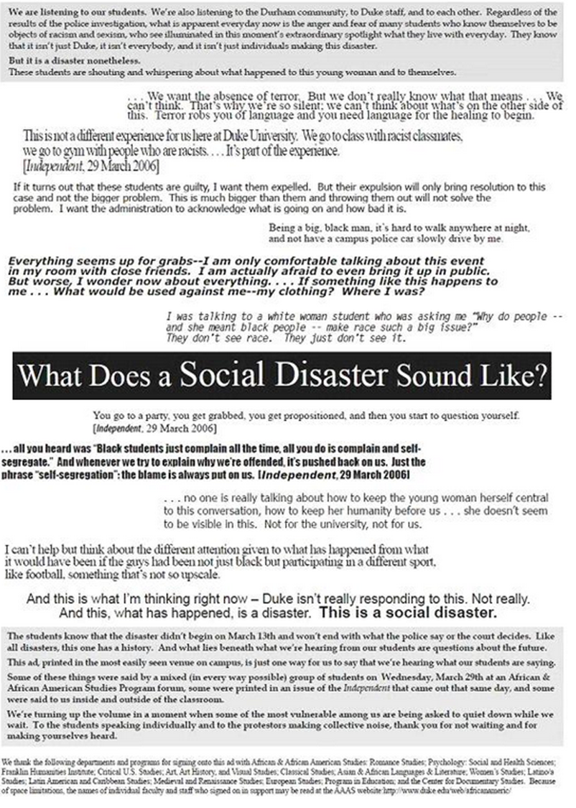
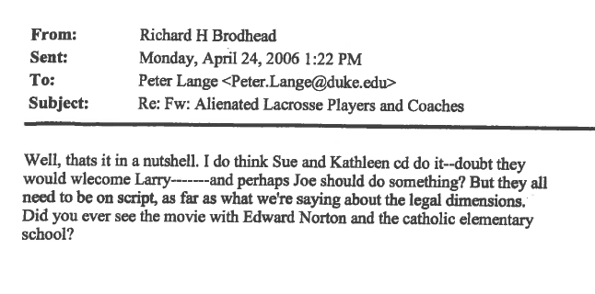

Slide 5

“The higher IQ, the more manipulative they are, the more cunning they are . . . Imagine the sex offenders we have here at Duke—cream of the crop.”
---------------
“The investigations of [sexual assault] can be further complicated by offenders who may also be categorized as antisocial or sociopathic, who are of above-average intelligence and can be highly manipulative and coercive, not only with victims but in the investigation process. Universities gather a lot of people with above average intelligence, so it stands to reason that campuses might see more of these kinds of individuals than the general population.”
--Ada Gregory, director (through 2013), Duke Women’s Center

Slide 6
“Why could we not expel a student based on an allegation? . . . It seems to me that we value fair and equitable processes more than we value the safety of our students. And higher education is not a right. Safety is a right. Higher education is a privilege.”
--Amanda Childress
Sexual Assault Awareness Program Coordinator, Dartmouth
https://www.insidehighered.com/news/2014/02/12/disagreement-campus-judicial-systems
Panelists should be “very, very cautious at accepting a man’s claims that he has been wrongly accused.”
“An abuser will . . . act persuasive and logical” and will “remain vague about events & omit details.”
--Stanford training, sexual assault disciplinary panelists
https://www.thefire.org/stanford-sexual-assault-policy/
--
Accused students must retain confidentiality, even about existence of charges; can “consult with and/or obtain advice from her/his supporter; family or guardian; physician, therapist, or counselor”
(Swarthmore 2012-2013 Sexual Assault Policy)
-----------------
--“Under this policy, ‘No’ always means ‘No,’ and ‘Yes’ may not always mean, ‘Yes.’”
(Occidental 2012-2013 Sexual Assault Policy)

Slide 7
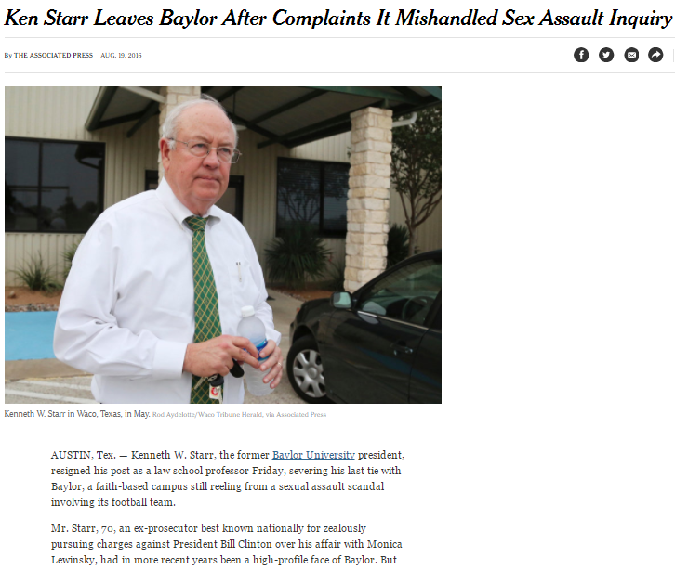
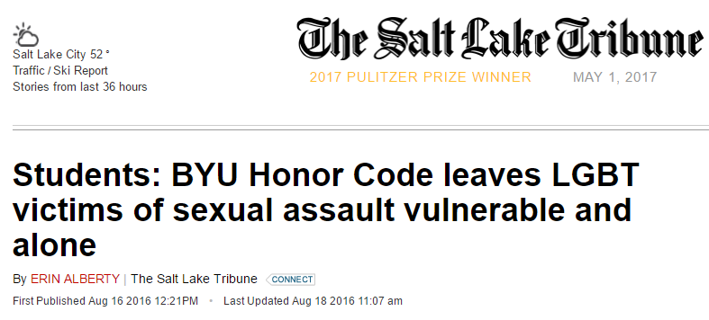

Slide 8
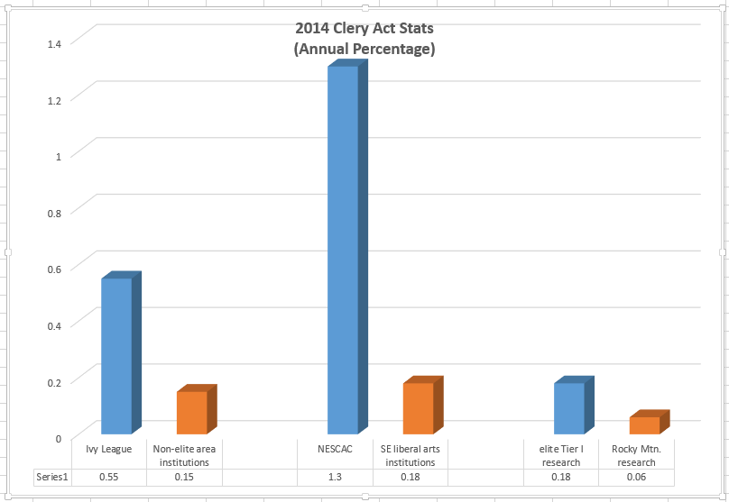

Slide 9
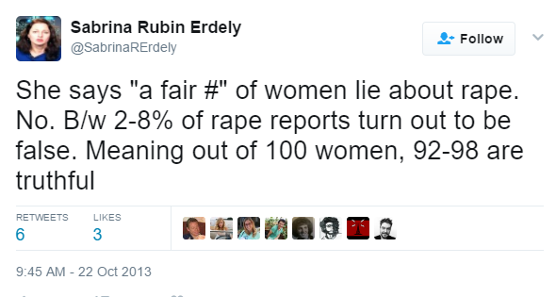
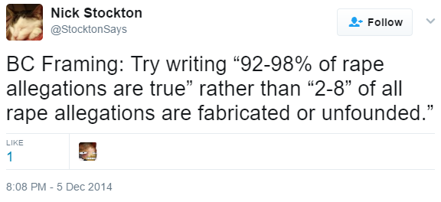
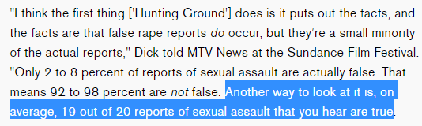
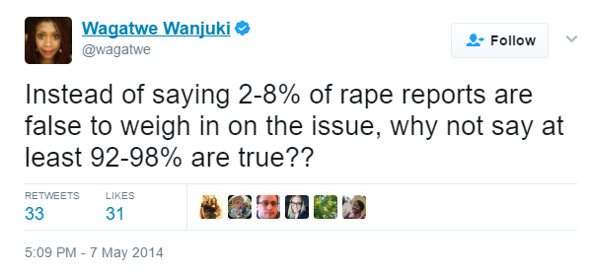
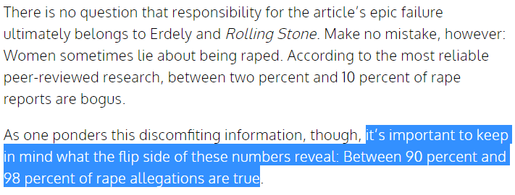

Slide 10
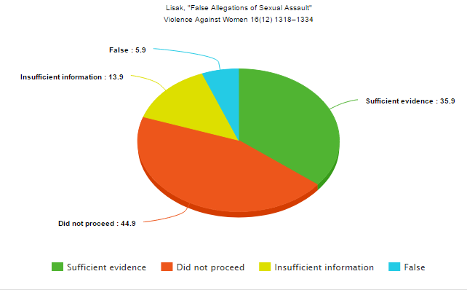
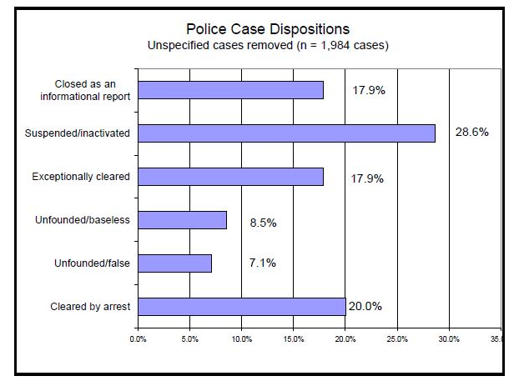
http://www.evawintl.org/images/uploads/BasicDataFindings_12-07-09.pdf
--Lonsway/Archambault “Making a Difference” study

Slide 11
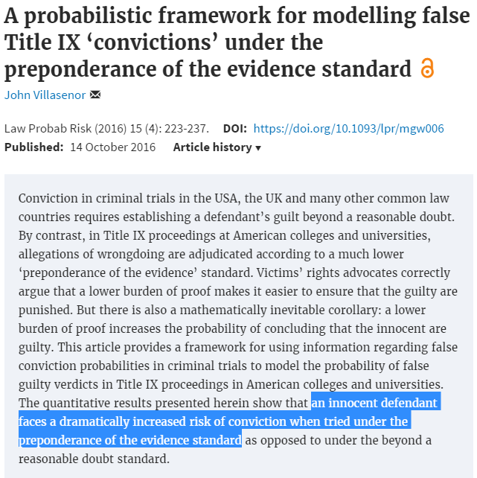

Slide 12
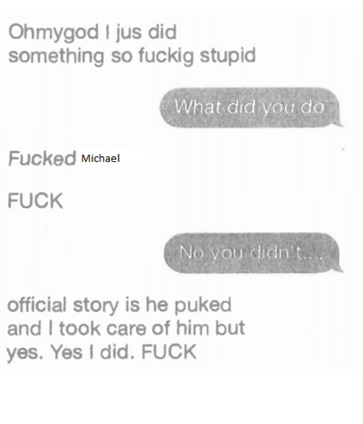
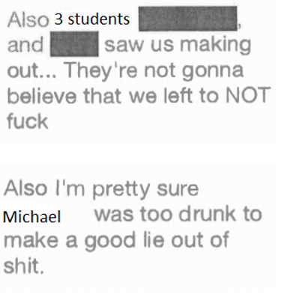

Slide 13

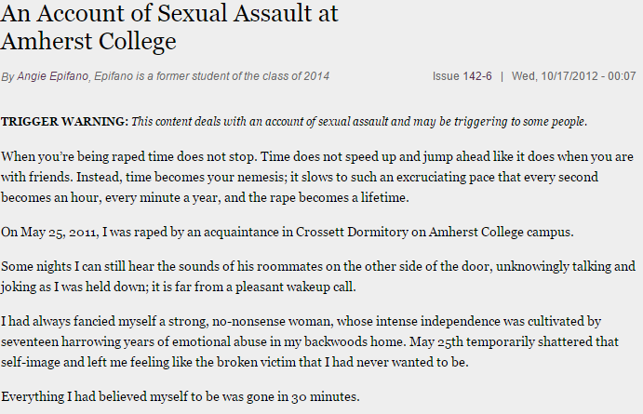
http://amherststudent.amherst.edu/?q=article/2012/10/17/account-sexual-assault-amherst-college

Slide 14
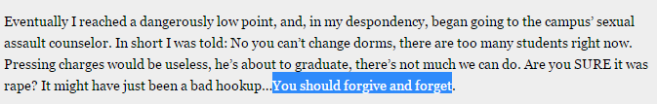
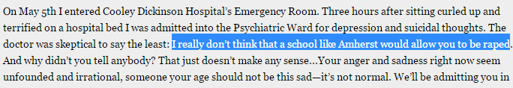
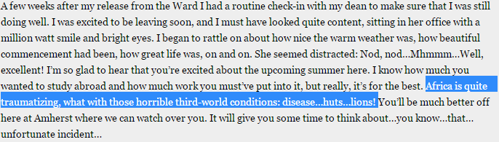

Slide 15
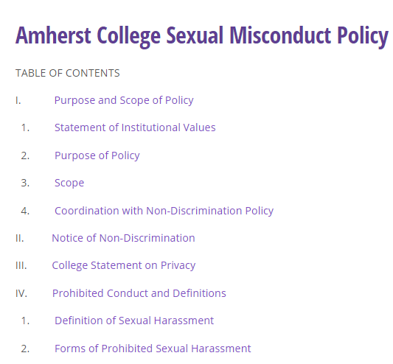
--“Dear Colleague” letter mandates: preponderance-of-evidence; right of accuser to appeal not-guilty finding; accelerated investigation
--accused student can’t have lawyer at hearing
--elimination of direct cross-examination; questions submitted in writing, in advance; may or may not be asked by panel
--no students in disciplinary panel; special training
--investigator hired by Title IX office, to use “affirmative consent” standard
--intoxicated students might “appear to be giving consent, but do not actually have conscious awareness or the ability to consent”; no standard on how to evaluate
--goal of procedure is “empowering victims”

Slide 16


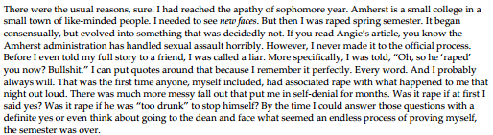
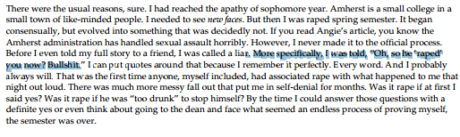

Slide 17
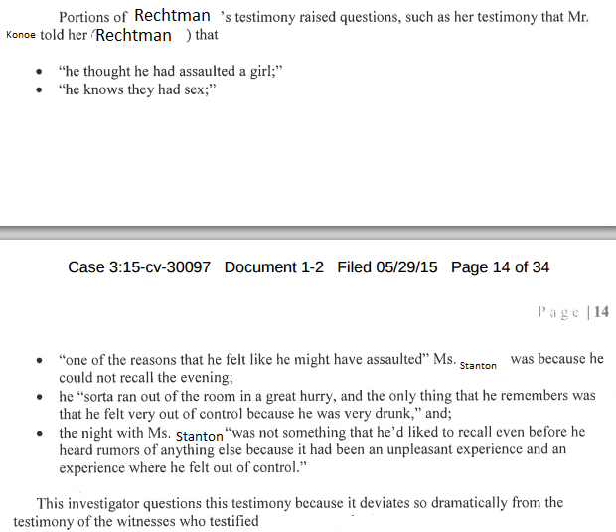
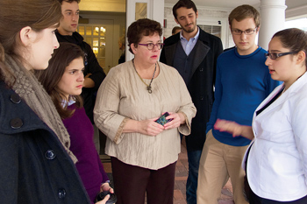

Slide 18
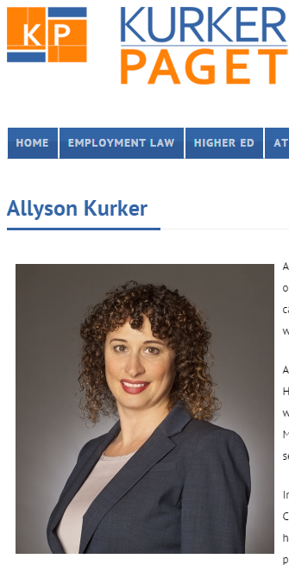
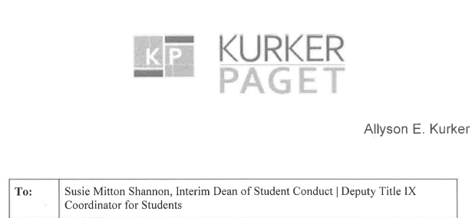
“Ms. [Stanton] did not keep a journal; she did not email, text or otherwise reduce what had happened with [Cheng] to writing.”

Slide 19
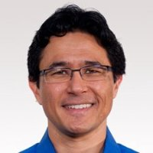


Stanton: I felt very alone and confused . . . I realized that I did not want to be alone. I texted a friend to come over and talk to me and spend the night . . .

Slide 20
Stanton: I felt very alone and confused . . . I realized that I did not want to be alone. I texted a friend to come over and talk to me and spend the night . . .
Chair: Any other questions from the hearing panel at this stage?
Q: How did your relationships with [common friends], how were your relationships affected [after the incident]?

Slide 21
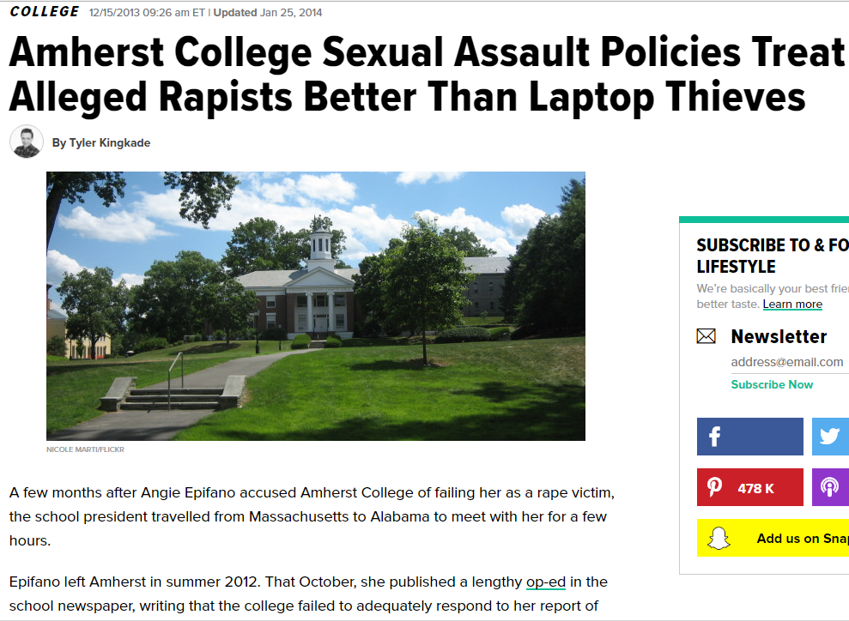

Slide 22
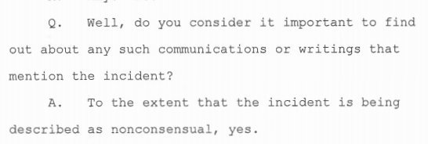
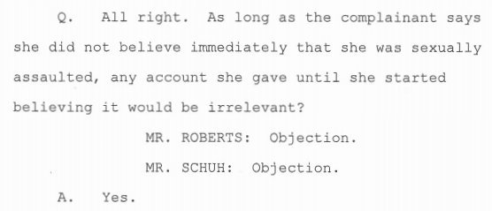
Amherst filing: Stanton’s non-production of the text messages wasn’t misleading, because Amherst was only interested in “whether she had communicated or recorded in writing that the Incident had been ‘non-consensual,’ which she did not.”

Slide 23
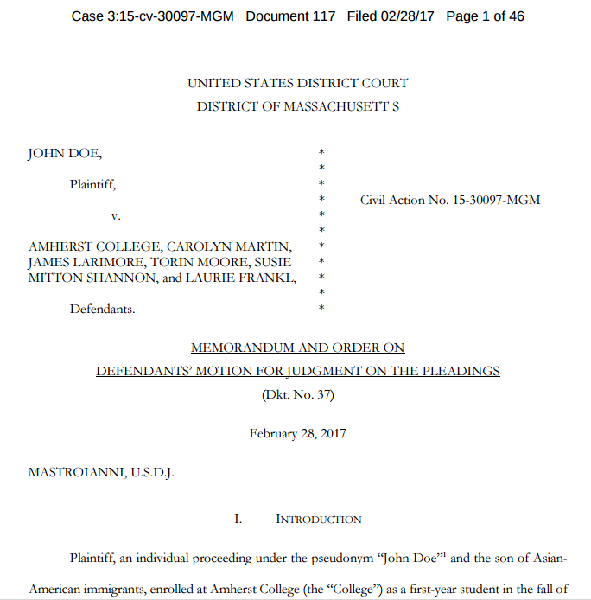

Slide 24
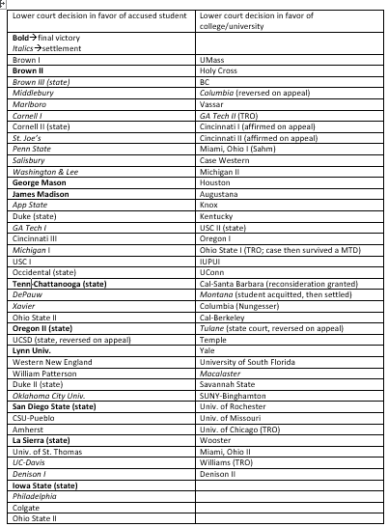
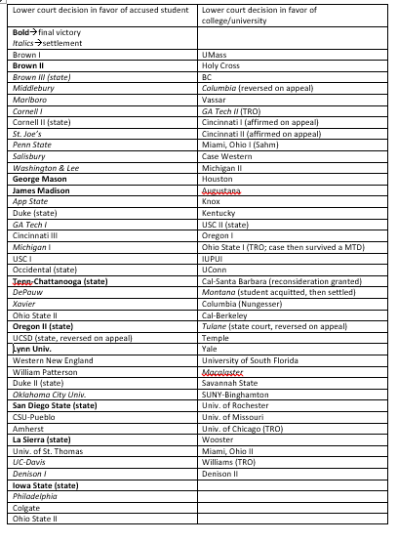


Slide 25




--Federal judge: That Title IX investigator discouraged student with exculpatory evidence from testifying is permissible under Constitution.
--Federal judge: University not required to turn over exculpatory evidence to accused student.
Federal judge: Evidence showed accused student had “a plausible claim that [he] was innocent of the charges levied against him.”
Federal judge: Nothing to suggest that “eight days between the notice of charges and the verdict, or three days between the presentation of evidence and the hearing, is inherently inadequate.”

Slide 26
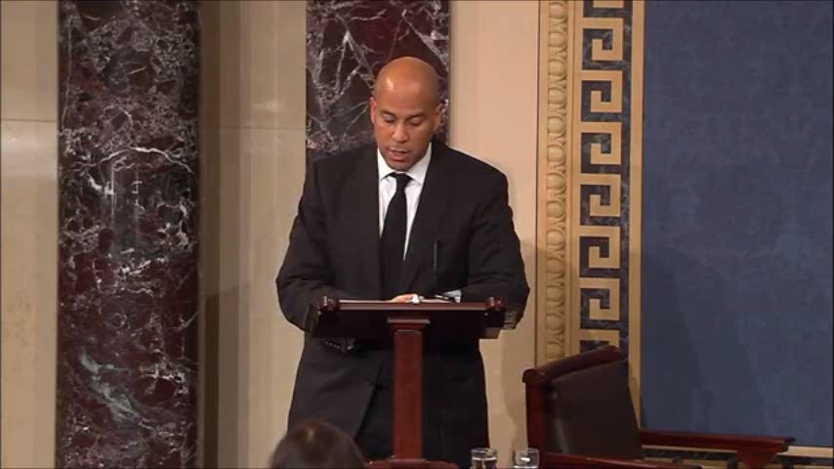

Slide 27
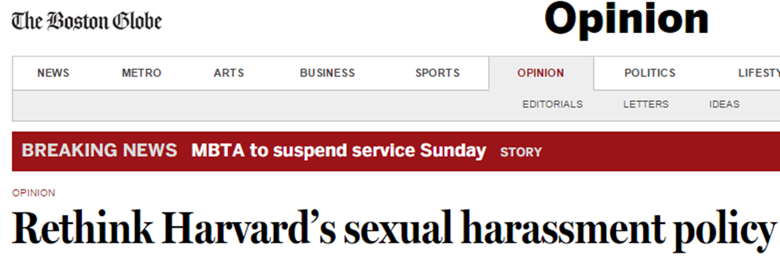
Harvard has adopted procedures for deciding cases of alleged sexual misconduct which lack the most basic elements of fairness and due process, are overwhelmingly stacked against the accused, and are in no way required by Title IX law or regulation …
The goal must not be simply to go as far as possible in the direction of preventing anything that some might characterize as sexual harassment. The goal must instead be to fully address sexual harassment while at the same time protecting students against unfair and inappropriate discipline, honoring individual relationship autonomy, and maintaining the values of academic freedom.
--15 Oct. 2014

