Slide 1
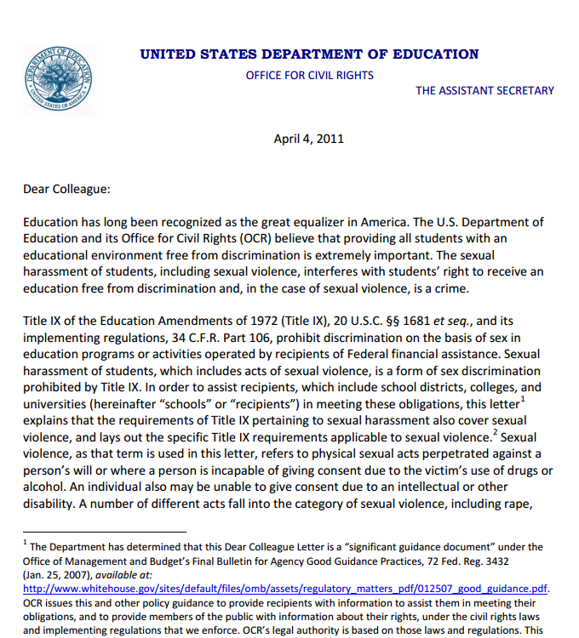

Slide 2
“In addressing complaints filed with OCR under Title IX, OCR reviews a school’s procedures to determine whether the school is using a preponderance of the evidence standard to evaluate complaints. The Supreme Court has applied a preponderance of the evidence standard in civil litigation involving discrimination under Title VII of the Civil Rights Act of 1964.”
“If a school provides for appeal of the findings or remedy, it must do so for both parties.”
“OCR will evaluate whether a school’s grievance procedures specify the time frames for all major stages of the procedures, as well as the process for extending timelines . . . Based on OCR experience, a typical investigation takes approximately 60 calendar days following receipt of the complaint.”
“OCR strongly discourages schools from allowing the parties personally to question or cross-examine each other during the hearing. Allowing an alleged perpetrator to question an alleged victim directly may be traumatic or intimidating, thereby possibly escalating or perpetuating a hostile environment

Slide 3
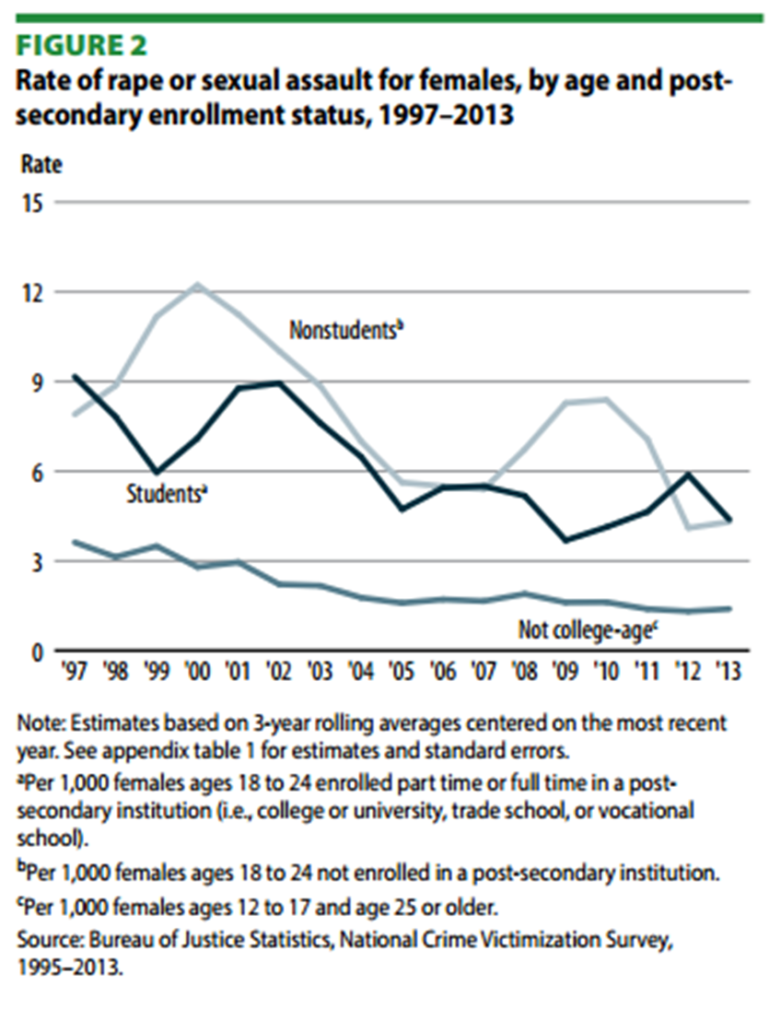

Slide 4
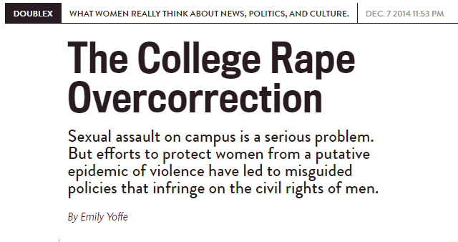
The one-fifth to one-quarter assertion would mean that young American college women are raped at a rate similar to women in Congo, where rape has been used as a weapon of war . . .
President Obama has asserted that only about 12 percent of sexual assault victims make a report to authorities. If he is correct, and we extrapolate from the Clery numbers, that would suggest there were 32,500 assaults in 2012, reported and not, or a 0.27 percent incidence.

Slide 5
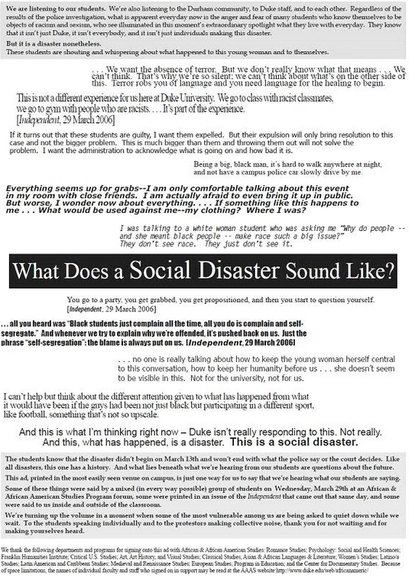


Slide 6
Duke 2009 Sexual Assault Policy
A “fundamental principle” of the sexual misconduct policy is that “real or perceived power differentials between individuals may create an unintentional atmosphere of coercion.”
------------------
“Conduct will be considered ‘without consent’ if no clear consent, verbal or nonverbal, is given. It should be noted that in some situations an individual’s ability to freely consent is taken away by another person or circumstance. Examples include, but are not limited to, when an individual is intoxicated, ‘high,’ scared, physically or psychologically pressured or forced, passed out, intimidated, coerced, mentally or physically impaired, beaten, threatened, isolated, or confined.”

Slide 7

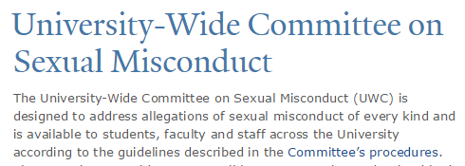
--informal complaint process, whose “goal is to achieve a resolution that is desired by the [accuser],” so that accusers can “regain their sense of wellbeing.” Accused student has no right to present evidence of innocence, or to be informed of the specifics of the allegations.
--formal complaint process, in which Yale “uses a more expansive definition of sexual assault” than that outlined by the federal government or local law enforcement. Accused student has no right to an attorney, no right to cross-examine accuser (or anyone else), no right to present exculpatory witnesses, no right to receive exculpatory evidence uncovered by university investigation. Judged according to preponderance of evidence standard.

Slide 8
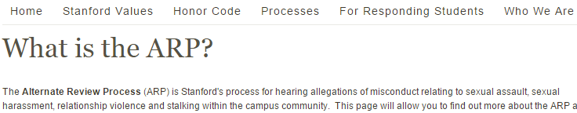
--preponderance of evidence (from beyond a reasonable doubt); accuser’s right to appeal; shortened investigative process; elimination of cross-examination (all questions instead submitted to panel)
-----------
--statute of limitations expanded (from 6 months to 2 years)
--culpability by majority vote of 4-person panel rather than unanimous vote
--training for all panelists, including assertions that:
--sexual assault abusers will “act persuasive and logical”
--“everyone should be very, very cautious in accepting a man’s claim that he has been wrongly accused of abuse or violence”

Slide 9
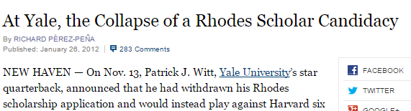
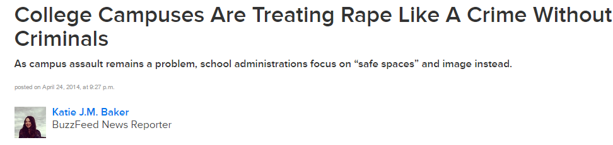
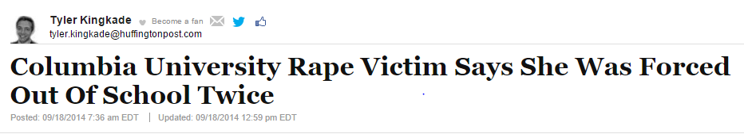

Slide 10
“When asked how an innocent person is to prove he or she indeed received consent [under California’s new ‘affirmative consent’ law, co-sponsor] Lowenthal said, ‘Your guess is as good as mine. I think it’s a legal issue.’”
--Assemblywoman Bonnie Lowenthal (D-California)
Long Beach Press Telegram, 8 June 2014
“Victim/Survivor bill of rights . . . Be free from any suggestion that the victim/survivor is at fault when these [alleged] crimes and [alleged] violations have occurred, or should have acted in a different manner to avoid such a crime.”
--Governor Andrew Cuomo (D-New York)
FY2016 executive budget

Slide 11
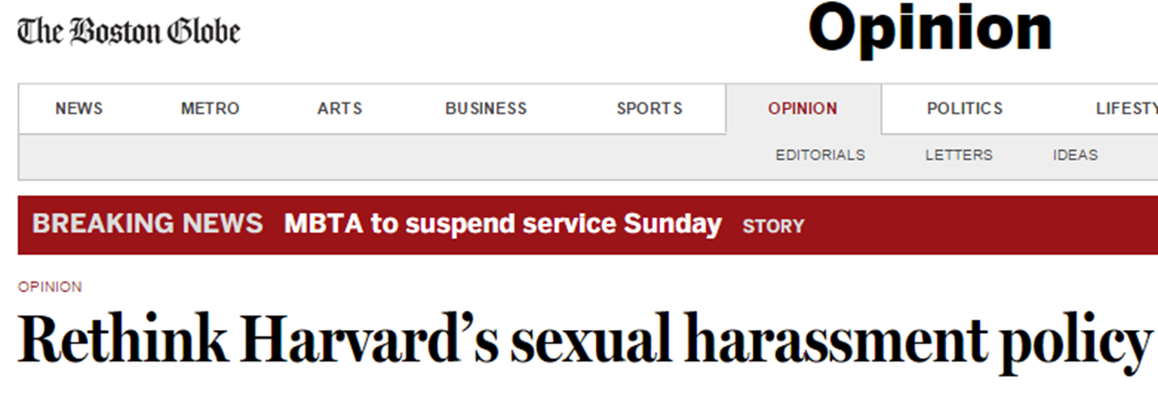
Harvard has adopted procedures for deciding cases of alleged sexual misconduct which lack the most basic elements of fairness and due process, are overwhelmingly stacked against the accused, and are in no way required by Title IX law or regulation …
The goal must not be simply to go as far as possible in the direction of preventing anything that some might characterize as sexual harassment. The goal must instead be to fully address sexual harassment while at the same time protecting students against unfair and inappropriate discipline, honoring individual relationship autonomy, and maintaining the values of academic freedom.
--15 Oct. 2014

Slide 12
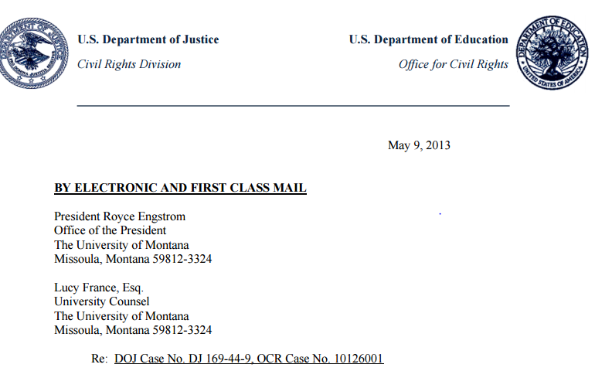
“The Agreement will serve as a blueprint for colleges and universities throughout the country to protect students from sexual harassment and assault.”
--sexual harassment as “any unwelcome conduct of a sexual nature.”
--“unwelcome conduct” includes “verbal conduct”
-- “Whether conduct is objectively offensive . . . is not the standard to determine whether conduct was ‘unwelcome conduct of a sexual nature’ and therefore constitutes ‘sexual harassment.'”

Slide 13



Over the past year and a half, we’ve seen a dramatic increase in our campus’ discussion of sexual assault. As Spectator’s opinion editor, I was privileged to help shape a little of that discussion. At the time, I was proud to help students tell their stories and to promote discourse about sexual assault policy. I still am.
But I think we—not just the opinion page, not just Spec—but we, the members of the campus media, failed specifically with [Emma] Sulkowicz’s story by not being thorough and impartial.
Instead, campus media’s goal to promote discussion about sexual assault and to support survivors became conflated with a fear of rigorous reporting. Personally, I felt that if I covered the existence of a different perspective—say, that due process should be respected—not only would I have been excoriated, but many would have said that I was harming survivors and the fight against sexual assault.

Slide 14
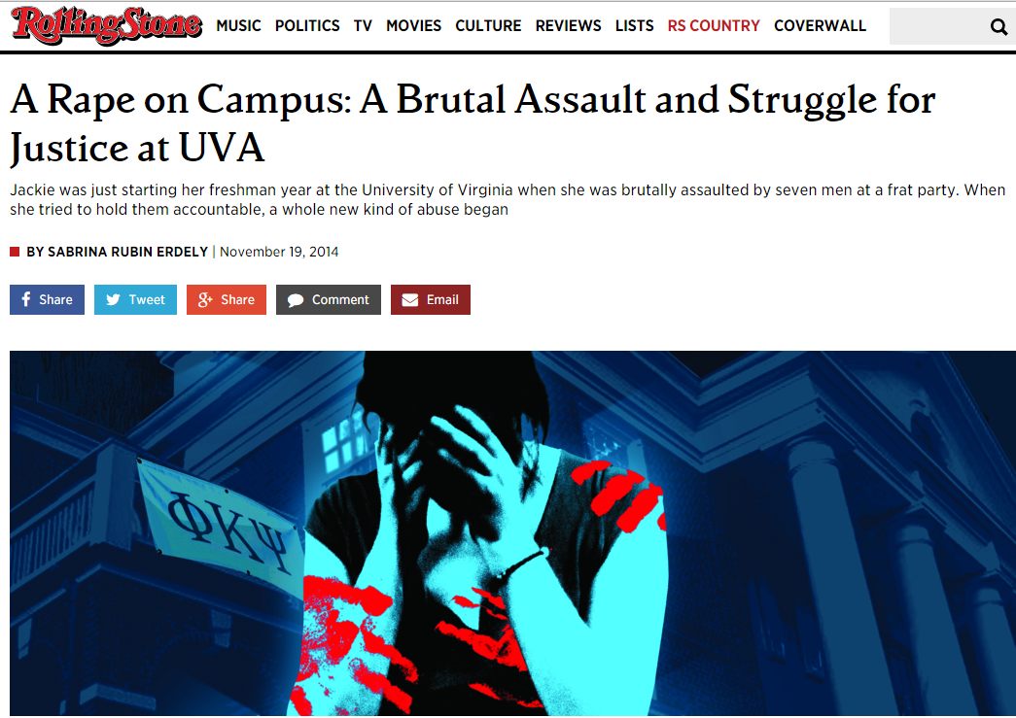

Slide 15
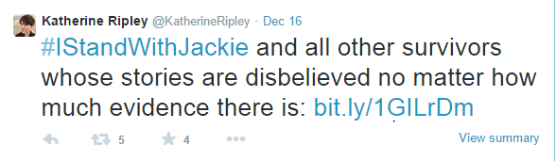
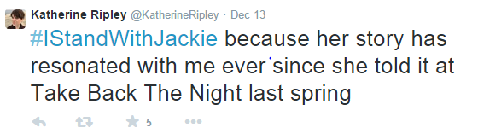
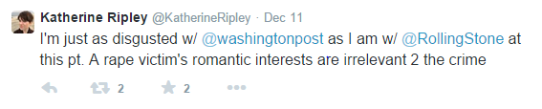

[O]n the whole, we did not question Jackie herself. And that’s because, when we sorted through Erdely’s snide tone and some small missteps, we found something in that article that struck a chord with us . . .
It is becoming increasingly clear that the story that blew the lid off campus sexual assault has some major, major holes. Ultimately, though, from where I sit in Charlottesville, to let fact checking define the narrative would be a huge mistake.

Slide 16
