Slide 1
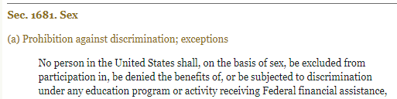

Slide 2



Slide 3
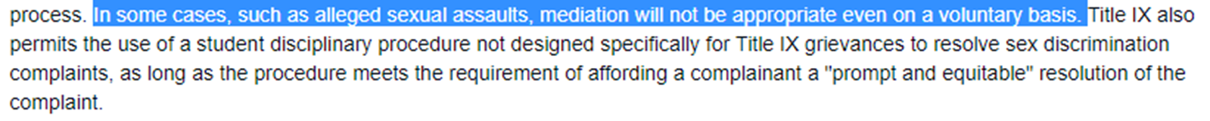
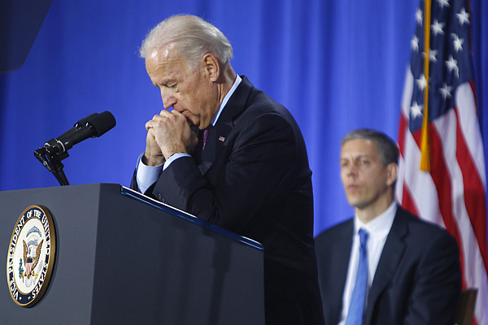

Slide 4
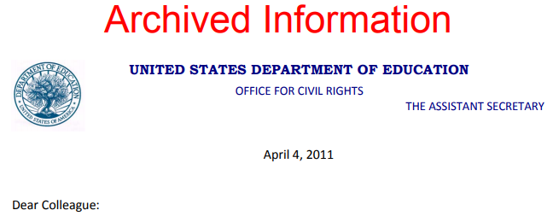
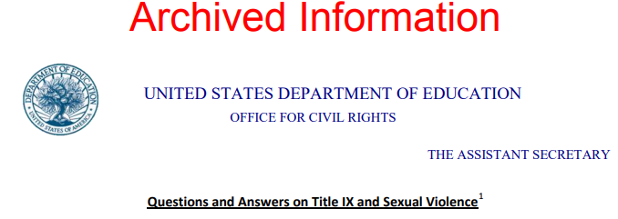
preponderance of the evidence (50.01 percent) for guilt
allow accusers to appeal not-guilty findings
“strongly” discourage cross-examination of accusers under procedures then used by most schools
discourage jury of accused student’s peers (fellow students) in Title IX tribunals
accelerated adjudications (60 days suggested limit)
mandatory training in effects of “neurobiological change” of all Title IX tribunals and investigators
praise for single investigator-adjudicator model (which eliminates all hearings and cross-examination)

Slide 5
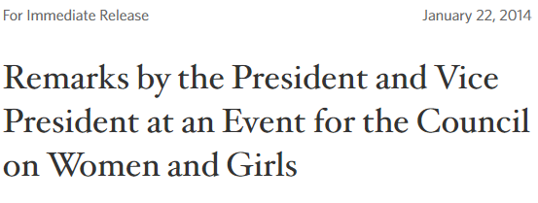
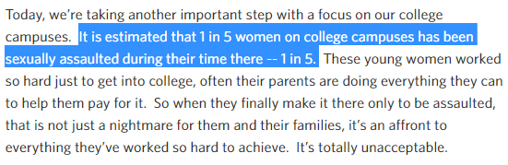

Slide 6
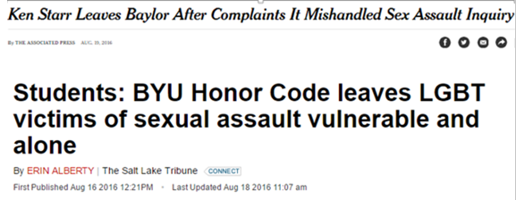

Slide 7
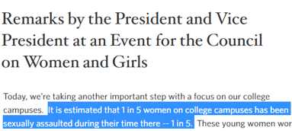
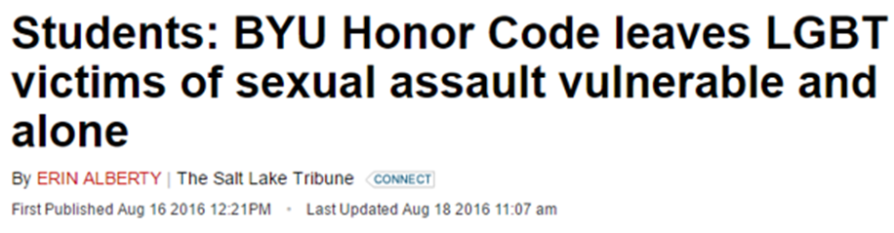
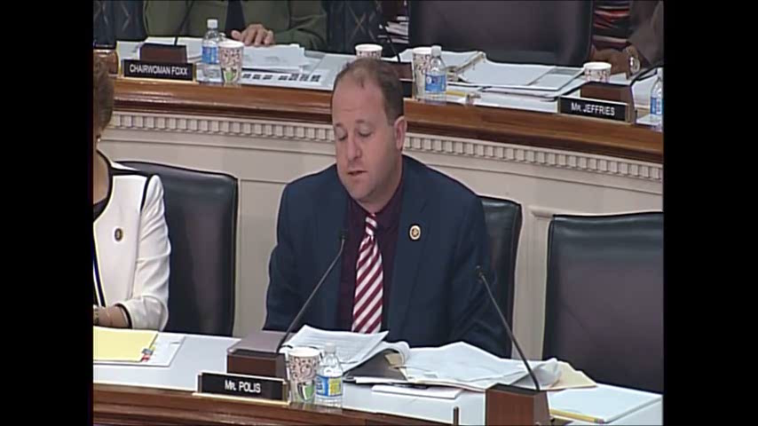

Slide 8
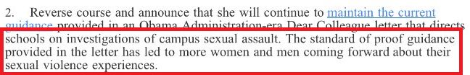

Slide 9


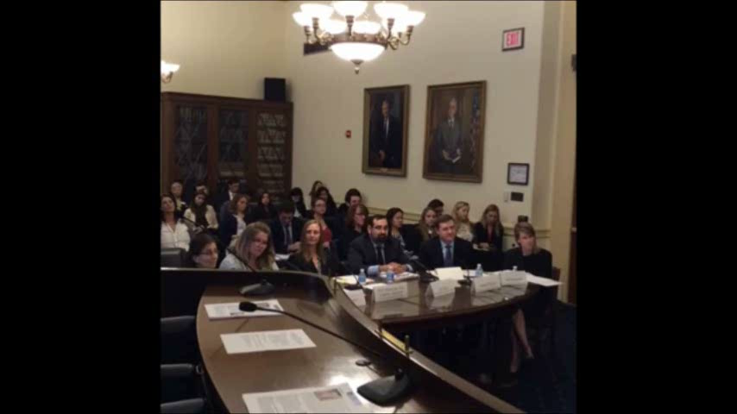

Slide 10
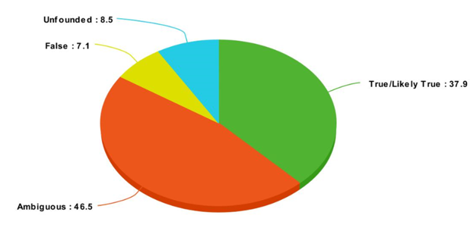
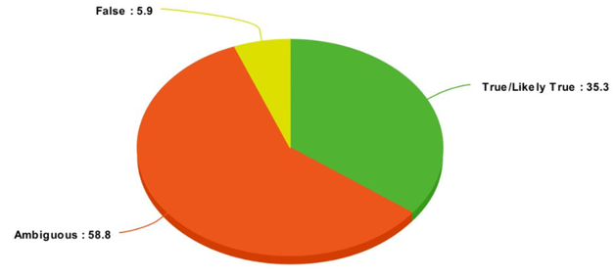



Slide 11


Slide 12
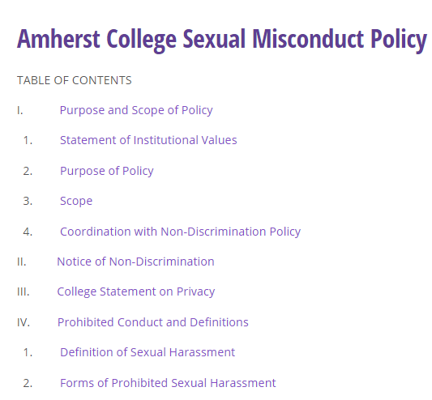
--“Dear Colleague” letter mandates: preponderance-of-evidence; right of accuser to appeal not-guilty finding; accelerated investigation
--accused student can’t have lawyer at hearing
--elimination of direct cross-examination; questions submitted in writing, in advance; may or may not be asked by panel
--no students in disciplinary panel; special training
--investigator hired by Title IX office, to use “affirmative consent” standard
--intoxicated students might “appear to be giving consent, but do not actually have conscious awareness or the ability to consent”; no standard on how to evaluate
--goal of procedure is “empowering victims”

Slide 13
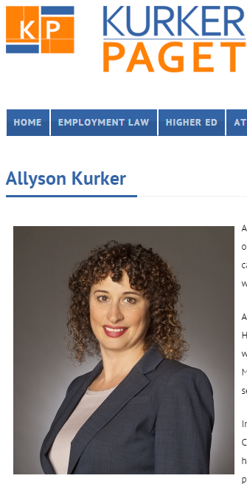
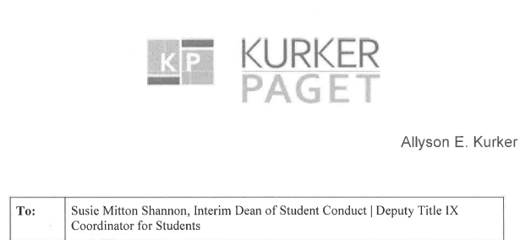
“Ms. [Stanton] did not keep a journal; she did not email, text or otherwise reduce what had happened with [Cheng] to writing.”

Slide 14
Stanton: I felt very alone and confused . . . I realized that I did not want to be alone. I texted a friend to come over and talk to me and spend the night . . .

Slide 15
Stanton: I felt very alone and confused . . . I realized that I did not want to be alone. I texted a friend to come over and talk to me and spend the night . . .
Chair: Any other questions from the hearing panel at this stage?
Q: How did your relationships with [common friends], how were your relationships affected [after the incident]?

Slide 16
Q: We heard in testimony that there was a text message sent to D.R., the resident advisor, after the incident. Do you recall that the content of that message was?
Stanton: I think I did say like, well, something about . . . Like, well doing a bad thing. So I actually, like, texted him right after [Cheng] had left . . .
Q: So you had said previously that immediately after [Cheng] had left you texted someone, and someone came over? Was D.R. the person who came over?
Stanton: No.

Slide 17
Q: We heard in testimony that there was a text message sent to D.R., the resident advisor, after the incident. Do you recall that the content of that message was?
Stanton: I think I did say like, well, something about . . . Like, well doing a bad thing. So I actually, like, texted him right after [Cheng] had left . . .
Q: So you had said previously that immediately after [Cheng] had left you texted someone, and someone came over? Was D.R. the person who came over?
Stanton: No.
Q: And . . . Thank you. [Question about Stanton’s difficult relations with her former friends.]

Slide 18
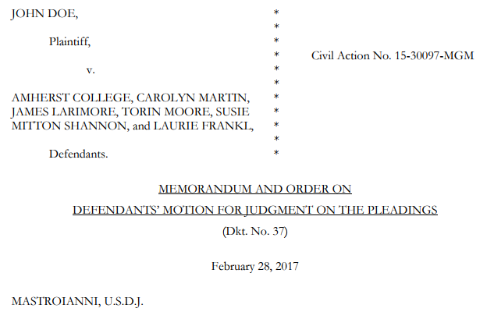
After Cheng left her room, Stanton exchanged text messages with another student, D.R., who lived on the same floor as Stanton and [her roommate] and served as a residential counselor. In the course of the text message exchange, Stanton stated that she “fucked” Cheng and proposed lying to others about what happened, expressing concern about the fact that others, including [another student in the dorm], had seen her kissing Cheng in the common room, and her belief that Cheng “was too drunk to make a good lie out of shit.” Stanton also told DR that another student, ML [who she had invited to her room to hook up before encountering Cheng], was coming to her room. After ML arrived, Stanton complained to DR that ML was “just talking” rather than initiating sexual contact. Later, Stanton complained to DR that “action did not happen til 5 in the . . . morning.” She also mentioned that Cheng had come to her room in search of his phone, but that she had told him to go away because ML was still in her room. The text messages contain a significant back and forth between DR and Stanton about what Stanton would tell her roommate, who had been casually dating Cheng. DR took the position that word would get out, stating Cheng had told someone else and reminding Stanton she too had also told someone, to which Stanton responded that DR did not count.

Slide 19
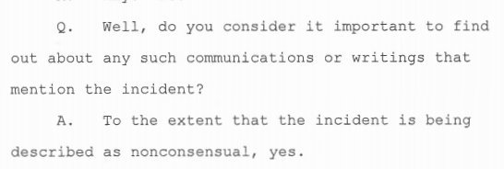
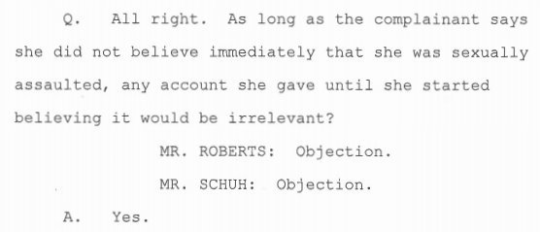
Amherst filing: Stanton’s non-production of the text messages wasn’t misleading, because Amherst was only interested in “whether she had communicated or recorded in writing that the Incident had been ‘non-consensual,’ which she did not.”

Slide 20
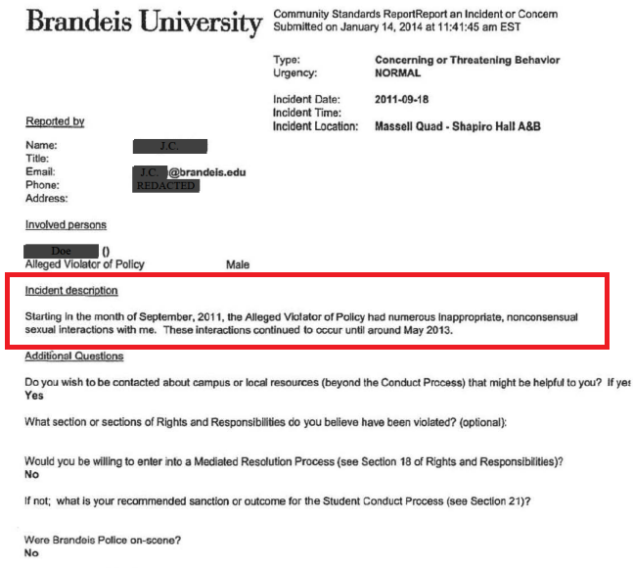

Slide 21
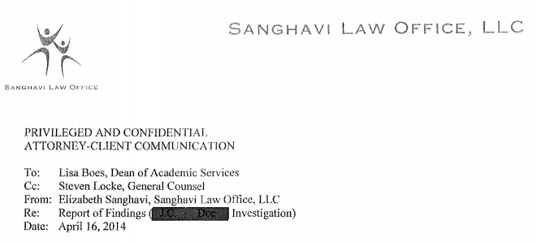
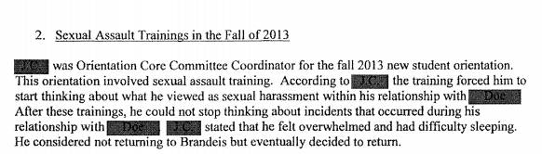
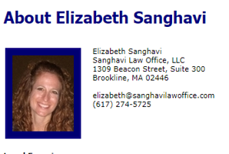



Slide 22

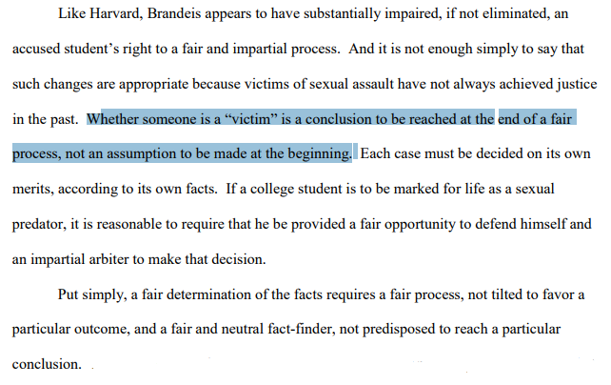
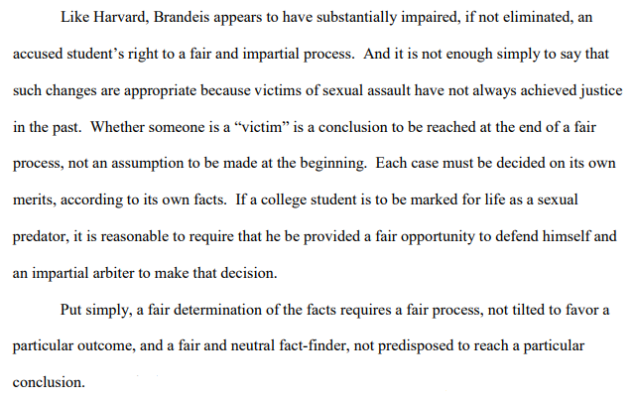

Slide 23


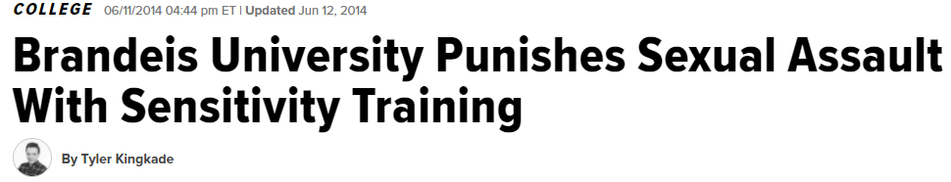
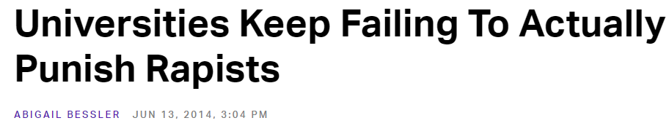
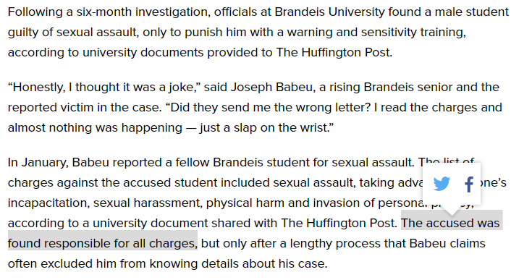
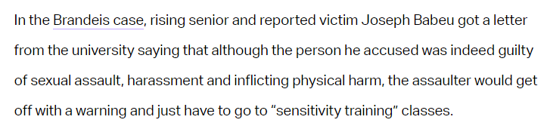

Slide 24
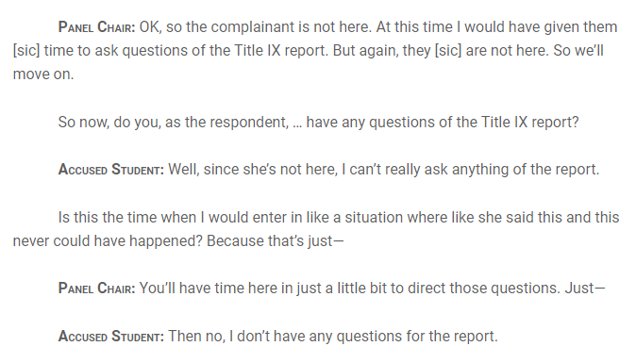
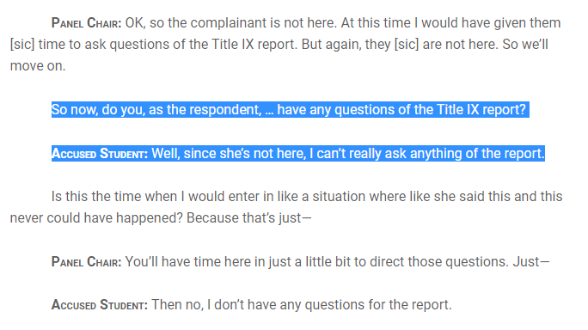

Slide 25

Evan Priestle (lawyer for University of Cincinnati): The one thing that he [the accused student] is claiming that he didn’t receive was the ability to confront and cross-examine his accuser. But, Your Honors, the probable value of cross-examination in these cases is likely going to be minimal. In fact, if hearsay evidence is still allowed to be—
Judge Amul Thapar: The courts—wait. The courts have said exactly the opposite. They’ve said when their [the students’] credibility is at issue, cross-examination is critical.
Priestle: Courts have said that in dictum statements, but they’ve never actually analyzed, under the Mathews v. Eldridge factors, how that would actually play out in reality. The only case that has actually analyzed the three Mathews v. Eldridge factors is Newsome v. Batavia Local School District, and it held—
Judge Thapar: I mean, you keep coming back to that, but Newsome was a high school setting. And they said how important cross-examination was. And then they said—and I’ve got it open—they said,
The value of cross-examining student witnesses in school disciplinary cases, however, is somewhat muted by the fact that the veracity of a student account of misconduct by another student is initially assessed by a school administrator—in this case, the school principal—who has, or has available to him, a particularized knowledge of the student’s trustworthiness.
Judge Thapar: And this Court has noted that is lacking in a university setting with 44,000 students.

Slide 26
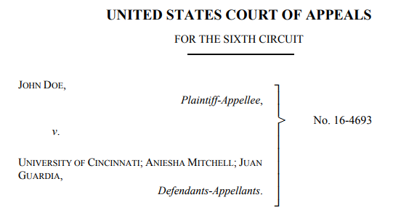
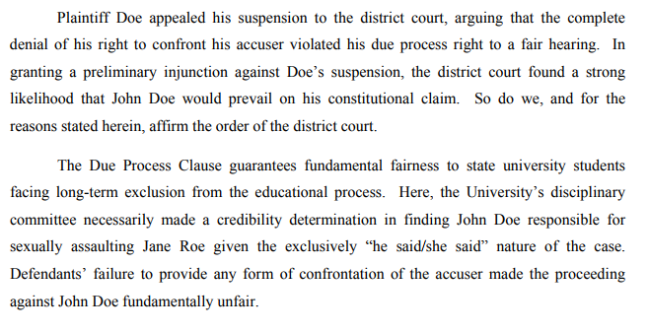
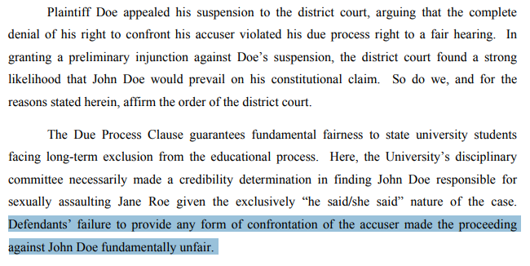

Slide 27

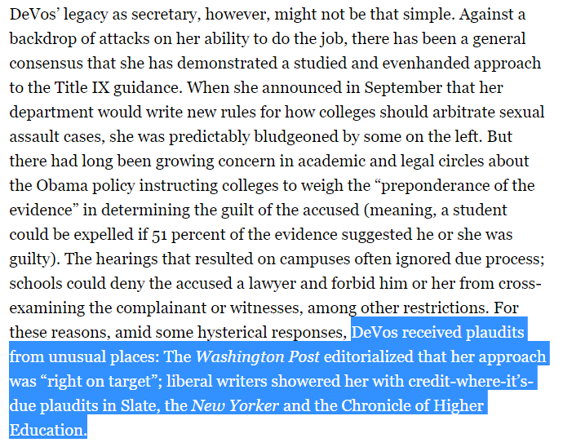

Slide 28
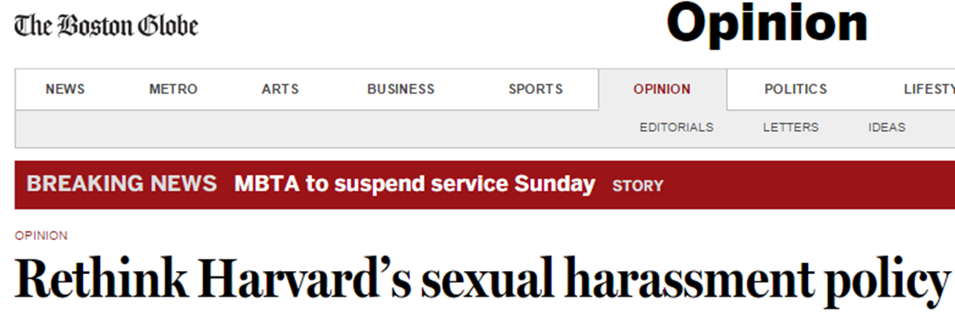
Harvard has adopted procedures for deciding cases of alleged sexual misconduct which lack the most basic elements of fairness and due process, are overwhelmingly stacked against the accused, and are in no way required by Title IX law or regulation …
The goal must not be simply to go as far as possible in the direction of preventing anything that some might characterize as sexual harassment. The goal must instead be to fully address sexual harassment while at the same time protecting students against unfair and inappropriate discipline, honoring individual relationship autonomy, and maintaining the values of academic freedom.
--15 Oct. 2014

Slide 29
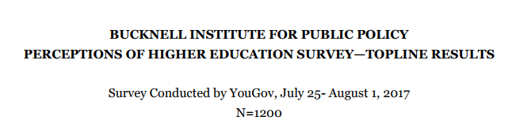
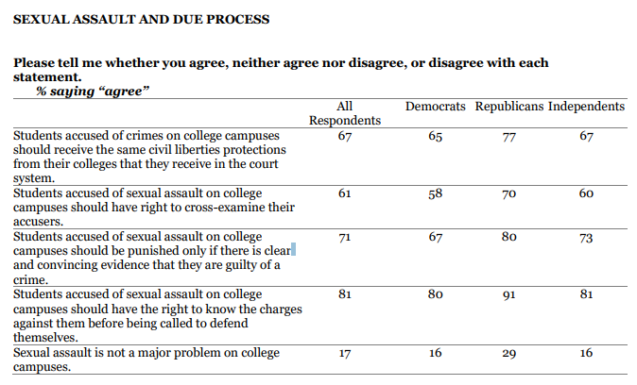

Slide 30
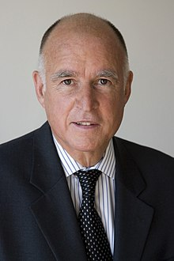
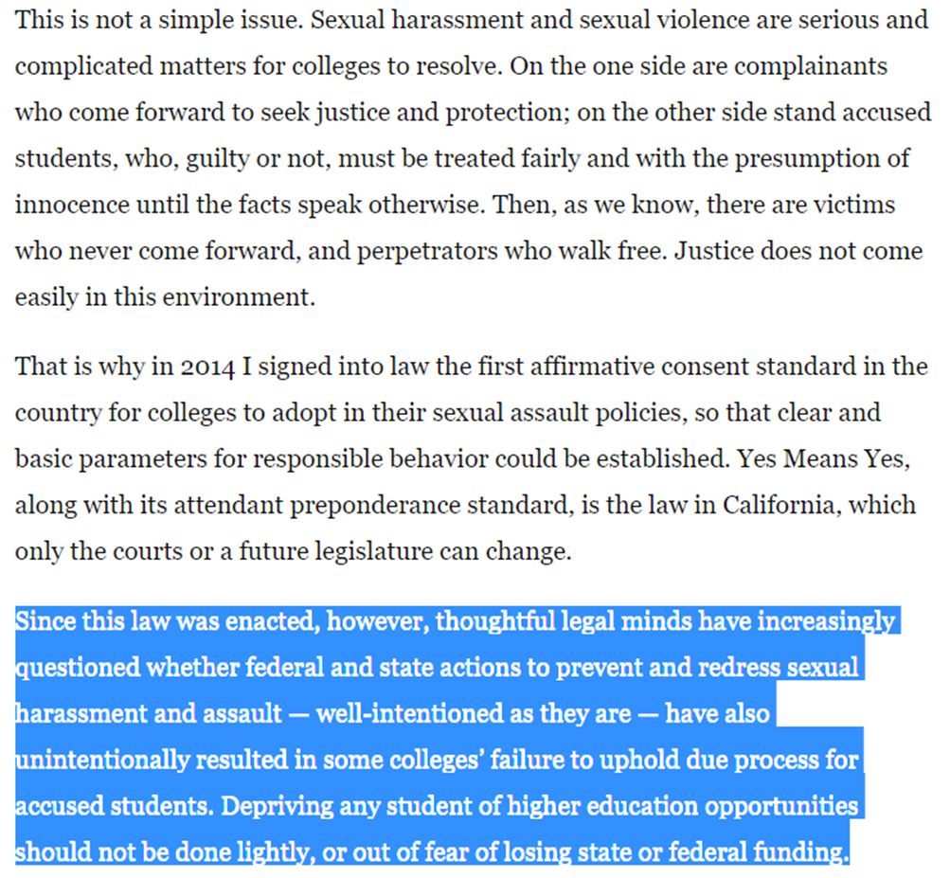

Slide 31
