Slide 1
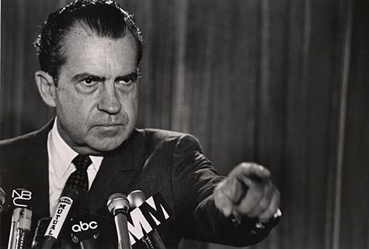

Slide 2
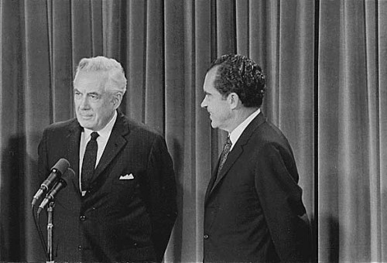

Slide 3
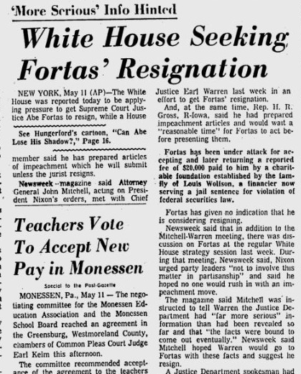

Slide 4
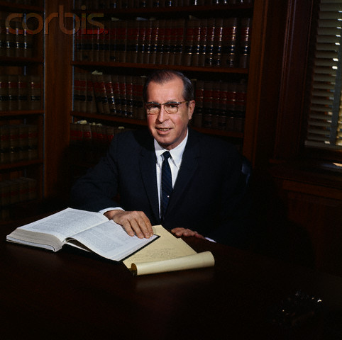

Slide 5
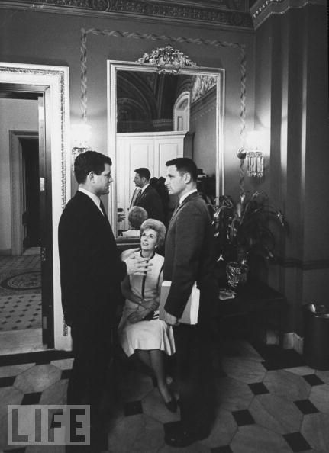
Notes:
Emk and bayh

Slide 6
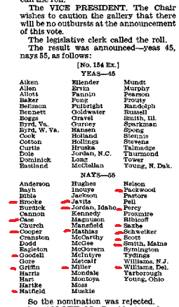

Slide 7
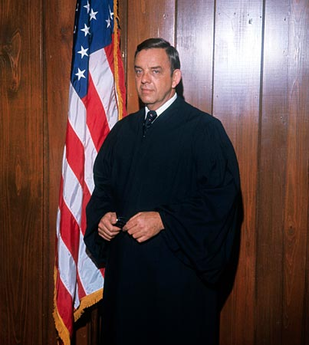
Notes:
carswell

Slide 8
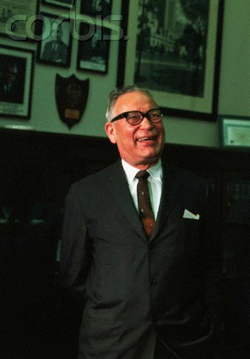
"Even if he were mediocre, there are a lot of mediocre judges and people and lawyers. They are entitled to a little representation, aren't they, and a little chance? We can't have all Brandeises, Frankfurters and Cardozos."
Notes:
hruska

Slide 9
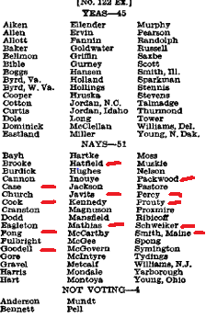

Slide 10
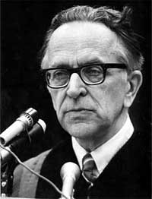

Slide 11

President Nixon: Now, on the other thing, John, on the second one, if it comes: can I urge you to try to examine everything to see if you can find a Catholic—a good Catholic?
John Mitchell: You want another [Justice William] Brennan?
President Nixon: No, Christ no! That’s what I mean. I mean—
Mitchell: You know, you went down—the Eisenhower administration went down that track before, you know . . .
President Nixon: And they got Brennan, I know. But you don’t have an honest Italian, do you?
Mitchell: [Chuckles.] God, they’re awful hard to find.
President Nixon: A Pole?
Mitchell: Uh . . .
President Nixon: No.
Mitchell: [California attorney and future Reagan AG] William French Smith—he isn’t one, is he?
President Nixon: Oh, Christ, no. He’s a Protestant.
Mitchell: WASP.
President Nixon: Rich and everything else.
Mitchell: All right.
President Nixon: Well, take a look at the Catholics, will you?
[Break.]
Mitchell: Do you think that’s a good line to take?
President Nixon: I do. Politically, we are going to gain a lot more from a Catholic. Look, the Protestants will just figure—if he’s a conservative, a Catholic conservative’s better than a Protestant conservative. We really need that—
Mitchell: Well, they’re more engrained, I’m sure.
President Nixon: Yeah. The point is, it’ll mean more to the Catholics—that’s my point—than it will to the Protestants. The Protestants expect to have things. The Catholics don’t.
Mitchell: When are you going to fill that Jewish seat on the Supreme Court?
President Nixon: Well, about . . . after I die. [Mitchell laughs.] You know and I know, there aren’t any.
Mitchell: There are no conservatives, I’ll say that.
President Nixon: Never.

Slide 12
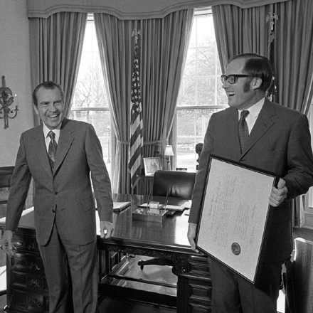

Slide 13
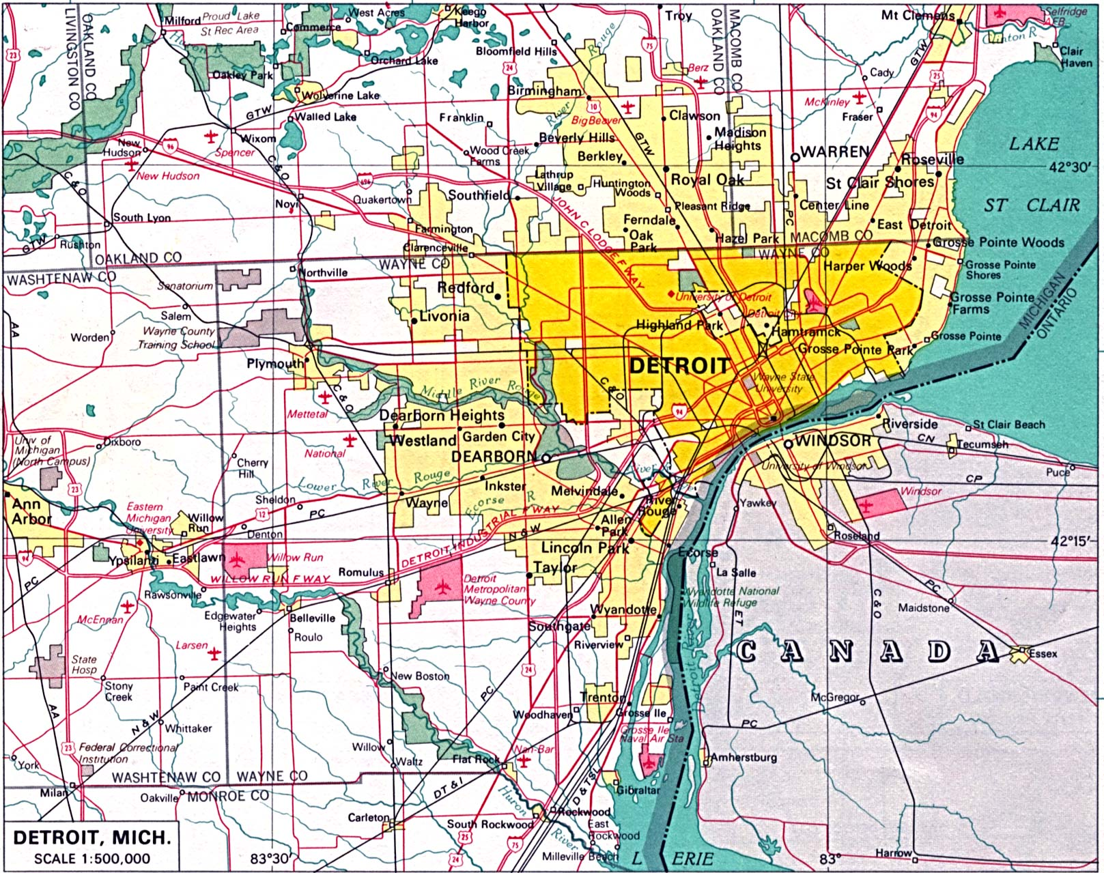

Slide 14
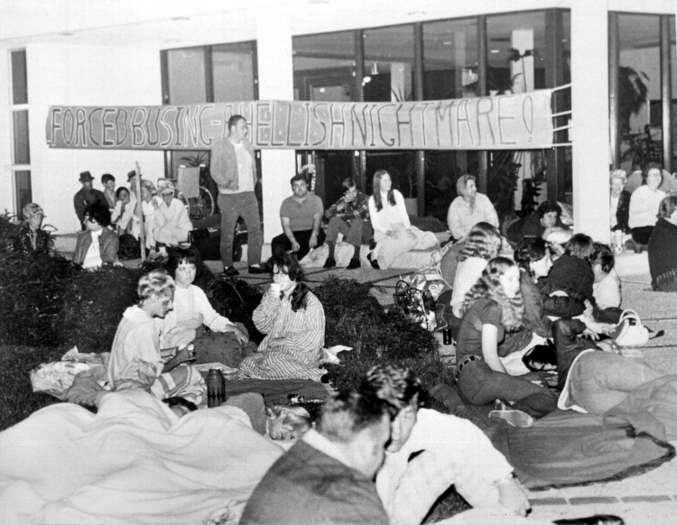

Slide 15
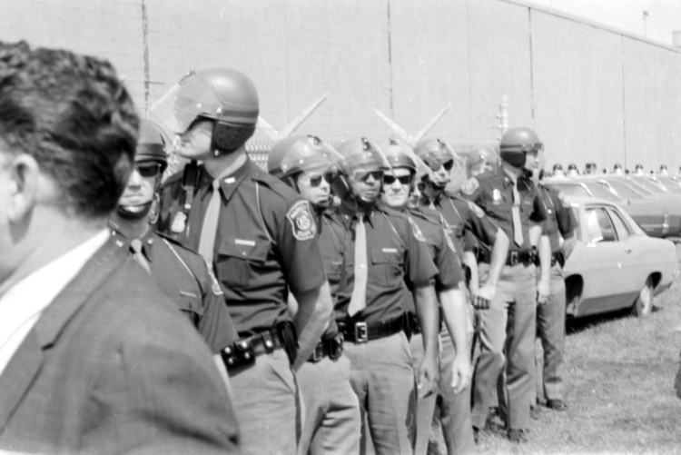

Slide 16
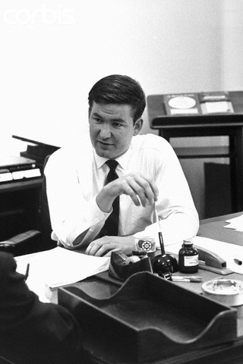

Slide 17
President Nixon: Well, I’ve basically—we’ve got to say that it’s only the extent that it is required by law—
Pat Buchanan: Right.
President Nixon: By a court order, do I think busing should be used.
Buchanan: Mm-hmm.
President Nixon: Don’t you think that’s really what you get down to?
Buchanan: Right. Right.
President Nixon: Because the line, actually, between my line and Muskie’s, is not as clear as—I mean, it’s just the way he said it. He starts at the other end. He says, “Well, I think busing is a legitimate tool—
Buchanan: Yeah.
President Nixon: And then, “but I’m against it.” I start at the other end. I say, “I’m against busing, but, if the law requires it, to the minimum extent necessary, I, of course, will not resist it.”
Buchanan: Mm-hmm.
President Nixon: Right?
Buchanan: Right.
President Nixon: It’s purely a question of tone.
Buchanan: Well, we’ve got to push Muskie’s emphasis up in the headlines; that’s the problem.
President Nixon: That’s right. That’s right. Yeah. It’s got to be—well, I think it probably is going to get some play in the South now—
Buchanan: I think, well, that’s something you could really move by various statements exaggerating his position, and then Muskie would come back sort of drawing it back and it raises—identifies him with it.
President Nixon: Yeah, the thing to do really is to praise him—have some civil rights people praise him for his defense of busing.
Buchanan: Mm-hmm.
President Nixon: That’s the way to really get that, you know. It’s much the better way than to have people attack him for it—
Buchanan: Mm-hmm.
President Nixon: —is to praise him for his defense of busing, see?
Buchanan: Mm-hmm. Mm-hmm.
President Nixon: And I don’t know if you’ve got any people that can do that or not. But I would think that would be very clever.
Buchanan: Mm-hmm. OK.

Slide 18
Milliken v. Bradley (1974)
The District Court and the Court of Appeals shifted the primary focus from a Detroit remedy to the metropolitan area only because of their conclusion that total desegregation of Detroit would not produce the racial balance which they perceived as desirable. Both courts proceeded on an assumption that the Detroit schools could not be truly desegregated -- in their view of what constituted desegregation -- unless the racial composition of the student body of each school substantially reflected the racial composition of the population of the metropolitan area as a whole . . .
Boundary lines may be bridged where there has been a constitutional violation calling for inter-district relief, but the notion that school district lines may be casually ignored or treated as a mere administrative convenience is contrary to the history of public education in our country. No single tradition in public education is more deeply rooted than local control over the operation of schools; local autonomy has long been thought essential both to the maintenance of community concern and support for public schools and to quality of the educational process . . .

Slide 19
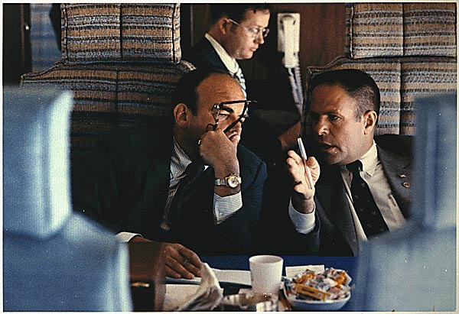

Slide 20
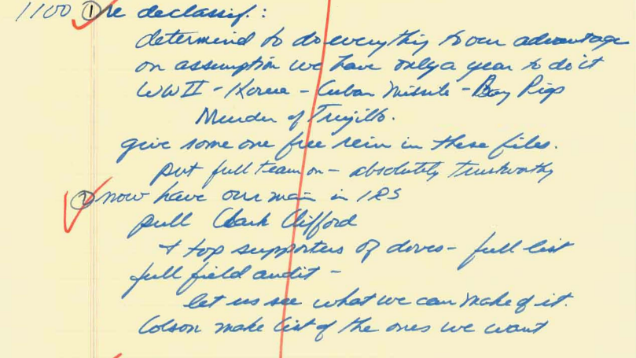

Slide 21
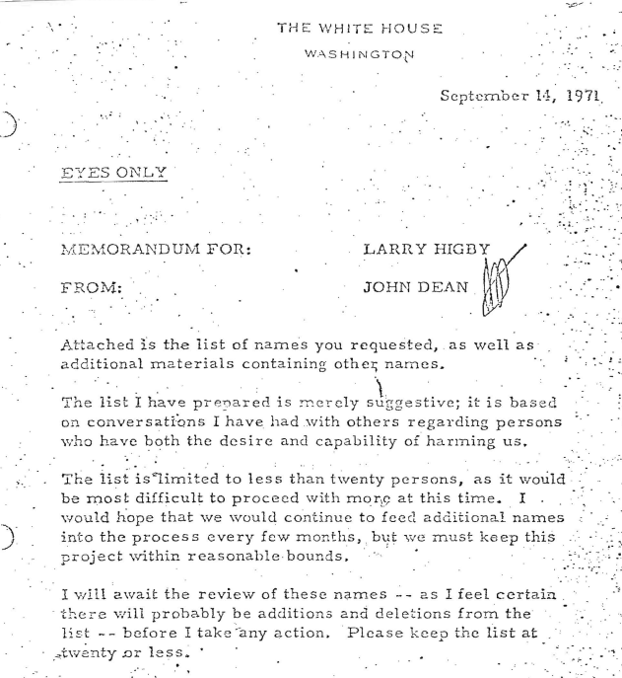

Slide 22
President Nixon: But, anyway, here we go. What in the name of God are we doing on this score? What are we doing about the financial contributors? Now, those lists are made there.
Are we looking over McGovern’s financial contributors? Are we looking over the financial contributors to the Democratic National Committee? Are we running their income tax returns? Is the Justice Department checking to see whether or not there is any anti-trust suits? Do we have anything going on any of these things?
H.R. Haldeman: Not as far as I know.
President Nixon: We better get the goddamn campaign right this time—not tomorrow, but now. That’s what concerns me. We have all this power and we aren’t using it. Now, what the Christ is the matter?
In other words, what I’m really saying is this: I think we’ve got to get it out.
Now, I’m just thinking about, for example, if there’s information on Larry O’Brien [regarding possible tax problems]. If there is, I wouldn’t wait. I’d worry the sons of bitches now, because after they select somebody else [as a running mate for McGovern], it is irrelevant, even though he’s still in the campaign. It’s much more relevant now, that then they drop him because . . . See what I mean?
John Ehrlichman: Yeah, well—
President Nixon: You’ve got the facts. Did they check the other side of the facts? What is being done, and who is doing this full-time? That’s what I’d like to know. Who is running the IRS? Who is running over at the Justice Department?
So, what I meant is, with all the agencies of government, what in the name of God are we doing about, my God, the McGovern contributors?
Ehrlichman: I think the short answer to your question is nothing, and . . .
President Nixon: There we are. Boy, they’re doing it to us.
Ehrlichman: No question; no question.
President Nixon: And it’s never happened that way before.
Ehrlichman: I can give you—
President Nixon: Johnson screwed everybody! Kennedy did. And when we were out, in ’52, the Truman people were kicking the hell out of me.
Ehrlichman: Sure.
President Nixon: In ’62 [when he ran for California governor], they kicked the hell out of me. In 1960, the bureaucracy bleached up on my visit to Khrushchev. Our bureaucracy—the guys in our bureaucracy.
A part of the problem is the bureaucracy. Part of the problem is our own goddamned fault. There must be something that we can do.
Ehrlichman: I don’t disagree with you at all—
President Nixon: Now, where’s [presidential aide Tom Charles] Huston? Is he around? Can we enlist him? Or anybody, to do this kind of work? I think the trouble is we’ve got too many nice guys around, who just want to do the right thing.

Slide 23
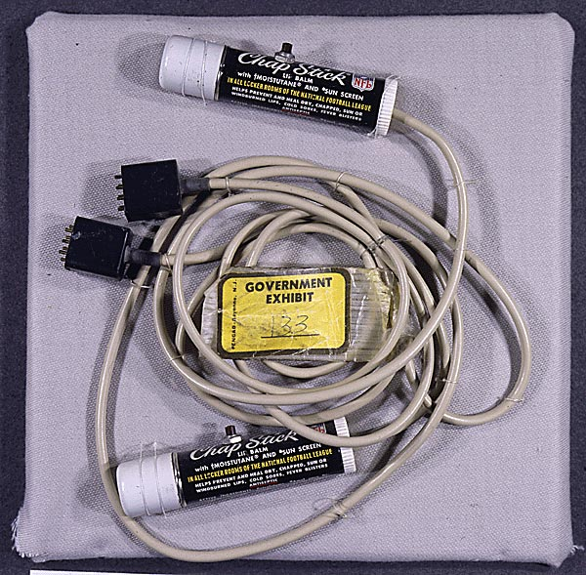

Slide 24
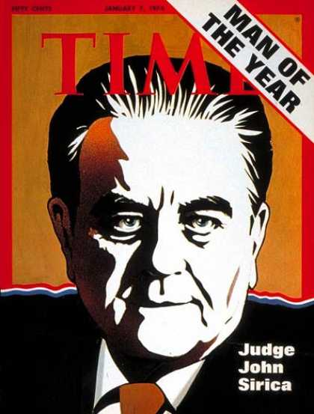

Slide 25
John Dean: Where are the soft spots on this? Well, first of all, there’s the problem of the continued blackmail.
President Nixon: Right.
Dean: Which will not only go on now, it will go on when these people are in prison. And it will compound the obstruction of justice situation. It will cost money. It’s dangerous. Nobody—people around here are not pros at this. This is the kind of thing Mafia people can do—washing money, getting clean money, things like that. We just don’t know about this. We’re not use to—we’re not criminals, we’re not used to dealing with that business. It’s a—
President Nixon: That’s right.
Dean: It’s a tough thing to know how to do.
President Nixon: Maybe we can’t do that.
Dean: That’s right. It’s a real problem as to whether we can do it. Plus there’s a real problem raising money. [Attorney General John] Mitchell has been working on raising some money, feeling that—you know, he’s one of the ones with the most to lose.
But there’s no denying that the White House ad [John] Ehrlichman, [Bob] Haldeman, [John] Dean are involved money decisions.
President Nixon: How much do you need?
Dean: I would say these people are going to cost a million dollars over the next few years.
President Nixon: We’ll get it.
Dean: Mm-hmm.
President Nixon: On the money—if you need the money, I mean, we’ll get the money.
Dean: Well, I think that we’ll—
President Nixon: My point is: you can get a million dollars; you can get it in cash. I know where it could be gotten.
Dean: Mm-hmm.
President Nixon: I mean, it’s not easy, but it could be done.

Slide 26
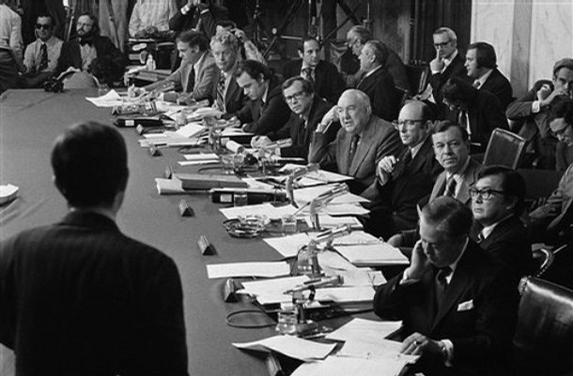

Slide 27
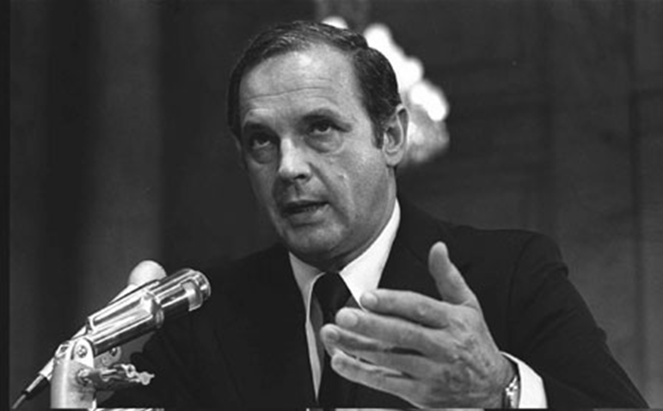

Slide 28
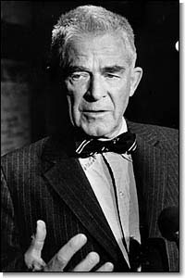

Slide 29
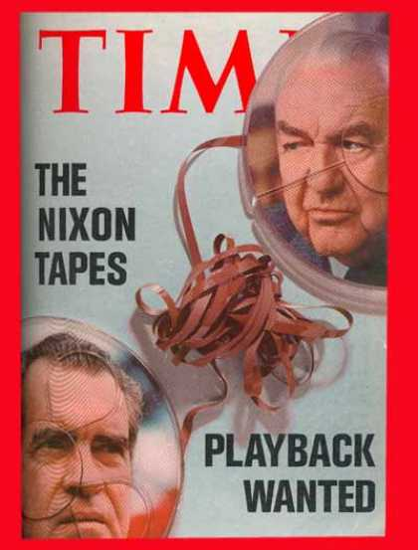

Slide 30
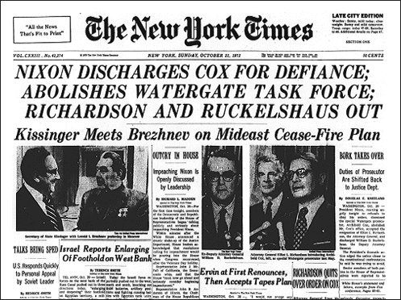

Slide 31
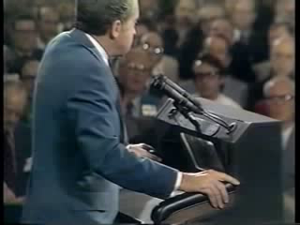

Slide 32
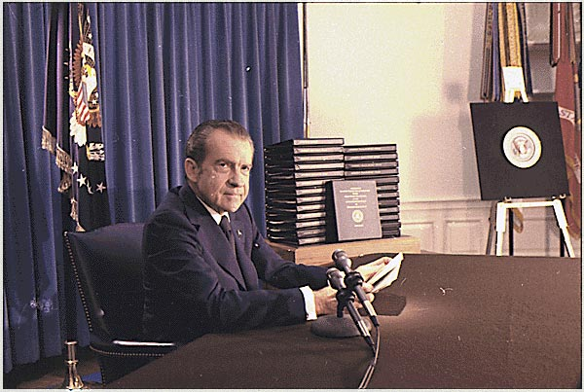

Slide 33
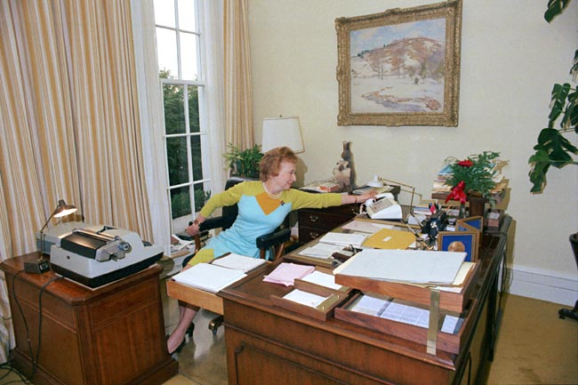

Slide 34
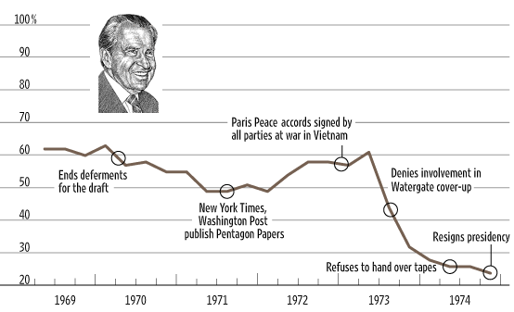

Slide 35


Slide 36
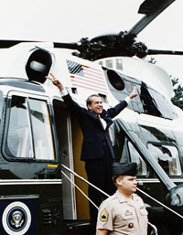

Slide 37
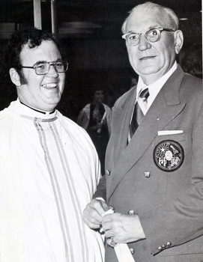
Notes:
hebert

Slide 38
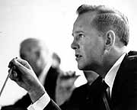
Notes:
adams

Slide 39


Slide 40
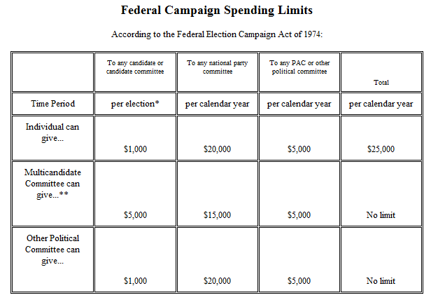

Slide 41
Buckley v. Valeo (1976)
A restriction on the amount of money a person or group can spend on political communication during a campaign necessarily reduces the quantity of expression by restricting the number of issues discussed, the depth of their exploration, and the size of the audience reached. This is because virtually every means of communicating ideas in today’s mass society requires the expenditure of money. The distribution of the humblest handbill or leaflet entails printing, paper, and circulation costs. Speeches and rallies generally necessitate hiring a hall and publicizing the event. The electorate’s increasing dependence on television, radio, and other mass media for news and information has made these expensive modes of communication indispensable instruments of effective political speech.
The expenditure limitations contained in the Act represent substantial, rather than merely theoretical, restraints on the quantity and diversity of political speech.

Slide 42
Roe v. Wade (1973)—Rehnquist dissent
I have difficulty in concluding, as the Court does, that the right of "privacy" is involved in this case. Texas, by the statute here challenged, bars the performance of a medical abortion by a licensed physician on a plaintiff such as Roe. A transaction resulting in an operation such as this is not "private" in the ordinary usage of that word. Nor is the "privacy" that the Court finds here even a distant relative of the freedom from searches and seizures protected by the Fourth Amendment to the Constitution . . .
The decision here to break pregnancy into three distinct terms and to outline the permissible restrictions the State may impose in each one, for example, partakes more of judicial legislation than it does of a determination of the intent of the drafters of the Fourteenth Amendment . . .
The fact that a majority of the States reflecting, after all, the majority sentiment in those States, have had restrictions on abortions for at least a century is a strong indication, it seems to me, that the asserted right to an abortion is not “so rooted in the traditions and conscience of our people as to be ranked as fundamental.” . . .

Slide 43


Slide 44
Hyde amendment (1976)
Public Law 111-8
H.R. 1105, Division F, Title V, General Provisions
SEC. 507. (a) None of the funds appropriated in this Act, and none of the funds in any trust fund to which funds are appropriated in this Act, shall be expended for any abortion.
(b) None of the funds appropriated in this Act, and none of the funds in any trust fund to which funds are appropriated in this Act, shall be expended for health benefits coverage that includes coverage of abortion . . .
SEC. 508. (a) The limitations established in the preceding section shall not apply to an abortion--
(1) if the pregnancy is the result of an act of rape or incest; or
(2) in the case where a woman suffers from a physical disorder, physical injury, or physical illness, including a life-endangering physical condition caused by or arising from the pregnancy itself, that would, as certified by a physician, place the woman in danger of death unless an abortion is performed.

Slide 45


Slide 46
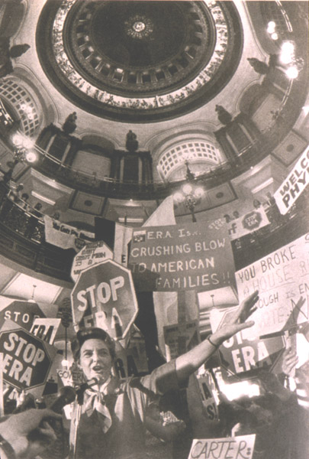

Slide 47


Slide 48


Slide 49
