Slide 1
Time Period | U.S. Troops in Vietnam | U.S. Personnel Killed
End of 1961 | 2,067 | 16
End of 1962 | 11,500 | 52
End of 1963 | 19,000+ | 118

Slide 2


Slide 3


Slide 4

Notes:
Lbj signing tgr

Slide 5
Tonkin Gulf Resolution
Resolved … That the Congress approves and supports the determination of the President, as Commander in Chief, to take all necessary measures to repel any armed attack against the forces of the United States and to prevent further aggression.
Section 2. The United States regards as vital to its national interest and to world peace the maintenance of international peace and security in southeast Asia. Consonant with the Constitution of the United States and the Charter of the United Nations and in accordance with its obligations under the Southeast Asia Collective Defense Treaty, the United States is, therefore, prepared, as the President determines, to take all necessary steps, including the use of armed force, to assist any member or protocol state of the Southeast Asia Collective Defense Treaty requesting assistance in defense of its freedom.
Section 3. This resolution shall expire when the President shall determine that the peace and security of the area is reasonably assured by international conditions created by action of the United Nations or otherwise, except that it may be terminated earlier by concurrent resolution of the Congress.

Slide 6
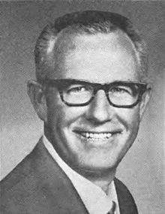
LBJ guilty of “publicity-happy political irresponsibility . . . shooting from the lip.”

Slide 7
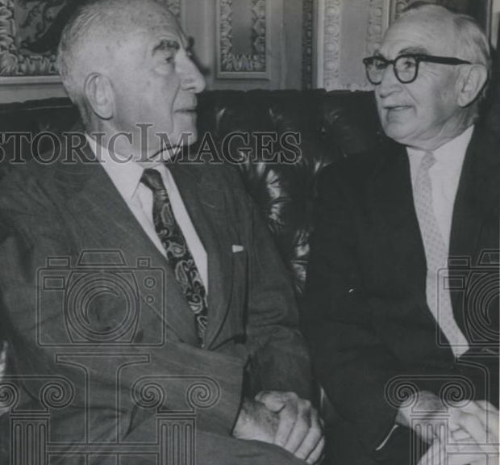

Slide 8

President Johnson: That was a good vote you had today.
Speaker McCormack: Yes, it was very good. 414 to nothing; one present. What’d the Senate do?
President Johnson: 88 to 2. Morse and Gruening.
McCormack: I don’t understand Gruening.
President Johnson: Oh, he’s no good. He’s worse than Morse. He’s just no good. I’ve spent millions on him up in Alaska [in reconstruction funds after the March 1964 Alaska earthquake]. He’s just no good.
And Morse is just as undependable and erratic as he can be.
McCormack: I know that. But I can’t understand the other fellow.
President Johnson: Say, I wanted to point out this little shitass [Ed] Foreman today got up and said that we [Johnson] acted impulsively by announcing that we had an answer on the way [to the Tonkin Gulf incidents] before the planes dropped their bombs.
[Break.]
President Johnson: It’s just a pure lie, and smokescreen.
McCormack: But he was booed two or three times. Tremendous booing on the Democratic side. He was—everybody knew he was just cheap and mean and contemptible. Well, you know what he is.
President Johnson: Yeah. Yeah, he’s no good.

Slide 9


Slide 10
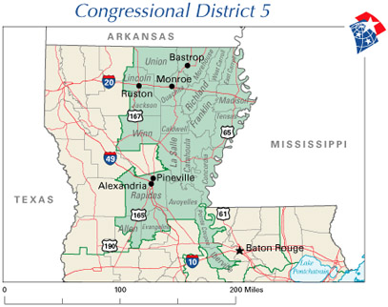

Slide 11
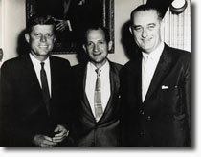

Slide 12
President Johnson: You want to know honestly how I feel?
Jack Brooks: Yeah.
President Johnson: I’m really humiliated that I’m President, and I’ve got a friendly Speaker, and I’ve got a friendly Majority Leader, and I’ve got a friendly Albert Thomas, I’ve got a friendly Jack Brooks, and Otto Passman is king. I think that’s disgraceful in this country.
Because I want to tell you when I see you the next time—confidentially—
Brooks: Mm-hmm.
President Johnson: —what we’re looking at in the world. And it’s a hell of a lot worse than it was last year. And you’re giving us 3 billion [dollars] to deal with, and you gave Kennedy 3.9 [billion dollars].
And I don’t think that’s fair, and I don’t think it’s right. I think it’s awful that a goddamned Cajun from the hills of Louisiana has got more power—
Brooks: He’s no Frenchman, though!
President Johnson: —has got more power than all of us. I just think that’s awful.
Brooks: Yes.
President Johnson: But that’s what you’ve got to do. And some day we’ll get our way, and if I ever walk up in the cold of night and a rattlesnake’s out there and about ready to get him, I ain’t going to pull him off—I’ll tell you that.
Brooks: No, I understand.
President Johnson: Now, you remember that.
Brooks: I want you to remember it. We’ve got some people from—
President Johnson: I remember it. Now, you just go and tell all these Texans that want to hit Russia that I want to put those sons of bitches in uniform.
Brooks: They ought to be.
President Johnson: Let them go fight the Communists for a while. They like to talk a big game—
Brooks: Yeah.
President Johnson: —but they don’t want to do a damn thing about it.
Brooks: I’m with you.
President Johnson: OK.
Brooks: Good night. Bless your heart.

Slide 13
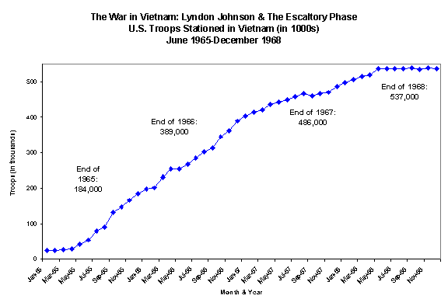

Slide 14
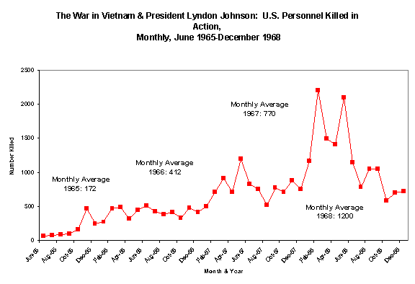

Slide 15
Special Message to the Congress Requesting Additional Appropriations for Military Needs in Viet-Nam
May 4, 1965
This is not a routine appropriation. For each member of Congress who supports this request is also voting to persist in our effort to halt communist aggression in South Viet-Nam. Each is saying that the Congress and the President stand united before the world in joint determination that the independence of South Viet-Nam shall be preserved and communist attack will not succeed . . .
Less than a year ago the Congress, by an almost unanimous vote, said that the United States was ready to take all necessary steps to meet its obligations under that Treaty.
That resolution of the Congress expressed support for the policies of the Administration to help the people of South Viet-Nam against attack--a policy established by two previous Presidents.
Thus we cannot, and will not, withdraw or be defeated. The stakes are too high, the commitment too deep, the lessons of history too plain.

Slide 16
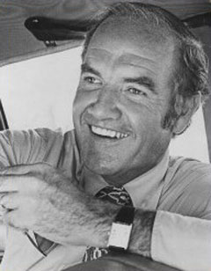
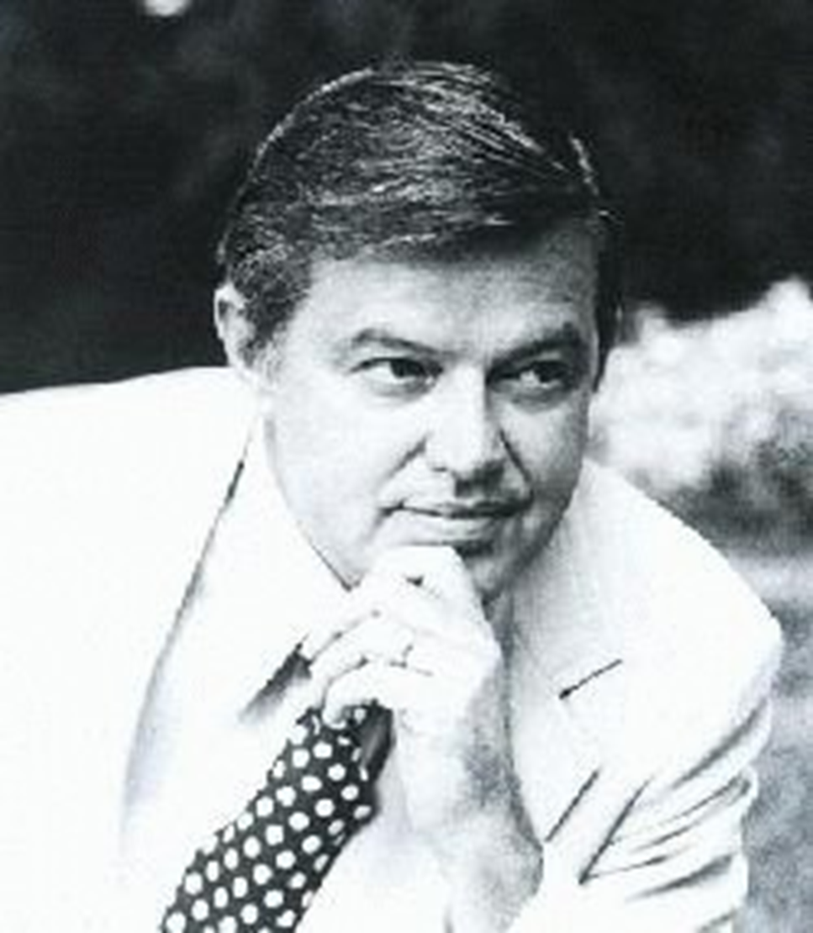

Slide 17


Slide 18
President Johnson: Everything we’ve done in the Pacific, we’ve done with the knowledge and the consent of the Senate. Most of it was done before I became President—was authorized.
Mike Manatos: Yeah.
President Johnson: And we haven’t done anything that hasn’t been.
And when he [Fulbright] says that, “Well, you bombed the oil storage [in North Vietnam],” or “You put people in [to South Vietnam],” the very simple answer is: they said [in the Tonkin Gulf Resolution] “we approve by any means to deter an aggression.”
Manatos: Mm-hmm.
President Johnson: “Any means he [the President] may select.”
Manatos: Right.
President Johnson: Now, he ought to be listed those things, and you ought to say, “The President says that what he was talking about the other night about in this speech”—and you ought to see the record of that speech, a copy is obtained, so you can show it—“was authorized by all of these things, and that’s what he’s talking about doing.”
Manatos: Right.
President Johnson: And Fulbright’s approved every one of ‘em, and either his speechwriter didn’t write it, or didn’t see [that].

Slide 19
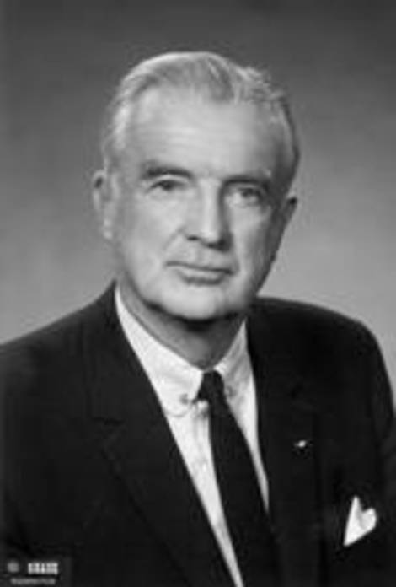

Slide 20
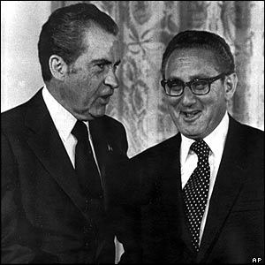

Slide 21
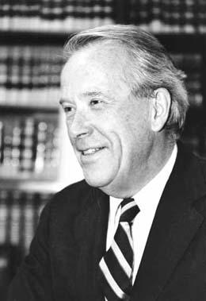

Slide 22
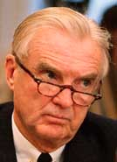

Slide 23
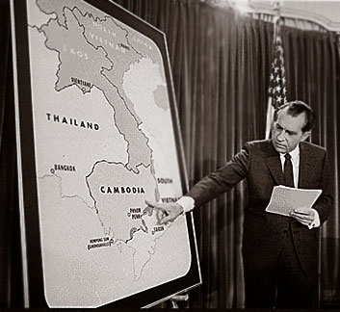

Slide 24
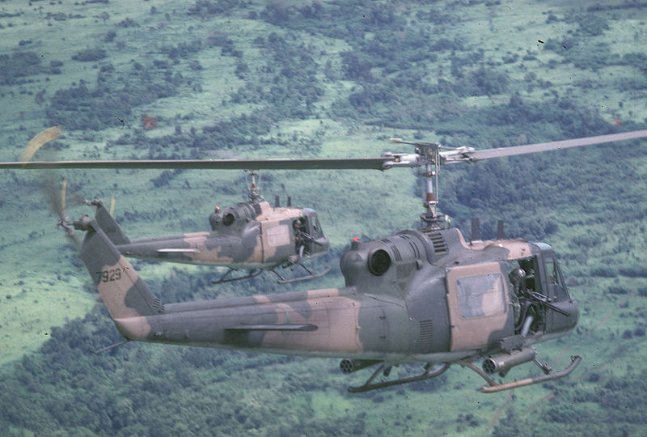

Slide 25
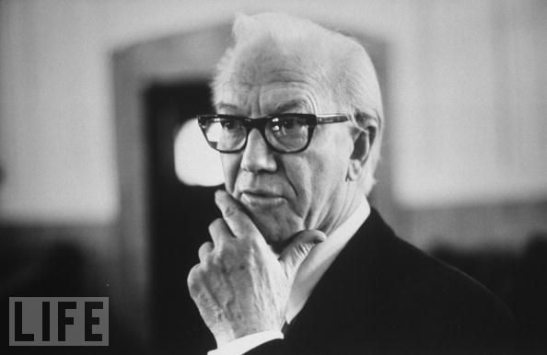
Notes:
Mendel rivers

Slide 26
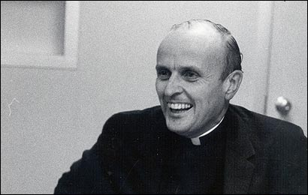

Slide 27
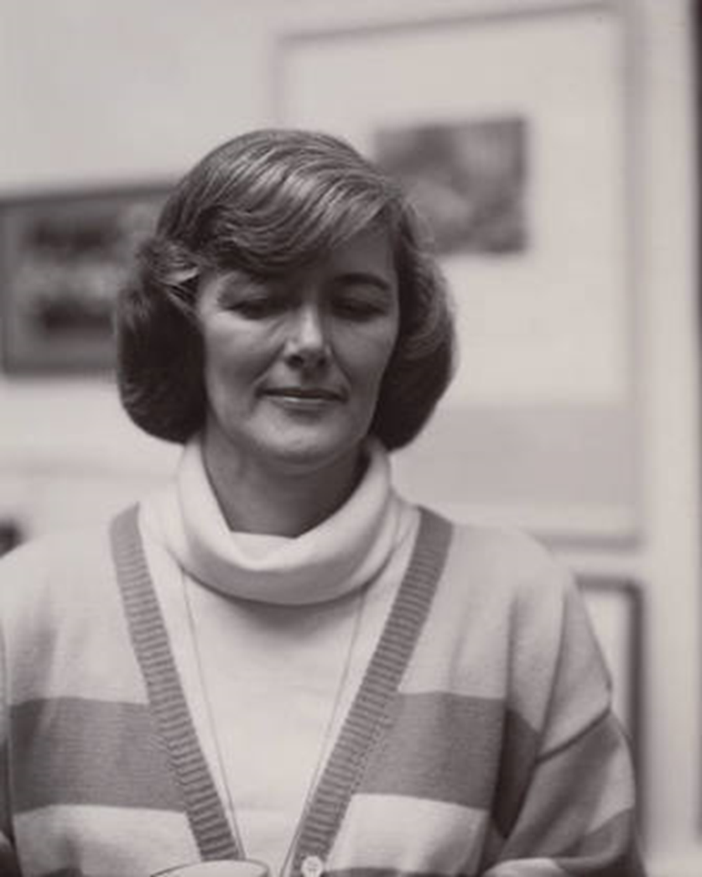
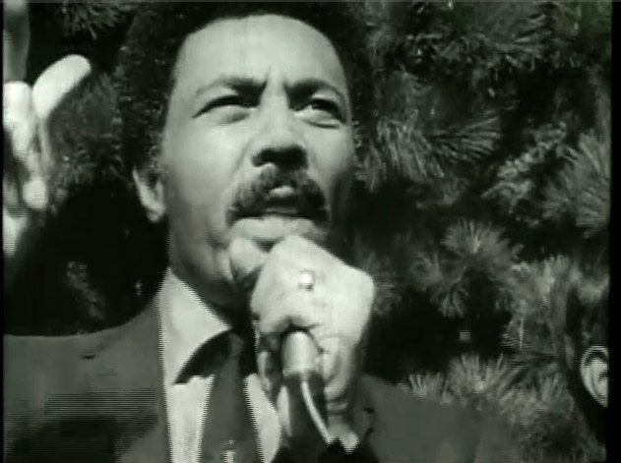

Slide 28
Within sixty calendar days after a report is submitted or is required to be submitted, whichever is earlier, the President shall terminate any use of United States Armed Forces with respect to which such report was submitted (or required to be submitted), unless the Congress (1) has declared war or has enacted a specific authorization for such use of United States Armed Forces, (2) has extended by law such sixty-day period, or (3) is physically unable to meet as a result of an armed attack upon the United States. Such sixty-day period shall be extended for not more than an additional thirty days if the President determines and certifies to the Congress in writing that unavoidable military necessity respecting the safety of United States Armed Forces requires the continued use of such armed forces in the course of bringing about a prompt removal of such forces..

Slide 29
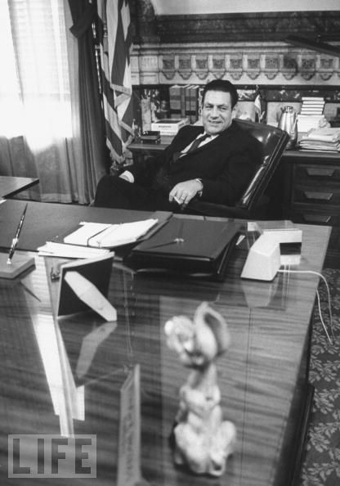

Slide 30
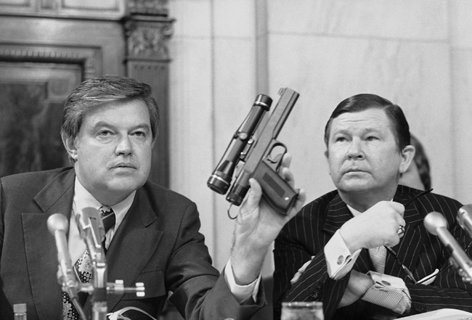

Slide 31
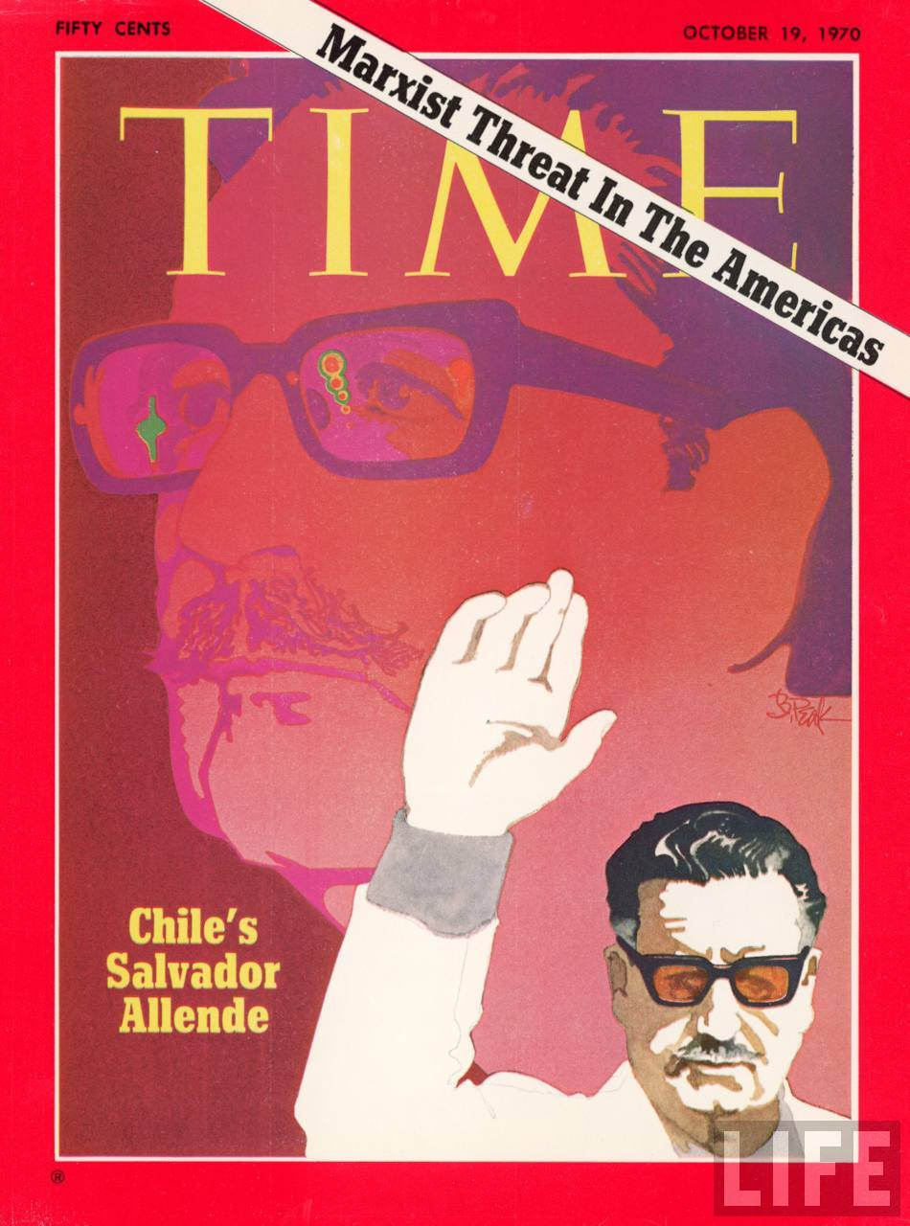
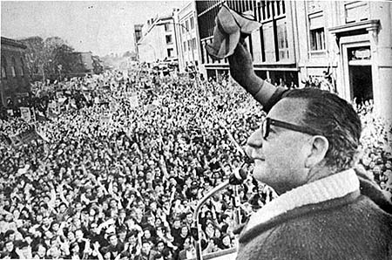

Slide 32
President Nixon: I believe we support whoever are our friends anyplace in the world. And I believe that in most Latin countries you kind of need not dictators—that’s a horrible word, and a reprehensible word to most Americans—but, that strong leadership is essential.
[General and former French president Charles] De Gaulle proved that. I mean, France is a Latin country. It couldn’t—Even France, with all of its sophistication, couldn’t handle a democracy . . . You can’t.
The Italians? That’s their problem. They can’t afford the luxury of democracy. Neither can Spain, and no country in Latin America can
that I know of.
[Break.]
President Nixon: The real thing you need to have from me is, first, this assurance—
DCI Richard Helms: That’s all I want.
President Nixon: I am not going to embarrass the CIA, because it’s terribly important.
Second, I believe in “dirty tricks.” I think we’ve got to do it. As we go into this period now, Dick, with the Chinese, and, you know, with the Russians in Berlin, and the rest, who knows what’s going to happen there?
And I am—I’m going to keep you very closely posted on what’s going to happen. But as we do that, the “dirty tricks” thing may become more and more important because all over the world, particularly if you look at Vietnam, probably, or the rest, but there is going to be the goddamnedest bunch of, you know, of a rash of screwing up of the Chilean things—that sort of thing.

Slide 33
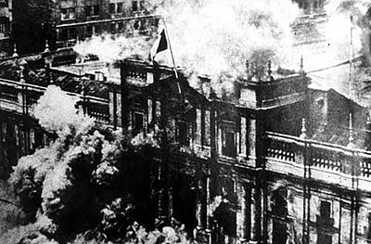

Slide 34
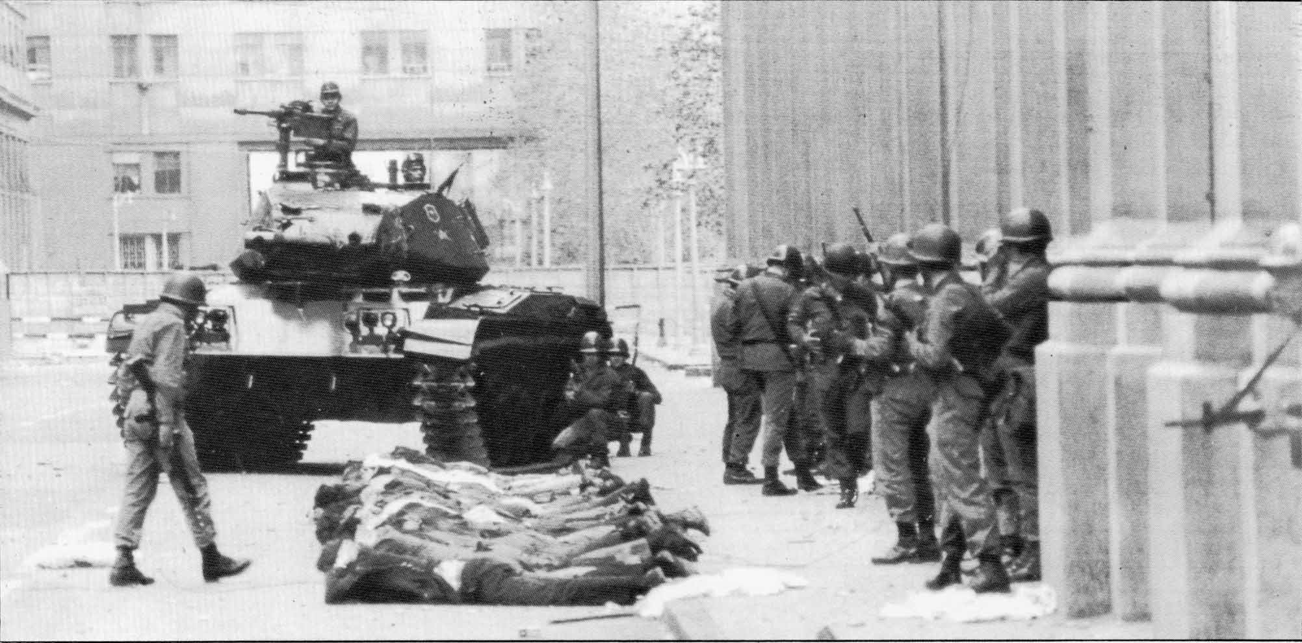

Slide 35
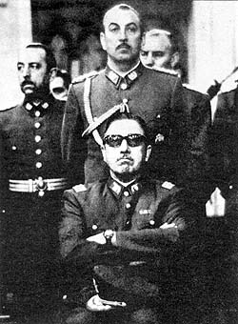

Slide 36
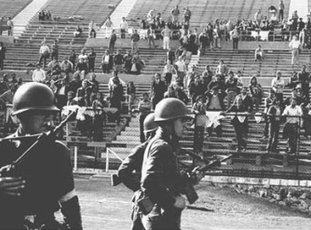

Slide 37
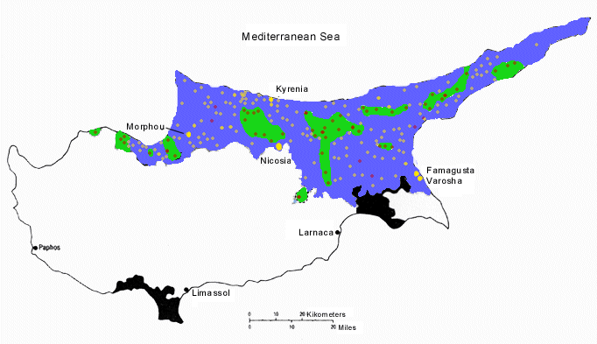

Slide 38
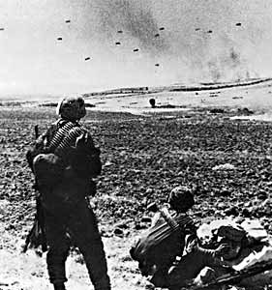

Slide 39
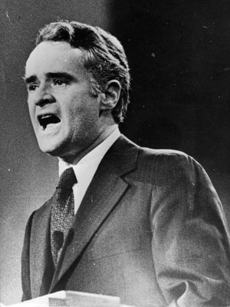

Slide 40
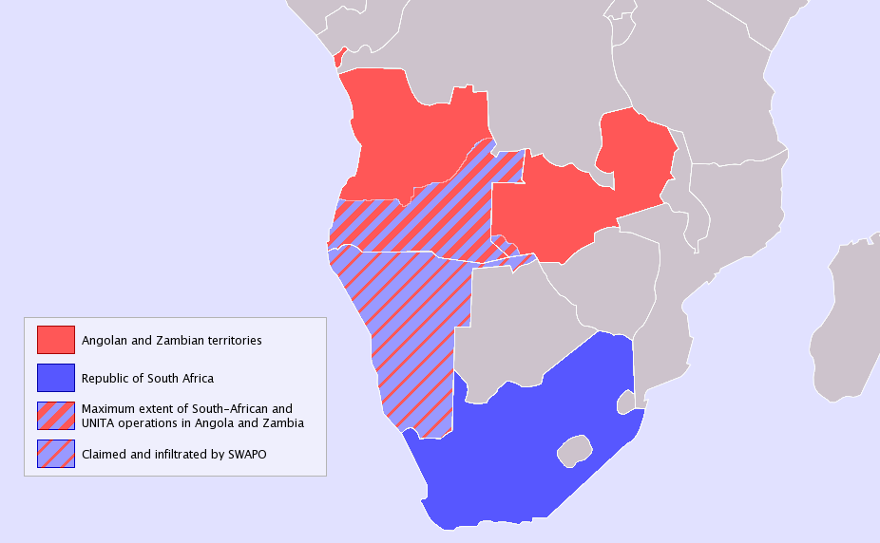

Slide 41
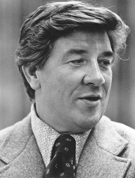

Slide 42
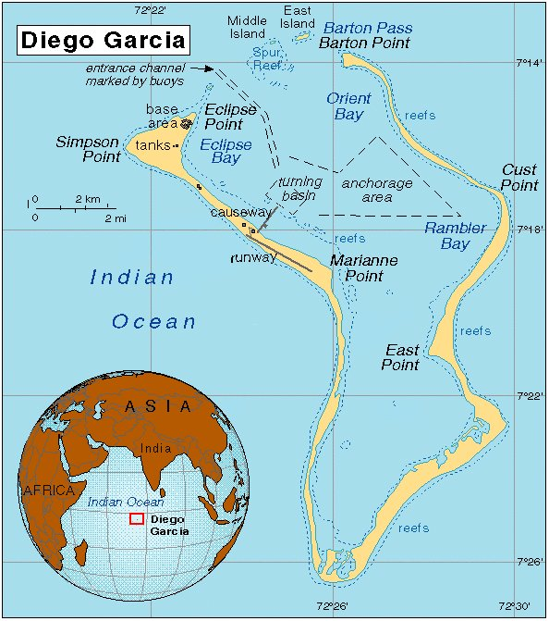

Slide 43
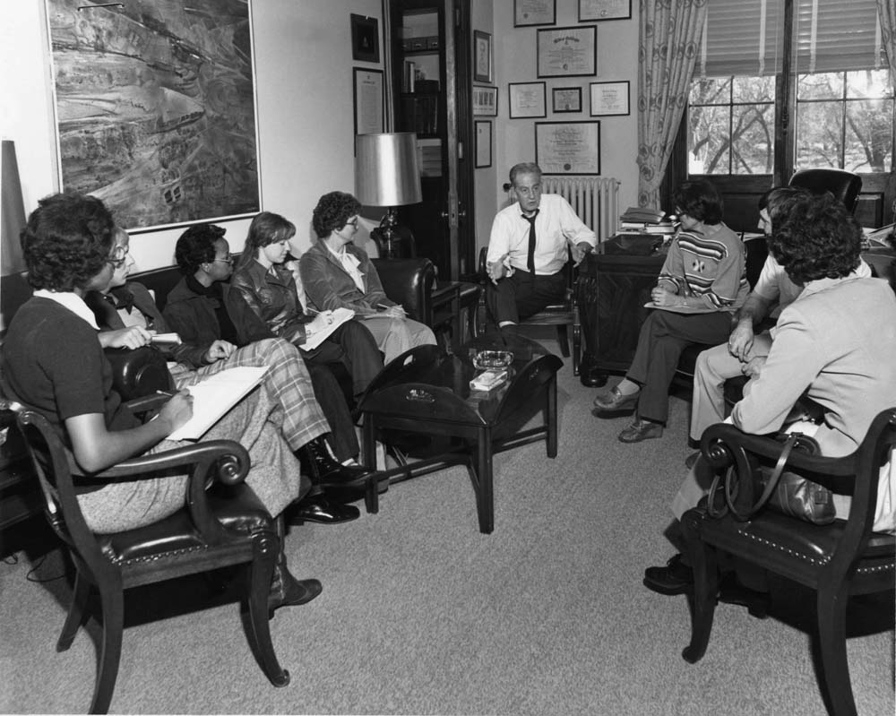

Slide 44
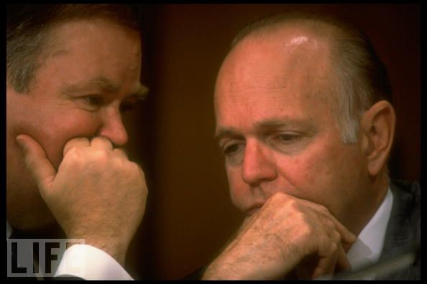

Slide 45
