Slide 1

Notes:
Salmon chase

Slide 2
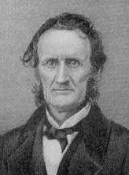
Notes:
Lambdin Milligan

Slide 3
Ex parte Milligan (1866)
It is claimed that martial law covers with its broad mantle the proceedings of this military commission. The proposition is this: that, in a time of war, the commander of an armed force . . . has the power, within the lines of his military district, to suspend all civil rights and their remedies and subject citizens, as well as soldiers to the rule of his will, and, in the exercise of his lawful authority, cannot be restrained except by his superior officer or the President of the United States.
The statement of this proposition shows its importance, for, if true, republican government is a failure, and there is an end of liberty regulated by law. Martial law established on such a basis destroys every guarantee of the Constitution, and effectually renders the "military independent of and superior to the civil power" -- the attempt to do which by the King of Great Britain was deemed by our fathers such an offence that they assigned it to the world as one of the causes which impelled them to declare their independence. Civil liberty and this kind of martial law cannot endure together; the antagonism is irreconcilable, and, in the conflict, one or the other must perish.

Slide 4
Reconstruction Plans
Lincoln
10% 1860 voters (white males) take oath of loyalty to Union
Wade-Davis bill
50% 1860 voters (white males) take oath of loyalty to Union
Confed. officeholders or those who “voluntarily” took up arms can’t vote/hold office
Confed. debt repudiated
New state constitutions that abolish slavery

Slide 5
Texas Black Code
That from and after the passage of this act, every Railroad Company heretofore incorporated, or which may hereafter be incorporated, by the Legislature of this State, shall be required to attach to each passenger train run by said Company, one car for the special accommodation of Freedmen . . .
That all laws and parts of laws relating to persons lately held as slaves, or free persons of color, contrary to, or in conflict with, the provisions of this act [that ensure non-discrimination], be and the same are herby repealed; Provided, nevertheless, that nothing herein shall be so construed as to repeal any law prohibiting the inter-marriage of the white and black races, nor to permit any other than white men to serve on juries, hold office, vote at any election, State, county, or municipal; Provided, further, that nothing herein contained shall be so construed as to allow them to testify, except in such cases and manner as is prescribed in the Constitution of the State . . .
That every able-bodied free white male inhabitant of this State between the ages of eighteen and forty-five years, shall be liable to perform military duty . . . .

Slide 6
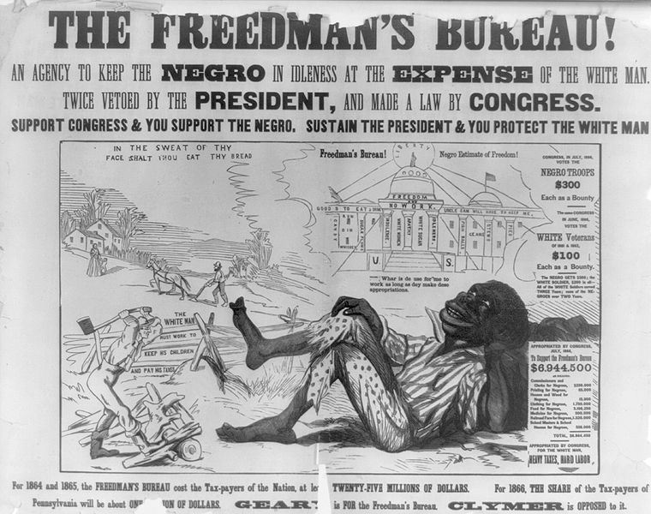

Slide 7
1866 Civil Rights Act
That all persons born in the United States and not subject to any foreign power, excluding Indians not taxed, are hereby declared to be citizens of the United States; and . . . shall have the same right, in every State and Territory in the United States, to make and enforce contracts, to sue, be parties, and give evidence, to inherit, purchase, lease, sell, hold, and convey real and personal property, and to full and equal benefit of all laws and proceedings for the security of person and property, as is enjoyed by white citizens, and shall be subject to like punishment, pains, and penalties, and to none other, any law, statute, ordinance, regulation, or custom, to the contrary notwithstanding . . .
That the district courts of the United States, within their respective districts, shall have, exclusively of the courts of the several States, cognizance of all crimes and offences committed against the provisions of this act . . .

Slide 8

Notes:
Johnson/Grant swing around circle

Slide 9


Slide 10


Slide 11
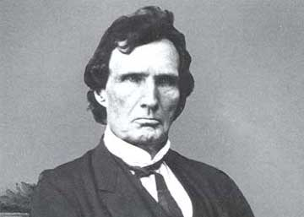

Slide 12
14th Amendment (1866-8)
Section 1.
All persons born or naturalized in the United States, and subject to the jurisdiction thereof, are citizens of the United States and of the state wherein they reside. No state shall make or enforce any law which shall abridge the privileges or immunities of citizens of the United States; nor shall any state deprive any person of life, liberty, or property, without due process of law; nor deny to any person within its jurisdiction the equal protection of the laws.
Section 2.
[States that deny right to vote lose representatives for voters disenfranchised.]
Section 3.
[No Confederate officeholder or military officer can serve in Congress.]
Section 4.
[Confederate debt repudiated.]

Slide 13
Reconstruction Acts (1867)
Creation of five military districts in the seceded states not including Tennessee, which had ratified the Fourteenth Amendment to the United States Constitution and was readmitted to the Union;
Requiring congressional approval for new state constitutions (which were required for Confederate states to rejoin the Union);
Confederate states give voting rights to all men;
All former Confederate states must ratify the 14th Amendment.

Slide 14


Slide 15
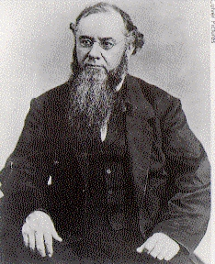
Notes:
stanton

Slide 16
Tenure of Office Act (1867)
Be it enacted, That every person holding any civil office to which he has been appointed by and with the advice and consent of the Senate, and every person who shall hereafter be appointed to any such office, and shall become duly qualified to act therein, is, and shall be entitled to hold such office until a successor shall have been in like manner appointed and duly qualified, except as herein otherwise provided: Provided, That the Secretaries of State, of the Treasury, of War, of the Navy, and of the Interior, the Postmaster-General, and the Attorney general, shall hold their offices respectively for and during the term of the President by whom they may have been appointed and for one month thereafter, subject to removal by and with the advice and consent of the Senate.

Slide 17
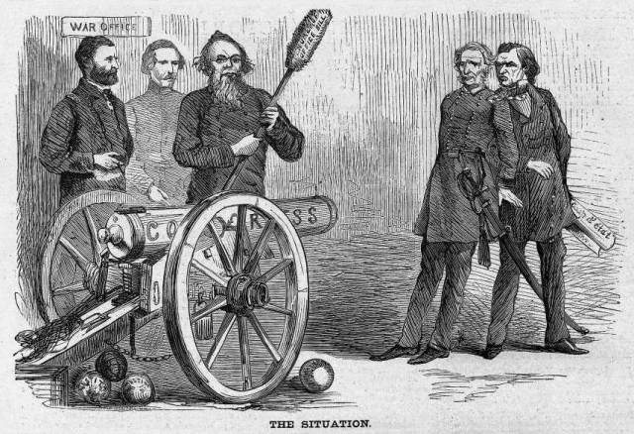

Slide 18
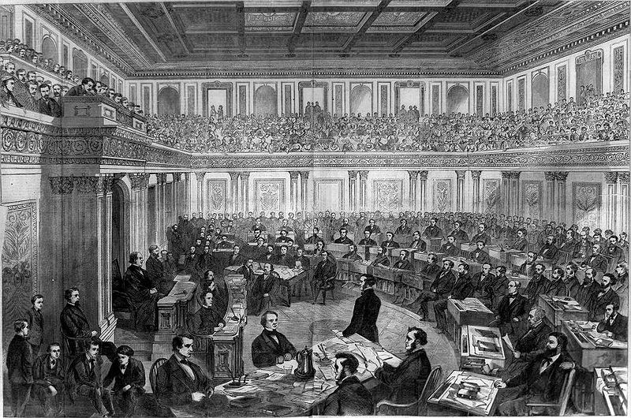

Slide 19
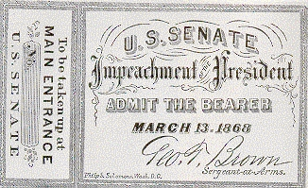

Slide 20
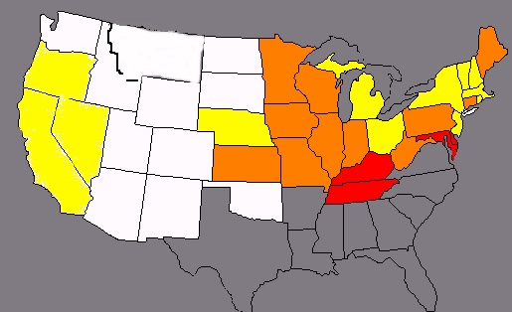
Impeachment vote map
Yellow—both senators vote to convict
Orange—divided delegation
Red—both senators vote to acquit

Slide 21
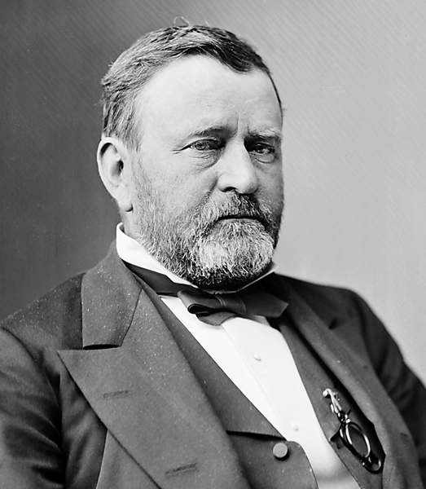
Notes:
grant

Slide 22
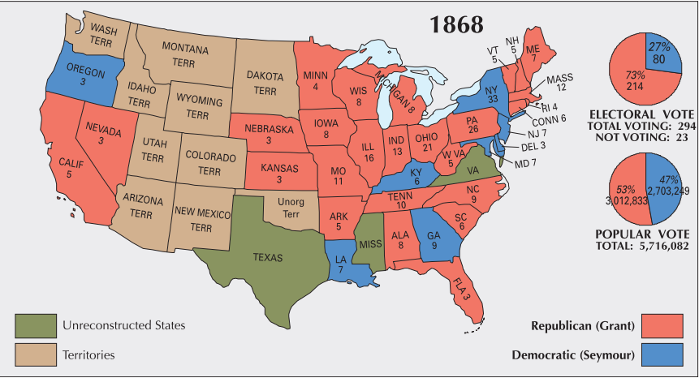

Slide 23
15th Amendment (1870)
Section 1.
The right of citizens of the United States to vote shall not be denied or abridged by the United States or by any state on account of race, color, or previous condition of servitude.
Section 2.
The Congress shall have power to enforce this article by appropriate legislation.

Slide 24
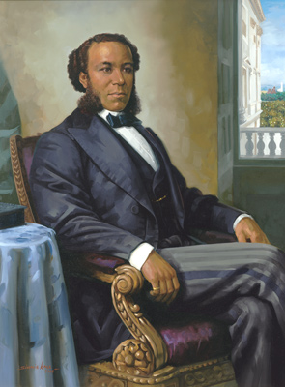
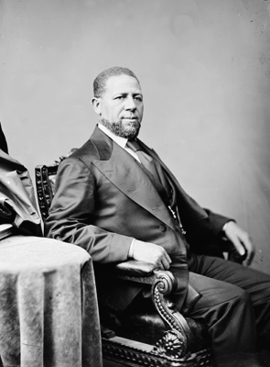
Notes:
Jpseph rainey—sc; hiram revels

Slide 25
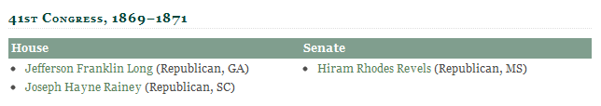
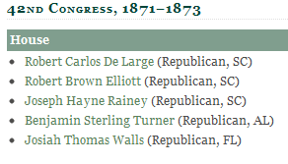
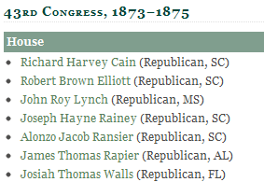
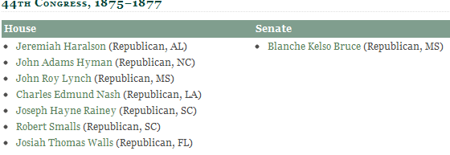
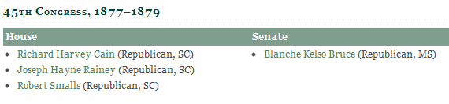

Slide 26
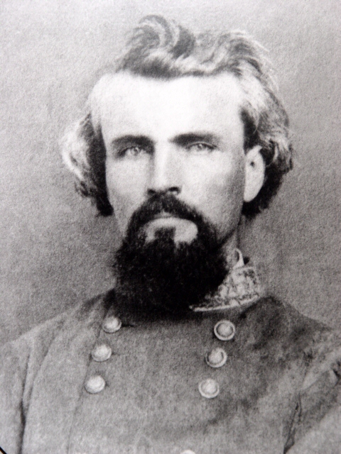
Notes:
Nathan fprrest

Slide 27
Force Act (1870)
Be it further enacted, That if any person shall prevent, hinder, control, or intimidate, or shall attempt to prevent, hinder, control, or intimidate, any person from exercising or in exercising the right of suffrage, to whom the right of suffrage is secured or guaranteed by the fifteenth amendment to the Constitution of the United States, by means of bribery, threats, or threats of depriving such person of employment or occupation, or of ejecting such person from rented house, lands, or other property, or by threats of refusing to renew leases or contracts for labor, or by threats of violence to himself or family, such person so offending shall be deemed guilty of a misdemeanor, and shall, on conviction thereof, be fined not less than five hundred dollars, or be imprisoned not less than one month and not more than one year, or both, at the discretion of the court . . .
And be it further enacted, That if two or more persons shall band or conspire together ... to violate any provision of this act, or to injure, oppress, threaten, or intimidate any citizen with intent to prevent or hinder his free exercise and enjoyment of any right or privilege granted or secured to him by the Constitution or laws of the United States, or because of his having exercised the same, such persons shall be held guilty of felony, and, on conviction thereof, shall be fined or imprisoned, or both, at the discretion of the court, -- the fine not to exceed five thousand dollars, and the imprisonment not to exceed ten years ...

Slide 28
Civil Rights Act (1871)
[Sec. 1983] Every person who under color of any statute, ordinance, regulation, custom, or usage, of any State or Territory or the District of Columbia, subjects, or causes to be subjected, any citizen of the United States or other person within the jurisdiction thereof to the deprivation of any rights, privileges, or immunities secured by the Constitution and laws, shall be liable to the party injured in an action at law, Suit in equity, or other proper proceeding for redress, except that in any action brought against a judicial officer for an act or omission taken in such officer's judicial capacity, injunctive relief shall not be granted unless a declaratory decree was violated or declaratory relief was unavailable. For the purposes of this section, any Act of Congress applicable exclusively to the District of Columbia shall be considered to be a statute of the District of Columbia.

Slide 29
Civil Rights Act (1875)
An act to protect all citizens in their civil and legal rights. Whereas, it is essential to just government we recognize the equality of all men before the law, and hold that it is the duty of government in its dealings with the people to mete out equal and exact justice to all, of whatever nativity, race, color, or persuasion, religious or political; and it being the appropriate object of legislation to enact great fundamental principles into law:
Therefore, Be it enacted by the Senate and House of Representatives of the United States of America in Congress assembled, That all persons within the jurisdiction of the United States shall be entitled to the full and equal and enjoyment of the accommodations, advantages, facilities, and privileges of inns, public conveyances on land or water, theaters, and other places of public amusement; subject only to the conditions and limitations established by law, and applicable alike to citizens of every race and color, regardless of any previous condition of servitude . . .
Sec. 3. That the district and circuit courts of the United States shall have, exclusively of the courts of the several States, cognizance of all crimes and offenses against, and violations of, the provisions of this act

Slide 30
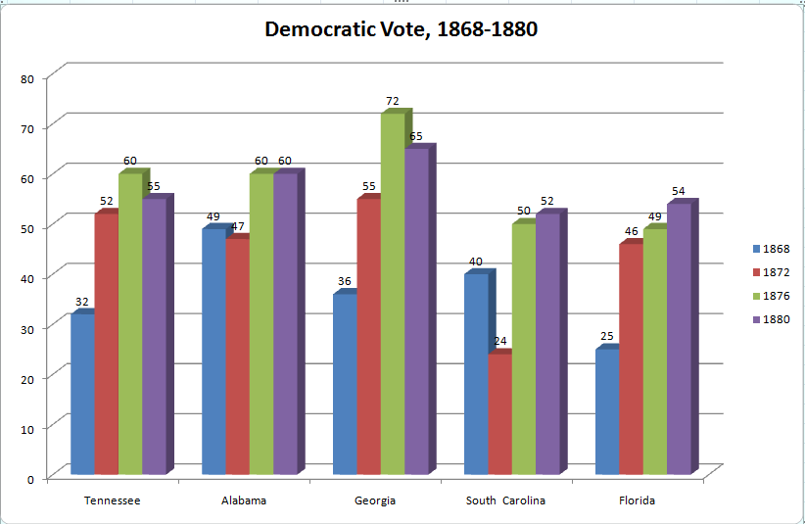

Slide 31
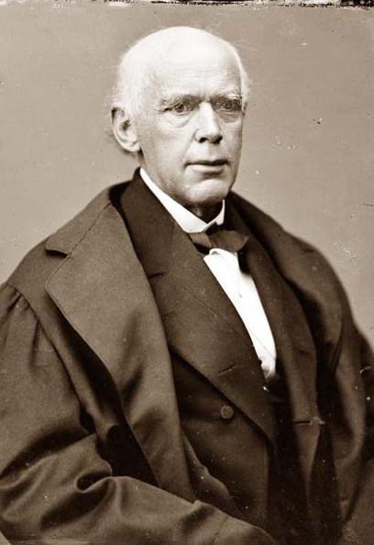
Notes:
Salmon chase

Slide 32
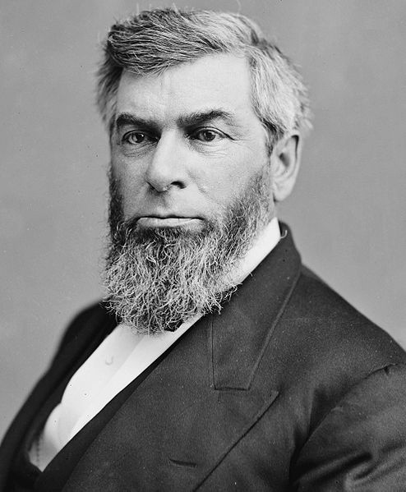
Notes:
Morrison Waite

Slide 33
Slaughterhouse Cases (1873)
We do not conceal from ourselves the great responsibility which this duty devolves upon us. No questions so far reaching and pervading in their consequences, so profoundly interesting to the people of this country, and so important in their bearing upon the relations of the United States and of the several States to each other, and to the citizens of the states and of the United States, have been before this court during the official life of any of its present members…
The distinction between citizenship of the United States and citizenship of a state is clearly recognized and established. . . . It is quite clear, then, that there is a citizenship of the United States, and a citizenship of a state, which are distinct from each other, and which depend upon different characteristics or circumstances in the individual.

Slide 34
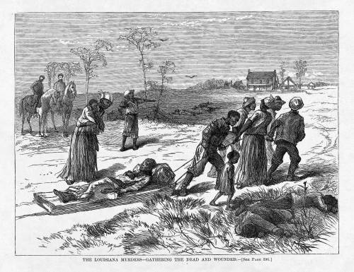
Notes:
Colfax massacre

Slide 35
U.S. v Cruikshank (1876)
The people of the United States resident within any State are subject to two governments: one State, and the other National; but there need be no conflict between the two. The powers which one possesses, the other does not . . .
The government of the United States is one of delegated powers alone. Its authority is defined and limited by the Constitution. All powers not granted to it by that instrument are reserved to the States or the people. No rights can be acquired under the constitution or laws of the United States, except such as the government of the United States has the authority to grant or secure. All that cannot be so granted or secured are left under the protection of the States . . .
Inasmuch, therefore, as it does not appear in these counts that the intent of the defendants was to prevent these parties from exercising their right to vote on account of their race, &c., it does not appear that it was their intent to interfere with any right granted or secured by the constitution or laws of the United States. We may suspect that race was the cause of the hostility; but it is not so averred.

Slide 36
U.S. v. Reese (1876)
Looking, then, to this statute, we find that its first section provides that all citizens of the United States, who are or shall be otherwise qualified by law to vote at any election, &c., shall be entitled and allowed to vote thereat, without distinction of race, color, or previous condition of servitude, any constitution, &c., of the State to the contrary notwithstanding. This simply declares a right, without providing a punishment for its violation . . .
The Fifteenth Amendment does not confer the right of suffrage upon any one. It prevents the States, or the United States, however, from giving preference, in this particular, to one citizen of the United States over another on account of race, color, or previous condition of servitude. . .
It has not been contended, nor can it be, that the amendment confers authority to impose penalties for every wrongful refusal to receive the vote of a qualified elector at State elections. It is only when the wrongful refusal at such an election is because of race, color, or previous condition of servitude, that Congress can interfere, and provide for its punishment.

Slide 37
Hall v. DeCuir (1877)
We think it may safely be said that State legislation which seeks to impose a direct burden upon inter-state commerce, or to interfere directly with its freedom, does encroach upon the exclusive power of Congress. The statute now under consideration, in our opinion, occupies that position. It does not act upon the business through the local instruments to be employed after coming within the State, but directly upon the business as it comes into the State from without or goes out from within…
By refraining from action, Congress, in effect, adopts as its own regulations those which the common law or the civil law, where that prevails, has provided for the government of such business, and those which the States, in the regulation of their domestic concerns, have established affecting commerce, but not regulating it within the meaning of the Constitution.

Slide 38
Civil Rights Cases (1883)
[Regarding the 14th amendment] it is State action of a particular character that is prohibited. Individual invasion of individual rights is not the subject matter of the amendment. It has a deeper and broader scope. It nullifies and makes void all State legislation, and State action of every kind, which impairs the privileges and immunities of citizens of the United States…
It does not invest Congress with power to legislate upon subjects which are within the domain of State legislation, but to provide modes of relief against State legislation, or State action, of the kind referred to. It does not authorize Congress to create a code of municipal law for the regulation of private rights, but to provide modes of redress against the operation of State laws and the action of State officers executive or judicial when these are subversive of the fundamental rights specified in the amendment.

Slide 39


Slide 40
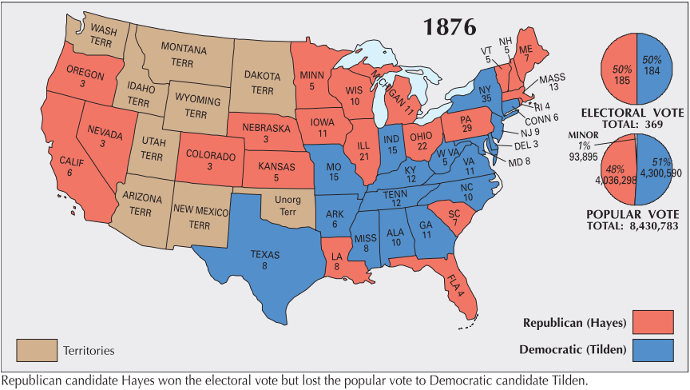

Slide 41


