Slide 1


Slide 2
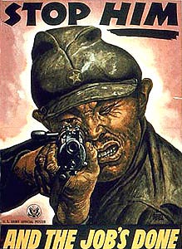

Slide 3
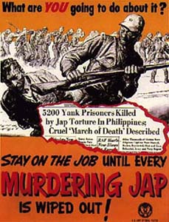

Slide 4
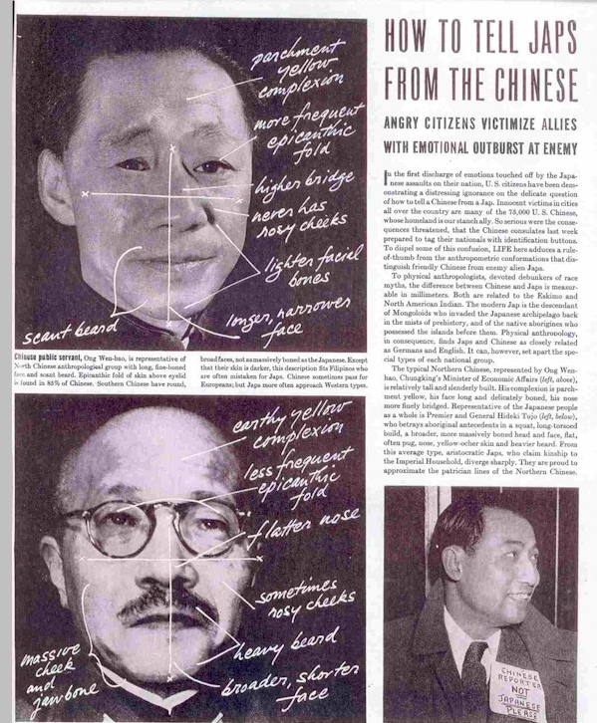

Slide 5
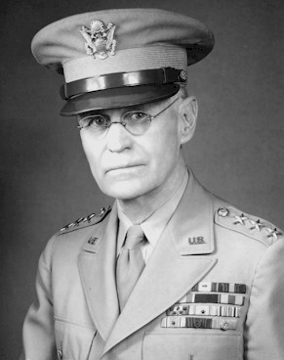
Notes:
John dewitt

Slide 6
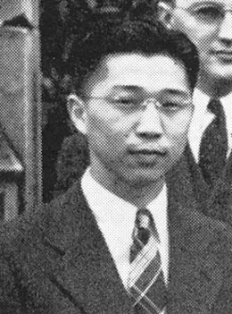
Notes:
Gordon hirabiyashi

Slide 7
Hirabiyashi v. United States (1943)
The war power of the national government is “the power to wage war successfully.” … The power is not restricted to the winning of victories in the field and the repulse of enemy forces. It embraces every phase of the national defense . . .
There is support for the view that social, economic and political conditions which have prevailed since the close of the last century, when the Japanese began to come to this country in substantial numbers, have intensified their solidarity and have in large measure prevented their assimilation as an integral part of the white population . . .
Viewing these data in all their aspects, Congress and the Executive could reasonably have concluded that these conditions have encouraged the continued attachment of members of this group to Japan and Japanese institutions.

Slide 8
EXECUTIVE ORDER 9066
February 19, 1942
Whereas, the successful prosecution of the war requires every possible protection against espionage and against sabotage to national-defense material, national-defense premises and national defense utilities . . .
Now therefore, by virtue of the authority vested in me as President of the United States, and Commander in Chief of the Army and Navy, I hereby authorize and direct the Secretary of War, and the Military Commanders whom he may from time to time designate, whenever he or any designated Commander deems such action to be necessary or desirable, to prescribe military areas in such places and of such extent as he or the appropriate Military Commander may determine, from which any or all persons may be excluded, and with respect to which, the right of any persons to enter, remain in, or leave shall be subject to whatever restriction the Secretary of War or the appropriate Military Commander may impose in his discretion.

Slide 9
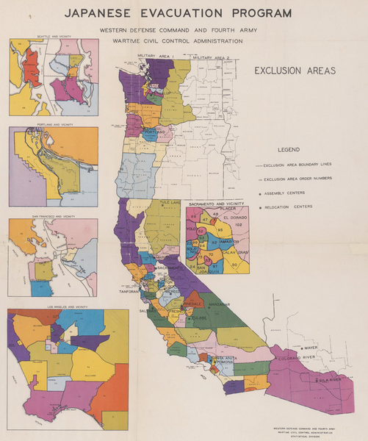

Slide 10
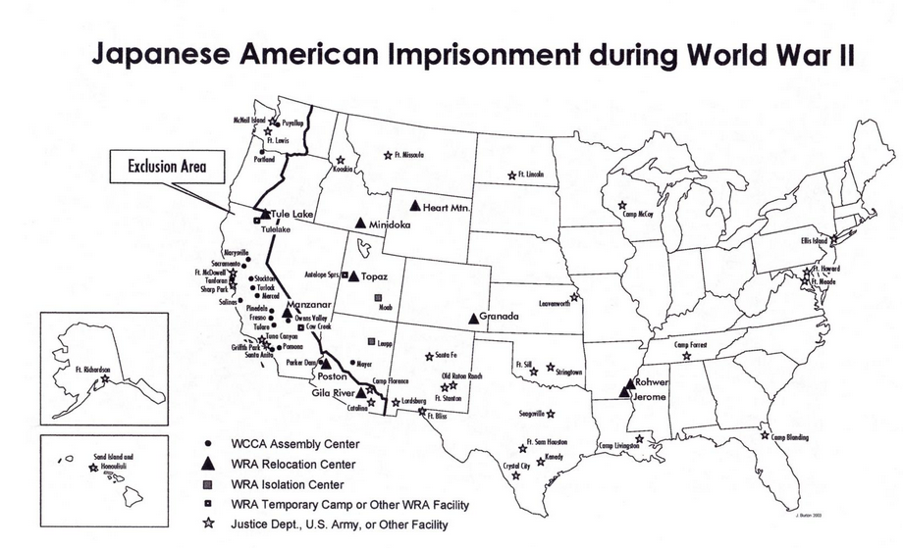

Slide 11
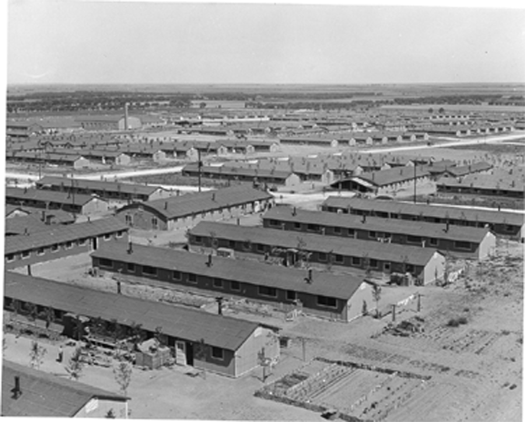
Notes:
Colorado internment camps

Slide 12
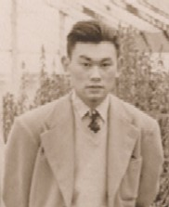

Slide 13
Korematsu v. United States (1944)
It should be noted, to begin with, that all legal restrictions which curtail the civil rights of a single racial group are immediately suspect. That is not to say that all such restrictions are unconstitutional. It is to say that courts must subject them to the most rigid scrutiny . . .
To cast this case into outlines of racial prejudice, without reference to the real military dangers which were presented, merely confuses the issue. Korematsu was not excluded from the Military Area because of hostility to him or his race. He was excluded because we are at war with the Japanese Empire, because the properly constituted military authorities feared an invasion of our West Coast and felt constrained to take proper security measures, because they decided that the military urgency of the situation demanded that all citizens of Japanese ancestry be segregated from the West Coast temporarily, and, finally, because Congress, reposing its confidence in this time of war in our military leaders -- as inevitably it must -- determined that they should have the power to do just this. There was evidence of disloyalty on the part of some, the military authorities considered that the need for action was great, and time was short. We cannot -- by availing ourselves of the calm perspective of hindsight -- now say that, at that time, these actions were unjustified.

Slide 14
Korematsu —Murphy dissent
This exclusion of “all persons of Japanese ancestry, both alien and non-alien,” from the Pacific Coast area on a plea of military necessity in the absence of martial law ought not to be approved. Such exclusion goes over “the very brink of constitutional power,” and falls into the ugly abyss of racism . . .
Justification for the exclusion is sought, instead, mainly upon questionable racial and sociological grounds not ordinarily within the realm of expert military judgment, supplemented by certain semi-military conclusions drawn from an unwarranted use of circumstantial evidence . . .
I dissent, therefore, from this legalization of racism. Racial discrimination in any form and in any degree has no justifiable part whatever in our democratic way of life. It is unattractive in any setting, but it is utterly revolting among a free people who have embraced the principles set forth in the Constitution of the United States.

Slide 15
Korematsu –Jackson dissent
A judicial construction of the due process clause that will sustain this order is a far more subtle blow to liberty than the promulgation of the order itself. A military order, however unconstitutional, is not apt to last longer than the military emergency. Even during that period, a succeeding commander may revoke it all. But once a judicial opinion rationalizes such an order to show that it conforms to the Constitution, or rather rationalizes the Constitution to show that the Constitution sanctions such an order, the Court for all time has validated the principle of racial discrimination in criminal procedure and of transplanting American citizens. The principle then lies about like a loaded weapon, ready for the hand of any authority that can bring forward a plausible claim of an urgent need. Every repetition imbeds that principle more deeply in our law and thinking and expands it to new purposes. All who observe the work of courts are familiar with what Judge Cardozo described as “the tendency of a principle to expand itself to the limit of its logic.” A military commander may overstep the bounds of constitutionality, and it is an incident. But if we review and approve, that passing incident becomes the doctrine of the Constitution. There it has a generative power of its own, and all that it creates will be in its own image. Nothing better illustrates this danger than does the Court's opinion in this case.

Slide 16
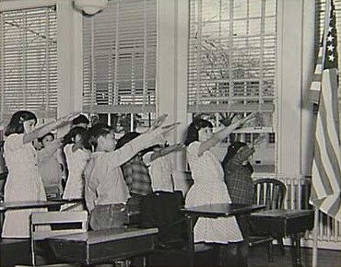

Slide 17
West Virginia Board of Education v. Barnette (1943)
The case is made difficult not because the principles of its decision are obscure but because the flag involved is our own. Nevertheless, we apply the limitations of the Constitution with no fear that freedom to be intellectually and spiritually diverse or even contrary will disintegrate the social organization. To believe that patriotism will not flourish if patriotic ceremonies are voluntary and spontaneous instead of a compulsory routine is to make an unflattering estimate of the appeal of our institutions to free minds…
If there is any fixed star in our constitutional constellation, it is that no official, high or petty, can prescribe what shall be orthodox in politics, nationalism, religion, or other matters of opinion or force citizens to confess by word or act their faith therein. If there are any circumstances which permit an exception, they do not now occur to us.

Slide 18
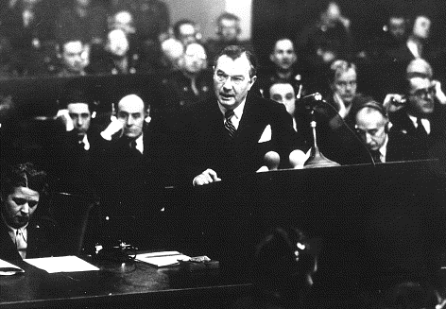

Slide 19
Jackson at Nuremberg (1945)
The privilege of opening the first trial in history for crimes against the peace of the world imposes a grave responsibility. The wrongs which we seek to condemn and punish have been so calculated, so malignant, and so devastating, that civilization cannot tolerate their being ignored, because it cannot survive their being repeated. That four great nations, flushed with victory and stung with injury stay the hand of vengeance and voluntarily submit their captive enemies to the judgment of the law is one of the most significant tributes that Power has ever paid to Reason . . .
Let me make clear that while this law is first applied against German aggressors, the law includes, and if it is to serve a useful purpose it must condemn aggression by any other nations, including those which sit here now in judgment.”

Slide 20
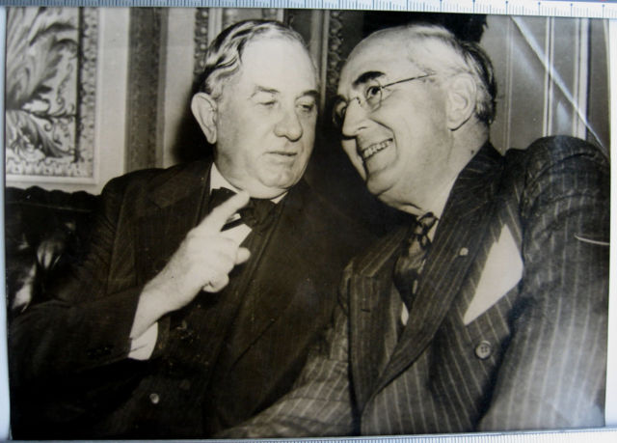
Notes:
Connally, vandenberg

Slide 21
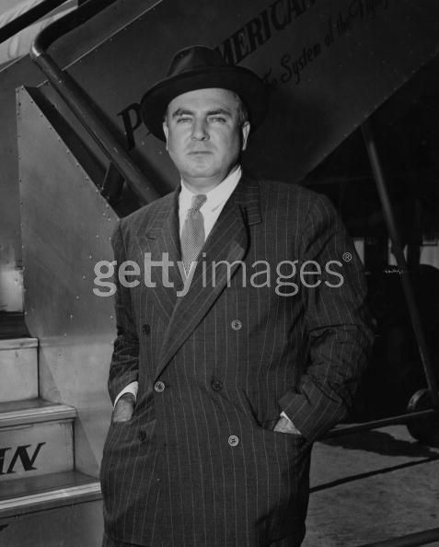
Notes:
mcmahon

Slide 22
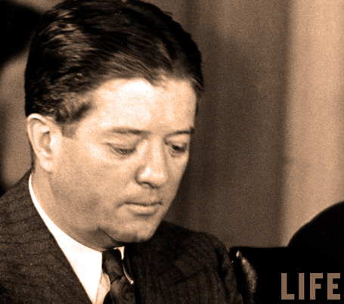

Slide 23
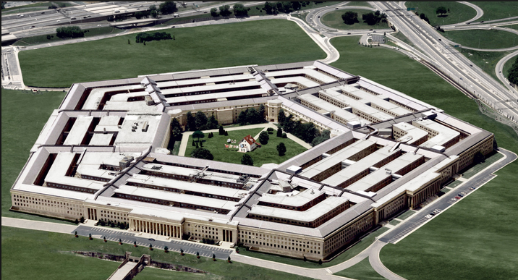

Slide 24
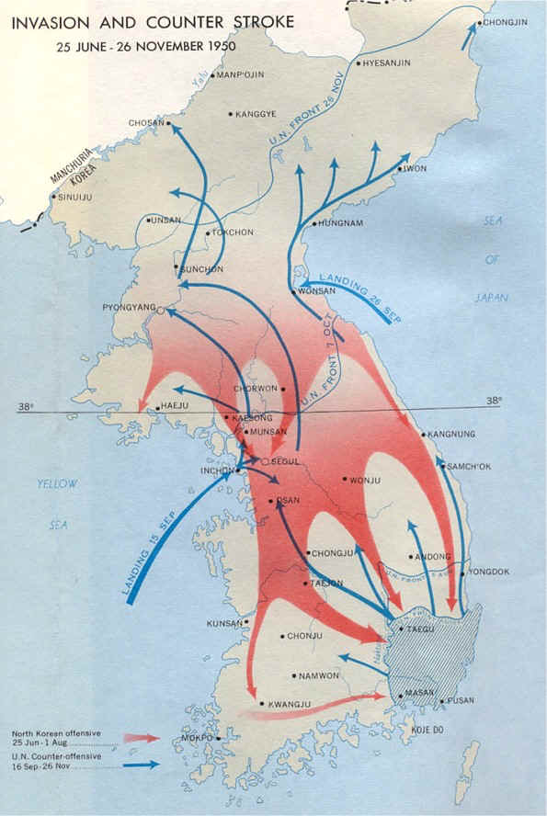

Slide 25
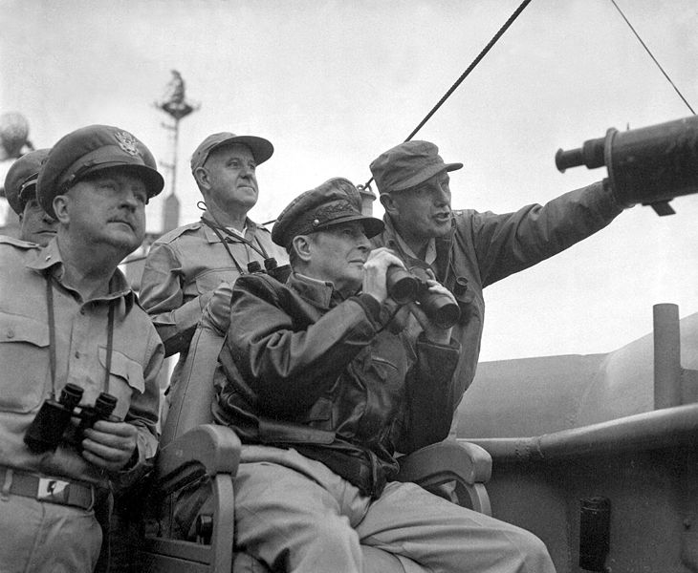
Notes:
inchon

Slide 26
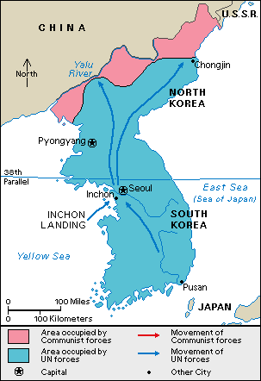

Slide 27
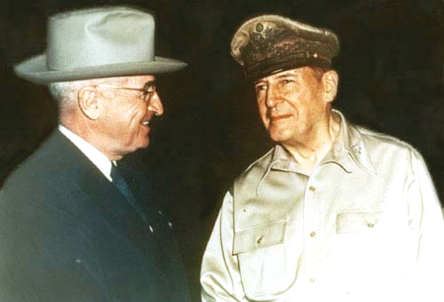
Notes:
wake

Slide 28
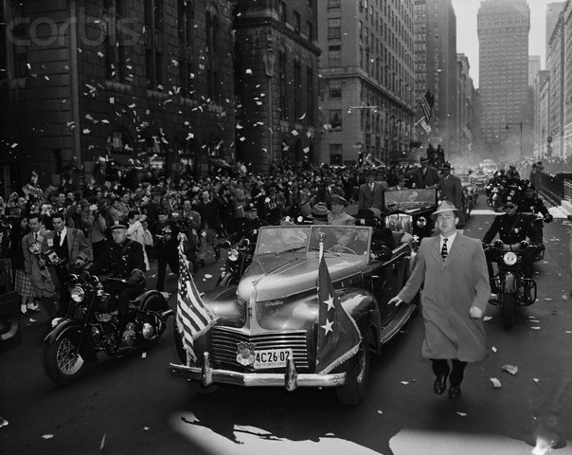

Slide 29
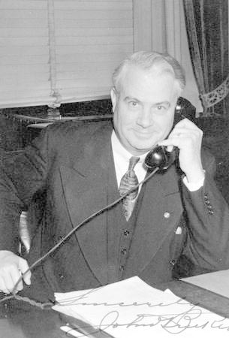
Notes:
bricker

Slide 30
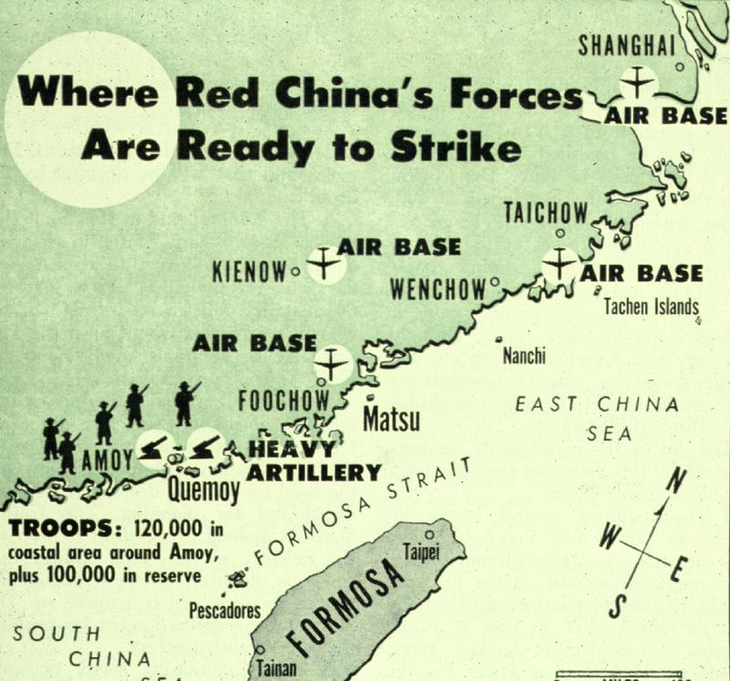

Slide 31
U.S. Congress
(Approved by House vote 409-3 on January 25, 1955
and by Senate vote 85-3 on January 28, 1955)
U.S. Congressional Authorization for the President to Employ the Armed Forces of the United States to Protect Formosa, the Pescadores, and Related Positions and Territories of That Area
Resolved by the Senate and House of Representatives of the United States of America in Congress assembled, That the President of the United States be and he hereby is authorized to employ the Armed Forces of the United States as he deems necessary for the specific purpose of securing and protecting Formosa and the Pescadores against armed attack, this authority to include the securing and protection of such related positions and territories of that area now in friendly hands and the taking of such other measures as he judges to be required or appropriate in assuring the defense of Formosa and the Pescadores.
This resolution shall expire when the President shall determine that the peace and security of the area is reasonably assured by international conditions created by action of the United Nations or otherwise, and shall so report to the Congress.

Slide 32
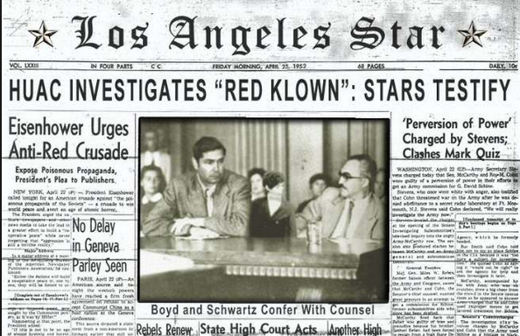

Slide 33
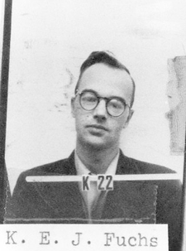

Slide 34
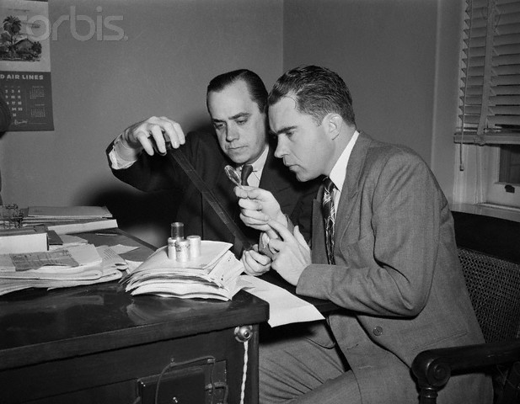

Slide 35
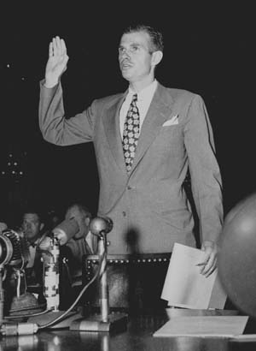

Slide 36


Slide 37
Dennis v. United States (1951)
Overthrow of the Government by force and violence is certainly a substantial enough interest for the Government to limit speech. Indeed, this is the ultimate value of any society, for if a society cannot protect its very structure from armed internal attack, it must follow that no subordinate value can be protected. If, then, this interest may be protected, the literal problem which is presented is what has been meant by the use of the phrase “clear and present danger” of the utterances bringing about the evil within the power of Congress to punish.
Obviously, the words cannot mean that, before the Government may act, it must wait until the putsch is about to be executed, the plans have been laid and the signal is awaited. If Government is aware that a group aiming at its overthrow is attempting to indoctrinate its members and to commit them to a course whereby they will strike when the leaders feel the circumstances permit, action by the Government is required.
Notes:
Vinson opinion

Slide 38
Dennis –Black dissent
The opinions for affirmance indicate that the chief reason for jettisoning the rule is the expressed fear that advocacy of Communist doctrine endangers the safety of the Republic. Undoubtedly a governmental policy of unfettered communication of ideas does entail dangers. To the Founders of this Nation, however, the benefits derived from free expression were worth the risk. They embodied this philosophy in the First Amendment's command that “Congress shall make no law . . . abridging the freedom of speech, or of the press. . . .” I have always believed that the First Amendment is the keystone of our Government, that the freedoms it guarantees provide the best insurance against destruction of all freedom. . .
Public opinion being what it now is, few will protest the conviction of these Communist petitioners. There is hope, however, that, in calmer times, when present pressures, passions and fears subside, this or some later Court will restore the First Amendment liberties to the high preferred place where they belong in a free society.

Slide 39
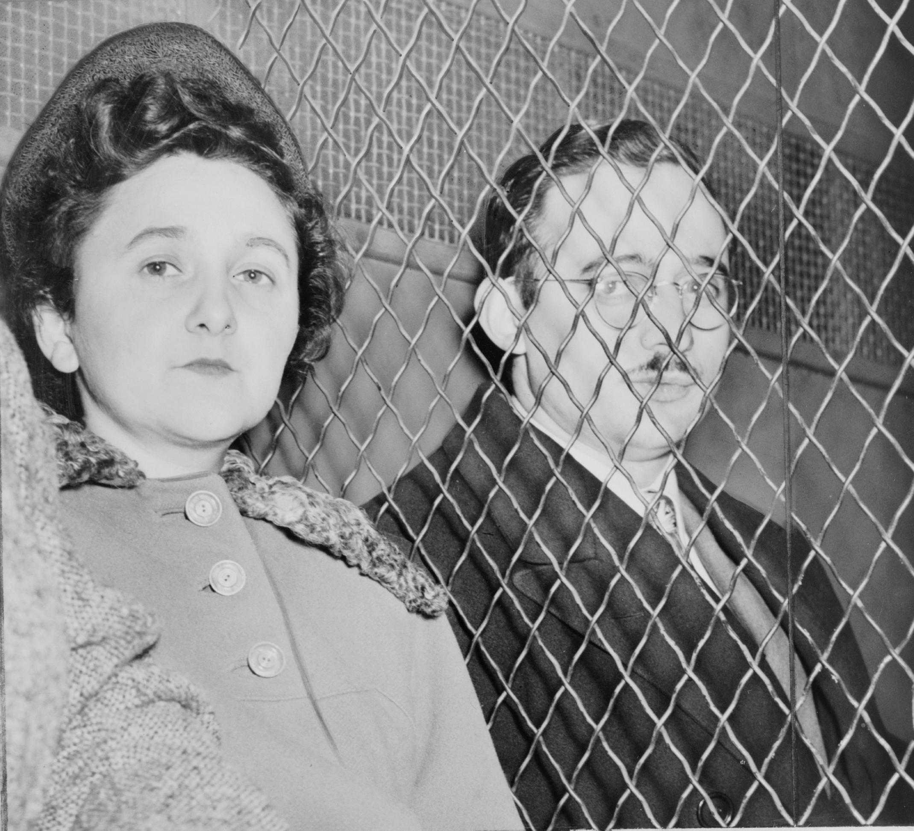

Slide 40
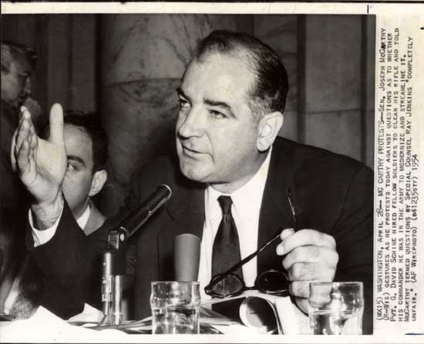

Slide 41
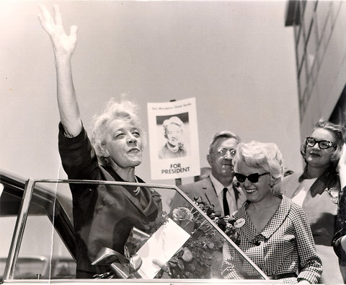

Slide 42


