Slide 1
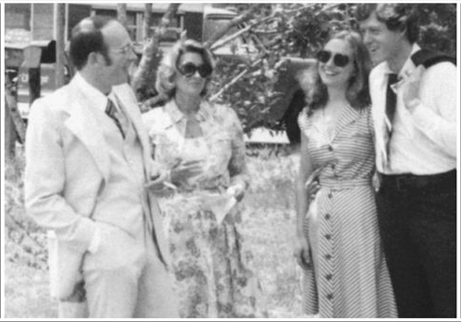

Slide 2
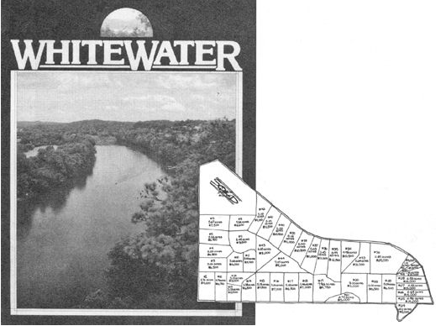

Slide 3
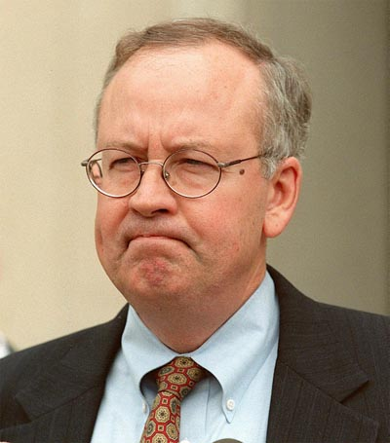

Slide 4
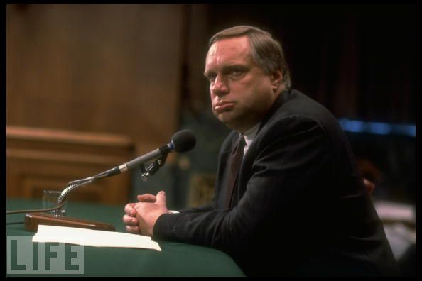
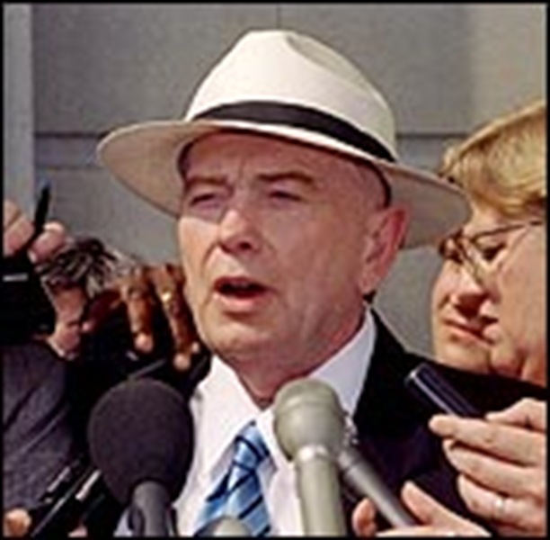
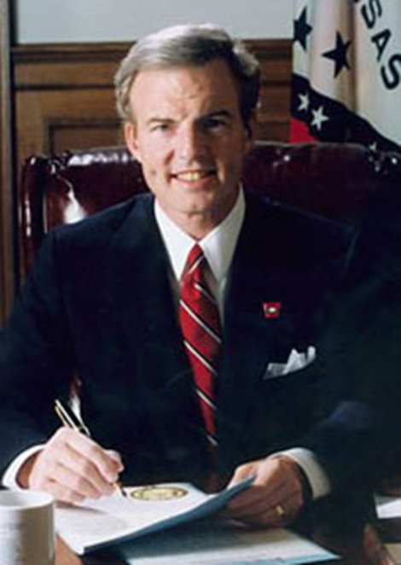
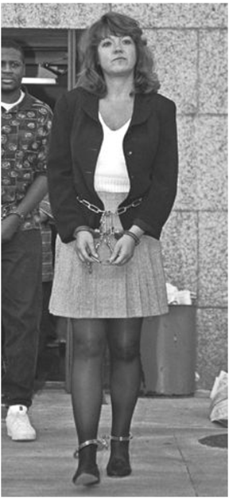

Slide 5
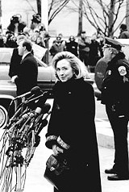

Slide 6
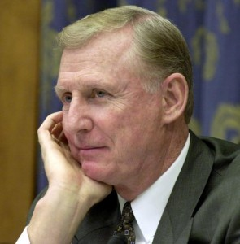

Slide 7
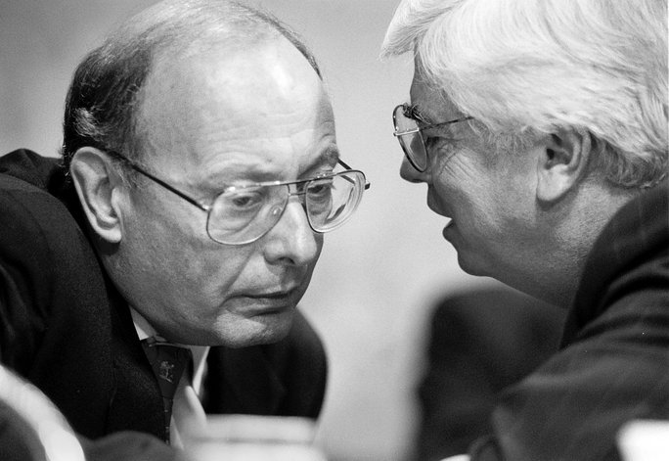

Slide 8
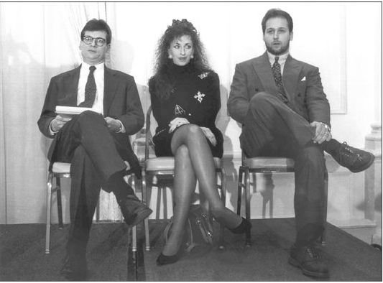

Slide 9
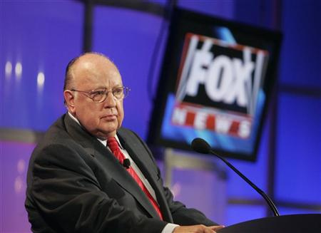

Slide 10
Jones v. Clinton (1997)
As a factual matter, petitioner contends that this particular case--as well as the potential additional litigation that an affirmance of the Court of Appeals judgment might spawn--may impose an unacceptable burden on the President's time and energy, and thereby impair the effective performance of his office.
Petitioner's predictive judgment finds little support in either history or the relatively narrow compass of the issues raised in this particular case. As we have already noted, in the more than 200 year history of the Republic, only three sitting Presidents have been subjected to suits for their private actions. If the past is any indicator, it seems unlikely that a deluge of such litigation will ever engulf the Presidency. As for the case at hand, if properly managed by the District Court, it appears to us highly unlikely to occupy any substantial amount of petitioner's time.

Slide 11
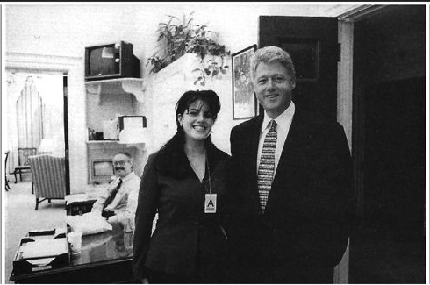

Slide 12
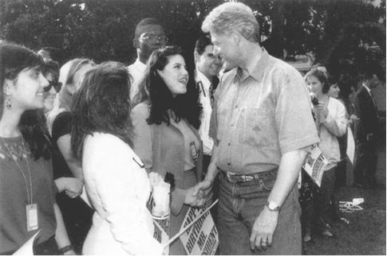

Slide 13
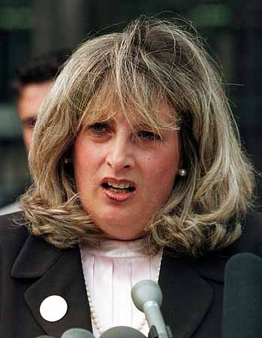

Slide 14


Slide 15
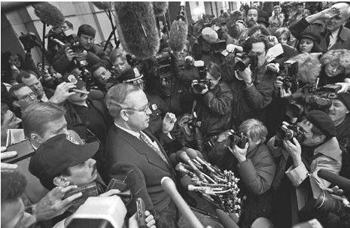

Slide 16
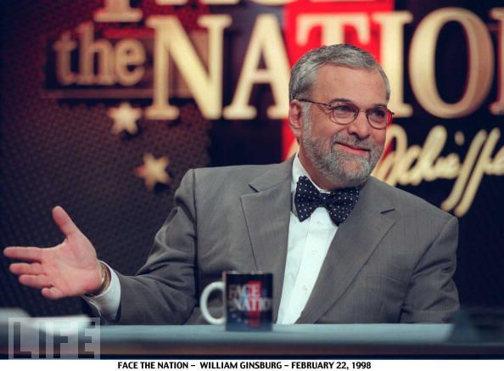

Slide 17
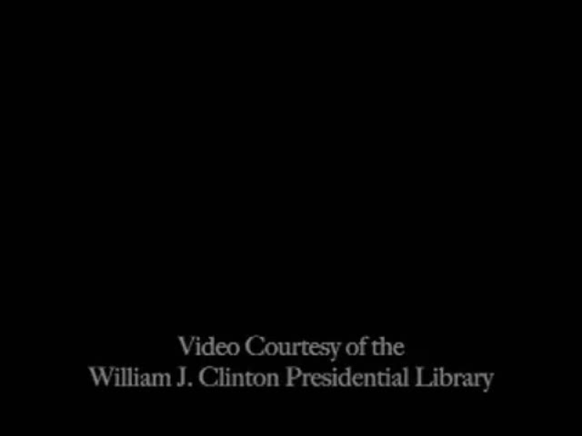

Slide 18


Slide 19
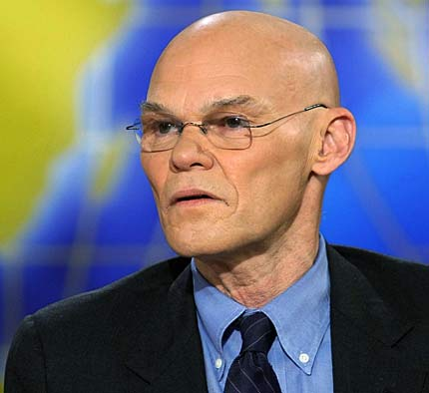

Slide 20
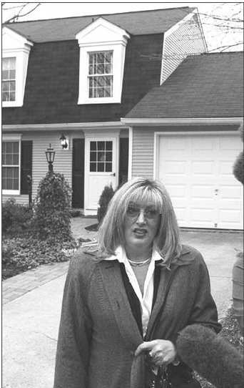

Slide 21
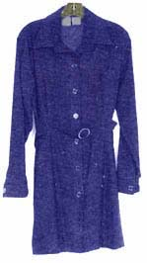

Slide 22
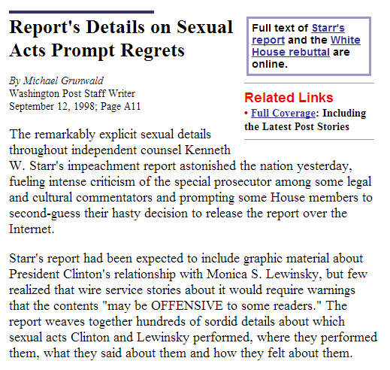
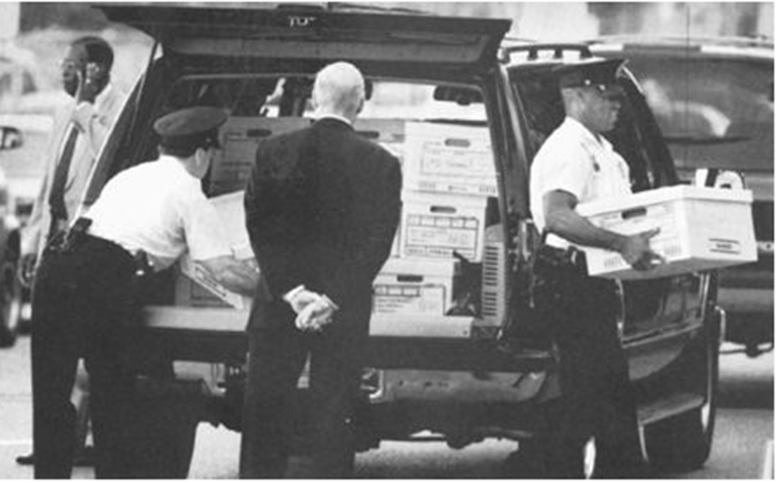

Slide 23
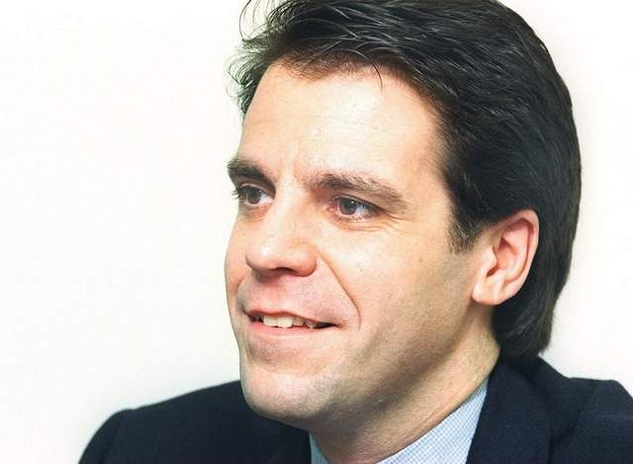
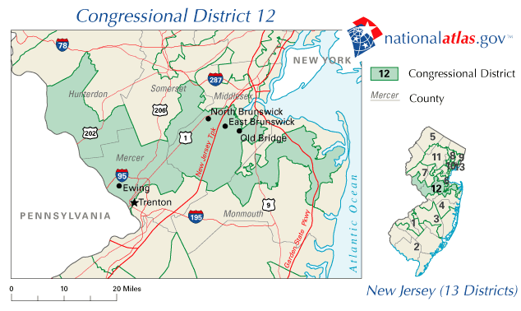
Notes:
pappas

Slide 24
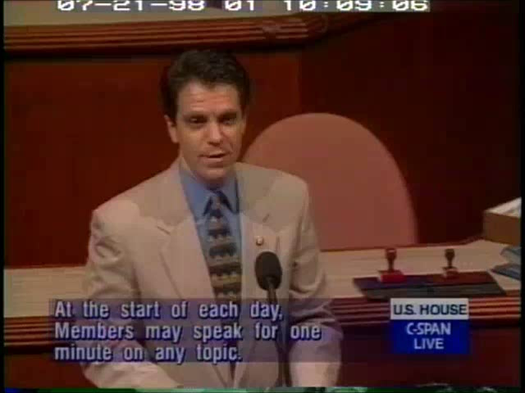

Slide 25
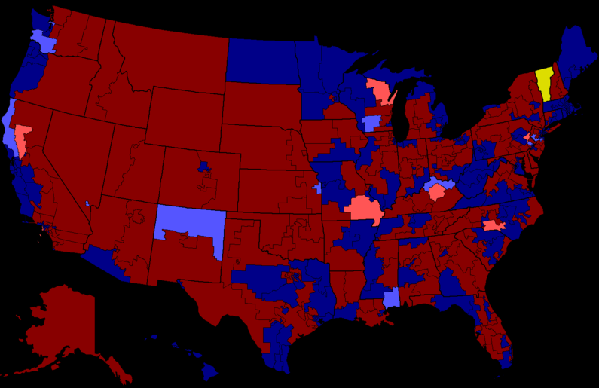
1998 House Elections

Slide 26
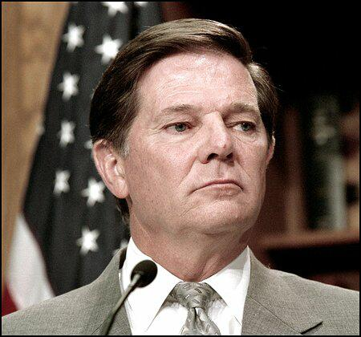

Slide 27
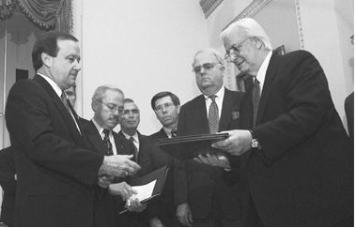

Slide 28
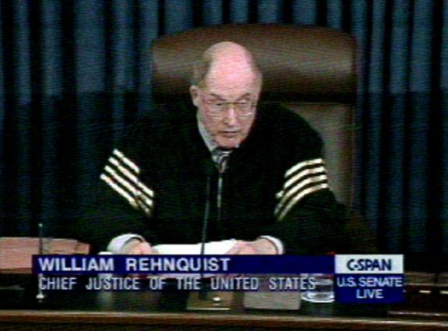

Slide 29
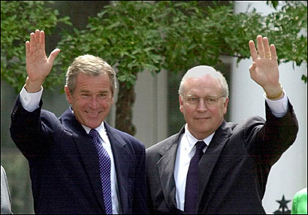

Slide 30
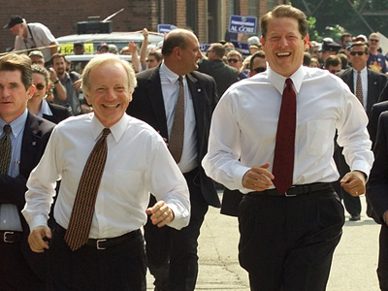

Slide 31
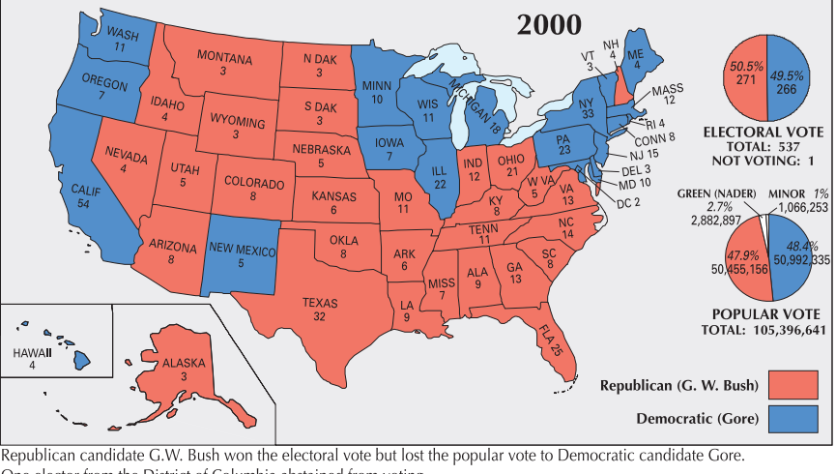

Slide 32
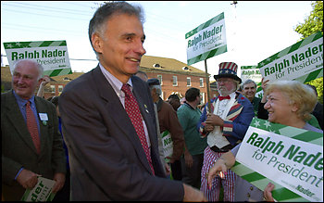

Slide 33
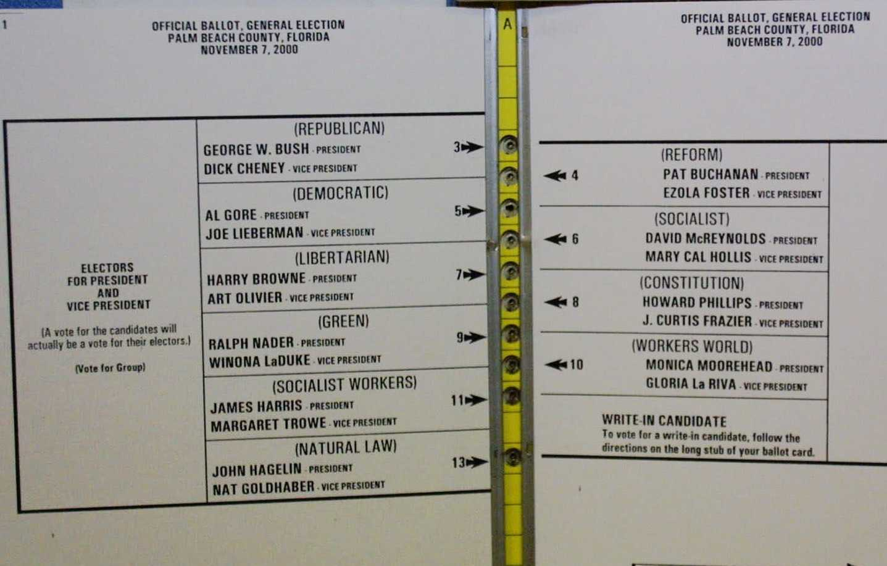

Slide 34
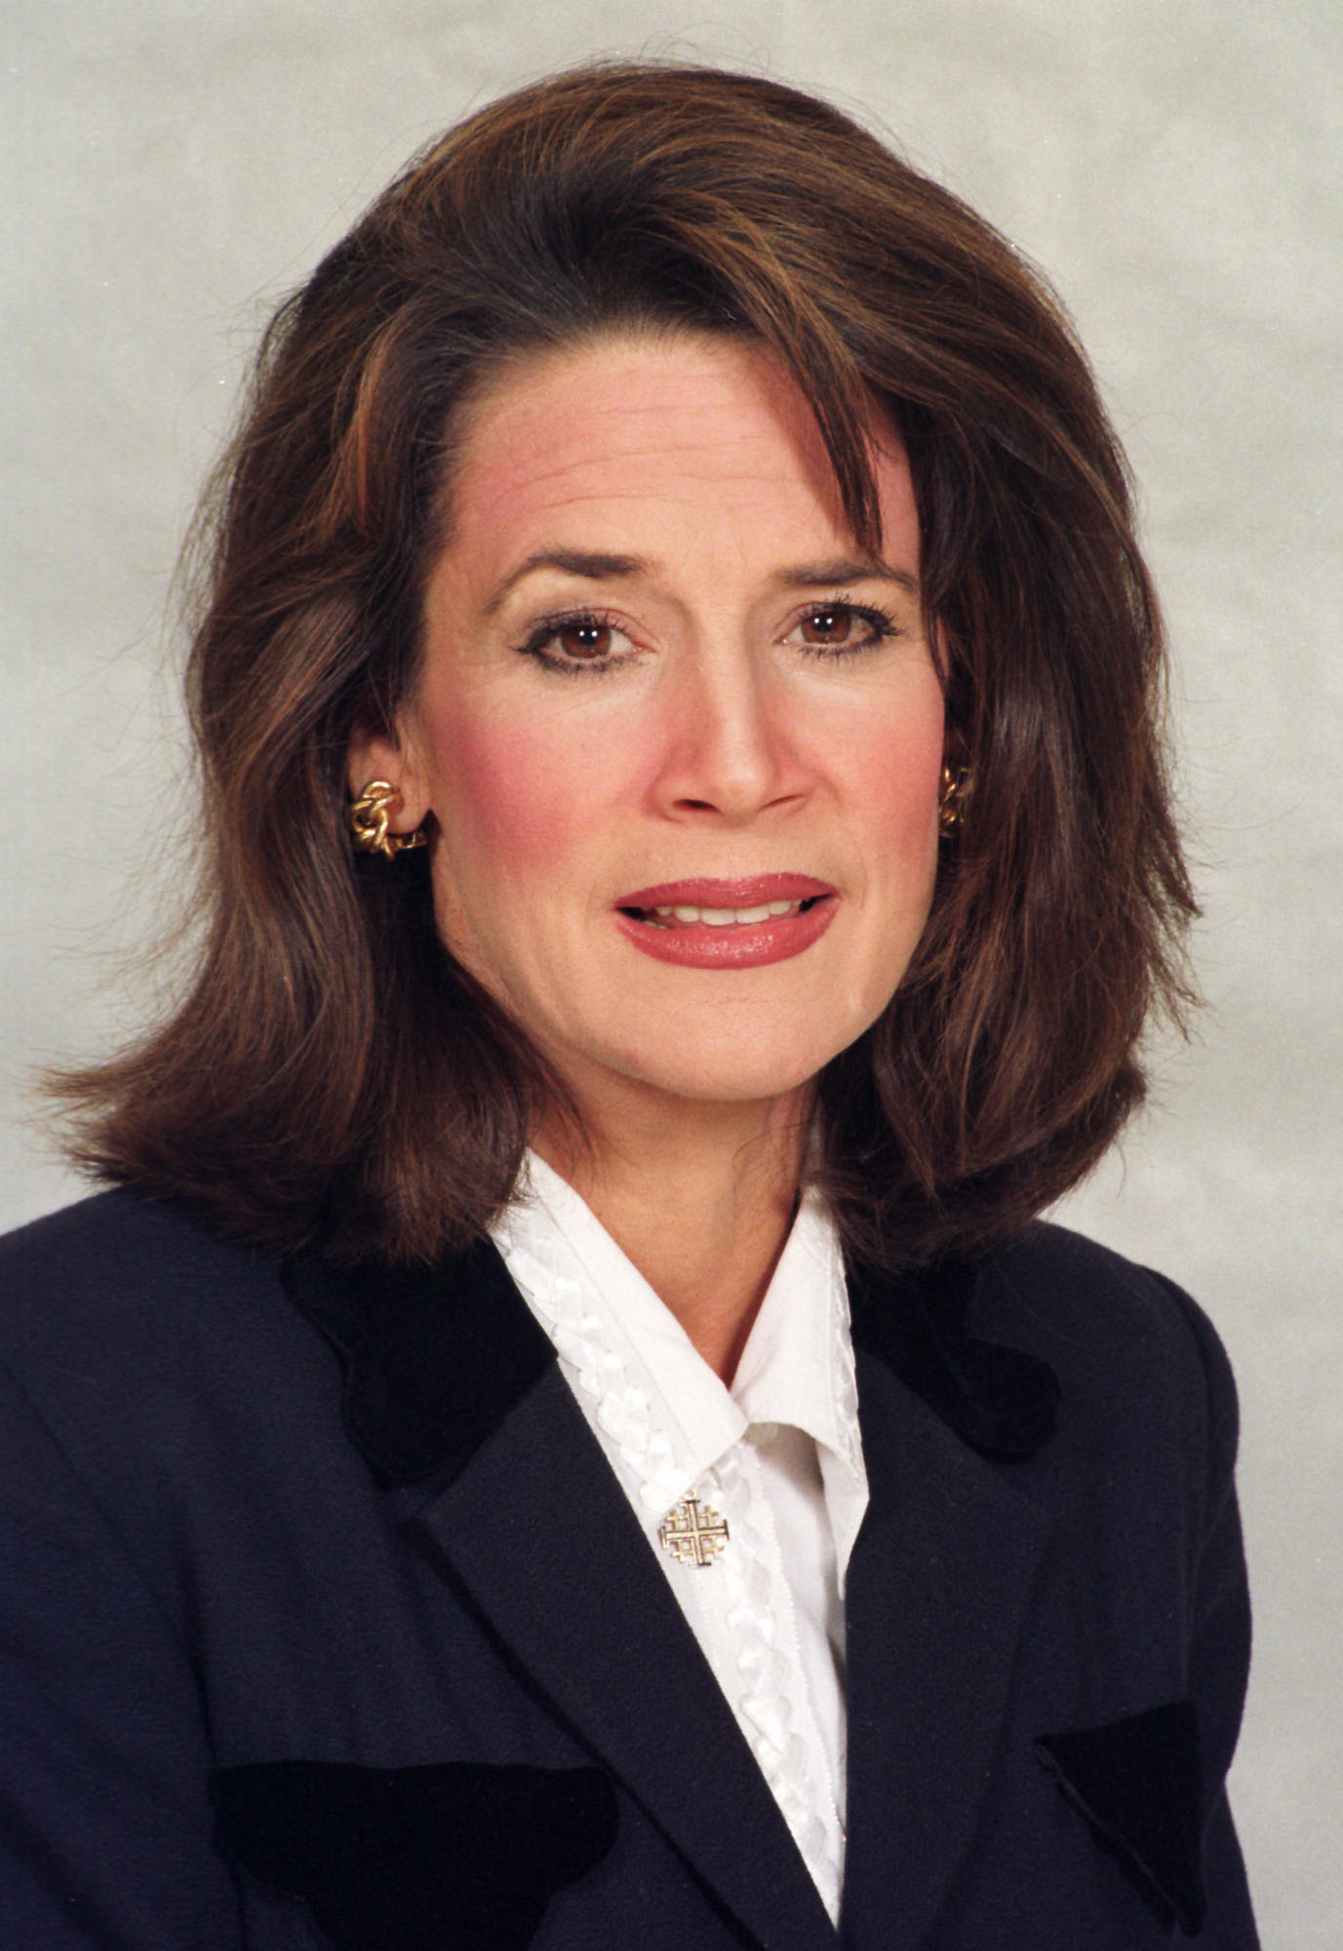

Slide 35
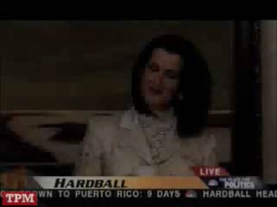

Slide 36
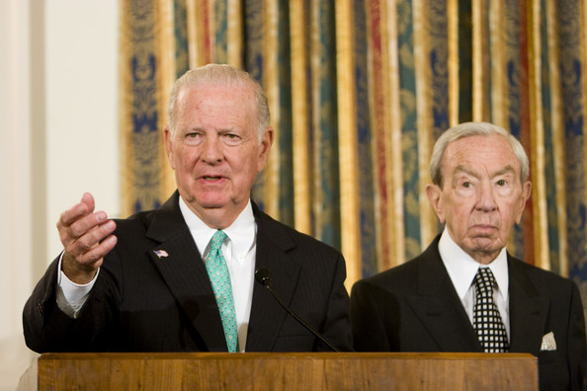

Slide 37
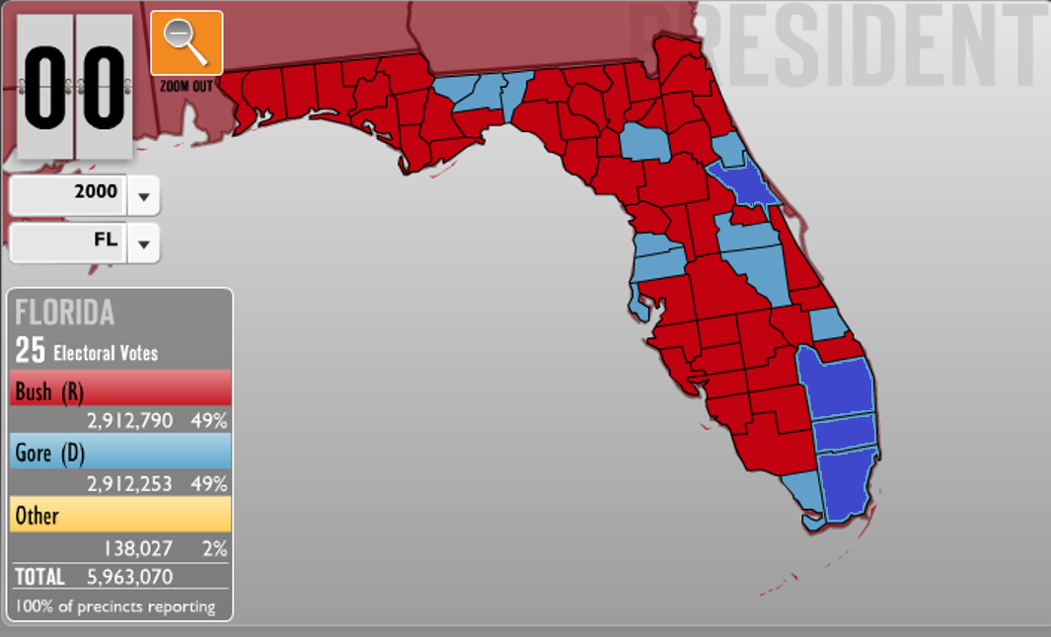

Slide 38
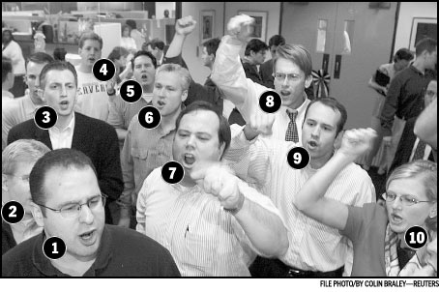

Slide 39
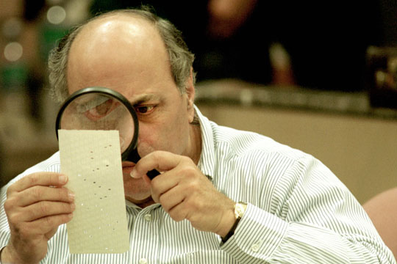

Slide 40
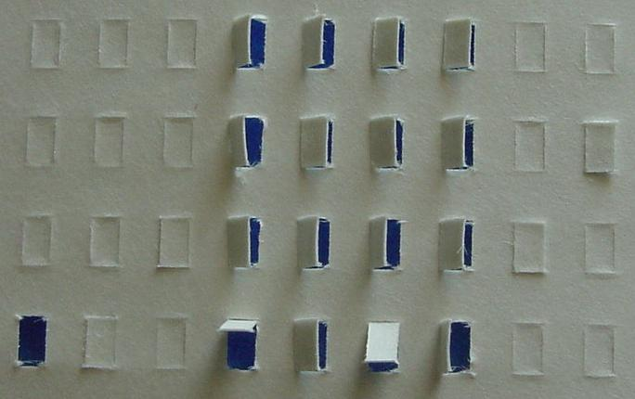

Slide 41
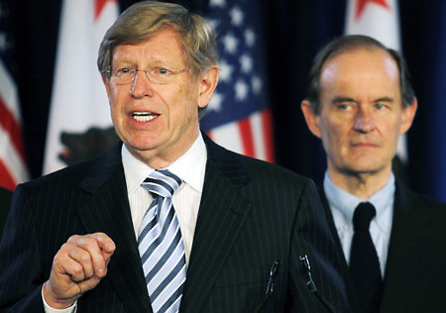

Slide 42
Bush v. Gore (2000)
The want of those rules here has led to unequal evaluation of ballots in various respects. As seems to have been acknowledged at oral argument, the standards for accepting or rejecting contested ballots might vary not only from county to county but indeed within a single county from one recount team to another . . .
The recount process, in its features here described, is inconsistent with the minimum procedures necessary to protect the fundamental right of each voter in the special instance of a statewide recount under the authority of a single state judicial officer. Our consideration is limited to the present circumstances, for the problem of equal protection in election processes generally presents many complexities . . .

Slide 43
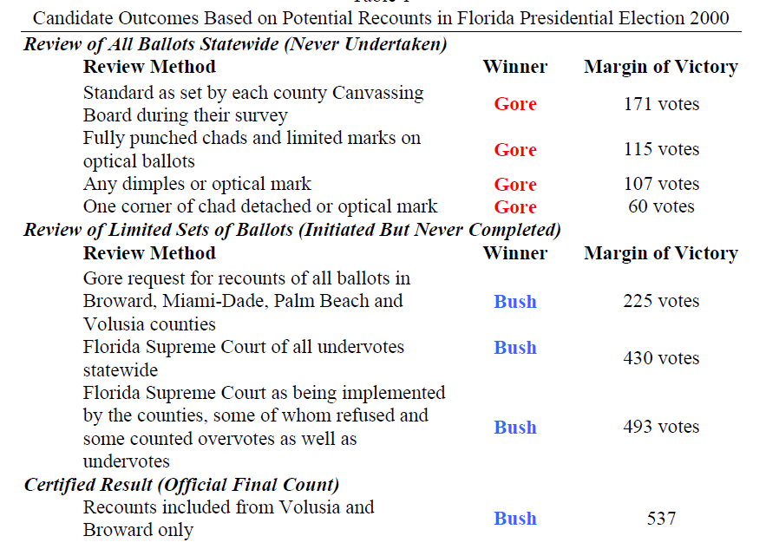

Slide 44


Slide 45
