Slide 1
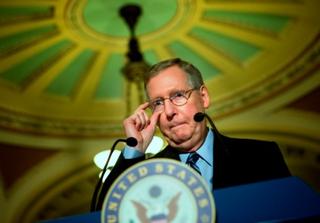

Slide 2
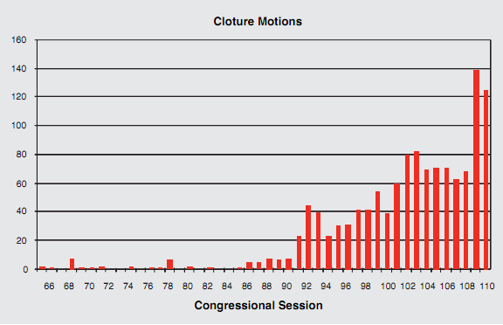

Slide 3
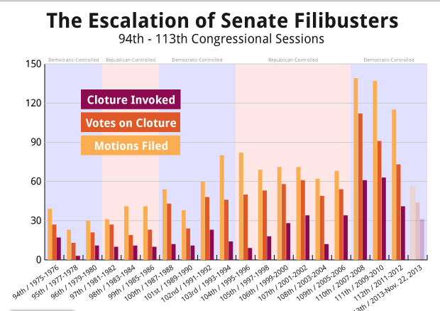

Slide 4
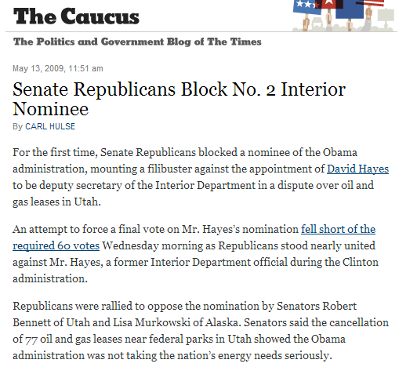

Slide 5
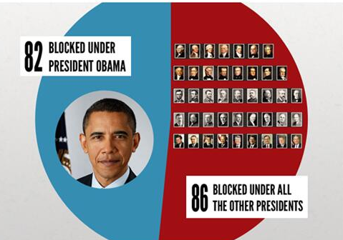

Slide 6
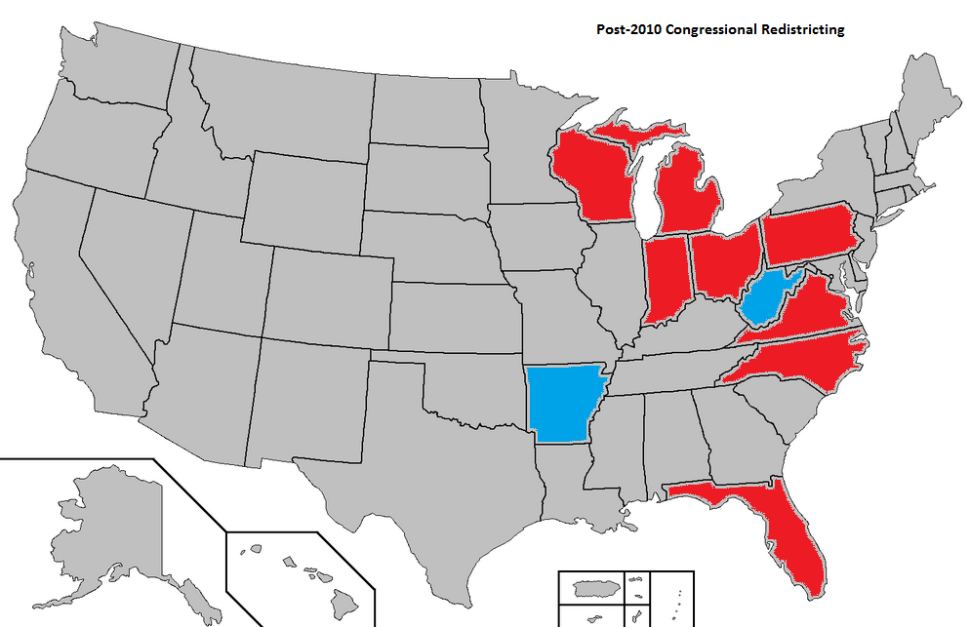

Slide 7
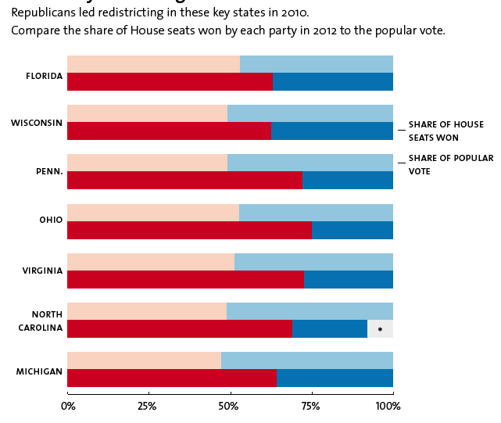

Slide 8
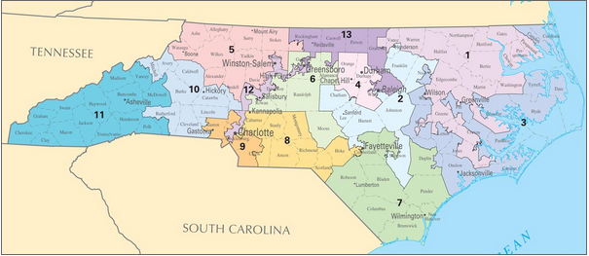
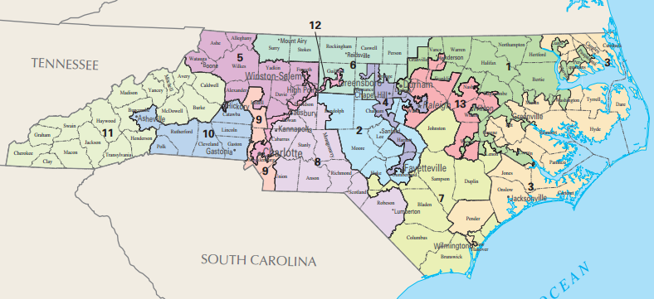
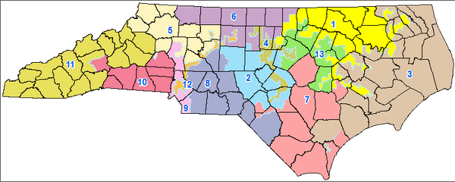

Slide 9
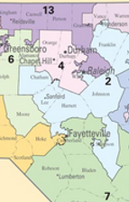


Slide 10
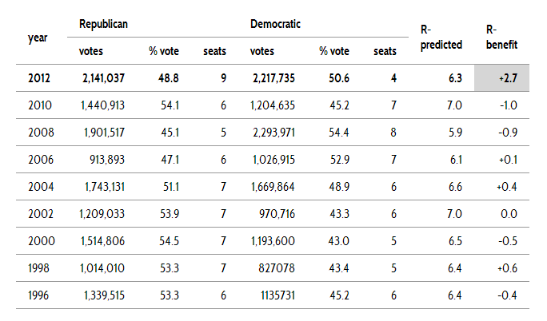

Slide 11
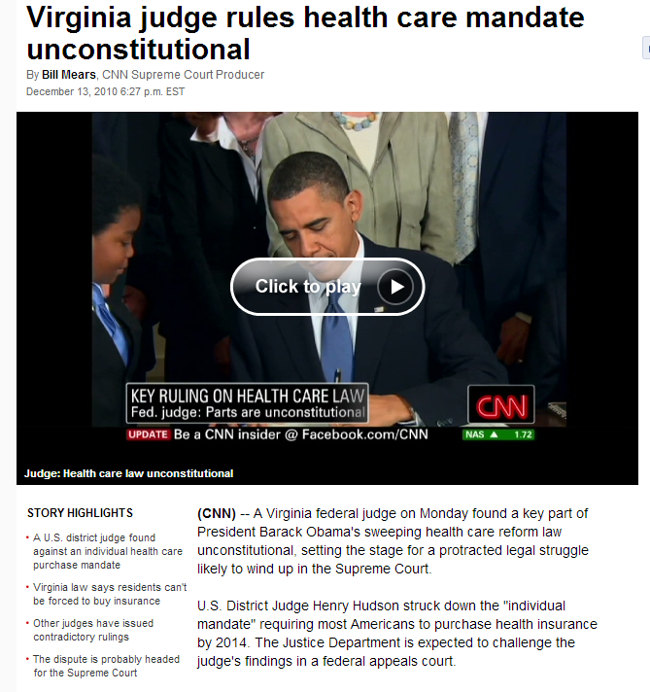

Slide 12
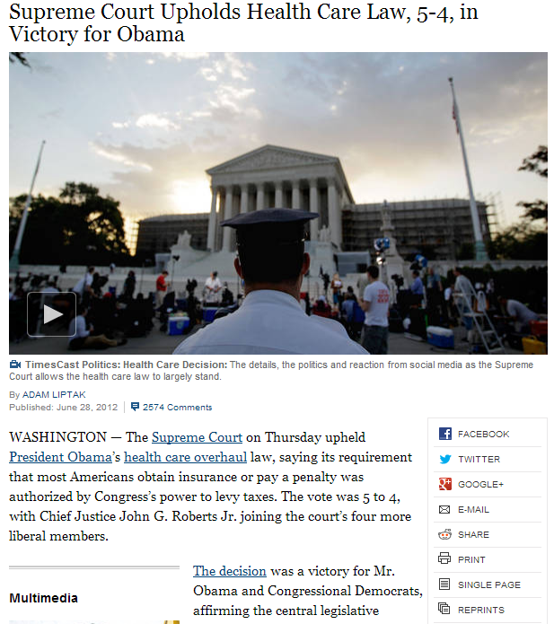

Slide 13
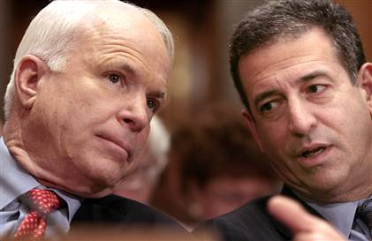

Slide 14
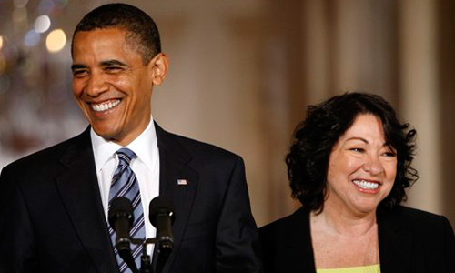

Slide 15
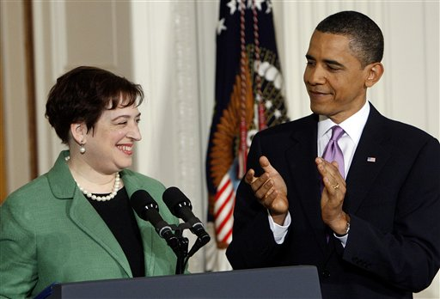

Slide 16
Citizens United v. FEC (2010)
Speech is an essential mechanism of democracy, for it is the means to hold officials accountable to the people. The right of citizens to inquire, to hear, to speak, and to use information to reach consensus is a precondition to enlightened self-government and a necessary means to protect it. The First Amendment “‘has its fullest and most urgent application’ to speech uttered during a campaign for political office.”…
The appearance of influence or access, furthermore, will not cause the electorate to lose faith in our democracy. By definition, an independent expenditure is political speech presented to the electorate that is not coordinated with a candidate. The fact that a corporation, or any other speaker, is willing to spend money to try to persuade voters presupposes that the people have the ultimate influence over elected officials. This is inconsistent with any suggestion that the electorate will refuse “‘to take part in democratic governance’” because of additional political speech made by a corporation or any other speaker.

Slide 17


Slide 18
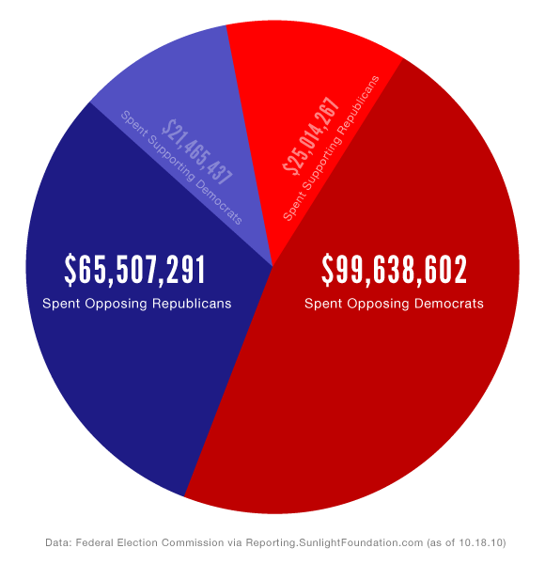

Slide 19
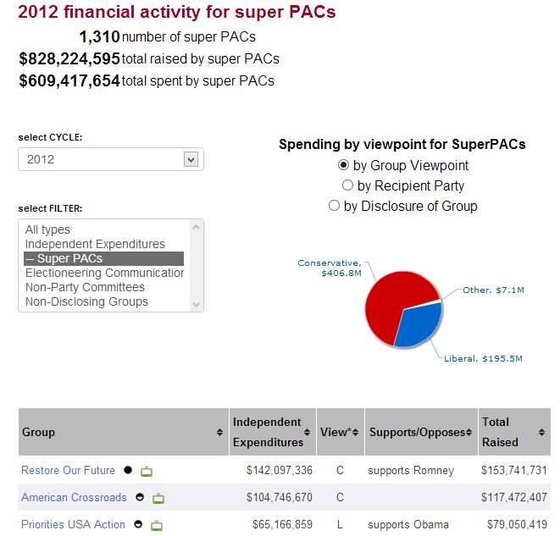

Slide 20
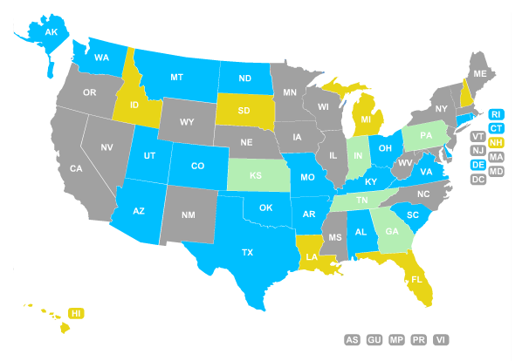
Voter ID Laws, 2012 election

Slide 21
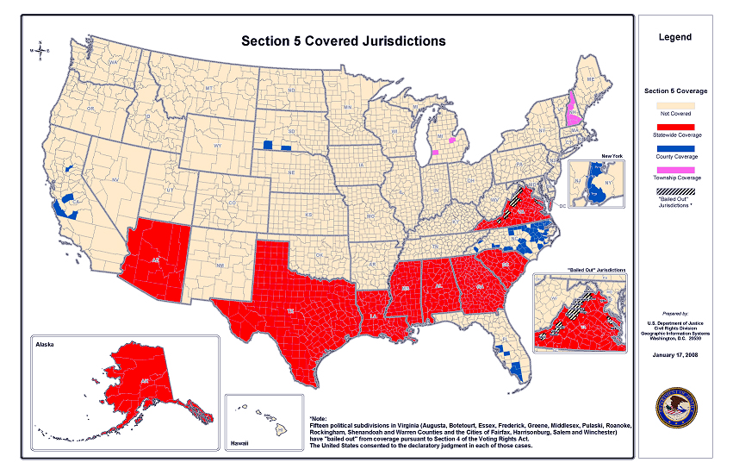

Slide 22

Solicitor General Verrilli: The covered jurisdictions [under Section 5 of the Voting Rights Act] contain only 14 percent of the subjurisdictions in the nation.
And so 14 percent of the subjurisdictions in the nation are generating up to 81 percent of the successful Section 2 litigation.
And I think--
Chief Justice Roberts: General, is it -- is it the government’s submission that the citizens in the South are more racist than the citizens in the North?
Solicitor General Verrilli: --It is not. And I do not know the answer to that, Your Honor, but I do think it was reasonable for Congress--
Chief Justice Roberts: Well, which: you said it is not, and [you said that] you don’t know the answer to it.
Solicitor General Verrilli: --I – it’s not our submission.
As an objective matter, I don't know the answer to that question.

Slide 23
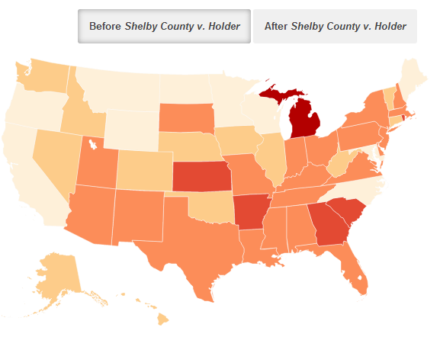
State—Restrictive Voting Policies

Slide 24
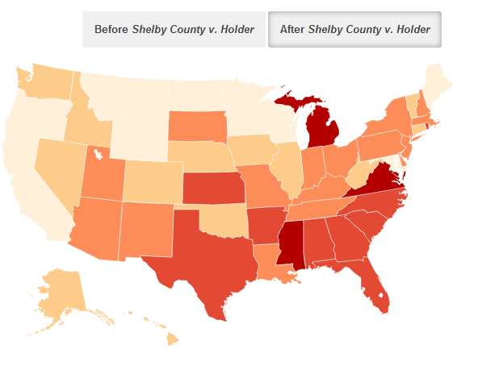
State—Restrictive Voting Policies

Slide 25
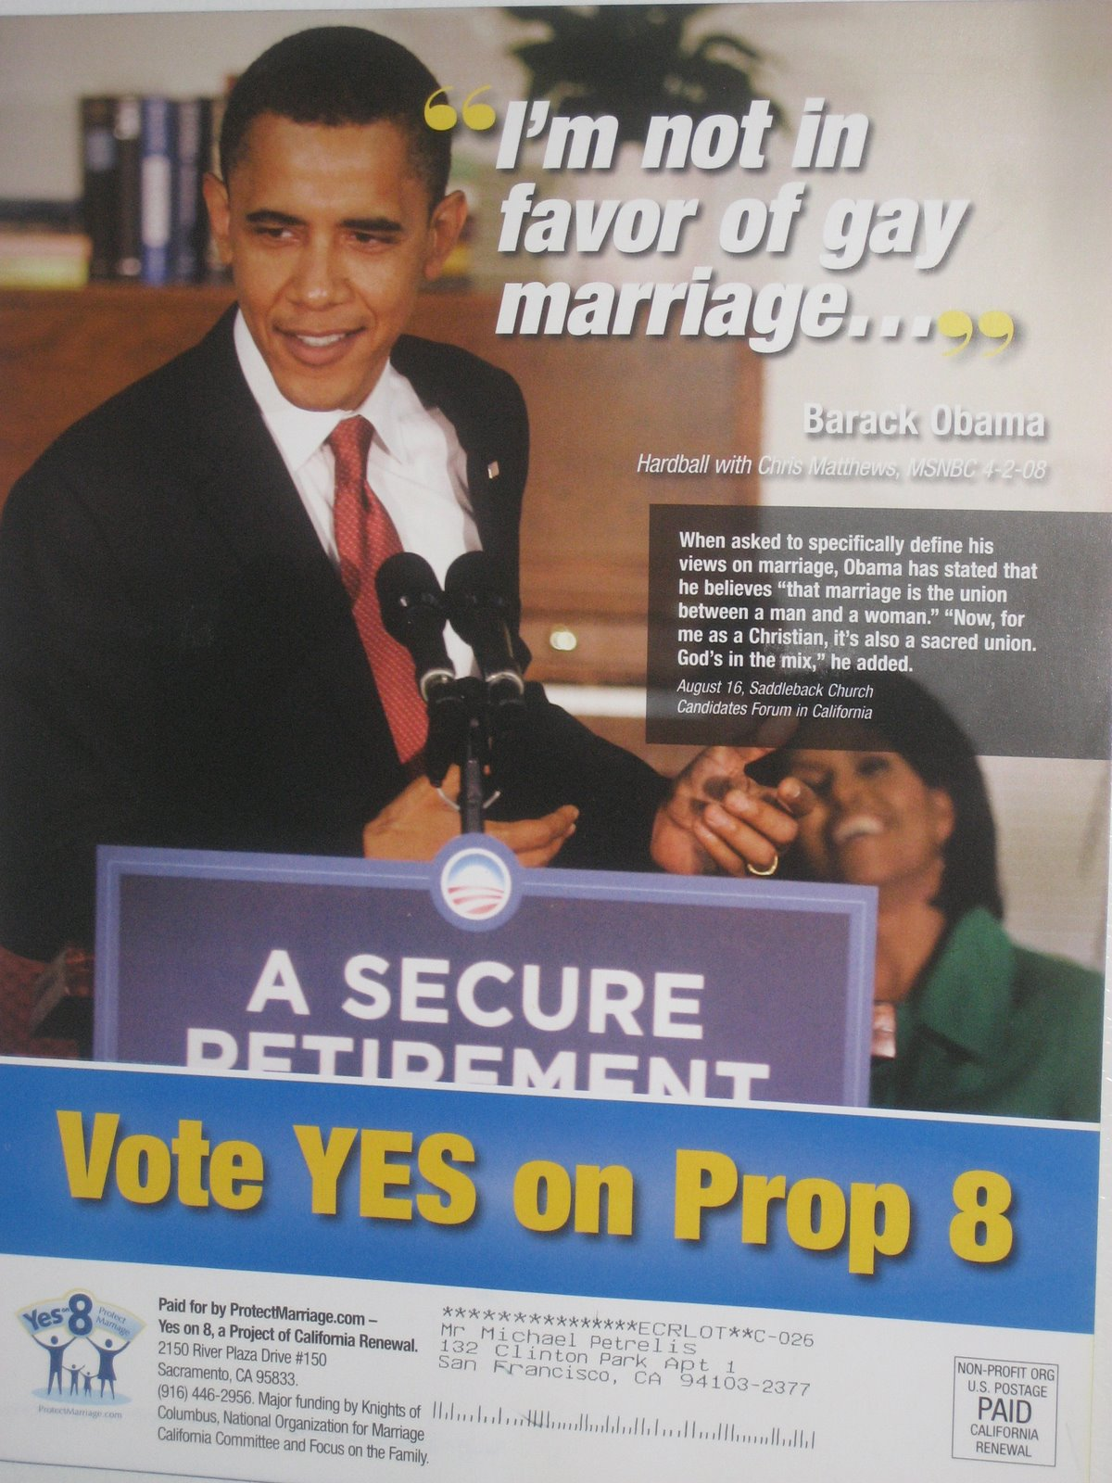

Slide 26
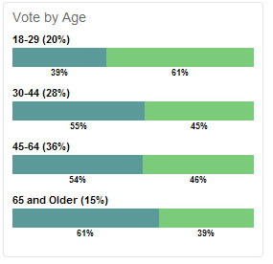
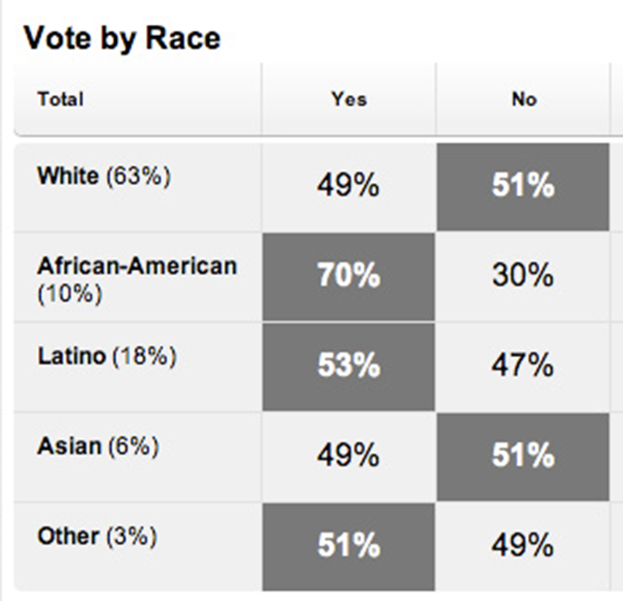

Slide 27
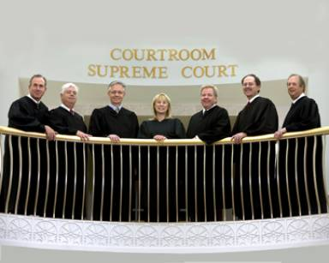
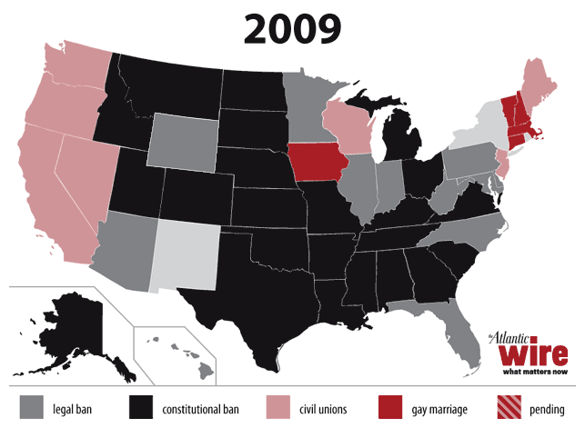

Slide 28
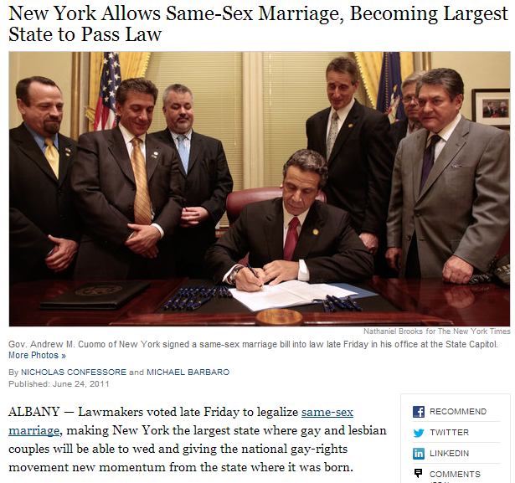

Slide 29
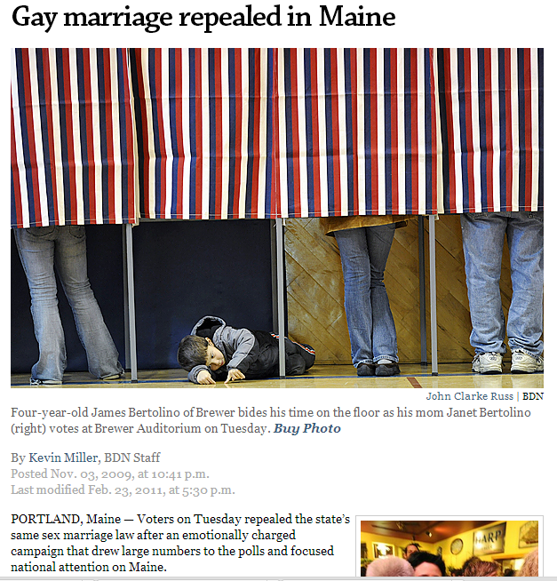
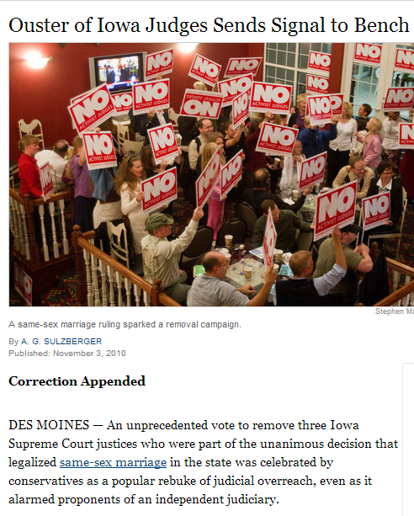

Slide 30
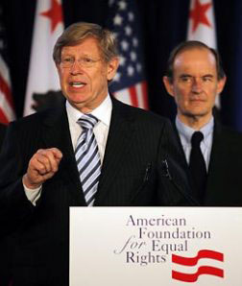

Slide 31
Perry v. Schwarzenegger (2010)
Proposition 8 cannot withstand any level of scrutiny under the equal protection clause, as excluding same-sex couples from marriage is simply not rationally related to a legitimate state interest…
Proponents’ argument that tradition prefers opposite-sex couples to same-sex couples equates to the notion that opposite-sex relationships are simply better than same-sex relationships. Tradition alone cannot legitimate this purported interest.
Many of the purported interests identified by the proponents [of Proposition 8] are nothing more than a fear or unarticulated dislike of same-sex couples.

Slide 32
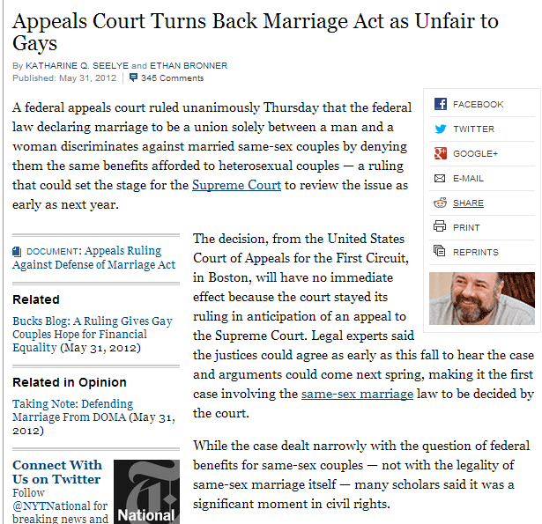

Slide 33


Slide 34
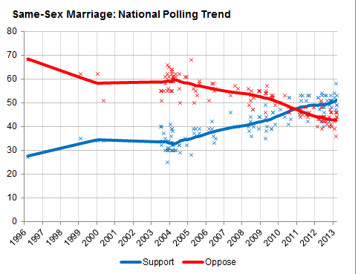

Slide 35
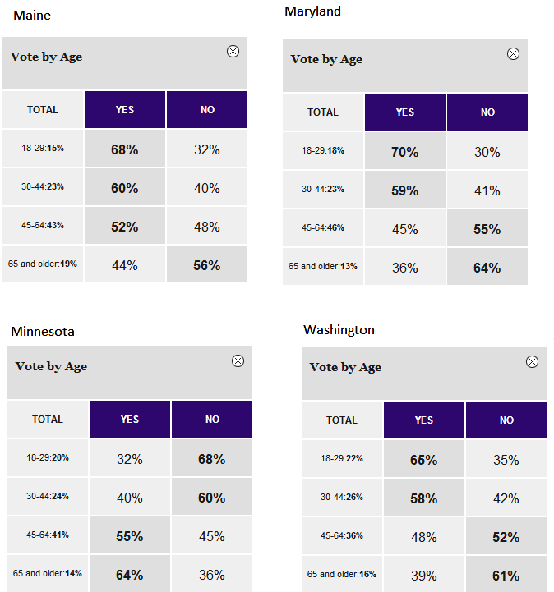

Slide 36
Justice Kagan: Suppose a State said, Because we think that the focus of marriage really should be on procreation, we’re not going to give marriage licenses anymore to any couple where both people are over the age of 55.
Would that be constitutional?
[Prop 8 attorney] Charles Cooper: No, Your Honor, it would not be constitutional.
Justice Kagan: Because that’s the same State interest [the Prop 8 proponents are offering], I would think, you know.
If you’re over the age of 55, you don’t help us serve the Government's interest in regulating procreation through marriage.
So why is that different?
Cooper: Your Honor, even with respect to couples over the age of 55, it is very rare that both couples -- both parties to the couple are infertile, and the traditional…
[Laughter.]
Justice Kagan: No, really, because if a couple -- I can just assure you, if both the woman and the man are over the age of 55, there are not a lot of children coming out of that marriage. [Laughter.]

Slide 37
Justice Kennedy: There’s substance to the point that the sociological information is new. We have five years of information to weigh against 2,000 years of history or more.
On the other hand, there is an immediate legal injury or legal -- what could be a legal injury, and that's the voice of these children. There are some 40,000 children in California, according to the Red [plaintiffs’] Brief, that live with same-sex parents, and they want their parents to have full recognition and full status.
The voice of those children is important in this case, don’t you think?
[Break.]
Paul Clement: Up until 1996, [Congress] essentially has it both ways: Every State has the traditional definition. Congress knows that’s the definition that's embedded in every Federal law. It says fine. We can defer. OK. [In] 1996--
Justice Kagan: Well, is what happened in 1996 -- and I’m going to quote from the House Report here -- is that “Congress decided to reflect and honor a collective moral judgment and to express moral disapproval of homosexuality.”
Is that what happened in 1996? [Murmuring in audience.]
Paul Clement: [Pauses.] Does the House Report say that? Of course, the House Report says that. And if that’s enough to invalidate the statute, then you should invalidate the statute.

Slide 38
Windsor v. United States (Kennedy opinion)
DOMA writes inequality into the entire United States Code. The particular case at hand concerns the estate tax, but DOMA is more than a simple determination of what should or should not be allowed as an estate tax refund. Among the over 1,000 statutes and numerous federal regulations that DOMA controls are laws pertaining to Social Security, housing, taxes, criminal sanctions, copyright, and veterans’ benefits. DOMA’s principal effect is to identify a subset of state-sanctioned marriages and make them unequal. The principal purpose is to impose inequality, not for other reasons like governmental efficiency…
The differentiation demeans the couple, whose moral and sexual choices the Constitution protects, see Lawrence v. Texas, and whose relationship the State has sought to dignify. And it humiliates tens of thousands of children now being raised by same-sex couples. The law in question makes it even more difficult for the children to understand the integrity and closeness of their own family and its concord with other families in their community and in their daily lives…

Slide 39
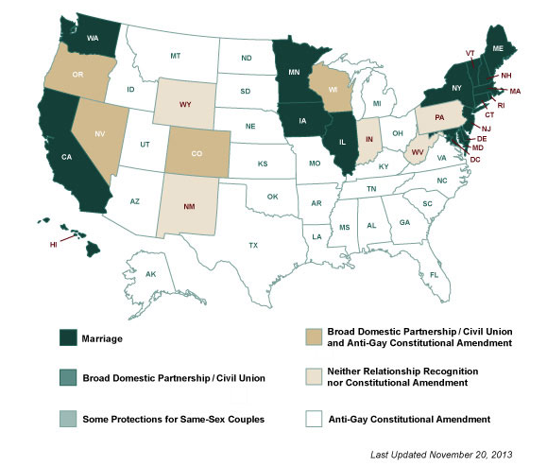

Slide 40
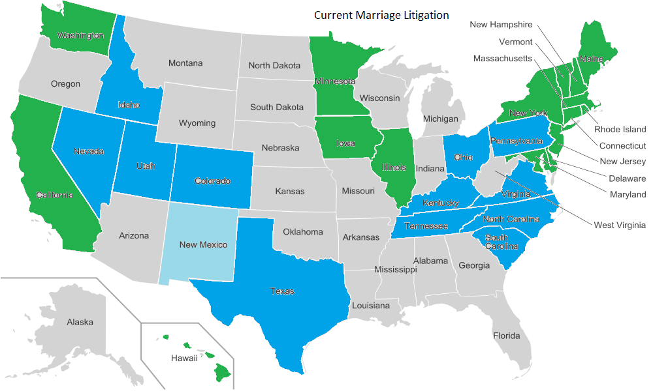

Slide 41
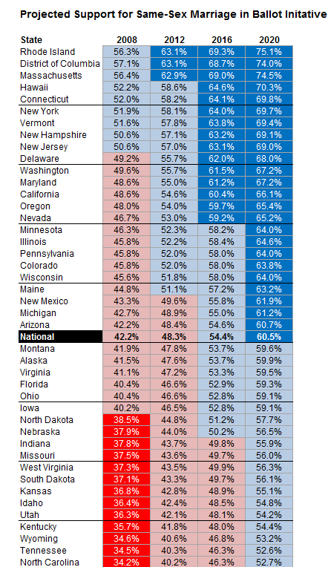
Source: Nate Silver, New York Times

Slide 42
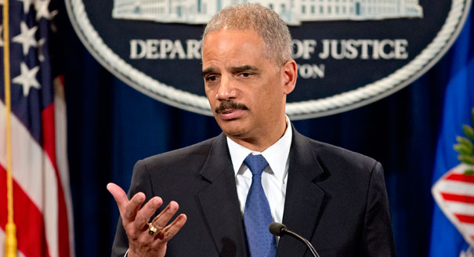

Slide 43


Slide 44
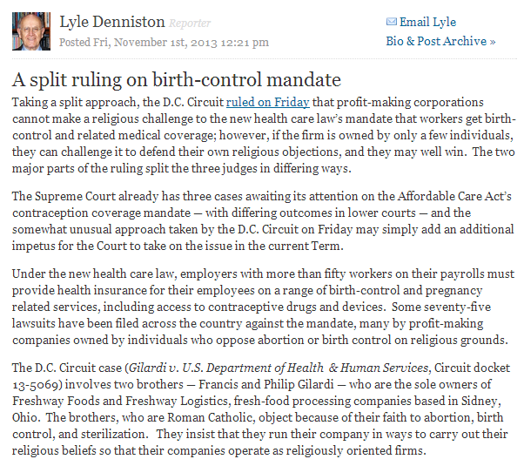

Slide 45
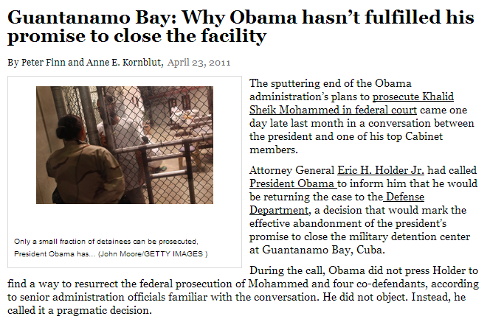

Slide 46
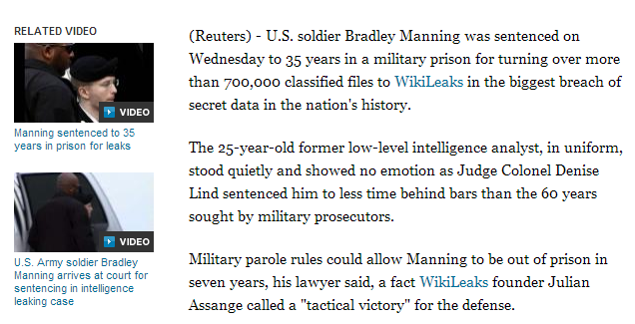

Slide 47


Slide 48

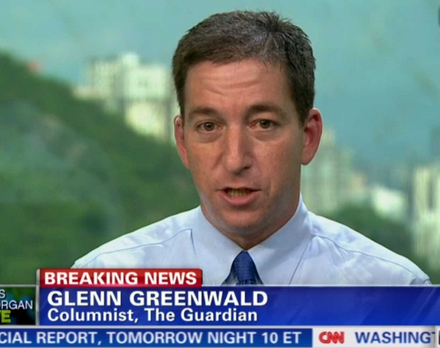

Slide 49
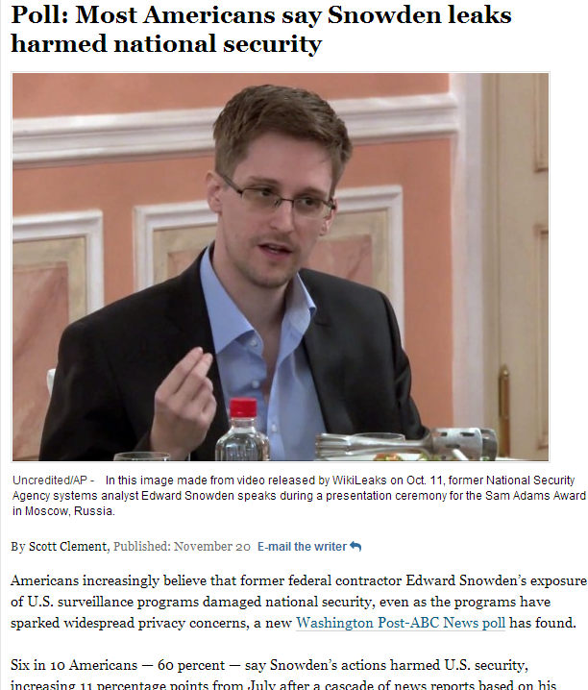

Slide 50
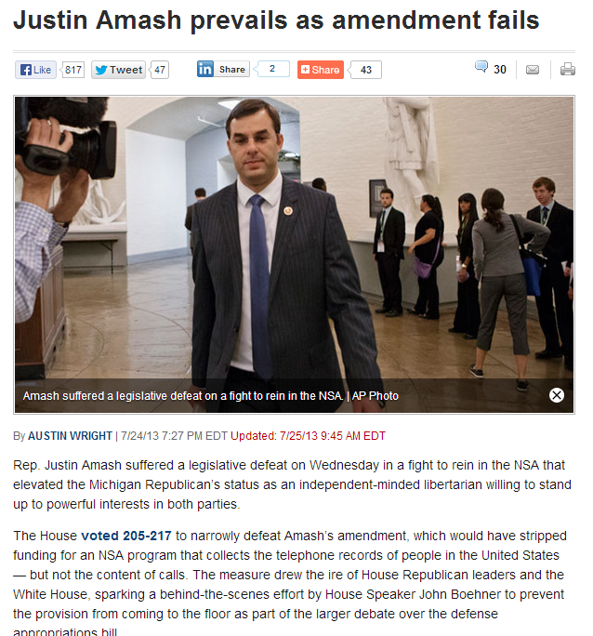

Slide 51
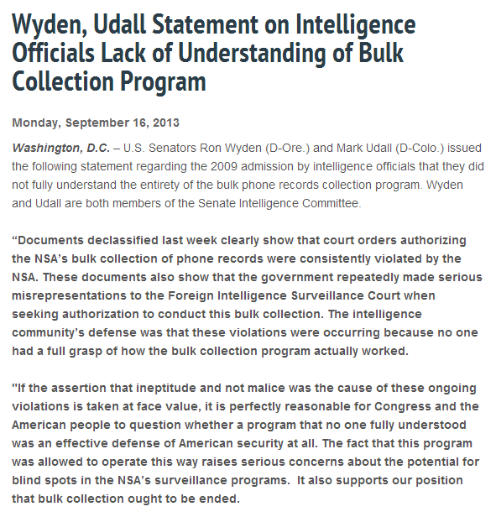

Slide 52
