Slide 1
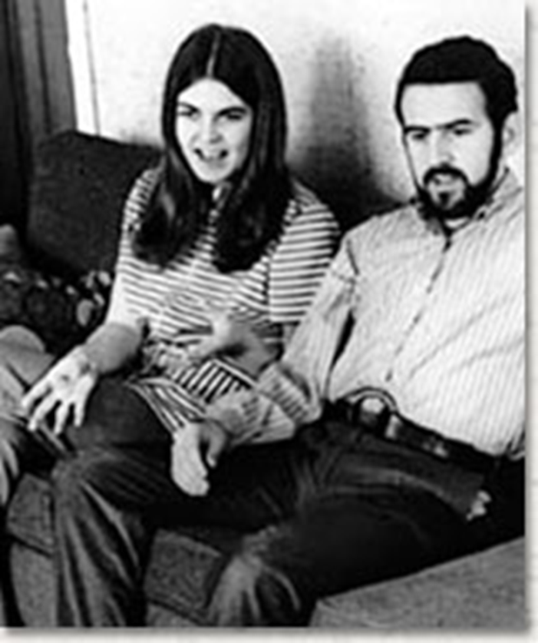
Frontiero v. Richardson (1973)
At the outset, appellants contend that classifications based upon sex, like classifications based upon race, alienage, and national origin, are inherently suspect, and must therefore be subjected to close judicial scrutiny. We agree.

Slide 2
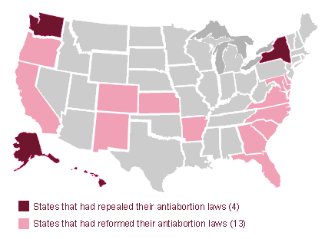
State Abortion Laws--1972

Slide 3
Roe v. Wade (1973)—Rehnquist dissent
I have difficulty in concluding, as the Court does, that the right of "privacy" is involved in this case. Texas, by the statute here challenged, bars the performance of a medical abortion by a licensed physician on a plaintiff such as Roe. A transaction resulting in an operation such as this is not "private" in the ordinary usage of that word. Nor is the "privacy" that the Court finds here even a distant relative of the freedom from searches and seizures protected by the Fourth Amendment to the Constitution . . .
The decision here to break pregnancy into three distinct terms and to outline the permissible restrictions the State may impose in each one, for example, partakes more of judicial legislation than it does of a determination of the intent of the drafters of the Fourteenth Amendment . . .
The fact that a majority of the States reflecting, after all, the majority sentiment in those States, have had restrictions on abortions for at least a century is a strong indication, it seems to me, that the asserted right to an abortion is not “so rooted in the traditions and conscience of our people as to be ranked as fundamental.” . . .

Slide 4
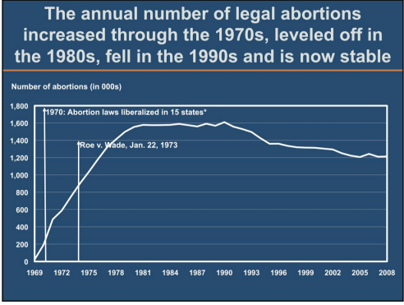
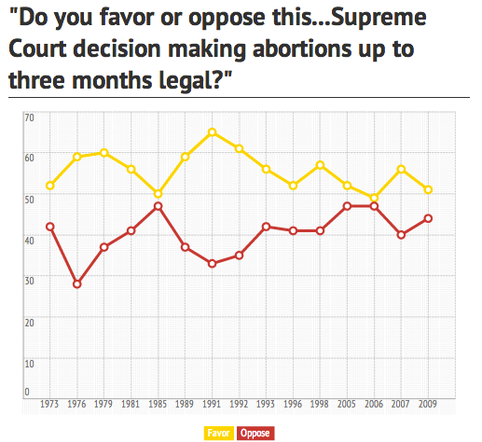

Slide 5


Slide 6

Equality of rights under the law shall not be denied or abridged by the United States or by any State on account of sex.

Slide 7


Slide 8



Slide 9


Slide 10
Webster v. Reproductive Health Services of Missouri (1989)
Blackmun dissent
Today, Roe v. Wade, and the fundamental constitutional right of women to decide whether to terminate a pregnancy, survive, but are not secure. Although the Court extricates itself from this case without making a single, even incremental, change in the law of abortion, the plurality and JUSTICE SCALIA would overrule Roe (the first silently, the other explicitly) and would return to the States virtually unfettered authority to control the quintessentially intimate, personal, and life-directing decision whether to carry a fetus to term. Although today, no less than yesterday, the Constitution and the decisions of this Court prohibit a State from enacting laws that inhibit women from the meaningful exercise of that right, a plurality of this Court implicitly invites every state legislature to enact more and more restrictive abortion regulations in order to provoke more and more test cases, in the hope that, sometime down the line, the Court will return the law of procreative freedom to the severe limitations that generally prevailed in this country before January 22, 1973. Never in my memory has a plurality announced a judgment of this Court that so foments disregard for the law and for our standing decisions.

Slide 11
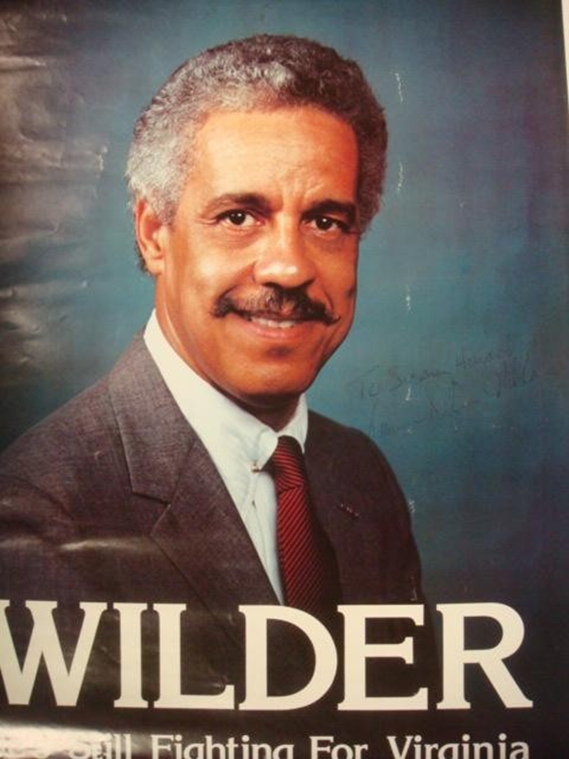
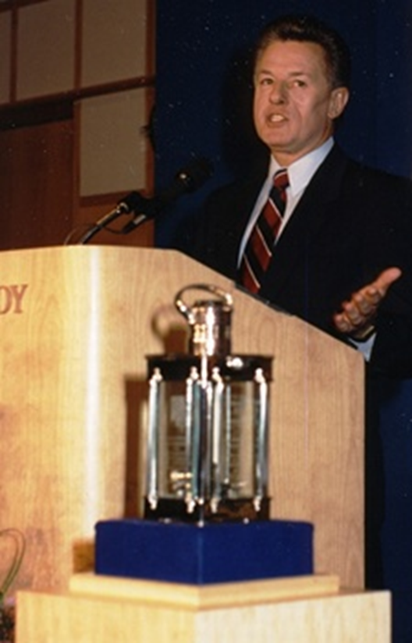

Slide 12










Slide 13

Justice Sandra Day O'Connor: Now, the provision does not require notification to a father who is not the husband, I take it--
Mr. Ernest Preate: That's correct, Justice O'Connor.
Justice O'Connor: --or notice if the woman is unmarried.
Mr. Preate: It only applies to married women.
Justice O'Connor: So what's the interest, to try to preserve the marriage?
Mr. Preate: There are several interests.
The interest, of course, in protecting the life of the unborn child.
Justice O'Connor: Well then, why not require notice to all fathers?
It's a curious sort of a provision, isn't it?
Mr. Preate: It is that, but the legislature has made the judgment that it wanted its statute to apply in this specific instance because it wanted to further the integrity of marriages.
Justice O'Connor: Would you say that the State could similarly require a woman to notify anyone with whom she had intercourse that she planned to use some means of birth control after the intercourse that operates, let's say, as an abortifacient?
Mr. Preate: Well--
Justice O'Connor: Could the State do that?
I mean, it would be the same State interest, I suppose.
[Break.]
Justice O'Connor: Well, we're talking about the provision for notification in this case under the statute to the husband, and I'm just asking whether a different type of State regulation would have to be upheld under your standard.
Mr. Preate: Well, if the State had posited its interest as protecting the life of the unborn, then utilizing the rational basis standard, then I would submit that it could legitimately require that kind of notification to all people.

Slide 14
Planned Parenthood v. Casey (1992)
Liberty finds no refuge in a jurisprudence of doubt. Yet 19 years after our holding that the Constitution protects a woman's right to terminate her pregnancy in its early stages, Roe v. Wade, that definition of liberty is still questioned…
Numerous forms of state regulation might have the incidental effect of increasing the cost or decreasing the availability of medical care, whether for abortion or any other medical procedure. The fact that a law which serves a valid purpose, one not designed to strike at the right itself, has the incidental effect of making it more difficult or more expensive to procure an abortion cannot be enough to invalidate it. Only where state regulation imposes an undue burden on a woman's ability to make this decision does the power of the State reach into the heart of the liberty protected by the Due Process Clause.

Slide 15
Planned Parenthood v. Casey (1992)—Scalia dissent
There is a poignant aspect to today’s opinion. Its length, and what might be called its epic tone, suggest that its authors believe they are bringing to an end a troublesome era in the history of our Nation and of our Court. “It is the dimension” of authority, they say, to “cal[l] the contending sides of national controversy to end their national division by accepting a common mandate rooted in the Constitution.”
There comes vividly to mind a portrait by Emanuel Leutze that hangs in the Harvard Law School: Roger Brooke Taney, painted in 1859, the 82nd year of his life, the 24th of his Chief Justiceship, the second after his opinion in Dred Scott…There seems to be on his face, and in his deep set eyes, an expression of profound sadness and disillusionment. Perhaps he always looked that way, even when dwelling upon the happiest of thoughts. But those of us who know how the lustre of his great Chief Justiceship came to be eclipsed by Dred Scott cannot help believing that he had that case--its already apparent consequences for the Court, and its soon to be played out consequences for the Nation--burning on his mind. I expect that two years earlier he, too, had thought himself “call[ing] the contending sides of national controversy to end their national division by accepting a common mandate rooted in the Constitution.”

Slide 16
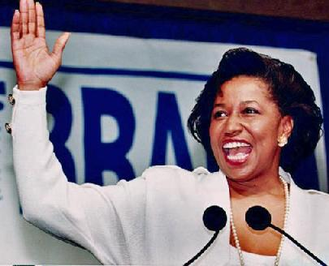

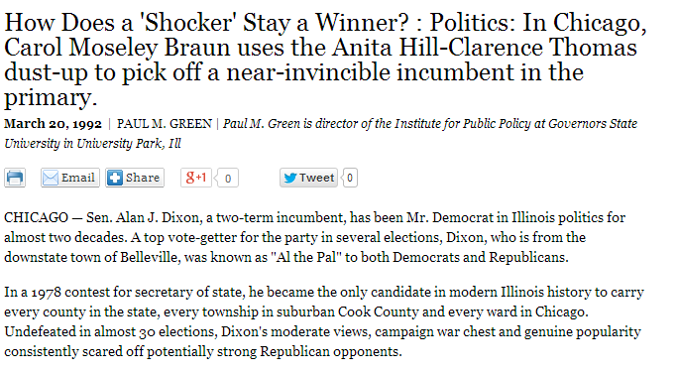

Slide 17


Slide 18
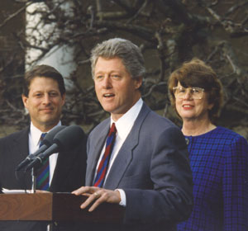

Slide 19
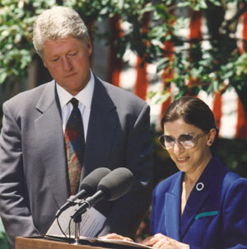

Slide 20
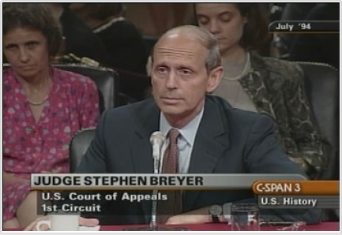

Slide 21
Meritor Savings Bank v. Vinson (1986)
In sum, we hold that a claim of "hostile environment" sex discrimination is actionable under Title VII.
Plaintiffs with hostile work environment claims must prove that the challenged conduct:
Was severe OR pervasive,
Created a hostile or abusive working environment,
Was unwelcome, and
Was based on the plaintiff’s gender

Slide 22
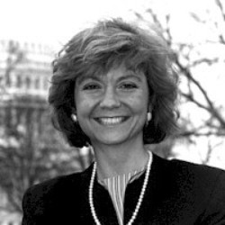

Slide 23


Slide 24
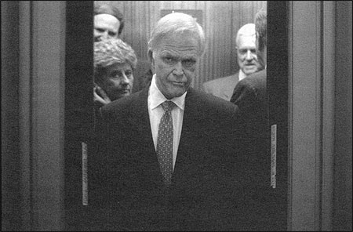

Slide 25
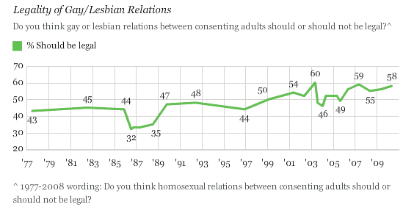

Slide 26


Slide 27
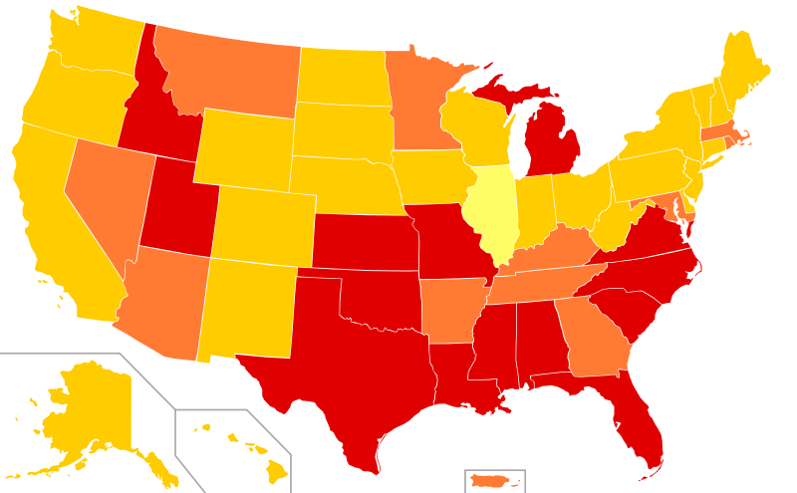


Slide 28
Bowers v. Hardwick (1986)
White opinion: “The issue presented is whether the Federal Constitution confers a fundamental right upon homosexuals to engage in sodomy, and hence invalidates the laws of the many States that still make such conduct illegal, and have done so for a very long time…It would be difficult, except by fiat, to limit the claimed right to homosexual conduct while leaving exposed to prosecution adultery, incest, and other sexual crimes even though they are committed in the home. We are unwilling to start down that road.”
Burger concurrence: “Decisions of individuals relating to homosexual conduct have been subject to state intervention throughout the history of Western civilization. Condemnation of those practices is firmly rooted in Judeo-Christian moral and ethical standards…To hold that the act of homosexual sodomy is somehow protected as a fundamental right would be to cast aside millennia of moral teaching.”

Slide 29

Amendment 2—Colorado (1992)
No Protected Status Based on Homosexual, Lesbian, or Bisexual Orientation.
Neither the State of Colorado, through any of its branches or departments, nor any of its agencies, political subdivisions, municipalities or school districts, shall enact, adopt or enforce any statute, regulation, ordinance or policy whereby homosexual, lesbian or bisexual orientation, conduct, practices or relationships shall constitute or otherwise be the basis of or entitle any person or class of persons to have or claim any minority status, quota preferences, protected status or claim of discrimination. This Section of the Constitution shall be in all respects self-executing.

Slide 30



Slide 31
Timothy Tymkovich: The rationality of the substantive policy judgment that has so far motivated Congress and other States in deciding not to extend Title VII [civil rights] protections or other... to homosexuals and bisexuals similarly supports the decision of Colorado to reserve that question to itself on a statewide basis.
Justice Anthony Kennedy: It may be, counsel, that we have to reach that question, but it seems to me there is a predicate or a preliminary matter that we must discuss at some point during your oral argument.
Usually when we have an equal protection question we measure the objective of the legislature against the class that is adopted, against the statutory classification. Here, the classification seems to be adopted for its own sake.
I’ve never seen a case like this. Is there any precedent that you can cite to the Court where we've upheld a law such as this?
[Break.]
Justice Kennedy: Here, the classification is adopted to fence out, in the Colorado supreme court’s words, the class for all purposes, and I’ve never seen a statute like that.
[Break.]
Tymkovich: For bases of this appeal, the Colorado court did make an interpretation that at least to the extent that it preempted local laws and State provisions, that’s all the farther it went.
Justice Sandra Day O’Connor: Well, does it mean that homosexuals are not covered by Colorado's laws of general applicability?
Tymkovich: No, it does not. In the--
Justice O’Connor: How do we know that?
I mean, the literal language would indicate that, for example, a public library could refuse to allow books to be borrowed by homosexuals and there would be no relief from that, apparently.

Slide 32
Romer v. Evans (1996)
Its sheer breadth is so discontinuous with the reasons offered for it that the amendment seems inexplicable by anything but animus toward the class that it affects; it lacks a rational relationship to legitimate state interests…
Amendment 2 … is at once too narrow and too broad. It identifies persons by a single trait and then denies them protection across the board. The resulting disqualification of a class of persons from the right to seek specific protection from the law is unprecedented in our jurisprudence . . .
We must conclude that Amendment 2 classifies homosexuals not to further a proper legislative end but to make them unequal to everyone else. This Colorado cannot do. A State cannot so deem a class of persons a stranger to its laws.

Slide 33
Romer v. Evans —Scalia dissent
The constitutional amendment before us here is not the manifestation of a “`bare . . . desire to harm'” homosexu­als, but is rather a modest attempt by seemingly tolerant Coloradans to preserve traditional sexual mores against the efforts of a politically powerful minority to revise those mores through use of the laws…
This Court has no business imposing upon all Americans the resolution favored by the elite class from which the Members of this institution are selected, pronouncing that "animosity" toward homosexuality is evil…
Coloradans are, as I say, entitled to be hostile toward homosexual conduct... The people of Colorado have adopted an entirely reasonable provision which does not even disfavor homosexuals in any substantive sense, but merely denies them preferential treatment. Amendment 2 is designed to prevent piecemeal deterioration of the sexual morality favored by a majority of Coloradans, and is an appropriate means to that legitimate end.

Slide 34
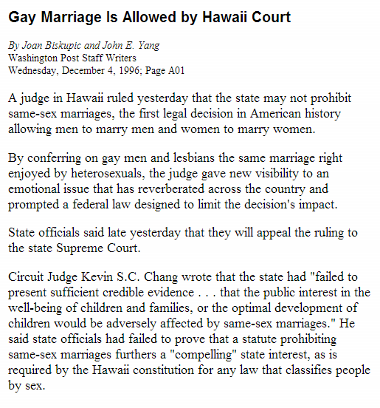

Slide 35
Defense of Marriage Act (1996); Passed House, 342-67, Senate, 85-14
Section 3. Definition of marriage
In determining the meaning of any Act of Congress, or of any ruling, regulation, or interpretation of the various administrative bureaus and agencies of the United States, the word 'marriage' means only a legal union between one man and one woman as husband and wife, and the word 'spouse' refers only to a person of the opposite sex who is a husband or a wife.
House Judiciary Committee report, DOMA
Civil laws that permit only heterosexual marriage reflect and
honor a collective moral judgment about human sexuality. This judgment entails both moral disapproval of homosexuality, and a moral conviction that heterosexuality better comports with traditional (especially Judeo-Christian) morality. As Representative Henry Hyde, the Chairman of the Judiciary Committee, stated during the Subcommittee markup of H.R. 3396: `[S]ame-sex marriage … trivializes the legitimate status of marriage and demeans it by putting a stamp of approval . . . on a union that many people . . . think is immoral.

Slide 36
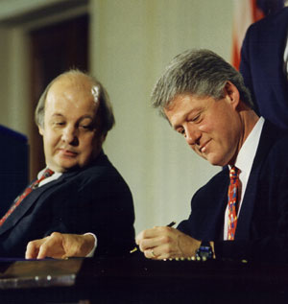

Slide 37
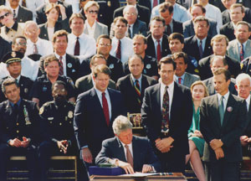
Notes:
Assault weapon ban

Slide 38


Slide 39
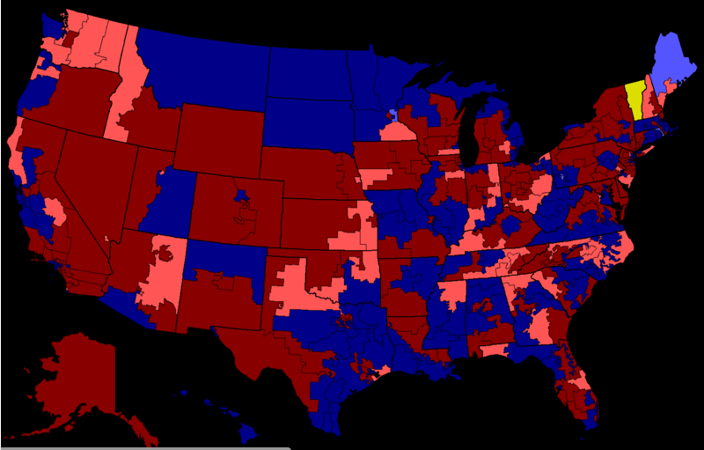
1994 House elections

Slide 40
United States v. Lopez (1995)
We start with first principles. The Constitution creates a Federal Government of enumerated powers . . . But even these modern era [1937-41] precedents which have expanded congressional power under the Commerce Clause confirm that this power is subject to outer limits . . .
Even Wickard, which is perhaps the most far reaching example of Commerce Clause authority over intrastate activity, involved economic activity in a way that the possession of a gun in a school zone does not . . .
To uphold the Government’s contentions here, we would have to pile inference upon inference in a manner that would bid fair to convert congressional authority under the Commerce Clause to a general police power of the sort retained by the States. Admittedly, some of our prior cases have taken long steps down that road, giving great deference to congressional action. The broad language in these opinions has suggested the possibility of additional expansion, but we decline here to proceed any further. To do so would require us to conclude that the Constitution’s enumeration of powers does not presuppose something not enumerated, and that there never will be a distinction between what is truly national and what is truly local. This we are unwilling to do.

Slide 41
Printz v. United States (1997)
The Framers’ experience under the Articles of Confederation had persuaded them that using the States as the instruments of federal governance was both ineffectual and provocative of federal state conflict . . .
Residual state sovereignty was also implicit, of course, in the Constitution’s conferral upon Congress of not all governmental powers, but only discrete, enumerated ones, Art. I, §8, which implication was rendered express by the Tenth Amendment’s assertion that “[t]he powers not delegated to the United States by the Constitution, nor prohibited by it to the States, are reserved to the States respectively, or to the people.”
Congress cannot compel the States to enact or enforce a federal regulatory program. Today we hold that Congress cannot circumvent that prohibition by conscripting the State's officers directly. The Federal Government may neither issue directives requiring the States to address particular problems, nor command the States’ officers, or those of their political subdivisions, to administer or enforce a federal regulatory program. It matters not whether policymaking is involved, and no case by case weighing of the burdens or benefits is necessary; such commands are fundamentally incompatible with our constitutional system of dual sovereignty.

Slide 42
Proposition 187 (“Save Our State” amendment)
The People of California find and declare as follows:
That they have suffered and are suffering economic hardship caused by the presence of illegal aliens in this state.
That they have suffered and are suffering personal injury and damage caused by the criminal conduct of illegal aliens in this state.
That they have a right to the protection of their government from any person or persons entering this country unlawfully.
Therefore, the People of California declare their intention to provide for cooperation between their agencies of state and local government with the federal government, and to establish a system of required notification by and between such agencies to prevent illegal aliens in the United States from receiving benefits or public services in the State of California.

Slide 43


Slide 44


Slide 45
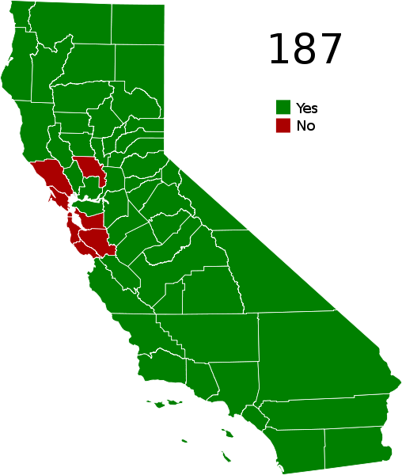


Slide 46
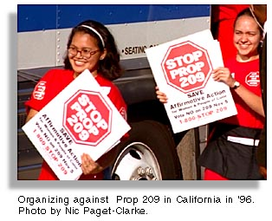
The state shall not discriminate against, or grant preferential treatment to, any individual or group on the basis of race, sex, color, ethnicity, or national origin in the operation of public employment, public education, or public contracting.

Slide 47
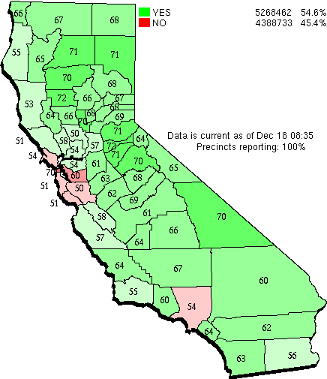

Slide 48


Slide 49


Slide 50
ADA
Employment (Title I): Businesses must provide reasonable accommodations to protect the rights of individuals with disabilities in all aspects of employment. Possible changes may include restructuring jobs, altering the layout of workstations, or modifying equipment. Employment aspects may include the application process, hiring, wages, benefits, and all other aspects of employment. Medical examinations are highly regulated.
Public Services (Title II): Public services, which include state and local government instrumentalities, the National Railroad Passenger Corporation, and other commuter authorities, cannot deny services to people with disabilities or deny participation in programs or activities that are available to people without disabilities. In addition, public transportation systems, such as public transit buses, must be accessible to individuals with disabilities.
Public Accommodations (Title III): All new construction and modifications must be accessible to individuals with disabilities. For existing facilities, barriers to services must be removed if readily achievable. Public accommodations include facilities such as restaurants, hotels, grocery stores, retail stores, etc., as well as privately owned transportation systems.
Telecommunications (Title IV): Telecommunications companies offering telephone service to the general public must have telephone relay service to individuals who use telecommunication devices for the deaf (TTYs) or similar devices.

