Slide 1
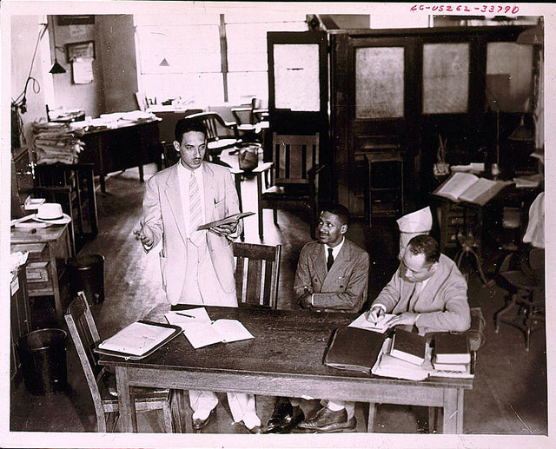

Slide 2
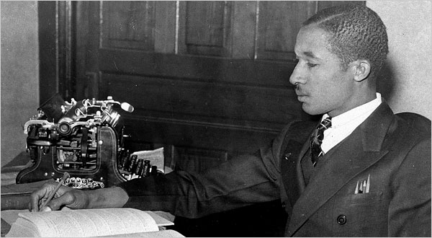
Notes:
Lloyd gaines

Slide 3
Missouri ex rel Gaines v. Canada (1938, 6-2 decision)
In answering petitioner's contention that this discrimination constituted a denial of his constitutional right, the state court has fully recognized the obligation of the State to provide negroes with advantages for higher education substantially equal to the advantages afforded to white students. The State has sought to fulfill that obligation by furnishing equal facilities in separate schools, a method the validity of which has been sustained by our decisions…
The basic consideration is not as to what sort of opportunities other States provide, or whether they are as good as those in Missouri, but as to what opportunities Missouri itself furnishes to white students and denies to negroes solely upon the ground of color. The admissibility of laws separating the races in the enjoyment of privileges afforded by the State rests wholly upon the equality of the privileges which the laws give to the separated groups within the State.

Slide 4
Pre-Brown key civil rights cases
Smith v. Allwright (1944): abolition of “all-white” primaries
Shelley v. Kramer (1948): courts can’t enforce “racial covenants” in house sales
Sweatt v. Painter (1950): separate law schools for blacks and whites unconstitutional
McLaurin v. Oklahoma (1950): separate graduate programs for blacks and whites unconstitutional

Slide 5
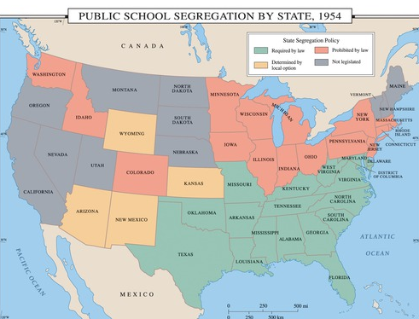

Slide 6
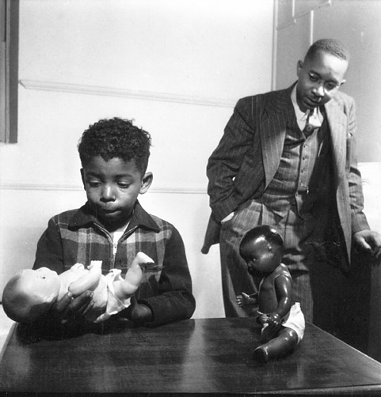

Slide 7
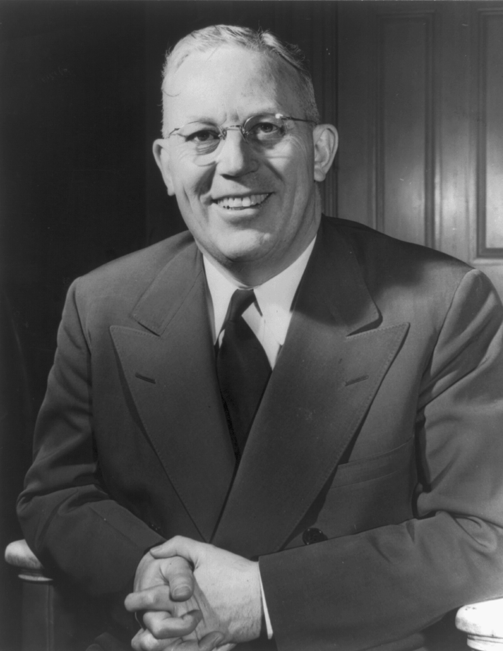

Slide 8
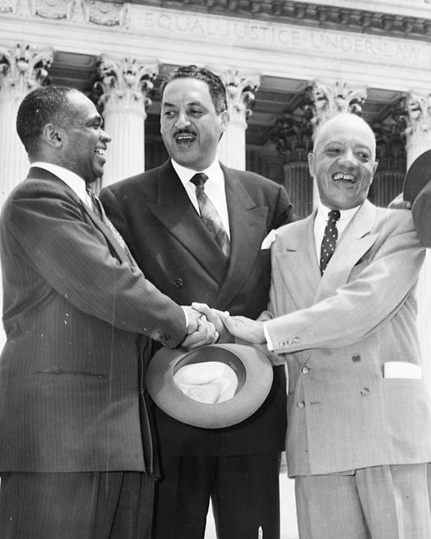

Slide 9
Brown v. Board of Education (1954, unanimous decision)
Does segregation of children in public schools solely on the basis of race, even though the physical facilities and other “tangible” factors may be equal, deprive the children of the minority group of equal educational opportunities? We believe that it does... Segregation of white and colored children in public schools has a detrimental effect upon the colored children. The impact is greater when it has the sanction of the law, for the policy of separating the races is usually interpreted as denoting the inferiority of the negro group...
We conclude that, in the field of public education, the doctrine of “separate but equal” has no place. Separate educational facilities are inherently unequal. Therefore, we hold that the plaintiffs and others similarly situated for whom the actions have been brought are, by reason of the segregation complained of, deprived of the equal protection of the laws guaranteed by the Fourteenth Amendment.

Slide 10


Slide 11


Slide 12
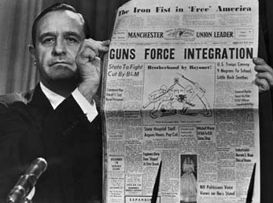

Slide 13
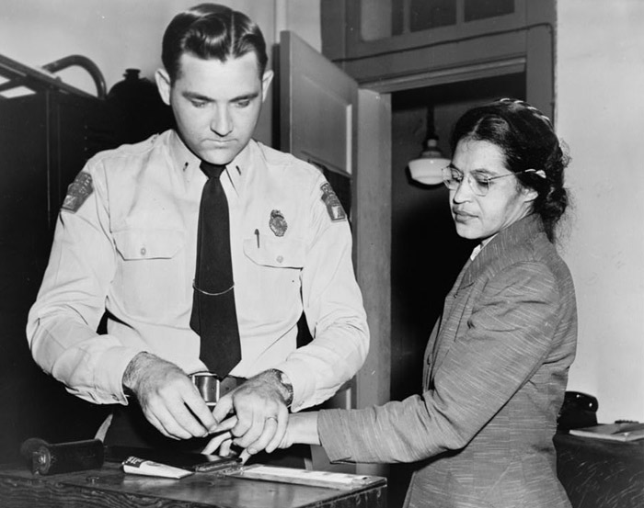

Slide 14
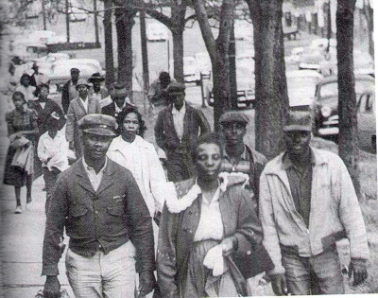

Slide 15
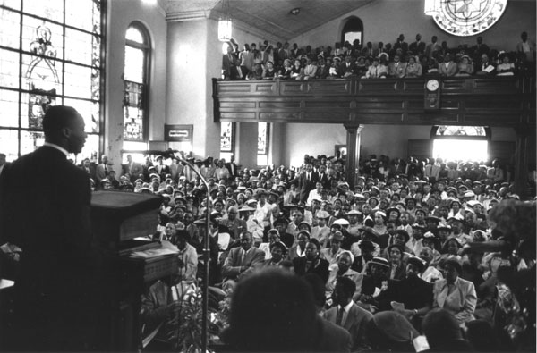

Slide 16
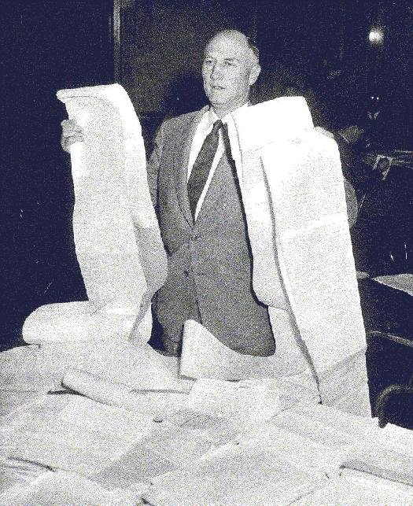

Slide 17
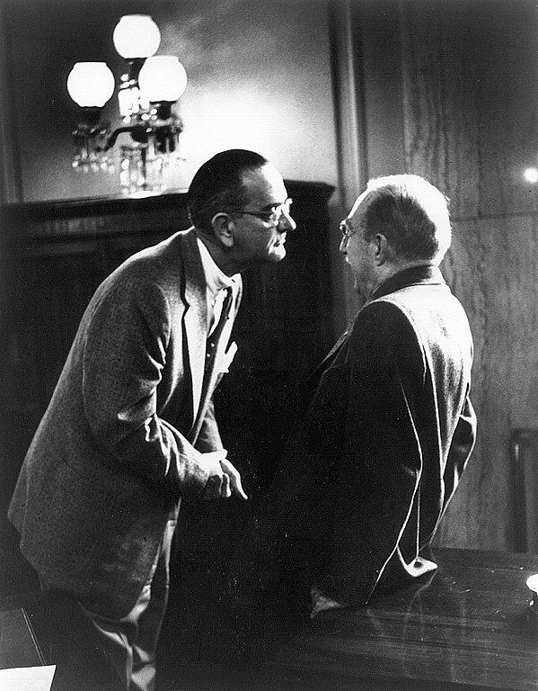

Slide 18
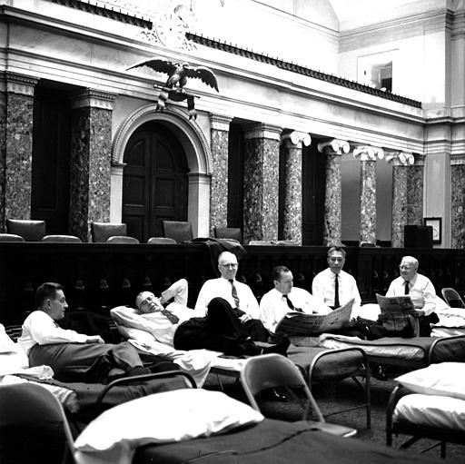

Slide 19
PART V. TO PROVIDE TRIAL BY JURY FOR PROCEEDINGS TO PUNISH CRIMINAL CONTEMPTS OF COURT GROWING OUT OF CIVIL RIGHTS CASES AND TO AMEND THE JUDICIAL CODE RELATING TO FEDERAL JURY QUALIFICATIONS.
Section 151.
All cases of criminal contempt arising under the provisions of this Act, the accused, upon conviction, shall be punished by fine or imprisonment or both: Provided however, That in case the accused is a natural person the fine to be paid shall not exceed the sum of $1,000, nor shall imprisonment exceed the term of six months: Provided Further, that in any such proceeding for criminal contempt, at the discretion of the judge, the accused may be tried with or without a jury: Provided further, however, That in the event such proceeding for a criminal contempt be tried before a judge without a jury and the sentence of the court upon conviction is a fine in excess of the sum of $30 or imprisonment in excess of forty-five days, the accused in said proceeding, upon demand therefor, shall be entitled to a trial de novo before a jury which shall conform as near as may be to the practice in other criminal cases.

Slide 20
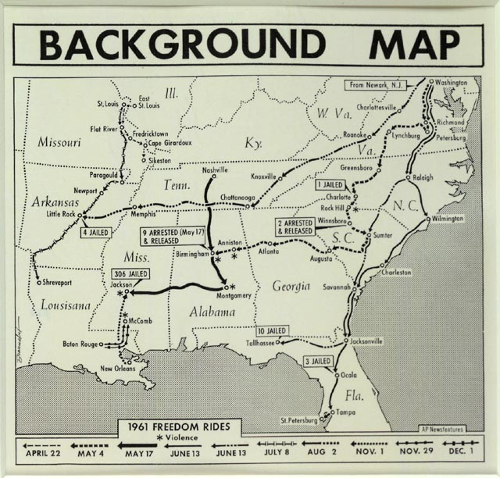

Slide 21
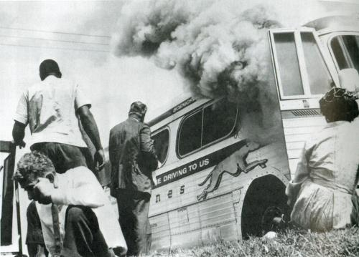

Slide 22
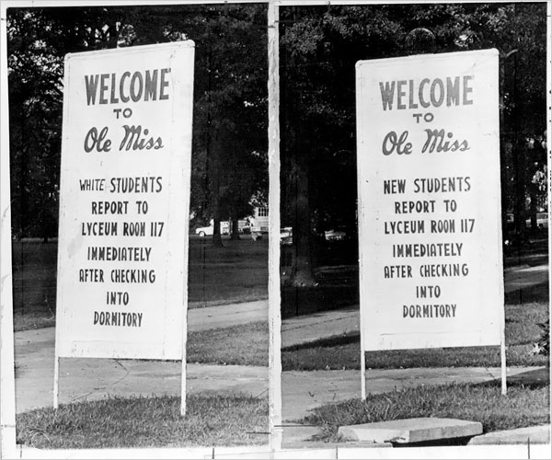

Slide 23
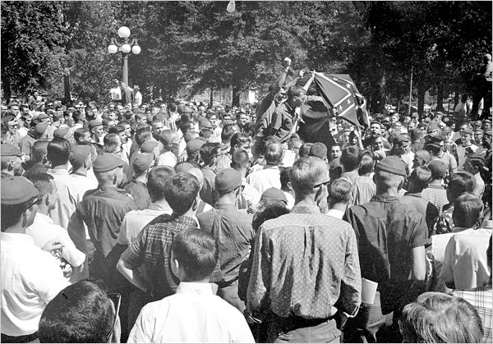

Slide 24


Slide 25
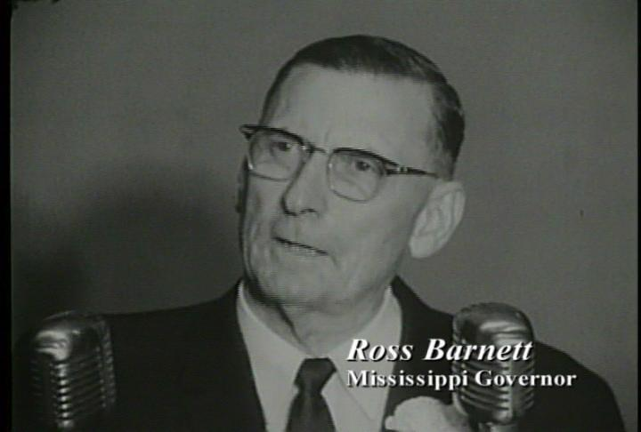

Slide 26

President Kennedy: We can’t consider moving [James] Meredith as long as, you know, there’s a riot outside, because he wouldn’t be safe.
Ross Barnett: Sir?
President Kennedy: We couldn’t consider moving Meredith if we haven’t been able to restore order outside. That’s the problem, Governor.
Barnett: Well, I’ll tell you what I’ll do, Mr. President--
President Kennedy: Yeah.
Barnett: I’ll go up there myself—
President Kennedy: Well, now, how long will it take you to get there?
Barnett: [ignoring Kennedy] And I’ll get a microphone and tell ‘em that you have agreed to re--, to, for him [Meredith] to be removed—
President Kennedy: [sharply] No. No. Now, wait a minute. How long—
Barnett: [Unclear interjection.]
President Kennedy: Wait a minute, Governor. Now, how long is it going to take you to get up there?
Barnett: About an hour.
President Kennedy: Now, I’ll tell you what, if you want to go up there and then you call me from up there. Then we’ll decide what we’re going to do, before you make any speeches about it.
Barnett: Well, all right.
President Kennedy: No sense in—
Barnett: Whatever you want—if you’d offer—
President Kennedy: You see, we’ve got an hour to go, and that’s not—we may not have an hour…
Barnett: Mr. President, please, why don’t you, can’t you give an order up there to remove Meredith?
President Kennedy: How can I remove him, Governor, when there’s a riot in the streets? He may step out of that building and something would happen to him. I can’t remove him under those conditions.

Slide 27
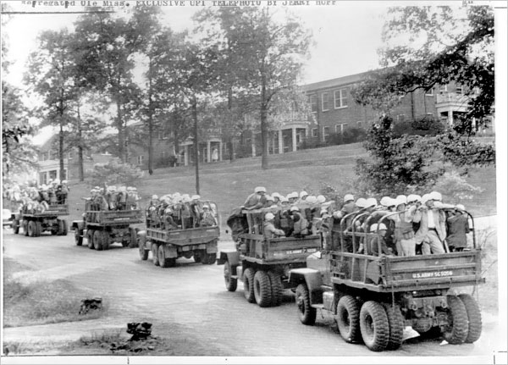

Slide 28


Slide 29


Slide 30


Slide 31
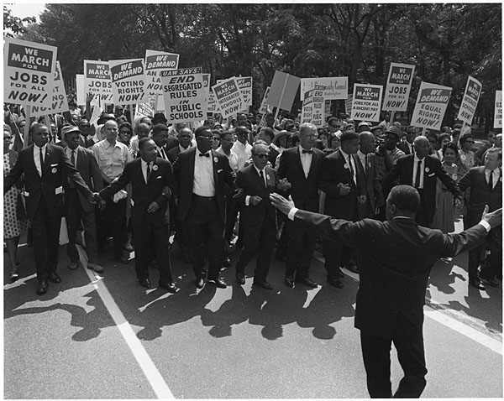

Slide 32


Slide 33
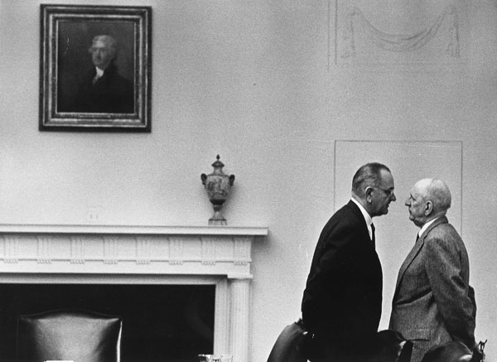

Slide 34
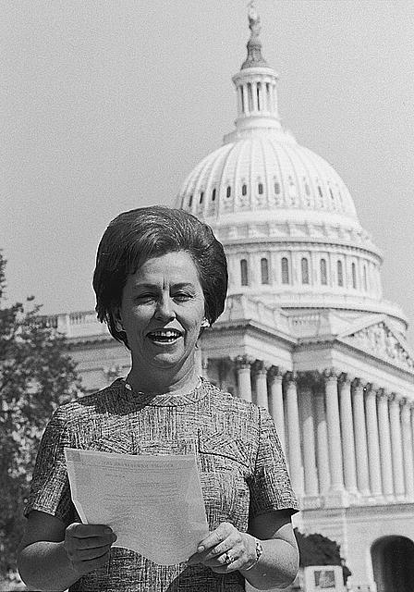

Slide 35
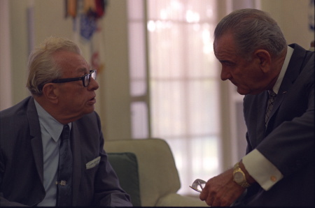

Slide 36
Major Features: Civil Rights Act (1964)
Title I
Barred unequal application of voter registration requirements, but did not abolish literacy tests sometimes used to disqualify African Americans and poor white voters.
Title II
Outlawed discrimination in hotels, motels, restaurants, theaters, and all other public accommodations engaged in interstate commerce; exempted private clubs without defining "private," thereby allowing a loophole.
Title III
Encouraged the desegregation of public schools and authorized the U. S. Attorney General to file suits to force desegregation, but did not authorize busing as a means to overcome segregation based on residence.
Title IV
Authorized but did not require withdrawal of federal funds from programs which practiced discrimination.
Title V
Outlawed discrimination in employment in any business exceeding twenty five people and creates an Equal Employment Opportunities Commission to review complaints, although it lacked meaningful enforcement powers.

Slide 37
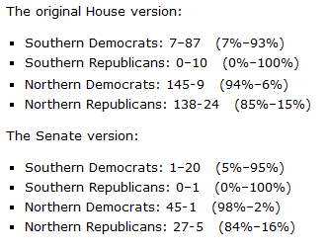

Slide 38
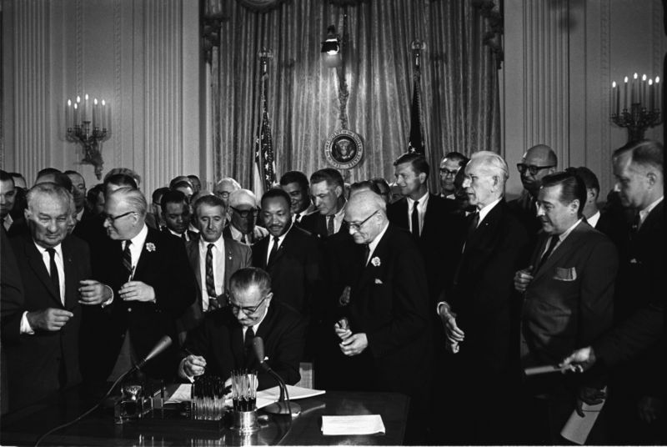

Slide 39


Slide 40
President Johnson: What’s happening is we’re doing four or five things. Number one: we’re coming in there and seating the state of Mississippi. Every damn one of them. Now, they oughtn’t to be, Carl. They oughtn’t to …
Carl Sanders: I don’t—
President Johnson: You and I just can’t survive our political modern life with these goddamned fellows down there [white Mississippi leaders] that are eating ‘em for breakfast every morning. They’ve got to quit that. And they’ve got to let ‘em [African-Americans] vote. And they’ve got to let ‘em shave. And they’ve got to let ‘em eat, and things like that. And they don’t do it.
However much we love [Democratic Senators] Jim Eastland and John Stennis, they get a governor like Ross Barnett, and he’s messing around there with [George] Wallace, and they won’t let one [black] man go in a precinct convention. We’ve got to put a stop to that, because that’s just like the old days, by God, when they wouldn’t let ‘em go in and cast a vote of any kind.
You’ve put a stop to it in your state. But we’re going to ignore that. We’re going to say, “Hell, yes, you did it. You’re wrong. You violated the ’57 [civil rights] law, and you violated the ’60 [civil rights] law, and you violated the ’64 [civil rights] law, but we’re going to seat you—every damn one of you. [dripping with sarcasm] You lily white babies, we’re going to salute you.”

Slide 41
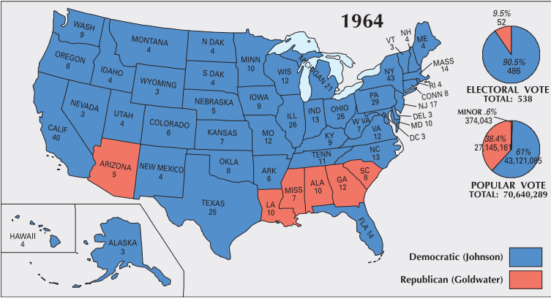

Slide 42
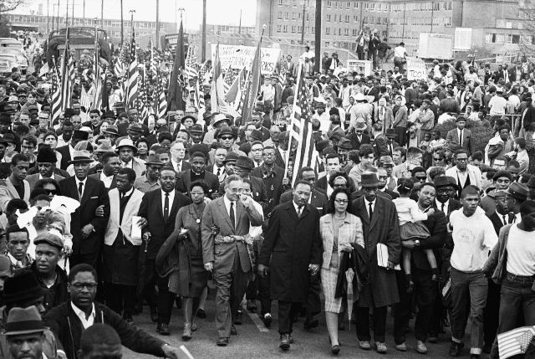

Slide 43


Slide 44
President Johnson: How are you?
Everett Dirksen: I’m all right; how are you?
President Johnson: Oh, a little bit grinding away.
Dirksen: I am bushed. This goddamn voting rights bill . . .
[Break.]
Dirksen: I hated like hell to leave some of them [senators] in the dark [about pending legislative strategy] because we had [South Carolina senator] Strom [Thurmond] this morning, and [Mississippi senator] John Stennis. We’ve modified this rather substantially to make damn sure that we’ll be on good constitutional ground.
President Johnson: Yeah?
Dirksen: But I couldn’t say it to ‘em. Now, they’re going to have to have a little time to look it over, and peck around. And I think if we work it out that way, that’s going to be all to the good, and it’s going to save us time in the end.
President Johnson: It is if we don’t get into another situation [like] Selma while we’re waiting.
Dirksen: Yeah.
President Johnson: That’s the damn danger.
Dirksen: Well—
President Johnson: Now, these boys—Strom and John are going to be as strong against it when they end, stronger than they are when they start. You got no chance there. And I sure don’t want to have to send another—go through a Selma, because we got through it locally pretty good.
Dirksen: Yeah.
President Johnson: But if they think we’re dilly-dallying, and off for Easter, why, it creates a hell of a lot of problems.
Dirksen: When you stop to consider the amount of staff work we’ve done on that damn bill, the senators are entitled to some time to have a good look-see; and that’s all the more reason, I think, why we ought to take that Easter recess as planned.

Slide 45
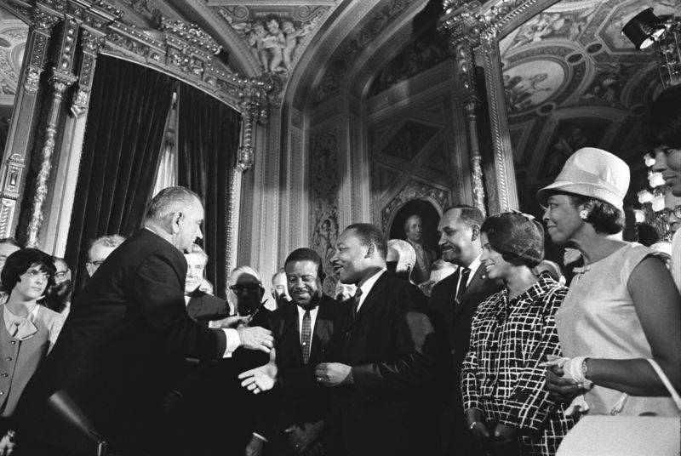

Slide 46
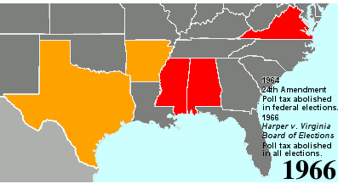

Slide 47
24th Amendment
Section 1.
The right of citizens of the United States to vote in any primary or other election for President or Vice President, for electors for President or Vice President, or for Senator or Representative in Congress, shall not be denied or abridged by the United States or any state by reason of failure to pay any poll tax or other tax.
Section 2.
The Congress shall have power to enforce this article by appropriate legislation.

