Slide 1


Slide 2
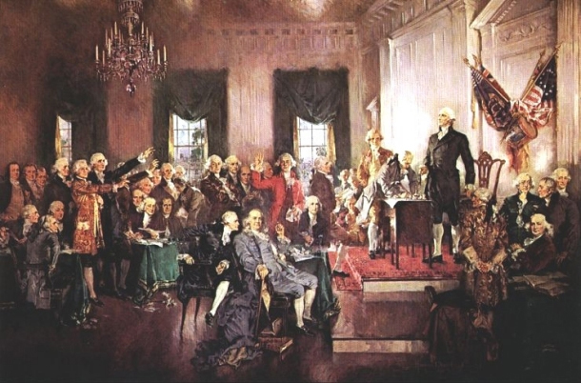

Slide 3


Slide 4
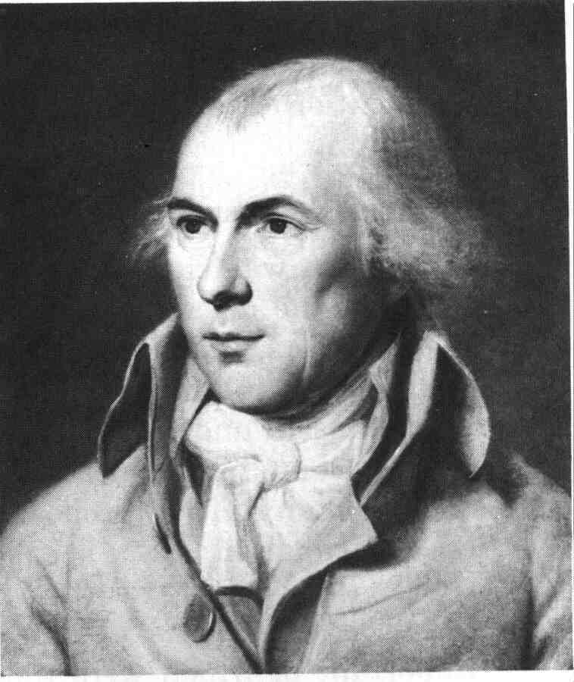

Slide 5
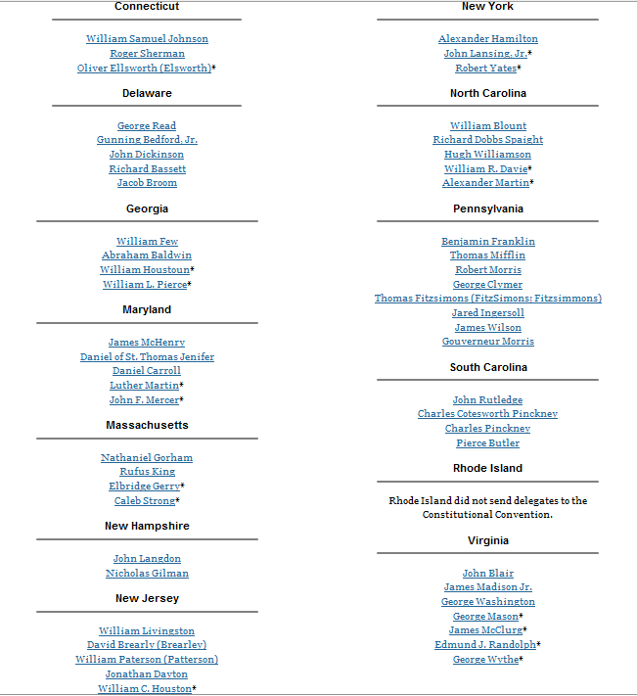

Slide 6
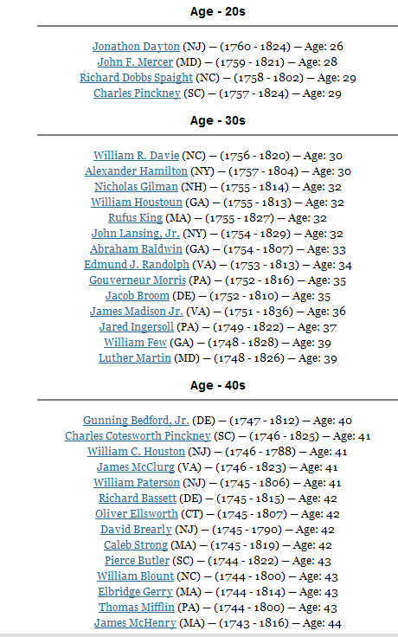
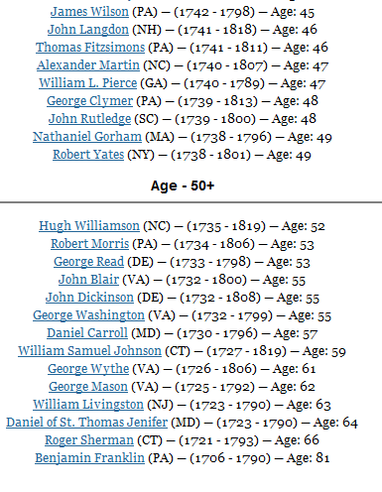

Slide 7
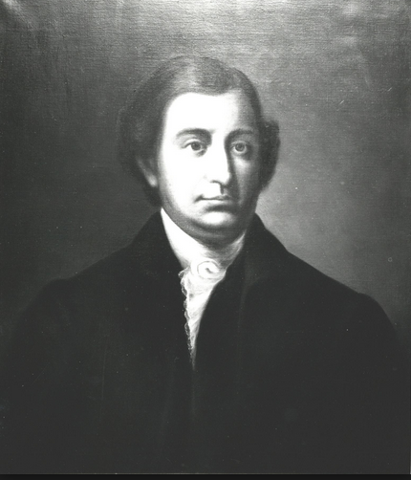
Notes:
Edmund randolph

Slide 8
Virginia Plan
2. Res^{d} therefore that the rights of suffrage in the National Legislature ought to be proportioned to the Quotas of contribution, or to the number of free inhabitants, as the one or the other rule may seem best in different cases.
3. Res^{d} that the National Legislature ought to consist of two branches.
4. Res^{d} that the members of the first branch of the National Legislature ought to be elected by the people of the several States every _______ for the term of ______ ; . . . to be incapable of reelection for the space of after the expiration of their term of service, and to be subject to recall.
5. Resol^{d} that the members of the second branch of the National Legislature ought to be elected by those of the first, out of a proper number of persons nominated by the individual Legislatures . . .
6. Resolved that each branch ought to possess the right of originating Acts . . . to negative all laws passed by the several States, contravening in the opinion of the National Legislature the articles of Union; and to call forth the force of the Union agst any member of the Union failing to fulfill its duty under the articles thereof.

Slide 9
7. Res^{d} that a National Executive be instituted; to be chosen by the National Legislature for the term of years, to receive punctually at stated times, a fixed compensation for the services rendered, in which no increase or diminution shall be made so as to affect the Magistracy, existing at the time of increase or diminution, and to be ineligible a second time; and that besides a general authority to execute the National laws, it ought to enjoy the Executive rights vested in Congress by the Confederation.
8. Res^{d} that the Executive and a convenient number of the National Judiciary, ought to compose a Council of revision with authority to examine every act of the National Legislature before it shall operate, & every act of a particular Legislature before a Negative thereon shall be final; and that the dissent of the said Council shall amount to a rejection, unless the Act of the National Legislature be again passed, or that of a particular Legislature be again negatived by of the members of each branch.

Slide 10
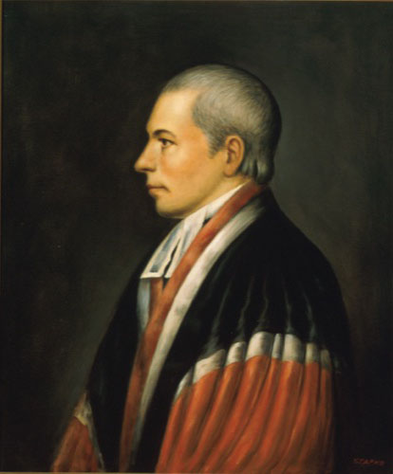
Notes:
William paterson (NJ)

Slide 11
New Jersey Plan
Resolved, that an union of the states, merely federal, ought to be the sole object of the exercise of the powers vested in this convention.
2. Resolved, that the articles of the confederation ought to be so revised, corrected, and enlarged, as to render the federal constitution adequate to the exigencies of government, and the preservation of the union.
3. Resolved, that in addition to the powers vested in the united states in congress, by the present existing articles of confederation, they be authorized to pass acts for raising a revenue by laying a duty or duties on all goods and merchandise of foreign growth or manufacture, imported into any part of the united states; by imposing stamps on paper, parchment, and vellum; and by a postage on all letters and packages passing through the general post office, to be applied to such federal purposes, as they shall deem proper and expedient;

Slide 12
6. Resolved, that the united states in congress, shall be authorised to elect a federal executive, to consist of _____ person or persons, to continue in office for the term of _____ years, to receive punctually, at stated times, a fixed compensation for the services by him or them to be rendered, in which no increase or diminution shall be made, so as to affect the executive in office, at the time of such increase or diminution, to be paid out of the federal treasury; to be incapable of holding any other office or appointment during the time of service, and for _____ years after; to be ineligible a second time, and removable on impeachment and conviction for mar-practice, corrupt conduct, and neglect of duty.
7. Resolved, that the executive, besides a general authority to execute the federal acts, ought to appoint all federal officers, not otherwise provided for, and to direct all military operations; provided that the executive shall not on any occasion take command of any troops, so as personally to conduct any military enterprise as general, or in any other capacity.

Slide 13


Slide 14
Hamilton Plan
I. The supreme legislative power of the United States of America to be vested in two distinct bodies of men: the one to be called the Assembly, the other the Senate; who together shall form the Legislature of the United States, with power to pass all laws whatsoever, subject to the negative hereafter mentioned.
II. The Assembly to consist of persons elected by the people, to serve for three years.
III. The Senate to consist of persons elected to serve during good behavior. Their election to be made by electors chosen for that purpose by the people. In order to this, the States to be divided into election districts. On the death, removal, or resignation of any Senator, his place to be filled out of the district from which he came.
VI. The Senate to have the sole power of declaring war-the power of advising and approving all treaties-the power of approving or rejecting all appointments of officers, except the heads or chiefs of the departments of finance, war, and foreign affairs.

Slide 15
Hamilton Plan: Executive Authority
IV. The supreme executive authority of the United States to be vested in a Governor, to be elected to serve during good behavior. His election to be made by electors chosen by electors chosen by the people, in the election districts aforesaid; or by electors chosen for that purpose by the respective Legislatures-provided that if an election be not made within a limited time, the President of the Senate shall be the Governor. The Governor to have a negative upon all laws about to be passed-and (to have) the execution of all laws passed-to be the Commander-in-Chief of the land and naval forces and of the militia of the United States- to have the entire direction of war when authorized or begun-to have, with the advice and approbation of the Senate, the power of making all treaties-to have the appointment of the heads or chief officers of the departments of finance, war, and foreign affairs-to have the nomination of all other officers (ambassadors to foreign nations included), subject to the approbation or rejection of the Senate to have the power of pardoning all offenses but treason, which he shall not pardon without the approbation of the Senate.

Slide 16
Hamilton Plan—judicial power
VII. The supreme judicial authority of the United States to be vested in twelve judges, to hold their offices during good behavior, with adequate and permanent salaries. This court to have original jurisdiction in all causes of capture, and an appellate jurisdiction (from the courts of the several States) in all causes in which the revenues of the General Government or the citizens of foreign nations are concerned.
VIII. The Legislature of the United States to have power to institute courts in each State for the determination of all causes of capture and of all matters relating to their revenues, or in which the citizens of foreign nations are concerned.
X. All laws of the particular States contrary to the Constitution or laws of the United States to be utterly void. And the better to prevent such laws being passed the Governor or President of each State shall be appointed by the General Government, and shall have a negative upon the laws about to be passed in the State of which he is Governor or President.

Slide 17


Slide 18
Article I, Section 8
The Congress shall have power . . . to make all laws which shall be necessary and proper for carrying into execution the foregoing powers, and all other powers vested by this Constitution in the government of the United States, or in any department or officer thereof…
The Congress shall have power to lay and collect taxes, duties, imposts and excises, to pay the debts and provide for the common defense and general welfare of the United States; but all duties, imposts and excises shall be uniform throughout the United States . . .

Slide 19
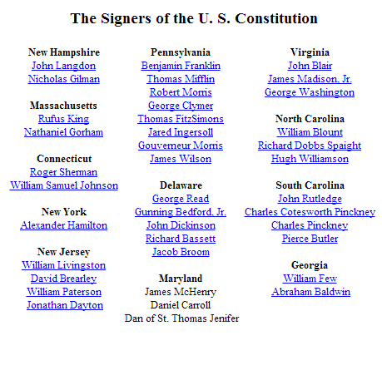

Slide 20

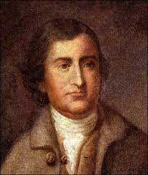
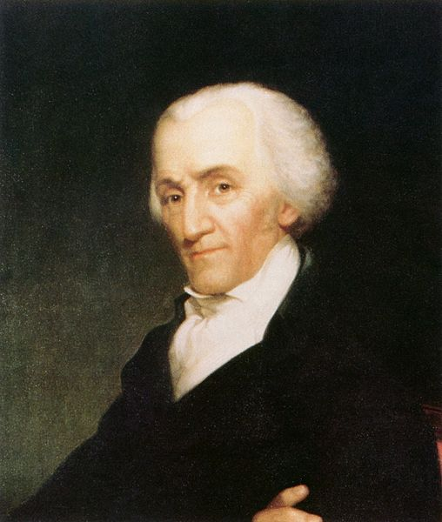
Notes:
Mason-gerry-randolph

Slide 21
Article II, Section 2.
[The President] shall have power, by and with the advice and consent of the Senate, to make treaties, provided two thirds of the Senators present concur; and he shall nominate, and by and with the advice and consent of the Senate, shall appoint ambassadors, other public ministers and consuls, judges of the Supreme Court, and all other officers of the United States, whose appointments are not herein otherwise provided for, and which shall be established by law: but the Congress may by law vest the appointment of such inferior officers, as they think proper, in the President alone, in the courts of law, or in the heads of departments.

Slide 22
Article II
Section 1. The executive power shall be vested in a President of the United States of America. He shall hold his office during the term of four years, and, together with the Vice President, chosen for the same term, be elected, as follows:
Each state shall appoint, in such manner as the Legislature thereof may direct, a number of electors, equal to the whole number of Senators and Representatives to which the State may be entitled in the Congress: but no Senator or Representative, or person holding an office of trust or profit under the United States, shall be appointed an elector.

Slide 23
Article II, Section 2. The President shall be commander in chief of the Army and Navy of the United States, and of the militia of the several states, when called into the actual service of the United States; he may require the opinion, in writing, of the principal officer in each of the executive departments, upon any subject relating to the duties of their respective offices, and he shall have power to grant reprieves and pardons for offenses against the United States, except in cases of impeachment.
He shall have power, by and with the advice and consent of the Senate, to make treaties, provided two thirds of the Senators present concur; and he shall nominate, and by and with the advice and consent of the Senate, shall appoint ambassadors, other public ministers and consuls, judges of the Supreme Court, and all other officers of the United States, whose appointments are not herein otherwise provided for, and which shall be established by law: but the Congress may by law vest the appointment of such inferior officers, as they think proper, in the President alone, in the courts of law, or in the heads of departments.

Slide 24
Article I, Section 8
Congress shall have power . . . to declare war, grant letters of marque and reprisal, and make rules concerning captures on land and water;
To raise and support armies, but no appropriation of money to that use shall be for a longer term than two years;
To provide and maintain a navy;
To make rules for the government and regulation of the land and naval forces;
To provide for calling forth the militia to execute the laws of the union, suppress insurrections and repel invasions.

Slide 25
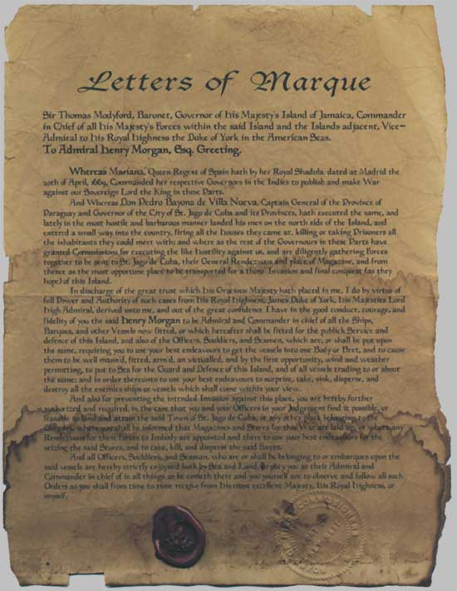

Slide 26
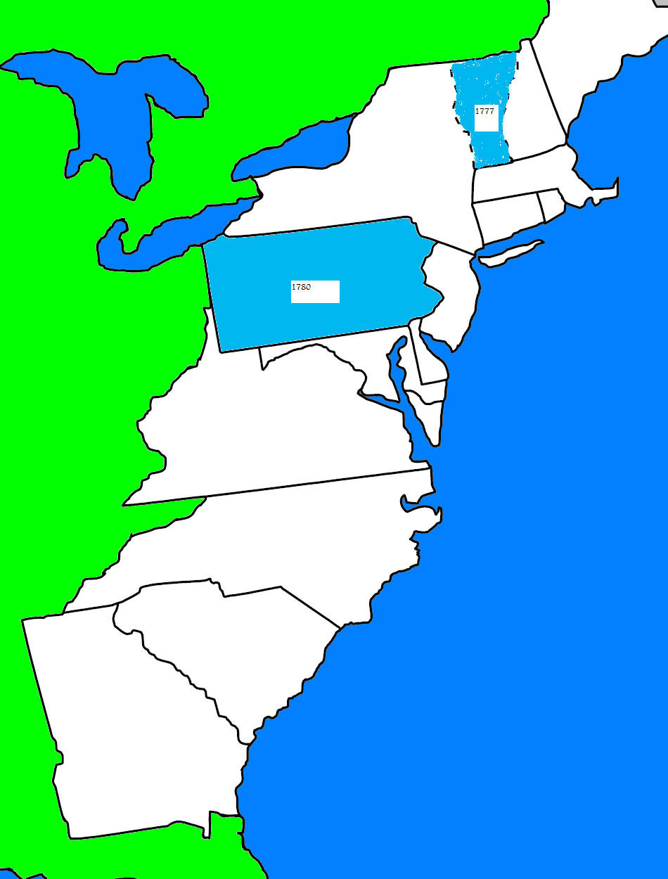

Slide 27
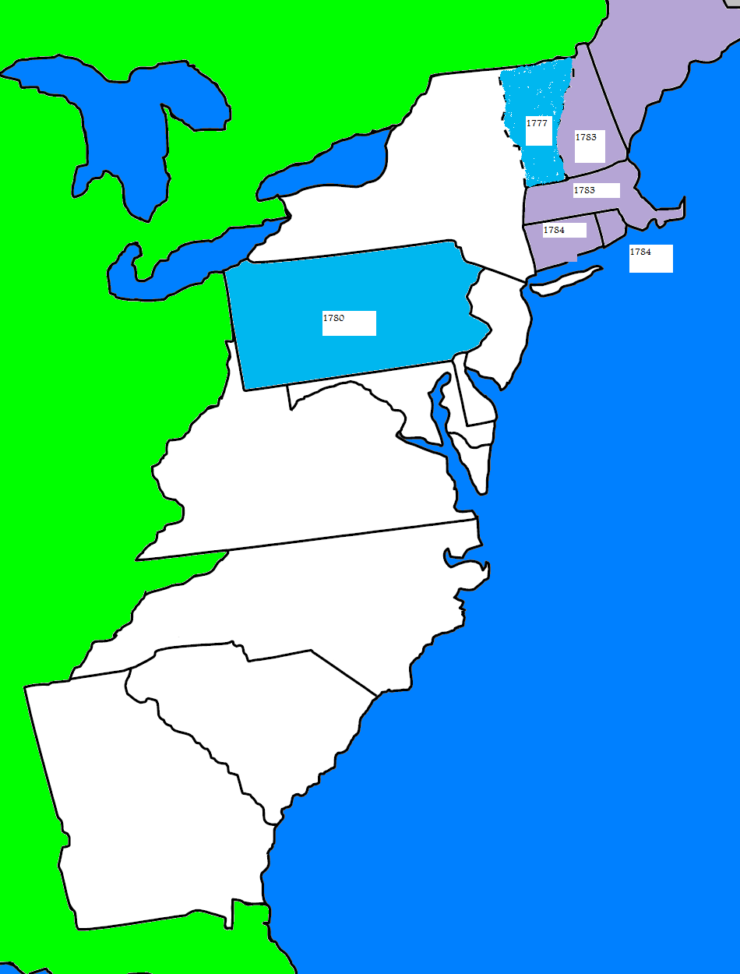

Slide 28
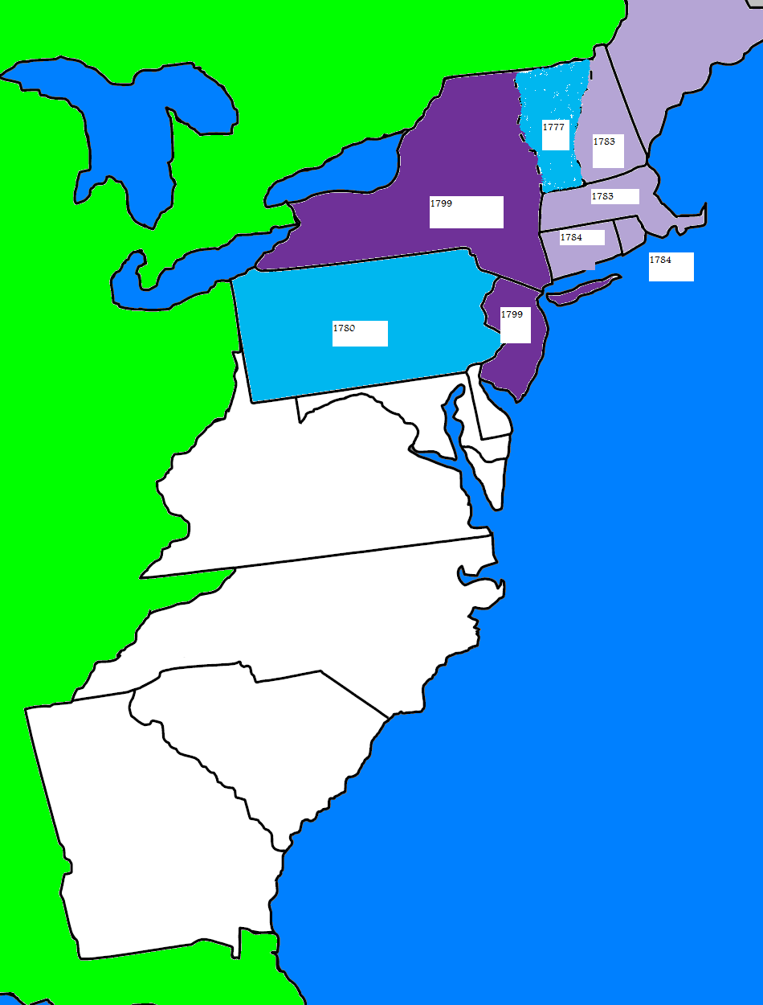

Slide 29
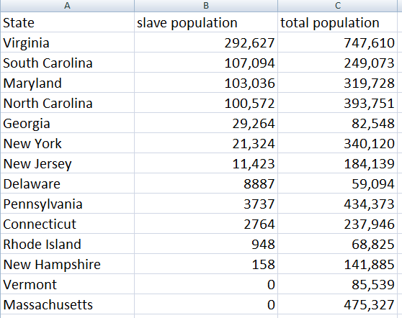

Slide 30
I: 2: Representatives and direct taxes shall be apportioned among the several states which may be included within this union, according to their respective numbers, which shall be determined by adding to the whole number of free persons, including those bound to service for a term of years, and excluding Indians not taxed, three fifths of all other Persons.
I:9: The migration or importation of such persons as any of the states now existing shall think proper to admit, shall not be prohibited by the Congress prior to the year one thousand eight hundred and eight, but a tax or duty may be imposed on such importation, not exceeding ten dollars for each person.
IV: 1: No person held to service or labor in one state, under the laws thereof, escaping into another, shall, in consequence of any law or regulation therein, be discharged from such service or labor, but shall be delivered up on claim of the party to whom such service or labor may be due.

