Slide 1
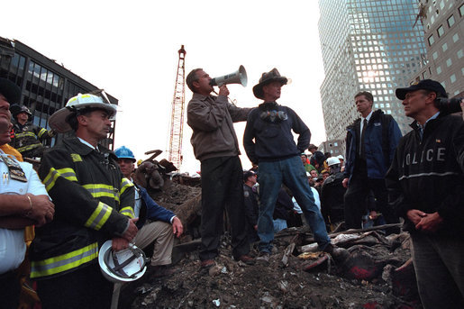

Slide 2
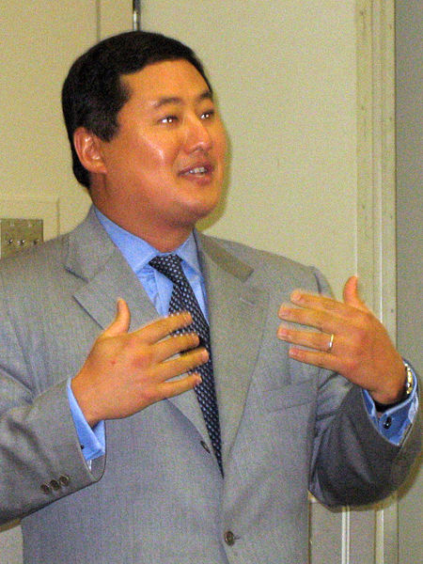

Slide 3
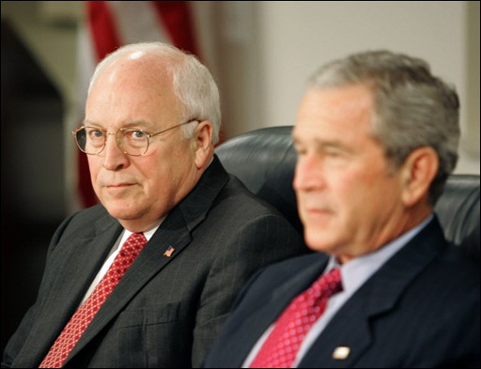

Slide 4
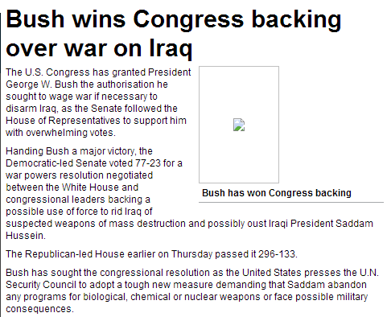

Slide 5
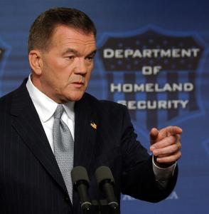

Slide 6
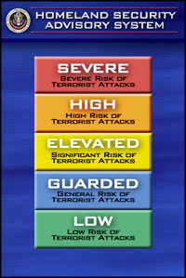

Slide 7
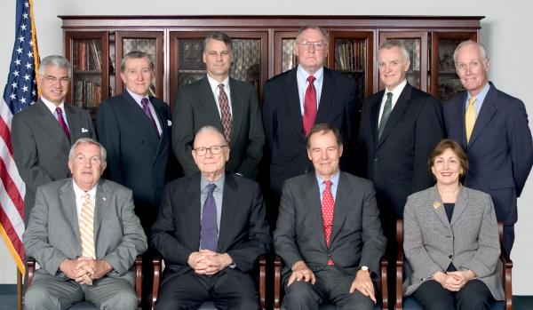

Slide 8


Slide 9
9-11 Commission Recommendations
The U.S. border security system should be integrated into a larger network of screening points that includes our transportation system and access to vital facilities, such as nuclear reactors. The President should direct the Department of Homeland Security to lead the effort to design a comprehensive screening system, addressing common problems and setting common standards with systemwide goals in mind. Extending those standards among other governments could dramatically strengthen America and the world's collective ability to intercept individuals who pose catastrophic threats.
Lead responsibility for directing and executing paramilitary operations, whether clandestine or covert, should shift to the Defense Department. There it should be consolidated with the capabilities for training, direction, and execution of such operations already being developed in the Special Operations Command.
The president should lead the government-wide effort to bring the major national security institutions into the information revolution. He should coordinate the resolution of the legal, policy, and technical issues across agencies to create a "trusted information network.“
Congressional oversight for intelligence -- and counterterrorism -- is now dysfunctional. Congress should address this problem. We have considered various alternatives: A joint committee on the old model of the Joint Committee on Atomic Energy is one. A single committee in each house of Congress, combining authorizing and appropriating authorities, is another.

Slide 10
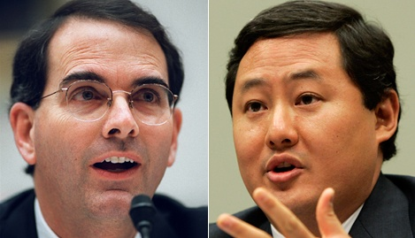

Slide 11
We have explained the scope of the President’s Commander-in Chief power. In those opinions, we explained that the text, structure and history of the Constitution establish that the Founders entrusted the President with the primary responsibility, and therefore the power, to protect the security of the United States…
The structure of the Constitution demonstrates that any power traditionally understood as pertaining to the executive -which includes the conduct of warfare and the defense of the nation-unless expressly assigned to Congress, is vested in the President…
Ordinary federal criminal statutes do not apply to the properly-authorized interrogation of enemy combatants by the United States Armed Forces during an armed conflict…
Even if these [anti-torture] statutes were misconstrued to apply to persons acting at the direction of the President during the conduct of war, the Department of Justice could not enforce this law or any of the other criminal statutes applicable to the special maritime and territorial jurisdiction against federal officials acting pursuant to the President’s constitutional authority to direct a war.

Slide 12
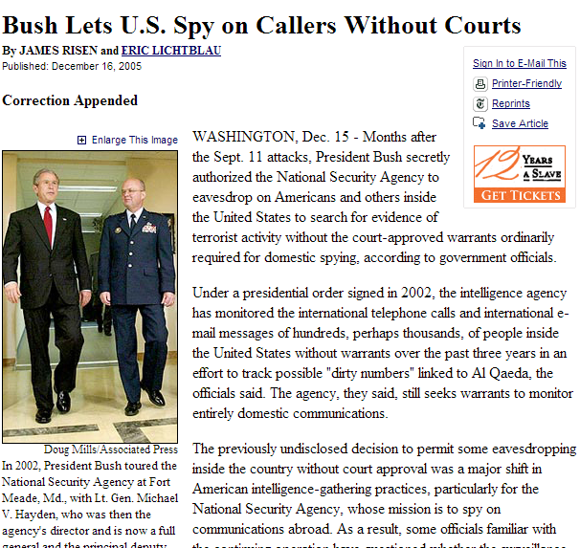

Slide 13
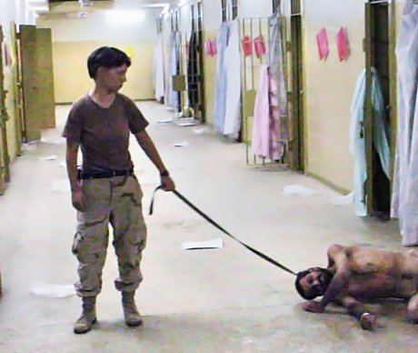

Slide 14
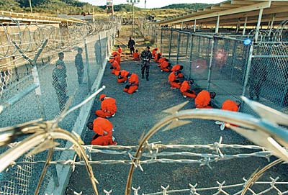

Slide 15
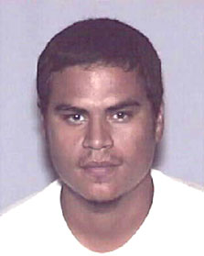

Slide 16
Hamdi v. Rumsfeld (2004)
Striking the proper constitutional balance here is of great importance to the Nation during this period of ongoing combat. But it is equally vital that our calculus not give short shrift to the values that this country holds dear or to the privilege that is American citizenship. It is during our most challenging and uncertain moments that our Nation’s commitment to due process is most severely tested; and it is in those times that we must preserve our commitment at home to the principles for which we fight abroad…
We therefore hold that a citizen-detainee seeking to challenge his classification as an enemy combatant must receive notice of the factual basis for his classification, and a fair opportunity to rebut the Government’s factual assertions before a neutral decisionmaker…
In so holding, we necessarily reject the Government’s assertion that separation of powers principles mandate a heavily circumscribed role for the courts in such circumstances. Indeed, the position that the courts must forgo any examination of the individual case and focus exclusively on the legality of the broader detention scheme cannot be mandated by any reasonable view of separation of powers, as this approach serves only to condense power into a single branch of government. We have long since made clear that a state of war is not a blank check for the President when it comes to the rights of the Nation’s citizens.

Slide 17

Justice Kennedy: I'm interested in your arguments on the... on the legitimacy and the regularity of these commissions.
Solicitor General Paul Clement: And if I could talk to various aspects of that, I'm happy--
Justice Breyer: Can I put the--
Mr. Clement: --to do so.
Justice Breyer: --that issue in... And ignore my question, which is the same as Justice Kennedy's, if it doesn't help.
I'm trying to focus this. And, in my mind, I take their argument as saying,
“Look, you want to try a war crime. You want to say this is a war crimes tribunal.
“One, this is not a war, at least not an ordinary war. Two, it's not a war crime, because that doesn't fall under international law. And, three, it's not a war crime tribunal or commission, because no emergency, not on the battlefield, civil courts are open, there is no military commander asking for it, it's not in any of those in other respects, like past history.
“And if the President can do this, well, then he can set up commissions to go to Toledo, and, in Toledo, pick up an alien, and not have any trial at all, except before that special commission.”

Slide 18
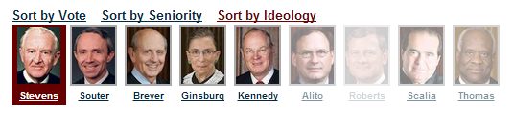
Hamdan v. Rumsfeld (2006)
At a minimum, the Government must make a substantial showing that the crime for which it seeks to try a defendant by military commission is acknowledged to be an offense against the law of war. That burden is far from satisfied here. The crime of “conspiracy” has rarely if ever been tried as such in this country by any law-of-war military commission not exercising some other form of jurisdiction, and does not appear in either the Geneva Conventions or the Hague Conventions—the major treaties on the law of war . . .
The charge’s shortcomings are not merely formal, but are indicative of a broader inability on the Executive’s part here to satisfy the most basic precondition—at least in the absence of specific congressional authorization—for establishment of military commissions: military necessity. . . .
In undertaking to try Hamdan and subject him to criminal punishment, the Executive is bound to comply with the Rule of Law that prevails in this jurisdiction.

Slide 19
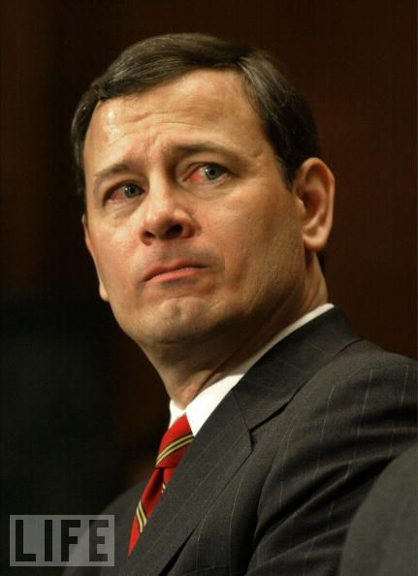

Slide 20
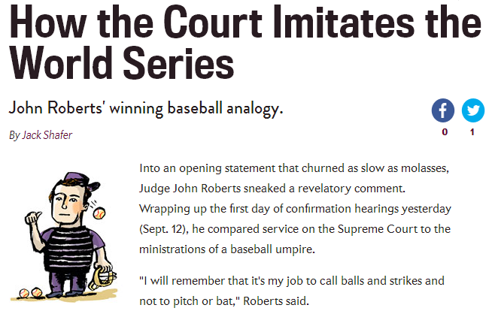

Slide 21
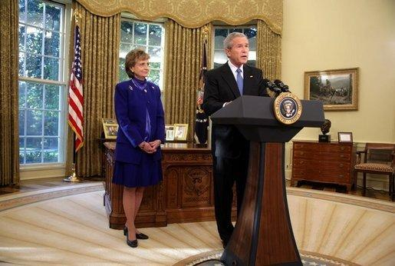

Slide 22
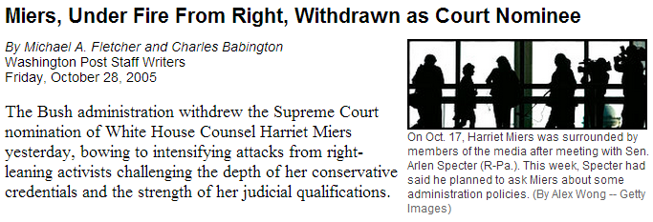

Slide 23
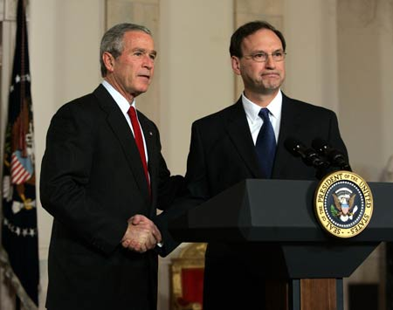

Slide 24
Lawrence v. Texas (2003)
We think that our laws and traditions in the past half century are of most relevance here. These references show an emerging awareness that liberty gives substantial protection to adult persons in deciding how to conduct their private lives in matters pertaining to sex…
Bowers was not correct when it was decided, and it is not correct today. It ought not to remain binding precedent. Bowers v. Hardwick should be and now is overruled.
Had those who drew and ratified the Due Process Clauses of the Fifth Amendment or the Fourteenth Amendment known the components of liberty in its manifold possibilities, they might have been more specific. They did not presume to have this insight. They knew times can blind us to certain truths and later generations can see that laws once thought necessary and proper in fact serve only to oppress. As the Constitution endures, persons in every generation can invoke its principles in their own search for greater freedom.

Slide 25
Goodridge v. Dept. of Public Health (MA, 2003)
Marriage is a vital social institution. … The question before us is whether, consistent with the Massachusetts Constitution, the Commonwealth may deny the protections, benefits, and obligations conferred by civil marriage to two individuals of the same sex who wish to marry. We conclude that it may not. The Massachusetts Constitution affirms the dignity and equality of all individuals. It forbids the creation of second class citizens…
The “marriage is procreation” argument singles out the one unbridgeable difference between same-sex and opposite-sex couples, and transforms that difference into the essence of legal marriage. Like "Amendment 2" to the Constitution of Colorado, which effectively denied homosexual persons equality under the law and full access to the political process, the marriage restriction impermissibly “identifies persons by a single trait and then denies them protection across the board.” Romer v. Evans, (1996). In so doing, the State's action confers an official stamp of approval on the destructive stereotype that same-sex relationships are inherently unstable and inferior to opposite-sex relationships and are not worthy of respect.

Slide 26
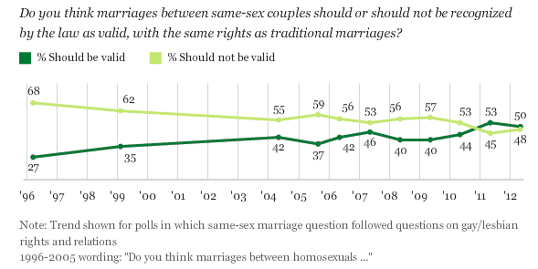

Slide 27
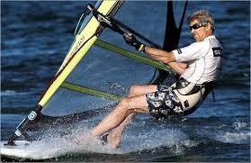
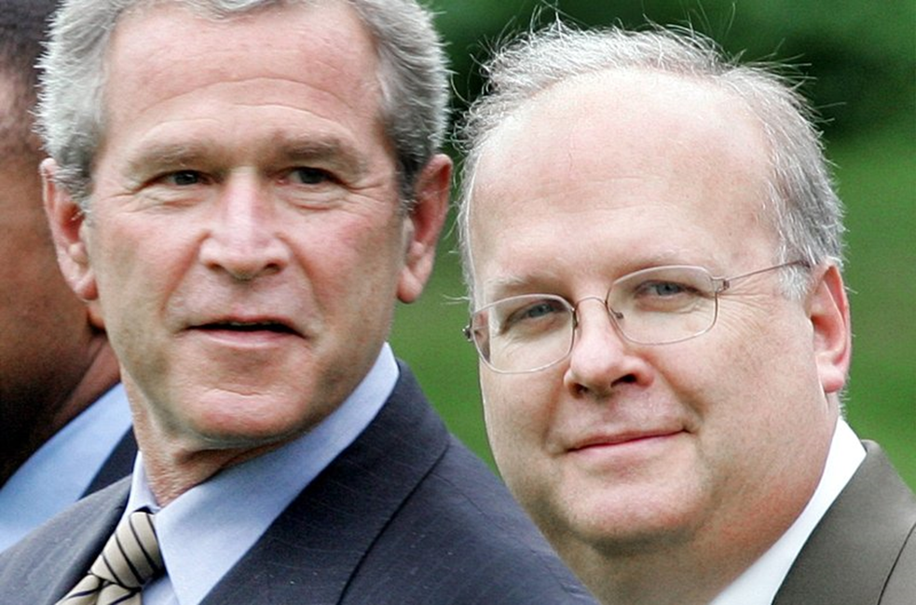

Slide 28
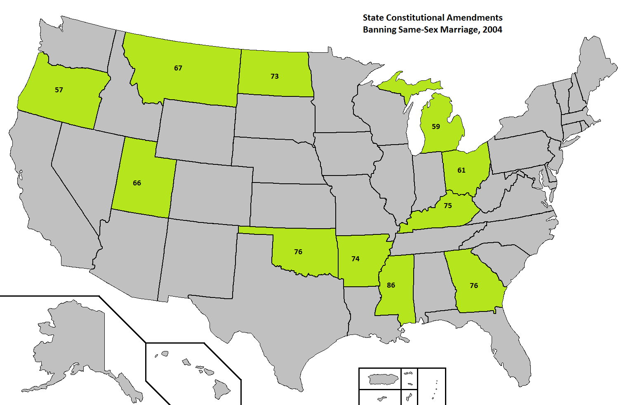

Slide 29
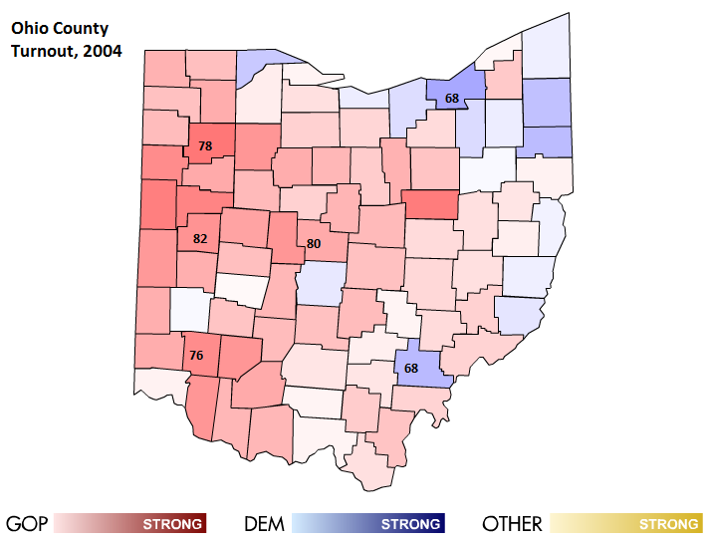
Notes:
Shelby, Warren, VanWert, and Delaware Counties; Bush gets 71% in Shelby

Slide 30
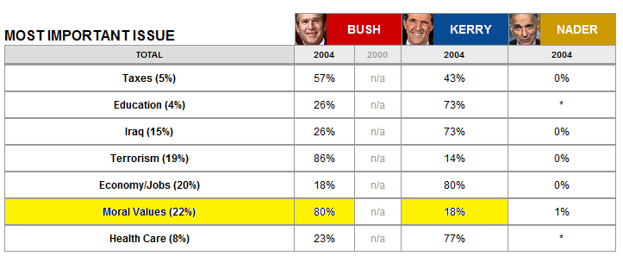

Slide 31
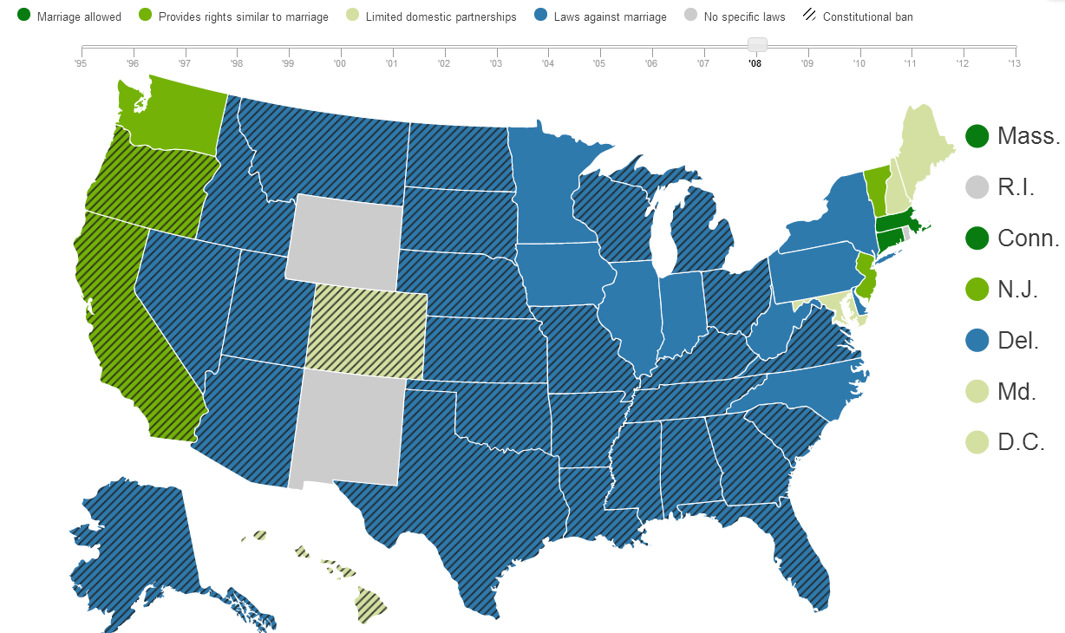

Slide 32


Slide 33
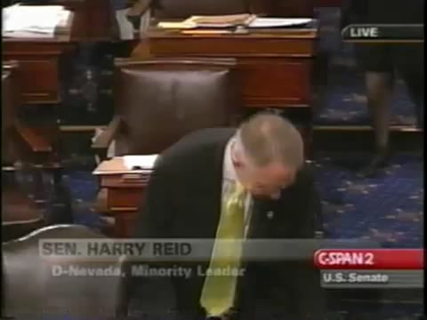

Slide 34
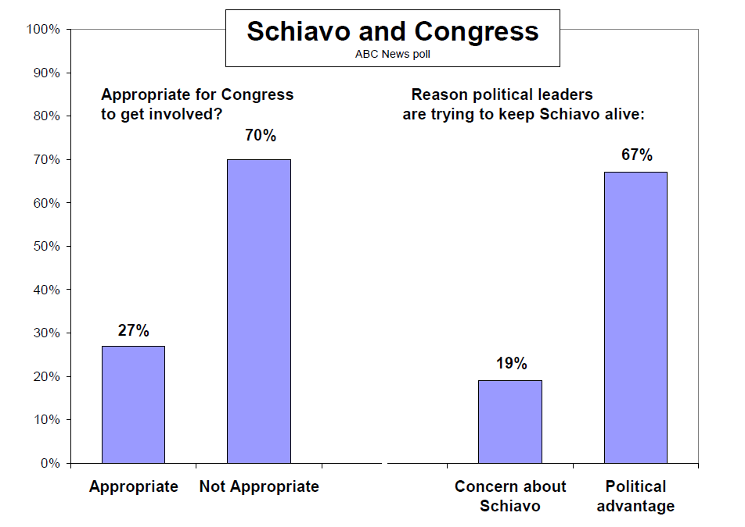

Slide 35
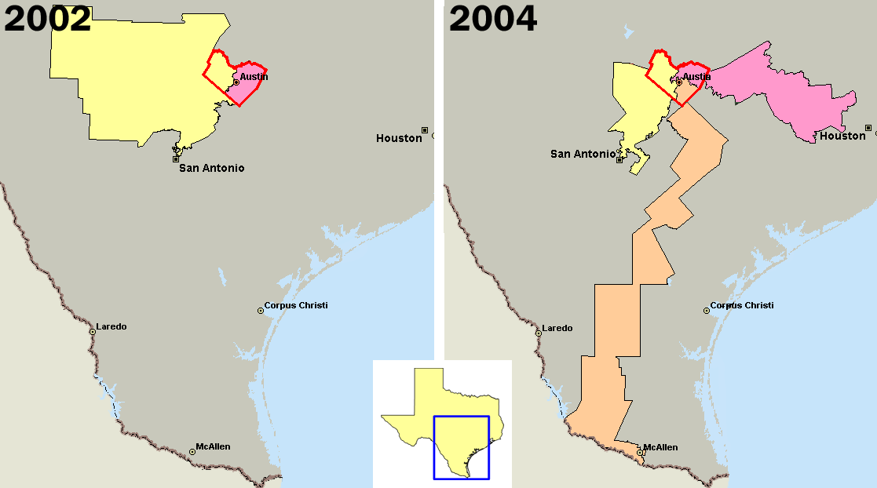

Slide 36
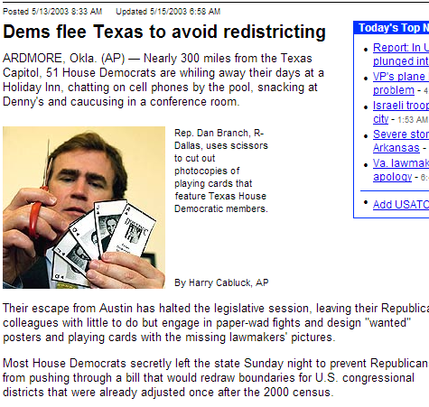

Slide 37
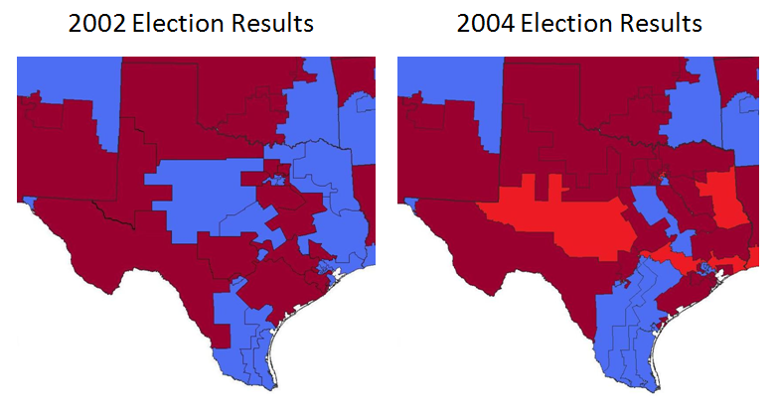

Slide 38
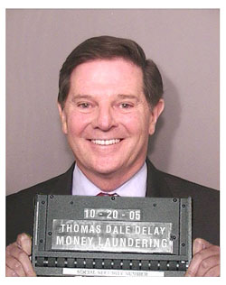

Slide 39
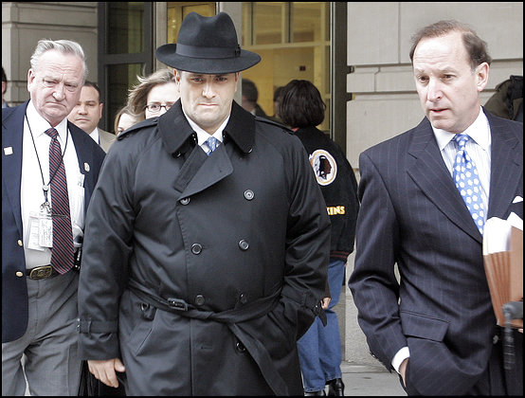

Slide 40


Slide 41


Slide 42
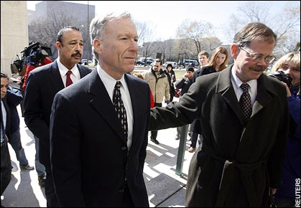

Slide 43
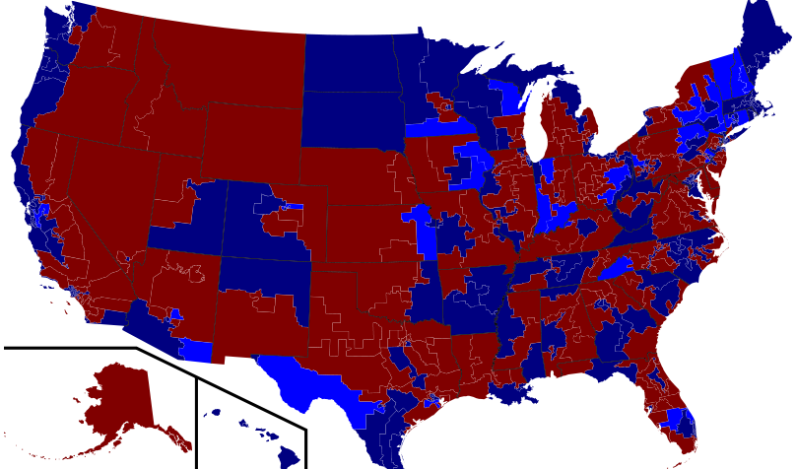
2006 House midterm elections

Slide 44
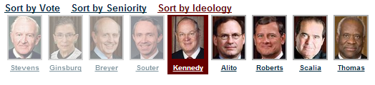
Gonzales v. Carhart (2007)
Whatever one’s views concerning the Casey joint opinion, it is evident a premise central to its conclusion—that the government has a legitimate and substantial interest in preserving and promoting fetal life—would be repudiated were the Court now to affirm the judgments of the Courts of Appeals [and overturn the NE law]…
The Act furthers the legitimate interest of the Government in protecting the life of the fetus that may become a child…
Respondents have not demonstrated that the Act, as a facial matter, is void for vagueness, or that it imposes an undue burden on a woman’s right to abortion based on its overbreadth or lack of a health exception.

Slide 45
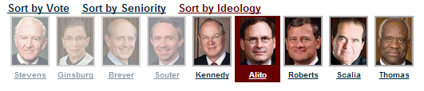
Ledbetter v. Goodyear Tire & Rubber (2007)—Ginsburg dissent
The Court’s insistence on immediate contest overlooks common characteristics of pay discrimination. Pay disparities often occur, as they did in Ledbetter’s case, in small increments; cause to suspect that discrimination is at work develops only over time. Comparative pay information, moreover, is often hidden from the employee’s view. Employers may keep under wraps the pay differentials maintained among supervisors, no less the reasons for those differentials…
This is not the first time the Court has ordered a cramped interpretation of Title VII, incompatible with the statute’s broad remedial purpose. Once again, the ball is in Congress’ court. As in 1991, the Legislature may act to correct this Court’s parsimonious reading of Title VII.

Slide 46
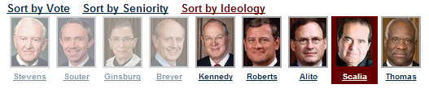
District of Columbia v. Heller (2008)
From our review of founding-era sources, we conclude that this natural meaning was also the meaning that “bear arms” had in the 18th century. In numerous instances, “bear arms” was unambiguously used to refer to the carrying of weapons outside of an organized militia…
Constitutional rights are enshrined with the scope they were understood to have when the people adopted them, whether or not future legislatures or (yes) even future judges think that scope too broad.

Slide 47
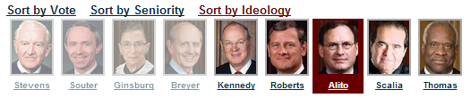
Davis v. FEC (2008)
Davis contends that §319(a) unconstitutionally burdens his exercise of his First Amendment right to make unlimited expenditures of his personal funds because making expenditures that create the imbalance has the effect of enabling his opponent to raise more money and to use that money to finance speech that counteracts and thus diminishes the effectiveness of Davis’ own speech…
We have never upheld the constitutionality of a law that imposes different contribution limits for candidates who are competing against each other…
The unprecedented step of imposing different contribution and coordinated party expenditure limits on candidates vying for the same seat is antithetical to the First Amendment .

Slide 48
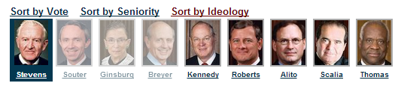
Crawford v. Marion County Election Board (2008)--Souter dissent
Without a shred of evidence that in-person voter impersonation is a problem in the State, much less a crisis, Indiana has adopted one of the most restrictive photo identification requirements in the country. …The State hardly even tries to explain its decision to force indigents or religious objectors to travel all the way to their county seats every time they wish to vote, and if there is any waning of confidence in the administration of elections it probably owes more to the State’s violation of federal election law than to any imposters at the polling places. It is impossible to say, on this record, that the State’s interest in adopting its signally inhibiting photo identification requirement has been shown to outweigh the serious burdens it imposes on the right to vote.
If more were needed to condemn this law, our own precedent would provide it, for the calculation revealed in the Indiana statute crosses a line when it targets the poor and the weak.

Slide 49
