Slide 1
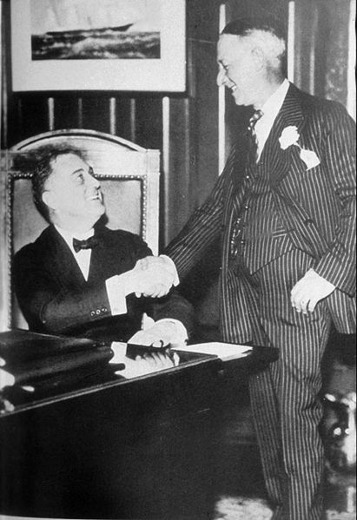

Slide 2
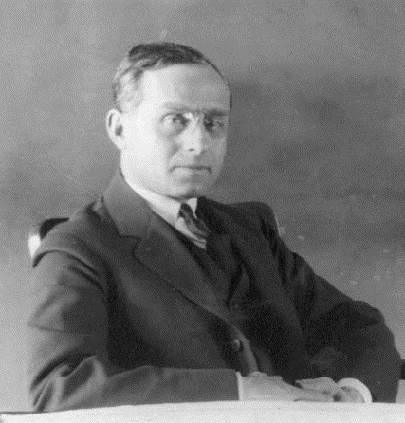

Slide 3


Slide 4
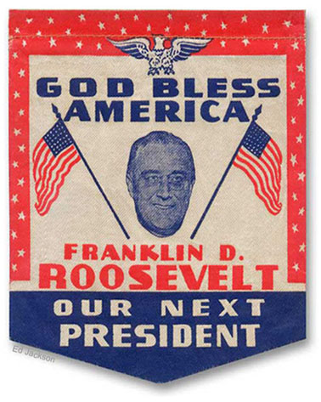

Slide 5
AMENDMENT XXI
SECTION 1.
The eighteenth article of amendment to the Constitution of the United States is hereby repealed.
SECTION 2.
The transportation or importation into any state, territory, or possession of the United States for delivery or use therein of intoxicating liquors, in violation of the laws thereof, is hereby prohibited.

Slide 6
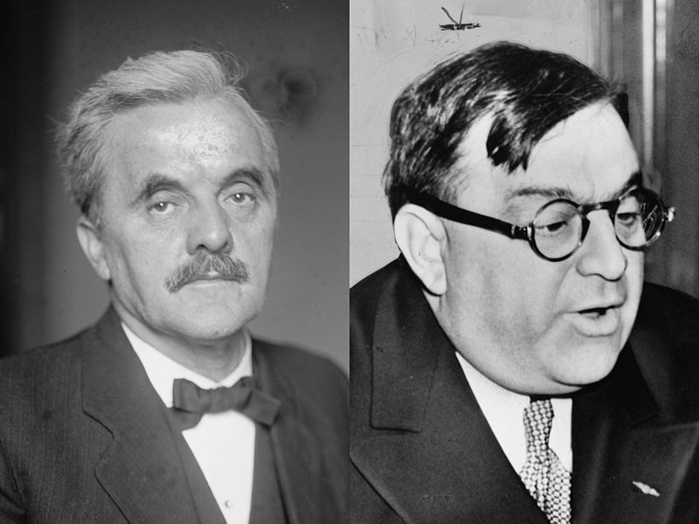

Slide 7
Norris-LaGuardia Act (1932)
--prohibits federal courts from enforcing “yellow dog" contracts
--bars federal courts from issuing injunctions against:
(*) joining or organizing a union, or assembling for union purposes;
(*) striking or refusing to work, or advising others to strike or organize;
(*) publicizing acts of a labor dispute; and
(*) providing lawful legal aid to persons participating in a labor dispute.

Slide 8
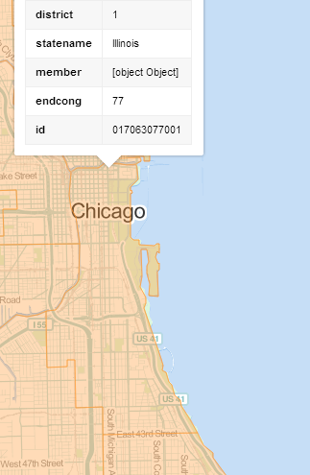
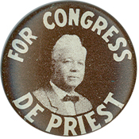
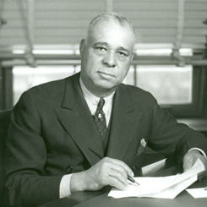
Notes:
Arthur mitchell

Slide 9
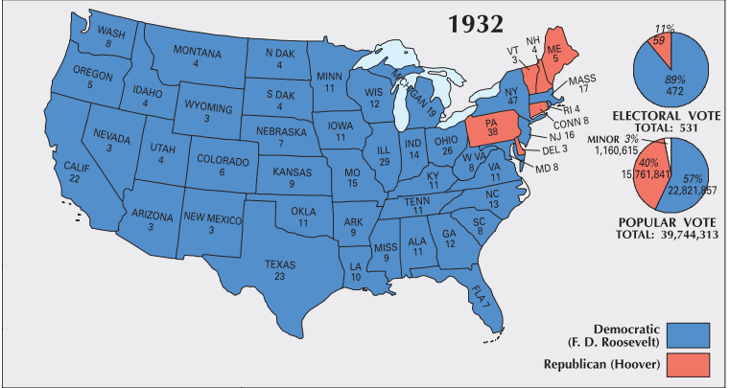

Slide 10
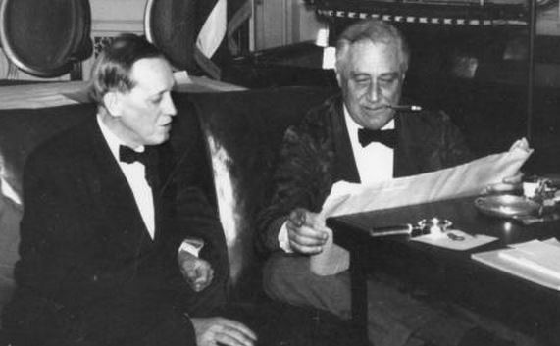
Notes:
Fdr harry hopkins

Slide 11



Slide 12
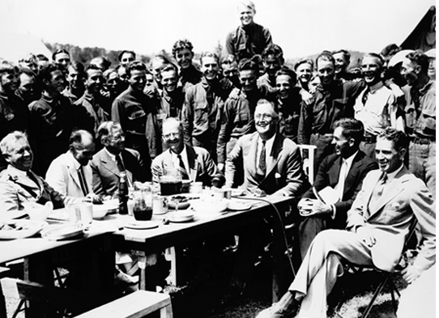
Notes:
Fdr with ccc camp in VA

Slide 13


Slide 14
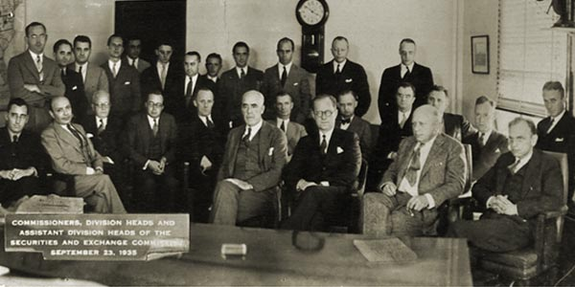

Slide 15
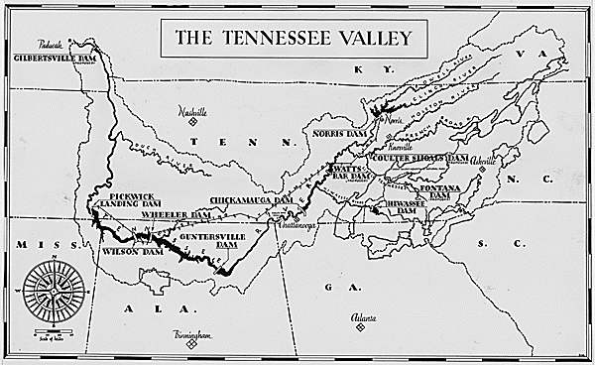

Slide 16


Slide 17


Slide 18
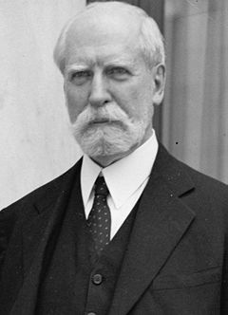
Notes:
hughes

Slide 19
Schecter Poultry Co. v. United States (1935)
It is not the province of the Court to consider the economic advantages or disadvantages of such a centralized system. It is sufficient to say that the Federal Constitution does not provide for it. Our growth and development have called for wide use of the commerce power of the federal government in its control over the expanded activities of interstate commerce and in protecting that commerce from burdens, interferences, and conspiracies to restrain and monopolize it. But the authority of the federal government may not be pushed to such an extreme as to destroy the distinction, which the commerce clause itself establishes, between commerce 'among the several States' and the internal concerns of a state.

Slide 20

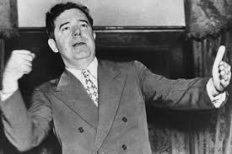

Slide 21
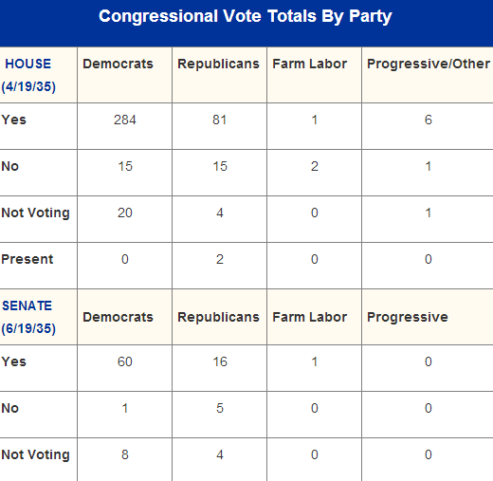
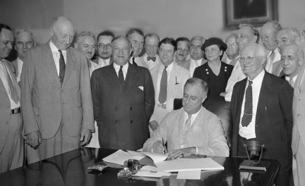

Slide 22
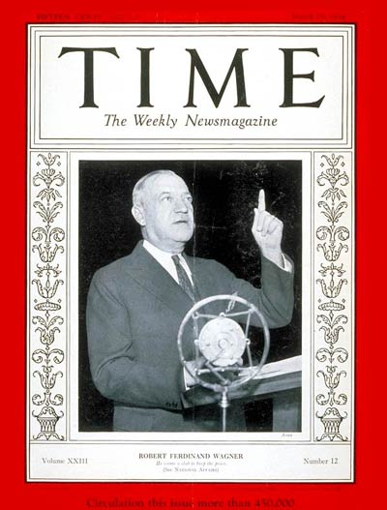

Slide 23


Slide 24
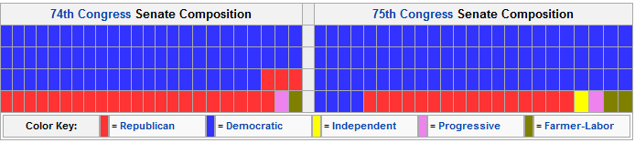
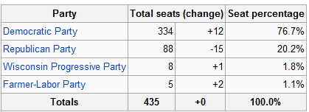
1936 Congressional Election Results

Slide 25
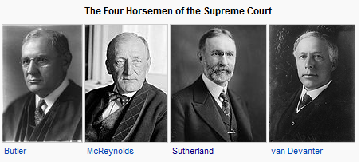

Slide 26
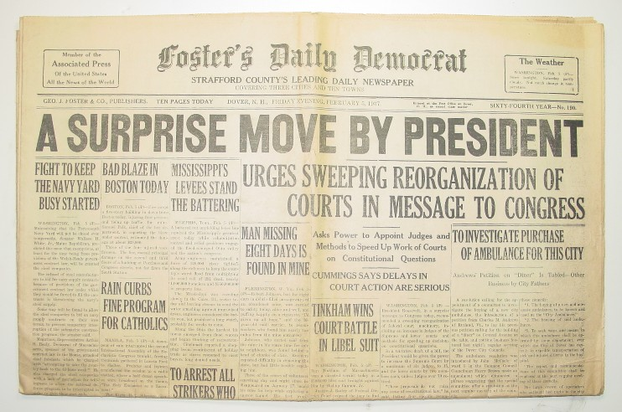

Slide 27
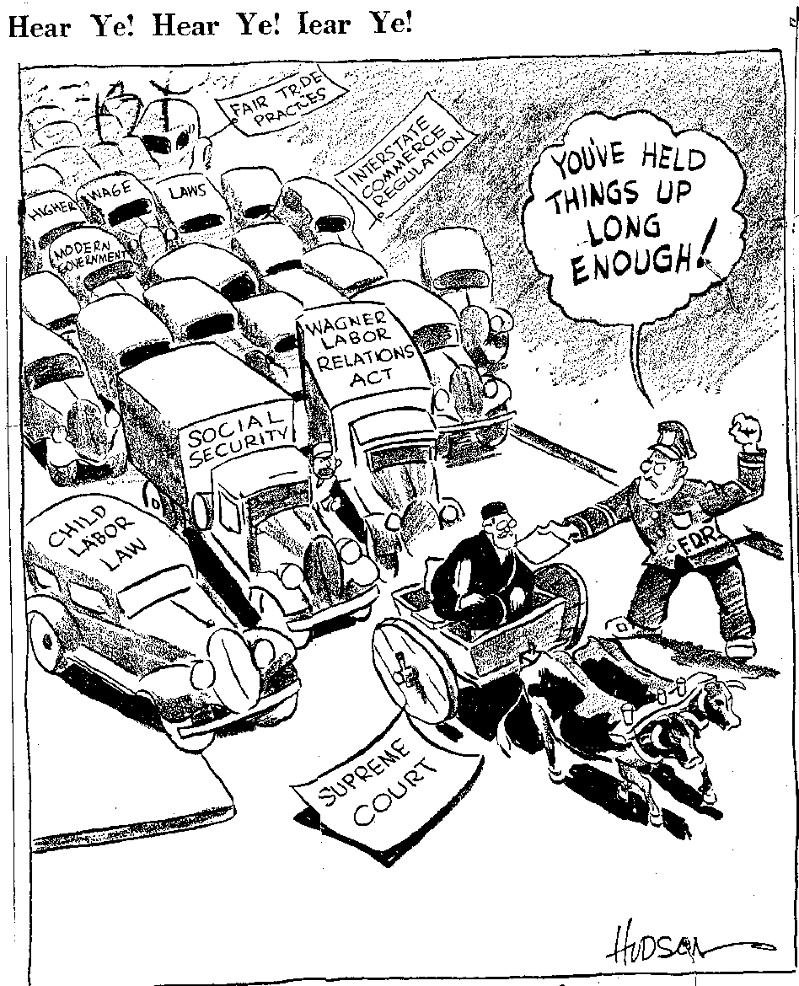

Slide 28
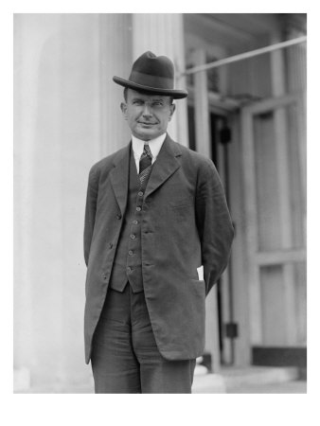
Notes:
wheeler

Slide 29
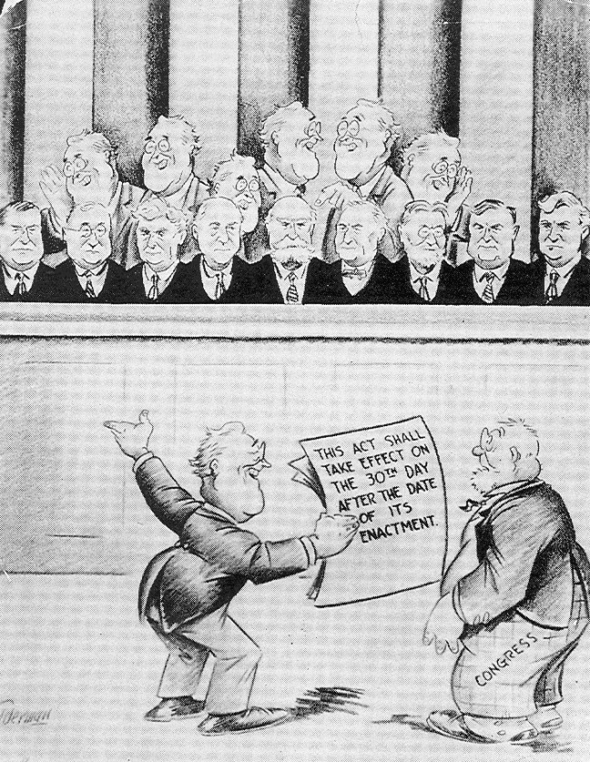

Slide 30
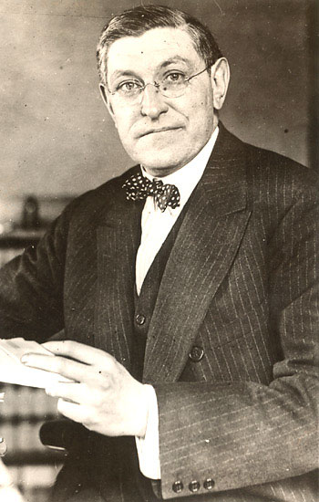

Slide 31
West Coast Hotel v. Parrish (1937)
The constitutional provision invoked is the due process clause of the Fourteenth Amendment governing the states, as the due process clause invoked in the Adkins Case governed Congress. In each case the violation alleged by those attacking minimum wage regulation for women is deprivation of freedom of contract. What is this freedom? The Constitution does not speak of freedom of contract. It speaks of liberty and prohibits the deprivation of liberty without due process of law. In prohibiting that deprivation, the Constitution does not recognize an absolute and uncontrollable liberty. Liberty in each of its phases has its history and connotation. But the liberty safeguarded is liberty in a social organization which requires the protection of law against the evils which menace the health, safety, morals, and welfare of the people. Liberty under the Constitution is thus necessarily subject to the restraints of due process, and regulation which is reasonable in relation to its subject and is adopted in the interests of the community is due process . . .
We think that the views thus expressed are sound and that the decision in the Adkins Case was a departure from the true application of the principles governing the regulation by the state of the relation of employer and employed.

Slide 32
West Coast Hotel—Sutherland dissent
Coming, then, to a consideration of the Washington statute, it first is to be observed that it is in every substantial respect identical with the statute involved in the Adkins Case. Such vices as existed in the latter are present in the former. And if the Adkins Case was properly decided, as we who join in this opinion think it was, it necessarily follows that the Washington statute is invalid . . .
Finally, it may be said that a statute absolutely fixing wages in the various industries at definite sums and forbidding employers and employees from contracting for any other than those designated would probably not be thought to be constitutional. It is hard to see why the power to fix minimum wages does not connote a like power in respect of maximum wages. And yet, if both powers be exercised in such a way that the minimum and the maximum so nearly approach each other as to become substantially the same, the right to make any contract in respect of wages will have been completely abrogated.

Slide 33
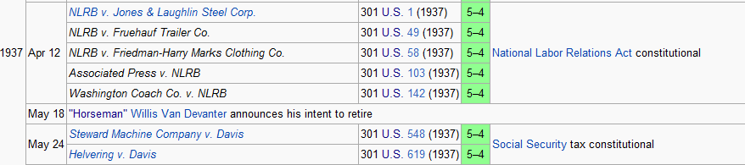

Slide 34
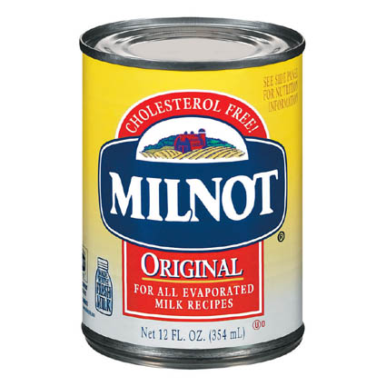

Slide 35
United States v. Carolene Products Co. (1938)
. . . we might rest decision wholly on the presumption of constitutionality. But affirmative evidence also sustains the statute . . .
Congress is free to exclude from interstate commerce articles whose use in the states for which they are destined it may reasonably conceive to be injurious to the public health, morals or welfare . . . or which contravene the policy of the state of their destination.

Slide 36
Carolene Products
^{4.} There may be narrower scope for operation of the presumption of constitutionality when legislation appears on its face to be within a specific prohibition of the Constitution, such as those of the first ten amendments, which are deemed equally specific when held to be embraced within the Fourteenth.
It is unnecessary to consider now whether legislation which restricts those political processes which can ordinarily be expected to bring about repeal of undesirable legislation is to be subjected to more exacting judicial scrutiny under the general prohibitions of the Fourteenth Amendment than are most other types of legislation . . .
Nor need we enquire whether similar considerations enter into the review of statutes directed at particular religious, or national, or racial minorities: whether prejudice against discrete and insular minorities may be a special condition, which tends seriously to curtail the operation of those political processes ordinarily to be relied upon to protect minorities, and which may call for a correspondingly more searching judicial inquiry.

Slide 37
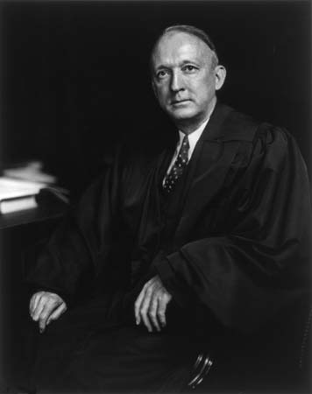
Notes:
Hugo black

Slide 38
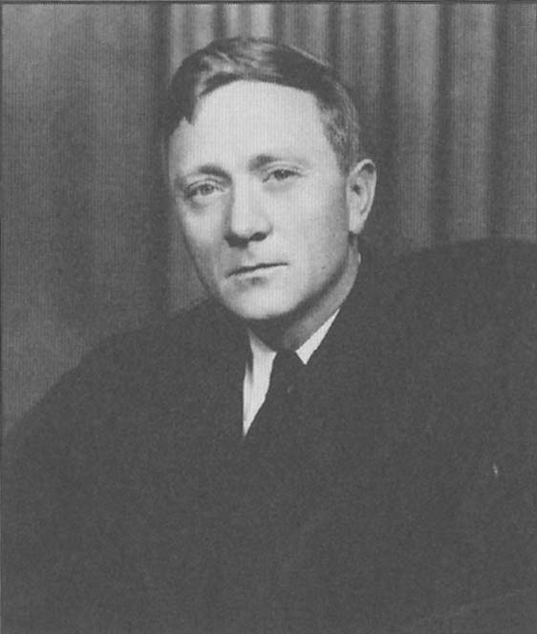
Notes:
douglas

Slide 39
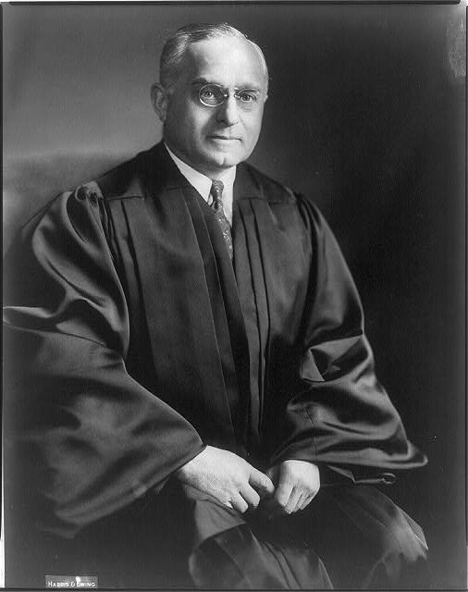
Notes:
F’frter

Slide 40
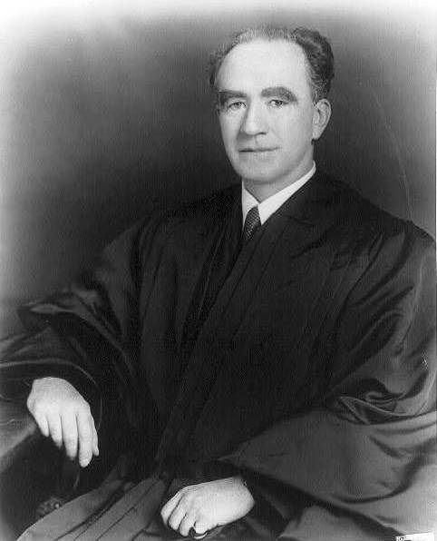
Notes:
murphy

Slide 41
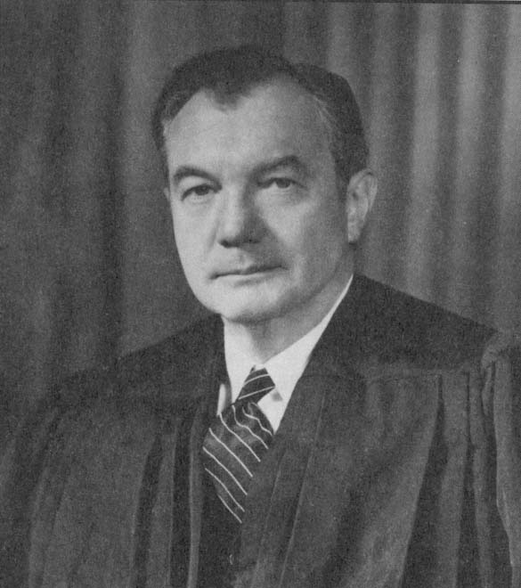
Notes:
jackson

Slide 42
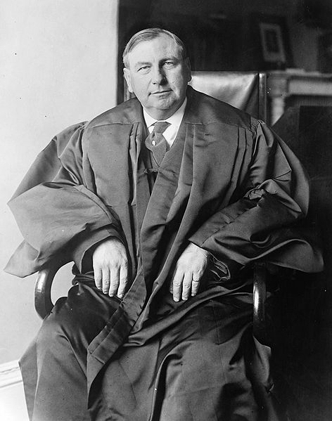
Notes:
stone

Slide 43
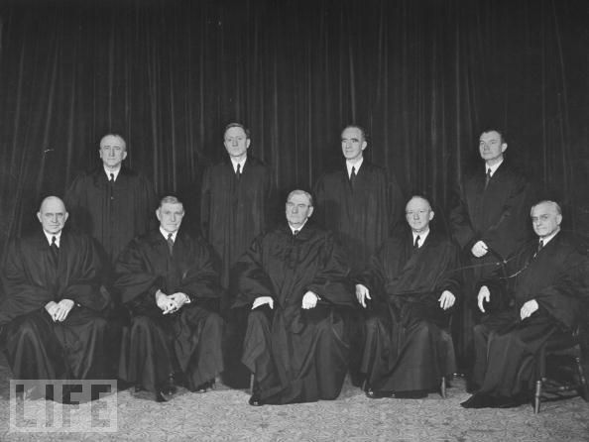

Slide 44
Wickard v. Filburn (1942)
It is said, however, that this Act, forcing some farmers into the market to buy what they could provide for themselves, is an unfair promotion of the markets and prices of specializing wheat growers. It is of the essence of regulation that it lays a restraining hand on the self-interest of the regulated, and that advantages from the regulation commonly fall to others. The conflicts of economic interest between the regulated and those who advantage by it are wisely left under our system to resolution by the Congress under its more flexible and responsible legislative process. Such conflicts rarely lend themselves to judicial determination. And with the wisdom, workability, or fairness, of the plan of regulation, we have nothing to do.

Slide 45
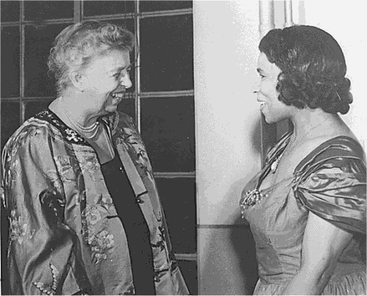

Slide 46


Slide 47
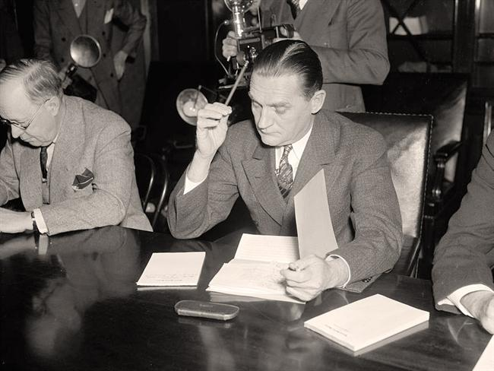
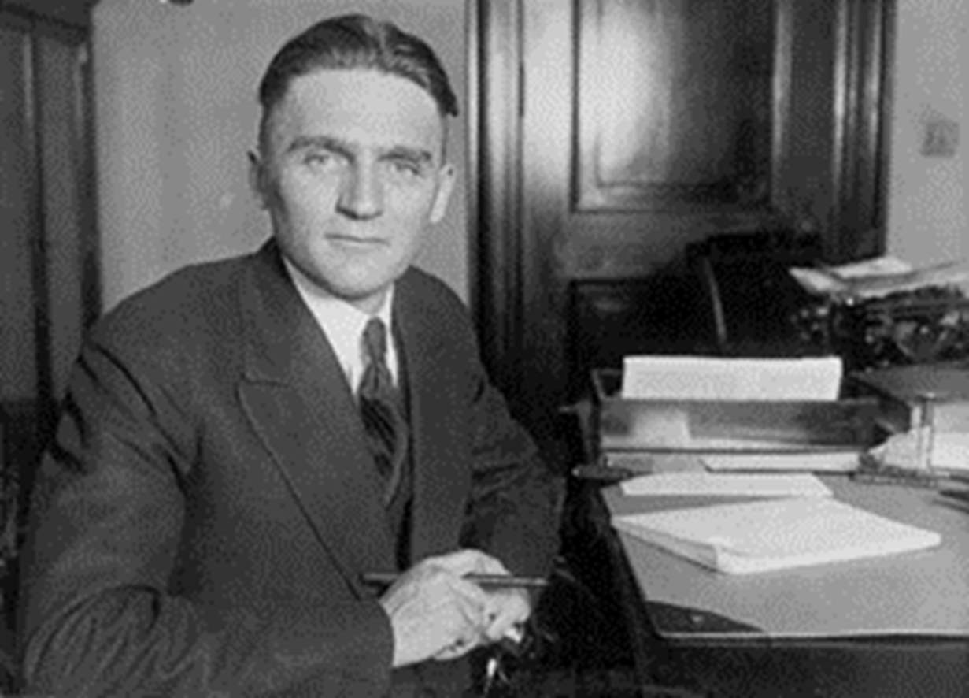
Neutrality Act (1935)
Embargo on all war materiel (arms, ammunition, etc.) to countries at war—applies to all U.S.-owned companies
American citizens travel on ships of warring countries at their own risk

Slide 48
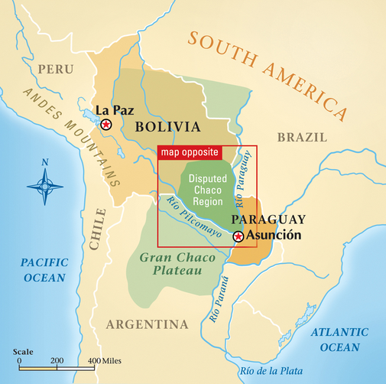

Slide 49
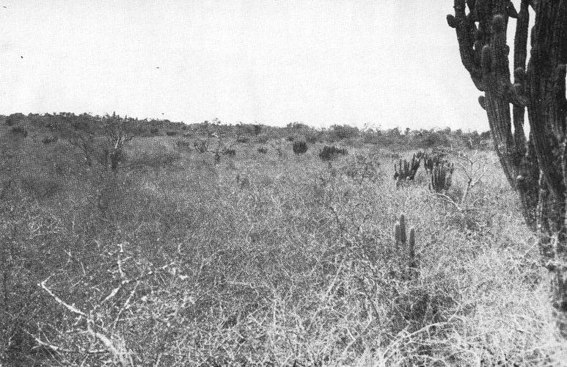

Slide 50
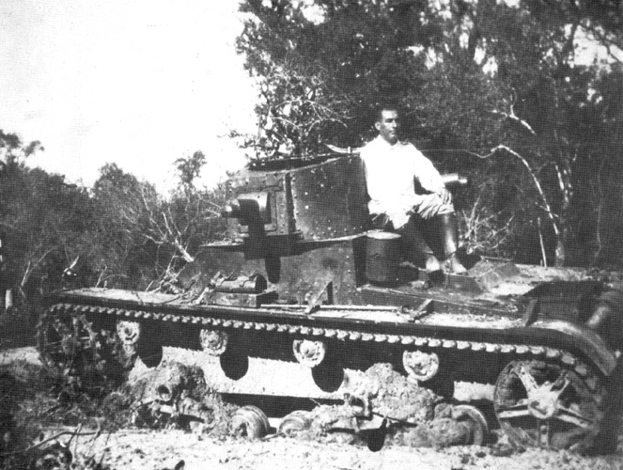

Slide 51
U.S. v. Curtiss-Wright Export Co. (1936)
Not only is the federal power over external affairs in origin and essential character different from that over internal affairs, but participation in the exercise of the power is significantly limited. In this vast external realm, with its important, complicated, delicate and manifold problems, the President alone has the power to speak or listen as a representative of the nation. He makes treaties with the advice and consent of the Senate; but he alone negotiates. Into the field of negotiation the Senate cannot intrude, and Congress itself is powerless to invade it.

Slide 52
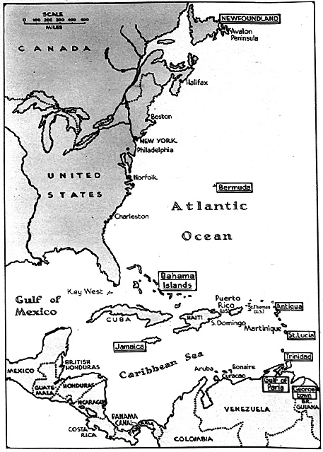

Slide 53


Slide 54
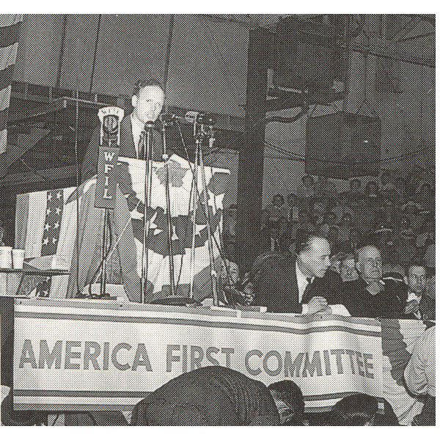

Slide 55
