Slide 1
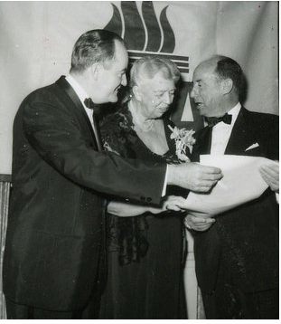

Slide 2
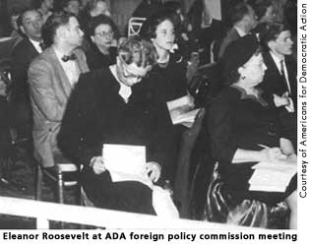

Slide 3
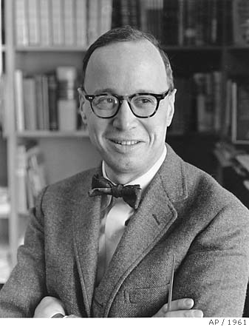

Slide 4
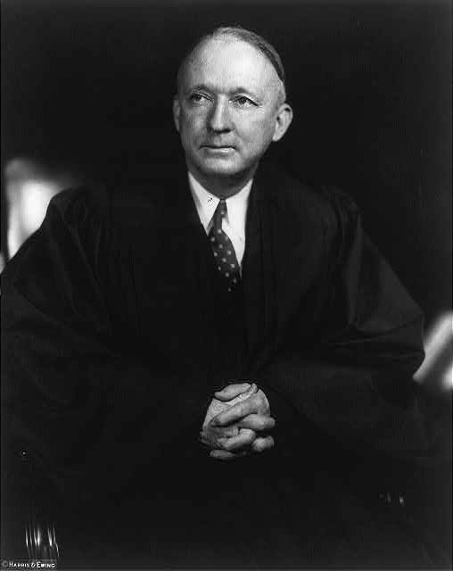
Notes:
black

Slide 5
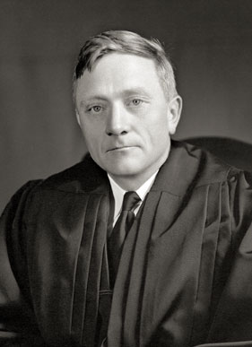
Notes:
douglas

Slide 6
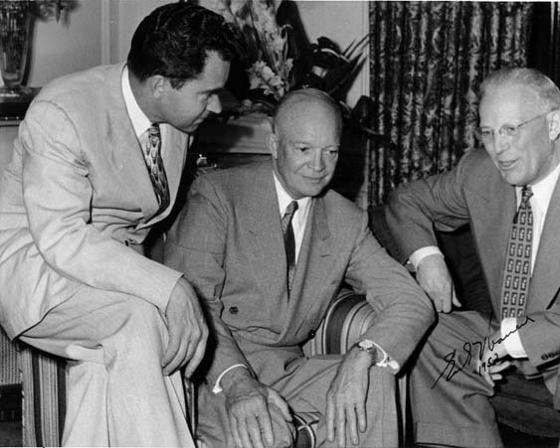

Slide 7
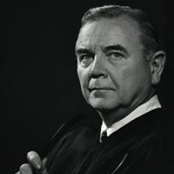

Slide 8
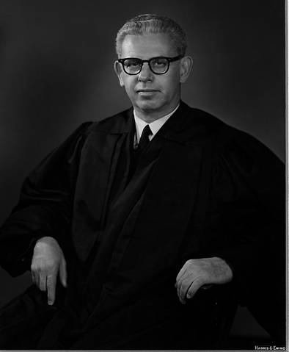

Slide 9
Carolene Products—FN 4 (1938)
It is unnecessary to consider now whether legislation which restricts those political processes which can ordinarily be expected to bring about repeal of undesirable legislation is to be subjected to more exacting judicial scrutiny under the general prohibitions of the Fourteenth Amendment than are most other types of legislation . . .
Nor need we enquire whether similar considerations enter into the review of statutes directed at particular religious or racial minorities: whether prejudice against discrete and insular minorities may be a special condition, which tends seriously to curtail the operation of those political processes ordinarily to be relied upon to protect minorities, and which may call for a correspondingly more searching judicial inquiry.

Slide 10
Everson v. Board of Education (1947)
The "establishment of religion" clause of the First Amendment means at least this: Neither a state nor the Federal Government can set up a church. Neither can pass laws which aid one religion, aid all religions, or prefer one religion over another. Neither can force nor influence a person to go to or to remain away from church against his will or force him to profess a belief or disbelief in any religion. No person can be punished for entertaining or professing religious beliefs or disbeliefs, for church attendance or non-attendance. No tax in any amount, large or small, can be levied to support any religious activities or institutions, whatever they may be called, or whatever form they may adopt to teach or practice religion. Neither a state nor the Federal Government can, openly or secretly, participate in the affairs of any religious organizations or groups and vice versa. In the words of Jefferson, the clause against establishment of religion by law was intended to erect "a wall of separation between church and State."

Slide 11
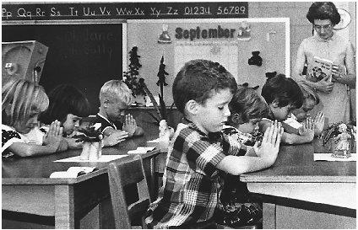

Slide 12
Engel v. Vitale (1962)
By the time of the adoption of the Constitution, our history shows that there was a widespread awareness among many Americans of the dangers of a union of Church and State. These people knew, some of them from bitter personal experience, that one of the greatest dangers to the freedom of the individual to worship in his own way lay in the Government’s placing its official stamp of approval upon one particular kind of prayer or one particular form of religious services…
It is neither sacrilegious nor anti-religious to say that each separate government in this country should stay out of the business of writing or sanctioning official prayers and leave that purely religious function to the people themselves and to those the people choose to look to for religious guidance.

Slide 13
Abington School District v. Schempp (1963)
Once again, we are called upon to consider the scope of the provision of the First Amendment to the United States Constitution which declares that "Congress shall make no law respecting an establishment of religion, or prohibiting the free exercise thereof. . . ."
The test may be stated as follows: what are the purpose and the primary effect of the enactment? If either is the advancement or inhibition of religion, then the enactment exceeds the scope of legislative power as circumscribed by the Constitution…
In the relationship between man and religion, the State is firmly committed to a position of neutrality.

Slide 14
Gallup Polls on Supreme Court
and school prayer
1962: 79% of Americans approve of "religious observances in public schools.“
1963: 70% of Americans disapprove of the Schempp decision.

Slide 15
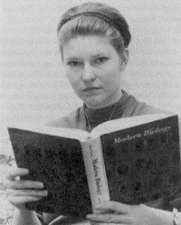
Notes:
Susan epperson

Slide 16
Epperson v. Arkansas (1968)
Government in our democracy, state and national, must be neutral in matters of religious theory, doctrine, and practice. It may not be hostile to any religion or to the advocacy of noreligion; and it may not aid, foster, or promote one religion or religious theory against another or even against the militant opposite. The First Amendment mandates governmental neutrality between religion and religion, and between religion and nonreligion . . .
There is and can be no doubt that the First Amendment does not permit the State to require that teaching and learning must be tailored to the principles or prohibitions of any religious sect or dogma . . .
Arkansas' law cannot be defended as an act of religious neutrality. Arkansas did not seek to excise from the curricula of its schools and universities all discussion of the origin of man. The law's effort was confined to an attempt to blot out a particular theory because of its supposed conflict with the Biblical account, literally read. Plainly, the law is contrary to the mandate of the First, and in violation of the Fourteenth, Amendment to the Constitution.

Slide 17
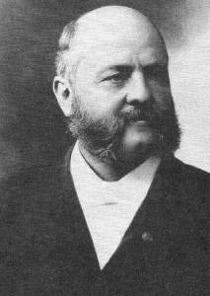
Notes:
comstock

Slide 18
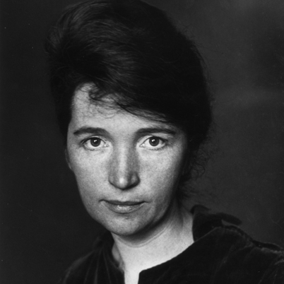
Notes:
Margaret sanger

Slide 19


Slide 20
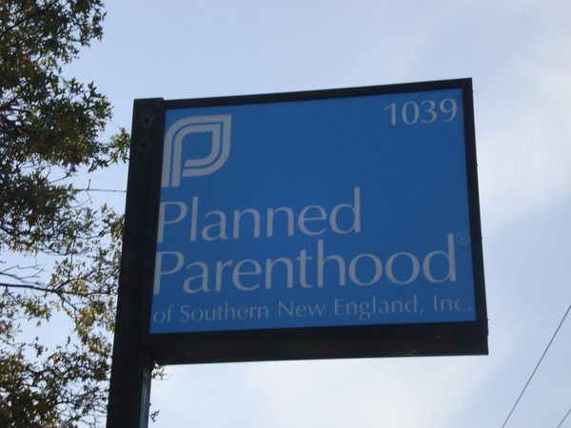

Slide 21
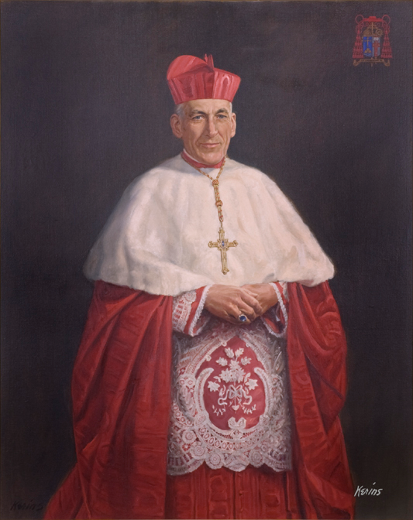

Slide 22
Griswold v. Connecticut (1965)
We do not sit as a super-legislature to determine the wisdom, need, and propriety of laws that touch economic problems, business affairs, or social conditions. This law, however, operates directly on an intimate relation of husband and wife and their physician's role in one aspect of that relation…
The foregoing cases suggest that specific guarantees in the Bill of Rights have penumbras, formed by emanations from those guarantees that help give them life and substance . . . Various guarantees create zones of privacy. The right of association contained in the penumbra of the First Amendment is one, as we have seen. The Third Amendment, in its prohibition against the quartering of soldiers "in any house" in time of peace without the consent of the owner, is another facet of that privacy. The Fourth Amendment explicitly affirms the "right of the people to be secure in their persons, houses, papers, and effects, against unreasonable searches and seizures." The Fifth Amendment, in its Self-Incrimination Clause, enables the citizen to create a zone of privacy which government may not force him to surrender to his detriment. The Ninth Amendment provides . . .

Slide 23
In re Gault (1967)
It would be extraordinary if our Constitution did not require the procedural regularity and the exercise of care implied in the phrase “due process.” Under our Constitution, the condition of being a boy does not justify a kangaroo court. The traditional ideas of Juvenile Court procedure, indeed, contemplated that time would be available and care would be used to establish precisely what the juvenile did and why he did it . . .
So wide a gulf between the State’s treatment of the adult and of the child requires a bridge sturdier than mere verbiage, and reasons more persuasive than cliché can provide.

Slide 24
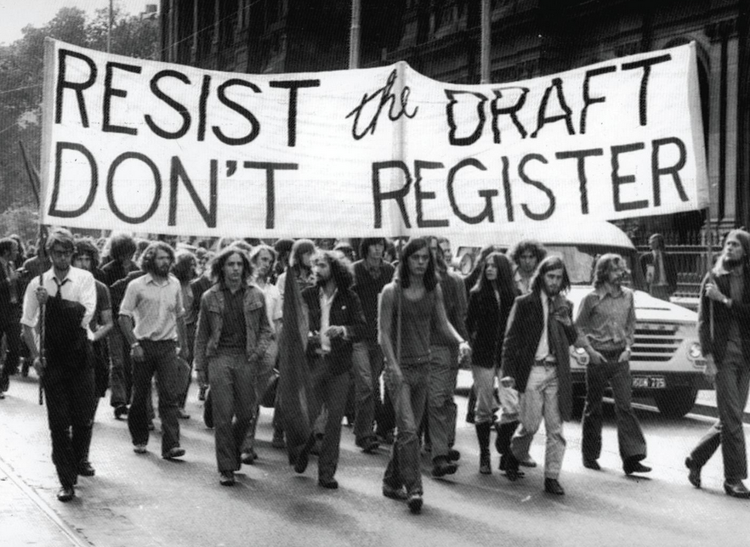

Slide 25
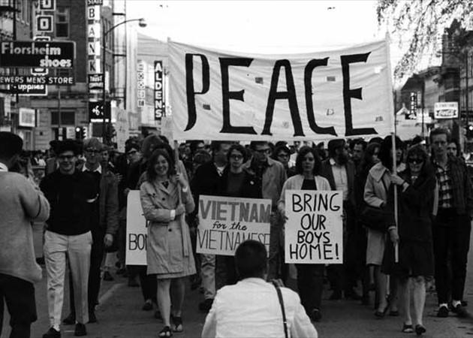

Slide 26
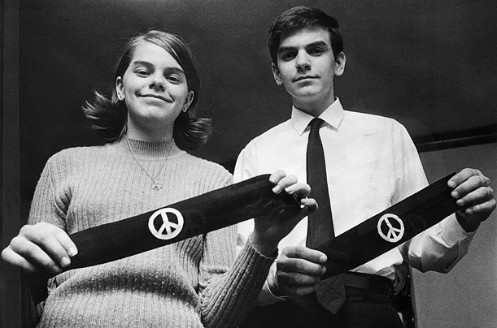
Notes:
Mary Beth and John Tinker

Slide 27
Tinker v. Des Moines (1969)
Our problem involves direct, primary First Amendment rights akin to “pure speech.”
The school officials banned and sought to punish petitioners for a silent, passive expression of opinion, unaccompanied by any disorder or disturbance on the part of petitioners. There is here no evidence whatever of petitioners’ interference, actual or nascent, with the schools’ work or of collision with the rights of other students to be secure and to be let alone . . .
In our system, state-operated schools may not be enclaves of totalitarianism. School officials do not possess absolute authority over their students. Students in school, as well as out of school, are “persons” under our Constitution. They are possessed of fundamental rights which the State must respect, just as they themselves must respect their obligations to the State. In our system, students may not be regarded as closed-circuit recipients of only that which the State chooses to communicate.

