Slide 1


Slide 2
1940 Statement on Academic Freedom
Teachers are entitled to freedom in the classroom in discussing their subject, but they should be careful not to introduce into their teaching controversial matter which has no relation to their subject…
College and university teachers are citizens, members of a learned profession, and officers of an educational institution. When they speak or write as citizens, they should be free from institutional censorship or discipline, but their special position in the community imposes special obligations. As scholars and educational officers, they should remember that the public may judge their profession and their institution by their utterances. Hence they should at all times be accurate, should exercise appropriate restraint, should show respect for the opinions of others, and should make every effort to indicate that they are not speaking for the institution.

Slide 3
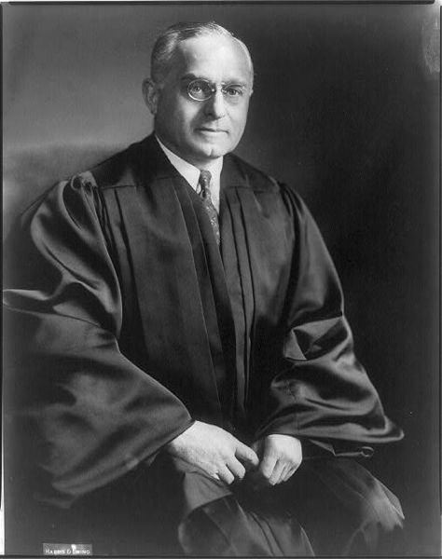

Slide 4
Sweezy v. New Hampshire (1957)
When weighed against the grave harm resulting from governmental intrusion into the intellectual life of a university, such justification for compelling a witness to discuss the contents of his lecture appears grossly inadequate…
Progress in the natural sciences is not remotely confined to findings made in the laboratory. Insights into the mysteries of nature are born of hypothesis and speculation. The more so is this true in the pursuit of understanding in the groping endeavors of what are called the social sciences, the concern of which is man and society. The problems that are the respective preoccupations of anthropology, economics, law, psychology, sociology and related areas of scholarship are merely departmentalized dealing, by way of manageable division of analysis, with interpenetrating aspects of holistic perplexities. For society's good - if understanding be an essential need of society - inquiries into these problems, speculations about them, stimulation in others of reflection upon them, must be left as unfettered as possible. Political power must abstain from intrusion into this activity of freedom, pursued in the interest of wise government and the people's well-being, except for reasons that are exigent and obviously compelling.

Slide 5
Bakke v. Cal Regents (1978)
The fourth goal asserted by petitioner is the attainment of a diverse student body. This clearly is a constitutionally permissible goal for an institution of higher education. Academic freedom, though not a specifically enumerated constitutional right, long has been viewed as a special concern of the First Amendment. The freedom of a university to make its own judgments as to education includes the selection of its student body…
The atmosphere of "speculation, experiment and creation" - so essential to the quality of higher education - is widely believed to be promoted by a diverse student body.

Slide 6
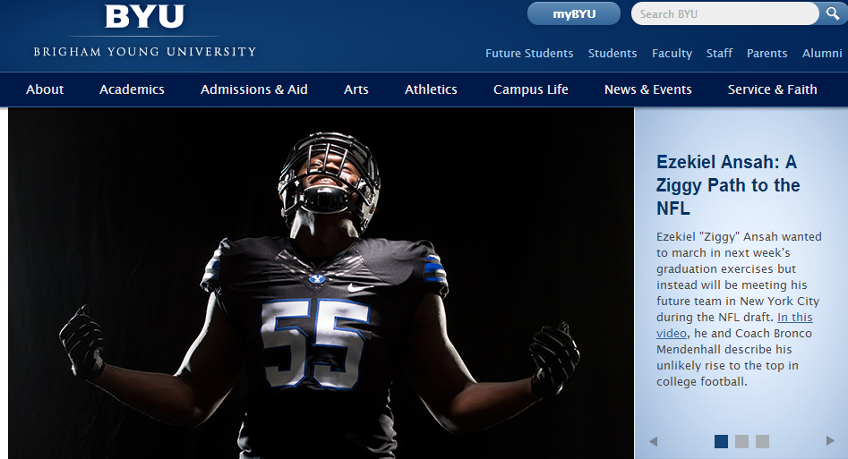
“BYU faculty should be models of spirituality to their students . . . BYU is an intellectual community of faithful Latter-day Saints, and those sympathetic to their convictions, who pursue knowledge from the baseline of religious belief.”

Slide 7
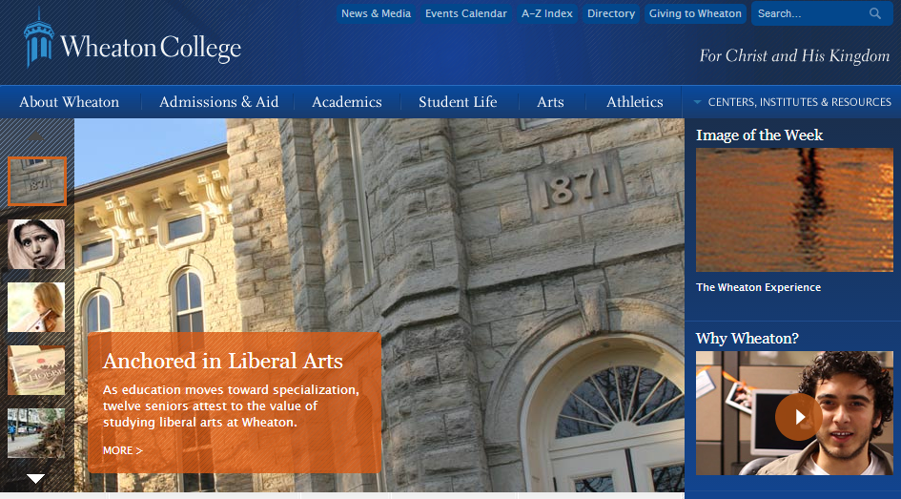
“Committed to the principle that truth is revealed by God through Christ ‘in whom are hid all the treasures of wisdom and knowledge,’ Wheaton College seeks to relate Christian liberal arts education to the needs of contemporary society.”

Slide 8
Brooklyn College guidelines
The tradition of the university as a sanctuary of academic freedom and center of informed discussion is long-honored and must be guarded vigilantly. The principle of intellectual freedom, rights of professors to teach and engage in scholarly research, and rights of students to learn and express their views free from external pressures and interference are deeply held values of institutions of higher education, including Brooklyn College. CUNY’s regulations to secure these benefits and ensure the academic freedom for all in this educational community.

Slide 9
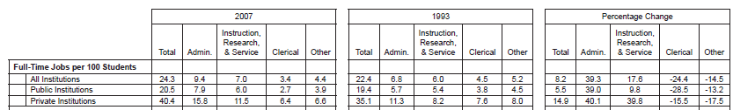

Slide 10
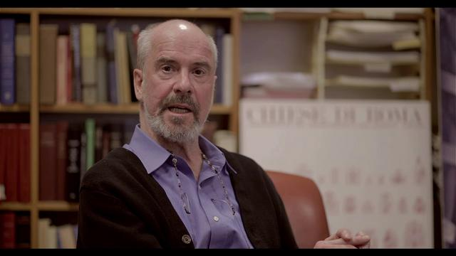
Notes:
Duncan kennedy

Slide 11
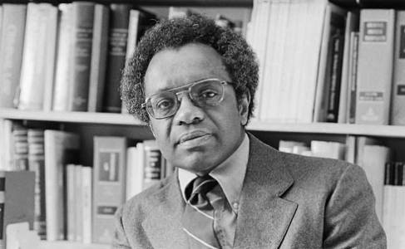

Slide 12
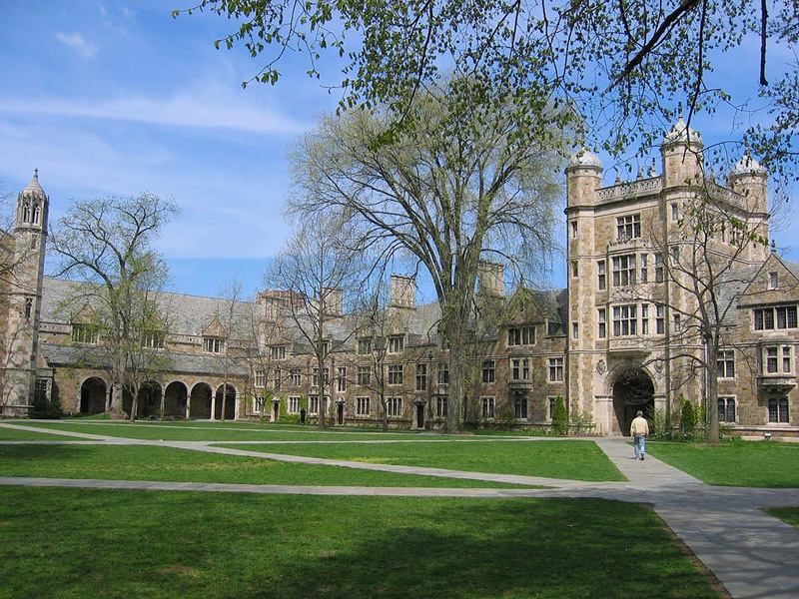

Slide 13
Robben Wright Fleming,
Acting president, Univ. of Michigan, 1987:
Just as an individual cannot shout "Fire!" in a crowded theater and then claim immunity from prosecution for causing a riot on the basis of exercising his rights of free speech, so a great many American universities have taken the position that students at a university cannot by speaking or writing discriminatory remarks which seriously offend many individuals beyond the immediate victim, and which, therefore detract from the necessary educational climate of a campus, claim immunity from a campus disciplinary proceeding. I believe that position to be valid.

Slide 14
University of Michigan speech code
The policy prohibited:
“Any behavior, verbal or physical, that stigmatizes or victimizes an individual on the basis of race, ethnicity, religion, sex, sexual orientation, creed … and that …
“Creates an intimidating, hostile, or demeaning environment for educational pursuits, employment or participation in University[-]sponsored extra-curricular activities.”
University examples of harassing conduct:
“You exclude someone from a study group because that person is of a different race, sex, or ethnic origin than you are.
“You display a confederate flag on the door of your room in your residence hall.
“You comment in a derogatory way about a particular person or group’s physical appearance or sexual orientation, or their cultural origins, or religious beliefs.
“A male student makes remarks in class like ‘Women just aren't as good in this field as men,’ thus creating a hostile learning atmosphere for female classmates.”

Slide 15
Doe v. University of Michigan (1989)
It is an unfortunate fact of our constitutional system that the ideals of freedom and equality are often in conflict. The difficult and sometimes painful task of our political and legal institutions is to mediate the appropriate balance between these two competing values…
What the University could not do, however, was establish an anti-discrimination policy which had the effect of prohibiting certain speech because it disagreed with ideas or messages sought to be conveyed…
While the Court is sympathetic to the University's obligation to ensure equal educational opportunities for all of its students, such efforts must not be at the expense of free speech. Unfortunately, this was precisely what the University did.

Slide 16
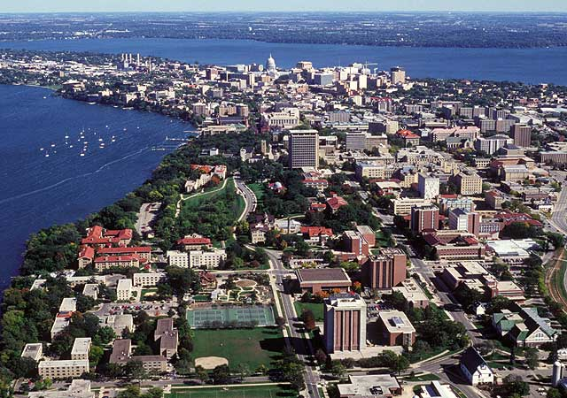

Slide 17
Univ. of Wisconsin “Design for Diversity”
Prohibits addressing any specific individuals with “racist or discriminatory comments” that:
“Demean the race, sex, religion, color, creed, disability, sexual orientation, national origin, ancestry or age of the individual or individuals; and
“Create an intimidating, hostile or demeaning environment for education, university-related work, or other university-authorized activity.”

Slide 18
UWM Post v. Board of Regents (1991)
This commitment to free expression must be unwavering, because there exist many situations where, in the short run, it appears advantageous to limit speech to solve pressing social problems, such as discriminatory harassment. If a balancing approach is applied, these pressing and tangible short run concerns are likely to outweigh the more amorphous and long run benefits of free speech. However, the suppression of speech, even where the speech’s content appears to have little value and great costs, amounts to governmental thought control…
The Board's first asserted compelling interest is increasing minority representation to add to the diversity of University of Wisconsin System campuses. Increasing diversity is "clearly a constitutionally permissible goal for an institution of higher education." University of California Regents v. Bakke, 438 U.S. 265, 311-312 (1978). However, the UW Rule does as much to hurt diversity on Wisconsin campuses as it does to help it. By establishing content-based restrictions on speech, the rule limits the diversity of ideas among students and thereby prevents the "robust exchange of ideas" which intellectually diverse campuses provide.

Slide 19
St. Paul Bias-Motivated Crime Ordinance (1990):
Whoever places on public or private property a symbol, object, appellation, characterization or graffiti, including, but not limited to, a burning cross or Nazi swastika, which one knows or has reasonable grounds to know arouses anger, alarm or resentment in others on the basis of race, color, creed, religion or gender commits disorderly conduct and shall be guilty of a misdemeanor.

Slide 20
R.A.V. v. City of St. Paul (1992)
The ordinance is facially unconstitutional in that it prohibits otherwise permitted speech solely on the basis of the subjects the speech addresses…
In its practical operation, moreover, the ordinance goes even beyond mere content discrimination to actual viewpoint discrimination. Displays containing some words -- odious racial epithets, for example -- would be prohibited to proponents of all views. But “fighting words” that do not themselves invoke race, color, creed, religion, or gender -- aspersions upon a person's mother, for example -- would seemingly be usable ad libitum in the placards of those arguing in favor of racial, color, etc. tolerance and equality, but could not be used by that speaker's opponents…
St. Paul has no such authority to license one side of a debate to fight freestyle, while requiring the other to follow Marquis of Queensbury Rules.

Slide 21
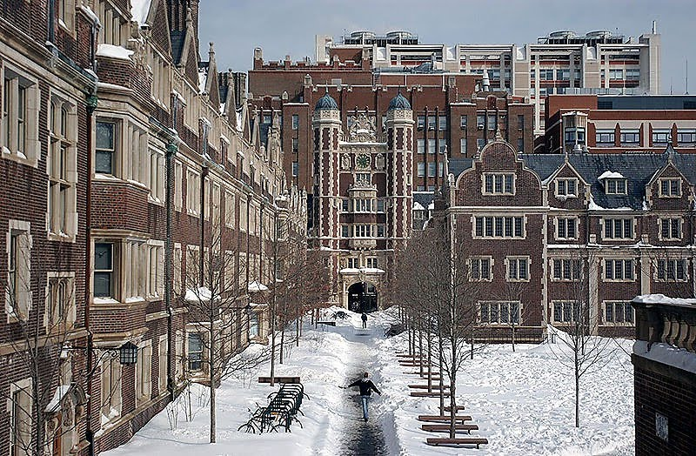

Slide 22
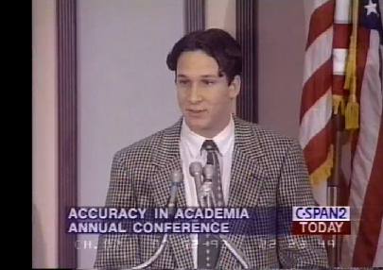

Slide 23
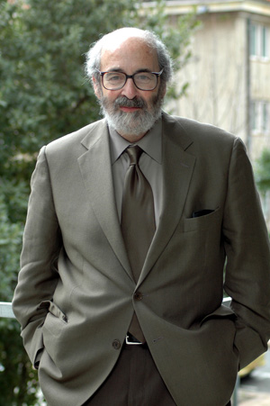

Slide 24
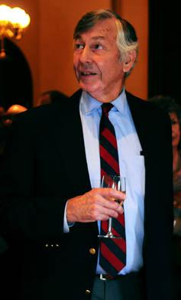
Notes:
hackney

Slide 25
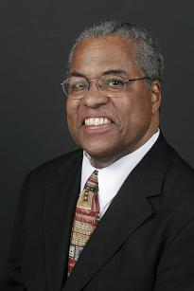

Slide 26
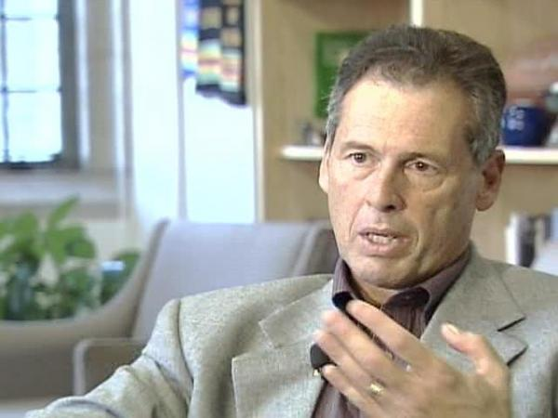
“The issue is not whether I have or not [heard water buffalo used as a racial slur]. The issue is also, you know, language in my mind is neutral. It’s a question of the context in which is language is used."

Slide 27
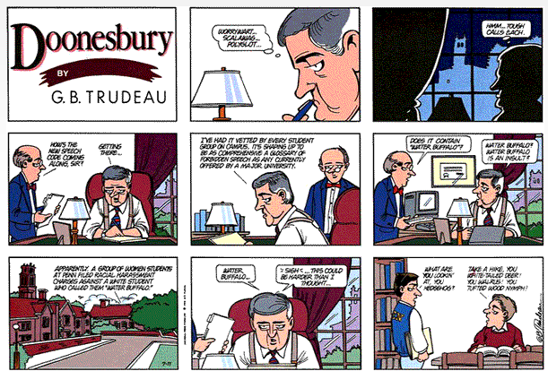

Slide 28


Slide 29
Washington Univ. St. Louis
Prohibits “any behavior or conduct that is injurious, or potentially injurious to a person's physical, emotional, or psychological well-being, as determined at the sole discretion of the University. Such behavior is subject to disciplinary action.”
Wesleyan College
“Every member of the University must refrain from actions that may be harmful to the health or emotional stability of the individual or that degrade the individual or infringe upon his/her personal dignity.”
SUNY-New Paltz
Prohibits “distribution, display or discussion of any written or graphic material that ridicules, denigrates, insults, belittles, or shows hostility or aversion toward an individual or group because of protected status.”

Slide 30
Colorado State University
Hate incidents are expressions of hostility against a person or property because of a person’s race, color, ancestry, national origin, religion, ability, age, gender, socio-economic status, ethnicity, or sexual orientation.
University of Mississippi
Offensive language is not to be used. All reported incidents of anyone using offensive language is referred to the Campus Police for further action.
SUNY-Buffalo
Students in the residence halls are required to be courteous and polite or, simply put, to be mannerly . . . Acts of incivility—will not be tolerated by the Residential Life community.

Slide 31
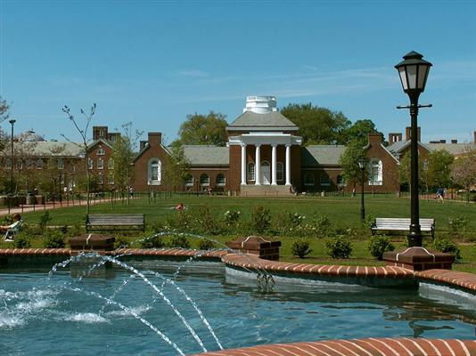

Slide 32
University of Delaware Residence Life
Diversity Training (2007)
Students will learn about the forms of oppression that are linked with social identity groups.
B. Students will recognize that systemic oppression exists in our society.
C. Students will recognize the benefits of dismantling systems of oppression.

Slide 33
“A RACIST: A racist is one who is both privileged and socialized on the basis of race by a white supremacist (racist) system. The term applies to all white people (i.e., people of European descent) living in the United States, regardless of class, gender, religion, culture or sexuality. By this definition, people of color cannot be racists, because as peoples within the U.S. system, they do not have the power to back up their prejudices, hostilities, or acts of discrimination…
“A NON-RACIST: A non-term. The term was created by whites to deny responsibility for systemic racism, to maintain an aura of innocence in the face of racial oppression, and to shift responsibility for that oppression from whites to people of color (called ‘blaming the victim’). Responsibility for perpetuating and legitimizing a racist system rests both on those who actively maintain it, and on those who refuse to challenge it. Silence is consent…”

Slide 34
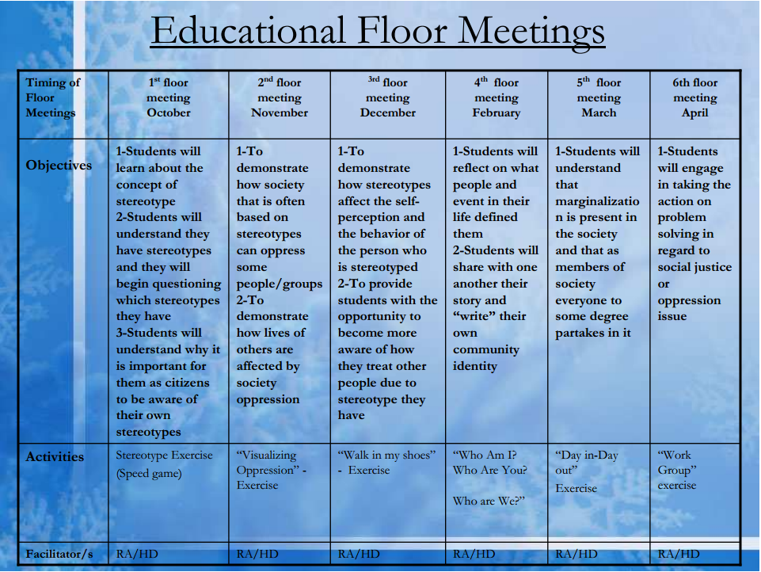

Slide 35
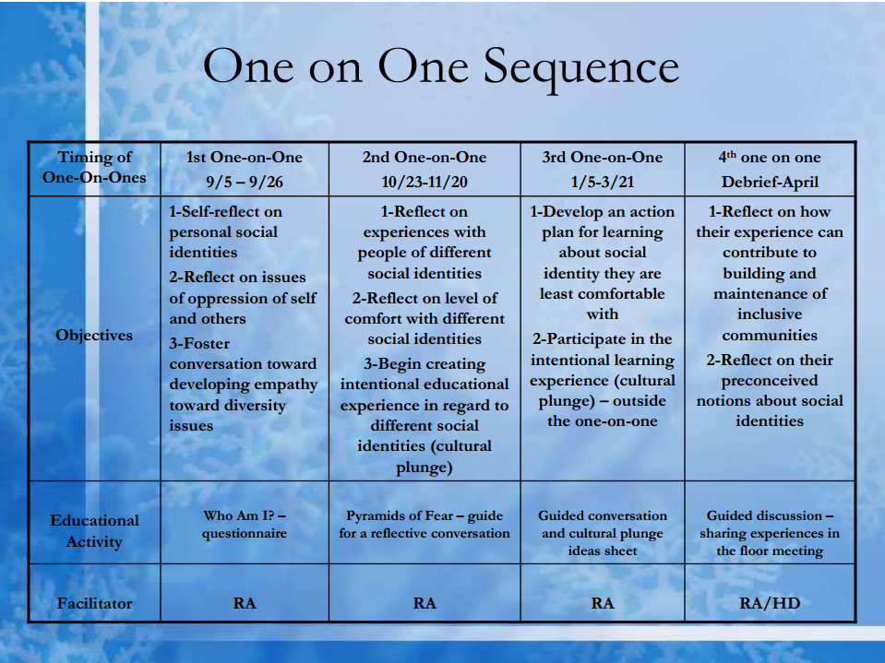

Slide 36
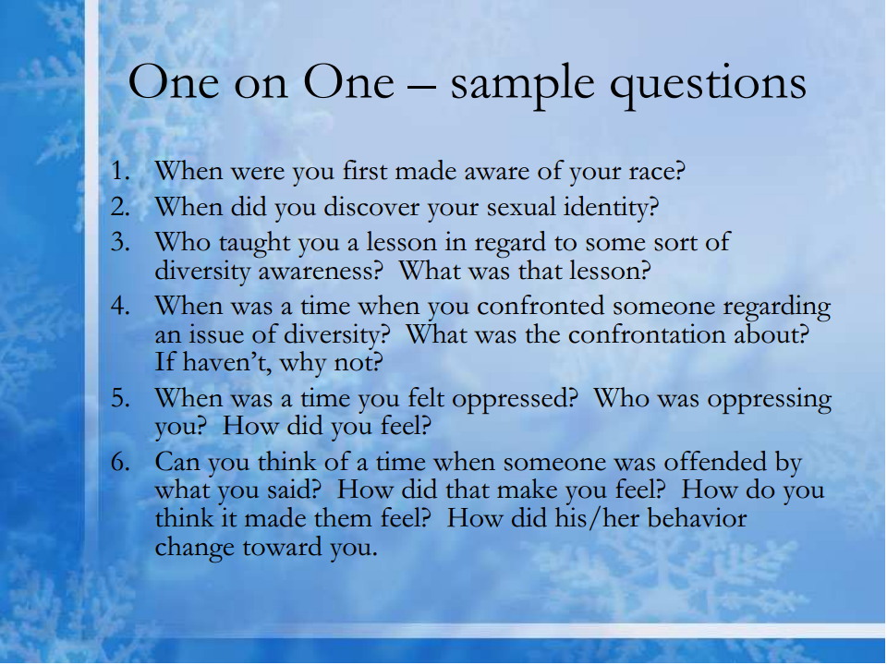

Slide 37
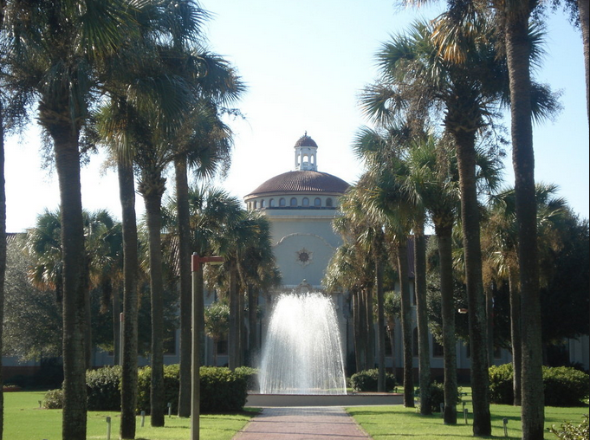

Slide 38
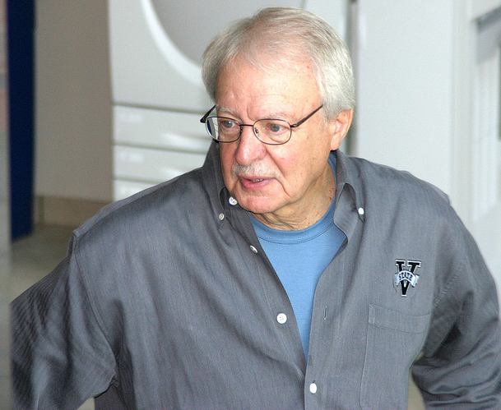
Notes:
Ronald zaccari

Slide 39

Notes:
Hayden barnes

Slide 40
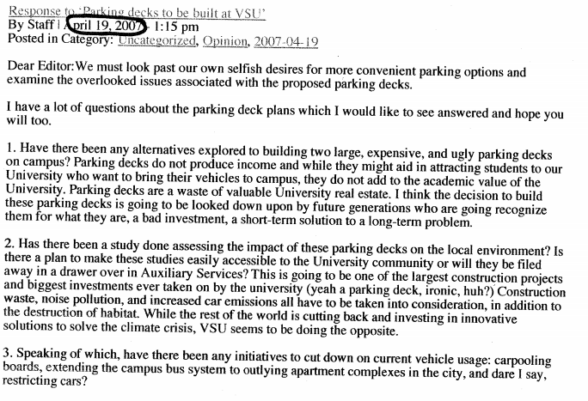

Slide 41
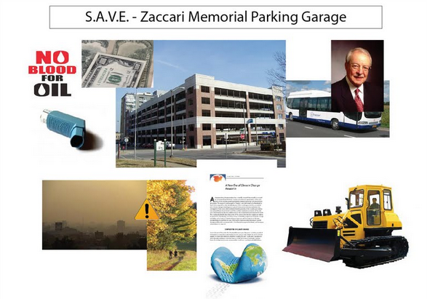

Slide 42
Valdosta State administrative withdrawal policy
Any student, faculty member, administrator, or employee, acting individually or in concert with others, who clearly obstructs or disrupts, or attempts to obstruct or disrupt any teaching, research, administrative, disciplinary, or public service activity, or any other activity authorized to be discharged or held on any campus of the University System is considered by the Board to have committed an act of gross irresponsibility and shall be subject to disciplinary procedures, possibly resulting in dismissal or termination of employment.

Slide 43
Barnes v. Zaccari (11th Circuit, 2012)
Zaccari contends that Barnes had no legitimate claim of entitlement to remain enrolled at VSU. But Barnes’s entitlement is established by both the Board’s Policy Manual and the VSU Student Code of Conduct (the “Code”). Both these documents constitute official regulations of the State of Georgia…
Policy 401.01 does not authorize institutions to punish all students—only a certain class of students, those violating the rules or regulations of the institution. By implication, then, Policy 401.01 withholds authority to discipline students who follow the rules and regulations…
The decisions of this court and the Supreme Court clearly established in May 2007 that (1) Barnes had a protected property interest and that (2) he was due some predeprivation process before VSU could deprive him of that interest.

Slide 44
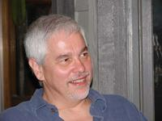
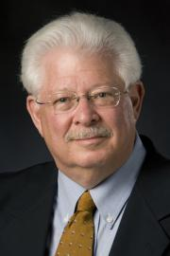
Duke Conservative Union Study (2004) reaction
"We try to hire the best, smartest people available. If, as John Stuart Mill said, stupid people are generally conservative, then there are lots of conservatives we will never hire. Mill's analysis may go some way towards explaining the power of the Republican party in our society and the relative scarcity of Republicans in academia . . . Members of academia tend to be a bit smarter than average. There is a good reason for this too.”
"If you look at the humanities in general, there's a great deal of creativity that goes on. In a sense it's innovation, and a perfectly logical criticism of the current society, in one form or another, that plays itself out in some of these disciplines. It doesn't surprise me that you might find people in humanities are more liberal than conservative."

Slide 45
Academic Bill of Rights
Students will be graded solely on the basis of their reasoned answers and appropriate knowledge of the subjects and disciplines they study, not on the basis of their political or religious beliefs.
Curricula and reading lists in the humanities and social sciences should reflect the uncertainty and unsettled character of all human knowledge in these areas by providing students with dissenting sources and viewpoints where appropriate. While teachers are and should be free to pursue their own findings and perspectives in presenting their views, they should consider and make their students aware of other viewpoints. Academic disciplines should welcome a diversity of approaches to unsettled questions.
Exposing students to the spectrum of significant scholarly viewpoints on the subjects examined in their courses is a major responsibility of faculty.
Faculty will not use their courses for the purpose of political, ideological, religious or anti-religious indoctrination.

Slide 46
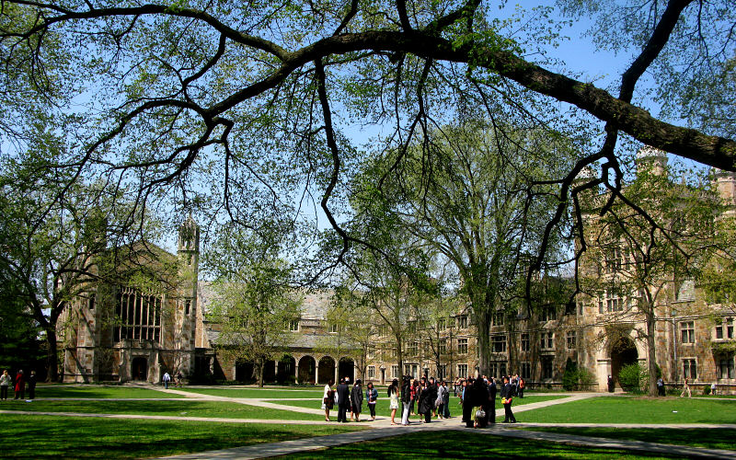

Slide 47
Grutter v. Bollinger (2003)
The policy aspires to “achieve that diversity which has the potential to enrich everyone’s education and thus make a law school class stronger than the sum of its parts.”… By enrolling a “ ‘critical mass’ of [underrepresented] minority students,” the Law School seeks to “ensur[e] their ability to make unique contributions to the character of the Law School.”…
We have long recognized that, given the important purpose of public education and the expansive freedoms of speech and thought associated with the university environment, universities occupy a special niche in our constitutional tradition….
The Law School’s claim of a compelling interest is further bolstered by its amici, who point to the educational benefits that flow from student body diversity. In addition to the expert studies and reports entered into evidence at trial, numerous studies show that student body diversity promotes learning outcomes, and “better prepares students for an increasingly diverse workforce and society, and better prepares them as professionals.”

Slide 48
Grutter – Rehnquist dissent (2003)
The Law School claims it must take the steps it does to achieve a “critical mass” of underrepresented minority students. But its actual program bears no relation to this asserted goal. Stripped of its “critical mass” veil, the Law School’s program is revealed as a naked effort to achieve racial balancing…
Respondents have never offered any race-specific arguments explaining why significantly more individuals from one underrepresented minority group are needed in order to achieve “critical mass” or further student body diversity. They certainly have not explained why Hispanics, who they have said are among “the groups most isolated by racial barriers in our country,” should have their admission capped out in this manner. True, petitioner is neither Hispanic nor Native American. But the Law School’s disparate admissions practices with respect to these minority groups demonstrate that its alleged goal of “critical mass” is simply a sham. Petitioner may use these statistics to expose this sham, which is the basis for the Law School’s admission of less qualified underrepresented minorities in preference to her. Surely strict scrutiny cannot permit these sort of disparities without at least some explanation….

Slide 49
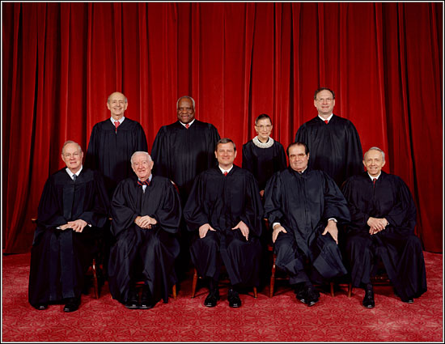

Slide 50
Parents Involved v. Seattle School District (2007)
Both cases [one from Washington, one from Kentucky] present the same underlying legal question—whether a public school that had not operated legally segregated schools or has been found to be unitary may choose to classify students by race and rely upon that classification in making school assignments…
In the present cases, by contrast, race is not considered as part of a broader effort to achieve “exposure to widely diverse people, cultures, ideas, and viewpoints,” ibid.; race, for some students, is determinative standing alone…
Even when it comes to race, the plans here employ only a limited notion of diversity, viewing race exclusively in white/nonwhite terms in Seattle and black/“other” terms in Jefferson County…
The way to stop discrimination on the basis of race is to stop discriminating on the basis of race.

Slide 51
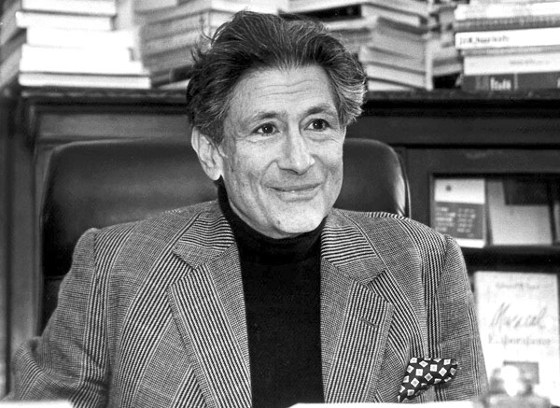

Slide 52
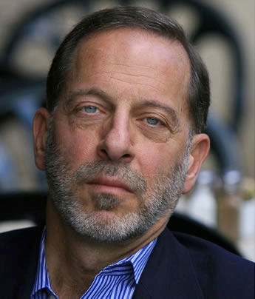

Slide 53


Slide 54


Slide 55


Slide 56
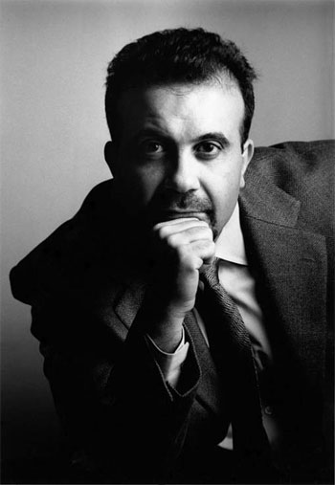

Slide 57
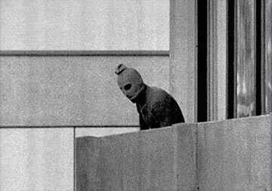

Slide 58
