Slide 1
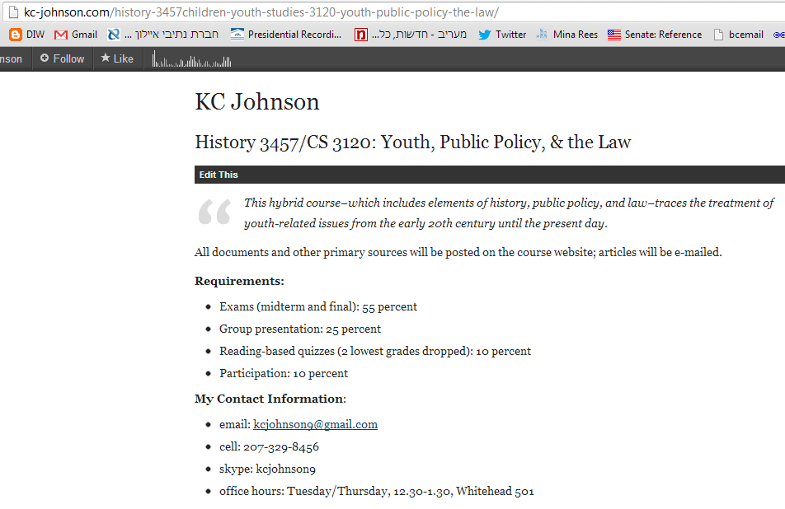

Slide 2
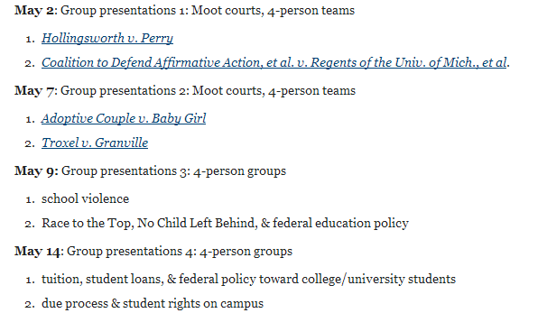

Slide 3
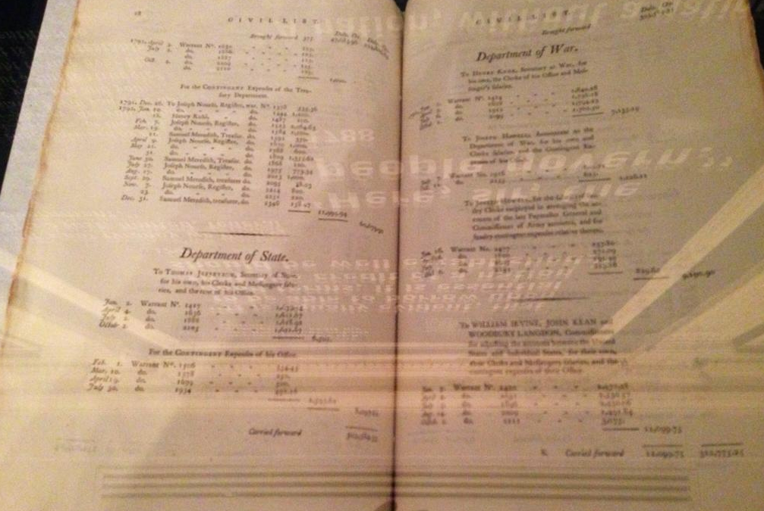
Notes:
1792 us budget

Slide 4
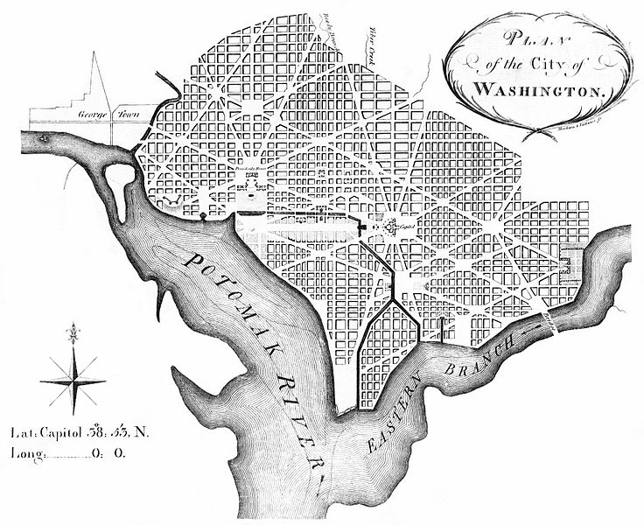

Slide 5
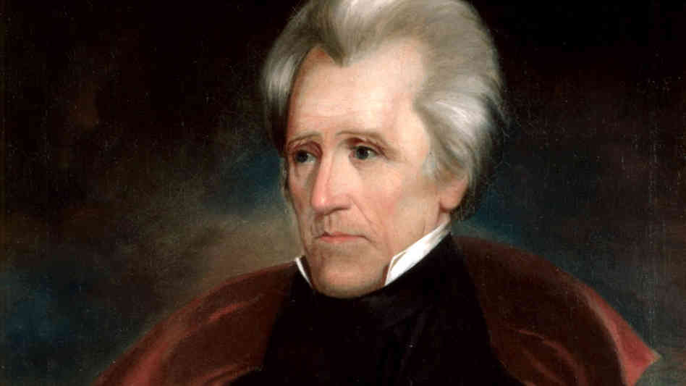
Notes:
Andrew jackson

Slide 6
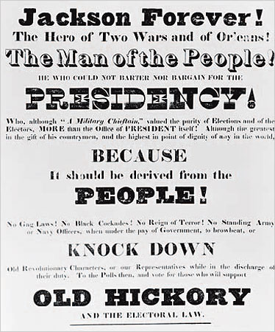

Slide 7
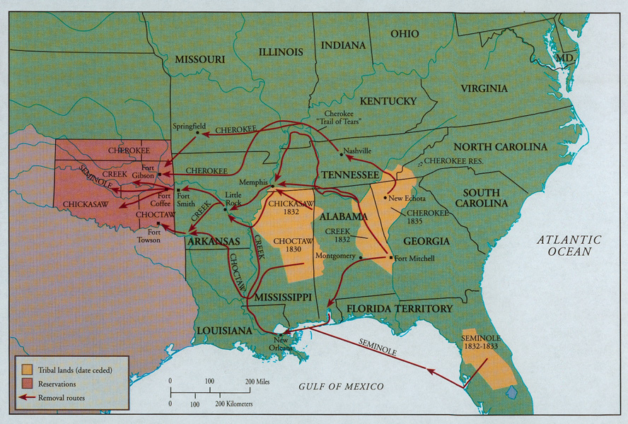

Slide 8
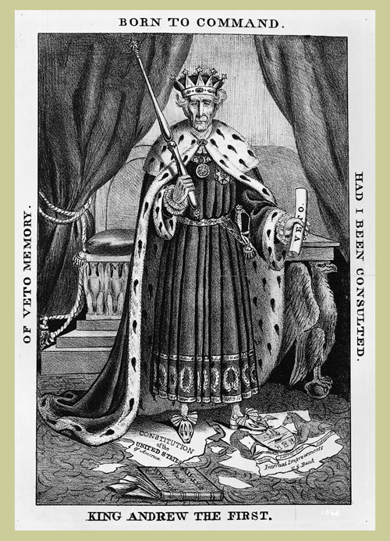

Slide 9
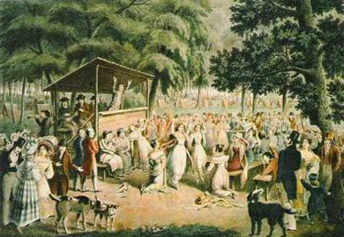
Notes:
2d great awakening

Slide 10
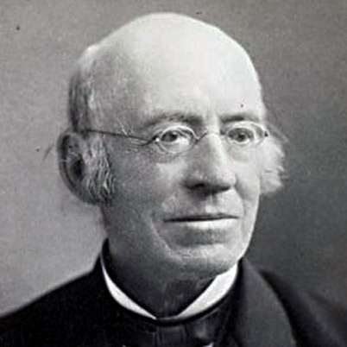
Notes:
garrison

Slide 11
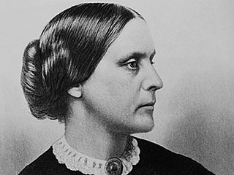
Notes:
Susan b anthony

Slide 12


Slide 13
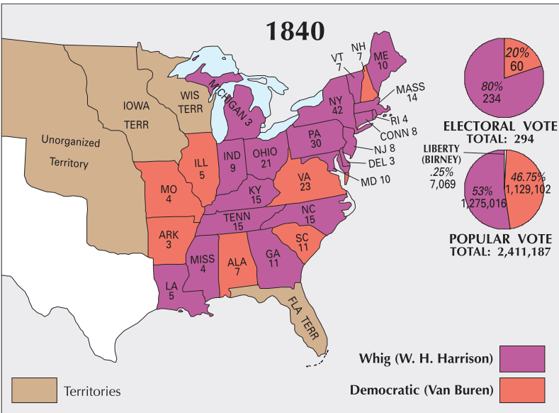

Slide 14
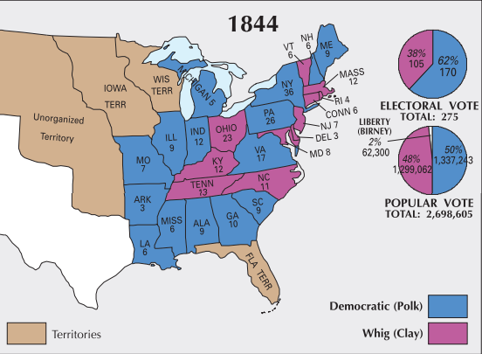

Slide 15
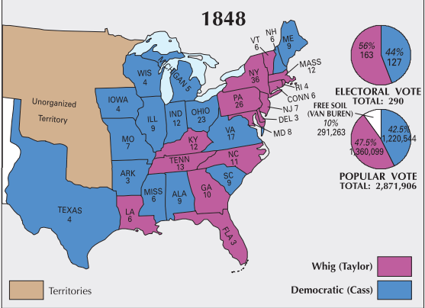

Slide 16
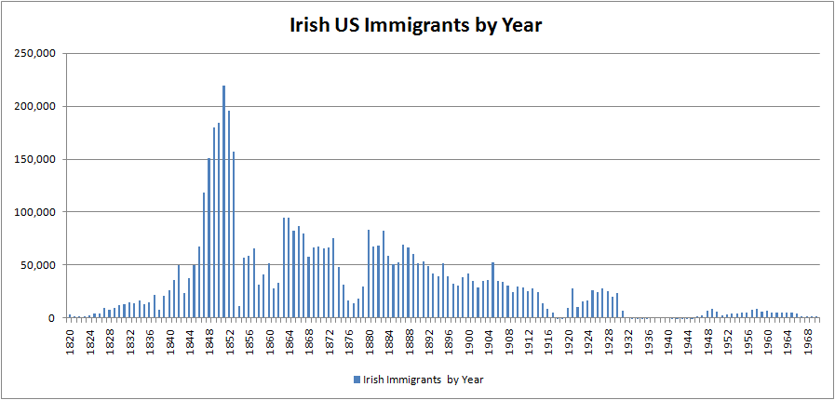

Slide 17
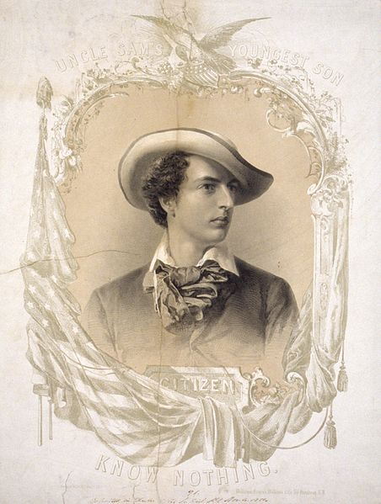
Notes:
K-n symbol

Slide 18
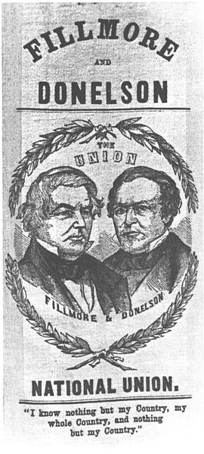

Slide 19
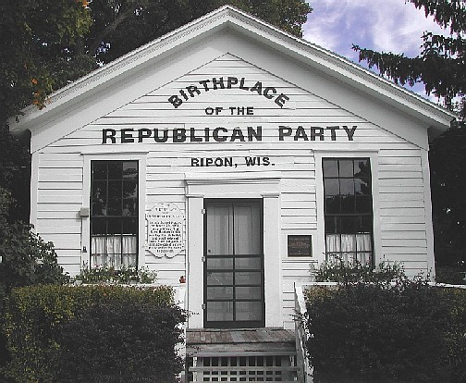

Slide 20
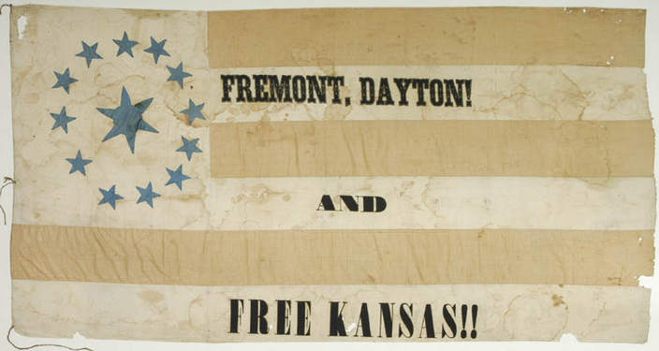

Slide 21
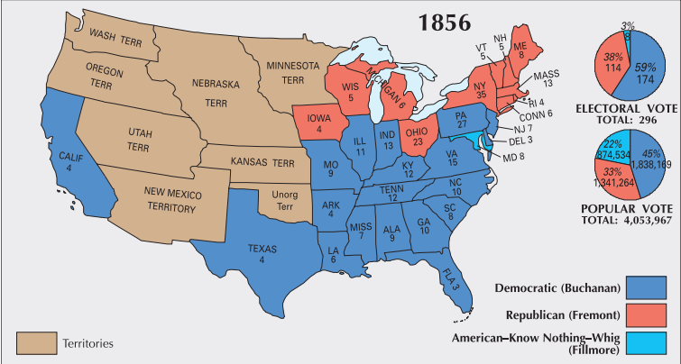

Slide 22
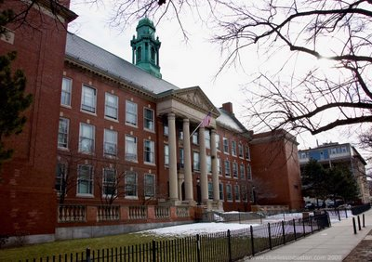
Notes:
Boston latin 1635

Slide 23
John Adams, 1776
Laws for the liberal education of youth, especially for the lower classes of people, are so extremely wise and useful that, to a humane and generous mind, no expense for this purpose would be thought extravagant.
Northwest Ordinance (1787)
Knowledge, being necessary to good government and the happiness of mankind, schools and the means of education shall forever be encouraged.

Slide 24
Anti-Catholic education-related legislation, 1840-1860
Laws banning state aid to parochial schools:
New Jersey
Wisconsin
Michigan
Ohio
Indiana
Massachusetts
Iowa
Minnesota
Kansas
Laws mandating King James (Church of England) Bible in public schools:
Massachusetts
Maine

Slide 25
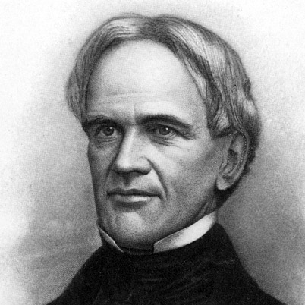
Notes:
Horace mann

Slide 26

Harvard, 1636

Slide 27
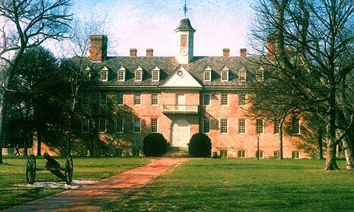
William & Mary, 1693

Slide 28
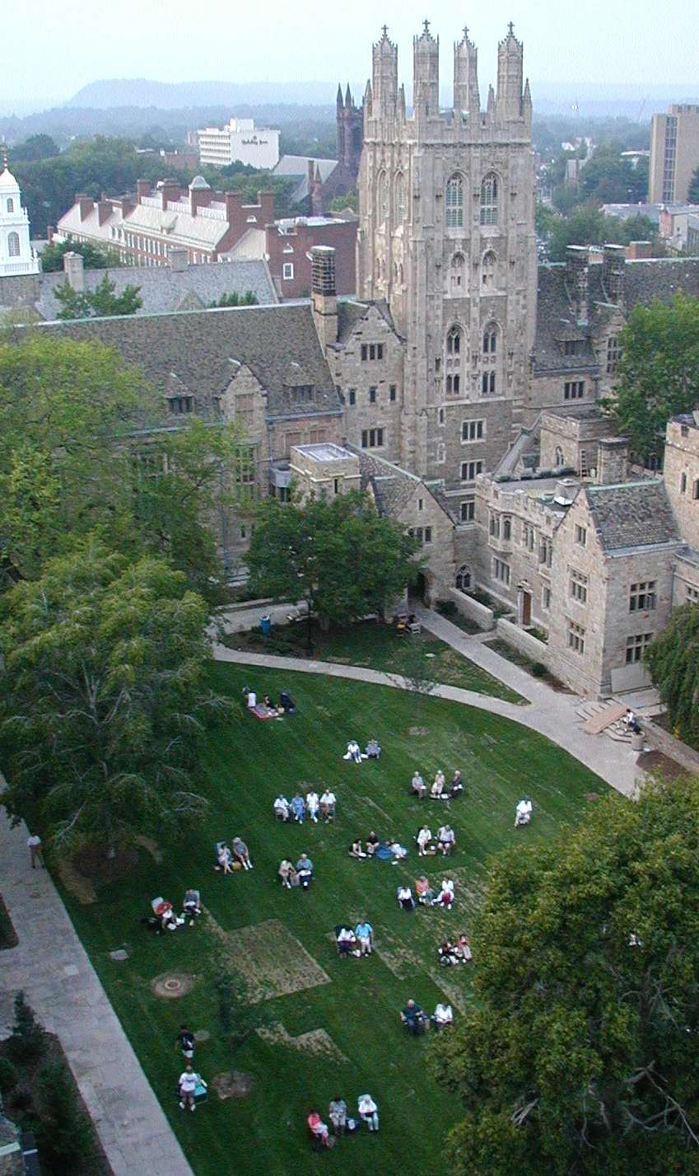
Yale, 1701

Slide 29
Other Colonial-Era Colleges
Princeton
Penn
Columbia
Brown
Rutgers
Dartmouth

Slide 30

University of North Carolina, 1795

Slide 31
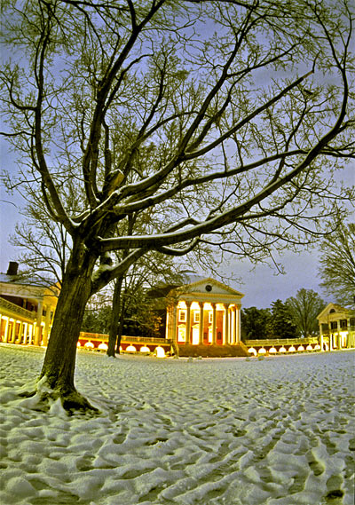
University of Virginia, 1819

Slide 32
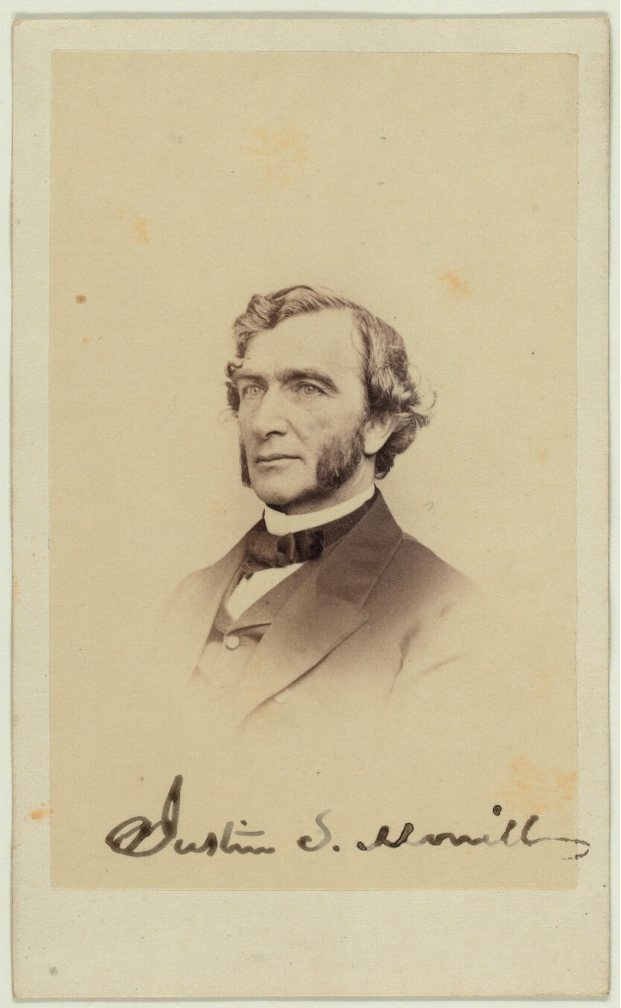
Notes:
Justin morrill

Slide 33
Morrill Act (1862)
Sale of federal public land for the “maintenance of at least one college where the leading object shall be, without excluding other scientific and classical studies and including military tactics, to teach such branches of learning as are related to agriculture and the mechanic arts, in such manner as the legislatures of the States may respectively prescribe, in order to promote the liberal and practical education of the industrial classes in the several pursuits and professions in life.”

Slide 34








Slide 35
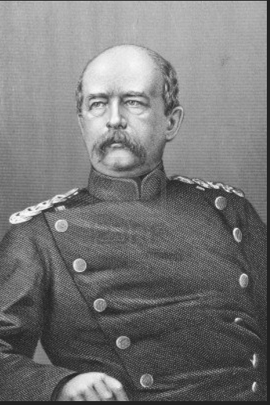

Slide 36
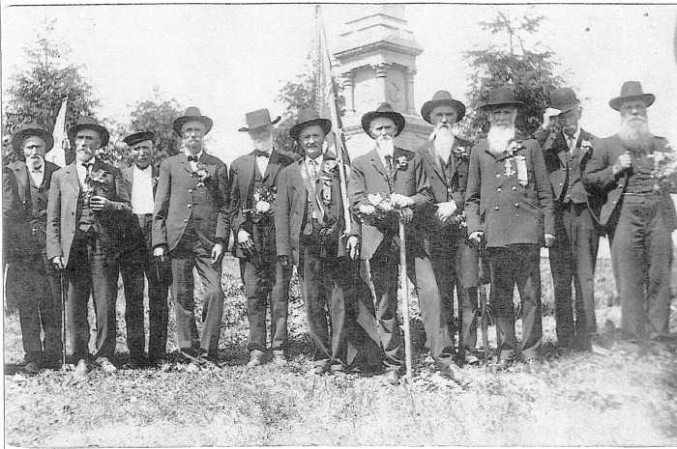

Slide 37
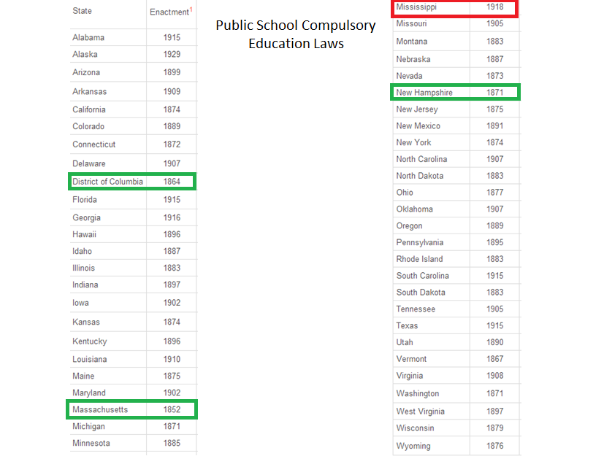

Slide 38
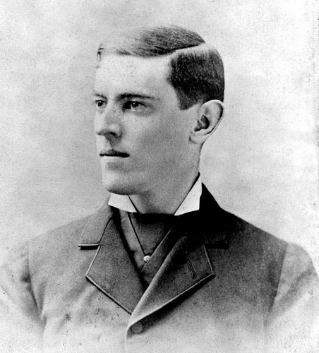

Slide 39
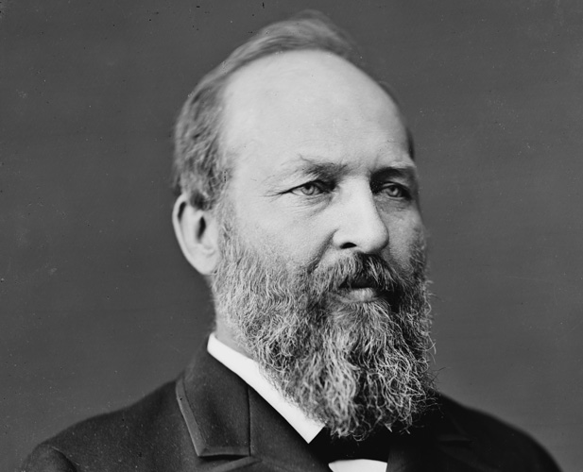

Slide 40
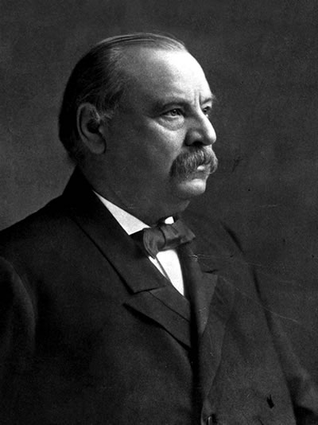

Slide 41
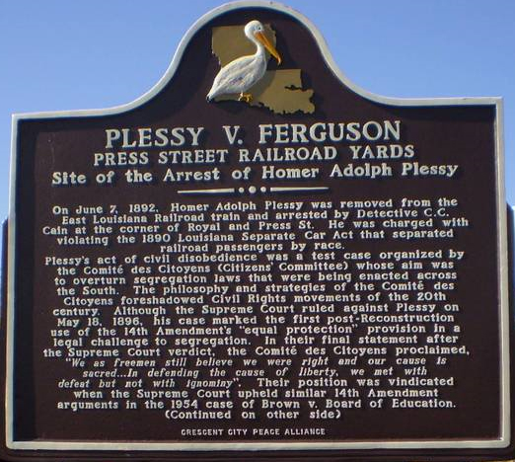
Plessy v. Ferguson (1896)
“We consider the underlying fallacy of the plaintiff's argument to consist in the assumption that the enforced separation of the two races stamps the colored race with a badge of inferiority. If this be so, it is not by reason of anything found in the act, but solely because the colored race chooses to put that construction upon it.”

