Slide 1
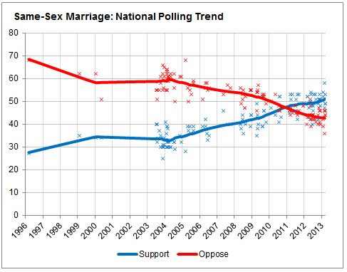

Slide 2
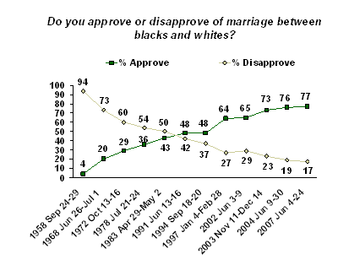

Slide 3
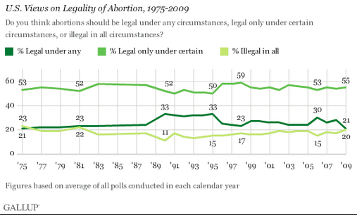

Slide 4
Baker v. State (Vermont, 1999)
We hold that the State is constitutionally required to extend to same-sex couples the common benefits and protections that flow from marriage under Vermont law. Whether this ultimately takes the form of inclusion within the marriage laws themselves or a parallel “domestic partnership” system or some equivalent statutory alternative, rests with the Legislature…
The concept of equality at the core of the Common Benefits Clause was not the eradication of racial or class distinctions, but rather the elimination of artificial governmental preferments and advantages. The Vermont Constitution would ensure that the law uniformly afforded every Vermonter its benefit, protection, and security so that social and political preeminence would reflect differences of capacity, disposition, and virtue, rather than governmental favor and privilege…
We find a constitutional obligation to extend to plaintiffs the common benefit, protection, and security that Vermont law provides opposite-sex married couples. It remains only to determine the appropriate means and scope of relief compelled by this constitutional mandate....

Slide 5
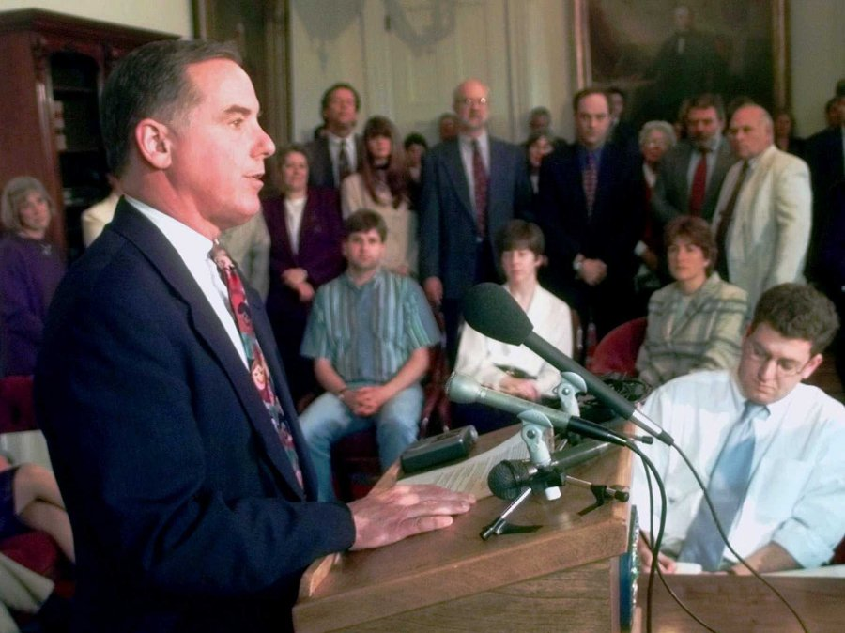

Slide 6


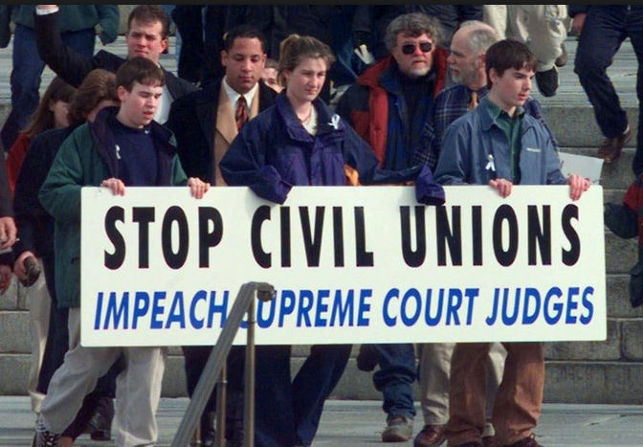

Slide 7
Goodridge v. Dept. of Health (MA, 2003)
The question before us is whether, consistent with the Massachusetts Constitution, the Commonwealth may deny the protections, benefits, and obligations conferred by civil marriage to two individuals of the same sex who wish to marry. We conclude that it may not. The Massachusetts Constitution affirms the dignity and equality of all individuals. It forbids the creation of second class citizens. In reaching our conclusion we have given full deference to the arguments made by the Commonwealth. But it has failed to identify any constitutionally adequate reason for denying civil marriage to same-sex couples…
The "marriage is procreation" argument singles out the one unbridgeable difference between same-sex and opposite-sex couples, and transforms that difference into the essence of legal marriage…
In this case, we are confronted with an entire, sizeable class of parents raising children who have absolutely no access to civil marriage and its protections because they are forbidden from procuring a marriage license. It cannot be rational under our laws, and indeed it is not permitted, to penalize children by depriving them of State benefits because the State disapproves of their parents' sexual orientation.

Slide 8
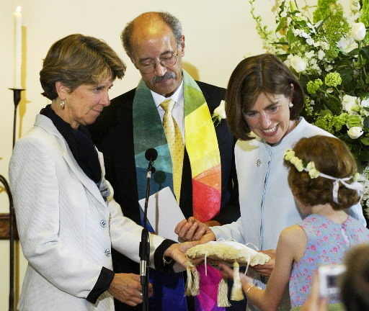

Slide 9


Slide 10
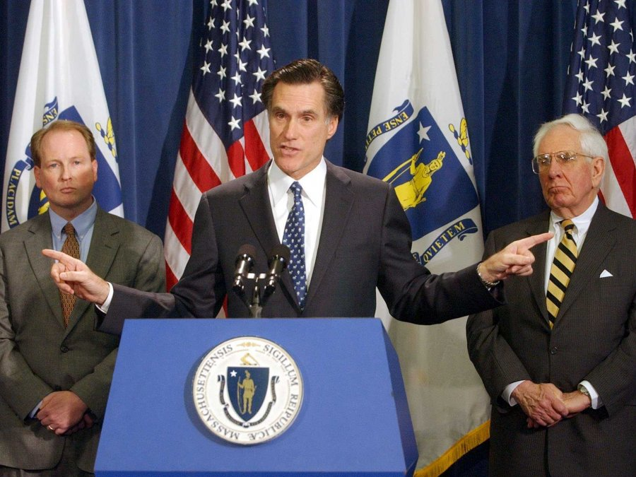

Slide 11
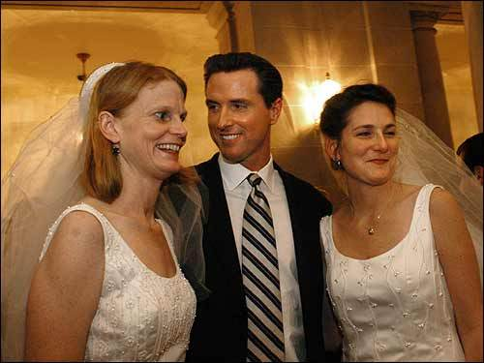

Slide 12
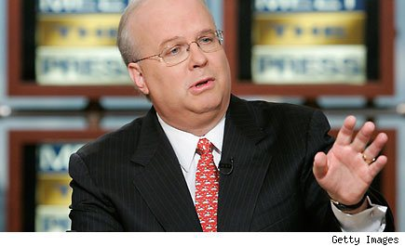

Slide 13
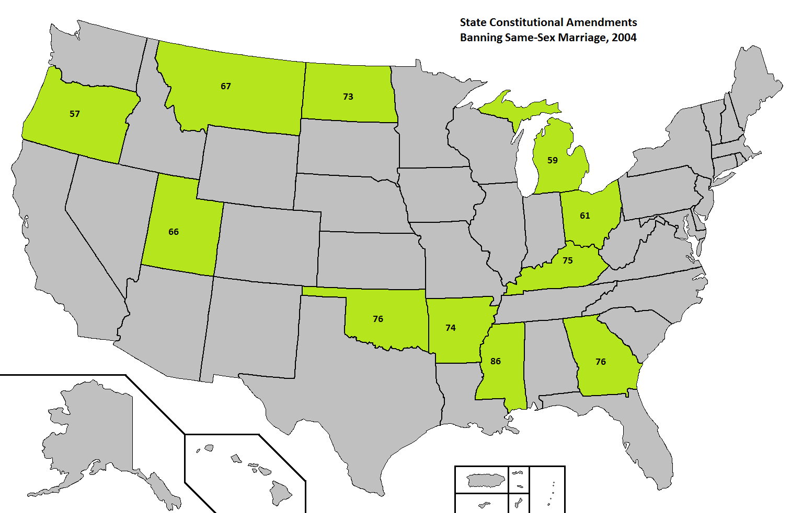

Slide 14
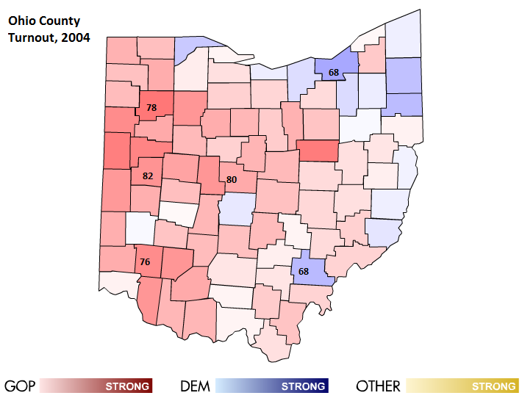
Notes:
Shelby, Warren, VanWert, and Delaware Counties; Bush gets 71% in Shelby

Slide 15
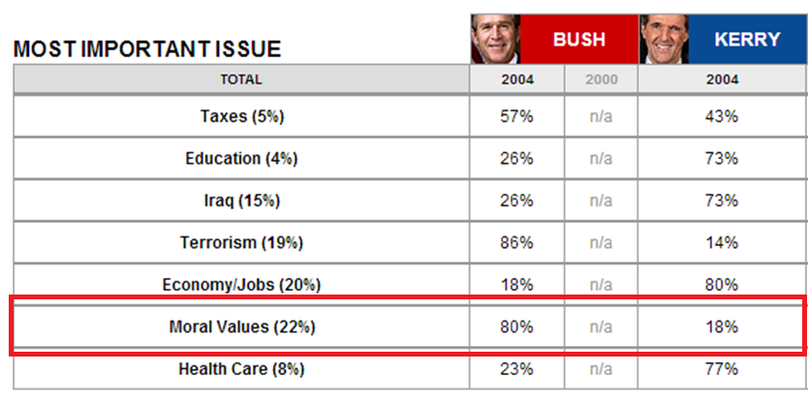

Slide 16
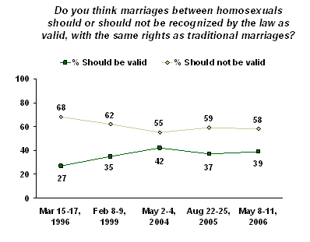

Slide 17
In re Marriage Cases (California, 2008)
The California Constitution properly must be interpreted to guarantee this basic civil right to all Californians, whether gay or heterosexual, and to same-sex couples as well as to opposite-sex couples…
Like Perez [the decision that overturned the ban on interracial marriage], subsequent California decisions discussing the nature of marriage and the right to marry have recognized repeatedly the linkage between marriage, establishing a home, and raising children in identifying civil marriage as the means available to an individual to establish, with a loved one of his or her choice, an officially recognized family relationship…
Whether or not the name “marriage,” in the abstract, is considered a core element of the state constitutional right to marry, one of the core elements of this fundamental right is the right of same-sex couples to have their official family relationship accorded the same dignity, respect, and stature as that accorded to all other officially recognized family relationships.

Slide 18
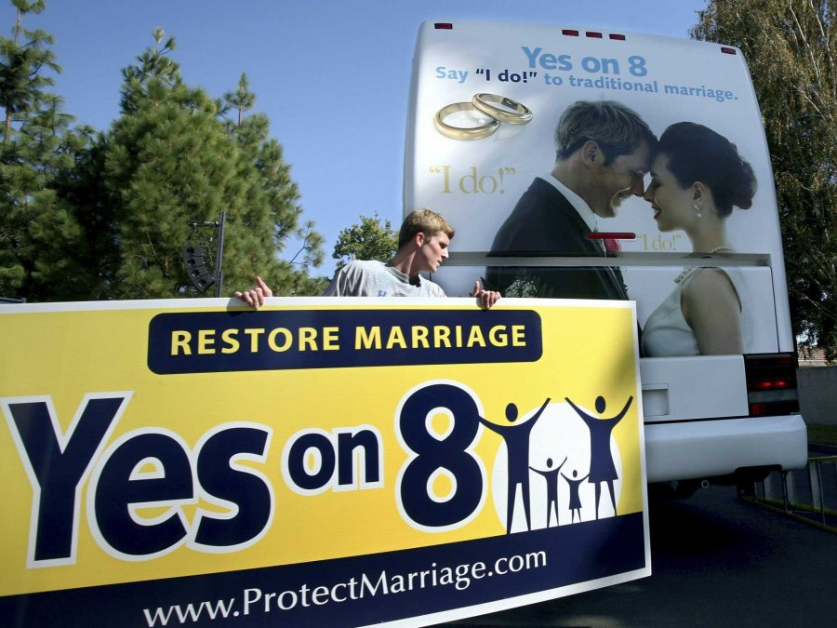

Slide 19
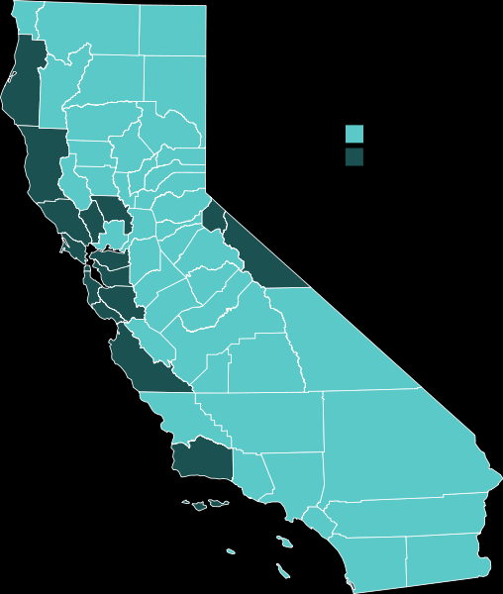

Slide 20
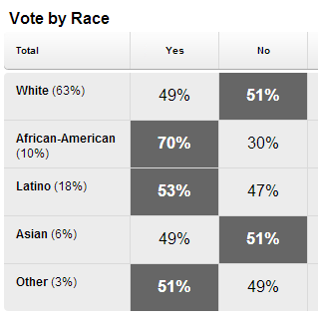
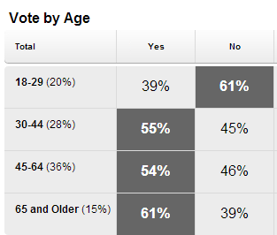
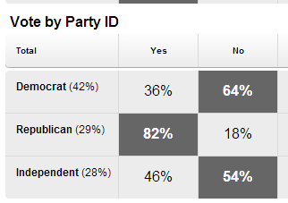
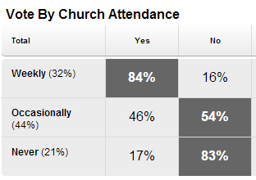
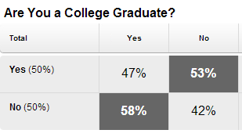

Slide 21


Slide 22
Varnum v. Brien (Iowa, 2009)
The primary constitutional principle at the heart of this case is the doctrine of equal protection…
We begin with the County’s argument that the goal of the same-sex
marriage ban is to ensure children will be raised only in the optimal milieu. In pursuit of this objective, the statutory exclusion of gay and lesbian people is both under-inclusive and over-inclusive. The civil marriage statute is under-inclusive because it does not exclude from marriage other groups of parents—such as child abusers, sexual predators, parents neglecting to provide child support, and violent felons—that are undeniably less than optimal parents…
While unexpressed, religious sentiment most likely motivates many, if
not most, opponents of same-sex civil marriage and perhaps even shapes the views of those people who may accept gay and lesbian unions but find the notion of same-sex marriage unsettling…Whether expressly or impliedly, much of society rejects same-sex marriage due to sincere, deeply ingrained—even fundamental—religious belief.

Slide 23
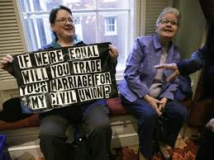

Slide 24
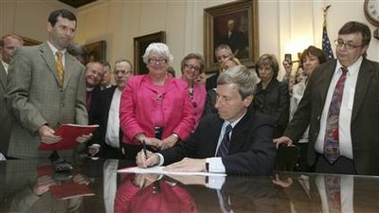

Slide 25


Slide 26
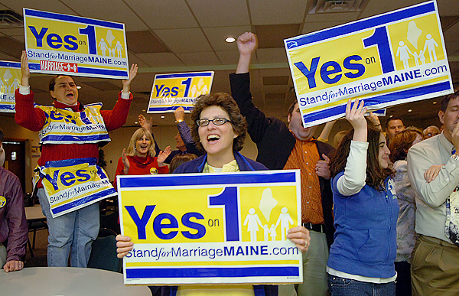

Slide 27



Slide 28
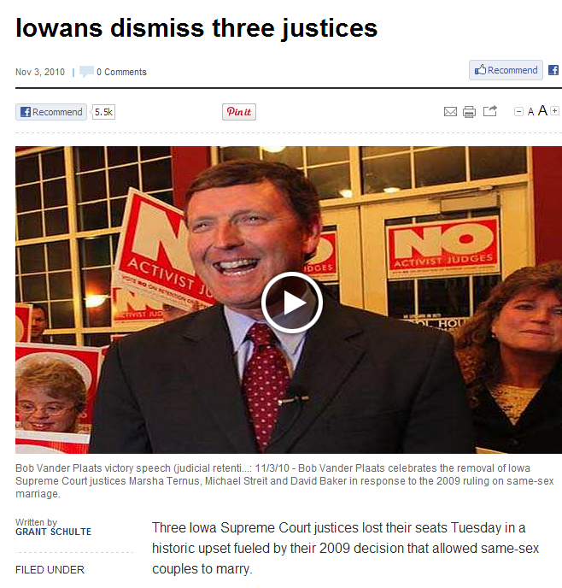

Slide 29
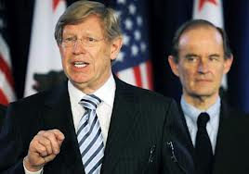

Slide 30
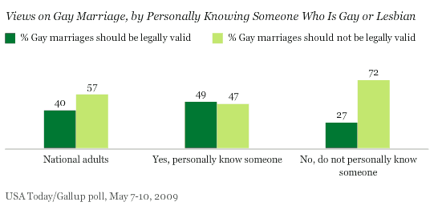

Slide 31
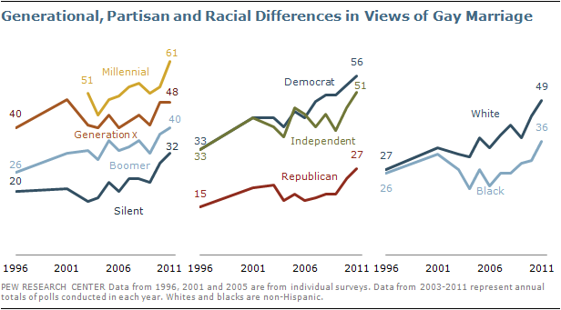

Slide 32
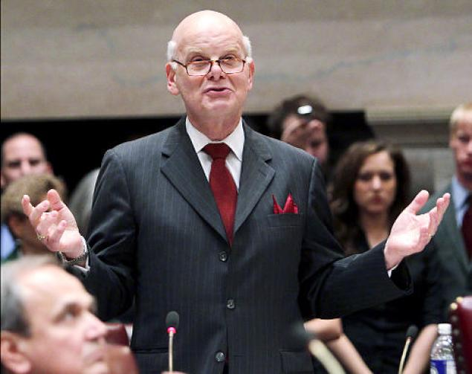

Slide 33
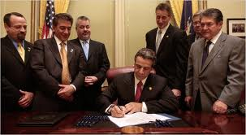

Slide 34


Slide 35
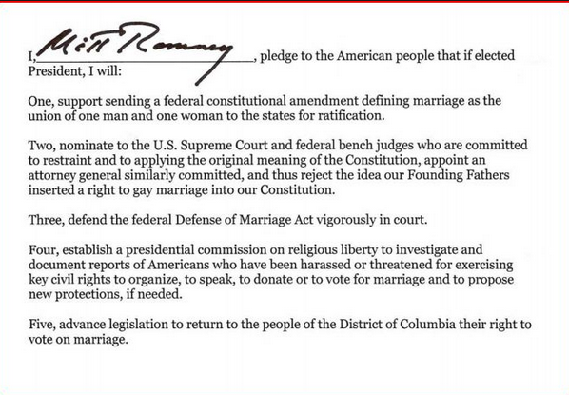

Slide 36
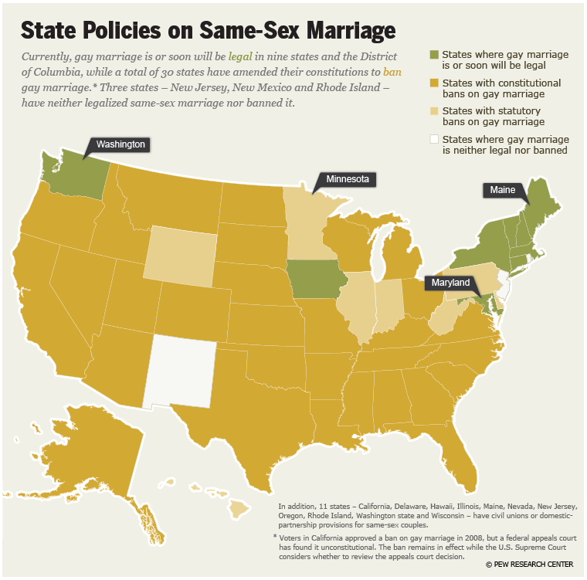

Slide 37


Slide 38
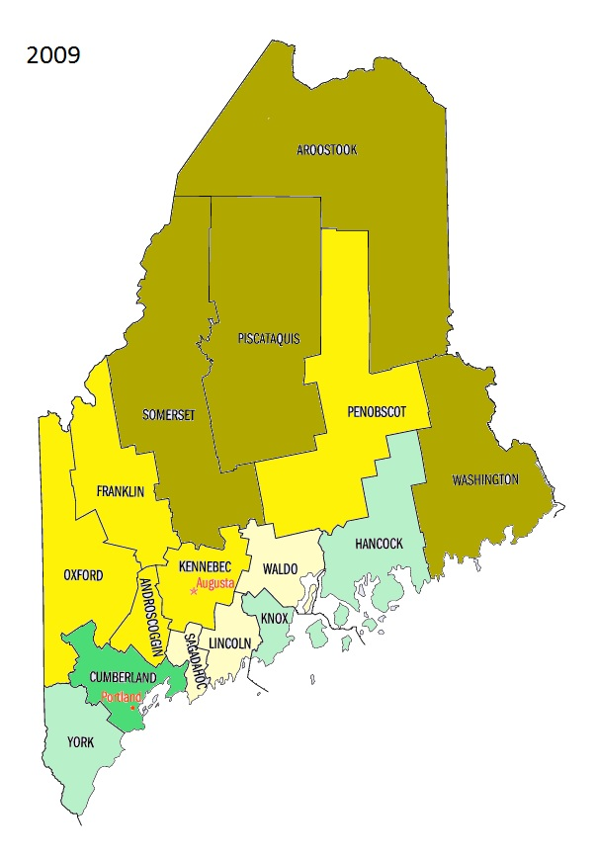
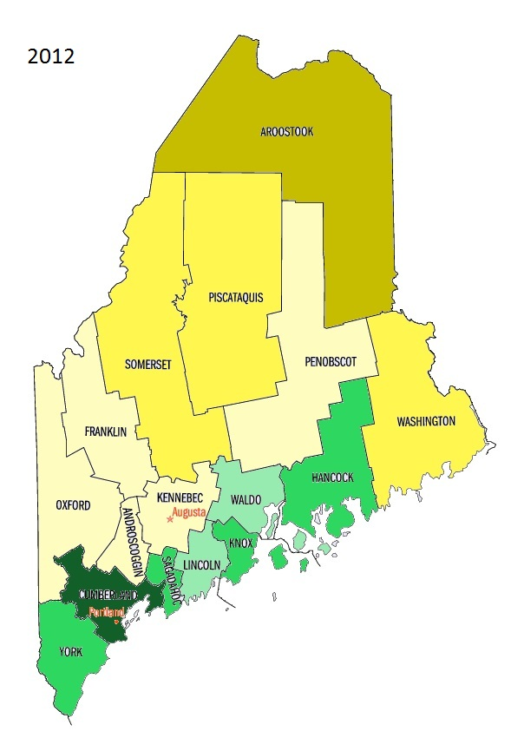



Slide 39
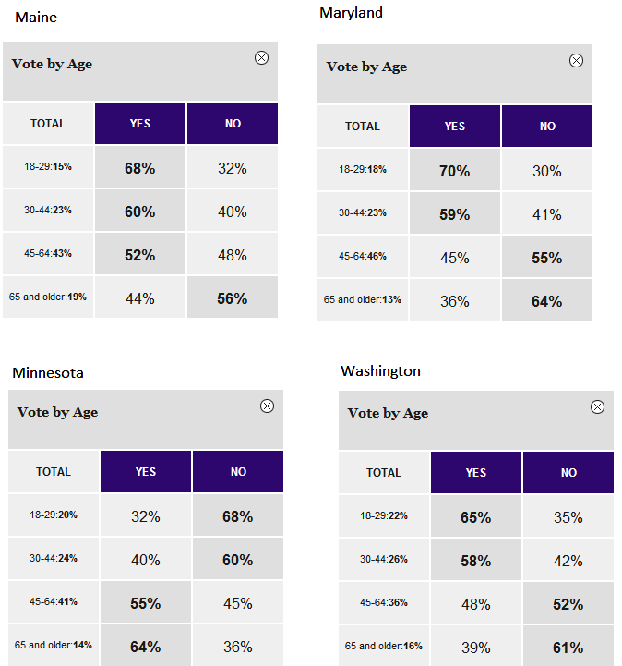

Slide 40
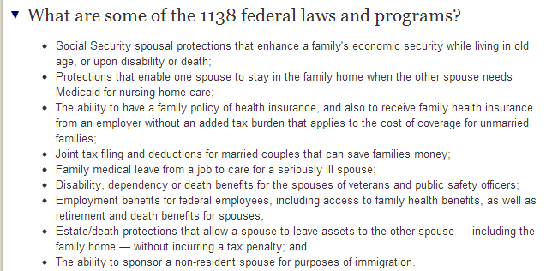

Slide 41
Massachusetts v. Dept. of Health and Human Services (1st circuit, 2012)
We conclude that the extreme deference accorded to ordinary economic legislation…would not be extended to DOMA by the Supreme Court; and without insisting on “compelling” or “important” justifications or "narrow tailoring," the Court would scrutinize with care the purported bases for the legislation. Before providing such scrutiny, a separate element…--federalism--must be considered…
Despite its ramifying application throughout the U.S. Code, only one day of hearings was held on DOMA, and none of the testimony concerned DOMA's effects on the numerous federal programs at issue. Some of the odder consequences of DOMA testify to the speed with which it was adopted…
For generations, moral disapproval has been taken as an adequate basis for legislation, although usually in choices made by state legislators to whom general police power is entrusted. But, speaking directly of same-sex preferences, Lawrence ruled that moral disapproval alone cannot justify legislation discriminating on this basis. Moral judgments can hardly be avoided in legislation, but Lawrence and Romer have undercut this basis.

Slide 42
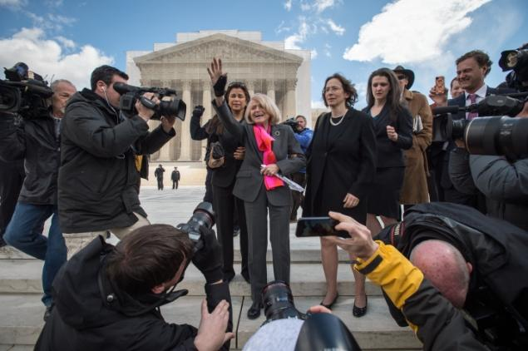

Slide 43
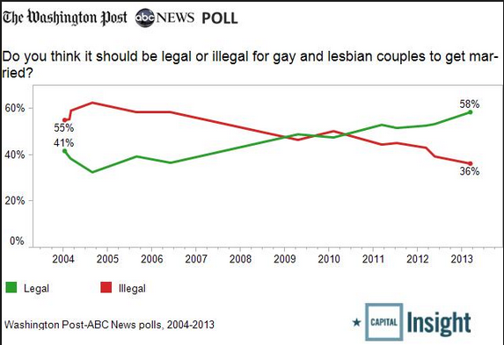

Slide 44
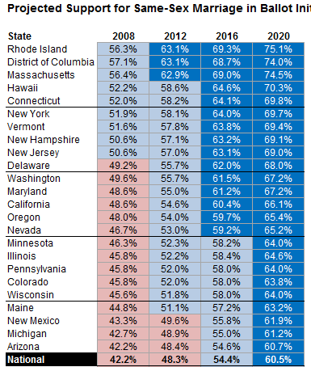
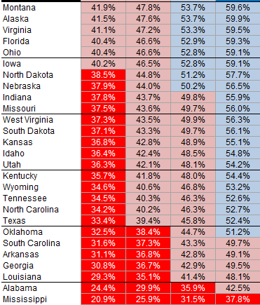
@538, New York Times

Slide 45


Slide 46



Slide 47
