Slide 1
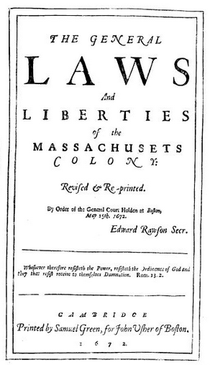

Slide 2
Blackstone on coverture
By marriage, the husband and wife are one person in law: that is, the very being or legal existence of the woman is suspended during the marriage, or at least is incorporated and consolidated into that of the husband: under whose wing, protection, and cover, she performs every thing; and is therefore called in our law-French a feme-covert; is said to be covert-baron, or under the protection and influence of her husband, her baron, or lord; and her condition during her marriage is called her coverture. Upon this principle, of a union of person in husband and wife, depend almost all the legal rights, duties, and disabilities, that either of them acquire by the marriage. I speak not at present of the rights of property, but of such as are merely personal. For this reason, a man cannot grant any thing to his wife, or enter into covenant with her: for the grant would be to suppose her separate existence; and to covenant with her, would be only to covenant with himself: and therefore it is also generally true, that all compacts made between husband and wife, when single, are voided by the intermarriage

Slide 3
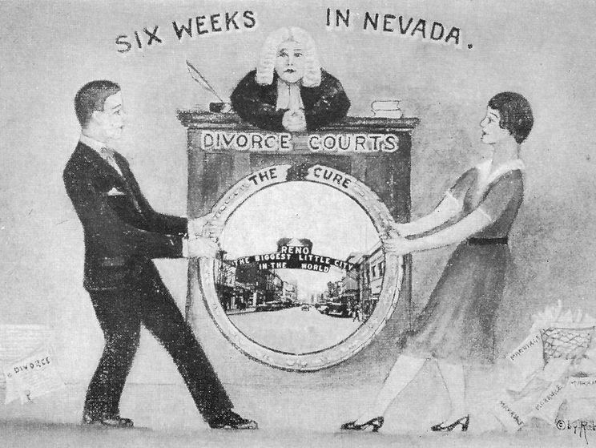

Slide 4
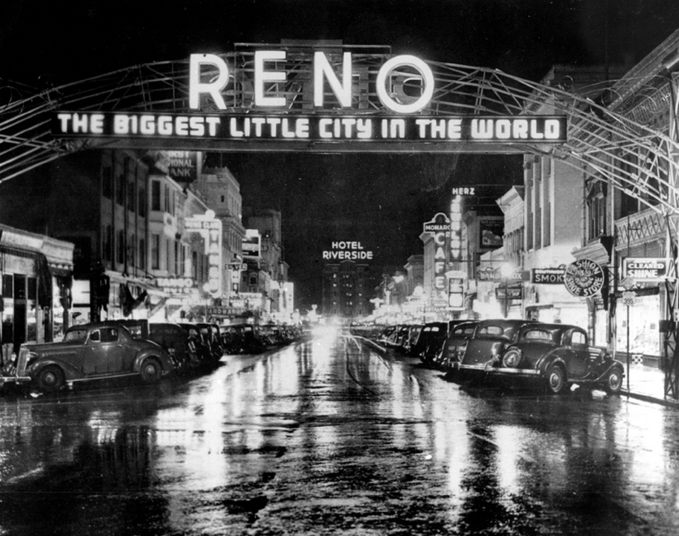

Slide 5
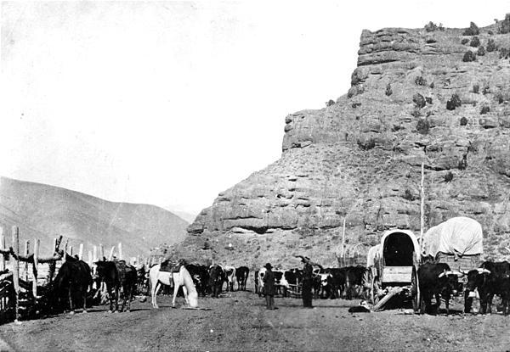

Slide 6
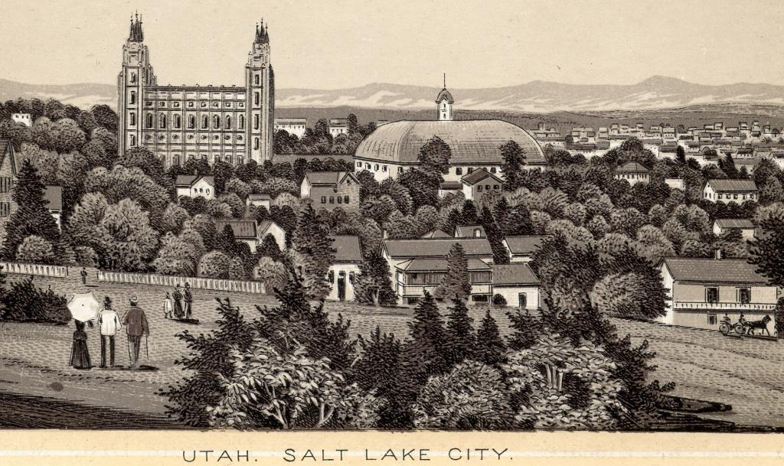

Slide 7
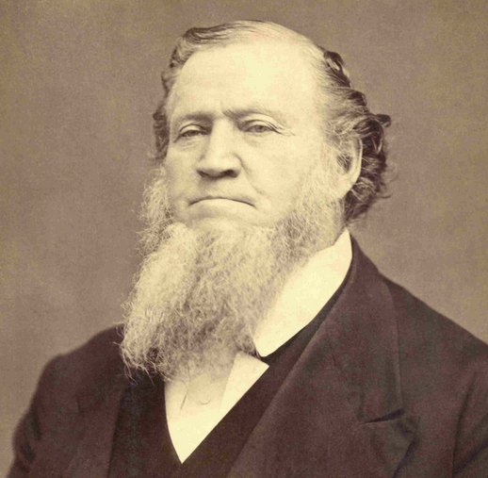
Notes:
Brigham young

Slide 8
Late Corporation of the Church of Jesus Christ
of Latter-Day Saints v. United States (1890)
One pretense for [Mormons’] obstinate course is that their belief in the practice of polygamy, or in the right to indulge in it, is a religious belief, and therefore under the protection of the constitutional guaranty of religious freedom. This is altogether a sophistical plea. No doubt the Thugs of India imagined that their belief in the right of assassination was a religious belief; but their thinking so did not make it so. The practice of suttee by the Hindu widows may have sprung from a supposed religious conviction. The offering of human sacrifices by our own ancestors in Britain was no doubt sanctioned by an equally conscientious impulse. But no one, on that account, would hesitate to brand these practices, now, as crimes against society, and obnoxious to condemnation and punishment by the civil authority. The state has a perfect right to prohibit polygamy, and all other open offenses against the enlightened sentiment of mankind, notwithstanding the pretense of religious conviction by which they may be advocated and practiced.

Slide 9
Meyer v. Nebraska, 262 U.S. 390, 399 (1923): The right “to marry, establish a home and bring up children” is a central part of liberty protected by the Due Process Clause.
Skinner v. Oklahoma ex rel. Williamson, 316 U.S. 535, 541 (1942): Marriage “one of the basic civil rights of man,” “fundamental to the very existence and survival of the race.”

Slide 10
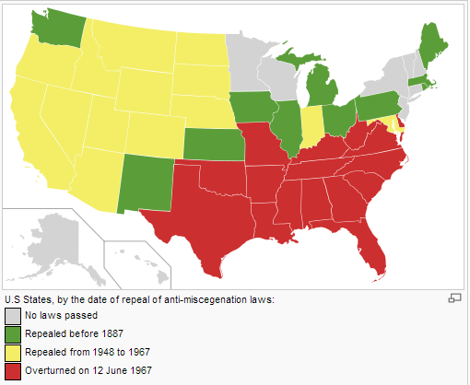

Slide 11
Pace v. Alabama (1883)
Equality of protection under the laws implies not only accessibility by each one, whatever his race, on the same terms with others to the courts of the country for the security of his person and property, but that in the administration of criminal justice he shall not be subjected, for the same offense, to any greater or different punishment…
Section 4189 [which criminalized interracial marriage] applies the same punishment to both offenders, the white and the black. Indeed, the offense against which this latter section is aimed cannot be committed without involving the persons of both races in the same punishment. Whatever discrimination is made in the punishment prescribed in the two sections is directed against the offense designated and not against the person of any particular color or race. The punishment of each offending person, whether white or black, is the same.

Slide 12
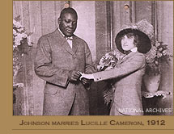

Slide 13
Rep. Seaborn Roddenberry (D-GA), on need for constitutional amendment banning interracial marriage, 1912
No brutality, no infamy, no degradation in all the years of southern slavery, possessed such villainious character and such atrocious qualities as the provision of the laws of Illinois, Massachusetts, and other states which allow the marriage of the negro, Jack Johnson, to a woman of Caucasian strain. [applause]. Gentleman, I offer this resolution ... that the States of the Union may have an opportunity to ratifty it.
...Intermarriage between whites and blacks is repulsive and averse to every sentiment of pure American spirit. It is abhorrent and repugnant to the very principles of Saxon government. It is subversive of social peace. It is destructive of moral supremacy, and ultimately this slavery of white women to black beasts will bring this nation a conflict as fatal as ever reddened the soil of Virginia or crimsoned the mountain paths of Pennsylvania.
... Let us uproot and exterminate now this debasing, ultra-demoralizing, un-American and inhuman leprosy

Slide 14
Massachusetts marriage amendment (1913)
Section 11. No marriage shall be contracted in this commonwealth by a party residing and intending to continue to reside in another jurisdiction if such marriage would be void if contracted in such other jurisdiction, and every marriage contracted in this commonwealth in violation hereof shall be null and void. Mass. Gen. L. ch. 207, § 11 (2005).

Slide 15
Sharp v. Perez (1948, CA), plurality opinion
The right to marry is as fundamental as the right to send one's child to a particular school or the right to have offspring . . . Legislation infringing such rights must be based upon more than prejudice and must be free from oppressive discrimination to comply with the constitutional requirements of due process and equal protection of the laws…
Even if we were to assume that inter-racial marriage results in
inferior progeny, we are unable to find any clear policy in the statute against marriages on that ground…
The rationalization that race discrimination diminishes the contacts and therefore the tensions between races would perpetuate the deprivation of rights of racial minorities. It would justify an abridgment of their privilege of holding office, of jury service, of entering the professions. The courts have made it clear that these privileges are not the prerogatives of any race.

Slide 16
Sharp v. Perez (1948, CA), dissent
It is difficult to see why such laws, valid when enacted and constitutionally enforceable in this state for nearly 100 years and elsewhere for a much longer period of time, are now unconstitutional under the same Constitution and with no change in the factual situation . . . they have a valid legislative purpose even though they may not conform to the sociogenetic views of some people…
The institution of matrimony is the foundation of society, and the community at large has an interest in the maintenance of its integrity and purity…
On the biological phase there is authority for the conclusion that the crossing of the primary races leads gradually to retrogression and to eventual extinction of the resultant type unless it is fortified by reunion with the parent stock.

Slide 17
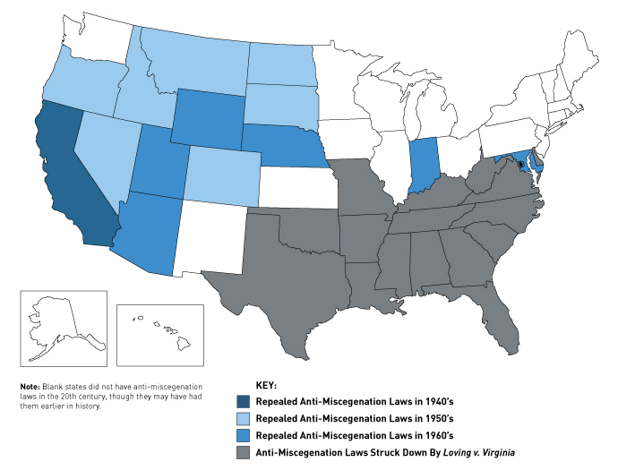

Slide 18
Naim v. Naim (1955)
Brown v. Board of Education, supra, reached its conclusion that segregation in the public schools was contrary to the Equal Protection clause on the basis that education is perhaps the most important function of State and local governments, “the very foundation of good citizenship,” and that the opportunity to acquire it, “where the state has undertaken to provide it, is a right which must be made available to all on equal terms.”
No such claim for the intermarriage of the races could be supported; by no sort of valid reasoning could it be found to be a foundation of good citizenship or a right which must be made available to all on equal terms. In the opinion of the legislatures of more than half the States it is harmful to good citizenship . . .
We are unable to read in the Fourteenth Amendment to the Constitution, or in any other provision of that great document, any words or any intendment which prohibit the State from enacting legislation to preserve the racial integrity of its citizens, or which denies the power of the State to regulate the marriage relation so that it shall not have a mongrel breed of citizens.

Slide 19
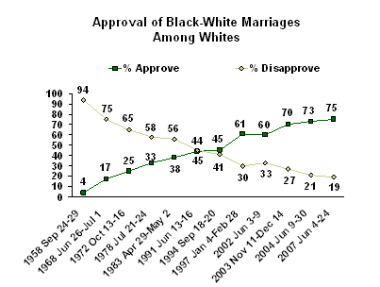

Slide 20
Griswold v. CT (1965)
We deal with a right of privacy older than the Bill of Rights—older than our political parties, older than our school system. Marriage is a coming together for better or for worse, hopefully enduring, and intimate to the degree of being sacred. It is an association that promotes a way of life, not causes; a harmony in living, not political faiths; a bilateral loyalty, not commercial or social projects. Yet it is an association for as noble a purpose as any involved in our prior decisions.

Slide 21
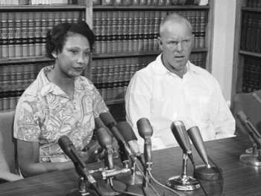

Slide 22
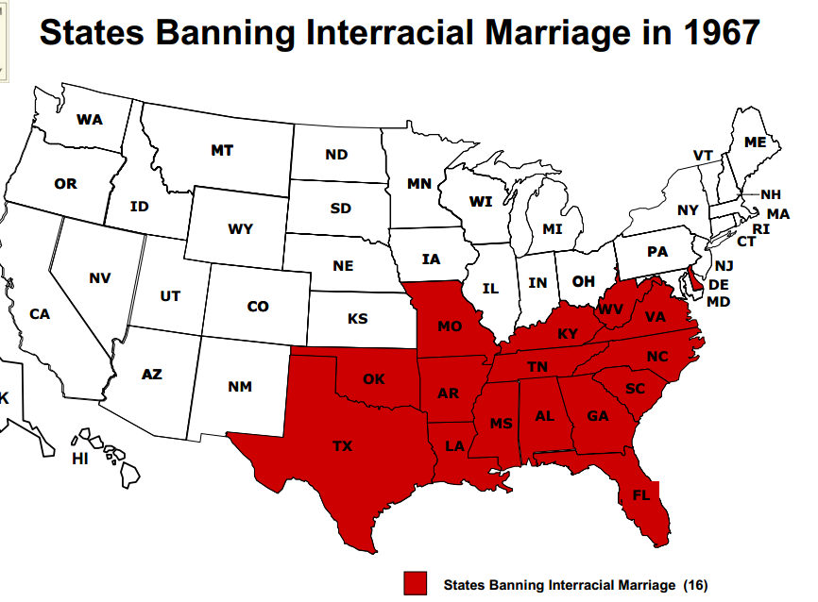

Slide 23
Loving v. Virginia (1967)
The freedom to marry has long been recognized as one of the vital personal rights essential to the orderly pursuit of happiness by free men . . . Marriage is one of the `basic civil rights of man,' fundamental to our very existence and survival . . .
There is patently no legitimate overriding purpose independent of invidious racial discrimination which justifies this classification. The fact that Virginia prohibits only interracial marriages involving white persons demonstrates that the racial classifications must stand on their own justification, as measures designed to maintain White Supremacy. We have consistently denied the constitutionality of measures which restrict the rights of citizens on account of race. There can be no doubt that restricting the freedom to marry solely because of racial classifications violates the central meaning of the Equal Protection Clause.

Slide 25
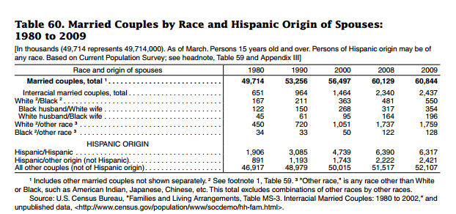

Slide 26
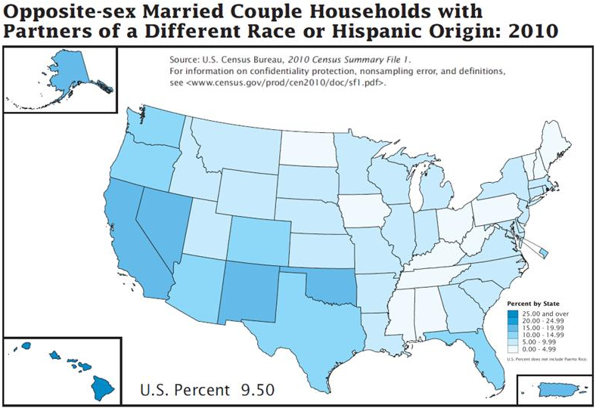

Slide 27
Zablocki v. Redhail (1978)
The leading decision of this Court on the right to marry is Loving v. Virginia . . . the Court went on to hold that the laws arbitrarily deprived the couple of a fundamental liberty protected by the Due Process Clause, the freedom to marry . . . Although Loving arose in the context of racial discrimination, prior and subsequent decisions of this Court confirm that the right to marry is of fundamental importance for all individuals . . .
Some of those in the affected class, like appellee, will never be able to obtain the necessary court order, because they either lack the financial means to meet their support obligations or cannot prove that their children will not become public charges. These persons are absolutely prevented from getting married. Many others, able in theory to satisfy the statute's requirements, will be sufficiently burdened by having to do so that they will in effect be coerced into forgoing their right to marry. And even those who can be persuaded to meet the statute's requirements suffer a serious intrusion into their freedom of choice in an area in which we have held such freedom to be fundamental.

Slide 28
Turner v. Safley (1987)
The decision to marry is a fundamental right . . .
Many important attributes of marriage remain, however, after taking into account the limitations imposed by prison life. First, inmate marriages, like others, are expressions of emotional support and public commitment. These elements are an important and significant aspect of the marital relationship . . . Finally, marital status often is a precondition to the receipt of government benefits (e. g., Social Security benefits), property rights (e. g., tenancy by the entirety, inheritance rights), and other, less tangible benefits (e. g., legitimation of children born out of wedlock). These incidents of marriage, like the religious and personal aspects of the marriage commitment, are unaffected by the fact of confinement or the pursuit of legitimate corrections goals . . .

