Slide 1
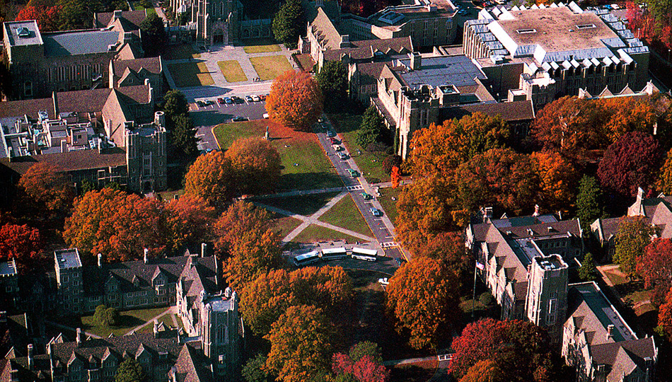

Slide 2
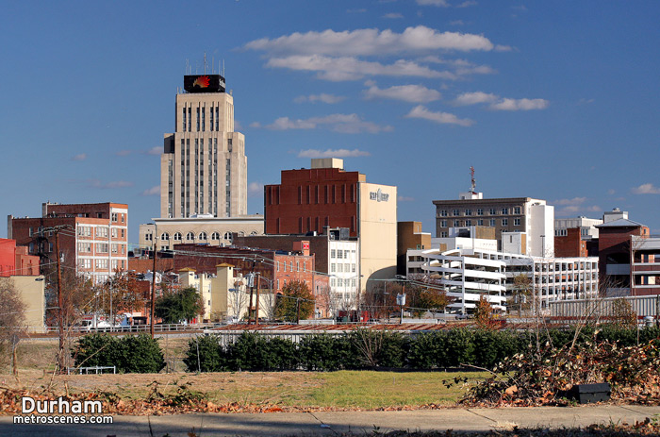

Slide 3
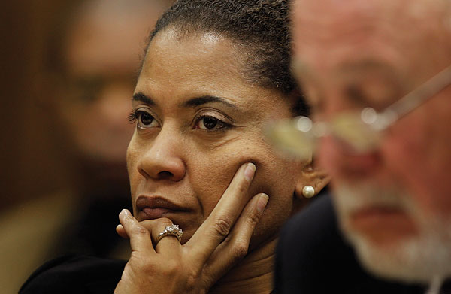

Slide 4
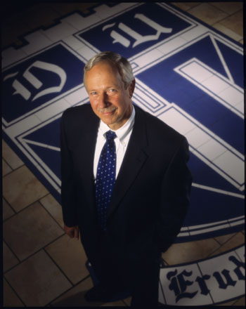
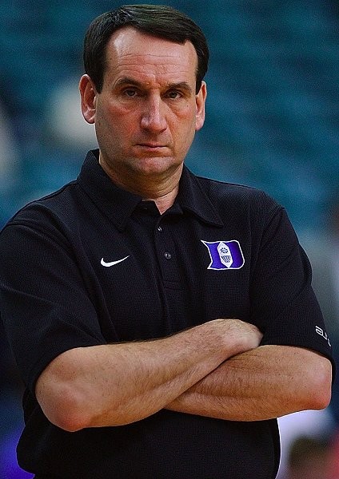

Slide 5
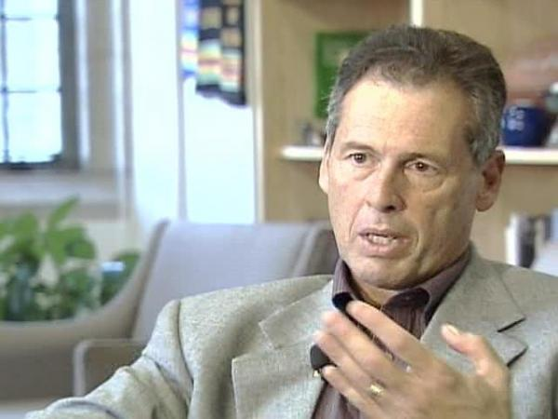


Slide 6
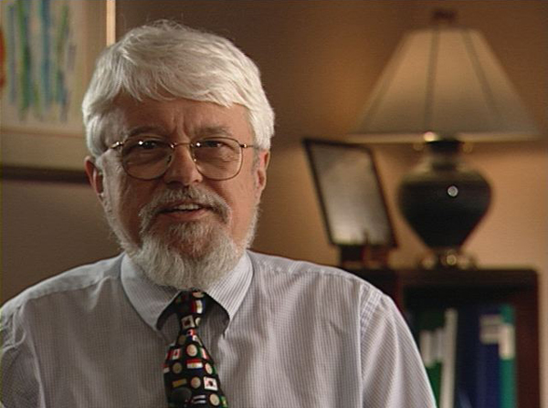

Slide 7
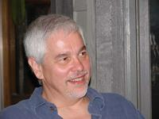
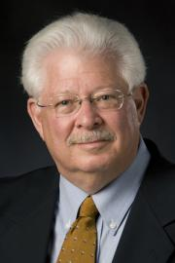
Duke Conservative Union Study (2004) reaction
"We try to hire the best, smartest people available. If, as John Stuart Mill said, stupid people are generally conservative, then there are lots of conservatives we will never hire. Mill's analysis may go some way towards explaining the power of the Republican party in our society and the relative scarcity of Republicans in academia . . . Members of academia tend to be a bit smarter than average. There is a good reason for this too.”
"If you look at the humanities in general, there's a great deal of creativity that goes on. In a sense it's innovation, and a perfectly logical criticism of the current society, in one form or another, that plays itself out in some of these disciplines. It doesn't surprise me that you might find people in humanities are more liberal than conservative."

Slide 8
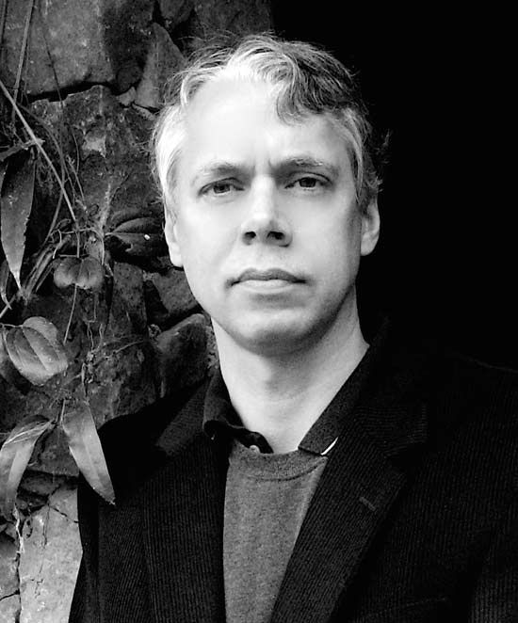
Groupthink Principles:
Common assumption
False consensus effect
Law of group polarization

Slide 9
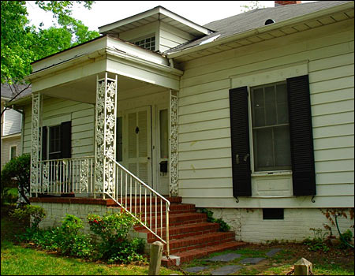

Slide 10
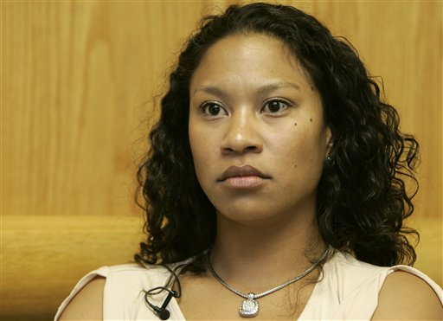

Slide 11


Slide 12
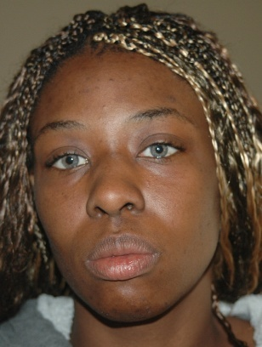

Slide 13
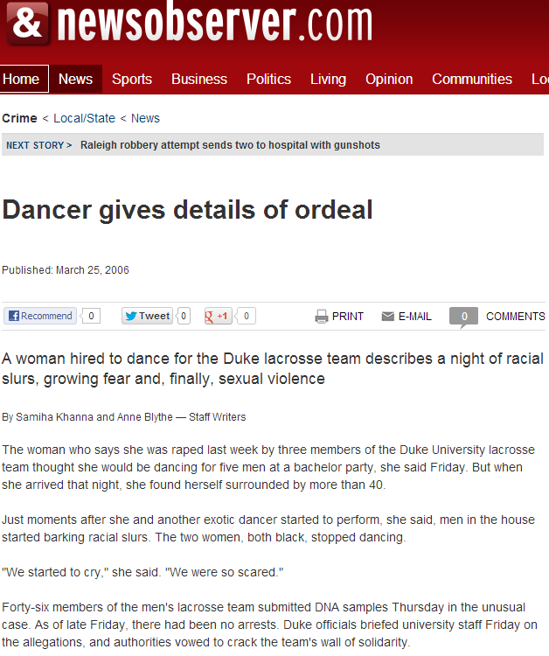

Slide 14
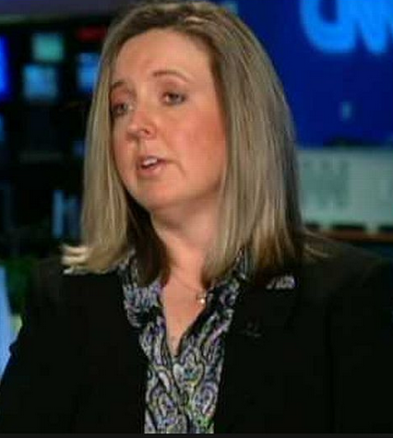
The season is over, but the paradox lives on in Duke’s lacrosse team, a group of privileged players of fine pedigree entangled in a night that threatens to belie their social standing as human beings…
Players have been forced to give up their DNA, but to the dismay of investigators, none have come forward to reveal an eyewitness account.
Does President Brodhead dare to confront the culture behind the lacrosse team’s code of silence or would he fear being ridiculed as a snitch?
Something happened March 13, when a woman, hired to dance at a private party, alleged that three lacrosse players sexually assaulted her in a bathroom for 30 minutes.
New York Times, 31 March 2006

Slide 15
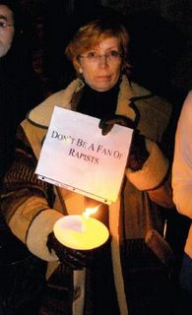
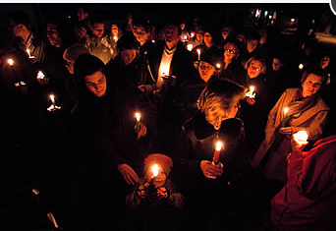
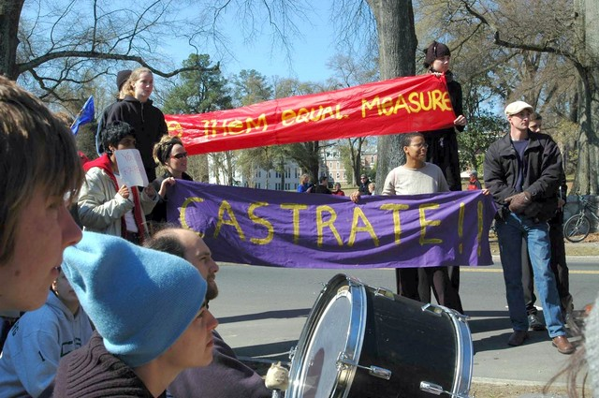

Slide 16
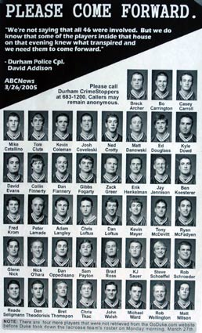

Slide 17
Duke Faculty Handbook
Members of the faculty expect Duke students to meet high standards of performance and behavior. It is only appropriate, therefore, that the faculty adheres to comparably high standards in dealing with students . . . Students are fellow members of the university community, deserving of respect and consideration in their dealings with the faculty.

Slide 18
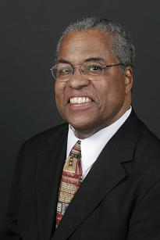
There can be no confidence in an administration that believes suspending a lacrosse season and removing pictures of Duke lacrosse players from a web page is a dutifully moral response to abhorrent sexual assault, verbal racial violence, and drunken white male privilege loosed amongst us.
How soon will confidence be restored to our university as a place where minds, souls, and bodies can feel safe from agents, perpetrators, and abettors of white privilege, irresponsibility, debauchery and violence?
Surely the answer to the question must come in the form of immediate dismissals of those principally responsible for the horrors of this spring moment at Duke. Coaches of the lacrosse team, the team itself and its players, and any other agents who silenced or lied about the real nature of events at 610 Buchanan on the evening of March 13, 2006. A day that, not even in a clichéd sense, will, indeed, always live in infamy for this university.
29 March 2006

Slide 19
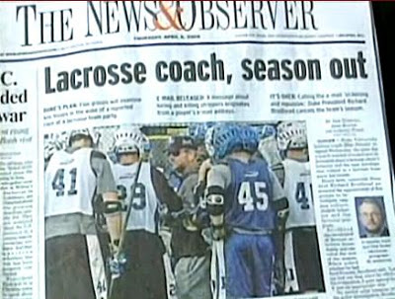

Slide 20
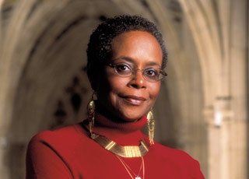
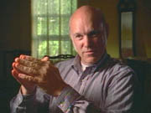
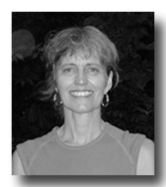

Slide 21
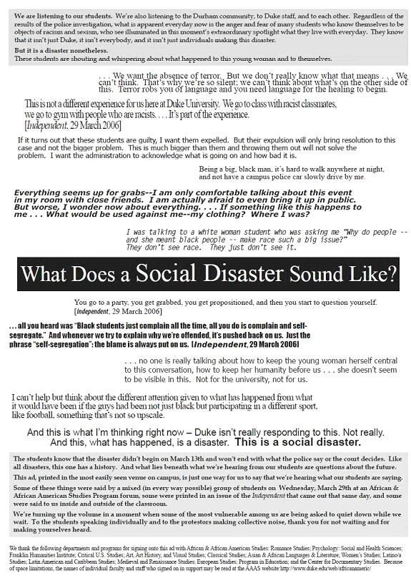

Slide 22
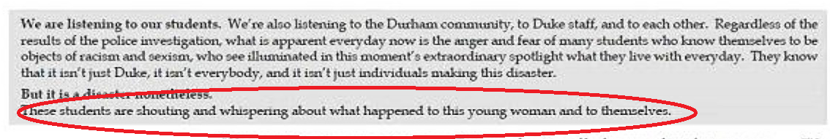
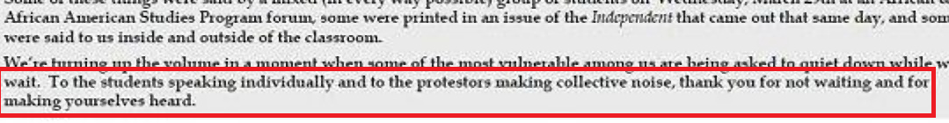


Slide 23
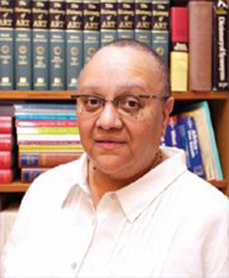
Lubiano knew some would see the ad as a stake through the collective heart of the lacrosse team. But if the black faculty couldn't speak for black students now, could it ever?
--ESPN, June 2006

Slide 24
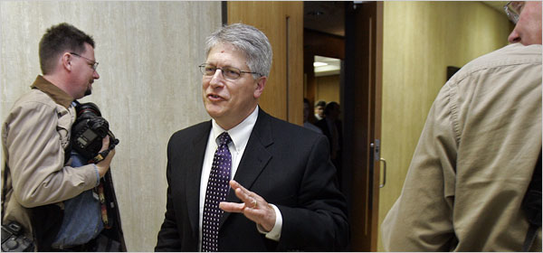

Slide 25
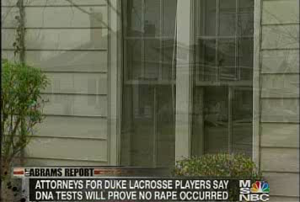

Slide 26
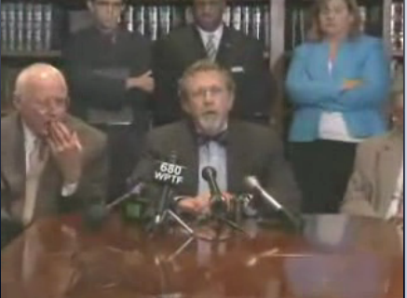

Slide 27
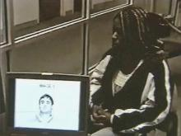

Slide 28


Slide 29
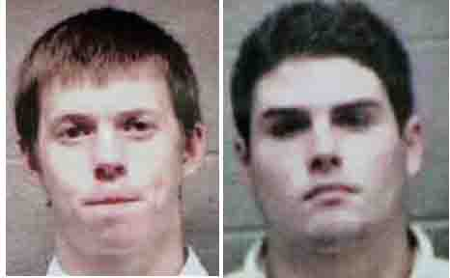

Slide 30
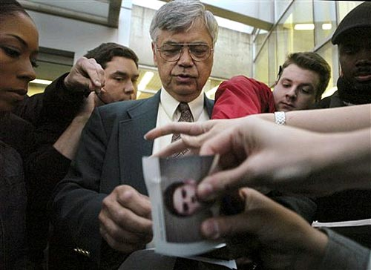

Slide 31
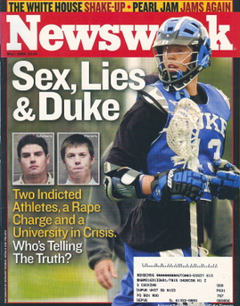

Slide 32
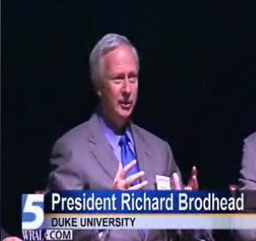
“If our students did what is alleged, it is abhorrent to the last degree. If they didn’t do it, whatever they did do is bad enough.”

Slide 33
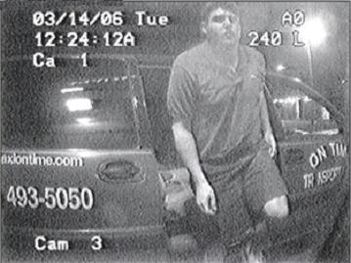

Slide 34
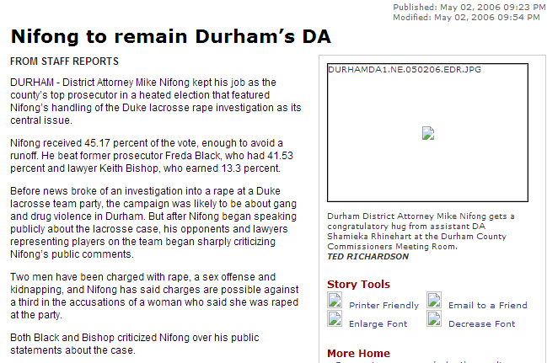
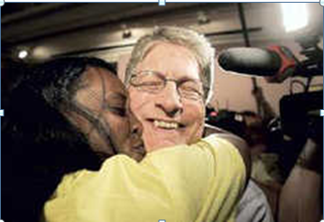

Slide 35
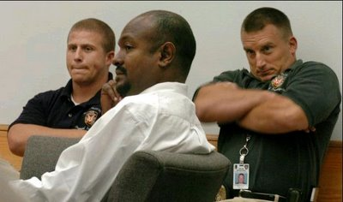

Slide 36
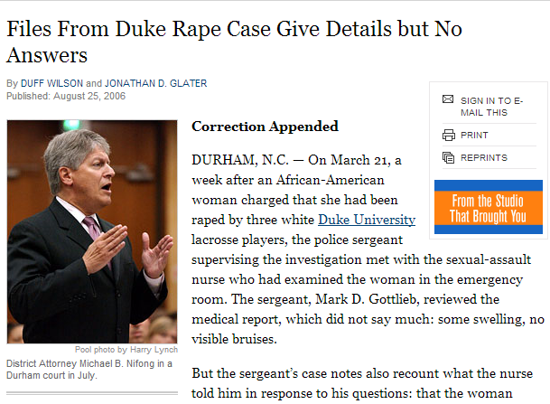
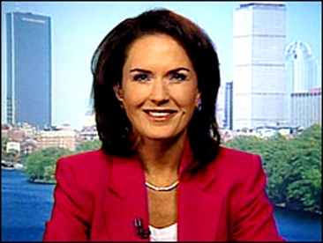
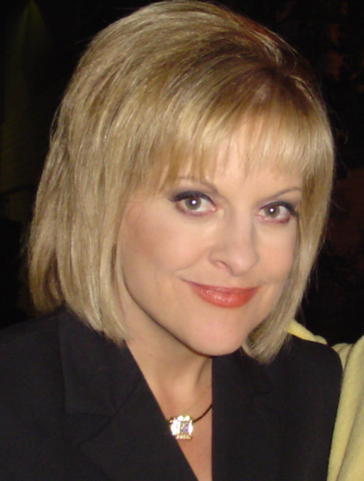

Slide 37
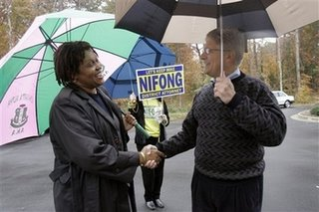
“You can make the case go away pretty easily; you can do it with the stroke of a pen.
“But such an action does nothing to address the underlying divisions that have been revealed. My personal feeling is the first step to addressing those divisions is addressing this case. The future of Durham’s in the balance.”

Slide 38
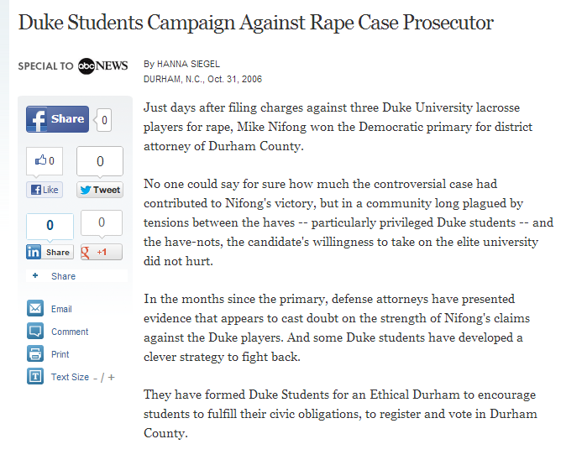

Slide 39
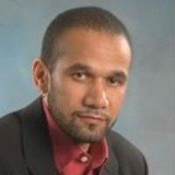
Mobilized through the proliferation of Blue Devil blue armbands, too visible on campus early in the fall semester, inscribed with the numbers of the three indicted players and the defiant proclamation, “Innocent” (in bold white), Duke University students are now said to be registering to vote in Durham in unprecedented numbers…What Duke students becoming Durham citizens does is displace the problem of racism from the lacrosse team and the university to Durham’s political system…
They should not exercise their right to the franchise without any other sense of civic responsibility.

Slide 40
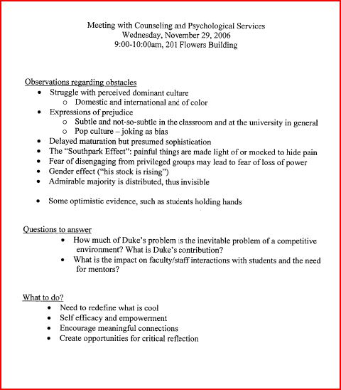

Slide 41
“clarifying” faculty statement
As a statement about campus culture, the ad deplores a "Social Disaster," as described in the student statements, which feature racism, segregation, isolation, and sexism as ongoing problems before the scandal broke, exacerbated by the heightened tensions in its immediate aftermath. The disaster is the atmosphere that allows sexism, racism, and sexual violence to be so prevalent on campus. The ad's statement that the problem "won't end with what the police say or the court decides" is as clearly true now as it was then. Whatever its conclusions, the legal process will not resolve these problems.
The ad thanked "the students speaking individually and...the protesters making collective noise." We do not endorse every demonstration that took place at the time. We appreciate the efforts of those who used the attention the incident generated to raise issues of discrimination and violence.
There have been public calls to the authors to retract the ad or apologize for it, as well as calls for action against them and attacks on their character. We reject all of these.

Slide 42
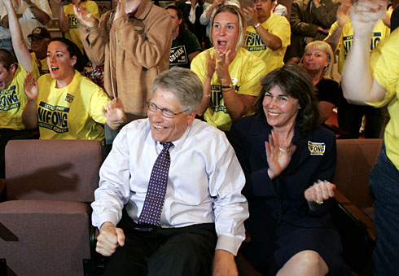
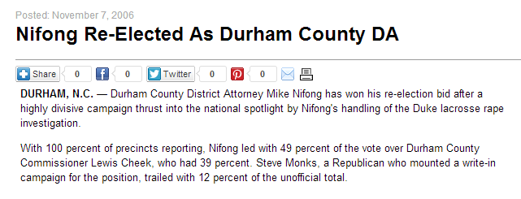

Slide 43
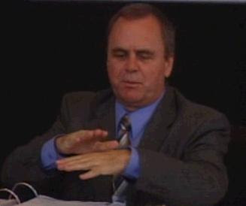


Slide 44


Slide 45


Slide 46


Slide 47


Slide 48


Slide 49


Slide 50


Slide 51


Slide 52


