Slide 1
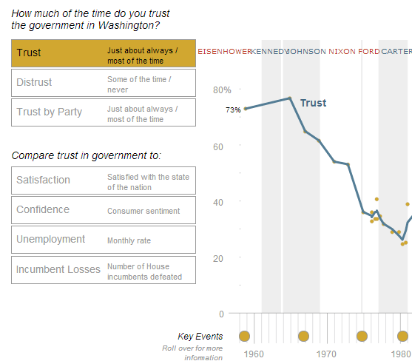

Slide 2
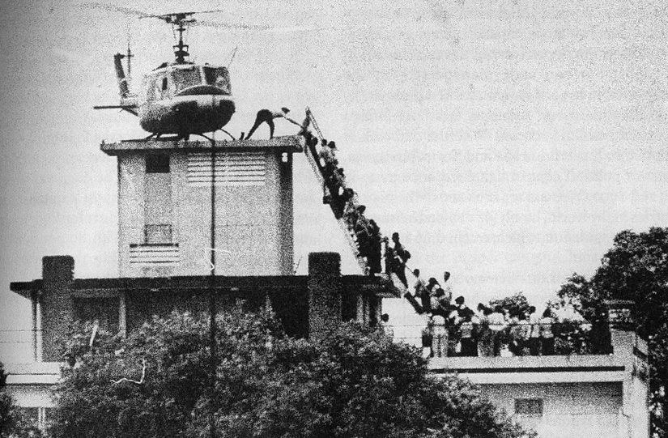

Slide 3
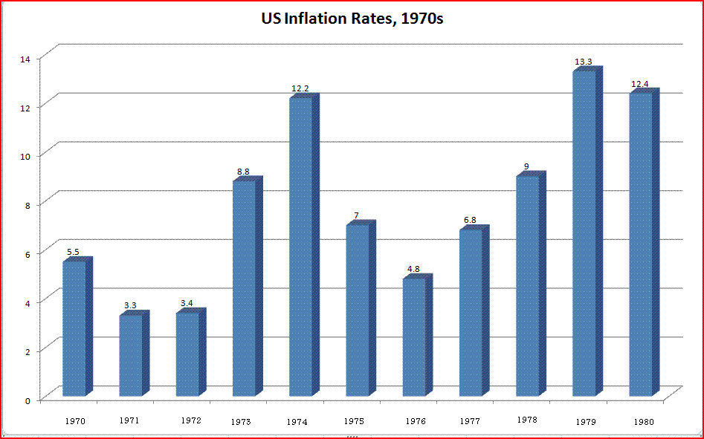

Slide 4
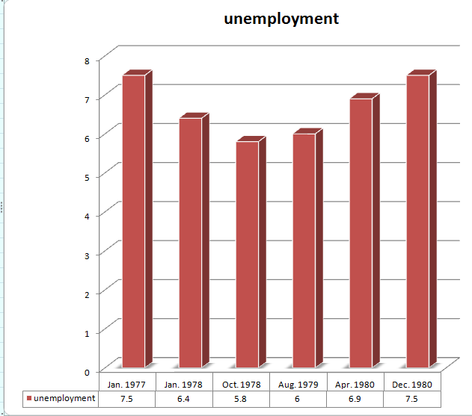

Slide 5
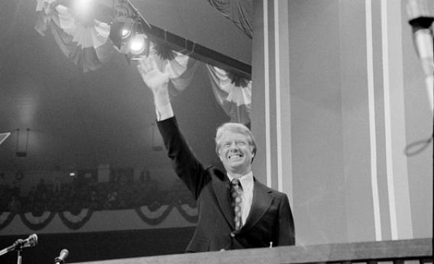
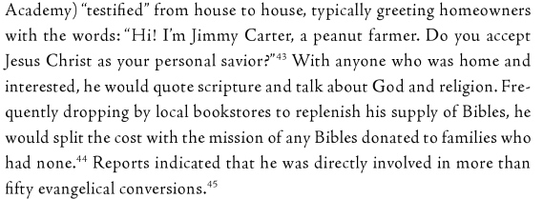

Slide 6
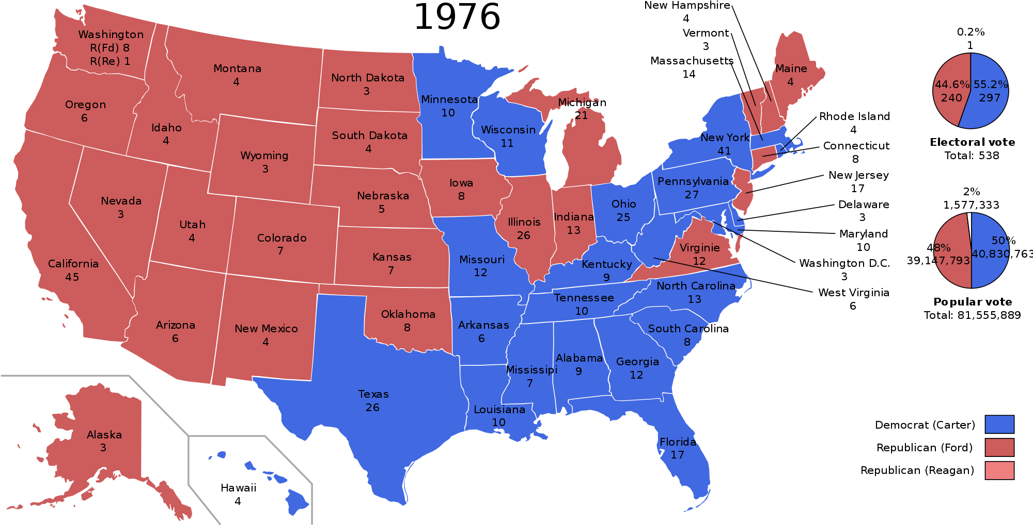

Slide 7
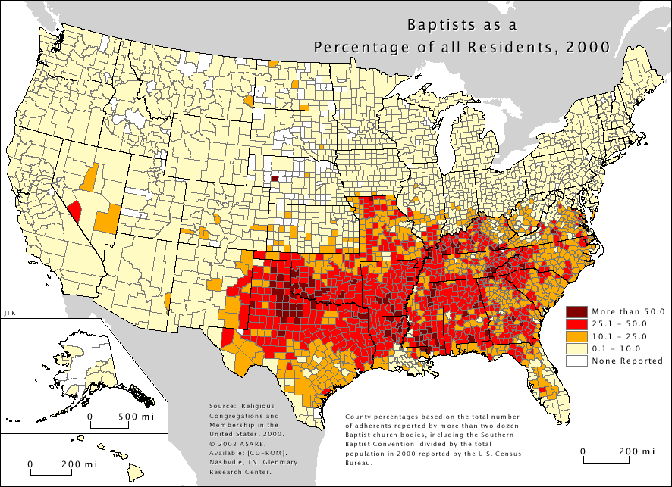

Slide 8
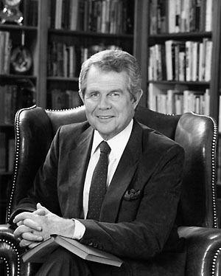

Slide 9
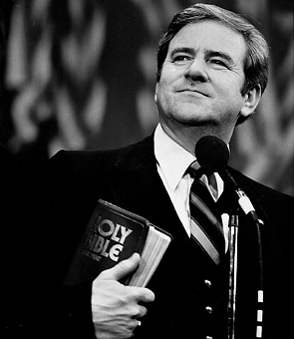

Slide 10
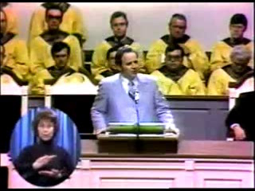

Slide 11
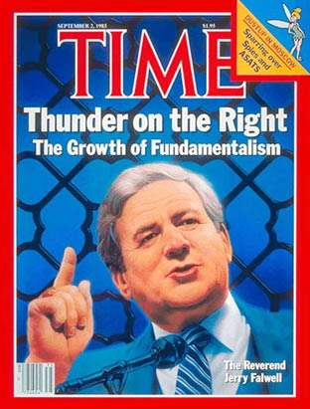

Slide 12
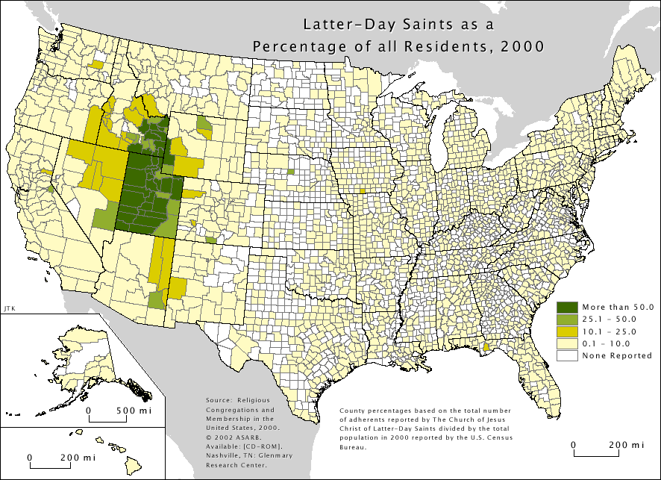

Slide 13
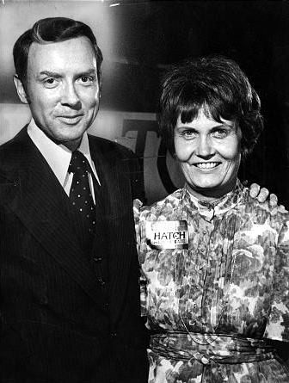

Slide 14
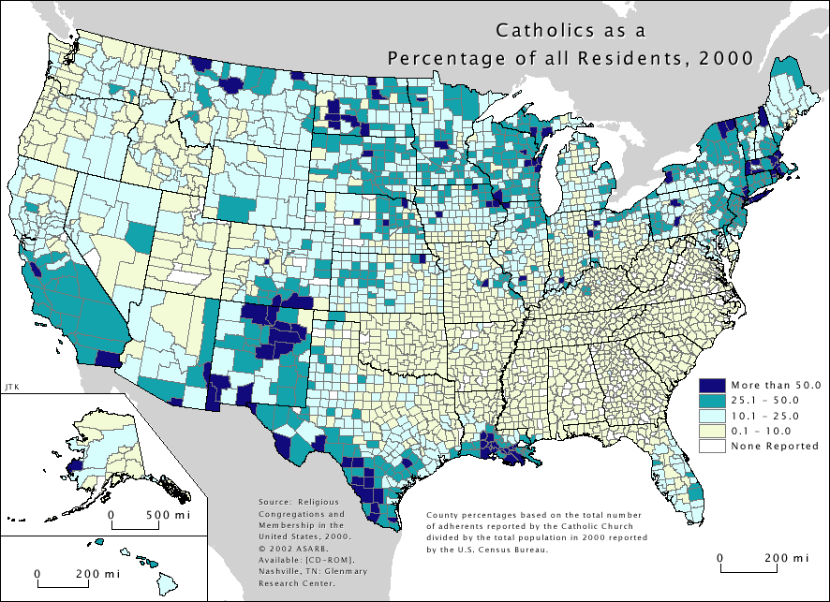

Slide 15
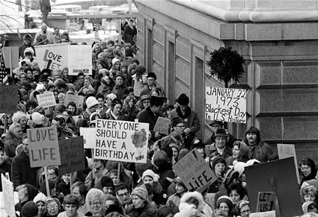

Slide 16


Slide 17


Slide 18
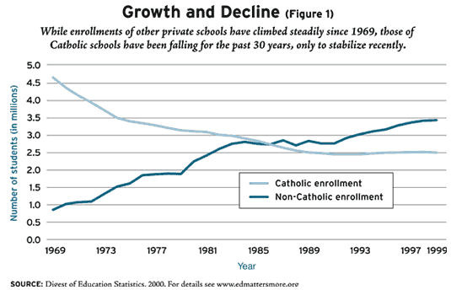

Slide 19
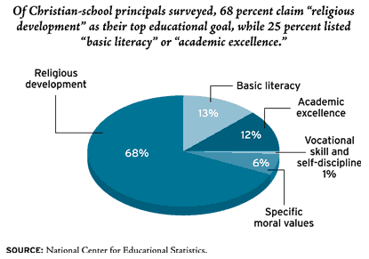

Slide 20
Runyon v. McCrary (1976)
The Court has repeatedly stressed that while parents have a constitutional right to send their children to private schools and a constitutional right to select private schools that offer specialized instruction, they have no constitutional right to provide their children with private school education unfettered by reasonable government regulation . . .
It may be assumed that parents have a First Amendment right to send their children to educational institutions that promote the belief that racial segregation is desirable, and that the children have an equal right to attend such institutions. But it does not follow that the practice of excluding racial minorities from such institutions is also protected by the same principle.

Slide 21
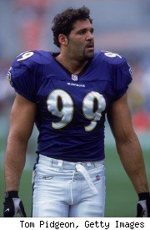
Notes:
Michael mccrary—superbow;

Slide 22
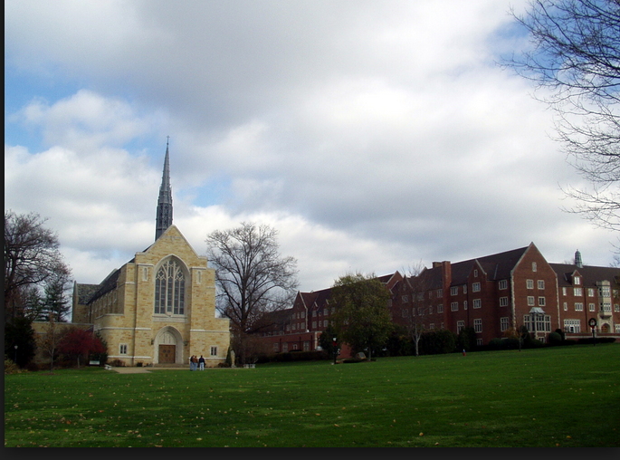
Notes:
Grove city

Slide 23
Title VI
“No person in the United States shall, on the grounds of race, color, or national origin, be excluded from participation in, be denied the benefits of, or be subjected to discrimination under any program or activity receiving federal financial assistance.”

Slide 24
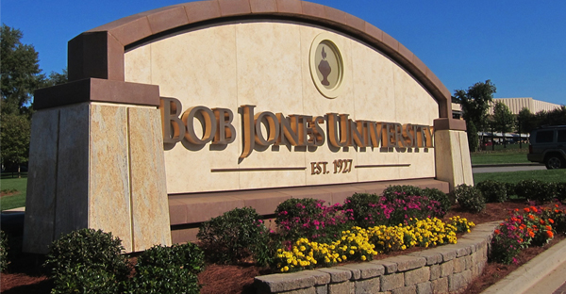

Slide 25
Bob Jones v. United States (1983)
We are bound to approach these questions with full awareness that determinations of public benefit and public policy are sensitive matters with serious implications for the institutions affected; a declaration that a given institution is not “charitable” should be made only where there can be no doubt that the activity involved is contrary to a fundamental public policy. But there can no longer be any doubt that racial discrimination in education violates deeply and widely accepted views of elementary justice . . .
The Government has a fundamental, overriding interest in eradicating racial discrimination in education – discrimination that prevailed, with official approval, for the first 165 years of this Nation’s constitutional history. That governmental interest substantially outweighs whatever burden denial of tax benefits places on petitioners’ exercise of their religious beliefs.

Slide 26
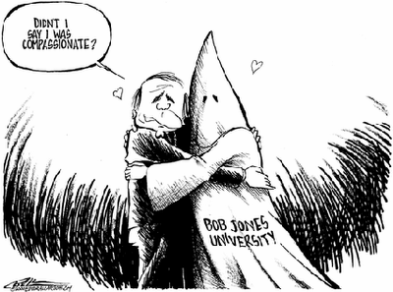

Slide 27

Notes:
Michael mcconnell and jack baker

Slide 28
Baker v. Nelson (Minnesota Supreme Court, 1971)
The institution of marriage as a union man and woman, uniquely involving the procreation and rearing of children within a family, is as old as the book of Genesis . . . This historic institution manifestly is more deeply founded than the asserted contemporary concept of marriage and societal interests for which petitioners contend. The due process clause of the Fourteenth Amendment is not a charter for restructuring it by judicial legislation . . .
Loving does indicate that not all state restrictions upon the right to marry are beyond reach of the Fourteenth Amendment. But in commonsense and in a constitutional sense, there is a clear distinction between a marital restriction based merely upon race and one based upon the fundamental difference in sex.

Slide 29
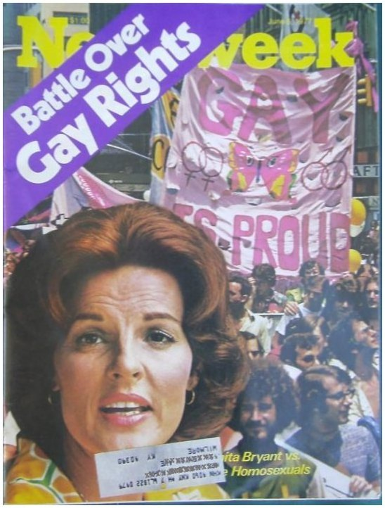

Slide 30
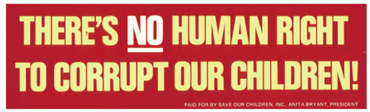
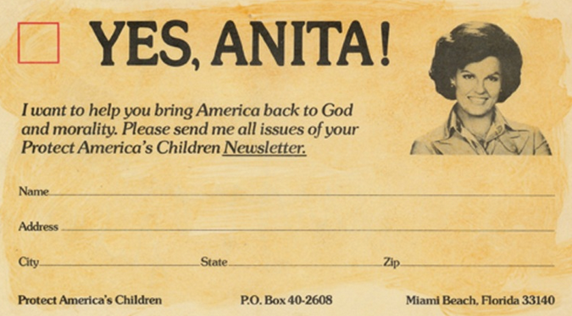

Slide 31
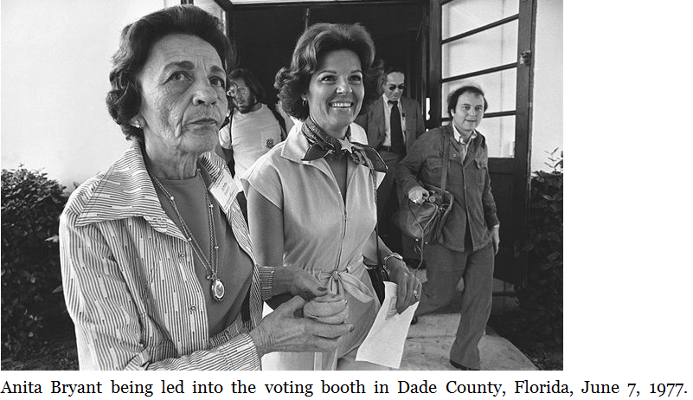

Slide 32
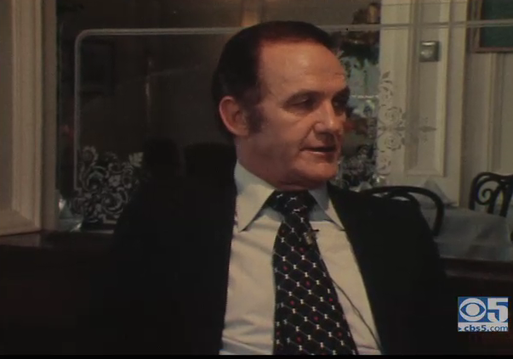

Slide 33
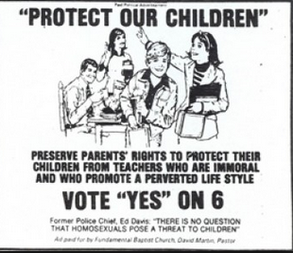

Slide 34
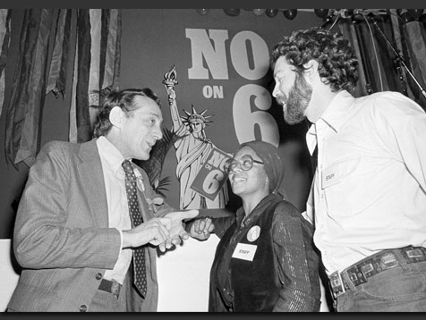

Slide 35
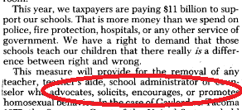


Slide 36
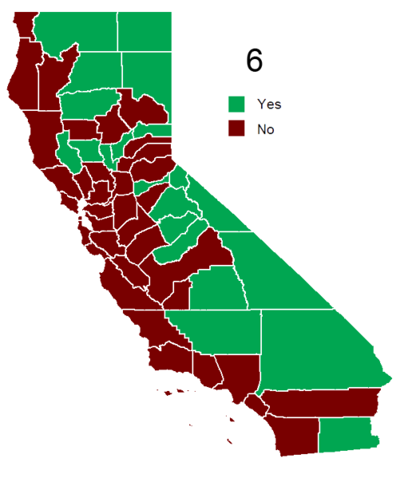
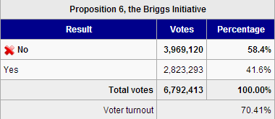

Slide 37
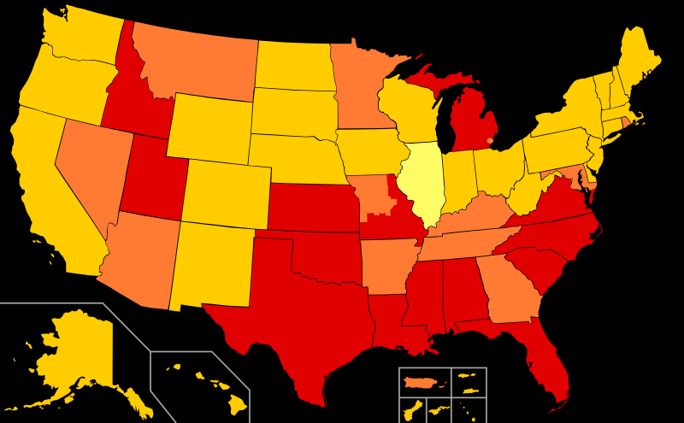
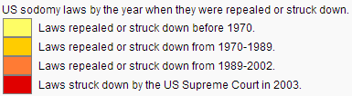

Slide 38
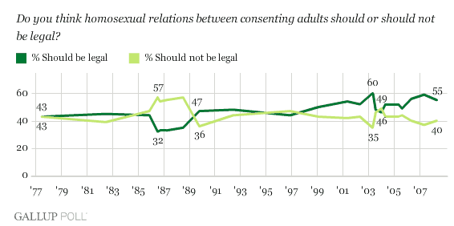

Slide 39
Bowers v. Hardwick (1986, Burger concurrence)
In constitutional terms, there is no such thing as a fundamental right to commit homosexual sodomy.
As the Court notes, the proscriptions against sodomy have very "ancient roots." Decisions of individuals relating to homosexual conduct have been subject to state intervention throughout the history of Western civilization. Condemnation of those practices is firmly rooted in Judeo-Christian moral and ethical standards . . .
Blackstone described "the infamous crime against nature" as an offense of "deeper malignity" than rape, a heinous act "the very mention of which is a disgrace to human nature," and "a crime not fit to be named.“ . . .
To hold that the act of homosexual sodomy is somehow protected as a fundamental right would be to cast aside millennia of moral teaching.

Slide 40
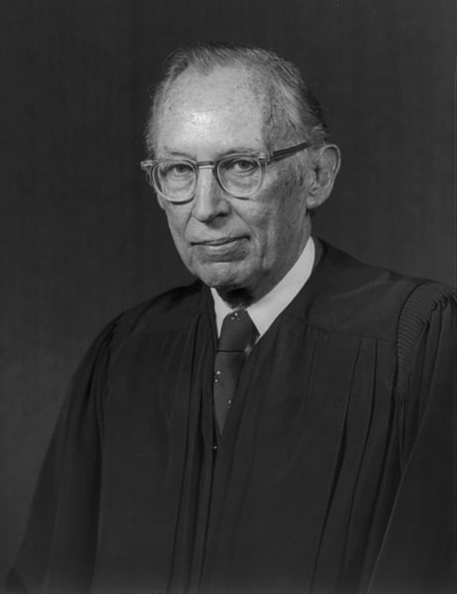

Slide 41
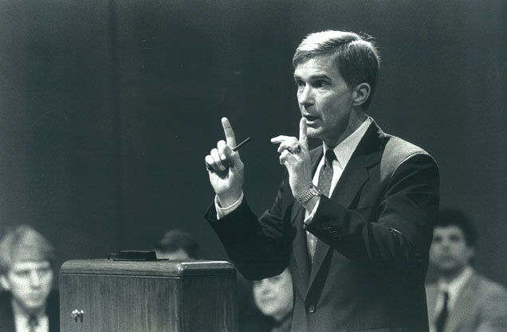
Notes:
Michael bowers

