Slide 1
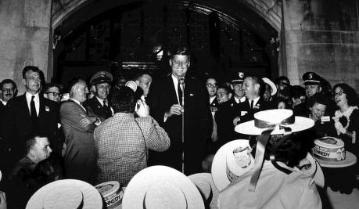
Notes:
Kennedy as candidate univ of mich—1st peace corps challenge

Slide 2
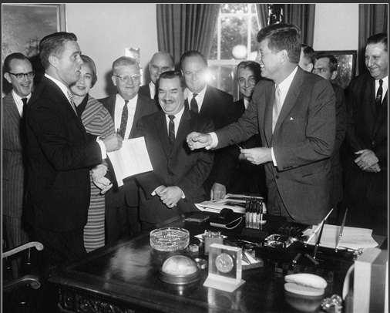

Slide 3
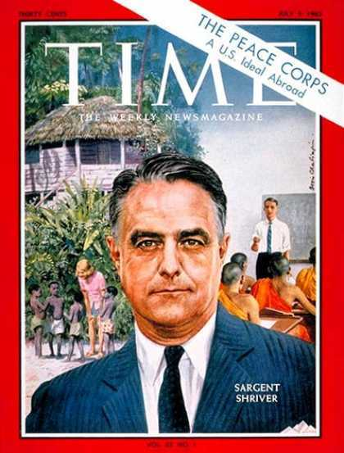

Slide 4
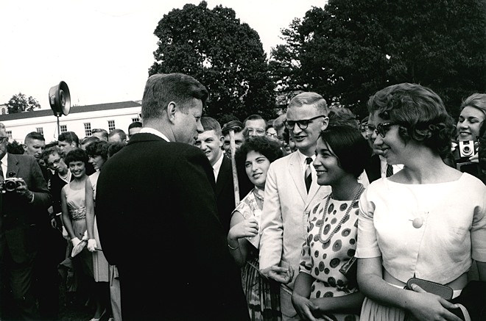
Notes:
1st peace corps class

Slide 5
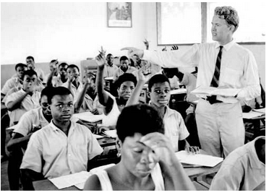
Notes:
28 countries by 62

Slide 6
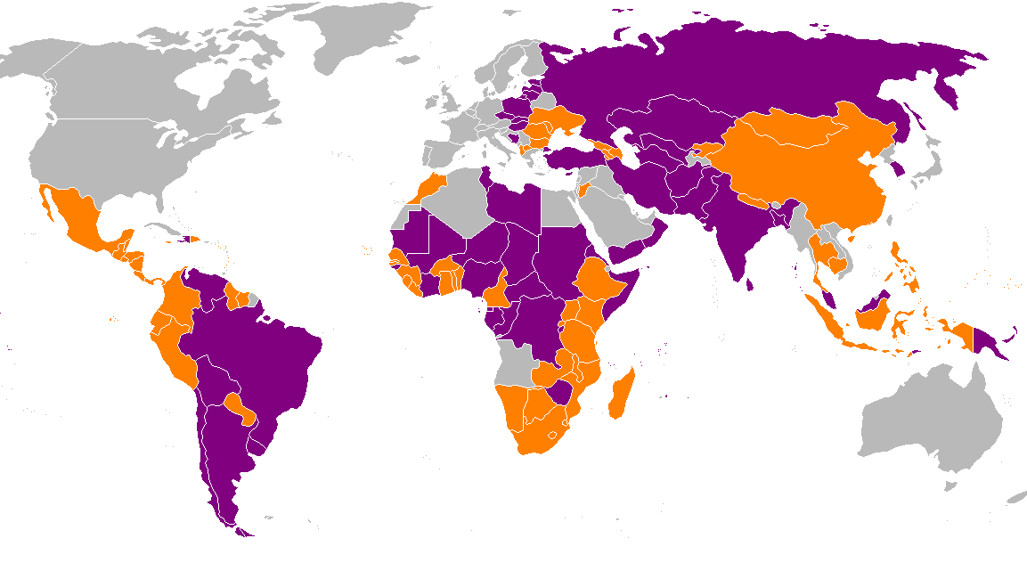
Peace Corps Host Nations
Notes:
Orange current; purple past; since 1961 210K vols, 139 countries

Slide 7
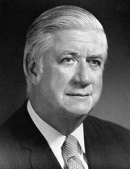
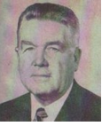
Tip O’Neill (D-Mass.)
James Delaney (D-NY)

Slide 8
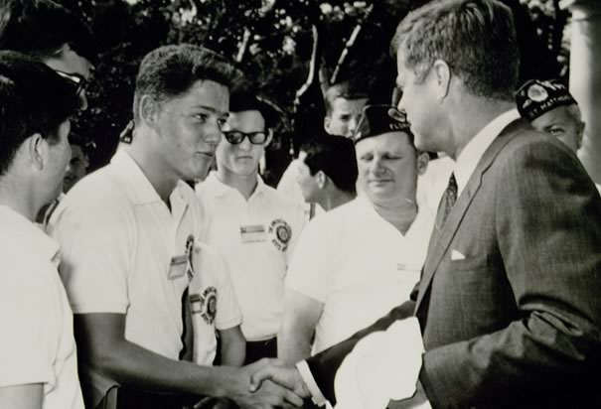

Slide 9
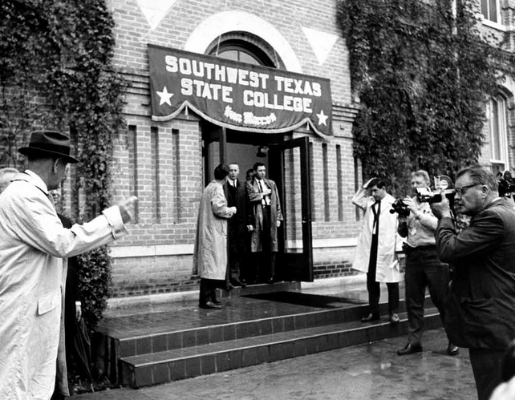

Slide 10
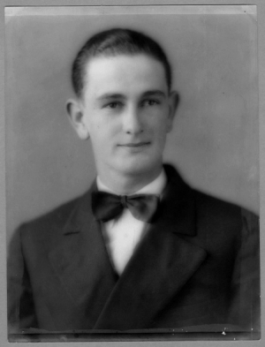

Slide 11
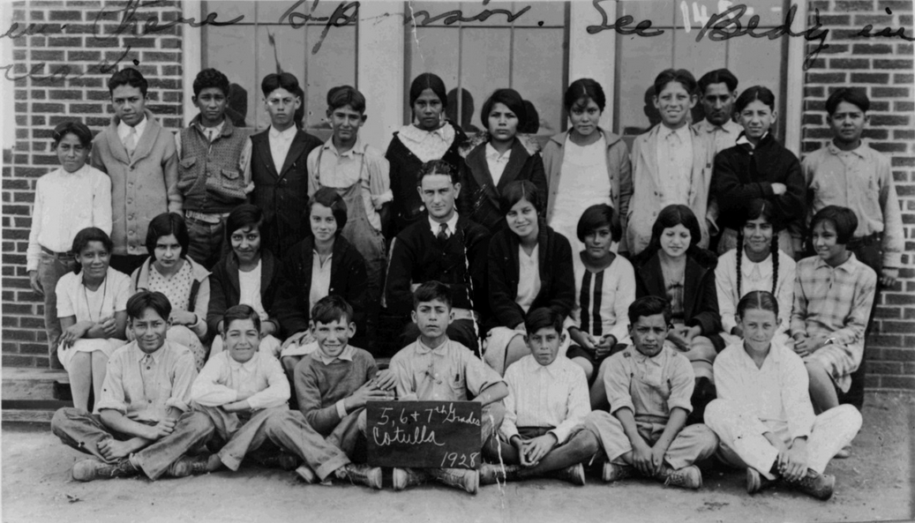

Slide 12
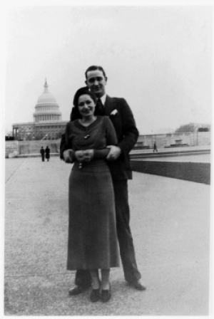

Slide 13
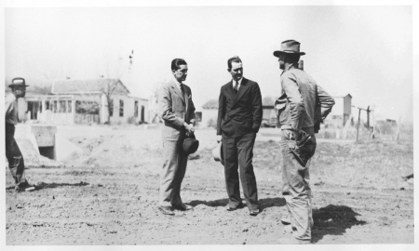

Slide 14
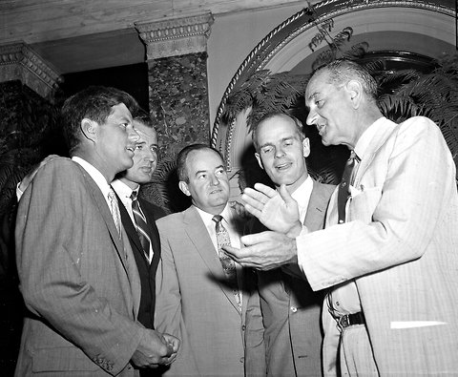

Slide 15
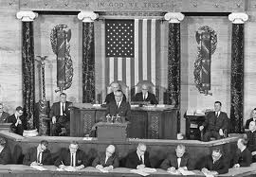

Slide 16
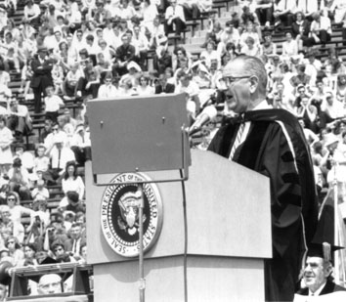

Slide 17
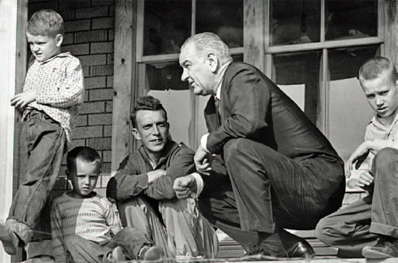
Notes:
Ap64—no electricity running water

Slide 18
Economic Opportunity Act (1964)
VISTA (Volunteers In Service To America)
Job Corps
Head Start
Legal Services
Various local anti-poverty programs & targeted medical programs
Community Action Programs
“provides services, assistance, and other activities of sufficient scope and size to give promise of progress toward elimination of poverty or a cause or causes of poverty through developing employment opportunities, improving human performance, motivation, and productivity, or bettering the conditions under which people live, learn, and work.

Slide 19
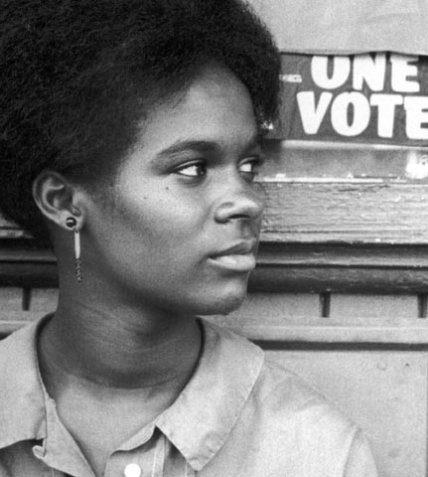

Slide 20
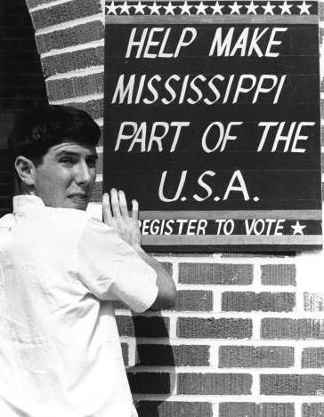

Slide 21
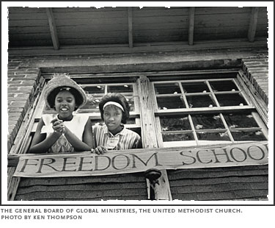

Slide 22
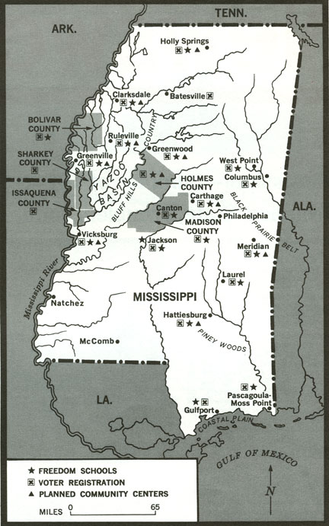

Slide 23
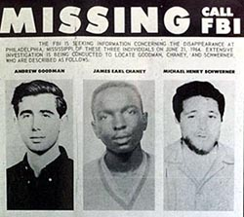

Slide 24
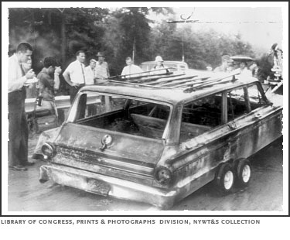

Slide 25


Slide 26
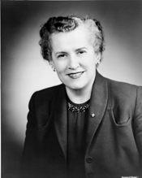

Slide 27
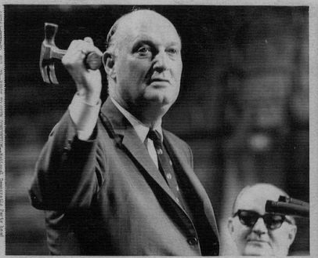
Notes:
John bailey

Slide 28

President Johnson: I think we’re doing the best we can, John. I don’t imagine there’s much we can do. You’ll probably have a roll call on the Minority Report, I gather.
John Bailey: I think we better have it late tonight, don’t you, if we’re going to have it?
President Johnson: I don’t know; I don’t know. I don’t care much. I’m awfully disappointed that folks would act that way. And I’m distressed that they would treat me that way. But I don’t want to say anything about it. I may—I may . . . well, I may be in touch with you a little bit later.
But I just—I think you will have it, and I know it’s pretty difficult on both sides . . .
Bailey: Well, there’s no need for it, really.
President Johnson: No. Not a bit. But . . .
Bailey: Well, some of the people have got the bit in their teeth. You know that, between you and I, that Mrs. [Edith] Green is a bitch.
President Johnson: Yeah.
Bailey: Huh?
President Johnson: Yeah. Yeah.
Bailey: And [civil rights lawyer] Joe Rauh keeps saying he wants to help, but he can’t get on the television often enough.
President Johnson: Yeah, that’s right.
Bailey: Just stirring the dogs up.
President Johnson: That’s right.

Slide 29
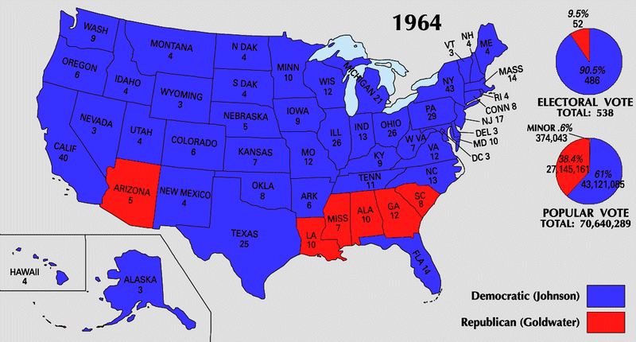

Slide 30
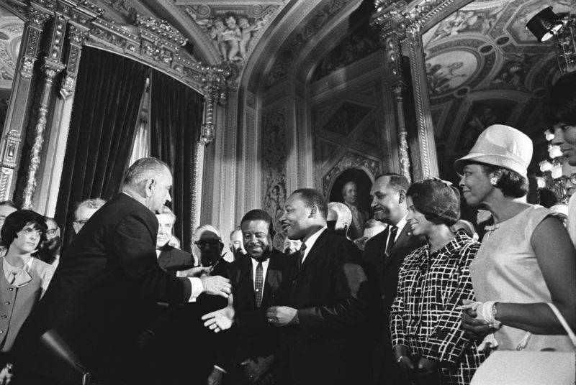

Slide 31


Slide 32
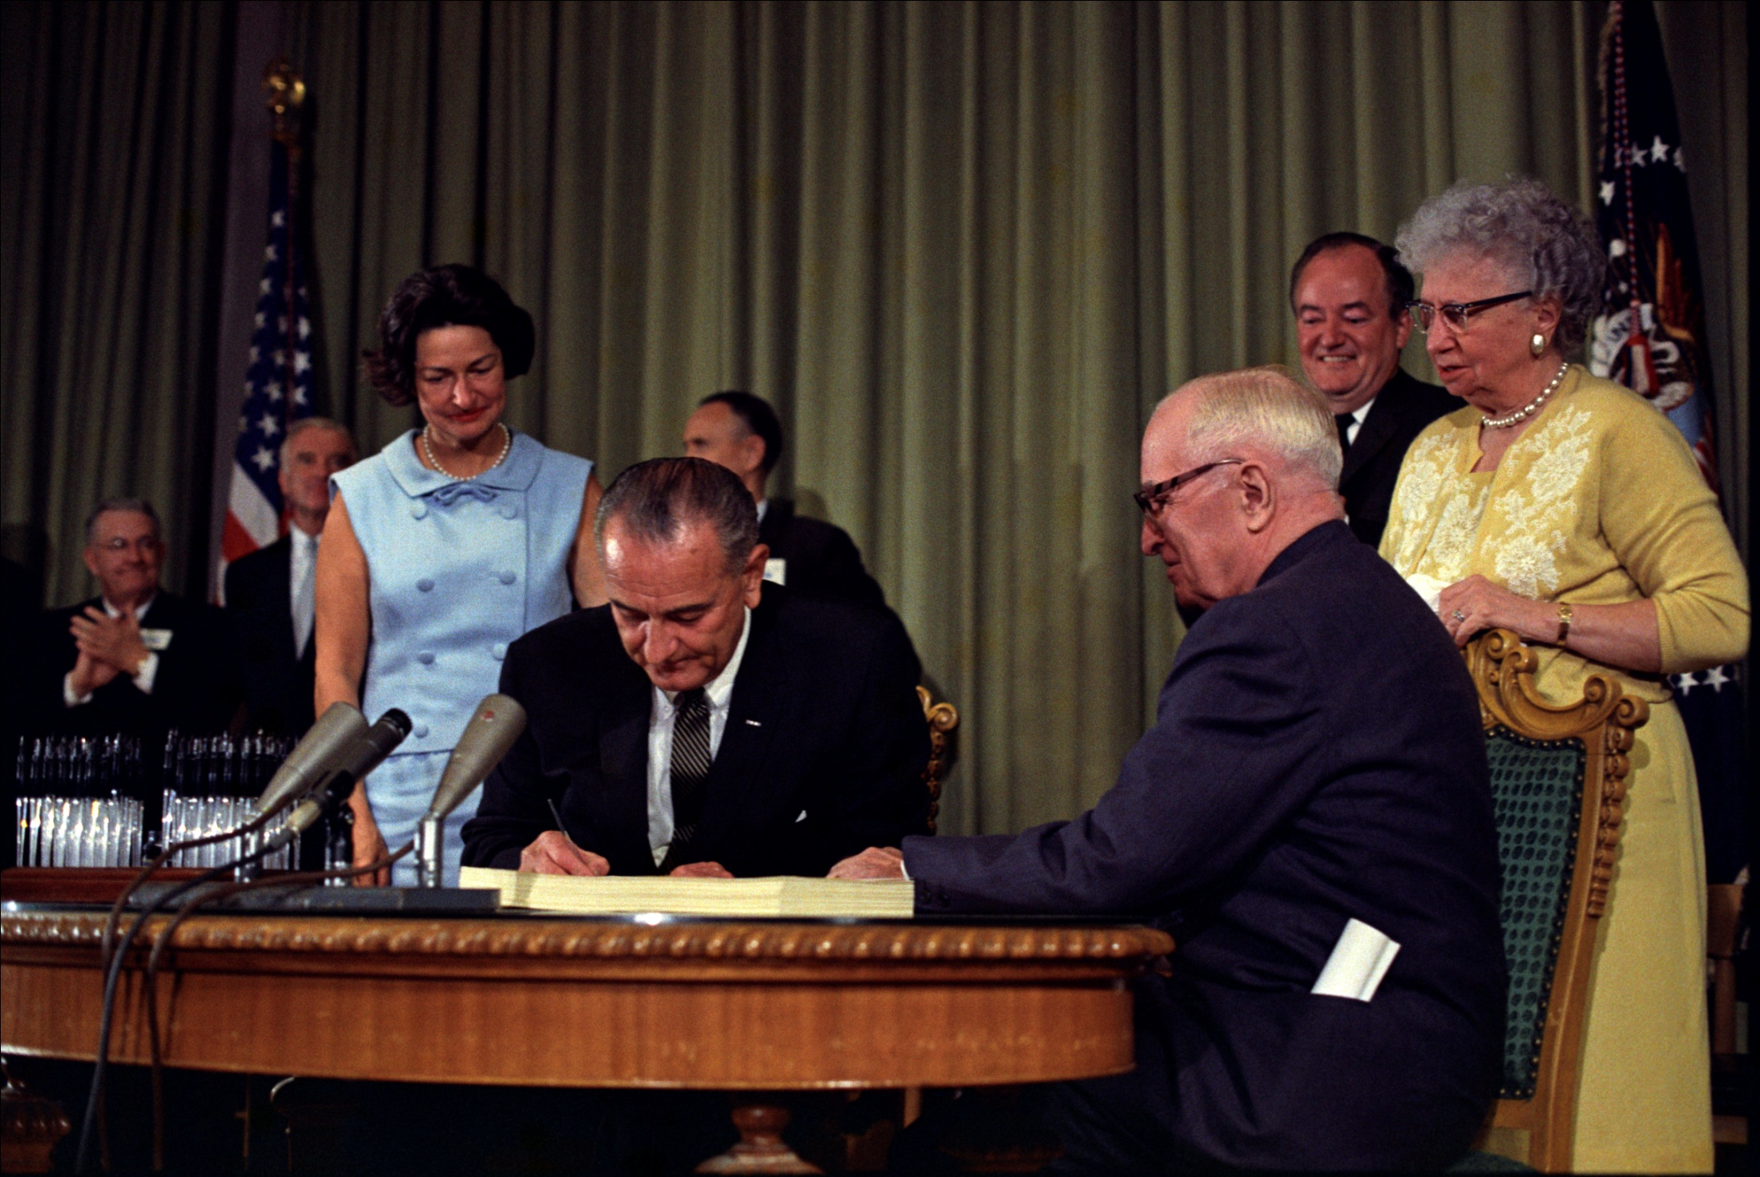

Slide 33
Medicaid (1965)
--children under 6 whose families are 133% of federal poverty level
--children 6-19 whose families are below poverty level
--currently 35m children covered

Slide 34
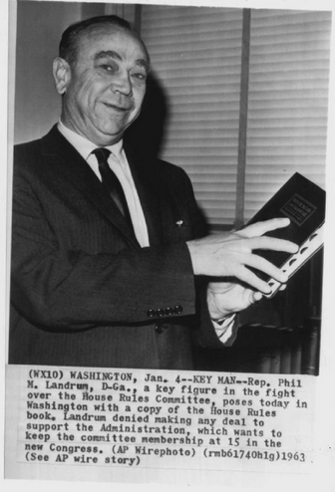

Slide 35
President Johnson: They told me that you’ve got to change your bill, or you won’t have it. And I told ‘em just to not change it—just go on, and vote it up or down. If we lose, why, we’ll just lose, and we’ll let the Catholics take over the country. But I ain’t going to be browbeat or blackmailed . . .
And if you can get it [the bill] out [of committee] without it, all right. If not, I’d take the whole goddamn section out. We don’t have to have that part of it.
Phil Landrum: Well, now, I think that’s a wise decision. Here’s—I think we can get it out of committee without [Bay Ridge congressman & future New York governor Hugh] Carey. And I believe if we get this thing out of committee, we can bring the responsibility for any roadblocks after that on the Republicans.
President Johnson: Yeah, that’s what I’d do.
[Break.]
President Johnson: Well, my judgment would be, if you could—we don’t have to get everything in one year.
Landrum: Mm-hmm.
President Johnson: If we don’t get anything but a work camp, we’re all right.
Landrum: Yeah. Well, that’s the truth—

Slide 36
President Johnson: If I had to—if I had to, and the Catholics made an issue, I’d just lay it right there in their lap with the Republicans, and say, “All right, you vote it out,” and let ‘em vote it out.
Landrum: Well, here’s what we can do: we can justify this by $100 million, with the first title of the bill. And I think—
President Johnson: Is that your work camp?
Landrum: Yes, sir. Work camp, and the work-study program, for the poor college boys and girls.
President Johnson: What do you do there on the Catholic college?
Landrum: We don’t do anything.
President Johnson: You pay it direct to the kid?
Landrum: That’s right, through the college. After he makes his choice.
President Johnson: Yeah.
Landrum: After the child makes his choice. There’s no direct line from the director to the—
President Johnson: Well, I’d just sure say (I don’t want to be quoted) but if I were you, I’d just seriously—that’s what we’re going to have. What you need is three camps in Danville, Georgia, and take these kids, and prepare ‘em where they won’t stay on relief all their life. And—
Landrum: This Community Action—
President Johnson: To hell with Community Action!
Landrum: It should be junked entirely.
President Johnson: To hell with Community Action.

Slide 37
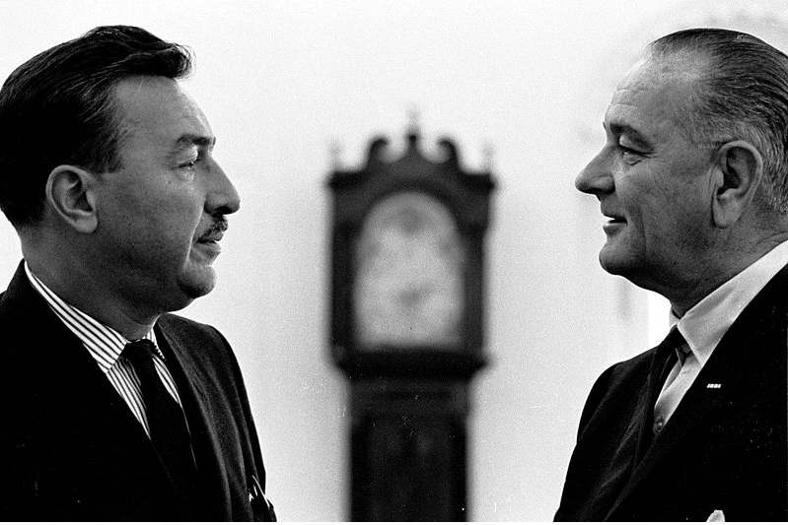

Slide 38
President Johnson: Hello?
Congressman Adam Clayton Powell: How’s my friend?
President Johnson: [stonily] Fine, Adam.
What the hell’s been happening to your [Education and Labor] Committee? I thought you told me two months ago that you were going to pass a [education] bill for me.
Powell: That’s right. Well, what happened: all hell’s broken loose, because—
President Johnson: Well, now, what the hell are you blackmailing me on a—
Powell: That’s not—
President Johnson: —four hundred . . . Well, hell, you didn’t—[because] you want a $400,000 appropriation for you, we couldn’t pass a billion, two hundred million [dollar funding bill] for the schoolkids.
Now, you know I’m for you, and you know that I’m going to help you any way I can. I’ve got nothing to do with what you’re doing in the House investigation [of Powell’s personal finances]. But you damn near defeated the best education bill I’ve got. And I hope you’re going to be proud of it.
Powell: No. Now, you know your Appalachia bill, that there is—
President Johnson: Well, now, Appalachia ain’t got a damn thing to do with you. If you handle your committee and let us handle the other one!

Slide 39
Powell: Yeah, but there’s a clause in there, Mr. President—
President Johnson: There’s a clause that’s been in there for a long time.
And if you’re going to let [Ohio congressman William] Ayres [the committee’s ranking Republican] and [Oregon congresswoman] Edith Green [a conservative Democrat] lead you off the reservation, well, then I ran for nothing last year—
Powell: No—
President Johnson: [continuing] With 15 million votes. If you’re going to tie up this Congress, and screw it up—which you’ve done for three weeks, by running off [to Bimini, in the Bahamas] till you got a 400,000 [dollar] appropriation—why, we never can get anywhere.
And you defeat this [bill], and you hold it up, and you delay it, and you get us in this kind of shape, why, we can’t pass anything.
And that’s all right. But I think you’ll beat a hell of a bunch of your liberal Democrats [in the 1966 midterm elections]. I’m going to be here—it’s not going to bother me. But I just sure thought I had better leadership on that committee than what I’ve got without even talking.
Powell: Well—
President Johnson: And I’m awfully disappointed. Just very disappointed.

Slide 40
Powell: Now, Mr. President, don’t you think I have an entitlement to—
President Johnson: [forcefully] No, I don’t think you’re entitled to a damn thing that you did.
I think you told me, and looked me straight in the eye—
Powell: Mm-hmm.
President Johnson: [continuing] And said, “I’ll report this bill, and I’ll get it on the floor.” And you didn’t do it.
Powell: [By] March 1st.
President Johnson: And you did not do it.
Powell: It was [by] March 1st, because—
President Johnson: Well, Adam—
Powell: It was March—
President Johnson: [voice rising] No. Oh, hell no, you didn’t say till March 1st. You told me you were going to do it. And then you ran off for three weeks and they couldn’t even locate you . . . And your people [African-Americans] are being damn well taken care of in it [the bill].
[Break.]
President Johnson: Hey, listen: if you can’t trust me on Appalachia, you damn sure can’t trust an amendment, or the Secretary of Commerce, or anybody else.
Powell: Mm-hmm. Yeah—
President Johnson: If there’s anything that’s going to happen in Appalachia that’s anti-Negro, I won’t let it happen. Period.

Slide 41
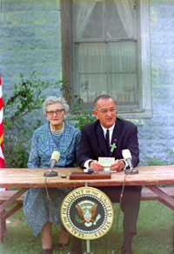
Notes:
signs the Elementary and Secondary Education Act in Stonewall, Texas. Sitting beside him is his first teacher, Mrs. Kathryn Deadrich Loney

Slide 42
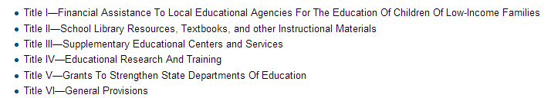

Slide 43
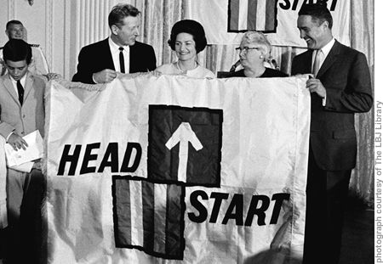

Slide 44
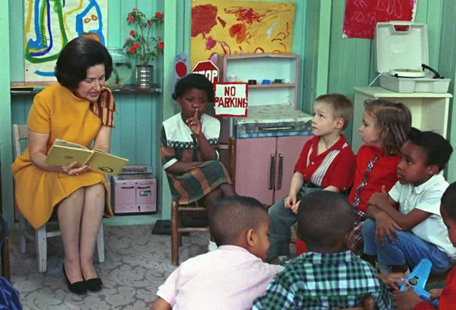

Slide 45
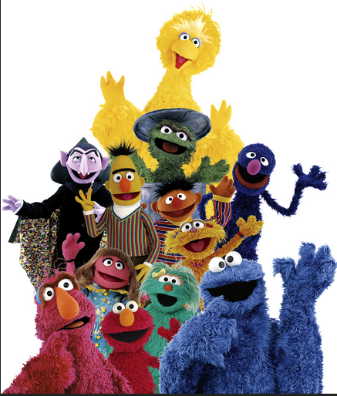
Notes:
Sesame street originally coming from head start funding 1968

